Slide 1
Insurance:
Leading Through Disruption
Sean Kevelighan, Chief Executive Officer
Steven Weisbart, Chief Economist
James Lynch, Chief Actuary
Insurance Information Institute  110 William Street  New York, NY 10038
212.346.5520  seank@iii.org  stevenw@iii.org  jamesl@iii.org  www.iii.org
Notes:
Introduction
Preliminary work and observations since starting with III
Disruption is everywhere and insurance is right in the middle of it
Relevant anecdote for audience

Slide 2
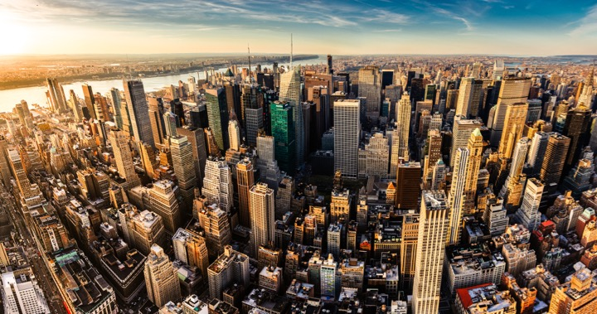
I.I.I. Mission Statement
Improving public understanding
of insurance...
…what it does and how it works
2

Slide 3
Insurance & Economic Leadership

Slide 4
Insurance & Economic Leadership
Sustainable Business Model
Strong Jobs Pool/Provider
Economic Growth Promoter/Facilitator
2010
$507.7B
2.7%
US GDP³
Bank Failures: 157
2.8M Employed
Premium Taxes Paid⁴ $19.2B
Insurance Impairments¹: 8
Bond Investment⁵ $489B
Policyholder Surplus:
$700.9B
Need to Fill
400K+ by 2022²
End
2016
Charity/Volunteerism⁶ 15%
¹Life/Health and P/C Insurance; ²PC 360 http://www.propertycasualty360.com/2013/04/17/insurance-industry-crisis-400000-positions-to-fill?slreturn=1476304299; ³U.S. Bureau of Economic Analysis, 2016; ⁴U.S. Department of Commerce, 2015;
⁵Federal Reserve, 2015; ⁶2011–2014, Insurance Industry Charitable Foundation.

Slide 5
The Insurance Industry’s Contribution to GDP Now Nearly Equals Banks’
Sources: US Bureau of Economic Analysis; Insurance Information Institute.

Slide 6




Insurance Industry Snapshot:
By the Numbers
2.8 million
People in the U.S. employed, in a wide variety of careers, from human resource administrators to public relations managers to financial analysts
$5.8 trillion
Assets under management
at year-end 2016, including
$1.5 trillion for the property/
casualty sector and $3.7 trillion
for the life sector
$508 billion
Contributed to the U.S. gross domestic product in 2016,
roughly 2.7%
of the whole
$40.0 billion
Federal and foreign income taxes paid
in 2016, plus U.S. premium taxes paid
Source: A Firm Foundation, Insurance Information Institute.

Slide 7

The Yearly Cash Flow to Rebuild Lives and Property is Substantial
Insurers annually pay over a trillion dollars in claims to rebuild lives, property, and businesses.
In 2016 alone, the industry paid
$ 386.4 billion P/C incurred claims (L + LAE)
554.7 Life/Annuity benefits
560.9 Health Insurance benefits
= $1.502 trillion
This is equivalent to $125 billion per month.
Notes:
7

Slide 8
Insurers Are Major Investors, 2015
Categories of investments ($billions)
Categories of bonds ($billions)
Total invested assets: $5.8 trillion
22% of corporate bonds outstanding
15% of municipal bonds outstanding
Sources: NAIC (the Center for Insurance Policy and Research, June 6, 2016) via SNL Financial; Insurance Information Institute.

Slide 9
As Economies Grow Wealthier, Insurance Market Penetration (Premium as % of GDP) Also Grows
Some wealthy countries have penetration rates of 10% and higher
Source: A.M. Best.

Slide 10
Insurance Market Report

Slide 11
State of Insurance
Top Issues
Catastrophe Costs
Consolidation/M&A
Insurance-related Deals
Involving U.S. Firms²
Autonomous
Vehicles
P/C Payouts / Property Losses¹
564
$101B
P2P insurance
2015
2016
2015
$15.4B
$21.6B
Cybersecurity
DEALS
VALUE
500
-11%
2016
$20B
-80%
Sharing Economy
U.S. Insured Cat Losses
Workers Comp
Regulation
2016 Loss Up Modestly Compared With 10-YearAaverage $19.1B
$6.3B
Politics
(JAPAN)
(BERMUDA)
pending or completed M&As involving U.S. insurance companies (2017)³
Overcapitalization
(Reinsurance)
25
¹PCS; ²Conning Research; ³S&P Financial.
Notes:
According to the KPMG report called “The New Deal: Driving Insurance Transformation with Strategy-aligned M&A,” 84% of insurance companies plan to make between one and three acquisitions in 2017, while 94% plan at least one divestiture.
In 2015 Anthem’s announced purchase of Cigna, and Aetna’s planned purchase of Humana together totaled $83 billion, according to S&P Global Market Intelligence. The continued scrutiny of these two deals may have dampened merger activity in this sector in 2016.

Slide 12
The Economy Drives P/C Insurance Industry Premiums
Direct Premium Growth (All P/C Lines) vs. Nominal GDP
Direct written premiums track nominal GDP—
not quarter by quarter but overall fairly well.
Sources: S&P Global Market Intelligence; U.S. Commerce Dept., Bureau of Economic Analysis; Insurance Information Institute.

Slide 13
Commercial & Personal Lines NPW Growth
5.7%
-1.3%
Commercial lines is prone to much more
cyclical volatility than personal lines.
Note: Data include state funds beginning in 1998.
Sources: A.M. Best; Insurance Information Institute.

Slide 14
P/C Insurance Industry
Combined Ratio, 2000-2017*
3 Consecutive Years of U/W Profits; 1st time since 1971-73
Heavy Use of Reinsurance Lowered Net Losses.
Higher CAT Losses, Shrinking Reserve Releases, Toll of Soft Market
Best Combined Ratio Since 1949 (87.6)
A return to more usual underwriting loss.
Sandy
*Excludes Mortgage & Financial Guaranty insurers 2008-2014.
Including M&FG, 2008=105.1, 2009=100.7, 2010=102.4, 2011=108.1; 2012:=103.2; 2013: = 96.1; 2014: = 97.0.
Sources: A.M. Best; ISO, a Verisk Analytics company; I.I.I.

Slide 15
P/C Insurer Portfolio Yields,
2003-2016
P/C carrier yields have been falling for over a decade, reflecting the long downtrend in prevailing interest rates.
Even as prevailing rates rise in the next few years,
portfolio yields are unlikely to rise quickly,
since low yields of recent years are “baked in” to future returns.
Sources: NAIC data, sourced from S&P Global Market Intelligence; Insurance Information Institute.
Notes:
Likely to be some time before industry gets any relief – yields continue to be declining.
70’s – 80’s investment yields were in the double digits.
Seeing some – but not a lot – where they are looking for higher, but can only do so much because of the liability cover issue AND regulatory scrutiny
Hedge funds
Pension funds

Slide 16
Sources of P/C Insurer Profits, 2007-2016
Insurer gains from investments vary from year to year (they plunged in
2008-09) but in the last decade, excluding the effect of the Great Recession, ranged between $55 billion and $65 billion each year. In contrast, net underwriting gains have not exceeded $21 billion in any year and were actual losses in five of the 10 years.
Sources: NAIC data, sourced from S&P Global Market Intelligence; Insurance Information Institute.

Slide 17
P/C Insurance Industry ROE by Presidential Party Affiliation
1950-2016*
Truman
Eisenhower
Kennedy/ Johnson
Nixon/
Ford
Carter
Reagan/
Bush I
Clinton
Bush II
Obama
BLUE = Democratic President RED = Republican President
*2016 data is through Q3. Source: Insurance Information Institute.

Slide 18
Catastrophe Change

Slide 19
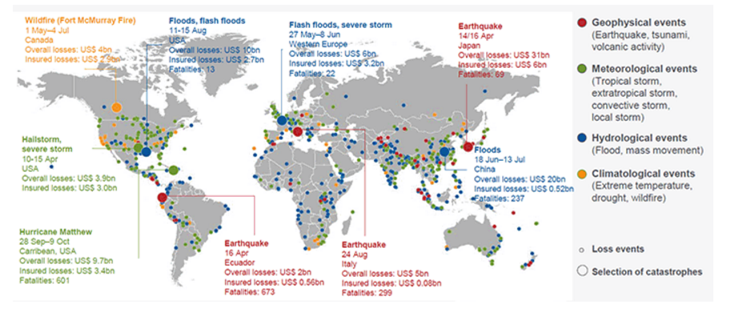
Natural Catastrophe Losses Totaled $175 Billion,
Up From $103 Billion in 2015
World Natural Catastrophes, 2016
Source: © 2017 Munich Re, Geo Risks Research, NatCatSERVICE. As of February 2017.
Notes:
This Year so far (2017 first half) (source – Munich Re)
Global: $41B, of which $19.5B insured: Last year - $111B, $32B
Insured losses higher than normal (half) because they were concentrated in USA – usually only 1/3 is insured
USA: $18.5B, of which $13.5B insured
Worst event this year – Feb/March Peru floods - $3.1B, $0.38B insured
US worst – May T-storms, $2.2B/$1.8B, also bad tornado/hail in March
In 2016
Hurricane Matthew – insured loss relatively low vs. econ loss because most losses were from flooding, particularly inland flooding for North Carolina
No major floods in USA since Matthew
Last year’s LA floods were the fourth biggest flood event in NFIP (Katrina, Sandy, Ike) – average claim was almost $90,000!

Slide 20
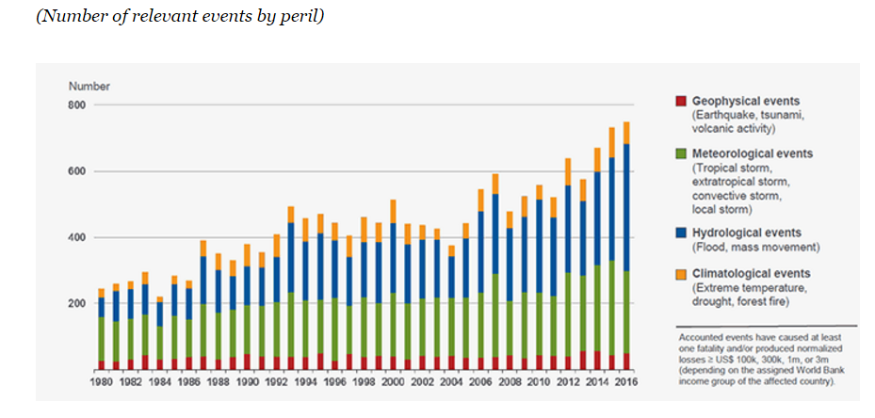
The Frequency of Extreme Weather Events
Is Rising
Number of World Natural Catastrophes, 1980-2016
Source: © 2017 Munich Re, Geo Risks Research, NatCatSERVICE. As of February 2017.
Notes:
So far this year:

Slide 21
Induced Earthquakes
Includes 20 quakes M4.0-5.1;
1 quake M5.8
Oklahoma Earthquakes Magnitude 3.0 and Greater
Includes 30 quakes M4.0-4.7
Includes 15 quakes M4.0-4.4
Includes 3 quakes M4.0-4.8;
1 quake M5.6
~1.6/year
Earthquake insurance take-up rates increased by over 300 percent
from 2006 to 2015 in Oklahoma.
Source: USGS-NEIC ComCat & Oklahoma Geological Survey; preliminary as of July 4, 2017.
Notes:
From USGS web site, looks like five 4.0M+ quakes in OK this year

Slide 22
Cyber Attacks – No. 2 Global Risk
Source: Allianz Risk Barometer on Business Risks 2017.
Notes:
140 carriers wrote cyber last year
$1.35B in writings, up from $1.0B
Combined ratio estimated at 76.6% - very profitable, but four points worse than 2015
By company, results vary a lot – one fourth of insurers booked CR of about 30 or less (estimated) but 5% were over 120 CR (estimated)

Slide 23
CAT Claims as a Percent of Total Claims*,
First Quarter, 2011-2017
CAT claims are normally a small part of total claims in the first quarter,
but that wasn’t true in 2017. Moreover, although it’s a small sample,
the trend seems to be rising.
*Net of reinsurance and including Loss Adjustment Expenses
Sources: ISO PCS; Insurance Information Institute calculations.
Notes:
First half – worst since 2011, highest number of events since 1980
4 events above $1B (CO, MN, TX – twice)
Hail is increasing problem

Slide 24






Road Safety
Better Economy = More Drivers = More Accidents
18 Percent of Injury Crashes
Economic
well-being
Distracted driving
Safety Devices Can Be Expensive
Why rates go up
Speed
Still
Kills
Expensive auto parts
Faster driving
Legalized marijuana
Driving While High
Source: Insurance Information Institute research.

Slide 25
Insurance and the Fourth Industrial Revolution

Slide 26
  Insurance Disruption
  Technology / Digitalization
Fundamental
Changes
Opportunities
Challenges
Future of Auto
Future of Reduced
Risk Pools
Automation / Efficiencies
New Product Lines (Cyber)
Emerging Technologies
Consumer Trust – Demonstrate the Societal Value
Big Data vs. Individual Privacy
New Market Entrants “Uber of Insurance”?
Regulatory Opportunities/Threats
Lemonade
  Offered in CA, IL, NJ, NY
Barrier to Entry
US vs. Other Less Regulated Regions
Trust Pull-back – the Sandbox Approach
Notes:
Insurance Disruption
Technology / Digitalization
Fundamental changes
Future of auto insurance
Autonomous vehicles -- reduction of accidents
Future of reduced risk pools
Disparate Impact
Opportunities
Automation and efficiencies -- claims, underwriting, filings (?)
New product lines -- cyber, sharing economy
Emerging technologies -- cognitive computing, predictive analytics
Challenges
Consumer trust will be key -- demonstrate the societal value
Big data vs. personal/information privacy
New market entrants -- "Uber of Insurance"
Lemonade: Approved in State of New York
Regulatory -- Opportunity / Threat
Barrier to entry (for potential disrupters)
US -- 50+ individual regulatory bodies
Taxi vs. Insurance Regulator: One can put you in jail…
Pull back / curb
Consumer trust will play key role
Sandbox approach
US vs. other global regions with less regulatory burden
[TBD] Audience Relevance Section

Slide 27
InsurTech Disruption: Threat or Opportunity?
Automation efficiencies can have powerful impact on industry
Focus of InsurTech in the insurance value chain¹, %
Future profits as a
% of today’s profits
Only nine percent of InsurTechs
aim to oust incumbents
Digitizing the business,
auto insurance example
Disrupting the value chain
Short-term gain
Long-term decline
120-200
220-300
-20 to -60
15-55
155-195
Disintermediating incumbents from customers
100
-60 to -100
Improvements in growth, and loss-and-expense ratio²
Impact from improved vehicle safety³⁻⁴
Shift in liability to commercial product lines⁴
Improved loss-and-expense ratio⁴
Enabling the value chain
Today’s profits
2025 profits
2035 profits⁵
¹Insurtechs are insurance businesses, usually startups, that use technologically innovative apps, processes, or business models; 2016 data based on some 500 commercially well-known cases. ²Assumes a 3 to 5 percentage point improvement in loss ratio, a 2 to 4 percentage point improvement in operating expenses, and a 6 to 8 percentage point improvement in direct sales conversions. ³Includes growth in investment income as well premiums. Investment income modeled as a ﬂat percentage of premium in each year. ⁴Includes impact of semi- and fully autonomous vehicles. ⁵Assumes a
25 percent reduction in premiums as a result of telematics and sensors and a 50 percent risk transfer to commercial product liability.
Source: Panorama by McKinsey; Digital and Auto Insurers Value at Stake Analysis, McKinsey, 2016.

Slide 28




























InsurTech Startups Have Broad Range…BUT…
Risk
Health
Insurance Marketplace
Digital Brokers
Peer to Peer
Health Navigators
Micro-duration Coverage
Telematics
Source: Aon.
Notes:
Based on our most recent count we are tracking over 500+ InsurTech Companies. Just a year ago that number was about half that. We are tracking companies across Risk and Health in a variety of themes. For us its more about business concepts than it is about individual companies.

Slide 29













…With Broad Incumbent Support
$205M
$57M
$37M
$21M
$4M
Note: Total funding.
Source: Aon.
Notes:
Some examples of insurance company investments in InsurTech…. As you can see it is across a variety of themes or business concepts….
Metromile – Telematics
CoverHound and Policy Genius- Insurance Marketplaces
One Inc. – Cloud Based IT Platform and
Slice - Micro-Duration Coverage.
These investments create an opportunity to accelerate growth, improve efficiency, enhance the customer experience and “Speed to Market” for new products in emerging risk.

Slide 30







Successful Digital Transformation → Holistic Approach
Notes:
All industries being impacted

Slide 31
THANK YOU
Q&A

Slide 32
APPENDIX

Slide 33
Rising Auto Costs
A force to be reckoned with…

Slide 34
Net Combined Ratio, 2005-2016
Loss ratios have been rising for a decade.
2015 return on net worth is likely close to zero or negative.
Source: National Association of Insurance Commissioners data, sourced from S&P Global Market Intelligence;
Insurance Information Institute.

Slide 35





State Issues
Auto Insurance
Increase in Loss Costs, 2015:Q1–2017:Q1
Bodily Injury
15.3%
Property
Damage
15.0%
Personal Injury Protection
14.1%
Collision
13.2%
Comprehensive
22.5%
From 2015 to 2017, the cost of accidents
has risen dramatically. By contrast, consumer prices overall
rose 3.9 percent during 2014 and 2015.
Source: Fast Track Monitoring System.
Notes:
The amount of claim costs per vehicle insured - known as loss costs in the industry - is the primary cost in auto insurance rates. Those have been rising across all major coverages.

Slide 36
More People Working and Driving
=> More Collisions, 2006-2016
Overall Collision Claims
Per 100 Insured Vehicles
Number Employed, Millions
Recession
When people are out of work, they drive less. When they get jobs,
they drive to work, helping drive claim frequency higher.
Sources: Seasonally Adjusted Employed from Bureau of Labor Statistics; Rolling four-quarter average frequency from Fast Track Monitoriing System; Insurance Information Institute.
Notes:
36
A lot of attention – WSJ, ABC
Nutshell: More people working, more people driving, more cars, more accidents
Costs are going up across the board – AAA numbers!
Manufacturing – Purchase – And depreciation
Repair & maintenance
Gas
Insurance – in that order!
Chart provides only frequency – seeing that level off
For reasons above, we still expect the severity will continue to

Slide 37
Severity: Driving Fatalities Are Rising
Annual Change in Motor Vehicle Deaths
Seatbelt Use Rose to 62% of Drivers, From 49% in ‘90
Big Drop-off Due to the Great Recession
Driving has been getting safer for decades, but recent trend is discouraging—38,300 deaths in 2015.
Sources: National Safety Council, Insurance Information Institute.
Notes:
Source: http://www.nsc.org/NewsDocuments/2017/12-month-estimates.pdf

Slide 38
Fixing a Bumper
…On an Entry-Level Luxury Car (~$35K)
2014 Cost vs. 2016 Cost
What Has Changed?
 | 2014 | 2016
Grille: Distance Sensor | $0 | $2,818
Headlamp Assembly | 394 | 918
Mechanical Labor | 0 | 108
Fewer Accidents, Higher Costs
Parts: 130% Higher
Labor: 18% Higher
Total cost: $1,705 higher
2016 vehicle has LED headlights and adaptive cruise control.
Source: Liberty Mutual Insurance.

Slide 39
Commercial Auto Rates Since Late 2008
(Rate Index: December 2008 = 100)
Commercial auto rates fell less in soft cycle and have risen
more than overall property/casualty market.
Sources: MarketScout, Insurance Information Institute.

Slide 40
Vehicles in Crashes Per 100
Registered Vehicles (Government Data)
Signs Frequency May Have Peaked
(% Change From Year Earlier)
Fast Track Data Lag Government Data.
Commercial Auto Claim Frequency Began Growing Before Personal Auto.
Property Damage Only (PDO) claims involving passenger vehicles and large trucks, respectively. Large trucks: GVW > 10,000 lbs.
Sources: Federal Highway Administration, National Highway Traffic Safety Administration, Insurance Information Institute.
Notes:
The chart on the left:
What is it?
For passenger vehicles (blue), it shows the change in the number of non-injury crashes involving passenger vehicles for every 100 passenger vehicles registered.
For large trucks (orange), it shows the change in the number of non-injury crashes involving large trucks for every 100 large trucks registered.
What does it say?
It says that after the great recession, people got in fewer accidents. In large part this is because people drive fewer miles when the economy is weak. Fewer people have jobs, and those without jobs drive less. When they drive less, they get in fewer accidents.
Also note that the accident rate is more volatile for large trucks. This makes sense because a falloff in trucking is a leading or coincident economic indicator while a falloff in employment is a lagging indicator.
The chart on the right
What is it?
It’s a lot like the chart on the left, showing passenger vehicle and large truck crash rates. Now, it is the crash rate per 100 million miles driven
What does it say?
Well, if number of miles driven falls, it makes sense that the crash rate per vehicle would fall. That is what the chart on the left shows.
However, it is not at all clear that accident rates should rise or fall once we’ve accounted for miles driven, which we do in the right hand chart. All else being equal, there should be little or no change in accidents per mile driven – or they should fall, as highways and vehicles get safer.
Instead, the accident rate falls per mile driven. This means in the recession and aftermath, drivers got safer and as the recovery accelerates, they are getting worse
Again notice that large trucks are more volatile than passenger vehicles.
Thoughts:
Driving more miles increases congestion, which increases the accident rate.
The people driven off the road may have been the worst drivers. IIHS has studied how the growth in teen employment seems to have accelerated the accident rate. The same logic may apply even more to commercial auto. If you lay off drivers, you’ll typically lay off the one who is the worst driver.

Slide 41
Insurance As An Economic Growth Driver

Slide 42
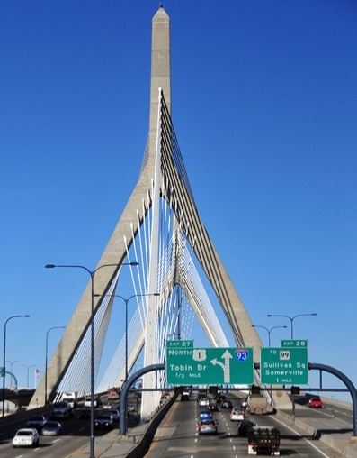
Major Construction Projects Don’t Start
Without Insurance
An example: Boston’s “Big Dig.”
At $14 billion, the project was…
  Larger than the original Panama Canal
  More expensive than the “Chunnel” connecting France and England
  Among the carriers who were winning bidders were AIG, Lexington, Zurich-American and Kemper Environmental.
  Workforce included 150 general contractors, 600 construction companies
  Worst fear: that a building within
  50 feet of the excavation would collapse
Source: Mark Hollmer, “The Big Risk: Insuring the Big Dig,” Insurance Times, Sept. 17, 2002.
Notes:
42
Image is from Wikimedia Commons.

Slide 43
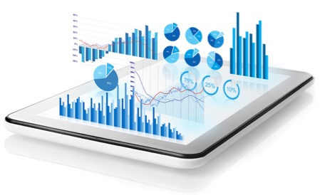
As Financial Intermediaries, Insurers Expand the Funds Available to Grow the Economy
  As financial intermediaries,
  insurers convert short-term funds
  into longer-term investments
In 2015, the industry converted $71 billion in premium income that was not needed for immediate claims payments into new long-term investments (bonds, mortgages, common and preferred stock, and owned real estate)
Notes:
43

Slide 44

Insurance Contributes to Growth by
Speeding Recovery
Insurers are “financial first responders”
  Insurance claims administration and payment is the most efficient way to achieve rapid recovery
  Insurers perform this function more quickly and reliably than government or other aid organizations
  This effect benefits not just those directly affected but also the wider community
  After SuperStorm Sandy, 93% of claims were closed within
  6 months
Notes:
44

Slide 45
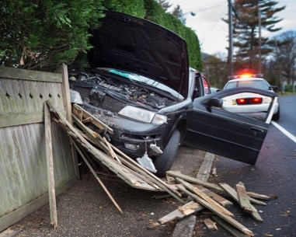
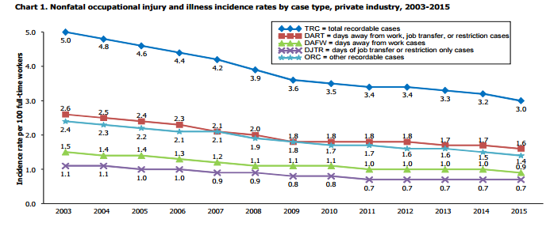
Insurance Is an Instrument of Social Policy
Mandated
auto liability insurance
Workers compensation insurance
Since 1959 (when IIHS was founded), over half a million deaths in auto crashes avoided
  In just the last dozen years, Workers Comp insurers have continued to help reduce injury and illness rates in the workplace.
Source for chart: U.S. Dept. of Labor, Bureau of Labor Statistics, “Employer-Reported Workplace Injuries and Illnesses—2015,” released October 27, 2016. Source for IIHS calculation: Robert Hartwig speech at IIHS 50th Anniversary, September 9, 2009.
Notes:
45

Slide 46

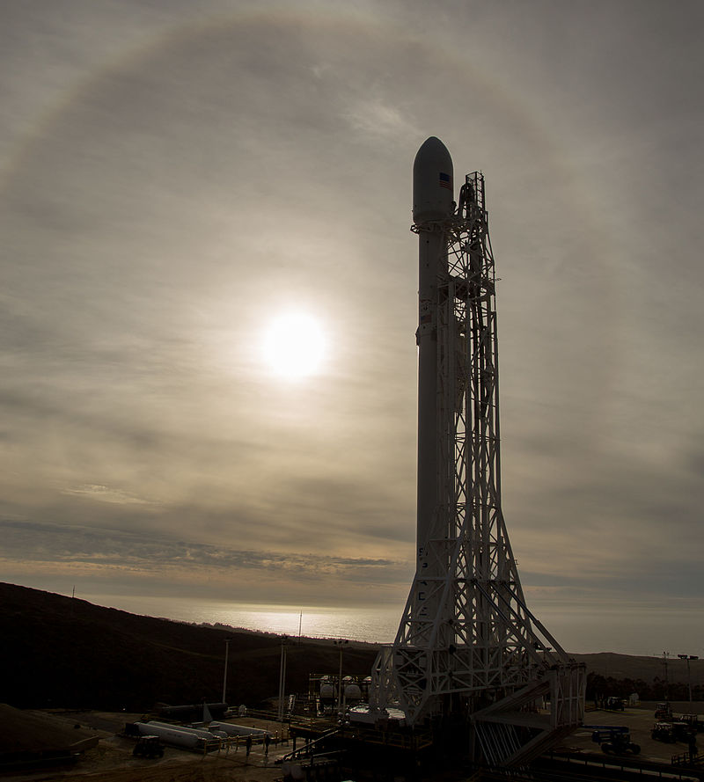

Insurance Supports New Ventures
Insurance enables individuals and organizations to take new risks.
In the case of the Falcon 9 launches, insurance is needed for potential damages to
  The launch pad
  Nearby government property
  Nongovernment property
  The rocket and [$200 million] satellite
Sources: Art: Cover of Contingencies magazine, May-June 2017 issue; headline: http://www.nbcnews.com/science/space/spacex-explains-september-explosion-says-it-ll-try-again-sunday-n702421
Notes:
46
Image from Wikimedia Commons: https://commons.wikimedia.org/w/index.php?title=Special:Search&profile=images&search=spacex+satellite+launch&fulltext=1&searchToken=aty1qrugm7dlyk32tlidos97b#/media/File:Jason-3_Satellite_Launch_(NHQ201601160007).jpg

Slide 47
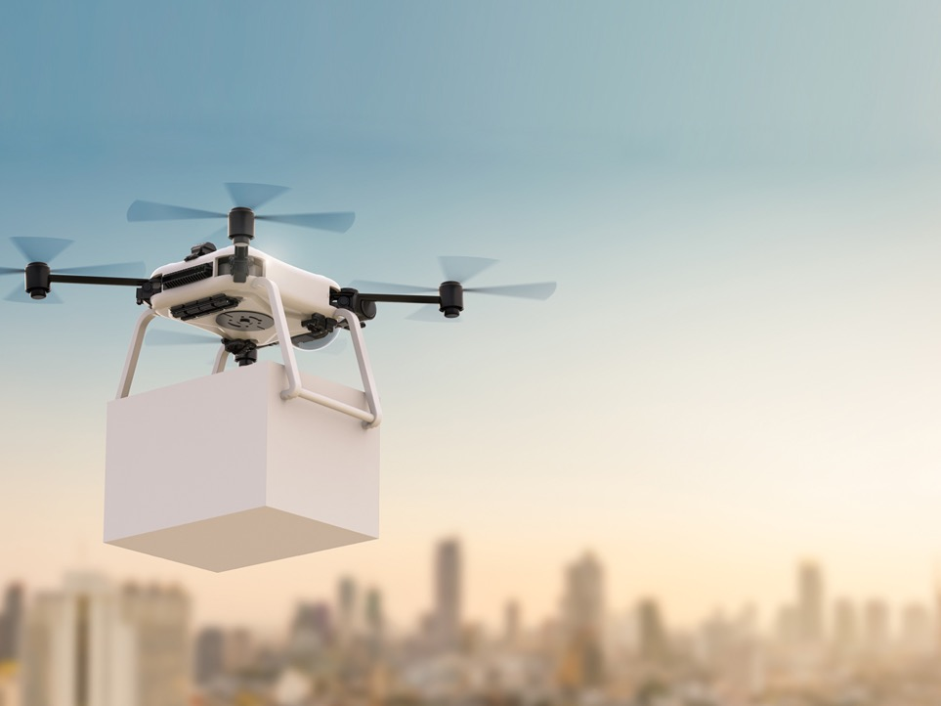
For the Economy, Insurance Is Growing in Importance
This is because economic activity is increasingly interdependent
  This translates to an increase in the need for, and the cost of, activities that ensure the functioning of production and consumption (e.g., transportation, information)
  With modern technology, the vulnerability of these systems and interdependencies increases
Notes:
47

