Slide 1
Under Pressure: P/C Insurance Markets in an Era of High Catastrophe Losses, Low Interest Rates and Tort Liability Concerns
Robert P. Hartwig, Ph.D., CPCU
President & Economist
Insurance Information Institute

Slide 2
P/C Insurance Industry Financial Overview
Industry Performance Has Been Affected by High CAT Losses and Low Interest Rates

Slide 3
P/C Net Income after Taxes
1991–2012 ($ Millions)
High catastrophe losses and
low interest rate have impacted insurer earnings, contributing to pricing pressure
2005 ROE*= 9.6%
2006 ROE = 12.7%
2007 ROE = 10.9%
2008 ROE = 0.1%
2009 ROE = 5.0%
2010 ROE = 6.6%
2011 ROAS¹ = 3.5%
2012 ROAS¹ = 5.9%
* ROE figures are GAAP; ¹Return on avg. surplus. Excluding Mortgage & Financial Guaranty insurers yields a 6.2% ROAS in 2012, 4.7% ROAS for 2011, 7.6% for 2010 and 7.4% for 2009.
Sources: A.M. Best, ISO, Insurance Information Institute.

Slide 4
A 100 Combined Ratio Isn’t What It Once Was:
Investment Impact on ROEs
Combined Ratio / ROE
A combined ratio of about 100 generated a ROE of just ~7.0%
in 2012, ~7.5% ROE in 2009/10, 10% in 2005 and 16% in 1979
Catastrophes and lower investment income pulled down ROE in 2012
Combined Ratios Must Be Lower in Today’s Depressed Investment Environment
to Generate Risk Appropriate ROEs
* 2008 -2012 figures are return on average surplus and exclude mortgage and financial guaranty insurers. 2012 combined ratio including M&FG insurers is 103.2, 2011 combined ratio including M&FG insurers is 108.1, ROAS = 3.5%.
Source: Insurance Information Institute from A.M. Best and ISO data.

Slide 5
Profitability Peaks & Troughs in the P/C Insurance Industry,
1975 – 2012*
ROE
History suggests next ROE peak will be in 2016-2017
1977: 19.0%
1987: 17.3%
1997: 11.6%
2006: 12.7%
10 Years
10 Years
2012:
5.9%
9 Years
1975: 2.4%
1984: 1.8%
1992: 4.5%
2001: -1.2%
*Profitability = P/C insurer ROEs. 2011 figure is an estimate based on ROAS data. Note: Data for 2008-2012 exclude mortgage and financial guaranty insurers.
Source: Insurance Information Institute; NAIC, ISO, A.M. Best.

Slide 6
Near Record Catastrophe Losses Continue to Pressure Rates
U.S. Catastrophe Losses in Recent Years Have Been Very High and Vulnerability Is Rising Globally

Slide 7
U.S. Insured Catastrophe Losses
($ Billions, 2012 Dollars)
2012 was likely the third most expensive year ever
for insured CAT losses
2012 Was the 3rd Highest Year on Record for Insured Losses in U.S. History on an Inflation-Adj. Basis. 2011 Losses Were the 6th Highest. YTD 2013 Running Below Average but Q3 Is Typically the Costliest Quarter.
Record tornado losses caused 2011 CAT losses to surge
*Through 6/2/13. Includes $2.6B for 2013:Q1 (PCS) and $5.32B for the period 4/1 – 6/2/13 (Aon Benfield Monthly Global Catastrophe Recap).
Note: 2001 figure includes $20.3B for 9/11 losses reported through 12/31/01 ($25.9B 2011 dollars). Includes only business and personal property claims, business interruption and auto claims. Non-prop/BI losses = $12.2B ($15.6B in 2011 dollars).
Sources: Property Claims Service/ISO; Insurance Information Institute.
Notes:
7

Slide 8
Top 16 Most Costly Disasters in U.S. History
(Insured Losses, 2012 Dollars, $ Billions)
Hurricane Sandy could become 5th costliest event in US insurance history
Includes Tuscaloosa, AL, tornado
Includes Joplin, MO, tornado
Hurricane Irene in 2011 ranks as the 12th most expense hurricane in US history
12 of the 16 Most Expensive Events in US History Have Occurred Over the Past Decade
Sources: PCS; Insurance Information Institute inflation adjustments to 2012 dollars using the CPI.

Slide 9
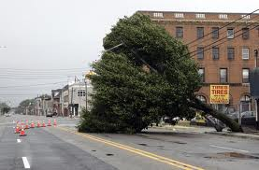
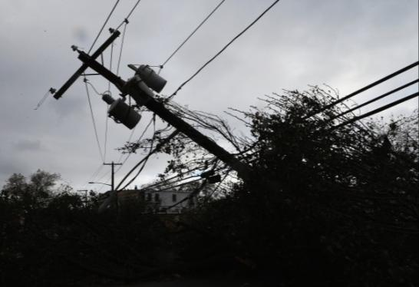
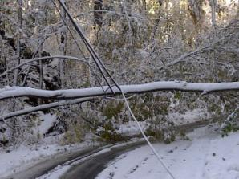
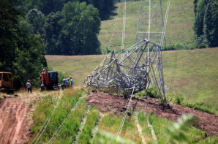
The Past Two Years Have Not Been Kind to Insurers or Utilities
Hurricane Irene: Aug. 27-29, 2011
Insured Losses: $4.3 Billion
Customers w/o Power: 5 Million
“Snowtober” Blizzard: Oct. 29, 2011
Insured Losses: ~$1 Billion
Customers w/o Power: 2.7 Million
Derecho: June 29, 2012
Insured Losses: ~$1+ Billion
Customers w/o Power: 3.7 Million
Superstorm Sandy: Oct. 29-30, 2012
Insured Losses: $18.8 Billion
Customers w/o Power: 8.1 Million
Source: Insurance Information Institute research.

Slide 10
Natural Disasters in the United States, 1980 – 2012
Number of Events (Annual Totals 1980 – 2012)
There were 184 natural disaster events in the US in 2012
Geophysical (earthquake, tsunami, volcanic activity)
Meteorological (storm)
Hydrological
(flood, mass movement)
Number
Climatological (temperature
extremes, drought, wildfire)
41
19
121
3
Source: MR NatCatSERVICE

Slide 11
Losses Due to Natural Disasters in the US, 1980–2012
(Overall and Insured Losses)
(2012 Dollars, $ Billions)
2012 was the
2nd most expensive year on record for insured catastrophe losses in the US (incl. NFIP flood).
Approximately 57% of the overall cost of catastrophes in the US was covered by insurance in 2012
2012 Losses
Overall : $101.1B
Insured: $57.9B
Source: MR NatCatSERVICE
Overall losses (in 2012 values)
Insured losses (in 2012 values)

Slide 12
Natural Disaster Losses in the United States: 2012
As of January 1, 2013 | Number of Events | Fatalities | Estimated Overall Losses (US $m) | Estimated Insured Losses (US $m)
Tropical Cyclone | 4 | 143 | 52,240 | 26,360
Severe Thunderstorm | 115 | 118 | 27,688 | 14,914
Drought | 2 | 0 | 20,000 | 16,000†
Wildfire | 38 | 13 | 1,112 | 595
Winter Storm | 2 | 7 | 81 | 38
Flood | 19 | 3 | 13 | 0††
TOTALS | 184 | 284 | $101,134 | $57,907
Source: MR NatCatSERVICE
† - Includes Federal Crop Insurance Losses. † † - Excludes federal flood.
12
Notes:
All data from NatCat Service

Slide 13
Inflation Adjusted U.S. Catastrophe Losses by Cause of Loss, 1992–2011¹
Fires (4), $6.0
Other (5), $1.4
0.4%
Wind/Hail/Flood (3), $14.8
Insured cat losses from 1992-2011 totaled $384.3B, an average of $19.2Bper year or $1.6B per month
Geological Events, $18.2
Terrorism, $24.4
Winter Storms, $28.2
Hurricanes &
Tropical Storms
$161.3
Tornadoes (2), $130.2
Wind losses are by far cause the most catastrophe losses, even
if hurricanes/TS are excluded.
Tornado share of CAT losses is rising
Catastrophes are defined as events causing direct insured losses to property of $25 million or more in 2009 dollars.
Excludes snow.
Does not include NFIP flood losses
Includes wildland fires
Includes civil disorders, water damage, utility disruptions and non-property losses such as those covered by workers compensation.
Source: ISO’s Property Claim Services Unit.

Slide 14
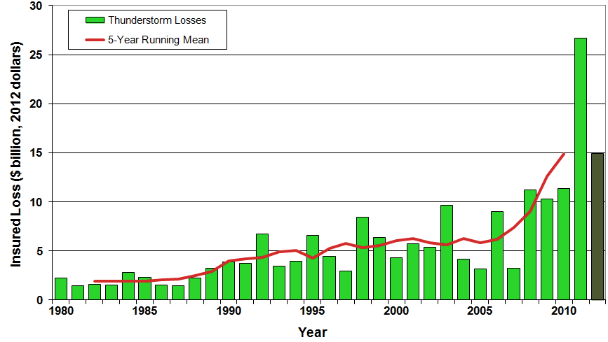
U.S. Thunderstorm Loss Trends, 1980 – 2012
Hurricanes get all the headlines,
but thunderstorms are consistent producers of large scale loss. 2008-2012 are
the most expensive years on record.
Average thunderstorm losses are up 7 fold since the early 1980s.
The 5-year running average loss
is up sharply.
Thunderstorm losses in 2012 totaled $14.9 billion, the 2nd highest on record
Source: Property Claims Service, MR NatCatSERVICE
14

Slide 15
Top 16 Most Costly World Insurance Losses, 1970-2012*
(Insured Losses, 2012 Dollars, $ Billions)
2012 insured CAT Losses totaled $60B; Economic losses totaled $140B, according to Swiss Re
5 of the top 14 most expensive catastrophes in world history have occurred within the past 3 years (2010-2012)
Hurricane Sandy is now the 6th costliest event in global insurance history
*PCS estimate as of 4/12/13.
Sources: PCS; Insurance Information Institute inflation adjustments to 2012 dollars using the CPI.

Slide 16
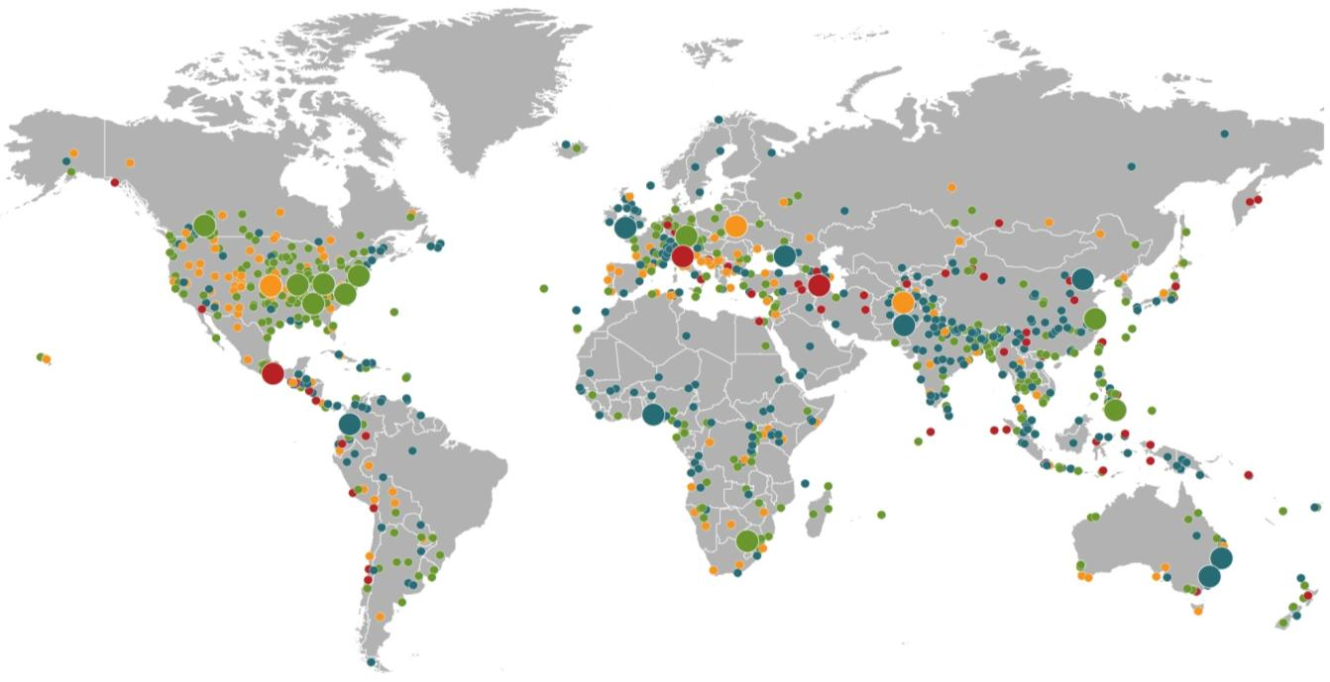
Natural Loss Events:
Full Year 2012
World Map
Winter Storm Andrea
Europe, 5–6 January
Floods
United Kingdom,
21–27 November
Cold Wave
Eastern Europe, Jan – Feb
Cold Wave
Afghanistan, Jan – Mar
Severe Weather
USA, 28–29 April
Hailstorms, severe weather
Canada, 12–14 August
Severe storms
USA, 28 June –2 July
Flash Floods
Russia, 6–8 July
Floods
China, 21–24 July
Drought
USA, Summer
Hurricane Sandy
USA, Caribbean
24–31 October
Earthquake
Italy,
29 May/3 June
Typhoon Haikui China, 8–9 August
Severe Storms, tornadoes
USA, 2–4 March
Hurricane Isaac
USA, Caribbean
24–31 August
Earthquake
Iran, 11 August
Earthquake
Mexico, 20 March
Floods
Nigeria, Jul – Oct
Floods
Pakistan, 3 –27 September
Typhoon Bopha Philippines, 4–5 December
Floods
Columbia, Mar – Jun
Floods, flash floods
Australia, Jan – Feb
Number of events: 905
Floods, hailstorms
South Africa, 20 –21 October
Floods. flash floods
Australia, Feb – Mar
Natural catastrophes
Geophysical events
(earthquake, tsunami, volcanic activity)
Hydrological events
(flood, mass movement)
Selection of significant
Natural catastrophes
Meteorological events
(storm)
Climatological events
(extreme temperature, drought, wildfire)
Source: Munich Re Geo Risks Research, NatCatSERVICE – As at January 2013.
16

Slide 17
Natural Disasters Worldwide, 1980 – 2013*
Number of Events
There were 460 natural disaster events globally in the first half of 2013 and 905 for full-year 2012
Geophysical (earthquake, tsunami, volcanic activity)
Meteorological (storm)
Hydrological
(flood, mass movement)
Number
Climatological (temperature
extremes, drought, wildfire)
41
19
121
3
Source: MR NatCatSERVICE

Slide 18
Losses Due to Natural Disasters Worldwide, 1980–2013* (Overall & Insured Losses)
(Overall and Insured Losses)
(2012 Dollars, $ Billions)
2012 Losses
Overall : $101.1B
Insured: $57.9B
2013: 1st Half Losses
Overall : $45B
Insured: $13B
There is a clear upward trend in both insured and overall losses over the past 30+ years
*Through June 30, 2013.
Source: MR NatCatSERVICE
Insured losses (in 2012 values)
Overall losses (in 2012 values)
18

Slide 19
Outlook for 2013 Hurricane Season:
Above Average Activity Expected
Hurricanes and Tropical Storms Drive Some of the Largest Losses Utilities Experience Each Year

Slide 20
Top 12 Most Costly Hurricanes in U.S. History
(Insured Losses, 2012 Dollars, $ Billions)
10 of the 12 most costly hurricanes in insurance history occurred
over the past 9 years (2004 - 2012)
Hurricane Sandy became
the 3rd costliest hurricane
in US insurance history
Hurricane Irene became
the 12th most expensive hurricane
in US history in 2011
*PCS estimate as of 4/12/13.
Sources: PCS; Insurance Information Institute inflation adjustments to 2012 dollars using the CPI.

Slide 21
Hurricane Sandy: Claim Payments to Policyholders, by State
($ Thousands)
TOTAL = $18.75 Billion*
At $9.6B and $6.6B, respectively,
NY and NJ suffered, by far, the largest losses from Hurricane Sandy
Insurers Will Pay at Least $18.75 Billion to 1.52 Million Policyholders across 15 States
and DC in the Wake of Hurricane Sandy
Sources: Catastrophe loss data is for Catastrophe Serial No. 90 (Oct. 28 - 31, 2012) from PCS as of Jan. 18, 2013; Insurance Information Institute .

Slide 22
Hurricane Sandy: Insured Loss by Claim Type*
($ Millions)
Total Claim Value = $18.75 Billion*
Although Commercial Lines accounted for
only 13% of total claims,
they account for 48%
of all claim dollars paid.
In most hurricanes, Commercial Lines accounts for about 1/3
of insured losses.
Commercial
$9,024
48%
Auto
$2,729
15%
Homeowner
$6,997
37%
*PCS insured loss estimates as of 1/18/13. Catastrophe modeler estimates range up to $25 billion. All figures exclude losses paid by the NFIP.
Source: PCS; Insurance Information Institute.

Slide 23
Outlook for 2013 Hurricane Season:
75% Worse Than Average
Forecast Parameter | Median (1981-2010) | 2013F
Named Storms | 12.0 | 18
Named Storm Days | 60.1 | 95
Hurricanes | 6.5 | 9
Hurricane Days | 21.3 | 40
Major Hurricanes | 2.0 | 4
Major Hurricane Days | 3.9 | 9
Accumulated Cyclone Energy | 92.0 | 165
Net Tropical Cyclone Activity | 103% | 175%
Source: Philip Klotzbach and Dr. William Gray, Colorado State University, June 2013, accessed at http://tropical.atmos.colostate.edu/forecasts/2013/jun2013/jun2013.pdf; Insurance Information Institute.

Slide 24
Landfall Probabilities for 2013 Hurricane Season:
Above Average
 | Average* | 2013F
Entire US East & Gulf Coasts | 52% | 72%
US East Coast Including Florida Peninsula | 31% | 48%
Gulf Coast from Florida Panhandle to Brownsville | 30% | 47%
Caribbean | 42% | 61%
*Average over the past century.
Source: Philip Klotzbach and Dr. William Gray, Colorado State University, June 2013.

Slide 25
Selected Large Outages Associated with Tropical Systems, by State
(Millions of Customers)
Hurricanes and tropical storms have produced significant losses for insurers in recent years, including with Sandy in 2012
Sources: US Dept. of Energy, Vertyx, AP analysis; Insurance Information Institute.

Slide 26
Total Value of Insured Coastal Exposure in 2012
(2012 Dollars, $ Billions)
$2.923 trillion insured coastal exposure in New York in 2012
In 2012, New York ranked as the #1 most
exposed state to hurricane loss, overtaking Florida with $2.862 trillion. Texas is very exposed too, and ranked #3 with $1.175 trillion
in insured coastal exposure
The insured value of all coastal property was $10.6 trillion in 2012 , up 20% from $8.9 trillion in 2007 and up 48% from $7.2 trillion in 2004
Source: AIR Worldwide.

Slide 27
Combined Ratio Points Associated with Catastrophe Losses: 1960 – 2012*
Catastrophe losses as a share of all losses reached a record high in 2012
Combined Ratio Points
Avg. CAT Loss Component of the Combined Ratio
by Decade
1960s: 1.04 1970s: 0.85 1980s: 1.31 1990s: 3.39 2000s: 3.52 2010s: 7.20*
The Catastrophe Loss Component of Private Insurer Losses Has Increased
Sharply in Recent Decades
Notes: Private carrier losses only. Excludes loss adjustment expenses and reinsurance reinstatement premiums. Figures are adjusted for losses ultimately paid by foreign insurers and reinsurers.
Source: ISO (1960-2011); A.M. Best (2012E) Insurance Information Institute.

Slide 28
Federal Disaster Declarations Patterns: 1953-2013
Disaster Declarations Set New Records in Recent Years

Slide 29
Number of Federal Disaster Declarations, 1953-2013*
There have been 2,117 federal disaster declarations since 1953. The average number of declarations per year is 35 from 1953-2012, though there few haven’t been recorded since 1995.
The number of federal disaster declarations set a new record in 2011, with 99, shattering 2010’s record 81 declarations.
27 federal disasters were declared so far in 2013*
The Number of Federal Disaster Declarations Is Rising and Set New Records in 2010 and 2011. Hurricane Sandy Produced 13 Declarations in 2012/13.
*Through July 7, 2013.
Source: Federal Emergency Management Administration; http://www.fema.gov/disasters; Insurance Information Institute.

Slide 30
Federal Disasters Declarations by State,
1953 – 2013: Highest 25 States*
Over the past 60 years, Texas has had the highest number of Federal Disaster Declarations
*Through July 7, 2013. Includes Puerto Rico and the District of Columbia.
Source: FEMA: http://www.fema.gov/news/disaster_totals_annual.fema; Insurance Information Institute.

Slide 31
Federal Disasters Declarations by State,
1953 – 2013: Lowest 25 States*
Over the past 60 years, Wyoming and Rhode Island had the fewest number of Federal Disaster Declarations
*Through July 7, 2013. Includes Puerto Rico and the District of Columbia.
Source: FEMA: http://www.fema.gov/news/disaster_totals_annual.fema; Insurance Information Institute.

Slide 32
Severe Weather Report Update: 2013
Damage from Tornadoes, Large Hail and High Winds
Keep Insurers Busy

Slide 33
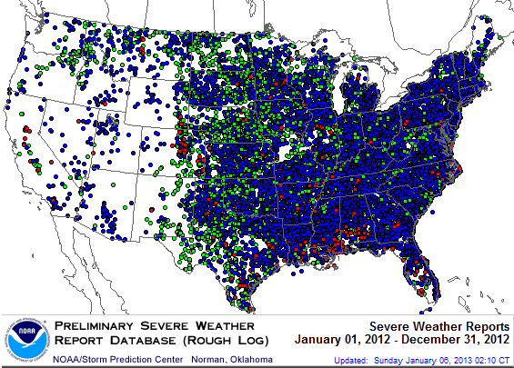
Severe Weather Reports, 2012
There were
22,503 severe weather reports in 2012; including 1,119 tornadoes; 7,033 “Large Hail” reports and 14,351 high wind events
Source: NOAA Storm Prediction Center; http://www.spc.noaa.gov/climo/online/monthly/2012 annual summary.html#

Slide 34
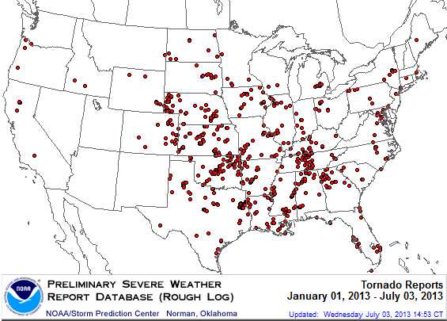
Location of Tornado Reports: through July 3, 2013
The storm system that spawned the deadly EF-5 tornado on May 19 in Moore, OK, produced insured losses of $1.575 billion
There were
630 tornadoes through July 3, causing extensive property damage in several states
Source: NOAA Storm Prediction Center; http://www.spc.noaa.gov/climo/online/monthly/2013 annual summary.html#; PCS.

Slide 35
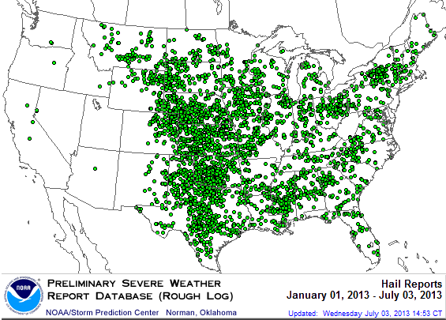
Location of Large Hail Reports: through July 3, 2013
There were
3,716 “Large Hail” reports through July 3, causing extensive property and vehicle damage
Large hail reports
were heavily concentrated
in the Plains states
Source: NOAA Storm Prediction Center; http://www.spc.noaa.gov/climo/online/monthly/2013 annual summary.html#

Slide 36
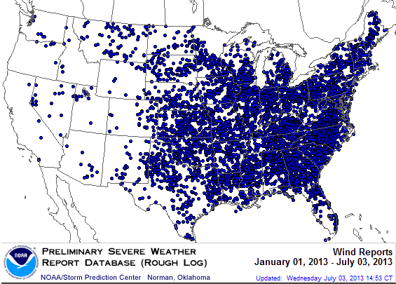
Location of High Wind Reports: through July 3, 2013
There were 7,371 “Wind Damage” reports through July 3, causing extensive property damage
Wind damage reports were more heavily concentrated
in the Southeast
Source: NOAA Storm Prediction Center; http://www.spc.noaa.gov/climo/online/monthly/2013 annual summary.html#

Slide 37
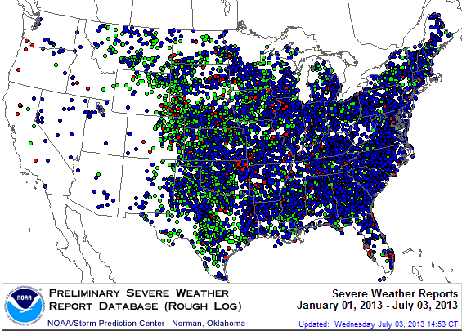
Severe Weather Reports: through July 3, 2013
There were 11,717 severe weather reports through July 3; including 630 tornadoes; 3,716 “Large Hail” reports and 7,371 high wind events
Source: NOAA Storm Prediction Center; http://www.spc.noaa.gov/climo/online/monthly/2013 annual summary.html#

Slide 38
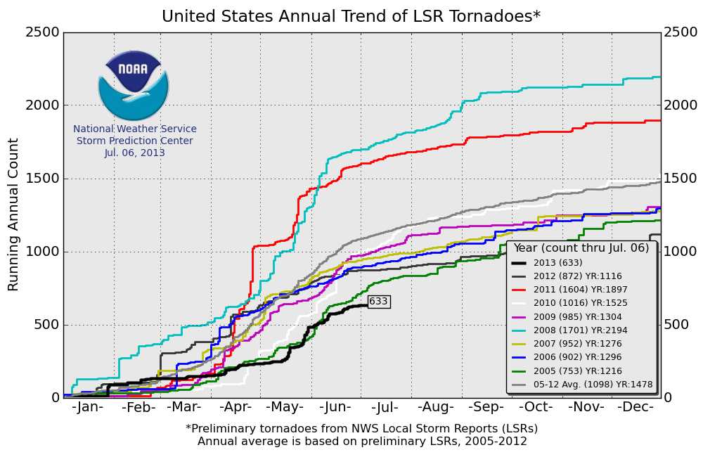
U.S. Tornado Count, 2005-2013*
There were 1,897 tornadoes in the U.S. in 2011 far above average, but well below 2008’s record
2013 count is running well below average
*Through July 6, 2013. Source: http://www.spc.noaa.gov/wcm/.
38

Slide 39
Investments: The New Reality
Investment Performance Is a Key Driver of Profitability
Depressed Yields Will Necessarily Impact Underwriting & Pricing

Slide 40
Property/Casualty Insurance Industry Investment
Income: 2000–2013*¹
($ Billions)
-16.7%*
Investment earnings are running 16.7% below their 2007 pre-crisis peak
Investment Income Fell in 2012 and is Falling in 2013 Due to Persistently Low Interest Rates, Putting Additional Pressure on (Re) Insurance Pricing
1 Investment gains consist primarily of interest and stock dividends..
*Estimate based on annualized actual Q1:2013 investment income of $11.385B.
Sources: ISO; Insurance Information Institute.

Slide 41
P/C Insurer Net Realized
Capital Gains/Losses, 1990-2013:Q1
Realized capital gains in 2012 were down 12% from 2011 and down 30% from 2007
($ Billions)
Insurers Posted Net Realized Capital Gains in 2010, 2011 and 2012 Following Two Years of Realized Losses During the Financial Crisis. Realized Capital Losses Were a Primary Cause of 2008/2009’s Large Drop in Profits and ROE
Sources: A.M. Best, ISO, Insurance Information Institute.
41
Notes:
41

Slide 42
Property/Casualty Insurance Industry
Investment Gain: 1994–2013:Q1¹
($ Billions)
-16%*
Investment gains in 2012 were approximately 16% below their pre-crisis peak
Investment Gains Slipped in 2012 as Low Interest Rates Reduced Investment Income and Realized Investment Gains Fell; The Financial Crisis Caused Investment Gains to Fall by 50% in 2008. Reduced investment earnings are pressuring rates/pricing.
1 Investment gains consist primarily of interest, stock dividends and realized capital gains and losses.
* 2005 figure includes special one-time dividend of $3.2B;
Sources: ISO; Insurance Information Institute.

Slide 43
P/C Industry Investment Gains,
Inflation-Adjusted: 1994–2013E¹
1994-2012 average yearly gain: $61B hasn’t been achieved since 2007
($ Billions)
-24%*
Because the Federal Reserve Board aims to keep interest rates exceptionally low until the unemployment rate hits 6.5%—likely well into 2014—maturing bonds will be re-invested at still low rates even once “tapering” begins.
1Investment gains consist primarily of interest, stock dividends and realized capital gains and losses.
*2005 figure includes special one-time dividend of $3.2B; 2013F figure is I.I.I. estimate for 2013:Q1, annualized.
Sources: ISO; Insurance Information Institute.

Slide 44
U.S. 10-Year Treasury Note Yields:
A Long Downward Trend, 1990–2013*
Yields on 10-Year U.S. Treasury Notes recently plunged to record modern-era lows and remain low by historical standards
Yields on 10-Year U.S. Treasury Notes have been essentially below 5% for a full decade.
Since roughly 80% of P/C bond/cash investments are in 10-year or shorter durations, most P/C insurer portfolios will have low-yielding bonds for years to come.
*Monthly, through June 2013. Note: Recessions indicated by gray shaded columns.
Sources: Federal Reserve Bank at http://www.federalreserve.gov/releases/h15/data.htm.
National Bureau of Economic Research (recession dates); Insurance Information Institutes.
Notes:
44

Slide 45
U.S. Treasury Security Yields:
A Long Downward Trend, 1990–2013*
Yields on 10-Year U.S. Treasury Notes have been essentially below 5% for a full decade.
U.S. Treasury security yields recently plunged to record lows
Since roughly 80% of P/C bond/cash investments are in 10-year or shorter durations, most P/C insurer portfolios will have low-yielding bonds for years to come.
*Monthly, constant maturity, nominal rates, through June 2013.
Sources: Federal Reserve Bank at http://www.federalreserve.gov/releases/h15/data.htm.
National Bureau of Economic Research (recession dates); Insurance Information Institute.
Notes:
45

Slide 46
Treasury Yield Curves:
Pre-Crisis (July 2007) vs. June 2013
Treasury yield curve remains near its most depressed level in at least 45 years. Investment income is falling as a result. If as Fed I “tapers” rates are unlikely to return to pre-crisis levels anytime soon
The Fed Is Actively Signaling that it Is Determined to Keep Rates Low Until Unemployment Drops Below 6.5% or Until Inflation Expectations Exceed 2.5%; Low Rates Add to Pricing Pressure for Insurers.
Source: Federal Reserve Board of Governors; Insurance Information Institute.

Slide 47
Average Maturity of Bonds Held by US P/C Insurers,
2006–2011*
Average Maturity (Years)
The average bond maturity is down by a full year between 2007 and 2011
Falling Average Maturity (and Duration) of the P/C Industry’s Bond Portfolio is Contributing to the Drop in Investment Income Along With Lower Yields
*Year-end figures. Latest available.
Sources: Insurance Information Institute calculations based on A.M. Best data.
Notes:
47

Slide 48
Distribution of Bond Maturities,
P/C Insurance Industry, 2003-2012
The main shift over these years has been from bonds with longer maturities to bonds with shorter maturities. Since 2006, the industry trimmed its holdings of bonds with maturities greater than 10 years from 20.5% in 2006 to 15.5% in 2012 and then trimmed bonds in the 5-10-year category from 34.1% in 2006 to 27.6% in 2012) . Falling average maturity of the P/C industry’s bond portfolio is contributing to a drop in investment income along with lower yields.
Sources: SNL Financial; Insurance Information Institute.

Slide 49
Bonds Rated NAIC Quality Category 3-6 as a Percent of Total Bonds, 2003–2012
From 2006-07 to year-end 2012, the percentage of lower-quality bonds in P/C industry portfolios more than doubled
There are many ways to capture higher yields on bond portfolios. One is to accept greater risk, as measured by NAIC bond ratings. The ratings range from 1 to 6, with the highest quality rated 1. Even in 2012, over 95% of the industry’s bonds were rated 1 or 2.
Sources: SNL Financial; Insurance Information Institute.
Notes:
49

Slide 50
Reduction in Combined Ratio Necessary to Offset 1% Decline in Investment Yield to Maintain Constant ROE, by Line*
Lower Investment Earnings Place a Greater Burden on Underwriting and Pricing Discipline
*Based on 2008 Invested Assets and Earned Premiums
**US domestic reinsurance only
Source: A.M. Best; Insurance Information Institute.
50
Notes:
50

Slide 51
Annual Inflation Rates, (CPI-U, %),
1990–2014F
Annual Inflation Rates (%)
Inflationary expectations remain quite low, allowing the Fed to continue its QE3 program into 2014
Inflation peaked at 5.6% in August 2008 on high energy and commodity crisis. The recession and the collapse of the commodity bubble reduced inflationary pressures in 2009/10
The slack in the U.S. economy suggests that inflationary pressures should remain subdued for an extended period of times. Energy, health care and commodity prices, plus U.S. debt burden, remain longer-run concerns
Sources: US Bureau of Labor Statistics; Blue Chip Economic Indicators, 7/13 (forecasts).

Slide 52
Property/Casualty Insurance Industry
Investment Income: 2000–2013*¹
($ Billions)
Investment earnings are running below their 2007 pre-crisis peak
Investment Income Fell in 2012 and is Falling in 2013 Due to Persistently Low Interest Rates, Putting Additional Pressure on (Re) Insurance Pricing
1 Investment gains consist primarily of interest and stock dividends..
*Estimate based on annualized actual Q1:2013 investment income of $11.385B.
Sources: ISO; Insurance Information Institute.
Notes:
52

Slide 53
P/C Insurer Net Realized
Capital Gains/Losses, 1990-2013:Q1
Realized capital gains in 2012 were down 12% from 2011
($ Billions)
Insurers Posted Net Realized Capital Gains in 2010, 2011 and 2012 Following Two Years of Realized Losses During the Financial Crisis. Realized Capital Losses Were the Primary Cause of 2008/2009’s Large Drop in Profits and ROE
Sources: A.M. Best, ISO, Insurance Information Institute.
53
Notes:
53

Slide 54
Property/Casualty Insurance Industry
Investment Gain: 1994–2013:Q1¹¹
($ Billions)
Investment gains in 2012 were approximately 16% below their pre-crisis peak
Investment Gains Are Slipping in 2012 as Low Interest Rates Reduce Investment Income and Lower Realized Investment Gains; The Financial Crisis Caused Investment Gains to Fall by 50% in 2008
1 Investment gains consist primarily of interest, stock dividends and realized capital gains and losses.
* 2005 figure includes special one-time dividend of $3.2B;
Sources: ISO; Insurance Information Institute.

Slide 55
U.S. 10-Year Treasury Note Yields:
A Long Downward Trend, 1990–2013*
Yields on 10-Year U.S. Treasury Notes recently plunged to all time record lows
Yields on 10-Year U.S. Treasury Notes have been essentially below 5% for a full decade.
Since roughly 80% of P/C bond/cash investments are in 10-year or shorter durations, most P/C insurer portfolios will have low-yielding bonds for years to come.
*Monthly, through June 2013. Note: Recessions indicated by gray shaded columns.
Sources: Federal Reserve Bank at http://www.federalreserve.gov/releases/h15/data.htm.
National Bureau of Economic Research (recession dates); Insurance Information Institutes.
Notes:
55

Slide 56
Treasury Yield Curves:
Pre-Crisis (July 2007) vs. Jan. 2013
Treasury yield curve remains near its most depressed level in at least 45 years. Investment income is falling as a result. Fed is unlikely to hike rates until well into 2014 at the earliest.
The Fed Is Actively Signaling that it Is Determined to Keep Rates Low Until Unemployment Drops Below 6.5% or Until Inflation Expectations Exceed 2.5%; Low Rates Add to Pricing Pressure for Insurers.
Source: Federal Reserve Board of Governors; Insurance Information Institute.

Slide 57
Distribution of Bond Maturities,
P/C Insurance Industry, 2003-2012
The main shift over these years has been from bonds with longer maturities to bonds with shorter maturities. The industry first trimmed its holdings of over-10-year bonds (from 24.6% in 2003 to 15.5% in 2012) and then trimmed bonds in the 5-10-year category (from 31.3% in 2003 to 27.6% in 2012) . Falling average maturity of the P/C industry’s bond portfolio is contributing to a drop in investment income along with lower yields.
Sources: SNL Financial; Insurance Information Institute.

Slide 58
Reduction in Combined Ratio Necessary to Offset 1% Decline in Investment Yield to Maintain Constant ROE, by Line*
Lower Investment Earnings Place a Greater Burden on Underwriting and Pricing Discipline
*Based on 2008 Invested Assets and Earned Premiums
**US domestic reinsurance only
Source: A.M. Best; Insurance Information Institute.
58
Notes:
58

Slide 59
Workers Compensation Operating Environment
Rising Medical and Indemnity Lost Time Claim Severities Continue to Rise
Persistently Low Interest Rates Have a Larger Impact on Long Tail Lines Like WC

Slide 60
Workers Compensation Combined Ratio: 1994–2012P
WC showed a better-than-expected improvement for private carriers in 2012
Workers Comp Results Began to Improve in 2012. Underwriting Results Deteriorated Markedly from 2007-2010/11 and Were the Worst They Had Been in a Decade.
Sources: A.M. Best (1994-2009); NCCI (2010-2012P) and are for private carriers only; Insurance Information Institute.

Slide 61
Workers Compensation Medical Severity
Moderate Increase in 2012
Average Medical Cost per Lost-Time Claim
Cumulative Change = 252%
(1991-2012p)
Medical Claim Cost ($000s)
Annual Change 1991–1993: +1.9%
Annual Change 1994–2001: +8.9%
Annual Change 2002–2011: +5.7%
Accident Year
2012p: Preliminary based on data valued as of 12/31/2012.
1991-2011: Based on data through 12/31/2011, developed to ultimate
Based on the states where NCCI provides ratemaking services including state funds, excluding WV; Excludes high deductible policies.

Slide 62
Workers Comp Indemnity Claim Costs:
Small Increase in 2012
Average indemnity costs per claim were up 1% in 2012 to $22,400
Average Indemnity Cost per Lost-Time Claim
Indemnity Claim Cost ($ 000s)
Annual Change 1991–1993: -1.7%
Annual Change 1994–2001: +7.3%
Annual Change 2002–2011: +3.2%
Accident Year
2012p: Preliminary based on data valued as of 12/31/2012.
1991-2011: Based on data through 12/31/2011, developed to ultimate
Based on the states where NCCI provides ratemaking services including state funds, excluding WV; Excludes high deductible policies.

Slide 63
Workers Compensation Premium:
Second Consecutive Year of Increase
Pvt. Carrier NWP growth was +9.0% in 2012, as pricing reacts to poor underwriting results and low interest rates
Net Written Premium
($ Billions)
Annual Change 1991–1993: +1.9%
Annual Change 1994–2001: +8.9%
Annual Change 2002–2011: +5.7%
p Preliminary
Source:1990–20102p Private Carriers, Annual Statement Data, NCCI.
1996–2012p State Funds: AZ, CA, CO, HI, ID, KY, LA, MD, MO, MT, NM, OK, OR, RI, TX, UT Annual Statements
State Funds available for 1996 and subsequent

Slide 64
Cyber Risk
Cyber Risk is a Rapidly Emerging Exposure for Businesses Large and Small in Every Industry
NEW III White Paper: http://www.iii.org/assets/docs/pdf/paper_CyberRisk_2013.pdf

Slide 65
Data Breaches 2005-2013,
By Number of Breaches and Records Exposed
# Data Breaches/Millions of Records Exposed
The total number of data breaches and number of records exposed fluctuates from year to year and over time.
*2013 figures as of March 19, 2013.
Source: Identity Theft Resource Center

Slide 66
2012 Data Breaches By Category, By Number of Records Exposed
Government/Military and Business organizations accounted for the majority of records exposed by data breaches during 2012.
Banking/Credit/Financial470,048 (2.7%)
Medical/Healthcare
2.2 million (12.9%)
Educational
2.3 million (13.3%)
Govt/Military
7.7 million (44.4%)
Business
4.6 million (26.7%)
Source: Identity Theft Resource Center, http://www.idtheftcenter.org/ITRC%20Breach%20Report%202012.pdf.

Slide 67
External Cyber Crime Costs: Fiscal Year 2012
Information loss (44%) and business disruption or lost productivity (30%) account for the majority of external costs due to cyber crime.
Other costs*
Equipment damages
Information loss
Revenue loss
Business disruption
* Other costs include direct and indirect costs that could not be allocated to a main external cost category
Source: 2012 Cost of Cyber Crime: United States, Ponemon Institute.

Slide 68
Main Causes of Data Breach
Negligent employees and malicious attacks are most often the cause of the data breach. Some 39 percent of incidents involve a negligent employee or contractor, while 37 percent concern a malicious or criminal attack.
System Glitch
24%
Negligence
39%
Malicious or Criminal Attack
37%
Source: 2011 Cost of Data Breach Study: United States, Ponemon Institute, March 2012

Slide 69
Average Organizational Cost of a Data Breach, 2008-2011*
($ Millions)
Government/Military and Business organizations accounted for the majority of records exposed by data breaches during 2012.
*Findings of this benchmark study pertain to the actual data breach experiences of 49 U.S. companies from 14 different industry sectors, all of which participated in the 2011 study.
Total breach costs include: lost business resulting from diminished trust or confidence of customers ;costs related to detection, escalation, and notification of the breach; and ex-post
response activities, such as credit report monitoring. Source: 2011 Annual Study: U.S. Cost of a Data Breach, the Ponemon Institute.

Slide 70
The Ever Shifting Legal Liability & Tort Environment
Mixed Experience Depending on the Age of Claims

Slide 71
Over the Last Three Decades, Total Tort Costs as a % of GDP Appear Somewhat Cyclical, 1980-2013E
($ Billions)
2.21% of GDP in 2003 = pre-tort reform peak
Deepwater Horizon Spike in 2010
Tort costs in dollar terms have remained high but relatively stable since the mid-2000s., but are down substantially as a share of GDP
1.68% of GDP in 2013
Sources: Towers Watson, 2011 Update on US Tort Cost Trends, Appendix 1A

Slide 72
Liability Costs as a Fraction of GDP, 2011
There US has by far the most costly tort system in the industrialized world. The very long-tailed nature of many liabilities is one reason.
Sources: US Chamber of Commerce; Insurance Information Institute.
Notes:
72

Slide 73
Which Accident Years Generated Reserve Changes in 2012:
Old Claims Still a Problem
($ Billions)
Reserves for older accident years (claims occurring many years ago) are actually increasing in cost—requiring insurers to add $2.3 billion to their reserves in 2012 alone. Old environmental claims are contributing to this deterioration.
Insurance liabilities, especially in areas such as environmental claims, can be very long-lived and can develop adversely even decades later
Sources: SNL Financial; Insurance Information Institute.
Notes:
73

Slide 74
Tort Costs: Rose for Seven Decades:
Old Claims Can Be Problematic
Growth in Tort Costs, Current (Nominal) Dollars,1933-2011
($ Millions)
* Projected
Sources: Trends in Tort Costs, Towers Watson; Insurance Information Institute.

Slide 75
Explosion in Tort Costs Lasted for Much of the 20th Century
Annual Change in Inflation-Adjusted Tort Costs
End of WWII
The postwar era: In 40 years of 43, tort costs rose faster than inflation
Decline in 6 of last 7
Deepwater Horizon
Mid-80s liability crisis
Sources: Trends in Tort Costs, Towers Perrin, Insurance Information Institute.
Notes:
75

Slide 76
From the 1940s through the 1980s, Tort Costs
Grew Much Faster than GDP
Some older liability claims from the era of explosive tort costs continue to suffer from adverse development, requiring insurers to add to their reserves
Sources: Trends in Tort Costs, Towers Perrin, Insurance Information Institute.
Notes:
76

Slide 77
Change in Tort Costs by Decade, Even After Adjusting for Inflation, Still Showed Rapid Growth
Change from Prior Decade
Liability claims from decades past grew with explosive momentum and still increase in cost today
Sources, Trends in Tort Costs, Towers Watson, Insurance Information Institute.
Notes:
77

Slide 78
Energy Supply and Demand
The World Will Remain Energy Hungry and Demand Will Increase Steadily for Decades on a Global Scale Utilizing All Fuel Sources

Slide 79
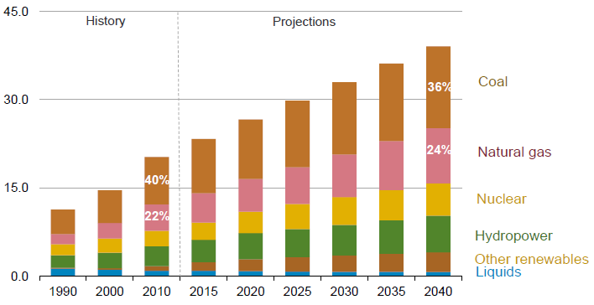
Global Electricity Generation by Fuel Source, 2010-2040
Billions of kWH
Electricity demand will continue to rise on a global scale
Source: Energy Information Administration, International Energy Outlook 2013.
79

Slide 80
Thank you for your time and your attention!
Insurance Information Institute Online: www.iii.org
Twitter: twitter.com/bob_hartwig
Download at: www.iii.org/presentations

