Slide 1
American Institute for Architects New York Chapter
Design for Risk and Reconstruction:
Who is Going to Pay for this?
November 13, 2013
Center for Architecture, Edgar Tafel Hall,
New York, N.Y.
Jeanne M. Salvatore, SVP, Public Affairs,
Insurance Information Institute ♦ 110 William Street ♦ New York, NY 10038
Tel: 212.346.5520 ♦ Fax: (212) 732-1916 ♦ www.iii.org

Slide 2
Presentation Outline
What is the I.I.I.?
Basics of Property Insurance: What is covered and what is not?
Sandy-Related Claims Paid
Insured Value of Coastal Property in the Northeast
Catastrophe Trends in the United States and the Northeast

Slide 3
What is the Insurance Information Institute?
The mission of the Insurance Information Institute (I.I.I.) is to improve public understanding of insurance—what it does and how it works.
For more than 50 years, the I.I.I. has provided definitive insurance information. Today, we are recognized by the media, governments, regulatory organizations, universities and the public as a primary source of information, analysis and referral concerning insurance.

Slide 4
Basics of Property Insurance
Are Acts of God Covered?

Slide 5
Basics of Property Insurance
What is Covered and What is not?
The term “Acts of God” is not mentioned in any property insurance policy in the U.S. Instead, business and home insurance policies list disasters that are covered and disasters that are not.
Standard business and home insurance policies offer insurance protection against fire, lightning, windstorms, theft and other disasters listed in the policy.
The two big disasters that are not covered are flood and earthquake. But, separate insurance is available for both of these disasters.
Damage due to flooding is provided by FEMA’s National Flood Insurance Program and from some private insurance companies.
Earthquake coverage is available from private insurance as an endorsement to a property policy.

Slide 6
Basics of Flood Insurance
Home/Renters
Commercial Insurance
The NFIP provides coverage for up to $250,000 for the structure of the home and $100,000 for personal possessions.
Some insurers have introduced special policies for high-value properties. These policies may cover homes in non-coastal areas and/or provide enhancements to traditional flood coverage.
The NFIP’s General Property Form offers commercial policyholders coverage for: Building Property up to $500,000 and Personal Property up to $500,000
A very large business may sometimes purchase flood insurance coverage through private insurance.
Coverage for basements is limited – something that individuals, business owners and designers need to take into consideration!
Private flood insurance is available for those who need additional insurance protection, known as "excess coverage,” over and above the basic policy or for people whose communities do not participate in the NFIP.

Slide 7
I.I.I. Poll: Disaster Preparedness
Q. Have recent flooding events such as Hurricane Sandy or Hurricane Irene motivated you to buy flood coverage?¹
Despite recent major flood events, few people see the need to buy coverage
Recent storms have not motivated people to buy flood insurance coverage
¹Asked of those who have homeowners insurance but not flood insurance.
Source: Insurance Information Institute Annual Pulse Survey.

Slide 8
I.I.I. Poll: Disaster Preparedness
Q. If you expect some relief from the government, would you purchase less insurance coverage against these natural disasters than you would have otherwise?
Don’t know
Yes
More than 20 percent cut back on insurance coverage in expectation of government disaster aid
No
Seventy-two percent of Americans would not purchase less insurance if they expect some relief from the government—but 22% would.
Source: Insurance Information Institute Annual Pulse Survey.

Slide 9
Basics of Property Insurance – Saving Money
Shopping around for private insurance – it is a highly competitive business.
Raising the deductible on property insurance, as well as flood insurance.
Make the home or business disaster-resistant – against wind, fire, flood, theft and other disasters.
Take advantage of discounts for security devices.
Consider the cost of insurance when purchasing a property.

Slide 10
Sandy-Related Claims Paid

Slide 11
Economic Overview: Sandy Facts and Statistics
Insurance claim payouts resulting from Hurricane Sandy, which struck the East Coast on October 29, 2012, are expected to total $18.8 billion arising from 1.5 million claims, according to ISO’s PCS unit.
Total damage (insured and uninsured) from Sandy is estimated at $50 billion.
The cost to private insurers might have been higher but much of the damage was due to the storm surge and subsequent flooding, which is not covered by standard homeowners or most commercial insurance policies.

Slide 12
Hurricane Sandy: Claim Payments to Policyholders, by State
($ Thousands)
TOTAL = $18.75 BILLION
At $9.6B and $6.6B, respectively, NY and NJ suffered, by far, the largest losses from Hurricane Sandy
Insurers Will Pay at Least $18.75 Billion to 1.52 Million Policyholders Across 15 States and DC in the Wake of Hurricane Sandy
Sources: Catastrophe loss data is for Catastrophe Serial No. 90 (Oct. 28 – 31, 2012) from PCS as of Jan. 18, 2013; Insurance Information Institute .

Slide 13
Hurricane Sandy: Number of Claims
by Type*
Total Claims = 1.52 Million*
Hurricane Sandy resulted in an estimated 1.52 million privately insured claims resulting in an estimated $18.75 insured losses. Hurricane Katrina produced 1.74 million claims and $48.7B in losses (in 2012 $)
Sandy is a high HO frequency, (relatively low) severity event (avg. severity <50% Katrina)
*PCS claim count estimate s as of 1/18/13. Loss estimate represents PCS total ($18.75B) and upper end of range estimates by risk modelers RMS, Eqecat and AIR. All figures exclude losses paid by the NFIP.
Source: PCS; AIR, Eqecat, AIR Worldwide; Insurance Information Institute.

Slide 14
Hurricane Sandy: Insured Loss by
Claim Type* ($ Millions)
Although Commercial Lines accounted for only 13% of total claims, they account for 48% of all claim dollars paid. In most hurricanes, Commercial Lines accounts for about 1/3 of insured losses.
Total Claim Value = $18.75 Billion*
*PCS insured loss estimates as of 1/18/13. Catastrophe modeler estimates range up to $25 billion. All figures exclude losses paid by the NFIP.
Source: PCS; Insurance Information Institute.

Slide 15
Insured Value of Coastal Property in Northeast

Slide 16
Total Value of Insured Coastal Exposure in 2012
(2012, $ Billions)
The value of insured coastal exposure in NY is now highest in the US for the first time.
In 2012, New York Ranked as the #1 Most Exposed State to Hurricane Loss, Overtaking Florida with $2.862 Trillion. Texas is very exposed too, and ranked #3 with $1.175 Trillion in insured coastal exposure
The Insured Value of All Coastal Property Was $10.6 Trillion in 2012 , Up 20% from $8.9 Trillion in 2007 and Up 48% from $7.2 Trillion in 2004
Source: AIR Worldwide

Slide 17
Total Potential Home Value Exposure to Storm Surge Risk in 2013*
($ Billions)
New York and New Jersey are the second and third states most vulnerable to storm surge.
The Value of Homes Exposed to Storm Surge was $1.147 Trillion in 2013.* Only a fraction of this is insured, hence the huge demand for federal aid following major coastal flooding events.
*Insured and uninsured property. Based on estimated property values as of April 2013.
Source: Storm Surge Report 2013, CoreLogic.

Slide 18
Catastrophe Trends in the United States and the Northeast

Slide 19
Top 12 Most Costly Hurricanes in U.S. History
(Insured Losses, 2012 Dollars, $ Billions)
10 of the 12 most costly hurricanes in insurance history occurred over the past 9 years (2004—2012)
Hurricane Sandy became the 3rd costliest hurricane in US insurance history
*PCS estimate as of 4/12/13.
Sources: PCS; Insurance Information Institute inflation adjustments to 2012 dollars using the CPI.

Slide 20
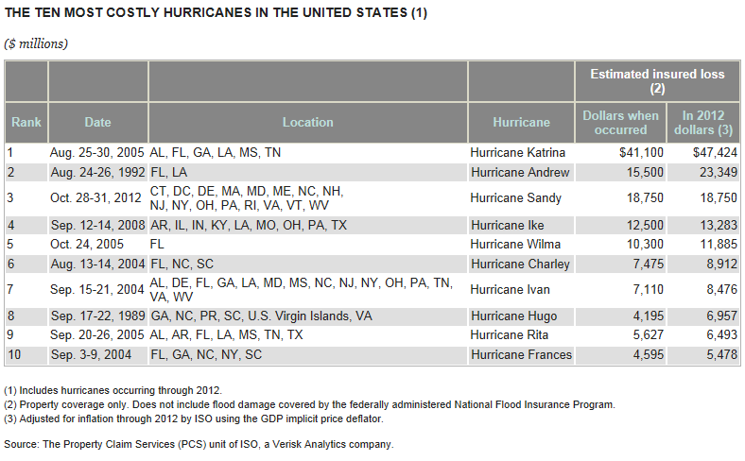
Three of the Top Ten Most Costly Hurricanes Hit NY – Sandy, Frances and Ivan

Slide 21
Inflation Adjusted U.S. Catastrophe Losses by Cause of Loss, 1992–2011¹
Wind/Hail/Flood (3), $14.8
Fires (4), $6.0
Other (5), $1.4
Insured cat losses from 1992-2011 totaled $384.3B, an average of $19.2B per year or $1.6B per month
Geological Events, $18.2
Terrorism, $24.4
Winter Storms, $28.2
Tornado share of CAT losses is rising
Hurricanes & Tropical Storms, $161.3
Wind losses are by far cause the most catastrophe losses, even if hurricanes/TS are excluded.
Tornadoes (2), $130.2
Catastrophes are defined as events causing direct insured losses to property of $25 million or more in 2009 dollars.
Excludes snow.
Does not include NFIP flood losses
Includes wildland fires
Includes civil disorders, water damage, utility disruptions and non-property losses such as those covered by workers compensation.
Source: ISO’s Property Claim Services Unit.

Slide 22
Insurance Information Institute
www.iii.org
Thank you for your time and your attention!
http://twitter.com/JeanneSalvatore
Notes:
22

