Slide 1
Building Better
Economic Risk Scenarios
Actuarial Society of Greater New York
New York, NY
May 23, 2013
Steven N. Weisbart, Ph.D., CLU, Senior Vice President & Chief Economist
Insurance Information Institute ♦ 110 William Street ♦ New York, NY 10038
Tel: 212.346.5540 ♦ Cell: 917.494.5945 ♦ stevenw@iii.org ♦ www.iii.org

Slide 2
World Economic Forum:
Examples of Global Economic Risk
Chronic fiscal imbalances
Severe income disparity
Extreme volatility in energy and food prices
Recurring liquidity crises
Major financial systemic failure
Adverse unintended consequences of regulation
Unmanageable inflation/deflation
Chronic labor market imbalances
“Hard landing” of emerging economies
Source: World Economic Forum, Global Risks 2013; Insurance Information Institute.

Slide 3
Examples of Economic Risk, Domestic Edition
Persistently Low Interest Rates
Severe income disparity
  Pressure to expand government programs
Mismanagement of population aging
Persistently high and soaring health care costs
Major financial systemic failure
Adverse unintended consequences of regulation
Unmanageable inflation/deflation
Chronic labor market imbalances

Slide 4
Perspective: Past and Present
It Helps to Remember
Where We Are
and Where We’ve Been
4

Slide 5
A Continued Weak Recovery is Forecast:
Real GDP Growth, Yearly, 1970-2014F
Real GDP Growth (%)
In recoveries, real yearly GDP growth is often 4% or more
The median forecast is for several more years of real yearly GDP growth under 3% -- weaker than after most recent recessions
Forecasts from Blue Chip Economic Indicators, 5/2013 issue, median of range of 52 forecasts.
Sources: (GDP) U.S. Department of Commerce at http://www.bea.gov/national/xls/gdpchg.xls.
5
12/01/09 - 9pm
eSlide – P6466 – The Financial Crisis and the Future of the P/C
Notes:
5

Slide 6
May 2013 Forecasts of Quarterly US Real GDP for 2013-14
Real GDP Growth Rate
The sequester is built into these forecasts
Virtually all forecasts see the economy improving through 2014, but the drag of the sequester and other threats could undermine that growth
Sources: Blue Chip Economic Indicators (5/13); Insurance Information Institute

Slide 7
Length of US Business Cycles,
1929–Present*
Length of Expansions
Greatly Exceeds Contractions
Duration (Months)
Based on recent history, the current “expansion” has 3-6 more years to go.
* Through May 2013 ** Post-WW II period through end of most recent expansion.
Sources: National Bureau of Economic Research; Insurance Information Institute.

Slide 8
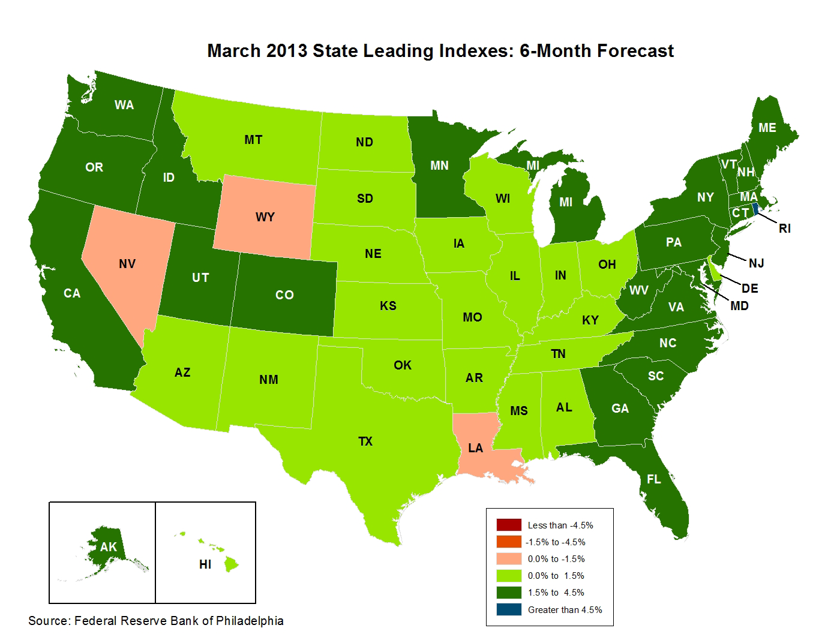
State-by-State Leading Indicators,
2013:Q2-Q3
Near-term growth forecasts vary widely by state. Strongest growth = dark green; weakest = beige
Sources: Federal Reserve Bank of Philadelphia at www.philadelphiafed.org/index.cfm; Insurance Information Institute.
Next release is May 28, 2013

Slide 9
Leading Indicator Indexes Vary Widely by State and Region
Great Lakes
Far West
Southwest
Mountain
Great Plains
Data from March 2013
Sources: Federal Reserve Bank of Philadelphia at www.philadelphiafed.org/index.cfm; Insurance Information Institute.
9
12/01/09 - 9pm
eSlide – P6466 – The Financial Crisis and the Future of the P/C
Notes:
9
In May for the first time in 2 years, Nevada overtook Michigan as the state with the highest unemployment rate

Slide 10
Leading Indicator Indexes Vary Widely by State and Region
Southeast
Mid-Atlantic
New England
Data for March 2013
Sources: Federal Reserve Bank of Philadelphia at www.philadelphiafed.org/index.cfm; Insurance Information Institute.
10
12/01/09 - 9pm
eSlide – P6466 – The Financial Crisis and the Future of the P/C
Notes:
10
This chart and the succeding one show that unemployment rates vary widely, not only by region, but within regions.

Slide 11
Households Are Still* Reducing
Their Financial Obligations
Financial Obligations Ratio
Financial Obligations Ratio: debt service (mortgage and consumer debt), auto lease, residence rent, HO insurance, and property tax payments as % of personal disposable income.
Decline began in 2007:Q4.
Lowest point since the early 1980s.
*Through 2012:Q4 (data posted on Mar 13, 2013).
Source: Federal Reserve Board, at www.federalreserve.gov/releases/housedebt.

Slide 12
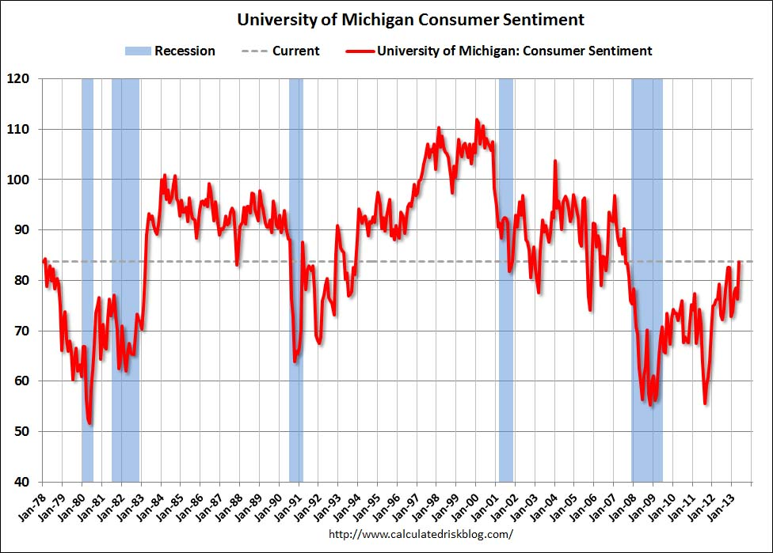
Consumer Sentiment is Rising But
Still Below Usual Post-Recession Level
Three years post-recession, consumer sentiment is usually 90 or higher
Dotted line shows current level

Slide 13
Unemployment and Underemployment Rates: Stubbornly High in 2012, But Falling
January 2000 through April 2013, Seasonally Adjusted (%)
U-6 went from 8.0% in March 2007 to 17.5% in
October 2009; Stood at 13.9% in April 2013
Unemployment “Headline” unemployment stood at 7.5% in April 2013.
The Federal Reserve’s target for ending “easy money” is 6.5% (assuming inflation remains within its 2% target).
Stubbornly high unemployment and underemployment constrain overall economic growth, but the job market is now clearly improving.
Source: US Bureau of Labor Statistics; Insurance Information Institute.
13
12/01/09 - 9pm
eSlide – P6466 – The Financial Crisis and the Future of the P/C
Notes:
13

Slide 14
Unemployment Rates Vary Widely by State and Region*
Southeast
Mid-Atlantic
New England
*Provisional figures for April 2013, seasonally adjusted.
Sources: US Bureau of Labor Statistics; Insurance Information Institute.
14
12/01/09 - 9pm
eSlide – P6466 – The Financial Crisis and the Future of the P/C
Notes:
14
This chart and the succeding one show that unemployment rates vary widely, not only by region, but within regions.

Slide 15
Unemployment Rates Vary Widely by State and Region* (cont’d)
Far West
Southwest
Mountain
Great Lakes
Great Plains
*Provisional figures for April 2013, seasonally adjusted.
Sources: US Bureau of Labor Statistics; Insurance Information Institute
15
12/01/09 - 9pm
eSlide – P6466 – The Financial Crisis and the Future of the P/C
Notes:
15
In May for the first time in 2 years, Nevada overtook Michigan as the state with the highest unemployment rate

Slide 16
Monthly Change in Private Employment, 2010 - 2013
Average Monthly Gain Since Jan 2011: 195,000 jobs
Thousands
Private employers added 1.2 million jobs in just the last six months.
Seasonally adjusted. Mar 2013 and Apr 2013 are preliminary data
Sources: US Bureau of Labor Statistics; Insurance Information Institute

Slide 17
Growth of Private Employment in February 2013, by BLS report month
Thousands of jobs added
73,000 more February jobs were reported in April than in February
There is a great deal of variation in employment growth by industry, indicating a very uneven and slow recovery
Sources: US Bureau of Labor Statistics Consumer Expenditure Survey; Insurance Information Institute.

Slide 18
Nonfarm Payroll (Wages and Salaries):
Quarterly, 2005–2013:Q1
Billions
Latest (2013:Q1) was $7.01 trillion, a new peak—$761B above 2009 trough
Prior peak was 2008:Q1 at $6.60 trillion
Recent trough (2009:Q3) was $6.25 trillion, down 5.3% from prior peak
Note: Recession indicated by gray shaded column. Data are seasonally adjusted annual rates.
Sources: research.stlouisfed.org/fred2/series/WASCUR; National Bureau of Economic Research (recession dates); Insurance Information Institute.
18
12/01/09 - 9pm
eSlide – P6466 – The Financial Crisis and the Future of the P/C
Notes:
18

Slide 19
Demographic Components
of Economic Risk
Population Components Matter… A Lot
19

Slide 20
Spending on Life and Personal Insurance, 2011, by Age of Consumer Unit
Sources: US Bureau of Labor Statistics Consumer Expenditure Survey; Insurance Information Institute.

Slide 21
Spending on Pensions and Social Security, 2011, by Age of Consumer Unit
Sources: US Bureau of Labor Statistics Consumer Expenditure Survey; Insurance Information Institute.

Slide 22
Projection of U.S. Population
Age Groups, 2015 - 2060
The 18-24 segment won’t grow, and the 45-64 segment won’t grow until 2040, but the 25-44 segment will grow slowly and the 65-84 segment
will double, with significant effects on P/C operations.
Sources: US Census Bureau; Insurance Information Institute.

Slide 23
Number of “Discouraged Workers”:
Elevated, but Dropping Jan 1994 – Sept. 2012
Thousands
A “discouraged worker” in a month did not actively look for work in the prior month
for reasons such as
--thinks no work available,
--could not find work,
--lacks schooling or training,
--thinks employer thinks too young or old, and other types of discrimination.
Latest reading: 835,000
in Apr. 2013.
In recent good times, the number of discouraged workers ranged from 200,000-400,000 (1995-2000) or from 300,000-500,000 (2002-2007).
Notes: Recessions indicated by gray shaded columns. Data are seasonally adjusted.
Sources: Bureau of Labor Statistics; National Bureau of Economic Research (recession dates).
23
12/01/09 - 9pm
eSlide – P6466 – The Financial Crisis and the Future of the P/C
Notes:
23

Slide 24
Effect of Discouraged Workers on Unemployment Rate
Civilian Labor Force: 155.238 (000)
Unemployed: 11.659 (000)
Unemployment Rate: 7.510%
Unemployed + 400,000 Discouraged: 12.059
Adjusted Unemployment Rate: 7.768%
Source: U. S. Bureau of Labor Statistics; Insurance Information Institute.

Slide 25
Number of “Discouraged Workers,”* Monthly, 2007-2013
Thousands
In “normal times” (2002-2007), the average monthly number of discouraged workers was 422,000.
In April 2013, the number of discouraged workers was down by 450,000 from its peak in December 2010 but is still roughly 450,000 above its “normal” level
*”Discouraged workers are persons marginally attached to the labor force who did not actively look for work in the prior four weeks for reasons such as thinks no work available, could not find work, lacks schooling or training, employer thinks too young or old, and other types of discrimination” BLS; data are not seasonally adjusted
Note: Recession months in gold
Source: U.S. Bureau of Labor Statistics: Employment Situation, various months; Insurance Information Institute.
25
Notes:
Typically, builders build smaller houses in recessions, to help make them more affordable
True again in 2009-2010
This means lower insurable values in new homes => lower exposure growth
25

Slide 26
Number of “Discouraged Workers,”* by Age Group, Annual Averages, 2006-2012
Thousands
Changes in the average annual number of discouraged workers differed by age group.
This is “normal”
*”Discouraged workers are persons marginally attached to the labor force who did not actively look for work in the prior four weeks for reasons such as thinks no work available, could not find work, lacks schooling or training, employer thinks too young or old, and other types of discrimination” BLS; data are not seasonally adjusted
Source: U.S. Bureau of Labor Statistics: Employment Situation, various months; Insurance Information Institute.
26
Notes:
Typically, builders build smaller houses in recessions, to help make them more affordable
True again in 2009-2010
This means lower insurable values in new homes => lower exposure growth
26

Slide 27
Number of Workers Age 65-69, 70-74, and 75+, Quarterly, 1998-2012
(Thousands)
There are now over 7.4 million senior workers. This is double the number in 1998. Over the next decade it will probably double again.
This is the leading edge of the older half of the “baby boom” generation
Source: US Bureau of Labor Statistics, US Department of Labor; Insurance Information Institute.

Slide 28
Labor Force Participation Rate,
Ages 65-69, Quarterly, 1998:Q1-2013:Q1
Labor Force participation rate
1 in 3 in this age group are working. Virtually none of them are “baby boomers”
The brown bars indicate recessions.
The switch from DB pension plans (with early-retirement incentives) to DC plans (with, in effect, later-retirement incentives) might be partly responsible for raising this rate.
Not seasonally adjusted. Sources: US Bureau of Labor Statistics, US Department of Labor; Insurance Information Institute.

Slide 29
Labor Force Participation Rate,
Ages 70-74, Quarterly, 1998:Q1-2013:Q1
Labor Force participation rate
Nearly 1 in 5 in this age group is working.
15 years ago it was 1 in 8.
The labor force participation rate for workers 70-74 grew by about 50% since 1998.
Growth stalled during and after the Great Recession but has since resumed.
Source: US Bureau of Labor Statistics, US Department of Labor; Insurance Information Institute.

Slide 30
Labor Force Participation Rate,
Ages 70-74, Quarterly, 1998:Q1-2013:Q1
Labor Force participation rate
The labor force participation rate for men 70-74 grew by about 50% since 1998,
but for women 70-74 it nearly doubled (from about 9% to about 15.5%).
Source: US Bureau of Labor Statistics, US Department of Labor; Insurance Information Institute.

Slide 31
Labor Force Participation Rate, Quarterly
Ages 75 and over, 1998-2013:Q1
Labor Force participation rate
The labor force participation rate for workers 75 and over will probably hit 10% soon. This is close to what the rate was for the 70-74 group a decade ago.
In the last 14 years, the labor force participation rate for workers 75 and over grew from 4.5% to 8.6%. So 91.4% of these people are retired.
Sources: US Bureau of Labor Statistics, US Department of Labor; Insurance Information Institute.

Slide 32
Labor Force Participation Rate, Quarterly
Ages 75 and over, 1998-2013:Q1
Labor Force participation rate
In the last 15 years, the labor force participation rate for men 75 and over
grew from 6.9% to 12.6% and for women doubled (from 2.9% to 5.8%).
Sources: US Bureau of Labor Statistics, US Department of Labor; Insurance Information Institute.

Slide 33
Annual Expenditure on Life and Personal Insurance, by Age of Consumer Unit, 1991-2011
Declines began before the “Great Recession” started
As the age-composition
of the population changes, premium volume will follow.
Sources: Bureau of Labor Statistics Consumer Expenditure Surveys; Insurance Information Institute

Slide 34
Annual Expenditure on Life and Personal Insurance, by Age of Consumer Unit, 1991-2011
As the age-composition
of the population changes, premium volume will follow.
Sources: Bureau of Labor Statistics Consumer Expenditure Surveys; Insurance Information Institute

Slide 35
Annual Expenditure on Pensions and Social Security, by Age of Consumer Unit, 1991-2011
As the age-composition of the population changes,
premium volume will follow.
Sources: Bureau of Labor Statistics Consumer Expenditure Surveys; Insurance Information Institute

Slide 36
Annual Expenditure on Pensions and Social Security, by Age of Consumer Unit, 1991-2011
As the age-composition of the population changes,
premium volume will follow.
Sources: Bureau of Labor Statistics Consumer Expenditure Surveys; Insurance Information Institute

Slide 37
Changes in Households, 2000 to 2010
Millions
During this decade the total number of households rose by 10.7%
24.84
23.59
9.75
11.16
The number of householders living alone rose by nearly 4 million from 2000
to 2010 (+14.6%). Single-parent households rose by 1.4 million (+14.4%). Married couples w/own kids fell by 5.0%. Will these trends continue?
Sources: U.S. Census Bureau at http://www.census.gov/construction/chars/pdf/medavgsqft.pdf and “Households and Families: 2010”, Census Brief issued April 2012; Insurance Information Institute
37
Notes:
Typically, builders build smaller houses in recessions, to help make them more affordable
True again in 2009-2010
This means lower insurable values in new homes => lower exposure growth
37

Slide 38
Investments and Interest Rates
38

Slide 39
U.S. Treasury Security Yields*:
A Long Downward Trend, 1990–2013
Yields on 10-Year U.S. Treasury Notes have been essentially below 5% for a full decade.
U.S. Treasury security yields recently plunged to record lows
Since roughly 80% of P/C bond/cash investments are in 10-year or shorter durations, most P/C insurer portfolios will have low-yielding bonds for years to come.
*Monthly, constant maturity, nominal rates, through March 2013.
Sources: Federal Reserve Bank at http://www.federalreserve.gov/releases/h15/data.htm.
National Bureau of Economic Research (recession dates); Insurance Information Institutes.
39
12/01/09 - 9pm
eSlide – P6466 – The Financial Crisis and the Future of the P/C
Notes:
39

Slide 40
Distribution of Bond Maturities,
Life Insurance Industry, 2003-2011
The main shift over these years has been from bonds with intermediate maturities to bonds with longer maturities. The industry added to its holdings of over-20-year bonds (from 16.5% in 2003 to 20.2% in 2012) and trimmed bonds in the 1-5-year and the 5-10-year categories (from 59.9% to 55.2%).
Sources: SNL Financial; Insurance Information Institute.

Slide 41
Distribution of Bond Maturities,
P/C Insurance Industry, 2003-2011
The main shift over these years has been from bonds with longer maturities to bonds with shorter maturities. The industry first trimmed its holdings of over-10-year bonds (from 24.6% in 2003 to 16.9% in 2011) and then trimmed bonds in the 5-10-year category. Falling average maturity of the P/C industry’s bond portfolio is contributing to a drop in investment income along with lower yields.
Sources: SNL Financial; Insurance Information Institute.

Slide 42
Inflation
42
Notes:
42

Slide 43
Change* in the Consumer Price Index, 2004–2013
For two months in 2008, led by gasoline, the general price level was rising at a 5.5% pace
But when gas prices dropped, the general price level was briefly lower than a year prior
Over the last decade, prices generally rose about 2% per year.
*Monthly, year-over-year, through April 2013. Not seasonally adjusted.
Sources: US Bureau of Labor Statistics; National Bureau of Economic Research (recession dates); Insurance Information Institutes.
43
12/01/09 - 9pm
eSlide – P6466 – The Financial Crisis and the Future of the P/C
Notes:
43

Slide 44
Prices for Hospital Services:
12-Month Change,* 1998–2013
April 2013
Inpatient services +4.0, Outpatient services +4.5%
Cyclical peaks in PP Auto tend to occur approximately every 10 years
(early 1990s, early 2000s, and possibly the early 2010s)
*Percentage change from same month in prior year; through April 2013; seasonally adjusted
Sources: US Bureau of Labor Statistics; National Bureau of Economic Research (recession dates); Insurance Information Institute.
44
12/01/09 - 9pm
eSlide – P6466 – The Financial Crisis and the Future of the P/C
Notes:
44

Slide 45
Insurance Information Institute
www.iii.org
Thank you for your time
and your attention!
Notes:
45

