Slide 1
Risk, Insurance and Interconnectedness in Today’s Global Insurance Industry
Australia & US Markets
May 8, 2013
Robert P. Hartwig, Ph.D., CPCU, President & Economist
Insurance Information Institute ♦ 110 William Street ♦ New York, NY 10038
Tel: 212.346.5520 ♦ Cell: 917.453.1885 ♦ bobh@iii.org ♦ www.iii.org

Slide 2
Presentation Outline
About the Insurance Information Institute
A Global View of Risk: Australia, U.S. & the World
  Economic Risk
  Catastrophe/Environmental Risk
  Geopolitical Risk
  Technological Risk
  Societal Risk
Insurance: Global Risk Management Tool
Insurers Never Ending Quests: Australia, US
  Growth
  Performance
  Distribution/Disintermediation
Q&A

Slide 3
The Insurance Information Institute
The Public Face of the Industry:
Explaining What Insurance Is and How It Works Since 1960
3

Slide 4
What Does the Insurance Information Institute Do and Why?
Communications
  Communicate what the insurance industry does and how insurance works to all stakeholders
Information Dissemination
  Assemble and disseminate vast amounts of industry data and respond to thousands of data requests each year
Research & Analysis
  Produce original research on topics of critical and timely importance
Industry Advocacy (non-lobbying)
  Play a critical informational role in key legislative and public policy debates

Slide 5
Who Are Our Stakeholders/Consumers of Our Products and Services?
General Public (Consumers of Insurance)
  Print, online, video, software (apps), partnerships
Media (Traditional & “New”)
Industry
Regulators, State and Federal Lawmakers & Other Public Policymakers
Investors
Academia

Slide 6
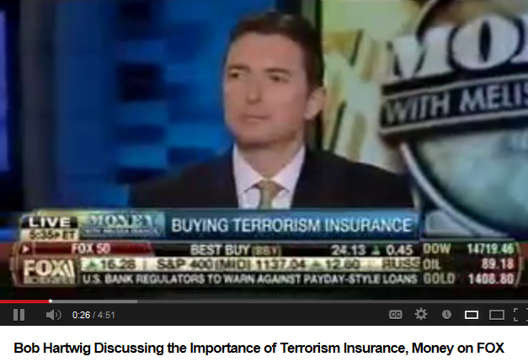
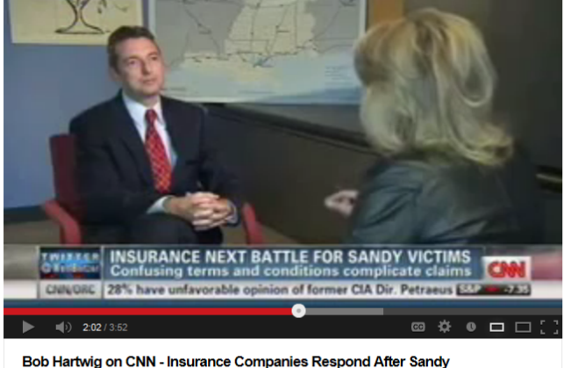
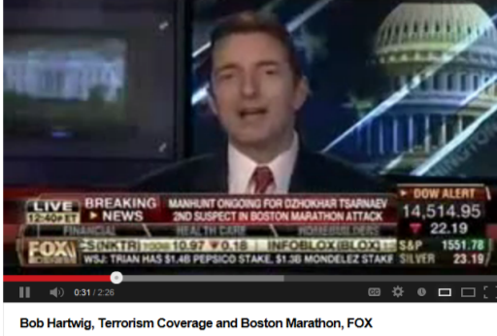

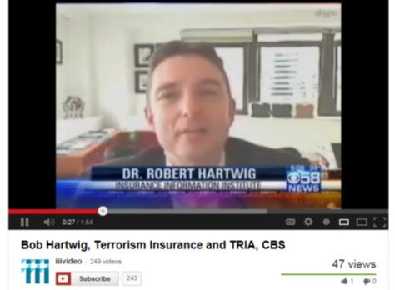
Television is a Principal Means by Which We Communicate to the Public

Slide 7
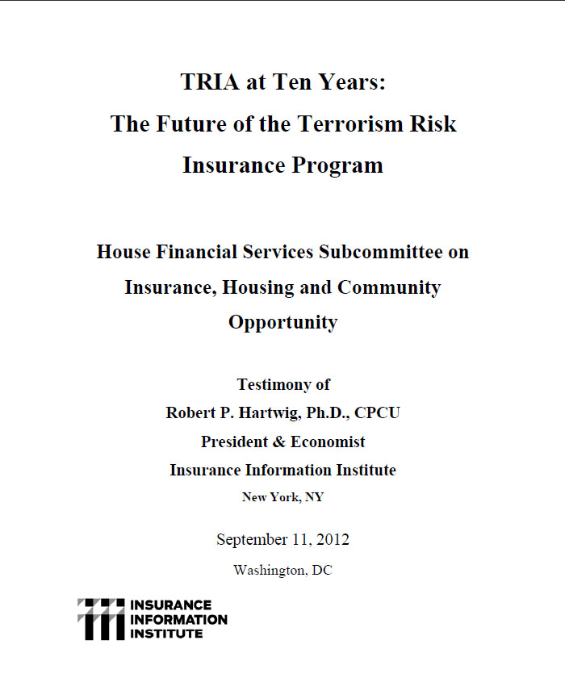
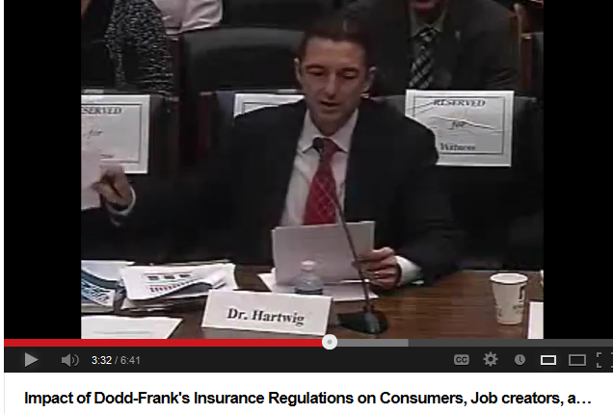
I.I.I. Congressional Testimony on the Future of the Terrorism Risk Insurance Program
Issue: Act expires 12/31/14. Insurers still generally regard large-scale terror attacks as fundamentally uninsurable
I.I.I. Input: Testified at first hearing on the issue in DC (on 9/11/12) on trends in terrorist activity in the US and abroad, difficulties in underwriting terror risk; Noted that bin Laden may be dead but war on terror is far from over
Status: New House FS Committee Chair Jeb Hensarling has opposed TRIA in the past; Obama Administration does not seem to support extension; Little institutional memory on insurance subcommittee
Media: Virtually no media coverage yet apart form trade press; WSJ will likely editorialize against it.
Objective: Work with trades, risk management community and others to help build support

Slide 8
Key Media Metrics
Conducted 120 television interviews in 2012.
Received an additional 2,600 mentions in print publications, wire services and prominent blogs.
Featured in more than 16,000 articles in Internet news publications.
I.I.I.’s main web site receives about 2 million page views per year
The I.I.I. is mentioned more than 100,000 times on any given day on the web

Slide 9
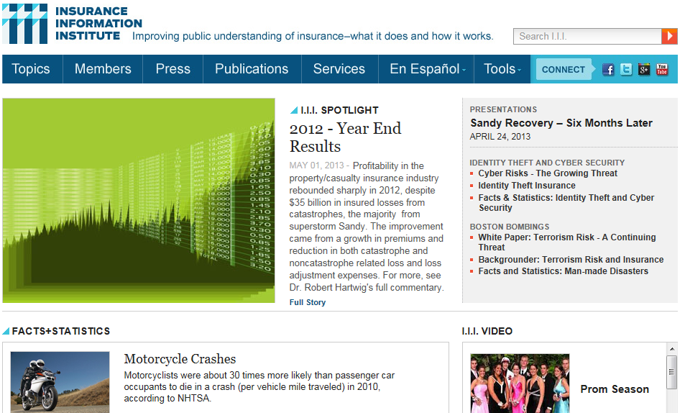
I.I.I.’s Web Site Is Extremely Popular

Slide 10
Year in Review - Top Issues, P/C, 2011 vs 2012 (1).I.I. Media Index, P/C, 2011 vs 2012 (1)
The top three issues in the news media were market conditions, hurricanes and solvency, not surprising given the interest in the cost and availability of insurance combined with questions regarding the industry’s ability to pay sizeable Sandy-related claims
(1) Based on a search of Lexis/Nexis.
Notes:
Notes: Market conditions which includes article on the cost and availability of insurance is the number 1 issue, not surprising hurricanes is number three. The reason that asbestos is ranked #4 is due to ongoing media coverage in local news outlets regarding court cases.

Slide 11
Total Pageviews and Visitors to iii.org
April 2013
Source: Google Analytics.

Slide 12



I.I.I. Mobile Apps
We conceived our mobile outreach as a branded suite of apps to provide guidance to consumers in making decisions about their insurance and preparing for a disaster.

Slide 13
Know Your Stuff Home Inventory
April 2013
Overall Android Know Your Stuff downloads: 3,364
Number of Downloads
Overall iTunes Know Your Stuff downloads: 13,548
Jump likely due to article in Denver Post (4/29)
Source: iTunes and Google Play.

Slide 14





Social Media Stats
 | 1,000+ likes
 | 10,000 followers
 | 600,000+ video views
 | 128 users have us in their circle
 | ~250,000 visitors

Slide 15
THE INSTITUTE’S EXPERTISE IS WIDE RANGING AND ALWAYS EVOLVING
I.I.I. Is Involved in a Range of Important Industry Issues Requiring a Wide Range of Economic and Actuarial Expertise
15

Slide 16
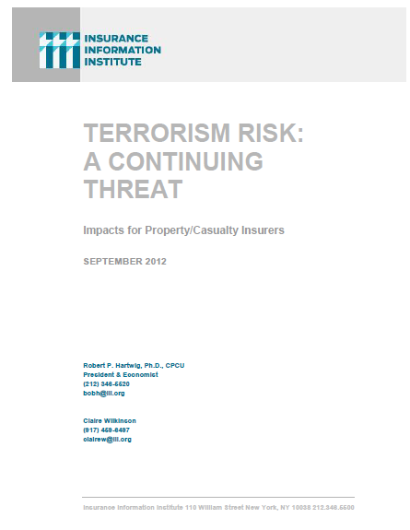
I.I.I. Expertise on Key Issues: Terrorism
I.I.I. periodic report provides readers, including those with little or no understanding of the issue, with a detailed understanding of the Terrorism Risk Insurance Program in the US.
The report provides an update on recent terrorist threats in the US and internationally.
Recently expanded to include a discuss of cyber terrorism risk
Includes a FAQ section for issues of key interest
I.I.I. will update and expand this report in the run-up to TRIPRA expiration at year-end 2014.
First update scheduled for Q2 2013.

Slide 17
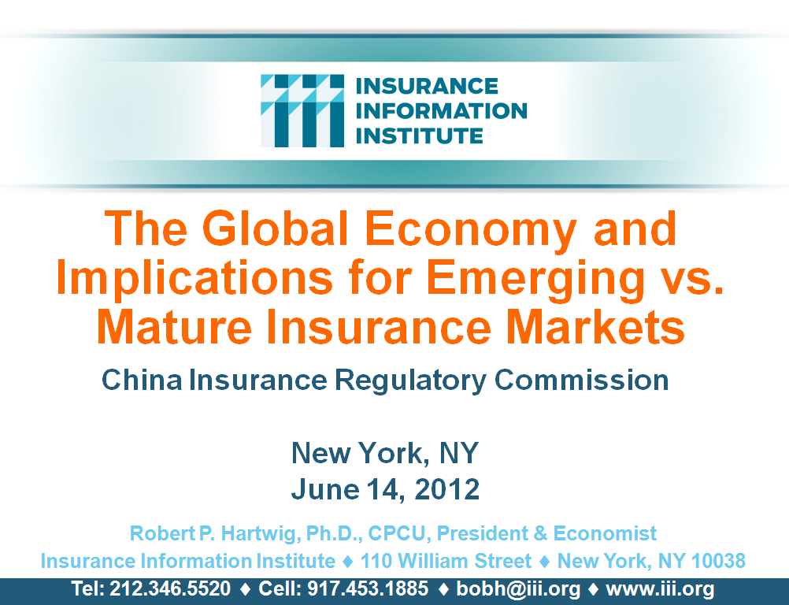
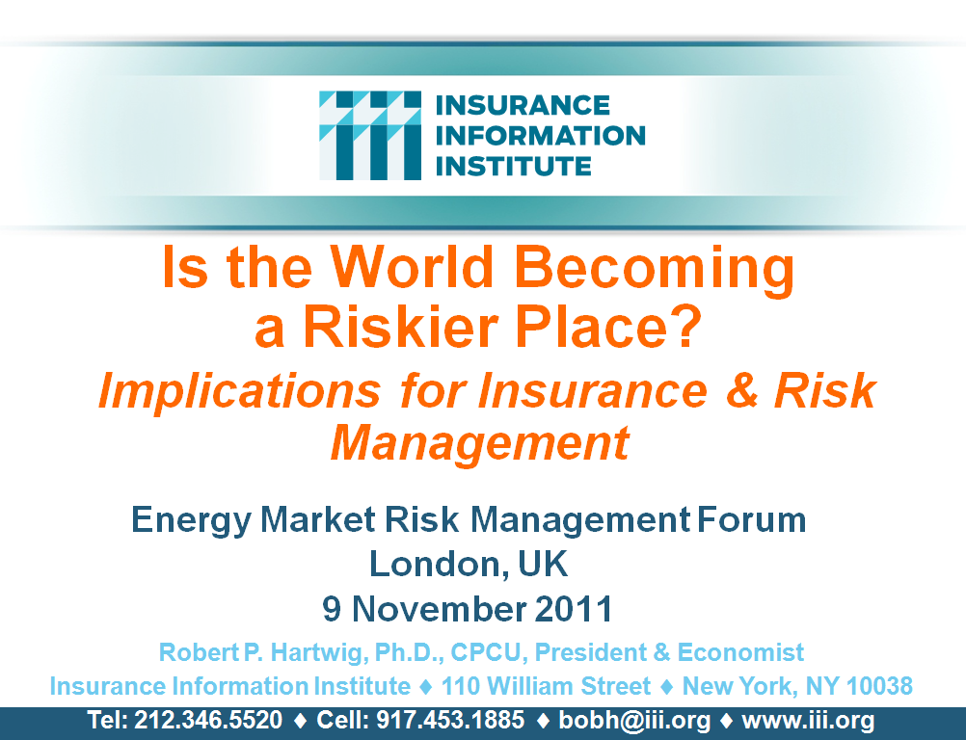
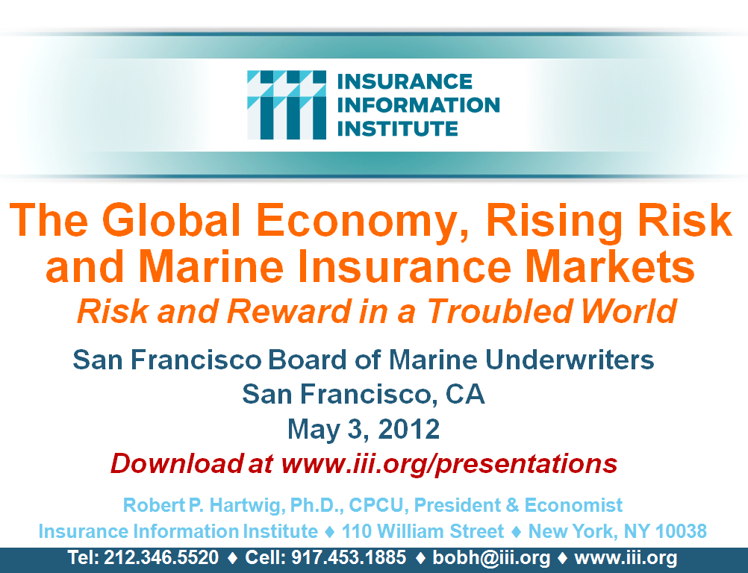

I.I.I.’s Global Perspective: Strong Demand for International Economic Expertise in an Age of Global Instability
I.I.I.’s membership is global, driving our global outlook…
…All insurers are impacted by the global economy
17
12/01/09 - 9pm
eSlide – P6466 – The Financial Crisis and the Future of the P/C
Notes:
17

Slide 18
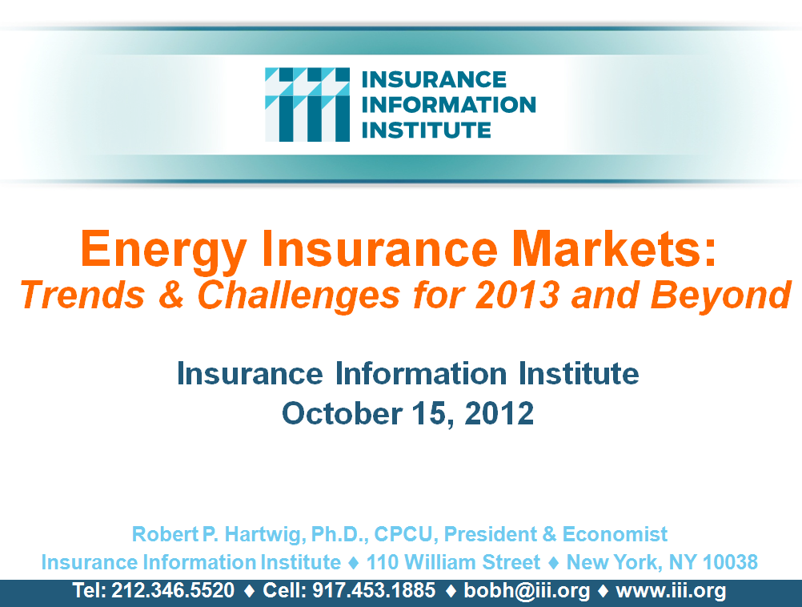
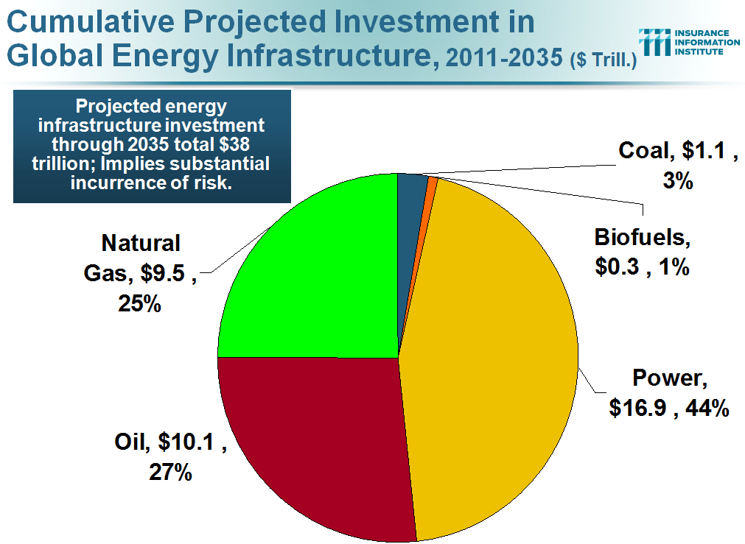
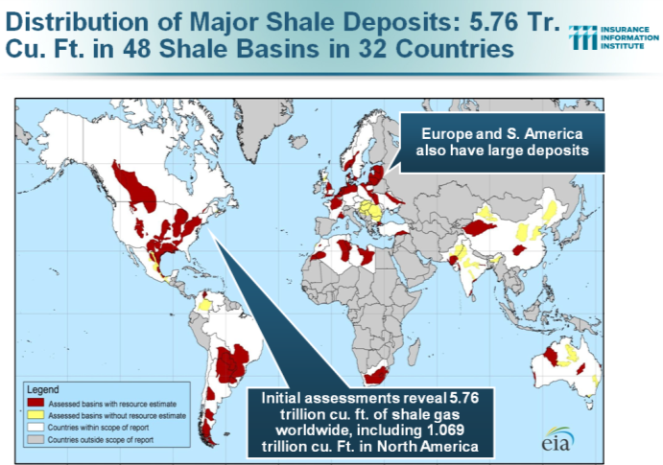
I.I.I. Expertise on Key Issues: Energy
Energy sector in the U.S. is expanding rapidly, especially with “fracking” activity.
Great deal of media interest.
…Sector will grow globally for decades
18
12/01/09 - 9pm
eSlide – P6466 – The Financial Crisis and the Future of the P/C
Notes:
18

Slide 19





I.I.I. Publications: Just a Few Examples

Slide 20
What in the World Is Going On: Australia, U.S. and Everywhere Else?
Is the World Becoming a Riskier, More Uncertain Place?
All Major Categories of Risk Influence Economies and Insurance Industry on a Global Scale
20

Slide 21
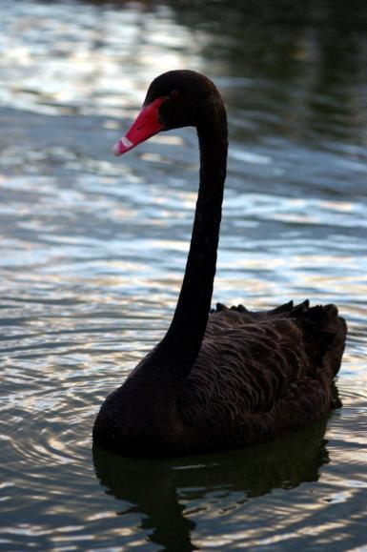
Uncertainty, Risk and Fear Abound
Never Ending Echoes of the Financial Crisis
European Sovereign Debt & Eurozone Crises
The “Fiscal Cliff”: US Debt and Budget Crisis
Unintended Consequences of (Over)Regulation
“Hard Landing” in China
Housing Crisis
Political Gridlock: US, Europe
Political Upheaval in the Middle East
Resurgent Terrorism Risk
Diffusion of Weapons of Mass Destruction
Cyber Attacks
Record Natural Disaster Losses
Climate Change
Environmental Degradation
Income Inequality
Insomnia???
Are “Black Swans” everywhere or does it just seem that way?

Slide 22
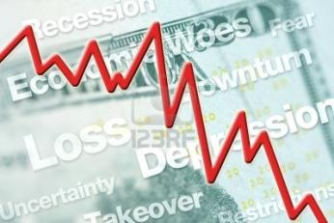



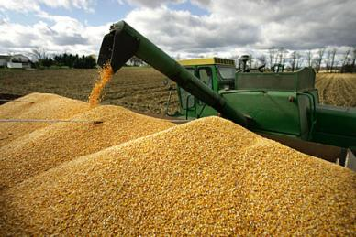
5 Major Categories for Global Risks, Uncertainties and Fears
Economic Risks
Geopolitical Risks
Environmental Risks
Technological Risks
Societal Risks
While risks can be broadly categorized, none are mutually exclusive
Source: World Economic Forum, Global Risks 2012; Insurance Information Institute.

Slide 23
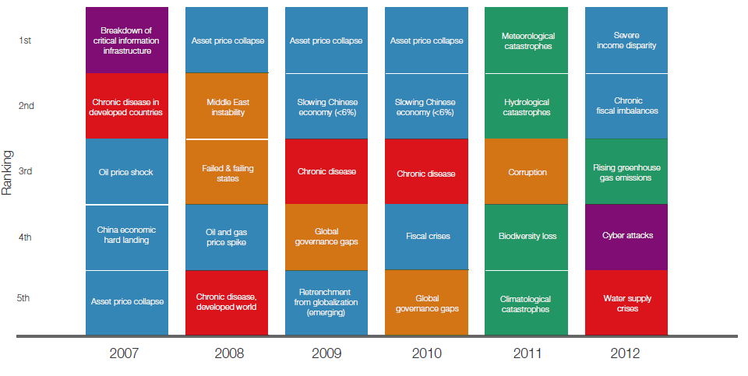
Top 5 Global Risks in Terms of Likelihood, 2007—2012: Insurance Can Help With Most
In 2012, concerns over income disparity and fiscal imbalances displaced weather and water concerns, as ranked by likelihood
Concerns Shift Considerably Over Short Spans of Time. Shift in 2012 to Economic Risks and Away from Environmental Risks
Source: World Economic Forum, Global Risks 2012; Insurance Information Institute.
23
12/01/09 - 9pm
eSlide – P6466 – The Financial Crisis and the Future of the P/C
Notes:
23

Slide 24
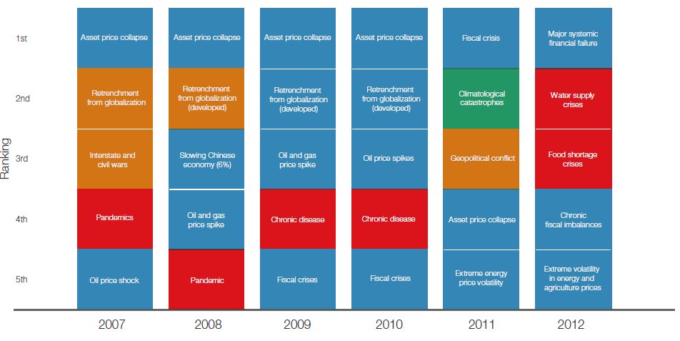
Top 5 Global Risks in Terms of Impact,
2007—2012: Insurance Can Help With Most
Impacts from economic and societal risks were of the greatest concern in 2012
Concerns Over the Impacts of Economics Risks Remained High in 2012, but Societal Risks Displaced Environmental Risks
Source: World Economic Forum, Global Risks 2012; Insurance Information Institute.
24
12/01/09 - 9pm
eSlide – P6466 – The Financial Crisis and the Future of the P/C
Notes:
24

Slide 25
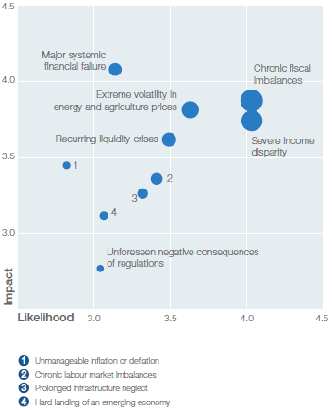
Economic Risk: Foremost on the Minds in “Advanced” Economies
Economic Risks
  Chronic fiscal imbalances
  Severe income disparity
  Extreme volatility in energy
    and food prices
  Recurring liquidity crises
  Major systemic failure
  Adverse unintended
  consequences of regulation
  Unmanageable in/deflation
  Chronic labor mkt. imbalances
  Hard landing of emerging economy
Economic Risk Landscape
Source: World Economic Forum, Global Risks 2012; Insurance Information Institute.

Slide 26
US Real GDP Growth*
The Q4:2008 decline was the steepest since the Q1:1982 drop of 6.8%
Real GDP Growth (%)
Recession began in Dec. 2007. Economic toll of credit crunch, housing slump, labor market contraction was severe
2013 is expected to see uneven growth, then gradually accelerate throughout the year and into 2014
Demand for Insurance Continues To Be Impacted by Sluggish Economic Conditions, but the Benefits of Even Slow Growth Will Compound and Gradually Benefit the Economy Broadly
* Estimates/Forecasts from Blue Chip Economic Indicators.
Source: US Department of Commerce, Blue Economic Indicators 4/13; Insurance Information Institute.

Slide 27

Federal Spending as a Share of State GDP: Vulnerability to Sequestration Varies
Austerity will hurt some states more than others
Sources: Pew Center on the States (2012) Impact of the Fiscal Cliff on the States; Wells Fargo; Insurance Information Institute.

Slide 28
GDP Growth: Advanced & Emerging Economies vs. World, 1970-2014F
Emerging economies (led by China) are expected to grow by 5.5% in 2013 and 5.9% in 2014.
GDP Growth (%)
World output is forecast to grow by 3.5% in 2013 and 4.1% in 2014. The world economy shrank by 0.6% in 2009 amid the global financial crisis
Advanced economies are expected to grow at a sluggish pace of 1.4% in 2013 but accelerate to 2.2% in 2014.
Source: International Monetary Fund, World Economic Outlook , Oct. 2012 and Jan. 2013 WEO Update; Ins. Info. Institute.

Slide 29
Real GDP Growth Forecasts:
Major Economies: 2011 – 2014F
The Eurozone is in recession, UK weak. Both should end by late 2013
China growth has slowed, but remains strong in an expected “soft landing” scenario
Rebuilding acts as a stimulus to Japanese economy
Tepid US recovery continues
Growth Prospects Vary Widely by Region: Growth Returning in the US, Mild Recession in the Eurozone, A “Soft Landing” in China, Sluggish Growth in Japan and Modest Growth in America’s Largest Trading Partners—Canada and Mexico.
Sources: Blue Chip Economic Indicators (4/2013 issue); Insurance Information Institute.
29
Notes:
29

Slide 30
Real GDP Growth Forecasts:
Selected Economies: 2011 – 2014F
Strong economies in smaller industrialized nations will bolster demand for commodities, energy
Growth Outside the US, Europe and Japan is Relatively Strong
Sources: Blue Chip Economic Indicators (4/2013 issue); Insurance Information Institute.
30
Notes:
30

Slide 31
World Trade Volume:
2010—2014F
Percentage Change (%)
After decelerating in 2011 and 2012, global trade growth is expected accelerate in 2013 and 2014
Growth in World Trade Volume (Imports + Exports) Has Slowed But Continues to Grow
Sources: IMF World Economic Outlook Update (Jan. 2013 ); Insurance Information Institute.

Slide 32
World Trade Volume: IMPORTS
2010 – 2014F
Growth (%)
Advanced Economies
Emerging Economies
Import growth in emerging economies outpaces Advanced Economies by a wide margin.
Sources: IMF World Economic Outlook Update (Jan. 2013 ); Insurance Information Institute.

Slide 33
World Trade Volume: EXPORTS
2010 – 2013F
Growth (%)
Advanced Economies
Emerging Economies
Export growth in emerging economies outpaces Advanced Economies by a much narrower margin than imports.
Sources: IMF World Economic Outlook Update (Jan. 2013 ); Insurance Information Institute.

Slide 34
THE INSURANCE INDUSTRY CAN BENEFIT FROM AND ENERGY AND COMMODITIES BOOM, EVEN AMID SLOWDOWN
Insurers in Australia and the U.S. Need to Provide Insurance Solutions Associated with a Rising Global Commodities Demand and Surging Energy Demand
34

Slide 35
Commodity Metals Global Price Index,
1980—2013F* (2005 =100)
Index Value
Though down from their 2011 peak, metals/ore prices remain more than 3 times their levels in 2002
The global financial crisis had only a temporary impact on metal/ore prices
Metal/ore price moved rapidly higher after the 2001 recession
* Includes: Copper, Aluminum, Iron Ore, Tin, Nickel, Zinc, Lead and Uranium.
Sources: International Monetary Fund; Insurance Information Institute.

Slide 36
Global Price Index: Copper, Aluminum & Iron Ore vs. Full Metals Index,1980—2013F*
Index Value (2005 = 100)
Metals prices soared in the aftermath of the global financial crisis, especially for iron ore, which by 2011 was up nearly 500% from pre-crisis levels
Copper prices rose nearly six fold from 2003 through 2011
* Full Metals Index Includes: Copper, Aluminum, Iron Ore, Tin, Nickel, Zinc, Lead and Uranium.
Sources: International Monetary Fund; Insurance Information Institute.

Slide 37
Global Price Index: Tin, Nickel, Zinc, Lead & Uranium vs. Full Metals Index,1980—2013F*
Index Value (2005 = 100)
Uranium and tin prices have seen significant volatility in recent years. The uncertain future of nuclear power weighs on the price of uranium.
Prices for nickel and zinc have moderated
* Full Metals Index Includes: Copper, Aluminum, Iron Ore, Tin, Nickel, Zinc, Lead and Uranium.
Sources: International Monetary Fund; Insurance Information Institute.

Slide 38
World Primary Energy Consumption, 1990-2030P
Quadrillion BTUs
Global energy consumption is expected to increase by 33.4% between 2010 and 2030 but by only 12% in the US
Between 2006 and 2030, energy consumption in projected to increase annually by 1.5% worldwide but only 0.5% in the US
Source: Energy Information Administration, 2009 International Energy Outlook, Insurance Information Institute.

Slide 39
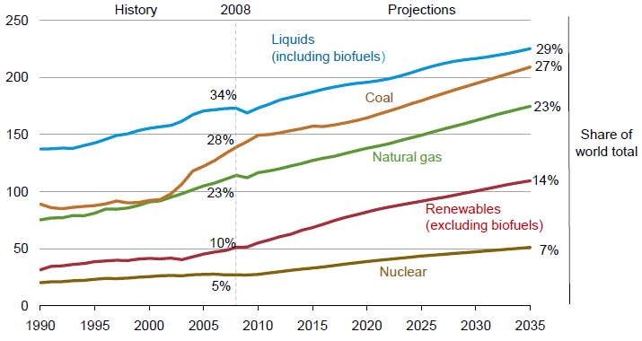
World Energy Consumption by Fuel,
1990—2035F
Renewables will account for 14% of global energy consumption by 2035, up from 20% in 2008
Source: US Energy Information Administration, International Energy Outlook 2011; Insurance Information Institute.
39
12/01/09 - 9pm
eSlide – P6466 – The Financial Crisis and the Future of the P/C
Notes:
39

Slide 40
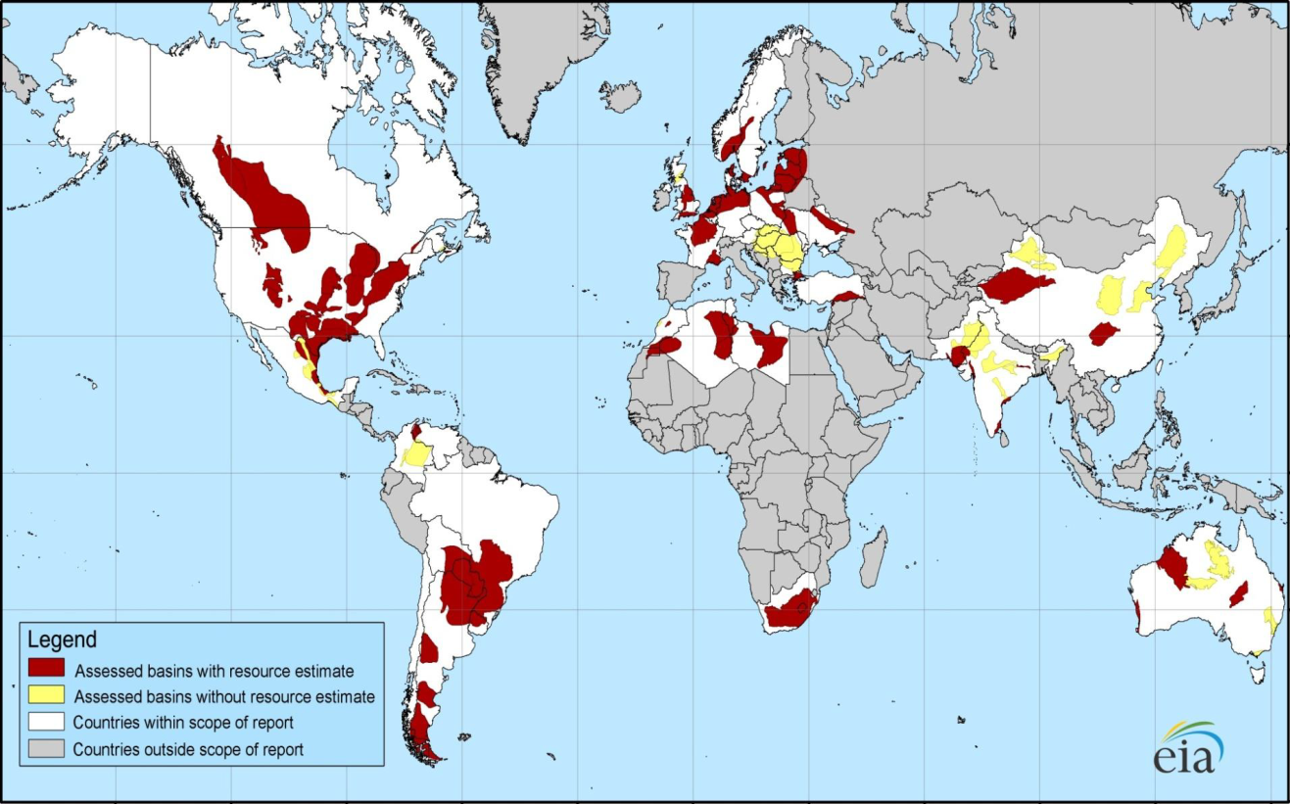
Distribution of Major Shale Deposits: 5.76 Tr. Cu. Ft. in 48 Shale Basins in 32 Countries
Europe and S. America also have large deposits
Australia has some promising shale deposits
Initial assessments reveal 5.76 trillion cu. ft. of shale gas worldwide, including 1.069 trillion cu. Ft. in North America
Source: US Energy Information Administration; Insurance Information Institute.
40
12/01/09 - 9pm
eSlide – P6466 – The Financial Crisis and the Future of the P/C
Notes:
40

Slide 41
Technically Recoverable Shale Gas Deposits, by Region
North America has 1,069 trillion cu. ft. of technically recoverable shale gas recources—18.6% of the global total
Trillion Cubic Ft.tts
Australia’s gas deposits are commercially viable and could expand insurance exposures
Source: US Energy Information Administration; Insurance Information Institute.

Slide 42
Global Real (Inflation Adjusted) Nonlife
Premium Growth: 1980-2010
Average: 1980-2010
Industrialized Countries: 3.8%
Emerging Markets: 9.2%
Overall Total: 4.2%
Nonlife premium growth in emerging markets has exceeded that of industrialized countries in 27 of the past 31 years, including the entirety of the global financial crisis..
Real nonlife premium growth is very erratic in part to inflation volatility in emerging markets as well as a lack of consistent cyclicality
Source: Swiss Re, sigma, No. 2/2010.
42
12/01/09 - 9pm
eSlide – P6466 – The Financial Crisis and the Future of the P/C
Notes:
42

Slide 43

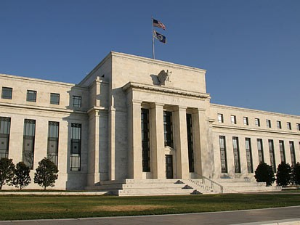

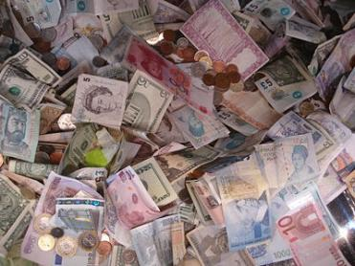
Regulatory Risk: Financial Sector in Consumed with Post-Crisis Concerns
Capital Adequacy, Quality, Liquidity,
  Leverage, Prudential Oversight
Dodd-Frank
Basel III
Solvency II
ComFrame
ORSA
Systemic Importance
  US
  Global
Source: Insurance Information Institute.

Slide 44
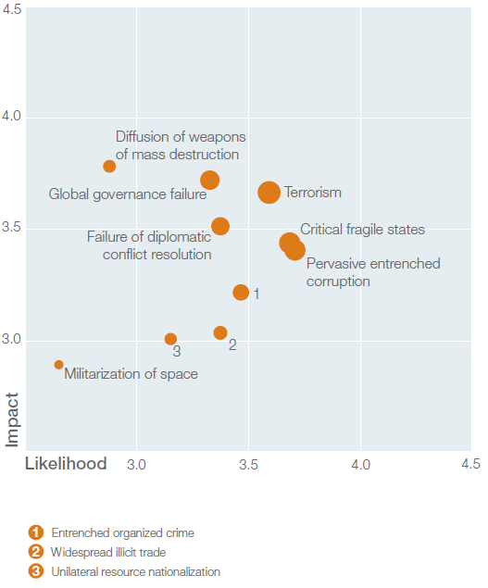
Geopolitical Risk: Foremost on the Minds in “Emerging” Economies
Geopolitical Risks
  Pervasive entrenched corruption
  Critical fragile states
  Terrorism
  Failure of diplomatic conflict
  resolution
  Global governance failure
  Entrenched organized crime
  Widespread illicit trade
  Diffusion of WMD
  Unilateral resource
  nationalization
  Militarization of space
Geopolitical Risk Landscape
Source: World Economic Forum, Global Risks 2012; Insurance Information Institute.

Slide 45
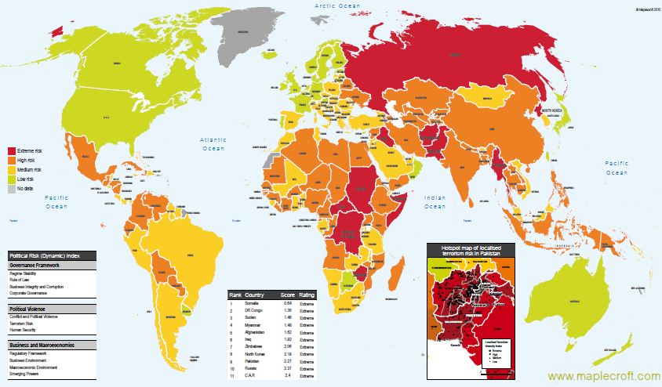
Political Risk in 2011/12: Greatest Business Opportunities Are Often in Risky Nations
The fastest growing markets are generally also among the politically riskiest, including East and South Asia
Heightened risk has economic and insurance implications
Australia and NZ rate well but most neighbors do not
Source: Maplecroft
45
12/01/09 - 9pm
eSlide – P6466 – The Financial Crisis and the Future of the P/C
Notes:
45

Slide 46
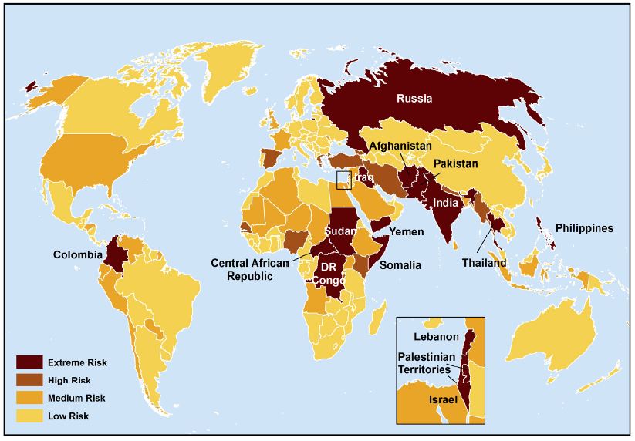
Terrorist Risk Index
The threat of terrorism is highest in South Asia, Russia, the Middle East and Central and East Africa
The US is still considered to be at “Medium Risk” for a terrorist attack
Australia and NZ are considered to be at low risk
Sources: Maplecroft Terrorism Risk Index; (2011); Guy Carpenter; Insurance Information Institute.

Slide 47
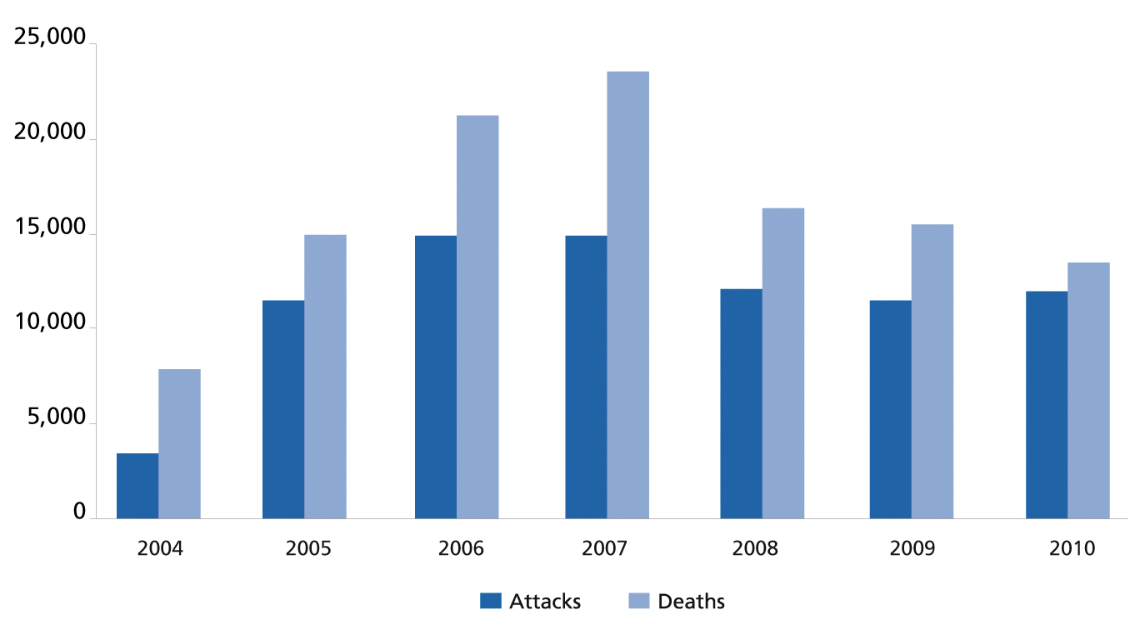
Global Terrorist Attacks and Deaths, 2004-2011
The number of terrorist attacks globally fell by 11.7% in 2011 while the number of deaths dropped by 5.0%
13,193
12,533
11,641
10,283
2011
Sources: National Counterterrorism Center, 2011 Report on Terrorism; Guy Carpenter; Insurance Information Institute.

Slide 48
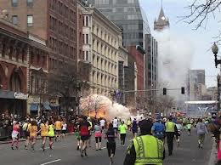
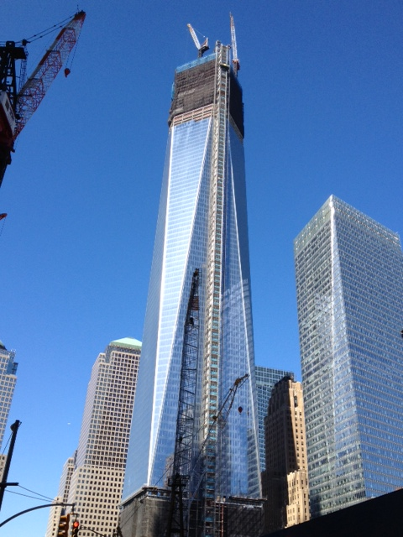
Frequent Reminders of Terrorist Threat: New and Old
Bombings at the Boston Marathon on April 15, 2013
Freedom Tower under construction. Insurance money is the primary source of funds for rebuilding the WTC site
Sources: Insurance Information Institute.

Slide 49
Loss Distribution by Type of Insurance from Sept. 11 Terrorist Attack ($ 2011)
($ Billions)
Total Insured Losses Estimate: $40.0B**
*Loss total does not include March 2010 New York City settlement of up to $657.5 million to compensate approximately 10,000 Ground Zero workers or any subsequent settlements.
**$32.5 billion in 2001 dollars.
Source: Insurance Information Institute.

Slide 50
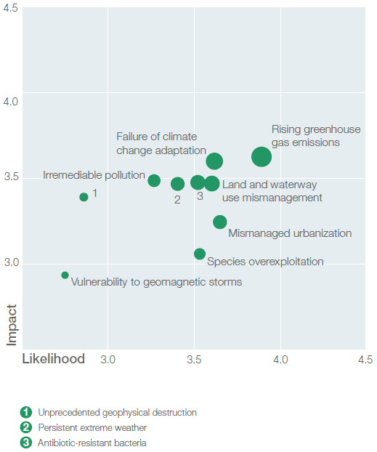
Environmental Risk: Vulnerability and Susceptibility Vary Across Globe
Environmental Risk Landscape
Environmental Risks
  Rising greenhouse gas emissions
  Failure of climate change
    adaptation
  Land/water use mismanagement
  Mismanaged urbanization
  Antibiotic-resistant bacteria
  Persistent extreme weather
  Species overexploitation
  Irremediable pollution
  Vulnerability to geomagnetic storms
Source: World Economic Forum, Global Risks 2012; Insurance Information Institute.

Slide 51
Catastrophe Risk: A Global Concern
The U.S. and Australia Face Many of the Same Catastrophe Risks
51

Slide 52
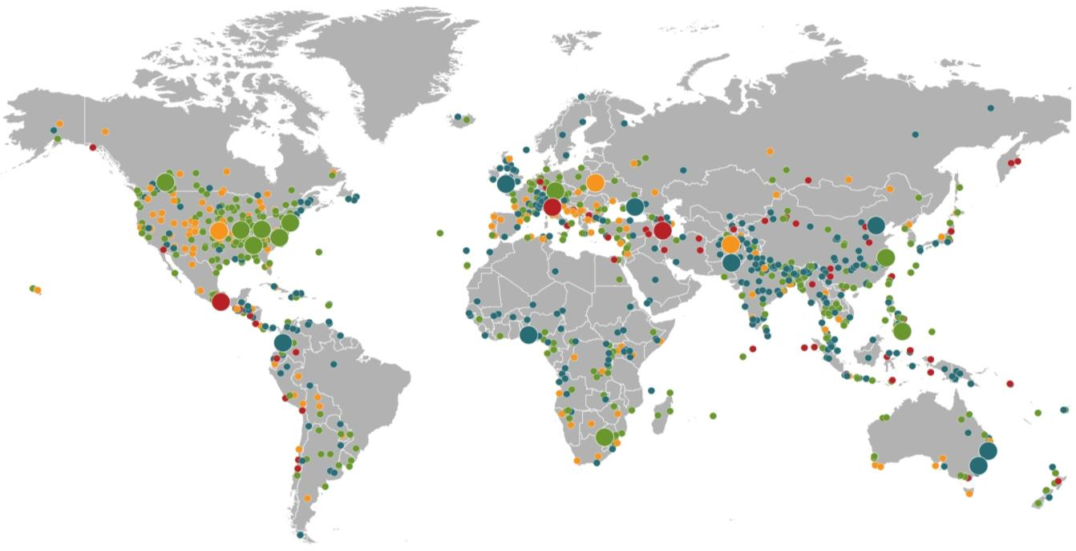
Natural Loss Events:
Full Year 2012
World Map
Winter Storm Andrea
Europe, 5–6 January
Floods
United Kingdom,
21–27 November
Cold Wave
Eastern Europe, Jan – Feb
Cold Wave
Afghanistan, Jan – Mar
Severe Weather
USA, 28–29 April
Hailstorms, severe weather
Canada, 12–14 August
Severe storms
USA, 28 June –2 July
Flash Floods
Russia, 6–8 July
Floods
China, 21–24 July
Drought
USA, Summer
Hurricane Sandy
USA, Caribbean
24–31 October
Earthquake
Italy,
29 May/3 June
Typhoon Haikui China, 8–9 August
Severe Storms, tornadoes
USA, 2–4 March
Hurricane Isaac
USA, Caribbean
24–31 August
Earthquake
Iran, 11 August
Earthquake
Mexico, 20 March
Floods
Nigeria, Jul – Oct
Floods
Pakistan, 3 –27 September
Typhoon Bopha Philippines, 4–5 December
Floods
Columbia, Mar – Jun
Floods, flash floods
Australia, Jan – Feb
Number of events: 905
Floods, hailstorms
South Africa, 20 –21 October
Floods. flash floods
Australia, Feb – Mar
Natural catastrophes
Geophysical events
(earthquake, tsunami, volcanic activity)
Hydrological events
(flood, mass movement)
Selection of significant
Natural catastrophes
Meteorological events
(storm)
Climatological events
(extreme temperature, drought, wildfire)
Source: Munich Re Geo Risks Research, NatCatSERVICE – As at January 2013.
52

Slide 53
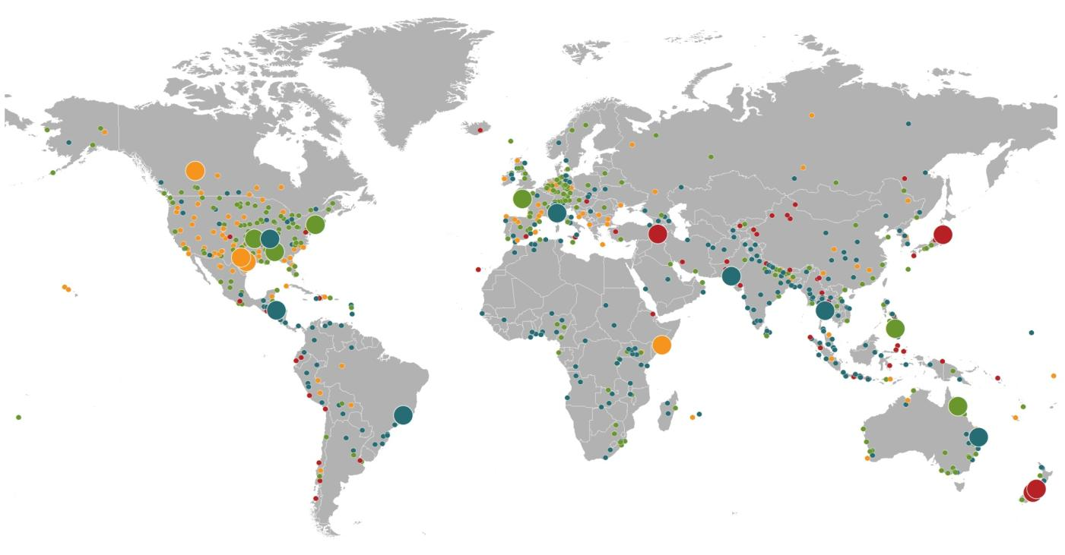
Natural Loss Events, 2011
World Map
Winter Storm Joachim
France, Switzerland,
Germany, 15–17 Dec.
Flash floods, floods
Italy, France, Spain
4–9 Nov.
Wildfires
Canada, 14–22 May
Severe storms, tornadoes
USA, 20–27 May
Earthquake
Turkey
23 Oct.
Hurricane Irene
USA, Caribbean
22 Aug.–2 Sept.
Earthquake, tsunami
Japan, 11 March
Floods
USA, April–May
Drought
USA, Oct. 2010–
ongoing
Severe storms, tornadoes
USA, 22–28 April
Tropical Storm Washi
Philippines, 16–18 Dec.
Wildfires
USA, April/Sept.
Floods
Pakistan
Aug.–Sept.
Cyclone Yasi
Australia, 2–7 Feb.
Floods, landslides
Guatemala, El Salvador
11–19 Oct.
Floods
Thailand
Aug.–Nov.
Landslides, flash floods
Brazil, 12/16 Jan.
Floods, flash floods
Australia,
Dec. 2010–Jan. 2011
Number of Events: 820
Drought
Somalia
Oct. 2010–Sept. 2011
Earthquake
New Zealand, 22 Feb.
Earthquake
New Zealand, 13 June
Natural catastrophes
Geophysical events
(earthquake, tsunami, volcanic activity)
Hydrological events
(flood, mass movement)
Selection of significant
loss events (see table)
Meteorological events
(storm)
Climatological events
(extreme temperature, drought, wildfire)
Source: MR NatCatSERVICE
53

Slide 54
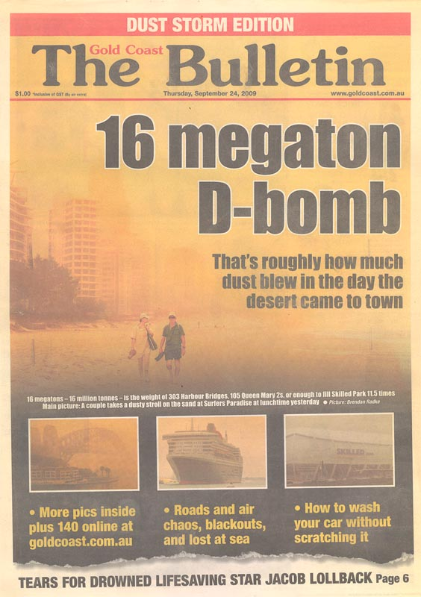
My One Trip to Australia:
Disaster Strikes
Huge dust storm blankets the Gold Coast in Sept. 2009
54

Slide 55
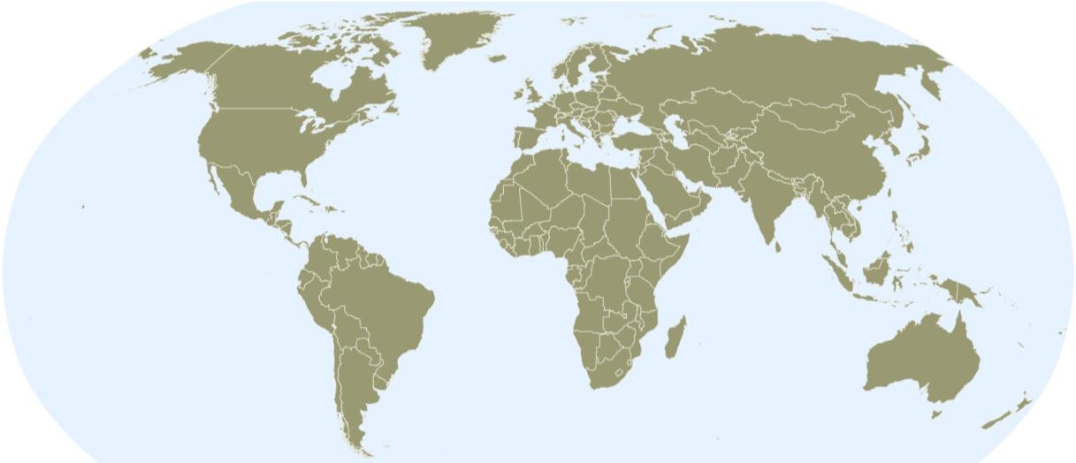
Natural Catastrophes Worldwide 2011
Insured losses US$ 105bn - Percentage distribution per continent
2%
44%
In 2011, just 37% of insured natural catastrophe losses were in the Americas, barely half the average of 66% over the prior 30 years (1981-2010)
37%
<1%
17%
Continent | Insured losses US$ m
America (North and South America) | 40,000
Europe | 2,000
Africa | Minor damages
Asia | 45,000
Australia/Oceania | 18,000
In 2011, 61% of insured natural catastrophe losses were in the Asia/Pacific region, nearly 3.5 times the average of 13% over the prior 30 years (1981-2010)
Source: MR NatCatSERVICE
55

Slide 56
Top 16 Most Costly World Insurance Losses, 1970-2012*
(Insured Losses, 2012 Dollars, $ Billions)
5 of the top 14 most expensive catastrophes in world history have occurred within the past 3 years (2010-2012)
2012 insured CAT Losses totaled $60B; Economic losses totaled $140B, according to Swiss Re
Hurricane Sandy is now the 6th costliest event in global insurance history
*Figures do not include federally insured flood losses.
**Estimate based on PCS value of $18.75B as of 4/12/13.
Sources: Munich Re; Swiss Re; Insurance Information Institute research.

Slide 57
US Insured Catastrophe Losses
($ Billions, 2012 Dollars)
2012 was likely the third most expensive year ever for insured CAT losses
2012 Was the 3rd Highest Year on Record for Insured Losses in US History on An Inflation-Adjusted Basis. 2011 Losses Were the 6th Highest.
Record Tornado Losses Caused 2011 CAT Losses to Surge
Note: 2001 figure includes $20.3B for 9/11 losses reported through 12/31/01 ($25.9B 2011 dollars). Includes only business and personal property claims, business interruption and auto claims. Non-prop/BI losses = $12.2B ($15.6B in 2011 dollars.)
Sources: Property Claims Service/ISO; Insurance Information Institute.
57
12/01/09 - 9pm
eSlide – P6466 – The Financial Crisis and the Future of the P/C
Notes:
57

Slide 58
Most Costly Natural Disasters in Australia by Type, 1967-2011
$ AUD millions
Total Losses: $52,973
Note: Expressed in December 2011 Australian dollars.
Source: AXCO.

Slide 59
Insured Losses From Natural Disasters in Australia by State, 1967-2011
$ AUD millions
Total Losses: $52,973
Note: Expressed in December 2011 Australian dollars.
Source: AXCO.

Slide 60
Top Five Natural Disasters in Australia by Insured Losses, 1967-2011
$ USD millions
Note: Expressed in December 2011 U.S. dollars.
Source: AXCO.

Slide 61
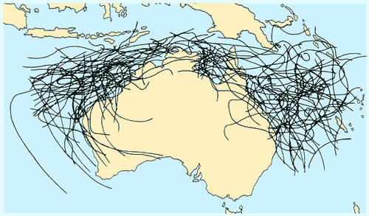
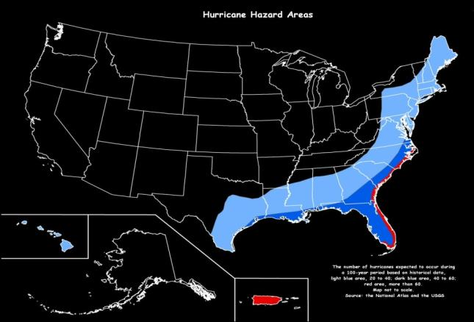
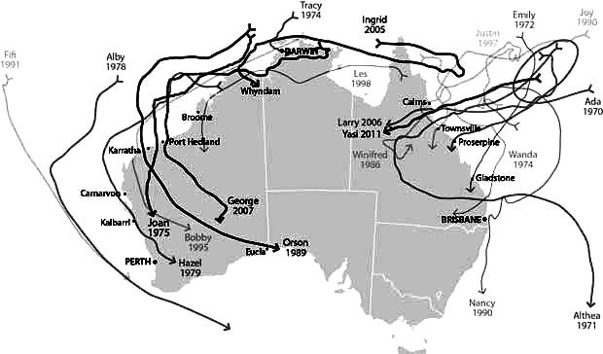
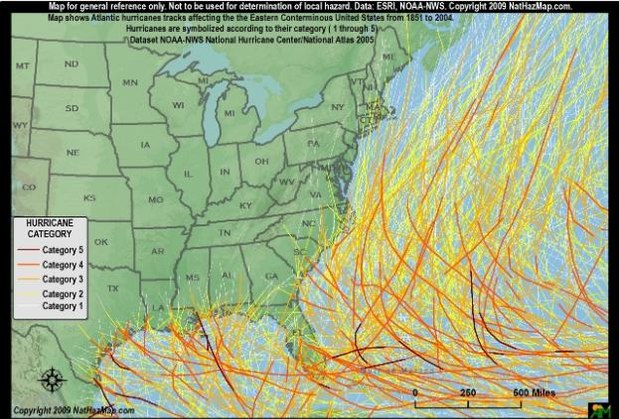
Tropical Cyclone Risk in Australia:
A Shared Risk with the US
US hurricane risk is concentrated on the Gulf and Southeast Coast and HI
Australia’s tropical cyclones often follow erratic paths
Source: The Weather Doctor http://www.islandnet.com/~see/weather/almanac/arc2013/alm13mar.htm; Red Cross,Ins. Info. Inst.
61
12/01/09 - 9pm
eSlide – P6466 – The Financial Crisis and the Future of the P/C
Notes:
61

Slide 62
Outlook for 2013 Hurricane Season:
75% Worse Than Average
Forecast Parameter | Median (1981-2010) | 2013F
Named Storms | 12.0 | 18
Named Storm Days | 60.1 | 95
Hurricanes | 6.5 | 9
Hurricane Days | 21.3 | 40
Major Hurricanes | 2.0 | 4
Major Hurricane Days | 3.9 | 9
Accumulated Cyclone Energy | 92.0 | 165
Net Tropical Cyclone Activity | 103% | 175%
Source: Philip Klotzbach and Dr. William Gray, Colorado State University, April 10, 2013, accessed at http://tropical.atmos.colostate.edu/forecasts/2013/apr2013/apr2013.pdf ; Insurance Information Institute..

Slide 63
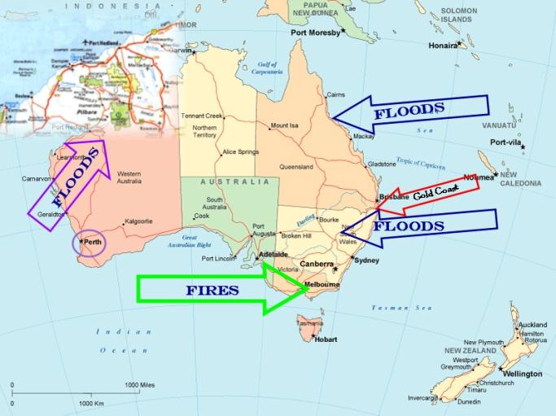
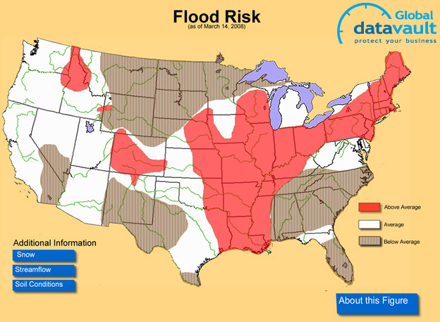
Flood Risk in Australia: Another Shared Risk with the US
US flooding is most commonly associated with rivers, though coastal inundation from tropical events is not uncommon
Australia has been hot by severe floods in recent years in areas such as the Gold Coast
Source: Insurance Information Institute research.
63
12/01/09 - 9pm
eSlide – P6466 – The Financial Crisis and the Future of the P/C
Notes:
63

Slide 64
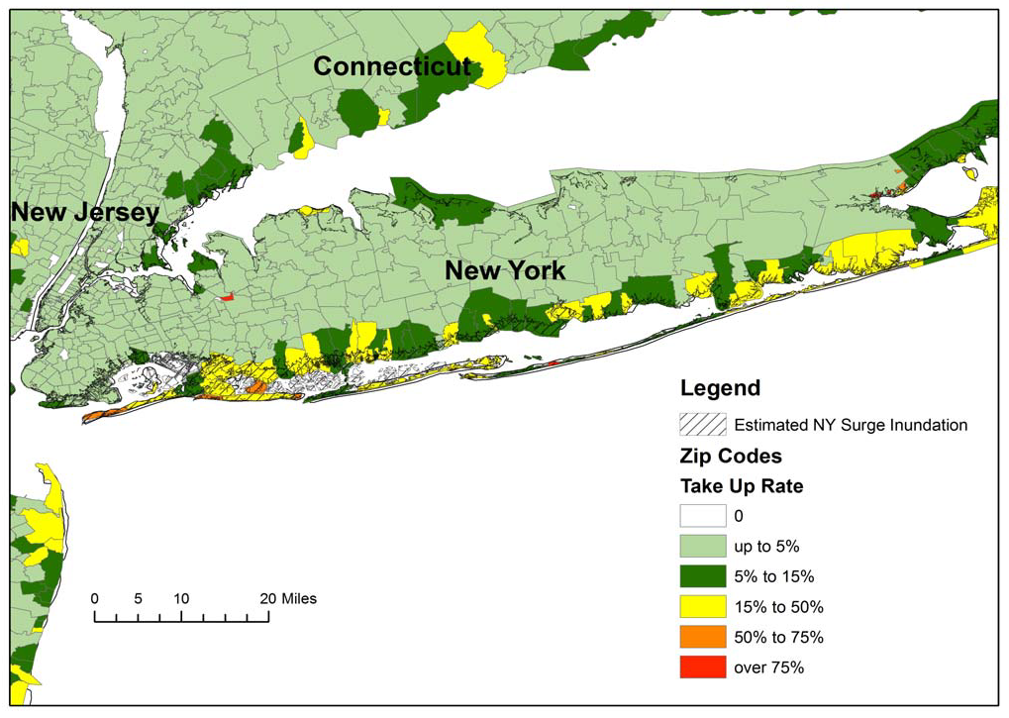
Residential NFIP Flood Take-Up Rates in NY, CT (2010) & Sandy Storm Surge
Flood coverage penetration rates were extremely low in many very vulnerable areas of NY and CT, with take-up rates far below 50% in many areas
Source: Wharton Center for Risk Management and Decision Processes, Issue Brief, Nov. 2012; Insurance Information Institute.
64

Slide 65
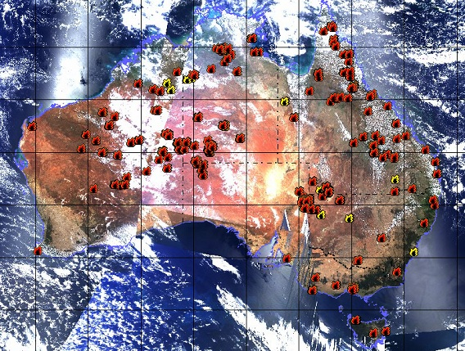
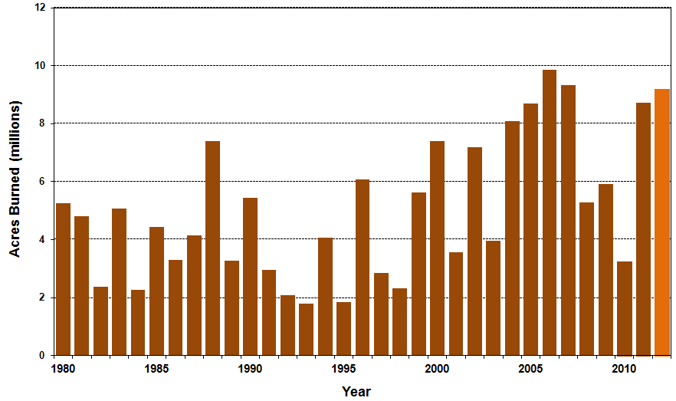
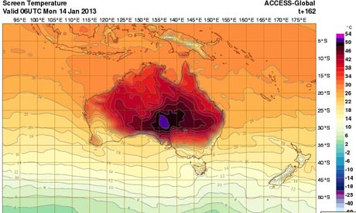
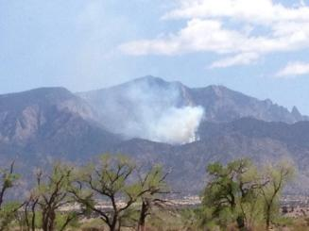
Wildfire Risk: Australia and America—Heating Up & Drying Out?
Australia has been hit by drought, extreme temperatures and wildfires
US Acres Burned
Acres burned remain high in the US
Record temps in Australia
Source: Insurance Information Institute research.
65
12/01/09 - 9pm
eSlide – P6466 – The Financial Crisis and the Future of the P/C
Notes:
65

Slide 66
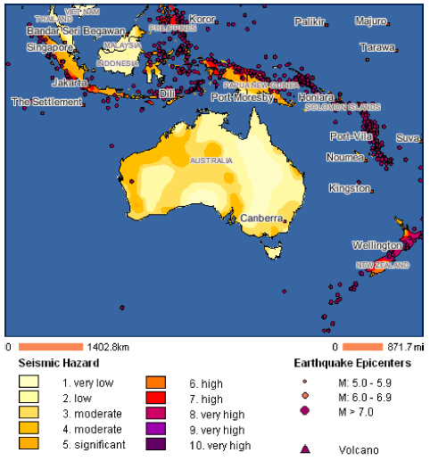
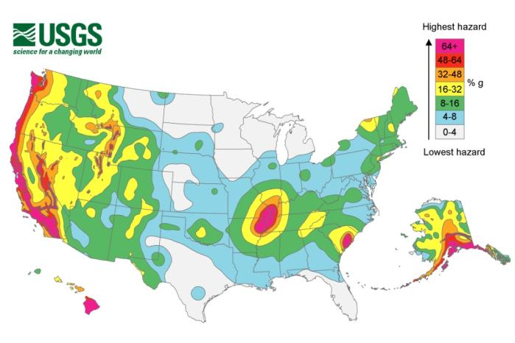
Earthquake Risk in Australia: Living in a Dangerous Neighborhood
US earthquake risk is concentrated on the West Coast and AK, HI
Australia’s earthquake risk is modest, especially relative to NZ and points north and east
Source: Axco from Swiss Re; US Geological Survey; Insurance Information Institute.
66
12/01/09 - 9pm
eSlide – P6466 – The Financial Crisis and the Future of the P/C
Notes:
66

Slide 67
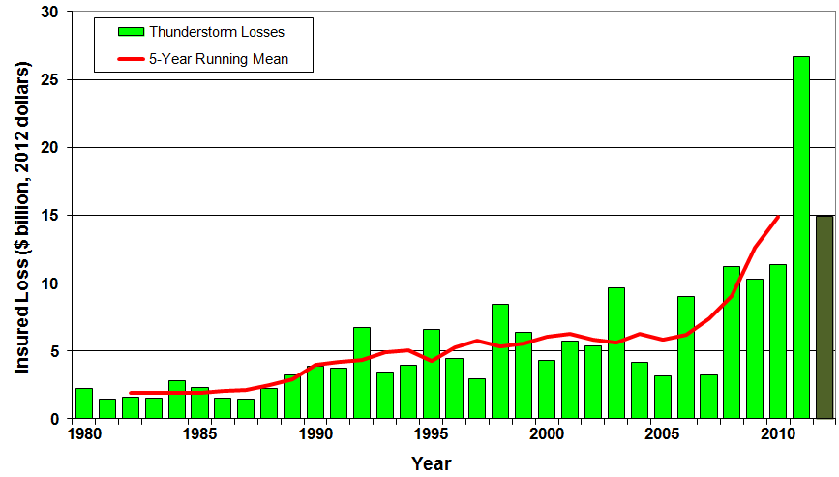
U.S. Thunderstorm Loss Trends, 1980 – 2012
Hurricanes get all the headlines, but thunderstorms are consistent producers of large scale loss. 2008-2012 are the most expensive years on record.
Average thunderstorm losses are up 7 fold since the early 1980s. The 5- year running average loss is up sharply.
Thunderstorm losses in 2012 totaled $14.9 billion, the 2nd highest on record
Source: Property Claims Service, MR NatCatSERVICE
67

Slide 68
Inflation Adjusted U.S. Catastrophe Losses by Cause of Loss, 1992–2011¹
Wind/Hail/Flood (3), $14.8
Fires (4), $6.0
Other (5), $1.4
Insured cat losses from 1992-2011 totaled $384.3B, an average of $19.2B per year or $1.6B per month
Geological Events, $18.2
Terrorism, $24.4
Winter Storms, $28.2
Hurricanes & Tropical Storms, $161.3
Tornado share of CAT losses is rising
Wind losses are by far cause the most catastrophe losses, even if hurricanes/TS are excluded.
Tornadoes (2), $130.2
Catastrophes are defined as events causing direct insured losses to property of $25 million or more in 2009 dollars.
Excludes snow.
Does not include NFIP flood losses
Includes wildland fires
Includes civil disorders, water damage, utility disruptions and non-property losses such as those covered by workers compensation.
Source: ISO’s Property Claim Services Unit.

Slide 69
GLOBAL REINSURANCE MARKET IMPACTS
Global Reinsurance Markets Proved Resilient Despite Record Catastrophe Losses Worldwide
69

Slide 70
Reinsurer Share of Recent Significant Market Losses
Billions of 2011 Dollars
40% Reinsurance share of total insured loss
$37.5
$15.0
73%
60%
95%
$13.0
44%
$10.0
$22.5
$8.3
$9.5
$6.0
$5.0
$7.9
$2.2
$3.5
$4.0
$2.8
$0.4
Reinsurers Paid a High Proportion of Insured Losses Arising from Major Catastrophic Events Around the World in Recent Years
Source: Insurance Information Institute from reinsurance share percentages provided in RAA, ABIR and CEA press release, Jan. 13, 2011.
70
12/01/09 - 9pm
eSlide – P6466 – The Financial Crisis and the Future of the P/C
Notes:
70

Slide 71
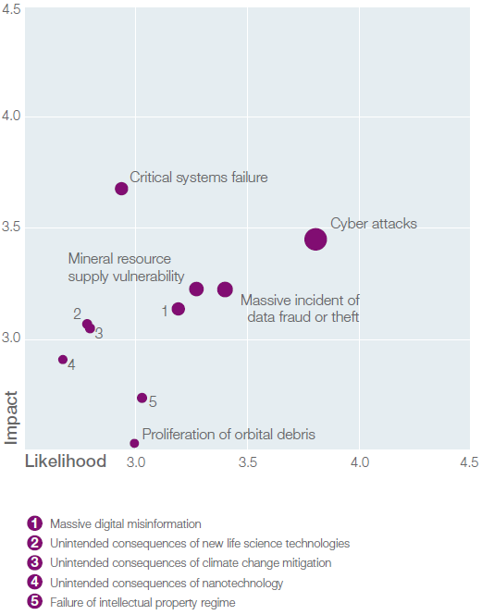
Technological Risks: Vulnerability and Susceptibility Vary Across the Globe
Technological Risks
  Cyber attacks
  Massive data fraud/theft
  Mineral resource supply
  vulnerability
  Massive digital misinformation
  Unintended consequences of
  new life sciences technologies
  Unintended consequences of
  climate change mitigation
  Unintended consequences of
  nanotechnology
Technological Risk Landscape
Source: World Economic Forum, Global Risks 2012; Insurance Information Institute.

Slide 72
U.S. Data Breaches 2005-2013, By Number of Breaches and Records Exposed
# Data Breaches/Millions of Records Exposed
Millions
The total number of data breaches and number of records exposed fluctuates from year to year and over time.
* 2013 figures as of March 19, 2013.
Source: Identity Theft Resource Center

Slide 73

Societal Risks: Vulnerability and Susceptibility Vary Across the Globe
Societal Risks
  Water supply crisis
  Food shortage crisis
  Rising religious fanaticism
  Vulnerability to pandemics
  Unmanaged migration
  Mismanagement of
  population aging
  Unsustainable population
  growth
  Backlash against globalization
  Ineffective drug policies
Societal Risk Landscape
Source: World Economic Forum, Global Risks 2012; Insurance Information Institute.

Slide 74
Liability Costs as a Fraction of GDP, 2011*
In March, 26 states and the District of Columbia had over-the-month unemployment rate decreases, 7 states had increases, and 17 states had no change.
*Provisional figures for March 2013, seasonally adjusted.
Sources: US Chamber of Commerce; Insurance Information Institute.

Slide 75
THE NEVER ENDING QUEST FOR GROWTH AND PERFORMANCE
Insurers, Brokers Around the World Share Many Concerns
75

Slide 76
Growth: Always a Challenge—
U.S. More So in Recent Years
Premium growth in Australia has greatly outpaced the US in recent years.
(Percent)
*2012 figure for Australia is through Q2 only.
Source: A.M. Best (U.S.); Australian Prudential Regulatory Authority; Insurance Information Institute.

Slide 77
Net Premium Growth: Annual Change,
1971—2012
(Percent)
1975-78
1984-87
2000-03
Net Written Premiums Fell 0.7% in 2007 (First Decline Since 1943) by 2.0% in 2008, and 4.2% in 2009, the First 3-Year Decline Since 1930-33.
2012 growth was +4.3%
Shaded areas denote “hard market” periods
Sources: A.M. Best (historical and forecast), ISO, Insurance Information Institute.

Slide 78
Average Commercial Rate Change,
All Lines, (1Q:2004–1Q:2013)
Pricing as of Q1:2013 was positive for the 8th consecutive quarter. Gains are likely to continue through 2013.
(Percent)
Q2 2011 marked the last of 30th consecutive quarter of price declines
KRW Effect
Note: CIAB data cited here are based on a survey. Rate changes earned by individual insurers can and do vary, potentially substantially.
Source: Council of Insurance Agents & Brokers; Insurance Information Institute

Slide 79

Change in Commercial Rate Renewals, by Account Size: 1999:Q4 to 2013:Q1
Percentage Change (%)
Peak = 2001:Q4 +28.5%
Pricing turned positive in Q3:2011, the first increase in nearly 8 years; Q1:2013 renewals were up 5.2%, the largest increase since late 2003; Some insurers posted stronger numbers.
Pricing Turned Negative in Early 2004 and Remained that way for 7 ½ years
KRW : No Lasting Impact
Trough = 2007:Q3 -13.6%
Source: Council of Insurance Agents and Brokers; Barclay’s Capital; Insurance Information Institute.
Note: CIAB data cited here are based on a survey. Rate changes earned by individual insurers can and do vary, potentially substantially.

Slide 80

Cumulative Qtrly. Commercial Rate Changes, by Account Size: 1999:Q4 to 2013:Q1
1999:Q4 = 100
Despite 8 consecutive quarters of gains (Q4:2012 = 5.0%), pricing today is where is was in mid-2001 (pre-9/11), suggesting additional rate need going forward, esp. in light of record low interest rates
Note: CIAB data cited here are based on a survey. Rate changes earned by individual insurers can and do vary, potentially substantially.
Source: Council of Insurance Agents and Brokers; Barclay’s Capital; Insurance Information Institute.

Slide 81
Change in Commercial Rate Renewals, by Line: 2013:Q1
Workers Comp rate increases are large than any other line, followed by Property lines
Percentage Change (%)
Major Commercial Lines Renewed Uniformly Upward in Q1:2013 for the 8th Consecutive Quarter; Property Lines & Workers Comp Leading the Way; Cat Losses and Low Interest Rates Provide Momentum Going Forward
Note: CIAB data cited here are based on a survey. Rate changes earned by individual insurers can and do vary, potentially substantially.
Source: Council of Insurance Agents and Brokers; Insurance Information Institute.

Slide 82
Monthly Change* in Auto Insurance Prices, 1991–2013*
Cyclical peaks in PP Auto tend to occur approximately every 10 years (early 1990s, early 2000s and likely the early 2010s)
Pricing peak occurred in late 2010 at 5.3%, falling to 2.8% by Mar. 2012
“Hard” markets tend to occur during recessionary periods
The Mar. 2013 reading of 4.8% is up from 2.8% a year earlier
*Percentage change from same month in prior year; through Mar. 2013; seasonally adjusted
Note: Recessions indicated by gray shaded columns.
Sources: US Bureau of Labor Statistics; National Bureau of Economic Research (recession dates); Insurance Information Institutes.
82
12/01/09 - 9pm
eSlide – P6466 – The Financial Crisis and the Future of the P/C
Notes:
82

Slide 83
Auto/Light Truck Sales, 1999-2019F
Job growth and improved credit market conditions will boost auto sales in 2013 and beyond
(Millions of Units)
New auto/light truck sales fell to the lowest level since the late 1960s. Forecast for 2013-14 is still below 1999-2007 average of 17 million units, but a robust recovery is well underway.
Car/Light Truck Sales Will Continue to Recover from the 2009 Low Point, Bolstering the Auto Insurer Growth and the Manufacturing Sector.
Source: U.S. Department of Commerce; Blue Chip Economic Indicators (4/13 and 3/13); Insurance Information Institute.

Slide 84
New Private Housing Starts, 1990-2019F
Job growth, low inventories of existing homes, low mortgage rates and demographics are stimulating new home construction for the first time in years
(Millions of Units)
New home starts plunged 72% from 2005-2009; A net annual decline of 1.49 million units, lowest since records began in 1959
Homeowners Insurers Are Starting to See Meaningful Exposure Growth for the First Time Since 2005. Commercial Insurers with Construction Risk Exposure, Surety, Workers Comp Also Benefit
Source: U.S. Department of Commerce; Blue Chip Economic Indicators (4/13 and 3/13); Insurance Information Institute.

Slide 85
Construction Employment,
Jan. 2010—March 2013*
(Thousands)
Construction employment growth accelerated in the second half of 2012. Stronger growth in this key sector is possible in 2013.
*Seasonally adjusted
Sources: US Bureau of Labor Statistics at http://data.bls.gov; Insurance Information Institute.
85
12/01/09 - 9pm
eSlide – P6466 – The Financial Crisis and the Future of the P/C
Notes:
85

Slide 86
Unemployment and Underemployment Rates: Stubbornly High in 2012, But Falling
January 2000 through Apr. 2013, Seasonally Adjusted (%)
U-6 went from 8.0% in March 2007 to 17.5% in
October 2009; Stood at 13.7% in Apr. 2013
Recession ended in November 2001
Unemployment kept rising for 19 more months
Recession began in December 2007
Unemployment stood at 7.5% in Apr. 2013—lowest in 4 years.
Unemployment peaked at 10.1% in October 2009, highest monthly rate since 1983.
Peak rate in the last 30 years: 10.8% in November - December 1982
Stubbornly high unemployment and underemployment constrain overall economic growth, but the job market is now clearly improving
Source: US Bureau of Labor Statistics; Insurance Information Institute.
86
12/01/09 - 9pm
eSlide – P6466 – The Financial Crisis and the Future of the P/C
Notes:
86

Slide 87
Payroll vs. Workers Comp Net Written Premiums, 1990-2012E
Payroll Base* WC NWP
$Billions $Billions
7/90-3/91
3/01-11/01
12/07-6/09
WC premium volume dropped two years before the recession began
+9% in 2012E
WC net premiums written were down $14B or 29.3% to $33.8B in 2010 after peaking at $47.8B in 2005
Continued Payroll Growth and Rate Increases Suggest WC NWP Will Grow Again in 2012; +7.9% Growth in 2011 Was the First Gain Since 2005
*Private employment; Shaded areas indicate recessions. WC premiums for 2012 are I.I.I. estimate based YTD 2012 actuals.
Sources: NBER (recessions); Federal Reserve Bank of St. Louis at http://research.stlouisfed.org/fred2/series/WASCUR ; NCCI; I.I.I.

Slide 88
12 Industries for the Next 10 Years: Insurance Solutions Needed
Health Care
Health Sciences
Energy (Traditional)
Many industries are poised for growth, though insurers’ ability to capitalize on these industries varies widely
Alternative Energy
Petrochemical
Agriculture
Natural Resources
Technology (incl. Biotechnology)
Light Manufacturing
Insourced Manufacturing
Export-Oriented Industries
Shipping (Rail, Marine, Trucking, Pipelines)

Slide 89
Growth Analysis by State and Business Segment
Premium Growth Rates Vary Tremendously by State
89

Slide 90
Direct Premiums Written: Total P/C
Percent Change by State, 2007-2012*
Top 25 States
*Data are preliminary as of 5/1/13 and do not yet fully reflect the impact of state-run pools and plans.
Sources: SNL Financial LC.; Insurance Information Institute.

Slide 91
Direct Premiums Written: Total P/C
Percent Change by State, 2007-2012*
Bottom 25 States
*Data are preliminary as of 5/1/13 and do not yet fully reflect the impact of state-run pools and plans.
Sources: SNL Financial LC.; Insurance Information Institute.

Slide 92
UNDERWRITING PERFORMANCE MUST IMPROVE IN CURRENT LOW INTEREST RATE ENVIRONMENT
Australia and U.S. Underwriting Performance/Trends Are More Similar than Might Be Expected
92

Slide 93
Loss Ratios: Homeowners (U.S.) & Property (Australia)
Loss ratios for property risks seem oddly in sync in the U.S. and Australia. Both reflect volatility.
(Percent)
*U.S., loss ratios include loss adjustment expense.
Source: A.M. Best (U.S.), Australian Prudential Regulation Authority; Insurance Information Institute

Slide 94
Combined Ratio Points Associated with Catastrophe Losses: 1960 – 2012*
Avg. CAT Loss Component of the Combined Ratio by Decade
1960s: 1.04 1970s: 0.85 1980s: 1.31 1990s: 3.39 2000s: 3.52 2010s: 7.20*
Catastrophe losses as a share of all losses reached a record high in 2012
Combined Ratio Points
The Catastrophe Loss Component of Private Insurer Losses Has Increased Sharply in Recent Decades
Notes: Private carrier losses only. Excludes loss adjustment expenses and reinsurance reinstatement premiums. Figures are adjusted for losses ultimately paid by foreign insurers and reinsurers.
Source: ISO (1960-2011); A.M. Best (2012E) Insurance Information Institute.

Slide 95
Loss Ratios: Motor/Auto
Loss ratios for motor insurance have been more stable in the U.S. than in U.S. and Australia.
(Percent)
*U.S., loss ratios include loss adjustment expense.
Source: A.M. Best (U.S.), Australian Prudential Regulation Authority; Insurance Information Institute

Slide 96
Loss Ratios: Workers Compensation
Loss ratios for workers comp have generally deteriorated in both the U.S. and Australia.
(Percent)
*U.S., loss ratios include loss adjustment expense.
Source: A.M. Best (U.S.), Australian Prudential Regulation Authority; Insurance Information Institute

Slide 97
Loss Ratios: Liability
In recent years, loss ratios for Liability coverage have been similar in the U.S. and Australia.
(Percent)
*U.S., loss ratios include loss adjustment expense.
Source: A.M. Best (U.S.), Australian Prudential Regulation Authority; Insurance Information Institute

Slide 98
U.S. Insurance Industry Employment Trends
Soft Market, Difficult Economy, Outsourcing, Productivity Enhancements and Consolidation Contributed to Industry’s Job Losses
98

Slide 99
U.S. Employment in the Direct
P/C Insurance Industry: 1990–2013*
Thousands
*As of March 2013; Seasonally adjusted; Does not including agents & brokers.
Note: Recessions indicated by gray shaded columns.
Sources: U.S. Bureau of Labor Statistics; National Bureau of Economic Research (recession dates); Insurance Information Institute.
99
12/01/09 - 9pm
eSlide – P6466 – The Financial Crisis and the Future of the P/C
Notes:
99

Slide 100
U.S. Employment in Insurance
Agencies & Brokerages: 1990–2013*
Thousands
As of March 2013, employment at insurance agencies and brokerages was down by 16,300 or 2.4% to 661,400 since the recession began in Dec. 2007 (vs. overall US employment decline of 2.0%).
*As of March 2013; Seasonally adjusted. Includes all types of insurance.
Note: Recessions indicated by gray shaded columns.
Sources: U.S. Bureau of Labor Statistics; National Bureau of Economic Research (recession dates); Insurance Information Institute.
100
12/01/09 - 9pm
eSlide – P6466 – The Financial Crisis and the Future of the P/C
Notes:
100

Slide 101
U.S. Employment in the
Reinsurance Industry: 1990–2013*
Thousands
As of March 2013, US employment in the reinsurance industry was down by 1,000 or 3.8% to 25,600 since the recession began in Dec. 2007 (vs. overall US employment decline of 2.0%).
*As of March 2013; Seasonally adjusted; Does not including agents & brokers.
Note: Recessions indicated by gray shaded columns.
Sources: U.S. Bureau of Labor Statistics; National Bureau of Economic Research (recession dates); Insurance Information Institute.
101
12/01/09 - 9pm
eSlide – P6466 – The Financial Crisis and the Future of the P/C
Notes:
101

Slide 102
Distribution Trends
Distribution by Channel Type Continues to Evolve Around the World
102

Slide 103
All P/C Lines Distribution Channels, Direct vs. Independent Agents
Independent agents steadily lost market share from the early 1980s through the early 2000s across all P/C lines, but have gained or held generally steady in recent years. Direct channels include exclusive agency companies, direct marketers and direct sales (e.g., internet)
Source: Insurance Information Institute; based on data from Conning and A.M. Best.

Slide 104
Commercial P/C Distribution Channels, Direct vs. Independent Agents
Independent agents have seen only modest erosion in commercial lines market share in recent decades
Source: Insurance Information Institute; based on data from Conning and A.M. Best.

Slide 105
Personal Lines Distribution Channels, Direct vs. Independent Agents
Independent agents have lost significant personal lines market share since the early 1970s. Although the trend has slowed, it may be accelerating again.
Source: Insurance Information Institute; based on data from Conning and A.M. Best.

Slide 106
P/C Insurance Industry Financial Overview
Profit Recovery in 2012 After High CAT Losses; Ultimate Impact of Sandy Still Unclear
106

Slide 107
P/C Net Income After Taxes
1991–2012 ($ Millions)
2005 ROE*= 9.6%
2006 ROE = 12.7%
2007 ROE = 10.9%
2008 ROE = 0.1%
2009 ROE = 5.0%
2010 ROE = 6.6%
2011 ROAS¹ = 3.5%
2012 ROAS¹ = 5.9%
P-C Industry 2012:Q3 profits were up 222% from 2011:Q3, due primarily to lower catastrophe losses
* ROE figures are GAAP; ¹Return on avg. surplus. Excluding Mortgage & Financial Guaranty insurers yields a 6.2% ROAS in 2012, 4.7% ROAS for 2011, 7.6% for 2010 and 7.4% for 2009.
Sources: A.M. Best, ISO, Insurance Information Institute

Slide 108
Profitability Peaks & Troughs in the P/C Insurance Industry, 1975 – 2013F*
ROE
History suggests next ROE peak will be in 2016-2017
1977:19.0%
1987:17.3%
10 Years
2006:12.7%
1997:11.6%
10 Years
9 Years
2013F: 6.2%
2012: 5.9%
1975: 2.4%
1984: 1.8%
1992: 4.5%
2001: -1.2%
*Profitability = P/C insurer ROEs. 2011 figure is an estimate based on ROAS data. Note: Data for 2008-2013 exclude mortgage and financial guaranty insurers. 2012:Q3 ROAS = 6.2% including M&FG.
Source: Insurance Information Institute; NAIC, ISO, A.M. Best.

Slide 109
Policyholder Surplus,
2006:Q4–2012:Q4
Drop due to near-record 2011 CAT losses
2007:Q3
Pre-Crisis Peak
($ Billions)
Surplus as of 12/31/12 was up $16.2B or 2.8% from the previous record high of $570.7B set as of 3/31/12.
The Industry now has $1 of surplus for every $0.80 of NPW, close to the strongest claims-paying status in its history.
*Includes $22.5B of paid-in capital from a holding company parent for one insurer’s investment in a non-insurance business in early 2010.
The P/C Insurance Industry Both Entered and Emerged from the 2012 Hurricane Season Very Strong Financially.
Sources: ISO, A.M .Best.
109
12/01/09 - 9pm
eSlide – P6466 – The Financial Crisis and the Future of the P/C
Notes:
109

Slide 110
INVESTMENTS:
THE NEW REALITY
Investment Performance is a Key Driver of Profitability
Depressed Yields Will Necessarily Influence Underwriting & Pricing
110

Slide 111
U.S. 10-Year Treasury Note Yields:
A Long Downward Trend, 1990–2013*
Yields on 10-Year U.S. Treasury Notes recently rose 53bp from its all time record lows to 1.96% in Mar. 2013
Yields on 10-Year U.S. Treasury Notes have been essentially below 5% for a full decade.
Since roughly 80% of P/C bond/cash investments are in 10-year or shorter durations, most P/C insurer portfolios will have low-yielding bonds for years to come.
*Monthly, through Mar. 2013. Note: Recessions indicated by gray shaded columns.
Sources: Federal Reserve Bank at http://www.federalreserve.gov/releases/h15/data.htm.
National Bureau of Economic Research (recession dates); Insurance Information Institutes.
111
12/01/09 - 9pm
eSlide – P6466 – The Financial Crisis and the Future of the P/C
Notes:
111

Slide 112
Property/Casualty Insurance Industry Investment Income: 2000–2012¹
($ Billions)
Investment earnings in 2012 were running 13% below their 2007 pre-crisis peak
Investment Income Fell in 2012 Due to Persistently Low Interest Rates, Putting Additional Pressure on (Re) Insurance Pricing
¹ Investment gains consist primarily of interest and stock dividends..
Sources: ISO; Insurance Information Institute.

Slide 113
Insurance Information Institute Online:
www.iii.org
Thank you for your time
and your attention!
Twitter: twitter.com/bob_hartwig

