Slide 1
What’s Next on the Mega Catastrophe Event Front?
Inundation, Litigation & Politicization
DRI Insurance Coverage and Practice Symposium
New York, NY
December 12, 2013
Download at www.iii.org/presentations
Robert P. Hartwig, Ph.D., CPCU, President & Economist
Insurance Information Institute ♦ 110 William Street ♦ New York, NY 10038
Tel: 212.346.5520 ♦ Cell: 917.453.1885 ♦ bobh@iii.org ♦ www.iii.org

Slide 2
Presentation Outline
U.S. Insured Catastrophe Loss Trends
  More CATs, More Disputes?
Hurricane Sandy
  Overview
  Issues and Concerns
Public Opinion Survey: Catastrophes and Insurance
Terrorism and TRIA
  Terrorism Risk Insurance Program expires 12/31/14
Tort Trends
  BP and the Deepwater Horizon Litigation

Slide 3
U.S. Insured Catastrophe Loss Update
Catastrophe Losses in Recent Years Have Been Very High
Events Like Sandy Attract Trial Lawyers
3

Slide 4
Catastrophe Loss Summary
The Number and Cost of Natural Catastrophes is Generally Rising
  Flooding events in particular may increase even more quickly
Disasters Have Become Highly Politicized Events
Media Attention to Disasters Is Rising Increasing
“Storm Chasing” Not Just for Meteorologists Anymore
  Becoming a Trial Bar Practice Area
Density of Population in CAT-Prone Area is Increasing
State/Federal Government Still Subsidize Coastal Living
  Some improvements w/ FL Citizens depop and BW-12
  Biggert-Waters NFIP reform is under siege
Large Gaps Between Insured and Economic Loss Persist for Some Types of CATs
  Breeding ground for disputes and litigation

Slide 5
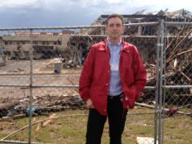
U.S. Insured Catastrophe Losses
($ Billions, $ 2012)
2012 was the third most expensive year ever for insured CAT losses
2012 Was the 3rd Highest Year on Record for Insured Losses in U.S. History on an Inflation-Adj. Basis. 2011 Losses Were the 6th Highest. YTD 2013 Running Well Below 2011 and 2012 YTD Totals.
Record tornado losses caused 2011 CAT losses to surge
*Through 8/31/13. Includes $9.7B for 2013:H1 (PCS) and $1.2B I.I.I. estimate for the period 7/1 – 8/31/13.
Note: 2001 figure includes $20.3B for 9/11 losses reported through 12/31/01 ($25.9B 2011 dollars). Includes only business and personal property claims, business interruption and auto claims. Non-prop/BI losses = $12.2B ($15.6B in 2011 dollars.)
Sources: Property Claims Service/ISO; Insurance Information Institute.
5
12/01/09 - 9pm
eSlide – P6466 – The Financial Crisis and the Future of the P/C
Notes:
5

Slide 6
ROE: Property/Casualty Insurance vs. Fortune 500, 1987–2013E*
(Percent)
P/C Profitability Is Both by
Cyclicality and Ordinary Volatility
Katrina, Rita, Wilma
Sandy
Sept. 11
Hugo
Lowest CAT Losses in
15 Years
4 Hurricanes
Andrew
Record Tornado Losses
Northridge
Financial Crisis*
* Excludes Mortgage & Financial Guarantee in 2008 – 2013E. 2013 P/C ROE is through 2013:Q2.
Sources: ISO, Fortune; Insurance Information Institute.

Slide 7
Combined Ratio Points Associated with Catastrophe Losses: 1960 – 2012*
Avg. CAT Loss Component of the Combined Ratio by Decade
1960s: 1.04 1970s: 0.85 1980s: 1.31 1990s: 3.39 2000s: 3.52 2010s: 7.20*
Catastrophe losses as a share of all losses reached a record high in 2012
Combined Ratio Points
The Catastrophe Loss Component of Private Insurer Losses Has Increased Sharply in Recent Decades
Notes: Private carrier losses only. Excludes loss adjustment expenses and reinsurance reinstatement premiums. Figures are adjusted for losses ultimately paid by foreign insurers and reinsurers.
Source: ISO (1960-2011); A.M. Best (2012E) Insurance Information Institute.

Slide 8
Homeowners Insurance Combined Ratio: 1990–2015F
Hurricane Andrew
Record tornado activity
Hurricane Sandy
Hurricane Ike
Homeowners Performance in 2011/12 Impacted by Large Cat Losses. Extreme Regional Variation Can Be Expected Due to Local Catastrophe Loss Activity
Sources: A.M. Best (1990-2012);Conning (2013E-2015F); Insurance Information Institute.

Slide 9
Reasons for US P/C Insurer Impairments, 1969–2010
Historically, Deficient Loss Reserves and Inadequate Pricing Are
By Far the Leading Cause of P-C Insurer Impairments.
Investment and Catastrophe Losses Play a Much Smaller Role
Reinsurance Failure
Sig. Change in Business
Misc.
Investment Problems (Overstatement of Assets)
Deficient Loss Reserves/
Inadequate Pricing
Affiliate Impairment
Catastrophe Losses
Alleged Fraud
Rapid Growth
Source: A.M. Best: 1969-2010 Impairment Review, Special Report, April 2011.

Slide 10
Top States by Inflation-Adjusted Insured Catastrophe Losses, 1983–2012
Over the Past 30 Years Florida Has Accounted for the Largest Share of Catastrophe Losses in the U.S., Followed by Texas and Louisiana
Louisiana
$42.0B
Texas
$48.8B
Rest of the U.S.
$309.9B
Florida
$66.7B
Total: $467.5 Billion, an average of $16.6B per year or $1.3B per month
Source: PCS unit of ISO, Verisk Company.; Insurance Information Institute.

Slide 11
Top 5 States by Insured Catastrophe Losses in 2012*
(2012, $ Billions)
NY and NJ led the country for privately insured CAT losses in 2012 due to Sandy
*Includes catastrophe losses of at least $25 million.
Sources: PCS unit of ISO; Insurance Information Institute.

Slide 12
Inflation Adjusted U.S. Catastrophe Losses by Cause of Loss, 1993–2012¹
Wind/Hail/Flood (3), $14.9
Fires (4), $6.5
Other (5), $0.2
Insured cat losses from 1993-2012 totaled $391.7B, an average of $19.6B per year or $1.6B per month
Geological Events, $18.4
Terrorism, $24.8
Winter Storms, $27.8
Hurricanes & Tropical Storms, $158.2
Tornado share of CAT losses is rising
Wind losses are by far cause the most catastrophe losses, even if hurricanes/TS are excluded.
Tornadoes (2), $140.9
Catastrophes are defined as events causing direct insured losses to property of $25 million or more in 2012 dollars.
Excludes snow.
Does not include NFIP flood losses
Includes wildland fires
Includes civil disorders, water damage, utility disruptions and non-property losses such as those covered by workers compensation.
Source: ISO’s Property Claim Services Unit.

Slide 13
Top 16 Most Costly Disasters in U.S. History
(Insured Losses, 2012 Dollars, $ Billions)
Hurricane Sandy could become the 4th or 5th costliest event in US insurance history
Includes Tuscaloosa, AL, tornado
Includes Joplin, MO, tornado
Hurricane Irene became the 12th most expense hurricane in US history in 2011
12 of the 16 Most Expensive Events in US History Have Occurred Over the Past Decade
*PCS estimate as of 4/12/13.
Sources: PCS; Insurance Information Institute inflation adjustments to 2012 dollars using the CPI.

Slide 14
Top 16 Most Costly World Insurance Losses, 1970-2012*
(Insured Losses, 2012 Dollars, $ Billions)
5 of the top 14 most expensive catastrophes in world history have occurred within the past 3 years (2010-2012)
2012 insured CAT Losses totaled $60B; Economic losses totaled $140B, according to Swiss Re
Hurricane Sandy is now the 6th costliest event in global insurance history
*Figures do not include federally insured flood losses.
**Estimate based on PCS value of $18.75B as of 4/12/13.
Sources: Munich Re; Swiss Re; Insurance Information Institute research.

Slide 15
Natural Disasters in the United States, 1980 – June 2013*
Number of Events (Annual Totals 1980 – June 2013*)
There were 68 natural disaster events in the first half of 2013
Number
41
19
121
3
Geophysical
(earthquake, tsunami,
volcanic activity)
Meteorological (storm)
Climatological
(temperature extremes,
drought, wildfire)
Hydrological
(flood, mass movement)
*Through June 30, 2013.
Source: MR NatCatSERVICE
15

Slide 16
Losses Due to Natural Disasters in the US, 1980–2013 (Jan.-June Only)
(Overall and Insured Losses)
(2012 Dollars, $ Billions)
First Half 2013 losses were running below 2011 and 2012 but were consistent with the decade prior. Approximately 57% of the overall cost of catastrophes in the US was covered by insurance in 2013:H1
Indicates a great deal of losses are uninsured (~40%-50% in the US). This gap is sometimes a breeding ground for disputes and litigation
2013 First Half Losses
Overall : $13.8B
Insured: $7.9B
Overall losses (in 2012 values)
Insured losses (in 2012 values)
Source: MR NatCatSERVICE
16

Slide 17
Hurricane Sandy: Average Claim Payment by Type of Claim
Commercial (i.e., business claims) are more expensive because the value of property is often higher as well as the impact of insured business interruption losses
The average insured flood loss was nearly 8 times larger than the average non-flood insured loss (mostly wind)
Commercial (Business) Claims Were Nearly Seven Times More Expensive than Homeowners Claims; Vehicle Claims Were Unusually Expensive Due to Extensive Flooding
*Includes rental and condo policies (excludes NFIP flood). **Preliminary as of May 14, 2013.
Sources: Catastrophe loss data is for Catastrophe Serial No. 90 (Oct. 28 – 31, 2012) from PCS as of March 2013; Insurance Information Institute.

Slide 18
Natural Disasters Worldwide,
1980 – 2013* (Number of Events)
There were 460 natural disaster events globally in the first half of 2013 and 905 for full-year 2012
Number
41
19
121
3
Geophysical
(earthquake, tsunami,
volcanic activity)
Meteorological (storm)
Climatological
(temperature extremes,
drought, wildfire)
Hydrological
(flood, mass movement)
*Through June 30, 2013.
Source: MR NatCatSERVICE
18

Slide 19
Losses Due to Natural Disasters Worldwide, 1980–2013* (Overall & Insured Losses)
(Overall and Insured Losses)
(2012 Dollars, $ Billions)
2012 Losses
Overall : $101.1B
Insured: $57.9B
2013: 1st Half Losses
Overall : $45B
Insured: $13B
There is a clear upward trend in both insured and overall losses over the past 30+ years
Overall losses (in 2012 values)
Insured losses (in 2012 values)
*Through June 30, 2013.
Source: MR NatCatSERVICE
19

Slide 20
Natural Disaster Losses in the United States: 2012
As of January 1, 2013 | Number of Events | Fatalities | Estimated Overall Losses (US $m) | Estimated Insured Losses (US $m)
Tropical Cyclone | 4 | 143 | 52,240 | 26,360
Severe Thunderstorm | 115 | 118 | 27,688 | 14,914
Drought | 2 | 0 | 20,000 | 16,000†
Wildfire | 38 | 13 | 1,112 | 595
Winter Storm | 2 | 7 | 81 | 38
Flood | 19 | 3 | 13 | 0††
TOTALS | 184 | 284 | $101,134 | $57,907
Source: MR NatCatSERVICE
† - Includes Federal Crop Insurance Losses. † † - Excludes federal flood.
20
Notes:
All data from NatCat Service

Slide 21
Natural Disaster Losses in the United States: First Half 2013
As of July 1, 2013 | Number of Events | Fatalities | Estimated Overall Losses (US $m) | Estimated Insured Losses (US $m)
Severe Thunderstorm | 29 | 66 | 10,180 | 6,325
Winter Storm | 13 | 17 | 2,434 | 1,255
Flood | 10 | 9 | 500 | Minor
Earthquake & Geophysical | 5 | 0 | Minor | Minor
Tropical Cyclone | 1 | 1 | Minor | Minor
Wildfire, Heat, & Drought | 11 | 23 | 700 | 365
Totals | 68 | 116 | 13,814 | 7,945
Source: MR NatCatSERVICE
21

Slide 22
Significant Natural Catastrophes, 2012
(Events with $1 billion economic loss and/or 50 fatalities)
Date | Event | Estimated Economic Losses (US $m) | Estimated Insured Losses (US $m)
June – Sept 2012 | Central US Drought | 20,000 | 16,000†
March 2 - 3 | Thunderstorms | 5,000 | 2,500
April 2 – 4 | Thunderstorms | 1,550 | 775
April 13- 15 | Thunderstorms | 1,800 | 910
April 28 – 29 | Thunderstorms | 4,500 | 2,500
May 25 – 30 | Thunderstorms | 3,400 | 1,700
June 6 – 7 | Thunderstorms | 1,400 | 1,000
June 11 – 13 | Thunderstorms | 1,900 | 950
June 28 – July 2 | Thunderstorms | 4,000 | 2,000
August 26 - 30 | Hurricane Isaac | 2,000 | 1,220
October 28 - 30 | Hurricane Sandy | 50,000 | 25,000††
Source: MR NatCatSERVICE
† - Includes Federal Crop Insurance Losses.; † † - Excludes NFIP losses.
22
22

Slide 23
Top 12 Most Costly Hurricanes in U.S. History
(Insured Losses, 2012 Dollars, $ Billions)
10 of the 12 most costly hurricanes in insurance history occurred over the past 9 years (2004—2012)
Hurricane Sandy became the 3rd costliest hurricane in US insurance history
Hurricane Irene became the 12th most expensive hurricane in US history in 2011
*PCS estimate as of 4/12/13.
Sources: PCS; Insurance Information Institute inflation adjustments to 2012 dollars using the CPI.

Slide 24
Total Value of Insured Coastal Exposure in 2012
(2012, $ Billions)
The value of insured coastal exposure in NY is now highest in the US for the first time.
In 2012, New York Ranked as the #1 Most
Exposed State to Hurricane Loss, Overtaking Florida with $2.862 Trillion. Texas is very exposed too, and ranked #3 with $1.175 Trillion
in insured coastal exposure
The Insured Value of All Coastal Property Was $10.6 Trillion in 2012 , Up 20% from $8.9 Trillion in 2007 and Up 48% from $7.2 Trillion in 2004
Source: AIR Worldwide

Slide 25
Total Value of Insured Coastal Exposure in 2007
(2007, $ Billions)
In 2007, Florida Still Ranked as the #1 Most
Exposed State to Hurricane Loss, with
$2.459 Trillion Exposure, but Texas is very exposed too, and ranked #3 with $895B
in insured coastal exposure
The Insured Value of All Coastal Property Was $8.9 Trillion in 2007, Up 24% from $7.2 Trillion in 2004
Source: AIR Worldwide

Slide 26
Total Potential Home Value Exposure to Storm Surge Risk in 2013*
($ Billions)
Florida is by the state most vulnerable to storm surge.
The Value of Homes Exposed to Storm Surge was $1.147 Trillion in 2013.* Only a fraction of this is insured, hence the huge demand for federal aid following major coastal flooding events.
*Insured and uninsured property. Based on estimated property values as of April 2013.
Source: Storm Surge Report 2013, CoreLogic.

Slide 27
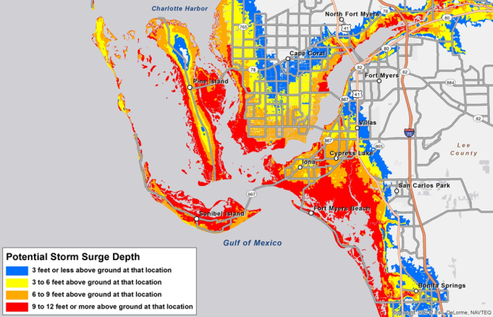
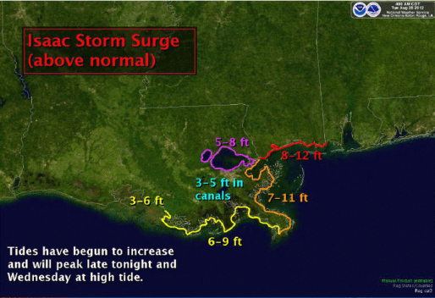

Storm Surge Inundation Graphic
NHC shooting for mid-season for deployment. First of many ways of distributing storm-surge forecasts.

Slide 28
The combined ratios for both personal and commercial lines improved substantially in 2013:H1

Slide 30
Convective Loss Events in the U.S.
Number of events 1980 – 2012 and First Half 2013
Number
The frequency of convective events has rising tremendously over the past 30+ years
Convective events are those caused by straight-line winds, tornadoes, hail, heavy precipitation, flash floods and lightning
Source: Geo Risks Research, NatCatSERVICE – As at July 2013
30

Slide 31
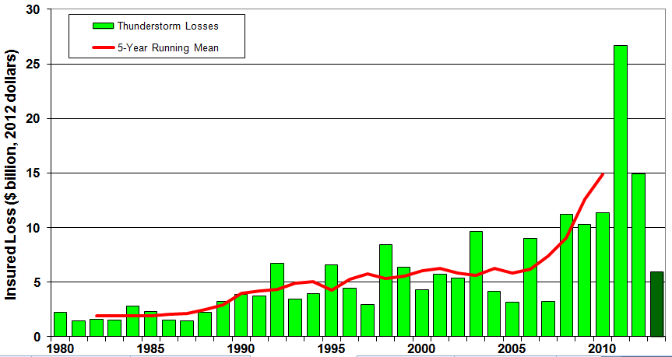
U.S. Thunderstorm Loss Trends, 1980 – June 30, 2013
Hurricanes get all the headlines, but thunderstorms are consistent producers of large scale loss. 2008-2012 are the most expensive years on record.
Average thunderstorm losses are up 7 fold since the early 1980s. The 5- year running average loss is up sharply.
1st Half 2013 thunderstorm losses total $6.325B; The system that included the EF-5 tornado in Moore, OK, accounted for $1.575B
Source: Property Claims Service, MR NatCatSERVICE
31

Slide 32
Convective Loss Events in the U.S.
Overall and insured losses 1980 – 2012 and First Half 2013
(Bill. US$)
The insured and total economic cost of convective events has rising tremendously over the past 30+ years
Convective events are those caused by straight-line winds, tornadoes, hail, heavy precipitation, flash floods and lightning
Analysis contains: straight-line winds, tornadoes, hail, heavy precipitation, flash floods, lightning.
Overall losses (in 2012 values)
Insured losses (in 2012 values)
Source: Geo Risks Research, NatCatSERVICE – As at July 2013
32

Slide 33
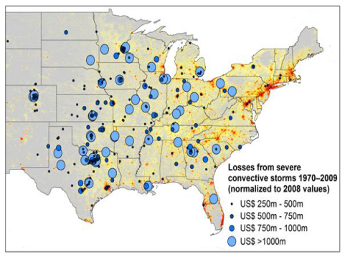
New Research Suggests Increase in Convective Activity Is Costly for Insurers
Study examines convective (hail, tornado, thundersquall and heavy rainfall) events in the US with losses exceeding US$ 250m in the period 1970–2009 (80% of all losses)
Past losses are normalized (i.e., adjusted) to currently exposed values
After normalization there are still increases of losses
Increases are correlated with
the increase in the meteorological
potential for severe thunderstorms
and its variability
For the first time research shows
that climatic changes have already
influenced US thunderstorm losses
Source: Munich Re research paper, Marhc 18, 2013: Rising Variability in Thunderstorm-Related U.S. Losses as a Reflection of Changes in Large-Scale Thunderstorm Forcing.
33

Slide 34
Hurricane Sandy Summary
Sandy Became One of the Most Expensive Events in Insurance History
34
Notes:
34

Slide 35
Sandy Summary
Issues Related to Hurricane Deductible Triggers
  Situation was quickly politicized as governors in several states declared that Sandy was not a hurricane and therefore hurricane deductibles did not apply
  Many reporting requirements; Sometimes conflicting; Short timelines
  Publishing of data online that was intended for internal DOI use
Possible Future Emulation of NY/NJ Actions in Other States
Wind vs. Water Issue Resurfaced
Dissatisfaction with FEMA/NFIP
Adjuster Deadlines Shortened
High Profile of Politicians and Promises of Massive Government Aid Are Deterring Purchases of Private Sector Insurance
  Overreliance on government aid frequently results in frustration, disappointment and can contribute litigation

Slide 36
Hurricane Sandy: Claim Payments to Policyholders, by State
($ Thousands)
TOTAL = $18.75 BILLION
At $9.6B and $6.6B, respectively, NY and NJ suffered, by far, the largest losses from Hurricane Sandy
Insurers Will Pay at Least $18.75 Billion to 1.52 Million Policyholders Across 15 States and DC in the Wake of Hurricane Sandy
Sources: Catastrophe loss data is for Catastrophe Serial No. 90 (Oct. 28 – 31, 2012) from PCS as of Jan. 18, 2013; Insurance Information Institute .

Slide 37
Hurricane Sandy: Number of Claims
by Type*
Total Claims = 1.52 Million*
Hurricane Sandy resulted in an estimated 1.52 million privately insured claims resulting in an estimated $18.75 to $25 billion in insured losses. Hurricane Katrina produced 1.74 million claims and $48.7B in losses (in 2012 $)
Sandy is a high HO frequency, (relatively low) severity event (avg. severity <50% Katrina)
*PCS claim count estimate s as of 1/18/13. Loss estimate represents PCS total ($18.75B) and upper end of range estimates by risk modelers RMS, Eqecat and AIR. All figures exclude losses paid by the NFIP.
Source: PCS; AIR, Eqecat, AIR Worldwide; Insurance Information Institute.

Slide 38
Hurricane Sandy: Insured Loss by
Claim Type* ($ Millions)
Total Claim Value = $18.75 Billion*
Although Commercial Lines accounted for only 13% of total claims, they account for 48% of all claim dollars paid. In most hurricanes, Commercial Lines accounts for about 1/3 of insured losses.
*PCS insured loss estimates as of 1/18/13. Catastrophe modeler estimates range up to $25 billion. All figures exclude losses paid by the NFIP.
Source: PCS; Insurance Information Institute.

Slide 39
U.S. Insured Catastrophe Losses by Cause of Loss, 2011 ($ Millions)
Wildfires, $855
Flood , $535, (1.5%)
Other, $1,000
Geological Events, $50, (0.1%)
Winter Storms, $2,017
Hurricanes & Tropical Storms, $5,510
Thunderstorm/ Tornado losses were 2.5 times above the 30-year average
Thunderstorms (Incl. Tornadoes , $25,813
2011’s insured loss distribution was unusual with tornado and thunderstorm accounting for the vast majority of loss
.
Source: ISO’s Property Claim Services Unit, Munich Re; Insurance Information Institute.

Slide 40
Inflation Adjusted U.S. Catastrophe Losses by Cause of Loss, 1992–2011¹
Wind/Hail/Flood (3), $14.8
Fires (4), $6.0
Other (5), $1.4
Insured cat losses from 1992-2011 totaled $384.3B, an average of $19.2B per year or $1.6B per month
Geological Events, $18.2
Terrorism, $24.4
Winter Storms, $28.2
Hurricanes & Tropical Storms, $161.3
Tornado share of CAT losses is rising
Wind losses are by far cause the most catastrophe losses, even if hurricanes/TS are excluded.
Tornadoes (2), $130.2
Catastrophes are defined as events causing direct insured losses to property of $25 million or more in 2009 dollars.
Excludes snow.
Does not include NFIP flood losses
Includes wildland fires
Includes civil disorders, water damage, utility disruptions and non-property losses such as those covered by workers compensation.
Source: ISO’s Property Claim Services Unit.

Slide 41
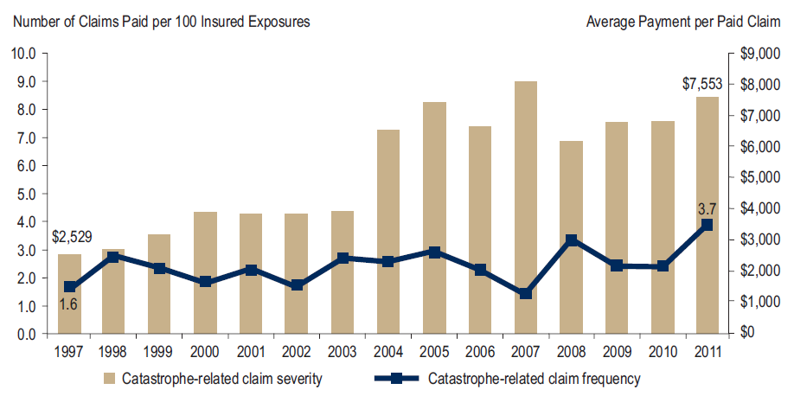
Homeowners Insurance Catastrophe-Related Claim Frequency and Severity, 1997—2012*
Avg. catastrophe claim cost rose approximately 200% from 1997-2011
Cat claim frequency in 2011 was at historic highs and more than double the rate in 1997
*All policy forms combined, countrywide.
Source: Insurance Research Council, Trends in Homeowners Insurance Claims, Sept. 2012 from ISO Fast Track data.
41

Slide 42
Combined Ratio Points Associated with Catastrophe Losses: 1960 – 2012*
Avg. CAT Loss Component of the Combined Ratio by Decade
1960s: 1.04 1970s: 0.85 1980s: 1.31 1990s: 3.39 2000s: 3.52 2010s: 7.20*
Catastrophe losses as a share of all losses reached a record high in 2012
Combined Ratio Points
The Catastrophe Loss Component of Private Insurer Losses Has Increased Sharply in Recent Decades
Notes: Private carrier losses only. Excludes loss adjustment expenses and reinsurance reinstatement premiums. Figures are adjusted for losses ultimately paid by foreign insurers and reinsurers.
Source: ISO (1960-2011); A.M. Best (2012E) Insurance Information Institute.

Slide 43
Homeowners Insurance Combined Ratio: 1990–2015F
Hurricane Andrew
Record tornado activity
Hurricane Sandy
Hurricane Ike
Homeowners Performance in 2011/12 Impacted by Large Cat Losses. Extreme Regional Variation Can Be Expected Due to Local Catastrophe Loss Activity
Sources: A.M. Best (1990-2011);Conning (2012E-2015F); Insurance Information Institute.

Slide 44
Federal Disaster Declarations Patterns: 1953-2013
Disaster Declarations Set New Records in Recent Years
44

Slide 45
Number of Federal Disaster Declarations, 1953-2013*
There have been 2,142 federal disaster declarations since 1953. The average number of declarations per year is 35 from 1953-2012, though there few haven’t been recorded since 1995.
The number of federal disaster declarations set a new record in 2011, with 99, shattering 2010’s record 81 declarations.
53 federal disasters were declared so far in 2013*
The Number of Federal Disaster Declarations Is Rising and Set New Records in 2010 and 2011. Hurricane Sandy Produced 13 Declarations in 2012/13.
*Through December 4, 2013.
Source: Federal Emergency Management Administration; http://www.fema.gov/disasters; Insurance Information Institute.

Slide 46
Federal Disasters Declarations by State,
1953 – 2013: Highest 25 States*
Over the past 60 years, Texas has had the highest number of Federal Disaster Declarations
*Through Dec. 4, 2013. Includes Puerto Rico and the District of Columbia.
Source: FEMA: http://www.fema.gov/news/disaster_totals_annual.fema; Insurance Information Institute.

Slide 47
Federal Disasters Declarations by State,
1953 – 2013: Lowest 25 States*
Over the past 60 years, Wyoming and Rhode Island had the fewest number of Federal Disaster Declarations
*Through Dec. 4, 2013. Includes Puerto Rico and the District of Columbia.
Source: FEMA: http://www.fema.gov/news/disaster_totals_annual.fema; Insurance Information Institute.

Slide 48
SEVERE WEATHER REPORT UPDATE: 2013
Damage from Tornadoes, Large Hail and High Winds Keep Insurers Busy
48

Slide 49
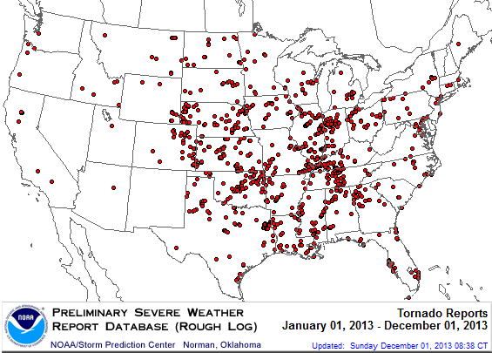
Location of Tornado Reports:
Through December 1, 2013
A deadly EF-5 tornado in May in Moore, OK, produced insured losses of $1.575 billion. November tornadoes in the Midwest like produced $1B in insured losses.
There were 926 tornadoes through Dec. 1, causing extensive property damage in several states
Source: NOAA Storm Prediction Center; http://www.spc.noaa.gov/climo/online/monthly/2013_annual_summary.html#; PCS.
49

Slide 50
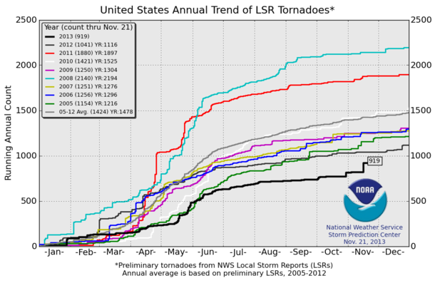
U.S. Tornado Count, 2005-2013*
There were 1,897 tornadoes in the U.S. in 2011 far above average, but well below 2008’s record
2013 count is running well below average
*Through November 21, 2013.
Source: http://www.spc.noaa.gov/wcm/.
50

Slide 51
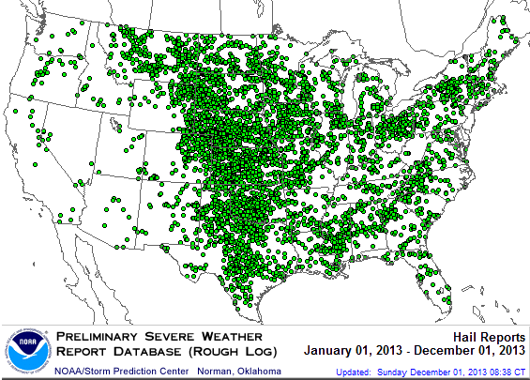
Location of Large Hail Reports:
Through December 1, 2013
There were 5,456 “Large Hail” reports through Dec. 1, causing extensive property and vehicle damage
Source: NOAA Storm Prediction Center; http://www.spc.noaa.gov/climo/online/monthly/2013_annual_summary.html#
51

Slide 52
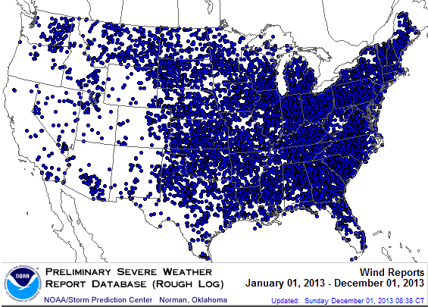
Location of High Wind Reports:
Through December 1, 2013
There were 12,611 “Wind Damage” reports through Dec. 1, causing extensive property damage
Source: NOAA Storm Prediction Center; http://www.spc.noaa.gov/climo/online/monthly/2013_annual_summary.html#
52

Slide 53
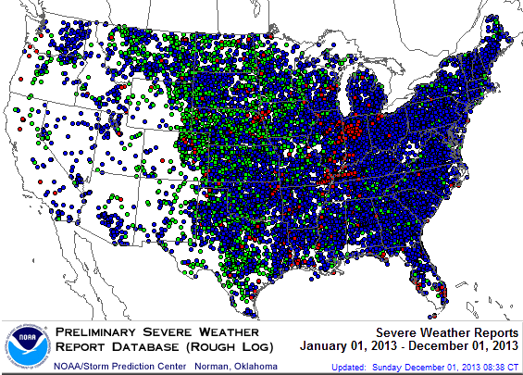
Severe Weather Reports:
Through December 1, 2013
Severe weather reports are concentrated east of the Rockies
There were 18,994 severe weather reports through Dec. 1; including 926 tornadoes; 5,456 “Large Hail” reports and 12,611 high wind events
Source: NOAA Storm Prediction Center; http://www.spc.noaa.gov/climo/online/monthly/2013_annual_summary.html#
53

Slide 54
Public Opinion Survey
Disaster Preparedness Issues
54
Notes:
54

Slide 55
I.I.I. Poll: Homeowners Insurance
Q. Do you think that it is fair that people who live in areas affected by record storms in 2011 and 2012 should pay more for their homeowners insurance in the future?
Don’t know
Public believes it is not fair to raise premiums of homeowners due to events they cannot control
No
Yes
Nearly 60 percent of Americans believe that homeowners insurance premiums should not be raised as a result of recent storms in their areas.
Source: Insurance Information Institute Annual Pulse Survey.

Slide 56
I.I.I. Poll: Flood Insurance
Q. The federal government plans to raise the price of flood insurance so it reflects the costs of paying claims. Do you believe this is fair?
[% Responding “NO”]
Most people believe it is unfair for government to raise flood insurance premiums, even though they are subsidized by taxpayers
More than one-half of Americans do not think it is fair for the federal government to raise its flood insurance premiums to better reflect claims payouts.
Source: Insurance Information Institute Annual Pulse Survey.

Slide 57
I.I.I. Poll: Disaster Preparedness
Q. Does your homeowners policy cover damage from flooding during a hurricane?¹
About 20 percent of the public still believes flooding from a hurricane is covered
The proportion of homeowners who believe their homeowners policy covers damage from flooding during a hurricane stands at 21 percent. This proportion rises eight percentage points in the South, to 29 percent.
¹Asked of those who have homeowners insurance and who responded “yes”.
Source: Insurance Information Institute Annual Pulse Survey.

Slide 58
I.I.I. Poll: Disaster Preparedness
Q. Have recent flooding events such as Hurricane Sandy or Hurricane Irene motivated you to buy flood coverage?¹
Despite recent major flood events, few people see the need to buy coverage
Recent storms have not motivated people to buy flood insurance coverag.e
¹Asked of those who have homeowners insurance but not flood insurance.
Source: Insurance Information Institute Annual Pulse Survey.

Slide 59
I.I.I. Poll: Disaster Preparedness
Q. If you expect some relief from the government, do you purchase less insurance coverage against these natural disasters than you would have otherwise?
Don’t know
Yes
More than 20 percent cut back on insurance coverage in expectation of government disaster aid
No
Seventy-two percent of Americans would not purchase less insurance if they expect some relief from the government—but 22% would.
Source: Insurance Information Institute Annual Pulse Survey.

Slide 60
Terrorism Update
Boston Marathon Bombings Underscore the Need for Extension of the Terrorism Risk Insurance Program
Download III’s Terrorism Insurance Report at: http://www.iii.org/white_papers/terrorism-risk-a-constant-threat-2013.html
60
Notes:
60

Slide 61
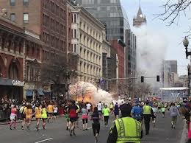
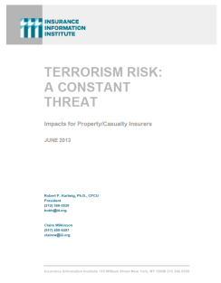
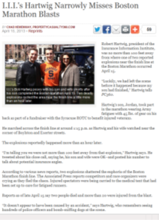
Terrorism Risk Insurance Program
Reauthorization Was a Major Industry Initiative for 2013 Even Before Boston
I.I.I. Testified at First Congressional Hearing on 9/11/12
  Provided testimony at NYC hearing on 6/17/13
I.I.I. Accelerated Planned Study on Terrorism Risk and Insurance in the Wake of Boston and Was Well Received
  Terrorism: A Constant Threat issued in June 2013
61
12/01/09 - 9pm
eSlide – P6466 – The Financial Crisis and the Future of the P/C
Notes:
61

Slide 62
Terrorism Risk Insurance Program
Boston Marathon Bombing Has Helped Focus Attention in Congress on TRIPRA and its Looming Expiration
  Act expires 12/31/14
  Exclusionary language will likely be inserted for post-1/1/2014 renewals and will likely lead to significant media interest (educational opportunity)
  Numerous headwinds; not a priority issue in 2013 in Congress
  3 extension bills introduced in 2013—2 since Boston
Media Interest Soared
  I.I.I. was conducting its first interviews within minutes after live-tweeting (nearly) from the scene; TV interest was high
  Local, national and international media focused on this topic for the first time in any significant way since TRIA’s inception in late 2002
  Inquiries revealed very little/no understanding (or even awareness) outside insurance industry and business owners
  Certification process caused confusion
62
12/01/09 - 9pm
eSlide – P6466 – The Financial Crisis and the Future of the P/C
Notes:
62

Slide 63
Loss Distribution by Type of Insurance from Sept. 11 Terrorist Attack ($ 2011)
($ Billions)
Total Insured Losses Estimate: $40.0B**
*Loss total does not include March 2010 New York City settlement of up to $657.5 million to compensate approximately 10,000 Ground Zero workers or any subsequent settlements.
**$32.5 billion in 2001 dollars.
Source: Insurance Information Institute.

Slide 64
TRIA Outlook
Difficult Reauthorization Battle Ahead
  Very difficult to overcome antigovernment/small government, Tea Party forces in the House
  Most Committee members in both houses weren’t around in 2007
House Hearings in 2012; House and Senate in late 2013
If Reauthorized, Insurer Participation Likely Increased
Some Have Attacked TRIA as “Corporate Welfare”
  In reality the taxpayer is 100% protected
  NFIP, Crop programs have led to miscomprehensions
Emphasizing Benefits to Employees Under WC is Key
Misperception by Some that Terrorism is Urban Issue
Growth Opportunity: Standalone Cover if No Reauthorization
  Though limited capacity will not be sufficient to meet need

Slide 65
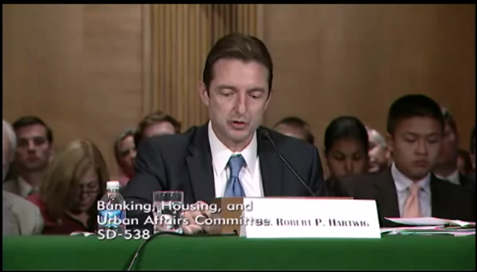
I.I.I. TRIA Testimony Before US Senate Banking Committee (Sept. 25, 2013)
Robert Hartwig, Future of TRIA Program, U.S. Senate Banking Committee

Slide 66
Terrorism Insurance Take-up Rates,
By Year, 2003-2012
Take-up rates for smaller commercial risks are lower—potentially very low in some areas and industries
In 2003, the first year TRIA was in effect, the terrorism take-up rate was 27 percent. Since then, it has increased steadily, remaining in the low 60 percent range since 2009.
Source: Marsh Global Analytics, 2013 Terrorism Risk Insurance Report, May 2013.
66
Notes:
66

Slide 67
Pyramid of Taxpayer Protection:
Strong, Stable, Sound and Secure
If TRIA is reauthorized, it is highly likely insurer retentions will be increased
Hard Cap
$100 Bill
Government Recoupment
Industry Aggregate
Retention: $27.5 Bill
Insurer Co-Payments
15% Above Retention
Individual Insurer Retention
20% of Premiums Earned
Program Dollar Threshold
$100 Million
Certification Dollar Threshold
$5 Million
Certification of Terrorist Act: Definition Must Be Met

Slide 68
Summary of Terrorism Risk Insurance Program Extension Bills Introduced in 2013
Bill | Summary
H.R. 508: “Terrorism Risk Insurance Act of 2002 Reauthorization Act of 2013” Introduced Feb. 5 by Rep. Michael Grimm (D-NY) | 5-Year Extension (through 2019) Extend recoupment period for any TRIA assistance from 2017 to 2019
H.R. 2146: “Terrorism Risk Insurance Program Reauthorization Act of 2013” Introduced May 23 by Rep. Michael Capuano (D-MA) | 10-Year Extension (through 2024) Extend recoupment period for any TRIA assistance from 2017 to 2024 Requires President’s Working Group on Financial Markets (PWGFM) to issue reports on long-term availability and affordability of terrorism insurance in 2017, 2020 and 2023 Reports to be drafted with consultation from NAIC and representatives of the insurance and securities industries and policyholders
H.R. 1945: “Fostering Resilience to Terrorism Act of 2013” Introduced May 9 by Rep. Benny Thompson (D-MS) | 10-Year Extension (through 2024) Recoupment period changed to 2024 Would transfer responsibility for certification of a “act of terrorism” to the Secretary of Homeland Security from Secretary of Treasury. PWGFM to issue reports in 2017, 2020 and 2023 Requires Sec. of DHS to provide insureds with “timely homeland security information, including terrorism risk information, at the appropriate level of classification and information on best practices to foster resilience to an act of terrorism.”
Source: Nelson, Levine, de Luca & Hamilton, FIO Focus, June 10, 2013; Insurance Information Institute.

Slide 69
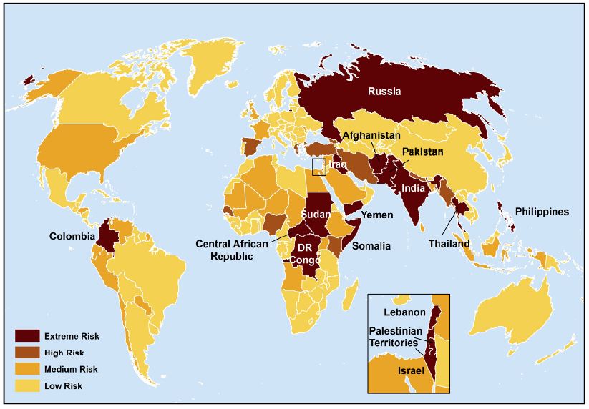
Terrorist Risk Index
The threat of terrorism is highest in South Asia, Russia, the Middle East and Central and East Africa
The US is still considered to be at “Medium Risk” for a terrorist attack
Sources: Maplecroft Terrorism Risk Index; (2011); Guy Carpenter; Insurance Information Institute.

Slide 70
Terrorism Violates Traditional Requirements for Insurability
Requirement | Definition | Violation
Estimable Frequency | Insurance requires large number of observations to develop predictive rate-making models (an actuarial concept known as credibility) | Very few data points Terror modeling still in infancy, untested. Inconsistent assessment of threat
Estimable Severity | Maximum possible/ probable loss must be at least estimable in order to minimize “risk of ruin” (insurer cannot run an unreasonable risk of insolvency though assumption of the risk) | Potential loss is virtually unbounded. Losses can easily exceed insurer capital resources for paying claims. Extreme risk in workers compensation and statute forbids exclusions.
Source: Insurance Information Institute

Slide 71
Terrorism Violates Traditional Requirements for Insurability (cont’d)
Requirement | Definition | Violation
Diversifiable Risk | Must be able to spread/distribute risk across large number of risks “Law of Large Numbers” helps makes losses manageable and less volatile | Losses likely highly concentrated geographically or by industry (e.g., WTC, power plants)
Random Loss Distribution/Fortuity | Probability of loss occurring must be purely random and fortuitous Events are individually unpredictable in terms of time, location and magnitude | Terrorism attacks are planned, coordinated and deliberate acts of destruction Dynamic target shifting from “hardened targets” to “soft targets” Terrorist adjust tactics to circumvent new security measures Actions of US and foreign govts. may affect likelihood, nature and timing of attack
Source: Insurance
Information Institute

Slide 72
Manmade Disasters &
The Tort Environment
The Lessons of Deepwater Horizon
72

Slide 73
Over the Last Three Decades, Total Tort Costs as a % of GDP Appear Somewhat Cyclical, 1980-2013E
($ Billions)
2.21% of GDP in 2003 = pre-tort reform peak
Deepwater Horizon Spike in 2010
Tort costs in dollar terms have remained high but relatively stable since the mid-2000s., but are down substantially as a share of GDP
1.68% of GDP in 2013
Sources: Towers Watson, 2011 Update on US Tort Cost Trends, Appendix 1A

Slide 74
Business Leaders Ranking of Liability Systems in 2012
Best States
Delaware
Nebraska
Wyoming
Minnesota
Kansas
Idaho
Virginia
North Dakota
Utah
Iowa
Worst States
Florida
Oklahoma
Alabama
New Mexico
Montana
Illinois
California
Mississippi
Louisiana
West Virginia
New in 2012
Wyoming
Minnesota
Kansas
Idaho
Newly Notorious
Oklahoma
Drop-offs
Rising Above
Indiana
Colorado
Massachusetts
South Dakota
Arkansas
Source: US Chamber of Commerce 2012 State Liability Systems Ranking Study; Insurance Info. Institute.

Slide 75
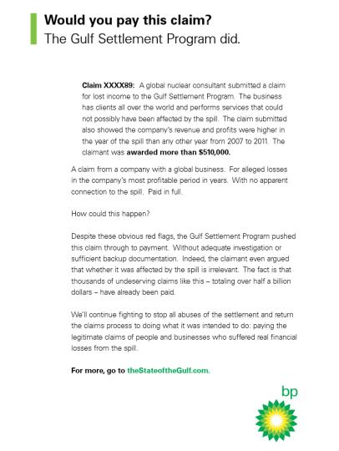
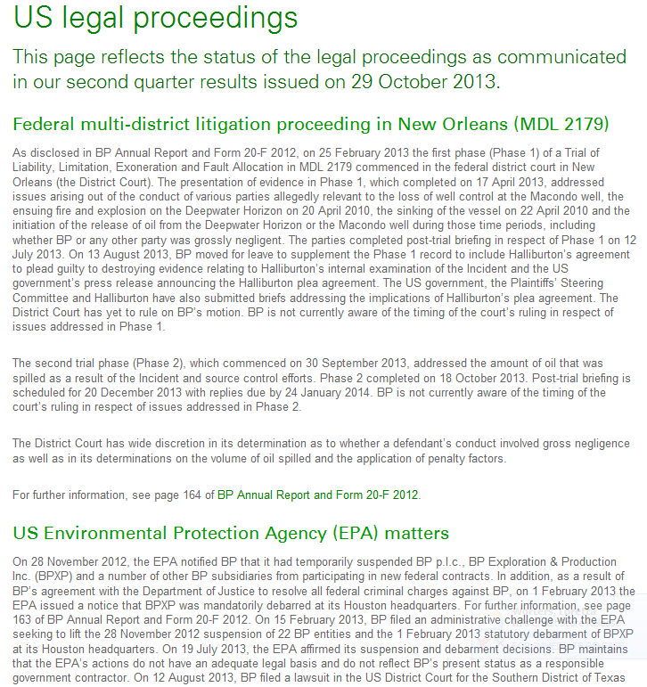
BP: Deepwater Settlement Process is Rife with Fraud and Abuse
BP is sparing no expense to fight what they view as fraud and abuse in Deepwater Horizon settlement litigation.
Sources: Full page ads in the Wall Street Journal and New York Times, Dec. 11, 2013 .
Sources: http://www.bp.com/en/global/corporate/gulf-of-mexico-restoration/investigations-and-legal-proceedings/US-legal-proceedings.html extracted Dec. 11, 2013; Insurance Information Institute.
75

Slide 76
Insurance Information Institute Online:
www.iii.org
Thank you for your time
and your attention!
Twitter: twitter.com/bob_hartwig
Download at www.iii.org/presentations

