Slide 1
Regulatory Expansion:
The Impact of Dodd-Frank’s Insurance Regulations
Chief Claims Officer Summit
Philadelphia, PA
September 9, 2013
Steven N. Weisbart, Ph.D., CLU, Senior Vice President & Chief Economist
Insurance Information Institute ♦ 110 William Street ♦ New York, NY 10038
Office: 212.346.5540 ♦ Cell: (917) 494-5945 ♦ stevenw@iii.org ♦ www.iii.org

Slide 2
Presentation Outline
The Federal Insurance Office
The Financial Stability Oversight Council
The Consumer Financial Protection Bureau
The Office of Financial Research
Dodd-Frank and Insurance: The Years Ahead
Insurance Industry Financial Strength
Q & A

Slide 3
The Federal Insurance Office (FIO)
3

Slide 4

The Federal Insurance Office (FIO)
Organization
  in the Department of Treasury, under the Office of Domestic Finance, under the Office of Financial Institutions
  Headed by a Director who is appointed by the Secretary of Treasury
    Currently Michael T. McRaith (formerly Director of Illinois Department of Insurance)
      Took office on June 1, 2011
    Small staff (6 people as of May 1, 2013); McRaith has said he expects to have 10-15
Sources: Insurance Information Institute (I.I.I.) updates and research; The Financial Services Roundtable; Adapted from summary by Dewey & LeBoeuf LLP; and http://www.treasury.gov/initiatives/fsoc/about/council/Pages/michael_mcraith.aspx

Slide 5
Authority of the Federal Insurance Office (FIO)
  Monitor all aspects of the insurance industry, identify regulatory gaps that could contribute to a systemic crisis in the insurance industry or the U.S. financial system,
  Monitor access to affordable insurance for traditionally underserved communities and consumers, minorities and low- and moderate income persons,
  Recommend to the Financial Stability Oversight Council that it designate an insurer as an entity subject to regulation as a nonbank financial company to be supervised by the Board of Governors of the Federal Reserve System [a SIFI],
  Coordinate federal efforts and develop federal policy on prudential aspects of international insurance matters, including representing the United States in the IAIS, and assisting the [Treasury] Secretary in negotiating covered agreements, and
  Consult with States regarding insurance matters of national importance and prudential insurance matters of international importance.
Sources: http://www.treasury.gov/initiatives/fio/reports-and-notices/Documents/FIO%20Annual%20Report%202013.pdf ; Insurance Information Institute

Slide 6
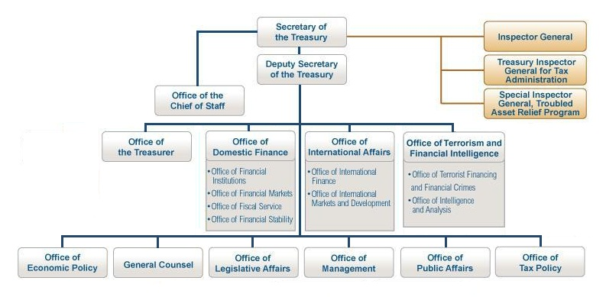
The Office of Domestic Finance
in the U.S. Treasury Department
FIO reports to this office

Slide 7
FIO within the Office of Domestic Finance in the U.S. Treasury Department
Assistant Secretary, Financial Institutions
Under Secretary, Domestic Finance
Deputy Assistant Secretary, Financial Institutions Policy
FIO & TRIA admin

Slide 8
The Federal Insurance Office (FIO)
Action Roles
  To represent the United States on prudential aspects of international insurance matters, including at the International Association of Insurance Supervisors
  To assist the Secretary [of the Treasury] with administration of the Terrorism Risk Insurance Program
  May require, via subpoenas, that insurers submit data (except small insurers)
Sources: Insurance Information Institute (I.I.I.) updates and research; The Financial Services Roundtable; Adapted from summary by Dewey & LeBoeuf LLP; and http://www.treasury.gov/initiatives/fsoc/about/council/Pages/michael_mcraith.aspx

Slide 9
The Federal Insurance Office (FIO)
Reports to the President and Congress
  Required annually
    State of the Insurance Industry
      Under Dodd-Frank, FIO’s First Annual Report was due January 21, 2012
        It was released on June 12, 2013.
    FIO actions taken regarding pre-emption of inconsistent state insurance measures
      First report, for FY 2012: FIO took no actions
  One-time
    Report to Congress on the current state of the market for natural catastrophe insurance in the United States.
      required by the Biggert-Waters Flood Insurance Reform Act of 2012
Sources: Insurance Information Institute (I.I.I.) updates and research; The Financial Services Roundtable; Adapted from summary by Dewey & LeBoeuf LLP; and http://www.treasury.gov/initiatives/fsoc/about/council/Pages/michael_mcraith.aspx

Slide 10
The FIO’s First Annual Report on the Insurance Industry
Covers Life/Annuity and Property/Casualty sectors but (mainly) not Health insurers
20-page section contains very general descriptions of financial characteristics of the L/A and P/C sectors, mainly for 2008-2012
  generally says they took hits during the recession but are recovering now
Report also has short descriptive sections on insurer impairments, distribution channels, and reinsurance
Report briefly describes 4 “current issues & emerging trends”
  Impact of low interest rates
  Natural catastrophes
  Changing U.S. demographics
  Growth opportunities in emerging markets
Sources: http://www.treasury.gov/initiatives/fio/reports-and-notices/Documents/FIO%20Annual%20Report%202013.pdf ; Insurance Information Institute

Slide 11
The FIO’s First Annual Report on the Insurance Industry (cont’d)
Report devotes 3 pages to a summary of recent changes in state regulation of insurance
Report only implicitly identifies “gaps” in state regulation
  For example, it describes the importance of enhanced group supervision of insurer holding companies and
  notes that, as of April 2013, only 14 states have enacted the NAIC’s amended [in 2010] Model Insurance Holding Company Act*
    But it makes no recommendation regarding the other states or the system of regulation overall
*Actually, as of the NAIC’s Spring 2013 meeting, 15 states and Puerto Rico had adopted the amended Model Act—California, Connecticut, Idaho, Indiana, Kansas, Kentucky, Louisiana, Maryland, Mississippi, Nebraska, Pennsylvania, Rhode Island, Texas, West Virginia, and Wyoming. Also, New York has issued a regulation that includes some aspects of the amended Model Act.
Sources: http://www.treasury.gov/initiatives/fio/reports-and-notices/Documents/FIO%20Annual%20Report%202013.pdf ; http://www.willkie.com/files/tbl_s29Publications%5CFileUpload5686%5C4365%5CNAIC_Report_2013_Spring_National_Meeting1.pdf ; Insurance Information Institute

Slide 12
Hurricane Sandy Rebuilding Strategy Task Force Recommendations: The FIO’s Role
Assist the Department of Homeland Security (DHS) in encouraging and promoting
  IBHS FORTIFIED home programs and Resilience STAR development standards*
Work with HUD and FEMA to analyze the affordability of flood insurance and the impact of rate increases on economically-distressed households
Support FEMA in its efforts to reduce consumer confusion regarding flood risk and insurance coverage
Notes that the BW-12 report deadline was missed because of a “dearth of data”
    Report says just “scoping the study” will take 2 years.
*IBHS is the Insurance Institute for Business and Home Safety. FORTIFIED is a construction program developed by IBHS. Resilience STAR is a designation developed by DHS for homes designed and constructed to be resilient to natural disasters.
Source: Nelson, Levine, de Luca, & Hamilton, FIO Focus, August 23, 2013, at nldhpublications@nldhlaw.com

Slide 13
The Financial Stability
Oversight Council (FSOC)
13

Slide 14
10 Voting Members of the FSOC
the Secretary of the Treasury, who serves as the Chairperson of the Council;
the Chairman of the Board of Governors of the Federal Reserve System;
the Comptroller of the Currency (OCC);
the Director of the Bureau of Consumer Financial Protection (CFPB);
the Chairman of the Securities and Exchange Commission (SEC);
the Chairperson of the Federal Deposit Insurance Corporation (FDIC);
the Chairperson of the Commodity Futures Trading Commission (CFTC);
the Director of the Federal Housing Finance Agency (FHFA);
the Chairman of the National Credit Union Administration (NCUA); and
an independent member with insurance expertise who is appointed by the President and confirmed by the Senate for a six-year term. Currently, this is Roy Woodall, formerly Kentucky Insurance Commissioner

Slide 15
5 Nonvoting (Advisory)
Members of the FSOC
the Director of the Office of Financial Research; currently Richard Berner, confirmed in January 2013 to serve a six-year term as the first Director of OFR. [OFR is in the Treasury Department.] Before joining the OFR, Berner was a Managing Director, Co-Head of Global Economics and Chief U.S. Economist at Morgan Stanley.
the Director of the Federal Insurance Office; currently Michael McRaith
      a state insurance commissioner designated by the state insurance commissioners; currently John Huff of Missouri; however, he is not allowed to brief fellow state insurance regulators on FSOC discussions
a state banking supervisor designated by the state banking supervisors; and
a state securities commissioner(or officer performing like functions) designated by the state securities commissioners.
The state insurance commissioner, state banking supervisor, and state securities commissioner serve two-year terms.

Slide 16
FSOC Can Designate Insurers as Systemically Important
Designation means the insurer (or its holding company) could be a threat to the stability of the U.S. financial system
  Designation requires 2/3 of FSOC members to vote yes, including Treasury Secretary
    Note: only 1 of 10 FSOC voters has insurance expertise
  Imposes new regulation by the Federal Reserve
Sources: http://www.treasury.gov/initiatives/fio/reports-and-notices/Documents/FIO%20Annual%20Report%202013.pdf ; Insurance Information Institute

Slide 17
SIFI Designation Protocol
All banks with assets > $50B are deemed Systemically Important
Non-bank financial groups (such as insurers) with global consolidated assets > $50B will be examined for Systemic Riskiness
  But not automatically designated as a Systemically Important Financial Institution (SIFI)
  Foreign firms with assets in the US exceeding $50 billion will also fall under review
If Firm Exceeds the $50B Threshold, a 3-Stage Test Applies
Sources: Financial Stability Oversight Council; Insurance Information Institute (I.I.I.) research.

Slide 18
US Insurer Groups, Total Insurance Assets Greater than $150 Billion, 2012
These totals
do not include
non-insurance-related assets.
As of year-end 2012, 31 US insurers exceeded the $50B threshold (measured by insurance net-admitted assets), but few met the other criteria for a SIFI designation
There were 5 groups with total insurance assets between $100 billion and $150 billion as of year-end 2012, and 8 groups with total insurance assets between $50 billion and $100 billion.
Sources: SNL Financial; I.I.I. calculations
18
12/01/09 - 9pm
eSlide – P6466 – The Financial Crisis and the Future of the P/C
Notes:
18

Slide 19
SIFI Designation Protocol: 3-Stage
Test for Firms with Assets Over $50B
STAGE 1: 5 “Uniform Quantitative Thresholds,” (meeting at least 1 of which will trigger a Stage 2 review)
  Leverage: Be leveraged more than 15:1 (insurers unlikely to trigger)
  ST Debt-to-Assets: Have a ratio of ST debt (less than 12 months to maturity) to consolidated assets exceeding 10%
  Debt: Have total debt exceeding $20 billion (i.e., loans borrowed and bond issues)
  Derivative Liabilities: Have derivative liabilities exceeding $3.5 billion
  Credit Default Swaps: Have more than $30 billion CDS outstanding for which the nonbank financial firm is the reference entity (i.e., CDS written against firm’s failure)
Thresholds considered to be guideposts
  Not all companies that breach a threshold will be deemed systemically important
  FSOC can include firms that do meet any of the criteria
Sources: Financial Stability Oversight Council; Insurance Information Institute (I.I.I.) research.

Slide 20
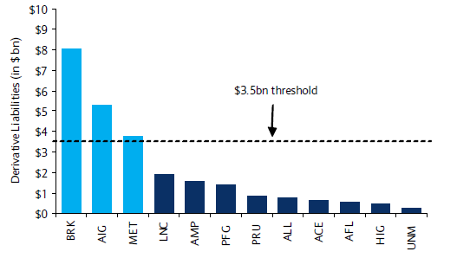
Derivative Liabilities: Publically Traded US Insurers
Few US insurers exceed the $3.5B threshold for derivatives liabilities
Source: Barclays Capital
20

Slide 21
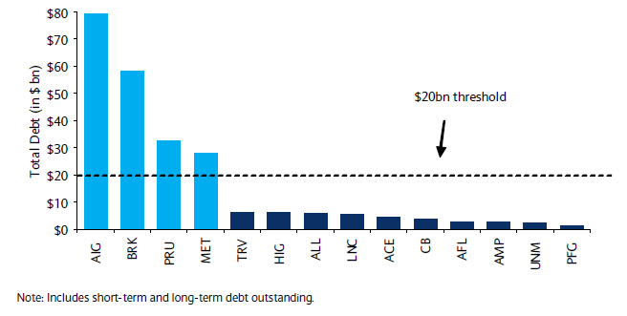
Total Debt: Publically Traded US Insurers
Few US insurers exceed the $20B threshold for total debt
Source: Barclays Capital
21

Slide 22
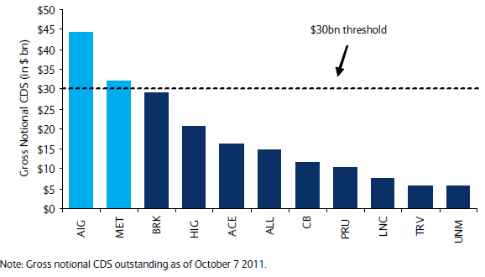
Gross Notional Amount in Credit Default Swaps on Publically Traded US Insurers
Very few US insurers exceed the $30B threshold for CDS written against them
Source: Barclays Capital
22

Slide 23
Dodd-Frank Implementation:
SYSTEMIC RISK CRITERIA (cont’d)
STAGE 2: Analysis of Firms Triggering Uniform Quantitative Thresholds
  Firms will be analyzed using publicly available information in order to conduct a more thorough review
  No data call will be required at this stage
  Firms viewed as potentially systemically important (candidate SIFIs) will subject to a Stage 3 analysis
STAGE 3: Analysis of Candidate Systemically Important Financial Institutions
  Firms will be subject to more detailed analysis including data not available during the Stage 2 analysis
  FSOC will notify Stage 3 firms that they are under SIFI consideration
    Firms will have the opportunity to contest their consideration
Sources: Financial Stability Oversight Council; Insurance Information Institute (I.I.I.) research.

Slide 24
Dodd-Frank Implementation:
SYSTEMIC RISK CRITERIA (concluded)
SIFI DESIGNATION PROCEDURE: 2-Stage Voting Procedure by FSOC is Required Before a Final SIFI Designation is Made
  At the end of Stage 3, FSOC has the authority to propose a firm be designated as a SIFI
  Requires 2/3 majority vote of FSOC members, including affirmation of the Chair (Treasury Secretary)
  Potential SIFI firm will be given written explanation for the determination
  Firm can request a hearing to contest the determination
  Final determination requires another 2/3 majority of FSOC members and affirmation of the Chair
Sources: Financial Stability Oversight Council; Insurance Information Institute (I.I.I.) research.

Slide 25
Liquidating Defaulting Insurers
Orderly Liquidation Authority
  Dodd-Frank gives the FDIC powers to liquidate Systemically Important insurers if the relevant state insurance regulator fails to take action within 60 days.
  If an insurer designated Systemically Important is in danger of default,
    The Treasury Secretary can seek to have the FDIC appointed as receiver to liquidate the company, but only after the Secretary gets both
      a written recommendation to do so from the FIO Director and
      an approval vote by 2/3 of the governors of the Federal Reserve
Sources: http://www.treasury.gov/initiatives/fio/reports-and-notices/Documents/FIO%20Annual%20Report%202013.pdf ; Insurance Information Institute

Slide 26
The Nonadmitted and Reinsurance Reform Act (NRRA)
26

Slide 27
The Nonadmitted and Reinsurance Reform Act (NRRA)
Title V of Dodd-Frank
  Affects regulation of surplus lines P/C insurance, but does not apply to workers comp, excess workers comp, or risk retention groups
    Limits regulatory authority over surplus lines insurance to the home state of the insured
    Sets federal standards for
      the collection of surplus lines premium taxes,
      insurer eligibility, and
      commercial purchaser exemptions
  Overrides state laws
Sources: Insurance Information Institute (I.I.I.); https://usa.marsh.com/Portals/9/Documents/DownloadAsset.pdf

Slide 28
New Derivatives Regulation
28

Slide 29
New Regulation of Derivatives
Commodities Futures Trading Commission issued new rules regarding derivatives
  Insurers use derivatives mainly to hedge interest rate risk and currency risk, not for investment/speculation; nonetheless,…
  Insurers required to trade and clear derivative trades on registered exchanges or clearinghouses
  Require additional collateral
    Might require additional capital and/or liquidity
    Collateral requirements will increase 1% - 3% and could go higher
Sources: A.M.Best, BestWeek, August 12, 2013, p.8; Insurance Information Institute (I.I.I.)

Slide 30
The Consumer Financial Protection Bureau (CFPB)
Dodd-Frank Title X (the Consumer Financial Protection Act of 2010), created the CFPB,
an independent bureau within the Federal Reserve System
30

Slide 31
Organization of the CFPB
Director is appointed by the President, confirmed by the Senate, for a 5-year term
The Bureau must have 4 offices:
  Fair Lending and Equal Opportunity (access to credit)
  Financial Education (of consumers)
  Service Member Affairs (for military and families)
  Financial Protection for Older Americans (financial literacy for those 62 and older)
The Bureau must have 3 functional units:
  Research
  Community Affairs
  Collecting and tracking complaints
Source: http://www.consumerfinance.gov/the-bureau/

Slide 32
CFPB Staffing (FTE), FY2011-2014
The numbers for 2013 and 2014 are lower than previously forecast,
likely due to the sequester
Source: http://www.consumerfinance.gov/strategic-plan-budget-and-performance-plan-and-report/#budget-overview

Slide 33
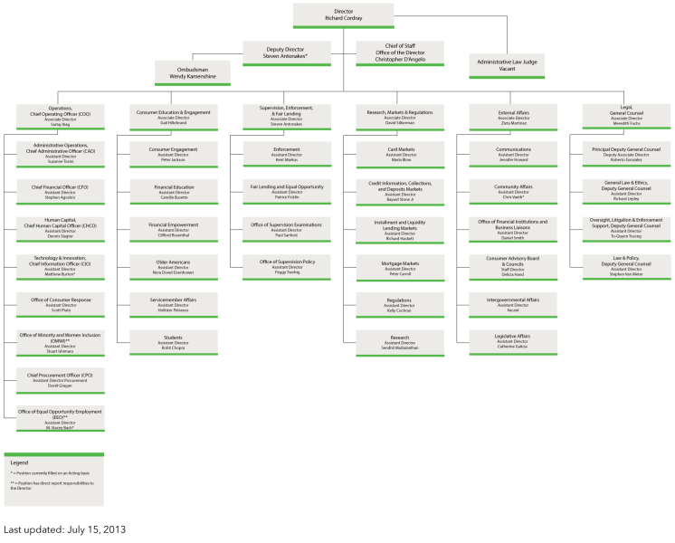
CFPB Organization Chart:
This is not a small agency

Slide 34
CFPB Powers and Limitations
The Bureau has the authority to administer, enforce, and otherwise implement federal consumer financial laws, which includes the power to make rules, issue orders, and issue guidance.
  See 12 U.S.C. § 5511 (Dodd-Frank Act § 1021).
The Financial Stability Oversight Council (FSOC) has the power to set aside any of the Bureau’s regulations if the FSOC decides that the regulation would put the safety and soundness of the banking system, or the stability of the financial system of the United States, at risk.
Source: http://www.law.cornell.edu/wex/dodd-frank_title_x

Slide 35
Functions of the CFPB (any or all of which might affect insurance)
Write rules, supervise companies, and enforce federal consumer financial protection laws
Restrict unfair, deceptive, or abusive acts or practices
Take consumer complaints
Promote financial education
Research consumer behavior
Monitor financial markets for new risks to consumers
Enforce laws that outlaw discrimination and other unfair treatment in consumer finance
Source: http://www.consumerfinance.gov/the-bureau/

Slide 36
Recent CFPB Action
Affecting Insurance
Lender-placed insurance
  New rules prevent servicer surprises and runarounds for mortgage borrowers
  Servicers typically must make sure borrowers maintain property insurance and if the borrower does not, the servicer generally has the right to purchase it. The CFPB’s rules ensure consumers will not be surprised by this insurance, which often can be more expensive than the insurance borrowers buy on their own.
  The rules say servicers must provide more transparency in this process, including advance notice and pricing information before charging consumers. Servicers must also have a reasonable basis for concluding that a borrower lacks such insurance before purchasing a new policy. If servicers buy the insurance but receive evidence that it was not needed, they must terminate it within fifteen days and refund the premiums.
Source: http://www.consumerfinance.gov/the-bureau/

Slide 37
The Office of Financial Research
(OFR)
37

Slide 38
OFR within the Office of Domestic Finance in the U.S. Treasury Department
Office of Financial Research reports to Under Secretary for Domestic Finance
FIO & TRIA admin

Slide 39
What the Office of Financial Research is Supposed to Do
Support the Financial Stability Oversight Council (Council) and member agencies by:
collecting data on behalf of the Council, and providing such data to the Council and member agencies;
standardizing the types and formats of data reported and collected;
performing applied research and essential long-term research;
developing tools for risk measurement and monitoring;
performing other related services;
making the results of the activities of the Office available to financial regulatory agencies; and
assisting such member agencies in determining the types and formats of data authorized by this Act to be collected by such member agencies.
Source: http://www.treasury.gov/initiatives/wsr/ofr/Documents/Office-of-Financial-Research.pdf

Slide 40
The OFR’s Research and Analysis Center
On behalf of the FSOC, the Center will develop and maintain independent analytical capabilities and computing resources to—
develop and maintain metrics and reporting systems for risks to the financial stability of the United States;
monitor, investigate, and report on changes in systemwide risk levels and patterns to the FSOC and Congress;
conduct, coordinate, and sponsor research to support and improve regulation of financial entities and markets;
evaluate and report on stress tests or other stability-related evaluations of financial entities overseen by the member agencies;
maintain expertise in such areas as may be necessary to support specific requests for advice and assistance from financial regulators;
investigate disruptions and failures in the financial markets, report findings, and make recommendations to the FSOC based on those findings;
conduct studies and provide advice on the impact of policies related to systemic risk; and
promote best practices for financial risk management.
Source: http://www.treasury.gov/initiatives/wsr/ofr/Documents/Office-of-Financial-Research.pdf

Slide 41
OFR Organization Chart:
This is not a small agency
Research & Analysis Center
Financial Institutions & Markets

Slide 42
Dodd-Frank and Insurance:
The Years Ahead
Questions Regarding both Domestic and International Regulation
42

Slide 43
New Rulemakings Under Dodd-Frank
By the time it’s done, at least 250-300* new rulemakings are expected under Dodd-Frank, resulting in increasing complexity, cost, discord and slowing Implementation
* Total eliminates double counting for joint rule-makings and this estimate only includes explicit rule-makings in the bill, and thus likely represents a significant underestimate.
Source: Wall Street Journal, July 14, 2010; Davis Polk & Wardwell.

Slide 44
Dodd-Frank:
What does the future hold for insurers?
SIFI Issues
  Do enhanced capital requirements put SIFIs at a competitive disadvantage, or is the “Too Big To Fail” designation viewed as an advantage?
  FSOC SIFI Designations: Initially 2 - 3 US insurers [Prudential Financial, AIG, maybe MetLife?], but will research and/or political pressure expand the list?
  The UK’s Financial Stability Board designated 9 Globally Systemically Important Insurers (G-SIIs)
US-based Insurers
AIG
MetLife
Prudential Financial
Non-US-based Insurers
Aviva (UK)
AXA (France)
Allianz (Germany)
Generali (Italy)
Ping An (China)
Prudential (UK)
Source: Insurance Information Institute (I.I.I.) updates and research.

Slide 45
G-SIFI Timetable for
Enhanced Capital Requirements
Enhanced capital requirements
  to be “spelled out” by the IAIS at the G-20 Summit in 2014.
  Implementation details to come “by the end of 2015.”
  Capital requirements will apply starting January 2019
    To G-SIIs designated as of November 2017
Sources: A.M. Best, BestWeek, July 29, 2013; Insurance Information Institute

Slide 46
Dodd-Frank: Future Issues
Short-to-Mid-Term Issues
  Outcome of new 250-300 rules across many federal agencies (ETA: months to years)
  Legal challenges to the Dodd-Frank (ETA: Years)
Mid-to-Longer-Term Issues
  Solvency II and ComFrame: Tough sell in the US right now (Solvency II = Basel III = European Banks)
Source: Insurance Information Institute (I.I.I.) updates and research.

Slide 47
How Extensive/Intrusive will the CFPB be
Regarding Insurance Market Conduct?
A major initiative of the CFPB is improving financial literacy and financial decision-making
  The CFPB is conducting research to develop measures of financial well-being
    How can this not involve insurance?
  Particular attention is likely to be paid to three audiences: military personnel (and their families), people over age 62, and the “underserved”
  It seems likely that, at some point, the CFPB will focus on health insurance, property insurance, and retirement

Slide 48
How Intrusive will the OFR be into Insurance?
Regarding Insurance Operations Data Collection?
  The OFR is to develop metrics for risks to the financial stability of the US
    Will it collect data only from SIFI insurers or a broader range of insurers?
  The OFR is to “evaluate and report on stress tests of financial entities overseen by the member agencies”
    Does this include stress tests of insurer SIFIs?
    Of Non-SIFI insurers?

Slide 49
Dodd-Frank:
Longer-term Issues for Insurers
Streamlining U.S. Regulation: Dodd-Frank does little to directly address the inefficiencies of the US insurance regulatory system
  Low likelihood of timely, uniform implementation of regulation (FIO has no regulatory power; Treasury/Fed powers very limited)
  But CFPB, OFR might add to the regulatory burden
International Regulation
  Dodd-Frank provides little guidance on international insurance issues, though FIO will define its role on this issue
  Elements of Dodd-Frank (e.g., derivatives regulation) could prove useful
Source: Insurance Information Institute (I.I.I.) updates and research.

Slide 50
Insurance Industry Financial Strength
The US financial system has little to fear from
the US Insurance Industry
50

Slide 51
P/C Insurer Impairments, 1969–2012
Impairments among P/C insurers remain infrequent and are almost always small companies
The Number of Impairments Varies Significantly Over the P/C Insurance Cycle, With Peaks Occurring Well into Hard Markets
Source: A.M. Best Special Report “1969-2011 Impairment Review,” June 2012 and March 6, 2013 update; Insurance Info. Institute.

Slide 52
P/C Insurer Impairment Frequency vs. Combined Ratio, 1969-2011
2011 impairment rate was 0.91% (vs. 0.67% in 2010), slightly higher than the 0.82% average since 1969
Impairment rates, highly correlated with underwriting performance, hit record lows in 2007. The recent increase is mainly due to Mortgage and Financial Guaranty insurers and does not represent the industry overall.
Sources: A.M. Best; Insurance Information Institute

Slide 53
US Policyholder Surplus:
1975–2013*
($ Billions)
Surplus as of 3/31/13 was a record $607.7, up 3.6% from $586.9 of 12/31/12, and up 39.0% ($170.6B) from the crisis trough of $437.1B at 3/31/09. Pre-crisis peak was $521.8 as of 9/30/07. Surplus as of 3/31/13 was 16.5% above 2007 peak.
“Surplus” is a measure of underwriting capacity. It is analogous to “Owners Equity” or “Net Worth” in non-insurance organizations
The Premium-to-Surplus Ratio Stood at $0.77:$1 as of
3/31/13, A Near Record Low (at Least in Recent History)*
* As of 3/31/13.
Source: A.M. Best, ISO, Insurance Information Institute.

Slide 54
Policyholder Surplus,
Quarterly, 2006:Q4–2013:Q1
Up nearly $170 Billion from the 2009:Q1 trough, a new peak
($ Billions)
Down $84 Billion from the previous peak, due to the financial crisis, CATs
The industry at year-end 2012 had $1 of surplus for every $0.78 of NPW, the strongest claims-paying status in its history.
2013:Q1 is estimated
Sources: ISO; A.M .Best.
54
12/01/09 - 9pm
eSlide – P6466 – The Financial Crisis and the Future of the P/C
Notes:
54

Slide 55
Number of Impaired L/H Insurers,
1969–2012
Average number
of impairments,
1969-2012: 16.7
Excluding 1989-1992 spike, avg. was 11.6.
Most of the 7 L/H impaired insurers in 2010 didn’t primarily write life insurance or annuities. Three wrote medical expense insurance and one was an LTC insurer. One of the two life insurers wrote mainly industrial life—a rapidly-disappearing line of business.
The number of impairments spiked in 1989-92, with smaller spikes in 1983 and 1999. But in the financial crisis of 2008-09, when hundreds of banks failed, very few Life/Annuity insurers failed.
Sources: A.M. Best Special Report; Insurance Information Institute.

Slide 56
Distribution of A.M. Best Ratings for L-A Insurers, 2000-2012
6.8% of Life-Annuity insurers had B or worse ratings in 2007.
Weakened by the Great Recession, that rose to 9.0% in 2010
but recovered to 6.0% in 2012.
Source: The Insurance Forum, September issue, various years; I.I.I. analysis

Slide 57
Insurance Information Institute Online:
www.iii.org
Thank you for your time
and your attention!

