Slide 1
Trends, Challenges and Opportunities for the P/C Insurance and Reinsurance Industries in the Post-Crisis World
Florida Insurance Summit
Amelia Island, FL
January 29, 2014
Download at www.iii.org/presentations
Robert P. Hartwig, Ph.D., CPCU, President & Economist
Insurance Information Institute ♦ 110 William Street ♦ New York, NY 10038
Tel: 212.346.5520 ♦ Cell: 917.453.1885 ♦ bobh@iii.org ♦ www.iii.org

Slide 2
Presentation Outline
P/C Performance
  Florida Profitability & Growth Analyses
U.S. and Global Catastrophe Loss Update
  Florida’s Role in History
Flood Reform in Jeopardy
  Biggert-Waters Rollback?
Reinsurance Markets: New Capital

Slide 3
P/C Insurance Industry Financial Overview
2013: Best Year in the Post-Crisis Era
Low CATs in Florida and Elsewhere Helped
3

Slide 4
P/C Net Income After Taxes
1991–2013:Q3 ($ Millions)
2005 ROE*= 9.6%
2006 ROE = 12.7%
2007 ROE = 10.9%
2008 ROE = 0.1%
2009 ROE = 5.0%
2010 ROE = 6.6%
2011 ROAS¹ = 3.5%
2012 ROAS¹ = 5.9%
2013:9M ROAS¹ = 9.5%
Net income is up substantially (+54.7%) from 2012:Q3 $27.8B
2013:9M ROAS was 9.5%
Katrina, Rita, Wilma
4 Hurricanes
Andrew
ROE figures are GAAP; ¹Return on avg. surplus. Excluding Mortgage & Financial Guaranty insurers yields a 8.9% ROAS through 2013:Q3, 6.2% ROAS in 2012, 4.7% ROAS for 2011, 7.6% for 2010 and 7.4% for 2009.
Sources: A.M. Best, ISO, Insurance Information Institute

Slide 5
Profitability Peaks & Troughs in the P/C Insurance Industry, 1975 – 2013:Q3*
ROE
History suggests next ROE peak will be in 2016-2017
1977:19.0%
1987:17.3%
10 Years
2006:12.7%
1997:11.6%
2013:Q3 8.9%
10 Years
9 Years
2004/5 Storms
Andrew
2012: 5.9%
1975: 2.4%
1984: 1.8%
1992: 4.5%
2001: -1.2%
*Profitability = P/C insurer ROEs. 2011-13 figures are estimates based on ROAS data. Note: Data for 2008-2013 exclude mortgage and financial guaranty insurers.
Source: Insurance Information Institute; NAIC, ISO, A.M. Best.

Slide 6
A 100 Combined Ratio Isn’t What It
Once Was: Investment Impact on ROEs
A combined ratio of about 100 generates an ROE of ~7.0% in 2012, ~7.5% ROE in 2009/10,
10% in 2005 and 16% in 1979
Combined Ratio / ROE
Lower CATs are improved ROEs in 2013
Combined Ratios Must Be Lower in Today’s Depressed
Investment Environment to Generate Risk Appropriate ROEs
* 2008 -2013 figures are return on average surplus and exclude mortgage and financial guaranty insurers. 2013:9M combined ratio including M&FG insurers is 95.8; 2012 =103.2, 2011 = 108.1, ROAS = 3.5%.
Source: Insurance Information Institute from A.M. Best and ISO Verisk Analytics data.

Slide 7
P/C Insurance Industry
Combined Ratio, 2001–2013:Q3*
Relatively Low CAT Losses, Reserve Releases
Higher CAT Losses, Shrinking Reserve Releases, Toll of Soft Market
As Recently as 2001, Insurers Paid Out Nearly $1.16 for Every $1 in Earned Premiums
Heavy Use of Reinsurance Lowered Net Losses
Relatively Low CAT Losses, Reserve Releases
Avg. CAT Losses, More Reserve Releases
Best Combined Ratio Since 1949 (87.6)
Sandy Impacts
Cyclical Deterioration
Lower CAT Losses
* Excludes Mortgage & Financial Guaranty insurers 2008--2012. Including M&FG, 2008=105.1, 2009=100.7, 2010=102.4, 2011=108.1; 2012:=103.2; 2013:Q3 = 95.8.
Sources: A.M. Best, ISO.

Slide 8
ROE: Property/Casualty Insurance vs. Fortune 500, 1987–2013E*
(Percent)
P/C Profitability Is Both by
Cyclicality and Ordinary Volatility
Katrina, Rita, Wilma
Sandy
Sept. 11
Hugo
Lowest CAT Losses in
15 Years
4 Hurricanes
Andrew
Record Tornado Losses
Northridge
Financial Crisis*
* Excludes Mortgage & Financial Guarantee in 2008 – 2013E. 2013 P/C ROE is through 2013:Q3.
Sources: ISO, Fortune; Insurance Information Institute.

Slide 9
RNW All Lines by State, 2003-2012 Average:
Highest 25 States
The most profitable states over the past decade are widely distributed geographically, though none are in the Gulf region
Source: NAIC.

Slide 10
RNW All Lines by State, 2003-2012 Average:
Lowest 25 States
Florida All Lines profitability was slightly above the US on average from 2003-2012
Some of the least profitable states over the past decade were hit hard by catastrophes
Source: NAIC.

Slide 11
Net Premium Growth: Annual Change,
1971—2013:Q3
(Percent)
1975-78
1984-87
2000-03
Net Written Premiums Fell 0.7% in 2007 (First Decline Since 1943) by 2.0% in 2008, and 4.2% in 2009, the First 3-Year Decline Since 1930-33.
2013:9M = 4.2%
2012 growth was +4.3%
Shaded areas denote “hard market” periods
Sources: A.M. Best (historical and forecast), ISO, Insurance Information Institute.

Slide 12
Growth in Direct Written Premium by Line, 2013-2015F*
(Percent)
P/C growth is expected to remain fairly stable through 2015
Source: Conning.

Slide 13
INVESTMENTS:
THE NEW REALITY
Investment Performance is a Key Driver of Profitability
Depressed Yields Will Necessarily Influence Underwriting & Pricing
13

Slide 14
Property/Casualty Insurance Industry Investment Income: 2000–2013*¹
($ Billions)
Investment earnings are running below their 2007 pre-crisis peak
Investment Income Fell in 2012 and is Falling in 2013 Due to Persistently Low Interest Rates, Putting Additional Pressure on (Re) Insurance Pricing
¹ Investment gains consist primarily of interest and stock dividends..
*Estimate based on annualized actual 9M:2013 investment income of $34.338B.
Sources: ISO; Insurance Information Institute.

Slide 15
U.S. Treasury Security Yields:
A Long Downward Trend, 1990–2013*
Yields on 10-Year U.S. Treasury Notes have been essentially below 5% for a full decade.
U.S. Treasury security yields recently plunged to record lows
Since roughly 80% of P/C bond/cash investments are in 10-year or shorter durations, most P/C insurer portfolios will have low-yielding bonds for years to come.
*Monthly, constant maturity, nominal rates, through December 2013.
Sources: Federal Reserve Bank at http://www.federalreserve.gov/releases/h15/data.htm.
National Bureau of Economic Research (recession dates); Insurance Information Institute.
15
12/01/09 - 9pm
eSlide – P6466 – The Financial Crisis and the Future of the P/C
Notes:
15

Slide 16
Profitability and Growth in Florida P/C Insurance Markets
Analysis by Line and Nearby State Comparisons
16

Slide 17
RNW All Lines: FL vs. U.S., 2003-2012
(Percent)
P/C Insurer profitability in FL is above that of the US overall over the past decade
US: 7.9%
FL: 8.6%
2004/2005 hurricanes
Sources: NAIC.
17
Notes:
17

Slide 18
RNW Homeowners: FL vs. U.S.,
2003-2012
(Percent)
Average 2003-2012
US: 6.0%
FL: 0.0%
The average rate of return on the FL homeowners line is ZERO percent over the decade from 2003 - 2012
-53.4%
2004/2005 hurricanes
183.3%
Sources: NAIC.
18
Notes:
18

Slide 19
RNW Comm. Multi-Peril: FL vs. U.S.,
2003-2012
(Percent)
Average 2003-2012
US: 9.0%
FL: 7.3%
-28.8%
2004/2005 hurricanes
-77.2%
Sources: NAIC.
19
Notes:
19

Slide 20
RNW PP Auto: FL vs. U.S., 2003-2012
Average 2003-2012
US: 7.6%
FL: 4.7%
Sources: NAIC.
20
Notes:
20

Slide 21
RNW Comm. Auto: FL vs. U.S.,
2003-2012
(Percent)
Commercial Auto profitability in FL is generally below the US average
Average 2003-2012
US: 9.8%
FL: 5.2%
Sources: NAIC.
21
Notes:
21

Slide 22
RNW Workers Comp: FL vs. U.S.,
2003-2012
(Percent)
Average 2003-2012
US: 7.1%
FL: 11.0%
Sources: NAIC.
22
Notes:
22

Slide 23
All Lines: 10-Year Average RNW FL & Nearby States
2003-2012
Florida All Lines profitability is above the US and the regional average
Source: NAIC, Insurance Information Institute

Slide 24
PP Auto: 10-Year Average RNW FL & Nearby States
2003-2012
Florida PP Auto profitability is below the US and regional average
Source: NAIC, Insurance Information Institute

Slide 25
Top Ten Most Expensive And Least Expensive States For Automobile Insurance, 2011 (1)
Rank | Most expensive states | Average expenditure | Rank | Least expensive states | Average expenditure
1 | New Jersey | $1,183.95 | 1 | Idaho | $525.15
2 | District of Columbia | 1,138.03 | 2 | South Dakota | 540.04
3 | Louisiana | 1,110.68 | 3 | North Dakota | 549.81
4 | New York | 1,108.64 | 4 | Iowa | 552.54
5 | Florida | 1,090.65 | 5 | Maine | 577.38
6 | Delaware | 1,052.28 | 6 | North Carolina | 600.33
7 | Rhode Island | 1,004.14 | 7 | Wisconsin | 601.40
8 | Michigan | 983.60 | 8 | Nebraska | 602.57
9 | Connecticut | 970.22 | 9 | Wyoming | 619.88
10 | Maryland | 956.17 | 10 | Ohio | 619.96
Florida ranked 5th as the most expensive state in 2011, with an average expenditure for auto insurance of $1,090.65.
Based on average automobile insurance expenditures.
Source: © 2013 National Association of Insurance Commissioners.

Slide 26
Homeowners: 10-Year Average RNW FL & Nearby States
At 0.0%, Florida Homeowners profitability is below the US average and above the regional average
2003-2012
Source: NAIC, Insurance Information Institute

Slide 27
Comm. M-P: 10-Year Average RNW FL & Nearby States
2003-2012
Florida Commercial Multi-Peril profitability is below the US average and above the regional average
Source: NAIC, Insurance Information Institute

Slide 28
Top Ten Most Expensive And Least Expensive States For Homeowners Insurance, 2011 (1)
Florida ranked as the most expensive state for homeowners insurance in 2011, with an average expenditure of $1,933.
Rank | Most expensive states | HO average premium | Rank | Least expensive states | HO average premium
1 | Florida | $1,933 | 1 | Idaho | $518
2 | Louisiana | 1,672 | 2 | Oregon | 559
3 | Texas (2) | 1,578 | 3 | Utah | 563
4 | Mississippi | 1,409 | 4 | Wisconsin | 592
5 | Oklahoma | 1,386 | 5 | Washington | 626
6 | Alabama | 1,163 | 6 | Ohio | 644
7 | Rhode Island | 1,139 | 7 | Delaware | 664
8 | Kansas | 1,103 | 8 | Arizona | 675
9 | New York | 1,097 | 9 | Nevada | 689
10 | Connecticut | 1,096 | 10 | Iowa | 713
Includes policies written by Citizens Property Insurance Corp. (Florida) and Citizens Property Insurance Corp. (Louisiana), Alabama Insurance Underwriting Association, Mississippi Windstorm Underwriting Association, North Carolina Joint Underwriting Association and South Carolina Wind and Hail Underwriting Association. Other southeastern states have wind pools in operation and their data may not be included in this chart. Based on the HO-3 homeowner package policy for owner-occupied dwellings, 1 to 4 family units. Provides “all risks” coverage (except those specifically excluded in the policy) on buildings and broad named-peril coverage on personal property, and is the most common package written.
The Texas Department of Insurance developed home insurance policy forms that are similar but not identical to the standard forms. In addition, due to the Texas Windstorm Association (which writes wind-only policies) classifying HO-1, 2 and 5 premiums as HO-3, the average premium for homeowners insurance is artificially high.
Note: Average premium=Premiums/exposure per house years. A house year is equal to 365 days of insured coverage for a single dwelling. The NAIC does not rank state average expenditures and does not endorse any conclusions drawn from this data.
Source: ©2013 National Association of Insurance Commissioners (NAIC). Reprinted with permission. Further reprint or distribution strictly prohibited without written permission of NAIC.

Slide 29
Comm. Auto: 10-Year Average RNW FL & Nearby States
2003-2012
Florida Commercial Auto profitability is below the US and regional average
Source: NAIC, Insurance Information Institute

Slide 30
Workers Comp: 10-Year Average RNW
FL & Nearby States
2003-2012
Florida Workers Comp profitability is above the US average and regional average
Source: NAIC, Insurance Information Institute

Slide 31
Premium Growth Analysis
Some Surprising States Are America’s Growth Leaders
31

Slide 32
Direct Premiums Written: Total P/C
Percent Change by State, 2007-2012*
Top 25 States
North Dakota was the country’s growth leader over the past 5 years with premiums written expanding by 58.4%
Sources: SNL Financial LC.; Insurance Information Institute.

Slide 33
Direct Premiums Written: Total P/C
Percent Change by State, 2007-2012*
Bottom 25 States
Overall premium volume across all P/C lines declined by 5.6% between 2007 and 2012
Sources: SNL Financial LC.; Insurance Information Institute.

Slide 34
Direct Premiums Written: Homeowners
Percent Change by State, 2007-2012*
Top 25 States
Sources: SNL Financial LLC.; Insurance Information Institute.

Slide 35
Direct Premiums Written: Homeowners
Percent Change by State, 2007-2012*
Bottom 25 States
Sources: SNL Financial LLC.; Insurance Information Institute.

Slide 36
All Lines DWP Growth: FL vs. U.S., 2003-2012
(Percent)
Average 2003-2012
US: 2.6%
FL: 3.9%
FL’s home building boom helped fuel industry growth
The housing bubble burst, hurting industry growth
Source: SNL Financial.
36
Notes:
36

Slide 37
Comm. Lines DWP Growth: FL vs. U.S., 2003-2012
(Percent)
Average 2003-2012
US: 2.5%
FL: 2.6%
Source: SNL Financial.
37
Notes:
37

Slide 38
Personal Lines DWP Growth: FL vs. U.S., 2003-2012
(Percent)
Average 2003-2012
US: 3.0%
FL: 5.3%
Source: SNL Financial.
38
Notes:
38

Slide 39
Private Passenger Auto DWP Growth:
FL vs. U.S., 2003-2012
(Percent)
Average 2003-2012
US: -1.8%
FL: 3.5%
Source: SNL Financial.
39
Notes:
39

Slide 40
Homeowner’s MP DWP Growth: FL vs. U.S., 2003-2012
(Percent)
The homeowners line grew rapidly during the housing boom then contracted during the crash
Average 2003-2012
US: 6.2%
FL: 9.4%
Source: SNL Financial.
40
Notes:
40

Slide 41
Florida Homeowners Direct Written Premium, 200-2013E*
Homeowners premium volume peaked at $8.59B prior to the housing collapse
($ Billions)
2007-09: -19% Growth
20090-13E: +21% Growth
2000-2007: +196% Growth
FL’s premium volume likely hit a new record high in 2013 as the economy continued to recover
Florida’s homeowners insurance market has been on a 15-year rollercoaster ride in terms of both volume and performance
*2013 is an I.I.I. estimate and assumes a 6.6% growth rate (same as in 2012).
Sources: SNL Financial; Insurance Information Institute.

Slide 42
Lender Placed Insurance Direct Earned Premiums, 2002-2011
By 2010, LPI volume had increased by 1,500%, from just $61 million in 2002 to nearly $1 billion in 2010, accounting for more than 10% of the residential mkt.
($ Millions)
Hundreds of thousands of FL homeowners defaulted on mortgages or stopped paying their home insurance premiums, triggering LPI coverage on these policies
Even Florida Citizens underwriting guidelines forbid it from underwriting properties on which LPI was triggered
Sources: Milliman, Inc., “Considerations When Developing Actuarially Sound Rates for Lender Placed Property Insurance,” NAIC Meeting, August 9, 2011; Insurance Information Institute.

Slide 43
The Strength of the U.S. Economy Will Influence P/C Insurer Growth and Exposure
Growth Will Expand Insurer Property Exposures
43

Slide 44
Florida’ Economy: Primed for Growth; Hurricane Vulnerability Increases
Home Construction in FL Will Rise Sharply
  110,000 new homes are expected to be built in FL in 2014
  148,000 in 2015; 167,000 in 2016 and 168,000+ in 2017
  Florida will account for 1-in-10 new homes built in the US
Real Economic Growth Average About 3% through 2017
  Will fuel commercial property exposures
Population Growth Will Greatly Exceed the US Overall
  1.3% to 1.4% per year, almost double ~0.75% for the US
  In 2013, FL likely overtook NY as the 3rd most populace state
  More than 1 million increase through 2017
  Will drive demand for housing, infrastructure, commercial prop.
  Increase of about 600,000 jobs through 2017

Slide 45
US Real GDP Growth*
The Q4:2008 decline was the steepest since the Q1:1982 drop of 6.8%
Real GDP Growth (%)
Recession began in Dec. 2007. Economic toll of credit crunch, housing slump, labor market contraction was severe
2014/15 are expected to see a modest acceleration in growth
Demand for Insurance Continues To Be Impacted by Sluggish Economic Conditions, but the Benefits of Even Slow Growth Will Compound and Gradually Benefit the Economy Broadly
* Estimates/Forecasts from Blue Chip Economic Indicators.
Source: US Department of Commerce, Blue Economic Indicators 1/14; Insurance Information Institute.

Slide 46
Real GDP by State Percent Change, 2012:
Highest 25 States
North Dakota was the economic growth juggernaut of the US in 2012—by far
FL’s growth has been reasonably strong relative to most other states in recent years
Sources: US Bureau of Labor Statistics; Insurance Information Institute.

Slide 47
Real GDP by State Percent Change, 2012:
Lowest 25 States
Growth rates in 8 states (and DC) were still below 1% in 2012
Connecticut was the only state to shrink in 2012
Sources: US Bureau of Labor Statistics; Insurance Information Institute.

Slide 48
Florida vs. US Real GDP Growth
PRE-CRISIS: Florida grew much faster than the US economy before the financial crisis but contracted more sharply when the housing bubble collapsed
POST-CRISIS: Florida’s economy is now growing at a pace more consistent with the US overall
Housing bubble collapse
Source: US Department of Commerce; Blue Economic Indicators 1/14 (for US 2013-15 figures); University of Central Florida for 2013-2015 Florida figures: http://iec.ucf.edu/post/2014/01/07/Florida-Metro-Forecast-December-2013.aspx

Slide 49
Strong Florida Population Growth Will Drive Coastal Exposure Sharply Upward
(Millions)
At 1.3% to 1.4%, FL’s population growth will well above the US
Florida is expected to add 1.1 million new residents by 2017 relative to 2013
Source: US Census Bureau; University of Central Florida Institute for Economic Competitiveness: http://iec.ucf.edu/post/2014/01/07/Florida-Metro-Forecast-December-2013.aspx ; Insurance Information Institute.

Slide 50
Interest Rate on Convention 30-Year Mortgages: Headed Back Up, 1990–2013*
Yields on 30-Year Mortgages in the U.S. plunged to all time record lows in late 2012 and early 2013 but are now rising as the Fed considers tapering its QE program
Yields on 30-Year mortgages have been below 6% for a five years
30-yr. mortgage rates are up 105 basis points since the beginning of the year
Since roughly 80% of P/C bond/cash investments are in 10-year or shorter durations, most P/C insurer portfolios will have low-yielding bonds for years to come.
*Monthly, through December 2013. Note: Recessions indicated by gray shaded columns.
Sources: Federal Reserve Bank at http://www.federalreserve.gov/releases/h15/data.htm.
National Bureau of Economic Research (recession dates); Insurance Information Institutes.
50
12/01/09 - 9pm
eSlide – P6466 – The Financial Crisis and the Future of the P/C
Notes:
50

Slide 51
New Private Housing Starts, 1990-2019F
Job growth, low inventories of existing homes, low mortgage rates and demographics should continue to stimulate new home construction for several more years
(Millions of Units)
New home starts plunged 72% from 2005-2009; A net annual decline of 1.49 million units, lowest since records began in 1959
FL will account for 10% of all new homes built nationally in 2014
Insurers Are Continue to See Meaningful Exposure Growth in the Wake of the “Great Recession” Associated with Home Construction: Construction Risk Exposure, Surety, Commercial Auto; Potent Driver of Workers Comp Exposure
Source: U.S. Department of Commerce; Blue Chip Economic Indicators (1/14 and 3/13); Insurance Information Institute.

Slide 52
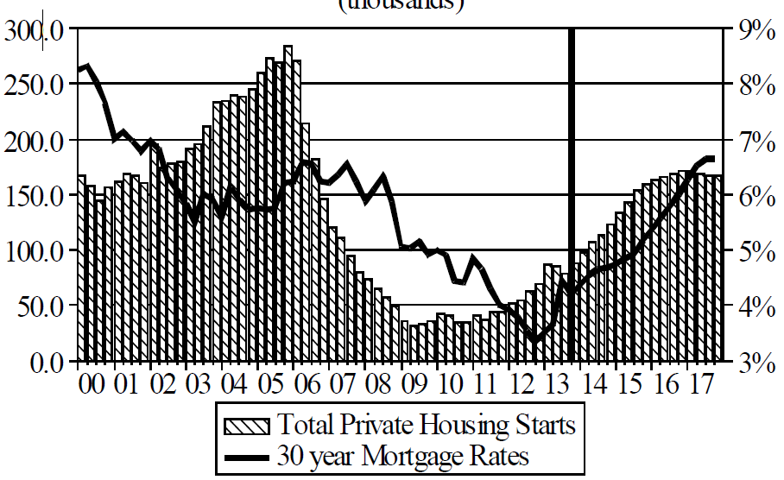
Florida Total Private Housing Starts,
2000 – 2017F
(Thousands of Units)
CRASH, CRATER, RECOVERY Homebuilding in FL continues to recover, adding substantially to coastal exposures.
The economic outlook for most of the US is positive for the first time in many years
Source: University of Central Florida Institute for Economic Competitiveness: http://iec.ucf.edu/post/2014/01/07/Florida-Metro-Forecast-December-2013.aspx

Slide 53
Net Worth of Households*
Recently Hit A Historic High
2008-09 recession: -15.7%
$ Trillions
Adjusted for population growth, net worth is slightly short of its prior peak
Housing “bubble”
2001 recession
1992 recession
1982 recession
Rising net worth fuels a “wealth affect” that helps fuel consumer spending, which accounts for 70% of spending in the U.S. economy
*and nonprofit organizations. Data are as of year-end, except in 2013:Q3 (data posted on Dec 9, 2013).
Next release March 6, 2014. Data not seasonally adjusted or inflation-adjusted
Source: Federal Reserve Board

Slide 54
Household Financial Obligations
Ratio Recently Hit A Historic Low
Financial Obligations Ratio
Financial Obligations Ratio: debt service (mortgage and consumer debt), auto lease, residence rent, HO insurance, and property tax payments as % of personal disposable income.
Household balance sheets are stronger than they’ve been in many years, setting the stage for more consumer spending
Decline began in 2008:Q1.
15.23% in 2012:Q4
is lowest ratio since 1980:Q4 (15.09%).
*through 2013:Q3 (data posted on Dec 13, 2013)
Source: Federal Reserve Board, at http://www.federalreserve.gov/releases/housedebt

Slide 55
Unemployment Rates by State, November 2013:
Highest 25 States*
In November 45 states and the District of Columbia had over-the-month unemployment rate decreases and 5 states had no change.
*Provisional figures for November 2013, seasonally adjusted.
Sources: US Bureau of Labor Statistics; Insurance Information Institute.

Slide 56
Unemployment Rates by State, November 2013:
Lowest 25 States*
Florida’s unemployment rate is now below the US overall
*Provisional figures for November 2013, seasonally adjusted.
Sources: US Bureau of Labor Statistics; Insurance Information Institute.

Slide 57
Insured Catastrophe Loss Update
Florida Has Played a Critical Role in the History of Catastrophe Losses in the U.S.
Relative Calm in Recent Years Is Unlikely to Endure
57

Slide 58
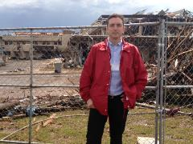
U.S. Insured Catastrophe Losses
($ Billions, $ 2012)
Storms of 2004/05
2012 was the third most expensive year ever for insured CAT losses
Andrew
2013 CATs Were Well Below Recent Years. 2012 Was the 3rd Highest Year on Record for Insured Losses in U.S. History on an Inflation-Adj. Basis. 2011 Losses Were the 6th Highest.
Record tornado losses caused 2011 CAT losses to surge
*Through 12/31/13.
Note: 2001 figure includes $20.3B for 9/11 losses reported through 12/31/01 ($25.9B 2011 dollars). Includes only business and personal property claims, business interruption and auto claims. Non-prop/BI losses = $12.2B ($15.6B in 2011 dollars.)
Sources: Property Claims Service/ISO; Insurance Information Institute.
58
12/01/09 - 9pm
eSlide – P6466 – The Financial Crisis and the Future of the P/C
Notes:
58

Slide 59
Combined Ratio Points Associated with Catastrophe Losses: 1960 – 2013*
Avg. CAT Loss Component of the Combined Ratio by Decade
1960s: 1.04 1970s: 0.85 1980s: 1.31 1990s: 3.39 2000s: 3.52 2010s: 6.1E*
Catastrophe losses as a share of all losses reached a record high in 2012
Combined Ratio Points
The Catastrophe Loss Component of Private Insurer Losses Has Increased Sharply in Recent Decades
*2010s represent 2010-2013.
Notes: Private carrier losses only. Excludes loss adjustment expenses and reinsurance reinstatement premiums. Figures are adjusted for losses ultimately paid by foreign insurers and reinsurers.
Source: ISO (1960-2011); A.M. Best (2012E) Insurance Information Institute.

Slide 60
Top 8 States for Insured
Catastrophe Losses, 2013
$ Millions
Oklahoma let the country in insured CAT losses in 2013
Source: The Property Claim Services (PCS) unit of ISO, a Verisk Analytics company.

Slide 61
Top 5 States by Insured Catastrophe Losses in 2012*
(2012, $ Billions)
NY and NJ let the US in CAT losses in 2012 due Sandy
*Includes catastrophe losses of at least $25 million.
Sources: PCS unit of ISO; Insurance Information Institute.

Slide 62
Top States by Inflation-Adjusted Insured Catastrophe Losses, 1983–2012
Over the Past 30 Years Florida Has Accounted for the Largest Share of Catastrophe Losses in the U.S., Followed by Texas and Louisiana
FL is the most costly state for CATs, with nearly $67B in insured losses over the past 30 years
Louisiana
$42.0B
Texas
$48.8B
Rest of the U.S.
$309.9B
Florida
$66.7B
Total: $467.5 Billion, an average of $16.6B per year or $1.3B per month
Source: PCS unit of ISO, Verisk Company.; Insurance Information Institute.

Slide 63
Inflation Adjusted U.S. Catastrophe Losses by Cause of Loss, 1993–2012¹
Wind/Hail/Flood (3), $14.9
Fires (4), $6.5
Other (5), $0.2
Insured cat losses from 1993-2012 totaled $391.7B, an average of $19.6B per year or $1.6B per month
Geological Events, $18.4
Terrorism, $24.8
Winter Storms, $27.8
Hurricanes & Tropical Storms, $158.2
Tornado share of CAT losses is rising
Wind losses are by far cause the most catastrophe losses, even if hurricanes/TS are excluded.
Tornadoes (2), $140.9
Catastrophes are defined as events causing direct insured losses to property of $25 million or more in 2012 dollars.
Excludes snow.
Does not include NFIP flood losses
Includes wildland fires
Includes civil disorders, water damage, utility disruptions and non-property losses such as those covered by workers compensation.
Source: ISO’s Property Claim Services Unit.

Slide 64
The combined ratios for both personal and commercial lines improved substantially in 2013:H1

Slide 66
Top 16 Most Costly Disasters in U.S. History
(Insured Losses, 2012 Dollars, $ Billions)
Hurricane Andrew remains the second most expensive natural disaster in US history
Includes Tuscaloosa, AL, tornado
Includes Joplin, MO, tornado
12 of the 16 Most Expensive Events in US History Have Occurred Over the Past Decade
*PCS estimate as of 4/12/13.
Sources: PCS; Insurance Information Institute inflation adjustments to 2012 dollars using the CPI.

Slide 67
Top 16 Most Costly World Insurance Losses, 1970-2013*
(Insured Losses, 2012 Dollars, $ Billions)
4 of the top 12 most expensive catastrophes in world history impacted Florida
Hurricane Sandy is now the 6th costliest event in global insurance history
*Figures do not include federally insured flood losses.
**Estimate based on PCS value of $18.75B as of 4/12/13.
Sources: Munich Re; Swiss Re; Insurance Information Institute research.

Slide 68
Top 12 Most Costly Hurricanes in U.S. History
(Insured Losses, 2012 Dollars, $ Billions)
6 of the 12 most costly hurricanes in insurance history impacted Florida
Hurricane Sandy is the costliest tropical event to not impact FL
*PCS estimate as of 4/12/13.
Sources: PCS; Insurance Information Institute inflation adjustments to 2012 dollars using the CPI.

Slide 69
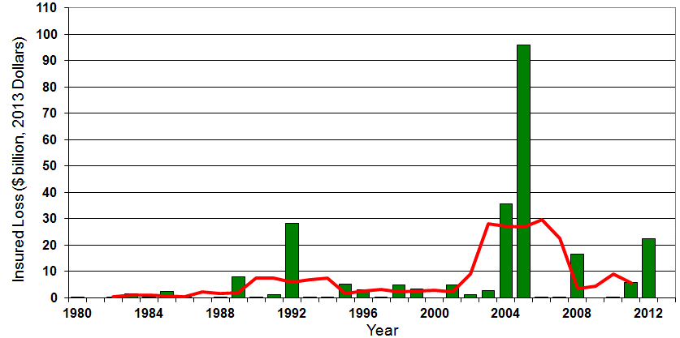

Insured US Tropical Cyclone Losses, 1980 - 2013
The current 5-year average (2008 - 2013) insured tropical cyclone loss is $5.6 billion per year.
Sources: Property Claims Service, Munich Re NatCatSERVICE, NFIP
69

Slide 70
Total Value of Insured Coastal Exposure in 2012
(2012, $ Billions)
The value of coastal exposure in FL was nearly $2.9 trillion in 2012, up 19% or $465 billion since 2007 despite the housing collapse
In 2012, New York Ranked as the #1 Most
Exposed State to Hurricane Loss, Overtaking Florida with $2.862 Trillion. Texas is very exposed too, and ranked #3 with $1.175 Trillion
in insured coastal exposure
The Insured Value of All Coastal Property Was $10.6 Trillion in 2012 , Up 20% from $8.9 Trillion in 2007 and Up 48% from $7.2 Trillion in 2004
Source: AIR Worldwide

Slide 71
Total Value of Insured Coastal Exposure in 2007
(2007, $ Billions)
In 2007, Florida Still Ranked as the #1 Most
Exposed State to Hurricane Loss, with
$2.459 Trillion Exposure, but Texas is very exposed too, and ranked #3 with $895B
in insured coastal exposure
The Insured Value of All Coastal Property Was $8.9 Trillion in 2007, Up 24% from $7.2 Trillion in 2004
Source: AIR Worldwide

Slide 72
Natural Disasters in the United States, 1980 – 2013
Number of Events (Annual Totals 1980 – 2013)
There were 128 natural disaster events in 2013
Number
22
19
81
6
Geophysical
(earthquake, tsunami,
volcanic activity)
Meteorological (storm)
Climatological
(temperature extremes,
drought, wildfire)
Hydrological
(flood, mass movement)
Source: MR NatCatSERVICE
72

Slide 73
Losses Due to Natural Disasters in the US, 1980–2013
(Overall and Insured Losses)
(2013 Dollars, $ Billions)
2013 CAT Losses
Overall : $21.8B
Insured: $12.8B
Indicates a great deal of losses are uninsured (~40%-50% in the US) = Growth Opportunity
2013 losses were far below 2011 and 2012 and were 44% lower than the average from 2000-2012
Overall losses (in 2012 values)
Insured losses (in 2013 values)
Source: MR NatCatSERVICE
73

Slide 74
Hurricane Sandy: Average Claim Payment by Type of Claim
Commercial (i.e., business claims) are more expensive because the value of property is often higher as well as the impact of insured business interruption losses
The average insured flood loss was nearly 9 times larger than the average non-flood insured loss (mostly wind)
Post-Sandy, the I.I.I. worked very hard to make help media, consumers and regulators understand the distinction between a flood claim and a standard homeowners claim. NFIP is $24B in debt.
*Includes rental and condo policies (excludes NFIP flood). **As of Oct. 31, 2013.
Sources: Catastrophe loss data is for Catastrophe Serial No. 90 (Oct. 28 – 31, 2012) from PCS as of March 2013; Insurance Information Institute.

Slide 75
Natural Disaster Losses in the United States, by Type, 2013
As of December 31, 2013 | Number of Events | Fatalities | Estimated Overall Losses (US $m) | Estimated Insured Losses (US $m)
Severe Thunderstorm | 69 | 110 | 16,341 | 10,274
Winter Storm | 11 | 43 | 2,935 | 1,895
Flood | 19 | 23 | 1,929 | 240
Earthquake & Geophysical | 6 | 1 | Minor | Minor
Tropical Cyclone | 1 | 1 | Minor | Minor
Wildfire, Heat, & Drought | 22 | 29 | 620 | 385
Totals | 128 | 207 | 21,825 | 12,794
Source: Munich Re NatCatSERVICE
75
75

Slide 76
Significant Natural Catastrophes, 2013
(Events with $1 billion economic loss and/or 50 fatalities)
Date | Event | Estimated Economic Losses (US $m) | Estimated Insured Losses (US $m)
February 24 – 25 | Winter Storm | 1,300 | 690
March 18 – 19 | Thunderstorms | 2,200 | 1,600
April 7 – 11 | Winter Storm | 1,600 | 1,200
April 16 – 18 | Thunderstorms | 1,100 | 560
May 18 – 20 | Thunderstorms | 3,100 | 1,800
May 28 – 31 | Thunderstorms | 2,800 | 1,400
August 6 – 7 | Thunderstorms | 1,300 | 740
September 9 – 16 | Flooding | 1,500 | 160
November 17 - 18 | Thunderstorms | 1,300 | 931
Source: Munich Re NatCatSERVICE
76

Slide 77
Convective Loss Events in the U.S.
Number of events 1980 – 2012 and First Half 2013
Number
The frequency of convective events has rising tremendously over the past 30+ years
Convective events are those caused by straight-line winds, tornadoes, hail, heavy precipitation, flash floods and lightning
Source: Geo Risks Research, NatCatSERVICE – As at July 2013
77

Slide 78
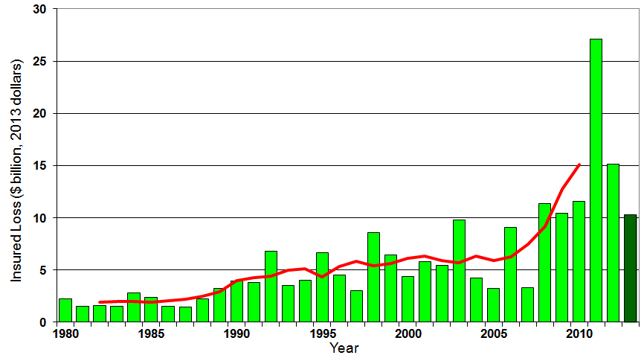
U.S. Thunderstorm Insured Loss Trends, 1980 – 2013
Hurricanes get all the headlines, but thunderstorms are consistent producers of large scale loss. 2008-2013 are the most expensive years on record.
Average thunderstorm losses are up 7 fold since the early 1980s. The 5-year running average loss is up sharply
Thunderstorm losses in 2013 totaled $10.3 billion, the 6th highest on record
Source: Property Claims Service, MR NatCatSERVICE
78

Slide 79
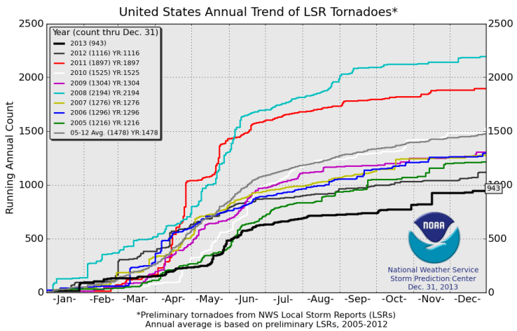
U.S. Tornado Count, 2005-2013*
There were 1,897 tornadoes in the U.S. in 2011 far above average, but well below 2008’s record
2013 count was the lowest in a decade
*Through Dec. 31, 2013.
Source: http://www.spc.noaa.gov/wcm/.
79

Slide 80
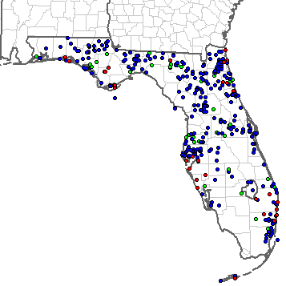
Severe Weather Reports in Florida: 2013
There were 400 severe weather reports in 2013
37 Tornadoes
47 Large Hail Reports
316 High Wind Events
Source: NOAA Storm Prediction Center; http://www.spc.noaa.gov/climo/online/monthly/2013_annual_summary.html#
80

Slide 81
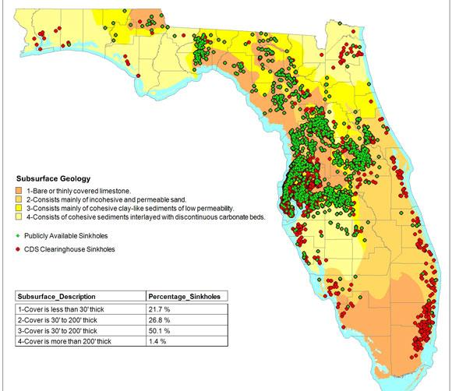
Sinkholes in FL Are Increasingly Common and Expensive
Florida has a huge sinkhole problem. FL is one of only 2 states where sinkhole coverage must be included in the standard HO policy
Sinkholes cost insurers $1.4B between 2006 and 2010
Top 10 Sinkhole Counties
Pasco
Hernando
Hillsborough
Marion
Pinellas
Citrus
Polk
Orange
Seminole
Lake
Source: Insurance Journal , March 30, 2011, from CDS Business Mapping at http://www.insurancejournal.com/news/southeast/2011/03/30/192278.htm
81

Slide 82
Convective Loss Events in the U.S.
Overall and insured losses 1980 – 2012 and First Half 2013
(Bill. US$)
The insured and total economic cost of convective events has rising tremendously over the past 30+ years
Convective events are those caused by straight-line winds, tornadoes, hail, heavy precipitation, flash floods and lightning
Analysis contains: straight-line winds, tornadoes, hail, heavy precipitation, flash floods, lightning.
Overall losses (in 2012 values)
Insured losses (in 2012 values)
Source: Geo Risks Research, NatCatSERVICE – As at July 2013
82

Slide 83
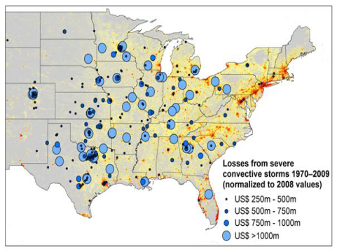
New Research Suggests Increase in Convective Activity Is Costly for Insurers
Study examines convective (hail, tornado, thundersquall and heavy rainfall) events in the US with losses exceeding US$ 250m in the period 1970–2009 (80% of all losses)
Past losses are normalized (i.e., adjusted) to currently exposed values
After normalization there are still increases of losses
Increases are correlated with
the increase in the meteorological
potential for severe thunderstorms
and its variability
For the first time research shows
that climatic changes have already
influenced US thunderstorm losses
Source: Munich Re research paper, Marhc 18, 2013: Rising Variability in Thunderstorm-Related U.S. Losses as a Reflection of Changes in Large-Scale Thunderstorm Forcing.
83

Slide 84
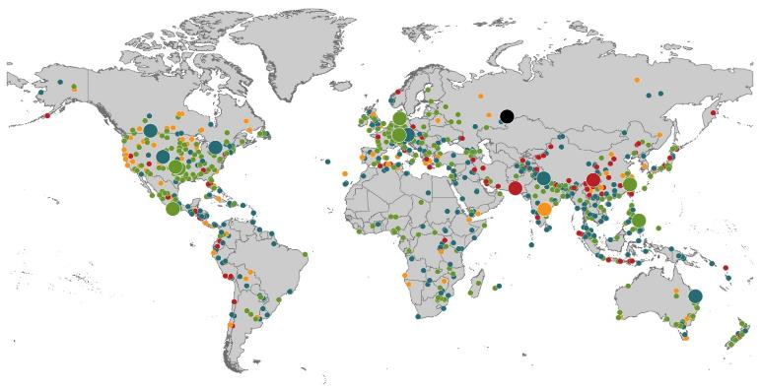
Natural Loss Events:
Full Year 2013
World Map
Winter Storm Christian (St. Jude)
Europe, 27–30 October
Floods
Europe,
30 May–19 June
Meteorite impact
Russian Federation, 15 February
Flash floods
Canada, 8–9 July
Floods
Canada, 19–24 June
Earthquake
China, 20 April
Hailstorms
Germany,
27–28 July
Floods
USA, 9–16 September
Typhoon Fitow
China, Japan,
5–9 October
Severe storms, tornadoes
USA, 18–22 May
Typhoon Haiyan
Philippines,
8–12 November
Severe storms, tornadoes
USA, 28–31 May
Floods
India, 14–30 June
Hurricanes Ingrid & Manuel
Mexico, 12–19 September
Floods
Australia,
21–31 January
880
Loss events
Earthquake (series)
Pakistan, 24–28 September
Heat wave
India, April–June
Geophysical events
(earthquake, tsunami, volcanic activity)
Hydrological events
(flood, mass movement)
Natural catastrophes
Geophysical events
(earthquake, tsunami, volcanic activity)
Hydrological events
(flood, mass movement)
Selection of significant
Natural catastrophes
Meteorological events
(storm)
Climatological events
(extreme temperature, drought, wildfire)
Meteorological events
(storm)
Climatological events
(extreme temperature, drought, wildfire)
Extraterrestrial events
(Meteorite impact)
Source: Munich Re Geo Risks Research, NatCatSERVICE – as of January 2014.
84

Slide 85
Natural Disasters Worldwide,
1980 – 2013 (Number of Events)
There were 880 natural disaster events globally in 2013 compared to 905 in 2012
Number
Geophysical
(earthquake, tsunami,
volcanic activity)
Meteorological (storm)
Climatological
(temperature extremes,
drought, wildfire)
Hydrological
(flood, mass movement)
Source: MR NatCatSERVICE
85

Slide 86
Losses Due to Natural Disasters Worldwide, 1980–2013 (Overall & Insured Losses)
(Overall and Insured Losses)
(2013 Dollars, $ Billions)
10-Yr. Avg. Losses
Overall : $184B
Insured: $56B
2013 Losses
Overall : $125B
Insured: $34B
There is a clear upward trend in both insured and overall losses over the past 30+ years
Overall losses (in 2013 values)
Insured losses (in 2013 values)
Source: MR NatCatSERVICE
86

Slide 87
Total Potential Home Value Exposure to Storm Surge Risk in 2013*
($ Billions)
Florida is by the state most vulnerable to storm surge.
The Value of Homes Exposed to Storm Surge was $1.147 Trillion in 2013.* Only a fraction of this is insured, hence the huge demand for federal aid following major coastal flooding events.
*Insured and uninsured property. Based on estimated property values as of April 2013.
Source: Storm Surge Report 2013, CoreLogic.

Slide 88
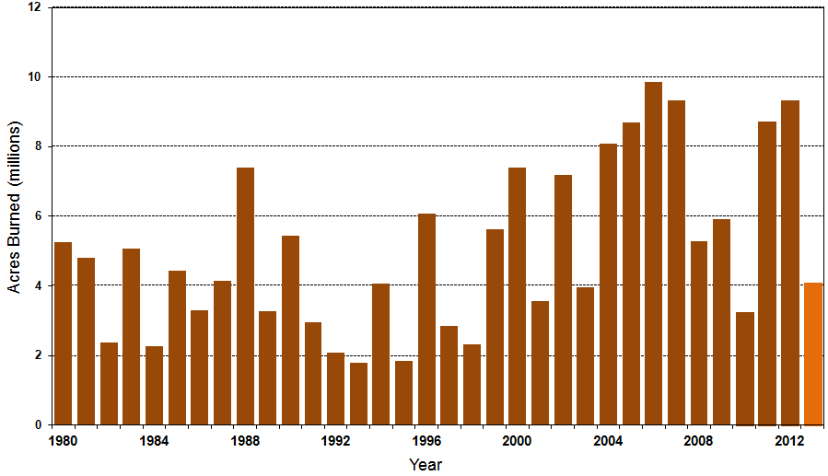
Number of Acres Burned in Wildfires, 1980 – 2013
TX experienced significant wildfire losses in 2011 (Bastrop fire insured losses ~$500 million)
Source: National Interagency Fire Center
88

Slide 89
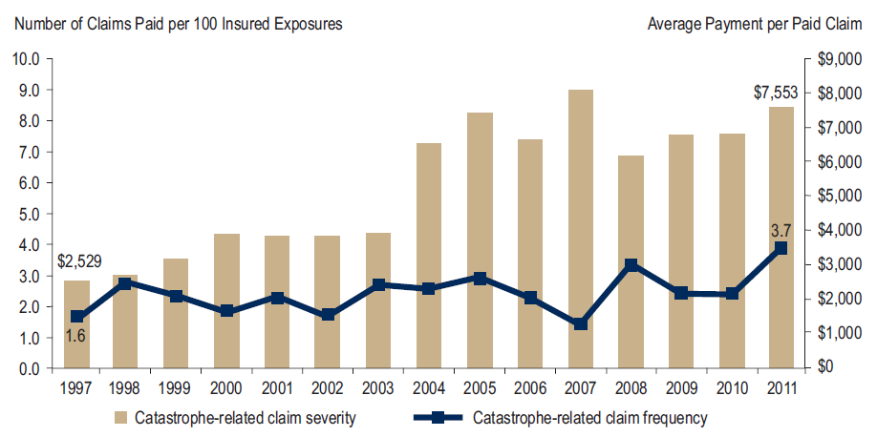
Homeowners Insurance Catastrophe-Related Claim Frequency and Severity, 1997—2012*
Avg. catastrophe claim cost rose approximately 200% from 1997-2011
Cat claim frequency in 2011 was at historic highs and more than double the rate in 1997
*All policy forms combined, countrywide.
Source: Insurance Research Council, Trends in Homeowners Insurance Claims, Sept. 2012 from ISO Fast Track data.
89

Slide 90
Homeowners Insurance Combined Ratio: 1990–2015F
Hurricane Andrew
Record tornado activity
Hurricane Sandy
Hurricane Ike
Homeowners Performance in 2011/12 Impacted by Large Cat Losses. Extreme Regional Variation Can Be Expected Due to Local Catastrophe Loss Activity
Sources: A.M. Best (1990-2011);Conning (2012E-2015F); Insurance Information Institute.

Slide 91
Flood Insurance
Flood Exposure: Reforms in Danger?
Flood Should Reflect True Risk
Keep the Subsidies
Would Prefer to Purchase from Private Insurers
91

Slide 92
Total Potential Home Value Exposure to Storm Surge Risk in 2013*
($ Billions)
Florida is by the state most vulnerable to storm surge.
The Value of Homes Exposed to Storm Surge was $1.147 Trillion in 2013.* Only a fraction of this is insured, hence the huge demand for federal aid following major coastal flooding events.
*Insured and uninsured property. Based on estimated property values as of April 2013.
Source: Storm Surge Report 2013, CoreLogic.

Slide 93
Total NFIP Policies in Force, 2012
Florida has almost three times as much flood insurance in force as any other state, accounting for 37% of all policies in the US
Source: U.S. Department of Homeland Security, Federal Emergency Management Agency; Insurance Information Institute.

Slide 94
Growth of NFIP program
Policies in Force at Year-End
Number of policies has not changed significantly though more homes are in harm’s way
Despite the growth of the program, approximately half of all properties in a flood zone lack flood insurance.
Source: U.S. Department of Homeland Security, Federal Emergency Management Agency; Insurance Information Institute.

Slide 95
What kind of Buildings Does Flood Insurance Protect?
One-fourth of all flood policies are written on commercial (non-residential) risks or on secondary homes.
Sources: Congressional Budget Office (2007), Insurance Information Institute.

Slide 96
Median Value of Flood Properties
A CBO survey indicated the typical home with flood insurance is worth significantly more than the typical home. The typical subsidized coastal risk was worth more than unsubsidized risks.
Congressional Budget Office 2007 survey of coastal risks, with U.S. owner-occupied home median from Bureau of Census, 2005 American Housing Survey; Insurance Information Institute.

Slide 97
Hurricane Sandy: Average Claim Payment by Type of Claim
Commercial (i.e., business claims) are more expensive because the value of property is often higher as well as the impact of insured business interruption losses
The average insured flood loss was nearly 9 times larger than the average non-flood insured loss (mostly wind)
Post-Sandy, the I.I.I. worked very hard to make help media, consumers and regulators understand the distinction between a flood claim and a standard homeowners claim. NFIP is $24B in debt.
*Includes rental and condo policies (excludes NFIP flood). **As of Oct. 31, 2013.
Sources: Catastrophe loss data is for Catastrophe Serial No. 90 (Oct. 28 – 31, 2012) from PCS as of March 2013; Insurance Information Institute.

Slide 98
Top 12 Most Costly Flood Events by NFIP Payout*
(NFIP Insured Losses, $ Millions)
8 of the 10 most costly events in NFIP history occurred over the past decade (2004‒2013); NFIP deficit now totals $24 billion
Katrina and Sandy are by far the most costly events in NFIP history
*Expressed in original dollars (not inflation-adjusted).
Sources: PCS; Insurance Information Institute inflation adjustments to 2012 dollars using the CPI.

Slide 99
I.I.I. Poll: Disaster Preparedness
Q. Do you have a separate flood insurance policy?¹
Percentage of people with flood insurance is unchanged
Only 13 percent of American homeowners say they have a flood insurance policy; the percentage is lowest in the Northeast at 10 percent.
¹Asked of those who have homeowners insurance and who responded “yes”.
Source: Insurance Information Institute Annual Pulse Survey.

Slide 100
I.I.I. Poll: Disaster Preparedness
Q. Does your homeowners policy cover damage from flooding during a hurricane?¹
About 30 percent of homeowners in the South still believe flooding from a hurricane is covered
The proportion of homeowners who believe their homeowners policy covers damage from flooding during a hurricane stands at 21 percent. This proportion rises eight percentage points in the South, to 29 percent.
¹Asked of those who have homeowners insurance and who responded “yes”.
Source: Insurance Information Institute Annual Pulse Survey.

Slide 101
Biggert-Waters: Media and Congressional Maelstrom
BW-12 Rate Increases to Phase Out Subsidies Began in 2013
  Note: Only 20% of NFIP policies are subsidized
Jan. 1, 2013: Non-Primary/Secondary Residences
  Increases of 25% per year until full-risk rate achieved
  Reaction: Very muted; Vacation homes/wealthier owners
Oct. 1, 2013: Subsidized Severe or Repetitive Loss Policies and Owners of Business/Non-Residential Properties
  Increases of 25% per year until full-risk rate achieved
  Reaction: Huge consumer backlash, intense media coverage leading to a Congressional effort to delay BW-12 by 4 years (effectively killing it). Even Maxine Waters supports delay…
Subsidy Lost if Policy Lapses, Severe Repeated, New Policy
I.I.I. Is Explaining the Risks Associated with BW-12 Delay
Future Pvt. Insurer Flood Participation Impacted by BW-12 Debate
I.I.I. Research Report on Issue Due Soon Under BW-12 Section 236 Study Requirement (National Academy of Sciences)
101
12/01/09 - 9pm
eSlide – P6466 – The Financial Crisis and the Future of the P/C
Notes:
101

Slide 102
Success of Write Your Own Program
Write Your Own Policies vs. Written Directly by NFIP
More than 80% of flood policies in the NFIP are written through the Write Your Own program, a public-private partnership.
Source: U.S. Department of Homeland Security, Federal Emergency Management Agency; Insurance Information Institute.

Slide 103
Extent of Flood Insurance Subsidy
The average subsidized policy pays about 40 percent of the full actuarial rate. Eliminating the subsidy would increase program premium by more than 50 percent.
Sources: NFIP 2011 Actuarial Rate Review, Insurance Information Institute.

Slide 104
Cost of Reinstituting Subsidies
Proposals to reduce rates will create a $2.1B shortfall in the NFIP over 10 years, would cause the NFIP to borrow more from the Treasury and could force a slowdown in claims payments.
Sources: Congressional Budget Office, Insurance Information Institute.

Slide 105
I.I.I. Poll: Flood Insurance
Q. Do you think it is fair that flood insurance premium increases are higher if people who live in high flood risk areas and rebuild their homes do not elevate them?
Don’t know
No
Yes
Almost two-thirds of Americans think that it is fair that flood insurance premiums be raised for people who live in high flood risk areas and rebuild their homes after a flood but do not elevate them.
Source: Insurance Information Institute Annual Pulse Survey.

Slide 106
I.I.I. Poll: Flood Insurance
Q. Do you think flood insurance premiums should reflect the risk of flooding no matter what the cost or do you think the government should subsidize the cost of flood insurance with taxpayers’ dollars?
Don’t know
Government should subsidize cost with taxpayers’ dollars
Premiums should reflect flood risk
Almost two-thirds of Americans think flood insurance premiums should be raised to reflect the risk of flooding.
Source: Insurance Information Institute Annual Pulse Survey (Nov. 2013).

Slide 107
I.I.I. Poll: Flood Insurance
Q. The federal government provides insurance coverage at taxpayer-subsidized rates for damage from floods through the National Flood Insurance Plan. A new law eliminates the subsidy and raises rates. Do you think the rate increase should be repealed?
It is inconsistent for the public to support full-risk rates but maintain subsidies, but this exactly mirrors Congressional sentiments, with supporters of BW-12 and even Tea Party conservatives supporting continuation of the subsidies
Don’t know
No
Yes
More than half of Americans polled for the November 2013 Pulse thought that hikes in National Flood Insurance premiums should be repealed.
Source: Insurance Information Institute Annual Pulse Survey.

Slide 108
I.I.I. Poll: Flood Insurance
Q. If the costs were similar, would you prefer to buy flood insurance from a private insurance company or from the federal government through the National Flood Insurance Program?
Don’t know
The federal government through the NFIP
Private insurance company
Six out of 10 Americans would prefer to buy flood insurance from a private insurance company as opposed to the federal government, if costs were similar.
Source: Insurance Information Institute Annual Pulse Survey.

Slide 109
Federal Disaster Declarations Patterns: 1953-2013
Disaster Declarations Set New Records in Recent Years
109

Slide 110
Number of Federal Major Disaster Declarations, 1953-2014*
There have been 2,147 federal disaster declarations since 1953. The average number of declarations per year is 35 from 1953-2013, though there few haven’t been recorded since 1995.
The number of federal disaster declarations set a new record in 2011, with 99, shattering 2010’s record 81 declarations.
3 federal disasters were declared so far in 2014*
The Number of Federal Disaster Declarations Is Rising and Set New Records in 2010 and 2011 Before Dropping in 2012/13
*Through January 25, 2014.
Source: Federal Emergency Management Administration; http://www.fema.gov/disasters; Insurance Information Institute.

Slide 111
Federal Disasters Declarations by State,
1953 – 2014: Highest 25 States*
Over the past 60 years, Florida has had the 5th highest number of Federal Disaster Declarations (32 were associated with tropical events)
Hurricanes Tornadoes Floods Freezes Wildfires Severe T-Storms High Winds Extreme Tides
*Through Jan. 25, 2014. Includes Puerto Rico and the District of Columbia.
Source: FEMA: http://www.fema.gov/news/disaster_totals_annual.fema; Insurance Information Institute.

Slide 112
Federal Disasters Declarations by State,
1953 – 2014: Lowest 25 States*
Over the past 60 years, Wyoming and Rhode Island had the fewest number of Federal Disaster Declarations
*Through Jan. 25, 2014. Includes Puerto Rico and the District of Columbia.
Source: FEMA: http://www.fema.gov/news/disaster_totals_annual.fema; Insurance Information Institute.

Slide 113
SEVERE WEATHER REPORT UPDATE: 2013
Damage from Tornadoes, Large Hail and High Winds Keep Insurers Busy in Every State—Including Florida
113

Slide 114
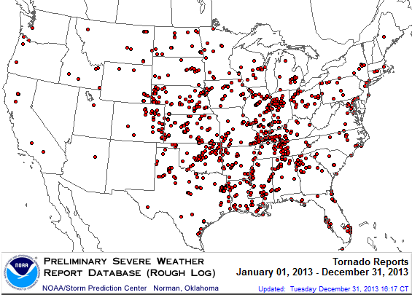
Location of Tornado Reports in 2013
A deadly EF-5 tornado in May in Moore, OK, produced insured losses of $1.575 billion
There were 943 tornadoes through Dec. 31, (37 of them in FL)causing extensive property damage in several states
Source: NOAA Storm Prediction Center; http://www.spc.noaa.gov/climo/online/monthly/2013_annual_summary.html#; PCS.
114

Slide 115
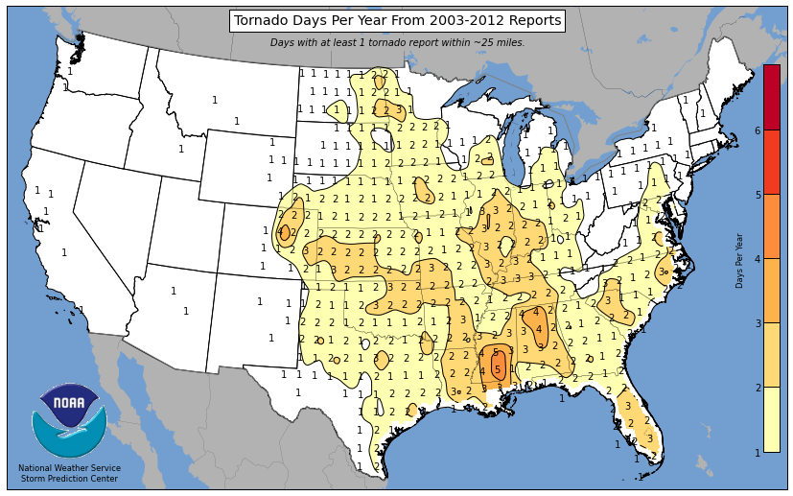
Tornado Days per Year, 2003-2012
Parts of inland FL have tornado frequencies that rival “Tornado Alley”
Source: http://www.spc.noaa.gov/wcm/.
115

Slide 116
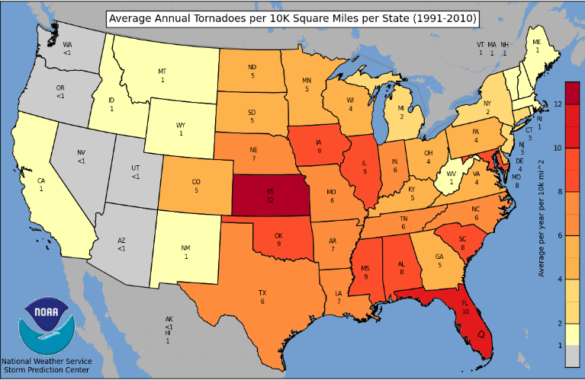
Severe Thunderstorm Wind Days per Year, 2003-2012
FL has among the highest frequency of tornadoes per kilometer in the U.S.
Source: http://www.spc.noaa.gov/wcm/.
116

Slide 117
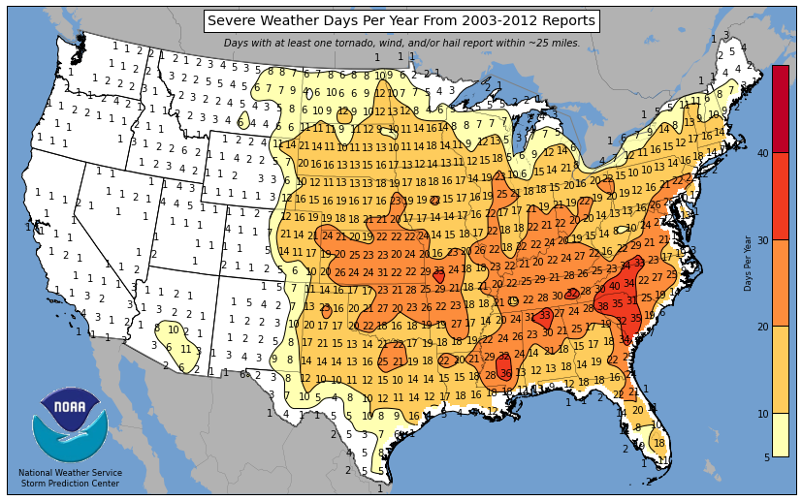
Severe Weather Days per Year, 2003-2012
North FL has more Severe Weather Days than south FL
Source: http://www.spc.noaa.gov/wcm/.
117

Slide 118
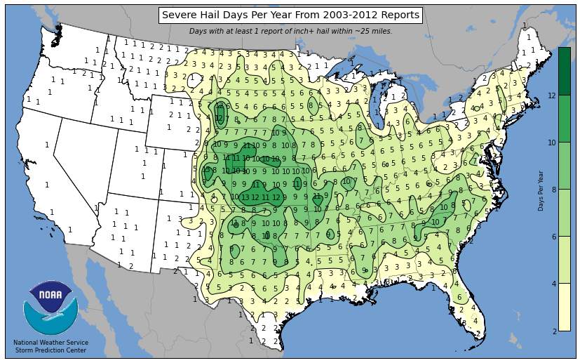
Severe Hail Days per Year, 2003-2012
Central and Northeast FL have elevated hail frequencies
Source: http://www.spc.noaa.gov/wcm/.
118

Slide 119
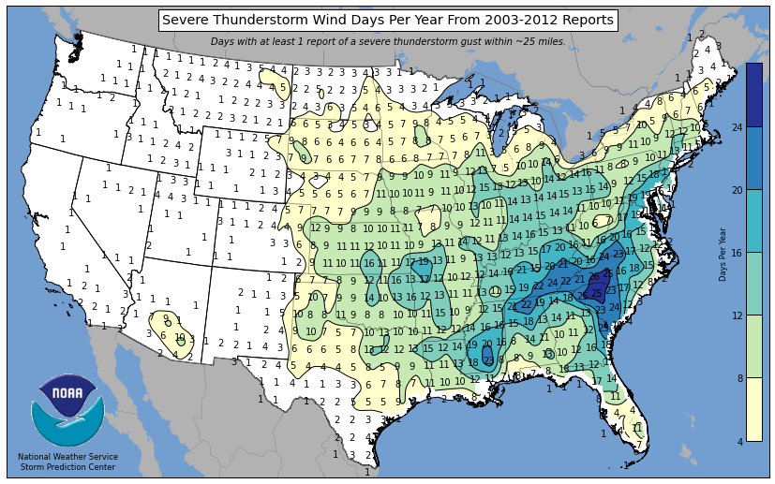
Severe Thunderstorm Wind Days per Year, 2003-2012
North FL experiences a high frequency of high winds from Severe T-Storms
Source: http://www.spc.noaa.gov/wcm/.
119

Slide 120
U.S. Thunderstorm Insured Loss Trends, 1980 – 2013
Hurricanes get all the headlines, but thunderstorms are consistent producers of large scale loss. 2008-2013 are the most expensive years on record.
Average thunderstorm losses are up 7 fold since the early 1980s. The 5-year running average loss is up sharply
Thunderstorm losses in 2013 totaled $10.3 billion, the 6th highest on record
Source: Property Claims Service, and MR NatCatSERVICE
120

Slide 121
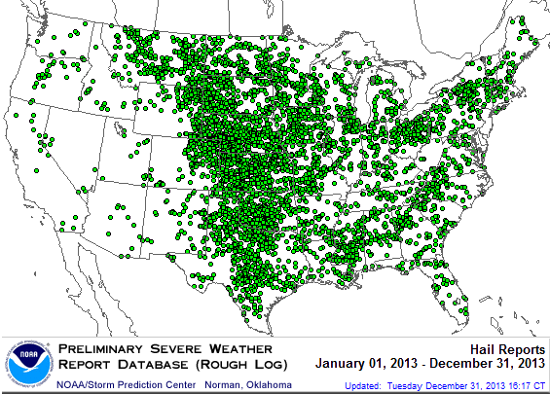
Location of Large Hail Reports: 2013
There were 5,457 “Large Hail” reports in 2013, causing extensive property and vehicle damage
Source: NOAA Storm Prediction Center; http://www.spc.noaa.gov/climo/online/monthly/2013_annual_summary.html#
121

Slide 122
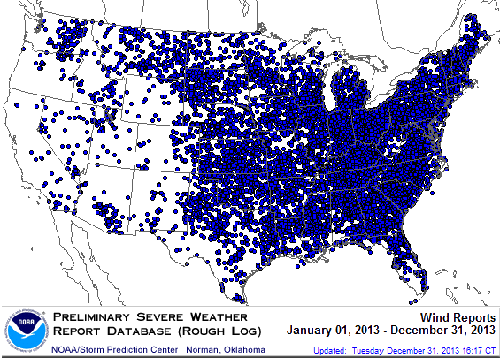
Location of High Wind Reports: 2013
There were 12,942 “Wind Damage” in 2013, causing extensive property damage
Source: NOAA Storm Prediction Center; http://www.spc.noaa.gov/climo/online/monthly/2013_annual_summary.html#
122

Slide 123
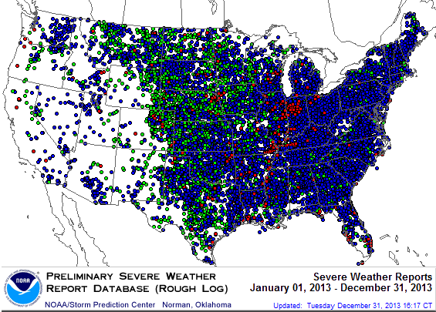
Severe Weather Reports: 2013
Severe weather reports are concentrated east of the Rockies
There were 19,342 severe weather reports in 2013; including 942 tornadoes; 5,457 “Large Hail” reports and 12,942 high wind events
Source: NOAA Storm Prediction Center; http://www.spc.noaa.gov/climo/online/monthly/2013_annual_summary.html#
123

Slide 124
Terrorism Update
Boston Marathon Bombings Underscore the Need for Extension of the Terrorism Risk Insurance Program
Download III’s Terrorism Insurance Report at: http://www.iii.org/white_papers/terrorism-risk-a-constant-threat-2013.html
124
Notes:
124

Slide 125
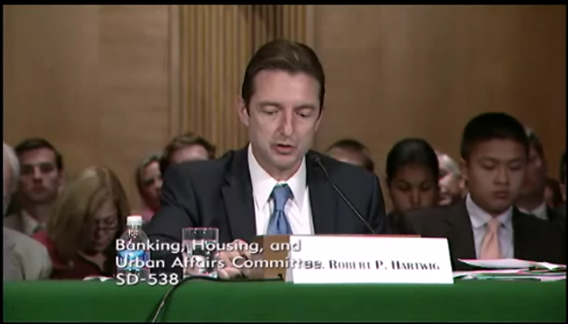
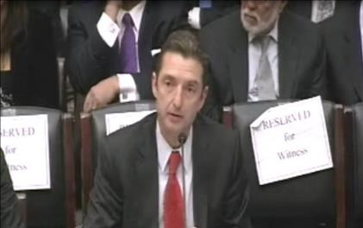
Terrorism Risk Insurance Program
Testified before Senate Banking Cmte. in Sept. 2013
Testified before House Financial Services Nov. 2013
Provided testimony at NYC hearing on June 2013
I.I.I. Accelerated Planned Study on Terrorism Risk and Insurance in the Wake of Boston and Hearings; Was Well Received and Widely Circulated
Working with Trades, Congressional Staff, GAO & Others
House Financial Services Subcommittee, 11/13/13
Senate Banking Committee, 9/25/13
125
12/01/09 - 9pm
eSlide – P6466 – The Financial Crisis and the Future of the P/C
Notes:
125

Slide 126
Financial Strength & Underwriting
Cyclical Pattern is P-C Impairment History is Directly Tied to Underwriting, Reserving & Pricing
126

Slide 127
P/C Insurer Impairments, 1969–2012
Impairments among P/C insurers remain infrequent
The Number of Impairments Varies Significantly Over the P/C Insurance Cycle, With Peaks Occurring Well into Hard Markets
Source: A.M. Best Special Report “1969-2011 Impairment Review,” June 2012 and March 6, 2013 update; Insurance Info. Institute.

Slide 128
P/C Insurer Impairment Frequency vs. Combined Ratio, 1969-2011
2011 impairment rate was 0.91%, up from 0.67% in 2010; the rate is slightly higher than the 0.82% average since 1969
Impairment Rates Are Highly Correlated With Underwriting Performance and Reached Record Lows in 2007; Recent Increase Was Associated Primarily With Mortgage and Financial Guaranty Insurers and Not Representative of the Industry Overall
Source: A.M. Best; Insurance Information Institute

Slide 129
Reasons for US P/C Insurer Impairments, 1969–2010
Historically, Deficient Loss Reserves and Inadequate Pricing Are
By Far the Leading Cause of P-C Insurer Impairments.
Investment and Catastrophe Losses Play a Much Smaller Role
Reinsurance Failure
Sig. Change in Business
Misc.
Investment Problems (Overstatement of Assets)
Deficient Loss Reserves/
Inadequate Pricing
Affiliate Impairment
Catastrophe Losses
Alleged Fraud
Rapid Growth
Source: A.M. Best: 1969-2010 Impairment Review, Special Report, April 2011.

Slide 130
Top 10 Lines of Business for US P/C Impaired Insurers, 2000–2010
Workers Comp and Pvt. Passenger Auto Account for Nearly Half of the Premium Volume of Impaired Insurers Over the Past Decade
Title
Financial Guaranty
Surety
Med Mal
Workers Comp
Other Liability
Commercial Auto Liability
Pvt. Passenger Auto
Commercial Multiperil
Homeowners
Source: A.M. Best: 1969-2010 Impairment Review, Special Report, April 2011.

Slide 131
CYBER RISK
Cyber Risk is a Rapidly Emerging Exposure for Businesses Large and Small in Every Industry
III White Paper: http://www.iii.org/assets/docs/pdf/paper_CyberRisk_2013.pdf
131

Slide 132





Data Breaches 2005-2013, by Number of Breaches and Records Exposed
# Data Breaches/Millions of Records Exposed
Millions
The Total Number of Data Breaches (+38%) and Number of Records Exposed (+408%) in 2013 Soared
* 2013 figures as of Jan. 1, 2014 from the ITRC updated to an additional 30 million records breached (Target) as disclosed in Jan. 2014.
Source: Identity Theft Resource Center.

Slide 133
SURPLUS/CAPITAL/CAPACITY
2013 Recorded Yet Another Record High
133

Slide 134
Policyholder Surplus,
2006:Q4–2013:Q3
Drop due to near-record 2011 CAT losses
($ Billions)
2007:Q3
Pre-Crisis Peak
Surplus as of 9/30/13 stood at a record high $624.4B
The industry now has $1 of surplus for every $0.78 of NPW,
close to the strongest claims-paying status in its history.
2010:Q1 data includes $22.5B of paid-in capital from a holding company parent for one insurer’s investment in a non-insurance business .
The P/C insurance industry entered 2014
in very strong financial condition.
Sources: ISO, A.M .Best.
134
12/01/09 - 9pm
eSlide – P6466 – The Financial Crisis and the Future of the P/C
Notes:
134

Slide 135
US Policyholder Surplus:
1975–2013*
($ Billions)
Surplus as of 9/30/13 was a record $624.4, up 6.4% from $586.9 of 12/31/12, and up 42.9% ($187.3B) from the crisis trough of $437.1B at 3/31/09. Pre-crisis peak was $521.8 as of 9/30/07. Surplus as of 9/30/13 was 19.7% above 2007 peak.
“Surplus” is a measure of underwriting capacity. It is analogous to “Owners Equity” or “Net Worth” in non-insurance organizations
The Premium-to-Surplus Ratio Stood at $0.78:$1 as of
9/30/13, a Near Record Low (at Least in Recent History)*
* As of 9/30/13.
Source: A.M. Best, ISO, Insurance Information Institute.

Slide 136
3. REINSURANCE MARKET CONDITIONS
Ample Capacity as Alternative Capital is Transforming the Market
136

Slide 137
Global Reinsurer Capital, 2007-2013:H1*
($ Billions)
+11%
+1%
+18%
-3%
+18%
-17%
Global Reinsurance Capital Has Been Trending Generally Upward Since the Global Financial Crisis, a Trend that Seems Likely to Continue
*Includes both traditional and non-traditional forms of reinsurance capital.
Source: Aon Benfield Aggregate study for the 6 months ending June 2013; Insurance Information Institute.

Slide 138
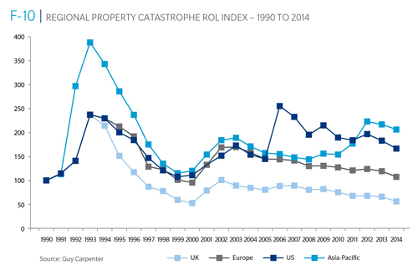
Reinsurance Pricing: Rate-on-Line Index by Region, 1990 – 2014*
Lower CATs and a flood of new capital has pushed reinsurance pricing down in most regions, including the US
*As of Jan. 1.
Source: Guy Carpenter

Slide 139
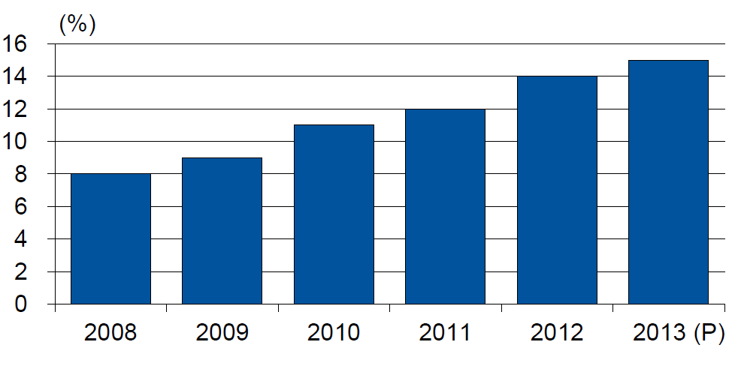
Alternative Capacity as a Percentage of Global Property Catastrophe Reinsurance Limit
(As of Year End)
Alternative Capacity accounted for approximately 14% or $45 billion of the $316 in global property catastrophe reinsurance capital as of mid-2013 (expected to rise to ~15% by year-end 2013)
Source: Guy Carpenter

Slide 140
Property Catastrophe Reinsurance Capacity by Source as of Mid-2013 ($ Bill)
Total = $316 Billion*
“Convergence Capital” accounted for an estimated $45B or 14% or total property catastrophe reinsurance capacity as of mid-2013, up $10B over the past 18 months (since 1/1/12). Penetration of this type of capacity is growing
Collateralized reinsurance (sidecars) is the fastest growing segment recently
Source: Guy Carpenter; Mid-Year Market Report, September 2013; Insurance Information Institute.

Slide 141
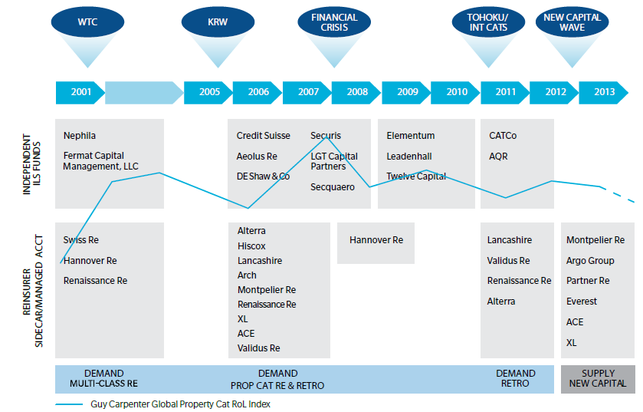
Alternative Capacity Development,
2001—2013:H1
Source: Guy Carpenter; Mid-Year Market Report, September 2013; Insurance Information Institute.

Slide 142
Non-Traditional Property Catastrophe
Limits by Type, YE 2012 vs. YE 2015E
Alternative capital is expected to rise by 30% by YE 2015 and will ultimately account for 20-30% of total reinsurance spend, according to Guy Carpenter
Source: Guy Carpenter; Reinsurance Association of America; Insurance Information Institute.

Slide 143
Catastrophe Bonds: Issuance and Outstanding, 1997- 2013*
Risk Capital Amount ($ Millions)
Risk capital outstanding reached a record high $18.6B in 2013
Financial crisis depressed issuance
CAT bond issuance reached a record $7.1B in 2013
Catastrophe Bond Issuance and Risk Capital Outstanding Reached All-Time Record Highs in 2013
*Through Dec. 31, 2013.
Source: Guy Carpenter; Insurance Information Institute.

Slide 144
CATASTROPHE BONDS, ANNUAL RISK CAPITAL ISSUED, 2002-2013
($ Billions)
Catastrophe bond issuance hit a new record high in 2013
Source: GC Securities and Guy Carpenter & Company, LLC.

Slide 145
CATASTROPHE BONDS, RISK CAPITAL OUTSTANDING, 2002-2013
($ Billions)
Catastrophe bond risk capital outstanding hit a new record high in 2013
Source: GC Securities and Guy Carpenter & Company, LLC.

Slide 146
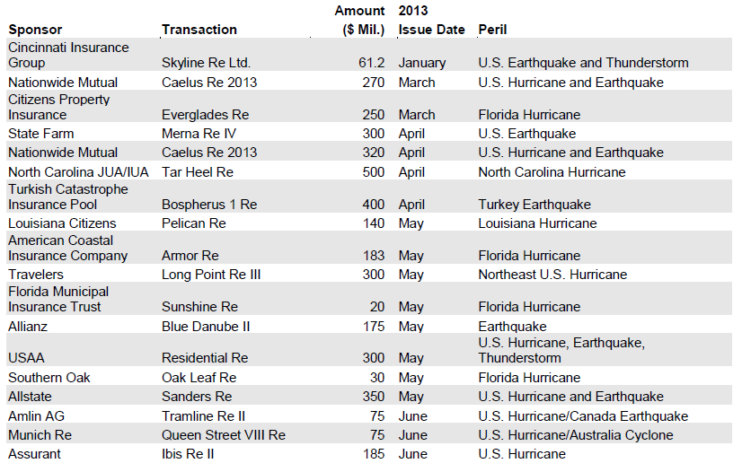
Catastrophe Bond Issuances,
First Half 2013
Sources: Willis Capital Markets & Advisory, Fitch Ratings; Insurance Information Institute.

Slide 147
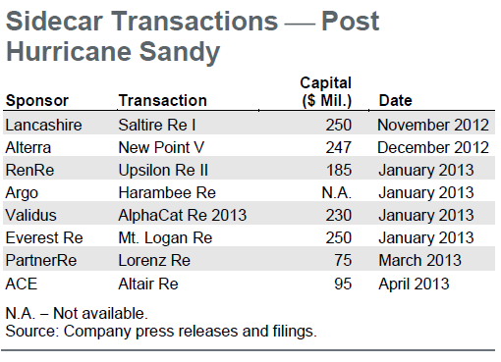
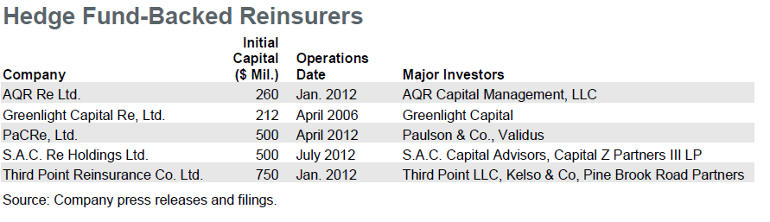
Sidecar Transactions (Post-Sandy) and Hedge Fund-Backed Reinsurers
Sidecars (collateralized reinsurance) are the fastest growing alternative capital segment, account for about 15% or $5 bill of total property catastrophe reinsurance capital
More hedge fund money is coming into the business
Sources: Willis Capital Markets & Advisory, Fitch Ratings; Insurance Information Institute.

Slide 148
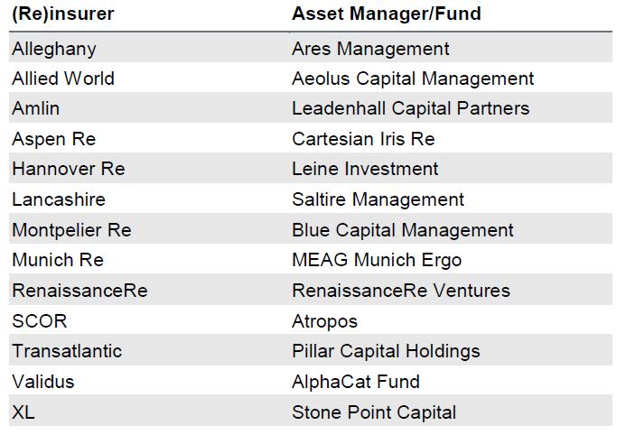
(Re) Insurers Investing in Insurance
Linked Securities (ILS) Fund Managers
Several (re)insurers have formed asset managers or invested in independent asset managers that are focused on managing catastrophe/ILS funds for outside investors. These asset managers invest third party capital in instruments with returns linked to property catastrophe reinsurance retrocession and ILS contracts.
Sources: Willis Capital Markets & Advisory, Fitch Ratings; Insurance Information Institute.

Slide 149
Alternative Reinsurance Capital Summary
Alternative Reinsurance Here to Stay
  Capital markets have effectively discovered reinsurance another “asset class,” in part due to Federal Reserve’s unprecedented actions since the financial crisis to keep interest rates low across the entire yield curve.
  A convergence of the reinsurance and capital markets persists with many companies both providing and using alternative forms of risk transfer to supplement the traditional balance sheet, transforming several reinsurers into risk asset managers. These structures include catastrophe bonds (cat bonds), collateralized quota-share reinsurance vehicles (sidecars), industry loss warranties (ILWs), hedge fund-supported reinsurers and asset managers investing in insurance-linked securities (ILS).
Property Catastrophe Drives Market:
  The nature of property catastrophe risk as being highly modeled and commoditized serves as an important economic force driving its transfer into the capital markets. Casualty (re)insurance lines have had limited movement into the alternative reinsurance market thus far, as the less standardized and more specialized nature of these longer term risks makes them better suited for more permanent traditional capacity providers.
Sources: Fitch Ratings, Alternative Reinsurance Market Update, September 5, 2013; Insurance Information Institute.

Slide 150
Alternative Reinsurance Capital Summary (continued)
Strong Investor Demand
  Comparatively high potential returns of catastrophe risk through cat bonds and sidecar investments are particularly attractive to investors, although this spread has been shrinking due to increased investor demand. However, the lack of correlation between catastrophe losses and returns on other major asset classes should continue to contribute to strong demand from investors, which include hedge funds, private equity and institutional investors.
Shock (i.e., Large Loss) Event Could Alter Market
  One area of uncertainty is how investors would react to an environment of less favorable catastrophe risk spreads or a large unexpected catastrophe loss, either of which could cause capital to retreat. This risk is likely higher for hedge fund capital, as pension fund capital tends to be more permanent, given their long-term investment outlook and more diversified risk exposure.
Mixed Impact to Reinsurers’ Ratings:
  Fitch views the growth and acceptance of alternative reinsurance as a mixed impact for the credit quality of reinsurers’ ratings. Favorably, these products can be used to manage reinsurers’ exposure and capital and serve as a source of fee income. Negatively, alternative coverage represents competition for traditional reinsurers that, in conjunction with the strong overall capitalization of the reinsurance industry, have worked to notably dampen reinsurance pricing
Sources: Fitch Ratings, Alternative Reinsurance Market Update, September 5, 2013.

Slide 151
Alternative Reinsurance Capital Summary (continued)
Sponsors Benefit From New Issuance:
  As investor demand has continued to grow for catastrophe bonds, sponsors have been able to offer deals at considerably lower coupon rates and with increasingly favorable structures that suit individual company needs. These market conditions are likely to drive further issuance of cat bonds in the near term if (re)insurers believe they can produce a cost-effective alternative to supplement their reinsurance program. As of midyear, 2013 is on track to produce a record amount of catastrophe bond issuance.
Sidecars Continue to Provide Capacity:
  Several sidecars emerged late in 2012 and early into 2013 following Hurricane Sandy. These vehicles were opportunistically seeking to capitalize on any potential improvements in property catastrophe pricing. However, they also represented several newer entrants into the alternative reinsurance space looking to participate in what continues to be an important and growing segment of the reinsurance market.
Sources: Fitch Ratings, Alternative Reinsurance Market Update, September 5, 2013.

Slide 152
Questions Arising from Influence of Alternative Capital
Could Pension Fund Money Swamp Traditional Capacity?
  US private pension funds hold ~$7 trillion in assets
  2% allocation = $140 billion
  Global property cat capital = ~$316 bill as of mid-2013
Do New Investors Have a Lower Cost of Capital?
  New capacity expects 6-8% rate of return compared to 8-10% for traditional reinsurance, according to Dowling & Partners
Will Reinsurance Pricing Become More Closely Linked to Interest Rates?
Will the New Capital Exit if:
  ILS sustain losses from major CAT events
  Interest rates rise

Slide 153
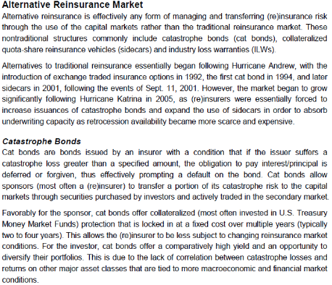
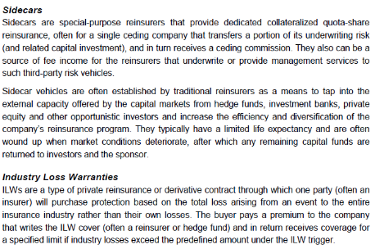
Alternative Capital: Important Definitions
Sources: Fitch Ratings; Insurance Information Institute.

Slide 154
Insurance Information Institute Online:
www.iii.org
Thank you for your time
and your attention!
Twitter: twitter.com/bob_hartwig
Download at www.iii.org/presentations

