Slide 1
Today’s Uncertain Economy: Implications for Public Entities and P/C Insurance
April 10, 2013
Steven N. Weisbart, Ph.D., CLU, Senior Vice President & Chief Economist
Insurance Information Institute ♦ 110 William Street ♦ New York, NY 10038
Tel: 212.346.5540 ♦ Cell: 917.494.5945 ♦ stevenw@iii.org ♦ www.iii.org

Slide 2
The Strength of the Economy Will Influence P/C Insurer Growth Opportunities
Growth Will Expand
the Insurer Exposure Base
Across Most Lines
2

Slide 3
A Continued Weak Recovery is Forecast:
Real GDP Growth, Yearly, 1970-2014F
Real GDP Growth (%)
In recoveries, real yearly GDP growth is often 4% or more
The median forecast is for several more years of real yearly GDP growth under 3% -- weaker than after most recent recessions
Forecasts from Blue Chip Economic Indicators, 3/2013 issue, median of range of 52 forecasts.
Sources: (GDP) U.S. Department of Commerce at http://www.bea.gov/national/xls/gdpchg.xls.
3
12/01/09 - 9pm
eSlide – P6466 – The Financial Crisis and the Future of the P/C
Notes:
3

Slide 4
March 2013 Forecasts of Quarterly US Real GDP for 2013-14
Real GDP Growth Rate
If it lasts, the sequester will have greatest effect here
Despite the sequester and other challenges to the U.S. economy,
virtually every forecast in the Blue Chip universe in early March sees improvement ahead
Sources: Blue Chip Economic Indicators (3/13); Insurance Information Institute

Slide 5
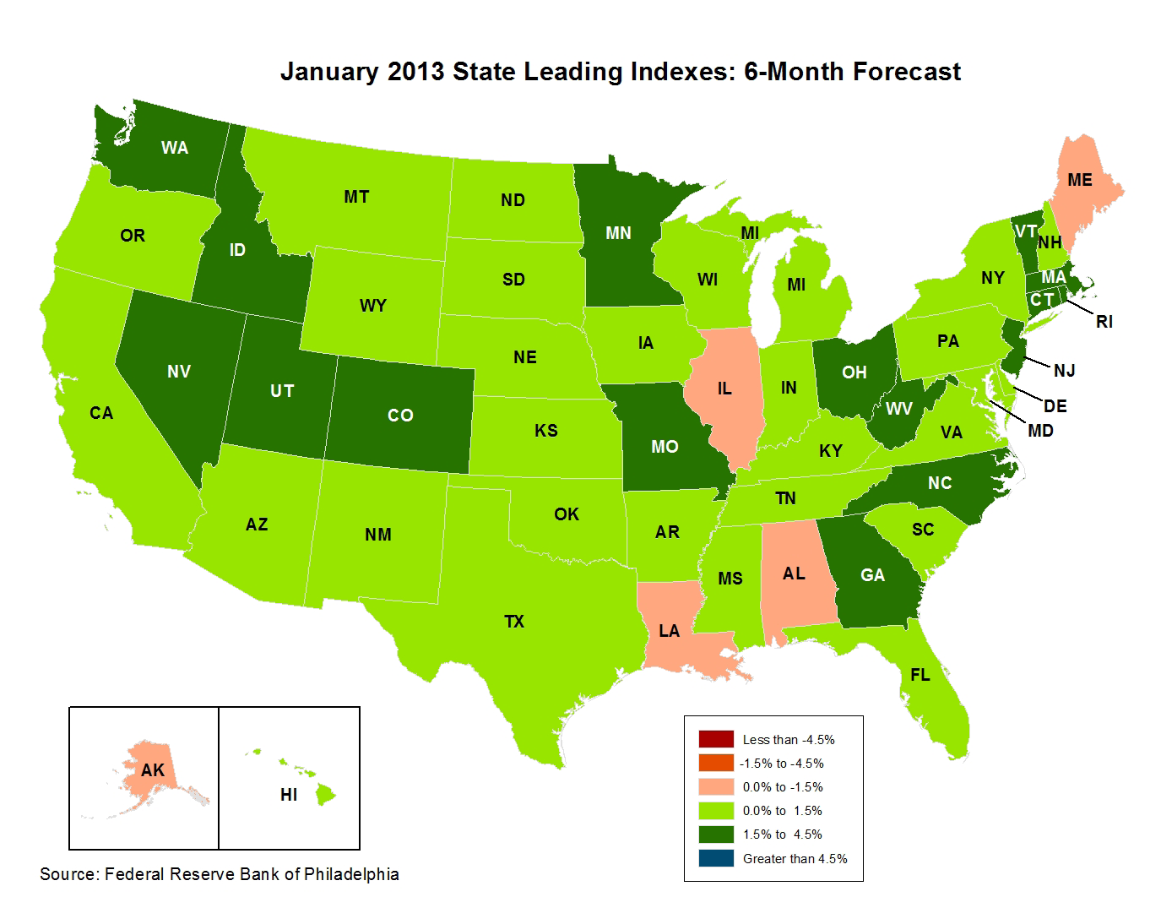
State-by-State Leading Indicators
through 2013:Q2
Near-term growth forecasts vary widely by state. Strongest growth = dark green; weakest = beige
Sources: Federal Reserve Bank of Philadelphia at www.philadelphiafed.org/index.cfm; Insurance Information Institute.
Next release is April 4, 2013

Slide 6
State & Local Government Contribution to Change* in Real US GDP, Quarterly, 2009-2012
Real GDP Growth (%)
Cutbacks by state and local governments have hampered the economy’s recovery from the recession
The drag on the economy from state & local governments is diminishing.
*seasonally adjusted at annual rates
Sources: (GDP) U.S. Department of Commerce at http://www.bea.gov/national/xls/gdpchg.xls.; I.I.I.
6
12/01/09 - 9pm
eSlide – P6466 – The Financial Crisis and the Future of the P/C
Notes:
6

Slide 7
Households Are Still* Reducing
Their Financial Obligations
Financial Obligations Ratio
Financial Obligations Ratio: debt service (mortgage and consumer debt), auto lease, residence rent, HO insurance, and property tax payments as % of personal disposable income.
Decline began in 2007:Q4.
It will be tough to shrink this ratio further as interest rates and property taxes rise.
*Through 2012:Q4 (data posted on Mar 13, 2013).
Source: Federal Reserve Board, at www.federalreserve.gov/releases/housedebt.

Slide 8
Y-o-Y Percentage Change in the Value of Public Construction Put in Place, by Segment, Feb. 2013*
Growth (%)
Transportation and Power projects lead public sector construction
With strained state and local government budgets, public construction activity declined in many segments; will the sequester crimp 2013?
*seasonally adjusted; data published April 1, 2013
Source: U.S. Census Bureau, http://www.census.gov/construction/c30/c30index.html ; Insurance Information Institute.

Slide 9
Labor Market Trends
Steady Job Gains in the Private Sector
Offset Steady Job Losses in the Public Sector
9

Slide 10
Unemployment and Underemployment Rates: Stubbornly High in 2012, But Falling
January 2000 through Mar. 2013, Seasonally Adjusted (%)
U-6 went from 8.0% in March 2007 to 17.5% in
October 2009; Stood at 13.8% in Mar. 2013
Unemployment “Headline” unemployment stood at 7.6% in Mar. 2013.
The Federal Reserve’s target for ending “easy money” is 6.5% (assuming inflation remains within its 2% target).
Nov. 12
Stubbornly high unemployment and underemployment constrain overall economic growth, but the job market is now clearly improving.
Source: US Bureau of Labor Statistics; Insurance Information Institute.
10
12/01/09 - 9pm
eSlide – P6466 – The Financial Crisis and the Future of the P/C
Notes:
10

Slide 11
State Government Employment
Monthly, 1990–2013*
Millions
State government employment rises in recessions, shrinks after them(for a while)
Latest was 5.02 million, down 3.7% from peak (Aug 2008)
State government employment rises in recessions, shrinks after them (for a while)
State government employment rises in recessions, shrinks after them (for a while)
*As of February 2013 (Jan 2013 and Feb 2013 are preliminary); Seasonally adjusted
Note: Recessions indicated by gray shaded columns.
Sources: US Bureau of Labor Statistics; National Bureau of Economic Research (recession dates); Insurance Information Institutes.
11
12/01/09 - 9pm
eSlide – P6466 – The Financial Crisis and the Future of the P/C
Notes:
11

Slide 12
Local Government Employment
Monthly, 1990–2013*
Millions
Recession proof? Local government employment rose through this and the prior recession
Latest was 14.03 million, down 3.9% from peak (Jun 2009)
First significant drop in local government employment in over three decades
(-4.2% in 1980-82)
*As of February 2013 (Jan 2013 and Feb 2013 are preliminary); Seasonally adjusted
Note: Recessions indicated by gray shaded columns.
Sources: US Bureau of Labor Statistics; National Bureau of Economic Research (recession dates); Insurance Information Institutes.
12
12/01/09 - 9pm
eSlide – P6466 – The Financial Crisis and the Future of the P/C
Notes:
12

Slide 13
Unemployment Rates Vary Widely by State and Region*
Southeast
Mid-Atlantic
New England
*Provisional figures for February 2013, seasonally adjusted.
Sources: US Bureau of Labor Statistics; Insurance Information Institute.
13
12/01/09 - 9pm
eSlide – P6466 – The Financial Crisis and the Future of the P/C
Notes:
13
This chart and the succeding one show that unemployment rates vary widely, not only by region, but within regions.

Slide 14
Unemployment Rates Vary Widely by State and Region* (cont’d)
Far West
Southwest
Mountain
Great Lakes
Great Plains
*Provisional figures for February 2013, seasonally adjusted.
Sources: US Bureau of Labor Statistics; Insurance Information Institute
14
12/01/09 - 9pm
eSlide – P6466 – The Financial Crisis and the Future of the P/C
Notes:
14
In May for the first time in 2 years, Nevada overtook Michigan as the state with the highest unemployment rate

Slide 15
Cumulative Change in Government Employment: Jan. 2010—Feb. 2013
Government at all levels has shed more than half a million jobs since Jan. 2010 even as private employers created 6.31 million jobs, though losses may now be ending.
January 2010 through Feb. 2013* (Millions)
Cumulative job losses through Feb. 2013 totaled 637,000
Temporary Census hiring distorted 2010 figures
Governments at All Levels are Under Severe Fiscal Strain As Tax Receipts Plunged and Pension Obligations Soared During the Financial Crisis: Sequestration Will Add to this Toll
Source: US Bureau of Labor Statistics http://www.bls.gov/data/#employment; Insurance Information Institute

Slide 16
Net Change in Government Employment: Jan. 2010—Feb. 2013*
State government employment fell by 2.6% since the end of 2009 while Federal employment is down by 1.1%
(Thousands)
Local government employment shrank by 473,000 from Jan. 2010 through Feb. 2013, accounting for 74% of all government job losses, negatively impacting WC exposures for those cities and counties that insure privately
*Cumulative change from prior month; Base employment date is Dec. 2009.
Source: US Bureau of Labor Statistics http://www.bls.gov/data/#employment; Insurance Information Institute

Slide 17
Wages/Salary Indexes, Private Industry vs. State & Local Government Quarterly, 2006–2012
Index
Note: Recession indicated by gray shaded column. Data are seasonally adjusted.
Sources: US. Bureau of Labor Statistics; National Bureau of Economic Research (recession dates); Insurance Information Institute.
17
12/01/09 - 9pm
eSlide – P6466 – The Financial Crisis and the Future of the P/C
Notes:
17

Slide 18
Benefits Indexes, Private Industry vs. State & Local Government Quarterly, 2006–2012
Index
Note: Recession indicated by gray shaded column. Data are seasonally adjusted.
Sources: US. Bureau of Labor Statistics; National Bureau of Economic Research (recession dates); Insurance Information Institute.
18
12/01/09 - 9pm
eSlide – P6466 – The Financial Crisis and the Future of the P/C
Notes:
18

Slide 19
The Aging Workforce
19
Notes:
19

Slide 20
Number of Workers Age 65-69, 70-74, and 75+, Quarterly, 1998-2012
(Thousands)
There are now over 7.4 million senior workers. This is double the number in 1998. Over the next decade it will probably double again.
This is the leading edge of the older half of the “baby boom” generation
Source: US Bureau of Labor Statistics, US Department of Labor; Insurance Information Institute.

Slide 21
Labor Force Participation Rate,
Ages 65-69, Quarterly, 1998:Q1-2013:Q1
Labor Force participation rate
1 in 3 in this age group are working. Virtually none of them are “baby boomers”
The brown bars indicate recessions.
The switch from DB pension plans (with early-retirement incentives) to DC plans (with, in effect, later-retirement incentives) might be partly responsible for raising this rate.
Not seasonally adjusted. Sources: US Bureau of Labor Statistics, US Department of Labor; Insurance Information Institute.

Slide 22
Labor Force Participation Rate,
Ages 70-74, Quarterly, 1998:Q1-2013:Q1
Labor Force participation rate
Nearly 1 in 5 in this age group is working.
15 years ago it was 1 in 8.
The labor force participation rate for workers 70-74 grew by about 50% since 1998.
Growth stalled during and after the Great Recession but has since resumed.
Source: US Bureau of Labor Statistics, US Department of Labor; Insurance Information Institute.

Slide 23
Labor Force Participation Rate,
Ages 70-74, Quarterly, 1998:Q1-2013:Q1
Labor Force participation rate
The labor force participation rate for men 70-74 grew by about 50% since 1998,
but for women 70-74 it nearly doubled (from about 9% to about 15.5%).
Source: US Bureau of Labor Statistics, US Department of Labor; Insurance Information Institute.

Slide 24
Labor Force Participation Rate, Quarterly
Ages 75 and over, 1998-2013:Q1
Labor Force participation rate
The labor force participation rate for workers 75 and over will probably hit 10% soon. This is close to what the rate was for the 70-74 group a decade ago.
In the last 14 years, the labor force participation rate for workers 75 and over grew from 4.5% to 8.6%. So 91.4% of these people are retired.
Sources: US Bureau of Labor Statistics, US Department of Labor; Insurance Information Institute.

Slide 25
Labor Force Participation Rate, Quarterly
Ages 75 and over, 1998-2013:Q1
Labor Force participation rate
In the last 15 years, the labor force participation rate for men 75 and over
grew from 6.9% to 12.6% and for women doubled (from 2.9% to 5.8%).
Sources: US Bureau of Labor Statistics, US Department of Labor; Insurance Information Institute.

Slide 26
Fatal Work Injury Rates Improved Slightly
Since 2006 but Still Climb Sharply With Age
Fatal Work Injury Rate per 100,000 full-time-equivalent workers
No improvement in fatal work injury rate for this age group
The fatality rate for workers 65 and older was 5 times that of workers age 25-34. The workplace of the future will have to be completely redesigned to accommodate the surge in older workers.
Source: US Bureau of Labor Statistics, at http://www.bls.gov/iif/oshcfoi1.htm/#2010
26

Slide 27
Older Workers Lose More Days from Work Due to Injury or Illness
Median Days Away From Work
Youngest baby boomer is age 49 (in 2013)
Oldest baby boomer is age 67 (in 2013)
Median lost time of workers age 65+ is 2-3X that of workers age 25-34. These numbers are pretty stable—they haven’t changed much since 2008.
Source: US Bureau of Labor Statistics, Nonfatal Occupational Injuries and Illnesses Requiring Days Away From Work, 2011 (Table 10), released November 8, 2012.
27

Slide 28
Percent of Days-Away-from-Work Cases, by Days Lost and Age Group, 2011
Over one-third of days-lost cases of older workers involved a month or more away from work. And virtually 9 of 10 cases were
for at least two days, compared to 8 of 10 for the youngest workers.
Source: US Bureau of Labor Statistics, Nonfatal Occupational Injuries and Illnesses Requiring Days Away From Work, 2011 (Table 11), released November 8, 2012.
28

Slide 29
Older Workers Are Much
More Likely to Break a Bone
Incidence Rate* (2011)
*per 10,000 full-time-equivalent workers
Source: US Bureau of Labor Statistics, US Department of Labor at http://www.bls.gov/news.release/pdf/osh2.pdf Table 14
29

Slide 30
Older Workers Are More Likely to Slip When Walking, but Less Likely to Overexert Themselves
Incidence Rate (2011)
Source/Nature of Injury:
Incidence rate for injury caused by vehicles is about the same for all age groups
30
Source: US Bureau of Labor Statistics, US Department of Labor at http://www.bls.gov/news.release/pdf/osh2.pdf Table 14

Slide 31
Investments:
The New Reality
Investment Performance is a Key Driver of Profitability
31

Slide 32
Insurers Have Not Yet Fully Adapted to a Persistently Low Interest Rate Environment
They Didn’t Expect Rates to be
  Pushed to Such Low Levels
  Pushed Down so Rapidly
  Held to Such Low Levels for So Long
  Suppressed via Unprecedented Aggressiveness of the Federal Reserve
Ability to Release Prior Reserves Eased Urgency
OFFSETTING FACTORS
Capitalization Still Solid
Emergence of Sophisticated Price Monitoring and Underwriting Tools

Slide 33
U.S. 10-Year Treasury Note Yields:
A Long Downward Trend, 1990–2013
Yields on 10-Year U.S. Treasury Notes recently plunged to all time record lows
Yields on 10-Year U.S. Treasury Notes have been essentially below 5% for a full decade.
Since roughly 80% of P/C bond/cash investments are in 10-year or shorter durations, most P/C insurer portfolios will have low-yielding bonds for years to come.
Note: Recessions indicated by gray shaded columns.
Sources: Federal Reserve Bank at http://www.federalreserve.gov/releases/h15/data.htm.
National Bureau of Economic Research (recession dates); Insurance Information Institutes.
33
12/01/09 - 9pm
eSlide – P6466 – The Financial Crisis and the Future of the P/C
Notes:
33

Slide 34
Distribution of Bond Maturities,
P/C Insurance Industry, 2003-2011
The main shift over these years has been from bonds with longer maturities to bonds with shorter maturities. The industry first trimmed its holdings of over-10-year bonds (from 24.6% in 2003 to 16.9% in 2011) and then trimmed bonds in the 5-10-year category. Falling average maturity of the P/C industry’s bond portfolio is contributing to a drop in investment income along with lower yields.
Sources: A.M. Best; Insurance Information Institute.

Slide 35
Property/Casualty Insurance Industry Investment Gain: 1994–2012F¹
($ Billions)
Investment gains in 2012 are running approximately 20% below their pre-crisis peak
In 2012 (1st three quarters) both investment income and realized capital gains were lower than in the comparable period in 2011. And because
the Federal Reserve Board aims to keep interest rates exceptionally low through mid-2015, maturing bonds will be re-invested at even lower rates.
¹Investment gains consist primarily of interest, stock dividends and realized capital gains and losses.
*2005 figure includes special one-time dividend of $3.2B; 2012F figure is I.I.I. estimate based on annualized actual 2012:Q3 result of $38.089B. Sources: ISO; Insurance Information Institute.

Slide 36
A 100 Combined Ratio Isn’t What It
Once Was: Investment Impact on ROEs
A combined ratio of about 100 generates an ROE of ~7.0% in 2012, ~7.5% ROE in 2009/10,
10% in 2005 and 16% in 1979
Combined Ratio / ROE
Year Ago
2011:H1 = 109.4, 2.3% ROE
Combined Ratios Must Be Lower in Today’s Depressed
Investment Environment to Generate Risk Appropriate ROEs
* 2008 -2012 figures are return on average surplus and exclude mortgage and financial guaranty insurers. 2012:H1 combined ratio including M&FG insurers is 102.2, ROAS = 5.9%; 2011 combined ratio including M&FG insurers is 108.2, ROAS = 3.5%.
Source: Insurance Information Institute from A.M. Best and ISO data.

Slide 37
Reduction in Combined Ratio Necessary to Offset 1% Decline in Investment Yield to Maintain Constant ROE, by Line*
Lower Investment Earnings Place a Greater Burden on Underwriting and Pricing Discipline
*Based on 2008 Invested Assets and Earned Premiums
**US domestic reinsurance only
Source: A.M. Best; Insurance Information Institute.
37
12/01/09 - 9pm
eSlide – P6466 – The Financial Crisis and the Future of the P/C
Notes:
37
This shows the drop in Combined Ratio for each line of business that would be needed to maintain a constant ROE, given a 1-percentage-point drop in investment yield

Slide 38
P/C Insurance Industry Financial Overview
Profit Recovery Was Set Back
in 2011 and 2012
by High Catastrophe Losses
& Other Factors
38

Slide 39
P/C Net Premiums Written: % Change, Quarter vs. Year-Prior Quarter, 2002–2012
Most recent “hard market”
This upward trend
is likely to continue
as the economy’s recovery strengthens
Finally! A sustained period (10 quarters) of growth in net premiums written (vs. same quarter, prior year), and strengthening.
Sources: ISO; Insurance Information Institute.
39
12/01/09 - 9pm
eSlide – P6466 – The Financial Crisis and the Future of the P/C
Notes:
39

Slide 40
Direct Premiums Written: Total P/C
Percent Change by State, 2006-2011
Top 25 States
Nine states showed strong growth over the past 5 years
Sources: SNL Financial, LLC.; Insurance Information Institute.

Slide 41
Direct Premiums Written: Total P/C
Percent Change by State, 2006-2011
Bottom 25 States
States with the poorest-performing economies also produced the most negative net change in direct premiums written from 2006 to 2011
Sources: SNL Financial, LLC.; Insurance Information Institute.

Slide 42
Commercial Lines Direct Premiums Written:
Pct. Change by State, 2006-2011*
Top 25 States
Only 13 states showed any direct written premium growth in commercial lines from 2006 to 2011
Sources: SNL Financial LC.; Insurance Information Institute.

Slide 43
Direct Premiums Written: Comm. Lines
Percent Change by State, 2006-2011*
Bottom 25 States
States with the poorest performing economies also produced
the most negative net change in premiums of the past 5 years
Sources: SNL Financial LC.; Insurance Information Institute.

Slide 44
Growth in Net Written Premium by Segment, 2012:9 Mos. vs. 2011:9 Mos.*
(Percent)
*Excludes mortgage and financial guaranty insurers.
Source: ISO/PCI; Insurance Information Institute.

Slide 45
Underwriting Gain (Loss)
1975–2012:Q3**
Net underwriting losses in 1st 3 qtrs of 2012 totaled $6.7B
($ Billions)
In historical context, 2006-07 underwriting results were an anomaly
High cat losses in 2011 led to the worst underwriting year since 2002
Cumulative underwriting loss since 1975? $500B, averaging $13.2B/year.
Average yearly underwriting loss in the 2008-2011 low-interest-rate environment? $17.8B. With interest rates this low, large persistent underwriting losses are not a recipe for success.
*Includes mortgage and financial guaranty insurers in all years. **through first three quarters of 2012
Sources: A.M. Best; ISO; Insurance Information Institute.

Slide 46
P/C Insurance Industry
Combined Ratio, 2001–2012:Q3*
Higher CAT Losses, Shrinking Reserve Releases, Toll of Soft Market
As Recently as 2001, Insurers Paid Out Nearly $1.16 for Every $1 in Earned Premiums
Heavy Use of Reinsurance Lowered Net Losses
Relatively Low CAT Losses, Reserve Releases
Relatively Low CAT Losses, Reserve Releases
Avg. CAT Losses, More Reserve Releases
Best Combined Ratio Since 1949 (87.6)
Lower CAT Losses Before Sandy
Cyclical Deterioration
* Excludes Mortgage & Financial Guaranty insurers 2008--2012. Including M&FG, 2008=105.1, 2009=100.7, 2010=102.4, 2011=108.2; 2012:Q3=100.9.
Sources: A.M. Best; ISO.

Slide 47
Commercial Lines Combined Ratio, 1990-2013F*
Commercial lines underwriting performance in 2012 was the worst since 2002 due to heavy impact from Sandy
*2007-2013F figures exclude mortgage and financial guaranty segments.
Sources: A.M. Best; Insurance Information Institute

Slide 48
Commercial Auto Combined Ratio: 1993–2014F
Commercial Auto is Expected to Improve as Rate Gains Outpace Any Adverse Frequency and Severity Trends
Sources: A.M. Best (1990-2013F);Conning (2014F); Insurance Information Institute.

Slide 49
Commercial Multi-Peril Combined Ratio: 1995–2013F
Commercial Multi-Peril Underwriting Performance is Expected to Improve in 2013 Assuming Normal Catastrophe Loss Activity
*2012-2013 figures are A.M. Best estimate/forecast for the combined liability and non-liability components.
Sources: A.M. Best; Insurance Information Institute.

Slide 50
General Liability Combined Ratio:
2005–2014F
Commercial General Liability Underwriting Performance Has Been Volatile in Recent Years
Source: Conning Research and Consulting.

Slide 51
Inland Marine Combined Ratio: 1999–2014F
Inland Marine is Expected to Remain Among the Most Profitable of All Lines
Sources: A.M. Best (1999-2011); Insurance Information Institute (2012F); Conning (2013F-2014F)

Slide 52
Surety Bonds Combined Ratio,
2002–2011
Source: A.M. Best Aggregates & Averages, 2012, p. 376.

Slide 53
Workers Compensation Combined Ratio: 1994–2014F
Workers Comp underwriting results are expected to begin improving in 2013. They deteriorated markedly since 2007 and in 2012 are estimated to have hit their worst level in a decade.
Sources: A.M. Best (1994-2013F); Insurance Information Institute (2014F).

Slide 54
P/C Industry Net Income,
Quarterly, 2009:Q1-2012:Q3
$Billions
Financial crisis, Hurricane Ike
Spring 2011 tornadoes
Hurricane Irene
Sources: SNL Financial; Insurance Information Institute

Slide 55
P/C Net Income After Taxes
1991–2012:Q3 ($ Millions)
2005 ROE*= 9.6%
2006 ROE = 12.7%
2007 ROE = 10.9%
2008 ROE = 0.1%
2009 ROE = 5.0%
2010 ROE = 6.6%
2011 ROAS¹ = 3.5%
2012:Q3 ROAS¹ = 6.3%
Through the first three quarters of 2012, P/C Industry profits were up 222% from the comparable period in 2011, mainly due to lower CAT losses in 2012:Q2 and Q3
* ROE figures are GAAP; ¹Return on avg. surplus. Excluding Mortgage & Financial Guaranty insurers yields a 6.2% ROAS for 2012:H1, 4.6% ROAS for 2011, 7.6% for 2010 and 7.4% for 2009.
Sources: A.M. Best; ISO; Insurance Information Institute.

Slide 56
Profitability Peaks & Troughs in the P/C Insurance Industry, 1975 – 2012:Q3*
ROE
History suggests next ROE peak will be in 2016-2017
1977:19.0%
1987:17.3%
10 Years
2006:12.7%
1997:11.6%
10 Years
9 Years
2012:Q3: 6.3%
2011:4.6%*
1975: 2.4%
1984: 1.8%
1992: 4.5%
2001: -1.2%
*Profitability = P/C insurer ROEs. 2012 is an estimate based on ROAS data. Note: Data for 2008-2012 exclude mortgage and financial guaranty insurers. 2012:H1 ROAS = 5.9% including M&FG.
Sources: Insurance Information Institute; NAIC; ISO; A.M. Best.

Slide 57
Return on Net Worth: Workers Comp,
Commercial Auto, & CMP, 2002-2011
Sources: NAIC.
57
Notes:
57

Slide 58
US Policyholder Surplus:
1975–2012*
($ Billions)
Surplus as of 9/30/12 was a record $583.5, up 6.0% from $550.3 of 12/31/11, but still up 33.5% ($146.4B) from the crisis trough of $437.1B at 3/31/09. Pre-crisis peak was $521.8 as of 9/30/07. Surplus as of 9/30/12 was 11.8% above 2007 peak.
“Surplus” is a measure of underwriting capacity. It is analogous to “Owners Equity” or “Net Worth” in non-insurance organizations
The Industry’s Claims Paying Resources Reached an All-Time Record High as of Q3 2012, Just Before Sandy Struck, A Vivid Demonstration of the Strength
* As of 9/30/12.
Source: A.M. Best, ISO, Insurance Information Institute.

Slide 59
Policyholder Surplus,
2006:Q4–2012:Q3
Drop due to near-record 2011 CAT losses
($ Billions)
The industry now has $1 of surplus for every $0.80 of NPW, the strongest claims-paying status in its history
Surplus as of 9/30/12 was a new peak
Sources: ISO; A.M .Best.
59
12/01/09 - 9pm
eSlide – P6466 – The Financial Crisis and the Future of the P/C
Notes:
59

Slide 60
Inflation and Claims Trends
60

Slide 61
Prices for Hospital Services:
12-Month Change,* 1998–2013
Cyclical peaks in PP Auto tend to occur approximately every 10 years
(early 1990s, early 2000s, and possibly the early 2010s)
*Percentage change from same month in prior year; through January 2013; seasonally adjusted
Sources: US Bureau of Labor Statistics; National Bureau of Economic Research (recession dates); Insurance Information Institute.
61
12/01/09 - 9pm
eSlide – P6466 – The Financial Crisis and the Future of the P/C
Notes:
61

Slide 62
Forces that Drive Car Repair Costs:
12-Month Change,* 2001–2013
Cyclical peaks in PP Auto tend to occur approximately every 10 years
(early 1990s, early 2000s, and possibly the early 2010s)
*Percentage change from same month in prior year; through January 2013; seasonally adjusted
Sources: US Bureau of Labor Statistics; National Bureau of Economic Research (recession dates); Insurance Information Institute.
62
12/01/09 - 9pm
eSlide – P6466 – The Financial Crisis and the Future of the P/C
Notes:
62

Slide 63
Catastrophes
63
Notes:
63

Slide 64
Natural Disasters in the United States, 1980 – 2012
Number of Events (Annual Totals 1980 – 2012)
There were 184 natural disaster events in the US in 2012
There were over 150 natural disaster events in the US every year since 2006. That hadn’t happened in any year before.
Number
41
19
121
3
Geophysical
(earthquake, tsunami,
volcanic activity)
Meteorological (storm)
Climatological
(temperature extremes,
drought, wildfire)
Hydrological
(flood, mass movement)
Source: MR NatCatSERVICE
64

Slide 65
US Insured Catastrophe Losses
($ Billions, 2012 Dollars)
2012 CAT losses were down nearly 50% from 2011 until Sandy struck in late October
US CAT Losses in 2012 Will Likely Become the 2nd or 3rd Highest in US History on An Inflation-Adjusted Basis (Pvt Insured). 2011 Losses Were the 5th Highest
Record Tornado Losses Caused 2011 CAT Losses to Surge
*As of 1/2/13. Includes $20B gross loss estimate for Hurricane Sandy.
Note: 2001 figure includes $20.3B for 9/11 losses reported through 12/31/01 ($25.9B 2011 dollars). Includes only business and personal property claims, business interruption and auto claims. Non-prop/BI losses = $12.2B ($15.6B in 2011 dollars.)
Sources: Property Claims Service/ISO; Insurance Information Institute.
65
12/01/09 - 9pm
eSlide – P6466 – The Financial Crisis and the Future of the P/C
Notes:
65

Slide 66
The Dozen Most Costly Hurricanes in U.S. History
Insured Losses, 2012 Dollars,
$ Billions
Sandy will likely become the 3rd costliest hurricane in US insurance history
Irene became the 12th most expensive hurricane in US history
10 of the 12 most costly hurricanes in insurance history occurred in the past 9 years (2004—2012)
*Estimate as of 12/09/12 based on estimates of catastrophe modeling firms and reported losses as of 1/12/13. Estimates range up to $25B.
Sources: PCS; Insurance Information Institute inflation adjustments to 2012 dollars using the CPI.

Slide 67
If They Hit Today, the Dozen Costliest (to Insurers) Hurricanes in U.S. History
Insured Losses,
2012 Dollars, $ Billions
Storms that hit long ago had less property and businesses to damage, so simply adjusting their actual claims for inflation doesn’t capture their destructive power.
Karen Clark’s analysis aims to overcome that.
When you adjust for the damage prior storms could have done if they occurred today, Hurricane Katrina slips to a tie for 6th among the most devastating storms.
*Estimate as of 12/09/12 based on estimates of catastrophe modeling firms and reported losses as of 1/12/13. Estimates range up to $25B.
Sources: Karen Clark & Company, Historical Hurricanes that Would Cause $10 Billion or More of Insured LossesToday, August 2012; I.I.I.

Slide 68
Superstorm Sandy:
Number of Claims by Type*
Hurricane Sandy resulted in an estimated 1.4 million privately insured claims resulting in an estimated $15 to $25 billion in insured losses. Hurricane Katrina produced 1.74 million claims and $47.6B in losses
(in 2011 $)
Sandy is a high frequency, (relatively low) severity event (avg. severity <50% Katrina)
*PCS claim count estimate as of 11/26/12. Loss estimate represents high and low end estimates by risk modelers RMS, Eqecat and AIR. PCS estimate of insured losses as of 11/26/12 $11 billion. All figures exclude losses paid by the NFIP.
Source: PCS; AIR, Eqecat, AIR Worldwide; Insurance Information Institute.

Slide 69
Long Island (NY) Flood-Damaged Structures with & w/o Flood Insurance
Only 37.5% of flood damaged buildings in Nassau County were insured for flood, 62.5% uninsured
Number of buildings
74,736
$15.0
27.6% of flood damaged buildings in Suffolk County were insured for flood, 73.4% uninsured
43,106
20,798
52,428
5,747
$2.2
15,051
The Maximum FEMA Grant is $31,900. The Average Grant Award to Homeowners and Renters on Long Island is About $7,300
Source: Newsday, 1/14/13 from FEMA and Small Business Administration.
69
12/01/09 - 9pm
eSlide – P6466 – The Financial Crisis and the Future of the P/C
Notes:
69

Slide 70
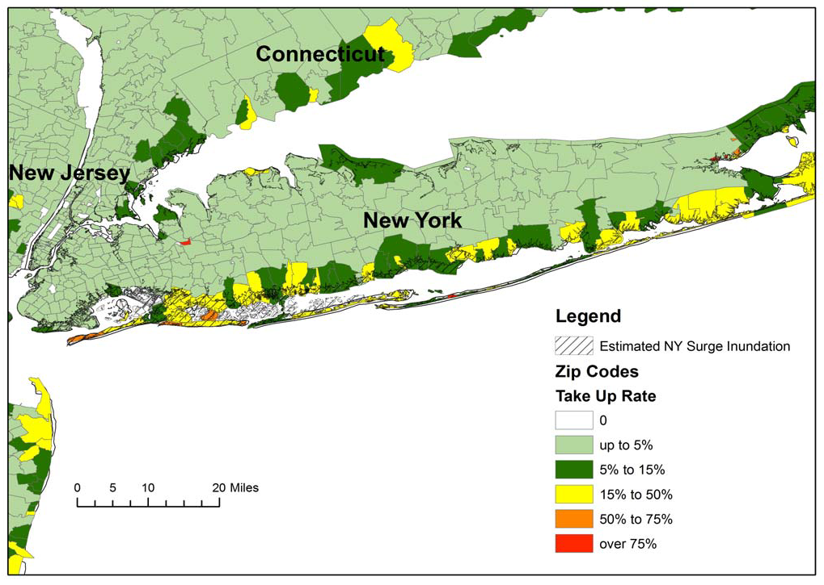
Residential NFIP Flood Take-Up Rates in NY, CT (2010) & Sandy Storm Surge
Flood coverage penetration rates were extremely low in many very vulnerable areas of NY and CT, with take-up rates far below 50% in many areas
Source: Wharton Center for Risk Management and Decision Processes, Issue Brief, Nov. 2012; Insurance Information Institute.
70

Slide 71
TERRORISM RISK
The Countdown to TRIA Expiration Begins
Reauthorization Faces an Uphill Battle in Congress
71

Slide 72
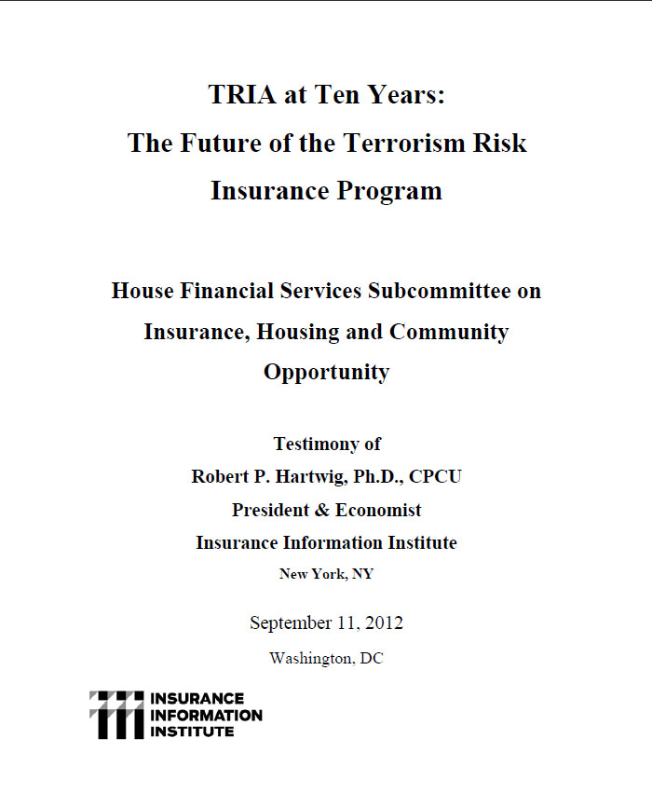
I.I.I. Congressional Testimony on the Future of the Terrorism Risk Insurance Program
Issue: Act expires 12/31/14. Insurers still generally regard large-scale terror attacks as fundamentally uninsurable
I.I.I. Input: Testified at first hearing on the issue in DC (on 9/11/12) on trends in terrorist activity in the US and abroad, difficulties in underwriting terror risk; Noted that bin Laden may be dead but war on terror is far from over
Status: New House FS Committee Chair Jeb Hensarling has opposed TRIA in the past; Obama Administration does not seem to support extension; Little institutional memory on insurance subcommittee
Media: Virtually no media coverage yet apart form trade press; WSJ will likely editorialize against it.
Objective: Work with trades, risk management community and others to help build support

Slide 73
Loss Distribution by Type of Insurance from Sept. 11 Terrorist Attack ($ 2011)
($ Billions)
Total Insured Losses Estimate: $40.0B**
*Loss total does not include March 2010 New York City settlement of up to $657.5 million to compensate approximately 10,000 Ground Zero workers or any subsequent settlements.
**$32.5 billion in 2001 dollars.
Source: Insurance Information Institute.

Slide 74
Terrorism Violates Traditional Requirements for Insurability
Requirement | Definition | Violation
Estimable Frequency | Insurance requires large number of observations to develop predictive rate-making models (an actuarial concept known as credibility) | Very few data points Terror modeling still in infancy, untested. Inconsistent assessment of threat
Estimable Severity | Maximum possible/ probable loss must be at least estimable in order to minimize “risk of ruin” (insurer cannot run an unreasonable risk of insolvency though assumption of the risk) | Potential loss is virtually unbounded. Losses can easily exceed insurer capital resources for paying claims. Extreme risk in workers compensation and statute forbids exclusions.
Source: Insurance Information Institute

Slide 75
Terrorism Violates Traditional Requirements for Insurability (cont’d)
Requirement | Definition | Violation
Diversifiable Risk | Must be able to spread/distribute risk across large number of risks “Law of Large Numbers” helps makes losses manageable and less volatile | Losses likely highly concentrated geographically or by industry (e.g., WTC, power plants)
Random Loss Distribution/Fortuity | Probability of loss occurring must be purely random and fortuitous Events are individually unpredictable in terms of time, location and magnitude | Terrorism attacks are planned, coordinated and deliberate acts of destruction Dynamic target shifting from “hardened targets” to “soft targets” Terrorist adjust tactics to circumvent new security measures Actions of US and foreign govts. may affect likelihood, nature and timing of attack
Source: Insurance
Information Institute

Slide 76
Key Takaways
76

Slide 77
Takeaways:
Insurance Industry Predictions for 2013
P/C Insurance Exposures Will Grow With the U.S. Economy
  Personal and commercial exposure growth is likely in 2013
    But restoration of destroyed exposure will take until mid-decade
  Wage growth is also positive and could modestly accelerate
P/C Industry Growth in 2013 Will Be Strongest Since 2004
  Growth likely to exceed A.M. Best projection of +3.8% for 2012
  No traditional “hard market” emerges in 2013
Underwriting Fundamentals Deteriorate Modestly
  Some pressure from claim frequency, severity in some key lines
  But WC will be tough to fix
Industry Capacity Hits a New Record by Year-End 2013 (Barring Meg-CAT)
Investment Environment Is/Remains Challenging
  Interest rates remain low

Slide 78
Insurance Information Institute
www.iii.org
Thank you for your time
and your attention!
Notes:
78

