Slide 1
Hurricane Sandy: A Progress Report and a Look Into the Future of the P/C Insurance Industry
Independent Insurance Agents and Brokers of Suffolk & Tri-County
Melville, NY
March 14, 2013
Download at www.iii.org/presentations
Robert P. Hartwig, Ph.D., CPCU, President & Economist
Insurance Information Institute ♦ 110 William Street ♦ New York, NY 10038
Tel: 212.346.5520 ♦ Cell: 917.453.1885 ♦ bobh@iii.org ♦ www.iii.org

Slide 2
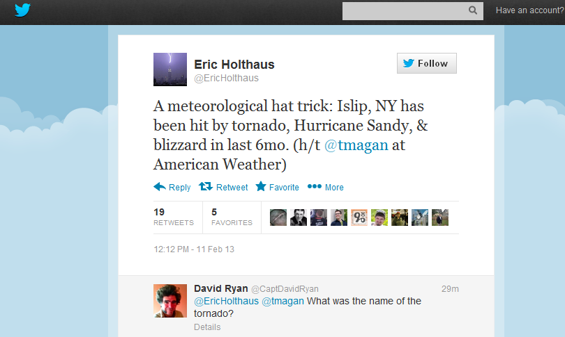
Meterological Hat Trick: Poor Islip Can’t Catch a Break…
…From the Twittersphere…
Long Islander’s understand that Mother Nature has not been kind to them
2

Slide 3
P/C Insurance Industry Financial Overview
Profit Recovery in 2012 After High CAT Losses; Ultimate Impact of Sandy Still Unclear
3

Slide 4
P/C Net Income After Taxes
1991–2012:Q3 ($ Millions)
2005 ROE*= 9.6%
2006 ROE = 12.7%
2007 ROE = 10.9%
2008 ROE = 0.1%
2009 ROE = 5.0%
2010 ROE = 6.6%
2011 ROAS¹ = 3.5%
2012:Q3 ROAS¹ = 6.3%
P-C Industry 2012:Q3 profits were up 222% from 2011:Q3, due primarily to lower catastrophe losses
* ROE figures are GAAP; ¹Return on avg. surplus. Excluding Mortgage & Financial Guaranty insurers yields a 6.6% ROAS through 2012:Q3, 4.6% ROAS for 2011, 7.6% for 2010 and 7.4% for 2009.
Sources: A.M. Best, ISO, Insurance Information Institute

Slide 5
A 100 Combined Ratio Isn’t What It
Once Was: Investment Impact on ROEs
A combined ratio of about 100 generates an ROE of ~6.6% in 2012, ~7.5% ROE in 2009/10,
10% in 2005 and 16% in 1979
Combined Ratio / ROE
Year Ago
2011:Q3 = 108.1, 3.1% ROE
Combined Ratios Must Be Lower in Today’s Depressed
Investment Environment to Generate Risk Appropriate ROEs
* 2008 -2012 figures are return on average surplus and exclude mortgage and financial guaranty insurers. 2012:Q3 combined ratio including M&FG insurers is 100.9, ROAS = 6.3%; 2011 combined ratio including M&FG insurers is 108.2, ROAS = 3.5%.
Source: Insurance Information Institute from A.M. Best and ISO data.

Slide 6
Profitability Peaks & Troughs in the P/C Insurance Industry, 1975 – 2012:Q3*
ROE
History suggests next ROE peak will be in 2016-2017
1977:19.0%
1987:17.3%
10 Years
2006:12.7%
1997:11.6%
10 Years
9 Years
2012:Q3: 6.6%
2011:4.6%*
1975: 2.4%
1984: 1.8%
1992: 4.5%
2001: -1.2%
*Profitability = P/C insurer ROEs. 2011 figure is an estimate based on ROAS data. Note: Data for 2008-2012 exclude mortgage and financial guaranty insurers. 2012:Q3 ROAS = 6.2% including M&FG.
Source: Insurance Information Institute; NAIC, ISO, A.M. Best.

Slide 7
ROE vs. Equity Cost of Capital:
U.S. P/C Insurance:1991-2012*
(Percent)
The P/C Insurance Industry Fell Well
Short of Its Cost of Capital Every Year Since 2008
+1.7 pts
-3.2 pts
-2.4 pts
-7.3 pts
-6.9 pts
+2.3 pts
-6.4 pts
-9.0 pts
-13.2 pts
The Cost of Capital is the Rate of Return Insurers Need to Attract and Retain Capital to the Business
US P/C Insurers Missed Their Cost of Capital by an Average 6.7 Points from 1991 to 2002, but on Target or Better 2003-07, Fell Short in 2008-2012
* Return on average surplus in 2008-2012 excluding mortgage and financial guaranty insurers. 2012 figures are III estimates.
Source: The Geneva Association, Insurance Information Institute
7
12/01/09 - 9pm
eSlide – P6466 – The Financial Crisis and the Future of the P/C
Notes:
7

Slide 8
Personal Lines Profitability Analysis
Significant Variability Over Time and Across States
8

Slide 9
Return on Net Worth: Homeowners Insurance,
10-Year Average (2002-2011*)
Top 25 States
(Percent)
Hawaii was the most profitable state for home insurers from 2002-2011 due to the absence of hurricanes during this period
Sandy will pull down NY’s profitability numbers
*Latest available.
Sources: NAIC.

Slide 10
Return on Net Worth: Homeowners Insurance,
10-Year Average (2002-2011*)
Bottom 25 States
(Percent)
Hurricanes Katrina and Rita made Louisiana and Mississippi the least profitable states for home insurers from 2002-2011
*Latest available.
Sources: NAIC

Slide 11
Return on Net Worth: All P-C Lines vs. Homeowners, 1990-2011*
(Percent)
Average RNW: 1990-2011*
All P-C Lines: 7.8% Homeowners: 3.2%**
Impact of Hurricane Irene
Texas “Mold” Crisis
Katrina, Rita, Wilma
Homeowners Insurance Is Considerably More Volatile than the Market Overall Due to Coastal Exposure and Interior Wind/Hail Events
*Latest available.
**Excluding Hurricane Andrew (1992); Including 1992 produces an average homeowners RNW of 0.5%.
Sources: NAIC; Insurance Information Institute.
11
Notes:
11

Slide 12
Return on Net Worth: Pvt. Passenger Auto,
10-Year Average (2002-2011*)
Top 25 States
(Percent)
Hawaii was the most profitable state for auto insurers from 2002-2011
*Latest available.
Sources: NAIC.

Slide 13
Return on Net Worth: Pvt. Passenger Auto,
10-Year Average (2002-2011*)
(Percent)
Bottom 25 States
Michigan was the least profitable state for auto insurers from 2002-2011
*Latest available.
Sources: NAIC

Slide 14
Profitability and Growth in New York P/C Insurance Markets
Analysis by Line and Nearby State Comparisons
14

Slide 15
RNW All Lines: NY vs. U.S., 2002-2011
(Percent)
Average 2002-2011
US: 7.7%
NY: 5.9%
Sources: NAIC.
15
Notes:
15

Slide 16
RNW Homeowners: NY vs. U.S.,
2002-2011
Average 2002-2011
US: 5.4%
NY: 17.8%
(Percent)
NY profitability in 2012 will take a nosedive due to Sandy
Sources: NAIC.
16
Notes:
16

Slide 17
RNW PP Auto: NY vs. U.S., 2002-2011
Average 2002-2011
US: 7.7%
NY: 9.1%
Sources: NAIC.
17
Notes:
17

Slide 18
RNW Comm. Auto: NY vs. U.S.,
2002-2011
(Percent)
Average 2002-2011
US: 9.8%
NY: 8.4%
Sources: NAIC.
18
Notes:
18

Slide 19
RNW Comm. Multi-Peril: NY vs. U.S.,
2002-2011
(Percent)
Average 2002-2011
US: 9.1%
NY: 11.6%
Sources: NAIC.
19
Notes:
19

Slide 20
RNW Workers Comp: NY vs. U.S.,
2002-2011
(Percent)
Average 2002-2011
US: 6.7%
NY: 5.0%
Sources: NAIC.
20
Notes:
20

Slide 21
All Lines: 10-Year Average RNW NY & Nearby States
2002-2011
New York All Lines profitability is below the US and regional average
Source: NAIC, Insurance Information Institute

Slide 22
Homeowners: 10-Year Average RNW NY & Nearby States
2002-2011
New York Homeowners profitability is above the US and regional average (Sandy will cause figure to drop)
Source: NAIC, Insurance Information Institute

Slide 23
Top Ten Most Expensive And Least Expensive States For Homeowners Insurance, 2010 (1)
New York ranked as the 11th most expensive state for homeowners insurance in 2010, with an average expenditure of $1,044.
Rank | Most expensive states | Average expenditure | Rank | Least expensive states | Average expenditure
1 | Texas (2) | $1,560 | 1 | Idaho | $500
2 | Louisiana (3) | 1,546 | 2 | Oregon | 535
3 | Florida (4) | 1,544 | 3 | Utah | 558
4 | Oklahoma | 1,246 | 4 | Wisconsin | 563
5 | Mississippi | 1,217 | 5 | Washington | 595
6 | Rhode Island | 1,092 | 6 | Ohio | 614
7 | Kansas | 1,066 | 7 | Delaware | 636
8 | District Of Columbia | 1,065 | 8 | Arizona | 666
9 | Connecticut | 1,052 | 9 | Maine | 676
10 | Alabama | 1,050 | 10 | South Dakota | 678
Based on the HO-3 homeowner package policy for owner-occupied dwellings, 1 to 4 family units. Provides “all risks” coverage (except those specifically excluded in the policy) on buildings and broad named-peril coverage on personal property, and is the most common package written.
The Texas Department of Insurance developed home insurance policy forms that are similar but not identical to the standard forms. Note: Average premium=Premiums/exposure per house years. A house year is equal to 365 days of insured coverage for a single dwelling. The NAIC does not rank State Average Expenditures and does not endorse any conclusions drawn from this data.
Policies written by Citizens Property Insurance (Louisiana), are not included.
Policies written by Citizens Property Insurance (Florida), are not included.
Note: Average premium=Premiums/exposure per house years. A house year is equal to 365 days of insured coverage for a single dwelling. The NAIC does not rank state average expenditures and does not endorse any conclusions drawn from this data.
Source: © 2012 National Association of Insurance Commissioners (NAIC). Reprinted with permission. Further reprint or distribution strictly prohibited without written permission of NAIC.

Slide 24
Average Premiums for Homeowners Insurance in New York State, 2000-2010 (1)
(1) Based on the HO-3 homeowner package policy for owner-occupied dwellings, 1 to 4 family units. Provides “all risks” coverage (except those specifically excluded in the policy) on buildings and broad named-peril coverage on personal property, and is the most common package written.
Note: Average premium=Premiums/exposure per house years. A house year is equal to 365 days of insured coverage for a single dwelling. The NAIC does not rank state average expenditures and does not endorse any conclusions drawn from this data.
Source: NAIC.

Slide 25
PP Auto: 10-Year Average RNW NY & Nearby States
2002-2011
New York PP Auto profitability is above the US average and below the regional average
Source: NAIC, Insurance Information Institute

Slide 26
Top Ten Most Expensive And Least Expensive States For Automobile Insurance, 2010 (1)
Rank | Most expensive states | Average expenditure | Rank | Least expensive states | Average expenditure
1 | New Jersey | $1,157.30 | 1 | South Dakota | $525.16
2 | District of Columbia | 1,133.87 | 2 | North Dakota | 528.81
3 | Louisiana | 1,121.46 | 3 | Iowa | 546.59
4 | New York | 1,078.88 | 4 | Idaho | 547.78
5 | Florida | 1,036.76 | 5 | Maine | 582.29
6 | Delaware | 1,030.98 | 6 | Nebraska | 592.69
7 | Rhode Island | 984.95 | 7 | North Carolina | 599.90
8 | Connecticut | 965.22 | 8 | Wisconsin | 613.37
9 | Maryland | 947.70 | 9 | Ohio | 619.46
10 | Michigan | 934.60 | 10 | Wyoming | 621.08
New York ranked 4th in 2010, with an average expenditure for auto insurance of $1,078.88
Based on average automobile insurance expenditures.
Source: © 2012 National Association of Insurance Commissioners.

Slide 27
Comm. Auto: 10-Year Average RNW NY & Nearby States
2002-2011
New York Commercial Auto profitability is below the US and regional average
Source: NAIC, Insurance Information Institute

Slide 28
Comm. M-P: 10-Year Average RNW NY & Nearby States
2002-2011
New York Commercial Multi-Peril profitability is above the US average and below the regional average
Source: NAIC, Insurance Information Institute

Slide 29
Workers Comp: 10-Year Average RNW
NY & Nearby States
2002-2011
New York Workers Comp profitability is below the US average and regional average
Source: NAIC, Insurance Information Institute

Slide 30
All Lines DWP Growth: NY vs. U.S., 2002-2011
(Percent)
Average 2002-2011
US: 3.6%
NY: 3.7%
Source: SNL Financial.
30
Notes:
30

Slide 31
Personal Lines DWP Growth: NY vs. U.S., 2002-2011
(Percent)
Average 2002-2011
US: 3.7%
NY: 2.7%
Source: SNL Financial.
31
Notes:
31

Slide 32
Homeowner’s MP DWP Growth: NY vs. U.S., 2002-2011
(Percent)
Average 2002-2011
US: 7.1%
NY: 6.2%
Source: SNL Financial.
32
Notes:
32

Slide 33
Private Passenger Auto DWP Growth: NY vs. U.S., 2002-2011
(Percent)
Average 2002-2011
US: 2.5%
NY: 1.5%
Source: SNL Financial.
33
Notes:
33

Slide 34
Comm. Lines DWP Growth: NY vs. U.S., 2002-2011
(Percent)
Average 2002-2011
US: 3.9%
NY: 4.8%
Source: SNL Financial.
34
Notes:
34

Slide 35
Hurricane Sandy Summary
Sandy Will Become One of the Most Expensive Events in Insurance History
35
Notes:
35

Slide 36
2012 Catastrophe Summary
Catastrophe Communications: US & Global
  U.S. Focus: ~$37-$42B = 2nd Most Costliest Year Ever for Insured Catastrophe Loss (Behind 2005)
    Economic Losses = $101B
    Crop = Additional ~$16B ($7B-$8B privately insured)
    NFIP Flood = Additional $9B+
    Flood losses/NFIP/FEMA has been the #1 communications “issue” in the wake of Sandy
  Global Focus: $65B in Insured Losses→Well Below $105B in 2011 but Above 10-Yr. Avg. of $50B
    Cats abroad did not drive media cycle in 2012, save ongoing Fukishima issues; Climate change
  Market Consequences: Primary & Reinsurance
    Impacts on price, availability
36
12/01/09 - 9pm
eSlide – P6466 – The Financial Crisis and the Future of the P/C
Notes:
36

Slide 37
Top 12 Most Costly Hurricanes in U.S. History
(Insured Losses, 2012 Dollars, $ Billions)
10 of the 12 most costly hurricanes in insurance history occurred over the past 9 years (2004—2012)
Hurricane Sandy could become the 3rd costliest hurricane in US insurance history
Hurricane Irene became the 12th most expensive hurricane in US history in 2011
*Estimate as of 12/09/12 based on estimates of catastrophe modeling firms and reported losses as of 1/12/13. Estimates range up to $25B.
Sources: PCS; Insurance Information Institute inflation adjustments to 2012 dollars using the CPI.

Slide 38
Hurricane Sandy: Claim Payments to Policyholders, by State
($ Thousands)
TOTAL = $18.75 BILLION
At $9.6B and $6.6B, respectively, NY and NJ suffered, by far, the largest losses from Hurricane Sandy
Insurers Will Pay at Least $18.75 Billion to 1.52 Million Policyholders Across 15 States and DC in the Wake of Hurricane Sandy
Sources: Catastrophe loss data is for Catastrophe Serial No. 90 (Oct. 28 – 31, 2012) from PCS as of Jan. 18, 2013; Insurance Information Institute .

Slide 39
Hurricane Sandy: Number of Claims
by Type*
Total Claims = 1.52 Million*
Hurricane Sandy resulted in an estimated 1.52 million privately insured claims resulting in an estimated $18.75 to $25 billion in insured losses. Hurricane Katrina produced 1.74 million claims and $48.7B in losses (in 2012 $)
Sandy is a high HO frequency, (relatively low) severity event (avg. severity <50% Katrina)
*PCS claim count estimate s as of 1/18/13. Loss estimate represents PCS total ($18.75B) and upper end of range estimates by risk modelers RMS, Eqecat and AIR. All figures exclude losses paid by the NFIP.
Source: PCS; AIR, Eqecat, AIR Worldwide; Insurance Information Institute.

Slide 40
Hurricane Sandy: Insured Loss by
Claim Type* ($ Millions)
Total Claim Value = $18.75 Billion*
Although Commercial Lines accounted for only 13% of total claims, they account for 48% of all claim dollars paid. In most hurricanes, Commercial Lines accounts for about 1/3 of insured losses.
*PCS insured loss estimates as of 1/18/13. Catastrophe modeler estimates range up to $25 billion. All figures exclude losses paid by the NFIP.
Source: PCS; Insurance Information Institute.

Slide 41
Hurricane Sandy: Value of Homeowners Claims Paid, by State* ($ Millions)
Hurricane Sandy
Estimated 1,067,000 homeowners claims**
$7.0 billion in insured losses.
Average loss per claim is $6,558
Claims in NJ estimated at $2.5 billion (36%) and $2.7 billion in NY (38%)
*Preliminary as of 1/18/13.
Source: PCS.

Slide 42
Hurricane Sandy: Number of Auto Claims by State*
Hurricane Sandy
Estimated 250,500 vehicle claims
$2.729 billion in insured losses.
Average loss per claim is $10,894
60% of the claims occurred in NY state.
*Preliminary as of 1/18/13.
Source: PCS.

Slide 43
Hurricane Sandy: Value of Auto Claims Paid, by State* ($ Millions)
Hurricane Sandy
Estimated 250,500 vehicle claims
$2.729 billion in insured losses.
Average loss per claim is $10,894
About 50% of the claim dollars will be paid in NY, 32% in NJ.
*Preliminary as of 1/18/13.
Source: PCS.

Slide 44
Hurricane Sandy: Loss Distribution by Commercial/Personal Lines and Reinsurance vs. Primary Insurer
Personal vs. Commercial Lines*
Primary vs. Reinsurer Share**
~60-65% of Sandy losses appear to be commercial lines, and 35-40% personal, the opposite of the norm for hurricane losses
Reinsurers’ share of Sandy losses appears to be in the 30% range, though this is highly preliminary
*Fitch Ratings assigns a range of 60-65% commercial and 35-40% personal lines., Hurricane Sandy Update, January 8, 2013.
**Source: Insurance Information Institute rough estimate based on company reports as of January 13, 2013. Actual number will vary.

Slide 45
Hurricane Sandy: Average Claim Payment by Type of Claim
Commercial (i.e., business claims) are more expensive because the value of property is often higher as well as the impact of insured business interruption losses
The average insured flood loss was 6.5 times larger than the average non-flood insured loss (mostly wind)
Commercial (Business) Claims Were Nearly Seven Times More Expensive than Homeowners Claims; Vehicle Claims Were Unusually Expensive Due to Extensive Flooding
*Includes rental and condo policies (excludes NFIP flood). **As of Feb. 20, 2013.
Sources: Catastrophe loss data is for Catastrophe Serial No. 90 (Oct. 28 – 31, 2012) from PCS as of Jan. 18, 2013; Insurance Information Institute .

Slide 46
Hurricane Sandy: Flood Issues
Most of the Uninsured Direct Losses Are Due to Flooding
46
Notes:
46

Slide 47
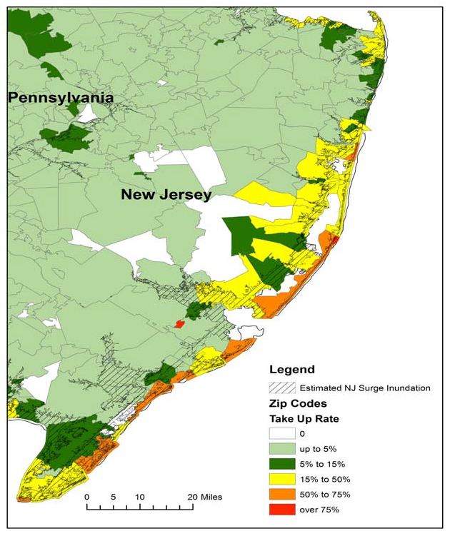
Residential NFIP Flood Take-Up Rates in NJ (2010) & Sandy Storm Surge
Flood coverage penetration rates were extremely low in many very vulnerable areas in NJ, with take-up rates far below 50% in many areas
Source: Wharton Center for Risk Management and Decision Processes, Issue Brief, Nov. 2012; Insurance Information Institute.
47

Slide 48
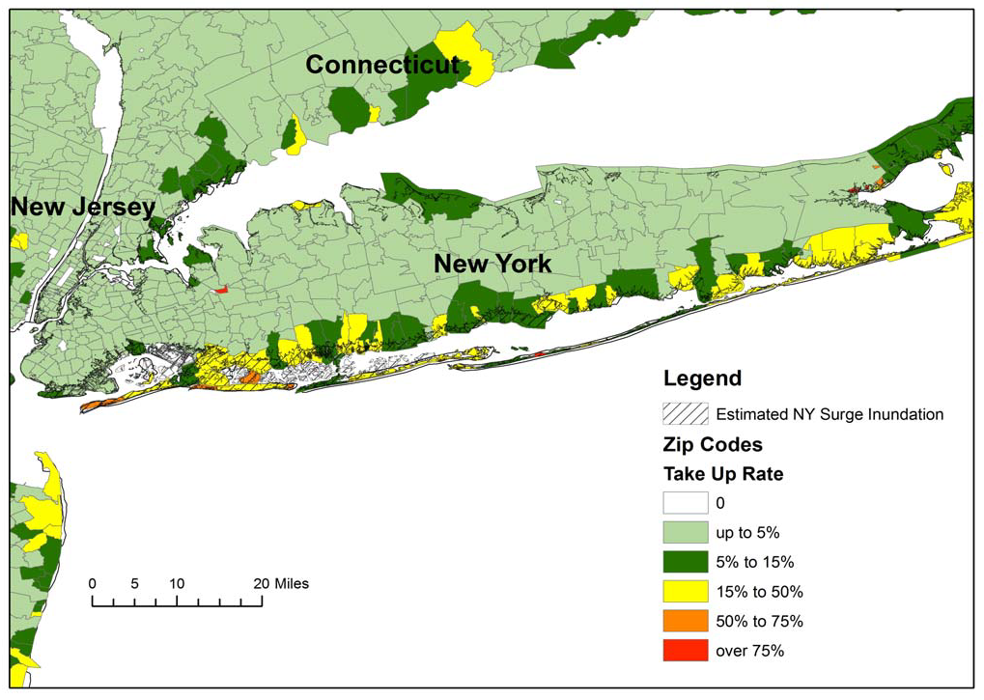
Residential NFIP Flood Take-Up Rates in NY, CT (2010) & Sandy Storm Surge
Flood coverage penetration rates were extremely low in many very vulnerable areas of NY and CT, with take-up rates far below 50% in many areas
Source: Wharton Center for Risk Management and Decision Processes, Issue Brief, Nov. 2012; Insurance Information Institute.
48

Slide 49
Hurricane Sandy: National Flood Insurance Program Payment, by State*
($ Millions)
TOTAL = $4.797 BILLION
At $2.437B and $2.152B, respectively, NY and NJ sustained, by far, the largest NFIP flood losses from Hurricane Sandy
The NFIP Will Ultimately Likely Pay Close to $7 Billion to 100,000 Policyholders Across 9 States and DC in the Wake of Hurricane Sandy
*As of February 20, 2013.
Sources: NFIP; Insurance Information Institute .

Slide 50
Flood Loss Paid by the National Flood Insurance Program, 1980-2012E
Billions (Original Values)
Hurricane Sandy and other events could result in $7.5 billion in payouts from the NFIP in 2012, second only to 2005 and potentially exhausting the NFIP’s borrowing authority
Hurricanes Katrina and Rita accounted for the majority of 2005’s record $17.4B payout
Hurricane Ike
*Estimate as of 11/25/12.
Sources: Department of Homeland Security, Federal Emergency Management Agency, NFIP; Insurance Information Institute.
50
12/01/09 - 9pm
eSlide – P6466 – The Financial Crisis and the Future of the P/C
Notes:
50

Slide 51
Federal Aid Requests for States With Greatest
Sandy Impact & Federal Aid Proposals (as of 1/6/13)
$33B to repair subways, hospitals and other facilities; $9B to upgrade infrastructure against future storms
$39.5B to repair schools roads, bridges, businesses, homes and other facilities; $7.4B to for mitigation and prevention against future storms
Billions
$60.4
$60.2
$60.0*
$9.7
$42.0
$3.2B to bury power lines, upgrade transmission systems, build sewage treatment plants and other mitigation projects
$36.9
House passed on Jan. 5
$9.0
$7.9
$7.4
$6.0
$33.0
$29.5
$3.2
$51.0
House passed on Jan. 15
States Requested Enormous Sums in Sandy Aid in the Middle of the “Fiscal Cliff” Debate, Causing Delays
*As of Jan. 2, 2013.
Source: New York Times, Dec. 6, 2012; Insurance Information Institute research.
51
12/01/09 - 9pm
eSlide – P6466 – The Financial Crisis and the Future of the P/C
Notes:
51

Slide 52
Federal Disaster Declarations Patterns: 1953-2012
Despite 11 Sandy Declarations, Fewer Disasters Were Declared in 2012 than the Record Number of Declarations in 2010 and 2011
52

Slide 53
Number of Federal Disaster Declarations, 1953-2013*
There have been 2,084 federal disaster declarations since 1953. The average number of declarations per year is 35 from 1953-2011, though that few haven’t been recorded since 1995.
The number of federal disaster declarations set a new record in 2011, with 99, shattering 2010’s record 81 declarations.
47 federal disasters were declared in 2012
The Number of Federal Disaster Declarations Is Rising and Set New Records in 2010 and 2011. Hurricane Sandy Produced 13 Declarations in 2012/13.
*Through Jan. 31, 2013.
Source: Federal Emergency Management Administration; http://www.fema.gov/disasters; Insurance Information Institute.

Slide 54
Federal Disasters Declarations by State,
1953 – 2013: Highest 25 States*
Over the past 60 years, Texas has had the highest number of Federal Disaster Declarations
NY has the 4th highest number of disaster declarations since 1953
*Through Jan. 31, 2012. Includes Puerto Rico and the District of Columbia.
Source: FEMA: http://www.fema.gov/news/disaster_totals_annual.fema; Insurance Information Institute.

Slide 55
Federal Disasters Declarations by State,
1953 – 2012: Lowest 25 States*
Over the past 60 years, Wyoming and Rhode Island had the fewest number of Federal Disaster Declarations
*Through Jan. 31, 2013. Includes Puerto Rico and the District of Columbia.
Source: FEMA: http://www.fema.gov/news/disaster_totals_annual.fema; Insurance Information Institute.

Slide 56
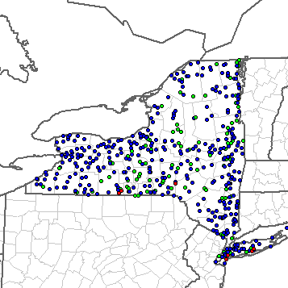
Severe Weather Reports in NY, 2012
There were 547 severe weather reports in NY 2012
Tornadoes (Red): 8 Large Hail (Green): 131 High Wind (Blue): 408
Source: NOAA Storm Prediction Center; http://www.spc.noaa.gov/climo/online/monthly/2011_annual_summary.html#; Ins. Information Institute.
56

Slide 57
Discussion of Long Island/Coastal New York Issues
Sandy is the Latest in a String of Major Nat Cat Events Leading to an Evolution of Thought on Property Risks
Experience of Sandy Will Be Incorporated into Cat Models
Risk of Northeast Hurricane Was Known to (Re)Insurers
No Evidence to Date of Rapid NYPIUA Growth
  NYPIUA had ~11,000 claims (only about 300 still open)
Market Shows No Signs of Dysfunction
Flood Remains Greatest Risk
  Biggert-Waters reforms will raise cost of flood insurance
  Remapping will expand flood zones
State Land Acquisition, Beach Replenishment, Rezoning, Code Strengthening Will Help Over Time
Cost of Coastal Living Will Rise in NY, Insurance is Only One Reason
57
12/01/09 - 9pm
eSlide – P6466 – The Financial Crisis and the Future of the P/C
Notes:
57

Slide 58
Hurricane Sandy: Regulatory & Legislative Consequences
Sandy Very Quickly Became a Highly Politicized Issue
58
Notes:
58

Slide 59
U.S. Insured Catastrophe Loss Update
2012 Catastrophe Losses Were Close to “Average” Until Sandy Hit
2011 Was the 5th Most Expensive Year on Record
59

Slide 60
Natural Disaster Losses in the United States: 2012
As of January 1, 2013 | Number of Events | Fatalities | Estimated Overall Losses (US $m) | Estimated Insured Losses (US $m)
Tropical Cyclone | 4 | 143 | 52,240 | 26,360
Severe Thunderstorm | 115 | 118 | 27,688 | 14,914
Drought | 2 | 0 | 20,000 | 16,000†
Wildfire | 38 | 13 | 1,112 | 595
Winter Storm | 2 | 7 | 81 | 38
Flood | 19 | 3 | 13 | 0††
TOTALS | 184 | 284 | $101,134 | $57,907
Source: MR NatCatSERVICE
† - Includes Federal Crop Insurance Losses. † † - Excludes federal flood.
60
Notes:
All data from NatCat Service

Slide 61
Significant Natural Catastrophes, 2012
(Events with $1 billion economic loss and/or 50 fatalities)
Date | Event | Estimated Economic Losses (US $m) | Estimated Insured Losses (US $m)
June – Sept 2012 | Central US Drought | 20,000 | 16,000†
March 2 - 3 | Thunderstorms | 5,000 | 2,500
April 2 – 4 | Thunderstorms | 1,550 | 775
April 13- 15 | Thunderstorms | 1,800 | 910
April 28 – 29 | Thunderstorms | 4,500 | 2,500
May 25 – 30 | Thunderstorms | 3,400 | 1,700
June 6 – 7 | Thunderstorms | 1,400 | 1,000
June 11 – 13 | Thunderstorms | 1,900 | 950
June 28 – July 2 | Thunderstorms | 4,000 | 2,000
August 26 - 30 | Hurricane Isaac | 2,000 | 1,220
October 28 - 30 | Hurricane Sandy | 50,000 | 25,000††
Source: MR NatCatSERVICE
† - Includes Federal Crop Insurance Losses.; † † - Excludes NFIP losses.
61
61

Slide 62
Natural Disasters in the United States, 1980 – 2012
Number of Events (Annual Totals 1980 – 2012)
There were 184 natural disaster events in the US in 2012
Number
41
19
121
3
Geophysical
(earthquake, tsunami,
volcanic activity)
Meteorological (storm)
Climatological
(temperature extremes,
drought, wildfire)
Hydrological
(flood, mass movement)
Source: MR NatCatSERVICE
62

Slide 63
Losses Due to Natural Disasters in the US, 1980–2012 (Overall & Insured Losses)
(Overall and Insured Losses)
(2012 Dollars, $ Billions)
2012 was the 2nd or 3rd most expensive year on record for insured catastrophe losses in the US.
Approximately 57% of the overall cost of catastrophes in the US was covered by insurance in 2012
2012 Losses
Overall : $101.1B
Insured: $57.9B
Overall losses (in 2012 values)
Insured losses (in 2012 values)
Source: MR NatCatSERVICE
63

Slide 64
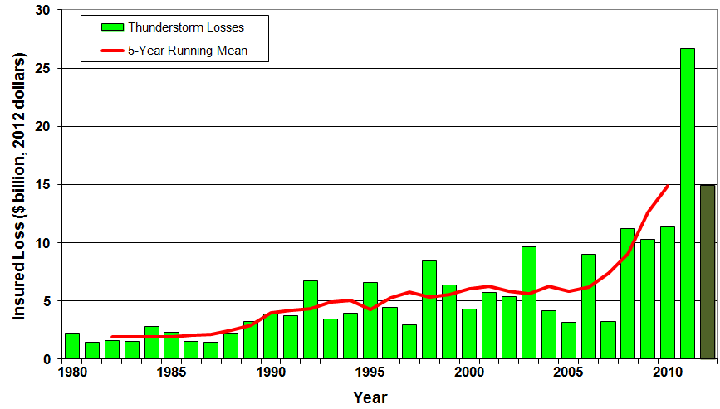
U.S. Thunderstorm Loss Trends, 1980 – 2012
Hurricanes get all the headlines, but thunderstorms are consistent producers of large scale loss. 2008-2012 are the most expensive years on record.
Average thunderstorm losses are up 7 fold since the early 1980s. The 5- year running average loss is up sharply.
Thunderstorm losses in 2012 totaled $14.9 billion, the 2nd highest on record
Source: Property Claims Service, MR NatCatSERVICE
64

Slide 65
Top 16 Most Costly Disasters in U.S. History
(Insured Losses, 2012 Dollars, $ Billions)
Hurricane Sandy could become the 4th or 5th costliest event in US insurance history
Includes Tuscaloosa, AL, tornado
Includes Joplin, MO, tornado
Hurricane Irene became the 12th most expense hurricane in US history in 2011
12 of the 16 Most Expensive Events in US History Have Occurred Over the Past Decade
*Estimate as of 12/09/12 based on estimates of catastrophe modeling firms and reported losses as of 1/12/13. Estimates range up to $25B.
Sources: PCS; Insurance Information Institute inflation adjustments to 2012 dollars using the CPI.

Slide 66
US Insured Catastrophe Losses
($ Billions, 2012 Dollars)
2012 CAT losses were down nearly 50% from 2011 until Sandy struck in late October
US CAT Losses in 2012 Will Likely Become the 2nd or 3rd Highest in US History on An Inflation-Adjusted Basis (Pvt Insured). 2011 Losses Were the 5th Highest
Record Tornado Losses Caused 2011 CAT Losses to Surge
*As of 1/2/13. Includes $20B gross loss estimate for Hurricane Sandy.
Note: 2001 figure includes $20.3B for 9/11 losses reported through 12/31/01 ($25.9B 2011 dollars). Includes only business and personal property claims, business interruption and auto claims. Non-prop/BI losses = $12.2B ($15.6B in 2011 dollars.)
Sources: Property Claims Service/ISO; Insurance Information Institute.
66
12/01/09 - 9pm
eSlide – P6466 – The Financial Crisis and the Future of the P/C
Notes:
66

Slide 67
Top 16 Most Costly World Insurance Losses, 1970-2012*
(Insured Losses, 2012 Dollars, $ Billions)
5 of the top 14 most expensive catastrophes in world history have occurred within the past 3 years
2012 insured CAT Losses totaled $60B; Economic losses totaled $140B, according to Swiss Re
Hurricane Sandy could become the 6th costliest event in global insurance history
*Figures do not include federally insured flood losses.
**Estimate based on PCS value of $18.75B as of 1/18/13 and assumption of upward development based on catastrophe modeler estimates ranging as high as $25B.
Sources: Swiss Re sigma 1/2011; Munich Re; Insurance Information Institute research.

Slide 68
U.S. Insured Catastrophe Losses by Cause of Loss, 2011 ($ Millions)
Wildfires, $855
Flood , $535, (1.5%)
Other, $1,000
Geological Events, $50, (0.1%)
Winter Storms, $2,017
Hurricanes & Tropical Storms, $5,510
Thunderstorm/ Tornado losses were 2.5 times above the 30-year average
Thunderstorms (Incl. Tornadoes , $25,813
2011’s insured loss distribution was unusual with tornado and thunderstorm accounting for the vast majority of loss
.
Source: ISO’s Property Claim Services Unit, Munich Re; Insurance Information Institute.

Slide 69
Inflation Adjusted U.S. Catastrophe Losses by Cause of Loss, 1990–2011¹
Wind/Hail/Flood (3), $14.8
Fires (4), $6.0
Other (5), $1.4
Insured cat losses from 1992-2011 totaled $384.3B, an average of $19.2B per year or $1.6B per month
Geological Events, $18.2
Terrorism, $24.4
Winter Storms, $28.2
Hurricanes & Tropical Storms, $161.3
Tornado share of CAT losses is rising
Wind losses are by far cause the most catastrophe losses, even if hurricanes/TS are excluded.
Tornadoes (2), $130.2
Catastrophes are defined as events causing direct insured losses to property of $25 million or more in 2009 dollars.
Excludes snow.
Does not include NFIP flood losses
Includes wildland fires
Includes civil disorders, water damage, utility disruptions and non-property losses such as those covered by workers compensation.
Source: ISO’s Property Claim Services Unit.

Slide 70
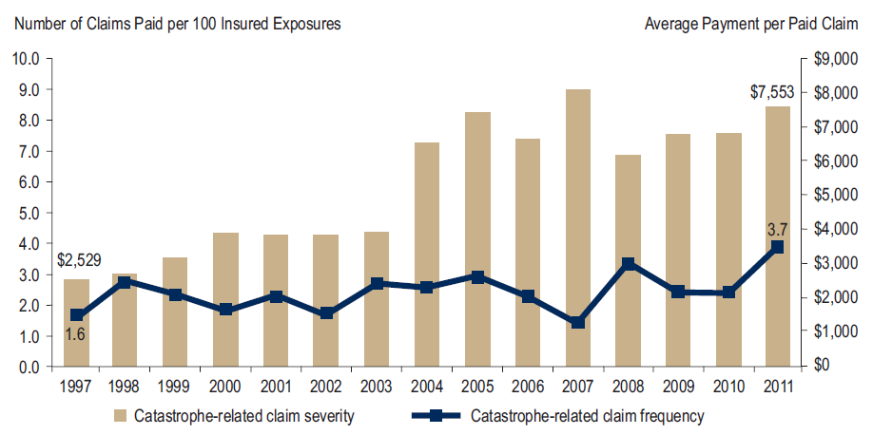
Homeowners Insurance Catastrophe-Related Claim Frequency and Severity, 1997—2012*
Avg. catastrophe claim cost rose approximately 200% from 1997-2011
Cat claim frequency in 2011 was at historic highs and more than double the rate in 1997
*All policy forms combined, countrywide.
Source: Insurance Research Council, Trends in Homeowners Insurance Claims, Sept. 2012 from ISO Fast Track data.
70

Slide 71
Combined Ratio Points Associated with Catastrophe Losses: 1960 – 2012*
Avg. CAT Loss Component of the Combined Ratio by Decade
1960s: 1.04 1970s: 0.85 1980s: 1.31 1990s: 3.39 2000s: 3.52 2010s: 7.20*
Catastrophe losses as a share of all losses reached a record high in 2012
Combined Ratio Points
The Catastrophe Loss Component of Private Insurer Losses Has Increased Sharply in Recent Decades
Notes: Private carrier losses only. Excludes loss adjustment expenses and reinsurance reinstatement premiums. Figures are adjusted for losses ultimately paid by foreign insurers and reinsurers.
Source: ISO (1960-2011); A.M. Best (2012E) Insurance Information Institute.

Slide 72
Homeowners Insurance Combined Ratio: 1990–2014F
Record tornado activity
Hurricane Sandy
Hurricane Ike
Homeowners Performance Deteriorated in 2011/12 Due to Large Cat Losses. Extreme Regional Variation Can Be Expected Due to Local Catastrophe Loss Activity
Sources: A.M. Best (1990-2013F);Conning (2014F); Insurance Information Institute.

Slide 73
The Strength of the Economy Will Influence P/C Insurer Growth Opportunities
Growth Will Expand Insurer Exposure Base Across Most Lines
73

Slide 74
US Real GDP Growth*
The Q4:2008 decline was the steepest since the Q1:1982 drop of 6.8%
Real GDP Growth (%)
Recession began in Dec. 2007. Economic toll of credit crunch, housing slump, labor market contraction was severe
2013 is expected to see initially slow growth, then gradually accelerate throughout the year and into 2014
Demand for Insurance Continues To Be Impacted by Sluggish Economic Conditions, but the Benefits of Even Slow Growth Will Compound and Gradually Benefit the Economy Broadly
* Estimates/Forecasts from Blue Chip Economic Indicators.
Source: US Department of Commerce, Blue Economic Indicators 3/13; Insurance Information Institute.

Slide 75
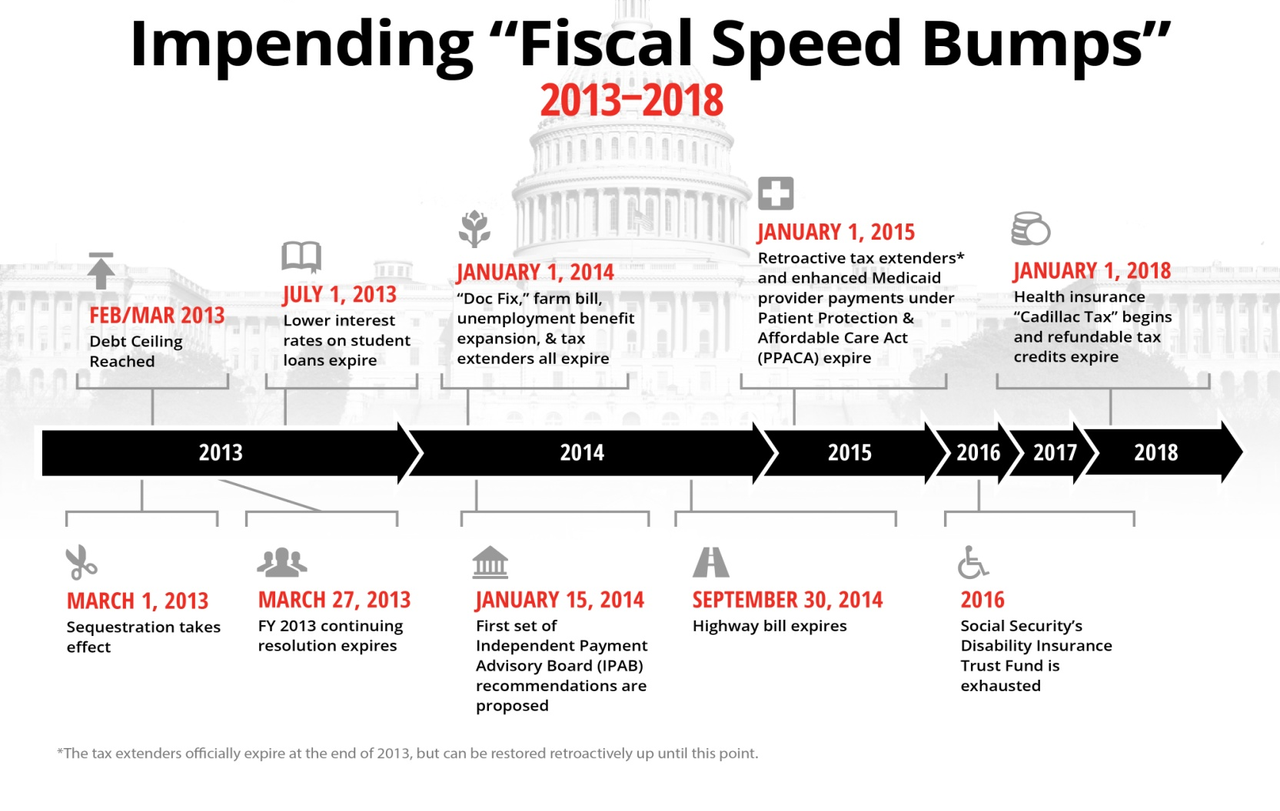
The Fiscal Cliff Was Just the Beginning: Budget Battles for Years to Come?
Poll: 94% of P/C insurance executives think looming budget battles
In Washington will hurt the economy.*
The “Fiscal Cliff” was just the beginning
There are 10+ “Fiscal Speed Bumps” over the next 5 years, setting up a potentially extended period of fiscal uncertainty
Creates long-term uncertainty around federal spending, tax policy, entitlements
*P/C Insurance Joint Industry Forum press release (www.iii.org/press_releases), January 15, 2013.
Source: Fix the Debt Coalition, January 18, 2013; Insurance Information Institute

Slide 76

Federal Spending as a Share of State GDP: Vulnerability to Sequestration Varies
NY has relatively little exposure to sequester cuts
Sources: Pew Center on the States (2012) Impact of the Fiscal Cliff on the States; Wells Fargo; Insurance Information Institute.

Slide 77
Defense and Non-Defense Federal Spending as a Share of State GDP: Top 10 States*
Defense Spending
Non-Defense Spending
Federal defense spending accounts for approximately 10%+ of GDP in 5 states
Federal non-defense spending accounts for 10%+ of GDP in 3 states
Sequestration Could Adversely Impact Commercial Insurance Exposures Directly at Defense Contractors and Indirectly in Impacted Communities
*As of 2010.
Sources: Pew Center on the States (2012) Impact of the Fiscal Cliff on the States; Wells Fargo Securities; Insurance Information Institute.

Slide 78
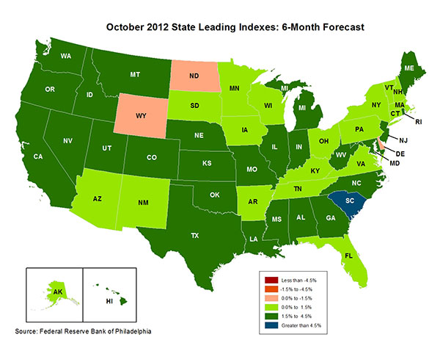
State-by-State Leading Indicators
through 2013:Q1
Near-term growth forecasts vary widely by state
5 Fastest Growing States
South Carolina 6.97%
Michigan 4.32%
West Virginia 3.59%
Idaho 3.14%
Georgia 3.04%
5 Slowest Growing States
Wyoming -1.09%
Delaware -0.24%
North Dakota -0.19%
Vermont 0.09%
Minnesota 0.18%
Sources: Federal Reserve Bank of Philadelphia at http://www.philadelphiafed.org/index.cfm ;Insurance Information Institute.

Slide 79
Consumer Sentiment Survey (1966 = 100)
January 2010 through February 2013
Optimism among consumers rose in February despite tax hike, federal budget concerns
Consumer confidence has been low for years amid high unemployment, falling home prices and other factors adversely impact consumers, but improved substantially in late 2011 and in 2012
Source: University of Michigan; Insurance Information Institute

Slide 80
Auto/Light Truck Sales, 1999-2019F
Job growth and improved credit market conditions will boost auto sales in 2013 and beyond
(Millions of Units)
New auto/light truck sales fell to the lowest level since the late 1960s. Forecast for 2013-14 is still far below 1999-2007 average of 17 million units, but a robust recovery is well underway.
Car/Light Truck Sales Will Continue to Recover from the 2009 Low Point, Bolstering the Auto Insurer Growth and the Manufacturing Sector.
Source: U.S. Department of Commerce; Blue Chip Economic Indicators (3/13); Insurance Information Institute.

Slide 81
Personal Auto Insurance Direct Written Premiums vs. Recently-Registered Cars
$ Billions
4%/yr growth forecast for PP DWP from recovering new car/truck sales
In 2004-07 no growth in PP DWP despite strong new car/truck sales
New car/truck sales grow to 14-15M/year
Average age of registered cars rose as fewer new cars were bought (and insured)
PP DWP, flat from 2004-2009, is rising again.
Conning forecasts growth at 3.5% in 2013 and 4.0% in 2014.
Sources: AIPSO Facts (various issues); SNL Financial; Conning Research & Consulting, Property-Casualty Forecast and Analysis, First Quarter 2012; Insurance Information Institute.

Slide 82
Monthly Change* in Auto Insurance Prices, 1991–2012*
Cyclical peaks in PP Auto tend to occur approximately every 10 years (early 1990s, early 2000s and likely the early 2010s)
Pricing peak occurred in 2010 at 5.1%, falling to 2.8% by Mar. 2012
“Hard” markets tend to occur during recessionary periods
The Dec. 2012 reading of 4.7% is up from 3.6% a year earlier
*Percentage change from same month in prior year; through Dec. 2012; seasonally adjusted
Note: Recessions indicated by gray shaded columns.
Sources: US Bureau of Labor Statistics; National Bureau of Economic Research (recession dates); Insurance Information Institutes.
82
12/01/09 - 9pm
eSlide – P6466 – The Financial Crisis and the Future of the P/C
Notes:
82

Slide 83
Monthly Change* in Auto Insurance Prices, January 2005 - December 2012
Pricing weakened materially in 2011 and early 2012 but has strengthened since then
(Percent Change
from same month,
prior year)
Auto Insurance Price Increases Averaged 5.1% in 2010 over 2009, After Averaging 4.5% in 2009 over 2008.
PPA Auto, like most p/c lines, exhibits strong cyclicality in pricing. Prices rose from 2000 to late 2005, were flat/falling in 2006 and 2007 before beginning to rise gain in 2008.
Underwriting performance remained strong even when prices were flat or falling due to improvements in underlying frequency and severity trends
* Percentage change from same month in prior year, seasonally adjusted.
Sources: US Bureau of Labor Statistics; Insurance Information Institute

Slide 84
New Private Housing Starts, 1990-2019F
Job growth, low inventories of existing homes, low mortgage rates and demographics are stimulating new home construction for the first time in years
(Millions of Units)
New home starts plunged 72% from 2005-2009; A net annual decline of 1.49 million units, lowest since records began in 1959
Homeowners Insurers Are Starting to See Meaningful Exposure Growth for the First Time Since 2005. Commercial Insurers with Construction Risk Exposure, Surety, Workers Comp Also Benefit
Source: U.S. Department of Commerce; Blue Chip Economic Indicators (3/13); Insurance Information Institute.

Slide 85
Construction Employment,
Jan. 2010—February 2013*
(Thousands)
Construction employment growth accelerated in the second half of 2012. Stronger growth in this key sector is possible in 2013.
Construction for the new $4B Tappan Zee Bridge will create thousands of jobs
*Seasonally adjusted
Sources: US Bureau of Labor Statistics at http://data.bls.gov; Insurance Information Institute.
85
12/01/09 - 9pm
eSlide – P6466 – The Financial Crisis and the Future of the P/C
Notes:
85

Slide 86
Construction Employment,
Jan. 2003–Feb. 2013
(Thousands)
Construction employment as of Feb. 2013 totaled 5.784 million, an increase of 349,000 jobs or 6.4% from the Jan. 2011 trough
Construction employment peaked at 7.726 million in April 2006
Construction employment troughed at 5.435 million in Jan. 2011, after a loss of 2.291 million jobs, a 29.7% plunge from the April 2006 peak
The “Great Recession” and housing bust destroyed 2.3 million constructions jobs
The Construction Sector Could Be a Growth Leader in 2013 and 2014 as the Housing Market and Private Investment Recover. Commercial Insurers Will Benefit.
Note: Recession indicated by gray shaded column.
Sources: U.S. Bureau of Labor Statistics; Insurance Information Institute.
86
12/01/09 - 9pm
eSlide – P6466 – The Financial Crisis and the Future of the P/C
Notes:
86

Slide 87
Commercial & Industrial Loans Outstanding at FDIC-Insured Banks, Quarterly, 2006-2012:Q3*
$Trillions
Commercial lending activity is nearly back to pre-crisis levels (+24.9% or $290B)
Commercial lending plunged by 21.2% ($330B) during the financial crisis and ensuing period of tight credit
Outstanding Commercial Loan Volume Has Been Growing for Over Two Years and Is Now Nearly Back to Early Recession Levels. Bodes Very Well for the Creation of Current and Future Commercial Insurance Exposures
*Latest data as of 2/24/2013.
Source: FDIC at http://www2.fdic.gov/qbp/ (Loan Performance spreadsheet); Insurance Information Institute.

Slide 88
Value of Construction Put in Place, December 2012 vs. December 2011*
Growth (%)
Private: +15.0%
Public: -5.6%
Private sector construction activity is up in both the residential and nonresidential segments
Public sector construction activity remains depressed
Overall Construction Activity is Up, But Growth Is Entirely in the Private Sector as State/Local Government Budget Woes Continue
*seasonally adjusted
Source: U.S. Census Bureau, http://www.census.gov/construction/c30/c30index.html ; Insurance Information Institute.

Slide 89
Value of Private Construction Put in Place, by Segment, Dec. 2012 vs. Dec. 2011*
Led by the Residential Construction, Lodging, Office, Transportation and Power industries, Private sector construction activity is up across many segments after plunging during the “Great Recession”
Growth (%)
Private Construction Activity is Up in Most Segments, Including the Key Residential Construction Sector
*seasonally adjusted
Source: U.S. Census Bureau, http://www.census.gov/construction/c30/c30index.html ; Insurance Information Institute.

Slide 90
Value of Public Construction Put in Place, by Segment, Dec. 2012 vs. Dec. 2011*
Growth (%)
Public sector construction activity is down substantially in many segments, but is actually now up in some key segments
Transportation and Power projects lead public sector construction
Public Construction Activity is Down in Many Segments as State and Local Budgets Remain Under Stress; Improvement Possible in 2013.
*seasonally adjusted
Source: U.S. Census Bureau, http://www.census.gov/construction/c30/c30index.html ; Insurance Information Institute.

Slide 91
ISM Manufacturing Index
(Values > 50 Indicate Expansion)
January 2010 through February 2013
Manufacturing activity expanded in 3 of the past 4 months, but only slightly. The recent trend is basically flat.
The manufacturing sector expanded for 33 of the 37 months from Jan. 2010 through Jan. 2013. The question is whether this will continue.
Source: Institute for Supply Management at http://www.ism.ws/ismreport/mfgrob.cfm; Insurance Information Institute.

Slide 92
Dollar Value* of Manufacturers’ Shipments Monthly, Jan. 1992—Dec. 2012
$ Millions
ENERGY INTENSIVE
The value of Manufacturing Shipments in Nov. 2012 were up 36% to $484.9B from its May 2009 trough. June figure is only 0.1% below its previous record high in July 2008.
Monthly shipments are nearly back to peak (in July 2008, 8 months into the recession). Trough in May 2009. Growth from trough to Dec. 2012 was 36%. Manufacturing is an energy intensive activity and growth leads to gains in many commercial exposures: WC, Commercial Auto, Marine, Property and Various Liability Coverages
*seasonally adjusted
Source: U.S. Census Bureau, Full Report on Manufacturers’ Shipments, Inventories, and Orders, http://www.census.gov/manufacturing/m3/
92
12/01/09 - 9pm
eSlide – P6466 – The Financial Crisis and the Future of the P/C
Notes:
92

Slide 93
Manufacturing Growth for Selected Sectors, 2012 vs. 2011*
Growth (%)
Durables: +7.0%
Non-Durables: +2.2%
Manufacturing of durable goods was especially strong in 2012
Manufacturing Is Expanding Across a Wide Range of Sectors that Will Contribute to Growth in Insurable Exposures Including: WC, Commercial Property, Commercial Auto and Many Liability Coverages
*Seasonally adjusted; Date are YTD comparing data through December 2012 to the same period in 2011.
Source: U.S. Census Bureau, Full Report on Manufacturers’ Shipments, Inventories, and Orders, http://www.census.gov/manufacturing/m3/

Slide 94
Recovery in Capacity Utilization is a Positive Sign for Commercial Exposures
March 2001 through December 2012
“Full Capacity”
The US operated at 78.8% of industrial capacity in Dec. 2012, well above the June 2009 low of 68.3%
Percent of Industrial Capacity
Hurricane Katrina
The closer the economy is to operating at “full capacity,” the greater the inflationary pressure
March 2001-November 2001 recession
December 2007-
June 2009 Recession
94
Source: Federal Reserve Board statistical releases at http://www.federalreserve.gov/releases/g17/Current/default.htm.
Notes:
94

Slide 95
Manufacturing Employment,
Jan. 2010—February 2013*
Manufacturing employment is up by more than 500,000 or 4.5% since Jan. 2010—a surprising source of strength in the economy. Employment in the sector is close to a multi-year high.
(Thousands)
*Seasonally adjusted
Sources: US Bureau of Labor Statistics at http://data.bls.gov; Insurance Information Institute.
95
12/01/09 - 9pm
eSlide – P6466 – The Financial Crisis and the Future of the P/C
Notes:
95

Slide 96
ISM Non-Manufacturing Index
(Values > 50 Indicate Expansion)
January 2010 through February 2013
Optimism among non-manufacturers is stable and remains expansionary in 2013
Non-manufacturing industries have been expanding and adding jobs. The question is whether this will continue.
Source: Institute for Supply Management at http://www.ism.ws/ismreport/nonmfgrob.cfm; Insurance Information Institute.

Slide 97
Business Bankruptcy Filings,
1980-2012:Q3
% Change Surrounding Recessions
1980-82 58.6%
1980-87 88.7%
1990-91 10.3%
2000-01 13.0%
2006-09 208.9%*
2011 bankruptcies totaled 47,806, down 15.1% from 56,282 in 2010—the second consecutive year of decline. Business bankruptcies more than tripled during the financial crisis. Through Q3:2012, filings were down 15.8% vs. Q3:2011
Significant Exposure Implications for All Commercial Lines as Business Bankruptcies Begin to Decline
Sources: American Bankruptcy Institute at http://www.abiworld.org/AM/AMTemplate.cfm?Section=Home&TEMPLATE=/CM/ContentDisplay.cfm&CONTENTID=61633; Insurance Information Institute
97
12/01/09 - 9pm
eSlide – P6466 – The Financial Crisis and the Future of the P/C
Notes:
97
Number of business bankruptcies still growing
Bankruptcy filings in 2010:Q1 were up 18% from 2009:Q1
Each bankruptcy costs commercial property, liability, WC, auto, life, health, pension, and other insurance exposures

Slide 98
Private Sector Business Starts,
1993:Q2 – 2012:Q2*
Business Starts
2006: 872,000
2007: 843,000
2008: 790,000
2009: 697,000 2010: 742,000 2011: 748,000*
(Thousands)
Business starts were up 2.2% to 748,000 in 2011 vs. 2010. In 2012, starts are likely to be up by about 2.7% over 2011 levels.
Business Starts Were Down Nearly 20% in the Recession,
Holding Back Most Types of Commercial Insurance Exposure, But Are Recovering Slowly
* Data through Jun. 30, 2012 are the latest available as of Feb. 6, 2013; Seasonally adjusted.
Source: Bureau of Labor Statistics, http://www.bls.gov/news.release/cewbd.t08.htm.
98
12/01/09 - 9pm
eSlide – P6466 – The Financial Crisis and the Future of the P/C
Notes:
98

Slide 99
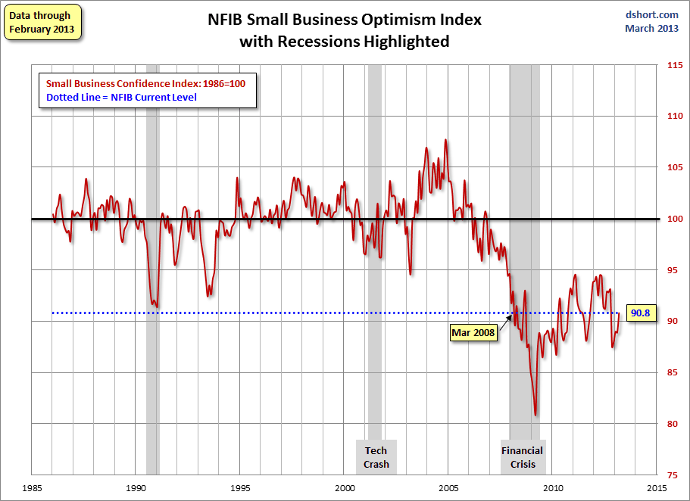
NFIB Small Business Optimism Index
January 1985 through February 2013
Small business optimism is returning after taking a big hit over “Fiscal Cliff” fears
Source: National Federation of Independent Business at http://www.advisorperspectives.com/dshort/charts/indicators/Sentiment.html?NFIB-optimism-index.gif ; Insurance Information Institute.

Slide 100
12 Industries for the Next 10 Years: Insurance Solutions Needed
Health Care
Health Sciences
Energy (Traditional)
Many industries are poised for growth, though insurers’ ability to capitalize on these industries varies widely
Alternative Energy
Petrochemical
Agriculture
Natural Resources
Technology (incl. Biotechnology)
Light Manufacturing
Insourced Manufacturing
Export-Oriented Industries
Shipping (Rail, Marine, Trucking, Pipelines)

Slide 101
Growth Analysis by State and Business Segment
Premium Growth Rates Vary Tremendously by State
101

Slide 102
Direct Premiums Written: Total P/C
Percent Change by State, 2006-2011*
Top 25 States
A limited number of states showed strong growth over the past 5 years
Sources: SNL Financial LC.; Insurance Information Institute.

Slide 103
Direct Premiums Written: Total P/C
Percent Change by State, 2006-2011*
Bottom 25 States
NY’s change in premium growth was similar to the US average
States with the poorest performing economies also produced the most negative net change in premiums of the past 5 years
Sources: SNL Financial LC.; Insurance Information Institute.

Slide 104
Direct Premiums Written: PP Auto
Percent Change by State, 2006-2011*
Top 25 States
Sources: SNL Financial LC.; Insurance Information Institute.

Slide 105
Direct Premiums Written: PP Auto
Percent Change by State, 2006-2011*
Bottom 25 States
NY’s change in premium growth was similar to the US average
States with the poorest performing economies also produced the most negative net change in premiums of the past 5 years
Sources: SNL Financial LC.; Insurance Information Institute.

Slide 106
Direct Premiums Written: Homeowners
Percent Change by State, 2006-2011*
Top 25 States
Sources: SNL Financial LC.; Insurance Information Institute.

Slide 107
Direct Premiums Written: Homeowners
Percent Change by State, 2006-2011*
Bottom 25 States
States with the poorest performing economies also produced the most negative net change in premiums of the past 5 years
Sources: SNL Financial LC.; Insurance Information Institute.

Slide 108
Direct Premiums Written: Comm. Lines
Percent Change by State, 2006-2011*
Top 25 States
Only 12 states showed any commercial lines growth 2006 and 2011
NY’s decline in commercial lines premiums written was less than the US overall
Sources: SNL Financial LC.; Insurance Information Institute.

Slide 109
Direct Premiums Written: Comm. Lines
Percent Change by State, 2006-2011*
Bottom 25 States
States with the poorest performing economies also produced the most negative net change in premiums of the past 5 years
Sources: SNL Financial LC.; Insurance Information Institute.

Slide 110
Direct Premiums Written: Workers’ Comp
Percent Change by State, 2006-2011*
Top 25 States
NY was one of the few states to show any growth in WC premiums written from 2006-2011
*Excludes monopolistic fund states: ND, OH, WA, WY as well as WV, which transitioned to a competitive structure during this period.
Sources: SNL Financial LC.; Insurance Information Institute.

Slide 111
Direct Premiums Written: Worker’s Comp
Percent Change by State, 2006-2011*
Bottom 25 States
States with the poorest performing economies also produced the most negative net change in premiums of the past 5 years
*Excludes monopolistic fund states: ND, OH, WA, WY as well as WV, which transitioned to a competitive structure during this period.
Sources: SNL Financial LC.; Insurance Information Institute.

Slide 112
Labor Market Trends
Massive Job Losses Sapped the Economy and Commercial/Personal Lines Exposure, But Trend is Improving
112

Slide 113
Unemployment and Underemployment Rates: Stubbornly High in 2012, But Falling
January 2000 through Feb. 2013, Seasonally Adjusted (%)
U-6 went from 8.0% in March 2007 to 17.5% in
October 2009; Stood at 14.3% in Feb. 2013
Recession ended in November 2001
Unemployment kept rising for 19 more months
Recession began in December 2007
Unemployment stood at 7.7% in Feb. 2013—lowest in 4 years.
Unemployment peaked at 10.1% in October 2009, highest monthly rate since 1983.
Peak rate in the last 30 years: 10.8% in November - December 1982
Stubbornly high unemployment and underemployment constrain overall economic growth, but the job market is now clearly improving
Source: US Bureau of Labor Statistics; Insurance Information Institute.
113
12/01/09 - 9pm
eSlide – P6466 – The Financial Crisis and the Future of the P/C
Notes:
113

Slide 114
Monthly Change in Private Employment
January 2007 through Feb. 2013 (Thousands)
246,000 private sector jobs were created in February
Monthly Losses in Dec. 08–Mar. 09 Were the Largest in the
Post-WW II Period
Jobs Created
2012: 2.247 Mill
2011: 2.420 Mill
2010: 1.235 Mill
Private Employers Added 6.31million Jobs Since Jan. 2010 After Having Shed 4.98 Million Jobs in 2009 and 3.80 Million in 2008 (State and Local Governments Have Shed Hundreds of Thousands of Jobs)
Source: US Bureau of Labor Statistics: http://www.bls.gov/ces/home.htm; Insurance Information Institute

Slide 115
Cumulative Change in Private Employment: Dec. 2007—Feb. 2013
December 2007 through February 2013 (Millions)
Cumulative job losses peaked at 8.765 million in February 2010
Cumulative job losses as of Feb. 2013 totaled 2.412 million
All of the jobs “lost” since President Obama took office in Jan. 2009 have been recouped
Private Employers Added 6.31million Jobs Since Jan. 2010 After Having Shed 4.98 Million Jobs in 2009 and 3.80 Million in 2008 (State and Local Governments Have Shed Hundreds of Thousands of Jobs)
Source: US Bureau of Labor Statistics: http://www.bls.gov/ces/home.htm; Insurance Information Institute

Slide 116
Cumulative Change in Private Sector Employment: Jan. 2010—Feb. 2013
January 2010 through February 2013* (Millions)
Job gains and pay increases have added more than $600 billion to payrolls since Jan. 2010
Cumulative job gains through Feb. 2013 totaled 6.31 million
Private Employers Added 6.31million Jobs Since Jan. 2010 After Having Shed 4.98 Million Jobs in 2009 and 3.80 Million in 2008 (State and Local Governments Have Shed Hundreds of Thousands of Jobs)
Source: US Bureau of Labor Statistics: http://www.bls.gov/ces/home.htm; Insurance Information Institute

Slide 117
Cumulative Change in Government Employment: Jan. 2010—Feb. 2013
Government at all levels has shed more than half a million jobs since Jan. 2010 even as private employers created 6.31 million jobs, though losses may now be ending.
January 2010 through Feb. 2013* (Millions)
Cumulative job losses through Feb. 2013 totaled 637,000
Temporary Census hiring distorted 2010 figures
Governments at All Levels are Under Severe Fiscal Strain As Tax Receipts Plunged and Pension Obligations Soared During the Financial Crisis: Sequestration Will Add to this Toll
Source: US Bureau of Labor Statistics http://www.bls.gov/data/#employment; Insurance Information Institute

Slide 118
Net Change in Government Employment: Jan. 2010—Feb. 2013*
State government employment fell by 2.6% since the end of 2009 while Federal employment is down by 1.1%
(Thousands)
Local government employment shrank by 473,000 from Jan. 2010 through Feb. 2013, accounting for 74% of all government job losses, negatively impacting WC exposures for those cities and counties that insure privately
*Cumulative change from prior month; Base employment date is Dec. 2009.
Source: US Bureau of Labor Statistics http://www.bls.gov/data/#employment; Insurance Information Institute

Slide 119
Unemployment Rates by State, December 2012:
Highest 25 States*
In December, 22 states reported over-the-month unemployment rate decreases, 16 states and the District of Columbia had increases, and 12 states had no change.
NY’s unemployment rate is above the US average
*Provisional figures for December 2012, seasonally adjusted.
Sources: US Bureau of Labor Statistics; Insurance Information Institute.

Slide 120
Unemployment Rates by State, December 2012:
Lowest 25 States*
In December, 22 states reported over-the-month unemployment rate decreases, 16 states and the District of Columbia had increases, and 12 states had no change.
*Provisional figures for December 2012, seasonally adjusted.
Sources: US Bureau of Labor Statistics; Insurance Information Institute.

Slide 121

Oil & Gas Extraction Employment,
Jan. 2010—February 2013*
(Thousands)
Oil and gas extraction employment is up 24.4% since Jan. 2010 as the energy sector booms. Domestic energy production is essential to any robust economic recovery in the US.
*Seasonally adjusted
Sources: US Bureau of Labor Statistics at http://data.bls.gov; Insurance Information Institute.
121
12/01/09 - 9pm
eSlide – P6466 – The Financial Crisis and the Future of the P/C
Notes:
121

Slide 122
US Unemployment Rate Forecast
2007:Q1 to 2014:Q4F*
Jobless figures have been revised slightly downwards for 2013/14
Rising unemployment
eroded payrolls
and workers comp’s
exposure base.
Unemployment peaked at 10% in late 2009.
Unemployment forecasts have been revised slightly downwards. Optimistic scenarios put the unemployment as low as 6.6% by Q4 of next year.
* = actual; = forecasts
Sources: US Bureau of Labor Statistics; Blue Chip Economic Indicators (3/13 edition); Insurance Information Institute.

Slide 123
US Unemployment Rate Forecasts
Quarterly, 2013:Q1 to 2014:Q4
Unemployment will remain high even under the most optimistic of scenarios, but forecasts are being revised downwards
Sources: Blue Chip Economic Indicators (Feb. 2013); Insurance Information Institute

Slide 124
Nonfarm Payroll (Wages and Salaries):
Quarterly, 2005–2012:Q4
Billions
Latest (2012:Q4) was $6.96 trillion, a new peak--$708B above 2009 trough
Prior Peak was 2008:Q1 at $6.60 trillion
Pace of payroll growth accelerated in late 2012
Growth rates in 2012
Q1:12 over Q4:11: 1.8%
Q2 over Q1: 1.4% Q3 over Q2: 0.3% Q4 over Q3: 1.0%
Recent trough (2009:Q3) was $6.25 trillion, down 5.3% from prior peak
Note: Recession indicated by gray shaded column. Data are seasonally adjusted annual rates.
Sources: http://research.stlouisfed.org/fred2/series/WASCUR; National Bureau of Economic Research (recession dates); Insurance Information Institute.
124
12/01/09 - 9pm
eSlide – P6466 – The Financial Crisis and the Future of the P/C
Notes:
124

Slide 125
Payroll vs. Workers Comp Net Written Premiums, 1990-2012E
Payroll Base* WC NWP
$Billions $Billions
7/90-3/91
3/01-11/01
12/07-6/09
WC premium volume dropped two years before the recession began
+9% in 2012E
WC net premiums written were down $14B or 29.3% to $33.8B in 2010 after peaking at $47.8B in 2005
Continued Payroll Growth and Rate Increases Suggest WC NWP Will Grow Again in 2012; +7.9% Growth in 2011 Was the First Gain Since 2005
*Private employment; Shaded areas indicate recessions. WC premiums for 2012 are I.I.I. estimate based YTD 2012 actuals.
Sources: NBER (recessions); Federal Reserve Bank of St. Louis at http://research.stlouisfed.org/fred2/series/WASCUR ; NCCI; I.I.I.

Slide 126
Mass Layoff Announcements,
Jan. 2002—November 2012*
Mass layoff announcements peaked at more than 3,000 per month in Feb. 2009
There were 1,759 may layoffs announced in Nov. 2012, likely a temporary spike arising from Hurricane Sandy
*Seasonally adjusted.
Note: Recessions indicated by gray shaded columns.
Sources: US Bureau of Labor Statistics at http://www.bls.gov/mls/; National Bureau of Economic Research (recession dates); Insurance Information Institute.
126
12/01/09 - 9pm
eSlide – P6466 – The Financial Crisis and the Future of the P/C
Notes:
126

Slide 127
2012 TORNADO &
SEVERE STORM SUMMARY
2012 Got Off to a Worrisome Start, But Is No Repeat of 2011
127

Slide 128
Number of Tornadoes and Related Deaths, 1990 – 2012*
Tornadoes claimed 553 lives in 2011, the most since 1925
936 tornadoes were recorded in 2012, causing, 68 deaths*
2012 Tornado Losses Got Off to an Ominous Beginning, but Slowed. Yet Despite Fewer Tornadoes, Overall Insured Losses from Thunderstorms Totaled $14.9B, the 2nd Highest on Record.
*Through Dec. 31, 2012.
Source: U.S. Department of Commerce, Storm Prediction Center, National Weather Service at http://www.spc.noaa.gov/climo/online/monthly/newm.html

Slide 129
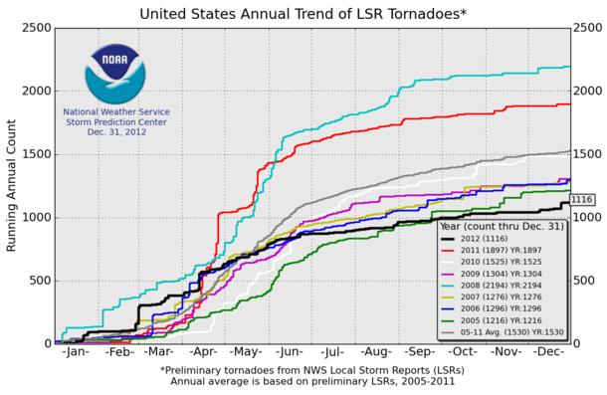
U.S. Tornado Count, 2005-2012*
There were 1,897 tornadoes in the US in 2011 far above average, but well below 2008’s record
2012 count was far below 2011
*Through Dec. 31, 2012.
Source: http://www.spc.noaa.gov/wcm/
129

Slide 130
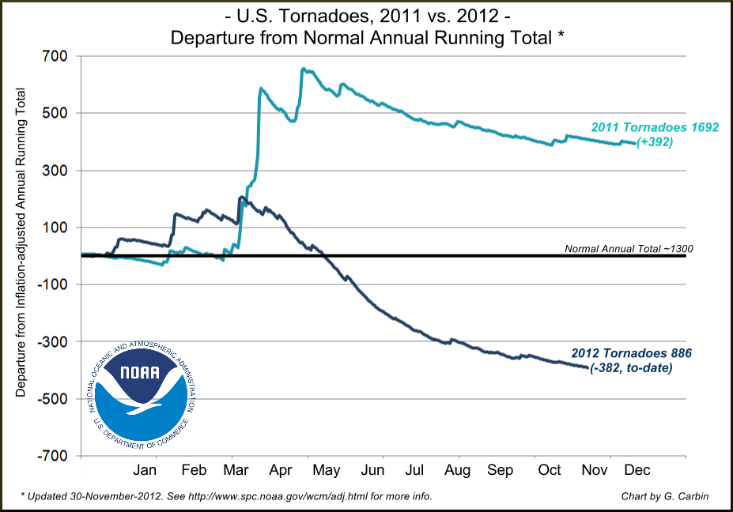
U.S. Tornado Count, Departure from Inflation-Adjusted Running Total, 2011 vs. 2012*
2011 count was far above average
2012 count is running far below average
*Through Nov. 30, 2012.
Source: http://www.spc.noaa.gov/wcm/
130

Slide 131
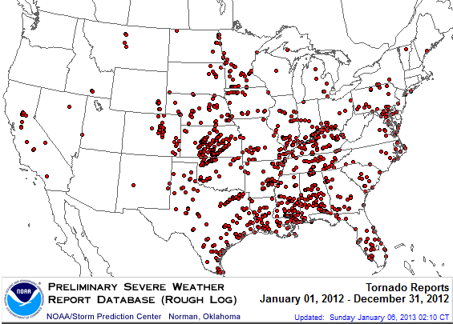
Location of Tornadoes in the US, 2012*
1,119 tornadoes killed 68 people through Dec. 31
*Through Dec. 31, 2012.
Source: NOAA Storm Prediction Center; http://www.spc.noaa.gov/climo/online/monthly/2012_annual_summary.html#
131

Slide 132
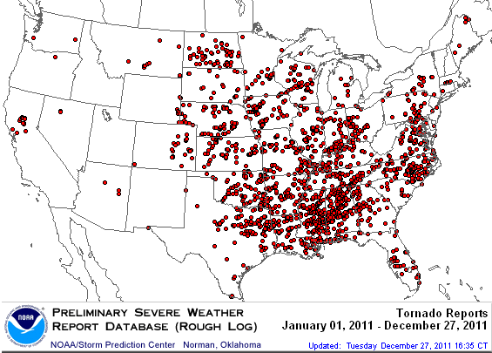
Location of Tornadoes in the US, 2011
1,894 tornadoes killed 553 people in 2011, including at least 340 on April 26 mostly in the Tuscaloosa area, and 130 in Joplin on May 22
Source: NOAA Storm Prediction Center; http://www.spc.noaa.gov/climo/online/monthly/2011_annual_summary.html#
132

Slide 133
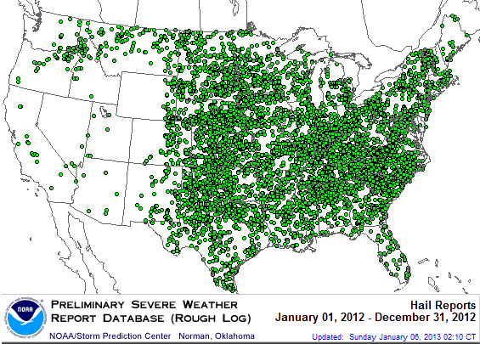
Location of Large Hail Reports in the US, 2012*
There were 7,033 “Large Hail” reports through Dec. 31, 2012, causing extensive damage to homes, businesses and vehicles
*Through Dec. 31, 2012.
Source: NOAA Storm Prediction Center; http://www.spc.noaa.gov/climo/online/monthly/2012_annual_summary.html#
133

Slide 134
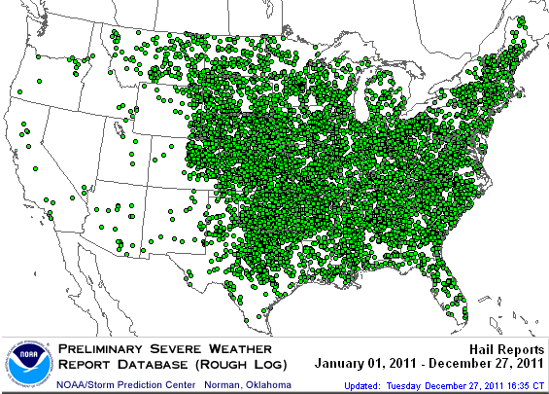
Location of Large Hail Reports in the US, 2011
There were 9,417 “Large Hail” reports in 2011, causing extensive damage to homes, businesses and vehicles
Source: NOAA Storm Prediction Center; http://www.spc.noaa.gov/climo/online/monthly/2011_annual_summary.html#
134

Slide 135
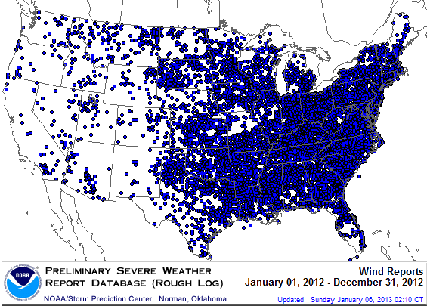
Location of Wind Damage Reports in the US, 2012*
Extreme density due to late June derecho
Hurricane Sandy resulted in a large volume of wind damage reports
There were 14,351 “Wind Damage” reports through Dec. 31, causing extensive damage to homes and, businesses
*Through Dec. 31, 2012.
Source: NOAA Storm Prediction Center; http://www.spc.noaa.gov/climo/online/monthly/2012_annual_summary.html#
135

Slide 136
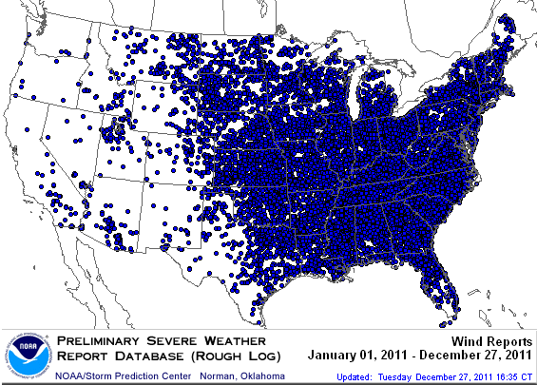
Location of Wind Damage Reports in the US, 2011
There were 18,685 “Wind Damage” reports through Dec. 27, causing extensive damage to homes and, businesses
Source: NOAA Storm Prediction Center; http://www.spc.noaa.gov/climo/online/monthly/2011_annual_summary.html#
136

Slide 137
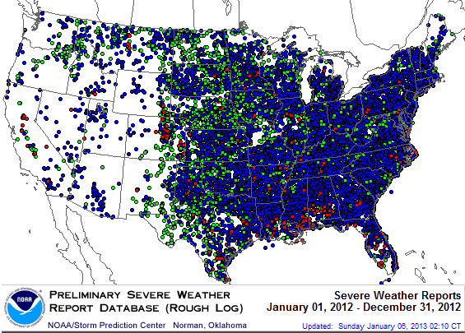
Severe Weather Reports, 2012*
There were 22,503 severe weather reports through Dec. 31; including 1,119 tornadoes; 7,033 “Large Hail” reports and 14,351 high wind events
*Through Dec. 31, 2012.
Source: NOAA Storm Prediction Center; http://www.spc.noaa.gov/climo/online/monthly/2012_annual_summary.html#
137

Slide 138
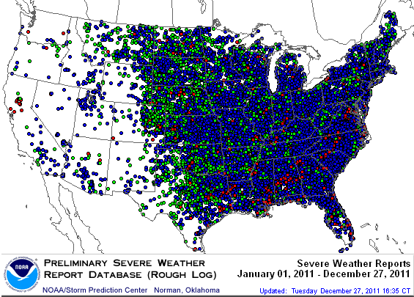
Severe Weather Reports, 2011
There were 29,996 severe weather reports in 2011; including 1,894 tornadoes; 9,417 “Large Hail” reports and 18,685 high wind events
Source: NOAA Storm Prediction Center; http://www.spc.noaa.gov/climo/online/monthly/2011_annual_summary.html#
138

Slide 139
Number of Severe Weather Reports in US, by Type, 2012
Wind damage from thunderstorms and tornadoes account for the majority of insured catastrophe losses in most years, including 2012
Source: NOAA Storm Prediction Center; http://www.spc.noaa.gov/climo/online/monthly/2011_annual_summary.html#

Slide 140
The BIG Question:
Where Is the Market Heading?
Catastrophes and Other Factors Are Pressuring Insurance Markets
New Factor: Record Low Interest Rates Are Contributing to Underwriting and Pricing Pressures
140
Notes:
140

Slide 141
Historical Criteria for a “Market Turn”:
Low Interest Rates Add New Pressure
Criteria | Status | Comments
Sustained Period of Large Underwriting Losses | Large CAT Losses in 2011/12 Pushed Up Combineds | CAT Losses contributing to higher underwriting losses Apart from CAT losses, overall p/c underwriting losses remain modest Combined ratios (ex-CATs) still in low 100s (vs. 110+ at onset of last hard market); CR= 101.1 in H1:2012 (ex-M&FG) Prior-year reserve releases continue to reduce u/w losses, boost ROEs, though more modestly
Material Decline in Surplus/ Capacity | Small Decline Due to 2011 Cats; Could drop in 2012 | Fell 1.6% in 2011 due to CATs Surplus reached record as of 9/30/12 record $583.5B Likely drop as of 12/31/12 due to Sandy impact Modest growth in demand for insurance should begin to absorb some capacity
Tight Reinsurance Market | Somewhat in Place | Ample capacity Market is generally flat except up for cat-impacted accounts Lower prices in Europe
Renewed Underwriting & Pricing Discipline | Firming Broad, Sustained,esp. in Property, WC | Commercial lines pricing is consistently and uniformly across all major lines, esp. Property & WC; Markets remain competitive in most segments
Sources: Barclays Capital; Insurance Information Institute.

Slide 142
INVESTMENTS:
THE NEW REALITY
Investment Performance is a Key Driver of Profitability
Depressed Yields Will Necessarily Influence Underwriting & Pricing
142

Slide 143
Property/Casualty Insurance Industry Investment Income: 2000–2012E¹
($ Billions)
Investment earnings in 2012 were running 14% below their 2007 pre-crisis peak
Investment Income Fell in 2012 Due to Persistently Low Interest Rates, Putting Additional Pressure on (Re) Insurance Pricing
¹ Investment gains consist primarily of interest and stock dividends.
*2012F is based on annualized 9M:2012 actual figure of $35.131B.
Sources: ISO; Insurance Information Institute.

Slide 144
Property/Casualty Insurance Industry Investment Gain: 1994–2012F¹
($ Billions)
Investment gains in 2012 are running approximately 20% below their pre-crisis peak
Investment Gains Are Slipping in 2012 as Low Interest Rates Reduce Investment Income and Lower Realized Investment Gains; The Financial Crisis Caused Investment Gains to Fall by 50% in 2008
¹ Investment gains consist primarily of interest, stock dividends and realized capital gains and losses.
* 2005 figure includes special one-time dividend of $3.2B; 2012F figure is III estimate based on annualized actual 9M:2012 result of $38.089B.
Sources: ISO; Insurance Information Institute.

Slide 145
P/C Insurer Net Realized
Capital Gains/Losses, 1990-2012:Q3
Realized capital gains through 2012:9M are down 46% from $5.53B in 2011:9M
($ Billions)
Insurers Posted Net Realized Capital Gains in 2010, 2011 and 2012 Following Two Years of Realized Losses During the Financial Crisis. Realized Capital Losses Were the Primary Cause of 2008/2009’s Large Drop in Profits and ROE
Sources: A.M. Best, ISO, Insurance Information Institute.
145
12/01/09 - 9pm
eSlide – P6466 – The Financial Crisis and the Future of the P/C
Notes:
145

Slide 146
U.S. 10-Year Treasury Note Yields:
A Long Downward Trend, 1990–2013*
Yields on 10-Year U.S. Treasury Notes recently rose 55bp from its all time record lows to 1.98% in Feb. 2013
Yields on 10-Year U.S. Treasury Notes have been essentially below 5% for a full decade.
Since roughly 80% of P/C bond/cash investments are in 10-year or shorter durations, most P/C insurer portfolios will have low-yielding bonds for years to come.
*Monthly, through Feb. 2013. Note: Recessions indicated by gray shaded columns.
Sources: Federal Reserve Bank at http://www.federalreserve.gov/releases/h15/data.htm.
National Bureau of Economic Research (recession dates); Insurance Information Institutes.
146
12/01/09 - 9pm
eSlide – P6466 – The Financial Crisis and the Future of the P/C
Notes:
146

Slide 147
Treasury Yield Curves:
Pre-Crisis (July 2007) vs. Jan. 2013
Treasury yield curve remains near its most depressed level in at least 45 years. Investment income is falling as a result. Fed is unlikely to hike rates until well into 2014 at the earliest.
The Fed Is Actively Signaling that it Is Determined to Keep Rates Low Until Unemployment Drops Below 6.5% or Until Inflation Expectations Exceed 2.5%; Low Rates Add to Pricing Pressure for Insurers.
Source: Federal Reserve Board of Governors; Insurance Information Institute.

Slide 148
Average Maturity of Bonds Held by US P/C Insurers, 2006—2011*
Average Maturity (Years)
The average bond maturity is down by a full year between 2007 and 2011
Falling Average Maturity (and Duration) of the P/C Industry’s Bond Portfolio is Contributing to a Drop in Investment Income Along With Lower Yields
*Year-end figures. Latest available.
Sources: Insurance Information Institute calculations based on A.M. Best data.
148
12/01/09 - 9pm
eSlide – P6466 – The Financial Crisis and the Future of the P/C
Notes:
148

Slide 149
Average Maturity of Bonds Held by US P/C Insurers, 2006—2011*
Average Maturity (Years)
The average bond maturity is down by a full year between 2007 and 2011
Falling Average Maturity (and Duration) of the P/C Industry’s Bond Portfolio is Contributing to the Drop in Investment Income Along With Lower Yields
*Year-end figures. Latest available.
Sources: Insurance Information Institute calculations based on A.M. Best data.
149
12/01/09 - 9pm
eSlide – P6466 – The Financial Crisis and the Future of the P/C
Notes:
149

Slide 150
Distribution of Bond Maturities,
P/C Insurance Industry, 2006-2011
The main shift over these 6 years has been from bonds with 5-10 years of maturity to bonds with 1-5 years of maturity. The industry also slightly trimmed it holdings of bonds in the 10-20-year maturity category
and bonds in the longest-maturity category.
Sources: A.M. Best; Insurance Information Institute.

Slide 151
Annual Inflation Rates, (CPI-U, %),
1990–2014F
Annual Inflation Rates (%)
Inflation peaked at 5.6% in August 2008 on high energy and commodity crisis. The recession and the collapse of the commodity bubble reduced inflationary pressures in 2009/10
Higher energy, commodity and food prices pushed up inflation in 2011, but not longer term inflationary expectations.
The slack in the U.S. economy suggests that inflationary pressures should remain subdued for an extended period of times. Energy, health care and commodity prices, plus U.S. debt burden, remain longer-run concerns
Sources: US Bureau of Labor Statistics; Blue Chip Economic Indicators, 1/13 (forecasts).

Slide 152
Reduction in Combined Ratio Necessary to Offset 1% Decline in Investment Yield to Maintain Constant ROE, by Line*
Lower Investment Earnings Place a Greater Burden on Underwriting and Pricing Discipline
*Based on 2008 Invested Assets and Earned Premiums
**US domestic reinsurance only
Source: A.M. Best; Insurance Information Institute.
152
12/01/09 - 9pm
eSlide – P6466 – The Financial Crisis and the Future of the P/C
Notes:
152
This shows the drop in Combined Ratio for each line of business that would be needed to maintain a constant ROE, given a 1-percentage-point drop in investment yield

Slide 153
1. UNDERWRITING
Underwriting Losses in 2011 and 2012 Are Elevated by High Catastrophe Losses
153

Slide 154
P/C Insurance Industry
Combined Ratio, 2001–2012:Q3*
Higher CAT Losses, Shrinking Reserve Releases, Toll of Soft Market
As Recently as 2001, Insurers Paid Out Nearly $1.16 for Every $1 in Earned Premiums
Heavy Use of Reinsurance Lowered Net Losses
Relatively Low CAT Losses, Reserve Releases
Relatively Low CAT Losses, Reserve Releases
Avg. CAT Losses, More Reserve Releases
Best Combined Ratio Since 1949 (87.6)
Lower CAT Losses Before Sandy
Cyclical Deterioration
* Excludes Mortgage & Financial Guaranty insurers 2008--2012. Including M&FG, 2008=105.1, 2009=100.7, 2010=102.4, 2011=108.2; 2012:Q3=100.0.
Sources: A.M. Best, ISO.

Slide 155
Underwriting Gain (Loss)
1975–2012:Q3*
($ Billions)
Cumulative underwriting deficit from 1975 through 2011 is $479B
Underwriting losses through 2012:Q3 totaled $6.7B
High cat losses in 2011 led to the highest underwriting loss since 2002
Large Underwriting Losses Are NOT Sustainable
in Current Investment Environment
* Includes mortgage and financial guaranty insurers in all years.
Sources: A.M. Best, ISO; Insurance Information Institute.

Slide 156
Combined Ratios by Predominant Business Segment, 2012:9 Mos. vs. 2011:9 Mos.*
The combined ratios for both personal and commercial lines improved substantially through 2012:Q3, prior to Hurricane Sandy
(Percent)
*Excludes mortgage and financial guaranty insurers.
Source: ISO/PCI; Insurance Information Institute

Slide 157
P/C Reserve Development, 1992–2013F
Prior year reserve releases totaled $8.8 billion in the first half of 2010, up from $7.1 billion in the first half of 2009
Reserve Releases Remained Strong in 2010 But Tapered Off in 2011. Releases Are Expected to Further Diminish in 2012 and 2103
Note: 2005 reserve development excludes a $6 billion loss portfolio transfer between American Re and Munich Re. Including this transaction, total prior year adverse development in 2005 was $7 billion. The data from 2000 and subsequent years excludes development from financial guaranty and mortgage insurance.
Sources: Barclays Capital; A.M. Best.

Slide 158
Number of Years with Underwriting Profits by Decade, 1920s–2010s
Number of Years with Underwriting Profits
Underwriting Profits Were Common Before the 1980s
(40 of the 60 Years Before 1980 Had Combined Ratios Below 100) –
But Then They Vanished. Not a Single Underwriting Profit Was
Recorded in the 25 Years from 1979 Through 2003
* 2009 combined ratio excl. mort. and finl. guaranty insurers was 99.3, which would bring the 2000s total to 4 years with an u/w profit.
**Data for the 2010s includes 2010 and 2011.
Note: Data for 1920–1934 based on stock companies only.
Sources: Insurance Information Institute research from A.M. Best Data.
158
12/01/09 - 9pm
eSlide – P6466 – The Financial Crisis and the Future of the P/C
Notes:
158

Slide 159
Financial Strength & Underwriting
Cyclical Pattern is P-C Impairment History is Directly Tied to Underwriting, Reserving & Pricing
159

Slide 160
P/C Insurer Impairments, 1969–2011
3 small insurers in Missouri did encounter problems in 2011 following the May tornado in Joplin. They were absorbed by a larger insurer and all claims were paid.
The Number of Impairments Varies Significantly Over the P/C Insurance Cycle, With Peaks Occurring Well into Hard Markets
Source: A.M. Best Special Report “1969-2011 Impairment Review,” June 2012; Insurance Information Institute.

Slide 161
P/C Insurer Impairment Frequency vs. Combined Ratio, 1969-2011
2011 impairment rate was 0.91%, up from 0.67% in 2010; the rate is slightly higher than the 0.82% average since 1969
Impairment Rates Are Highly Correlated With Underwriting Performance and Reached Record Lows in 2007; Recent Increase Was Associated Primarily With Mortgage and Financial Guaranty Insurers and Not Representative of the Industry Overall
Source: A.M. Best; Insurance Information Institute

Slide 162
Reasons for US P/C Insurer Impairments, 1969–2010
Historically, Deficient Loss Reserves and Inadequate Pricing Are
By Far the Leading Cause of P-C Insurer Impairments.
Investment and Catastrophe Losses Play a Much Smaller Role
Reinsurance Failure
Sig. Change in Business
Misc.
Investment Problems (Overstatement of Assets)
Deficient Loss Reserves/
Inadequate Pricing
Affiliate Impairment
Catastrophe Losses
Alleged Fraud
Rapid Growth
Source: A.M. Best: 1969-2010 Impairment Review, Special Report, April 2011.

Slide 163
Top 10 Lines of Business for US P/C Impaired Insurers, 2000–2010
Workers Comp and Pvt. Passenger Auto Account for Nearly Half of the Premium Volume of Impaired Insurers Over the Past Decade
Title
Financial Guaranty
Surety
Med Mal
Workers Comp
Other Liability
Commercial Auto Liability
Pvt. Passenger Auto
Commercial Multiperil
Homeowners
Source: A.M. Best: 1969-2010 Impairment Review, Special Report, April 2011.

Slide 164
Number of Recessions Endured by P/C Insurers, by Number of Years in Operation
Number of Recessions Since 1860
Insurers are true survivors—not just of natural catastrophes but also economic ones
Number of Years in Operation
Many US Insurers Are Close to a Century Old or Older
Sources: Insurance Information Institute research from National Bureau of Economic Research data.
164
12/01/09 - 9pm
eSlide – P6466 – The Financial Crisis and the Future of the P/C
Notes:
164

Slide 165
Performance by Segment
165
Notes:
165

Slide 166
Private Passenger Auto Combined Ratio: 1993–2014F
Private Passenger Auto Accounts for 34% of Industry Premiums and Remains the Profit Juggernaut of the P/C Insurance Industry
Sources: A.M. Best (1990-2013F);Conning (2014F); Insurance Information Institute.

Slide 167
Homeowners Insurance Combined Ratio: 1990–2014F
Record tornado activity
Hurricane Sandy
Hurricane Ike
Homeowners Performance Deteriorated in 2011/12 Due to Large Cat Losses. Extreme Regional Variation Can Be Expected Due to Local Catastrophe Loss Activity
Sources: A.M. Best (1990-2013F);Conning (2014F); Insurance Information Institute.

Slide 168
Homeowners Multi-Peril Loss & LAE Ratio, 2011:
Highest 25 States
TN and AL had the worst underwriting performance of all states in 2011 due to high tornado and storm losses
Sources: SNL Financial; Insurance Information Institute.

Slide 169
Homeowners Multi-Peril Loss & LAE Ratio, 2011:
Lowest 25 States
HI and FL had the best performance in 2011 due to the absence of hurricanes/tropical storms impacts in either state last year
Sources: SNL Financial; Insurance Information Institute.

Slide 170
Commercial Lines Combined Ratio, 1990-2013F*
Commercial lines underwriting performance in 2012 was the worst since 2002 due to heavy impact from Sandy
*2007-2013F figures exclude mortgage and financial guaranty segments.
Source: A.M. Best; Insurance Information Institute

Slide 171
Commercial Auto Combined Ratio: 1993–2014F
Commercial Auto is Expected to Improve as Rate Gains Outpace Any Adverse Frequency and Severity Trends
Sources: A.M. Best (1990-2013F);Conning (2014F); Insurance Information Institute.

Slide 172
Commercial Multi-Peril Combined Ratio: 1995–2013F
Commercial Multi-Peril Underwriting Performance is Expected to Improve in 2013 Assuming Normal Catastrophe Loss Activity
*2012-2013 figures are A.M. Best estimate/forecast for the combined liability and non-liability components.
Sources: A.M. Best; Insurance Information Institute.

Slide 173
General Liability Combined Ratio:
2005–2014F
Commercial General Liability Underwriting Performance Has Been Volatile in Recent Years
Source: Conning Research and Consulting.

Slide 174
Inland Marine Combined Ratio: 1999–2014F
Inland Marine is Expected to Remain Among the Most Profitable of All Lines
Sources: A.M. Best (1999-2011); Insurance Information Institute (2012F); Conning (2013F-2014F)

Slide 175
Other & Products Liability Combined Ratio: 1991–2013F
Liability Lines Have Performed Better in the Post-Tort Reform Era (~2005), but There Has Been Some Deterioration in Recent Years
Sources: A.M. Best ; Insurance Information Institute.

Slide 176
Medical Malpractice Combined Ratio vs. All Lines Combined Ratio, 1991-2013F
Med Mal Insurers in 2012 paid out $0.91 in loss and expense for every $1 they earned in premiums
The dramatic improvement over the past decade has restored med mal’s viability
In 2001, med mal insurers paid out $1.55 for every dollar earned
Source: AM Best, Insurance Information Institute

Slide 177
Workers Compensation Operating Environment
The Weak Economy and Soft Market Have Made the Workers Comp Operating Increasingly Challenging
177

Slide 178
Workers Compensation Combined Ratio: 1994–2014F
Workers Comp Results Should Begin to Improve in 2013. Underwriting Results Deteriorated Markedly from 2007-2012 and Were the Worst They Had Been in a Decade.
Sources: A.M. Best (1994-2013F); Insurance Information Institute (2014F).

Slide 179
Workers Compensation Medical Severity
Moderate Increase in 2011
Medical
Claim Cost ($000s)
Average Medical Cost per Lost-Time Claim
Annual Change 1991–1993: +1.9%
Annual Change 1994–2001: +8.9%
Annual Change 2002–2010: +6.0%
Cumulative Change = 245%
(1991-2011p)
Accident Year
2011p: Preliminary based on data valued as of 12/31/2011
1991-2010: Based on data through 12/31/2010, developed to ultimate
Based on the states where NCCI provides ratemaking services; Excludes high deductible policies

Slide 180
Workers Comp Indemnity Claim Costs: Modest Increase in 2011
Average Indemnity Cost per Lost-Time Claim
Indemnity
Claim Cost ($ 000s)
Average indemnity costs per claim resumed its upward climb in 2011
Annual Change 1991–1993: -1.7%
Annual Change 1994–2001: +7.3%
Annual Change 2002–2010: +3.4%
Accident Year
2010p: Preliminary based on data valued as of 12/31/2011
1991–2010: Based on data through 12/31/2010, developed to ultimate
Based on the states where NCCI provides ratemaking services
Excludes high deductible policies
Notes:
180
Exhibit 11 of Article

Slide 181
Workers Compensation Premium:
First Increase in Years
Net Written Premium
$ Billions
p Preliminary
Source: 1990–2010 Private Carriers, Best's Aggregates & Averages; 2011p, NCCI
1996–2011p State Funds: AZ, CA, CO, HI, ID, KY, LA, MD, MO, MT, NM, OK, OR, RI, TX, UT Annual Statements
State Funds available for 1996 and subsequent
Calendar Year

Slide 182
Nonfarm Payroll (Wages and Salaries):
Quarterly, 2005–2011:Q4
Billions
Peak was 2008:Q1 at $6.60 trillion
Latest (2011:Q4) was $6.71 trillion, a new peak
Pace of payroll growth is accelerating
Recent trough (2009:Q3) was $6.25 trillion, down 5.3% from prior peak
Growth rates in 2011
Q2 over Q1: 0.6%
Q3 over Q2: 0.4% Q4 over Q3: 1.0%
Note: Recession indicated by gray shaded column. Data are seasonally adjusted annual rates.
Sources: http://research.stlouisfed.org/fred2/series/WASCUR; National Bureau of Economic Research (recession dates); Insurance Information Institute.
182
12/01/09 - 9pm
eSlide – P6466 – The Financial Crisis and the Future of the P/C
Notes:
182

Slide 183
Payroll vs. Workers Comp Net Written Premiums, 1990-2011
Payroll Base* WC NWP
$Billions $Billions
12/07-6/09
7/90-3/91
3/01-11/01
WC premium volume dropped two years before the recession began
WC net premiums written were down $14B or 29.3% to $33.8B in 2010 after peaking at $47.8B in 2005
Resumption of payroll growth and rate increases suggests WC NWP will grow again in 2012
*Private employment; Shaded areas indicate recessions. Payroll and WC premiums for 2011 is I.I.I. estimate
Sources: NBER (recessions); Federal Reserve Bank of St. Louis at http://research.stlouisfed.org/fred2/series/WASCUR ; NCCI; I.I.I.

Slide 184
Average Approved Bureau
Rates/Loss Costs
Percent
History of Average WC Bureau Rate/Loss Cost Level Changes
Cumulative 2000–2003
+17.1%
Approve rates/loss costs are seeing their first significant increase since 2003
Cumulative 1994–1999
-27.8%
Cumulative 2004–2011
-25.6%
Cumulative
1990–1993
+36.3%
Calendar Year
*States approved through 7/31/12.
Note: Countrywide approved changes in advisory rates, loss costs and assigned risk rates as filed by applicable rating organization.
Source: NCCI.

Slide 185
Current NCCI Voluntary Market
Filed Rate/Loss Cost Changes
(Excludes Law-Only Filings)
Ratio
IN and NC filed in cooperation with state rating bureau
Source: NCCI

Slide 186
Impact of Discounting on Workers Compensation Premium
NCCI States—Private Carriers
Percent
p Preliminary
Dividend ratios are based on calendar year statistics
NCCI benchmark level does not include an underwriting contingency provision
Based on data through 12/31/2011 for the states where NCCI provides ratemaking services
Source: NCCI.
Policy Year

Slide 187
Workers Comp Rate Changes,
2008:Q4 – 2012:Q4
WC rate changes have been positive for 7 consecutive quarters, longer than any other commercial line
(Percent Change)
Note: CIAB data cited here are based on a survey. Rate changes earned by individual insurers can and do vary, potentially substantially.
Source: Council of Insurance Agents and Brokers; Information Institute.

Slide 188
2. SURPLUS/CAPITAL/CAPACITY
How Will Large Catastrophe Losses Impact Capacity?
188

Slide 189
US Policyholder Surplus:
1975–2012*
($ Billions)
Surplus as of 9/30/12 was a record $583.5, up 6.0% from $550.3 of 12/31/11, but still up 33.5% ($146.4B) from the crisis trough of $437.1B at 3/31/09. Pre-crisis peak was $521.8 as of 9/30/07. Surplus as of 9/30/12 was 11.8% above 2007 peak.
“Surplus” is a measure of underwriting capacity. It is analogous to “Owners Equity” or “Net Worth” in non-insurance organizations
The Premium-to-Surplus Ratio Stood at $0.80:$1 as of
9/30/12, A Near Record Low (at Least in Recent History)*
* As of 9/30/12.
Source: A.M. Best, ISO, Insurance Information Institute.

Slide 190
Policyholder Surplus,
2006:Q4–2012:Q3
Drop due to near-record 2011 CAT losses
2007:Q3
Pre-Crisis Peak
($ Billions)
Surplus as of 9/30/12 was up $12.8B or 2.2% from the previous record high of $570.7B set as of 3/31/12.
The Industry now has $1 of surplus for every $0.80 of NPW, close to the strongest claims-paying status in its history.
*Includes $22.5B of paid-in capital from a holding company parent for one insurer’s investment in a non-insurance business in early 2010.
The P/C Insurance Industry Both Entered and Emerged from the 2012 Hurricane Season Very Strong Financially. There is No Insurance Industry “Fiscal Cliff”
Sources: ISO, A.M .Best.
190
12/01/09 - 9pm
eSlide – P6466 – The Financial Crisis and the Future of the P/C
Notes:
190

Slide 191
3. REINSURANCE MARKET CONDITIONS
Record Global Catastrophes Activity is Pressuring Pricing
191

Slide 192
Reinsurer Share of Recent Significant Market Losses
Billions of 2011 Dollars
40% Reinsurance share of total insured loss
$37.5
$15.0
73%
60%
95%
$13.0
44%
$10.0
$22.5
$8.3
$9.5
$6.0
$5.0
$7.9
$2.2
$3.5
$4.0
$2.8
$0.4
Reinsurers Paid a High Proportion of Insured Losses Arising from Major Catastrophic Events Around the World in Recent Years
Source: Insurance Information Institute from reinsurance share percentages provided in RAA, ABIR and CEA press release, Jan. 13, 2011.
192
12/01/09 - 9pm
eSlide – P6466 – The Financial Crisis and the Future of the P/C
Notes:
192

Slide 193
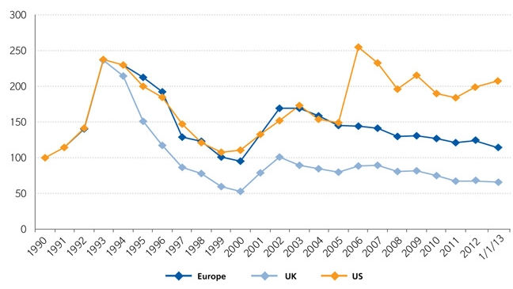
Regional Property Catastrophe Rate on Line Index, 1990—2013 (as of January 1)
Property-Cat reinsurance pricing was up in the US as of 1/1/13 but was down in Europe/UK
Sources: Guy Carpenter; Insurance Information Institute.

Slide 194
4. RENEWED PRICING DISCIPLINE
Evidence of a Broad and Sustained Shift in Pricing
194

Slide 195
Distribution of Direct Premiums Written by Segment/Line, 2010
Personal/Commercial lines split has been about 50/50 for many years; Personal Lines overtook Commercial Lines in 2010
Pvt. Passenger Auto is by far the largest line of insurance and is currently the most important source of industry profits
Billions of additional dollars in homeowners insurance premiums are written by state-run residual market plans
Distribution Facts
2010
Commercial Lines
$226.8B/49%
Homeowners
$68.2B/15%
Pvt. Pass Auto
$165.0B/36%
Sources: A.M. Best; Insurance Information Institute research.

Slide 196
Net Premium Growth: Annual Change,
1971—2012:Q3
(Percent)
1975-78
1984-87
2000-03
Net Written Premiums Fell 0.7% in 2007 (First Decline Since 1943) by 2.0% in 2008, and 4.2% in 2009, the First 3-Year Decline Since 1930-33.
2012:Q3 growth was +4.2%
Shaded areas denote “hard market” periods
Sources: A.M. Best (historical and forecast), ISO, Insurance Information Institute.

Slide 197
P/C Net Premiums Written: % Change, Quarter vs. Year-Prior Quarter
Premium growth in Q3 2012 was up 5.1% over Q3 2011, the strongest growth since Q4 2006
Sustained Growth in Written Premiums
(vs. the same quarter, prior year) Will Continue into 2013
Sources: ISO, Insurance Information Institute.
197
12/01/09 - 9pm
eSlide – P6466 – The Financial Crisis and the Future of the P/C
Notes:
197

Slide 198
Growth in Net Written Premium by Segment, 2012:9 Mos. vs. 2011:9 Mos.*
(Percent)
*Excludes mortgage and financial guaranty insurers.
Source: ISO/PCI; Insurance Information Institute

Slide 199
Average Commercial Rate Change,
All Lines, (1Q:2004–4Q:2012)
Pricing as of Q4:2012 was positive for the 6th consecutive quarter. Gains are likely to continue through 2013.
(Percent)
Q2 2011 marked the last of 30th consecutive quarter of price declines
KRW Effect
Note: CIAB data cited here are based on a survey. Rate changes earned by individual insurers can and do vary, potentially substantially.
Source: Council of Insurance Agents & Brokers; Insurance Information Institute

Slide 200
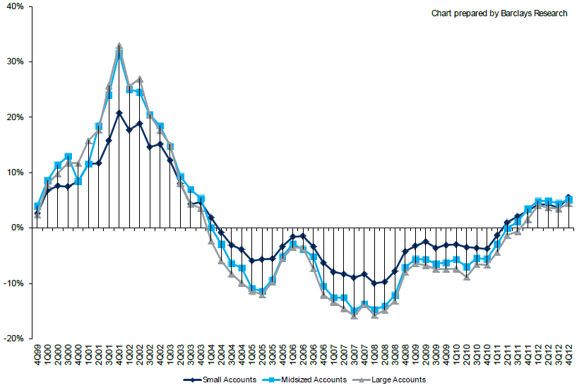
Change in Commercial Rate Renewals, by Account Size: 1999:Q4 to 2012:Q4
Percentage Change (%)
Peak = 2001:Q4 +28.5%
Pricing turned positive in Q3:2011, the first increase in nearly 8 years; Q4:2012 renewals were up 5.0%, the largest increase since late 2003; Some insurers posted stronger numbers.
Pricing Turned Negative in Early 2004 and Remained that way for 7 ½ years
KRW : No Lasting Impact
Trough = 2007:Q3 -13.6%
Source: Council of Insurance Agents and Brokers; Barclay’s Capital; Insurance Information Institute.
Note: CIAB data cited here are based on a survey. Rate changes earned by individual insurers can and do vary, potentially substantially.

Slide 201
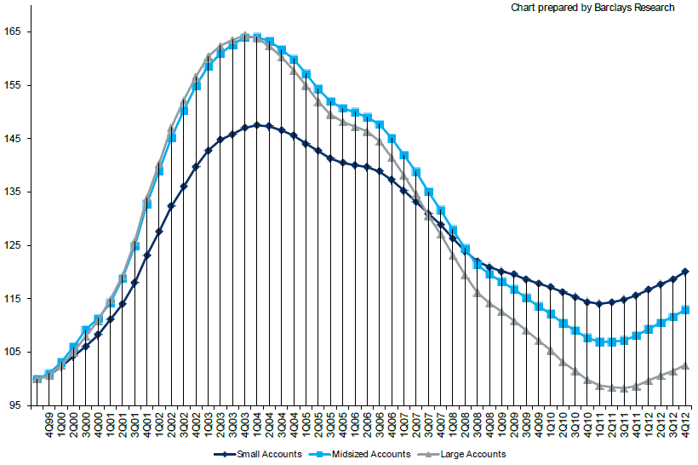
Cumulative Qtrly. Commercial Rate Changes, by Account Size: 1999:Q4 to 2012:Q4
1999:Q4 = 100
Despite 6 consecutive quarters of gains (Q4:2012 = 5.0%), pricing today is where is was in mid-2001 (pre-9/11), suggesting additional rate need going forward, esp. in light of record low interest rates
Note: CIAB data cited here are based on a survey. Rate changes earned by individual insurers can and do vary, potentially substantially.
Source: Council of Insurance Agents and Brokers; Barclay’s Capital; Insurance Information Institute.

Slide 202
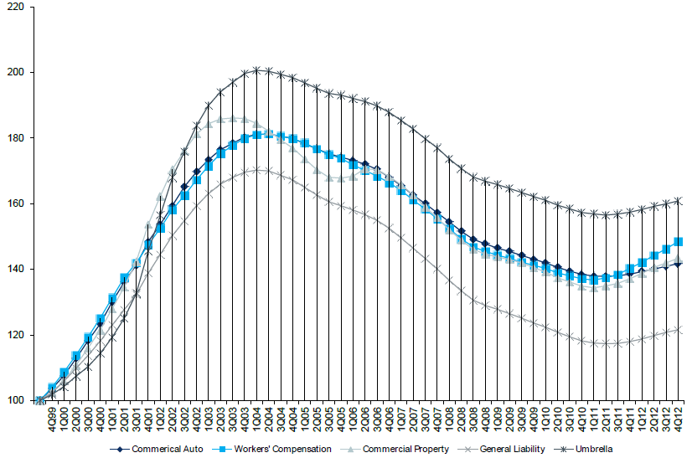
Cumulative Qtrly. Commercial Rate Changes, by Line: 1999:Q4 to 2012:Q4
1999:Q4 = 100
WC rate levels are rising and are now back to where they were in late 2008 and shortly after 9/11
Note: CIAB data cited here are based on a survey. Rate changes earned by individual insurers can and do vary, potentially substantially.
Source: Council of Insurance Agents and Brokers; Barclay’s Capital; Insurance Information Institute.

Slide 203
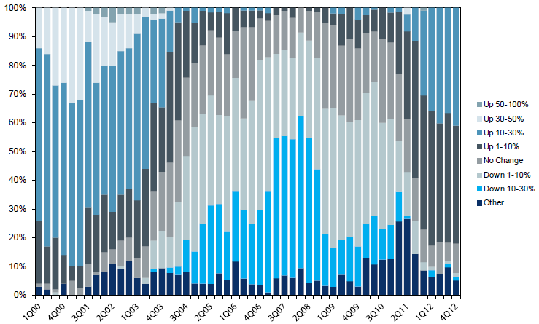
Workers Comp. Quarterly Rate Changes, by Line: 2000:Q1 to 2012:Q4
1999:Q4 = 100
Most accounts are now renewing upwards
Note: CIAB data cited here are based on a survey. Rate changes earned by individual insurers can and do vary, potentially substantially.
Source: Council of Insurance Agents and Brokers; Barclay’s Capital; Insurance Information Institute.

Slide 204
Change in Commercial Rate Renewals, by Line: 2012:Q4
Workers Comp rate increases are large than any other line, followed by Property lines
Percentage Change (%)
Major Commercial Lines Renewed Uniformly Upward in Q4:2012 for the Sixth Consecutive Quarter; Property Lines & Workers Comp Leading the Way; Cat Losses and Low Interest Rates Provide Momentum Going Forward
Note: CIAB data cited here are based on a survey. Rate changes earned by individual insurers can and do vary, potentially substantially.
Source: Council of Insurance Agents and Brokers; Insurance Information Institute.

Slide 205
CLIPS: Change in Written Price Level:
All Lines, 2010:Q2 – 2012:Q4
Rate changes have been positive for 8 consecutive quarters, longer than any other commercial line
(Percent Change)
Note: Towers Watson data cited here are based on a survey. Rate changes earned by individual insurers can and do vary, potentially substantially.
Source: Towers Watson; Information Institute.

Slide 206
Workers Comp Rate Changes,
2008:Q4 – 2012:Q4
WC rate changes have been positive for 7 consecutive quarters, longer than any other commercial line
(Percent Change)
Note: CIAB data cited here are based on a survey. Rate changes earned by individual insurers can and do vary, potentially substantially.
Source: Council of Insurance Agents and Brokers; Information Institute.

Slide 207
Shifting Legal Liability &
Tort Environment
Is the Tort Pendulum
Swinging Against Insurers?
207

Slide 208
Over the Last Three Decades, Total Tort Costs as a % of GDP Appear Somewhat Cyclical, 1980-2013E
($ Billions)
2.21% of GDP in 2003 = pre-tort reform peak
Deepwater Horizon Spike in 2010
Tort costs in dollar terms have remained high but relatively stable since the mid-2000s., but are down substantially as a share of GDP
1.68% of GDP in 2013
Sources: Towers Watson, 2011 Update on US Tort Cost Trends, Appendix 1A

Slide 209
Commercial Lines Tort Costs: Insured vs. Self-(Un)Insured Shares, 1973-2010
2005: $143.5B 66.4% insured, 33.6% self-(un)insured
Billions of Dollars
$15.0
1995: $83.6B 69.5% insured, 30.5% self-(un)insured
1973: Commercial Tort Costs Totaled $6.49B, 94% was insured, 6% self-(un)insured
1985: $46.6B 74.5% insured, 25.5% self-(un)insured
$9.5
$6.0
2009: $126.5B 64.4% insured, 35.6% self-(un)insured
Tort Costs and the Share Retained by Risks Both Grew Rapidly from the mid-1970s to mid-2000s, When Tort Costs Began to Fall But Self-Insurance Shares Continued to Rise
Sources: Towers Watson, 2011 Update on US Tort Cost Trends, III Calculations based on data from Appendix 4.
209
12/01/09 - 9pm
eSlide – P6466 – The Financial Crisis and the Future of the P/C
Notes:
209

Slide 210
Commercial Lines Tort Costs: Insured vs. Self-(Un)Insured Shares, 1973-2010
Percent
2010: $138.1B 56.6% insured, 44.4% self-(un)insured (distorted by Deepwater Horizon event with most losses retained by BP)
1973: 94% was insured, 6% self-(un)insured
1985:74.5% insured, 25.5% self-(un)insured
1995: 69.5% insured, 30.5% self-(un)insured
2005: 66.4% insured, 33.6% self-(un)insured
The Share of Tort Costs Retained by Risks Has Been Steadily Increasing for Nearly 40 Years. This Trend Contributes Has Left Insurers With Less Control Over Pricing.
Sources: Towers Watson, 2011 Update on US Tort Cost Trends, III Calculations based on data from Appendix 4.
210
12/01/09 - 9pm
eSlide – P6466 – The Financial Crisis and the Future of the P/C
Notes:
210

Slide 211
Business Leaders Ranking of Liability Systems in 2012
Best States
Delaware
Nebraska
Wyoming
Minnesota
Kansas
Idaho
Virginia
North Dakota
Utah
Iowa
Worst States
Florida
Oklahoma
Alabama
New Mexico
Montana
Illinois
California
Mississippi
Louisiana
West Virginia
New in 2012
Wyoming
Minnesota
Kansas
Idaho
Newly Notorious
Oklahoma
Drop-offs
Rising Above
Indiana
Colorado
Massachusetts
South Dakota
Arkansas
Source: US Chamber of Commerce 2012 State Liability Systems Ranking Study; Insurance Info. Institute.

Slide 212
The Nation’s Judicial Hellholes: 2011
Watch List
Illinois
Madison , St. Clair and McLean counties
West Virginia
Philadelphia
Eastern District of Texas
Cook County, IL
Southern NJ
Franklin County, AL
Smith County, MS
Louisiana
California
Dishonorable Mention
New York
Albany and NYC
MI Supreme Court
AK Supreme Court
MO Supreme Court
Nevada
Clark County
South Florida
Source: American Tort Reform Association; Insurance Information Institute

Slide 213
Insurance Information Institute Online:
www.iii.org
Thank you for your time
and your attention!
Twitter: twitter.com/bob_hartwig
Download at: www.iii.org/presentations

