Slide 1
Drink From My Firehose:
Everything Communicators Need to Know About the P/C Insurance Industry in 60 Minutes or Less
Insurance Marketing Communications Association
Philadelphia, PA
June 24, 2013
Robert P. Hartwig, Ph.D., CPCU, President & Economist
Insurance Information Institute ♦ 110 William Street ♦ New York, NY 10038
Tel: 212.346.5520 ♦ Cell: 917.453.1885 ♦ bobh@iii.org ♦ www.iii.org

Slide 2
P/C Insurance Industry Financial Overview
Profit Recovery in 2012 After High CAT Losses; Ultimate Impact of Sandy Still Unclear
2

Slide 3
P/C Net Income After Taxes
1991–2013:Q1 ($ Millions)
2005 ROE*= 9.6%
2006 ROE = 12.7%
2007 ROE = 10.9%
2008 ROE = 0.1%
2009 ROE = 5.0%
2010 ROE = 6.6%
2011 ROAS¹ = 3.5%
2012 ROAS¹ = 5.9%
2013:Q1 ROAS¹ = 9.5%
2012:Q1 ROAS was 7.2%
Net income is up substantially from 2012:Q1 $10.2B
* ROE figures are GAAP; ¹Return on avg. surplus. Excluding Mortgage & Financial Guaranty insurers yields a 6.2% ROAS in 2012, 4.7% ROAS for 2011, 7.6% for 2010 and 7.4% for 2009.
2013:Q1 is estimated. Sources: A.M. Best, ISO, Insurance Information Institute

Slide 4
Profitability Peaks & Troughs in the P/C Insurance Industry, 1975 – 2013:Q1*
ROE
History suggests next ROE peak will be in 2016-2017
1977:19.0%
1987:17.3%
10 Years
2006:12.7%
1997:11.6%
2013:Q1 9.5%
10 Years
9 Years
2012: 5.9%
1975: 2.4%
1984: 1.8%
1992: 4.5%
2001: -1.2%
*Profitability = P/C insurer ROEs. 2011 figure is an estimate based on ROAS data. Note: Data for 2008-2013 exclude mortgage and financial guaranty insurers. 2012:Q3 ROAS = 6.2% including M&FG.
Source: Insurance Information Institute; NAIC, ISO, A.M. Best.

Slide 5
A 100 Combined Ratio Isn’t What It
Once Was: Investment Impact on ROEs
A combined ratio of about 100 generates an ROE of ~7.0% in 2012, ~7.5% ROE in 2009/10,
10% in 2005 and 16% in 1979
Combined Ratio / ROE
Catastrophes and lower investment income pulled down ROE in 2012
Combined Ratios Must Be Lower in Today’s Depressed
Investment Environment to Generate Risk Appropriate ROEs
* 2008 -2012 figures are return on average surplus and exclude mortgage and financial guaranty insurers. 2012 combined ratio including M&FG insurers is 103.2, 2011 combined ratio including M&FG insurers is 108.1, ROAS = 3.5%.
Source: Insurance Information Institute from A.M. Best and ISO data.

Slide 6
The Strength of the Economy Will Influence P/C Insurer Growth Opportunities
Growth Will Expand Insurer Exposure Base Across Most Lines
6

Slide 7
US Real GDP Growth*
The Q4:2008 decline was the steepest since the Q1:1982 drop of 6.8%
Real GDP Growth (%)
Recession began in Dec. 2007. Economic toll of credit crunch, housing slump, labor market contraction was severe
2013 is expected to see uneven growth, then gradually accelerate throughout the year and into 2014
Demand for Insurance Continues To Be Impacted by Sluggish Economic Conditions, but the Benefits of Even Slow Growth Will Compound and Gradually Benefit the Economy Broadly
* Estimates/Forecasts from Blue Chip Economic Indicators.
Source: US Department of Commerce, Blue Economic Indicators 6/13; Insurance Information Institute.

Slide 8

Federal Spending as a Share of State GDP: Vulnerability to Sequestration Varies
WA and ID are more vulnerable to the effects of sequestration
Sources: Pew Center on the States (2012) Impact of the Fiscal Cliff on the States; Wells Fargo; Insurance Information Institute.

Slide 9
Defense and Non-Defense Federal Spending as a Share of State GDP: Top 10 States*
Defense Spending
Non-Defense Spending
Federal defense spending accounts for approximately 10%+ of GDP in 5 states
Federal non-defense spending accounts for 10%+ of GDP in 3 states
Sequestration Could Adversely Impact Commercial Insurance Exposures Directly at Defense Contractors and Indirectly in Impacted Communities
*As of 2010.
Sources: Pew Center on the States (2012) Impact of the Fiscal Cliff on the States; Wells Fargo Securities; Insurance Information Institute.

Slide 10
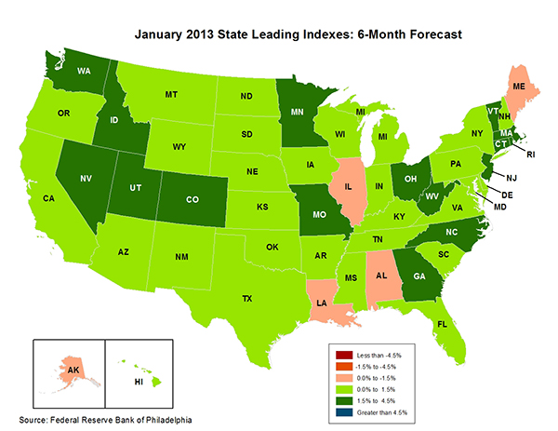
State-by-State Leading Indicators
through 2013:Q2
The economic outlook for most of New England is relatively strong, suggesting future strength in the creation of insurable exposures
Sources: Federal Reserve Bank of Philadelphia at http://www.philadelphiafed.org/index.cfm ;Insurance Information Institute.

Slide 11
Consumer Sentiment Survey (1966 = 100)
January 2010 through May 2013
Optimism among consumers has remained fairly strong despite tax hike, federal budget concerns. May’s reading was the highest since July 2007
Consumer confidence has been low for years amid high unemployment, falling home prices and other factors adversely impact consumers, but improved substantially in late 2011 and in 2012
Source: University of Michigan; Insurance Information Institute

Slide 12
Auto/Light Truck Sales, 1999-2019F
Job growth and improved credit market conditions will boost auto sales in 2013 and beyond
(Millions of Units)
New auto/light truck sales fell to the lowest level since the late 1960s. Forecast for 2013-14 is still below 1999-2007 average of 17 million units, but a robust recovery is well underway.
Truck purchases by contractors are especially strong
Car/Light Truck Sales Will Continue to Recover from the 2009 Low Point, Bolstering the Auto Insurer Growth and the Manufacturing Sector Along With Workers Comp Exposures
Source: U.S. Department of Commerce; Blue Chip Economic Indicators (6/13 and 3/13); Insurance Information Institute.

Slide 13
Personal Auto Insurance Direct Written Premiums vs. Recently-Registered Cars
$ Billions
4%/yr growth forecast for PP DWP from recovering new car/truck sales
In 2004-07 no growth in PP DWP despite strong new car/truck sales
New car/truck sales grow to 14-15M/year
Average age of registered cars rose as fewer new cars were bought (and insured)
PP DWP, flat from 2004-2009, is rising again.
Conning forecasts growth at 3.5% in 2013 and 4.0% in 2014.
Sources: AIPSO Facts (various issues); SNL Financial; Conning Research & Consulting, Property-Casualty Forecast and Analysis, First Quarter 2012; Insurance Information Institute.

Slide 14
Monthly Change* in Auto Insurance Prices, 1991–2013*
Cyclical peaks in PP Auto tend to occur approximately every 10 years (early 1990s, early 2000s and likely the early 2010s)
Pricing peak occurred in late 2010 at 5.3%, falling to 2.8% by Mar. 2012
“Hard” markets tend to occur during recessionary periods
The May 2013 reading of 4.1% is up from 3.0% a year earlier
*Percentage change from same month in prior year; through May 2013; seasonally adjusted
Note: Recessions indicated by gray shaded columns.
Sources: US Bureau of Labor Statistics; National Bureau of Economic Research (recession dates); Insurance Information Institutes.
14
12/01/09 - 9pm
eSlide – P6466 – The Financial Crisis and the Future of the P/C
Notes:
14

Slide 15
Monthly Change* in Auto Insurance Prices, January 2005 - May 2013
Pricing weakened materially in 2011 and early 2012 but has strengthened since then
(Percent Change
from same month,
prior year)
Auto Insurance Price Increases Averaged 5.1% in 2010 over 2009, After Averaging 4.5% in 2009 over 2008.
PPA Auto, like most p/c lines, exhibits strong cyclicality in pricing. Prices rose from 2000 to late 2005, were flat/falling in 2006 and 2007 before beginning to rise gain in 2008.
Underwriting performance remained strong even when prices were flat or falling due to improvements in underlying frequency and severity trends
* Percentage change from same month in prior year, seasonally adjusted.
Sources: US Bureau of Labor Statistics; Insurance Information Institute

Slide 16
New Private Housing Starts, 1990-2019F
Job growth, low inventories of existing homes, low mortgage rates and demographics are stimulating new home construction for the first time in years
(Millions of Units)
New home starts plunged 72% from 2005-2009; A net annual decline of 1.49 million units, lowest since records began in 1959
Insurers Are Starting to See Meaningful Exposure Growth for the First Time Since 2005 Associated with Home Construction: Construction Risk Exposure, Surety, Commercial Auto; Potent Driver of Workers Comp Exposure
Source: U.S. Department of Commerce; Blue Chip Economic Indicators (6/13 and 3/13); Insurance Information Institute.

Slide 17
Average Premium for
Home Insurance Policies**
Countrywide Home Insurance Expenditures Increased by an Estimated 4.0% in 2011-2013
* Insurance Information Institute Estimates/Forecasts **Excludes state-run insurers.
Source: NAIC, Insurance Information Institute estimates for 2011-2013 based on CPI data and other data.

Slide 18
Construction Employment,
Jan. 2010—May 2013*
(Thousands)
Construction employment growth accelerated in the second half of 2012. Continued growth in this key sector is possible through 2013. Construction is a key driver of workers comp exposure growth.
*Seasonally adjusted
Sources: US Bureau of Labor Statistics at http://data.bls.gov; Insurance Information Institute.
18
12/01/09 - 9pm
eSlide – P6466 – The Financial Crisis and the Future of the P/C
Notes:
18

Slide 19
Construction Employment,
Jan. 2003–May 2013
(Thousands)
Construction employment as of May 2013 totaled 5.804 million, an increase of 369,000 jobs or 6.8% from the Jan. 2011 trough
Construction employment peaked at 7.726 million in April 2006
Construction employment troughed at 5.435 million in Jan. 2011, after a loss of 2.291 million jobs, a 29.7% plunge from the April 2006 peak
The “Great Recession” and housing bust destroyed 2.3 million constructions jobs
The Construction Sector Could Be a Growth Leader in 2013 and 2014 as the Housing Market and Private Investment Recover. WC Insurers Will Benefit.
Note: Recession indicated by gray shaded column.
Sources: U.S. Bureau of Labor Statistics; Insurance Information Institute.
19
12/01/09 - 9pm
eSlide – P6466 – The Financial Crisis and the Future of the P/C
Notes:
19

Slide 20
Nonfarm Payroll (Wages and Salaries):
Quarterly, 2005–2013:Q1
Billions
Latest (2013:Q4) was $7.01 trillion, a new peak--$762B above 2009 trough
Prior Peak was 2008:Q1 at $6.60 trillion
Payrolls are 12.2% above their 2009 trough and up 2.7% over the past year
Recent trough (2009:Q3) was $6.25 trillion, down 5.3% from prior peak
Note: Recession indicated by gray shaded column. Data are seasonally adjusted annual rates.
Sources: http://research.stlouisfed.org/fred2/series/WASCUR; National Bureau of Economic Research (recession dates); Insurance Information Institute.
20
12/01/09 - 9pm
eSlide – P6466 – The Financial Crisis and the Future of the P/C
Notes:
20

Slide 21
Commercial & Industrial Loans Outstanding at FDIC-Insured Banks, Quarterly, 2006-2013*
$Trillions
Recession
In nominal dollar terms, this is an all-time high.
Outstanding loan volume has been growing for over two years
and (as of year-end 2012) surpassed previous peak levels.
*Latest data as of 6/14/2013.
Source: FDIC at http://www2.fdic.gov/qbp/ (Loan Performance spreadsheet); Insurance Information Institute.

Slide 22
Percent of Non-current Commercial & Industrial Loans Outstanding at FDIC-Insured Banks,
Quarterly, 2006-2012:Q4*
Almost back to “normal” levels of noncurrent industrial & commercial loans
Recession
Non-current loans (those past due 90 days or more or in nonaccrual status) are back to early-recession levels, fueling bank willingness to lend.
*Latest data as of 3/18/2013.
Source: FDIC at http://www2.fdic.gov/qbp/ (Loan Performance spreadsheet); Insurance Information Institute.

Slide 23
Value of Construction Put in Place, April 2013 vs. April 2012*
Growth (%)
Private: +9.0%
Public: -5.1%
Public sector construction activity remains depressed
Private sector construction activity is up in the residential segment but down in nonresidential
Overall Construction Activity is Up, But Growth Is Entirely in the Private Sector as State/Local Government Budget Woes Continue
*seasonally adjusted
Source: U.S. Census Bureau, http://www.census.gov/construction/c30/c30index.html ; Insurance Information Institute.

Slide 24
Value of Private Construction Put in Place, by Segment, Apr. 2013 vs. Apr. 2012*
Growth (%)
Led by the Residential Construction, Lodging, Office, and Manufacturing industries, Private sector construction activity is mixed up across many segments after plunging during the “Great Recession.” Most segments expanded in 2012 but weakened in early 2013.
Private Construction Activity is Up inSome Segments, Including the Key Residential Construction Sector, But Weakening in Early 2013
*seasonally adjusted
Source: U.S. Census Bureau, http://www.census.gov/construction/c30/c30index.html ; Insurance Information Institute.

Slide 25
Value of Public Construction Put in Place, by Segment, Apr. 2013 vs. Apr. 2012*
Growth (%)
Public sector construction activity is down substantially in most segments, a situation that will likely persist, dragging on public entity risk exposures
Transportation and Power projects lead public sector construction
Public Construction Activity is Down in Many Segments as State and Local Budgets Remain Under Stress; Improvement Possible in 2014.
*seasonally adjusted
Source: U.S. Census Bureau, http://www.census.gov/construction/c30/c30index.html ; Insurance Information Institute.

Slide 26
ISM Manufacturing Index
(Values > 50 Indicate Expansion)
January 2010 through May 2013
Manufacturing contracted in May, albeit modestly
The manufacturing sector expanded for 39 of the 41 months from Jan. 2010 through May 2013. Recent weakness stems largely from woes in Europe and a Slowdown in China.
Source: Institute for Supply Management at http://www.ism.ws/ismreport/mfgrob.cfm; Insurance Information Institute.

Slide 27
Dollar Value* of Manufacturers’ Shipments Monthly, Jan. 1992—Apr. 2013
$ Millions
The value of Manufacturing Shipments in Apr. 2013 were up 34% to $478.7B from its May 2009 trough. March figure is now 2.2% below its previous record high in Feb. 2013. Modest weakening in recent months.
Monthly shipments in Feb. 2013 exceeded their pre-crisis (July 2008) peak. Trough in May 2009. Growth from trough to Apr. 2013 was 34%. Manufacturing is an energy intensive activity and growth leads to gains in many commercial exposures: WC, Commercial Auto, Marine, Property and Various Liability Coverages
*seasonally adjusted
Source: U.S. Census Bureau, Full Report on Manufacturers’ Shipments, Inventories, and Orders, http://www.census.gov/manufacturing/m3/
27
12/01/09 - 9pm
eSlide – P6466 – The Financial Crisis and the Future of the P/C
Notes:
27

Slide 28
Manufacturing Growth for Selected Sectors, 2013 vs. 2013*
Growth (%)
Durables: +2.5%
Non-Durables: -0.3%
Construction machinery is up 35.4% YTD
Manufacturing of durable goods was especially strong in 2012 but weakened in 2013
Manufacturing Is Expanding—Albeit More Slowly—Across a Number of Sectors that Will Contribute to Growth in Insurable Exposures Including: WC, Commercial Property, Commercial Auto and Many Liability Coverages
*Seasonally adjusted; Date are YTD comparing data through April 2013 to the same period in 2012.
Source: U.S. Census Bureau, Full Report on Manufacturers’ Shipments, Inventories, and Orders, http://www.census.gov/manufacturing/m3/

Slide 29
Recovery in Capacity Utilization is a Positive Sign for Commercial Exposures
March 2001 through April 2013
“Full Capacity”
The US operated at 77.8% of industrial capacity in Apr. 2013, well above the June 2009 low of 66.9% but is still below pre-recession levels.
Percent of Industrial Capacity
Hurricane Katrina
The closer the economy is to operating at “full capacity,” the greater the inflationary pressure
March 2001-November 2001 recession
December 2007-
June 2009 Recession
29
Source: Federal Reserve Board statistical releases at http://www.federalreserve.gov/releases/g17/Current/default.htm.
Notes:
29

Slide 30
Manufacturing Employment,
Jan. 2010—May 2013*
Manufacturing employment is up by more than 500,000 or 4.4% since Jan. 2010—a surprising source of strength in the economy. The sector has weakened recently as US corporations remains cautious and Europe, China slow.
(Thousands)
*Seasonally adjusted
Sources: US Bureau of Labor Statistics at http://data.bls.gov; Insurance Information Institute.
30
12/01/09 - 9pm
eSlide – P6466 – The Financial Crisis and the Future of the P/C
Notes:
30

Slide 31
ISM Non-Manufacturing Index
(Values > 50 Indicate Expansion)
January 2010 through May 2013
Optimism among non-manufacturers is stable and remains expansionary in 2013
Non-manufacturing industries have been expanding and adding jobs. The question is whether this will continue.
Source: Institute for Supply Management at http://www.ism.ws/ismreport/nonmfgrob.cfm; Insurance Information Institute.

Slide 32
Business Bankruptcy Filings,
1980-2012:Q3
% Change Surrounding Recessions
1980-82 58.6%
1980-87 88.7%
1990-91 10.3%
2000-01 13.0%
2006-09 208.9%*
2011 bankruptcies totaled 47,806, down 15.1% from 56,282 in 2010—the second consecutive year of decline. Business bankruptcies more than tripled during the financial crisis. Through Q3:2012, filings were down 15.8% vs. Q3:2011
Significant Exposure Implications for All Commercial Lines as Business Bankruptcies Begin to Decline
Sources: American Bankruptcy Institute at http://www.abiworld.org/AM/AMTemplate.cfm?Section=Home&TEMPLATE=/CM/ContentDisplay.cfm&CONTENTID=61633; Insurance Information Institute
32
12/01/09 - 9pm
eSlide – P6466 – The Financial Crisis and the Future of the P/C
Notes:
32

Slide 33
Private Sector Business Starts,
1993:Q2 – 2012:Q3*
Business Starts
2006: 872,000
2007: 843,000
2008: 790,000
2009: 697,000 2010: 742,000 2011: 748,000 2012E: 769,000*
(Thousands)
Business starts were up an estimated 2.8% in 2012 to 769,000 following a 2.2% to 748,000 in 2011. Start-ups could accelerate in 2013.
Business Starts Were Down Nearly 20% in the Recession,
Holding Back Most Types of Commercial Insurance Exposure, But Are Recovering Slowly
* Data through Sep. 30, 2012 are the latest available as of June 21, 2013; Seasonally adjusted.
Source: Bureau of Labor Statistics, http://www.bls.gov/news.release/cewbd.t08.htm.
33
12/01/09 - 9pm
eSlide – P6466 – The Financial Crisis and the Future of the P/C
Notes:
33

Slide 34
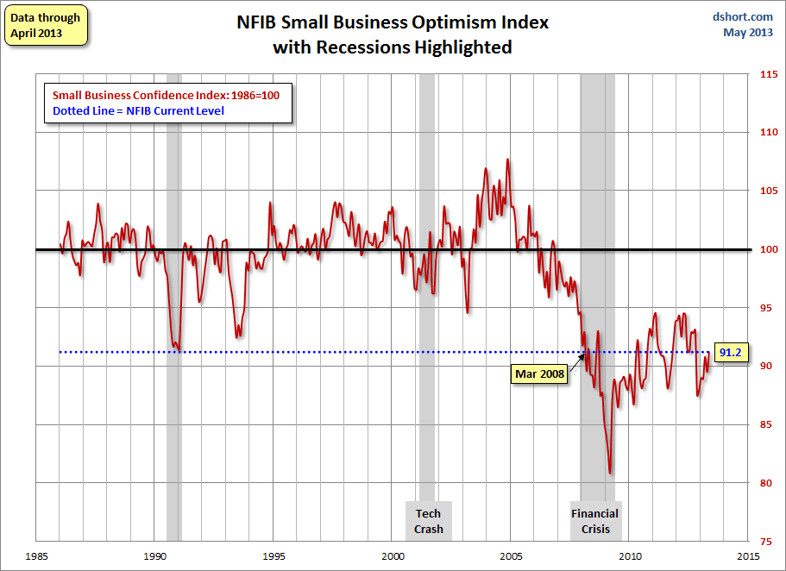
NFIB Small Business Optimism Index
January 1985 through April 2013
Small business optimism is off crisis lows but still suffering from economic and regulatory uncertainty
Source: National Federation of Independent Business at http://www.advisorperspectives.com/dshort/charts/indicators/Sentiment.html?NFIB-optimism-index.gif ; Insurance Information Institute.

Slide 35
12 Industries for the Next 10 Years: Insurance Solutions Needed
Health Care
Health Sciences
Energy (Traditional)
Many industries are poised for growth, though insurers’ ability to capitalize on these industries varies widely
Alternative Energy
Petrochemical
Agriculture
Natural Resources
Technology (incl. Biotechnology)
Light Manufacturing
Insourced Manufacturing
Export-Oriented Industries
Shipping (Rail, Marine, Trucking, Pipelines)

Slide 36
U.S. Insured Catastrophe Loss Update
Catastrophe Losses in Recent Years Have Been Very High
36

Slide 37
U.S. Insured Catastrophe Losses
($ Billions, 2012 Dollars)
2012 was likely the third most expensive year ever for insured CAT losses
2012 Was the 3rd Highest Year on Record for Insured Losses in U.S. History on an Inflation-Adj. Basis. 2011 Losses Were the 6th Highest. YTD 2013 Running Below Average But Q3 Is Typically the Costliest Quarter.
Record tornado losses caused 2011 CAT losses to surge
*Through 6/2/13. Includes $2.6B for 2013:Q1 (PCS) and $5.32B for the period 4/1 – 6/2/13 (Aon Benfield Monthly Global Catastrophe Recap).
Note: 2001 figure includes $20.3B for 9/11 losses reported through 12/31/01 ($25.9B 2011 dollars). Includes only business and personal property claims, business interruption and auto claims. Non-prop/BI losses = $12.2B ($15.6B in 2011 dollars.)
Sources: Property Claims Service/ISO; Insurance Information Institute.
37
12/01/09 - 9pm
eSlide – P6466 – The Financial Crisis and the Future of the P/C
Notes:
37

Slide 38


Impact: Documents Insurer Charitable Actions Following Hurricane Sandy

Slide 39
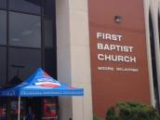


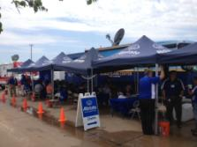

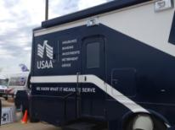
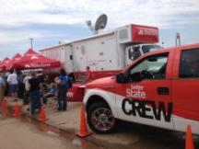
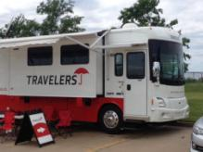
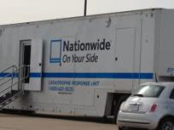
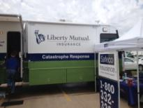
Moore, OK, Tornado: Media Coverage Was Generally Favorable
Industry had a highly visible, rapid response as Catastrophe Response Teams massed at the “Command Center” at the First Baptist Church in Moore within 48 hours
A number of insurers had communications people embedded with their Cat teams
39
12/01/09 - 9pm
eSlide – P6466 – The Financial Crisis and the Future of the P/C
Notes:
39

Slide 40
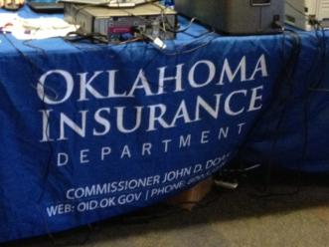
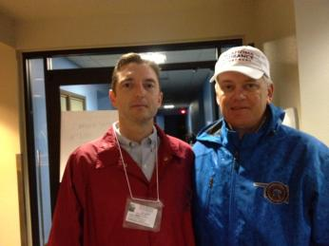
Moore, OK, Tornado: Media Coverage Was Generally Favorable
OK Insurance Commissioner John Doak & DOI
  Fair, friendly, efficient, well-prepared, organized
  Former State Farm/Farmers agent; Also worked for Marsh and Aon
  Excellent communications person (Kelly Collins)
  Doak and Collins are both media savvy
Rapid credentialing of out-of-state adjusters
OK Insurance Commissioner John Doak with me shortly before our tour
OK DOI was credentialing ~40 out of state adjusters per hour on site
40
12/01/09 - 9pm
eSlide – P6466 – The Financial Crisis and the Future of the P/C
Notes:
40

Slide 41
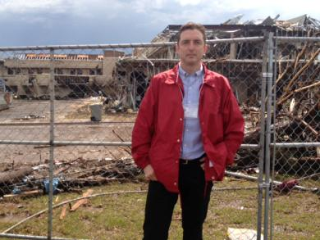
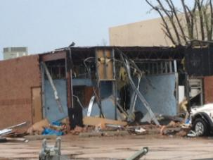
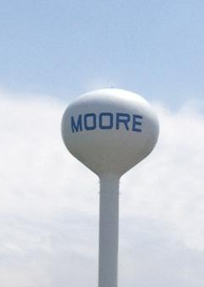

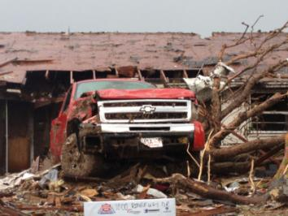
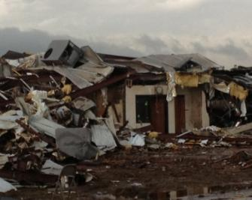

Scenes from my Visit to Moore, OK, Tornado: High Claim Severity
41

Slide 42
Top 16 Most Costly Disasters in U.S. History
(Insured Losses, 2012 Dollars, $ Billions)
Hurricane Sandy could become the 4th or 5th costliest event in US insurance history
Includes Tuscaloosa, AL, tornado
Includes Joplin, MO, tornado
Hurricane Irene became the 12th most expense hurricane in US history in 2011
12 of the 16 Most Expensive Events in US History Have Occurred Over the Past Decade
*PCS estimate as of 4/12/13.
Sources: PCS; Insurance Information Institute inflation adjustments to 2012 dollars using the CPI.

Slide 43
Top 16 Most Costly World Insurance Losses, 1970-2012*
(Insured Losses, 2012 Dollars, $ Billions)
5 of the top 14 most expensive catastrophes in world history have occurred within the past 3 years (2010-2012)
2012 insured CAT Losses totaled $60B; Economic losses totaled $140B, according to Swiss Re
Hurricane Sandy is now the 6th costliest event in global insurance history
*Figures do not include federally insured flood losses.
**Estimate based on PCS value of $18.75B as of 4/12/13.
Sources: Munich Re; Swiss Re; Insurance Information Institute research.

Slide 44
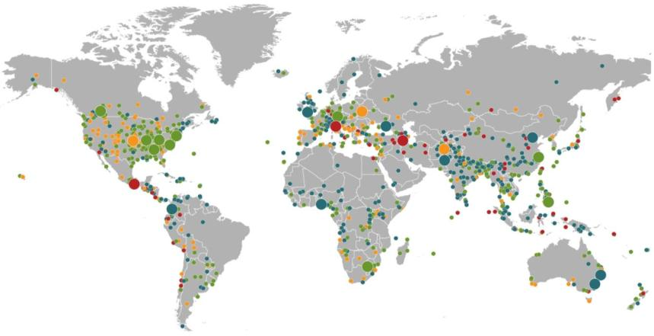
Natural Loss Events:
Full Year 2012
World Map
Winter Storm Andrea
Europe, 5–6 January
Floods
United Kingdom,
21–27 November
Cold Wave
Eastern Europe, Jan – Feb
Cold Wave
Afghanistan, Jan – Mar
Severe Weather
USA, 28–29 April
Hailstorms, severe weather
Canada, 12–14 August
Severe storms
USA, 28 June –2 July
Flash Floods
Russia, 6–8 July
Floods
China, 21–24 July
Drought
USA, Summer
Hurricane Sandy
USA, Caribbean
24–31 October
Earthquake
Italy,
29 May/3 June
Typhoon Haikui China, 8–9 August
Severe Storms, tornadoes
USA, 2–4 March
Hurricane Isaac
USA, Caribbean
24–31 August
Earthquake
Iran, 11 August
Earthquake
Mexico, 20 March
Floods
Nigeria, Jul – Oct
Floods
Pakistan, 3 –27 September
Typhoon Bopha Philippines, 4–5 December
Floods
Columbia, Mar – Jun
Floods, flash floods
Australia, Jan – Feb
Number of events: 905
Floods, hailstorms
South Africa, 20 –21 October
Floods. flash floods
Australia, Feb – Mar
Natural catastrophes
Geophysical events
(earthquake, tsunami, volcanic activity)
Hydrological events
(flood, mass movement)
Selection of significant
Natural catastrophes
Meteorological events
(storm)
Climatological events
(extreme temperature, drought, wildfire)
Source: Munich Re Geo Risks Research, NatCatSERVICE – As at January 2013.
44

Slide 45
Top 12 Most Costly Hurricanes in U.S. History
(Insured Losses, 2012 Dollars, $ Billions)
10 of the 12 most costly hurricanes in insurance history occurred over the past 9 years (2004—2012)
Hurricane Sandy became the 3rd costliest hurricane in US insurance history
Hurricane Irene became the 12th most expensive hurricane in US history in 2011
*PCS estimate as of 4/12/13.
Sources: PCS; Insurance Information Institute inflation adjustments to 2012 dollars using the CPI.

Slide 46
Outlook for 2013 Hurricane Season:
75% Worse Than Average
Forecast Parameter | Median (1981-2010) | 2013F
Named Storms | 12.0 | 18
Named Storm Days | 60.1 | 95
Hurricanes | 6.5 | 9
Hurricane Days | 21.3 | 40
Major Hurricanes | 2.0 | 4
Major Hurricane Days | 3.9 | 9
Accumulated Cyclone Energy | 92.0 | 165
Net Tropical Cyclone Activity | 103% | 175%
Source: Philip Klotzbach and Dr. William Gray, Colorado State University, April 10, 2013, accessed at http://tropical.atmos.colostate.edu/forecasts/2013/apr2013/apr2013.pdf ; Insurance Information Institute..

Slide 47
Landfall Probabilities for 2013 Hurricane Season: Above Average
 | Average* | 2013F
Entire US East & Gulf Coasts | 52% | 72%
US East Coast Including Florida Peninsula | 31% | 48%
Gulf Coast from Florida Panhandle to Brownsville | 30% | 47%
Caribbean | 42% | 61%
*Average over the past century.
Source: Philip Klotzbach and Dr. William Gray, Colorado State University, April 10, 2013.

Slide 48
Natural Disaster Losses in the United States: 2012
As of January 1, 2013 | Number of Events | Fatalities | Estimated Overall Losses (US $m) | Estimated Insured Losses (US $m)
Tropical Cyclone | 4 | 143 | 52,240 | 26,360
Severe Thunderstorm | 115 | 118 | 27,688 | 14,914
Drought | 2 | 0 | 20,000 | 16,000†
Wildfire | 38 | 13 | 1,112 | 595
Winter Storm | 2 | 7 | 81 | 38
Flood | 19 | 3 | 13 | 0††
TOTALS | 184 | 284 | $101,134 | $57,907
Source: MR NatCatSERVICE
† - Includes Federal Crop Insurance Losses. † † - Excludes federal flood.
48
Notes:
All data from NatCat Service

Slide 49
Significant Natural Catastrophes, 2012
(Events with $1 billion economic loss and/or 50 fatalities)
Date | Event | Estimated Economic Losses (US $m) | Estimated Insured Losses (US $m)
June – Sept 2012 | Central US Drought | 20,000 | 16,000†
March 2 - 3 | Thunderstorms | 5,000 | 2,500
April 2 – 4 | Thunderstorms | 1,550 | 775
April 13- 15 | Thunderstorms | 1,800 | 910
April 28 – 29 | Thunderstorms | 4,500 | 2,500
May 25 – 30 | Thunderstorms | 3,400 | 1,700
June 6 – 7 | Thunderstorms | 1,400 | 1,000
June 11 – 13 | Thunderstorms | 1,900 | 950
June 28 – July 2 | Thunderstorms | 4,000 | 2,000
August 26 - 30 | Hurricane Isaac | 2,000 | 1,220
October 28 - 30 | Hurricane Sandy | 50,000 | 25,000††
Source: MR NatCatSERVICE
† - Includes Federal Crop Insurance Losses.; † † - Excludes NFIP losses.
49
49

Slide 50
Natural Disasters in the United States, 1980 – 2012
Number of Events (Annual Totals 1980 – 2012)
There were 184 natural disaster events in the US in 2012
Number
41
19
121
3
Geophysical
(earthquake, tsunami,
volcanic activity)
Meteorological (storm)
Climatological
(temperature extremes,
drought, wildfire)
Hydrological
(flood, mass movement)
Source: MR NatCatSERVICE
50

Slide 51
Losses Due to Natural Disasters in the US, 1980–2012 (Overall & Insured Losses)
(Overall and Insured Losses)
(2012 Dollars, $ Billions)
2012 was the 2nd or 3rd most expensive year on record for insured catastrophe losses in the US.
Approximately 57% of the overall cost of catastrophes in the US was covered by insurance in 2012
2012 Losses
Overall : $101.1B
Insured: $57.9B
Overall losses (in 2012 values)
Insured losses (in 2012 values)
Source: MR NatCatSERVICE
51

Slide 52
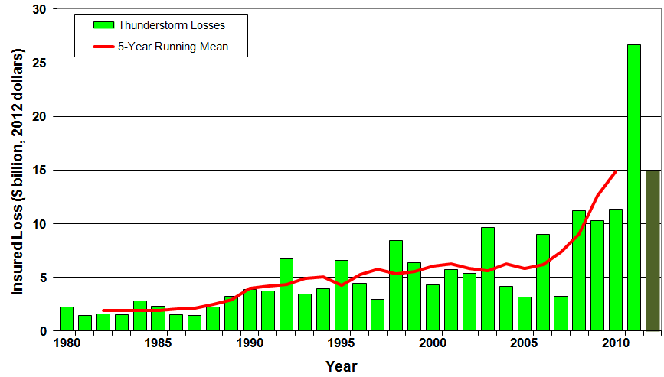
U.S. Thunderstorm Loss Trends, 1980 – 2012
Hurricanes get all the headlines, but thunderstorms are consistent producers of large scale loss. 2008-2012 are the most expensive years on record.
Average thunderstorm losses are up 7 fold since the early 1980s. The 5- year running average loss is up sharply.
Thunderstorm losses in 2012 totaled $14.9 billion, the 2nd highest on record
Source: Property Claims Service, MR NatCatSERVICE
52

Slide 53
U.S. Insured Catastrophe Losses by Cause of Loss, 2011 ($ Millions)
Wildfires, $855
Flood , $535, (1.5%)
Other, $1,000
Geological Events, $50, (0.1%)
Winter Storms, $2,017
Hurricanes & Tropical Storms, $5,510
Thunderstorm/ Tornado losses were 2.5 times above the 30-year average
Thunderstorms (Incl. Tornadoes , $25,813
2011’s insured loss distribution was unusual with tornado and thunderstorm accounting for the vast majority of loss
.
Source: ISO’s Property Claim Services Unit, Munich Re; Insurance Information Institute.

Slide 54
Inflation Adjusted U.S. Catastrophe Losses by Cause of Loss, 1992–2011¹
Wind/Hail/Flood (3), $14.8
Fires (4), $6.0
Other (5), $1.4
Insured cat losses from 1992-2011 totaled $384.3B, an average of $19.2B per year or $1.6B per month
Geological Events, $18.2
Terrorism, $24.4
Winter Storms, $28.2
Hurricanes & Tropical Storms, $161.3
Tornado share of CAT losses is rising
Wind losses are by far cause the most catastrophe losses, even if hurricanes/TS are excluded.
Tornadoes (2), $130.2
Catastrophes are defined as events causing direct insured losses to property of $25 million or more in 2009 dollars.
Excludes snow.
Does not include NFIP flood losses
Includes wildland fires
Includes civil disorders, water damage, utility disruptions and non-property losses such as those covered by workers compensation.
Source: ISO’s Property Claim Services Unit.

Slide 55
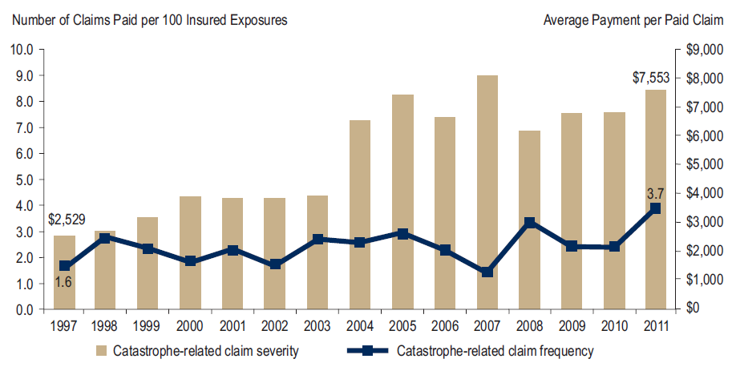
Homeowners Insurance Catastrophe-Related Claim Frequency and Severity, 1997—2012*
Avg. catastrophe claim cost rose approximately 200% from 1997-2011
Cat claim frequency in 2011 was at historic highs and more than double the rate in 1997
*All policy forms combined, countrywide.
Source: Insurance Research Council, Trends in Homeowners Insurance Claims, Sept. 2012 from ISO Fast Track data.
55

Slide 56
Combined Ratio Points Associated with Catastrophe Losses: 1960 – 2012*
Avg. CAT Loss Component of the Combined Ratio by Decade
1960s: 1.04 1970s: 0.85 1980s: 1.31 1990s: 3.39 2000s: 3.52 2010s: 7.20*
Catastrophe losses as a share of all losses reached a record high in 2012
Combined Ratio Points
The Catastrophe Loss Component of Private Insurer Losses Has Increased Sharply in Recent Decades
Notes: Private carrier losses only. Excludes loss adjustment expenses and reinsurance reinstatement premiums. Figures are adjusted for losses ultimately paid by foreign insurers and reinsurers.
Source: ISO (1960-2011); A.M. Best (2012E) Insurance Information Institute.

Slide 57
Homeowners Insurance Combined Ratio: 1990–2015F
Hurricane Andrew
Record tornado activity
Hurricane Sandy
Hurricane Ike
Homeowners Performance in 2011/12 Impacted by Large Cat Losses. Extreme Regional Variation Can Be Expected Due to Local Catastrophe Loss Activity
Sources: A.M. Best (1990-2011);Conning (2012E-2015F); Insurance Information Institute.

Slide 58
Federal Disaster Declarations Patterns: 1953-2013
Disaster Declarations YTD in 2013 Are Running Below Recent Record Highs
58

Slide 59
Number of Federal Disaster Declarations, 1953-2013*
There have been 2,115 federal disaster declarations since 1953. The average number of declarations per year is 35 from 1953-2012, though there few haven’t been recorded since 1995.
The number of federal disaster declarations set a new record in 2011, with 99, shattering 2010’s record 81 declarations.
24 federal disasters were declared so far in 2013*
The Number of Federal Disaster Declarations Is Rising and Set New Records in 2010 and 2011. Hurricane Sandy Produced 13 Declarations in 2012/13.
*Through June 23, 2013.
Source: Federal Emergency Management Administration; http://www.fema.gov/disasters; Insurance Information Institute.

Slide 60
Federal Disasters Declarations by State,
1953 – 2013: Highest 25 States*
Over the past 60 years, Texas has had the highest number of Federal Disaster Declarations
*Through June 23, 2013. Includes Puerto Rico and the District of Columbia.
Source: FEMA: http://www.fema.gov/news/disaster_totals_annual.fema; Insurance Information Institute.

Slide 61
Federal Disasters Declarations by State,
1953 – 2013: Lowest 25 States*
Over the past 60 years, Wyoming and Rhode Island had the fewest number of Federal Disaster Declarations
*Through June 23, 2013. Includes Puerto Rico and the District of Columbia.
Source: FEMA: http://www.fema.gov/news/disaster_totals_annual.fema; Insurance Information Institute.

Slide 62
SEVERE WEATHER REPORT UPDATE: 2013
Damage from Tornadoes, Large Hail and High Winds Keep Insurers Busy
62

Slide 63
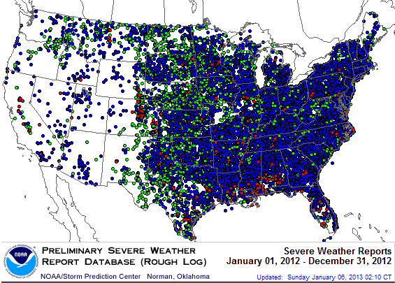
Severe Weather Reports, 2012
There were 22,503 severe weather reports in 2011; including 1,119 tornadoes; 7,033 “Large Hail” reports and 14,351 high wind events
Source: NOAA Storm Prediction Center; http://www.spc.noaa.gov/climo/online/monthly/2012_annual_summary.html#
63

Slide 64
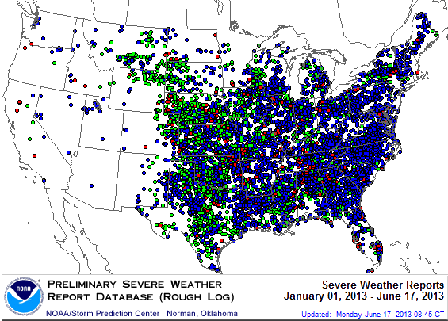
Severe Weather Reports:
Through June 17, 2013
There were 8,976 severe weather reports through June 17; including 573 tornadoes; 3,002 “Large Hail” reports and 5,401 high wind events
Source: NOAA Storm Prediction Center; http://www.spc.noaa.gov/climo/online/monthly/2013_annual_summary.html#
64

Slide 65
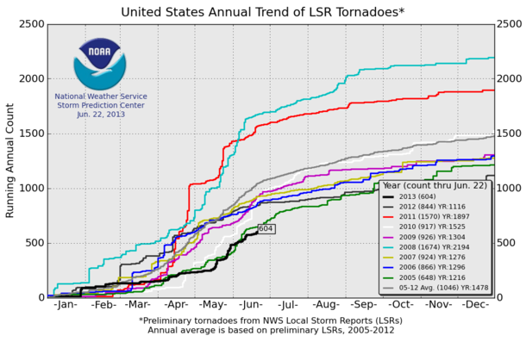
U.S. Tornado Count, 2005-2013*
There were 1,897 tornadoes in the U.S. in 2011 far above average, but well below 2008’s record
2013 count is running well below average
*Through June 22, 2013.
Source: http://www.spc.noaa.gov/wcm/.
65

Slide 66
Terrorism Update
Boston Marathon Bombings Underscore the Need for Extension of the Terrorism Risk Insurance Program
66
Notes:
66

Slide 67

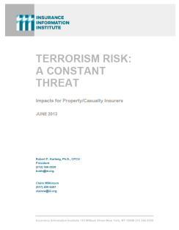
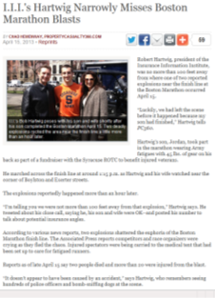
Terrorism Risk Insurance Program
Reauthorization Was a Major Industry Initiative for 2013 Even Before Boston
I.I.I. Testified at First Congressional Hearing on 9/11/12
  Provided testimony at NYC hearing on 6/17/13
I.I.I. Accelerated Planned Study on Terrorism Risk and Insurance in the Wake of Boston and Was Well Received
  Terrorism: A Constant Threat issued in June 2013
67
12/01/09 - 9pm
eSlide – P6466 – The Financial Crisis and the Future of the P/C
Notes:
67

Slide 68
Terrorism Risk Insurance Program
Boston Marathon Bombing Has Helped Focus Attention in Congress on TRIPRA and its Looming Expiration
  Act expires 12/31/14
  Exclusionary language will likely be inserted for post-1/1/2014 renewals and will likely lead to significant media interest (educational opportunity)
  Numerous headwinds; not a priority issue in 2013 in Congress
  3 extension bills introduced in 2013—2 since Boston
Media Interest Soared
  I.I.I. was conducting its first interviews within minutes after live-tweeting (nearly) from the scene; TV interest was high
  Local, national and international media focused on this topic for the first time in any significant way since TRIA’s inception in late 2002
  Inquiries revealed very little/no understanding (or even awareness) outside insurance industry and business owners
  Certification process caused confusion
68
12/01/09 - 9pm
eSlide – P6466 – The Financial Crisis and the Future of the P/C
Notes:
68

Slide 69

Terrorism Risk Insurance Program
Boston Marathon Bombing Should Help Focus Attention in Congress on TRIA
  Act expires 12/31/14
  Numerous headwinds
Exclusionary Language Will Be Inserted for Renewals Occurring After 1/1/14
Boston Marathon Issues
  Property and BI losses not large but could breach $5 mill threshold for certification under TRIPRA
  Certification issue is generating press; No deadline to certify
  Disincentive for Treasury (and Sec. of State and US AG) to certify?
  Many of the impacted business had terror coverage
  Longer-term: Litigation issues (e.g., race organizers)
69
12/01/09 - 9pm
eSlide – P6466 – The Financial Crisis and the Future of the P/C
Notes:
69

Slide 70
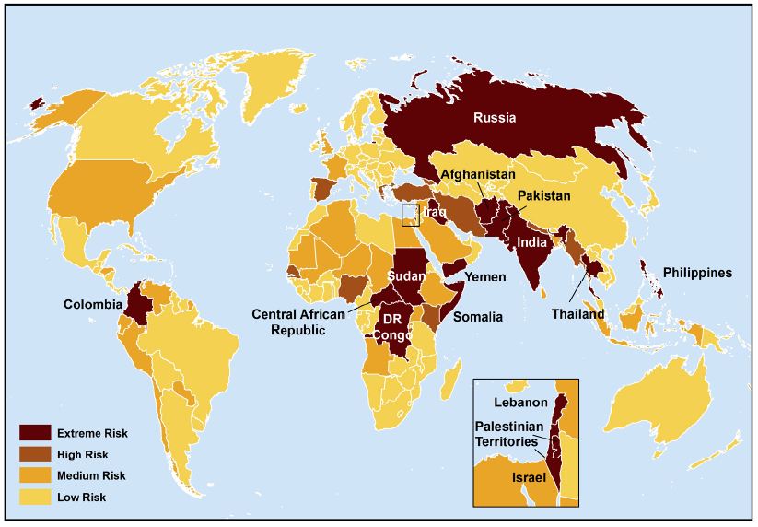
Terrorist Risk Index
The threat of terrorism is highest in South Asia, Russia, the Middle East and Central and East Africa
The US is still considered to be at “Medium Risk” for a terrorist attack
Sources: Maplecroft Terrorism Risk Index; (2011); Guy Carpenter; Insurance Information Institute.

Slide 71
Loss Distribution by Type of Insurance from Sept. 11 Terrorist Attack ($ 2011)
($ Billions)
Total Insured Losses Estimate: $40.0B**
*Loss total does not include March 2010 New York City settlement of up to $657.5 million to compensate approximately 10,000 Ground Zero workers or any subsequent settlements.
**$32.5 billion in 2001 dollars.
Source: Insurance Information Institute.

Slide 72
Terrorism Violates Traditional Requirements for Insurability
Requirement | Definition | Violation
Estimable Frequency | Insurance requires large number of observations to develop predictive rate-making models (an actuarial concept known as credibility) | Very few data points Terror modeling still in infancy, untested. Inconsistent assessment of threat
Estimable Severity | Maximum possible/ probable loss must be at least estimable in order to minimize “risk of ruin” (insurer cannot run an unreasonable risk of insolvency though assumption of the risk) | Potential loss is virtually unbounded. Losses can easily exceed insurer capital resources for paying claims. Extreme risk in workers compensation and statute forbids exclusions.
Source: Insurance Information Institute

Slide 73
Terrorism Violates Traditional Requirements for Insurability (cont’d)
Requirement | Definition | Violation
Diversifiable Risk | Must be able to spread/distribute risk across large number of risks “Law of Large Numbers” helps makes losses manageable and less volatile | Losses likely highly concentrated geographically or by industry (e.g., WTC, power plants)
Random Loss Distribution/Fortuity | Probability of loss occurring must be purely random and fortuitous Events are individually unpredictable in terms of time, location and magnitude | Terrorism attacks are planned, coordinated and deliberate acts of destruction Dynamic target shifting from “hardened targets” to “soft targets” Terrorist adjust tactics to circumvent new security measures Actions of US and foreign govts. may affect likelihood, nature and timing of attack
Source: Insurance
Information Institute

Slide 74
Hurricane Sandy Summary
Sandy Will Become One of the Most Expensive Events in Insurance History
74
Notes:
74

Slide 75
2012 Catastrophe Summary
Catastrophe Communications: US & Global
  U.S. Focus: ~$37-$42B = 2nd Most Costliest Year Ever for Insured Catastrophe Loss (Behind 2005)
    Economic Losses = $101B
    Crop = Additional ~$16B ($7B-$8B privately insured)
    NFIP Flood = Additional $9B+
    Flood losses/NFIP/FEMA has been the #1 communications “issue” in the wake of Sandy
  Global Focus: $65B in Insured Losses→Well Below $105B in 2011 but Above 10-Yr. Avg. of $50B
    Cats abroad did not drive media cycle in 2012, save ongoing Fukishima issues; Climate change
  Market Consequences: Primary & Reinsurance
    Impacts on price, availability
75
12/01/09 - 9pm
eSlide – P6466 – The Financial Crisis and the Future of the P/C
Notes:
75

Slide 76
Top 12 Most Costly Hurricanes in U.S. History
(Insured Losses, 2012 Dollars, $ Billions)
10 of the 12 most costly hurricanes in insurance history occurred over the past 9 years (2004—2012)
Hurricane Sandy became the 3rd costliest hurricane in US insurance history
Hurricane Irene became the 12th most expensive hurricane in US history in 2011
*PCS estimate as of 4/12/13.
Sources: PCS; Insurance Information Institute inflation adjustments to 2012 dollars using the CPI.

Slide 77
Hurricane Sandy: Claim Payments to Policyholders, by State
($ Thousands)
TOTAL = $18.75 BILLION
At $9.6B and $6.6B, respectively, NY and NJ suffered, by far, the largest losses from Hurricane Sandy
Insurers Will Pay at Least $18.75 Billion to 1.52 Million Policyholders Across 15 States and DC in the Wake of Hurricane Sandy
Sources: Catastrophe loss data is for Catastrophe Serial No. 90 (Oct. 28 – 31, 2012) from PCS as of Jan. 18, 2013; Insurance Information Institute .

Slide 78
Hurricane Sandy: Number of Claims
by Type*
Total Claims = 1.52 Million*
Hurricane Sandy resulted in an estimated 1.52 million privately insured claims resulting in an estimated $18.75 to $25 billion in insured losses. Hurricane Katrina produced 1.74 million claims and $48.7B in losses (in 2012 $)
Sandy is a high HO frequency, (relatively low) severity event (avg. severity <50% Katrina)
*PCS claim count estimate s as of 1/18/13. Loss estimate represents PCS total ($18.75B) and upper end of range estimates by risk modelers RMS, Eqecat and AIR. All figures exclude losses paid by the NFIP.
Source: PCS; AIR, Eqecat, AIR Worldwide; Insurance Information Institute.

Slide 79
Hurricane Sandy: Insured Loss by
Claim Type* ($ Millions)
Total Claim Value = $18.75 Billion*
Although Commercial Lines accounted for only 13% of total claims, they account for 48% of all claim dollars paid. In most hurricanes, Commercial Lines accounts for about 1/3 of insured losses.
*PCS insured loss estimates as of 1/18/13. Catastrophe modeler estimates range up to $25 billion. All figures exclude losses paid by the NFIP.
Source: PCS; Insurance Information Institute.

Slide 80
Hurricane Sandy: Value of Homeowners Claims Paid, by State* ($ Millions)
Hurricane Sandy
Estimated 1,067,000 homeowners claims**
$7.0 billion in insured losses.
Average loss per claim is $6,558
Claims in NJ estimated at $2.5 billion (36%) and $2.7 billion in NY (38%)
*Preliminary as of 1/18/13.
Source: PCS.

Slide 81
Hurricane Sandy: Number of Auto Claims by State*
Hurricane Sandy
Estimated 250,500 vehicle claims
$2.729 billion in insured losses.
Average loss per claim is $10,894
60% of the claims occurred in NY state.
*Preliminary as of 1/18/13.
Source: PCS.

Slide 82
Hurricane Sandy: Value of Auto Claims Paid, by State* ($ Millions)
Hurricane Sandy
Estimated 250,500 vehicle claims
$2.729 billion in insured losses.
Average loss per claim is $10,894
About 69% of the claim dollars will be paid in NY, 26% in NJ.
*Preliminary as of 1/18/13.
Source: PCS.

Slide 83
Hurricane Sandy: Loss Distribution by Commercial/Personal Lines and Reinsurance vs. Primary Insurer
Personal vs. Commercial Lines*
Primary vs. Reinsurer Share**
~55% of Sandy losses appear to be commercial lines, and ~45% personal, the opposite of the norm for hurricane losses
Reinsurers’ share of Sandy losses appears to be in the 30% range, though this is highly preliminary
*Fitch Ratings assigns a range of 60-65% commercial and 35-40% personal lines., Hurricane Sandy Update, January 8, 2013.
**Source: Insurance Information Institute rough estimate based on company reports as of January 13, 2013. Actual number will vary.

Slide 84
Hurricane Sandy: Average Claim Payment by Type of Claim
Commercial (i.e., business claims) are more expensive because the value of property is often higher as well as the impact of insured business interruption losses
The average insured flood loss was nearly 8 times larger than the average non-flood insured loss (mostly wind)
Commercial (Business) Claims Were Nearly Seven Times More Expensive than Homeowners Claims; Vehicle Claims Were Unusually Expensive Due to Extensive Flooding
*Includes rental and condo policies (excludes NFIP flood). **Preliminary as of May 14, 2013.
Sources: Catastrophe loss data is for Catastrophe Serial No. 90 (Oct. 28 – 31, 2012) from PCS as of March 2013; Insurance Information Institute.

Slide 85
Hurricane Sandy: Flood Issues
Most of the Uninsured Direct Losses Are Due to Flooding
85
Notes:
85

Slide 86
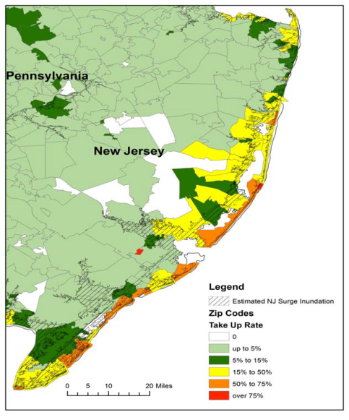
Residential NFIP Flood Take-Up Rates in NJ (2010) & Sandy Storm Surge
Flood coverage penetration rates were extremely low in many very vulnerable areas in NJ, with take-up rates far below 50% in many areas
Source: Wharton Center for Risk Management and Decision Processes, Issue Brief, Nov. 2012; Insurance Information Institute.
86

Slide 87
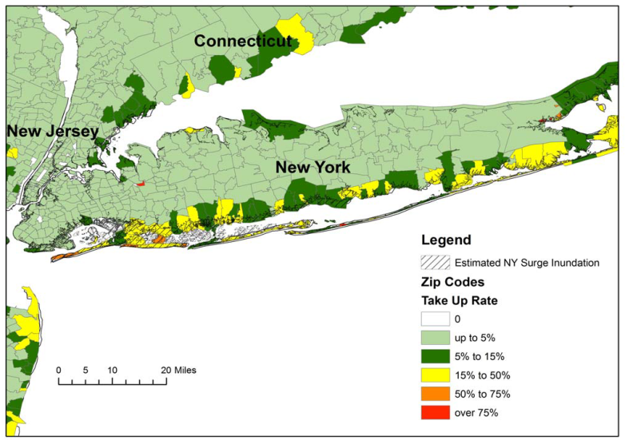
Residential NFIP Flood Take-Up Rates in NY, CT (2010) & Sandy Storm Surge
Flood coverage penetration rates were extremely low in many very vulnerable areas of NY and CT, with take-up rates far below 50% in many areas
Source: Wharton Center for Risk Management and Decision Processes, Issue Brief, Nov. 2012; Insurance Information Institute.
87

Slide 88
Hurricane Sandy: National Flood Insurance Program Payment, by State*
($ Millions)
TOTAL = $4.797 BILLION
At $2.437B and $2.152B, respectively, NY and NJ sustained, by far, the largest NFIP flood losses from Hurricane Sandy
The NFIP Will Ultimately Likely Pay Close to $7 Billion to 100,000 Policyholders Across 9 States and DC in the Wake of Hurricane Sandy
*As of February 20, 2013.
Sources: NFIP; Insurance Information Institute .

Slide 89
Flood Loss Paid by the National Flood Insurance Program, 1980-2012E
Billions (Original Values)
Hurricane Sandy and other events could result in $7.5 billion in payouts from the NFIP in 2012, second only to 2005 and potentially exhausting the NFIP’s borrowing authority
Hurricanes Katrina and Rita accounted for the majority of 2005’s record $17.4B payout
Hurricane Ike
*Estimate as of 11/25/12.
Sources: Department of Homeland Security, Federal Emergency Management Agency, NFIP; Insurance Information Institute.
89
12/01/09 - 9pm
eSlide – P6466 – The Financial Crisis and the Future of the P/C
Notes:
89

Slide 90
Federal Aid Requests for States With Greatest
Sandy Impact & Federal Aid Proposals (as of 1/6/13)
$33B to repair subways, hospitals and other facilities; $9B to upgrade infrastructure against future storms
$39.5B to repair schools roads, bridges, businesses, homes and other facilities; $7.4B to for mitigation and prevention against future storms
Billions
$60.4
$60.2
$60.0*
$9.7
$42.0
$3.2B to bury power lines, upgrade transmission systems, build sewage treatment plants and other mitigation projects
$36.9
House passed on Jan. 5
$9.0
$7.9
$7.4
$6.0
$33.0
$29.5
$3.2
$51.0
House passed on Jan. 15
States Requested Enormous Sums in Sandy Aid in the Middle of the “Fiscal Cliff” Debate, Causing Delays
*As of Jan. 2, 2013.
Source: New York Times, Dec. 6, 2012; Insurance Information Institute research.
90
12/01/09 - 9pm
eSlide – P6466 – The Financial Crisis and the Future of the P/C
Notes:
90

Slide 91
Public Opinion Survey
Industry Favorability Ratings
Policy Forms & Disclosure
Disaster Preparedness
91
Notes:
91

Slide 92
I.I.I. Poll: Favorability
Percent of Public Rating Industry as Very or Mostly Favorable, 2013
Viewed separately, auto and home insurers have highest favorability ratings of all industries surveyed
Auto Insurers and Home Insurers Ranked Highest.
Source: Insurance Information Institute Annual Pulse Survey.

Slide 93
I.I.I. Poll: Homeowners Insurance
Q. Do you think that it is fair that people who live in areas affected by record storms in 2011 and 2012 should pay more for their homeowners insurance in the future?
Don’t know
Public believes it is not fair to raise premiums of homeowners due to events they cannot control
No
Yes
Nearly 60 percent of Americans believe that homeowners insurance premiums should not be raised as a result of recent storms in their areas.
Source: Insurance Information Institute Annual Pulse Survey.

Slide 94
I.I.I. Poll: Flood Insurance
Q. The federal government plans to raise the price of flood insurance so it reflects the costs of paying claims. Do you believe this is fair?
[% Responding “NO”]
Most people believe it is unfair for government to raise flood insurance premiums, even though they are subsidized by taxpayers
More than one-half of Americans do not think it is fair for the federal government to raise its flood insurance premiums to better reflect claims payouts.
Source: Insurance Information Institute Annual Pulse Survey.

Slide 95
I.I.I. Poll: Disaster Preparedness
Q. Does your homeowners policy cover damage from flooding during a hurricane?¹
About 20 percent of the public still believes flooding from a hurricane is covered
The proportion of homeowners who believe their homeowners policy covers damage from flooding during a hurricane stands at 21 percent. This proportion rises eight percentage points in the South, to 29 percent.
¹Asked of those who have homeowners insurance and who responded “yes”.
Source: Insurance Information Institute Annual Pulse Survey.

Slide 96
I.I.I. Poll: Disaster Preparedness
Q. Have recent flooding events such as Hurricane Sandy or Hurricane Irene motivated you to buy flood coverage?¹
Despite recent major flood events, few people see the need to buy coverage
Recent storms have not motivated people to buy flood insurance coverag.e
¹Asked of those who have homeowners insurance but not flood insurance.
Source: Insurance Information Institute Annual Pulse Survey.

Slide 97
I.I.I. Poll: Disaster Preparedness
Q. If you expect some relief from the government, do you purchase less insurance coverage against these natural disasters than you would have otherwise?
Don’t know
Yes
More than 20 percent cut back on insurance coverage in expectation of government disaster aid
No
Seventy-two percent of Americans would not purchase less insurance if they expect some relief from the government—but 22% would.
Source: Insurance Information Institute Annual Pulse Survey.

Slide 98
Growth Analysis by State and Business Segment
Premium Growth Rates Vary Tremendously by State
98

Slide 99
Direct Premiums Written: Total P/C
Percent Change by State, 2007-2012*
Top 25 States
*Data are preliminary as of 5/1/13 and do not yet fully reflect the impact of state-run pools and plans.
Sources: SNL Financial LC.; Insurance Information Institute.

Slide 100
Direct Premiums Written: Total P/C
Percent Change by State, 2007-2012*
Bottom 25 States
*Data are preliminary as of 5/1/13 and do not yet fully reflect the impact of state-run pools and plans.
Sources: SNL Financial LC.; Insurance Information Institute.

Slide 101
Direct Premiums Written: Total P/C
Percent Change by State, 2006-2011*
Top 25 States
A limited number of states showed strong growth over the past 5 years
Sources: SNL Financial LC.; Insurance Information Institute.

Slide 102
Direct Premiums Written: Total P/C
Percent Change by State, 2006-2011*
Bottom 25 States
NY’s change in premium growth was similar to the US average
States with the poorest performing economies also produced the most negative net change in premiums of the past 5 years
Sources: SNL Financial LC.; Insurance Information Institute.

Slide 103
Direct Premiums Written: PP Auto
Percent Change by State, 2006-2011*
Top 25 States
Sources: SNL Financial LC.; Insurance Information Institute.

Slide 104
Direct Premiums Written: PP Auto
Percent Change by State, 2006-2011*
OR and ID saw sluggish PPA growth in recent years
Bottom 25 States
States with the poorest performing economies also produced the most negative net change in premiums of the past 5 years
Sources: SNL Financial LC.; Insurance Information Institute.

Slide 105
Direct Premiums Written: Homeowners
Percent Change by State, 2006-2011*
Top 25 States
Sources: SNL Financial LC.; Insurance Information Institute.

Slide 106
Direct Premiums Written: Homeowners
Percent Change by State, 2006-2011*
Bottom 25 States
States with the poorest performing economies also produced the most negative net change in premiums of the past 5 years
Sources: SNL Financial LC.; Insurance Information Institute.

Slide 107
Direct Premiums Written: Comm. Lines
Percent Change by State, 2006-2011*
Top 25 States
Only 12 states showed any commercial lines growth 2006 and 2011
Sources: SNL Financial LC.; Insurance Information Institute.

Slide 108
Direct Premiums Written: Comm. Lines
Percent Change by State, 2006-2011*
Bottom 25 States
States with the poorest performing economies also produced the most negative net change in premiums of the past 5 years
Sources: SNL Financial LC.; Insurance Information Institute.

Slide 109
Direct Premiums Written: Workers’ Comp
Percent Change by State, 2006-2011*
Top 25 States
*Excludes monopolistic fund states: ND, OH, WA, WY as well as WV, which transitioned to a competitive structure during this period.
Sources: SNL Financial LC.; Insurance Information Institute.

Slide 110
Direct Premiums Written: Worker’s Comp
Percent Change by State, 2006-2011*
Bottom 25 States
States with the poorest performing economies also produced the most negative net change in premiums of the past 5 years
*Excludes monopolistic fund states: ND, OH, WA, WY as well as WV, which transitioned to a competitive structure during this period.
Sources: SNL Financial LC.; Insurance Information Institute.

Slide 111
Labor Market Trends
Massive Job Losses Sapped the Economy and Commercial/Personal Lines Exposure, But Trend is Improving
111

Slide 112
Unemployment and Underemployment Rates: Stubbornly High in 2012, But Falling
January 2000 through Apr. 2013, Seasonally Adjusted (%)
U-6 went from 8.0% in March 2007 to 17.5% in
October 2009; Stood at 13.7% in Apr. 2013
Recession ended in November 2001
Unemployment kept rising for 19 more months
Recession began in December 2007
Unemployment stood at 7.5% in Apr. 2013—lowest in 4 years.
Unemployment peaked at 10.1% in October 2009, highest monthly rate since 1983.
Peak rate in the last 30 years: 10.8% in November - December 1982
Stubbornly high unemployment and underemployment constrain overall economic growth, but the job market is now clearly improving
Source: US Bureau of Labor Statistics; Insurance Information Institute.
112
12/01/09 - 9pm
eSlide – P6466 – The Financial Crisis and the Future of the P/C
Notes:
112

Slide 113
Monthly Change in Private Employment
January 2007 through Apr. 2013 (Thousands)
176,000 private sector jobs were created in April
Jobs Created
2012: 2.247 Mill
2011: 2.420 Mill
2010: 1.235 Mill
Monthly Losses in Dec. 08–Mar. 09 Were the Largest in the
Post-WW II Period
Private Employers Added 6.74 million Jobs Since Jan. 2010 After Having Shed 4.98 Million Jobs in 2009 and 3.80 Million in 2008 (State and Local Governments Have Shed Hundreds of Thousands of Jobs)
Source: US Bureau of Labor Statistics: http://www.bls.gov/ces/home.htm; Insurance Information Institute

Slide 114
Cumulative Change in Private Employment: Dec. 2007—Apr. 2013
December 2007 through April 2013 (Millions)
Cumulative job losses as of Apr. 2013 totaled 1.985 million
Cumulative job losses peaked at 8.765 million in February 2010
All of the jobs “lost” since President Obama took office in Jan. 2009 have been recouped
Private Employers Added 6.74 million Jobs Since Jan. 2010 After Having Shed 4.98 Million Jobs in 2009 and 3.80 Million in 2008 (State and Local Governments Have Shed Hundreds of Thousands of Jobs)
Source: US Bureau of Labor Statistics: http://www.bls.gov/ces/home.htm; Insurance Information Institute

Slide 115
Cumulative Change in Private Sector Employment: Jan. 2010—Apr. 2013
January 2010 through April 2013* (Millions)
Job gains and pay increases have added more than $600 billion to payrolls since Jan. 2010
Cumulative job gains through Apr. 2013 totaled 6.74 million
Private Employers Added 6.74 million Jobs Since Jan. 2010 After Having Shed 4.98 Million Jobs in 2009 and 3.80 Million in 2008 (State and Local Governments Have Shed Hundreds of Thousands of Jobs)
Source: US Bureau of Labor Statistics: http://www.bls.gov/ces/home.htm; Insurance Information Institute

Slide 116
Cumulative Change in Government Employment: Jan. 2010—Apr. 2013
Government at all levels has shed more than 600,000 jobs since Jan. 2010 even as private employers created 6.74 million jobs, though losses may now be ending.
January 2010 through Apr. 2013* (Millions)
Cumulative job losses through Apr. 2013 totaled 636,000
Temporary Census hiring distorted 2010 figures
Governments at All Levels are Under Severe Fiscal Strain As Tax Receipts Plunged and Pension Obligations Soared During the Financial Crisis: Sequestration Will Add to this Toll
Source: US Bureau of Labor Statistics http://www.bls.gov/data/#employment; Insurance Information Institute

Slide 117
Net Change in Government Employment: Jan. 2010—Apr. 2013*
State government employment fell by 1.9% since the end of 2009 while Federal employment is down by 2.1%
(Thousands)
Local government employment shrank by 480,000 from Jan. 2010 through Apr. 2013, accounting for 65% of all government job losses, negatively impacting WC exposures for those cities and counties that insure privately
*Cumulative change from prior month; Base employment date is Dec. 2009.
Source: US Bureau of Labor Statistics http://www.bls.gov/data/#employment; Insurance Information Institute

Slide 118
Unemployment Rates by State, April 2013:
Highest 25 States*
In April, 40 states and the District of Columbia had over-the-month unemployment rate decreases, 3 states had increases, and 7 states had no change.
*Provisional figures for April 2013, seasonally adjusted.
Sources: US Bureau of Labor Statistics; Insurance Information Institute.

Slide 119
Unemployment Rates by State, April 2013:
Lowest 25 States*
In April, 40 states and the District of Columbia had over-the-month unemployment rate decreases, 3 states had increases, and 7 states had no change.
*Provisional figures for April 2013, seasonally adjusted.
Sources: US Bureau of Labor Statistics; Insurance Information Institute.

Slide 120

Oil & Gas Extraction Employment,
Jan. 2010—April 2013*
(Thousands)
Oil and gas extraction employment is up 23.1% since Jan. 2010 as the energy sector booms. Domestic energy production is essential to any robust economic recovery in the US.
*Seasonally adjusted
Sources: US Bureau of Labor Statistics at http://data.bls.gov; Insurance Information Institute.
120
12/01/09 - 9pm
eSlide – P6466 – The Financial Crisis and the Future of the P/C
Notes:
120

Slide 121
US Unemployment Rate Forecast
2007:Q1 to 2014:Q4F*
Rising unemployment
eroded payrolls
and workers comp’s
exposure base.
Unemployment peaked at 10% in late 2009.
Jobless figures have been revised slightly downwards for 2013/14
Unemployment forecasts have been revised slightly downwards. Optimistic scenarios put the unemployment as low as 6.6% by Q4 of next year.
* = actual; = forecasts
Sources: US Bureau of Labor Statistics; Blue Chip Economic Indicators (6/13 edition); Insurance Information Institute.

Slide 122
US Unemployment Rate Forecasts
Quarterly, 2013:Q1 to 2014:Q4
Unemployment will remain high even under the most optimistic of scenarios, but forecasts are being revised downwards
Sources: Blue Chip Economic Indicators (May 2013); Insurance Information Institute

Slide 123
Nonfarm Payroll (Wages and Salaries):
Quarterly, 2005–2013:Q1
Billions
Latest (2013:Q4) was $7.01 trillion, a new peak--$762B above 2009 trough
Prior Peak was 2008:Q1 at $6.60 trillion
Payrolls are 12.2% above their 2009 trough and up 2.7% over the past year
Recent trough (2009:Q3) was $6.25 trillion, down 5.3% from prior peak
Note: Recession indicated by gray shaded column. Data are seasonally adjusted annual rates.
Sources: http://research.stlouisfed.org/fred2/series/WASCUR; National Bureau of Economic Research (recession dates); Insurance Information Institute.
123
12/01/09 - 9pm
eSlide – P6466 – The Financial Crisis and the Future of the P/C
Notes:
123

Slide 124
Payroll vs. Workers Comp Net Written Premiums, 1990-2012E
Payroll Base* WC NWP
$Billions $Billions
7/90-3/91
3/01-11/01
12/07-6/09
WC premium volume dropped two years before the recession began
+9% in 2012E
WC net premiums written were down $14B or 29.3% to $33.8B in 2010 after peaking at $47.8B in 2005
Continued Payroll Growth and Rate Increases Suggest WC NWP Will Grow Again in 2012; +7.9% Growth in 2011 Was the First Gain Since 2005
*Private employment; Shaded areas indicate recessions. WC premiums for 2012 are I.I.I. estimate based YTD 2012 actuals.
Sources: NBER (recessions); Federal Reserve Bank of St. Louis at http://research.stlouisfed.org/fred2/series/WASCUR ; NCCI; I.I.I.

Slide 125
The BIG Question:
Where Is the Market Heading?
Catastrophes and Other Factors Are Pressuring Insurance Markets
New Factor: Record Low Interest Rates Are Contributing to Underwriting and Pricing Pressures
125
Notes:
125

Slide 126
INVESTMENTS:
THE NEW REALITY
Investment Performance is a Key Driver of Profitability
Depressed Yields Will Necessarily Influence Underwriting & Pricing
126

Slide 127
Property/Casualty Insurance Industry Investment Income: 2000–2013*¹
($ Billions)
Investment earnings are running below their 2007 pre-crisis peak
Investment Income Fell in 2012 and is Falling in 2013 Due to Persistently Low Interest Rates, Putting Additional Pressure on (Re) Insurance Pricing
¹ Investment gains consist primarily of interest and stock dividends..
*Estimate based on annualized actual Q1:2013 investment income of $11.385B.
Sources: ISO; Insurance Information Institute.

Slide 128
P/C Insurer Net Realized
Capital Gains/Losses, 1990-2013:Q1
Realized capital gains in 2012 were down 12% from 2011
($ Billions)
Insurers Posted Net Realized Capital Gains in 2010, 2011 and 2012 Following Two Years of Realized Losses During the Financial Crisis. Realized Capital Losses Were the Primary Cause of 2008/2009’s Large Drop in Profits and ROE
Sources: A.M. Best, ISO, Insurance Information Institute.
128
12/01/09 - 9pm
eSlide – P6466 – The Financial Crisis and the Future of the P/C
Notes:
128

Slide 129
Property/Casualty Insurance Industry Investment Gain: 1994–2013:Q1¹
($ Billions)
Investment gains in 2012 were approximately 16% below their pre-crisis peak
Investment Gains Are Slipping in 2012 as Low Interest Rates Reduce Investment Income and Lower Realized Investment Gains; The Financial Crisis Caused Investment Gains to Fall by 50% in 2008
¹ Investment gains consist primarily of interest, stock dividends and realized capital gains and losses.
* 2005 figure includes special one-time dividend of $3.2B;
Sources: ISO; Insurance Information Institute.

Slide 130
U.S. 10-Year Treasury Note Yields:
A Long Downward Trend, 1990–2013*
Yields on 10-Year U.S. Treasury Notes recently plunged to all time record lows
Yields on 10-Year U.S. Treasury Notes have been essentially below 5% for a full decade.
Since roughly 80% of P/C bond/cash investments are in 10-year or shorter durations, most P/C insurer portfolios will have low-yielding bonds for years to come.
*Monthly, through Apr. 2013. Note: Recessions indicated by gray shaded columns.
Sources: Federal Reserve Bank at http://www.federalreserve.gov/releases/h15/data.htm.
National Bureau of Economic Research (recession dates); Insurance Information Institutes.
130
12/01/09 - 9pm
eSlide – P6466 – The Financial Crisis and the Future of the P/C
Notes:
130

Slide 131
Treasury Yield Curves:
Pre-Crisis (July 2007) vs. Jan. 2013
Treasury yield curve remains near its most depressed level in at least 45 years. Investment income is falling as a result. Fed is unlikely to hike rates until well into 2014 at the earliest.
The Fed Is Actively Signaling that it Is Determined to Keep Rates Low Until Unemployment Drops Below 6.5% or Until Inflation Expectations Exceed 2.5%; Low Rates Add to Pricing Pressure for Insurers.
Source: Federal Reserve Board of Governors; Insurance Information Institute.

Slide 132
Average Maturity of Bonds Held by US P/C Insurers, 2006—2011*
Average Maturity (Years)
The average bond maturity is down by a full year between 2007 and 2011
Falling Average Maturity (and Duration) of the P/C Industry’s Bond Portfolio is Contributing to the Drop in Investment Income Along With Lower Yields
*Year-end figures. Latest available.
Sources: Insurance Information Institute calculations based on A.M. Best data.
132
12/01/09 - 9pm
eSlide – P6466 – The Financial Crisis and the Future of the P/C
Notes:
132

Slide 133
Distribution of Bond Maturities,
P/C Insurance Industry, 2003-2012
The main shift over these years has been from bonds with longer maturities to bonds with shorter maturities. The industry first trimmed its holdings of over-10-year bonds (from 24.6% in 2003 to 15.5% in 2012) and then trimmed bonds in the 5-10-year category (from 31.3% in 2003 to 27.6% in 2012) . Falling average maturity of the P/C industry’s bond portfolio is contributing to a drop in investment income along with lower yields.
Sources: SNL Financial; Insurance Information Institute.

Slide 134
Reduction in Combined Ratio Necessary to Offset 1% Decline in Investment Yield to Maintain Constant ROE, by Line*
Lower Investment Earnings Place a Greater Burden on Underwriting and Pricing Discipline
*Based on 2008 Invested Assets and Earned Premiums
**US domestic reinsurance only
Source: A.M. Best; Insurance Information Institute.
134
12/01/09 - 9pm
eSlide – P6466 – The Financial Crisis and the Future of the P/C
Notes:
134
This shows the drop in Combined Ratio for each line of business that would be needed to maintain a constant ROE, given a 1-percentage-point drop in investment yield

Slide 135
Annual Inflation Rates, (CPI-U, %),
1990–2014F
Annual Inflation Rates (%)
Inflation peaked at 5.6% in August 2008 on high energy and commodity crisis. The recession and the collapse of the commodity bubble reduced inflationary pressures in 2009/10
Inflationary expectations remain quite low, allowing the Fed to continue its QE3 program
The slack in the U.S. economy suggests that inflationary pressures should remain subdued for an extended period of times. Energy, health care and commodity prices, plus U.S. debt burden, remain longer-run concerns
Sources: US Bureau of Labor Statistics; Blue Chip Economic Indicators, 5/13 (forecasts).

Slide 136
1. UNDERWRITING
Underwriting Losses in 2011 and 2012 Are Elevated by High Catastrophe Losses
136

Slide 137
P/C Insurance Industry
Combined Ratio, 2001–2013:Q1*
Relatively Low CAT Losses, Reserve Releases
Higher CAT Losses, Shrinking Reserve Releases, Toll of Soft Market
As Recently as 2001, Insurers Paid Out Nearly $1.16 for Every $1 in Earned Premiums
Heavy Use of Reinsurance Lowered Net Losses
Relatively Low CAT Losses, Reserve Releases
Avg. CAT Losses, More Reserve Releases
Best Combined Ratio Since 1949 (87.6)
Lower CAT Losses Before Sandy
Cyclical Deterioration
* Excludes Mortgage & Financial Guaranty insurers 2008--2012. Including M&FG, 2008=105.1, 2009=100.7, 2010=102.4, 2011=108.1; 2012:=103.2.
Sources: A.M. Best, ISO.

Slide 138
Underwriting Gain (Loss)
1975–2013:Q1*
($ Billions)
Cumulative underwriting deficit from 1975 through 2012 is $510B
Underwriting profit in 2013:Q1 totaled $4.6B
High cat losses in 2011 led to the highest underwriting loss since 2002
Large Underwriting Losses Are NOT Sustainable
in Current Investment Environment
* Includes mortgage and financial guaranty insurers in all years.
Sources: A.M. Best, ISO; Insurance Information Institute.

Slide 139
Combined Ratios by Predominant Business Segment, 2012 vs. 2011*
The combined ratios for both personal and commercial lines improved substantially in 2012, Despite Sandy
(Percent)
*Excludes mortgage and financial guaranty insurers.
Source: ISO/PCI; Insurance Information Institute

Slide 140
P/C Reserve Development, 1992–2013F
Prior year reserve releases totaled $8.8 billion in the first half of 2010, up from $7.1 billion in the first half of 2009
Reserve Releases Remained Strong in 2010 But Tapered Off in 2011. Releases Are Expected to Further Diminish in 2012 and 2103
Note: 2005 reserve development excludes a $6 billion loss portfolio transfer between American Re and Munich Re. Including this transaction, total prior year adverse development in 2005 was $7 billion. The data from 2000 and subsequent years excludes development from financial guaranty and mortgage insurance.
Sources: Barclays Capital; A.M. Best.

Slide 141
Number of Years with Underwriting Profits by Decade, 1920s–2010s
Number of Years with Underwriting Profits
Underwriting Profits Were Common Before the 1980s
(40 of the 60 Years Before 1980 Had Combined Ratios Below 100) –
But Then They Vanished. Not a Single Underwriting Profit Was
Recorded in the 25 Years from 1979 Through 2003
* 2009 combined ratio excl. mort. and finl. guaranty insurers was 99.3, which would bring the 2000s total to 4 years with an u/w profit.
**Data for the 2010s includes 2010 and 2011.
Note: Data for 1920–1934 based on stock companies only.
Sources: Insurance Information Institute research from A.M. Best Data.
141
12/01/09 - 9pm
eSlide – P6466 – The Financial Crisis and the Future of the P/C
Notes:
141

Slide 142
Financial Strength & Underwriting
Cyclical Pattern is P-C Impairment History is Directly Tied to Underwriting, Reserving & Pricing
142

Slide 143
P/C Insurer Impairments, 1969–2012
Impairments among P/C insurers remain infrequent
The Number of Impairments Varies Significantly Over the P/C Insurance Cycle, With Peaks Occurring Well into Hard Markets
Source: A.M. Best Special Report “1969-2011 Impairment Review,” June 2012 and March 6, 2013 update; Insurance Info. Institute.

Slide 144
P/C Insurer Impairment Frequency vs. Combined Ratio, 1969-2011
2011 impairment rate was 0.91%, up from 0.67% in 2010; the rate is slightly higher than the 0.82% average since 1969
Impairment Rates Are Highly Correlated With Underwriting Performance and Reached Record Lows in 2007; Recent Increase Was Associated Primarily With Mortgage and Financial Guaranty Insurers and Not Representative of the Industry Overall
Source: A.M. Best; Insurance Information Institute

Slide 145
Reasons for US P/C Insurer Impairments, 1969–2010
Historically, Deficient Loss Reserves and Inadequate Pricing Are
By Far the Leading Cause of P-C Insurer Impairments.
Investment and Catastrophe Losses Play a Much Smaller Role
Reinsurance Failure
Sig. Change in Business
Misc.
Investment Problems (Overstatement of Assets)
Deficient Loss Reserves/
Inadequate Pricing
Affiliate Impairment
Catastrophe Losses
Alleged Fraud
Rapid Growth
Source: A.M. Best: 1969-2010 Impairment Review, Special Report, April 2011.

Slide 146
Top 10 Lines of Business for US P/C Impaired Insurers, 2000–2010
Workers Comp and Pvt. Passenger Auto Account for Nearly Half of the Premium Volume of Impaired Insurers Over the Past Decade
Title
Financial Guaranty
Surety
Med Mal
Workers Comp
Other Liability
Commercial Auto Liability
Pvt. Passenger Auto
Commercial Multiperil
Homeowners
Source: A.M. Best: 1969-2010 Impairment Review, Special Report, April 2011.

Slide 147
Number of Recessions Endured by P/C Insurers, by Number of Years in Operation
Number of Recessions Since 1860
Insurers are true survivors—not just of natural catastrophes but also economic ones
Number of Years in Operation
Many US Insurers Are Close to a Century Old or Older
Sources: Insurance Information Institute research from National Bureau of Economic Research data.
147
12/01/09 - 9pm
eSlide – P6466 – The Financial Crisis and the Future of the P/C
Notes:
147

Slide 148
Performance by Segment
148
Notes:
148

Slide 149
Private Passenger Auto Combined Ratio: 1993–2015F
Private Passenger Auto Accounts for 34% of Industry Premiums and Remains the Profit Juggernaut of the P/C Insurance Industry
Sources: A.M. Best (1990-2012E);Conning (2013F-15F); Insurance Information Institute.

Slide 150
Homeowners Insurance Combined Ratio: 1990–2015F
Hurricane Andrew
Record tornado activity
Hurricane Sandy
Hurricane Ike
Homeowners Performance in 2011/12 Impacted by Large Cat Losses. Extreme Regional Variation Can Be Expected Due to Local Catastrophe Loss Activity
Sources: A.M. Best (1990-2011);Conning (2012E-2015F); Insurance Information Institute.

Slide 151
Homeowners Multi-Peril Loss & LAE Ratio, 2011:
Highest 25 States
TN and AL had the worst underwriting performance of all states in 2011 due to high tornado and storm losses
Sources: SNL Financial; Insurance Information Institute.

Slide 152
Homeowners Multi-Peril Loss & LAE Ratio, 2011:
Lowest 25 States
HI and FL had the best performance in 2011 due to the absence of hurricanes/tropical storms impacts in either state last year
Sources: SNL Financial; Insurance Information Institute.

Slide 153
Commercial Lines Combined Ratio, 1990-2015F*
Commercial lines underwriting performance is expected to improve as improvement in pricing environment persists
*2007-2012 figures exclude mortgage and financial guaranty segments.
Source: A.M. Best (1990-2011); Conning (2012-2015F) Insurance Information Institute

Slide 154
Commercial Auto Combined Ratio: 1993–2015F
Commercial Auto is Expected to Improve as Rate Gains Outpace Any Adverse Frequency and Severity Trends
Sources: A.M. Best (1990-2012E);Conning (2012-2015F); Insurance Information Institute.

Slide 155
Commercial Multi-Peril Combined Ratio: 1995–2015F
Commercial Multi-Peril Underwriting Performance is Expected to Improve in 2013 Assuming Normal Catastrophe Loss Activity
*2012-2013 figures are A.M. Best estimate/forecast for the combined liability and non-liability components. Same for Conning 2014-2015F figures.
Sources: A.M. Best; Conning; Insurance Information Institute.

Slide 156
General Liability Combined Ratio:
2005–2015F
Commercial General Liability Underwriting Performance Has Been Volatile in Recent Years
Source: Conning Research and Consulting.

Slide 157
Inland Marine Combined Ratio: 1999–2015F
Inland Marine is Expected to Remain Among the Most Profitable of All Lines
Sources: A.M. Best (1999-2011); Conning (2012-2015F)

Slide 158
Other & Products Liability Combined Ratio: 1991–2013F
Liability Lines Have Performed Better in the Post-Tort Reform Era (~2005), but There Has Been Some Deterioration in Recent Years
Sources: A.M. Best ; Insurance Information Institute.

Slide 159
Medical Malpractice Combined Ratio vs. All Lines Combined Ratio, 1991-2015F
Med Mal Insurers in 2012 paid out $0.91 in loss and expense for every $1 they earned in premiums
The dramatic improvement over the past decade has restored med mal’s viability, though some deterioration is anticipated
In 2001, med mal insurers paid out $1.55 for every dollar earned
Source: AM Best (1991-2011); Conning (2012E-2015F) Insurance Information Institute

Slide 160
Workers Compensation Operating Environment
The Weak Economy and Soft Market Have Made the Workers Comp Operating Increasingly Challenging
160

Slide 161
Workers Compensation Combined Ratio: 1994–2012P
WC showed a better-than-expected improvement for private carriers in 2012
Workers Comp Results Began to Improve in 2012. Underwriting Results Deteriorated Markedly from 2007-2010/11 and Were the Worst They Had Been in a Decade.
Sources: A.M. Best (1994-2009); NCCI (2010-2012P) and are for private carriers only; Insurance Information Institute.

Slide 162
Workers Compensation Medical Severity
Moderate Increase in 2012
Medical
Claim Cost ($000s)
Average Medical Cost per Lost-Time Claim
Annual Change 1991–1993: +1.9%
Annual Change 1994–2001: +8.9%
Annual Change 2002–2010: +6.0%
Annual Change 1991–1993: +1.9%
Annual Change 1994–2001: +8.9%
Annual Change 2002–2011: +5.7%
Cumulative Change = 252%
(1991-2012p)
Accident Year
Accident Year
2012p: Preliminary based on data valued as of 12/31/2012.
1991-2011: Based on data through 12/31/2011, developed to ultimate
Based on the states where NCCI provides ratemaking services including state funds, excluding WV; Excludes high deductible policies.

Slide 163
Workers Comp Indemnity Claim Costs: Small Increase in 2012
Average Indemnity Cost per Lost-Time Claim
Indemnity
Claim Cost ($ 000s)
Average indemnity costs per claim were up 1% in 2012 to $22,400
Annual Change 1991–1993: -1.7%
Annual Change 1994–2001: +7.3%
Annual Change 2002–2011: +3.2%
Accident Year
2012p: Preliminary based on data valued as of 12/31/2012.
1991-2011: Based on data through 12/31/2011, developed to ultimate
Based on the states where NCCI provides ratemaking services including state funds, excluding WV; Excludes high deductible policies.
Notes:
163
Exhibit 11 of Article

Slide 164
Workers Compensation Premium:
Second Consecutive Year of Increase
Net Written Premium
$ Billions
p Preliminary
Source: 1990–20102p Private Carriers, Annual Statement Data, NCCI.
1996–2012p State Funds: AZ, CA, CO, HI, ID, KY, LA, MD, MO, MT, NM, OK, OR, RI, TX, UT Annual Statements
State Funds available for 1996 and subsequent
Calendar Year

Slide 165
Nonfarm Payroll (Wages and Salaries):
Quarterly, 2005–2011:Q4
Billions
Peak was 2008:Q1 at $6.60 trillion
Latest (2011:Q4) was $6.71 trillion, a new peak
Pace of payroll growth is accelerating
Recent trough (2009:Q3) was $6.25 trillion, down 5.3% from prior peak
Growth rates in 2011
Q2 over Q1: 0.6%
Q3 over Q2: 0.4% Q4 over Q3: 1.0%
Note: Recession indicated by gray shaded column. Data are seasonally adjusted annual rates.
Sources: http://research.stlouisfed.org/fred2/series/WASCUR; National Bureau of Economic Research (recession dates); Insurance Information Institute.
165
12/01/09 - 9pm
eSlide – P6466 – The Financial Crisis and the Future of the P/C
Notes:
165

Slide 166
Payroll vs. Workers Comp Net Written Premiums, 1990-2011
Payroll Base* WC NWP
$Billions $Billions
12/07-6/09
7/90-3/91
3/01-11/01
WC premium volume dropped two years before the recession began
WC net premiums written were down $14B or 29.3% to $33.8B in 2010 after peaking at $47.8B in 2005
Resumption of payroll growth and rate increases suggests WC NWP will grow again in 2012
*Private employment; Shaded areas indicate recessions. Payroll and WC premiums for 2011 is I.I.I. estimate
Sources: NBER (recessions); Federal Reserve Bank of St. Louis at http://research.stlouisfed.org/fred2/series/WASCUR ; NCCI; I.I.I.

Slide 167
Average Approved Bureau
Rates/Loss Costs
Percent
History of Average WC Bureau Rate/Loss Cost Level Changes
Cumulative 2000–2003
+17.1%
Approve rates/loss costs are seeing their first significant increase since 2003
Cumulative 1994–1999
-27.8%
Cumulative 2004–2011
-25.6%
Cumulative
1990–1993
+36.3%
Calendar Year
*States approved through 7/31/12.
Note: Countrywide approved changes in advisory rates, loss costs and assigned risk rates as filed by applicable rating organization.
Source: NCCI.

Slide 168
Current NCCI Voluntary Market
Filed Rate/Loss Cost Changes
(Excludes Law-Only Filings)
Ratio
IN and NC filed in cooperation with state rating bureau
Source: NCCI

Slide 169
Impact of Discounting on Workers Compensation Premium
NCCI States—Private Carriers
Percent
p Preliminary
Dividend ratios are based on calendar year statistics
NCCI benchmark level does not include an underwriting contingency provision
Based on data through 12/31/2011 for the states where NCCI provides ratemaking services
Source: NCCI.
Policy Year

Slide 170
Workers Comp Rate Changes,
2008:Q4 – 2012:Q4
WC rate changes have been positive for 7 consecutive quarters, longer than any other commercial line
(Percent Change)
Note: CIAB data cited here are based on a survey. Rate changes earned by individual insurers can and do vary, potentially substantially.
Source: Council of Insurance Agents and Brokers; Information Institute.

Slide 171
2. SURPLUS/CAPITAL/CAPACITY
How Will Large Catastrophe Losses Impact Capacity?
171

Slide 172
US Policyholder Surplus:
1975–2012*
($ Billions)
Surplus as of 9/30/12 was a record $583.5, up 6.0% from $550.3 of 12/31/11, but still up 33.5% ($146.4B) from the crisis trough of $437.1B at 3/31/09. Pre-crisis peak was $521.8 as of 9/30/07. Surplus as of 9/30/12 was 11.8% above 2007 peak.
“Surplus” is a measure of underwriting capacity. It is analogous to “Owners Equity” or “Net Worth” in non-insurance organizations
The Premium-to-Surplus Ratio Stood at $0.80:$1 as of
9/30/12, A Near Record Low (at Least in Recent History)*
* As of 9/30/12.
Source: A.M. Best, ISO, Insurance Information Institute.

Slide 173
Policyholder Surplus,
2006:Q4–2013:Q1
Drop due to near-record 2011 CAT losses
2007:Q3
Pre-Crisis Peak
($ Billions)
The Industry now has $1 of surplus for every $0.80 of NPW, close to the strongest claims-paying status in its history.
Surplus as of 3/31/13 stood at a record high $607.7B
*Includes $22.5B of paid-in capital from a holding company parent for one insurer’s investment in a non-insurance business in early 2010.
The P/C Insurance Industry Both Entered and Emerged from the 2012 Hurricane Season Very Strong Financially.
Sources: ISO, A.M .Best.
173
12/01/09 - 9pm
eSlide – P6466 – The Financial Crisis and the Future of the P/C
Notes:
173

Slide 174
U.S. INSURANCE MERGERS AND ACQUISITIONS, 2002-2012 (1)
($ Millions)
M&A activity has returned to its pre-crisis levels.
(1) Includes transactions where a U.S. company was the acquirer and/or the target.
Source: Conning proprietary database.

Slide 175
3. REINSURANCE MARKET CONDITIONS
Record Global Catastrophes Activity is Pressuring Pricing
175

Slide 176
Reinsurer Share of Recent Significant Market Losses
Billions of 2011 Dollars
40% Reinsurance share of total insured loss
$37.5
$15.0
73%
60%
95%
$13.0
44%
$10.0
$22.5
$8.3
$9.5
$6.0
$5.0
$7.9
$2.2
$3.5
$4.0
$2.8
$0.4
Reinsurers Paid a High Proportion of Insured Losses Arising from Major Catastrophic Events Around the World in Recent Years
Source: Insurance Information Institute from reinsurance share percentages provided in RAA, ABIR and CEA press release, Jan. 13, 2011.
176
12/01/09 - 9pm
eSlide – P6466 – The Financial Crisis and the Future of the P/C
Notes:
176

Slide 177
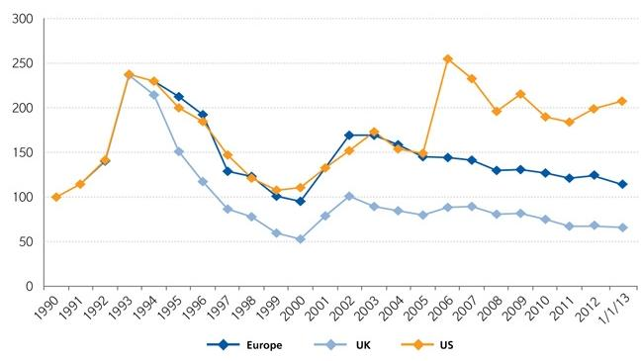
Regional Property Catastrophe Rate on Line Index, 1990—2013 (as of January 1)
Property-Cat reinsurance pricing was up in the US as of 1/1/13 but was down in Europe/UK
Sources: Guy Carpenter; Insurance Information Institute.

Slide 178
CATASTROPHE BONDS, ANNUAL RISK CAPITAL ISSUED, 2002-2012
($ Billions)
Note
Source: GC Securities and Guy Carpenter & Company, LLC.

Slide 179
CATASTROPHE BONDS, RISK CAPITAL OUTSTANDING, 2002-2012
($ Billions)
Note
Source: GC Securities and Guy Carpenter & Company, LLC.

Slide 180
4. RENEWED PRICING DISCIPLINE
Evidence of a Broad and Sustained Shift in Pricing
180

Slide 181
Distribution of Direct Premiums Written by Segment/Line, 2010
Personal/Commercial lines split has been about 50/50 for many years; Personal Lines overtook Commercial Lines in 2010
Pvt. Passenger Auto is by far the largest line of insurance and is currently the most important source of industry profits
Billions of additional dollars in homeowners insurance premiums are written by state-run residual market plans
Distribution Facts
2010
Commercial Lines
$226.8B/49%
Homeowners
$68.2B/15%
Pvt. Pass Auto
$165.0B/36%
Sources: A.M. Best; Insurance Information Institute research.

Slide 182
Net Premium Growth: Annual Change,
1971—2012
(Percent)
1975-78
1984-87
2000-03
Net Written Premiums Fell 0.7% in 2007 (First Decline Since 1943) by 2.0% in 2008, and 4.2% in 2009, the First 3-Year Decline Since 1930-33.
2012 growth was +4.3%
Shaded areas denote “hard market” periods
Sources: A.M. Best (historical and forecast), ISO, Insurance Information Institute.

Slide 183
P/C Net Premiums Written: % Change, Quarter vs. Year-Prior Quarter
Premium growth in Q1 2013 was up 4.1% over Q1 2012, marking the 12th consecutive quarter of growth
Sustained Growth in Written Premiums
(vs. the same quarter, prior year) Will Continue through 2013
Sources: ISO, Insurance Information Institute.
183
12/01/09 - 9pm
eSlide – P6466 – The Financial Crisis and the Future of the P/C
Notes:
183

Slide 184
Growth in Net Written Premium by Segment, 2012 vs. 2011*
(Percent)
*Excludes mortgage and financial guaranty insurers.
Source: ISO/PCI; Insurance Information Institute

Slide 185
Average Commercial Rate Change,
All Lines, (1Q:2004–1Q:2013)
Pricing as of Q1:2013 was positive for the 8th consecutive quarter. Gains are likely to continue through 2013.
(Percent)
Q2 2011 marked the last of 30th consecutive quarter of price declines
KRW Effect
Note: CIAB data cited here are based on a survey. Rate changes earned by individual insurers can and do vary, potentially substantially.
Source: Council of Insurance Agents & Brokers; Insurance Information Institute

Slide 186
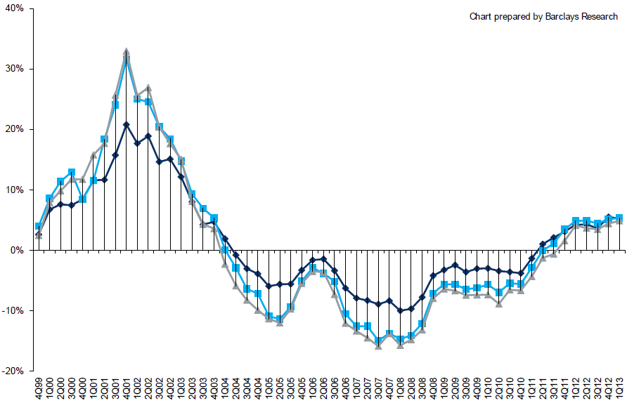
Change in Commercial Rate Renewals, by Account Size: 1999:Q4 to 2013:Q1
Percentage Change (%)
Peak = 2001:Q4 +28.5%
Pricing turned positive in Q3:2011, the first increase in nearly 8 years; Q1:2013 renewals were up 5.2%, the largest increase since late 2003; Some insurers posted stronger numbers.
Pricing Turned Negative in Early 2004 and Remained that way for 7 ½ years
KRW : No Lasting Impact
Trough = 2007:Q3 -13.6%
Source: Council of Insurance Agents and Brokers; Barclay’s Capital; Insurance Information Institute.
Note: CIAB data cited here are based on a survey. Rate changes earned by individual insurers can and do vary, potentially substantially.

Slide 187
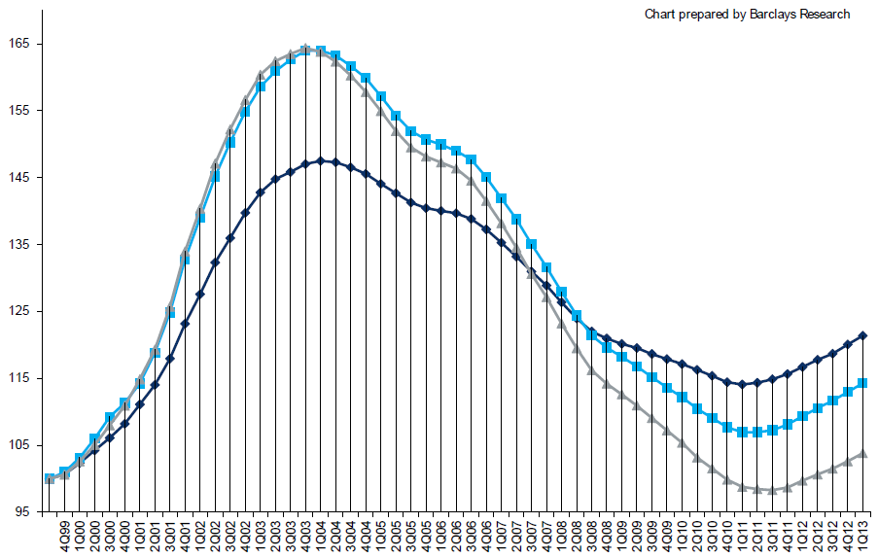
Cumulative Qtrly. Commercial Rate Changes, by Account Size: 1999:Q4 to 2013:Q1
1999:Q4 = 100
Despite 8 consecutive quarters of gains (Q4:2012 = 5.0%), pricing today is where is was in mid-2001 (pre-9/11), suggesting additional rate need going forward, esp. in light of record low interest rates
Note: CIAB data cited here are based on a survey. Rate changes earned by individual insurers can and do vary, potentially substantially.
Source: Council of Insurance Agents and Brokers; Barclay’s Capital; Insurance Information Institute.

Slide 188
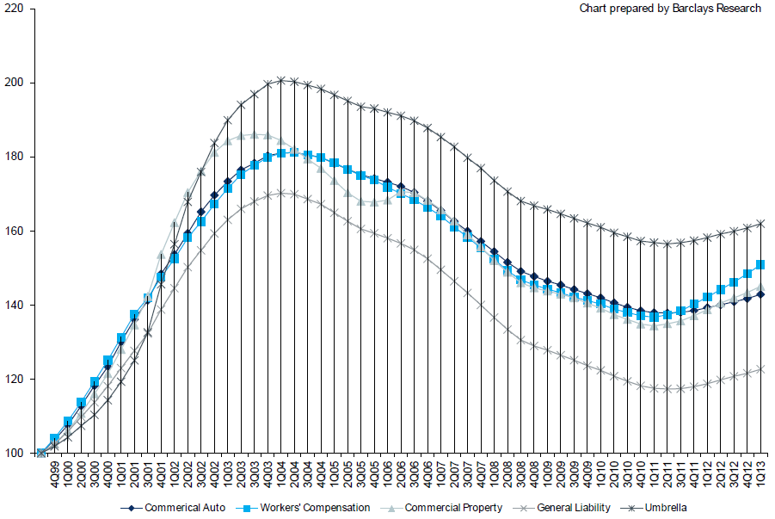
Cumulative Qtrly. Commercial Rate Changes, by Line: 1999:Q4 to 2013:Q1
1999:Q4 = 100
WC rate levels are rising and are now back to where they were in late 2008 and shortly after 9/11
Note: CIAB data cited here are based on a survey. Rate changes earned by individual insurers can and do vary, potentially substantially.
Source: Council of Insurance Agents and Brokers; Barclay’s Capital; Insurance Information Institute.

Slide 189
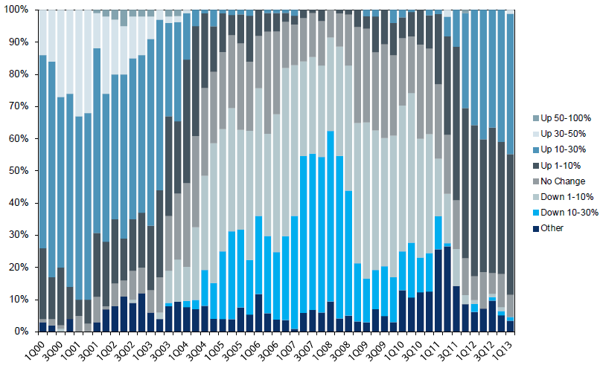
Workers Comp. Quarterly Rate Changes, by Line: 2000:Q1 to 2013:Q1
1999:Q4 = 100
Most accounts are now renewing upwards
Note: CIAB data cited here are based on a survey. Rate changes earned by individual insurers can and do vary, potentially substantially.
Source: Council of Insurance Agents and Brokers; Barclay’s Capital; Insurance Information Institute.

Slide 190
Change in Commercial Rate Renewals, by Line: 2013:Q1
Workers Comp rate increases are large than any other line, followed by Property lines
Percentage Change (%)
Major Commercial Lines Renewed Uniformly Upward in Q1:2013 for the 8th Consecutive Quarter; Property Lines & Workers Comp Leading the Way; Cat Losses and Low Interest Rates Provide Momentum Going Forward
Note: CIAB data cited here are based on a survey. Rate changes earned by individual insurers can and do vary, potentially substantially.
Source: Council of Insurance Agents and Brokers; Insurance Information Institute.

Slide 191
CLIPS: Change in Written Price Level:
All Lines, 2010:Q2 – 2012:Q4
Rate changes have been positive for 8 consecutive quarters, longer than any other commercial line
(Percent Change)
Note: Towers Watson data cited here are based on a survey. Rate changes earned by individual insurers can and do vary, potentially substantially.
Source: Towers Watson; Information Institute.

Slide 192
Workers Comp Rate Changes,
2008:Q4 – 2013:Q1
WC rate changes have been positive for 7 consecutive quarters, longer than any other commercial line
(Percent Change)
Note: CIAB data cited here are based on a survey. Rate changes earned by individual insurers can and do vary, potentially substantially.
Source: Council of Insurance Agents and Brokers; Information Institute.

Slide 193
Shifting Legal Liability &
Tort Environment
Is the Tort Pendulum
Swinging Against Insurers?
193

Slide 194
Over the Last Three Decades, Total Tort Costs as a % of GDP Appear Somewhat Cyclical, 1980-2013E
($ Billions)
2.21% of GDP in 2003 = pre-tort reform peak
Deepwater Horizon Spike in 2010
Tort costs in dollar terms have remained high but relatively stable since the mid-2000s., but are down substantially as a share of GDP
1.68% of GDP in 2013
Sources: Towers Watson, 2011 Update on US Tort Cost Trends, Appendix 1A

Slide 195
Commercial Lines Tort Costs: Insured vs. Self-(Un)Insured Shares, 1973-2010
2005: $143.5B 66.4% insured, 33.6% self-(un)insured
Billions of Dollars
$15.0
1995: $83.6B 69.5% insured, 30.5% self-(un)insured
1973: Commercial Tort Costs Totaled $6.49B, 94% was insured, 6% self-(un)insured
1985: $46.6B 74.5% insured, 25.5% self-(un)insured
$9.5
$6.0
2009: $126.5B 64.4% insured, 35.6% self-(un)insured
Tort Costs and the Share Retained by Risks Both Grew Rapidly from the mid-1970s to mid-2000s, When Tort Costs Began to Fall But Self-Insurance Shares Continued to Rise
Sources: Towers Watson, 2011 Update on US Tort Cost Trends, III Calculations based on data from Appendix 4.
195
12/01/09 - 9pm
eSlide – P6466 – The Financial Crisis and the Future of the P/C
Notes:
195

Slide 196
Commercial Lines Tort Costs: Insured vs. Self-(Un)Insured Shares, 1973-2010
Percent
2010: $138.1B 56.6% insured, 44.4% self-(un)insured (distorted by Deepwater Horizon event with most losses retained by BP)
1973: 94% was insured, 6% self-(un)insured
1985:74.5% insured, 25.5% self-(un)insured
1995: 69.5% insured, 30.5% self-(un)insured
2005: 66.4% insured, 33.6% self-(un)insured
The Share of Tort Costs Retained by Risks Has Been Steadily Increasing for Nearly 40 Years. This Trend Contributes Has Left Insurers With Less Control Over Pricing.
Sources: Towers Watson, 2011 Update on US Tort Cost Trends, III Calculations based on data from Appendix 4.
196
12/01/09 - 9pm
eSlide – P6466 – The Financial Crisis and the Future of the P/C
Notes:
196

Slide 197
Business Leaders Ranking of Liability Systems in 2012
Best States
Delaware
Nebraska
Wyoming
Minnesota
Kansas
Idaho
Virginia
North Dakota
Utah
Iowa
Worst States
Florida
Oklahoma
Alabama
New Mexico
Montana
Illinois
California
Mississippi
Louisiana
West Virginia
New in 2012
Wyoming
Minnesota
Kansas
Idaho
Newly Notorious
Oklahoma
Drop-offs
Rising Above
Indiana
Colorado
Massachusetts
South Dakota
Arkansas
Source: US Chamber of Commerce 2012 State Liability Systems Ranking Study; Insurance Info. Institute.

Slide 198
The Nation’s Judicial Hellholes: 2011
Watch List
Illinois
Madison , St. Clair and McLean counties
West Virginia
Philadelphia
Eastern District of Texas
Cook County, IL
Southern NJ
Franklin County, AL
Smith County, MS
Louisiana
California
Dishonorable Mention
New York
Albany and NYC
MI Supreme Court
AK Supreme Court
MO Supreme Court
Nevada
Clark County
South Florida
Source: American Tort Reform Association; Insurance Information Institute

Slide 199
CYBER RISK
Cyber Risk is a Rapidly Emerging Exposure for Businesses Large and Small in Every Industry
NEW III White Paper: http://www.iii.org/assets/docs/pdf/paper_CyberRisk_2013.pdf
199

Slide 200
Data Breaches 2005-2013, By Number of Breaches and Records Exposed
# Data Breaches/Millions of Records Exposed
Millions
The total number of data breaches and number of records exposed fluctuates from year to year and over time.
* 2013 figures as of March 19, 2013.
Source: Identity Theft Resource Center

Slide 201
2012 Data Breaches By Business Category, By Number of Breaches
The majority of the 447 data breaches in 2012 affected business and medical/healthcare organizations, according to the Identity Theft Resource Center.
Banking/Credit/Financial, 17 (3.8%)
Govt/Military, 50 (11.2%)
Business, 165 (36.9%)
Educational, 61 (13.6%)
Medical/Healthcare, 154 (34.5%)
Source: Identity Theft Resource Center, http://www.idtheftcenter.org/ITRC%20Breach%20Report%202012.pdf.

Slide 202
2012 Data Breaches By Category, By Number of Records Exposed
Government/Military and Business organizations accounted for the majority of records exposed by data breaches during 2012.
Banking/Credit/Financial, 470,048 (2.7%)
Medical/Healthcare, 2.2 million (12.9%)
Govt/Military, 7.7 million (44.4%)
Educational, 2.3 million (13.3%)
Business, 4.6 million (26.7%)
Source: Identity Theft Resource Center, http://www.idtheftcenter.org/ITRC%20Breach%20Report%202012.pdf.

Slide 203
AIG Survey: Cyber Attacks Top Concern Among Execs
While companies are focused on managing a variety of business risks, cyber attacks are a top concern. Some 85% of 258 executives surveyed said they were very or somewhat concerned about cyber attacks on their businesses.
Source: Penn Schoen Berland on behalf of American International Group.
203
Notes:
203

Slide 204
The Most Costly Cyber Crimes, Fiscal Year 2012
Malicious code, denial of service and web-based attacks account for more than 58 percent of the total annualized cost of cyber crime experienced by 56 companies.
Malware
Botnets
Malicious code
Viruses, Worms, Trojans
Phishing + social engineering
Malicious insiders
Stolen devices
Denial of service
Web-based attacks
Source: 2012 Cost of Cyber Crime: United States, Ponemon Institute.

Slide 205
External Cyber Crime Costs: Fiscal Year 2012
Information loss (44%) and business disruption or lost productivity (30%) account for the majority of external costs due to cyber crime.
Other costs*
Equipment damages
Information loss
Revenue loss
Business disruption
* Other costs include direct and indirect costs that could not be allocated to a main external cost category
Source: 2012 Cost of Cyber Crime: United States, Ponemon Institute.

Slide 206
High Profile Data Breaches, 2012-2013
Date | Company | Description of Breach
Mar 2013* | South Korean banks, media cos | Cyber attack causes computers to crash at South Korean banks and media companies, paralyzing bank machines across the country. No immediate reports of records compromised.
July 2012 | Yahoo | Security breach at Yahoo in which some 450,000 passwords lifted and posted to the Internet.
July 2012 | eHarmony | Online dating site eHarmony confirms security breach in which some 1.5 million user names and passwords compromised.
July 2012 | LinkedIn | Social networking site LinkedIn reportedly targeted in hacker attack that saw 6.5 million hashed passwords posted to the Internet.
April 2012 | Utah Dept of Technology Services | Utah Department of Technology notifies of a March 30 breach of a server containing personal data including social security numbers for about 780,000 Medicaid patient claims. Breach traced to Eastern Europe hackers.
Mar 2012 | Global Payments | Credit card processor Global Payments confirms hacker attack has compromised the payment card numbers of around 1.5 million cardholders.
Mar 2012 | CA Dept of Child Support Services | Officials announce that four computer storage devices containing personal information for about 800,000 adults and children in California’s child support system were lost by IBM and Iron Mountain Inc.
Jan 2012 | Zappos | Online shoe retailer Zappos announces that information, such as names, addresses and passwords on as many as 24 million customers illegally accessed.
Jan 2012 | NY State Electric + Gas Co | Security breach at NYSEG that allowed unauthorized access to NYSEG customer data, containing social security numbers, dates of birth and bank account numbers, exposing 1.8 million records.
*March 2013 attack is not part of ITRC research.
Sources: Identity Theft Resource Center, http://www.idtheftcenter.org/ITRC%20Breach%20Report%202012.pdf; Insurance Information Institute (I.I.I.) research.

Slide 207
Average Organizational Cost of a Data Breach, 2008-2011* ($ Millions)
The average organizational cost of a data breach in 2011 was $5.5 million, down 24% from $7.2 million in 2010. Companies have improved steps taken in both preparing for and responding to a data breach.
($ Millions)
*Findings of this benchmark study pertain to the actual data breach experiences of 49 U.S. companies from 14 different industry sectors, all of which participated in the 2011 study. Total breach costs include: lost business resulting from diminished trust or confidence of customers ;costs related to detection, escalation, and notification of the breach; and ex-post response activities, such as credit report monitoring.
Source: 2011 Annual Study: U.S. Cost of a Data Breach, the Ponemon Institute.
207
Notes:
207

Slide 208
Main Causes of Data Breach
Negligent employees and malicious attacks are most often the cause of the data breach. Some 39 percent of incidents involve a negligent employee or contractor, while 37 percent concern a malicious or criminal attack.
Negligence
System glitch
Malicious or criminal attack
Source: 2011 Cost of Data Breach Study: United States, Ponemon Institute, March 2012

Slide 209
Marsh: Increase in Purchase of Cyber Insurance Among U.S. Companies, 2012
Interest in cyber insurance continues to climb. The number of companies purchasing cyber insurance increased 33 percent from 2011 to 2012.
Source: Marsh Global Analytics, Marsh Risk Management Research Briefing, March 2013
209
Notes:
209

Slide 210
Marsh: Total Limits Purchased, By Industry – Cyber Liability, All Revenue Size
Cyber insurance limits purchased in 2012 averaged $16.8 million across all industries, an increase of nearly 20% over 2011.
($ Millions)
Source: Marsh Global Analytics, Marsh Risk Management Research Briefing, March 2013
210
Notes:
210

Slide 211
Marsh: Total Limits Purchased, By Industry – Cyber Liability, Revenue $1 Billion+
Among larger companies, average cyber insurance limits purchased in 2012 increased nearly 30% over 2011.
($ Millions)
Source: Marsh Global Analytics, Marsh Risk Management Research Briefing, March 2013
211
Notes:
211

Slide 212
Cyber Liability: Historical Rate (price per million) Changes
Overall, rates for cyber insurance were essentially flat in the fourth quarter of 2012.
Source: Marsh Global Analytics, Marsh Risk Management Research Briefing, March 2013

Slide 213
Insurance Information Institute Online:
www.iii.org
Thank you for your time
and your attention!
Twitter: twitter.com/bob_hartwig
Download at www.iii.org/presentations

