Slide 1
Calamities Natural and Political: Implications for P/C Insurance
Midwestern Actuarial Forum, Spring Meeting
Chicago, IL
March 22, 2013
Steven N. Weisbart, Ph.D., CLU, Senior Vice President & Chief Economist
Insurance Information Institute ♦ 110 William Street ♦ New York, NY 10038
Tel: 212.346.5540 ♦ Cell: 917.494.5945 ♦ stevenw@iii.org ♦ www.iii.org

Slide 2
Calamities Natural
SuperStorm Sandy
Raises New Questions
as it Becomes one of
the Most Expensive Storms in US History
2

Slide 3
US Insured Catastrophe Losses
($ Billions, 2012 Dollars)
2012 CAT losses were down nearly 50% from 2011 until Sandy struck in late October
US CAT Privately-insured losses in 2012 will likely become the 2nd or 3rd highest in US history (on an inflation-adjusted basis). 2011 losses were the 5th highest.
Record Tornado Losses Caused 2011 CAT Losses to Surge
*As of 1/2/13. Includes $20B gross loss estimate for Hurricane Sandy.
Note: 2001 figure includes $20.3B for 9/11 losses reported through 12/31/01 ($25.9B 2011 dollars). Includes only business and personal property claims, business interruption and auto claims. Non-prop/BI losses = $12.2B ($15.6B in 2011 dollars.)
Sources: Property Claims Service/ISO; Insurance Information Institute.
3
12/01/09 - 9pm
eSlide – P6466 – The Financial Crisis and the Future of the P/C
Notes:
3

Slide 4
Natural Disasters in the United States, 1980 – 2012
Number of Events (Annual Totals 1980 – 2012)
There were 184 natural disaster events in the US in 2012
Number
41
19
121
3
Geophysical
(earthquake, tsunami,
volcanic activity)
Meteorological (storm)
Climatological
(temperature extremes,
drought, wildfire)
Hydrological
(flood, mass movement)
Source: MR NatCatSERVICE
4

Slide 5
The Dozen Most Costly Hurricanes
(Privately Insured Claims) in U.S. History
Insured Losses, 2012 Dollars,
$ Billions
Sandy likely will be the 3rd costliest hurricane in US insurance history
Irene became the 12th most expensive hurricane in US history
10 of the 12 most costly hurricanes in insurance history occurred in the past 9 years (2004—2012)
*Estimate as of 12/09/12 based on estimates of catastrophe modeling firms and reported losses as of 1/12/13. Estimates range up to $25B.
Sources: PCS; Insurance Information Institute inflation adjustments to 2012 dollars using the CPI.

Slide 6
If They Hit Today, the Dozen Costliest (to Insurers) Hurricanes in U.S. History
Insured Losses,
2012 Dollars, $ Billions
Storms that hit long ago had less property and businesses to damage, so simply adjusting their actual claims for inflation doesn’t capture their destructive power.
Karen Clark’s analysis aims to overcome that.
When you adjust for the damage prior storms could have done if they occurred today, Hurricane Katrina slips to a tie for 6th among the most devastating storms.
*Estimate as of 12/09/12 based on estimates of catastrophe modeling firms and reported losses as of 1/12/13. Estimates range up to $25B.
Sources: Karen Clark & Company, Historical Hurricanes that Would Cause $10 Billion or More of Insured LossesToday, August 2012; I.I.I.

Slide 7
Homeowners Insurance Combined Ratio: 1990–2014F
Hurricane Sandy
Record tornado activity
Hurricane Ike
Homeowners Performance Deteriorated in 2011/12 Due to Large Cat Losses. Extreme Regional Variation Can Be Expected Due to Local Catastrophe Loss Activity
Sources: A.M. Best (1990-2013F);Conning (2014F); Insurance Information Institute.

Slide 8
Combined Ratio Points Associated with Catastrophe Losses: 1960 – 2012*
Avg. CAT Loss Component of the Combined Ratio by Decade
1960s: 1.04 1970s: 0.85 1980s: 1.31 1990s: 3.39 2000s: 3.52 2010s: 7.20*
Catastrophe losses as a share of all losses reached a record high in 2012
Combined Ratio Points
The Catastrophe Loss Component of Private Insurer Losses Has Increased Sharply in Recent Decades
Notes: Private carrier losses only. Excludes loss adjustment expenses and reinsurance reinstatement premiums. Figures are adjusted for losses ultimately paid by foreign insurers and reinsurers.
Source: ISO (1960-2011); A.M. Best (2012E) Insurance Information Institute.

Slide 9
P/C Industry Homeowners Claim Frequency, CATs vs. non-CATs, 1997-2011
Claims Paid per 100 Exposures
CAT claim frequency in 2011 was at historic highs and more than double the rate in 1997
Sources: Insurance Research Council, “Trends in Homeowners Insurance Claims,” p.29; Insurance Information Institute

Slide 10
P/C Industry Homeowners
CAT Claim Severity, 1997-2011
(in 2011 $)
HO average claim severity is now three times what it was in 1997.
Sources: Insurance Research Council, “Trends in Homeowners Insurance Claims,” p. 29, BLS inflation calculator,
and Insurance Information Institute

Slide 11
Superstorm Sandy:
Number of Claims by Type*
Total Claims = 1.52 Million*
Hurricane Sandy resulted in an estimated 1.52 million privately insured claims resulting in an estimated $18.75 to $25 billion in insured losses. Hurricane Katrina produced 1.74 million claims and $48.7B in losses (in 2012 $)
Sandy was a high HO frequency, (relatively low) severity event (avg. severity <50% Katrina)
*PCS claim count estimate s as of 1/18/13. Loss estimate represents PCS total ($18.75B) and upper end of range estimates by risk modelers RMS, Eqecat and AIR. All figures exclude losses paid by the NFIP.
Source: PCS; AIR, Eqecat, AIR Worldwide; Insurance Information Institute.

Slide 12
SuperStorm Sandy: Amount of
Insured Loss by Claim Type* ($ Millions)
Total Claim Value = $18.75 Billion*
Although Commercial Lines accounted for only 13% of total claims, they account for 48% of all claim dollars paid. In most hurricanes, Commercial Lines accounts for about 1/3 of insured losses.
*PCS insured loss estimates as of 1/18/13. Catastrophe modeler estimates range up to $25 billion. All figures exclude losses paid by the NFIP.
Source: PCS; Insurance Information Institute.

Slide 13
Hurricane Sandy: Average Claim Payment by Type of Claim
Commercial (i.e., business claims) are more expensive because the value of property is often higher as well as the impact of insured business interruption losses
The average insured flood loss was 6.5 times larger than the average non-flood insured loss (mostly wind)
Commercial (Business) Claims Were Nearly Seven Times More Expensive than Homeowners Claims; Vehicle Claims Were Unusually Expensive Due to Extensive Flooding
*Includes rental and condo policies (excludes NFIP flood). **As of Feb. 20, 2013.
Sources: Catastrophe loss data is for Catastrophe Serial No. 90 (Oct. 28 – 31, 2012) from PCS as of Jan. 18, 2013; Insurance Information Institute .

Slide 14
Sandy and Flood Insurance
14

Slide 15
Years in Which Flood Loss Paid by the National Flood Insurance Program Exceeded $1 Billion
Billions in Paid Claims
(in 2012 $)
Hurricane Sandy and other events could result in $7.5 billion in payouts from the NFIP in 2012, second only to 2005
Hurricanes Katrina and Rita accounted for the majority of 2005’s record payout
*Estimate as of 11/25/12.
Sources: Department of Homeland Security, Federal Emergency Management Agency, NFIP; Insurance Information Institute.
15
12/01/09 - 9pm
eSlide – P6466 – The Financial Crisis and the Future of the P/C
Notes:
15

Slide 16
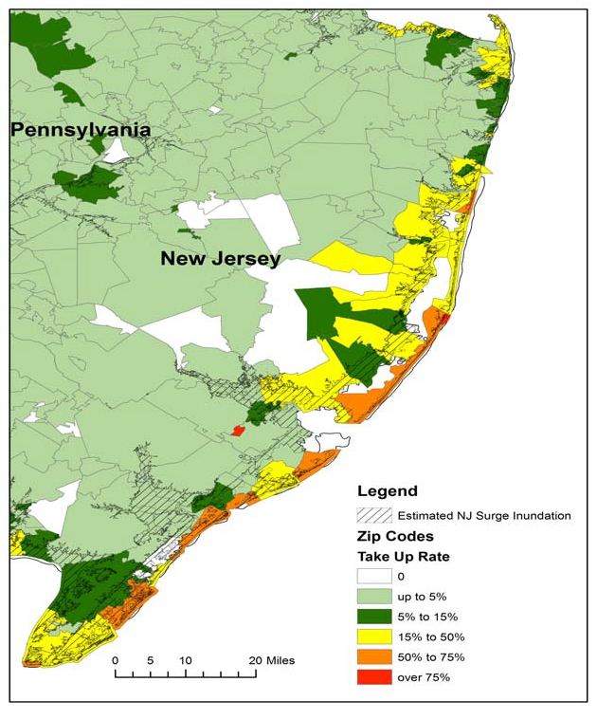
Residential NFIP Flood Take-Up Rates in NJ (2010) & Sandy Storm Surge
Even along the shore, flood insurance take-up rates were extremely low. Take-up rates in yellow were 15-50%
Flood insurance take-up rates were extremely low in many vulnerable (and affected) areas in NJ. Take-up rates in light green color were below 5%
Source: Wharton Center for Risk Management and Decision Processes, Issue Brief, Nov. 2012; Insurance Information Institute.
16

Slide 17
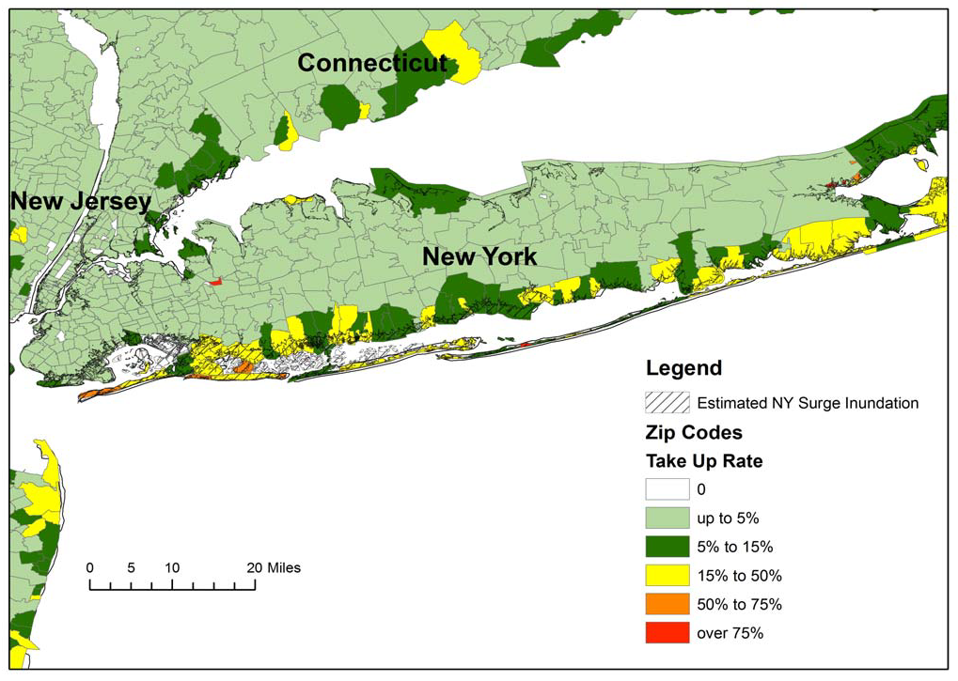
Residential NFIP Flood Take-Up Rates in NY, CT (2010) & Sandy Storm Surge
Almost nowhere were flood insurance take-up rates in coastal areas of NY and CT as high as 50%.
Take-up rates in dark green were 5-15%, yellow 15-50%.
Source: Wharton Center for Risk Management and Decision Processes, Issue Brief, Nov. 2012; Insurance Information Institute.
17

Slide 18
Flood Damaged Structures with/without Flood Insurance: Long Island NY
Number of structures
62.5% of flood-damaged buildings in Nassau County were uninsured for flood
74,736
46,681
73.4% of flood-damaged buildings in Suffolk County were uninsured for flood
46,681
20,798
$2.2
28,055
15,051
5,747
5,747
The Maximum FEMA Grant is $31,900. The Average Grant Award to Homeowners and Renters on Long Island is About $7,300
Source: Newsday, 1/14/13 from FEMA and Small Business Administration.
18
12/01/09 - 9pm
eSlide – P6466 – The Financial Crisis and the Future of the P/C
Notes:
18

Slide 19
Insurance Education Needed
for Home & Business Owners
Many Insurance Buyers Remain Confused About,
or Make Poor Decisions, Regarding Insurance Coverage
19

Slide 20
I.I.I. Poll: Do HO Policies Cover Hurricane-Related Flood Damage?
Percent who said “yes”
Q. Does your homeowners policy cover damage from flooding during a hurricane?¹
The proportion of homeowners who believe their homeowners policy covers damage from flooding during a hurricane stands at 17%. This proportion rises ten percentage points in the South, to 27%.
¹Asked of those who have homeowners insurance and who responded “yes” to being a homeowner.
Source: Insurance Information Institute Annual Pulse Survey.

Slide 21
I.I.I. Poll: Uninsured Flood Victims Didn’t Drive People to Buy Flood Insurance
Q. Have recent flooding events such as Hurricane Sandy
or Hurricane Irene motivated you to buy flood coverage?¹
Surprisingly few people were motivated to buy flood coverage
despite recent catastrophic flooding events
and the media’s attention on the people who had no flood insurance.
¹Asked of those who have homeowners insurance but not flood insurance.
Source: Insurance Information Institute Annual Pulse Survey.

Slide 22
Q. Will the government pay for damage to your home that is not covered in your homeowners policy?¹
Consumer education seems to be working: a growing percentage
of HO insureds say flood damage isn’t covered by HO,
but one-third of HO insureds still haven’t learned this
¹Asked of those who have homeowners insurance and who responded “yes”.
Source: Insurance Information Institute Annual Pulse Survey.

Slide 23
Flood Insurance Program: 2012 Reforms
2012 Reforms Were a Step in the Right Direction—But Too Late to Help With Sandy Shortfall
23
Notes:
23

Slide 24
Key Provisions, Flood Insurance
Reform & Modernization Act of 2012
Reauthorized NFIP and its financing through 9/30/17
Raises Average Annual Limit on Premium Increase
  Annual increases now capped at 20% (was 10%)
Phase-in of Actuarial Rates for:
  non-primary residences,
  severe repetitive loss properties,
  properties where flood losses have exceed property value,
  business property,
  property that has sustained damage > 50% of fair market value
Source: Independent Insurance Agents and Brokers Association at http://www.iiaba.net/webfolder/na/jeff/big%20i%20firm%20summary.pdf;
Insurance Information Institute.

Slide 25
Flood Insurance Reform & Modernization
Act of 2012: Key Provisions (cont’d)
Actuarially Sound Rates for Certain Severe Repetitive Loss Properties
  Charge actuarially sound rates to any prospective or repetitive loss properties that refused to accept offers of mitigation assistance after a major disaster
Prohibits Subsidized Premium Rates on New or Lapsed Policies
Sources: Independent Insurance Agents and Brokers Association
at http://www.iiaba.net/webfolder/na/jeff/big%20i%20firm%20summary.pdf ; Insurance Information Institute.

Slide 26
Other Changes, Net Impacts
& Outstanding Questions
Remapping Initiative (Flood maps out of date)
  Already resulting in expansion of high hazard flood zones
  Will also increase costs to many
Post-Sandy Changes in Building Codes
Use of State and Federal Funds to Purchase Vulnerable Property from Current Owners Who Had Homes Damaged or Destroyed in Sandy
  Most seem willing to sell since they are being offered 100%+ or pre-Sandy value and many were not insured for flood damage
Given only 1/2 to 1/3 of Coastal Dwellers Maintain Flood Coverage, What Will Be the Impact of Higher Price?
  What is elasticity of demand for flood insurance?
Will Private Insurers Have a Greater Incentive to Participate in the Flood Insurance Market?

Slide 27
When a Disaster Strikes,
People Ask Five Questions
Is it covered under my policy?
How much will it cost the industry?
Can you afford to pay for it?
Will the price of (re)insurance go up?
Will coverage still be available?
Sandy Addition: How do I get govt. aid?
Much of the I.I.I.’s time with media interested in CAT issues involves these questions
27
12/01/09 - 9pm
eSlide – P6466 – The Financial Crisis and the Future of the P/C
Notes:
27

Slide 28
Are You Safe Here in the Midwest?
28

Slide 29
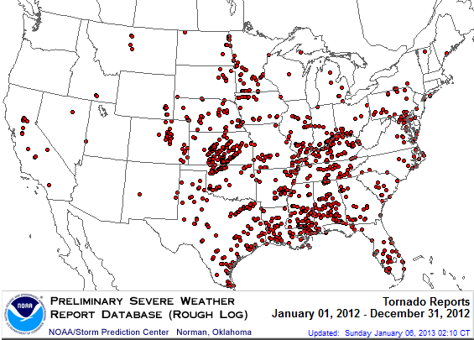
Location of Tornadoes in the US, 2012*
1,119 tornadoes killed 68 people through Dec. 31
*Through Dec. 31, 2012.
Source: NOAA Storm Prediction Center; http://www.spc.noaa.gov/climo/online/monthly/2012_annual_summary.html#
29

Slide 30
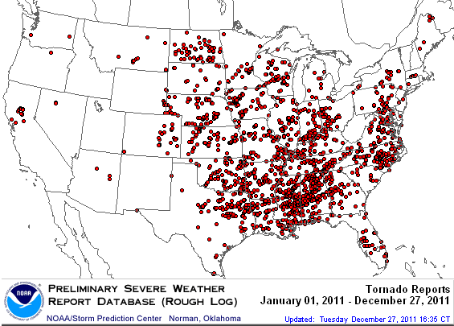
Location of Tornadoes in the US, 2011
1,894 tornadoes killed 553 people in 2011, including at least 340 on April 26 mostly in the Tuscaloosa area, and 130 in Joplin on May 22
Source: NOAA Storm Prediction Center; http://www.spc.noaa.gov/climo/online/monthly/2011_annual_summary.html#
30

Slide 31
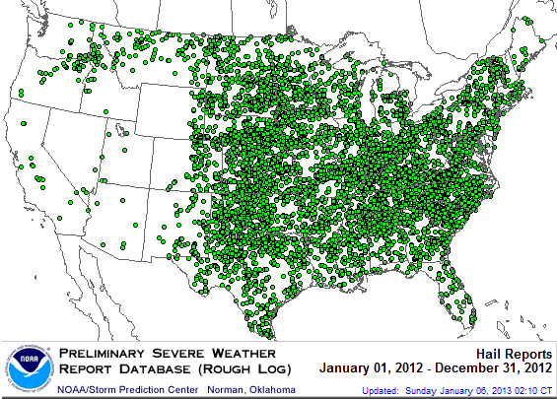
Location of Large Hail Reports in the US, 2012*
There were 7,033 “Large Hail” reports through Dec. 31, 2012, causing extensive damage to homes, businesses and vehicles
*Through Dec. 31, 2012.
Source: NOAA Storm Prediction Center; http://www.spc.noaa.gov/climo/online/monthly/2012_annual_summary.html#
31

Slide 32
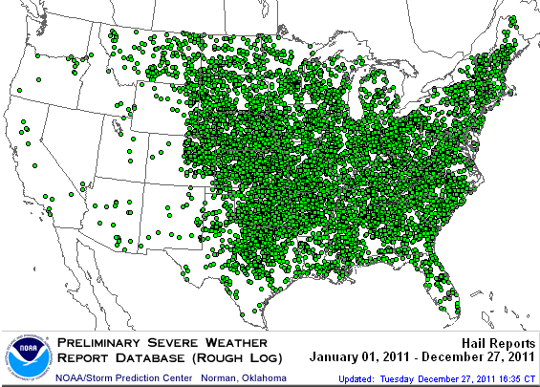
Location of Large Hail Reports in the US, 2011
There were 9,417 “Large Hail” reports in 2011, causing extensive damage to homes, businesses and vehicles
Source: NOAA Storm Prediction Center; http://www.spc.noaa.gov/climo/online/monthly/2011_annual_summary.html#
32

Slide 33
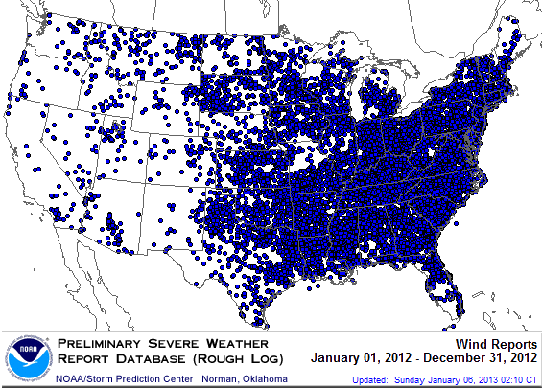
Location of Wind Damage Reports in the US, 2012*
Extreme density due to late June derecho
Hurricane Sandy resulted in a large volume of wind damage reports
There were 14,351 “Wind Damage” reports through Dec. 31, causing extensive damage to homes and, businesses
*Through Dec. 31, 2012.
Source: NOAA Storm Prediction Center; http://www.spc.noaa.gov/climo/online/monthly/2012_annual_summary.html#
33

Slide 34
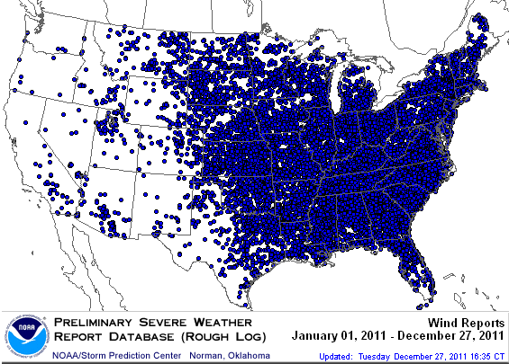
Location of Wind Damage Reports in the US, 2011
There were 18,685 “Wind Damage” reports through Dec. 27, causing extensive damage to homes and, businesses
Source: NOAA Storm Prediction Center; http://www.spc.noaa.gov/climo/online/monthly/2011_annual_summary.html#
34

Slide 35
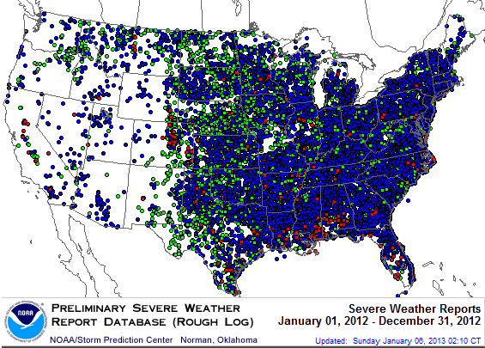
Severe Weather Reports, 2012*
There were 22,503 severe weather reports through Dec. 31; including 1,119 tornadoes; 7,033 “Large Hail” reports and 14,351 high wind events
*Through Dec. 31, 2012.
Source: NOAA Storm Prediction Center; http://www.spc.noaa.gov/climo/online/monthly/2012_annual_summary.html#
35

Slide 36
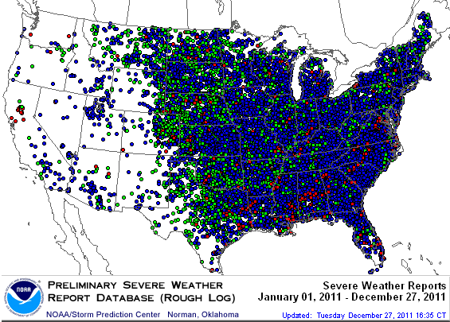
Severe Weather Reports, 2011
There were 29,996 severe weather reports in 2011; including 1,894 tornadoes; 9,417 “Large Hail” reports and 18,685 high wind events
Source: NOAA Storm Prediction Center; http://www.spc.noaa.gov/climo/online/monthly/2011_annual_summary.html#
36

Slide 37
Calamities Natural:
Key Take-aways
37

Slide 38
Takeaways: Lessons from, and
a “New Normal” for Catastrophes
A CAT 1 or Even Weaker Storm Can Cause Enormous Losses
  Sandy’s winds were barely hurricane strength with she hit the Jersey Shore, yet she might have been the second most destructive storm in U.S. history
    Large storm surge (storm hit at high tide) caused extensive flooding
    Natural protection (e.g., beach dunes) works well
    Despite lower average severity, relatively higher claim frequency and long-lasting power outages slowed recovery

Slide 39
Takeaways: Lessons from, and
a “New Normal” for Catastrophes
Flood Insurance Coverage Will Grow Slowly, Thanks to
  Steep Premium Increases,
  New Flood Zone Maps,
  Ending Actuarial Subsidies
  Persistent belief that
    No need for flood insurance--FEMA will pay
    Homeowners policy covers flood
    Risk of another flood is low because
      Just had a flood
      Haven’t had a flood in a long time

Slide 40
Calamities Political
The Strength of the Economy Will Influence
P/C Insurer Growth Opportunities, but…
40

Slide 41
Three Potential “Calamities Political”
Budget Battles and Other Political Obstacles to Economic Growth, including
  the Sequester, the Debt Ceiling, the Continuing Resolution,
  Fallout from Europe
  a Middle-East Crisis
Will TRIA be reauthorized?
How Will the new HUD Ruling Affect Property Insurance?

Slide 42
Budget Battles, etc.
42

Slide 43
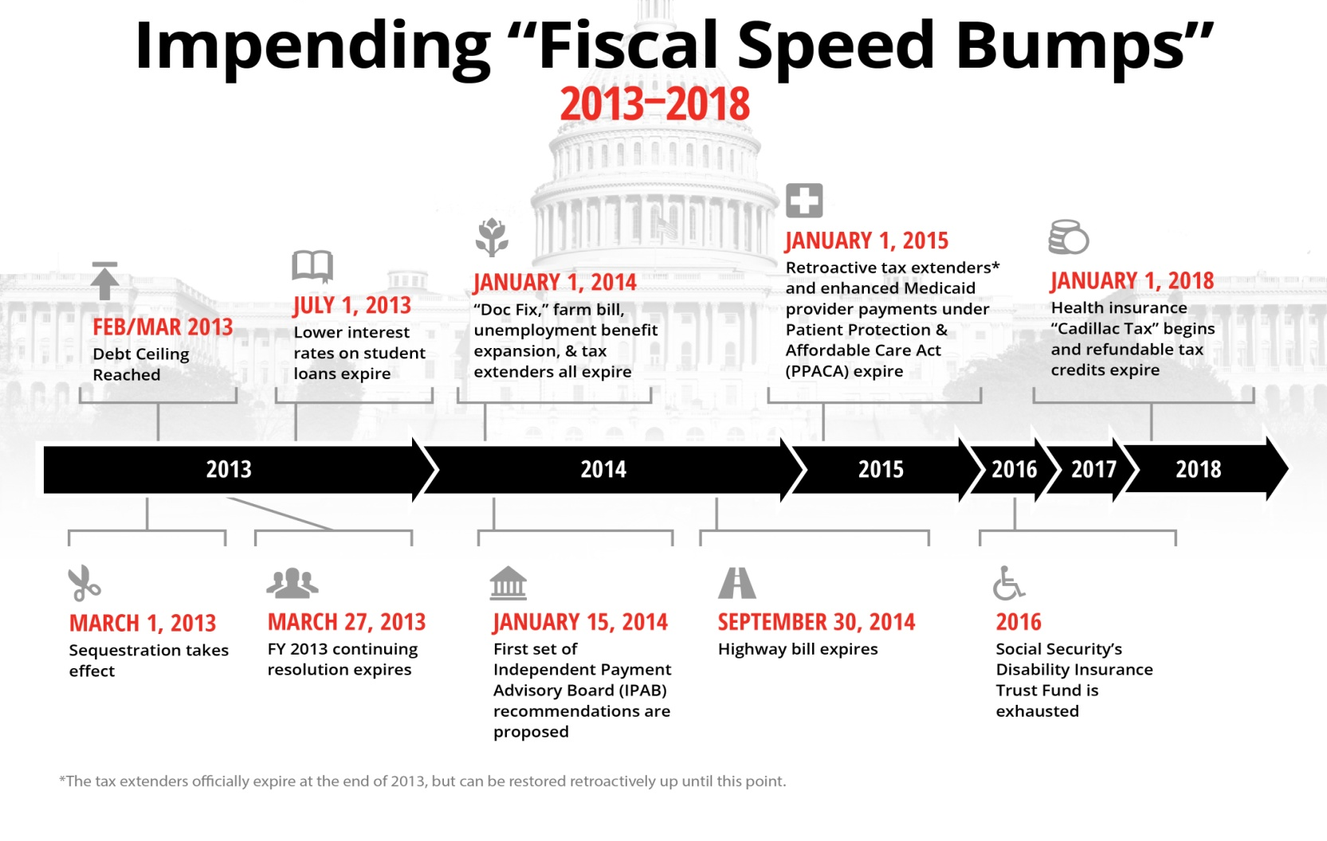
The Fiscal Cliff Was Just the Beginning: Budget Battles for Next Five Years?
Poll: 94% of P/C insurance executives think looming budget battles
In Washington will hurt the economy.*
There are 10+ “Fiscal Speed Bumps” over the next five years =>
a potentially extended period of fiscal uncertainty
Creates
long-term uncertainty around federal spending, tax policy, entitlements
*P/C Insurance Joint Industry Forum press release (www.iii.org/press_releases), January 15, 2013.
Chart Source: Fix the Debt Coalition, January 18, 2013; Insurance Information Institute

Slide 44

Federal Spending as Percent of State GDP: Vulnerability to the Sequester Varies
The Midwest will be relatively unaffected by the Sequester
Sources: Pew Center on the States (2012) Impact of the Fiscal Cliff on the States; Wells Fargo; Insurance Information Institute.

Slide 45
Defense and Non-Defense Federal Spending as a Share of State GDP: Top 10 States*
Defense Spending
Non-Defense Spending
Federal defense spending accounts for approximately 10%+ of GDP in 5 states
Federal non-defense spending accounts for 10%+ of GDP in 3 states
Sequestration Could Adversely Impact Commercial Insurance Exposures Directly at Defense Contractors and Indirectly in Impacted Communities
*As of 2010.
Sources: Pew Center on the States (2012) Impact of the Fiscal Cliff on the States; Wells Fargo Securities; Insurance Information Institute.

Slide 46
TERRORISM RISK
The Countdown to TRIA Expiration Begins
Reauthorization Faces an Uphill Battle in Congress
46

Slide 47
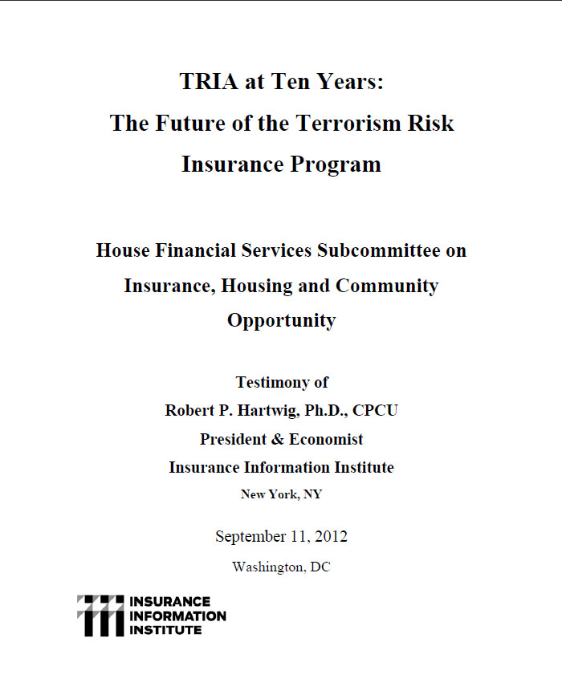
I.I.I. Congressional Testimony on the Future of the Terrorism Risk Insurance Program
Issue: Act expires 12/31/14. Insurers still generally regard large-scale terror attacks as fundamentally uninsurable
I.I.I. Input: Testimony at first hearing on the issue in DC (on 9/11/12) on trends in terrorist activity in the US and abroad, difficulties in underwriting terror risk; Noted that bin Laden may be dead but war on terror is far from over
Status: New House FS Committee Chair Jeb Hensarling has opposed TRIA in the past; Obama Administration does not seem to support extension; Little institutional memory on insurance subcommittee

Slide 48
Loss Distribution by Type of Insurance from Sept. 11 Terrorist Attack ($ 2011)
($ Billions)
Total Insured Losses Estimate: $40.0B**
*Loss total does not include March 2010 New York City settlement of up to $657.5 million to compensate approximately 10,000 Ground Zero workers or any subsequent settlements.
**$32.5 billion in 2001 dollars.
Source: Insurance Information Institute.

Slide 49
Terrorism Violates Traditional Requirements for Insurability
Requirement | Definition | Violation
Estimable Frequency | Insurance requires large number of observations to develop predictive rate-making models (an actuarial concept known as credibility) | Very few data points Terror modeling still in infancy, untested. Inconsistent assessment of threat
Estimable Severity | Maximum possible/ probable loss must be at least estimable in order to minimize “risk of ruin” (insurer cannot run an unreasonable risk of insolvency though assumption of the risk) | Potential loss is virtually unbounded. Losses can easily exceed insurer capital resources for paying claims. Extreme risk in workers compensation and statute forbids exclusions.
Source: Insurance Information Institute

Slide 50
Terrorism Violates Traditional Requirements for Insurability (cont’d)
Requirement | Definition | Violation
Diversifiable Risk | Must be able to spread/distribute risk across large number of risks “Law of Large Numbers” helps makes losses manageable and less volatile | Losses likely highly concentrated geographically or by industry (e.g., WTC, power plants)
Random Loss Distribution/Fortuity | Probability of loss occurring must be purely random and fortuitous Events are individually unpredictable in terms of time, location and magnitude | Terrorism attacks are planned, coordinated and deliberate acts of destruction Dynamic target shifting from “hardened targets” to “soft targets” Terrorist adjust tactics to circumvent new security measures Actions of US and foreign govts. may affect likelihood, nature and timing of attack
Source: Insurance
Information Institute

Slide 51
The New HUD Ruling
HO Underwriting vs. Disparate Impact
51

Slide 52
What Did HUD Rule?
The Fair Housing Act prohibits discrimination in the sale, rental, or financing of dwellings on the basis of race, color, religion, sex, disability, familial status, or national origin.
HUD’s rule says Plaintiffs may use statistical analysis to show that certain insurer/lender/municipality behavior had a disproportionately adverse effect on the sale, rental, or financing of housing for minorities
  Under the rule, this showing violates the federal Fair Housing Act even if the insurer/lender/municipality did not intend to discriminate
  Defendant can prevail if it shows the practice was needed to achieve one or more substantial, legitimate, nondiscriminatory interests
  But plaintiff may win by showing that another practice with a less discriminatory effect could achieve this interest

Slide 53
Potential Impact on
Property Insurance Underwriting
Why does this affect property insurance?
  Insurers don’t use race, religion, sex, etc. to underwrite property insurance
  But they do use credit-based insurance scores, neighborhood, and other factors that could be the basis of a “disparate impact” conclusion
Isn’t this a federal government agency’s intrusion into state regulation, against McCarran-Ferguson?
  HUD says M-F says federal laws/regulations that “specifically relate to the business of insurance” supercede state law
But how can insurers defend themselves if they don’t have data on race (which they’re prohibited from collecting)?
  HUD says plaintiff have the same problem, so it’s fair

Slide 54
Potential Impact on Property Insurance Underwriting (cont’d)
Higher Rates for Homeowners Insurance?
  Might result if carriers can’t use credit-based insurance scores in underwriting
    This might worsen conditions for lower-income people with good scores, some of whom are minorities
    Insurance pricing becomes less accurate => better risks subsidize worse risks
  Could also increase costs to monitor compliance and defend suits alleging discrimination
Potentially Changes State/Federal Regulatory Balance
  Not necessarily by itself, but in the trail of
    Federal Insurance Office
    FSOC
    CFPB

Slide 55
Other “Calamities Political”
That We Could Mention
55

Slide 56
Designating Some Insurers as Systemically Important?
  Creating a two-tiered, “unlevel playing field”
Extending the “Reach” of the Consumer Financial Protection Bureau?
  The CFPB is now proposing regulations for mortgage servicers regarding property insurance on homes with mortgages
  Will it deal with insurance offered with credit cards?
  Bank marketing of insurance products?

Slide 57
Insurance Information Institute
www.iii.org
Thank you for your time
and your attention!
Notes:
57

Slide 58
U.S. Residual Market: Total Policies In-Force (1990-2011) (000)
(000)
Katrina, Rita and Wilma
4 Florida Hurricanes
Hurricane Andrew
In the 22-year period between 1990 and 2011, the total number of policies in-force in the residual market (FAIR & Beach/Windstorm) Plans has more than tripled.
Source: PIPSO; Insurance Information Institute

Slide 59
U.S. Residual Market Exposure to Loss
($ Billions)
($ Billions)
Katrina, Rita and Wilma
4 Florida Hurricanes
Hurricane Andrew
In the 22-year period between 1990 and 2011, total exposure to loss in the residual market (FAIR & Beach/Windstorm) Plans has surged from $54.7 billion in 1990 to a record high of $884.7 billion in 2011.
Source: PIPSO; Insurance Information Institute (I.I.I.).
59
Notes:
59

