Slide 1

Presentation to the National Policy Institute on Emergency Planning and Preparation
Presented by National Association of Latino Elected and Appointed Officials Educational Fund
July 22, 2012
New Orleans, LA
Jeanne M. Salvatore, Senior Vice President, Public Affairs and Consumer Spokesperson
Insurance Information Institute ♦ 110 William Street ♦ New York, NY 10038
Tel: 212.346.5555 ♦ jeannes@iii.org ♦ www.iii.org

Slide 2
Presentation Outline – Insurance and
Disasters
Disaster Insurance 101 – What’s Covered and What’s not by Standard Home and Business Insurance Policies
Steps Should Consumers Take to Prepare for a Disaster
How the Claims Process Works
Results of an I.I.I. Poll on Disaster Preparedness
I.I.I. Resources

Slide 3

Disaster Insurance

Slide 4

Are Acts of God Covered?
What do You Think?
Why?

Slide 5
Disaster Insurance
The term “Act of God” is not written in standard auto, home or
business insurance policies in the U.S.
Instead, insurance policies list disaster which are covered and disasters which are not.
Standard homeowners, renters and business insurance policies provide coverage for fire, lightning, windstorm, hail, theft, vandalism, explosion and other disasters listed in the policy. The two major disasters that are not covered are flood and earthquake. Separate insurance is available, however.
The optional comprehensive coverage under an auto insurance policy provides coverage for damage caused by natural disasters including earthquake and flooding.

Slide 6
Flood Insurance
Flood coverage is available from FEMA’s National Flood Insurance Program and from a few private insurers.
The NFIP provides coverage for up to $250,000 for the structure of the home and $100,000 for personal possessions. The NFIP policy provides replacement cost coverage for the structure of your home, but only actual cash value coverage for your possessions. Flood insurance is available for renters as well as homeowners.
There is a 30-day waiting period before the coverage takes
effect.
Excess flood insurance is also available from some private insurers for those who need additional insurance protection over and above the basic policy or whose community does not participate in the NFIP.

Slide 7
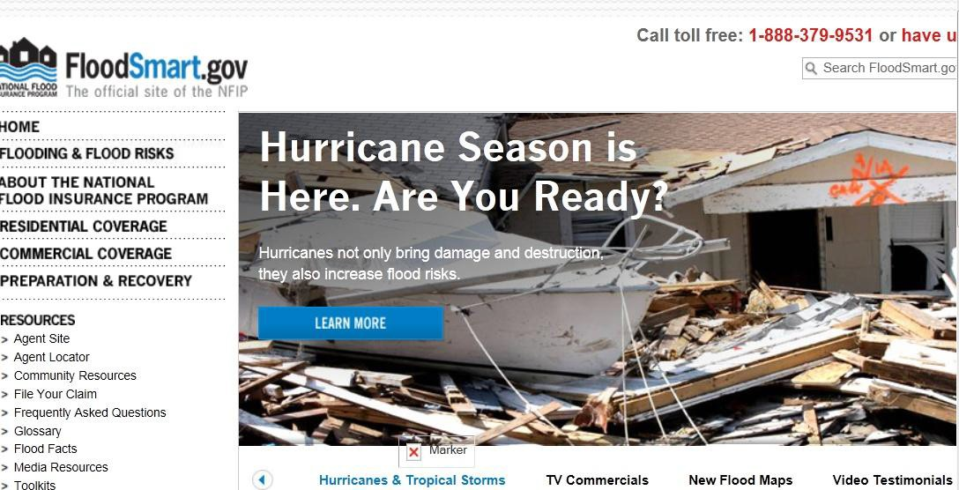
NFIP’s Flood Smart Website

Slide 8
Earthquake Insurance
An earthquake is a sudden and rapid shaking of the earth caused by the breaking and shifting of rock beneath the earth’s surface. This shaking can sometimes trigger landslides, avalanches, flash floods, fires and tsunamis. Unlike other natural disasters such as hurricanes, there are no specific seasons for earthquakes.
Earthquake coverage is available for homes and businesses from private insurance companies and in California from the California Earthquake Authority. Earthquakes are covered under the optional comprehensive portion of an auto insurance policy
The potential cost of earthquakes has been growing because of increasing urban development in seismically active areas and the vulnerability of older buildings, which may not have been built or upgraded to current building codes.

Slide 9
Deductibles
A deductible is basically the amount “deducted” from an insured loss. Deductibles have been an essential part of the insurance contract for many years and represent a sharing of the risk between the insurance company and the policyholder. When repairing your home or replacing personal possessions, the amount of the deductible would come out of your own pocket.
A deductible can be either a specific dollar amount or a percentage of the total amount of insurance on a policy. Generally speaking, the larger the deductible, the less a consumer pays in premiums for an insurance policy. Deductible amounts can be found on the declarations (or front) page of standard homeowners and auto insurance policies.

Slide 10
Deductibles
if you have a $500 “dollar deductible,” that $500 would be deducted from your claim. So, if you have an insured loss worth
$10,000 you would receive a claims check for $9,500.
Percentage deductibles are calculated differently. They are based on a percentage of the home’s insured value. So if your house is insured for $100,000 and you have a 2 percent deductible, $2,000 would be deducted from the amount you are reimbursed on a claim. In the event of the $10,000 insurance loss, you would be paid $8,000.
Deductibles in many parts of the country have been going up. In hurricane prone states, where there is a greater risk of a major catastrophe, special deductibles may apply for homeowners insurance claims when the cause of damage is attributable to a hurricane. These deductibles generally take the form of a
percentage of the policy limits.
10

Slide 11
Deductibles
Percentage Deductibles Apply to Earthquakes,
Hurricanes and Hail
Earthquakes: Deductibles for earthquake coverage can range anywhere from 2 percent to 20 percent of the replacement value of the structure.
Hurricanes and Hail: There are two kinds of wind damage deductibles: hurricane deductibles, which apply to damage solely from hurricanes; and windstorm or wind/hail deductibles, which apply to any kind of wind damage.
Every state from Maine to Texas has windstorm
deductible.

Slide 12
Are Natural Disasters Getting
More Frequent?
What do You Think?

Slide 13
I.I.I. Poll: Disaster Preparedness
Q. Regarding the weather in the United States in general, with which comment do you most agree?
Don’t know
Getting less severe and causing less damage
2%
6%
Weather unchanged
30%
61%
Getting more severe and causing more damage
Americans Think the Weather Is Becoming More Severe
Source: Insurance Information Institute Annual Pulse Survey.

Slide 14


Top 14 Most Costly Disasters
in U.S. History – Occurred last 20 Years
(Insured Losses, 2011 Dollars, $ Billions)
Taken as a single event, the Spring 2011 tornado and storm season are
$50
$45
$40
$35
$30
$25
$20
$15
$10
$5
$0
$47.6
the 4th costliest event in US insurance history
$24.0
$25.0
_{$19.1} $21.3
_{$11.9} $13.1
$6.5
$7.7
$8.5
$9.0
$4.3
$4.4
$5.5
Irene (2011)
Jeanne Frances Rita (2004) (2004) (2005)
Hugo Ivan
(1989) (2004)
Charley (2004)
Wilma (2005)
Ike (2008)
Northridge Spring (1994) Tornadoes
& Storms* (2011)
9/11
Attack (2001)
Andrew (1992)
Katrina (2005)
Hurricane Irene became the 11th most expense hurricane in US history
*Losses will actually be broken down into several “events” as determined by PCS. Includes losses for the period April 1 – June 30.
Sources: PCS; Insurance Information Institute inflation adjustments.

Slide 15

Steps Should Consumers Take to Prepare for a Disaster

Slide 16
Elements of a Disaster Plan
There are four key ways to Prepare for a disaster.
First, you need the right type and amount of insurance for your specific insurance needs.
Second, you need a home inventory.
Third, know what you will need to take if you have to evacuated
Four, know where you will go and how you will get there
when there is a disaster.
Lastly, remember to think about pets and others with special needs when creating your disaster plan

Slide 17
Get the Right Amount and Type of
Insurance
You need enough insurance to:
Rebuild your home. Do not insure to the real estate value of your home or you will likely be very under-insured. It is important to get the right amount of rebuilding costs and know all of your options.
Replace all of your personal belongings.
Have enough insurance for the cost of additional living expenses.
If you are a renter get renters insurance.

Slide 18
Conduct a Home Inventory
A home inventory is a detailed list of all your personal
possessions with their estimated value.
It helps to purchase the right amount of insurance coverage.
Makes it easier to file an insurance claim.
And, lastly to substantiate unreimbursed property
insurance losses for tax purposes or to apply for aid.

Slide 19
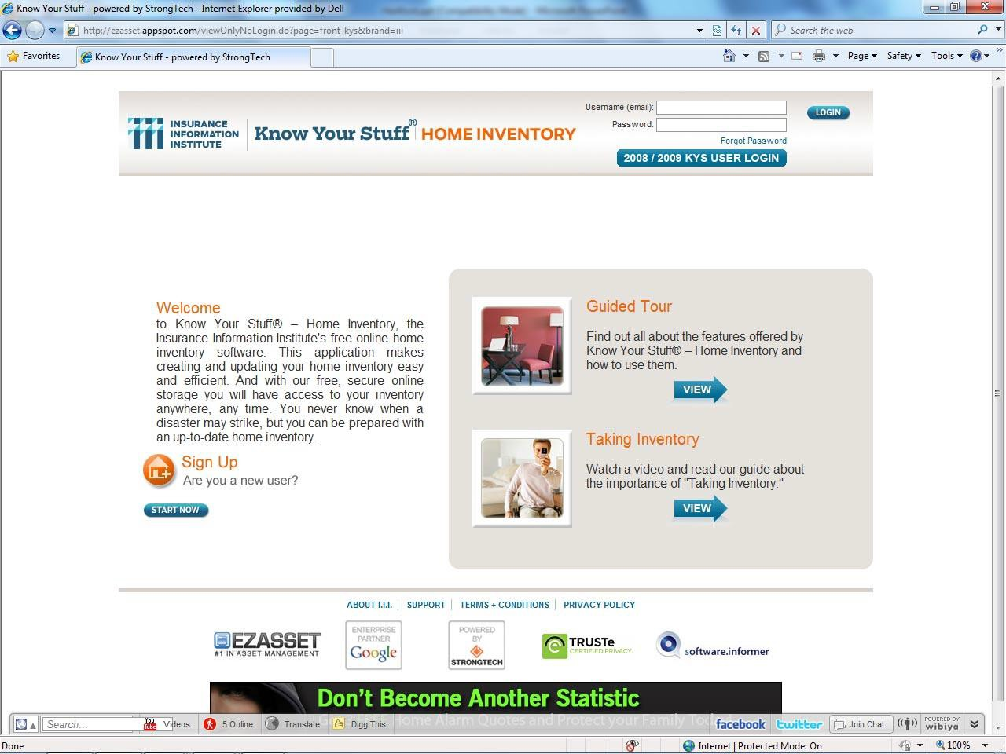

Know Your Stuff® - Home Inventory
Know Your Stuff is a free, online home inventory application that is highly regarded by the public and media, and represents the type of outreach by the industry that generates great PR; it is also available for co branding

Slide 20
Know What to Take
Medicines, prescriptions and first aid kit
Bottled water
Clothing and bedding (sleeping bags, pillows)
Flashlight, battery-powered radio and extra batteries
Special items for infants or elderly or
disabled family members
Computer hard drive or laptop
Photographs
Pet food and other items for pets (litter
boxes, leashes)
Keep important documents in a safe place that you can access easily. In the event of an evacuation take the following documents with you:
Insurance policies
Prescriptions
Birth and marriage certificates
Passports
Drivers license or personal identification
Social Security cards
Recent tax returns
Employment information
Wills, deeds and recent tax returns
Stocks, bonds and other negotiable certificates
Bank, savings and retirement account numbers
Home inventory

Slide 21
Know Where to Go
Plan where you will go &
How you will get there
Practice this ahead of time.
Take the Ten-Minute Challenge To find out if you are ready, do a real-time test. Give yourself just 10 minutes to get your family and belongings into the car and on the road to safety. By planning ahead and practicing, you should be able to gather your family members and pets, along with the most important items they will need, calmly and efficiently, with a minimum of stress and confusion.

Slide 22
Results of an I.I.I. Poll on
Disaster Preparedness

Slide 23
I.I.I. Poll: Disaster Preparedness
Q. Does your homeowners policy cover damage from flooding during a hurricane?¹
40%
35%
30%
25%
32%
32%
23%
22%
20%
20%
15%
10%
5%
0%
16%
12%
14%
12%
9%
Northeast
Midwest
South
2011 2012
West
Total U.S.
About One Out of Five Homeowners Believe Their Homeowners Policy Covers Damage From Flooding During a Hurricane. Almost a Third of Homeowners in the South Share This Belief
¹Asked of those who have homeowners insurance and who responded “yes”.
Source: Insurance Information Institute Annual Pulse Survey.

Slide 24
I.I.I. Poll: Disaster Preparedness
Q. How likely do you think it is that your home may be damaged or destroyed by a hurricane, fire, flood, earthquake or other disaster? Would you say…
Don’t know Very likely
1%
Not likely at all
8%
Somewhat likely
24%
35%
32%
Somewhat unlikely
About Half of Americans Think It Is Likely That Their Home Will Be Destroyed by a Disaster
Source: Insurance Information Institute Annual Pulse Survey.

Slide 25
How to File an Insurance
Claim

Slide 26
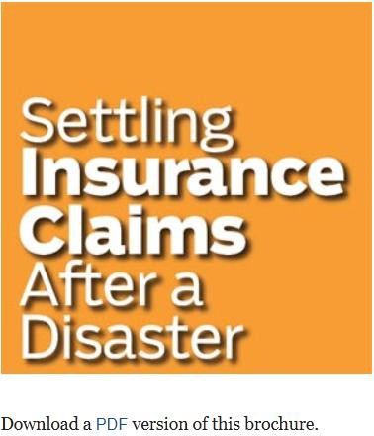
How to File an Insurance Claim
1. Contact your agent or company immediately. Find out:
Whether the damage is covered under the terms of your policy
How long you have to file a claim
Whether your claim exceeds your deductible (the amount of loss you agree to pay before insurance kicks in)
How long it will take to process the claim
Whether you’ll need estimates for repairs

Slide 27
How to File an Insurance Claim
2. Let your insurance company know the extent of the
damage to your home.
If you can't live in your home because it was damaged or destroyed by an insured disaster, your insurance company will pay for reasonable additional living expenses.
The amount is generally equal to 20 percent of the insurance on your home. This amount is in addition to the money for repairs or to rebuild your home. Some insurance companies pay more than 20 percent. Others limit additional living expenses to the amount spent during a certain period of time.
Among the items typically covered are eating out, rent, telephone or utility installation costs in a temporary residence, and extra transportation costs

Slide 28
How to File an Insurance Claim
3. Make temporary repairs:
Take reasonable steps to protect your property from
further damage.
Save receipts for what you spend and submit them to your insurance company for reimbursement. Remember that payments for temporary repairs are part of the total settlement. So if you pay a contractor a large sum for a temporary repair job, you may not have enough money for permanent repairs.
Don't make extensive permanent repairs until the claims adjuster has assessed the damage

Slide 29
How to File an Insurance Claim
4. Prepare for the adjuster's visits: Your insurance company may send you a proof of loss form to complete or an adjuster may visit your home first.
Don’t throw out damaged items until the adjuster has visited. You should also consider photographing or videotaping the damage. If your property was destroyed or you no longer have any records, work from memory.
Identify structural damage to your home and other structures such as a garage, tool shed or in-ground swimming pool. Make a list of everything you want to show the adjuster, for example, cracks in the walls and missing roof tiles. You should also get the electrical system checked. Most insurance companies pay for these inspections.

Slide 30
How to File an Insurance Claim
Get written bids from licensed contractors. The bids should include details of the materials to be used and prices on a line-by-line basis. This makes adjusting the claim faster and simpler.
Get organized. Keep copies of the lists and other documents you submit to your insurance company. Also keep copies of whatever paperwork your insurance company gives you and record the names and phone numbers of everyone you speak to.

Slide 31
I.I.I. Resources

Slide 32
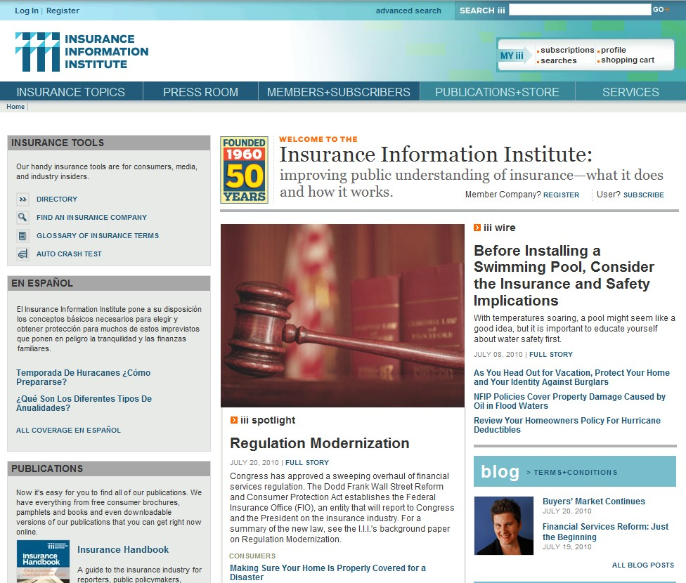

34

Slide 33
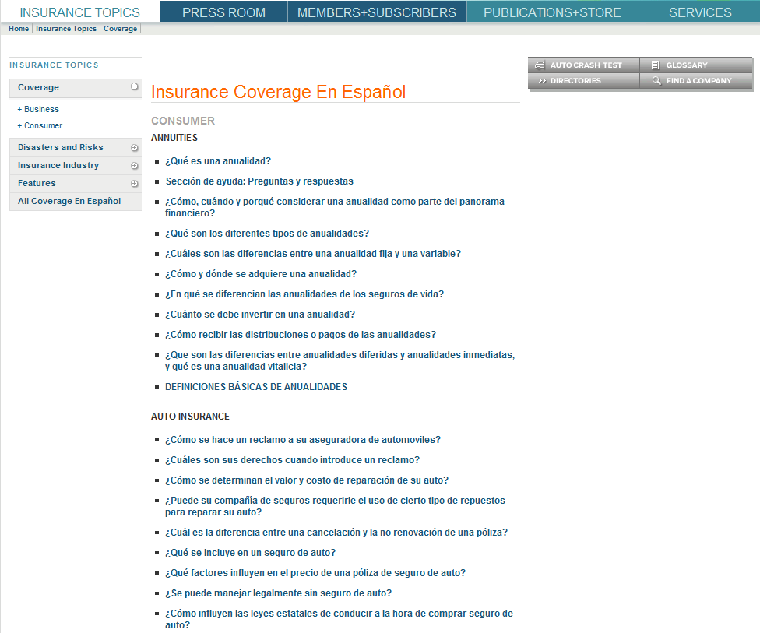

Much of the consumer information on the site is also available in Spanish
35

Slide 34
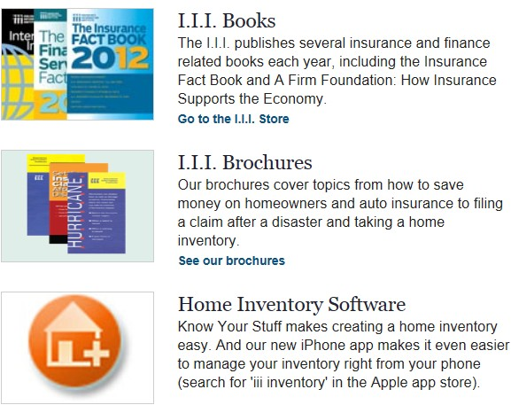
I.I.I. Resources
36

Slide 35





Social Media Stats
828 likes
7,285 followers
599,257 video views
128 users have us in their circle
229,146 visitors

Slide 36
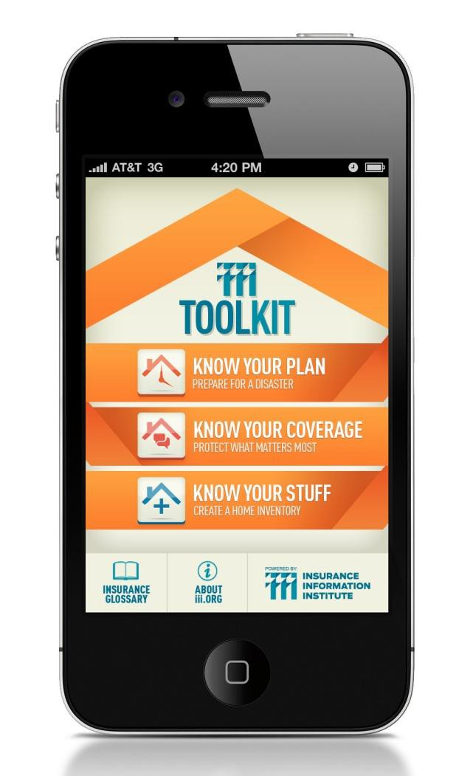
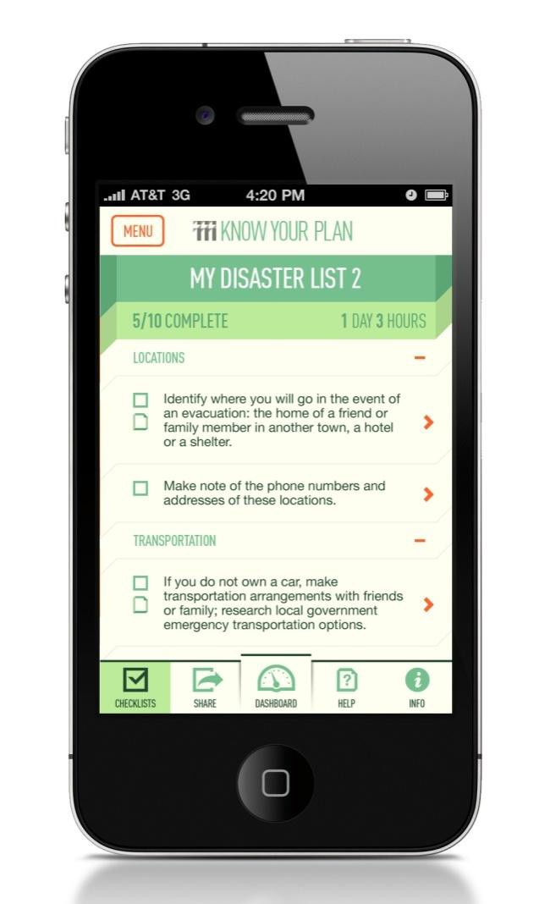
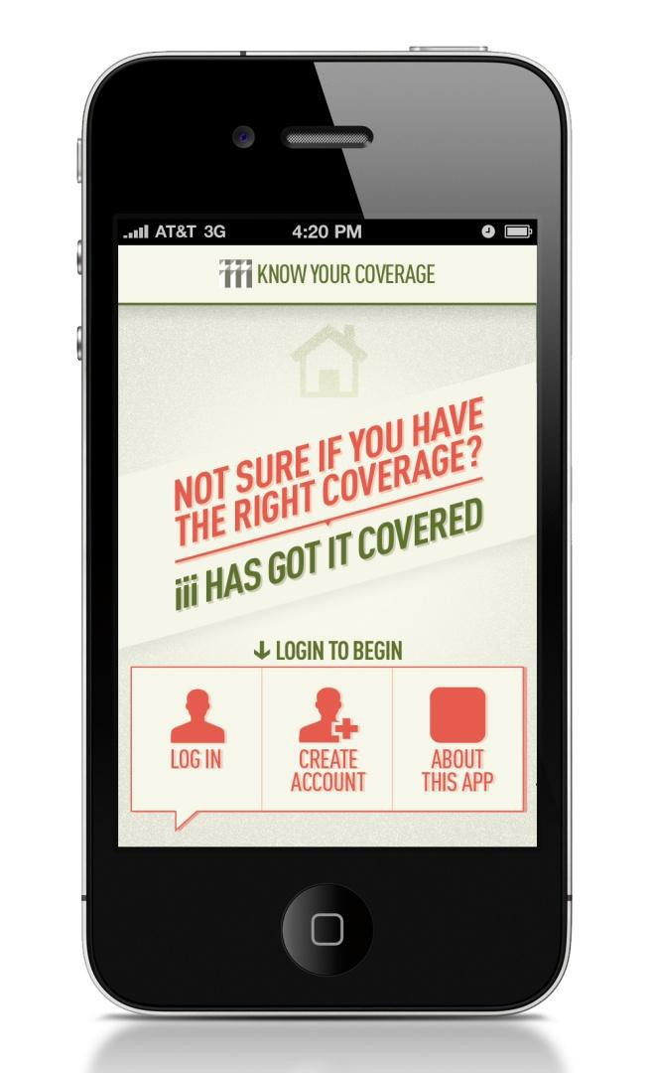
I.I.I. Mobile Apps
The I.I.I. is developing a branded suite of apps to provide guidance to consumers in making decisions about their insurance and preparing for a disaster.
38

Slide 37
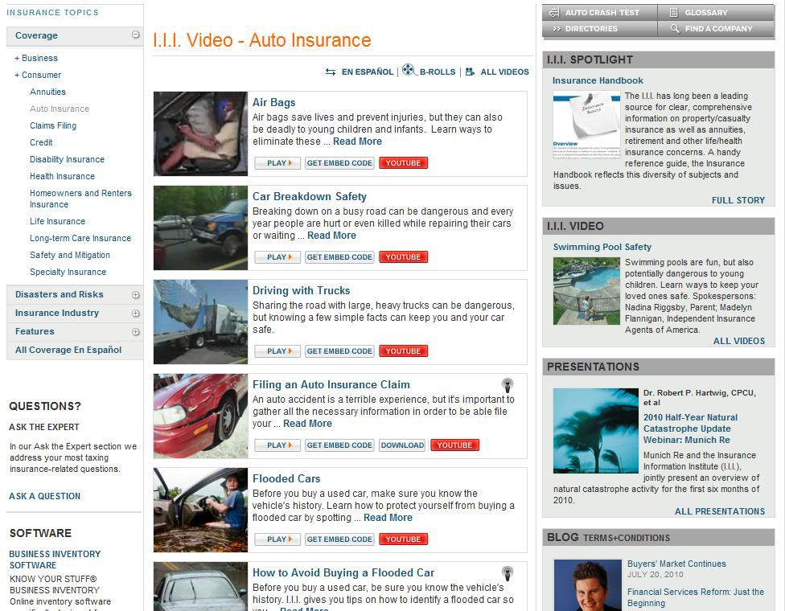

Videos can be embedded and/or downloaded directly from the site; broadcast quality files of VNRs are available for download also
39

Slide 38
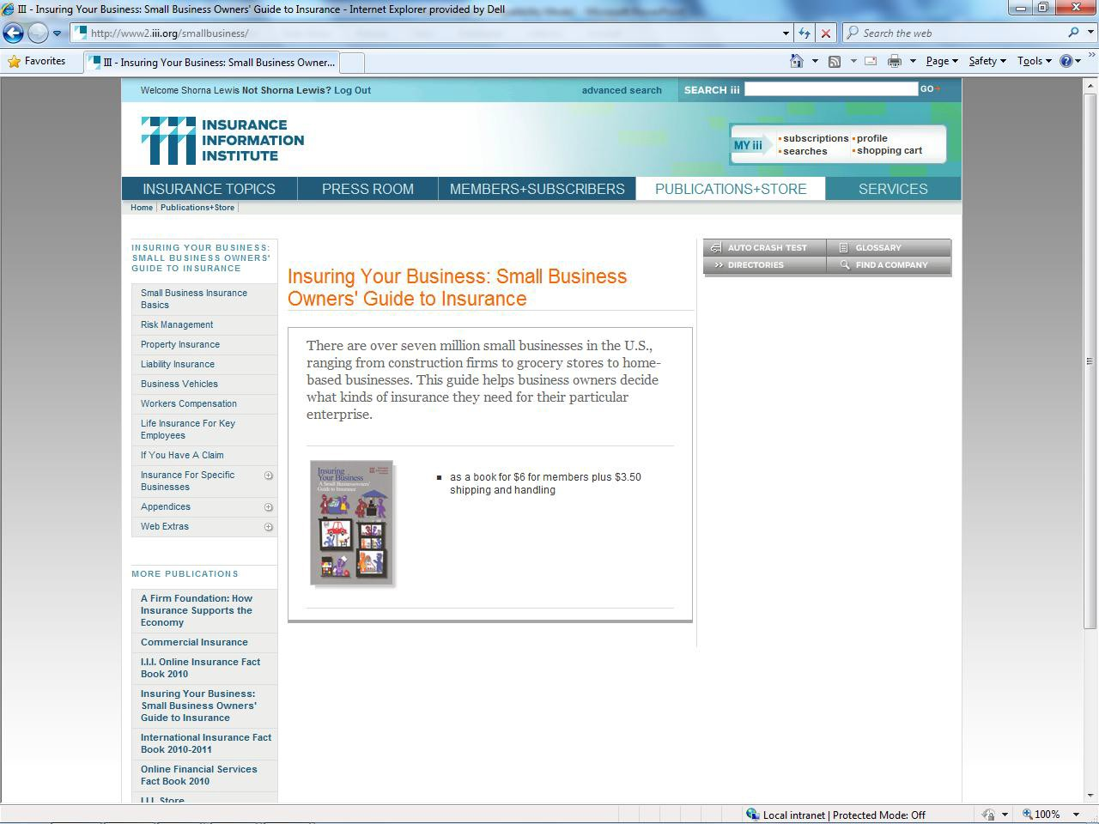

Insuring Your Business
Site for small and middle market commercial risks; has been highlighted by major media, including the WSJ
40

Slide 39


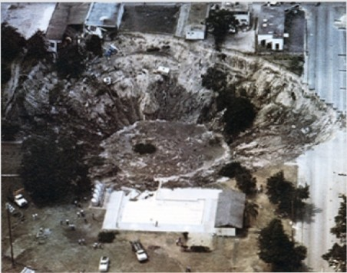


ttt INSURING FLORIDA
PRESS RELEASES
ENESPANOL
INSURANCE TOOLS
search our site
Improving public understanding of insurance in Florida­ what it does and how it works
s
Al L '
Blogging about insurance in Florida
INSURANCE 101
Who regulates insurance companies? Insurance is regulated by the states ,with each state having its own set of statutes and rules. State insurance departments oversee insurer solvency, review market conduct, rule on requests for rate increases,among other things. Click on the link to learn more.
FLORIDA OFFICE OF rnsuRAtKE REGULATIOti
0Share This Story
ru::1 t:
Sinkhole insurance and your options
AUGUST 16,2010 I
Experts can predict the weather, but they can't predict sinkholes.We have more sinkholes in
Florida than any other state,and some areas are more vulnerable to sinkholes , such as
We st Central Florida and Tampa Bay,and they open up when 11is very dry or very wet So, rainy season 1s humcane season 1s sinkhole season.
SOF1WA E
Business Inventory Software
KNOW YOUR STUFF® BUSINESS INVENTORY
BUSINESS
INVENTORY
Online inventory software specifically designed for businesses
MORE
More
Home Inventory Sottware
KNOW YOUR STUFF® HOME INVENTORY
Online software to help you create a room-by-room inventory
MORE
MORE FROM THE STRAIGHT TALK BLOG
Consumers benefit 1n fight against auto insurance fraud 1 AUGUST 13, 2010
HOME INVENTORY
Sinkholes Sinking Citizens Insurance 1JULY 30,201o
Got new stuff? Update your home inventory 1JULY 26,201o
I.I.I.VIDEO
Be A Responsible Dog Owner
Dogs may be man's best friend, but as
I SU
G 1:J_ORI nA \JL\U'-1LRU>..L
an owner you are l iable i f your pet bites

Slide 40
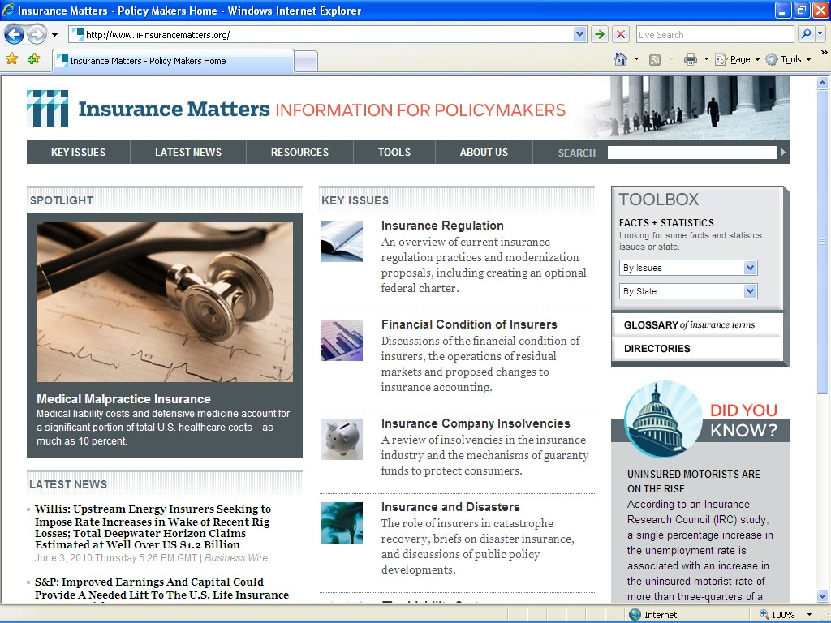


Policymakers website:
InsuranceMatters
User Highlights
Tailored
Focused
Current
Clear and Concise
Factual
Searchable
Exportable
Multimedia Content
Accessible
Content is arranged so that material most important to policymakers is just one or two clicks away
42

Slide 41
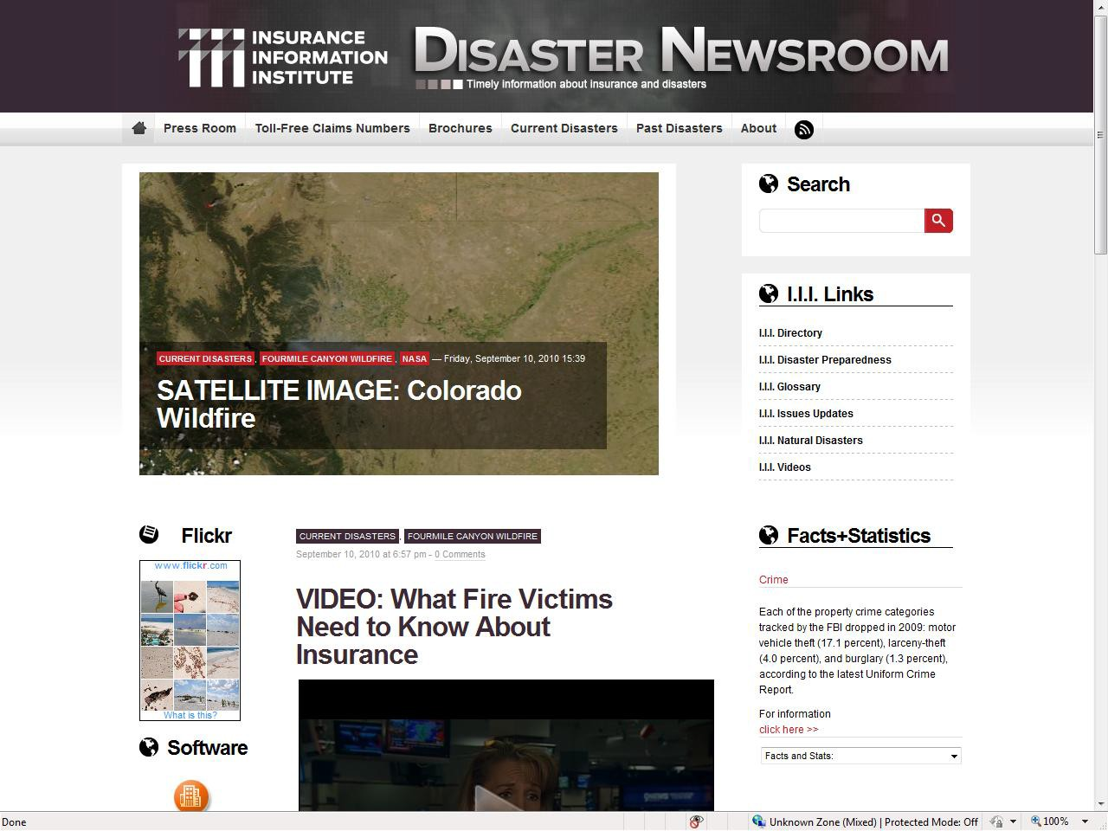
43

Slide 42

Insurance Information Institute Online:
www.iii.org
Thank you for your time
and your attention!

