Slide 1
Industry Outlook:
2013 and Beyond
NAMIC Personal Lines Seminar
Chicago, IL
April 10, 2013
Steven N. Weisbart, Ph.D., CLU, Senior Vice President & Chief Economist
Insurance Information Institute ♦ 110 William Street ♦ New York, NY 10038
Tel: 212.346.5540 ♦ Cell: 917.494.5945 ♦ stevenw@iii.org ♦ www.iii.org

Slide 2
Personal Lines:
Demographic and Macroeconomic Drivers
Brighter Days Ahead,
but Not Without Challenges
2

Slide 3
Real GDP Growth: Past Recessions and Recoveries, Yearly, 1970-2012
Real GDP Growth (%)
In most recoveries, real yearly GDP growth is often 4% or more
In the current recovery, real yearly GDP growth
has been 2.4% or less
But, following the 1991 and 2001 recessions, real yearly GDP growth was weaker than 4%
Source: (GDP) U.S. Department of Commerce at http://www.bea.gov/national/xls/gdpchg.xls.
3
12/01/09 - 9pm
eSlide – P6466 – The Financial Crisis and the Future of the P/C
Notes:
3

Slide 4
March 2013 Forecasts of Quarterly US Real GDP for 2013-14
Real GDP Growth Rate
If the sequester lasts, it will have greatest effect here
Despite the sequester and other challenges to the U.S. economy,
virtually every forecast in the Blue Chip universe in early March sees improvement ahead
Sources: Blue Chip Economic Indicators (3/13); Insurance Information Institute

Slide 5
Projected Population Growth Rates (2010-2020) Vary Widely by State and Region*
Southeast
Mid-Atlantic
New England
U.S. population growth overall, 2010-2020, is projected to be 8.7%
*based on 2000 census.
Source: http://www.census.gov/population/projections/data/state/projectionsagesex.html (Table 7)
5
12/01/09 - 9pm
eSlide – P6466 – The Financial Crisis and the Future of the P/C
Notes:
5
This chart and the succeding one show that unemployment rates vary widely, not only by region, but within regions.

Slide 6
Projected Population Growth Rates (2010-2020) Vary Widely by State and Region* (cont’d)
Southwest
Mountain
Far West
Great Lakes
Great Plains
U.S. population growth overall, 2010-2020, is projected to be 8.7%
*based on 2000 census.
Source: http://www.census.gov/population/projections/data/state/projectionsagesex.html (Table 7)
6
12/01/09 - 9pm
eSlide – P6466 – The Financial Crisis and the Future of the P/C
Notes:
6
In May for the first time in 2 years, Nevada overtook Michigan as the state with the highest unemployment rate

Slide 7
Demographic Tsunami: Average Number of People per Household, by Age of Householder, 2012
Average Household Size
The number of households in these age brackets will soar in the next 20 years
Age of Householder
As the “baby boom” ages and households get smaller, this will spur growth of smaller homes that are more suited to their requirements.
Source: US Census Bureau at http://www.census.gov/hhes/families/data/cps2012.html Table AVG1.

Slide 8
State Population Growth Rate Projections, 2010-2020*
Projected Population Growth
Highest Growth Rate States
U.S. overall: +8.7%
Lowest Growth Rate States
The Mountain West region is projected to grow the most from now to 2020 (up 17.6%), followed by the South Atlantic (up 14.5%) and Pacific (up 11.2%).
The Mid-Atlantic is projected to be the slowest-growing region (up 1.9%).
*based on 2000 census. Source: http://www.census.gov/population/projections/data/state/projectionsagesex.html (Table 7)
8
12/01/09 - 9pm
eSlide – P6466 – The Financial Crisis and the Future of the P/C
Notes:
8

Slide 9
As a Group, Households Are Still*
Reducing Debt & Related Obligations
Debt Service as a Percent of Personal Disposable Income
Peak at 11.3% in 2007:Q3
Latest (2012:Q4) at 8.67%
Lowest (1980:Q1)
at 8.17%
1998:Q4: 8.67%
Latest (2012:Q4) at 4.9%
Peak at 6.53% in 2005:Q1
*Includes payments on mortgage debt, homeowners’ insurance, and property taxes. **Includes payments on consumer debt and automobile leases.
*through 2012:Q4 (latest data, posted on March 13, 2013). Source: Federal Reserve Board, at http://www.federalreserve.gov/releases/housedebt

Slide 10
Interest Rate on 30-Year, Fixed-Rate
Conventional Home Mortgages, Monthly, 2000-2013
Source: Federal Reserve Board, at http://www.federalreserve.gov/releases/h15/data.htm

Slide 11
Monthly Change in Private Employment, 2010 - 2013
Average Monthly Gain Since Jan 2011: 195,200 jobs
Thousands
The private sector created 700,000 jobs in 2012:Q4
Private employers added 1.2 million jobs in just the last six months.
Seasonally adjusted. Feb 2013 and Mar 2013 are preliminary data
Sources: US Bureau of Labor Statistics; Insurance Information Institute

Slide 12
Private Housing Unit Starts, 1990-2014F
Millions of Units
Forecast range for 2013 is 0.88 to 1.15 million units
Housing
“Bubble”
Housing unit starts plunged 72% from 2005-2009 to lowest level since records began in 1959
Homeowners insurers are starting to see meaningful exposure growth for the first time since 2005. Commercial insurers with construction risk exposure, surety also benefit.
Sources: U.S. Department of Commerce; Blue Chip Economic Indicators (3/13); Insurance Information Institute.

Slide 13
Housing Unit Starts: Building Momentum,
Monthly, Jan 2011-Feb 2013*
Thousands
of Units
The number of units in multi-unit starts more than doubled
from Dec 2011 to Dec 2012. Single family start rose nicely, too.
*at annualized rate, seasonally adjusted; Feb 2013 numbers are preliminary.
Source: US Census Bureau at www.census.gov/construction/nrc/pdf/newresconst.pdf.

Slide 14
Auto/Light Truck Sales, 1999-2014F
Forecast range for 2013 is 14.4 to 15.8 million units
(Millions of Units)
Lowest level since the late 1960s
Job growth and improved credit market conditions will boost auto sales in 2013 and beyond, bolstering the manufacturing sector and the economy generally.
Sources: U.S. Department of Commerce; Blue Chip Economic Indicators (3/13); Insurance Information Institute.

Slide 15
Unemployment and Underemployment Rates: Stubbornly High in 2012, But Falling
January 2000 through Mar. 2013, Seasonally Adjusted (%)
U-6 went from 8.0% in March 2007 to 17.5% in
October 2009; Stood at 13.8% in Mar. 2013
Unemployment “Headline” unemployment stood at 7.6% in Mar. 2013.
The Federal Reserve’s target for ending “easy money” is 6.5% (assuming inflation remains within its 2% target).
Nov. 12
Stubbornly high unemployment and underemployment constrain overall economic growth, but the job market is now clearly improving.
Source: US Bureau of Labor Statistics; Insurance Information Institute.
15
12/01/09 - 9pm
eSlide – P6466 – The Financial Crisis and the Future of the P/C
Notes:
15

Slide 16
Unemployment Rates Vary Widely by State and Region*
Southeast
Mid-Atlantic
New England
*Provisional figures for February 2013, seasonally adjusted.
Sources: US Bureau of Labor Statistics; Insurance Information Institute.
16
12/01/09 - 9pm
eSlide – P6466 – The Financial Crisis and the Future of the P/C
Notes:
16
This chart and the succeding one show that unemployment rates vary widely, not only by region, but within regions.

Slide 17
Unemployment Rates Vary Widely by State and Region* (cont’d)
Far West
Southwest
Mountain
Great Lakes
Great Plains
*Provisional figures for February 2013, seasonally adjusted.
Sources: US Bureau of Labor Statistics; Insurance Information Institute
17
12/01/09 - 9pm
eSlide – P6466 – The Financial Crisis and the Future of the P/C
Notes:
17
In May for the first time in 2 years, Nevada overtook Michigan as the state with the highest unemployment rate

Slide 18
Annual Inflation Rates, (CPI-U, %),
1990–2017F
Annual Inflation Rates (%)
The recession and the collapse of the commodity bubble slowed inflation in 2009/10
Higher energy, commodity and food prices pushed up inflation in 2011, but not longer term inflationary expectations.
The slack in the U.S. economy suggests that inflationary pressures should remain subdued for an extended period. Energy, health care and commodity prices, plus U.S. debt burden, remain longer-run concerns
Sources: US Bureau of Labor Statistics; Blue Chip Economic Indicators, 3/13 (forecasts).

Slide 19
Personal Lines Segment Performance
19
Notes:
19

Slide 20
Distribution of Net Premiums Written, by Segment/Line, 2011
Personal/Commercial lines split has been about 50/50 for many years; Personal Lines overtook Commercial Lines in 2010
Pvt. Passenger Auto is by far the largest line of insurance and is currently the most important source of industry profits
Billions of additional dollars in homeowners insurance premiums are written by state-run residual market plans
Distribution Facts
2011
Commercial Lines
$226.8B/49%
Homeowners
$68.2B/15%
Pvt. Pass Auto
$165.0B/36%
Sources: A.M. Best; Insurance Information Institute research.

Slide 21
Growth Rates of PP Auto & HO
Net Written Premium, 2000–2013F
Homeowners insurance has grown faster than PP Auto over the past dozen years,
but auto is generally more profitable
Sources: A.M. Best (2000-2012F); Insurance Information Institute (2013F).

Slide 22
Homeowners & PP Auto
Combined Ratios: 1993–2012F
The Homeowners Combined Ratio (1993-2012 range: 89 to 122) is more volatile than the PP Auto Combined Ratio (1993-2012 range: 94 to 109) .
Sources: A.M. Best (1990-2012E); Insurance Information Institute.

Slide 23
Return on Net Worth: Homeowners vs. Private Passenger Auto, 1990-2010*
(Percent)
Hurricane Andrew
Katrina, Rita, Wilma
Average RNW: 1990-2010*
All P-C Lines: 7.9% PP Auto: 8.9% Homeowners: 0.7%**
Pvt. Pass. Auto has consistently outperformed the P-C industry overall. Homeowners RNW volatility is due mainly to coastal exposure issues.
*Latest available. **Excluding Hurricane Andrew produces a homeowners RNW of +3.5%.
Sources: NAIC; I.I.I.
23
Notes:
23

Slide 24
Private Passenger Auto Insurance
24
Notes:
24

Slide 25
PP Auto NWP vs. # of Vehicles in Operation, 2001–2011
NWP
$ Billions
Vehicles in Operation (millions)
PP Auto net written premiums are starting to recover from a period of no growth attributable to the weak economy affecting new vehicle sales, car choice, and increased price sensitivity among consumers
Sources: A.M. Best; NADA, State of the Industry Report 2012, p. 16, at www.nada.org/nadadata citing R. L. Polk;
Insurance Information Institute.

Slide 26
Prices for Hospital Services,
12-Month Change,* 1998–2013
Moderating, but still more than double the CPI
Hospital services are a main driver of PP Auto BI claims
Are price changes for Hospital Services cyclical?
If so, is the peak-to-peak interval 5-6 years?
*Percentage change from same month in prior year; through February 2013; seasonally adjusted
Sources: US Bureau of Labor Statistics; National Bureau of Economic Research (recession dates); Insurance Information Institute.
26
12/01/09 - 9pm
eSlide – P6466 – The Financial Crisis and the Future of the P/C
Notes:
26

Slide 27
Forces that Drive Car Repair Costs:
12-Month Change,* 2001–2013
At their worst, these prices rose at an annual rate of 5-6%
During the recession, more people kept old cars, pushing repair prices up
Lately rising at about 2% or less
12-month price changes for auto repair and body work have rarely exceeded 4%. Fixing people hurt in auto accidents costs much more.
*Percentage change from same month in prior year; through February 2013; seasonally adjusted
Sources: US Bureau of Labor Statistics; National Bureau of Economic Research (recession dates); Insurance Information Institute.
27
12/01/09 - 9pm
eSlide – P6466 – The Financial Crisis and the Future of the P/C
Notes:
27

Slide 28
Medical Cost Inflation Has Outpaced Overall Inflation For Over 50 Years
A claim that cost $1,000 in 1961 would cost nearly $17,500 based on medical cost inflation trends over the past 51 years.
Source: Department of Labor (Bureau of Labor Statistics)

Slide 29
Monthly Change* in Auto Insurance Prices, 1991–2013
Sharp price growth tends to occur during recessions
Price growth might be due to low investment yields
Sharp price growth tends to occur during recessions
Latest
(Feb 2013) at 5.2%
PPA Auto, like most p/c lines, exhibits strong cyclicality in pricing.
Cyclical peaks in PP Auto tend to occur approximately every 10 years
(early 1990s, early 2000s, and possibly the early 2010s)
*Percentage change from same month in prior year; through February 2013; seasonally adjusted
Note: Recessions indicated by gray shaded columns.
Sources: US Bureau of Labor Statistics; National Bureau of Economic Research (recession dates); Insurance Information Institute.
29
12/01/09 - 9pm
eSlide – P6466 – The Financial Crisis and the Future of the P/C
Notes:
29

Slide 30
Direct Premiums Written: Auto
Percent Change by State, 2006-2011
Top 25 States
Texas was the fastest growing state between 2006 and 2011
Sources: SNL Financial LLC; Insurance Information Institute.

Slide 31
Direct Premiums Written: Auto
Percent Change by State, 2006-2011
Bottom 25 States
Maine saw the biggest drop in premiums written between 2006 and 2011
Sources: SNL Financial LLC; Insurance Information Institute.

Slide 32
Return on Net Worth: Pvt. Passenger Auto,
10-Year Average (2001-2010*): Top 25 States
(Percent)
For a decade, PP Auto Return on Net Worth in these 4 states averaged more than 14%
In the 25 states with the highest RNW for the decade,
every one hit 9% or better
*Latest available. Source: NAIC.

Slide 33
Return on Net Worth: Pvt. Passenger Auto,
10-Year Average (2001-2010*): Bottom 25 States
(Percent)
The U.S. weighted annual average RNW for PP Auto Insurance in
2001-2010 was 7.6%
For a decade, PP Auto Return on Net Worth in these states averaged less than 5.5%
*Latest available.
Sources: NAIC

Slide 34
Claim Trends in Auto Insurance
Rising Costs Held in Check by Falling Frequency;
Can That Pattern Be Sustained?
34

Slide 35
CDC Report: Cell Phone Use While Driving, US and Europe, Fall 2011
Percent saying
“regularly” or
“fairly often”
“In the past 30 days, how often have you talked on the phone while you were driving?”
“In the past 30 days, how often have you sent a text message or e-mail while you were driving?”
Sources: “Mobile Device Use While Driving—United States and Seven European Countries, 2011,” in Morbidity and Mortality Weekly Report, Centers for Disease Control and Prevention, Vol. 62, No. 10, (March 15, 2013) available at http://www.cdc.gov/mmwr/preview/mmwrhtml/mm6210a1.ht5m?s_cid=6210a1_e ;Insurance Information Institute
35
12/01/09 - 9pm
eSlide – P6466 – The Financial Crisis and the Future of the P/C
Notes:
35

Slide 36
Bodily Injury Claims: Frequency and Severity Trends Still Up
Annual % Change, 2005 through 2012*
Cost Pressures Will Increase if BI Severity Increases Continue or Frequency Ticks Up
*2012 figure is for the 4 quarters ending with 2012:Q3.
Source: ISO/PCI Fast Track data; Insurance Information Institute

Slide 37
Property Damage Liability:
Severity is Up, Frequency Trend Mixed
Annual Change, 2005 through 2012*
Severity/Frequency Trends Have Been Volatile, But Rising Frequency & Severity in 2012 Is a Concern
*2012 figure is for the 4 quarters ending with 2012:Q3.
Source: ISO/PCI Fast Track data; Insurance Information Institute

Slide 38
No-Fault (PIP) Liability: Severity Trend Remains Adverse*
Annual Change, 2005 through 2012**
Multiple States Are Experiencing Severe Fraud and Abuse Problems in their No-Fault Systems, Especially FL, MI, NY and NJ
*No-fault states included are: FL, HI, KS, KY, MA, MI, MN, NY, ND and UT.
**2012 figure is for the 4 quarters ending in 2012:Q1.
Source: ISO/PCI Fast Track data; Insurance Information Institute

Slide 39
Collision Coverage Claims Trends:
Severity Rising Again, Frequency Low
Annual Change, 2005 through 2012*
The recession, high fuel prices have helped temper
frequency and severity, but this trend will likely reverse
based on evidence from past recoveries
*2012 figure is for the 4 quarters ending with 2012:Q3.
Source: ISO/PCI Fast Track data; Insurance Information Institute

Slide 40
Comprehensive Coverage: Frequency and Severity Trends Are Unfavorable
Main cause of the 2011 spike in both frequency and severity? Severe weather
2012 percentages
are down only in comparison with 2011
Annual Change,
2005 through 2012*
Weather Creates Volatility for Comprehensive Coverage; Recession Has Helped Push Down Frequency and Temper Severity, But This Factor Will Weaken as Economy Recovers
*2012 figure is for the 4 quarters ending with 2012:Q1.
Source: ISO/PCI Fast Track data; Insurance Information Institute

Slide 41
Usage-Based Insurance (UBI): Telematics
UBI Is Catching On Among Insurers and Consumers
41

Slide 42
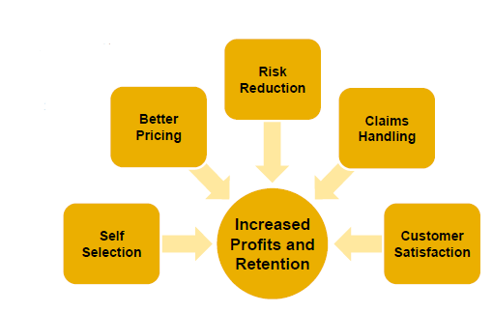
Why Is UBI Game-Changing?
Differentiates product offering by offering additional services
Significantly increases pricing accuracy
Appeals to consumers as it makes sense, is controllable and minimizes reliance on controversial proxies
Attracts lower-risk insureds via self-selection
Allows customers to understand
and eliminate risky behaviors,
reduce accident frequency
May improve claims handling
Can improve retention and profits
Source: Towers Watson presentation at Casualty Actuarial Society PRM Conference, March 20, 2012: Usage-Based Insurance: Are You Ready?” by Robin Harbage, FCAS, MAAA.

Slide 43
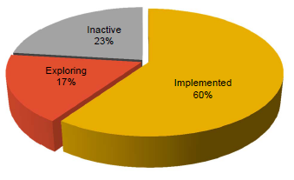
Top 50 U.S. Private Passenger Auto Companies
At least 7 top-10 personal auto insurers have implemented programs in at least one state
U.S. companies representing over 75% of the market already have programs or are actively pursuing them
“UBI device sales rocketing from $50 million in 2011 to approximately $2.6 billion by 2015.” — FC Business Intelligence
Source: Towers Watson presentation at Casualty Actuarial Society PRM Conference, March 20, 2012: Usage-Based Insurance: Are You Ready?” by Robin Harbage, FCAS, MAAA.

Slide 44
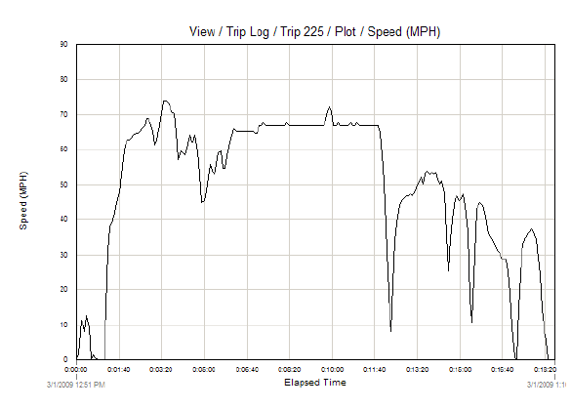
Appeals To The “Right” Consumers
Improves driving behavior
Controllable and enables potentially large premium savings
Makes sense and reduces reliance on proxies
  Insurance credit scores
  Driver assignment
  Charges for relatively rare
  accidents, convictions
Ancillary services
Source: Towers Watson presentation at Casualty Actuarial Society PRM Conference, March 20, 2012: Usage-Based Insurance: Are You Ready?” by Robin Harbage, FCAS, MAAA.

Slide 45
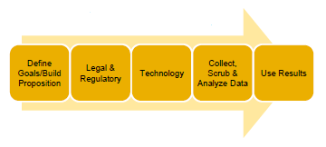
UBI Implementation Challenges
UBI projects are extremely complex and require cross-functional teams
Product must appeal to your market while still being profitable
Managing the legal and regulatory hurdles
Determining which of the multitude of devices available will best meet the needs of the program
Extensive IT infrastructure required to collect driving data, to integrate UBI scores with the current system and to give driving feedback
No publicly available data to jump-start a program
Danger of wasting time and money collecting the wrong data
Driving data is much different than traditional experience data and requires special data scrubbing and analysis techniques
Source: Towers Watson.

Slide 46
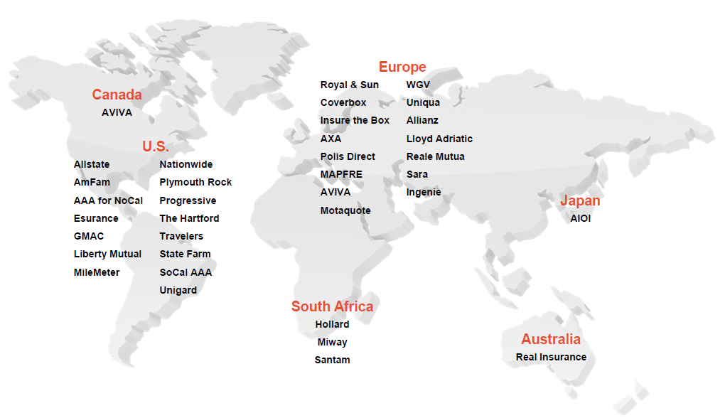
UBI In Personal Auto Around The Globe
Source: Towers Watson presentation at Casualty Actuarial Society PRM Conference, March 20, 2012: Usage-Based Insurance: Are You Ready?” by Robin Harbage, FCAS, MAAA.

Slide 47
Homeowners Insurance
47
Notes:
47

Slide 48
Homeowners Insurance
Net Written Premium, 2000–2011
$ Billions
Homeowners insurance NWP continues rising (up 95% 2000-2011) despite very little unit growth in recent years. Reasons include rate increases, especially in coastal zones, ITV endorsements (e.g., “inflation guards”), and inelastic demand
Sources: A.M. Best; Insurance Information Institute.

Slide 49
Monthly Change* in HO-4
Insurance Prices, 1998–2013
Latest
(Feb 2013) at 4.9%
“Hard” market of 2002-03
A price change peak, Nov 2010, at a 4.3% rate
Since 1998, the 12-month change in HO-4 prices has rarely been
above 3% (and from Oct 2005 through Sept 2006 was negative!)
*Percentage change from same month in prior year; through February 2013; not seasonally adjusted; first data point is Dec 1998;
Recessions indicated by gray shaded columns.
Sources: US Bureau of Labor Statistics; National Bureau of Economic Research (recession dates); Insurance Information Institute.
49
12/01/09 - 9pm
eSlide – P6466 – The Financial Crisis and the Future of the P/C
Notes:
49

Slide 50
Average Premiums For Home Insurance
By State, 2009* (1)
Top 25 States
*Latest available.
(1) Based on the HO-3 homeowner package policy for owner-occupied dwellings, 1 to 4 family units. Provides “all risks” coverage (except those specifically excluded in the policy) on buildings and broad named-peril coverage on personal property, and is the most common package written.
Note: Average premium=Premiums/exposure per house years. A house year is equal to 365 days insured coverage for a single dwelling.
Source: NAIC; Insurance Information Institute.

Slide 51
Average Premiums For Home Insurance
By State, 2009* (1)
Bottom 25 States
(1) Based on the HO-3 homeowner package policy for owner-occupied dwellings, 1 to 4 family units. Provides “all risks” coverage (except those specifically excluded in the policy) on buildings and broad named-peril coverage on personal property, and is the most common package written.
Note: Average premium=Premiums/exposure per house years. A house year is equal to 365 days insured coverage for a single dwelling.
Source: © 2010 National Association of Insurance Commissioners (NAIC). Reprinted with permission. Further reprint or distribution strictly prohibited without written permission of NAIC.

Slide 52
Avg. Premium for Homeowners Insurance
as Pct. of Median Family Income, 2009
Top 25 States
(Percent)
*Average homeowners insurance expenditure as a percentage of the 2009 median income for a family of four
Sources: Prepared by the Insurance Information Institute, based on data from the U.S. Census and the National Association of Insurance Commissioners.

Slide 53
Avg. Premium for Homeowners Insurance
as Pct. of Median Family Income, 2009
(Percent)
Bottom 25 States
*Average homeowners insurance expenditure as a percentage of the 2009 median income for a family of four
Sources: Prepared by the Insurance Information Institute, based on data from the U.S. Census and the National Association of Insurance Commissioners.

Slide 54
Average Premium for
Home Insurance Policies**
Home insurance premiums are rising in response to higher catastrophe losses
* Insurance Information Institute Estimates/Forecasts **Excludes state-run insurers.
Source: NAIC, Insurance Information Institute estimates 2010-2012 based on CPI and other data.

Slide 55
U.S. Residual Market: Total Policies In-Force at Year-End (1999-2011)
(Thousands of Policies in Force
Gustav, Ike
Irene
4 Florida Hurricanes
Katrina, Rita and Wilma
In the 10-year period 2001 to 2011, the total number of policies
in-force in the residual market (FAIR & Beach/Windstorm Plans) roughly tripled.
Source: PIPSO; Insurance Information Institute

Slide 56
U.S. Residual Market Exposure to Loss
Katrina, Rita and Wilma
($ Billions)
4 Florida Hurricanes
In the 12-year period 2000 through 2011, total exposure to loss in the residual market (FAIR & Beach/Windstorm Plans) quadrupled (from $221.3 billion in 2000 to a record high of $884.7 billion in 2011).
Source: PIPSO; Insurance Information Institute (I.I.I.).
56
Notes:
56

Slide 57
Return on Net Worth: Homeowners Insurance,
10-Year Average (2001-2010*)
Top 25 States
(Percent)
Hawaii was the most profitable state for home insurers from 2001-2010 due to the absence of hurricanes during this period
*Latest available. Sources: NAIC.

Slide 58
Return on Net Worth: HO Insurance,
10-Year Average (2001-2010*)
Bottom 25 States
Hurricanes Katrina & Rita made Louisiana and Mississippi the least profitable states for home insurers from 2001-2010
(Percent)
Except for 2004 and Wilma in 2005, Florida dodged major hurricanes in the 2001-2010 decade. So HO RNW in Florida for the decade averaged -0.3%.
Note: these are annual averages for a decade!
*Latest available. Source: NAIC

Slide 59
Catastrophes
59
Notes:
59

Slide 60
Joplin Home Damage Claims Consumed a Large Share of MO’s Homeowners Premiums
($ Millions)
Catastrophe losses paid to homeowners arising from the May 22 Joplin tornado consumed 44% of all homeowners premiums written throughout the state in 2011
Insurers ROE in the MO Homeowners Line in 2011 Will be Negative by Several Hundred Percent
Sources: SNL Securities (Homeowners DPW for MO); Catastrophe loss data is from PCS as of May 10, 2012; Insurance Information Inst.

Slide 61
Joplin Tornado Claims Consumed a Large Share of MO’s P/C Insurance Premiums
($ Millions)
Catastrophe losses paid to Missouri policyholders arising from the May 22 Joplin tornado consumed 24% of premiums written for all p/c lines throughout the state in 2011
Insurers ROE in the MO Property/Casualty Insurance Market in 2011 Will be Very Low, If Not Negative
Sources: SNL Securities (Homeowners DPW for MO); Catastrophe loss data is from PCS as of May 10, 2012; Insurance Information Inst.

Slide 62
The Dozen Most Costly Hurricanes in U.S. History
Insured Losses, 2012 Dollars,
$ Billions
Sandy will likely become the 3rd costliest hurricane in US insurance history
Irene became the 12th most expensive hurricane in US history
10 of the 12 most costly hurricanes in insurance history occurred in the past 9 years (2004—2012)
*Estimate as of 12/09/12 based on estimates of catastrophe modeling firms and reported losses as of 1/12/13. Estimates range up to $25B.
Sources: PCS; Insurance Information Institute inflation adjustments to 2012 dollars using the CPI.

Slide 63
If They Hit Today, the Dozen Costliest (to Insurers) Hurricanes in U.S. History
Insured Losses,
2012 Dollars, $ Billions
Storms that hit long ago had less property and businesses to damage, so simply adjusting their actual claims for inflation doesn’t capture their destructive power.
Karen Clark’s analysis aims to overcome that.
When you adjust for the damage prior storms could have done if they occurred today, Hurricane Katrina slips to a tie for 6th among the most devastating storms.
*Estimate as of 12/09/12 based on estimates of catastrophe modeling firms and reported losses as of 1/12/13. Estimates range up to $25B.
Sources: Karen Clark & Company, Historical Hurricanes that Would Cause $10 Billion or More of Insured LossesToday, August 2012; I.I.I.

Slide 64
Superstorm Sandy:
Number of Claims by Type*
Hurricane Sandy resulted in an estimated 1.4 million privately insured claims resulting in an estimated $15 to $25 billion in insured losses. Hurricane Katrina produced 1.74 million claims and $47.6B in losses
(in 2011 $)
Sandy is a high frequency, (relatively low) severity event (avg. severity <50% Katrina)
*PCS claim count estimate as of 11/26/12. Loss estimate represents high and low end estimates by risk modelers RMS, Eqecat and AIR. PCS estimate of insured losses as of 11/26/12 $11 billion. All figures exclude losses paid by the NFIP.
Source: PCS; AIR, Eqecat, AIR Worldwide; Insurance Information Institute.

Slide 65
US Insured Catastrophe Losses
($ Billions, 2012 Dollars)
2012 CAT losses were down nearly 50% from 2011 until Sandy struck in late October
US CAT Losses in 2012 Will Likely Become the 2nd or 3rd Highest in US History on An Inflation-Adjusted Basis (Pvt Insured). 2011 Losses Were the 5th Highest
Record Tornado Losses Caused 2011 CAT Losses to Surge
*As of 1/2/13. Includes $20B gross loss estimate for Hurricane Sandy.
Note: 2001 figure includes $20.3B for 9/11 losses reported through 12/31/01 ($25.9B 2011 dollars). Includes only business and personal property claims, business interruption and auto claims. Non-prop/BI losses = $12.2B ($15.6B in 2011 dollars.)
Sources: Property Claims Service/ISO; Insurance Information Institute.
65
12/01/09 - 9pm
eSlide – P6466 – The Financial Crisis and the Future of the P/C
Notes:
65

Slide 66
Natural Disasters in the United States, 1980 – 2012
Number of Events (Annual Totals 1980 – 2012)
There were 184 natural disaster events in the US in 2012
There were over 150 natural disaster events in the US every year since 2006. That hadn’t happened in any year before.
Number
41
19
121
3
Geophysical
(earthquake, tsunami,
volcanic activity)
Meteorological (storm)
Climatological
(temperature extremes,
drought, wildfire)
Hydrological
(flood, mass movement)
Source: MR NatCatSERVICE
66

Slide 67
Share of Flood Damaged Structures with Flood Insurance: Long Island
Only 37.5% of flood damaged buildings in Nassau County were insured for flood, 62.5% uninsured
Number of buildings
74,736
$15.0
27.6% of flood damaged buildings in Suffolk County were insured for flood, 73.4% uninsured
43,106
20,798
52,428
5,747
$2.2
15,051
The Maximum FEMA Grant is $31,900. The Average Grant Award to Homeowners and Renters on Long Island is About $7,300
Source: Newsday, 1/14/13 from FEMA and Small Business Administration.
67
12/01/09 - 9pm
eSlide – P6466 – The Financial Crisis and the Future of the P/C
Notes:
67

Slide 68
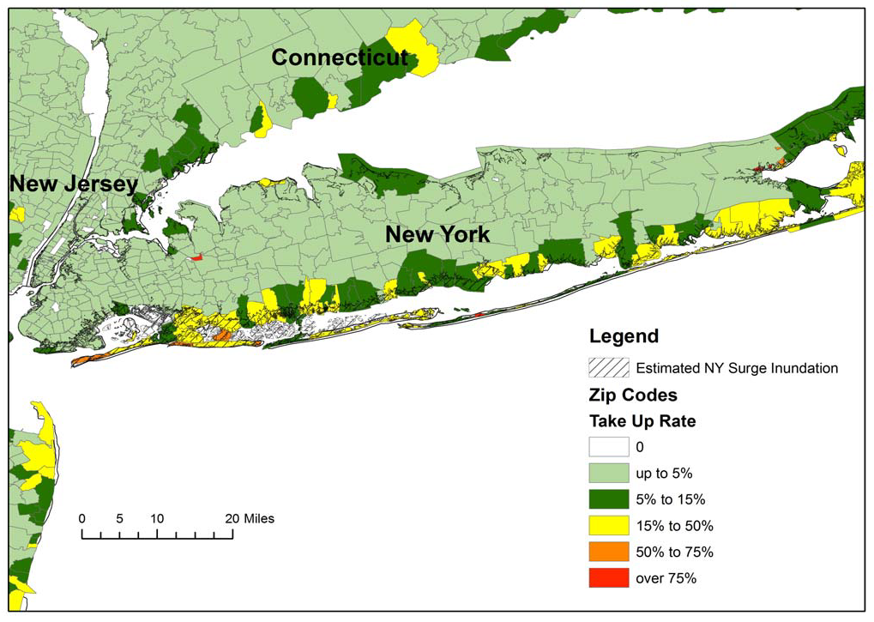
Residential NFIP Flood Take-Up Rates in NY, CT (2010) & Sandy Storm Surge
Flood coverage penetration rates were extremely low in many very vulnerable areas of NY and CT, with take-up rates far below 50% in many areas
Source: Wharton Center for Risk Management and Decision Processes, Issue Brief, Nov. 2012; Insurance Information Institute.
68

Slide 69
P/C Industry Homeowners Claim Frequency, US, 1997-2011
Claims Paid per 100 Exposures
Sources: Insurance Research Council, “Trends in Homeowners Insurance Claims,” p.29; Insurance Information Institute

Slide 70
P/C Industry Homeowners Average Claim Severity, 1997-2011
HO average claim severity is now three times what it was in 1997.
Sources: Insurance Research Council, “Trends in Homeowners Insurance Claims,” p. 29, BLS inflation calculator,
and Insurance Information Institute

Slide 71
Investments:
The New Reality
Investment Performance is a Key Driver of Profitability
71

Slide 72
U.S. 10-Year Treasury Note Yields:
A Long Downward Trend, 1990–2013
Yields on 10-Year U.S. Treasury Notes recently plunged to all time record lows
Yields on 10-Year U.S. Treasury Notes have been essentially below 5% for a full decade.
Since roughly 80% of P/C bond/cash investments are in 10-year or shorter durations, most P/C insurer portfolios will have low-yielding bonds for years to come.
Note: Recessions indicated by gray shaded columns.
Sources: Federal Reserve Bank at http://www.federalreserve.gov/releases/h15/data.htm.
National Bureau of Economic Research (recession dates); Insurance Information Institutes.
72
12/01/09 - 9pm
eSlide – P6466 – The Financial Crisis and the Future of the P/C
Notes:
72

Slide 73
Insurers Have Not Yet Fully Adapted to a Persistently Low Interest Rate Environment
They Didn’t Expect Rates to be
  Pushed to Such Low Levels
  Pushed Down so Rapidly
  Held to Such Low Levels for So Long
  Suppressed via Unprecedented Aggressiveness of the Federal Reserve
Ability to Release Prior Reserves Eased Urgency
OFFSETTING FACTORS
Capitalization Still Solid
Emergence of Sophisticated Price Monitoring and Underwriting Tools

Slide 74
Distribution of Bond Maturities,
P/C Insurance Industry, 2003-2011
The main shift over these years has been from bonds with longer maturities to bonds with shorter maturities. The industry first trimmed its holdings of over-10-year bonds (from 24.6% in 2003 to 16.9% in 2011) and then trimmed bonds in the 5-10-year category. Falling average maturity of the P/C industry’s bond portfolio is contributing to a drop in investment income along with lower yields.
Sources: A.M. Best; Insurance Information Institute.

Slide 75
Property/Casualty Insurance Industry Investment Gain: 1994–2012F¹
($ Billions)
Investment gains in 2012 are running approximately 20% below their pre-crisis peak
In 2012 (1st three quarters) both investment income and realized capital gains were lower than in the comparable period in 2011. And because
the Federal Reserve Board aims to keep interest rates exceptionally low through mid-2015, maturing bonds will be re-invested at even lower rates.
¹Investment gains consist primarily of interest, stock dividends and realized capital gains and losses.
*2005 figure includes special one-time dividend of $3.2B; 2012F figure is I.I.I. estimate based on annualized actual 2012:Q3 result of $38.089B. Sources: ISO; Insurance Information Institute.

Slide 76

An Insightful Book
Published About 4 Years Ago
Mark Penn’s book
cites
75 MicroTrends

Slide 77
Sex-Ratio Singles (Single Women)
For the first time in America, there are more single women than ever who are likely to stay that way.
From shortly after birth, women outnumber men, and men are more likely to be homosexual than women are
  In 2005, single women were the 2nd largest group of home buyers, just behind married couples.
    They bought 1.5 million homes, more than twice as many as single men.
  The number of single women bearing/adopting children in 2005 tripled since the early 1990s

Slide 78
Commuter Couples
Dual-career couples who maintain two households
In 1990: 1.7 million people
In 2005: 3.5 million
All ages – the number of married people over 50 who live separately
tripled between 2001 and 2005

Slide 79
30-Winkers
The number of people who sleep fewer than 6 hours/night is rising fast
  1998: 12%
  2005: 16% (34 million people)
In the 2005 “Sleep in America” poll,
  37% said they’ve nodded off or fallen asleep while driving
Less sleep leads to
  Less productivity
  Increased obesity
  New businesses to help people get more sleep
Should sleep be an underwriting factor?

Slide 80
Hard-of-Hearers
Roughly 1/3 of people over 65 (about 35 million) are hard-of-hearing
  But many with hearing loss are under 65
  Hearing loss varies by race, geography, gender
Occupational/Business Impact: Overcoming hearing loss will be a hot industry in the next few decades
  New technology (who will lead this? Apple? Bose? Sony? Ford? New entrepreneurs?)
Public policy/Insurance impact
  An anti-noise campaign similar to anti-smoking?
  Do the hard-of-hearing cause more accidents?

Slide 81
Old New Dads
Births to men aged 50 or older
  In 1980: 1 in 23
  In 2002: 1 in 18
Births to men age 40-44: up 32%
Births to men age 45-49: up 21%
Old dads will likely
  Work longer
  Retire later
  Drive at older ages

Slide 82
Newly Released Ex-Cons
650,000 people (90% men, avg. age 34) released from prison of jail each year
These people generally have little connection with economic society:
  Little education
  Few job prospects
    Many employers won’t hire them
Likely results:
  Increasing crime
  Worsening public cost of family support “financial safety net”
Are these people insurable in the voluntary market?

Slide 83
High School Moguls
A dozen years ago 8% of all teens (1.6 million) were making money on the internet
The top 100 entrepreneurs aged 8-18 in 2001 earned total profits of $7 million
In 2006 the U.S. Small Business Administration launched “Mind Your Own Business,” an online resource to help teenagers develop their start-ups
How much do teen business owners know about insurance? How well are we reaching them?

Slide 84
P/C Insurance Industry Financial Overview
Profit Recovery Was Set Back in 2011 by High Catastrophe Loss & Other Factors
84

Slide 85
A 100 Combined Ratio Isn’t What It
Once Was: Investment Impact on ROEs
A combined ratio of about 100 generates an ROE of ~7.0% in 2012, ~7.5% ROE in 2009/10,
10% in 2005 and 16% in 1979
Combined Ratio / ROE
Year Ago
2011:H1 = 109.4, 2.3% ROE
Combined Ratios Must Be Lower in Today’s Depressed
Investment Environment to Generate Risk Appropriate ROEs
* 2008 -2012 figures are return on average surplus and exclude mortgage and financial guaranty insurers. 2012:H1 combined ratio including M&FG insurers is 102.2, ROAS = 5.9%; 2011 combined ratio including M&FG insurers is 108.2, ROAS = 3.5%.
Source: Insurance Information Institute from A.M. Best and ISO data.

Slide 86
P/C Net Premiums Written: % Change, Quarter vs. Year-Prior Quarter, 2002–2012
Most recent “hard market”
This upward trend
is likely to continue
as the economy’s recovery strengthens
Finally! A sustained period (10 quarters) of growth in net premiums written (vs. same quarter, prior year), and strengthening.
Sources: ISO; Insurance Information Institute.
86
12/01/09 - 9pm
eSlide – P6466 – The Financial Crisis and the Future of the P/C
Notes:
86

Slide 87
Direct Premiums Written: Total P/C
Percent Change by State, 2006-2011
Top 25 States
Nine states showed strong growth over the past 5 years
Sources: SNL Financial, LLC.; Insurance Information Institute.

Slide 88
Direct Premiums Written: Total P/C
Percent Change by State, 2006-2011
Bottom 25 States
States with the poorest performing economies also produced the most negative net change in premiums of the past 5 years
Sources: SNL Financial, LLC.; Insurance Information Institute.

Slide 89
P/C Net Income After Taxes
1991–2012:Q3 ($ Millions)
2005 ROE*= 9.6%
2006 ROE = 12.7%
2007 ROE = 10.9%
2008 ROE = 0.1%
2009 ROE = 5.0%
2010 ROE = 6.6%
2011 ROAS¹ = 3.5%
2012:Q3 ROAS¹ = 6.3%
Through the first three quarters of 2012, P/C Industry profits were up 222% from the comparable period in 2011, mainly due to lower CAT losses in 2012:Q2 and Q3
* ROE figures are GAAP; ¹Return on avg. surplus. Excluding Mortgage & Financial Guaranty insurers yields a 6.2% ROAS for 2012:H1, 4.6% ROAS for 2011, 7.6% for 2010 and 7.4% for 2009.
Sources: A.M. Best; ISO; Insurance Information Institute.

Slide 90
Profitability Peaks & Troughs in the P/C Insurance Industry, 1975 – 2012:Q3*
ROE
History suggests next ROE peak will be in 2016-2017
1977:19.0%
1987:17.3%
10 Years
2006:12.7%
1997:11.6%
10 Years
9 Years
2012:Q3: 6.3%
2011:4.6%*
1975: 2.4%
1984: 1.8%
1992: 4.5%
2001: -1.2%
*Profitability = P/C insurer ROEs. 2012 is an estimate based on ROAS data. Note: Data for 2008-2012 exclude mortgage and financial guaranty insurers. 2012:H1 ROAS = 5.9% including M&FG.
Sources: Insurance Information Institute; NAIC; ISO; A.M. Best.

Slide 91
Policyholder Surplus,
2006:Q4–2012:Q3
Drop due to near-record 2011 CAT losses
($ Billions)
The industry now has $1 of surplus for every $0.80 of NPW, the strongest claims-paying status in its history
Surplus as of 9/30/12 was a new peak
Sources: ISO; A.M .Best.
91
12/01/09 - 9pm
eSlide – P6466 – The Financial Crisis and the Future of the P/C
Notes:
91

Slide 92
Key Takaways
92

Slide 93
Takeaways:
Insurance Industry Predictions for 2013
P/C Insurance Exposures Will Grow With the U.S. Economy
  Personal lines exposure growth is likely in 2013
  Wage growth is also positive and could modestly accelerate
P/C Industry Growth in 2013 Will Be Strongest Since 2004
  Growth likely to exceed A.M. Best projection of +3.8% for 2012
  No traditional “hard market” emerges in 2013
Underwriting Fundamentals Deteriorate Modestly
  Some pressure from claim frequency, severity in some key lines
Industry Capacity Hits a New Record by Year-End 2013 (Barring Meg-CAT)
Investment Environment Is/Remains Challenging
  Interest rates remain low

Slide 94
Insurance Information Institute
www.iii.org
Thank you for your time
and your attention!
Notes:
94

