Slide 1
NCIGF Economic Update:
Implications for P/C Insurance
National Conference of Insurance Guaranty Funds
2013 Annual Conference
Phoenix, AZ
April 17, 2013
Steven N. Weisbart, Ph.D., CLU, Senior Vice President & Chief Economist
Insurance Information Institute ♦ 110 William Street ♦ New York, NY 10038
Tel: 212.346.5540 ♦ Cell: 917.494.5945 ♦ stevenw@iii.org ♦ www.iii.org

Slide 2
P/C Insurance Industry Financial Overview
Profit Recovery Was Set Back
in 2011 and 2012
by High Catastrophe Losses
and Other Factors
2

Slide 3
P/C Net Premiums Written: % Change, Quarter vs. Year-Prior Quarter, 2002–2012
Most recent “hard market”
This upward trend
is likely to continue
as the economy’s recovery strengthens
Finally! A sustained period (10 quarters) of growth in net premiums written (vs. same quarter, prior year), and strengthening.
Sources: ISO; Insurance Information Institute.
3
12/01/09 - 9pm
eSlide – P6466 – The Financial Crisis and the Future of the P/C
Notes:
3

Slide 4
Underwriting is Rarely a Profit Source
Gain (Loss)* 1975–2012**
$ Billions
Net underwriting losses in 1st 3 qtrs of 2012 totaled $6.7B
In historical context, 2006-07 underwriting results were an anomaly
High cat losses in 2011 led to the worst underwriting year since 2002
Cumulative underwriting loss since 1975? $500B, averaging $13.2B/year.
Average yearly underwriting loss in the 2008-2011 low-interest-rate environment? $17.8B. With interest rates this low, large persistent underwriting losses are not a recipe for success.
*Includes mortgage and financial guaranty insurers in all years. **through first three quarters of 2012
Sources: A.M. Best; ISO; Insurance Information Institute.

Slide 5
P/C Insurance Industry
Combined Ratio, 2001–2012:Q3*
As Recently as 2001, Insurers Paid Out Nearly $1.16 for Every $1 in Earned Premiums
Relatively Low CAT Losses, Reserve Releases
Higher CAT Losses, Shrinking Reserve Releases, Toll of Soft Market
Heavy Use of Reinsurance Lowered Net Losses
Relatively Low CAT Losses, Reserve Releases
Best Combined Ratio Since 1949 (87.6)
Avg. CAT Losses, More Reserve Releases
Lower CAT Losses Before Sandy
Cyclical Deterioration
* Excludes Mortgage & Financial Guaranty insurers 2008--2012. Including M&FG, 2008=105.1, 2009=100.7, 2010=102.4, 2011=108.2; 2012:Q3=100.9.
Sources: A.M. Best; ISO.

Slide 6
P/C Net Income After Taxes
1991–2012:Q3
$ Millions
Through the first three quarters of 2012, P/C Industry profits were up 222% from the comparable period in 2011, mainly due to lower CAT losses in 2012:Q2 and Q3
2005 ROE*= 9.6%
2006 ROE = 12.7%
2007 ROE = 10.9%
2008 ROE = 0.1%
2009 ROE = 5.0%
2010 ROE = 6.6%
2011 ROAS¹ = 3.5%
2012:Q3 ROAS¹ = 6.3%
* ROE figures are GAAP; ¹Return on avg. surplus. Excluding Mortgage & Financial Guaranty insurers yields a 6.2% ROAS for 2012:H1, 4.6% ROAS for 2011, 7.6% for 2010 and 7.4% for 2009.
Sources: A.M. Best; ISO; Insurance Information Institute.

Slide 7
P/C Industry Net Income,
Quarterly, 2007:Q1-2012:Q3
$Billions
Financial crisis, Hurricane Ike
Spring 2011 tornadoes
Virtually a year
without any profits
Sources: SNL Financial; Insurance Information Institute

Slide 8
P/C Industry Net Income,
Quarterly, 2007:Q1-2012:Q3
$Billions
Spring 2011 tornadoes
Hurricane Irene
Financial crisis, Hurricane Ike
Over the past 6 years, no calendar quarter has been consistently profitable.
Sources: SNL Financial; Insurance Information Institute

Slide 9
Profitability (ROE) Peaks & Troughs,
P/C Insurance Industry, 1975 – 2012:Q3*
ROE
1977:19.0%
1987:17.3%
2006:12.7%
History suggests next ROE peak will be in 2016-2017
10 Years
1997:11.6%
10 Years
9 Years
6+ years so far
1975: 2.4%
1984: 1.8%
1992: 4.5%
2001: -1.2%
*Profitability = P/C insurer ROEs. 2012 is an estimate based on ROAS data. Note: Data for 2008-2012 exclude mortgage and financial guaranty insurers. 2012:H1 ROAS = 5.9% including M&FG.
Sources: Insurance Information Institute; NAIC; ISO; A.M. Best.

Slide 10
ROE vs. Equity Cost of Capital:
U.S. P/C Insurance: 1991-2012*
The Cost of Capital:
the Rate of Return insurers must earn to attract and retain capital
From 2003 to 2007 U.S. P/C insurers were on target or better.
-7.3 pts
-6.9 pts
-6.4 pts
-9.0 pts
-13.2 pts
From 1991 to 2002 US P/C Insurers missed earning their cost of capital by an average 6.7 percentage points.
From 2008 to 2012 U.S. P/C Insurers fell short again
Over the last 22 years, the P/C insurance industry
fell well short of earning its cost of capital in all but 4 years
* Return on average surplus in 2008-2012 excluding mortgage and financial guaranty insurers. 2012 figures are III estimates.
Source: The Geneva Association, Insurance Information Institute
10
12/01/09 - 9pm
eSlide – P6466 – The Financial Crisis and the Future of the P/C
Notes:
10

Slide 11
US Policyholder Surplus:
1975–2012*
($ Billions)
Surplus as of 9/30/12 was a record $583.5, up 6.0% from $550.3 of 12/31/11, but still up 33.5% ($146.4B) from the crisis trough of $437.1B at 3/31/09. Pre-crisis peak was $521.8 as of 9/30/07. Surplus as of 9/30/12 was 11.8% above 2007 peak.
“Surplus” is a measure of underwriting capacity. It is analogous to “Owners Equity” or “Net Worth” in non-insurance organizations
The Industry’s Claims Paying Resources Reached an All-Time Record High as of Q3 2012, Just Before Sandy Struck, A Vivid Demonstration of the Strength
* As of 9/30/12.
Source: A.M. Best, ISO, Insurance Information Institute.

Slide 12
Policyholder Surplus,
2006:Q4–2012:Q3
Drop due to near-record 2011 CAT losses
($ Billions)
The industry now has $1 of surplus for every $0.80 of NPW, the strongest claims-paying status in its history
Surplus as of 9/30/12 was a new peak
Sources: ISO; A.M .Best.
12
12/01/09 - 9pm
eSlide – P6466 – The Financial Crisis and the Future of the P/C
Notes:
12

Slide 13
Impairments
13
Notes:
13

Slide 14
Number of Financially-Impaired
P/C Insurers, 1969–2012
1984-93 average: 46.2
3 small Missouri insurers had problems in 2011 following the May tornado in Joplin. They were absorbed by a larger insurer and all claims were paid.
1969-83 average: 13.4
1994-2011 average: 24.9
The number of financially-impaired insurers varies each year, correlated with the P/C insurance cycle. Peaks occur well into hard markets.
Sources: A.M. Best Special Report “1969-2011 Impairment Review,” June 2012; BestWeek March 25, 2013; The 2012 count is preliminary. Insurance Information Institute.

Slide 15
Financially-Impaired P/C Insurer Rate vs. Combined Ratio, 1969-2011
2011 impairment rate was 0.91%, up from 0.67% in 2010
average since 1969: 0.82%
Impairment rates are highly correlated with underwriting performance. 2007 was a record low. The recent increase was not representative of the industry overall; it was associated mainly with problems experienced by Mortgage and Financial Guaranty insurers.
Source: A.M. Best; Insurance Information Institute

Slide 16
Number of Financially-Impaired
P/C Insurers, by Primary LOB, 2010-2011
Number of Insurers
Source: A.M. Best Special Report “1969-2011 Impairment Review,” June 2012; Insurance Information Institute.
16
12/01/09 - 9pm
eSlide – P6466 – The Financial Crisis and the Future of the P/C
Notes:
16

Slide 17
Number of Financially-Impaired
P/C Insurers, by Domicile, 2010 & 2011
Number of Insurers
Source: A.M. Best Special Report “1969-2011 Impairment Review,” June 2012; Insurance Information Institute.
17
12/01/09 - 9pm
eSlide – P6466 – The Financial Crisis and the Future of the P/C
Notes:
17

Slide 18
Number of Financially-Impaired P/C Insurers, by Impairment Cause, 2010-11
Number of Insurers
*Deficient Loss Reserves/Inadequate Pricing
Source: A.M. Best Special Report “1969-2011 Impairment Review,” June 2012; Insurance Information Institute.
18
12/01/09 - 9pm
eSlide – P6466 – The Financial Crisis and the Future of the P/C
Notes:
18

Slide 19
Reasons for US P/C Insurer Impairments, 1969–2011
Historically, deficient loss reserves and inadequate pricing have been
the leading cause of P-C insurer impairments, by far.
Investment and catastrophe losses have played a much smaller role.
Reinsurance Failure
Sig. Change in Business
Misc.
Investment Problems (Overstatement of Assets)
Deficient Loss Reserves/
Inadequate Pricing
Affiliate Impairment
Catastrophe Losses
Alleged Fraud
Rapid Growth
Source: A.M. Best Special Report “1969-2011 Impairment Review,” June 2012; Insurance Information Institute.

Slide 20
Top 10 Lines of Business for
US P/C Impaired Insurers, 1991–2011
Commercial lines of business account for two-thirds of the premium volume of impaired insurers over the past two decades,
but PP Auto is the single largest line among impaired insurers.
Financial Guaranty
Unknown
Title
Surety
Workers Comp
Med Mal
Other Liability
Pvt. Passenger Auto
Homeowners
Commercial Multiperil
Commercial Auto Liability
Source: A.M. Best Special Report “1969-2011 Impairment Review,” June 2012; Insurance Information Institute.

Slide 21
Catastrophes
21
Notes:
21

Slide 22
US Insured Catastrophe Losses
($ Billions, 2012 Dollars)
2012 CAT losses were down nearly 50% from 2011 until Sandy struck in late October
US CAT Losses in 2012 Will Likely Become the 2nd or 3rd Highest in US History on An Inflation-Adjusted Basis (Pvt Insured). 2011 Losses Were the 5th Highest
Record Tornado Losses Caused 2011 CAT Losses to Surge
*As of 1/2/13. Includes $20B gross loss estimate for Hurricane Sandy.
Note: 2001 figure includes $20.3B for 9/11 losses reported through 12/31/01 ($25.9B 2011 dollars). Includes only business and personal property claims, business interruption and auto claims. Non-prop/BI losses = $12.2B ($15.6B in 2011 dollars.)
Sources: Property Claims Service/ISO; Insurance Information Institute.
22
12/01/09 - 9pm
eSlide – P6466 – The Financial Crisis and the Future of the P/C
Notes:
22

Slide 23
Natural Disasters in the United States, 1980 – 2012
Number of Events (Annual Totals 1980 – 2012)
There were 184 natural disaster events in the US in 2012
There were over 150 natural disaster events in the US every year since 2006. That hadn’t happened in any year before.
Number
41
19
121
3
Geophysical
(earthquake, tsunami,
volcanic activity)
Meteorological (storm)
Climatological
(temperature extremes,
drought, wildfire)
Hydrological
(flood, mass movement)
Source: MR NatCatSERVICE
23

Slide 24
The Dozen Most Costly Hurricanes in U.S. History
Insured Losses, 2012 Dollars,
$ Billions
Sandy will likely become the 3rd costliest hurricane in US insurance history
Irene became the 12th most expensive hurricane in US history
10 of the 12 most costly hurricanes in insurance history occurred in the past 9 years (2004—2012)
*Estimate as of 12/09/12 based on estimates of catastrophe modeling firms and reported losses as of 1/12/13. Estimates range up to $25B.
Sources: PCS; Insurance Information Institute inflation adjustments to 2012 dollars using the CPI.

Slide 25
If They Hit Today, the Dozen Costliest (to Insurers) Hurricanes in U.S. History
Insured Losses,
2012 Dollars, $ Billions
Storms that hit long ago had less property and businesses to damage, so simply adjusting their actual claims for inflation doesn’t capture their destructive power.
Karen Clark’s analysis aims to overcome that.
When you adjust for the damage prior storms could have done if they occurred today, Hurricane Katrina slips to a tie for 6th among the most devastating storms.
*Estimate as of 12/09/12 based on estimates of catastrophe modeling firms and reported losses as of 1/12/13. Estimates range up to $25B.
Sources: Karen Clark & Company, Historical Hurricanes that Would Cause $10 Billion or More of Insured LossesToday, August 2012; I.I.I.

Slide 26
Superstorm Sandy:
Number of Claims by Type*
Hurricane Sandy resulted in an estimated 1.4 million privately insured claims resulting in an estimated $15 to $25 billion in insured losses. Hurricane Katrina produced 1.74 million claims and $47.6B in losses
(in 2011 $)
Sandy was a high frequency, (relatively low) severity event (avg. severity <50% Katrina)
*PCS claim count estimate as of 11/26/12. Loss estimate represents high and low end estimates by risk modelers RMS, Eqecat and AIR. PCS estimate of insured losses as of 11/26/12 $11 billion. All figures exclude losses paid by the NFIP.
Source: PCS; AIR, Eqecat, AIR Worldwide; Insurance Information Institute.

Slide 27
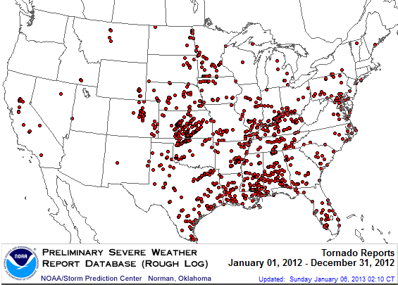
Location of Tornadoes in the US, 2012*
1,119 tornadoes killed 68 people through Dec. 31
*Through Dec. 31, 2012.
Source: NOAA Storm Prediction Center; http://www.spc.noaa.gov/climo/online/monthly/2012_annual_summary.html#
27

Slide 28
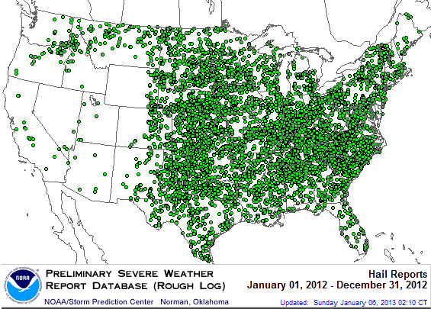
Location of Large Hail Reports in the US, 2012*
There were 7,033 “Large Hail” reports through Dec. 31, 2012, causing extensive damage to homes, businesses and vehicles
*Through Dec. 31, 2012.
Source: NOAA Storm Prediction Center; http://www.spc.noaa.gov/climo/online/monthly/2012_annual_summary.html#
28

Slide 29
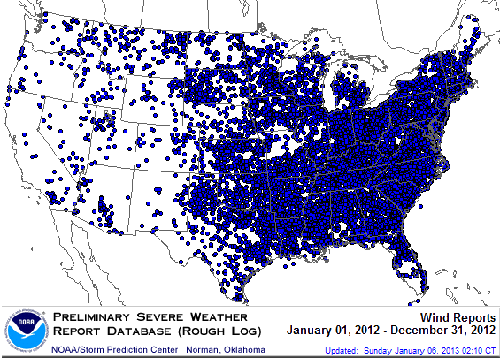
Location of Wind Damage Reports in the US, 2012*
Extreme density due to late June derecho
Hurricane Sandy resulted in a large volume of wind damage reports
There were 14,351 “Wind Damage” reports through Dec. 31, causing extensive damage to homes and businesses
*Through Dec. 31, 2012.
Source: NOAA Storm Prediction Center; http://www.spc.noaa.gov/climo/online/monthly/2012_annual_summary.html#
29

Slide 30
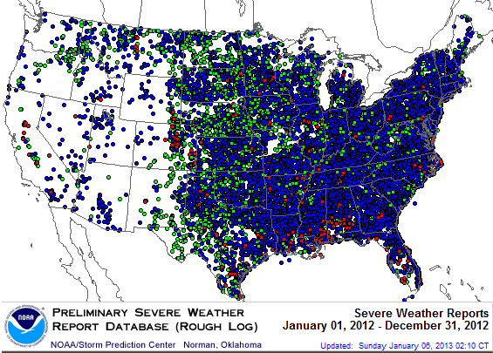
Severe Weather Reports, 2012*
There were 22,503 severe weather reports through Dec. 31; including 1,119 tornadoes; 7,033 “Large Hail” reports and 14,351 high wind events
*Through Dec. 31, 2012.
Source: NOAA Storm Prediction Center; http://www.spc.noaa.gov/climo/online/monthly/2012_annual_summary.html#
30

Slide 31
Combined Ratio Points Associated with Catastrophe Losses: 1960 – 2012*
Avg. CAT Loss Component of the Combined Ratio by Decade
1960s: 1.04 1970s: 0.85 1980s: 1.31 1990s: 3.39 2000s: 3.52 2010s: 7.20*
Catastrophe losses as a share of all losses reached a record high in 2012
Combined Ratio Points
The Catastrophe Loss Component of Private Insurer Losses Has Increased Sharply in Recent Decades
Notes: Private carrier losses only. Excludes loss adjustment expenses and reinsurance reinstatement premiums. Figures are adjusted for losses ultimately paid by foreign insurers and reinsurers.
Source: ISO (1960-2011); A.M. Best (2012E) Insurance Information Institute.

Slide 32
P/C Industry Homeowners Claim Frequency, US, 1997-2011
Claims Paid per 100 Exposures
Sources: Insurance Research Council, “Trends in Homeowners Insurance Claims,” p.29; Insurance Information Institute

Slide 33
P/C Industry Homeowners Average Claim Severity, 1997-2011
HO average claim severity is now three times what it was in 1997.
Sources: Insurance Research Council, “Trends in Homeowners Insurance Claims,” p. 29, BLS inflation calculator,
and Insurance Information Institute

Slide 34
Investments:
The New Reality
Investment Performance is a Key Driver of Profitability
34

Slide 35
U.S. Treasury Security Yields*:
A Long Downward Trend, 1990–2013
Yields on 10-Year U.S. Treasury Notes have been essentially below 5% for a full decade.
U.S. Treasury security yields recently plunged to record lows
Since roughly 80% of P/C bond/cash investments are in 10-year or shorter durations, most P/C insurer portfolios will have low-yielding bonds for years to come.
*Monthly, constant maturity, nominal rates, through Feb 2013.
Sources: Federal Reserve Bank at http://www.federalreserve.gov/releases/h15/data.htm.
National Bureau of Economic Research (recession dates); Insurance Information Institutes.
35
12/01/09 - 9pm
eSlide – P6466 – The Financial Crisis and the Future of the P/C
Notes:
35

Slide 36
Distribution of Bond Maturities,
P/C Insurance Industry, 2003-2011
The main shift over these years has been from bonds with longer maturities to bonds with shorter maturities. The industry first trimmed its holdings of over-10-year bonds (from 24.6% in 2003 to 16.9% in 2011) and then trimmed bonds in the 5-10-year category. Falling average maturity of the P/C industry’s bond portfolio is contributing to a drop in investment income along with lower yields.
Sources: A.M. Best; Insurance Information Institute.

Slide 37
Property/Casualty Insurance Industry Investment Gain: 1994–2012F¹
This trend line should be rising
($ Billions)
Investment gains through 2012:Q3 are about 20% below their pre-crisis peak
In 2012 (1st three quarters) both investment income and realized capital gains were lower than in the comparable period in 2011. And because
the Federal Reserve Board aims to keep interest rates exceptionally low through mid-2015, maturing bonds will be re-invested at even lower rates.
¹Investment gains consist primarily of interest, stock dividends and realized capital gains and losses.
*2005 figure includes special one-time dividend of $3.2B; 2012F figure is I.I.I. estimate based on annualized actual 2012:Q3 result of $38.089B. Sources: ISO; Insurance Information Institute.

Slide 38
A 100 Combined Ratio Isn’t What It
Once Was: Investment Impact on ROEs
A combined ratio of about 100 generates an ROE of ~7.0% in 2012, ~7.5% ROE in 2009/10,
10% in 2005 and 16% in 1979
Combined Ratio / ROE
Year Ago
2011:H1 = 109.4, 2.3% ROE
Combined Ratios Must Be Lower in Today’s Depressed
Investment Environment to Generate Risk Appropriate ROEs
* 2008 -2012 figures are return on average surplus and exclude mortgage and financial guaranty insurers. 2012:H1 combined ratio including M&FG insurers is 102.2, ROAS = 5.9%; 2011 combined ratio including M&FG insurers is 108.2, ROAS = 3.5%.
Source: Insurance Information Institute from A.M. Best and ISO data.

Slide 39
Reduction in Combined Ratio Necessary to Offset 1% Decline in Investment Yield to Maintain Constant ROE, by Line*
Lower Investment Earnings Place a Greater Burden on Underwriting and Pricing Discipline
*Based on 2008 Invested Assets and Earned Premiums
**US domestic reinsurance only
Source: A.M. Best; Insurance Information Institute.
39
12/01/09 - 9pm
eSlide – P6466 – The Financial Crisis and the Future of the P/C
Notes:
39
This shows the drop in Combined Ratio for each line of business that would be needed to maintain a constant ROE, given a 1-percentage-point drop in investment yield

Slide 40
Perspectives on
Premium Growth
Premium Growth Rates
Vary Tremendously
40

Slide 41
Total P/C Direct Premiums Written:
Percent Change by State, 2006-2011
Southeast
Mid-Atlantic
New England
Sources: SNL Financial, LLC.; Insurance Information Institute.
41
12/01/09 - 9pm
eSlide – P6466 – The Financial Crisis and the Future of the P/C
Notes:
41

Slide 42
Total P/C Direct Premiums Written:
Percent Change by State, 2006-2011
Southwest
Mountain
Far West
Great Lakes
Great Plains
Sources: SNL Financial, LLC.; Insurance Information Institute.
42
12/01/09 - 9pm
eSlide – P6466 – The Financial Crisis and the Future of the P/C
Notes:
42

Slide 43
PP Auto NWP vs. # of Vehicles in Operation, 2001–2011
NWP
$ Billions
Vehicles in Operation (millions)
PP Auto net written premiums are starting to recover from a period of no growth attributable to the weak economy affecting new vehicle sales, car choice, and increased price sensitivity among consumers
Sources: A.M. Best; NADA, State of the Industry Report 2012, p. 16, at www.nada.org/nadadata citing R. L. Polk;
Insurance Information Institute.

Slide 44
HO Insurance Net Written Premium vs.
No. of Housing Units*, 2000–2011
Millions of Occupied Units
$ Billions
Homeowners insurance NWP continues rising (up 95% 2000-2011) despite very little unit growth in recent years. Reasons include rate increases, esp
*occupied as of start of year indicated
Sources: A.M. Best; Insurance Information Institute.

Slide 45
Employment in the P/C Insurance Industry
45

Slide 46
U.S. Employment in the Direct
P/C Insurance Industry: 1990–2013*
Thousands
*As of January 2013; Seasonally adjusted; Does not include agents & brokers.
Note: Recessions indicated by gray shaded columns.
Sources: U.S. Bureau of Labor Statistics; National Bureau of Economic Research (recession dates); Insurance Information Institute.
46
12/01/09 - 9pm
eSlide – P6466 – The Financial Crisis and the Future of the P/C
Notes:
46

Slide 47
U.S. Employment in the Direct
Life Insurance Industry: 1990–2013*
As of January 2013, Life insurance industry employment was down by 15,900 (-4.5%) to 338,300 since the recession began in Dec. 2007 (vs. overall US employment decline of 2.3%).
Thousands
Every 4-5 years BLS reconciles its data with census data; sometimes this reclassifies employment within industries. This drop, spread over March 2004-March 2005, moved some people to the Health/Medical Expense sector.
*As of January 2013; Seasonally adjusted; Does not including agents & brokers.
Note: Recessions indicated by gray shaded columns.
Sources: U.S. Bureau of Labor Statistics; National Bureau of Economic Research (recession dates); Insurance Information Institute.
47
12/01/09 - 9pm
eSlide – P6466 – The Financial Crisis and the Future of the P/C
Notes:
47

Slide 48
U.S. Employment in the Direct Health-
Medical Insurance Industry: 1990–2013*
Thousands
As of January 2013, Health-Medical insurance industry employment was up by 26,500 or 6.0% to 466,000 since the recession began in Dec. 2007 (vs. overall US employment decline of 2.3%).
*As of January 2013; Seasonally adjusted; Does not include agents & brokers.
Note: Recessions indicated by gray shaded columns.
Sources: U.S. Bureau of Labor Statistics; National Bureau of Economic Research (recession dates); Insurance Information Institute.
48
12/01/09 - 9pm
eSlide – P6466 – The Financial Crisis and the Future of the P/C
Notes:
48

Slide 49
Employment in the U.S.
Reinsurance Industry: 1990–2013*
Thousands
As of January 2013, US employment in the reinsurance industry was down by 800 or 3.0% to 25,800 since the recession began in Dec. 2007 (vs. overall US employment decline of 2.3%).
*As of January 2013; Seasonally adjusted; Does not including agents & brokers.
Note: Recessions indicated by gray shaded columns.
Sources: U.S. Bureau of Labor Statistics; National Bureau of Economic Research (recession dates); Insurance Information Institute.
49
12/01/09 - 9pm
eSlide – P6466 – The Financial Crisis and the Future of the P/C
Notes:
49

Slide 50
U.S. Employment in Insurance
Agencies & Brokerages: 1990–2013*
Thousands
As of January 2013, employment at insurance agencies and brokerages was down by 14,900 or 2.2% to 662,800 since the recession began in Dec. 2007 (vs. overall US employment decline of 2.3%).
*As of January 2013; Seasonally adjusted. Includes all types of insurance.
Note: Recessions indicated by gray shaded columns.
Sources: U.S. Bureau of Labor Statistics; National Bureau of Economic Research (recession dates); Insurance Information Institute.
50
12/01/09 - 9pm
eSlide – P6466 – The Financial Crisis and the Future of the P/C
Notes:
50

Slide 51
U.S. Employment in Insurance
Claims Adjusting: 1990–2013*
As of January 2013, claims adjusting employment was up by 400 or 0.8% to 52,800 since the recession began in Dec. 2007 (vs. overall US employment decline of 2.3%).
Thousands
Katrina, Rita, Wilma
*As of January 2013; Seasonally adjusted.
Note: Recessions indicated by gray shaded columns.
Sources: U.S. Bureau of Labor Statistics; National Bureau of Economic Research (recession dates); Insurance Information Institute.
51
12/01/09 - 9pm
eSlide – P6466 – The Financial Crisis and the Future of the P/C
Notes:
51

Slide 52
Key Take-aways
52

Slide 53
Take-aways:
Insurance Industry Predictions for 2013
P/C Insurance Exposures Will Grow With the U.S. Economy
  Personal and commercial exposure growth is likely in 2013
    But restoration of destroyed exposure will take until mid-decade
  Wage growth is also positive and could modestly accelerate
P/C Industry Growth in 2013 Will Be Strongest Since 2004
  Growth likely to exceed A.M. Best projection of +3.8% for 2012
  No traditional “hard market” emerges in 2013
Underwriting Fundamentals Weak But Improving
  Some pressure from claim frequency, severity in some key lines
  But WC will be tough to fix
Industry Capacity Hits a New Record by Year-End 2013 (Barring Meg-CAT)
Investment Environment Is/Remains Challenging
  Interest rates remain low

Slide 54
Insurance Information Institute
www.iii.org
Thank you for your time
and your attention!
Notes:
54

