Slide 1
The P/C Insurance Industry: Overview and Outlook
May 14, 2013
Steven N. Weisbart, Ph.D., CLU, Senior Vice President & Chief Economist
Insurance Information Institute ♦ 110 William Street ♦ New York, NY 10038
Tel: 212.346.5540 ♦ Cell: 917.494.5945 ♦ stevenw@iii.org ♦ www.iii.org

Slide 2
The Strength of the Economy Will Influence P/C Insurer Growth Opportunities
Growth Will Expand
the Insurer Exposure Base
Across Most Lines
2

Slide 3
Real GDP Growth: Past Recessions and Recoveries, Yearly, 1970-2012
Real GDP Growth (%)
In most recoveries, real yearly GDP growth is often 4% or more
In the current recovery, real yearly GDP growth
has been 2.4% or less
But, following the 1991 and 2001 recessions, real yearly GDP growth was weaker than 4%
Source: (GDP) U.S. Department of Commerce at http://www.bea.gov/national/xls/gdpchg.xls.
3
12/01/09 - 9pm
eSlide – P6466 – The Financial Crisis and the Future of the P/C
Notes:
3

Slide 4
April 2013 Forecasts of Quarterly US Real GDP for 2013-14
Real GDP Growth Rate
Currently, the sequester will have greatest effect here
Despite the sequester and other challenges to the U.S. economy,
virtually every forecast in the Blue Chip universe in early April sees improvement ahead
Sources: Blue Chip Economic Indicators (4/13); Insurance Information Institute

Slide 5
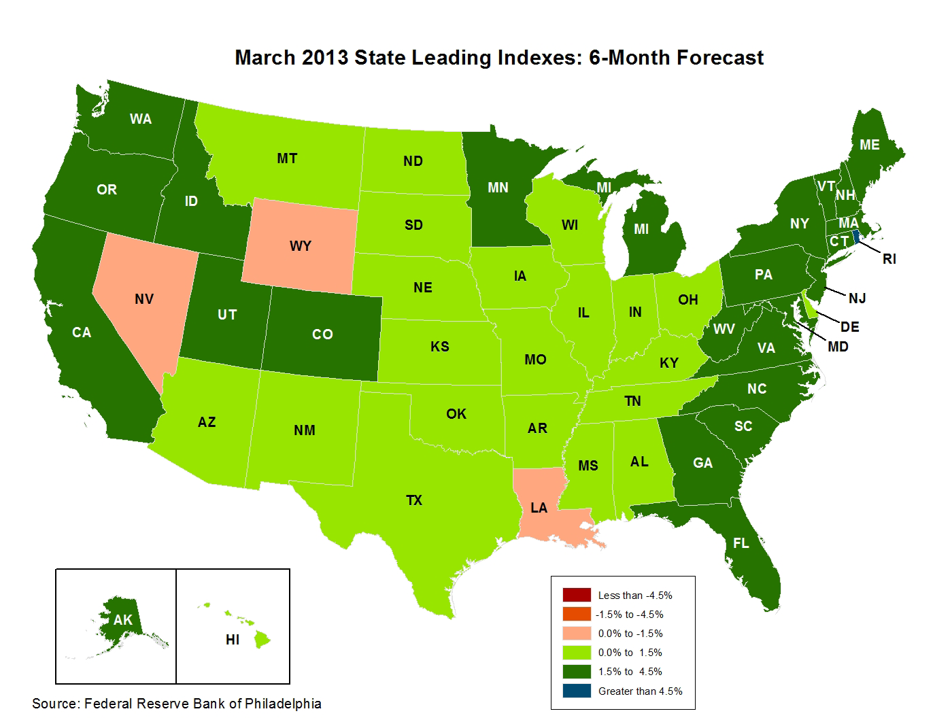
State-by-State Leading Indicators,
2013:Q2-Q3
Near-term growth forecasts vary widely by state. Strongest growth = dark green; weakest = beige
Sources: Federal Reserve Bank of Philadelphia at www.philadelphiafed.org/index.cfm; Insurance Information Institute.
Next release is May 28, 2013

Slide 6
Leading Indicator Indexes Vary Widely by State and Region
Great Lakes
Far West
Southwest
Mountain
Great Plains
Data from March 2013
Sources: Federal Reserve Bank of Philadelphia at www.philadelphiafed.org/index.cfm; Insurance Information Institute.
6
12/01/09 - 9pm
eSlide – P6466 – The Financial Crisis and the Future of the P/C
Notes:
6
In May for the first time in 2 years, Nevada overtook Michigan as the state with the highest unemployment rate

Slide 7
Leading Indicator Indexes Vary Widely by State and Region
Southeast
Mid-Atlantic
New England
Data for March 2013
Sources: Federal Reserve Bank of Philadelphia at www.philadelphiafed.org/index.cfm; Insurance Information Institute.
7
12/01/09 - 9pm
eSlide – P6466 – The Financial Crisis and the Future of the P/C
Notes:
7
This chart and the succeding one show that unemployment rates vary widely, not only by region, but within regions.

Slide 8
Monthly Change in Private Employment, 2010 - 2013
Average Monthly Gain Since Jan 2011: 196,500 jobs
Thousands
Private employers added 1.2 million jobs in just the last six months.
Seasonally adjusted. Mar 2013 and Apr 2013 are preliminary data
Sources: US Bureau of Labor Statistics; Insurance Information Institute

Slide 9
Nonfarm Payroll (Wages and Salaries):
Quarterly, 2005–2013:Q1
Billions
Latest (2013:Q1) was $7.01 trillion, a new peak—$761B above 2009 trough
Prior peak was 2008:Q1 at $6.60 trillion
Recent trough (2009:Q3) was $6.25 trillion, down 5.3% from prior peak
Note: Recession indicated by gray shaded column. Data are seasonally adjusted annual rates.
Sources: research.stlouisfed.org/fred2/series/WASCUR; National Bureau of Economic Research (recession dates); Insurance Information Institute.
9
12/01/09 - 9pm
eSlide – P6466 – The Financial Crisis and the Future of the P/C
Notes:
9

Slide 10
Commercial & Industrial Loans Outstanding at FDIC-Insured Banks, Quarterly, 2006-2012*
$Trillions
In dollar terms, this is an all-time high.
Outstanding loan volume has been growing for over two years
and (as of year-end 2012) has surpassed previous peak levels.
*Latest data as of 5/2/2013.
Source: FDIC at http://www2.fdic.gov/qbp/ (Loan Performance spreadsheet); Insurance Information Institute.

Slide 11
Percent of Non-current Commercial & Industrial Loans Outstanding at FDIC-Insured Banks,
Quarterly, 2006-2012*
Almost back to “normal” levels of noncurrent industrial & commercial loans
Recession
Non-current loans (those past due 90 days or more or in nonaccrual status) are back to early-recession levels, fueling bank willingness to lend.
*Latest data as of 5/2/2013.
Source: FDIC at http://www2.fdic.gov/qbp/ (Loan Performance spreadsheet); Insurance Information Institute.

Slide 12
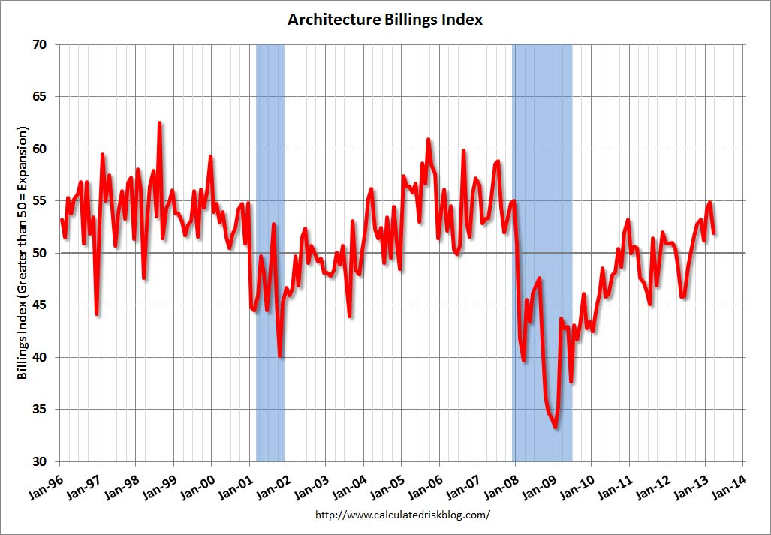
The Architecture Billings Index: a Leading Indicator for Commercial Real Estate
A Post-Recession Peak
Values over 50 indicate expansion

Slide 13
Business Bankruptcy Filings: Falling but Still High in 2012 (1994:Q1 – 2012:Q3)
Quarterly average for 2001:Q1-2005:Q3 was 8,915
New Bankruptcy Law Takes Effect
(Thousands)
Recessions in orange
Business bankruptcies were down 42% in 2012:Q3 vs. recent peak in 2009:Q2 but were still higher than 2008:Q1, the first full quarter of the Great Recession. Bankruptcies restrict exposure growth in all commercial lines.
Sources: American Bankruptcy Institute at www.abiworld.org/AM/AMTemplate.cfm?Section=Home&TEMPLATE=/CM/ContentDisplay.cfm&CONTENTID=61633; Insurance Information Institute.
13
12/01/09 - 9pm
eSlide – P6466 – The Financial Crisis and the Future of the P/C
Notes:
13

Slide 14
Private Sector Business Starts,
1993:Q2 – 2012:Q2*
Business Starts
2006: 861,000
2007: 844,000
2008: 787,000
2009: 701,000 2010: 742,000 2011: 781,000
(Thousands)
Recessions in orange
Business starts were down nearly 20% in the Great Recession,
holding back most types of commercial insurance exposure,
but now are recovering.
* Data through Jun 30, 2012 are the latest available (posted Jan 29, 2013); Seasonally adjusted.
Sources: Bureau of Labor Statistics, www.bls.gov/news.release/cewbd.t08.htm; NBER (recession dates).
14
12/01/09 - 9pm
eSlide – P6466 – The Financial Crisis and the Future of the P/C
Notes:
14

Slide 15
Recovery in Capacity Utilization is a Positive Sign for Commercial Exposures
March 2001 through Mar. 2013
Percent of Industrial Capacity
“Full Capacity”
Hurricane Katrina
The closer the economy is to operating at “full capacity,” the greater the inflationary pressure
The US operated at 78.5% of industrial capacity in Feb. 2013, above the June 2009 low of 66.9% and close to its post-crisis peak
March 2001-November 2001 recession
December 2007-
June 2009 Recession
15
Source: Federal Reserve Board statistical releases at http://www.federalreserve.gov/releases/g17/Current/default.htm.
Notes:
15

Slide 16
P/C Insurance Industry Financial Overview
High catastrophe losses
in 2011 and 2012 affected
the industry’s profit performance
16

Slide 17
P/C Net Premiums Written: % Change, Quarter vs. Year-Prior Quarter, 2002–2012
Most recent “hard market”
It looks like we have an upward trend here.
Will it continue as the economy’s recovery strengthens?
Finally! A sustained period (11 quarters) of growth in net premiums written (vs. same quarter, prior year).
Sources: ISO; Insurance Information Institute.
17
12/01/09 - 9pm
eSlide – P6466 – The Financial Crisis and the Future of the P/C
Notes:
17

Slide 18
Underwriting is Rarely a Profit Source
Gain (Loss)* 1975–2012
$ Billions
Net underwriting losses in 2012 totaled $14.6B
In historical context, 2006-07 underwriting results were an anomaly
High cat losses in 2011 led to the worst underwriting year since 2002
Average yearly underwriting loss in the 2008-2012 low-interest-rate environment? $17.2B. With interest rates this low,
large persistent underwriting losses are not a recipe for success.
*Includes mortgage and financial guaranty insurers in all years.
Sources: A.M. Best; ISO; Insurance Information Institute.

Slide 19
P/C Insurance Industry
Combined Ratio, 2001–2012
As recently as 2001, insurers paid out nearly $1.16 for every $1 in Earned Premiums
Relatively Low CAT Losses, Reserve Releases
Higher CAT Losses, Reserve Releases, Toll of Soft Market
Heavy Use of Reinsurance Lowered Net Losses
Relatively Low CAT Losses, Reserve Releases
Best Combined Ratio Since 1949 (87.6)
Avg. CAT Losses, Reserve Releases
Avg. CAT Losses, Reserve Releases
Cyclical Deterioration
* Excludes Mortgage & Financial Guaranty insurers 2008--2012. Including M&FG, 2008=105.1, 2009=100.7, 2010=102.4, 2011=108.2; 2012=103.2.
Sources: A.M. Best; ISO.

Slide 20
P/C Net Income After Taxes
1991–2012
$ Millions
2005 ROE*= 9.6%
2006 ROE = 12.7%
2007 ROE = 10.9%
2008 ROE = 0.1%
2009 ROE = 5.0%
2010 ROE = 6.6%
2011 ROAS¹ = 3.5%
2012 ROAS¹ = 5.9%
* ROE figures are GAAP; ¹Return on avg. surplus. Excluding Mortgage & Financial Guaranty insurers yields a 6.2% ROAS for 2012:H1, 4.6% ROAS for 2011, 7.6% for 2010 and 7.4% for 2009.
Sources: A.M. Best; ISO; Insurance Information Institute.

Slide 21
P/C Industry Net Income,
Quarterly, 2007:Q1-2012:Q4
$Billions
Financial crisis, Hurricane Ike
Spring 2011 tornadoes
Sandy
Virtually a year
without any profits
Sources: SNL Financial; Insurance Information Institute

Slide 22
P/C Industry Net Income,
Quarterly, 2007:Q1-2012:Q4
$Billions
Spring 2011 tornadoes
Hurricane Irene
Financial crisis, Hurricane Ike
Over the past 6 years, no calendar quarter has been consistently profitable.
Sources: SNL Financial; Insurance Information Institute

Slide 23
Profitability (ROE) Peaks & Troughs,
P/C Insurance Industry, 1975 – 2012
ROE
1977:19.0%
1987:17.3%
2006:12.7%
History suggests next ROE peak will be in 2016-2017
10 Years
1997:11.6%
10 Years
9 Years
6+ years so far
1975: 2.4%
1984: 1.8%
1992: 4.5%
2001: -1.2%
*Profitability = P/C insurer ROEs. 2012 is an estimate based on ROAS data. Note: Data for 2008-2012 exclude mortgage and financial guaranty insurers. 2012 ROAS = 5.9% including M&FG.
Sources: Insurance Information Institute; NAIC; ISO; A.M. Best.

Slide 24
Policyholder Surplus,
Quarterly, 2006:Q4–2012:Q4
Up $150 Billion from the 2009:Q1 trough, a new peak
($ Billions)
Down $84 Billion from the previous peak, due to the financial crisis, CATs
The industry now (at year-end 2012) has $1 of surplus for every $0.78 of NPW, the strongest claims-paying status in its history.
Sources: ISO; A.M .Best.
24
12/01/09 - 9pm
eSlide – P6466 – The Financial Crisis and the Future of the P/C
Notes:
24

Slide 25
US Policyholder Surplus:
1975–2012*
($ Billions)
Surplus as of 9/30/12 was a record $583.5, up 6.0% from $550.3 of 12/31/11, but still up 33.5% ($146.4B) from the crisis trough of $437.1B at 3/31/09. Pre-crisis peak was $521.8 as of 9/30/07. Surplus as of 9/30/12 was 11.8% above 2007 peak.
“Surplus” is a measure of underwriting capacity. It is analogous to “Owners Equity” or “Net Worth” in non-insurance organizations
The Industry’s Claims Paying Resources Reached an All-Time Record High as of Q3 2012, Just Before Sandy Struck, A Vivid Demonstration of the Strength
* As of 9/30/12.
Source: A.M. Best, ISO, Insurance Information Institute.

Slide 26
Direct Premiums Written: Total P/C
Percent Change by State, 2007-2012
Top 25 States
Just 10 states showed double-digit DPW growth over the 5-year period 2007-2012, which includes the “Great Recession”
Sources: SNL Financial LC.; Insurance Information Institute.

Slide 27
Direct Premiums Written: Total P/C
Percent Change by State, 2007-2012
Bottom 25 States
13 states lost DPW over the 5-year period 2007-2012, including New York, California, and Florida
Sources: SNL Financial LC.; Insurance Information Institute.

Slide 28
Direct Premiums Written: Comm. Lines
Percent Change by State, 2007-2012
Top 25 States
Sources: SNL Financial LC.; Insurance Information Institute.

Slide 29
Direct Premiums Written: Comm. Lines
Percent Change by State, 2007-2012
Bottom 25 States
Sources: SNL Financial LC.; Insurance Information Institute.

Slide 30
Direct Premiums Written: Workers’ Comp
Percent Change by State, 2007-2012
Top 25 States
*Excludes monopolistic fund states: ND, OH, WA, WY as well as WV, which transitioned to a competitive structure during this period.
Sources: SNL Financial LC.; Insurance Information Institute.

Slide 31
Direct Premiums Written: Worker’s Comp
Percent Change by State, 2007-2012
Bottom 25 States
*Excludes monopolistic fund states: ND, OH, WA, WY as well as WV, which transitioned to a competitive structure during this period.
Sources: SNL Financial LC.; Insurance Information Institute.

Slide 32
Commercial Lines Combined Ratio, 1990-2013F*
Commercial lines underwriting performance in 2012 was the worst since 2002 due to heavy impact from Sandy
*2007-2013F figures exclude mortgage and financial guaranty segments.
Sources: A.M. Best; Insurance Information Institute

Slide 33
Commercial Auto Combined Ratio: 1993–2014F
Commercial Auto is Expected to Improve as Rate Gains Outpace Any Adverse Frequency and Severity Trends
Sources: A.M. Best (1990-2013F);Conning (2014F); Insurance Information Institute.

Slide 34
Commercial Multi-Peril Combined Ratio: 1995–2013F
Commercial Multi-Peril Underwriting Performance is Expected to Improve in 2013 Assuming Normal Catastrophe Loss Activity
*2012-2013 figures are A.M. Best estimate/forecast for the combined liability and non-liability components.
Sources: A.M. Best; Insurance Information Institute.

Slide 35
General Liability Combined Ratio:
2005–2014F
Commercial General Liability Underwriting Performance Has Been Volatile in Recent Years
Source: Conning Research and Consulting.

Slide 36
Inland Marine Combined Ratio: 1999–2014F
Inland Marine is Expected to Remain Among the Most Profitable of All Lines
Sources: A.M. Best (1999-2011); Insurance Information Institute (2012F); Conning (2013F-2014F)

Slide 37
Surety Bonds Combined Ratio,
2002–2011
Source: A.M. Best Aggregates & Averages, 2012, p. 376.

Slide 38
Workers Compensation
Combined Ratio: 1994–2014F
Workers Comp underwriting results are expected to begin improving in 2013. They deteriorated markedly since 2007 and in 2012 are estimated to have hit their worst level in a decade.
Sources: A.M. Best (1994-2013F); Insurance Information Institute (2014F).

Slide 39
Catastrophes
39
Notes:
39

Slide 40
US Insured Catastrophe Losses
($ Billions, 2012 Dollars)
2012 CAT losses were down nearly 50% from 2011 until Sandy struck in late October
US CAT losses in 2012 marked the sixth year in the past 12 that privately-insured CAT claims topped $29 billion (on an inflation-adjusted basis).
That happened only once in the prior dozen years (1989-2000).
*As of 1/2/13. Includes $20B gross loss estimate for Hurricane Sandy.
Note: 2001 figure includes $20.3B for 9/11 losses reported through 12/31/01 ($25.9B 2011 dollars). Includes only business and personal property claims, business interruption and auto claims. Non-prop/BI losses = $12.2B ($15.6B in 2011 dollars.)
Sources: Property Claims Service/ISO; Insurance Information Institute.
40
12/01/09 - 9pm
eSlide – P6466 – The Financial Crisis and the Future of the P/C
Notes:
40

Slide 41
Natural Disasters in the United States, 1980 – 2012
Number of Events (Annual Totals 1980 – 2012)
There were 184 natural disaster events in the US in 2012
There were over 150 natural disaster events in the US every year since 2006. That hadn’t happened in any year before.
Number
41
19
121
3
Geophysical
(earthquake, tsunami,
volcanic activity)
Meteorological (storm)
Climatological
(temperature extremes,
drought, wildfire)
Hydrological
(flood, mass movement)
Source: MR NatCatSERVICE
41

Slide 42
The Dozen Most Costly Hurricanes in U.S. History
Insured Losses, 2012 Dollars,
$ Billions
Sandy will likely become the 3rd costliest hurricane in US insurance history
Irene became the 12th most expensive hurricane in US history
10 of the 12 most costly hurricanes in insurance history occurred in the past 9 years (2004—2012)
*Estimate as of 12/09/12 based on estimates of catastrophe modeling firms and reported losses as of 1/12/13. Estimates range up to $25B.
Sources: PCS; Insurance Information Institute inflation adjustments to 2012 dollars using the CPI.

Slide 43
If They Hit Today, the Dozen Costliest (to Insurers) Hurricanes in U.S. History
Insured Losses,
2012 Dollars, $ Billions
Storms that hit long ago had less property and businesses to damage, so simply adjusting their actual claims for inflation doesn’t capture their destructive power.
Karen Clark’s analysis aims to overcome that.
When you adjust for the damage prior storms could have done if they occurred today, Hurricane Katrina slips to a tie for 6th among the most devastating storms.
*Estimate as of 12/09/12 based on estimates of catastrophe modeling firms and reported losses as of 1/12/13. Estimates range up to $25B.
Sources: Karen Clark & Company, Historical Hurricanes that Would Cause $10 Billion or More of Insured LossesToday, August 2012; I.I.I.

Slide 44
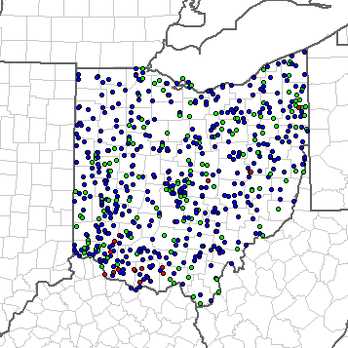
Location of Tornadoes, Large Hail, and Wind Reports in OH, 2012
18 tornadoes in OH in 2012, 195 large hail reports, and 533 high wind reports.
Source: NOAA Storm Prediction Center; http://www.spc.noaa.gov/climo/online/monthly/2012_annual_summary.html#
44

Slide 45
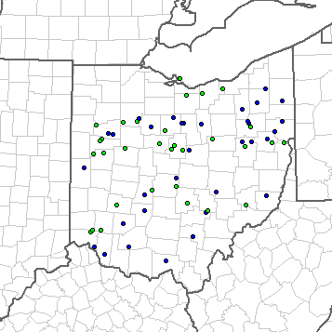
Location of Severe Weather Reports in OH, 2013 (through May 1)
No tornadoes in OH so far in 2013, but 34 large hail reports and 33 high wind reports.
Source: NOAA Storm Prediction Center; http://www.spc.noaa.gov/climo/online/monthly/states.php?month=00&year=2013&state=OH#
45

Slide 46
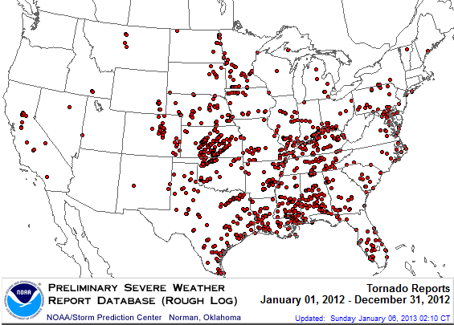
Location of Tornadoes in the US, 2012
1,119 tornadoes killed 68 people through Dec. 31
Source: NOAA Storm Prediction Center; http://www.spc.noaa.gov/climo/online/monthly/2012_annual_summary.html#
46

Slide 47
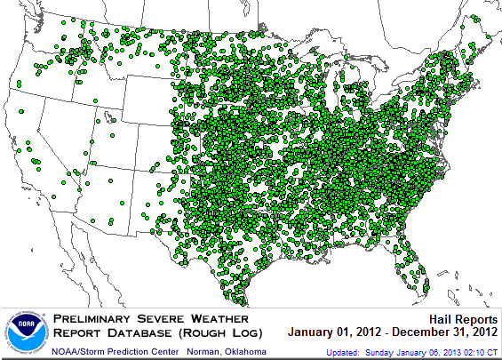
Location of Large Hail Reports in the US, 2012
There were 7,033 “Large Hail” reports through Dec. 31, 2012, causing extensive damage to homes, businesses and vehicles
Source: NOAA Storm Prediction Center; http://www.spc.noaa.gov/climo/online/monthly/2012_annual_summary.html#
47

Slide 48
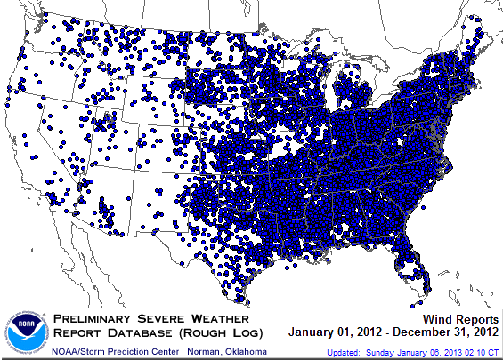
Location of Wind Damage Reports in the US, 2012
Extreme density due to late-June derecho
SuperStorm Sandy resulted in a large volume of wind damage reports
There were 14,351 “Wind Damage” reports through Dec. 31, causing extensive damage to homes and businesses
Source: NOAA Storm Prediction Center; http://www.spc.noaa.gov/climo/online/monthly/2012_annual_summary.html#
48

Slide 49
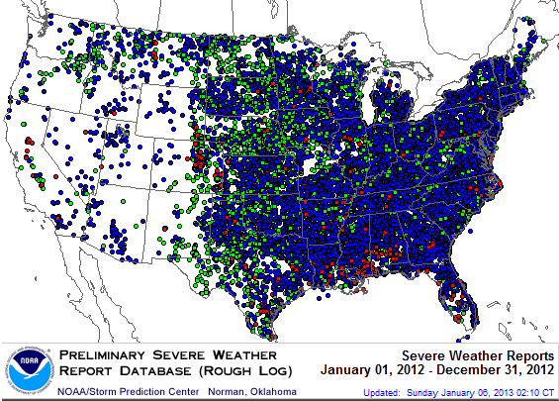
Severe Weather Reports, 2012
There were 22,503 severe weather reports through Dec. 31; including 1,119 tornadoes; 7,033 “Large Hail” reports and 14,351 high wind events
Source: NOAA Storm Prediction Center; http://www.spc.noaa.gov/climo/online/monthly/2012_annual_summary.html#
49

Slide 50
P/C Industry Homeowners Claim Frequency, US, 1997-2011
Claims Paid per 100 Exposures
Sources: Insurance Research Council, “Trends in Homeowners Insurance Claims,” p.29; Insurance Information Institute

Slide 51
P/C Industry Homeowners Average Claim Severity, 1997-2011
HO average claim severity is now three times what it was in 1997.
Sources: Insurance Research Council, “Trends in Homeowners Insurance Claims,” p. 29, BLS inflation calculator,
and Insurance Information Institute

Slide 52
Inflation and Claims Trends
52

Slide 53
Change* in the Consumer Price Index, 2004–2013
For two months in 2008, led by gasoline, the general price level was rising at a 5.5% pace
Over the last decade, prices generally rose about 2% per year.
*Monthly, year-over-year, through March 2013. Not seasonally adjusted.
Sources: US Bureau of Labor Statistics; National Bureau of Economic Research (recession dates); Insurance Information Institutes.
53
12/01/09 - 9pm
eSlide – P6466 – The Financial Crisis and the Future of the P/C
Notes:
53

Slide 54
Prices for Hospital Services:
12-Month Change,* 1998–2013
Cyclical peaks in PP Auto tend to occur approximately every 10 years
(early 1990s, early 2000s, and possibly the early 2010s)
*Percentage change from same month in prior year; through January 2013; seasonally adjusted
Sources: US Bureau of Labor Statistics; National Bureau of Economic Research (recession dates); Insurance Information Institute.
54
12/01/09 - 9pm
eSlide – P6466 – The Financial Crisis and the Future of the P/C
Notes:
54

Slide 55
Forces that Drive Car Repair Costs:
12-Month Change,* 2001–2013
Cyclical peaks in PP Auto tend to occur approximately every 10 years
(early 1990s, early 2000s, and possibly the early 2010s)
*Percentage change from same month in prior year; through January 2013; seasonally adjusted
Sources: US Bureau of Labor Statistics; National Bureau of Economic Research (recession dates); Insurance Information Institute.
55
12/01/09 - 9pm
eSlide – P6466 – The Financial Crisis and the Future of the P/C
Notes:
55

Slide 56
Change* in Price Index for Lumber: A Downward Trend but Sudden Spikes, 2004–2013
But 30% spikes can happen with no warning
The price of lumber dropped before and during the recession…
The prices of building materials vary wildly and change levels rapidly.
Prices for hardwood have been much less variable than softwood lumber.
*Monthly, year-over-year, through March 2013. Not seasonally adjusted. Dec. 2012 and Jan., Feb., and Mar. prices are preliminary.
Sources: US Bureau of Labor Statistics, Producer Price Index series WPS0811; National Bureau of Economic Research (recession dates); Insurance Information Institutes.
56
12/01/09 - 9pm
eSlide – P6466 – The Financial Crisis and the Future of the P/C
Notes:
56

Slide 57
Change* in Price Index for Plywood: A Downward Trend but Sudden Spikes, 2004–2013
The price of plywood rose by 50% in late Spring 2004 over the prior year
March 2013: +8.4%
From the end of the recession (June 2009) to March 2013, the effect
of the ups and downs of the price of plywood has resulted in a rise of 25.6%.
*Monthly, year-over-year, through March 2013. Not seasonally adjusted. Dec. 2012 and Jan., Feb., and Mar. prices are preliminary.
Sources: US Bureau of Labor Statistics, Producer Price Index series WPU083; National Bureau of Economic Research (recession dates); Insurance Information Institutes.
57
12/01/09 - 9pm
eSlide – P6466 – The Financial Crisis and the Future of the P/C
Notes:
57

Slide 58
Investments:
How Long will Rates Stay This Low?
Investment Performance is a Key Driver of Insurer Profitability
58

Slide 59
U.S. Treasury Security Yields*:
A Long Downward Trend, 1990–2013
Yields on 10-Year U.S. Treasury Notes have been essentially below 5% for a full decade.
U.S. Treasury security yields recently plunged to record lows
Since roughly 80% of P/C bond/cash investments are in 10-year or shorter durations, most P/C insurer portfolios will have low-yielding bonds for years to come.
*Monthly, constant maturity, nominal rates, through March 2013.
Sources: Federal Reserve Bank at http://www.federalreserve.gov/releases/h15/data.htm.
National Bureau of Economic Research (recession dates); Insurance Information Institutes.
59
12/01/09 - 9pm
eSlide – P6466 – The Financial Crisis and the Future of the P/C
Notes:
59

Slide 60
Distribution of Bond Maturities,
P/C Insurance Industry, 2003-2011
The main shift over these years has been from bonds with longer maturities to bonds with shorter maturities. The industry first trimmed its holdings of over-10-year bonds (from 24.6% in 2003 to 16.9% in 2011) and then trimmed bonds in the 5-10-year category. Falling average maturity of the P/C industry’s bond portfolio is contributing to a drop in investment income along with lower yields.
Sources: A.M. Best; Insurance Information Institute.

Slide 61
Property/Casualty Insurance Industry Investment Gain: 1994–2012F¹
This trend line should be rising
($ Billions)
In 2012 investment gains were roughly the same as in 1997—15 years earlier. Adjusted for inflation, 2012 gains were equivalent in purchasing power to the $35 billion in 1994.
¹Investment gains consist primarily of interest, stock dividends and realized capital gains and losses.
*2005 figure includes special one-time dividend of $3.2B.
Sources: ISO; Insurance Information Institute.

Slide 62
To Maintain Constant ROE, Combined Ratio Drop Needed to Offset 1% Decline in Investment Yield, by Line*
Lower Investment Earnings Place a Greater Burden on Underwriting and Pricing Discipline
*Based on 2008 Invested Assets and Earned Premiums
**US domestic reinsurance only
Source: A.M. Best; Insurance Information Institute.
62
12/01/09 - 9pm
eSlide – P6466 – The Financial Crisis and the Future of the P/C
Notes:
62
This shows the drop in Combined Ratio for each line of business that would be needed to maintain a constant ROE, given a 1-percentage-point drop in investment yield

Slide 63
Unemployment and Underemployment Rates: Stubbornly High in 2012, But Falling
January 2000 through Mar. 2013, Seasonally Adjusted (%)
U-6 went from 8.0% in March 2007 to 17.5% in
October 2009; Stood at 13.8% in Mar. 2013
Unemployment “Headline” unemployment stood at 7.6% in Mar. 2013.
The Federal Reserve’s target for ending “easy money” is 6.5% (assuming inflation remains within its 2% target).
Nov. 12
Stubbornly high unemployment and underemployment constrain overall economic growth, but the job market is now clearly improving.
Source: US Bureau of Labor Statistics; Insurance Information Institute.
63
12/01/09 - 9pm
eSlide – P6466 – The Financial Crisis and the Future of the P/C
Notes:
63

Slide 64
A 100 Combined Ratio Isn’t What It
Once Was: Investment Impact on ROEs
A combined ratio of about 100 generates an ROE of ~7.0% in 2012, ~7.5% ROE in 2009/10,
10% in 2005 and 16% in 1979
Combined Ratio / ROE
Year Ago
2011:H1 = 109.4, 2.3% ROE
Combined Ratios Must Be Lower in Today’s Depressed
Investment Environment to Generate Risk Appropriate ROEs
* 2008 -2012 figures are return on average surplus and exclude mortgage and financial guaranty insurers. 2012:H1 combined ratio including M&FG insurers is 102.2, ROAS = 5.9%; 2011 combined ratio including M&FG insurers is 108.2, ROAS = 3.5%.
Source: Insurance Information Institute from A.M. Best and ISO data.

Slide 65
Key Take-aways
65

Slide 66
Take-aways:
Insurance Industry Predictions for 2013
P/C Insurance Exposures Will Grow With the U.S. Economy
  Personal and commercial exposure growth is likely in 2013
    But restoration of destroyed exposure will take until mid-decade
  Wage growth is also positive and could modestly accelerate
P/C Industry Growth in 2013 Will Be Strongest Since 2004
  Growth likely to exceed A.M. Best projection of +3.8% for 2012
  No traditional “hard market” emerges in 2013
Underwriting Fundamentals Weak But Improving
  Some pressure from claim frequency, severity in some key lines
  But WC will be tough to fix
Industry Capacity Hits a New Record by Year-End 2013 (Barring Meg-CAT)
Investment Environment Is/Remains Challenging
  Interest rates remain low

Slide 67
Insurance Information Institute
www.iii.org
Thank you for your time
and your attention!
Notes:
67

