Slide 1
Presentation Annual Meeting of Philanthropy New York Rebuilding and Reimagining Resilient Communities How the Money Flows
Ford Foundation
New York, N.Y.
April 26, 2013
Jeanne M. Salvatore, SVP, Public Affairs & Consumer Spokesperson
Twitter @JeanneSalvatore
Insurance Information Institute ♦ 110 William Street ♦ New York, NY 10038
www.iii.org

Slide 2
The Property/Casualty Insurance Industry Provides Crucial Financial Protection Against Disasters
Insurers are economic first responders after a disaster.
Insurance company claims adjusters get into a disaster zone as soon as they are allowed by the civil authorities to start the claims process – frequently writing a check (for part of the claim) on the spot to help with immediate expenses. The infusion of claims dollars from private insurers helps to stabilize communities hit by disasters such as Hurricane Sandy.
Insurance Companies are also philanthropic and civic minded – donating to charities and offering insurance company volunteers in the wake of a disaster.

Slide 3
Sandy Claims
There were over 1.5 million property claims for damage to homes, cars, boats and businesses.
The property/casualty insurance industry will pay an estimated $18.8 billion to policyholders making Sandy the third most costly disaster after 2005’s Hurricane Katrina ($48.7 billion*) and 1992’s Hurricane Andrew ($25.6 billion*).
There were 1.1 million home insurance claims, a quarter million vehicle claims and more than 200,000 business claims. Business claims accounted for only 13 percent of those filed, yet they account for 48 percent of all Sandy Claims. The value of commercial property is often higher than that of home properties and thus the cost to repair and rebuild is greater.
Flood is not covered under standard home or business insurance policies. Flood insurance is covered by FEMA’s National Flood Insurance Program.
*Note: Claims losses are expressed in 2012 Dollars.

Slide 4
Insurance Companies Also Donated To Sandy-Related Charities & Humanitarian Efforts
Insurers contributed over $12 million to Sandy Relief based on those companies tracked by the Chamber of Commerce (there are many others).
The Insurance Industry Charitable Foundation’s Northeast Division also donated over $100,000 to the Red Cross
Insurance companies have also provided assistance by providing volunteers to disaster assistance organizations or by creating their own programs.
The I.I.I.’s winter 2013 issue of Impact magazine highlighted humanitarian efforts of the insurance industry. The June 2013 issue will focus on 17 insurance companies and their ongoing Sandy Programs.

Slide 5
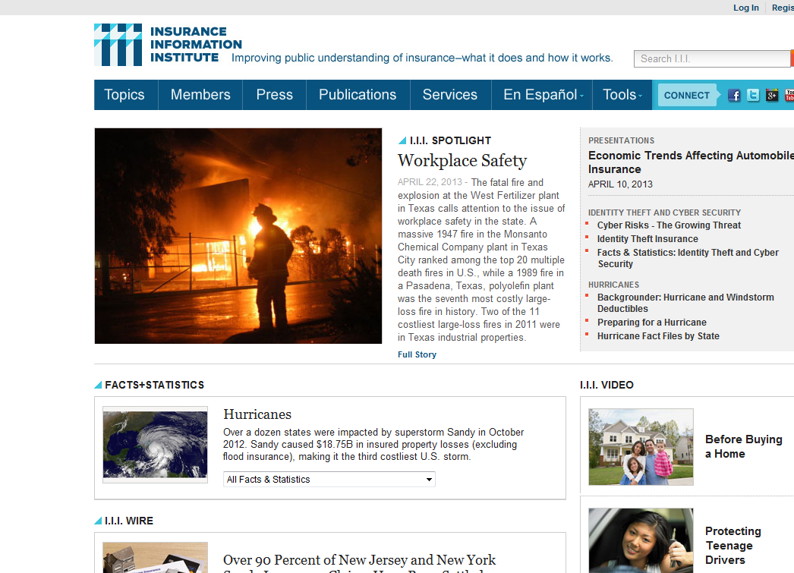

Slide 6
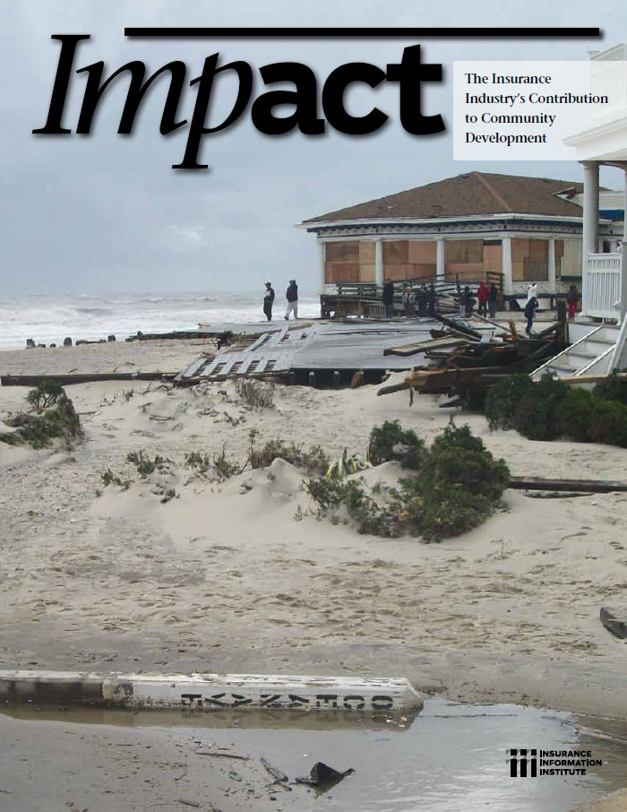
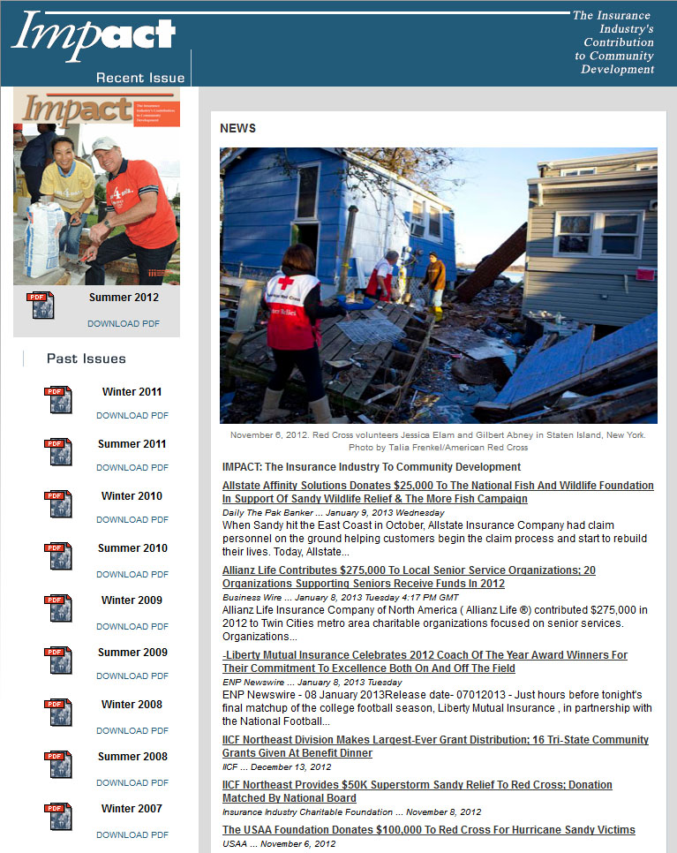
Impact: Documents Insurer Charitable Actions (e.g. Following Hurricane Sandy)
http://www.iii.org/impact/

Slide 7
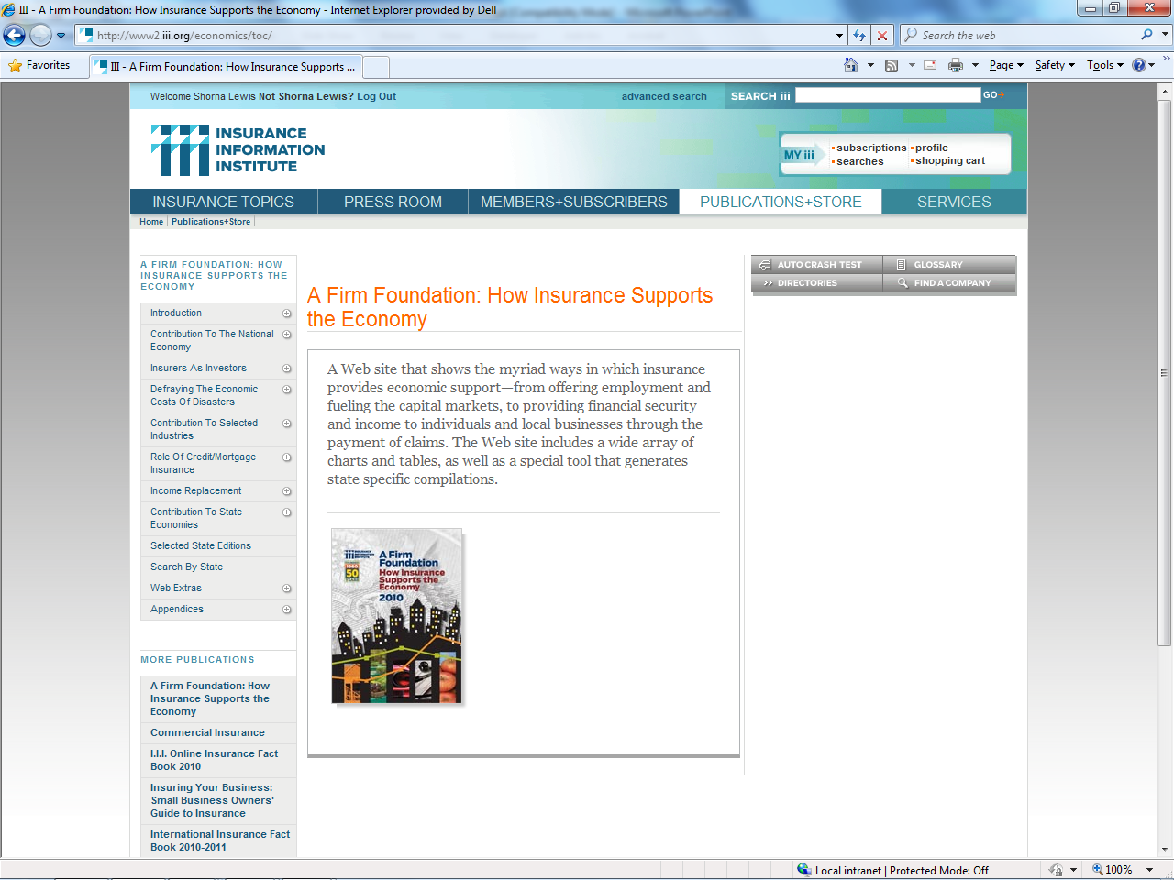
A Firm Foundation
Insurers Don’t Just Pay Claims They Are
Employers
Income Providers
Taxpayers
Investors
Engines of Growth & Recovery
Philanthropists
A Firm Foundation provides details on the impact and importance of the insurance industry on national and state economies
7
12/01/09 - 9pm
eSlide – P6466 – The Financial Crisis and the Future of the P/C

Slide 8
Insurance Information Institute Online:
www.iii.org

