Slide 1
Superstorm Sandy: Impacts for Insurers, Reinsurers and the Debate on Climate Change
Amsterdam Circle of Chief Economists
Geneva Association
Amsterdam, Netherlands
1 March 2013
Download at www.iii.org/presentations
Robert P. Hartwig, Ph.D., CPCU, President & Economist
Insurance Information Institute ♦ 110 William Street ♦ New York, NY 10038
Tel: 212.346.5520 ♦ Cell: 917.453.1885 ♦ bobh@iii.org ♦ www.iii.org

Slide 2
Presentation Outline
I. Summary of Superstorm Sandy’s Impact on the Insurance Industry
II. Impact on the Discussion Debate on Climate Change

Slide 3
Hurricane Sandy:
Summary of Insurance Impacts
Sandy Will Become One of the Most Expensive Events in Global Insurance History
3
Notes:
3

Slide 4
Top 12 Most Costly Hurricanes in U.S. History
(Insured Losses, 2012 Dollars, $ Billions)
10 of the 12 most costly hurricanes in insurance history occurred over the past 9 years (2004—2012)
Hurricane Sandy could become the 3rd costliest hurricane in US insurance history
Hurricane Irene became the 12th most expensive hurricane in US history in 2011
*Estimate as of 1/18/13 based on estimates of catastrophe modeling firms and reported losses as of 2/26/13.
Sources: PCS; Insurance Information Institute inflation adjustments to 2012 dollars using the CPI.

Slide 5
Hurricane Sandy: Claim Payments to Policyholders, by State
($ Thousands)
TOTAL = $18.75 BILLION
At $9.6B and $6.6B, respectively, NY and NJ suffered, by far, the largest losses from Hurricane Sandy
Insurers Will Pay at Least $18.75 Billion to 1.52 Million Policyholders Across 15 States and DC in the Wake of Hurricane Sandy
Sources: Catastrophe loss data is for Catastrophe Serial No. 90 (Oct. 28 – 31, 2012) from PCS as of Jan. 18, 2013; Insurance Information Institute .

Slide 6
Hurricane Sandy: Number of Claims
by Type*
Total Claims = 1.52 Million*
Hurricane Sandy resulted in an estimated 1.52 million privately insured claims resulting in an estimated $18.75 to $25 billion in insured losses. Hurricane Katrina produced 1.74 million claims and $48.7B in losses (in 2012 $)
Sandy is a high HO frequency, (relatively low) severity event (avg. severity <50% Katrina)
*PCS claim count estimate s as of 1/18/13. Loss estimate represents PCS total ($18.75B) and upper end of range estimates by risk modelers RMS, Eqecat and AIR. All figures exclude losses paid by the NFIP.
Source: PCS; AIR, Eqecat, AIR Worldwide; Insurance Information Institute.

Slide 7
Hurricane Sandy: Insured Loss by
Claim Type* ($ Millions)
Total Claim Value = $18.75 Billion*
Although Commercial Lines accounted for only 13% of total claims, they account for 48% of all claim dollars paid. In most hurricanes, Commercial Lines accounts for about 1/3 of insured losses.
*PCS insured loss estimates as of 1/18/13. Catastrophe modeler estimates range up to $25 billion. All figures exclude losses paid by the NFIP.
Source: PCS; Insurance Information Institute.

Slide 8
Hurricane Sandy: Value of Homeowners Claims Paid, by State* ($ Millions)
Hurricane Sandy
Estimated 1,067,000 homeowners claims**
$7.0 billion in insured losses.
Average loss per claim is $6,558
Claims in NJ estimated at $2.5 billion (36%) and $2.7 billion in NY (38%)
*Preliminary as of 1/18/13.
Source: PCS.

Slide 9
Homeowners Insurance Combined Ratio: 1990–2014F
Record tornado activity
Hurricane Sandy
Hurricane Ike
Homeowners Performance Deteriorated in 2011/12 Due to Large Cat Losses. Extreme Regional Variation Can Be Expected Due to Local Catastrophe Loss Activity
Sources: A.M. Best (1990-2013F);Conning (2014F); Insurance Information Institute.

Slide 10
Hurricane Sandy: Number of Auto Claims by State*
Hurricane Sandy
Estimated 250,500 vehicle claims
$2.729 billion in insured losses.
Average loss per claim is $10,894
60% of the claims occurred in NY state.
*Preliminary as of 1/18/13.
Source: PCS.

Slide 11
Hurricane Sandy: Value of Auto Claims Paid, by State* ($ Millions)
Hurricane Sandy
Estimated 250,500 vehicle claims
$2.729 billion in insured losses.
Average loss per claim is $10,894
About 50% of the claim dollars will be paid in NY, 32% in NJ.
*Preliminary as of 1/18/13.
Source: PCS.

Slide 12
Hurricane Sandy: Loss Distribution by Commercial/Personal Lines and Reinsurance vs. Primary Insurer
Personal vs. Commercial Lines*
Primary vs. Reinsurer Share**
~60-65% of Sandy losses appear to be commercial lines, and 35-40% personal, the opposite of the norm for hurricane losses
Reinsurers’ share of Sandy losses appears to be in the 30% range, though this is highly preliminary
*Fitch Ratings assigns a range of 60-65% commercial and 35-40% personal lines., Hurricane Sandy Update, January 8, 2013.
**Source: Insurance Information Institute rough estimate based on company reports as of January 13, 2013. Actual number will vary.

Slide 13
Hurricane Sandy: Average Claim Payment by Type of Claim
Commercial (i.e., business claims) are more expensive because the value of property is often higher as well as the impact of insured business interruption losses
The average insured flood loss was 6.5 times larger than the average non-flood insured loss (mostly wind)
Commercial (Business) Claims Were Nearly Seven Times More Expensive than Homeowners Claims; Vehicle Claims Were Unusually Expensive Due to Extensive Flooding
*Includes rental and condo policies (excludes NFIP flood). **As of Feb. 20, 2013.
Sources: Catastrophe loss data is for Catastrophe Serial No. 90 (Oct. 28 – 31, 2012) from PCS as of Jan. 18, 2013; Insurance Information Institute .

Slide 14
Flood Loss Paid by the National Flood Insurance Program, 1980-2012E
Billions (Original Values)
Hurricane Sandy and other events could result in $7+ billion in payouts from the NFIP in 2012, second only to 2005 and potentially exhausting the NFIP’s borrowing authority
Hurricanes Katrina and Rita accounted for the majority of 2005’s record $17.4B payout
Hurricane Ike
*Estimate as of 11/25/12.
Sources: Department of Homeland Security, Federal Emergency Management Agency, NFIP; Insurance Information Institute.
14
12/01/09 - 9pm
eSlide – P6466 – The Financial Crisis and the Future of the P/C
Notes:
14

Slide 15
Federal Aid Requests for States With Greatest
Sandy Impact & Federal Aid Proposals (as of 1/6/13)
$33B to repair subways, hospitals and other facilities; $9B to upgrade infrastructure against future storms
$39.5B to repair schools roads, bridges, businesses, homes and other facilities; $7.4B to for mitigation and prevention against future storms
Billions
$60.4
$60.2
$60.0*
$9.7
$42.0
$3.2B to bury power lines, upgrade transmission systems, build sewage treatment plants and other mitigation projects
$36.9
House passed on Jan. 5
$9.0
$7.9
$7.4
$6.0
$33.0
$29.5
$3.2
$51.0
House passed on Jan. 15
States Requested Enormous Sums in Sandy Aid in the Middle of the “Fiscal Cliff” Debate, Causing Delays
*As of Jan. 2, 2013.
Source: New York Times, Dec. 6, 2012; Insurance Information Institute research.
15
12/01/09 - 9pm
eSlide – P6466 – The Financial Crisis and the Future of the P/C
Notes:
15

Slide 16
Hurricane Sandy: Flood Issues
Most of the Uninsured Direct Losses Are Due to Flooding
16
Notes:
16

Slide 17
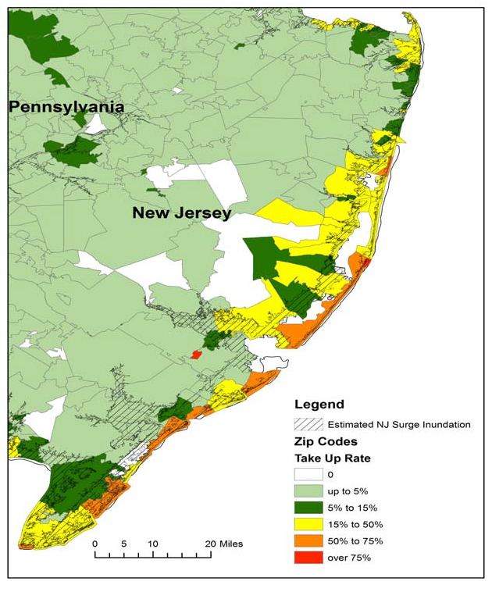
Residential NFIP Flood Take-Up Rates in NJ (2010) & Sandy Storm Surge
Flood coverage penetration rates were extremely low in many very vulnerable areas in NJ, with take-up rates far below 50% in many areas
Source: Wharton Center for Risk Management and Decision Processes, Issue Brief, Nov. 2012; Insurance Information Institute.
17

Slide 18
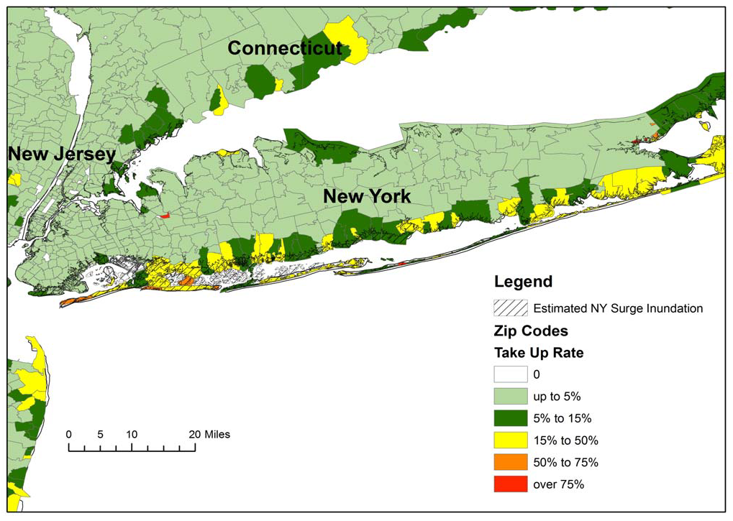
Residential NFIP Flood Take-Up Rates in NY, CT (2010) & Sandy Storm Surge
Flood coverage penetration rates were extremely low in many very vulnerable areas of NY and CT, with take-up rates far below 50% in many areas
Source: Wharton Center for Risk Management and Decision Processes, Issue Brief, Nov. 2012; Insurance Information Institute.
18

Slide 19
Hurricane Sandy: National Flood Insurance Program Payment, by State*
($ Millions)
TOTAL = $4.797 BILLION
At $2.437B and $2.152B, respectively, NY and NJ sustained, by far, the largest NFIP flood losses from Hurricane Sandy
The NFIP Will Ultimately Likely Pay Close to $7 Billion to 100,000 Policyholders Across 9 States and DC in the Wake of Hurricane Sandy
*As of February 20, 2013.
Sources: NFIP; Insurance Information Institute .

Slide 20
Percentage of California Homeowners with Earthquake Insurance, 1994-2010*
The vast majority of California homeowners forego earthquake coverage and play Russian Roulette with their most valuable asset
*Includes CEA policies beginning in 1996. **2006 estimate from Insurance Information Network of CA. 2010 from CEA.
Source: California Department of Insurance; Insurance Information Institute.

Slide 21
Flood Insurance Reform & Modernization Act of 2012: Key Provisions
Reauthorized NFIP and Its Financing Through 9/30/17
Increase in Average Annual Limit on Premium Increase
  Increases annual limit on premium increase from 10% to 20%
Phase-in of Actuarial Rates for Certain Properties
  Applies to non-primary residences, severe repetitive loss properties, properties where flood losses have exceed property value, business property, property that has sustained damage > 50% of fair market value
Actuarial Sound Rates for Certain Severe Repetitive Loss Properties
  Charge actuarially sound rates to any prospective or repetitive loss properties that refused to accept offers of mitigation assistance after a major disaster
Prohibition of Premium Rate Subsidy on New or Lapsed Policies
Source: Independent Insurance Agents and Brokers Association at http://www.iiaba.net/webfolder/na/jeff/big%20i%20firm%20summary.pdf;
Insurance Information Institute.

Slide 22
Other Changes, Net Impacts & Outstanding Questions
Separate Remapping Initiative (Flood maps out of date)
  Already resulting in expansion of high hazard flood zones
  Will also increase costs to many
Post-Sandy Changes in Building Codes
Use of State and Federal Funds to Purchase Vulnerable Property from Current Owners Who Had Homes Damaged or Destroyed in Sandy
  Most seem willing to sell since they are being offered 100%+ or pre-Sandy value and many were not insured for flood damage
Given only 1/2 to 1/3 of Coastal Dwellers Maintain Flood Coverage, What Will Be the Impact of Higher Price?
  What is elasticity of demand for flood insurance?
Will Private Insurers Have a Greater Incentive to Participate in the Flood Insurance Market?

Slide 23
I.I.I. PULSE SURVEY
Despite Education Efforts and Numerous Disasters, Many Insurance Buyers Have Serious Misconceptions or Make Poor Decisions Related to their Insurance Coverage
23

Slide 24
I.I.I. Poll: Disaster Preparedness
Q. Do you have a separate flood insurance policy?¹
Only 14 percent of American homeowners say they have a flood insurance policy. The percentage is lowest in the Northeast at 8 percent.
¹Asked of those who have homeowners insurance and who responded “yes”.
Source: Insurance Information Institute Annual Pulse Survey.

Slide 25
I.I.I. Poll: Disaster Preparedness
Q. Have recent flooding events such as Hurricane Sandy or Hurricane Irene motivated you to buy flood coverage?¹
Surprisingly few people are motivated to buy flood coverage despite recent catastrophic flooding events
Recent storms have not motivated people to buy flood insurance coverage.
¹Asked of those who have homeowners insurance but not flood insurance.
Source: Insurance Information Institute Annual Pulse Survey.

Slide 26
I.I.I. Poll: Disaster Preparedness
Q. Will the government pay for damage to your home that is not covered in your homeowners policy?¹
Sixty-four percent of homeowners say that the government will not pay for damage to their homes that is not covered by their homeowners policy.
¹Asked of those who have homeowners insurance and who responded “yes”.
Source: Insurance Information Institute Annual Pulse Survey.

Slide 27
I.I.I. Poll: Financial Strength
Q. There have been a number of major weather-related events in recent years, such as Hurricane Sandy and severe tornadoes. Do you believe that insurers have the financial strength to pay claims following a natural disaster?
Don’t know
It is likely that concerns about the NFIP to pay claims feed into concerns over insurer ability to pay
No
Yes
While more than 60% of Americans believe insurance companies have the resources to pay claims after a natural disaster, nearly one-third do not—about the same as last year.
Source: Insurance Information Institute Annual Pulse Survey.

Slide 28
I.I.I. Poll: Homeowners Insurance
Q. Do you think that it is fair that people who live in areas affected by record storms in 2011 and 2012 should pay more for their homeowners insurance in the future?
Don’t know
View is that such catastrophes are random “Acts of God” and therefore people have no control over them hence reflecting their costs in the premium is not fair
No
Yes
About one-half of Americans (55 percent) believe that homeowners insurance premiums should not be raised as a result of recent storms in their areas.
Source: Insurance Information Institute Annual Pulse Survey.

Slide 29
I.I.I. Poll: Homeowners Insurance
Q. Do you think that it’s fair that people who live in areas prone to hurricanes pay a ‘hurricane deductible’ when damage from a hurricane occurs?
Don’t know
People appear to draw a distinction between random catastrophic events occurring anywhere and the decision to live in a hurricane prone area
No
Yes
More than half of Americans think that it is fair that residents of hurricane-prone areas pay a hurricane deductible if a hurricane damages their homes.
Source: Insurance Information Institute Annual Pulse Survey.

Slide 30
Superstorm Sandy: Rewriting of the Insurance History Books Continues
Sandy Was Only the Most Recent of Many Large Scale Catastrophes Around the Globe
30

Slide 31
2012 Catastrophe Summary
Catastrophe Communications: US & Global
  U.S. Focus: ~$37-$42B = 2nd Most Costliest Year Ever for Insured Catastrophe Loss (Behind 2005)
    Economic Losses = $101B
    Crop = Additional ~$16B ($7B-$8B privately insured)
    NFIP Flood = Additional $9B+
    Flood losses/NFIP/FEMA has been the #1 communications “issue” in the wake of Sandy
  Global Focus: $65B in Insured Losses→Well Below $105B in 2011 but Above 10-Yr. Avg. of $50B
    Cats abroad did not drive media cycle in 2012, save ongoing Fukishima issues; Climate change
  Market Consequences: Primary & Reinsurance
    Impacts on price, availability
31
12/01/09 - 9pm
eSlide – P6466 – The Financial Crisis and the Future of the P/C
Notes:
31

Slide 32
Natural Disaster Losses in the United States: 2012
As of January 1, 2013 | Number of Events | Fatalities | Estimated Overall Losses (US $m) | Estimated Insured Losses (US $m)
Tropical Cyclone | 4 | 143 | 52,240 | 26,360
Severe Thunderstorm | 115 | 118 | 27,688 | 14,914
Drought | 2 | 0 | 20,000 | 16,000†
Wildfire | 38 | 13 | 1,112 | 595
Winter Storm | 2 | 7 | 81 | 38
Flood | 19 | 3 | 13 | 0††
TOTALS | 184 | 284 | $101,134 | $57,907
Source: MR NatCatSERVICE
† - Includes Federal Crop Insurance Losses. † † - Excludes federal flood.
32
Notes:
All data from NatCat Service

Slide 33
Significant Natural Catastrophes, 2012
(Events with $1 billion economic loss and/or 50 fatalities)
Date | Event | Estimated Economic Losses (US $m) | Estimated Insured Losses (US $m)
June – Sept 2012 | Central US Drought | 20,000 | 16,000†
March 2 - 3 | Thunderstorms | 5,000 | 2,500
April 2 – 4 | Thunderstorms | 1,550 | 775
April 13- 15 | Thunderstorms | 1,800 | 910
April 28 – 29 | Thunderstorms | 4,500 | 2,500
May 25 – 30 | Thunderstorms | 3,400 | 1,700
June 6 – 7 | Thunderstorms | 1,400 | 1,000
June 11 – 13 | Thunderstorms | 1,900 | 950
June 28 – July 2 | Thunderstorms | 4,000 | 2,000
August 26 - 30 | Hurricane Isaac | 2,000 | 1,220
October 28 - 30 | Hurricane Sandy | 50,000 | 25,000††
Source: MR NatCatSERVICE
† - Includes Federal Crop Insurance Losses.; † † - Excludes NFIP losses.
33
33

Slide 34
Top 16 Most Costly Disasters in U.S. History
(Insured Losses, 2012 Dollars, $ Billions)
Hurricane Sandy could become the 4th or 5th costliest event in US insurance history
Includes Tuscaloosa, AL, tornado
Includes Joplin, MO, tornado
Hurricane Irene became the 12th most expense hurricane in US history in 2011
12 of the 16 Most Expensive Events in US History Have Occurred Over the Past Decade
*Estimate as of 12/09/12 based on estimates of catastrophe modeling firms and reported losses as of 1/12/13. Estimates range up to $25B.
Sources: PCS; Insurance Information Institute inflation adjustments to 2012 dollars using the CPI.

Slide 35
Top 16 Most Costly World Insurance Losses, 1970-2012*
(Insured Losses, 2012 Dollars, $ Billions)
5 of the top 14 most expensive catastrophes in world history have occurred within the past 3 years
2012 insured CAT Losses totaled $60B; Economic losses totaled $140B, according to Swiss Re
Hurricane Sandy could become the 6th costliest event in global insurance history
*Figures do not include federally insured flood losses.
**Estimate based on PCS value of $18.75B as of 1/18/13 and assumption of upward development based on catastrophe modeler estimates ranging as high as $25B.
Sources: Swiss Re sigma 1/2011; Munich Re; Insurance Information Institute research.

Slide 36
Natural Disasters in the United States, 1980 – 2012
Number of Events (Annual Totals 1980 – 2012)
There were 184 natural disaster events in the US in 2012
Number
41
19
121
3
Geophysical
(earthquake, tsunami,
volcanic activity)
Meteorological (storm)
Climatological
(temperature extremes,
drought, wildfire)
Hydrological
(flood, mass movement)
Source: MR NatCatSERVICE
36

Slide 37
Losses Due to Natural Disasters in the US, 1980–2012 (Overall & Insured Losses)
(Overall and Insured Losses)
(2012 Dollars, $ Billions)
2012 was the 2nd or 3rd most expensive year on record for insured catastrophe losses in the US.
Approximately 57% of the overall cost of catastrophes in the US was covered by insurance in 2012
2012 Losses
Overall : $101.1B
Insured: $57.9B
Overall losses (in 2012 values)
Insured losses (in 2012 values)
Source: MR NatCatSERVICE
37

Slide 38
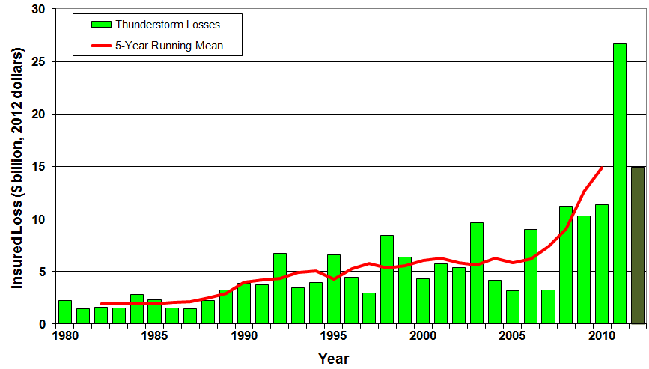
U.S. Thunderstorm Loss Trends, 1980 – 2012
Hurricanes get all the headlines, but thunderstorms are consistent producers of large scale loss. 2008-2012 are the most expensive years on record.
Average thunderstorm losses are up 7 fold since the early 1980s. The 5- year running average loss is up sharply.
Thunderstorm losses in 2012 totaled $14.9 billion, the 2nd highest on record
Source: Property Claims Service, MR NatCatSERVICE
38

Slide 39
US Insured Catastrophe Losses
($ Billions, 2012 Dollars)
2012 CAT losses were down nearly 50% from 2011 until Sandy struck in late October
US CAT Losses in 2012 Will Likely Become the 2nd or 3rd Highest in US History on An Inflation-Adjusted Basis (Pvt Insured). 2011 Losses Were the 5th Highest
Record Tornado Losses Caused 2011 CAT Losses to Surge
*As of 1/2/13. Includes $20B gross loss estimate for Hurricane Sandy.
Note: 2001 figure includes $20.3B for 9/11 losses reported through 12/31/01 ($25.9B 2011 dollars). Includes only business and personal property claims, business interruption and auto claims. Non-prop/BI losses = $12.2B ($15.6B in 2011 dollars.)
Sources: Property Claims Service/ISO; Insurance Information Institute.
39
12/01/09 - 9pm
eSlide – P6466 – The Financial Crisis and the Future of the P/C
Notes:
39

Slide 40
Combined Ratio Points Associated with Catastrophe Losses: 1960 – 2012*
Avg. CAT Loss Component of the Combined Ratio by Decade
1960s: 1.04 1970s: 0.85 1980s: 1.31 1990s: 3.39 2000s: 3.52 2010s: 7.20*
Catastrophe losses as a share of all losses reached a record high in 2012
Combined Ratio Points
The Catastrophe Loss Component of Private Insurer Losses Has Increased Sharply in Recent Decades
Notes: Private carrier losses only. Excludes loss adjustment expenses and reinsurance reinstatement premiums. Figures are adjusted for losses ultimately paid by foreign insurers and reinsurers.
Source: ISO (1960-2011); A.M. Best (2012E) Insurance Information Institute.

Slide 41
Federal Disaster Declarations Patterns: 1953-2012
Despite 11 Sandy Declarations, Fewer Disasters Were Declared in 2012 than the Record Number of Declarations in 2010 and 2011
41

Slide 42
Number of Federal Disaster Declarations, 1953-2013*
There have been 2,101 federal disaster declarations since 1953. The average number of declarations per year is 35 from 1953-2012, though that few haven’t been recorded since 1995.
The number of federal disaster declarations set a new record in 2011, with 99, shattering 2010’s record 81 declarations.
47 federal disasters were declared in 2012
The Number of Federal Disaster Declarations Is Rising and Set New Records in 2010 and 2011. Hurricane Sandy Produced 13 Declarations in 2012/13.
*Through Feb. 24, 2013.
Source: Federal Emergency Management Administration; http://www.fema.gov/disasters; Insurance Information Institute.

Slide 43
Federal Disasters Declarations by State,
1953 – 2013: Highest 25 States*
Over the past 60 years, Texas has had the highest number of Federal Disaster Declarations
*Through Feb. 24, 2012. Includes Puerto Rico and the District of Columbia.
Source: FEMA: http://www.fema.gov/news/disaster_totals_annual.fema; Insurance Information Institute.

Slide 44
Federal Disasters Declarations by State,
1953 – 2013: Lowest 25 States*
Over the past 60 years, Wyoming and Rhode Island had the fewest number of Federal Disaster Declarations
*Through Feb. 24, 2013. Includes Puerto Rico and the District of Columbia.
Source: FEMA: http://www.fema.gov/news/disaster_totals_annual.fema; Insurance Information Institute.

Slide 45
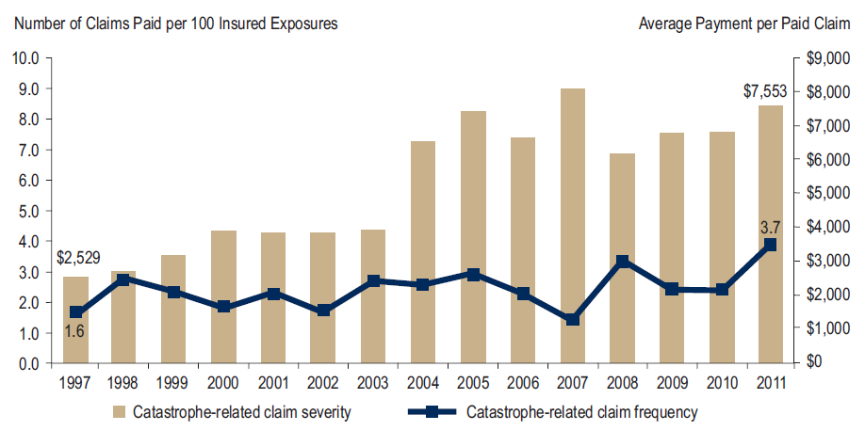
Homeowners Insurance Catastrophe-Related Claim Frequency and Severity, 1997—2012*
Avg. catastrophe claim cost rose approximately 200% from 1997-2011
Cat claim frequency in 2011 was at historic highs and more than double the rate in 1997
*All policy forms combined, countrywide.
Source: Insurance Research Council, Trends in Homeowners Insurance Claims, Sept. 2012 from ISO Fast Track data.
45

Slide 46
U.S. Insured Catastrophe Losses by Cause of Loss, 2011 ($ Millions)
Wildfires, $855
Flood , $535, (1.5%)
Other, $1,000
Geological Events, $50, (0.1%)
Winter Storms, $2,017
Hurricanes & Tropical Storms, $5,510
Thunderstorm/ Tornado losses were 2.5 times above the 30-year average
Thunderstorms (Incl. Tornadoes , $25,813
2011’s insured loss distribution was unusual with tornado and thunderstorm accounting for the vast majority of loss
.
Source: ISO’s Property Claim Services Unit, Munich Re; Insurance Information Institute.

Slide 47
Inflation Adjusted U.S. Catastrophe Losses by Cause of Loss, 1990–2011¹
Wind/Hail/Flood (3), $14.8
Fires (4), $6.0
Other (5), $1.4
Insured cat losses from 1992-2011 totaled $384.3B, an average of $19.2B per year or $1.6B per month
Geological Events, $18.2
Terrorism, $24.4
Winter Storms, $28.2
Hurricanes & Tropical Storms, $161.3
Tornado share of CAT losses is rising
Wind losses are by far cause the most catastrophe losses, even if hurricanes/TS are excluded.
Tornadoes (2), $130.2
Catastrophes are defined as events causing direct insured losses to property of $25 million or more in 2009 dollars.
Excludes snow.
Does not include NFIP flood losses
Includes wildland fires
Includes civil disorders, water damage, utility disruptions and non-property losses such as those covered by workers compensation.
Source: ISO’s Property Claim Services Unit.

Slide 48
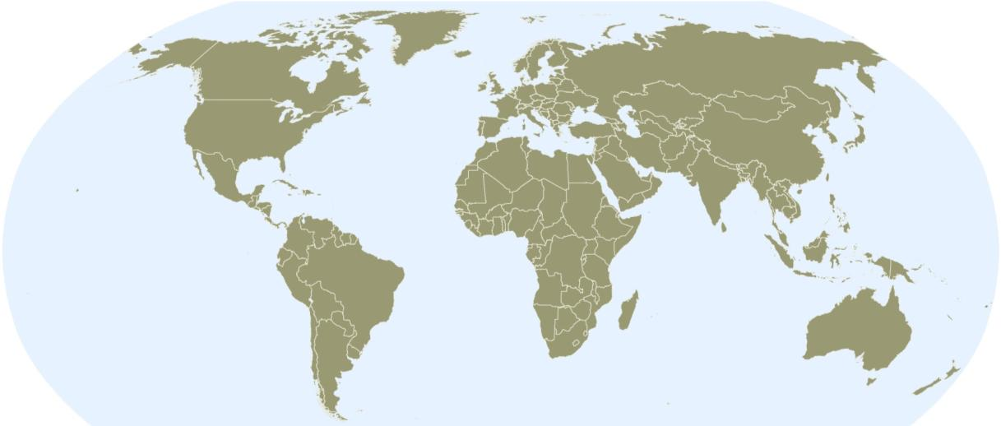
Natural Catastrophes Worldwide 2012
Insured Losses = $65bn - % distribution per continent
91%
5%
2012: 91 %
65%
<3%
1980-2011: 65 %
Insured losses in the Americas were 91% of the global total in 2012, compared to an average of 65% from 1980-2011
<1%
<1%
Continent | Insured losses US$ m
America (North & South Am.) | 60,000
Europe | 3,200
Africa | 200
Asia | 1,700
Australia/Oceania | 300
© 2013 Munich Re
48
Source: Geo Risks Research, NatCatSERVICE – As at January 2013

Slide 49

Natural Catastrophes Worldwide 2012
Overall Losses = $160bn - % distribution per continent
69%
13%
16%
Overall losses (insured & uninsured) in the Americas totaled $110B or 69% of the $160B global total in 2012
<1%
<1%
<1%
Continent | Overall losses US$ m
America (North & South) | 110,000
Europe | 21,000
Africa | 1,000
Asia | 26,000
Australia/Oceania | 1,000
Source: Munich Re Geo Risks Research, NatCatSERVICE – As at January 2013
49

Slide 50
Top 16 Most Costly World Insurance Losses, 1970-2012*
(Insured Losses, 2012 Dollars, $ Billions)
5 of the top 14 most expensive catastrophes in world history have occurred within the past 3 years
2012 insured CAT Losses totaled $60B; Economic losses totaled $140B, according to Swiss Re
Hurricane Sandy could become the 6th costliest event in global insurance history
*Figures do not include federally insured flood losses.
**Average of range estimates of $35B - $40B as of 1/4/12 adjusted to 2012 dollars; Privately insured losses only.
***Estimate as of 12/09/12, based on average of midpoints from range estimates from AIR, RMS and Eqecat.
Sources: Swiss Re sigma 1/2011; Munich Re; Insurance Information Institute research.

Slide 51
P/C Insurance Industry Financial Overview
Sandy Impacted 2012 Financial Performance, But the Industry Remains Very Strong Financially
51

Slide 52
P/C Net Income After Taxes
1991–2012:Q3 ($ Millions)
2005 ROE*= 9.6%
2006 ROE = 12.7%
2007 ROE = 10.9%
2008 ROE = 0.1%
2009 ROE = 5.0%
2010 ROE = 6.6%
2011 ROAS¹ = 3.5%
2012:Q3 ROAS¹ = 6.3%
P-C Industry 2012:Q3 profits were up 222% from 2011:Q3, due primarily to lower catastrophe losses
* ROE figures are GAAP; ¹Return on avg. surplus. Excluding Mortgage & Financial Guaranty insurers yields a 6.6% ROAS through 2012:Q3, 4.6% ROAS for 2011, 7.6% for 2010 and 7.4% for 2009.
Sources: A.M. Best, ISO, Insurance Information Institute

Slide 53
P/C Insurance Industry
Combined Ratio, 2001–2012E*
Higher CAT Losses, Shrinking Reserve Releases, Toll of Soft Market
As Recently as 2001, Insurers Paid Out Nearly $1.16 for Every $1 in Earned Premiums
Heavy Use of Reinsurance Lowered Net Losses
Relatively Low CAT Losses, Reserve Releases
Relatively Low CAT Losses, Reserve Releases
Avg. CAT Losses, More Reserve Releases
Lower CAT Losses Before Sandy
Best Combined Ratio Since 1949 (87.6)
Cyclical Deterioration
* Excludes Mortgage & Financial Guaranty insurers 2008--2012. Including M&FG, 2008=105.1, 2009=100.7, 2010=102.4, 2011=108.2; 2012:Q3=100.0.
Sources: A.M. Best, ISO.

Slide 54
A 100 Combined Ratio Isn’t What It
Once Was: Investment Impact on ROEs
A combined ratio of about 100 generates an ROE of ~6.6% in 2012, ~7.5% ROE in 2009/10,
10% in 2005 and 16% in 1979
Combined Ratio / ROE
Combined Ratios Must Be Lower in Today’s Depressed
Investment Environment to Generate Risk Appropriate ROEs
* 2008 -2012 figures are return on average surplus and exclude mortgage and financial guaranty insurers. 2012:Q3 combined ratio including M&FG insurers is 100.9, ROAS = 6.3%; 2011 combined ratio including M&FG insurers is 108.2, ROAS = 3.5%.
Source: Insurance Information Institute from A.M. Best and ISO data.

Slide 55
Profitability Peaks & Troughs in the P/C Insurance Industry, 1975 – 2012E*
ROE
History suggests next ROE peak will be in 2016-2017
1977:19.0%
1987:17.3%
10 Years
2006:12.7%
1997:11.6%
10 Years
9 Years
2012E: ~4.5%
2011:4.6%*
1975: 2.4%
1984: 1.8%
1992: 4.5%
2001: -1.2%
*Profitability = P/C insurer ROEs. 2012 figure is an estimate based on ROAS data. Note: Data for 2008-2012 exclude mortgage and financial guaranty insurers. 2012:Q3 ROAS = 6.2% including M&FG.
Source: Insurance Information Institute; NAIC, ISO, A.M. Best.

Slide 56
Underwriting Gain (Loss)
1975–2012E*
($ Billions)
Cumulative underwriting deficit from 1975 through 2011 is $479B
Underwriting losses in 2012 totaled an est. $30B
High cat losses in 2011 led to the highest underwriting loss since 2002
Large Underwriting Losses Are NOT Sustainable
in Current Investment Environment
* Includes mortgage and financial guaranty insurers in all years.
Sources: A.M. Best, ISO; Insurance Information Institute.

Slide 57
Combined Ratios by Predominant Business Segment, 2012:9 Mos. vs. 2011:9 Mos.*
The combined ratios for both personal and commercial lines improved substantially through 2012:Q3, prior to Hurricane Sandy
(Percent)
*Excludes mortgage and financial guaranty insurers.
Source: ISO/PCI; Insurance Information Institute

Slide 58
PREMIUM GROWTH TRENDS
Sustained Shift in Pricing in the Wake of CATs, Low Interest Rates
58

Slide 59
Net Premium Growth: Annual Change,
1971—2013F
(Percent)
1975-78
1984-87
2000-03
Net Written Premiums Fell 0.7% in 2007 (First Decline Since 1943) by 2.0% in 2008, and 4.2% in 2009, the First 3-Year Decline Since 1930-33.
2012E growth was +4.7%
Shaded areas denote “hard market” periods
Sources: A.M. Best (historical and forecast), ISO, Insurance Information Institute.

Slide 60
P/C Net Premiums Written: % Change, Quarter vs. Year-Prior Quarter
Premium growth in Q3 2012 was up 5.1% over Q3 2011, the strongest growth since Q4 2006
Sustained Growth in Written Premiums
(vs. the same quarter, prior year) Will Continue into 2013
Sources: ISO, Insurance Information Institute.
60
12/01/09 - 9pm
eSlide – P6466 – The Financial Crisis and the Future of the P/C
Notes:
60

Slide 61
Growth in Net Written Premium by Segment, 2012:9 Mos. vs. 2011:9 Mos.*
(Percent)
*Excludes mortgage and financial guaranty insurers.
Source: ISO/PCI; Insurance Information Institute

Slide 62
Average Commercial Rate Change,
All Lines, (1Q:2004–3Q:2012)
Pricing as of Q3:2012 was positive for the 5th consecutive quarter. Gains are likely to continue in 2013.
(Percent)
Q2 2011 marked the last of 30th consecutive quarter of price declines
KRW Effect
Note: CIAB data cited here are based on a survey. Rate changes earned by individual insurers can and do vary, potentially substantially.
Source: Council of Insurance Agents & Brokers; Insurance Information Institute

Slide 63
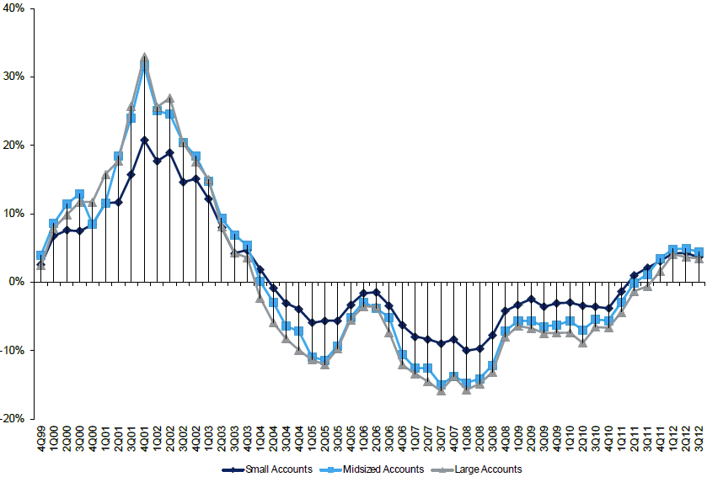
Change in Commercial Rate Renewals, by Account Size: 1999:Q4 to 2012:Q3
Percentage Change (%)
Peak = 2001:Q4 +28.5%
Pricing turned positive in Q3:2011, the first increase in nearly 8 years; Q3:2012 renewals were up 3.9%, though some insurers posted stronger numbers
Pricing Turned Negative in Early 2004 and Remained that way for 7 ½ years
KRW : No Lasting Impact
Trough = 2007:Q3 -13.6%
Source: Council of Insurance Agents and Brokers; Barclay’s Capital; Insurance Information Institute.
Note: CIAB data cited here are based on a survey. Rate changes earned by individual insurers can and do vary, potentially substantially.

Slide 64
Change in Commercial Rate Renewals, by Line: 2012:Q3
Workers Comp rate increases are large than any other line, followed by Property lines
Percentage Change (%)
Major Commercial Lines Renewed Uniformly Upward in Q3:2012 for the Fifth Consecutive Quarter Since 2003; Property Lines & Workers Comp Leading the Way; Cat Losses and Low Interest Rates Provide Momentum Going Forward
Note: CIAB data cited here are based on a survey. Rate changes earned by individual insurers can and do vary, potentially substantially.
Source: Council of Insurance Agents and Brokers; Insurance Information Institute.

Slide 65
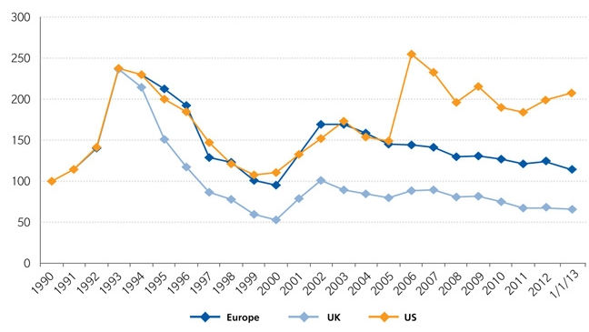
Regional Property Catastrophe Rate on Line Index, 1990—2013 (as of January 1)
Property-Cat reinsurance pricing was up in the US as of 1/1/13 but was down in Europe/UK
Sources: Guy Carpenter; Insurance Information Institute.

Slide 66
SURPLUS/CAPITAL/CAPACITY
How Will Large Catastrophe Losses Impact Capacity?
66

Slide 67
US Policyholder Surplus:
1975–2012*
($ Billions)
Surplus as of 9/30/12 was a record $583.5, up 6.0% from $550.3 of 12/31/11, but still up 33.5% ($146.4B) from the crisis trough of $437.1B at 3/31/09. Pre-crisis peak was $521.8 as of 9/30/07. Surplus as of 9/30/12 was 11.8% above 2007 peak.
“Surplus” is a measure of underwriting capacity. It is analogous to “Owners Equity” or “Net Worth” in non-insurance organizations
The Premium-to-Surplus Ratio Stood at $0.80:$1 as of
9/30/12, A Near Record Low (at Least in Recent History)*
* As of 9/30/12.
Source: A.M. Best, ISO, Insurance Information Institute.

Slide 68
Policyholder Surplus,
2006:Q4–2012:Q3
Drop due to near-record 2011 CAT losses
2007:Q3
Pre-Crisis Peak
($ Billions)
Surplus as of 9/30/12 was up $12.8B or 2.2% from the previous record high of $570.7B set as of 3/31/12.
The Industry now has $1 of surplus for every $0.80 of NPW, close to the strongest claims-paying status in its history.
*Includes $22.5B of paid-in capital from a holding company parent for one insurer’s investment in a non-insurance business in early 2010.
The P/C Insurance Industry Both Entered and Emerged from the 2012 Hurricane Season Very Strong Financially. There is No Insurance Industry “Fiscal Cliff”
Sources: ISO, A.M .Best.
68
12/01/09 - 9pm
eSlide – P6466 – The Financial Crisis and the Future of the P/C
Notes:
68

Slide 69
Hurricane Sandy Reignited in the United States the Debate on Climate Change
Climate Change Remains a Controversial Topic in the US
69
Notes:
69

Slide 70
Climate Change: Did Sandy Revitalize the Debate in the US?
The Issue of Climate Change Received Relatively Little Attention in the US until Hurricane Katrina in 2005
  Katrina was (and remains) the costliest disaster in US and global history (both in economic and insurance terms)
  Katrina occurred near the end of a long series of costly tropical events over the previous two years
  Severe floods and wildfires had occurred as well
  Coincided with the 2006 release of former Vice President Al Gore’s book and film “An Inconvenient Truth” which warned of the perils of global warming
Real Estate Bubble Was Inflating Rapidly in 2004-2007
  Large share of development in environmentally vulnerable areas
  Population shift to more vulnerable areas
US Economy Was Strong, Unemployment Was Low
  Climate was an issue the country could “afford” to be concerned about

Slide 71
Climate Change: Did Sandy Revitalize the Debate in the US? (continued)
Issue Was an Important One in the Early Stages of 2008 Presidential Election; Cause Championed by Obama
2008 Financial Crisis Pushed Issue to the Back Burner
  View by some that massive job losses during the crisis would be made worse with carbon/GHG legislation
Volatile Weather in the US in 2011 (Tornadoes, Wildfire) and Hurricane Sandy and Drought in 2012 Coincided with 2012 Political Cycle and Recovering Economy
  Issue once again became part of political discourse in US
  Still polarizing issue, but is now on Obama agenda
  Mentioned by politicians such as NY Gov. Andrew Cuomo
Sustained Increase in Variability and Volatility in US Weather Cited More Often by Insurance CEOs as Driver of Higher Claim Costs (Associated with Higher Claim Frequency/Severity)

Slide 72
Insurance Information Institute Online:
www.iii.org
Thank you for your time
and your attention!
Twitter: twitter.com/bob_hartwig
Download at www.iii.org/presentations

