Slide 1
Presentation to the Federal Disaster Recovery
Coordination Group
Sandy Recovery – Six Months Later
Queens, New York
April 24, 2013
Jeanne M. Salvatore, Senior Vice President – Public Affairs
Dr. Steven Weisbart, Senior Vice President – Economist
Loretta Worters, Vice President - Communications
Insurance Information Institute ♦ 110 William Street ♦ New York, NY

Slide 2
Presentation Outline
What is the I.I.I.?
I.I.I.’s role in the Aftermath of Sandy
Small Business Insurance and Disaster Planning
Economic ramifications of Sandy
I.I.I. Resources

Slide 3
What is the Mission of the I.I.I.?
The mission of the Insurance Information Institute is to build public understanding of insurance—what it does and how it works—primarily through the media.
  The I.I.I. is dedicated to making sure the media covers our business fairly and accurately.
  I.I.I. assists its member companies with their communications, information, research and planning needs.

Slide 4
I.I.I.’s Role Regarding Sandy
During the storm and its immediate aftermath, I.I.I. staff worked from their homes, giving interviews and providing information to virtually every major news outlet.
The I.I.I. appeared several times a day on local news stations. These broadcasts were also made available to stations around the country, amplifying the I.I.I.’s reach.
The I.I.I. gave over 44 television interviews (including several in Spanish), which were aired nationwide 730 times to over 25 million viewers.
Before, during and after the storm, we also issued a steady stream of news releases timed to be one step ahead of the news cycle–15 in total. This resulted in the I.I.I. appearing in nearly 3,000 Internet news publications, such as the New York Times website, and over 918 times in print publications, wire services and prominent blogs.
Notes:
Thanks, Bob. As the video we just saw demonstrated

Slide 5
Hurricane Sandy Outreach
For some residents with no electricity, battery-operated radios were their only source of information. Therefore, the I.I.I. created media opportunities with a number of local radio outlets.
It is worth noting that outside of national and Tri-state media, Florida news outlets were the most likely to quote the I.I.I. or to cover Hurricane Sandy.
Essentially, it was the I.I.I.’s relationships with national and local news outlets, our 24/7 availability to the news media as well the steady flow of information that we distributed which resulted in our significant media outreach.
Coordinated with a number of federal organizations such as the NFIP and NOAA.

Slide 6
Hurricane Sandy: News Cycle
Before the Storm – There were two key questions:
1. What is this storm going to cost?
2. What is covered and what is not covered?
During the Storm – Media had specific coverage questions especially about flood insurance. Hurricane deductibles were also a prominent topic, as well as the financial strength of the industry and its ability to pay claims. There was also keen interest in historical data about other storms/disasters.
Immediately After the Storm –There was intense media interest in the claims process, especially how long it will take for an adjuster to visit. Lastly, there were questions on the impact of Sandy on the cost of coverage.
Note: While all disasters are different, the media’s questions generally follows a very specific pattern.
Notes:
Hurricane Sandy had an interesting news cycle

Slide 7
Current Media Environment
Media interest in Sandy has decreased substantially, but the types of questions are now more difficult and sensitive in nature–driven largely by claims disputes.
Flood insurance continues to dominate media interest, particularly the lack of coverage, limitations in the NFIP policy itself and complaints about slow claims handling. In fact, a majority of the negative media coverage is regarding flood insurance.
There are also ongoing questions and concerns about claims handling, business insurance and FEMA assistance.
Notes:
NOTE:
In terms of the current media environment
Mention that in live interviews I.I.I. have been pressed continually to answer questions about FEMA. I.I.I. in the past has had a productive partnership with the NFIP. In fact, they have paid for I.I.I. spokespeople to participate in SMT’s and most recently arranged for me to appear on Life Time Television popular program, Designing Spaces. Dave Miller, the new head of the Federal Insurance and Mitigation Administration along with his deputy, Edward Connor will be speaking at the I.I.I. Communications Committee tommorrow.

Slide 8
Insurance Lessons Learned From Sandy for Consumers
Homeowners, renters and small business owners need to understand the importance of purchasing flood insurance. There also needs to be greater education about what is and is not covered under a flood insurance policy.
There was widespread confusion on the role of deductibles in an insurance policy. And, even more misunderstanding regarding wind and hurricane deductibles.
Homeowners and renters did not understand their overall coverage and their various insurance options.
Claimants need to have a better understanding of how the claims process works before there is a disasters.
Notes:
Our Continuing communications include

Slide 9
Business Insurance Overview
Sandy provided a reminder that every business needs to have a disaster plan and appropriate business insurance for their specific needs.

Slide 10
How Business Interruption (Income) Insurance Works
Business Interruption (also known as Business Income) insurance covers continuing expenses and the net profit lost during the period when normal operations are interrupted because of physical damage by a peril covered in the policy. BI applies when:
There is physical damage to property. The absence of physical loss or damage will likely result in coverage being denied.
The damage must be from an insured peril. In addition to the requirement that the insured property suffer actual physical damage, the cause of the damage must be from a covered peril for the policy to trigger.

Slide 11
How Business Interruption (Income) Insurance Works
The loss or damage must prevent, suspend, or at least reduce the ability of the business to operate.
The inability of the business to operate continues only for the time required to repair or replace the damaged property, known as the period of restoration. BI provides coverage only for the time required — in the exercise of due diligence and dispatch — to repair or rebuild the property so the insured can resume normal operations. The key requirement is “due diligence and dispatch,” as the period of restoration likely would last longer than anticipated if insureds did not make all reasonable attempts to restore their businesses quickly.

Slide 12
How Business Interruption (Income) Insurance Works
The business must sustain an actual loss. The calculation of actual loss sustained will take into consideration whether the insured has recouped any of the losses it sustained once the business resumes. This method of calculating business interruption can be lengthy and complex and often requires forensic accountants to determine the quantum of loss. Additionally, the underwriter will consider the financial records of the entire corporation when determining the actual loss sustained by an operating entity.

Slide 13
How Business Interruption (Income) Insurance Works
In order for businesses to tap into business interruption insurance, the disruption typically must go on for longer than 72 hours.
It is also possible for business interruption coverage to come into play when access to the insured’s property is prevented because of physical damage elsewhere, such as a bridge damaged in a storm. This coverage can be provided under ingress/egress or order of civil or military authority.
Contingent business interruption is also available and provides coverage against the physical damage to third parties, such as suppliers or customers, or for damage at an attraction or leader property, such as a large department store in a mall.

Slide 14
MAJOR PROBLEMS FACED BY SMALL BUSINESS AFTER SANDY
Separate endorsements were typically needed for losses resulting from utility service interruptions, blocked ingress or egress to particular locations and government-ordered roadblocks or evacuations. (For example, some restaurants in downtown Manhattan that were forced to close for days or weeks after superstorm Sandy caused a major power outage found that their business interruption insurance would not kick in because the cause of the outage was flooding.)
Much like homeowners some business owners did not receive payouts from their insurers, if they had a mortgagee clause in their property policies directing the insurer to pay the mortgage holder.
Notes:
Not all restaurant policies excluded claims caused by flood damage to utilities and some insurers were paying lost business claims due to flooding even when the policies excluded them. On Long Island, where the power company did not say that the loss of power was specifically due to flooding, many restaurants have been able to collect business interruption payments. This contrasts with Manhattan, where Con ED blamed power outage on flooding.
Governor Cuomo has tried to improve that situation by mandating mortgage lenders expedite the payouts.

Slide 15
MAJOR PROBLEMS FACED BY SMALL BUSINESS AFTER SANDY
Companies that incurred time-element losses needed to calculate their losses and compare their actual earnings during the interruption period to their prior-year financial returns and projections of what earning would have been absent the storm’s effects.
New flood maps will require thousands of businesses to increase their flood protection or pay higher insurance premiums, and some will be required to purchase flood insurance for the first time.
Notes:
Not all restaurant policies excluded claims caused by flood damage to utilities and some insurers were paying lost business claims due to flooding even when the policies excluded them. On Long Island, where the power company did not say that the loss of power was specifically due to flooding, many restaurants have been able to collect business interruption payments. This
contrasts with Manhattan, where Con ED blamed power outage on flooding

Slide 16
Lessons Learned from Sandy for Small Business
Business owners need to read their policy thoroughly and understand what is covered and what is not, including flood insurance.
Business owners — along with their brokers — should evaluate the risk of loss from all perils before purchasing a property insurance policy.
Have an accurate accounting of the maximum damage that could occur as a result of any peril. Review all current policies to make certain the limits of liability are in line with the dollar value of the cost to repair or replace the damage.
Incorporate supply chain in a business continuity plan.
Finally, having a contingency plan in place which includes establishing relationships with remediation specialists, contingency services providers, engineers and contractors so that your business will be prepared for any future disasters.
Notes:
One business owner, for example, purchased flood insurance, but unfortunately did not read the policy thoroughly. When preparing the Sandy claim, he finally read his policy and discovered that the named insured was actually the landlord’s name, not the name of his limited liability company. As a result, any payment for loss or damage owed on the policy would be sent to the landlord, not the business owner who paid the premium for the policy.
If the business is located on or near the ocean, bay, or canal the risk or probability of loss as a result of flooding is high. Coverage should be purchased in proportion to the insured’s probability of risk.
Companies should consider engaging a loss control engineer or contractor in order to fully understand the dollar value of the cost to replace or repair the damage.

Slide 17
Economic ramifications of Sandy

Slide 18
Nov 2012 “Beige Book,” 2d Federal Reserve District (NY, Northern NJ, Southern CT)
Difficult to Measure Effect of Sandy on the Region’s Economy
  Offsetting Activity. Examples:
    Tourism was down, but hotels and restaurants hosted residents without power or livable homes
    Retail sales dipped in early November but were strong in October and strong again in December (holiday shopping)
  Overall: Widespread dips in first week/10 days but bounce back from mid-November on
    Insurance claim payments undoubtedly helped spur the recovery
18
12/01/09 - 9pm
eSlide – P6466 – The Financial Crisis and the Future of the P/C
Notes:
18

Slide 19
Employment* in the NY-NJ Metro Region, Sept-Feb 2012 vs. 2013
Immediate effect of Sandy: Nov 2012 down 25,000 jobs
Despite holiday hiring, Dec employment still down 9,000 from October
Millions Employed
In Nov 2011, employment rose by 10,000
*not seasonally adjusted
Sources: U.S. Department of Labor; Insurance Information Institute.

Slide 20
Retail Sales,* U.S.: 2011, 2012, 2013
Billions
Sandy
*seasonally adjusted
Sources: U.S. Census Bureau; Insurance Information Institute.

Slide 21
Percent Change* in Personal Income,
NY, NJ, PA, CT, Quarterly, 2011:Q4 - 2012:Q4
There is no evidence that Personal Income in NY and NJ was affected by Sandy any more than Personal Income in PA or CT
*from preceding quarter, seasonally adjusted
Sources: U.S. Department of Labor; Insurance Information Institute.

Slide 22
Change* in Price Index for Lumber:
Sudden Spikes, 2008–2013
But 30% spikes can happen suddenly
The price of lumber dropped before and during the recession…
Oct 2012 to Mar 2013
The prices of building materials vary wildly and change levels rapidly.
Prices for hardwood have been much less variable than softwood lumber.
*Monthly, year-over-year, through March 2013. Not seasonally adjusted. Dec. 2012 and Jan., Feb., and Mar. prices are preliminary.
Sources: US Bureau of Labor Statistics, Producer Price Index series WPS0811; National Bureau of Economic Research (recession dates); Insurance Information Institutes.
22
12/01/09 - 9pm
eSlide – P6466 – The Financial Crisis and the Future of the P/C
Notes:
22

Slide 23
P/C Industry Net Income,
Fourth Quarters, 2007-2012
$Billions
Financial crisis, Hurricane Ike
Sandy
Over the past 6 years, the fourth calendar quarter usually
has been more profitable for the P/C industry than it was in 2012.
Sources: ISO; Insurance Information Institute

Slide 24
P/C Industry Net Income,
Quarterly, 2007:Q1-2012:Q4
$Billions
Financial crisis, Hurricane Ike
Spring 2011 tornadoes
Virtually a year
without any profits
Sources: SNL Financial; Insurance Information Institute

Slide 25
If They Hit Today, the Dozen Costliest (to Insurers) Hurricanes in U.S. History
Insured Losses,
2012 Dollars, $ Billions
Storms that hit long ago had less property and businesses to damage, so simply adjusting their actual claims for inflation doesn’t capture their destructive power.
Karen Clark’s analysis aims to overcome that.
When you adjust for the damage prior storms could have done if they occurred today, Hurricane Katrina slips to a tie for 6th among the most devastating storms.
*Estimate as of 12/09/12 based on estimates of catastrophe modeling firms and reported losses as of 1/12/13. Estimates range up to $25B.
Sources: Karen Clark & Company, Historical Hurricanes that Would Cause $10 Billion or More of Insured LossesToday, August 2012; I.I.I.

Slide 26
P/C Industry Homeowners Claim Frequency, US, 1997-2011
Claims Paid per 100 Exposures
Sources: Insurance Research Council, “Trends in Homeowners Insurance Claims,” p.29; Insurance Information Institute

Slide 27
P/C Industry Homeowners Average Claim Severity, 1997-2011
HO average claim severity is now three times what it was in 1997.
Sources: Insurance Research Council, “Trends in Homeowners Insurance Claims,” p. 29, BLS inflation calculator,
and Insurance Information Institute

Slide 28
I.I.I. Resources

Slide 29
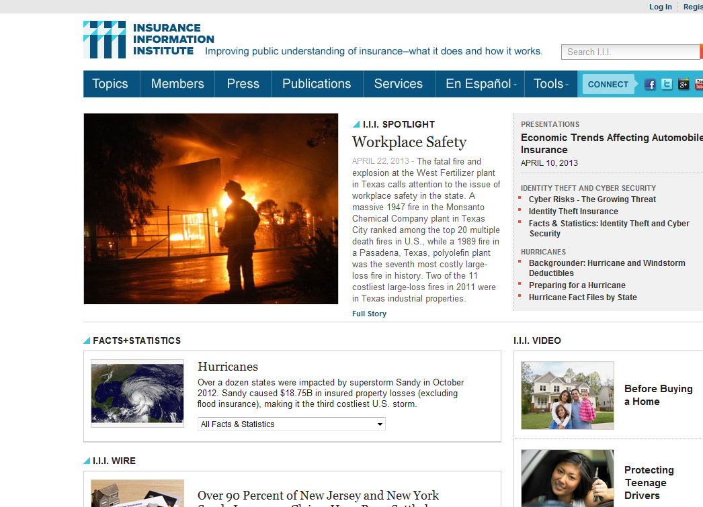

Slide 30
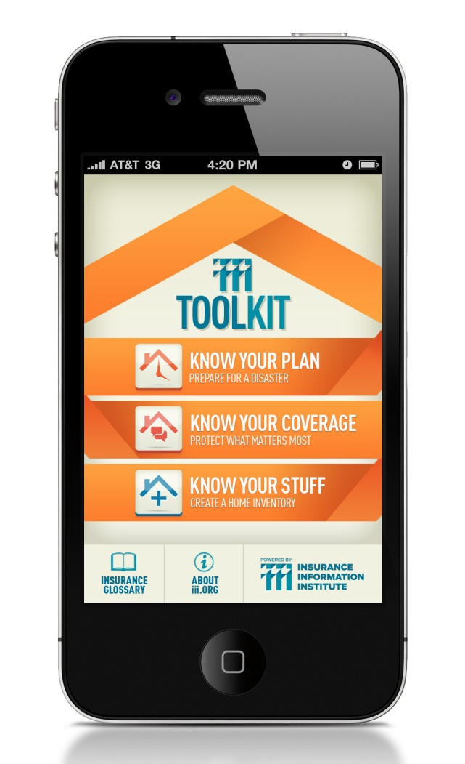
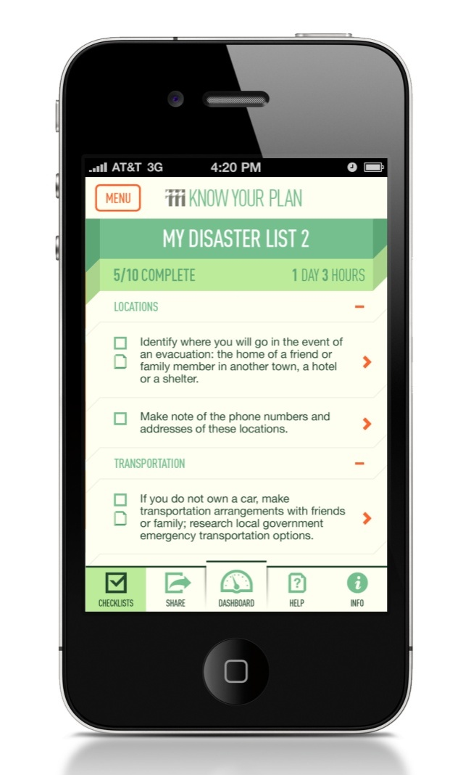
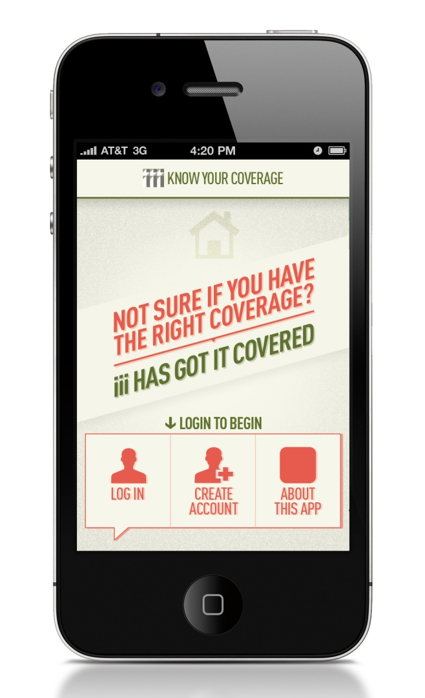
I.I.I. Mobile Apps – Disaster Resource
The I.I.I. is developing a branded suite of apps to provide guidance to consumers in making decisions about their insurance and preparing for a disaster.

Slide 31
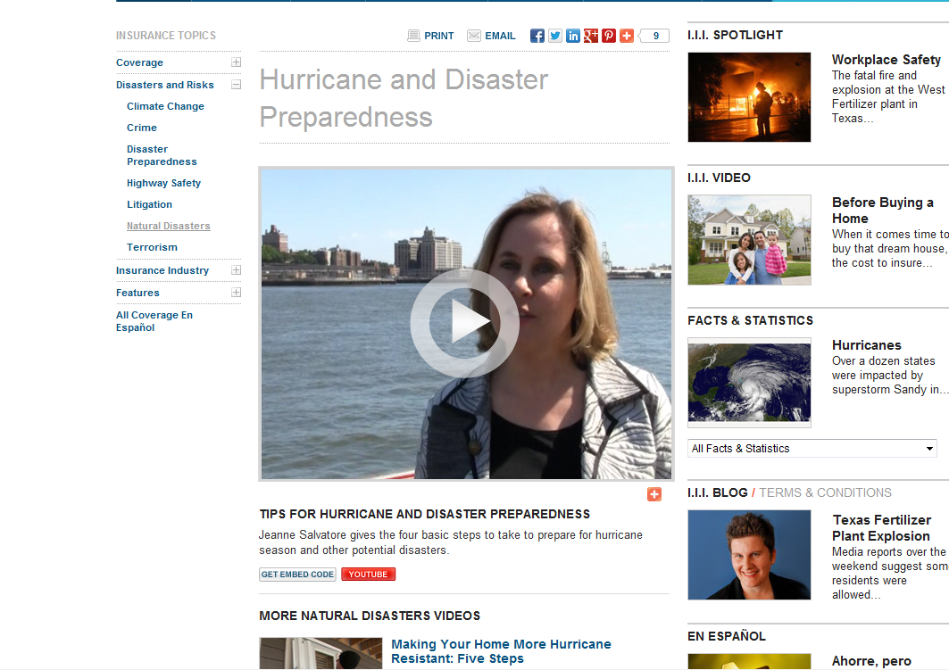
Disaster preparedness videos

Slide 32
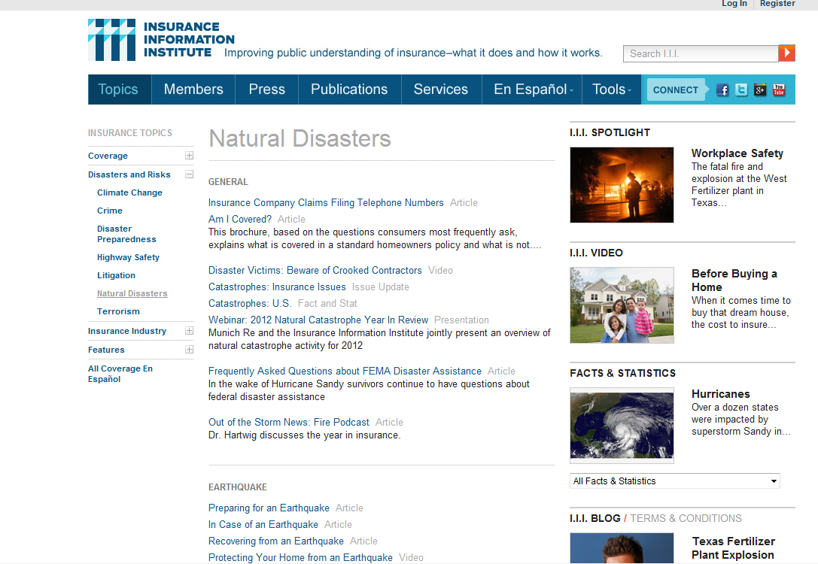
Wide variety of information on Natural Disasters

Slide 33
Insurance Information Institute
www.iii.org
Thank you for your time
and your attention!
Notes:
33

