Slide 1
P/C Insurance in the Post-Crisis World:
Opportunities and Challenges in U.S. and Texas Markets
Insurance Council of Texas
Annual Insurance Symposium
Austin, TX
July 18, 2013
Robert P. Hartwig, Ph.D., CPCU, President & Economist
Insurance Information Institute ♦ 110 William Street ♦ New York, NY 10038
Tel: 212.346.5520 ♦ Cell: 917.453.1885 ♦ bobh@iii.org ♦ www.iii.org

Slide 2
P/C Insurance Industry Financial Overview
Profit Recovery in 2012 After High CAT Losses; Ultimate Impact of Sandy Still Unclear
2

Slide 3
P/C Net Income After Taxes
1991–2013:Q1 ($ Millions)
2005 ROE*= 9.6%
2006 ROE = 12.7%
2007 ROE = 10.9%
2008 ROE = 0.1%
2009 ROE = 5.0%
2010 ROE = 6.6%
2011 ROAS¹ = 3.5%
2012 ROAS¹ = 5.9%
2013:Q1 ROAS¹ = 9.6%
2012:Q1 ROAS was 7.2%
Net income is up substantially (+40.9%) from 2012:Q1 $10.2B
ROE figures are GAAP; ¹Return on avg. surplus. Excluding Mortgage & Financial Guaranty insurers yields a 9.7% ROAS in 2013:Q1, 6.2% ROAS in 2012, 4.7% ROAS for 2011, 7.6% for 2010 and 7.4% for 2009.
Sources: A.M. Best, ISO, Insurance Information Institute

Slide 4
Profitability Peaks & Troughs in the P/C Insurance Industry, 1975 – 2013:Q1*
ROE
History suggests next ROE peak will be in 2016-2017
1977:19.0%
1987:17.3%
10 Years
2006:12.7%
1997:11.6%
2013:Q1 9.7%
10 Years
9 Years
2012: 5.9%
1975: 2.4%
1984: 1.8%
1992: 4.5%
2001: -1.2%
*Profitability = P/C insurer ROEs. 2011-13 figures are estimates based on ROAS data. Note: Data for 2008-2013 exclude mortgage and financial guaranty insurers.
Source: Insurance Information Institute; NAIC, ISO, A.M. Best.

Slide 5
A 100 Combined Ratio Isn’t What It
Once Was: Investment Impact on ROEs
A combined ratio of about 100 generates an ROE of ~7.0% in 2012, ~7.5% ROE in 2009/10,
10% in 2005 and 16% in 1979
Combined Ratio / ROE
Catastrophes and lower investment income pulled down ROE in 2012
Combined Ratios Must Be Lower in Today’s Depressed
Investment Environment to Generate Risk Appropriate ROEs
* 2008 -2012 figures are return on average surplus and exclude mortgage and financial guaranty insurers. 2012 combined ratio including M&FG insurers is 103.2, 2011 combined ratio including M&FG insurers is 108.1, ROAS = 3.5%.
Source: Insurance Information Institute from A.M. Best and ISO data.

Slide 6
Profitability and Growth in the Texas P/C Insurance Markets
Analysis by Line and Nearby State Comparisons
6

Slide 7
RNW All Lines: TX vs. U.S., 2002-2011
(Percent)
Average 2002-2011
US: 7.7%
TX: 6.9%
Hurricane Ike
Sources: NAIC.
7
Notes:
7

Slide 8
RNW PP Auto: TX vs. U.S., 2002-2011
Average 2002-2011
US: 7.7%
TX: 8.3%
Sources: NAIC.
8
Notes:
8

Slide 9
RNW Comm. Auto: TX vs. U.S.,
2002-2011
(Percent)
Average 2002-2011
US: 9.8%
TX: 7.9%
Sources: NAIC.
9
Notes:
9

Slide 10
RNW Comm. Multi-Peril: TX vs. U.S., 2002-2011
(Percent)
Average 2002-2011
US: 9.1%
TX: 3.1%
Hurricane Ike
Sources: NAIC.
10
Notes:
10

Slide 11
RNW Homeowners: TX vs. U.S.,
2002-2011
(Percent)
Average 2002-2011
US: 5.4%
TX: 4.2%
Hurricane Ike
Sources: NAIC.
11
Notes:
11

Slide 12
Top Ten Most Expensive And Least Expensive States For Homeowners Insurance, 2010
Texas ranked as the most expensive state for homeowners insurance in 2010, with an average expenditure of $1,560.
Rank (1) | Most expensive states | HO average premium (2) | Rank | Least expensive states | HO average premium (2)
1 | Texas (2) | $1,560 | 1 | Idaho | $500
2 | Louisiana (3) | 1,546 | 2 | Oregon | 535
3 | Florida (4) | 1,544 | 3 | Utah | 558
4 | Oklahoma | 1,246 | 4 | Wisconsin | 563
5 | Mississippi | 1,217 | 5 | Washington | 595
6 | Rhode Island | 1,092 | 6 | Ohio | 614
7 | Kansas | 1,066 | 7 | Delaware | 636
8 | District Of Columbia | 1,065 | 8 | Arizona | 666
9 | Connecticut | 1,052 | 9 | Maine | 676
10 | Alabama | 1,050 | 10 | South Dakota | 678
Based on the HO-3 homeowner package policy for owner-occupied dwellings, 1 to 4 family units. Provides “all risks” coverage (except those specifically excluded in the policy) on buildings and broad named-peril coverage on personal property, and is the most common package written.
The Texas Department of Insurance developed home insurance policy forms that are similar but not identical to the standard forms. Note: Average premium=Premiums/exposure per house years. A house year is equal to 365 days of insured coverage for a single dwelling. The NAIC does not rank State Average Expenditures and does not endorse any conclusions drawn from this data.
Policies written by Citizens Property Insurance (Louisiana), are not included.
Policies written by Citizens Property Insurance (Florida), are not included.
Note: Average premium=Premiums/exposure per house years. A house year is equal to 365 days of insured coverage for a single dwelling. The NAIC does not rank state average expenditures and does not endorse any conclusions drawn from this data.
Source: © 2012 National Association of Insurance Commissioners (NAIC). Reprinted with permission. Further reprint or distribution strictly prohibited without written permission of NAIC.

Slide 13
RNW Workers Comp: TX vs. U.S.,
2002-2011
(Percent)
Average 2002-2011
US: 6.7%
TX: 10.9%
Sources: NAIC.
13
Notes:
13

Slide 14
All Lines: 10-Year Average RNW TX & Nearby States
2002-2011
Texas All Lines profitability is below the US and above the regional average
Source: NAIC, Insurance Information Institute

Slide 15
PP Auto: 10-Year Average RNW TX & Nearby States
2002-2011
Texas Private Passenger Auto profitability is above the US and regional average
Source: NAIC, Insurance Information Institute

Slide 16
Top Ten Most Expensive And Least Expensive States For Automobile Insurance, 2010 (1)
Rank | Most expensive states | Average expenditure | Rank | Least expensive states | Average expenditure
1 | New Jersey | $1,157.30 | 1 | South Dakota | $525.16
2 | District of Columbia | 1,133.87 | 2 | North Dakota | 528.81
3 | Louisiana | 1,121.46 | 3 | Iowa | 546.59
4 | New York | 1,078.88 | 4 | Idaho | 547.78
5 | Florida | 1,036.76 | 5 | Maine | 582.29
6 | Delaware | 1,030.98 | 6 | Nebraska | 592.69
7 | Rhode Island | 984.95 | 7 | North Carolina | 599.90
8 | Connecticut | 965.22 | 8 | Wisconsin | 613.37
9 | Maryland | 947.70 | 9 | Ohio | 619.46
10 | Michigan | 934.60 | 10 | Wyoming | 621.08
Texas ranked as the 14th most expensive state in 2010, with an average expenditure for auto insurance of $848.11.
Based on average automobile insurance expenditures.
Source: © 2012 National Association of Insurance Commissioners.

Slide 17
Comm. Auto: 10-Year Average RNW TX & Nearby States
2002-2011
Texas Commercial Auto profitability is below the US average and above the regional average
Source: NAIC, Insurance Information Institute

Slide 18
Comm. M-P: 10-Year Average RNW TX & Nearby States
2002-2011
Texas Commercial MP profitability is below the US average and above the regional average
Source: NAIC, Insurance Information Institute

Slide 19
Homeowners: 10-Year Average RNW TX & Nearby States
2002-2011
Texas Homeowners profitability is below the US average and above the regional average
Source: NAIC, Insurance Information Institute

Slide 20
Workers Comp: 10-Year Average RNW TX & Nearby States
2002-2011
Texas Workers Comp profitability is above the US and regional average
Source: NAIC, Insurance Information Institute

Slide 21
All Lines DWP Growth: TX vs. U.S., 2002-2011
(Percent)
Average 2002-2011
US: 3.6%
TX: 4.7%
Source: SNL Financial.
21
Notes:
21

Slide 22
Comm. Lines DWP Growth: TX vs. U.S., 2002-2011
(Percent)
Average 2002-2011
US: 4.0%
TX: 5.5%
Source: SNL Financial.
22
Notes:
22

Slide 23
Personal Lines DWP Growth: TX vs. U.S., 2002-2011
(Percent)
Average 2002-2011
US: 3.7%
TX: 4.5%
Source: SNL Financial.
23
Notes:
23

Slide 24
Private Passenger Auto DWP Growth: TX vs. U.S., 2002-2011
(Percent)
Average 2002-2011
US: 2.5%
TX: 3.9%
Source: SNL Financial.
24
Notes:
24

Slide 25
Homeowners DWP Growth: TX vs. U.S., 2002-2011
(Percent)
Average 2002-2011
US: 7.1%
TX: 6.0%
Source: SNL Financial.
25
Notes:
25

Slide 26
The Strength of the Economy Will Influence P/C Insurer Growth Opportunities
Growth Will Expand Insurer Exposure Base Across Most Lines
26

Slide 27
US Real GDP Growth*
The Q4:2008 decline was the steepest since the Q1:1982 drop of 6.8%
Real GDP Growth (%)
Recession began in Dec. 2007. Economic toll of credit crunch, housing slump, labor market contraction was severe
2013 is expected to see uneven growth, then gradually accelerate throughout the year and into 2014
Demand for Insurance Continues To Be Impacted by Sluggish Economic Conditions, but the Benefits of Even Slow Growth Will Compound and Gradually Benefit the Economy Broadly
* Estimates/Forecasts from Blue Chip Economic Indicators.
Source: US Department of Commerce, Blue Economic Indicators 7/13; Insurance Information Institute.

Slide 28
Real GDP by State Percent Change, 2012:
Highest 25 States
North Dakota was the economic growth juggernaut of the US in 2012—by far
Texas has had the 2nd fastest growing economy in the US in 2012
Only 10 states experienced growth in excess of 3%, which is what we would see nationally in a more typical recovery
Sources: US Bureau of Labor Statistics; Insurance Information Institute.

Slide 29
Real GDP by State Percent Change, 2012:
Lowest 25 States
Growth rates in 8 states (and DC) were still below 1% in 2012
Connecticut was the only state to shrink in 2012
Sources: US Bureau of Labor Statistics; Insurance Information Institute.

Slide 30

Federal Spending as a Share of State GDP: Vulnerability to Sequestration Varies
Some Mid-Atlantic and Southern state are more vulnerable to the effects of sequestration
Sources: Pew Center on the States (2012) Impact of the Fiscal Cliff on the States; Wells Fargo; Insurance Information Institute.

Slide 31
Defense and Non-Defense Federal Spending as a Share of State GDP: Top 10 States*
Defense Spending
Non-Defense Spending
Federal defense spending accounts for approximately 10%+ of GDP in 5 states
Federal non-defense spending accounts for 10%+ of GDP in 3 states
Sequestration Could Adversely Impact Commercial Insurance Exposures Directly at Defense Contractors and Indirectly in Impacted Communities
*As of 2010.
Sources: Pew Center on the States (2012) Impact of the Fiscal Cliff on the States; Wells Fargo Securities; Insurance Information Institute.

Slide 32
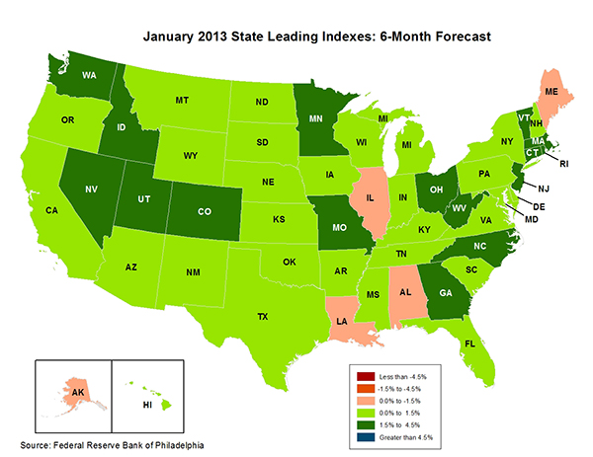
State-by-State Leading Indicators
through 2013:Q2
The economic outlook for most of New England is relatively strong, suggesting future strength in the creation of insurable exposures
Sources: Federal Reserve Bank of Philadelphia at http://www.philadelphiafed.org/index.cfm ;Insurance Information Institute.

Slide 33
Consumer Sentiment Survey (1966 = 100)
January 2010 through June 2013
Optimism among consumers has remained fairly strong despite tax hikes, federal budget concerns. May’s reading was the highest since July 2007
Consumer confidence has been low for years amid high unemployment, falling home prices and other factors adversely impact consumers, but improved substantially over the past two years
Source: University of Michigan; Insurance Information Institute

Slide 34
Auto/Light Truck Sales, 1999-2019F
Job growth and improved credit market conditions will boost auto sales in 2013 and beyond
(Millions of Units)
New auto/light truck sales fell to the lowest level since the late 1960s. Forecast for 2013-14 is still below 1999-2007 average of 17 million units, but a robust recovery is well underway.
Truck purchases by contractors are especially strong
Car/Light Truck Sales Will Continue to Recover from the 2009 Low Point, Bolstering the Auto Insurer Growth and the Manufacturing Sector Along With Workers Comp Exposures
Source: U.S. Department of Commerce; Blue Chip Economic Indicators (7/13 and 3/13); Insurance Information Institute.

Slide 35
Personal Auto Insurance Direct Written Premiums vs. Recently-Registered Cars
$ Billions
4%/yr growth forecast for PP DWP from recovering new car/truck sales
In 2004-07 no growth in PP DWP despite strong new car/truck sales
New car/truck sales grow to 14-15M/year
Average age of registered cars rose as fewer new cars were bought (and insured)
PP DWP, flat from 2004-2009, is rising again.
Conning forecasts growth at 3.5% in 2013 and 4.0% in 2014.
Sources: AIPSO Facts (various issues); SNL Financial; Conning Research & Consulting, Property-Casualty Forecast and Analysis, First Quarter 2012; Insurance Information Institute.

Slide 36
Monthly Change* in Auto Insurance Prices, 1991–2013*
Cyclical peaks in PP Auto tend to occur approximately every 10 years (early 1990s, early 2000s and likely the early 2010s)
Pricing peak occurred in late 2010 at 5.3%, falling to 2.8% by Mar. 2012
“Hard” markets tend to occur during recessionary periods
The June 2013 reading of 3.9% is up from 3.0% a year earlier
*Percentage change from same month in prior year; through June 2013; seasonally adjusted
Note: Recessions indicated by gray shaded columns.
Sources: US Bureau of Labor Statistics; National Bureau of Economic Research (recession dates); Insurance Information Institutes.
36
12/01/09 - 9pm
eSlide – P6466 – The Financial Crisis and the Future of the P/C
Notes:
36

Slide 37
Monthly Change* in Auto Insurance Prices, January 2005 - June 2013
Pricing weakened materially in 2011 and early 2012 but has strengthened since then
(Percent Change
from same month,
prior year)
Auto Insurance Price Increases Averaged 5.1% in 2010 over 2009, After Averaging 4.5% in 2009 over 2008.
PPA Auto, like most p/c lines, exhibits strong cyclicality in pricing. Prices rose from 2000 to late 2005, were flat/falling in 2006 and 2007 before beginning to rise gain in 2008.
Underwriting performance remained strong even when prices were flat or falling due to improvements in underlying frequency and severity trends
* Percentage change from same month in prior year, seasonally adjusted.
Sources: US Bureau of Labor Statistics; Insurance Information Institute

Slide 38
New Private Housing Starts, 1990-2019F
Job growth, low inventories of existing homes, low mortgage rates and demographics are stimulating new home construction for the first time in years
(Millions of Units)
New home starts plunged 72% from 2005-2009; A net annual decline of 1.49 million units, lowest since records began in 1959
Insurers Are Starting to See Meaningful Exposure Growth for the First Time Since 2005 Associated with Home Construction: Construction Risk Exposure, Surety, Commercial Auto; Potent Driver of Workers Comp Exposure
Source: U.S. Department of Commerce; Blue Chip Economic Indicators (7/13 and 3/13); Insurance Information Institute.

Slide 39
Average Premium for
Home Insurance Policies**
Countrywide Home Insurance Expenditures Increased by an Estimated 4.0% in 2011-2013
* Insurance Information Institute Estimates/Forecasts **Excludes state-run insurers.
Source: NAIC, Insurance Information Institute estimates for 2011-2013 based on CPI data and other data.

Slide 40
Construction Employment,
Jan. 2010—June 2013*
(Thousands)
Construction employment growth accelerated in the second half of 2012. Continued growth in this key sector is possible through 2013. Construction is a key driver of workers comp exposure growth.
*Seasonally adjusted
Sources: US Bureau of Labor Statistics at http://data.bls.gov; Insurance Information Institute.
40
12/01/09 - 9pm
eSlide – P6466 – The Financial Crisis and the Future of the P/C
Notes:
40

Slide 41
Construction Employment,
Jan. 2003–June 2013
(Thousands)
Construction employment as of June 2013 totaled 5.812 million, an increase of 377,000 jobs or 6.9% from the Jan. 2011 trough
Construction employment peaked at 7.726 million in April 2006
Construction employment troughed at 5.435 million in Jan. 2011, after a loss of 2.291 million jobs, a 29.7% plunge from the April 2006 peak
The “Great Recession” and housing bust destroyed 2.3 million constructions jobs
The Construction Sector Could Be a Growth Leader in 2013 and 2014 as the Housing Market and Private Investment Recover. WC Insurers Will Benefit.
Note: Recession indicated by gray shaded column.
Sources: U.S. Bureau of Labor Statistics; Insurance Information Institute.
41
12/01/09 - 9pm
eSlide – P6466 – The Financial Crisis and the Future of the P/C
Notes:
41

Slide 42
Nonfarm Payroll (Wages and Salaries):
Quarterly, 2005–2013:Q1
Billions
Latest (2013:Q4) was $7.01 trillion, a new peak--$762B above 2009 trough
Prior Peak was 2008:Q1 at $6.60 trillion
Payrolls are 12.2% above their 2009 trough and up 2.7% over the past year
Recent trough (2009:Q3) was $6.25 trillion, down 5.3% from prior peak
Note: Recession indicated by gray shaded column. Data are seasonally adjusted annual rates.
Sources: http://research.stlouisfed.org/fred2/series/WASCUR; National Bureau of Economic Research (recession dates); Insurance Information Institute.
42
12/01/09 - 9pm
eSlide – P6466 – The Financial Crisis and the Future of the P/C
Notes:
42

Slide 43
Commercial & Industrial Loans Outstanding at FDIC-Insured Banks, Quarterly, 2006-2013*
$Trillions
Recession
In nominal dollar terms, this is an all-time high.
Outstanding loan volume has been growing for over two years
and (as of year-end 2012) surpassed previous peak levels.
*Latest data as of 6/14/2013.
Source: FDIC at http://www2.fdic.gov/qbp/ (Loan Performance spreadsheet); Insurance Information Institute.

Slide 44
Percent of Non-current Commercial & Industrial Loans Outstanding at FDIC-Insured Banks,
Quarterly, 2006-2012:Q4*
Almost back to “normal” levels of noncurrent industrial & commercial loans
Recession
Non-current loans (those past due 90 days or more or in nonaccrual status) are back to early-recession levels, fueling bank willingness to lend.
*Latest data as of 3/18/2013.
Source: FDIC at http://www2.fdic.gov/qbp/ (Loan Performance spreadsheet); Insurance Information Institute.

Slide 45
Value of Construction Put in Place, May 2013 vs. May 2012*
Growth (%)
Private: +10.6%
Public: -4.7%
Public sector construction activity remains depressed
Private sector construction activity is up in the residential segment but down in nonresidential
Overall Construction Activity is Up, But Growth Is Entirely in the Private Sector as State/Local Government Budget Woes Continue
*seasonally adjusted
Source: U.S. Census Bureau, http://www.census.gov/construction/c30/c30index.html ; Insurance Information Institute.

Slide 46
Value of Private Construction Put in Place, by Segment, May 2013 vs. May 2012*
Growth (%)
Led by the Residential Construction, Lodging and Office segments, Private sector construction activity is remains mixed after plunging during the “Great Recession.” Most segments expanded in 2012 but weakened in early 2013.
Private Construction Activity is Up in Some Segments, Including the Key Residential Construction Sector, But Weakening in Early 2013
*seasonally adjusted
Source: U.S. Census Bureau, http://www.census.gov/construction/c30/c30index.html ; Insurance Information Institute.

Slide 47
Value of Public Construction Put in Place, by Segment, May 2013 vs. May 2012*
Growth (%)
Public sector construction activity is down substantially in most segments, a situation that will likely persist, dragging on public entity risk exposures
Transportation and Power projects lead public sector construction
Public Construction Activity is Down in Many Segments as State and Local Budgets Remain Under Stress; Improvement Possible in 2014.
*seasonally adjusted
Source: U.S. Census Bureau, http://www.census.gov/construction/c30/c30index.html ; Insurance Information Institute.

Slide 48
ISM Manufacturing Index
(Values > 50 Indicate Expansion)
January 2010 through June 2013
Manufacturing expanded in May, albeit modestly
The manufacturing sector expanded for 39 of the 42 months from Jan. 2010 through June 2013. Recent weakness stems largely from woes in Europe and a Slowdown in China.
Source: Institute for Supply Management at http://www.ism.ws/ismreport/mfgrob.cfm; Insurance Information Institute.

Slide 49
Dollar Value* of Manufacturers’ Shipments Monthly, Jan. 1992—Apr. 2013
$ Millions
The value of Manufacturing Shipments in Apr. 2013 were up 34% to $478.7B from its May 2009 trough. March figure is now 2.2% below its previous record high in Feb. 2013. Modest weakening in recent months.
Monthly shipments in Feb. 2013 exceeded their pre-crisis (July 2008) peak. Trough in May 2009. Growth from trough to Apr. 2013 was 34%. Manufacturing is an energy intensive activity and growth leads to gains in many commercial exposures: WC, Commercial Auto, Marine, Property and Various Liability Coverages
*seasonally adjusted
Source: U.S. Census Bureau, Full Report on Manufacturers’ Shipments, Inventories, and Orders, http://www.census.gov/manufacturing/m3/
49
12/01/09 - 9pm
eSlide – P6466 – The Financial Crisis and the Future of the P/C
Notes:
49

Slide 50
Manufacturing Growth for Selected Sectors, 2013 vs. 2013*
Growth (%)
Durables: +2.6%
Non-Durables: -0.2%
Manufacturing of durable goods was especially strong in 2012 but weakened in 2013
Manufacturing Is Expanding—Albeit More Slowly—Across a Number of Sectors that Will Contribute to Growth in Insurable Exposures Including: WC, Commercial Property, Commercial Auto and Many Liability Coverages
*Seasonally adjusted; Date are YTD comparing data through May 2013 to the same period in 2012.
Source: U.S. Census Bureau, Full Report on Manufacturers’ Shipments, Inventories, and Orders, http://www.census.gov/manufacturing/m3/

Slide 51
Recovery in Capacity Utilization is a Positive Sign for Commercial Exposures
March 2001 through April 2013
“Full Capacity”
The US operated at 77.8% of industrial capacity in Apr. 2013, well above the June 2009 low of 66.9% but is still below pre-recession levels.
Percent of Industrial Capacity
Hurricane Katrina
The closer the economy is to operating at “full capacity,” the greater the inflationary pressure
March 2001-November 2001 recession
December 2007-
June 2009 Recession
51
Source: Federal Reserve Board statistical releases at http://www.federalreserve.gov/releases/g17/Current/default.htm.
Notes:
51

Slide 52
Manufacturing Employment,
Jan. 2010—June 2013*
Manufacturing employment is up by more than 500,000 or 4.4% since Jan. 2010—a surprising source of strength in the economy. The sector has weakened recently as US corporations remains cautious and Europe, China slow.
(Thousands)
*Seasonally adjusted
Sources: US Bureau of Labor Statistics at http://data.bls.gov; Insurance Information Institute.
52
12/01/09 - 9pm
eSlide – P6466 – The Financial Crisis and the Future of the P/C
Notes:
52

Slide 53
ISM Non-Manufacturing Index
(Values > 50 Indicate Expansion)
January 2010 through June 2013
Optimism among non-manufacturers is stable and remains expansionary in 2013
Non-manufacturing industries have been expanding and adding jobs. The question is whether this will continue.
Source: Institute for Supply Management at http://www.ism.ws/ismreport/nonmfgrob.cfm; Insurance Information Institute.

Slide 54
Business Bankruptcy Filings,
1980-2012:Q3
% Change Surrounding Recessions
1980-82 58.6%
1980-87 88.7%
1990-91 10.3%
2000-01 13.0%
2006-09 208.9%*
2011 bankruptcies totaled 47,806, down 15.1% from 56,282 in 2010—the second consecutive year of decline. Business bankruptcies more than tripled during the financial crisis. Through Q3:2012, filings were down 15.8% vs. Q3:2011
Significant Exposure Implications for All Commercial Lines as Business Bankruptcies Begin to Decline
Sources: American Bankruptcy Institute at http://www.abiworld.org/AM/AMTemplate.cfm?Section=Home&TEMPLATE=/CM/ContentDisplay.cfm&CONTENTID=61633; Insurance Information Institute
54
12/01/09 - 9pm
eSlide – P6466 – The Financial Crisis and the Future of the P/C
Notes:
54

Slide 55
Private Sector Business Starts,
1993:Q2 – 2012:Q3*
Business Starts
2006: 872,000
2007: 843,000
2008: 790,000
2009: 697,000 2010: 742,000 2011: 748,000 2012E: 769,000*
(Thousands)
Business starts were up an estimated 2.8% in 2012 to 769,000 following a 2.2% to 748,000 in 2011. Start-ups could accelerate in 2013.
Business Starts Were Down Nearly 20% in the Recession,
Holding Back Most Types of Commercial Insurance Exposure, But Are Recovering Slowly
* Data through Sep. 30, 2012 are the latest available as of June 21, 2013; Seasonally adjusted.
Source: Bureau of Labor Statistics, http://www.bls.gov/news.release/cewbd.t08.htm.
55
12/01/09 - 9pm
eSlide – P6466 – The Financial Crisis and the Future of the P/C
Notes:
55

Slide 56
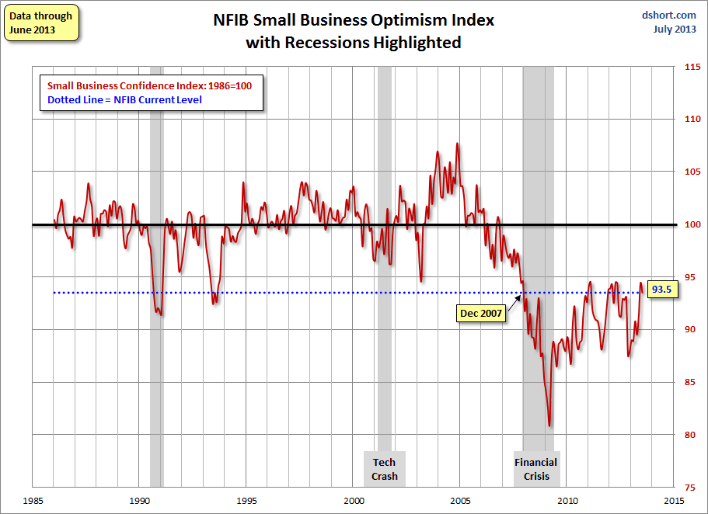
NFIB Small Business Optimism Index
January 1985 through June 2013
Small business optimism is off crisis lows but still suffering from economic and regulatory uncertainty. Confidence today is basically where it was when the crisis began in Dec. 2007.
Source: National Federation of Independent Business at http://www.advisorperspectives.com/dshort/charts/indicators/Sentiment.html?NFIB-optimism-index.gif ; Insurance Information Institute.

Slide 57
12 Industries for the Next 10 Years: Insurance Solutions Needed
Health Care
Health Sciences
Energy (Traditional)
Many industries are poised for growth, though insurers’ ability to capitalize on these industries varies widely
Alternative Energy
Petrochemical
Agriculture
Natural Resources
Technology (incl. Biotechnology)
Light Manufacturing
Insourced Manufacturing
Export-Oriented Industries
Shipping (Rail, Marine, Trucking, Pipelines)

Slide 58
U.S. Insured Catastrophe Loss Update
Catastrophe Losses in Recent Years Have Been Very High
58

Slide 59
U.S. Insured Catastrophe Losses
($ Billions, 2012 Dollars)
2012 was likely the third most expensive year ever for insured CAT losses
2012 Was the 3rd Highest Year on Record for Insured Losses in U.S. History on an Inflation-Adj. Basis. 2011 Losses Were the 6th Highest. YTD 2013 Running Below Average But Q3 Is Typically the Costliest Quarter.
Record tornado losses caused 2011 CAT losses to surge
*Through 6/2/13. Includes $2.6B for 2013:Q1 (PCS) and $5.32B for the period 4/1 – 6/2/13 (Aon Benfield Monthly Global Catastrophe Recap).
Note: 2001 figure includes $20.3B for 9/11 losses reported through 12/31/01 ($25.9B 2011 dollars). Includes only business and personal property claims, business interruption and auto claims. Non-prop/BI losses = $12.2B ($15.6B in 2011 dollars.)
Sources: Property Claims Service/ISO; Insurance Information Institute.
59
12/01/09 - 9pm
eSlide – P6466 – The Financial Crisis and the Future of the P/C
Notes:
59

Slide 60
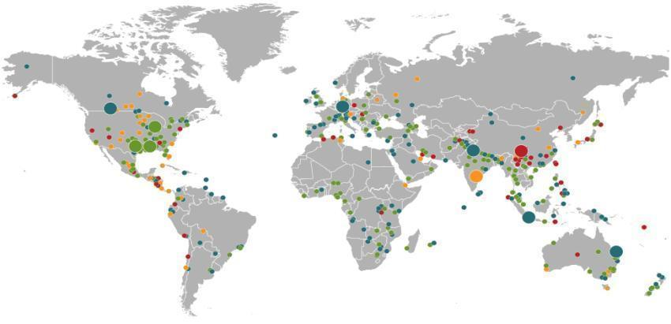
Natural Catastrophes January – June 2013
World map with significant events
Floods
Canada, June
Floods
Europe,
June
Winter storm
USA, 7–11 April
Earthquake
China,
20 April
Severe storms, tornadoes
USA, 18–20 March
Floods
India,
June
Severe storms, tornadoes
USA, 18–19 March
Heat wave
India, June
Number of events: 460
Floods
Indonesia,
15–22 January
Floods
Australia,
21–31 January
Natural catastrophes
Geophysical events
(earthquake, tsunami, volcanic activity)
Hydrological events
(flood, mass movement)
Selection of significant
loss events
Meteorological events
(storm)
Climatological events
(extreme temperature, drought, wildfire)
Source: 2013 Münchener Rückversicherungs-Gesellschaft, Geo Risks Research, NatCatSERVICE – as at June 2013
60

Slide 61
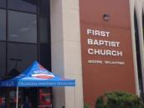


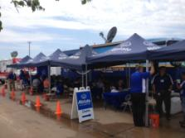

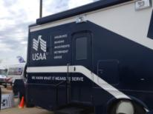
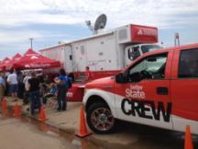
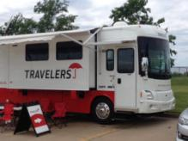
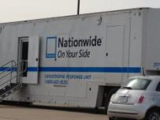
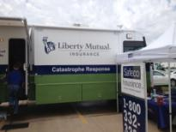
Moore, OK, Tornado: Media Coverage Was Generally Favorable
Industry had a highly visible, rapid response as Catastrophe Response Teams massed at the “Command Center” at the First Baptist Church in Moore within 48 hours
Developed good working relationship with OK Insurance Commissioner John Doak
61
12/01/09 - 9pm
eSlide – P6466 – The Financial Crisis and the Future of the P/C
Notes:
61

Slide 62
Top 16 Most Costly Disasters in U.S. History
(Insured Losses, 2012 Dollars, $ Billions)
Hurricane Sandy could become the 4th or 5th costliest event in US insurance history
Includes Tuscaloosa, AL, tornado
Includes Joplin, MO, tornado
Hurricane Irene became the 12th most expense hurricane in US history in 2011
12 of the 16 Most Expensive Events in US History Have Occurred Over the Past Decade
*PCS estimate as of 4/12/13.
Sources: PCS; Insurance Information Institute inflation adjustments to 2012 dollars using the CPI.

Slide 63
Top 16 Most Costly World Insurance Losses, 1970-2012*
(Insured Losses, 2012 Dollars, $ Billions)
5 of the top 14 most expensive catastrophes in world history have occurred within the past 3 years (2010-2012)
2012 insured CAT Losses totaled $60B; Economic losses totaled $140B, according to Swiss Re
Hurricane Sandy is now the 6th costliest event in global insurance history
*Figures do not include federally insured flood losses.
**Estimate based on PCS value of $18.75B as of 4/12/13.
Sources: Munich Re; Swiss Re; Insurance Information Institute research.

Slide 64
Natural Disasters in the United States, 1980 – June 2013*
Number of Events (Annual Totals 1980 – June 2013*)
There were 68 natural disaster events in the first half of 2013
Number
41
19
121
3
Geophysical
(earthquake, tsunami,
volcanic activity)
Meteorological (storm)
Climatological
(temperature extremes,
drought, wildfire)
Hydrological
(flood, mass movement)
*Through June 30, 2013.
Source: MR NatCatSERVICE
64

Slide 65
Natural Disasters Worldwide,
1980 – 2013* (Number of Events)
There were 460 natural disaster events globally in the first half of 2013 and 905 for full-year 2012
Number
41
19
121
3
Geophysical
(earthquake, tsunami,
volcanic activity)
Meteorological (storm)
Climatological
(temperature extremes,
drought, wildfire)
Hydrological
(flood, mass movement)
*Through June 30, 2013.
Source: MR NatCatSERVICE
65

Slide 66
Losses Due to Natural Disasters Worldwide, 1980–2013* (Overall & Insured Losses)
(Overall and Insured Losses)
(2012 Dollars, $ Billions)
2012 Losses
Overall : $101.1B
Insured: $57.9B
2013: 1st Half Losses
Overall : $45B
Insured: $13B
There is a clear upward trend in both insured and overall losses over the past 30+ years
Overall losses (in 2012 values)
Insured losses (in 2012 values)
*Through June 30, 2013.
Source: MR NatCatSERVICE
66

Slide 67
Losses Due to Natural Disasters in the US, 1980–2012 (Overall & Insured Losses)
(Overall and Insured Losses)
(2012 Dollars, $ Billions)
2012 was the 2nd or 3rd most expensive year on record for insured catastrophe losses in the US.
Approximately 57% of the overall cost of catastrophes in the US was covered by insurance in 2012
2012 Losses
Overall : $101.1B
Insured: $57.9B
Overall losses (in 2012 values)
Insured losses (in 2012 values)
Source: MR NatCatSERVICE
67

Slide 68
Losses Due to Natural Disasters in the US, 1980–2013 (Jan.-June Only)
(Overall and Insured Losses)
(2012 Dollars, $ Billions)
First Half 2013 losses were running below 2011 and 2012 but were consistent with the decade prior. Approximately 57% of the overall cost of catastrophes in the US was covered by insurance in 2013:H1
2013 First Half Losses
Overall : $13.8B
Insured: $7.9B
Overall losses (in 2012 values)
Insured losses (in 2012 values)
Source: MR NatCatSERVICE
68

Slide 69
Natural Disaster Losses in the United States: 2012
As of January 1, 2013 | Number of Events | Fatalities | Estimated Overall Losses (US $m) | Estimated Insured Losses (US $m)
Tropical Cyclone | 4 | 143 | 52,240 | 26,360
Severe Thunderstorm | 115 | 118 | 27,688 | 14,914
Drought | 2 | 0 | 20,000 | 16,000†
Wildfire | 38 | 13 | 1,112 | 595
Winter Storm | 2 | 7 | 81 | 38
Flood | 19 | 3 | 13 | 0††
TOTALS | 184 | 284 | $101,134 | $57,907
Source: MR NatCatSERVICE
† - Includes Federal Crop Insurance Losses. † † - Excludes federal flood.
69
Notes:
All data from NatCat Service

Slide 70
Natural Disaster Losses in the United States: First Half 2013
As of July 1, 2013 | Number of Events | Fatalities | Estimated Overall Losses (US $m) | Estimated Insured Losses (US $m)
Severe Thunderstorm | 29 | 66 | 10,180 | 6,325
Winter Storm | 13 | 17 | 2,434 | 1,255
Flood | 10 | 9 | 500 | Minor
Earthquake & Geophysical | 5 | 0 | Minor | Minor
Tropical Cyclone | 1 | 1 | Minor | Minor
Wildfire, Heat, & Drought | 11 | 23 | 700 | 365
Totals | 68 | 116 | 13,814 | 7,945
Source: MR NatCatSERVICE
70

Slide 71
Significant Natural Catastrophes, 2012
(Events with $1 billion economic loss and/or 50 fatalities)
Date | Event | Estimated Economic Losses (US $m) | Estimated Insured Losses (US $m)
June – Sept 2012 | Central US Drought | 20,000 | 16,000†
March 2 - 3 | Thunderstorms | 5,000 | 2,500
April 2 – 4 | Thunderstorms | 1,550 | 775
April 13- 15 | Thunderstorms | 1,800 | 910
April 28 – 29 | Thunderstorms | 4,500 | 2,500
May 25 – 30 | Thunderstorms | 3,400 | 1,700
June 6 – 7 | Thunderstorms | 1,400 | 1,000
June 11 – 13 | Thunderstorms | 1,900 | 950
June 28 – July 2 | Thunderstorms | 4,000 | 2,000
August 26 - 30 | Hurricane Isaac | 2,000 | 1,220
October 28 - 30 | Hurricane Sandy | 50,000 | 25,000††
Source: MR NatCatSERVICE
† - Includes Federal Crop Insurance Losses.; † † - Excludes NFIP losses.
71
71

Slide 72
Convective Loss Events in the U.S.
Number of events 1980 – 2012 and First Half 2013
Number
The frequency of convective events has rising tremendously over the past 30+ years
Convective events are those caused by straight-line winds, tornadoes, hail, heavy precipitation, flash floods and lightning
Source: Geo Risks Research, NatCatSERVICE – As at July 2013
72

Slide 73
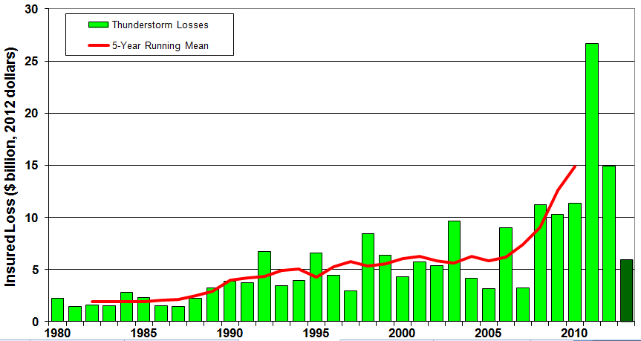
U.S. Thunderstorm Loss Trends, 1980 – June 30, 2013
Hurricanes get all the headlines, but thunderstorms are consistent producers of large scale loss. 2008-2012 are the most expensive years on record.
Average thunderstorm losses are up 7 fold since the early 1980s. The 5- year running average loss is up sharply.
1st Half 2013 thunderstorm losses total $6.325B; The system that included the EF-5 tornado in Moore, OK, accounted for $1.575B
Source: Property Claims Service, MR NatCatSERVICE
73

Slide 74
Convective Loss Events in the U.S.
Overall and insured losses 1980 – 2012 and First Half 2013
(Bill. US$)
The insured and total economic cost of convective events has rising tremendously over the past 30+ years
Convective events are those caused by straight-line winds, tornadoes, hail, heavy precipitation, flash floods and lightning
Analysis contains: straight-line winds, tornadoes, hail, heavy precipitation, flash floods, lightning.
Overall losses (in 2012 values)
Insured losses (in 2012 values)
Source: Geo Risks Research, NatCatSERVICE – As at July 2013
74

Slide 75
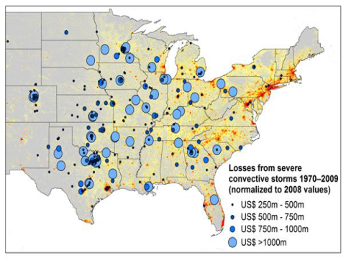
New Research Suggests Increase in Convective Activity Is Costly for Insurers
Study examines convective (hail, tornado, thundersquall and heavy rainfall) events in the US with losses exceeding US$ 250m in the period 1970–2009 (80% of all losses)
Past losses are normalized (i.e., adjusted) to currently exposed values
After normalization there are still increases of losses
Increases are correlated with
the increase in the meteorological
potential for severe thunderstorms
and its variability
For the first time research shows
that climatic changes have already
influenced US thunderstorm losses
Source: Munich Re research paper, Marhc 18, 2013: Rising Variability in Thunderstorm-Related U.S. Losses as a Reflection of Changes in Large-Scale Thunderstorm Forcing.
75

Slide 76
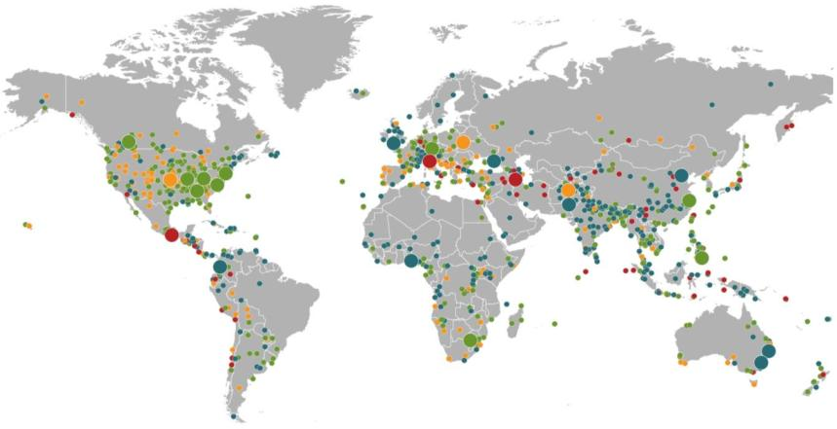
Natural Loss Events:
Full Year 2012
World Map
Winter Storm Andrea
Europe, 5–6 January
Floods
United Kingdom,
21–27 November
Cold Wave
Eastern Europe, Jan – Feb
Cold Wave
Afghanistan, Jan – Mar
Severe Weather
USA, 28–29 April
Hailstorms, severe weather
Canada, 12–14 August
Severe storms
USA, 28 June –2 July
Flash Floods
Russia, 6–8 July
Floods
China, 21–24 July
Drought
USA, Summer
Hurricane Sandy
USA, Caribbean
24–31 October
Earthquake
Italy,
29 May/3 June
Typhoon Haikui China, 8–9 August
Severe Storms, tornadoes
USA, 2–4 March
Hurricane Isaac
USA, Caribbean
24–31 August
Earthquake
Iran, 11 August
Earthquake
Mexico, 20 March
Floods
Nigeria, Jul – Oct
Floods
Pakistan, 3 –27 September
Typhoon Bopha Philippines, 4–5 December
Floods
Columbia, Mar – Jun
Floods, flash floods
Australia, Jan – Feb
Number of events: 905
Floods, hailstorms
South Africa, 20 –21 October
Floods. flash floods
Australia, Feb – Mar
Natural catastrophes
Geophysical events
(earthquake, tsunami, volcanic activity)
Hydrological events
(flood, mass movement)
Selection of significant
Natural catastrophes
Meteorological events
(storm)
Climatological events
(extreme temperature, drought, wildfire)
Source: Geo Risks Research, NatCatSERVICE – As of January 2013
76

Slide 77
Top 12 Most Costly Hurricanes in U.S. History
(Insured Losses, 2012 Dollars, $ Billions)
10 of the 12 most costly hurricanes in insurance history occurred over the past 9 years (2004—2012)
Hurricane Sandy became the 3rd costliest hurricane in US insurance history
Hurricane Irene became the 12th most expensive hurricane in US history in 2011
*PCS estimate as of 4/12/13.
Sources: PCS; Insurance Information Institute inflation adjustments to 2012 dollars using the CPI.

Slide 78
Outlook for 2013 Hurricane Season:
75% Worse Than Average
Forecast Parameter | Median (1981-2010) | 2013F
Named Storms | 12.0 | 18
Named Storm Days | 60.1 | 95
Hurricanes | 6.5 | 9
Hurricane Days | 21.3 | 40
Major Hurricanes | 2.0 | 4
Major Hurricane Days | 3.9 | 9
Accumulated Cyclone Energy | 92.0 | 165
Net Tropical Cyclone Activity | 103% | 175%
Source: Philip Klotzbach and Dr. William Gray, Colorado State University, June 2013, accessed at http://tropical.atmos.colostate.edu/forecasts/2013/apr2013/apr2013.pdf ; Insurance Information Institute..

Slide 79
Landfall Probabilities for 2013 Hurricane Season: Above Average
 | Average* | 2013F
Entire US East & Gulf Coasts | 52% | 72%
US East Coast Including Florida Peninsula | 31% | 48%
Gulf Coast from Florida Panhandle to Brownsville | 30% | 47%
Caribbean | 42% | 61%
*Average over the past century.
Source: Philip Klotzbach and Dr. William Gray, Colorado State University, June 2013.

Slide 80
Total Value of Insured Coastal Exposure in 2012
(2012, $ Billions)
$1.175 Trillion Insured Coastal Exposure in Texas in 2012, up $280.2 bill or 33.1% since 2007—well above the 20% for overall coastal exposure growth
In 2012, New York Ranked as the #1 Most
Exposed State to Hurricane Loss, Overtaking Florida with $2.862 Trillion. Texas is very exposed too, and ranked #3 with $1.175 Trillion
in insured coastal exposure
The Insured Value of All Coastal Property Was $10.6 Trillion in 2012 , Up 20% from $8.9 Trillion in 2007 and Up 48% from $7.2 Trillion in 2004
Source: AIR Worldwide

Slide 81
Total Value of Insured Coastal Exposure in 2007
(2007, $ Billions)
In 2007, Florida Still Ranked as the #1 Most
Exposed State to Hurricane Loss, with
$2.459 Trillion Exposure, but Texas is very exposed too, and ranked #3 with $895B
in insured coastal exposure
The Insured Value of All Coastal Property Was $8.9 Trillion in 2007, Up 24% from $7.2 Trillion in 2004
Source: AIR Worldwide

Slide 82
Total Potential Home Value Exposure to Storm Surge Risk in 2013*
($ Billions)
Texas has $51 billion in home value is exposed to storm surge
The Value of Homes Exposed to Storm Surge was $1.147 Trillion in 2013.* Only a fraction of this is insured, hence the huge demand for federal aid following major coastal flooding events.
*Insured and uninsured property. Based on estimated property values as of April 2013.
Source: Storm Surge Report 2013, CoreLogic.

Slide 83
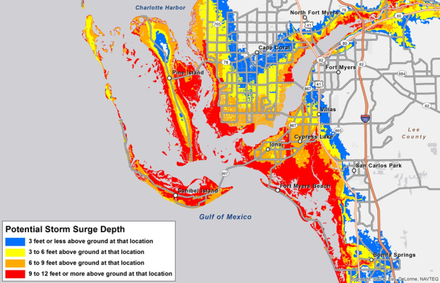
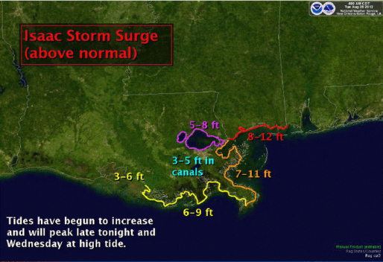

Storm Surge Inundation Graphic
NHC shooting for mid-season for deployment. First of many ways of distributing storm-surge forecasts.

Slide 84
Storm Surge Warning
Separate from the Hurricane Warning
Different timing than Hurricane Warning
Development, plan, test in 2013 & 2014
Deploy in 2015

Slide 85
U.S. Insured Catastrophe Losses by Cause of Loss, 2011 ($ Millions)
Wildfires, $855
Flood , $535, (1.5%)
Other, $1,000
Geological Events, $50, (0.1%)
Winter Storms, $2,017
Hurricanes & Tropical Storms, $5,510
Thunderstorm/ Tornado losses were 2.5 times above the 30-year average
Thunderstorms (Incl. Tornadoes , $25,813
2011’s insured loss distribution was unusual with tornado and thunderstorm accounting for the vast majority of loss
.
Source: ISO’s Property Claim Services Unit, Munich Re; Insurance Information Institute.

Slide 86
Inflation Adjusted U.S. Catastrophe Losses by Cause of Loss, 1992–2011¹
Wind/Hail/Flood (3), $14.8
Fires (4), $6.0
Other (5), $1.4
Insured cat losses from 1992-2011 totaled $384.3B, an average of $19.2B per year or $1.6B per month
Geological Events, $18.2
Terrorism, $24.4
Winter Storms, $28.2
Hurricanes & Tropical Storms, $161.3
Tornado share of CAT losses is rising
Wind losses are by far cause the most catastrophe losses, even if hurricanes/TS are excluded.
Tornadoes (2), $130.2
Catastrophes are defined as events causing direct insured losses to property of $25 million or more in 2009 dollars.
Excludes snow.
Does not include NFIP flood losses
Includes wildland fires
Includes civil disorders, water damage, utility disruptions and non-property losses such as those covered by workers compensation.
Source: ISO’s Property Claim Services Unit.

Slide 87
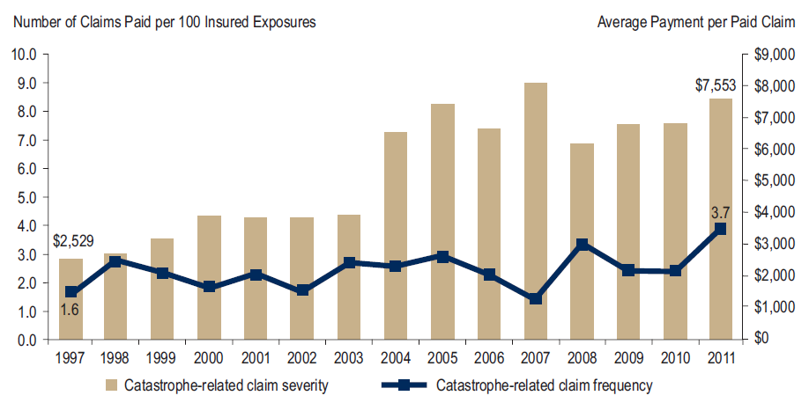
Homeowners Insurance Catastrophe-Related Claim Frequency and Severity, 1997—2012*
Avg. catastrophe claim cost rose approximately 200% from 1997-2011
Cat claim frequency in 2011 was at historic highs and more than double the rate in 1997
*All policy forms combined, countrywide.
Source: Insurance Research Council, Trends in Homeowners Insurance Claims, Sept. 2012 from ISO Fast Track data.
87

Slide 88
Combined Ratio Points Associated with Catastrophe Losses: 1960 – 2012*
Avg. CAT Loss Component of the Combined Ratio by Decade
1960s: 1.04 1970s: 0.85 1980s: 1.31 1990s: 3.39 2000s: 3.52 2010s: 7.20*
Catastrophe losses as a share of all losses reached a record high in 2012
Combined Ratio Points
The Catastrophe Loss Component of Private Insurer Losses Has Increased Sharply in Recent Decades
Notes: Private carrier losses only. Excludes loss adjustment expenses and reinsurance reinstatement premiums. Figures are adjusted for losses ultimately paid by foreign insurers and reinsurers.
Source: ISO (1960-2011); A.M. Best (2012E) Insurance Information Institute.

Slide 89
Homeowners Insurance Combined Ratio: 1990–2015F
Hurricane Andrew
Record tornado activity
Hurricane Sandy
Hurricane Ike
Homeowners Performance in 2011/12 Impacted by Large Cat Losses. Extreme Regional Variation Can Be Expected Due to Local Catastrophe Loss Activity
Sources: A.M. Best (1990-2011);Conning (2012E-2015F); Insurance Information Institute.

Slide 90
Federal Disaster Declarations Patterns: 1953-2013
Disaster Declarations Set New Records in Recent Years
90

Slide 91
Number of Federal Disaster Declarations, 1953-2013*
There have been 2,118 federal disaster declarations since 1953. The average number of declarations per year is 35 from 1953-2012, though there few haven’t been recorded since 1995.
The number of federal disaster declarations set a new record in 2011, with 99, shattering 2010’s record 81 declarations.
28 federal disasters were declared so far in 2013*
The Number of Federal Disaster Declarations Is Rising and Set New Records in 2010 and 2011. Hurricane Sandy Produced 13 Declarations in 2012/13.
*Through July 10, 2013.
Source: Federal Emergency Management Administration; http://www.fema.gov/disasters; Insurance Information Institute.

Slide 92
Federal Disasters Declarations by State,
1953 – 2013: Highest 25 States*
Over the past 60 years, Texas has had the highest number of Federal Disaster Declarations
*Through July 10, 2013. Includes Puerto Rico and the District of Columbia.
Source: FEMA: http://www.fema.gov/news/disaster_totals_annual.fema; Insurance Information Institute.

Slide 93
Federal Disasters Declarations by State,
1953 – 2013: Lowest 25 States*
Over the past 60 years, Wyoming and Rhode Island had the fewest number of Federal Disaster Declarations
*Through July 10, 2013. Includes Puerto Rico and the District of Columbia.
Source: FEMA: http://www.fema.gov/news/disaster_totals_annual.fema; Insurance Information Institute.

Slide 94
SEVERE WEATHER REPORT UPDATE: 2013
Damage from Tornadoes, Large Hail and High Winds Keep Insurers Busy
94

Slide 95
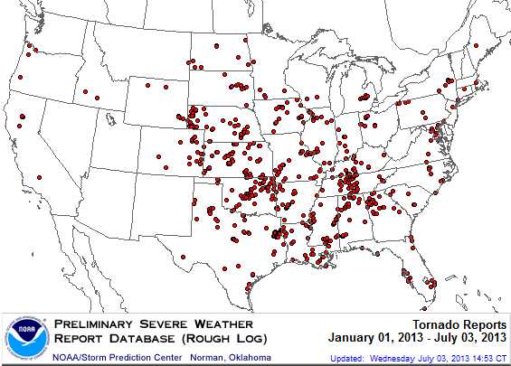
Location of Tornado Reports:
Through July 3, 2013
The storm system that spawned the deadly EF-5 tornado on May 19 in Moore, OK, produced insured losses of $1.575 billion
There were 630 tornadoes through July 3, causing extensive property damage in several states
Source: NOAA Storm Prediction Center; http://www.spc.noaa.gov/climo/online/monthly/2013_annual_summary.html#; PCS.
95

Slide 96
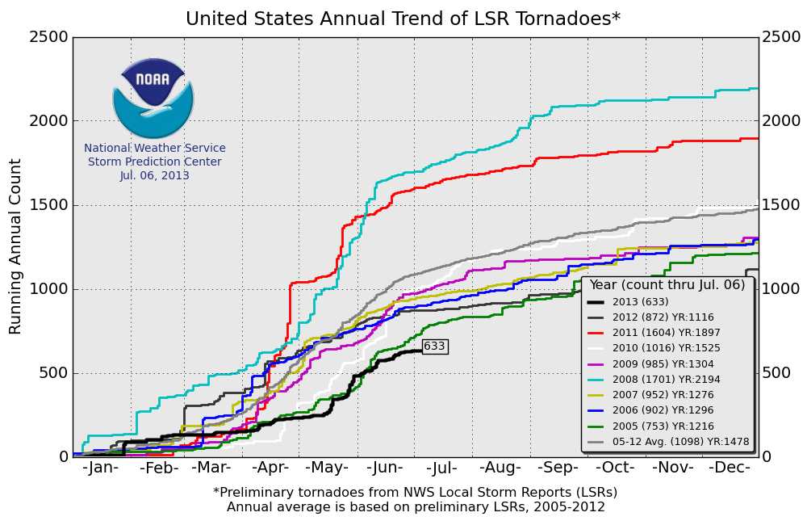
U.S. Tornado Count, 2005-2013*
There were 1,897 tornadoes in the U.S. in 2011 far above average, but well below 2008’s record
2013 count is running well below average
*Through July 6, 2013.
Source: http://www.spc.noaa.gov/wcm/.
96

Slide 97
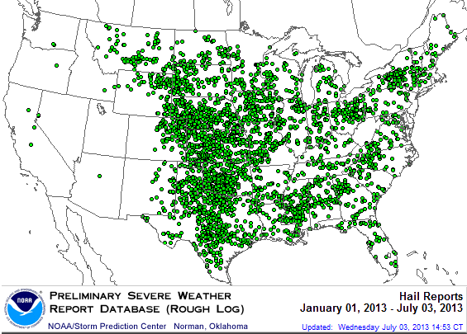
Location of Large Hail Reports:
Through July 3, 2013
Large hail reports were heavily concentrated in the Plains states
There were 3,716 “Large Hail” reports through July 3, causing extensive property and vehicle damage
Source: NOAA Storm Prediction Center; http://www.spc.noaa.gov/climo/online/monthly/2013_annual_summary.html#
97

Slide 98
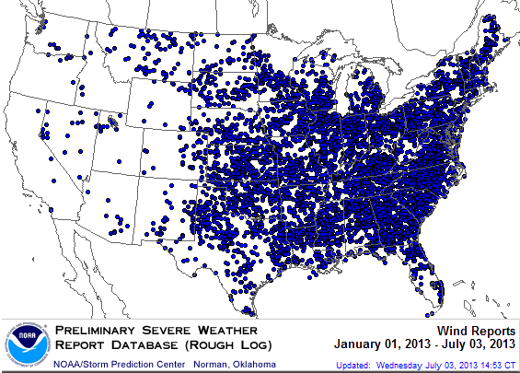
Location of High Wind Reports:
Through July 3, 2013
Wind damage reports were more heavily concentrated in the Southeast
There were 7,371 “Wind Damage” reports through July 3, causing extensive property damage
Source: NOAA Storm Prediction Center; http://www.spc.noaa.gov/climo/online/monthly/2013_annual_summary.html#
98

Slide 99
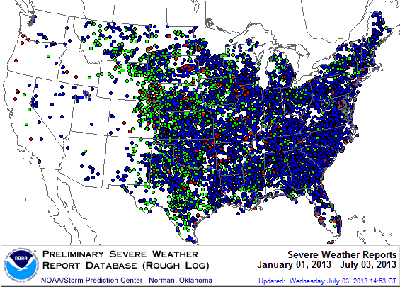
Severe Weather Reports:
Through July 3, 2013
There were 11,717 severe weather reports through July 3; including 630 tornadoes; 3,716 “Large Hail” reports and 7,371 high wind events
More than 1,200 severe weather reports in TX so far in 2013, more than any other state by far
Source: NOAA Storm Prediction Center; http://www.spc.noaa.gov/climo/online/monthly/2013_annual_summary.html#
99

Slide 100
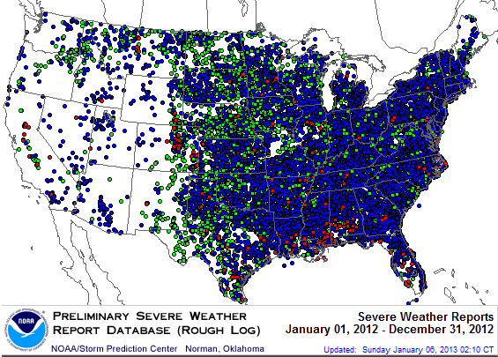
Severe Weather Reports, 2012
There were 22,503 severe weather reports in 2011; including 1,119 tornadoes; 7,033 “Large Hail” reports and 14,351 high wind events
Source: NOAA Storm Prediction Center; http://www.spc.noaa.gov/climo/online/monthly/2012_annual_summary.html#
100

Slide 101
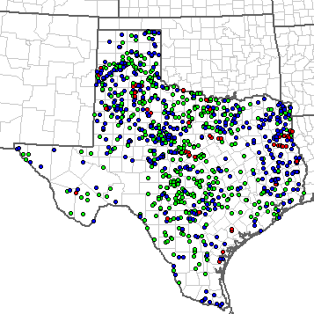
Severe Weather Reports in Texas: January 1—July 10, 2013
There have been a combined 1,212 severe weather reports so far in 2013 in TX, more than any other state by far (OK is #2 with 695 reports)
Texas
Total Reports = 1,212
Tornadoes = 56 (Red)
Hail Reports = 613 (Green)
Wind Reports = 542 (Blue)
Source: NOAA Storm Prediction Center; http://www.spc.noaa.gov/climo/online/monthly/2013_annual_summary.html#
101

Slide 102
Terrorism Update
Boston Marathon Bombings Underscore the Need for Extension of the Terrorism Risk Insurance Program
Download III’s Terrorism Insurance Report at: http://www.iii.org/white_papers/terrorism-risk-a-constant-threat-2013.html
102
Notes:
102

Slide 103

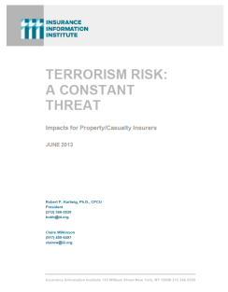
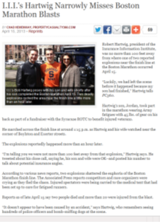
Terrorism Risk Insurance Program
Reauthorization Was a Major Industry Initiative for 2013 Even Before Boston
I.I.I. Testified at First Congressional Hearing on 9/11/12
  Provided testimony at NYC hearing on 6/17/13
I.I.I. Accelerated Planned Study on Terrorism Risk and Insurance in the Wake of Boston and Was Well Received
  Terrorism: A Constant Threat issued in June 2013
103
12/01/09 - 9pm
eSlide – P6466 – The Financial Crisis and the Future of the P/C
Notes:
103

Slide 104
Terrorism Risk Insurance Program
Boston Marathon Bombing Has Helped Focus Attention in Congress on TRIPRA and its Looming Expiration
  Act expires 12/31/14
  Exclusionary language will likely be inserted for post-1/1/2014 renewals and will likely lead to significant media interest (educational opportunity)
  Numerous headwinds; not a priority issue in 2013 in Congress
  3 extension bills introduced in 2013—2 since Boston
Media Interest Soared
  I.I.I. was conducting its first interviews within minutes after live-tweeting (nearly) from the scene; TV interest was high
  Local, national and international media focused on this topic for the first time in any significant way since TRIA’s inception in late 2002
  Inquiries revealed very little/no understanding (or even awareness) outside insurance industry and business owners
  Certification process caused confusion
104
12/01/09 - 9pm
eSlide – P6466 – The Financial Crisis and the Future of the P/C
Notes:
104

Slide 105
Summary of Terrorism Risk Insurance Program Extension Bills Introduced in 2013
Bill | Summary
H.R. 508: “Terrorism Risk Insurance Act of 2002 Reauthorization Act of 2013” Introduced Feb. 5 by Rep. Michael Grimm (D-NY) | 5-Year Extension (through 2019) Extend recoupment period for any TRIA assistance from 2017 to 2019
H.R. 2146: “Terrorism Risk Insurance Program Reauthorization Act of 2013” Introduced May 23 by Rep. Michael Capuano (D-MA) | 10-Year Extension (through 2024) Extend recoupment period for any TRIA assistance from 2017 to 2024 Requires President’s Working Group on Financial Markets (PWGFM) to issue reports on long-term availability and affordability of terrorism insurance in 2017, 2020 and 2023 Reports to be drafted with consultation from NAIC and representatives of the insurance and securities industries and policyholders
H.R. 1945: “Fostering Resilience to Terrorism Act of 2013” Introduced May 9 by Rep. Benny Thompson (D-MS) | 10-Year Extension (through 2024) Recoupment period changed to 2024 Would transfer responsibility for certification of a “act of terrorism” to the Secretary of Homeland Security from Secretary of Treasury. PWGFM to issue reports in 2017, 2020 and 2023 Requires Sec. of DHS to provide insureds with “timely homeland security information, including terrorism risk information, at the appropriate level of classification and information on best practices to foster resilience to an act of terrorism.”
Source: Nelson, Levine, de Luca & Hamilton, FIO Focus, June 10, 2013; Insurance Information Institute.

Slide 106
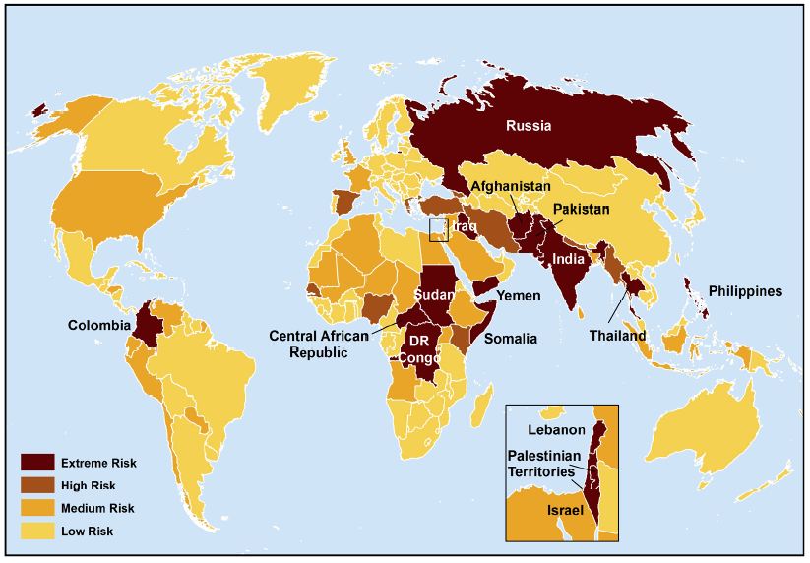
Terrorist Risk Index
The threat of terrorism is highest in South Asia, Russia, the Middle East and Central and East Africa
The US is still considered to be at “Medium Risk” for a terrorist attack
Sources: Maplecroft Terrorism Risk Index; (2011); Guy Carpenter; Insurance Information Institute.

Slide 107
Loss Distribution by Type of Insurance from Sept. 11 Terrorist Attack ($ 2011)
($ Billions)
Total Insured Losses Estimate: $40.0B**
*Loss total does not include March 2010 New York City settlement of up to $657.5 million to compensate approximately 10,000 Ground Zero workers or any subsequent settlements.
**$32.5 billion in 2001 dollars.
Source: Insurance Information Institute.

Slide 108
Terrorism Violates Traditional Requirements for Insurability
Requirement | Definition | Violation
Estimable Frequency | Insurance requires large number of observations to develop predictive rate-making models (an actuarial concept known as credibility) | Very few data points Terror modeling still in infancy, untested. Inconsistent assessment of threat
Estimable Severity | Maximum possible/ probable loss must be at least estimable in order to minimize “risk of ruin” (insurer cannot run an unreasonable risk of insolvency though assumption of the risk) | Potential loss is virtually unbounded. Losses can easily exceed insurer capital resources for paying claims. Extreme risk in workers compensation and statute forbids exclusions.
Source: Insurance Information Institute

Slide 109
Terrorism Violates Traditional Requirements for Insurability (cont’d)
Requirement | Definition | Violation
Diversifiable Risk | Must be able to spread/distribute risk across large number of risks “Law of Large Numbers” helps makes losses manageable and less volatile | Losses likely highly concentrated geographically or by industry (e.g., WTC, power plants)
Random Loss Distribution/Fortuity | Probability of loss occurring must be purely random and fortuitous Events are individually unpredictable in terms of time, location and magnitude | Terrorism attacks are planned, coordinated and deliberate acts of destruction Dynamic target shifting from “hardened targets” to “soft targets” Terrorist adjust tactics to circumvent new security measures Actions of US and foreign govts. may affect likelihood, nature and timing of attack
Source: Insurance
Information Institute

Slide 110
Public Opinion Survey
Disaster Preparedness
110
Notes:
110

Slide 111
I.I.I. Poll: Favorability
Percent of Public Rating Industry as Very or Mostly Favorable, 2013
Viewed separately, auto and home insurers have highest favorability ratings of all industries surveyed
Auto Insurers and Home Insurers Ranked Highest.
Source: Insurance Information Institute Annual Pulse Survey.

Slide 112
I.I.I. Poll: Homeowners Insurance
Q. Do you think that it is fair that people who live in areas affected by record storms in 2011 and 2012 should pay more for their homeowners insurance in the future?
Don’t know
Public believes it is not fair to raise premiums of homeowners due to events they cannot control
No
Yes
Nearly 60 percent of Americans believe that homeowners insurance premiums should not be raised as a result of recent storms in their areas.
Source: Insurance Information Institute Annual Pulse Survey.

Slide 113
I.I.I. Poll: Flood Insurance
Q. The federal government plans to raise the price of flood insurance so it reflects the costs of paying claims. Do you believe this is fair?
[% Responding “NO”]
Most people believe it is unfair for government to raise flood insurance premiums, even though they are subsidized by taxpayers
More than one-half of Americans do not think it is fair for the federal government to raise its flood insurance premiums to better reflect claims payouts.
Source: Insurance Information Institute Annual Pulse Survey.

Slide 114
I.I.I. Poll: Disaster Preparedness
Q. Does your homeowners policy cover damage from flooding during a hurricane?¹
About 20 percent of the public still believes flooding from a hurricane is covered
The proportion of homeowners who believe their homeowners policy covers damage from flooding during a hurricane stands at 21 percent. This proportion rises eight percentage points in the South, to 29 percent.
¹Asked of those who have homeowners insurance and who responded “yes”.
Source: Insurance Information Institute Annual Pulse Survey.

Slide 115
I.I.I. Poll: Disaster Preparedness
Q. Have recent flooding events such as Hurricane Sandy or Hurricane Irene motivated you to buy flood coverage?¹
Despite recent major flood events, few people see the need to buy coverage
Recent storms have not motivated people to buy flood insurance coverag.e
¹Asked of those who have homeowners insurance but not flood insurance.
Source: Insurance Information Institute Annual Pulse Survey.

Slide 116
I.I.I. Poll: Disaster Preparedness
Q. If you expect some relief from the government, do you purchase less insurance coverage against these natural disasters than you would have otherwise?
Don’t know
Yes
More than 20 percent cut back on insurance coverage in expectation of government disaster aid
No
Seventy-two percent of Americans would not purchase less insurance if they expect some relief from the government—but 22% would.
Source: Insurance Information Institute Annual Pulse Survey.

Slide 117
Growth Analysis by State and Business Segment
Premium Growth Rates Vary Tremendously by State
117

Slide 118
Direct Premiums Written: Total P/C
Percent Change by State, 2007-2012*
Top 25 States
Texas was a growth leader over the past 5 years with premiums written expanding by 13.2%
*Data are preliminary as of 5/1/13 and do not yet fully reflect the impact of state-run pools and plans.
Sources: SNL Financial LC.; Insurance Information Institute.

Slide 119
Direct Premiums Written: Total P/C
Percent Change by State, 2007-2012*
Bottom 25 States
*Data are preliminary as of 5/1/13 and do not yet fully reflect the impact of state-run pools and plans.
Sources: SNL Financial LC.; Insurance Information Institute.

Slide 120
Direct Premiums Written: Total P/C
Percent Change by State, 2006-2011*
Top 25 States
A limited number of states showed strong growth over the past 5 years
Sources: SNL Financial LC.; Insurance Information Institute.

Slide 121
Direct Premiums Written: Total P/C
Percent Change by State, 2006-2011*
Bottom 25 States
NY’s change in premium growth was similar to the US average
States with the poorest performing economies also produced the most negative net change in premiums of the past 5 years
Sources: SNL Financial LC.; Insurance Information Institute.

Slide 122
Direct Premiums Written: PP Auto
Percent Change by State, 2006-2011*
Top 25 States
Sources: SNL Financial LC.; Insurance Information Institute.

Slide 123
Direct Premiums Written: PP Auto
Percent Change by State, 2006-2011*
OR and ID saw sluggish PPA growth in recent years
Bottom 25 States
States with the poorest performing economies also produced the most negative net change in premiums of the past 5 years
Sources: SNL Financial LC.; Insurance Information Institute.

Slide 124
Direct Premiums Written: Homeowners
Percent Change by State, 2006-2011*
Top 25 States
Sources: SNL Financial LC.; Insurance Information Institute.

Slide 125
Direct Premiums Written: Homeowners
Percent Change by State, 2006-2011*
Bottom 25 States
States with the poorest performing economies also produced the most negative net change in premiums of the past 5 years
Sources: SNL Financial LC.; Insurance Information Institute.

Slide 126
Direct Premiums Written: Comm. Lines
Percent Change by State, 2006-2011*
Top 25 States
Only 12 states showed any commercial lines growth 2006 and 2011
Sources: SNL Financial LC.; Insurance Information Institute.

Slide 127
Direct Premiums Written: Comm. Lines
Percent Change by State, 2006-2011*
Bottom 25 States
States with the poorest performing economies also produced the most negative net change in premiums of the past 5 years
Sources: SNL Financial LC.; Insurance Information Institute.

Slide 128
Direct Premiums Written: Workers’ Comp
Percent Change by State, 2006-2011*
Top 25 States
*Excludes monopolistic fund states: ND, OH, WA, WY as well as WV, which transitioned to a competitive structure during this period.
Sources: SNL Financial LC.; Insurance Information Institute.

Slide 129
Direct Premiums Written: Worker’s Comp
Percent Change by State, 2006-2011*
Bottom 25 States
States with the poorest performing economies also produced the most negative net change in premiums of the past 5 years
*Excludes monopolistic fund states: ND, OH, WA, WY as well as WV, which transitioned to a competitive structure during this period.
Sources: SNL Financial LC.; Insurance Information Institute.

Slide 130
Labor Market Trends
Massive Job Losses Sapped the Economy and Commercial/Personal Lines Exposure, But Trend is Improving
130

Slide 131
Unemployment and Underemployment Rates: Stubbornly High in 2012, But Falling
January 2000 through June 2013, Seasonally Adjusted (%)
U-6 went from 8.0% in March 2007 to 17.5% in
October 2009; Stood at 14.3% in June 2013
Recession ended in November 2001
Unemployment kept rising for 19 more months
Recession began in December 2007
Unemployment stood at 7.6% in June 2013—nearly its lowest level in 4 years.
Unemployment peaked at 10.1% in October 2009, highest monthly rate since 1983.
Peak rate in the last 30 years: 10.8% in November - December 1982
Stubbornly high unemployment and underemployment constrain overall economic growth, but the job market is now clearly improving
Source: US Bureau of Labor Statistics; Insurance Information Institute.
131
12/01/09 - 9pm
eSlide – P6466 – The Financial Crisis and the Future of the P/C
Notes:
131

Slide 132
Monthly Change in Private Employment
January 2007 through June 2013 (Thousands)
202,000 private sector jobs were created in June
Jobs Created
2012: 2.247 Mill
2011: 2.420 Mill
2010: 1.235 Mill
Monthly Losses in Dec. 08–Mar. 09 Were the Largest in the
Post-WW II Period
Private Employers Added 7.16 million Jobs Since Jan. 2010 After Having Shed 4.98 Million Jobs in 2009 and 3.80 Million in 2008 (State and Local Governments Have Shed Hundreds of Thousands of Jobs)
Source: US Bureau of Labor Statistics: http://www.bls.gov/ces/home.htm; Insurance Information Institute

Slide 133
Cumulative Change in Private Employment: Dec. 2007—May 2013
December 2007 through May 2013 (Millions)
Cumulative job losses as of June 2013 totaled 1.564 million
Cumulative job losses peaked at 8.765 million in February 2010
All of the jobs “lost” since President Obama took office in Jan. 2009 have been recouped
Private Employers Added 7.16 million Jobs Since Jan. 2010 After Having Shed 4.98 Million Jobs in 2009 and 3.80 Million in 2008 (State and Local Governments Have Shed Hundreds of Thousands of Jobs)
Source: US Bureau of Labor Statistics: http://www.bls.gov/ces/home.htm; Insurance Information Institute

Slide 134
Cumulative Change in Private Sector Employment: Jan. 2010—June 2013
January 2010 through June 2013* (Millions)
Job gains and pay increases have added more than $600 billion to payrolls since Jan. 2010
Cumulative job gains through June 2013 totaled 7.16 million
Private Employers Added 7.16 million Jobs Since Jan. 2010 After Having Shed 4.98 Million Jobs in 2009 and 3.80 Million in 2008 (State and Local Governments Have Shed Hundreds of Thousands of Jobs)
Source: US Bureau of Labor Statistics: http://www.bls.gov/ces/home.htm; Insurance Information Institute

Slide 135
Cumulative Change in Government Employment: Jan. 2010—June 2013
Government at all levels has shed more than 625,000 jobs since Jan. 2010 even as private employers created 7.16 million jobs, though losses may now be stabilizing.
January 2010 through June 2013* (Millions)
Cumulative job losses through June 2013 totaled 629,000
Temporary Census hiring distorted 2010 figures
Governments at All Levels are Under Severe Fiscal Strain As Tax Receipts Plunged and Pension Obligations Soared During the Financial Crisis: Sequestration Will Add to this Toll
Source: US Bureau of Labor Statistics http://www.bls.gov/data/#employment; Insurance Information Institute

Slide 136
Net Change in Government Employment: Jan. 2010—Apr. 2013*
State government employment fell by 1.9% since the end of 2009 while Federal employment is down by 2.1%
(Thousands)
Local government employment shrank by 480,000 from Jan. 2010 through Apr. 2013, accounting for 65% of all government job losses, negatively impacting WC exposures for those cities and counties that insure privately
*Cumulative change from prior month; Base employment date is Dec. 2009.
Source: US Bureau of Labor Statistics http://www.bls.gov/data/#employment; Insurance Information Institute

Slide 137
Unemployment Rates by State, May 2013:
Highest 25 States*
In May, 25 states had over-the-month unemployment rate decreases, 17 had increases, and 8 and the District of Columbia had no change.
*Provisional figures for May 2013, seasonally adjusted.
Sources: US Bureau of Labor Statistics; Insurance Information Institute.

Slide 138
Unemployment Rates by State, May 2013:
Lowest 25 States*
In May, 25 states had over-the-month unemployment rate decreases, 17 had increases, and 8 and the District of Columbia had no change.
*Provisional figures for May 2013, seasonally adjusted.
Sources: US Bureau of Labor Statistics; Insurance Information Institute.

Slide 139

Oil & Gas Extraction Employment,
Jan. 2010—June 2013*
(Thousands)
Oil and gas extraction employment is up 22.8% since Jan. 2010 as the energy sector booms. Domestic energy production is essential to any robust economic recovery in the US.
*Seasonally adjusted
Sources: US Bureau of Labor Statistics at http://data.bls.gov; Insurance Information Institute.
139
12/01/09 - 9pm
eSlide – P6466 – The Financial Crisis and the Future of the P/C
Notes:
139

Slide 140
US Unemployment Rate Forecast
2007:Q1 to 2014:Q4F*
Rising unemployment
eroded payrolls
and workers comp’s
exposure base.
Unemployment peaked at 10% in late 2009.
Jobless figures have been revised slightly downwards for 2013/14
Unemployment forecasts have been revised slightly downwards. Optimistic scenarios put the unemployment as low as 6.5% by Q4 of next year.
* = actual; = forecasts
Sources: US Bureau of Labor Statistics; Blue Chip Economic Indicators (7/13 edition); Insurance Information Institute.

Slide 141
US Unemployment Rate Forecasts
Quarterly, 2013:Q1 to 2014:Q4
Unemployment will remain high even under the most optimistic of scenarios, but forecasts are being revised downwards
Sources: Blue Chip Economic Indicators (May 2013); Insurance Information Institute

Slide 142
Nonfarm Payroll (Wages and Salaries):
Quarterly, 2005–2013:Q1
Billions
Latest (2013:Q4) was $7.01 trillion, a new peak--$762B above 2009 trough
Prior Peak was 2008:Q1 at $6.60 trillion
Payrolls are 12.2% above their 2009 trough and up 2.7% over the past year
Recent trough (2009:Q3) was $6.25 trillion, down 5.3% from prior peak
Note: Recession indicated by gray shaded column. Data are seasonally adjusted annual rates.
Sources: http://research.stlouisfed.org/fred2/series/WASCUR; National Bureau of Economic Research (recession dates); Insurance Information Institute.
142
12/01/09 - 9pm
eSlide – P6466 – The Financial Crisis and the Future of the P/C
Notes:
142

Slide 143
Payroll vs. Workers Comp Net Written Premiums, 1990-2012E
Payroll Base* WC NWP
$Billions $Billions
7/90-3/91
3/01-11/01
12/07-6/09
WC premium volume dropped two years before the recession began
+9% in 2012E
WC net premiums written were down $14B or 29.3% to $33.8B in 2010 after peaking at $47.8B in 2005
Continued Payroll Growth and Rate Increases Suggest WC NWP Will Grow Again in 2012; +7.9% Growth in 2011 Was the First Gain Since 2005
*Private employment; Shaded areas indicate recessions. WC premiums for 2012 are I.I.I. estimate based YTD 2012 actuals.
Sources: NBER (recessions); Federal Reserve Bank of St. Louis at http://research.stlouisfed.org/fred2/series/WASCUR ; NCCI; I.I.I.

Slide 144
The BIG Question:
Where Is the Market Heading?
Catastrophes and Other Factors Are Pressuring Insurance Markets
New Factor: Record Low Interest Rates Are Contributing to Underwriting and Pricing Pressures
144
Notes:
144

Slide 145
INVESTMENTS:
THE NEW REALITY
Investment Performance is a Key Driver of Profitability
Depressed Yields Will Necessarily Influence Underwriting & Pricing
145

Slide 146
Property/Casualty Insurance Industry Investment Income: 2000–2013*¹
($ Billions)
Investment earnings are running below their 2007 pre-crisis peak
Investment Income Fell in 2012 and is Falling in 2013 Due to Persistently Low Interest Rates, Putting Additional Pressure on (Re) Insurance Pricing
¹ Investment gains consist primarily of interest and stock dividends..
*Estimate based on annualized actual Q1:2013 investment income of $11.385B.
Sources: ISO; Insurance Information Institute.

Slide 147
P/C Insurer Net Realized
Capital Gains/Losses, 1990-2013:Q1
Realized capital gains in 2012 were down 12% from 2011
($ Billions)
Insurers Posted Net Realized Capital Gains in 2010, 2011 and 2012 Following Two Years of Realized Losses During the Financial Crisis. Realized Capital Losses Were the Primary Cause of 2008/2009’s Large Drop in Profits and ROE
Sources: A.M. Best, ISO, Insurance Information Institute.
147
12/01/09 - 9pm
eSlide – P6466 – The Financial Crisis and the Future of the P/C
Notes:
147

Slide 148
Property/Casualty Insurance Industry Investment Gain: 1994–2013:Q1¹
($ Billions)
Investment gains in 2012 were approximately 16% below their pre-crisis peak
Investment Gains Are Slipping in 2012 as Low Interest Rates Reduce Investment Income and Lower Realized Investment Gains; The Financial Crisis Caused Investment Gains to Fall by 50% in 2008
¹ Investment gains consist primarily of interest, stock dividends and realized capital gains and losses.
* 2005 figure includes special one-time dividend of $3.2B;
Sources: ISO; Insurance Information Institute.

Slide 149
P/C Industry Investment Gains, Inflation-Adjusted: 1994–2012¹
($ Billions, 2012 dollars)
1994-2012 average yearly gain: $60.85B. We haven’t hit that average in the last 5 years.
Because the Federal Reserve Board aims to keep interest rates exceptionally low until the unemployment rate hits 6.5%—likely at least another year off—maturing bonds will be re-invested at even lower rates.
¹Investment gains consist primarily of interest, stock dividends and realized capital gains and losses.
*2005 figure includes special one-time dividend of $3.2B; 2013F figure is I.I.I. estimate for 2013:Q1, annualized.
Sources: ISO; Insurance Information Institute.

Slide 150
U.S. 10-Year Treasury Note Yields:
A Long Downward Trend, 1990–2013*
Yields on 10-Year U.S. Treasury Notes recently plunged to all time record lows
Yields on 10-Year U.S. Treasury Notes have been essentially below 5% for a full decade.
Since roughly 80% of P/C bond/cash investments are in 10-year or shorter durations, most P/C insurer portfolios will have low-yielding bonds for years to come.
*Monthly, through Apr. 2013. Note: Recessions indicated by gray shaded columns.
Sources: Federal Reserve Bank at http://www.federalreserve.gov/releases/h15/data.htm.
National Bureau of Economic Research (recession dates); Insurance Information Institutes.
150
12/01/09 - 9pm
eSlide – P6466 – The Financial Crisis and the Future of the P/C
Notes:
150

Slide 151
U.S. Treasury Security Yields*:
A Long Downward Trend, 1990–2013
Yields on 10-Year U.S. Treasury Notes have been essentially below 5% for a full decade.
U.S. Treasury security yields recently plunged to record lows
Since roughly 80% of P/C bond/cash investments are in 10-year or shorter durations, most P/C insurer portfolios will have low-yielding bonds for years to come.
*Monthly, constant maturity, nominal rates, through May 2013.
Sources: Federal Reserve Bank at http://www.federalreserve.gov/releases/h15/data.htm.
National Bureau of Economic Research (recession dates); Insurance Information Institute.
151
12/01/09 - 9pm
eSlide – P6466 – The Financial Crisis and the Future of the P/C
Notes:
151

Slide 152
Treasury Yield Curves:
Pre-Crisis (July 2007) vs. Jan. 2013
Treasury yield curve remains near its most depressed level in at least 45 years. Investment income is falling as a result. Fed is unlikely to hike rates until well into 2014 at the earliest.
The Fed Is Actively Signaling that it Is Determined to Keep Rates Low Until Unemployment Drops Below 6.5% or Until Inflation Expectations Exceed 2.5%; Low Rates Add to Pricing Pressure for Insurers.
Source: Federal Reserve Board of Governors; Insurance Information Institute.

Slide 153
Average Maturity of Bonds Held by US P/C Insurers, 2006—2011*
Average Maturity (Years)
The average bond maturity is down by a full year between 2007 and 2011
Falling Average Maturity (and Duration) of the P/C Industry’s Bond Portfolio is Contributing to the Drop in Investment Income Along With Lower Yields
*Year-end figures. Latest available.
Sources: Insurance Information Institute calculations based on A.M. Best data.
153
12/01/09 - 9pm
eSlide – P6466 – The Financial Crisis and the Future of the P/C
Notes:
153

Slide 154
Distribution of Bond Maturities,
P/C Insurance Industry, 2003-2012
The main shift over these years has been from bonds with longer maturities to bonds with shorter maturities. The industry first trimmed its holdings of over-10-year bonds (from 24.6% in 2003 to 15.5% in 2012) and then trimmed bonds in the 5-10-year category (from 31.3% in 2003 to 27.6% in 2012) . Falling average maturity of the P/C industry’s bond portfolio is contributing to a drop in investment income along with lower yields.
Sources: SNL Financial; Insurance Information Institute.

Slide 155
Bonds Rated NAIC Quality Category 3-6 as a Percent of Total Bonds, 2003–2012
From 2006-07 to year-end 2012, the percentage of lower-quality bonds in P/C industry portfolios more than doubled
There are many ways to capture higher yields on bond portfolios.
One is to accept greater risk, as measured by NAIC bond ratings.
The ratings range from 1 to 6, with the highest quality rated 1.
Even in 2012, over 95% of the industry’s bonds were rated 1 or 2.
Sources: SNL Financial; Insurance Information Institute.

Slide 156
Insurance Industry Fair Value as a Percent of Par History, by Bond Type, 2002–2012
“flight to safety”
Because the Federal Reserve Board aims to keep interest rates exceptionally low until the “headline” unemployment rate hits 6.5%,
maturing bonds will be re-invested at even lower rates.
Sources: NAIC Capital Markets Special Report 5.21.13 “The Trajectory of Interest Rates and Its Impact on the Market Value of the U.S. Insurance Industry’s Bond Portfolio,” Table 2; Insurance Information Institute.

Slide 157
As Yields (Blue) Sank, Fair Value as a Percent of Par (Orange) Rose, 2002–2012
When interest rates rise again, the Fair Value of Insurance Industry bonds will fall. How far and how fast the fall occurs depends on many factors, but the direction of change is clear.
Sources: NAIC Capital Markets Special Report 5.21.13 “The Trajectory of Interest Rates and Its Impact on the Market Value of the U.S. Insurance Industry’s Bond Portfolio,” Table 2; Insurance Information Institute.

Slide 158
Reduction in Combined Ratio Necessary to Offset 1% Decline in Investment Yield to Maintain Constant ROE, by Line*
Lower Investment Earnings Place a Greater Burden on Underwriting and Pricing Discipline
*Based on 2008 Invested Assets and Earned Premiums
**US domestic reinsurance only
Source: A.M. Best; Insurance Information Institute.
158
12/01/09 - 9pm
eSlide – P6466 – The Financial Crisis and the Future of the P/C
Notes:
158
This shows the drop in Combined Ratio for each line of business that would be needed to maintain a constant ROE, given a 1-percentage-point drop in investment yield

Slide 159
Annual Inflation Rates, (CPI-U, %),
1990–2014F
Annual Inflation Rates (%)
Inflation peaked at 5.6% in August 2008 on high energy and commodity crisis. The recession and the collapse of the commodity bubble reduced inflationary pressures in 2009/10
Inflationary expectations remain quite low, allowing the Fed to continue its QE3 program
The slack in the U.S. economy suggests that inflationary pressures should remain subdued for an extended period of times. Energy, health care and commodity prices, plus U.S. debt burden, remain longer-run concerns
Sources: US Bureau of Labor Statistics; Blue Chip Economic Indicators, 5/13 (forecasts).

Slide 160
1. UNDERWRITING
Underwriting Losses in 2011 and 2012 Are Elevated by High Catastrophe Losses
160

Slide 161
P/C Insurance Industry
Combined Ratio, 2001–2013:Q1*
Relatively Low CAT Losses, Reserve Releases
Higher CAT Losses, Shrinking Reserve Releases, Toll of Soft Market
As Recently as 2001, Insurers Paid Out Nearly $1.16 for Every $1 in Earned Premiums
Heavy Use of Reinsurance Lowered Net Losses
Relatively Low CAT Losses, Reserve Releases
Avg. CAT Losses, More Reserve Releases
Best Combined Ratio Since 1949 (87.6)
Lower CAT Losses Before Sandy
Cyclical Deterioration
* Excludes Mortgage & Financial Guaranty insurers 2008--2012. Including M&FG, 2008=105.1, 2009=100.7, 2010=102.4, 2011=108.1; 2012:=103.2.
Sources: A.M. Best, ISO.

Slide 162
Underwriting Gain (Loss)
1975–2013:Q1*
($ Billions)
Cumulative underwriting deficit from 1975 through 2012 is $510B
Underwriting profit in 2013:Q1 totaled $4.6B
High cat losses in 2011 led to the highest underwriting loss since 2002
Large Underwriting Losses Are NOT Sustainable
in Current Investment Environment
* Includes mortgage and financial guaranty insurers in all years.
Sources: A.M. Best, ISO; Insurance Information Institute.

Slide 163
Combined Ratios by Predominant Business Segment, 2012 vs. 2011*
The combined ratios for both personal and commercial lines improved substantially in 2012, Despite Sandy
(Percent)
*Excludes mortgage and financial guaranty insurers.
Source: ISO/PCI; Insurance Information Institute

Slide 164
P/C Reserve Development, 1992–2015E
Note: 2005 reserve development excludes a $6 billion loss portfolio transfer between American Re and Munich Re. Including this transaction, total prior year adverse development in 2005 was $7 billion. The data from 2000 and subsequent years excludes development from financial guaranty and mortgage insurance.
Sources: A.M. Best, ISO, Barclays Research (estimates).

Slide 165
Number of Years with Underwriting Profits by Decade, 1920s–2010s
Number of Years with Underwriting Profits
Underwriting Profits Were Common Before the 1980s
(40 of the 60 Years Before 1980 Had Combined Ratios Below 100) –
But Then They Vanished. Not a Single Underwriting Profit Was
Recorded in the 25 Years from 1979 Through 2003
* 2009 combined ratio excl. mort. and finl. guaranty insurers was 99.3, which would bring the 2000s total to 4 years with an u/w profit.
**Data for the 2010s includes 2010 and 2011.
Note: Data for 1920–1934 based on stock companies only.
Sources: Insurance Information Institute research from A.M. Best Data.
165
12/01/09 - 9pm
eSlide – P6466 – The Financial Crisis and the Future of the P/C
Notes:
165

Slide 166
Financial Strength & Underwriting
Cyclical Pattern is P-C Impairment History is Directly Tied to Underwriting, Reserving & Pricing
166

Slide 167
P/C Insurer Impairments, 1969–2012
Impairments among P/C insurers remain infrequent
The Number of Impairments Varies Significantly Over the P/C Insurance Cycle, With Peaks Occurring Well into Hard Markets
Source: A.M. Best Special Report “1969-2011 Impairment Review,” June 2012 and March 6, 2013 update; Insurance Info. Institute.

Slide 168
P/C Insurer Impairment Frequency vs. Combined Ratio, 1969-2011
2011 impairment rate was 0.91%, up from 0.67% in 2010; the rate is slightly higher than the 0.82% average since 1969
Impairment Rates Are Highly Correlated With Underwriting Performance and Reached Record Lows in 2007; Recent Increase Was Associated Primarily With Mortgage and Financial Guaranty Insurers and Not Representative of the Industry Overall
Source: A.M. Best; Insurance Information Institute

Slide 169
Reasons for US P/C Insurer Impairments, 1969–2010
Historically, Deficient Loss Reserves and Inadequate Pricing Are
By Far the Leading Cause of P-C Insurer Impairments.
Investment and Catastrophe Losses Play a Much Smaller Role
Reinsurance Failure
Sig. Change in Business
Misc.
Investment Problems (Overstatement of Assets)
Deficient Loss Reserves/
Inadequate Pricing
Affiliate Impairment
Catastrophe Losses
Alleged Fraud
Rapid Growth
Source: A.M. Best: 1969-2010 Impairment Review, Special Report, April 2011.

Slide 170
Top 10 Lines of Business for US P/C Impaired Insurers, 2000–2010
Workers Comp and Pvt. Passenger Auto Account for Nearly Half of the Premium Volume of Impaired Insurers Over the Past Decade
Title
Financial Guaranty
Surety
Med Mal
Workers Comp
Other Liability
Commercial Auto Liability
Pvt. Passenger Auto
Commercial Multiperil
Homeowners
Source: A.M. Best: 1969-2010 Impairment Review, Special Report, April 2011.

Slide 171
Number of Recessions Endured by P/C Insurers, by Number of Years in Operation
Number of Recessions Since 1860
Insurers are true survivors—not just of natural catastrophes but also economic ones
Number of Years in Operation
Many US Insurers Are Close to a Century Old or Older
Sources: Insurance Information Institute research from National Bureau of Economic Research data.
171
12/01/09 - 9pm
eSlide – P6466 – The Financial Crisis and the Future of the P/C
Notes:
171

Slide 172
Performance by Segment
172
Notes:
172

Slide 173
Private Passenger Auto Combined Ratio: 1993–2015F
Private Passenger Auto Accounts for 34% of Industry Premiums and Remains the Profit Juggernaut of the P/C Insurance Industry
Sources: A.M. Best (1990-2012E);Conning (2013F-15F); Insurance Information Institute.

Slide 174
Homeowners Insurance Combined Ratio: 1990–2015F
Hurricane Andrew
Record tornado activity
Hurricane Sandy
Hurricane Ike
Homeowners Performance in 2011/12 Impacted by Large Cat Losses. Extreme Regional Variation Can Be Expected Due to Local Catastrophe Loss Activity
Sources: A.M. Best (1990-2011);Conning (2012E-2015F); Insurance Information Institute.

Slide 175
Homeowners Multi-Peril Loss & LAE Ratio, 2011:
Highest 25 States
TN and AL had the worst underwriting performance of all states in 2011 due to high tornado and storm losses
Sources: SNL Financial; Insurance Information Institute.

Slide 176
Homeowners Multi-Peril Loss & LAE Ratio, 2011:
Lowest 25 States
HI and FL had the best performance in 2011 due to the absence of hurricanes/tropical storms impacts in either state last year
Sources: SNL Financial; Insurance Information Institute.

Slide 177
Commercial Lines Combined Ratio, 1990-2015F*
Commercial lines underwriting performance is expected to improve as improvement in pricing environment persists
*2007-2012 figures exclude mortgage and financial guaranty segments.
Source: A.M. Best (1990-2011); Conning (2012-2015F) Insurance Information Institute

Slide 178
Commercial Auto Combined Ratio: 1993–2015F
Commercial Auto is Expected to Improve as Rate Gains Outpace Any Adverse Frequency and Severity Trends
Sources: A.M. Best (1990-2012E);Conning (2012-2015F); Insurance Information Institute.

Slide 179
Commercial Multi-Peril Combined Ratio: 1995–2015F
Commercial Multi-Peril Underwriting Performance is Expected to Improve in 2013 Assuming Normal Catastrophe Loss Activity
*2012-2013 figures are A.M. Best estimate/forecast for the combined liability and non-liability components. Same for Conning 2014-2015F figures.
Sources: A.M. Best; Conning; Insurance Information Institute.

Slide 180
General Liability Combined Ratio:
2005–2015F
Commercial General Liability Underwriting Performance Has Been Volatile in Recent Years
Source: Conning Research and Consulting.

Slide 181
Inland Marine Combined Ratio: 1999–2015F
Inland Marine is Expected to Remain Among the Most Profitable of All Lines
Sources: A.M. Best (1999-2011); Conning (2012-2015F)

Slide 182
Other & Products Liability Combined Ratio: 1991–2013F
Liability Lines Have Performed Better in the Post-Tort Reform Era (~2005), but There Has Been Some Deterioration in Recent Years
Sources: A.M. Best ; Insurance Information Institute.

Slide 183
Medical Malpractice Combined Ratio vs. All Lines Combined Ratio, 1991-2015F
Med Mal Insurers in 2012 paid out $0.91 in loss and expense for every $1 they earned in premiums
The dramatic improvement over the past decade has restored med mal’s viability, though some deterioration is anticipated
In 2001, med mal insurers paid out $1.55 for every dollar earned
Source: AM Best (1991-2011); Conning (2012E-2015F) Insurance Information Institute

Slide 184
Workers Compensation Operating Environment
The Weak Economy and Soft Market Have Made the Workers Comp Operating Increasingly Challenging
184

Slide 185
Workers Compensation Combined Ratio: 1994–2012P
WC showed a better-than-expected improvement for private carriers in 2012
Workers Comp Results Began to Improve in 2012. Underwriting Results Deteriorated Markedly from 2007-2010/11 and Were the Worst They Had Been in a Decade.
Sources: A.M. Best (1994-2009); NCCI (2010-2012P) and are for private carriers only; Insurance Information Institute.

Slide 186
Workers Compensation Medical Severity
Moderate Increase in 2012
Medical
Claim Cost ($000s)
Average Medical Cost per Lost-Time Claim
Annual Change 1991–1993: +1.9%
Annual Change 1994–2001: +8.9%
Annual Change 2002–2010: +6.0%
Annual Change 1991–1993: +1.9%
Annual Change 1994–2001: +8.9%
Annual Change 2002–2011: +5.7%
Cumulative Change = 252%
(1991-2012p)
Accident Year
Accident Year
2012p: Preliminary based on data valued as of 12/31/2012.
1991-2011: Based on data through 12/31/2011, developed to ultimate
Based on the states where NCCI provides ratemaking services including state funds, excluding WV; Excludes high deductible policies.

Slide 187
Change in Price Paid for Medical Professional Services in WC, 2002-2012*
%
Increases in WC med costs varied enormously over the past decade from a high of 56% in Wisconsin to a low of 2% in North Carolina
States in GOLD had no fee schedule in 2012. These generally saw larger increases in WC medical costs over the past decade.
*Data are preliminary as of 6/30/12.
Sources: Workers Compensation Research Institute, WCRI Medical Price Index for Workers Compensation, 5th Edition; Ins. Info. Institute.

Slide 188
WC Medical Severity Generally Outpaces the Medical CPI Rate
Average annual increase in WC medical severity form 1995 through 2011 was well above the medical CPI (6.8% vs. 3.8%), but the gap is narrowing.
Sources: Med CPI from US Bureau of Labor Statistics, WC med severity from NCCI based on NCCI states.

Slide 189
Workers Comp Indemnity Claim Costs: Small Increase in 2012
Average Indemnity Cost per Lost-Time Claim
Indemnity
Claim Cost ($ 000s)
Average indemnity costs per claim were up 1% in 2012 to $22,400
Annual Change 1991–1993: -1.7%
Annual Change 1994–2001: +7.3%
Annual Change 2002–2011: +3.2%
Accident Year
2012p: Preliminary based on data valued as of 12/31/2012.
1991-2011: Based on data through 12/31/2011, developed to ultimate
Based on the states where NCCI provides ratemaking services including state funds, excluding WV; Excludes high deductible policies.
Notes:
189
Exhibit 11 of Article

Slide 190
Workers Compensation Lost-Time
Claim Frequency Declined in 2012
Lost-Time Claims
Percent
Cumulative Change of –55.4%
(1991–2011 adj.)
Accident Year
*Adjustments primarily due to significant audit activity.
2012p: Preliminary based on data valued as of 12/31/2012
1991–2011: Based on data through 12/31/2011, developed to ultimate
Based on the states where NCCI provides ratemaking services, including state funds; excludes high deductible policies
Frequency is the number of lost-time claims per $1M pure premium at current wage and voluntary loss cost level
Source: NCCI.

Slide 191
WC Indemnity Severity vs. Wage Inflation, 1995 -2012p
Indemnity severities usually outpace wage gains
Annual Change 1991–1993: -1.7%
Annual Change 1994–2001: +7.3%
Annual Change 2002–2011: +3.2%
WC indemnity severity turned positive again in 2011
2011p: Preliminary based on data valued as of 12/31/2011; 1991-2010: Based on data through 12/31/2010, developed to ultimate. Based on the states where NCCI provides ratemaking services. Excludes the effects of deductible policies. CPS = Current Population Survey.
Source: NCCI

Slide 192
Workers Compensation Premium:
Second Consecutive Year of Increase
Net Written Premium
$ Billions
p Preliminary
Source: 1990–20102p Private Carriers, Annual Statement Data, NCCI.
1996–2012p State Funds: AZ, CA, CO, HI, ID, KY, LA, MD, MO, MT, NM, OK, OR, RI, TX, UT Annual Statements
State Funds available for 1996 and subsequent
Calendar Year

Slide 193
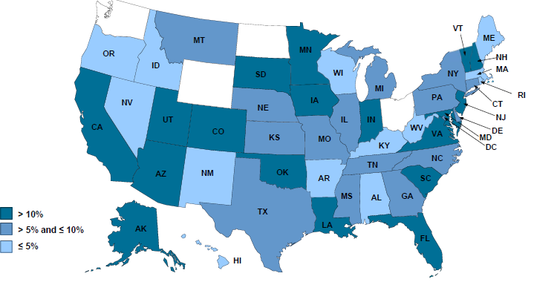
2012 Workers Compensation Direct Written Premium Growth, by State*
PRIVATE CARRIERS: Overall 2012 Growth = +9%
While growth rates varied widely, all states experienced growth in excess of 5% in 2012
*Excludes monopolistic fund states (in white): OH, ND, WA and WY.
Source: NCCI.

Slide 194
Nonfarm Payroll (Wages and Salaries):
Quarterly, 2005–2011:Q4
Billions
Peak was 2008:Q1 at $6.60 trillion
Latest (2011:Q4) was $6.71 trillion, a new peak
Pace of payroll growth is accelerating
Recent trough (2009:Q3) was $6.25 trillion, down 5.3% from prior peak
Growth rates in 2011
Q2 over Q1: 0.6%
Q3 over Q2: 0.4% Q4 over Q3: 1.0%
Note: Recession indicated by gray shaded column. Data are seasonally adjusted annual rates.
Sources: http://research.stlouisfed.org/fred2/series/WASCUR; National Bureau of Economic Research (recession dates); Insurance Information Institute.
194
12/01/09 - 9pm
eSlide – P6466 – The Financial Crisis and the Future of the P/C
Notes:
194

Slide 195
Payroll vs. Workers Comp Net Written Premiums, 1990-2011
Payroll Base* WC NWP
$Billions $Billions
12/07-6/09
7/90-3/91
3/01-11/01
WC premium volume dropped two years before the recession began
WC net premiums written were down $14B or 29.3% to $33.8B in 2010 after peaking at $47.8B in 2005
Resumption of payroll growth and rate increases suggests WC NWP will grow again in 2012
*Private employment; Shaded areas indicate recessions. Payroll and WC premiums for 2011 is I.I.I. estimate
Sources: NBER (recessions); Federal Reserve Bank of St. Louis at http://research.stlouisfed.org/fred2/series/WASCUR ; NCCI; I.I.I.

Slide 196
Average Approved Bureau
Rates/Loss Costs
Percent
History of Average WC Bureau Rate/Loss Cost Level Changes
Cumulative 2000–2003
+17.1%
Approve rates/loss costs are seeing their first significant increase since 2003
Cumulative 1994–1999
-27.8%
Cumulative 2004–2011
-25.6%
Cumulative
1990–1993
+36.3%
Calendar Year
*States approved through 7/31/12.
Note: Countrywide approved changes in advisory rates, loss costs and assigned risk rates as filed by applicable rating organization.
Source: NCCI.

Slide 197
Current NCCI Voluntary Market
Filed Rate/Loss Cost Changes
(Excludes Law-Only Filings)
Ratio
IN and NC filed in cooperation with state rating bureau
Source: NCCI

Slide 198
Impact of Discounting on Workers Compensation Premium
NCCI States—Private Carriers
Percent
p Preliminary
Dividend ratios are based on calendar year statistics
NCCI benchmark level does not include an underwriting contingency provision
Based on data through 12/31/2011 for the states where NCCI provides ratemaking services
Source: NCCI.
Policy Year

Slide 199
Workers Comp Rate Changes,
2008:Q4 – 2013:Q1
WC rate changes have been positive for 8 consecutive quarters, longer than any other commercial line
(Percent Change)
Note: CIAB data cited here are based on a survey. Rate changes earned by individual insurers can and do vary, potentially substantially.
Source: Council of Insurance Agents and Brokers; Information Institute.

Slide 200
2. SURPLUS/CAPITAL/CAPACITY
How Will Large Catastrophe Losses Impact Capacity?
200

Slide 201
US Policyholder Surplus:
1975–2013*
($ Billions)
Surplus as of 3/31/13 was a record $607.7, up 3.6% from $586.9 of 12/31/12, and up 39.0% ($170.6B) from the crisis trough of $437.1B at 3/31/09. Pre-crisis peak was $521.8 as of 9/30/07. Surplus as of 3/31/13 was 16.5% above 2007 peak.
“Surplus” is a measure of underwriting capacity. It is analogous to “Owners Equity” or “Net Worth” in non-insurance organizations
The Premium-to-Surplus Ratio Stood at $0.77:$1 as of
3/31/13, A Near Record Low (at Least in Recent History)*
* As of 3/31/13.
Source: A.M. Best, ISO, Insurance Information Institute.

Slide 202
Policyholder Surplus,
2006:Q4–2013:Q1
Drop due to near-record 2011 CAT losses
2007:Q3
Pre-Crisis Peak
($ Billions)
The Industry now has $1 of surplus for every $0.80 of NPW, close to the strongest claims-paying status in its history.
Surplus as of 3/31/13 stood at a record high $607.7B
*Includes $22.5B of paid-in capital from a holding company parent for one insurer’s investment in a non-insurance business in early 2010.
The P/C Insurance Industry Both Entered and Emerged from the 2012 Hurricane Season Very Strong Financially.
Sources: ISO, A.M .Best.
202
12/01/09 - 9pm
eSlide – P6466 – The Financial Crisis and the Future of the P/C
Notes:
202

Slide 203
U.S. INSURANCE MERGERS AND ACQUISITIONS, 2002-2012 (1)
($ Millions)
M&A activity has returned to its pre-crisis levels.
(1) Includes transactions where a U.S. company was the acquirer and/or the target.
Source: Conning proprietary database.

Slide 204
3. REINSURANCE MARKET CONDITIONS
Record Global Catastrophes Activity is Pressuring Pricing
204

Slide 205
Reinsurer Share of Recent Significant Market Losses
Billions of 2011 Dollars
40% Reinsurance share of total insured loss
$37.5
$15.0
73%
60%
95%
$13.0
44%
$10.0
$22.5
$8.3
$9.5
$6.0
$5.0
$7.9
$2.2
$3.5
$4.0
$2.8
$0.4
Reinsurers Paid a High Proportion of Insured Losses Arising from Major Catastrophic Events Around the World in Recent Years
Source: Insurance Information Institute from reinsurance share percentages provided in RAA, ABIR and CEA press release, Jan. 13, 2011.
205
12/01/09 - 9pm
eSlide – P6466 – The Financial Crisis and the Future of the P/C
Notes:
205

Slide 206
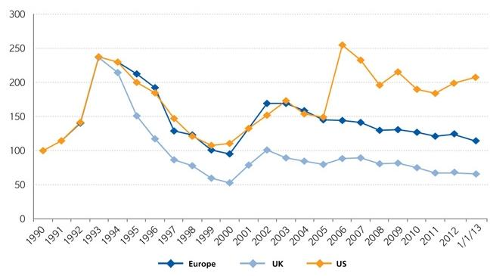
Regional Property Catastrophe Rate on Line Index, 1990—2013 (as of January 1)
Property-Cat reinsurance pricing was up in the US as of 1/1/13 but was down in Europe/UK
Sources: Guy Carpenter; Insurance Information Institute.

Slide 207
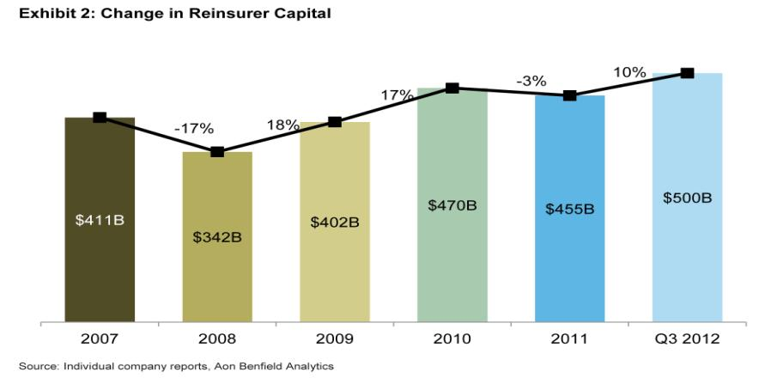
Reinsurance Capital Is at a Record High
Change in Global Reinsurer Capital
Source: Reinsurance Association of America from company reports and Aon Benfield Analytics.

Slide 208
Long-Term Evolution of Shareholders’ Funds for the Guy Carpenter Global Reinsurance Composite
Source: Guy Carpenter

Slide 209
CATASTROPHE BONDS, ANNUAL RISK CAPITAL ISSUED, 2002-2012
($ Billions)
Note
Source: GC Securities and Guy Carpenter & Company, LLC.

Slide 210
CATASTROPHE BONDS, RISK CAPITAL OUTSTANDING, 2002-2012
($ Billions)
Note
Source: GC Securities and Guy Carpenter & Company, LLC.

Slide 211
4. RENEWED PRICING DISCIPLINE
Evidence of a Broad and Sustained Shift in Pricing
211

Slide 212
Distribution of Direct Premiums Written by Segment/Line, 2010
Personal/Commercial lines split has been about 50/50 for many years; Personal Lines overtook Commercial Lines in 2010
Pvt. Passenger Auto is by far the largest line of insurance and is currently the most important source of industry profits
Billions of additional dollars in homeowners insurance premiums are written by state-run residual market plans
Distribution Facts
2010
Commercial Lines
$226.8B/49%
Homeowners
$68.2B/15%
Pvt. Pass Auto
$165.0B/36%
Sources: A.M. Best; Insurance Information Institute research.

Slide 213
Net Premium Growth: Annual Change,
1971—2013:Q1
(Percent)
1975-78
1984-87
2000-03
Net Written Premiums Fell 0.7% in 2007 (First Decline Since 1943) by 2.0% in 2008, and 4.2% in 2009, the First 3-Year Decline Since 1930-33.
2013:Q1 = 4.1%
2012 growth was +4.3%
Shaded areas denote “hard market” periods
Sources: A.M. Best (historical and forecast), ISO, Insurance Information Institute.

Slide 214
P/C Net Premiums Written: % Change, Quarter vs. Year-Prior Quarter
Premium growth in Q1 2013 was up 4.1% over Q1 2012, marking the 12th consecutive quarter of growth
Sustained Growth in Written Premiums
(vs. the same quarter, prior year) Will Continue through 2013
Sources: ISO, Insurance Information Institute.
214
12/01/09 - 9pm
eSlide – P6466 – The Financial Crisis and the Future of the P/C
Notes:
214

Slide 215
Growth in Net Written Premium by Segment, 2012 vs. 2011*
(Percent)
*Excludes mortgage and financial guaranty insurers.
Source: ISO/PCI; Insurance Information Institute

Slide 216
Average Commercial Rate Change,
All Lines, (1Q:2004–1Q:2013)
Pricing as of Q1:2013 was positive for the 8th consecutive quarter. Gains are likely to continue through 2013.
(Percent)
Q2 2011 marked the last of 30th consecutive quarter of price declines
KRW Effect
Note: CIAB data cited here are based on a survey. Rate changes earned by individual insurers can and do vary, potentially substantially.
Source: Council of Insurance Agents & Brokers; Insurance Information Institute

Slide 217
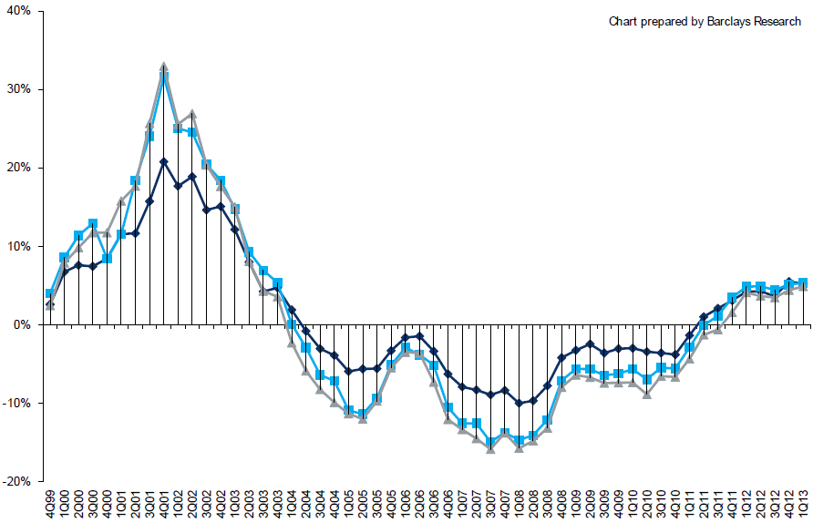
Change in Commercial Rate Renewals, by Account Size: 1999:Q4 to 2013:Q1
Percentage Change (%)
Peak = 2001:Q4 +28.5%
Pricing turned positive in Q3:2011, the first increase in nearly 8 years; Q1:2013 renewals were up 5.2%, the largest increase since late 2003; Some insurers posted stronger numbers.
Pricing Turned Negative in Early 2004 and Remained that way for 7 ½ years
KRW : No Lasting Impact
Trough = 2007:Q3 -13.6%
Source: Council of Insurance Agents and Brokers; Barclay’s Capital; Insurance Information Institute.
Note: CIAB data cited here are based on a survey. Rate changes earned by individual insurers can and do vary, potentially substantially.

Slide 218
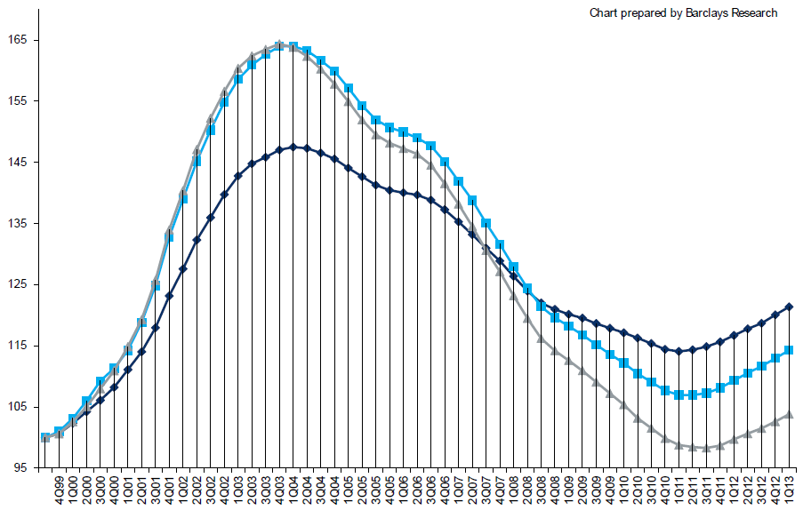
Cumulative Qtrly. Commercial Rate Changes, by Account Size: 1999:Q4 to 2013:Q1
1999:Q4 = 100
Despite 8 consecutive quarters of gains (Q4:2012 = 5.0%), pricing today is where is was in mid-2001 (pre-9/11), suggesting additional rate need going forward, esp. in light of record low interest rates
Note: CIAB data cited here are based on a survey. Rate changes earned by individual insurers can and do vary, potentially substantially.
Source: Council of Insurance Agents and Brokers; Barclay’s Capital; Insurance Information Institute.

Slide 219
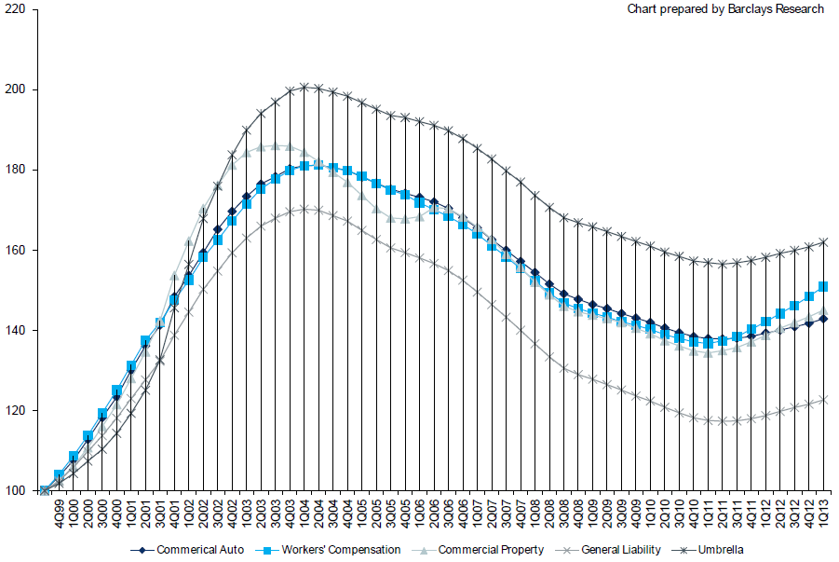
Cumulative Qtrly. Commercial Rate Changes, by Line: 1999:Q4 to 2013:Q1
1999:Q4 = 100
WC rate levels are rising and are now back to where they were in late 2008 and shortly after 9/11
Note: CIAB data cited here are based on a survey. Rate changes earned by individual insurers can and do vary, potentially substantially.
Source: Council of Insurance Agents and Brokers; Barclay’s Capital; Insurance Information Institute.

Slide 220
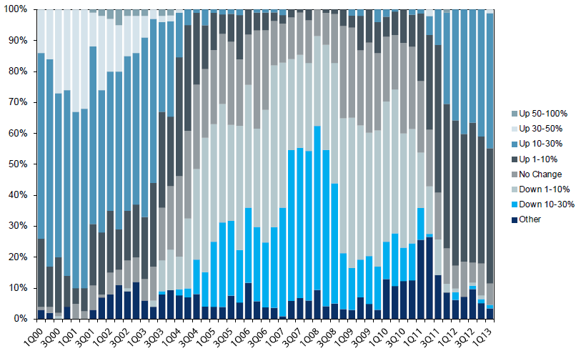
Workers Comp. Quarterly Rate Changes, by Line: 2000:Q1 to 2013:Q1
1999:Q4 = 100
Most accounts are now renewing upwards
Note: CIAB data cited here are based on a survey. Rate changes earned by individual insurers can and do vary, potentially substantially.
Source: Council of Insurance Agents and Brokers; Barclay’s Capital; Insurance Information Institute.

Slide 221
Change in Commercial Rate Renewals, by Line: 2013:Q1
Workers Comp rate increases are large than any other line, followed by Property lines
Percentage Change (%)
Major Commercial Lines Renewed Uniformly Upward in Q1:2013 for the 8th Consecutive Quarter; Property Lines & Workers Comp Leading the Way; Cat Losses and Low Interest Rates Provide Momentum Going Forward
Note: CIAB data cited here are based on a survey. Rate changes earned by individual insurers can and do vary, potentially substantially.
Source: Council of Insurance Agents and Brokers; Insurance Information Institute.

Slide 222
CLIPS: Change in Written Price Level:
All Lines, 2010:Q2 – 2012:Q4
Rate changes have been positive for 8 consecutive quarters, longer than any other commercial line
(Percent Change)
Note: Towers Watson data cited here are based on a survey. Rate changes earned by individual insurers can and do vary, potentially substantially.
Source: Towers Watson; Information Institute.

Slide 223
Workers Comp Rate Changes,
2008:Q4 – 2013:Q1
WC rate changes have been positive for 7 consecutive quarters, longer than any other commercial line
(Percent Change)
Note: CIAB data cited here are based on a survey. Rate changes earned by individual insurers can and do vary, potentially substantially.
Source: Council of Insurance Agents and Brokers; Information Institute.

Slide 224
Shifting Legal Liability &
Tort Environment
Is the Tort Pendulum
Swinging Against Insurers?
224

Slide 225
Over the Last Three Decades, Total Tort Costs as a % of GDP Appear Somewhat Cyclical, 1980-2013E
($ Billions)
2.21% of GDP in 2003 = pre-tort reform peak
Deepwater Horizon Spike in 2010
Tort costs in dollar terms have remained high but relatively stable since the mid-2000s., but are down substantially as a share of GDP
1.68% of GDP in 2013
Sources: Towers Watson, 2011 Update on US Tort Cost Trends, Appendix 1A

Slide 226
Commercial Lines Tort Costs: Insured vs. Self-(Un)Insured Shares, 1973-2010
2005: $143.5B 66.4% insured, 33.6% self-(un)insured
Billions of Dollars
$15.0
1995: $83.6B 69.5% insured, 30.5% self-(un)insured
1973: Commercial Tort Costs Totaled $6.49B, 94% was insured, 6% self-(un)insured
1985: $46.6B 74.5% insured, 25.5% self-(un)insured
$9.5
$6.0
2009: $126.5B 64.4% insured, 35.6% self-(un)insured
Tort Costs and the Share Retained by Risks Both Grew Rapidly from the mid-1970s to mid-2000s, When Tort Costs Began to Fall But Self-Insurance Shares Continued to Rise
Sources: Towers Watson, 2011 Update on US Tort Cost Trends, III Calculations based on data from Appendix 4.
226
12/01/09 - 9pm
eSlide – P6466 – The Financial Crisis and the Future of the P/C
Notes:
226

Slide 227
Commercial Lines Tort Costs: Insured vs. Self-(Un)Insured Shares, 1973-2010
Percent
2010: $138.1B 56.6% insured, 44.4% self-(un)insured (distorted by Deepwater Horizon event with most losses retained by BP)
1973: 94% was insured, 6% self-(un)insured
1985:74.5% insured, 25.5% self-(un)insured
1995: 69.5% insured, 30.5% self-(un)insured
2005: 66.4% insured, 33.6% self-(un)insured
The Share of Tort Costs Retained by Risks Has Been Steadily Increasing for Nearly 40 Years. This Trend Contributes Has Left Insurers With Less Control Over Pricing.
Sources: Towers Watson, 2011 Update on US Tort Cost Trends, III Calculations based on data from Appendix 4.
227
12/01/09 - 9pm
eSlide – P6466 – The Financial Crisis and the Future of the P/C
Notes:
227

Slide 228
Business Leaders Ranking of Liability Systems in 2012
Best States
Delaware
Nebraska
Wyoming
Minnesota
Kansas
Idaho
Virginia
North Dakota
Utah
Iowa
Worst States
Florida
Oklahoma
Alabama
New Mexico
Montana
Illinois
California
Mississippi
Louisiana
West Virginia
New in 2012
Wyoming
Minnesota
Kansas
Idaho
Newly Notorious
Oklahoma
Drop-offs
Rising Above
Indiana
Colorado
Massachusetts
South Dakota
Arkansas
Source: US Chamber of Commerce 2012 State Liability Systems Ranking Study; Insurance Info. Institute.

Slide 229
The Nation’s Judicial Hellholes: 2011
Watch List
Illinois
Madison , St. Clair and McLean counties
West Virginia
Philadelphia
Eastern District of Texas
Cook County, IL
Southern NJ
Franklin County, AL
Smith County, MS
Louisiana
California
Dishonorable Mention
New York
Albany and NYC
MI Supreme Court
AK Supreme Court
MO Supreme Court
Nevada
Clark County
South Florida
Source: American Tort Reform Association; Insurance Information Institute

Slide 230
CYBER RISK
Cyber Risk is a Rapidly Emerging Exposure for Businesses Large and Small in Every Industry
NEW III White Paper: http://www.iii.org/assets/docs/pdf/paper_CyberRisk_2013.pdf
230

Slide 231
Data Breaches 2005-2013, By Number of Breaches and Records Exposed
# Data Breaches/Millions of Records Exposed
Millions
The total number of data breaches and number of records exposed fluctuates from year to year and over time.
* 2013 figures as of March 19, 2013.
Source: Identity Theft Resource Center

Slide 232
2012 Data Breaches By Business Category, By Number of Breaches
The majority of the 447 data breaches in 2012 affected business and medical/healthcare organizations, according to the Identity Theft Resource Center.
Banking/Credit/Financial, 17 (3.8%)
Govt/Military, 50 (11.2%)
Business, 165 (36.9%)
Educational, 61 (13.6%)
Medical/Healthcare, 154 (34.5%)
Source: Identity Theft Resource Center, http://www.idtheftcenter.org/ITRC%20Breach%20Report%202012.pdf.

Slide 233
2012 Data Breaches By Category, By Number of Records Exposed
Government/Military and Business organizations accounted for the majority of records exposed by data breaches during 2012.
Banking/Credit/Financial, 470,048 (2.7%)
Medical/Healthcare, 2.2 million (12.9%)
Govt/Military, 7.7 million (44.4%)
Educational, 2.3 million (13.3%)
Business, 4.6 million (26.7%)
Source: Identity Theft Resource Center, http://www.idtheftcenter.org/ITRC%20Breach%20Report%202012.pdf.

Slide 234
AIG Survey: Cyber Attacks Top Concern Among Execs
While companies are focused on managing a variety of business risks, cyber attacks are a top concern. Some 85% of 258 executives surveyed said they were very or somewhat concerned about cyber attacks on their businesses.
Source: Penn Schoen Berland on behalf of American International Group.
234
Notes:
234

Slide 235
The Most Costly Cyber Crimes, Fiscal Year 2012
Malicious code, denial of service and web-based attacks account for more than 58 percent of the total annualized cost of cyber crime experienced by 56 companies.
Malware
Botnets
Malicious code
Viruses, Worms, Trojans
Phishing + social engineering
Malicious insiders
Stolen devices
Denial of service
Web-based attacks
Source: 2012 Cost of Cyber Crime: United States, Ponemon Institute.

Slide 236
External Cyber Crime Costs: Fiscal Year 2012
Information loss (44%) and business disruption or lost productivity (30%) account for the majority of external costs due to cyber crime.
Other costs*
Equipment damages
Information loss
Revenue loss
Business disruption
* Other costs include direct and indirect costs that could not be allocated to a main external cost category
Source: 2012 Cost of Cyber Crime: United States, Ponemon Institute.

Slide 237
High Profile Data Breaches, 2012-2013
Date | Company | Description of Breach
Mar 2013* | South Korean banks, media cos | Cyber attack causes computers to crash at South Korean banks and media companies, paralyzing bank machines across the country. No immediate reports of records compromised.
July 2012 | Yahoo | Security breach at Yahoo in which some 450,000 passwords lifted and posted to the Internet.
July 2012 | eHarmony | Online dating site eHarmony confirms security breach in which some 1.5 million user names and passwords compromised.
July 2012 | LinkedIn | Social networking site LinkedIn reportedly targeted in hacker attack that saw 6.5 million hashed passwords posted to the Internet.
April 2012 | Utah Dept of Technology Services | Utah Department of Technology notifies of a March 30 breach of a server containing personal data including social security numbers for about 780,000 Medicaid patient claims. Breach traced to Eastern Europe hackers.
Mar 2012 | Global Payments | Credit card processor Global Payments confirms hacker attack has compromised the payment card numbers of around 1.5 million cardholders.
Mar 2012 | CA Dept of Child Support Services | Officials announce that four computer storage devices containing personal information for about 800,000 adults and children in California’s child support system were lost by IBM and Iron Mountain Inc.
Jan 2012 | Zappos | Online shoe retailer Zappos announces that information, such as names, addresses and passwords on as many as 24 million customers illegally accessed.
Jan 2012 | NY State Electric + Gas Co | Security breach at NYSEG that allowed unauthorized access to NYSEG customer data, containing social security numbers, dates of birth and bank account numbers, exposing 1.8 million records.
*March 2013 attack is not part of ITRC research.
Sources: Identity Theft Resource Center, http://www.idtheftcenter.org/ITRC%20Breach%20Report%202012.pdf; Insurance Information Institute (I.I.I.) research.

Slide 238
Average Organizational Cost of a Data Breach, 2008-2011* ($ Millions)
The average organizational cost of a data breach in 2011 was $5.5 million, down 24% from $7.2 million in 2010. Companies have improved steps taken in both preparing for and responding to a data breach.
($ Millions)
*Findings of this benchmark study pertain to the actual data breach experiences of 49 U.S. companies from 14 different industry sectors, all of which participated in the 2011 study. Total breach costs include: lost business resulting from diminished trust or confidence of customers ;costs related to detection, escalation, and notification of the breach; and ex-post response activities, such as credit report monitoring.
Source: 2011 Annual Study: U.S. Cost of a Data Breach, the Ponemon Institute.
238
Notes:
238

Slide 239
Main Causes of Data Breach
Negligent employees and malicious attacks are most often the cause of the data breach. Some 39 percent of incidents involve a negligent employee or contractor, while 37 percent concern a malicious or criminal attack.
Negligence
System glitch
Malicious or criminal attack
Source: 2011 Cost of Data Breach Study: United States, Ponemon Institute, March 2012

Slide 240
Marsh: Increase in Purchase of Cyber Insurance Among U.S. Companies, 2012
Interest in cyber insurance continues to climb. The number of companies purchasing cyber insurance increased 33 percent from 2011 to 2012.
Source: Marsh Global Analytics, Marsh Risk Management Research Briefing, March 2013
240
Notes:
240

Slide 241
Marsh: Total Limits Purchased, By Industry – Cyber Liability, All Revenue Size
Cyber insurance limits purchased in 2012 averaged $16.8 million across all industries, an increase of nearly 20% over 2011.
($ Millions)
Source: Marsh Global Analytics, Marsh Risk Management Research Briefing, March 2013
241
Notes:
241

Slide 242
Marsh: Total Limits Purchased, By Industry – Cyber Liability, Revenue $1 Billion+
Among larger companies, average cyber insurance limits purchased in 2012 increased nearly 30% over 2011.
($ Millions)
Source: Marsh Global Analytics, Marsh Risk Management Research Briefing, March 2013
242
Notes:
242

Slide 243
Cyber Liability: Historical Rate (price per million) Changes
Overall, rates for cyber insurance were essentially flat in the fourth quarter of 2012.
Source: Marsh Global Analytics, Marsh Risk Management Research Briefing, March 2013

Slide 244
Insurance Information Institute Online:
www.iii.org
Thank you for your time
and your attention!
Twitter: twitter.com/bob_hartwig
Download at www.iii.org/presentations

