Slide 1
Tornadoes and Severe Convective Events:
Insurance Trends and Challenges in an Era of Climate Volatility
National Tornado Summit
Oklahoma City, OK
February 11, 2014
Robert P. Hartwig, Ph.D., CPCU, President & Economist
Insurance Information Institute ♦ 110 William Street ♦ New York, NY 10038
Tel: 212.346.5520 ♦ Cell: 917.453.1885 ♦ bobh@iii.org ♦ www.iii.org

Slide 2
U.S. Insured Catastrophe Loss Update
Tornadoes Are Among the Top Causes of Catastrophic Claims
The Toll of Tornadoes in Increasing
2

Slide 3
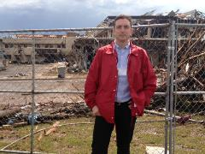
U.S. Insured Catastrophe Losses
($ Billions, $ 2012)
2011 was the costliest year ever for tornado and t-storm events at $26 billion
Tornadoes are among the largest causes of insured losses (claims) in any given year, accounting for 36% of all insured losses since 1983.
Overall CAT losses eased in 2013. The Moore, OK, event was the costliest of 2013.
*Through 12/31/13.
Note: 2001 figure includes $20.3B for 9/11 losses reported through 12/31/01 ($25.9B 2011 dollars). Includes only business and personal property claims, business interruption and auto claims. Non-prop/BI losses = $12.2B ($15.6B in 2011 dollars.)
Sources: Property Claims Service/ISO; Insurance Information Institute.
3
12/01/09 - 9pm
eSlide – P6466 – The Financial Crisis and the Future of the P/C
Notes:
3

Slide 4
Natural Disaster Losses in the United States, by Type, 2013
As of December 31, 2013 | Number of Events | Fatalities | Estimated Overall Losses (US $m) | Estimated Insured Losses (US $m)
Severe Thunderstorm | 69 | 110 | 16,341 | 10,274
Winter Storm | 11 | 43 | 2,935 | 1,895
Flood | 19 | 23 | 1,929 | 240
Earthquake & Geophysical | 6 | 1 | Minor | Minor
Tropical Cyclone | 1 | 1 | Minor | Minor
Wildfire, Heat, & Drought | 22 | 29 | 620 | 385
Totals | 128 | 207 | 21,825 | 12,794
Source: Munich Re NatCatSERVICE
4
4

Slide 5
Significant Natural Catastrophes, 2013
(Events with $1 billion economic loss and/or 50 fatalities)
Date | Event | Estimated Economic Losses (US $m) | Estimated Insured Losses (US $m)
February 24 – 25 | Winter Storm | 1,300 | 690
March 18 – 19 | Thunderstorms | 2,200 | 1,600
April 7 – 11 | Winter Storm | 1,600 | 1,200
April 16 – 18 | Thunderstorms | 1,100 | 560
May 18 – 20 | Thunderstorms | 3,100 | 1,800
May 28 – 31 | Thunderstorms | 2,800 | 1,400
August 6 – 7 | Thunderstorms | 1,300 | 740
September 9 – 16 | Flooding | 1,500 | 160
November 17 - 18 | Thunderstorms | 1,300 | 931
Source: Munich Re NatCatSERVICE
5

Slide 6
Top 8 States for Insured
Catastrophe Losses, 2013
$ Millions
Oklahoma led the country in insured CAT losses in 2013
Source: The Property Claim Services (PCS) unit of ISO, a Verisk Analytics company.

Slide 7
Top 5 States by Insured Catastrophe Losses in 2012*
(2012, $ Millions)
NY and NJ led the US in CAT losses in 2012 due Sandy
*Includes catastrophe losses of at least $25 million.
Sources: PCS unit of ISO; Insurance Information Institute.

Slide 8
Top 5 States by Insured Catastrophe Losses in 2011*
2011 experienced record claims from tornadoes. Insured losses from thunderstorms (including tornadoes) totaled $26 Bill.
(2012, $ Millions)
*Includes catastrophe losses of at least $25 million.
Sources: PCS unit of ISO; Insurance Information Institute.

Slide 9
Inflation Adjusted U.S. Catastrophe Losses by Cause of Loss, 1993–2012¹
Wind/Hail/Flood (3), $14.9
Fires (4), $6.5
Other (5), $0.2
Insured cat losses from 1993-2012 totaled $391.7B, an average of $19.6B per year or $1.6B per month
Geological Events, $18.4
Terrorism, $24.8
Winter Storms, $27.8
Hurricanes & Tropical Storms, $158.2
Tornado share of CAT losses is rising
Tornadoes accounted for 36% of insured CAT losses from 1993-2012—a total of $140.9B
Tornadoes (2), $140.9
Catastrophes are defined as events causing direct insured losses to property of $25 million or more in 2012 dollars.
Excludes snow.
Does not include NFIP flood losses
Includes wildland fires
Includes civil disorders, water damage, utility disruptions and non-property losses such as those covered by workers compensation.
Source: ISO’s Property Claim Services Unit.

Slide 10
Top States by Inflation-Adjusted Insured Catastrophe Losses, 1983–2012
Over the Past 30 Years Florida Has Accounted for the Largest Share of Catastrophe Losses in the U.S., Followed by Texas and Louisiana
TX is the second costliest state for CATs, with nearly $49B in insured losses over the past 30 years—tornadoes are a significant share of the total
Louisiana
$42.0B
Texas
$48.8B
Rest of the U.S.
$309.9B
Florida
$66.7B
Total: $467.5 Billion, an average of $16.6B per year or $1.3B per month
Source: PCS unit of ISO, Verisk Company.; Insurance Information Institute.

Slide 11
Top 16 Most Costly Disasters in U.S. History
(Insured Losses, 2012 Dollars, $ Billions)
Hurricane Sandy became the 5th costliest event in US insurance history
Includes Tuscaloosa, AL, tornado
Includes Joplin, MO, tornado
Hurricane Irene became the 12th most expense hurricane in US history in 2011
12 of the 16 Most Expensive Events in US History Have Occurred Since 2004
Sources: PCS; Insurance Information Institute inflation adjustments to 2012 dollars using the CPI.

Slide 12
Natural Disasters in the United States, 1980 – 2013
Number of Events (Annual Totals 1980 – 2013)
There were 128 natural disaster events in 2013
Number
22
19
81
6
Geophysical
(earthquake, tsunami,
volcanic activity)
Meteorological (storm)
Climatological
(temperature extremes,
drought, wildfire)
Hydrological
(flood, mass movement)
Source: MR NatCatSERVICE
12

Slide 13
Losses Due to Natural Disasters in the US, 1980–2013
(Overall and Insured Losses)
(2013 Dollars, $ Billions)
2013 CAT Losses
Overall : $21.8B
Insured: $12.8B
Indicates a great deal of losses are uninsured (~40%-50% in the US) = Growth Opportunity
2013 losses were far below 2011 and 2012 and were 44% lower than the average from 2000-2012
Overall losses (in 2012 values)
Insured losses (in 2013 values)
Source: MR NatCatSERVICE
13

Slide 14
The Terrible and Costly Toll of Tornadoes
Tornadoes Cause Billions in Insured Losses Each Year
Costs Are Increasing
14

Slide 15
Number of Tornadoes and Related Deaths, 1990 – 2013*
Tornadoes claimed 553 lives in 2011, the most since 1925
898 tornadoes were recorded in 2013 and 55 deaths*
2013 tornado activity was below average despite major storms in Oklahoma. Since 1990, 1,859 people have been killed in tornado events.
*Through Dec. 31, 2013.
Source: U.S. Department of Commerce, Storm Prediction Center, National Weather Service at http://www.spc.noaa.gov/climo/online/monthly/newm.html

Slide 16
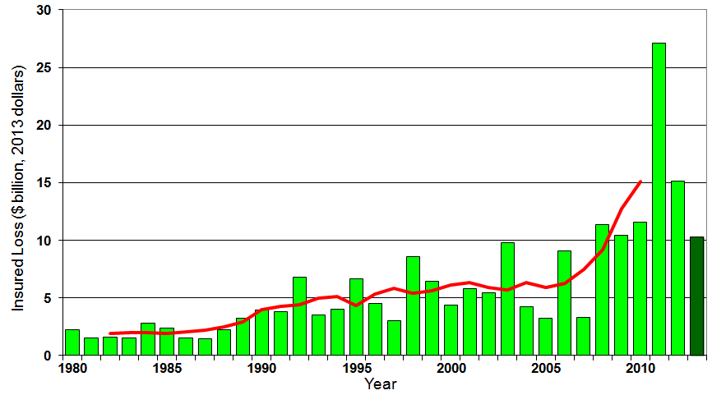
U.S. Thunderstorm Insured Loss Trends, 1980 – 2013
Hurricanes get all the headlines, but thunderstorms are consistent producers of large scale loss. 2008-2013 are the most expensive years on record.
Average thunderstorm losses are up 7 fold since the early 1980s. The 5-year running average loss is up sharply
Thunderstorm losses in 2013 totaled $10.3 billion, the 6th highest on record
Source: Property Claims Service, and MR NatCatSERVICE
16

Slide 17
Convective Loss Events in the U.S.
Overall and insured losses 1980 – 2012 and First Half 2013
(Bill. US$)
The insured and total economic cost of convective events has rising tremendously over the past 30+ years
Convective events are those caused by straight-line winds, tornadoes, hail, heavy precipitation, flash floods and lightning
Analysis contains: straight-line winds, tornadoes, hail, heavy precipitation, flash floods, lightning.
Overall losses (in 2012 values)
Insured losses (in 2012 values)
Source: Geo Risks Research, NatCatSERVICE – As at July 2013
17

Slide 18
Insured Losses from Tornado/Thunderstorm/
Hail Catastrophes, 2000-2013, (Top 25 States)
Insured Losses (in Millions of 2013 Dollars)
Insurers paid $134.6 billion to policyholders in claims associated with severe convective events from 2000-2013 (in 2013 dollars)—or $9.6 billion per year, on average
Texas leads the US by a wide margin in insured losses from convective events
Oklahoma has the second highest insured losses in the US from tornado/thunderstorm and hail events
Sources: Property Claims Service, a Division of Verisk Analytics; Insurance Information Institute.

Slide 19
Insured Losses from Tornado/Thunderstorm/
Hail Catastrophes, 2000-2013 (Bottom 25 States)
Insured Losses (in Millions of 2013 Dollars)
Insurers paid $134.6 billion to policyholders in claims associated with severe convective events from 2000-2013 (in 2013 dollars)—or $9.6 billion per year, on average
States in the West and North have the fewest convective losses
Sources: Property Claims Service, a Division of Verisk Analytics; Insurance Information Institute.

Slide 20
Oklahoma: Insured Losses from Tornado/ Thunderstorm/Hail Catastrophes, 2000-2013
Insured Losses (in Millions of 2013 Dollars)
Oklahoma sustained $9.8 billion in insured losses from convective events from 2000-2013, second only to $16.9 billion in Texas over the same period
Sources: Property Claims Service, a Division of Verisk Analytics; Insurance Information Institute.

Slide 21
Texas: Insured Losses from Tornado/ Thunderstorm/Hail Catastrophes, 2000-2013
Insured Losses (in Millions of 2013 Dollars)
Texas sustained $16.9 billion in insured losses from convective events from 2000-2013, far ahead of #2 Oklahoma at $9.8 billion over the same period
Sources: Property Claims Service, a Division of Verisk Analytics; Insurance Information Institute.

Slide 22
Missouri: Insured Losses from Tornado/ Thunderstorm/Hail Catastrophes, 2000-2013
Insured Losses (in Millions of 2013 Dollars)
Missouri sustained $9.4 billion in insured losses from convective events from 2000-2013, ranking third in the country behind only Texas ($16.9B) and Oklahoma ($9.8B)
Sources: Property Claims Service, a Division of Verisk Analytics; Insurance Information Institute.

Slide 23
States with Highest Insured Losses from Tornado/ Thunderstorm/Hail Catastrophes, 2000-2013
Insured Losses (in Millions of 2013 Dollars)
8 different states have led the country in insured losses from severe convective events from 2000-2013. The average peak state loss is $1.78 billion.
TX
MO
KY
TN
CO
TX
IN
MN
MN
TX
OK
AL
TX
OK
Sources: Insurance Information Institute based on data from Property Claims Service, a Division of Verisk Analytics.

Slide 24
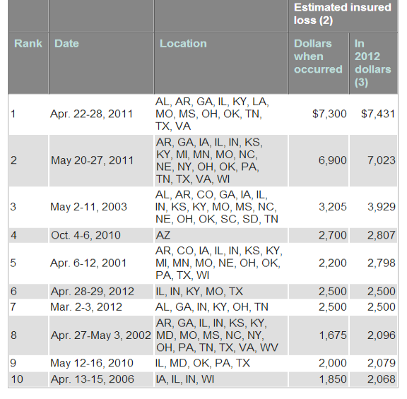
Top 10 Costliest Events Involving Tornadoes Count ($ millions)*
The 2011 events in Joplin and Tuscaloosa remain the costliest in US history (Moore would rank about 15th on an inflation adjusted basis)
All 10 of the costliest tornado events in US history occurred since 2001
*Also includes damage from other causes of losses occurring during the same event such as hail, wind and flood.
Source: PCS, a division of Verisk Analytics; Insurance Information Institute.
24

Slide 25
Insurance Industry Financial Impacts of Tornadoes and Convective Events
Convective Events Are a Major Driver of Higher Property Insurance Premiums
25

Slide 26
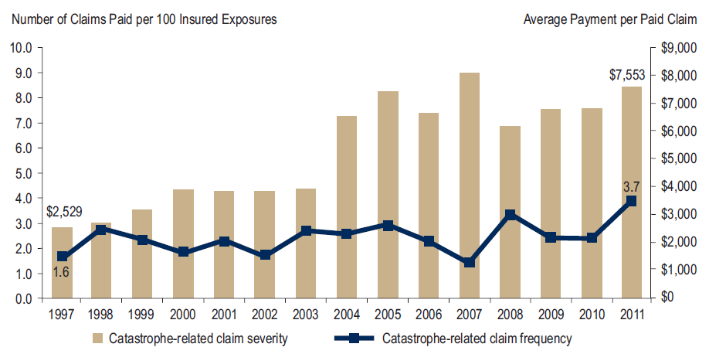
Homeowners Insurance Catastrophe-Related Claim Frequency and Severity, 1997—2012*
Avg. catastrophe claim cost rose approximately 200% from 1997-2011
Cat claim frequency in 2011 was at historic highs and more than double the rate in 1997
*All policy forms combined, countrywide.
Source: Insurance Research Council, Trends in Homeowners Insurance Claims, Sept. 2012 from ISO Fast Track data.
26

Slide 27
Combined Ratio Points Associated with Catastrophe Losses: 1960 – 2013*
Avg. CAT Loss Component of the Combined Ratio by Decade
1960s: 1.04 1970s: 0.85 1980s: 1.31 1990s: 3.39 2000s: 3.52 2010s: 6.1E*
Catastrophe losses as a share of all losses reached a record high in 2012
Combined Ratio Points
The Catastrophe Loss Component of Private Insurer Losses Has Increased Sharply in Recent Decades
*2010s represent 2010-2013.
Notes: Private carrier losses only. Excludes loss adjustment expenses and reinsurance reinstatement premiums. Figures are adjusted for losses ultimately paid by foreign insurers and reinsurers.
Source: ISO (1960-2011); A.M. Best (2012E) Insurance Information Institute.

Slide 28
ROE: Property/Casualty Insurance vs. Fortune 500, 1987–2013E*
(Percent)
P/C Profitability Is Both by
Cyclicality and Ordinary Volatility
Katrina, Rita, Wilma
Sandy
Sept. 11
Hugo
Lowest CAT Losses in
15 Years
4 Hurricanes
Andrew
Record Tornado Losses
Northridge
Financial Crisis*
* Excludes Mortgage & Financial Guarantee in 2008 – 2013E. 2013 P/C ROE is through 2013:Q3.
Sources: ISO, Fortune; Insurance Information Institute.

Slide 29
Homeowners Insurance Combined Ratio: 1990–2013E
Hurricane Andrew
Record tornado activity
Hurricane Sandy
Hurricane Ike
Homeowners performance in 2011 was severely impacted by record tornado activity. Home insurers paid out $1.22 in claims and expenses for every dollar they earned in premium.
Sources: A.M. Best; Insurance Information Institute.

Slide 30
Top Ten Most Expensive And Least Expensive States For Homeowners Insurance, 2011 (1)
Texas ranked as the 3rd most expensive state for homeowners insurance in 2011, with an average expenditure of $1,578.
Rank | Most expensive states | HO average premium | Rank | Least expensive states | HO average premium
1 | Florida | $1,933 | 1 | Idaho | $518
2 | Louisiana | 1,672 | 2 | Oregon | 559
3 | Texas (2) | 1,578 | 3 | Utah | 563
4 | Mississippi | 1,409 | 4 | Wisconsin | 592
5 | Oklahoma | 1,386 | 5 | Washington | 626
6 | Alabama | 1,163 | 6 | Ohio | 644
7 | Rhode Island | 1,139 | 7 | Delaware | 664
8 | Kansas | 1,103 | 8 | Arizona | 675
9 | New York | 1,097 | 9 | Nevada | 689
10 | Connecticut | 1,096 | 10 | Iowa | 713
Includes policies written by Citizens Property Insurance Corp. (Florida) and Citizens Property Insurance Corp. (Louisiana), Alabama Insurance Underwriting Association, Mississippi Windstorm Underwriting Association, North Carolina Joint Underwriting Association and South Carolina Wind and Hail Underwriting Association. Other southeastern states have wind pools in operation and their data may not be included in this chart. Based on the HO-3 homeowner package policy for owner-occupied dwellings, 1 to 4 family units. Provides “all risks” coverage (except those specifically excluded in the policy) on buildings and broad named-peril coverage on personal property, and is the most common package written.
The Texas Department of Insurance developed home insurance policy forms that are similar but not identical to the standard forms. In addition, due to the Texas Windstorm Association (which writes wind-only policies) classifying HO-1, 2 and 5 premiums as HO-3, the average premium for homeowners insurance is artificially high.
Note: Average premium=Premiums/exposure per house years. A house year is equal to 365 days of insured coverage for a single dwelling. The NAIC does not rank state average expenditures and does not endorse any conclusions drawn from this data.
Source: ©2013 National Association of Insurance Commissioners (NAIC). Reprinted with permission. Further reprint or distribution strictly prohibited without written permission of NAIC.

Slide 31
Federal Disaster Declarations Patterns: 1953-2014
Disaster Declarations Set New Records in Recent Years
Hundreds of Declarations Involved Tornadoes
31

Slide 32
Number of Federal Major Disaster Declarations, 1953-2014*
There have been 2,150 federal disaster declarations since 1953. The average number of declarations per year is 35 from 1953-2013, though there few haven’t been recorded since 1995.
The number of federal disaster declarations set a new record in 2011, with 99, shattering 2010’s record 81 declarations.
7 federal disasters were declared so far in 2014*
The Number of Federal Disaster Declarations Is Rising and Set New Records in 2010 and 2011 Before Dropping in 2012/13
*Through February 9, 2014.
Source: Federal Emergency Management Administration; http://www.fema.gov/disasters; Insurance Information Institute.

Slide 33
Federal Disasters Declarations by State,
1953 – 2014: Highest 25 States*
Over the past 60 years, Texas has had the highest number of Federal Disaster Declarations
*Through Feb. 9, 2014. Includes Puerto Rico and the District of Columbia.
Source: FEMA: http://www.fema.gov/news/disaster_totals_annual.fema; Insurance Information Institute.

Slide 34
Federal Disasters Declarations by State,
1953 – 2014: Lowest 25 States*
Over the past 60 years, Wyoming and Rhode Island had the fewest number of Federal Disaster Declarations
*Through Feb. 9, 2014. Includes Puerto Rico and the District of Columbia.
Source: FEMA: http://www.fema.gov/news/disaster_totals_annual.fema; Insurance Information Institute.

Slide 35
SEVERE WEATHER REPORT UPDATE: 2013
Damage from Tornadoes, Large Hail and High Winds Keep Insurers Busy
35

Slide 36
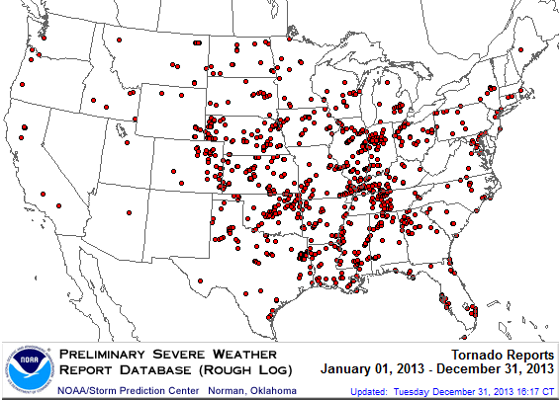
Location of Tornado Reports in 2013
A deadly EF-5 tornado in May in Moore, OK, produced insured losses of $1.575 billion. November tornadoes in the Midwest produced $1B in insured losses.
There were 943 tornadoes through Dec. 31, causing extensive property damage in several states
Source: NOAA Storm Prediction Center; http://www.spc.noaa.gov/climo/online/monthly/2013_annual_summary.html#; PCS.
36

Slide 37
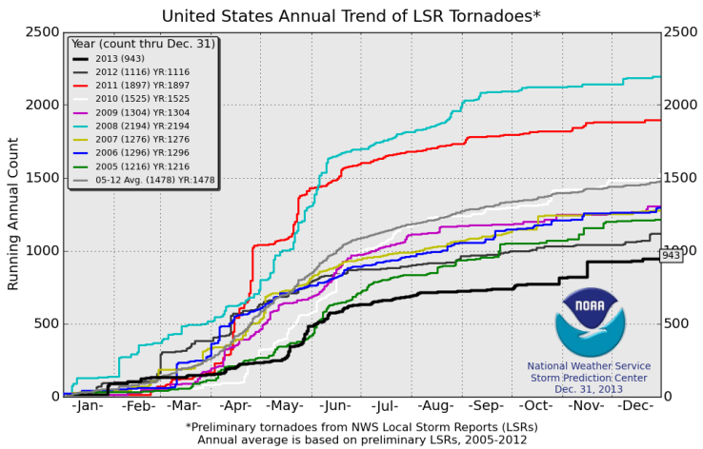
U.S. Tornado Count, 2005-2013*
There were 1,897 tornadoes in the U.S. in 2011 far above average, but well below 2008’s record
2013 count was the lowest in a decade
*Through Dec. 31, 2013.
Source: http://www.spc.noaa.gov/wcm/.
37

Slide 38
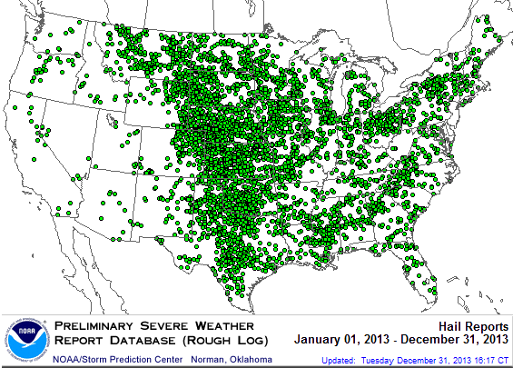
Location of Large Hail Reports: 2013
There were 5,457 “Large Hail” reports in 2013, causing extensive property and vehicle damage
Source: NOAA Storm Prediction Center; http://www.spc.noaa.gov/climo/online/monthly/2013_annual_summary.html#
38

Slide 39
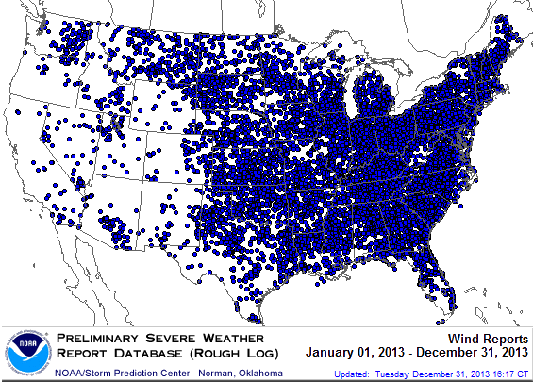
Location of High Wind Reports: 2013
There were 12,942 “Wind Damage” in 2013, causing extensive property damage
Source: NOAA Storm Prediction Center; http://www.spc.noaa.gov/climo/online/monthly/2013_annual_summary.html#
39

Slide 40
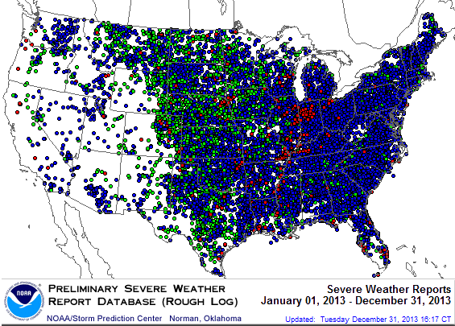
Severe Weather Reports: 2013
Severe weather reports are concentrated east of the Rockies
There were 19,342 severe weather reports in 2013; including 942 tornadoes; 5,457 “Large Hail” reports and 12,942 high wind events
Source: NOAA Storm Prediction Center; http://www.spc.noaa.gov/climo/online/monthly/2013_annual_summary.html#
40

Slide 41
SEVERE WEATHER REPORTS:
LONGER-RUN CONVECTIVE EVENT TRENDS
Damage from Tornadoes, Large Hail and High Winds Keep Insurers Busy
41

Slide 42
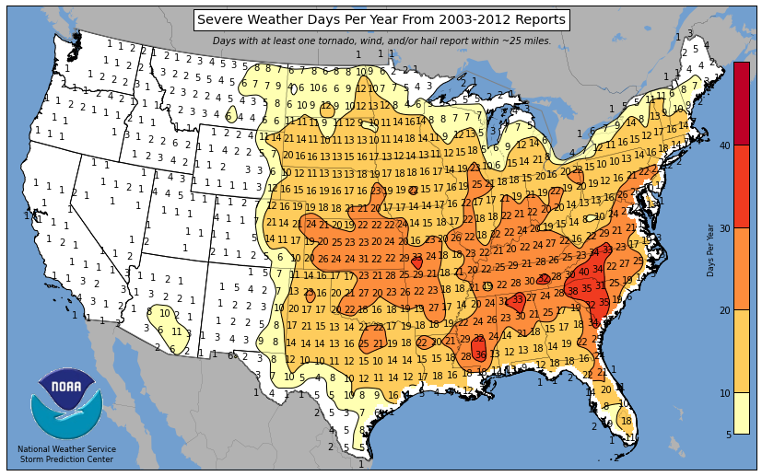
Severe Weather Days per Year, 2003-2012
Areas in the heart of Tornado Alley typically have 20-25 “Severe Weather Days” per year
Source: http://www.spc.noaa.gov/wcm/.
42

Slide 43
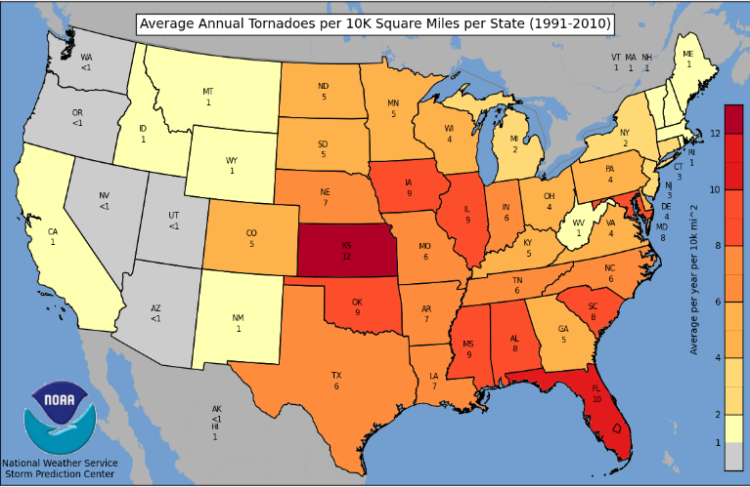
Severe Thunderstorm Wind Days per Year, 2003-2012
Severe t-storm events can breed tornadoes. KS and FL have the highest density of severe t-storms.
Source: http://www.spc.noaa.gov/wcm/.
43

Slide 44
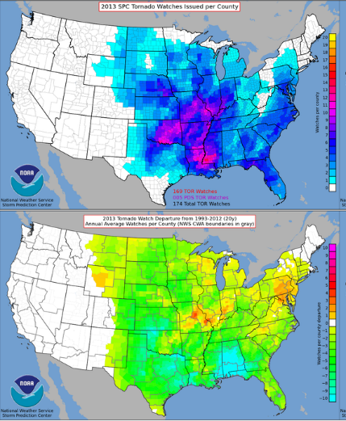
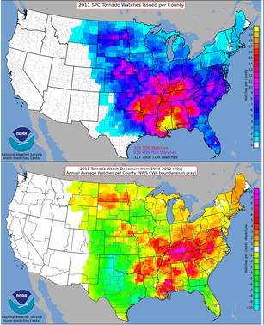
Tornado Watches and Departure from Average: 2013 vs. 2011
2013: LOW ACTIVITY
2011: HIGH ACTIVITY
Far above normal number of watches
Departure from average was enormous
Source: http://www.spc.noaa.gov/wcm/.
44

Slide 45
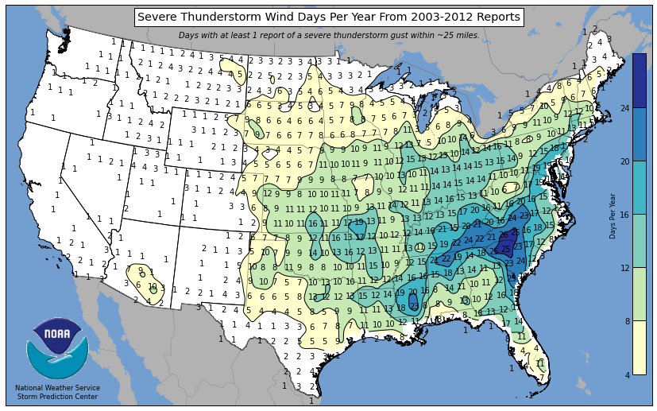
Severe Thunderstorm Wind Days per Year, 2003-2012
Wind due to severe t-storm can occur in many areas but is concentrated further east
Source: http://www.spc.noaa.gov/wcm/.
45

Slide 46
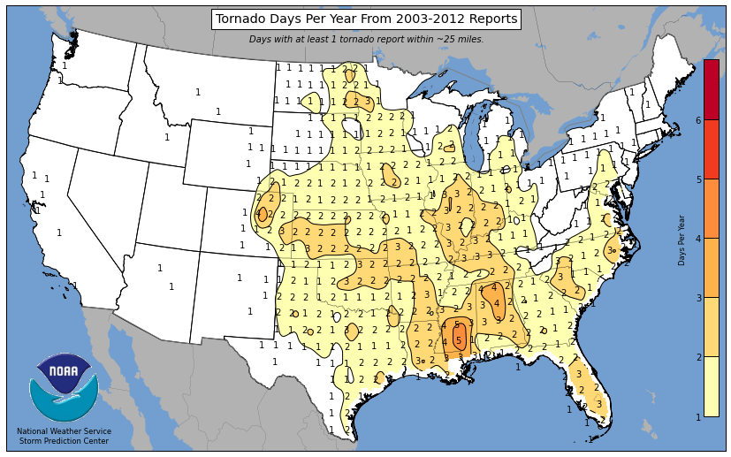
Tornado Days per Year, 2003-2012
Peak tornado zones have 2-3 Tornado Days per year
Source: http://www.spc.noaa.gov/wcm/.
46

Slide 47
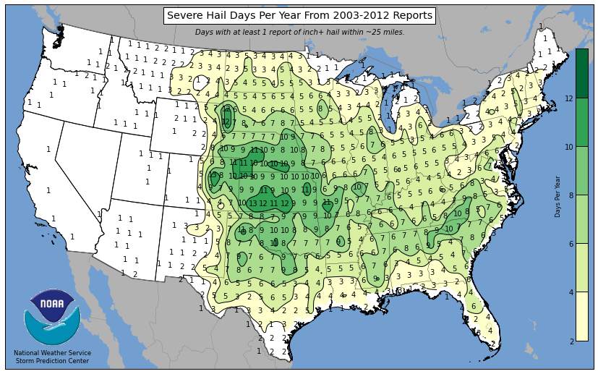
Severe Hail Days per Year, 2003-2012
Severe hail occurs commonly in severe t-storms and areas experiencing tornadoes
Source: http://www.spc.noaa.gov/wcm/.
47

Slide 48
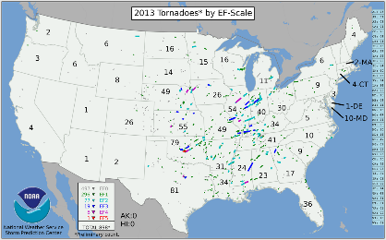
2013 Tornadoes by State by EF-Scale
The Moore, OK, event stands out as the most severe of 2013
Source: http://www.spc.noaa.gov/wcm/.
48

Slide 49
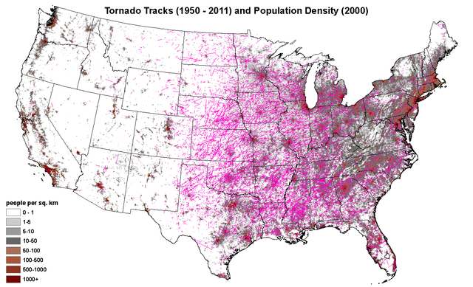
Tornado Tracks (1950-2000) and Population Density (2000)
Increased population density is contributing to higher insured losses from tornadoes and convective events in general
Source: http://www.spc.noaa.gov/wcm/.
49

Slide 50
Severe Convective Events: A Global Perspective
Severe Thunderstorm Events Are Becoming More Common Globally
Trend Is Likely to Continue
50

Slide 51
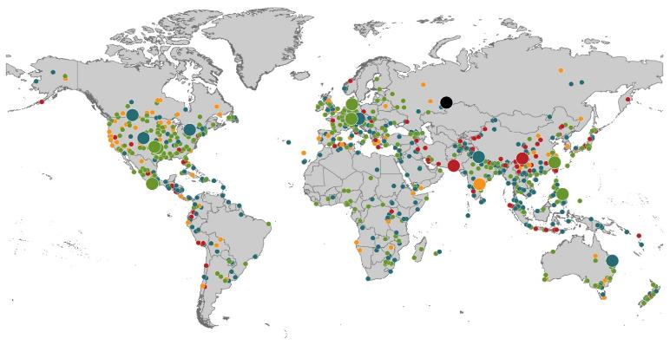
Natural Loss Events:
Full Year 2013
World Map
Winter Storm Christian (St. Jude)
Europe, 27–30 October
Floods
Europe,
30 May–19 June
Meteorite impact
Russian Federation, 15 February
Flash floods
Canada, 8–9 July
Floods
Canada, 19–24 June
Earthquake
China, 20 April
Hailstorms
Germany,
27–28 July
Floods
USA, 9–16 September
Typhoon Fitow
China, Japan,
5–9 October
Severe storms, tornadoes
USA, 18–22 May
Typhoon Haiyan
Philippines,
8–12 November
Severe storms, tornadoes
USA, 28–31 May
Floods
India, 14–30 June
Hurricanes Ingrid & Manuel
Mexico, 12–19 September
Floods
Australia,
21–31 January
880
Loss events
Earthquake (series)
Pakistan, 24–28 September
Heat wave
India, April–June
Geophysical events
(earthquake, tsunami, volcanic activity)
Hydrological events
(flood, mass movement)
Natural catastrophes
Geophysical events
(earthquake, tsunami, volcanic activity)
Hydrological events
(flood, mass movement)
Selection of significant
Natural catastrophes
Meteorological events
(storm)
Climatological events
(extreme temperature, drought, wildfire)
Meteorological events
(storm)
Climatological events
(extreme temperature, drought, wildfire)
Extraterrestrial events
(Meteorite impact)
Source: Munich Re Geo Risks Research, NatCatSERVICE – as of January 2014.
51

Slide 52
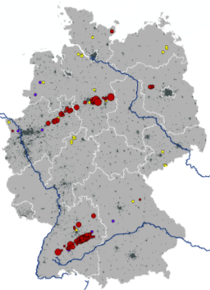
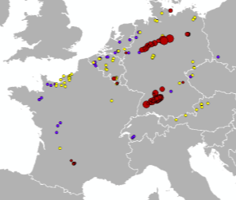
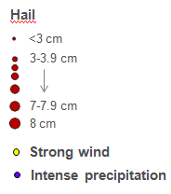
Hailstorm on July 27-28 2013 in Germany Was Most Expensive CAT Worldwide!
Hailstones with
diameters up to 8 cm
(tennis ball ≈ 7 cm)
July 27
July 28
Region | Overall losses | Insured losses | Fatalities
Southwestern and Northern Germany | US$ 4.8bn | US$ 3.7bn | 0
Source: Munich Re Geo Risks Research, NatCatSERVICE – as of January 2014.
52

Slide 53
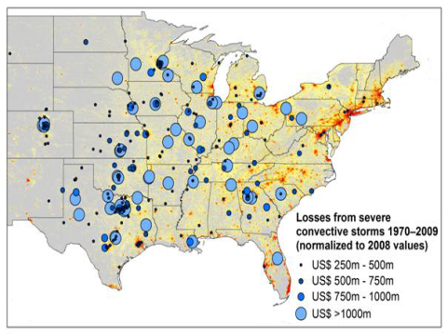
New Research Suggests Increase in Convective Activity Is Costly for Insurers
Study examines convective (hail, tornado, thundersquall and heavy rainfall) events in the US with losses exceeding US$ 250m in the period 1970–2009 (80% of all losses)
Past losses are normalized (i.e., adjusted) to currently exposed values
After normalization there are still increases of losses
Increases are correlated with
the increase in the meteorological
potential for severe thunderstorms
and its variability
For the first time research shows
that climatic changes have already
influenced US thunderstorm losses
Source: Munich Re research paper, Marhc 18, 2013: Rising Variability in Thunderstorm-Related U.S. Losses as a Reflection of Changes in Large-Scale Thunderstorm Forcing.
53

Slide 54
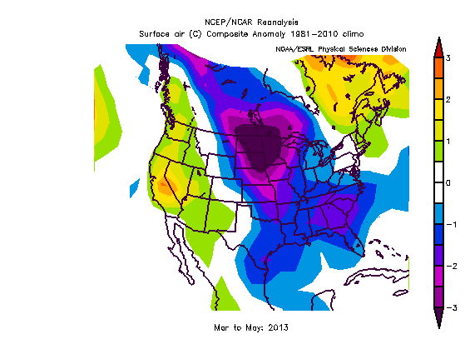
Unusual Weather Pattern Over the US in Spring 2013 Led to Low Convective Activity
Reasons for lack of tornado activity during spring:
Strong high pressure anchored over the northeast Pacific Ocean
Polar jet stream forced much further north than normal into Alaska before diving southward across the eastern United States
This pattern allowed cool Arctic air masses to dive south over the central United States, keeping the atmosphere relatively stable.
Source: Munich Re Geo Risks Research, NatCatSERVICE .
54

Slide 55
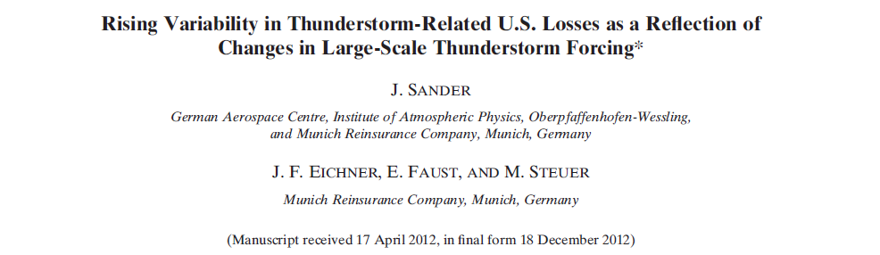
New Research by Munich Re on Trends of Convective Loss Events in the US
Published in Journal “Weather, Climate and Society“ of the American Meteorological Society
© 2014 Munich Re
55
55

Slide 56
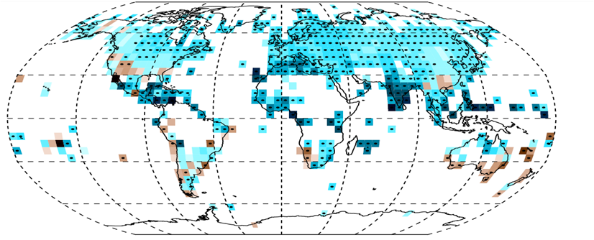
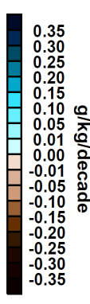
Water content of the atmosphere has already increased
Decadal changes of Specific Humidity of the lower atmosphere between 1973 and 2012
Black dots:
regions with significant trend
© 2014 Munich Re
Source: Willett et. al. (2013), Clim. Past, 9, 657–677
56

Slide 57
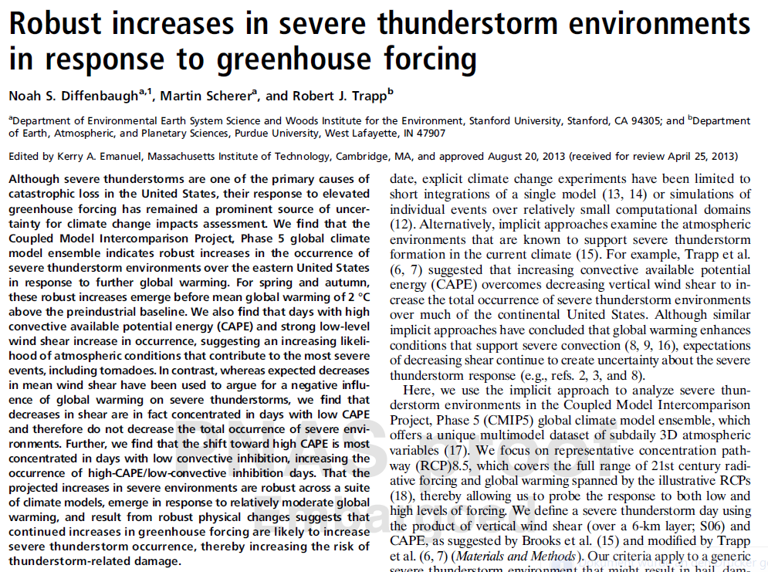

New study suggests future increases in convective storm risk
PNAS Early Edition, September 2013
© 2014 Munich Re
57

Slide 58
What Do the 2013 Tornado and Tropical Storm Anomalies Mean for the Next Years?
Convective Storms
US Tornado season 2013 dominated by short term air pressures patterns
No reason to expect another season like 2013 in 2014
On the long term climate change most probably will increase activity of convective storms, events like in Germany 2013 may become more frequent.
Tropical Storms
2013 hurricane activity dominated by unusual short term effects
- such short term effects cannot be predicted on a seasonal basis
- no reason to believe to see a repetition next year
- 2014 starts again with the odds of the current Atlantic warm phase.
Typhoon activity will rise in the next years due to a natural oscillation
2013 a first indicator of this?
Source: Munich Re Geo Risks Research, NatCatSERVICE .
58

Slide 59
Insurance Information Institute Online:
www.iii.org
Thank you for your time
and your attention!
Twitter: twitter.com/bob_hartwig
Download at www.iii.org/presentations

