Slide 1
Adapting to an Ever-Changing and Risky World of Tort Liability
American Bar Association
Magna Carta 800 Conference
London, UK
12 June 2015
Download at www.iii.org/presentations
Robert P. Hartwig, Ph.D., CPCU, President & Economist
Insurance Information Institute ♦ 110 William Street ♦ New York, NY 10038
Tel: 212.346.5520 ♦ Cell: 917.453.1885 ♦ bobh@iii.org ♦ www.iii.org

Slide 2
How Big Are Liability Insurance Markets in Major Economies?
The US and UK have the highest shares of liability premiums relative to GDP
Liability premiums in China account for a much smaller share of GDP
Liability insurance premiums totaled $160 billion in 2013, accounting for 0.26% of global GDP. This also equates to 10% of global non-life premiums and 23% of global commercial lines premiums
Source: Swiss Re, sigma, 4/2014.

Slide 3
General Liability Claims Incurred as a Percent of GDP
Traditionally, liability claims grow faster than GDP.
The decline in claims began in 2004 and was revealed by a turn in the reserves cycle. Improved safety reduced the frequency of claims.
After 2008, underlying claims trends slowed down due to the global recession.
The question is whether economic drivers of claims costs have begun to accelerate in the US and some other countries.
If historical trends re-emerge, then claims trends are likely to rise with stronger economic growth and at a pace greater than that of overall GDP
General liability claims incurred as a % of GDP
?
Question as to what will happen when the current period of reserve releases runs its course
Source: Swiss Re, sigma 4/2014; Insurance Information Institute.
Notes:
Based on historic relationships, future annual nominal claims growth would be expected to average 5-6% in the US, and 6-7% in Canada.
The US, Canada, and the UK have the highest GDP forecasts, France and Italy the lowest.
With rising claims, demand for commercial casualty covers will pick up as well.

Slide 4
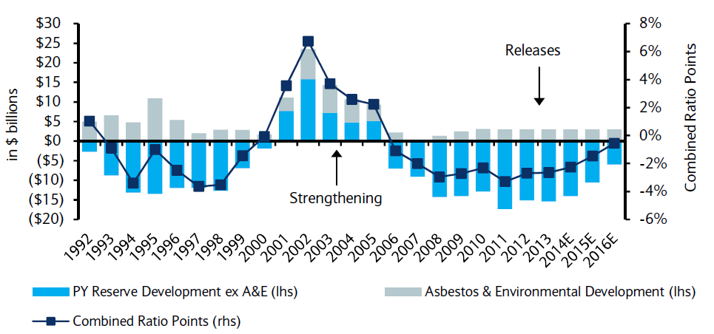
US Non-Life Insurance Loss Reserve Development, 1992 – 2016E*
Reserve releases are expected to gradually taper off, but will continue to benefit the bottom line and combined ratio through at least 2016
Reserve Change
Source: A.M. Best; Barclays research for estimates.

Slide 5
Some Expect Higher Claim Cost Growth to Resume in Post-Crisis Era
Range of Expected Liability Claims Growth (2014-20) vs historic growth (2007-12)
US, Canada, and the UK have the highest GDP forecasts; France and Italy the lowest.
The UK and France have historically shown low growth of claims in relation to GDP.
Canada and Germany have historically high correlations of claims growth to wage and CPI inflation.
Historic growth (2007-2012)
Expected claims growth (2014-2020)
Source: Swiss Re, sigma 4/2014

Slide 6
Post-Crisis Question: Will Long-Run Pre-Crisis (1975-2007) Growth Trends Re-Emerge?
Liability claims grew faster than the general economy (measured by GDP)
Prior to the financial crisis (1975-2007), general liability claims rose roughly 1% for every 1% rise in GDP in the UK and France and 1.4% in Canada and Italy. The US and Germany ranked in between.
This was also substantially faster than CPI inflation
In the US, for example, general liability claims rose 1.9% for every 1% rise in CPI
Multi-year trends in claims growth are correlated with:
Medical expenditure growth (highly) in the US
Consumer price and wage inflation in European countries

Slide 7
US Medical Cost Inflation vs. Overall Consumer Price Index (CPI), 1995 – 2014*
Medical cost inflation has moderated substantially in recent years
Average Annual Growth Average 1995 – 2014
Healthcare: 3.7%
Total Nonfarm: 2.4%
Sources: US Bureau of Labor Statistics; Insurance Information Institute.

Slide 8
US National Health Care Expenditures as a Share of GDP, 1965 – 2022F*
% of GDP
{
Current Period
Health care expenditures as a share of GDP rose from 5.8% in 1965 to 18.0% in 2013 and are expected to reach 19.9% of GDP by 2022
2022 19.9%
2010: 17.9%
2000: 13.8%
1990: 12.5%
Since 2009, heath expenditures as a % of GDP have flattened out at about 18%--the question is why and will it last?
1980: 9.2%
1965 5.8%
Sources: Centers for Medicare & Medicaid Services, Office of the Actuary at http://www.cms.gov/Research-Statistics-Data-and-Systems/Statistics-Trends-and-Reports/NationalHealthExpendData/NationalHealthAccountsProjected.html accessed 3/14/14; Insurance Information Institute.

Slide 9
US Tort Cost Trends:
1933-Current Era
Examination of Long-Term Escalation of Tort Costs and Evidence of a “Bending” in the Cost Curve
9

Slide 10
Tort Costs: Rising for Eight Decades

Slide 11
Over the Last Three Decades, Total Tort Costs as a % of GDP Appear Somewhat Cyclical, 1980-2013E
($ Billions)
2.21% of GDP in 2003 = pre-tort reform peak
Deepwater Horizon Spike in 2010
Tort costs in dollar terms have remained high but relatively stable since the mid-2000s., but are down substantially as a share of GDP
1.68% of GDP in 2013
Sources: Towers Watson, 2011 Update on US Tort Cost Trends, Appendix 1A

Slide 12
The Nation’s Judicial Hellholes: 2014/2015 (Are Now Fewer in Number)
Watch List
Illinois
Madison County
West Virginia
Atlantic County, New Jersey
Mississippi Delta
Montana
Nevada
Newport News, Virginia
Philadelphia, Pennsylvania
California
Dishonorable Mention
New York City Asbestos Litigation
AL Supreme Court
PA Supreme Court
Florida
Source: American Tort Reform Association; Insurance Information Institute

Slide 13
Commercial Lines Tort Costs: Insured vs. Self-(Un)Insured Shares, 1973-2010
Percent
2010: $138.1B 56.6% insured, 44.4% self-(un)insured (distorted by Deepwater Horizon event with most losses retained by BP)
1973: 94% was insured, 6% self-(un)insured
1985:74.5% insured, 25.5% self-(un)insured
1995: 69.5% insured, 30.5% self-(un)insured
2005: 66.4% insured, 33.6% self-(un)insured
Commercial Risks Are More Comfortable Retaining Tort Risks.
The Question is Why?
Sources: Towers Watson, 2011 Update on US Tort Cost Trends, III Calculations based on data from Appendix 4.
13
12/01/09 - 9pm
eSlide – P6466 – The Financial Crisis and the Future of the P/C
Notes:
13

Slide 14
List of Emerging Risks Future Tort Cost Drivers is Endless
New Risks Emerge Every Day
Can They Be Contained and Managed?
14

Slide 15
A Few Concerns…
Return of Historical Tort Cost Trends Based on Historical Cost Drivers
Reversal of Current Favorable Loss Development in Casualty Line
Emergence of New Risks
Fracking
Cyber Risk
Autonomous Vehicles
GMOs
New Generation of Environmental Risks
Climate Change Litigation
Reversal/Erosion of Tort Reforms in US
Export of Mass Tort/Class Action/Collective Redress to Europe, Asia
Third-Party Financing of Litigation
Old Issues: Asbestos, Hurricane Katrina, Hurricane Sandy (flood litigation)

Slide 16
Data Breaches 2005-2014, by Number of Breaches and Records Exposed
# Data Breaches/Millions of Records Exposed
Millions
The Total Number of Data Breaches Rose 28% While the Number of Records Exposed Was Relatively Flat (-2.6%)
16
* 2014 figures as of Jan. 12, 2014 from the ITRC.
Source: Identity Theft Resource Center.

Slide 17
Data/Privacy Breach: Many Potential Costs Can Be Insured
Data Breach Event
Costs of notifying affecting individuals
Defense and settlement costs
Lost customers and damaged reputation
Cyber extortion payments
Costs of notifying regulatory authorities
Regulatory fines at home & abroad
Business Income Loss
Forensic costs to discover cause
Source: Zurich Insurance; Insurance Information Institute
17

Slide 18
Insurance Information Institute Online:
www.iii.org
Thank you for your time and your attention!
Twitter: twitter.com/bob_hartwig
Download at www.iii.org/presentations

