Slide 1
Automobile Trends:
Who (or What) is at the Wheel
AIPSO Residual Market Forum
Providence, RI
April 14, 2015
Download at www.iii.org/presentations
James P. Lynch, FCAS MAAA, chief actuary
Insurance Information Institute ♦ 110 William Street ♦ New York, NY 10038
Tel: 212.346.5533 ♦ Cell: 917.359.3908 ♦ jamesl@iii.org ♦ www.iii.org

Slide 2
Automobile Trends: Outline
Trends in Auto Usage
Driving Trends
  Unauthorized Immigrants
  Uninsured Motorists
  Insurance Affordability
Autonomous Vehicles
2
12/01/09 - 9pm
eSlide – P6466 – The Financial Crisis and the Future of the P/C
Notes:
2

Slide 3
Trends in Auto Usage
Shaking off the Recessionary Hangover
3

Slide 4
The Price of Gas, 2014-2015
Avg. Price /Gallon
Even after rebound, prices remain 30% below the July peak.
Until July, gas prices were persistently high
From July through December, gas prices fell virtually every week
Over the Course of the Second Half of the 2014 Calendar Year,
Gas Prices Fell 34%.
Price is Weekly U.S. All Grades All Formulations Retail Gasoline Prices
Sources: Federal Energy Administration (http://www.eia.gov/petroleum/gasdiesel/ ); I.I.I.

Slide 5
Do Changes in Gas Prices
Affect Miles Driven? 2000-2014
Avg. Price
Miles Driven
/Gallon
(Billions)
Focus On 2014
2002-2007: People Drive More Despite Higher Prices
Lots of Factors Affect Miles Driven: State of Economy, Weather, Gas Prices, Etc.
Sources: Federal Energy Administration (http://www.eia.gov/petroleum/gasdiesel/ ); *gas prices and miles driven through December
Federal Highway Administration (http://www.fhwa.dot.gov/ohim/tvtw/tvtpage.cfm ); I.I.I.

Slide 6
Do Changes in Gas Prices Affect Miles Driven? A Look at 2014
Avg. Price
% Chg. in Miles Driven
/Gallon
… Four Months Later, Mileage Starts to Surge.
June-July: Gas Prices Peak …
Still Lower Gas Prices Imply Surge Will Continue.
Prior research on the relationship between gas prices and miles driven says that, in the short run, an increase in gas prices produces little change in miles driven. No recent research on the effect of price drops.
Sources: Federal Energy Administration (http://www.eia.gov/petroleum/gasdiesel/ ); *gas prices and miles driven through December
Federal Highway Administration (http://www.fhwa.dot.gov/ohim/tvtw/tvtpage.cfm ); I.I.I.

Slide 7
Something Unusual is Happening:
Miles Driven*, 1990–2015
Billions
Some of the growth in miles driven is due to population growth:
1997 vs. 1992: +5.1%
2002 vs. 1997: +7.4%
2007 vs. 2002: +4.7%
2012 vs. 2007: +3.4%
A new record in January 2015: miles driven was below the prior peak for 87 straight months—
over 7 years! Previous record was in the early 1980s (39 months).
*Moving 12-month total. The 2015 figure is through January 2015, the latest available.
Note: Recessions indicated by gray shaded columns.
Sources: Federal Highway Administration (http://www.fhwa.dot.gov/policyinformation/travel_monitoring/tvt.cfm);
National Bureau of Economic Research (recession dates); Insurance Information Institute.
7
12/01/09 - 9pm
eSlide – P6466 – The Financial Crisis and the Future of the P/C
Notes:
7

Slide 8
Driving Trends
Illegal Immigrants,
Legal Drivers
8

Slide 9
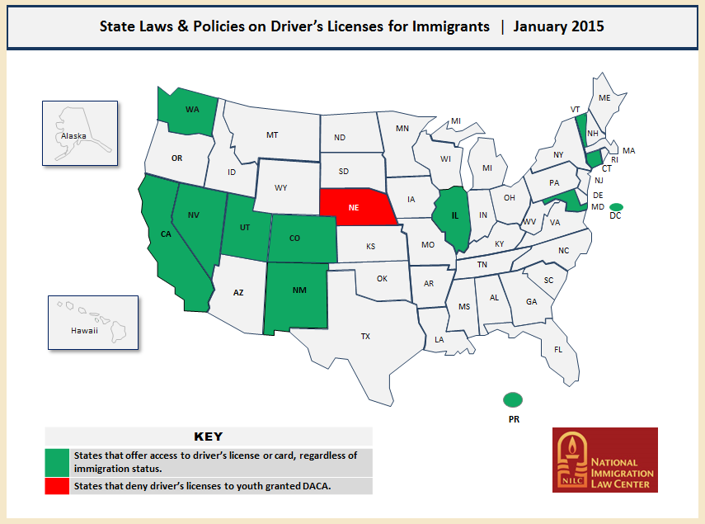
Unauthorized Immigrants
10 States Allow Illegal Immigrants to Get Licenses, plus DC, Puerto Rico
Could Always Get Insurance, Usually Non-standard Before
California Became Latest State to Allow Unauthorized Immigrants to Get Driver’s Licenses (AB60 – 1/1/15) – And by Far the Largest
DACA: Deferred Action for Childhood Arrivals (arrived in U.S before age 16, not automatically eligible for license)
SOURCE: National Immigration Law Center.

Slide 10
California AB60
In Addition to Standard Driving Tests (Vision/Written/Behind the Wheel), Illegal Immigrants Need:
  Proof of Identity (Foreign passport/ID card/birth certificate OR tax returns/school documents/marriage license, etc.)
  Proof of California Residency (Lease/mortgage bills/medical documents, etc.)
SOURCE: California Department of Motor Vehicles: http://dmv.ca.gov/portal/dmv/detail/pubs/newsrel/newsrel15/2015_27 .

Slide 11
California AB60
DMV estimated 1.5 million applicants in 3 years
  900 new employees
  Added Saturday hours
  200,000 New Licenses
Insurance Issues
  Eligible for Low-Cost Auto (CLCA)
  Low Limits: $200-$500 a Year
  Takeup Seems Low
  Standard, Nonstandard Pursuing
SOURCE: California Department of Motor Vehicles.

Slide 12
Non-standard: A Growing Niche
Insurers Have Become More Sophisticated, Can Price Risks More Precisely.
SOURCES: SNL Financial data; Insurance Information Institute calculations.

Slide 13
Impact on Uninsured Motorists
UM Rate Slowly Declining
Why? Auto Insurance Is Gradually Becoming More Affordable.
SOURCE: Insurance Research Council.

Slide 14
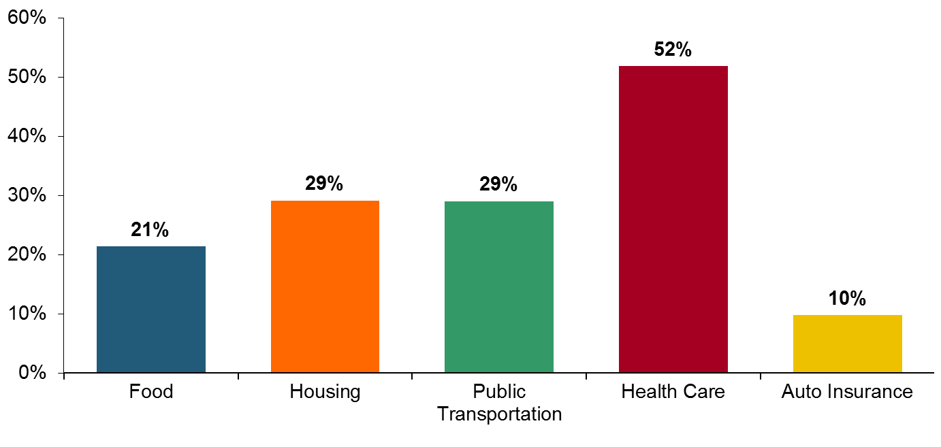
Auto Insurance vs. Other Essentials
Auto insurance expenditures growing more slowly
Percent Growth, 2001-2011
Source: Insurance Information Institute calculation based on data from Bureau of Labor Statistics, Consumer Expenditure Surveys for 2001 and 2011, and National Association of Insurance Commissioners.

Slide 15
Spending Pattern in 2012 of Americans in the Lowest-Income Quintile
Income range for this quintile: $0 to $19,111
Average annual expenditure range*: $21,382 to $22,926
Average annual expenditure for auto insurance*: $406 to $616
16%
21%
13%
40%
Auto Insurance – Not A Big Bill, Even Among Least Affluent
2%
8%
*Range computed by adding or subtracting two standard deviations from the mean expenditure.
Source: Insurance Information Institute calculations based on data from Bureau of Labor Statistics, Consumer Expenditure Surveys for 2012.

Slide 16
Average Expenditure for Pvt. Passenger Auto
Insurance as Pct. of Median Family Income*, 2011
Highest States
States Allowing Unauthorized Immigrant Drivers
*Average auto insurance expenditure as a percentage of the 2011 median income for a family of four
Source: Auto Insurance Report, January 20, 2014.

Slide 17
Average Expenditure for Pvt. Passenger Auto
Insurance as Pct. of Median Family Income*, 2011
Lowest States
More Affordable → More Flexible U/W → Smaller Residual Market
In Most States With Illegal Immigrant Laws, Insurance Costs Trail National Average.
*Average auto insurance expenditure as a percentage of the 2011 median income for a family of four
Source: Auto Insurance Report, January 20, 2014.

Slide 18
Auto Insurance Burden Easing,
Lower-Income* Americans Say
Fewer Than 1 in 4 Finds Cost a Significant Burden
% Saying Auto Insurance is a ‘Significant Burden’
The effects of the “Great Recession” briefly caused auto insurance premiums to be burdensome for more low-income people
For the last 4 years (since 2010), among those with incomes in the two lowest quintiles, fewer than 1 in 4 said auto insurance premiums were a significant burden
*Annual income less than $35,000. Source: Insurance Information Institute Annual Pulse Surveys (1997-2014).

Slide 19
I.I.I. Poll: Shopping for Insurance
Q. When your auto insurance policy was up for renewal did you compare prices at different insurance companies in any of the following ways (Phone, Online, Agent)?
Insurance Has Also Gotten Easier to Shop For.
Source: Insurance Information Institute Annual Pulse Survey.

Slide 20
I.I.I. Poll: Shopping for Insurance
Q. Do you think you have more choices today among auto insurers than people had 10 years ago?
People Say They Have More Choices for Auto Insurance. Lowest-Income Americans Are the Most Likely to Say So.
Source: Insurance Information Institute Annual Pulse Survey.

Slide 21
I.I.I. Poll: Ads Are Everywhere
Q. How long has it been since you have seen or heard an advertisement for auto insurance?
Insurers Are Spending More on Ads, and the Ads Are Effective, Including Among Lowest-Income Americans.
Source: Insurance Information Institute Annual Pulse Survey.

Slide 22
Autonomous Vehicles
They’ll Change Insurance - Slowly
22

Slide 23

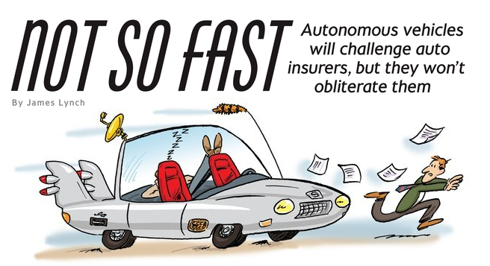
When Computers Take the Wheel . . .

Slide 24
Step 1: Co-pilot
In Theory
Crashes Avoided Per Year | All | Injury | Fatal
Forward Collision Warning | 1,165,000 | 66,000 | 879
Lane Departure Warning | 179,000 | 37,000 | 7,529
Side Assist View (Blind Spots) | 395,000 | 20,000 | 393
Adaptive Headlights | 142,000 | 29,000 | 2,484
Total Unique Crashes | 1,866,000 | 149,000 | 10,238
In Practice
Forward Collision Warning Working
Adaptive Headlights Working
Others: Benefits ‘Less Clear’
6% of Injuries
30% of Fatalities
Some of These Features Are Already on Vehicles. Others Are On Their Way Soon.
Source: Highway Loss Data Institute, Insurance Institute for Highway Safety, National Highway Traffic Safety Administration.

Slide 25
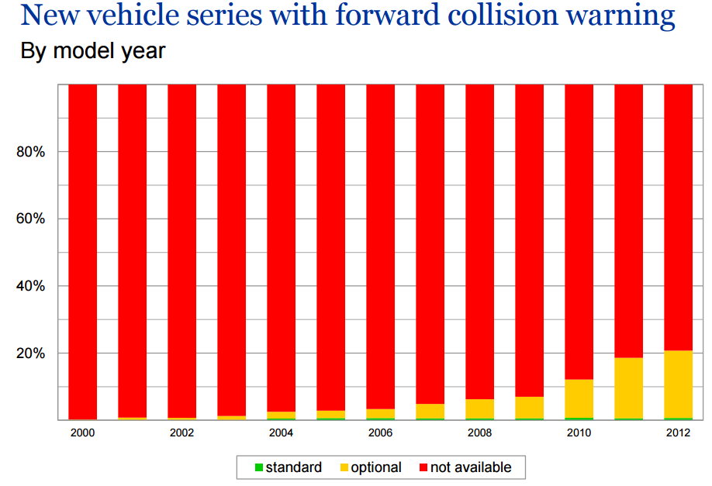
Step 1: Co-pilot
Technology Emerges Slowly.
Source: Highway Loss Data Institute, Insurance Institute for Highway Safety.

Slide 26
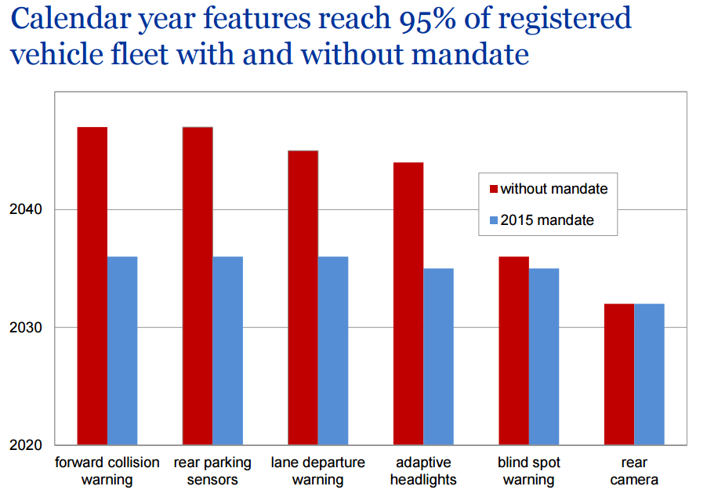
Step 1: Co-pilot
20 Years With Mandate, Longer Without.
Source: Highway Loss Data Institute, Insurance Institute for Highway Safety.

Slide 27
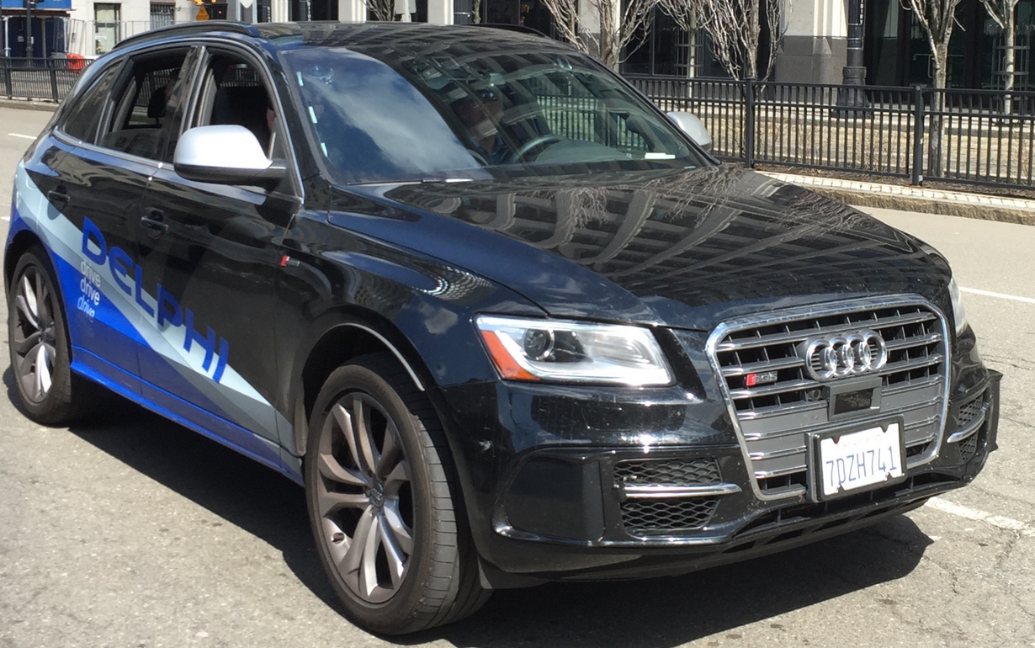
Step 2: The ‘Dream Vehicle’
Delphi prototype “Roadrunner”
SF to NYC in Nine Days (4/2015)
3,400 Miles – All but 50 Autonomous
Issues: ‘Unmarked Lanes, Heavy Roadworks,’ When Sun Was Low in Sky
These Are on the Drawing Boards of Almost All Automakers. But the Dream Vehicle Is a Long Ways Away.

Slide 28
When Will This Happen?
Standard Equipment
Minimal Price
Moderate
Expensive
SOURCE: Autonomous Vehicle Implementation Predictions, Victoria Transport Policy Institute, 2015.

Slide 29
Why Will It Take So Long?
Average Vehicle
Age (Years)
Recession Hangover – People Struggling to Afford Major Purchase; Cars Are Built Better, Last Longer.
Sources: Polk, August 2013 Survey, IHS Automotive June 2014; Insurance Information Institute.
29
12/01/09 - 9pm
eSlide – P6466 – The Financial Crisis and the Future of the P/C
Notes:
29

Slide 30
Why Will It Take So Long?
Q. Would You Be Willing to Ride in a Driverless Car?
Don’t Know
No
Yes
Nearly Three Out of Five People Say They Would Not Ride in a Driverless Car.
Source: Insurance Information Institute annual Pulse Survey, June 2014.

Slide 31
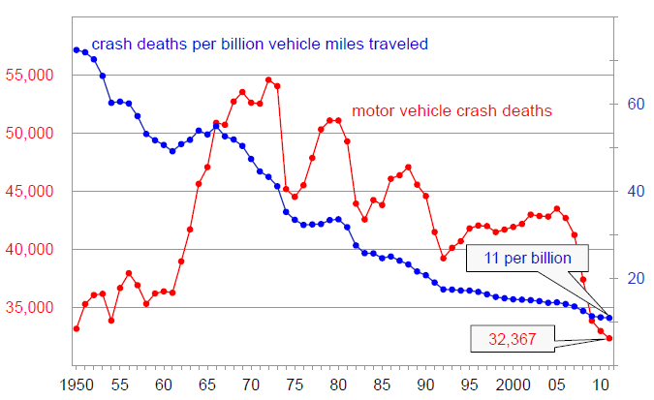
Enhanced Vehicle and Road Safety Have Made Driving Much Safer
Motor Vehicle Crash Deaths and Crash Death Rate, 1950-2012
Crash deaths are down 40% since the early 1970s
Fatal crash rates have fallen by 85% over the past 60 years
Source: National Highway Transportation Safety Administration as cited in Insurance Institute for Highway Safety presentation by Adrian Lund, Ph.D., Drivers and Driver Assistance Systems: How Well Do They Match?’, June 18, 2013; Insurance Information Institute.
31

Slide 32
Fatalities per Hundred
Million Miles Driven
32,719 Traffic Deaths in 2013, 2.1% Less Than 2012.
Auto Fatality/Injury Rates Have Been Falling for Decades.
Sources: National Highway Traffic Safety Administration.

Slide 33
But Auto Insurance Expenditures Rise
For Past 20 Years, Expenditures Rising About 1.5% Annually
If Cars Are Safer, Why Are Insurance Costs Rising?
* Insurance Information Institute Estimates/Forecasts
Source: NAIC, Insurance Information Institute estimate for 2013-2014 based on Motor Insurance CPI.

Slide 34
Auto Insurance: Frequency vs. Severity
Down 55%!
Sources: Insurance Institute for Highway Safety, Insurance Services Office, Insurance Information Institute.

Slide 35
Auto Claims Have Grown Faster Than Inflation for 50 Years
Percentage Change, 1963-2013

Slide 36
I.I.I. Poll: Who Is Responsible?
Q. Who should be responsible if an accident occurred involving a driverless car?
Don’t Know
Car’s Occupant
Car’s Insurer
Car’s Manufacturer
Car’s Owner
Half of Respondents Think a Driverless Car’s Manufacturer Should Bear Responsibility in Case of an Accident.
Source: Insurance Information Institute Annual Pulse Survey.

Slide 37
I.I.I. Poll: Who Is Responsible?
Q. Would you be willing to pay more for your car to cover the manufacturer’s liability in case of an accident?
Don’t Know
Yes
No
Only a Quarter of Americans Would Be Willing to Pay More for a Driverless Car to Cover the Manufacturer’s Liability in Case of an Accident.
Source: Insurance Information Institute Annual Pulse Survey.

Slide 38
The Future of the Car of the Future
Technology Has Been Making Cars Safer for Decades.
It takes a Long Time for Technology to Penetrate the Marketplace.
The Size of Claims Has Grown Faster Than the Frequency of Claims Has Shrunk.
Auto Insurers Should Be Up to the Challenge.

Slide 39
Insurance Information Institute Online:
www.iii.org
Thank you for your time
and your attention!
Twitter: twitter.com/@III_Research

