Slide 1
Private Passenger and Commercial Auto Overview:
Frequency & Severity on the Rise
Insurance Information Institute
July 12, 2016
Download at www.iii.org/presentations
Robert P. Hartwig, Ph.D., CPCU, President & Economist
Insurance Information Institute ♦ 110 William Street ♦ New York, NY 10038
Tel: 212.346.5520 ♦ Cell: 917.453.1885 ♦ bobh@iii.org ♦ www.iii.org

Slide 2
Personal & Commercial Auto Underwriting Performance
Auto Has Been Under Some Underwriting Pressure Recently as Frequency and Severity Trends Deteriorate
2

Slide 3
Private Passenger Auto Combined Ratio: 1993–2017F
Private Passenger Auto Underwriting Performance Is Showing the Strains of Rising Frequency (and Severity) Trends in Many States
Sources: A.M. Best (1990-2014); Conning (2015E-17F); Insurance Information Institute.

Slide 4
Commercial Auto Combined Ratio: 1993–2017F
Commercial Auto Results Are Challenged as Rate Gains Barely Have Yet to Offset Adverse Frequency and Severity Trends
Sources: A.M. Best (1990-2014);Conning (2015E-2017F); Insurance Information Institute.

Slide 5
Profitability and Growth in Personal and Commercial Auto Insurance Markets
Analysis by Selected States and United States Totals
5

Slide 6
RNW Pvt. Passenger Auto, 2005-2014 Average: Highest 25 States
(Percent)
Hawaii was the most profitable state for auto insurers from 2005-2014
Sources: NAIC; Insurance Information Institute

Slide 7
RNW Pvt. Passenger Auto,
2005-2014 Average: Lowest 25 States
(Percent)
Michigan was the least profitable state for auto insurers from 2005-2014
Sources: NAIC; Insurance Information Institute

Slide 8
RNW PP Auto: Selected States vs. U.S., 2005-2014
Average 2005-2014
US: 6.2% TX: 6.4% IL: 7.8% MI*: -2.9%
GA: 4.7% OH: 10.1% PA: 7.0% CO: 7.5%
Source: NAIC.
*The profit reported for Michigan’s passenger and commercial auto liability lines are not meaningful because of data reporting anomalies arising from the data related to the Michigan Catastrophic Claims Association.
8
Notes:
8

Slide 9
PP Auto: 10-Year Average RNW
Select States & The U.S.
2005-2014
Ohio’s PP Auto profitability is above the US and selected state averages
Source: NAIC, Insurance Information Institute

Slide 10
Top Ten Most Expensive And Least Expensive States For Pvt. Pass. Auto Insurance, 2013 (1)
Rank | Most expensive states | Average expenditure | Rank | Least expensive states | Average expenditure
1 | New Jersey | $1,254.10 | 1 | Idaho | $553.38
2 | D.C. | 1,187.49 | 2 | Iowa | 572.14
3 | New York | 1,181.86 | 3 | South Dakota | 580.99
4 | Louisiana | 1,146.29 | 4 | Maine | 592.82
5 | Florida | 1,143.83 | 5 | North Dakota | 604.58
6 | Michigan | 1,131.40 | 6 | Wisconsin | 621.05
7 | Delaware | 1,101.12 | 7 | Indiana | 621.71
8 | Rhode Island | 1,066.25 | 8 | North Carolina | 624.76
9 | Connecticut | 1,011.27 | 9 | Nebraska | 638.74
10 | Massachusetts | 1,007.98 | 10 | Wyoming | 639.71
The US average expenditure for auto insurance in 2013 was $841.23.
Based on average automobile insurance expenditures.
Source: © 2016 National Association of Insurance Commissioners.

Slide 11
PP Auto DPW Growth:
Selected States vs. U.S., 2006-2015
(Percent)
Average 2006-2015
US: 2.1% TX: 4.3% CO: 2.8% GA: 3.1%
IL: 1.5% MI: 2.7% OH: 1.2% PA: 1.0%
Source: SNL Financial.
11
Notes:
11

Slide 12
PP Auto Direct Incurred Loss Ratios
Selected States vs. U.S., 2006-2015
(Percent)
Source: SNL Financial.
12
Notes:
12

Slide 13
PP Auto Direct Incurred Loss Ratios
Selected States vs. U.S., 2006-2015
(Percent)
Source: SNL Financial.
13
Notes:
13

Slide 14
Facts About Commercial Auto Insurance
Incurred Loss Ratio: 65.9% in 2015, highest since the 66.3% reached in 2002 and up from 64.1% in 2014
  Reserve deficiencies/strengthening could further pressure loss ratios
Direct Written Premium Growth: +7.35% in 2015 to a record $31.08B, a modest deceleration from +8.66% in 2014
  2015 was the 5th consecutive year of growth and the 4th consecutive year of strong growth
  Growth is being driven primarily by rate increases in response to rising claim costs and secondarily by exposure growth
Market Share: Progressive became the #1 commercial auto carrier in the US in 2015 (7.0% market share), displacing Travelers (6.4% market share), which had been #1 for decades
  The top 10 commercial auto insurers accounted for 43.1% of the market in 2015
Source: Auto insurance Report, June 13, 2016; Conning.
14
12/01/09 - 9pm
eSlide – P6466 – The Financial Crisis and the Future of the P/C
Notes:
14

Slide 15
Commercial Auto DPW Growth:
Selected States vs. U.S., 2006-2015
(Percent)
Average 2006-2015
US: 0.5%
Rates and exposure have been rebounding since 2011
The soft market and Great Recession had a severe adverse impact on the commercial auto line
Source: SNL Financial; Insurance Information Institute.
15
Notes:
15

Slide 16
RNW Commercial Auto: Selected States vs. U.S., 2005-2014
Average 2005-2014
US: 8.1% TX: 6.3% IL: 8.9% MI*: 5.2%
GA: 5.2% OH: 14.3% PA: 8.4% CO: 11.4%
Source: NAIC.
*The profit reported for Michigan’s passenger and commercial auto liability lines are not meaningful because of data reporting anomalies arising from the data related to the Michigan Catastrophic Claims Association.
16
Notes:
16

Slide 17
Commercial Auto: 10-Year Average RNW Select States & The U.S.
2005-2014
Ohio’s Commercial Auto profitability is above the US and selected state averages
Source: NAIC, Insurance Information Institute

Slide 18
Commercial Auto DPW Growth:
Selected States vs. U.S., 2006-2015
(Percent)
Average 2006-2015
US: 0.5% TX: 4.0% CO: 0.3%
GA: 0.5% IL: 1.0% MI: 0.5%
OH: -0.7% PA: 0.3%
Source: SNL Financial.
18
Notes:
18

Slide 19
Auto Insurance Claim Cost Drivers Continue to Grow Faster than CPI
Price Level Change: December 2015 vs. December 2014
Excludes Food and Energy
Healthcare costs are a major cost driver and are expected to accelerate in the years ahead
Sources: Bureau of Labor Statistics; Insurance Information Institute.
19

Slide 20
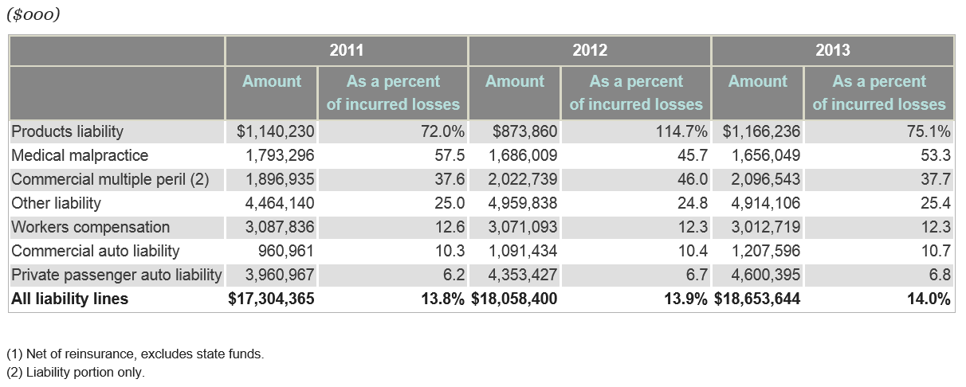
Defense Costs and Cost Containment Expenses as a Percent of Incurred Losses, 2011 – 2013*
Defense and Cost Containment expenses in Personal and Commercial Auto Liability have edged up slightly in recent years, from 6.2% of incurred losses to 6.8%
*Latest available.
Source: SNL Financial; Insurance Information Institute.

Slide 21
Median and Average Personal Injury Jury Award by Type of Liability, 2013
Porducts Liability and Medical Malpractice cases tend to have among the highest jury awards
Source: Current Award Trends in Personal Injury, 54th Edition; Insurance Information Institute.
21
Notes:
21

Slide 22
INVESTMENTS:
THE NEW REALITY
Investment Performance is a Key Driver of Profitability
Depressed Yields Will Necessarily Influence Underwriting & Pricing
22

Slide 23
Property/Casualty Insurance Industry Investment Income: 2000–2016:Q1¹
Investment earnings are still below their 2007 pre-crisis peak
($ Billions)
Due to persistently low interest rates, investment income fell in 2012, 2013 and 2014 but showed a small (1.9%) increase in 2015—another drop in 2016 seems likely.
*Annualized figure based on actual Q1:2016 net investment income earned of $10.893B.
¹ Investment gains consist primarily of interest and stock dividends. Sources: ISO; Insurance Information Institute.

Slide 24
U.S. Treasury Security Yields:
A Long Downward Trend, 1990–2016*
Yields on 10-Year U.S. Treasury Notes have been essentially below 5% for more than a decade.
Despite the Fed’s December 2015 rate hike, yields remain low though short-term yields have seen some gains; Yield curve is flattening.
Since roughly 80% of P/C bond/cash investments are in 10-year or shorter durations, most P/C insurer portfolios will have low-yielding bonds for years to come.
*Monthly, constant maturity, nominal rates, through May 20, 2016.
Sources: Federal Reserve Bank at http://www.federalreserve.gov/releases/h15/data.htm. National Bureau of Economic Research (recession dates); Insurance Information Institute.
24
12/01/09 - 9pm
eSlide – P6466 – The Financial Crisis and the Future of the P/C
Notes:
24

Slide 25
Claim Trends in Private Passenger Auto Insurance
Rising Frequencies and Severities in Many Coverages
Will that Pattern Be Sustained?
25

Slide 26
Net Investment Yield on Property/ Casualty Insurance Invested Assets, 2007–2016P*
(Percent)
Estimated book yield in 2016 is down about 140 BP from pre-crisis levels
The yield on invested assets remains low relative to pre-crisis yields. The Fed’s plan to raise interest rates in late 2015 has pushed up some yields, albeit quite modestly.
Sources: A.M. Best; 2015E-2016P figures from A.M. Best P/C Review and Preview, Feb. 2016; Insurance Information Institute

Slide 27
Auto Severity & Frequency by Coverage: Trending Up in 2015
Annual Change, 2015 Over 2014
Frequency and Severity Were Up Across Most Coverage Types in 2015; A Trend Likely to Continue in 2016
Source: ISO/PCI Fast Track data; Insurance Information Institute

Slide 28
Collision Coverage: Severity & Frequency Trends Are Both Higher in 2015
Annual Change, 2005 through 2015
The Recession, High Fuel Prices Helped Temper Frequency and Severity, But this Trend Has Clearly Reversed, Consistent with Experience from Past Recoveries
Source: ISO/PCI Fast Track data; Insurance Information Institute

Slide 29
Collision Claims: Frequency Trending
Higher in 2015
Annual Change, 2005 through 2015
For a Long Time, Claim Frequency Has Been Falling, But Since 2009 This Trend Seems to Have Reversed
Source: ISO, a Verisk Analytics company; Insurance Information Institute.

Slide 30
Collision Claims: Severity Trending
Higher in 2009-2015
Annual Change, 2005 through 2015
The Great Recession and High Fuel Prices Helped to Temper Claim Severity, But These forces Have Clearly Reversed, Consistent with Experience from Past Recoveries
Source: ISO, a Verisk Analytics company; Insurance Information Institute.

Slide 31
Collision Claims: Pure Premium (Losses per Insured Unit), 2011:Q4–2015:Q4
Over the Latest Four Years,
the Collision Pure Premium Rose by 19.75%
Note: Number of claims is for four quarters ending in quarter shown.
Source: ISO/PCI Fast Track data; Insurance Information Institute.

Slide 32
Collision Loss Ratio Trending Upward:
Private Passenger Auto, 2010 – 2015
Loss Ratio
Collision Loss Ratios are Trending Steadily Upward
Source: ISO/PCI Fast Track data; Insurance Information Institute

Slide 33
Bodily Injury: Severity Trend Is Up, Frequency Decline Has Ended—Rising?
Annual Change, 2005 through 2015
Cost Pressures Will Increase if BI Frequency and Severity Trends Persist
Source: ISO/PCI Fast Track data; Insurance Information Institute

Slide 34
Property Damage Liability: Severity and Frequency Are Up
Annual Change, 2005 through 2015
Severity/Frequency Trends Have Been Volatile, But Rising Severity since 2011 Is a Concern
Source: ISO/PCI Fast Track data; Insurance Information Institute

Slide 35
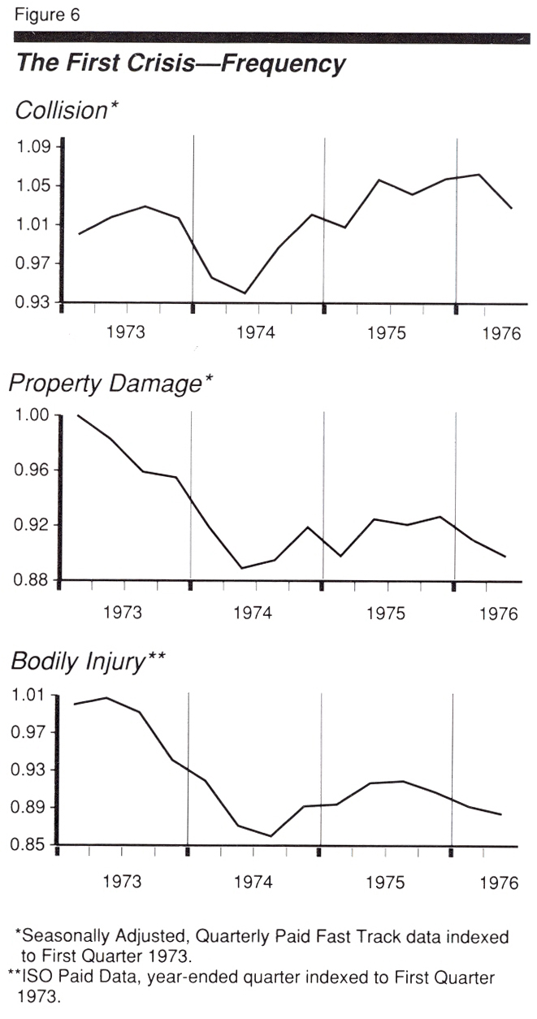
Auto Insurance: Claim Frequency Impacts of Energy Crisis of 1973/4
Oct. 17, 1973: Arab oil embargo begins
March 17, 1974: Arab oil states announce end to embargo
Frequency Impacts
Collision: -7.7%
PD: -9.5%
BI: -13.3%
Frequency began to rebound almost immediately after the embargo ended
Driving Stats
Gas prices rose 35-40%
Miles driven fell 6.7% in 1974
Source: ISO, US DOT.

Slide 36
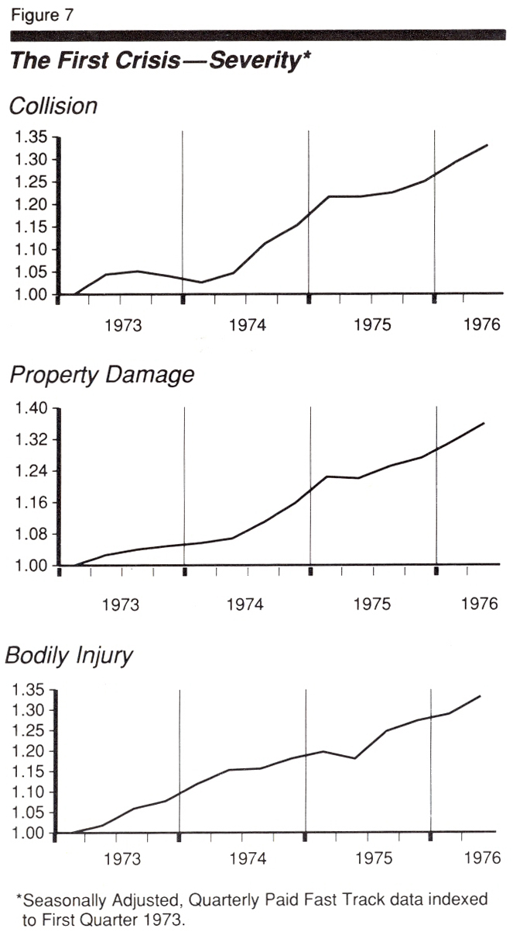
Auto Insurance: Claim Severity Impacts of Energy Crisis of 1973/4
Oct. 17, 1973: Arab oil embargo begins
March 17, 1974: Arab oil states announce end to embargo
Severity Impacts
Collision: -7.5%
PD: +15.9%
BI: N/A*
Collision severity began to rebound almost immediately after the embargo ended; PD accelerated as inflation rose; No discernable trend change in BI.
Driving Stats
Gas prices rose 35-40%
Miles driven fell 6.7% in 1974
Source: ISO.

Slide 37
WEATHER CLAIMS & AUTO INSURANCE
Impact of Weather of Auto Claims Is Underappreciated by Consumers and Regulators
37

Slide 38
Comprehensive Coverage: Frequency and Severity Trends Are Volatile
Severe weather is a principal cause of the spikes in both frequency and severity
Annual Change, 2005 through 2015
Weather Creates Volatility for Comprehensive Coverage
Source: ISO/PCI Fast Track data; Insurance Information Institute

Slide 39
What the Hail? Hail Loss Claims in Auto Insurance, 2013-2015
(Percent)
There were about 750 hail claims on vehicles form 2013-2015
Hail loss claims on vehicles account for about 35% of all hail claims across all policy types
Sources: NICB Forecast Report, May 2, 2016; Insurance Information Institute

Slide 40
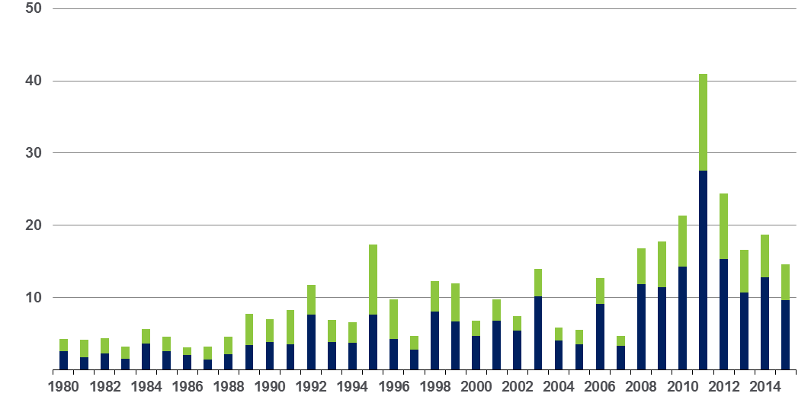
Convective Loss Events in the US
Overall and insured losses, 1980 – 2015
Overall losses
(in 2015 values)*
$ Billions
Insured losses
(in 2015 values)*
The period from 2008-2015 has been the most expensive on record for insured losses from “Convective Events” (severe thunderstorms, tornado, hail, lightning and flash flood)
*Losses adjusted to inflation based on CPI
Analysis contains:
severe storm, tornado, hail, flash flood and lightning
40
Source: Geo Risks Research, NatCatSERVICE

Slide 41
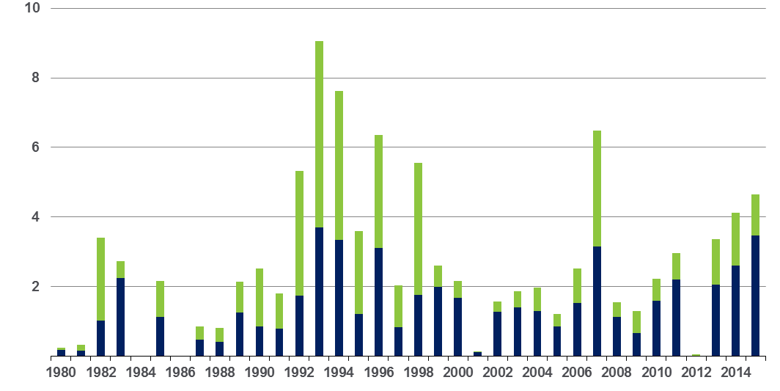
Winter Storm Losses in the US
1980 – 2015 (Overall and Insured Losses)*
$ Billions
Winter storm losses have been increasing rapidly in recent years
Overall losses
(in 2015 values)*
Insured losses
(in 2015 values)*
*Winter storms include also winter damages, blizzards and cold waves
Source: Property Claim Services, MR NatCatSERVICE.
*Losses adjusted to inflation based on CPI.
41

Slide 42
U.S. Insured Catastrophe Losses
($ Billions, $ 2015)
2012 was the 3rd most expensive year ever for insured CAT losses
2013/14/15 Were Welcome Respites from 2011/12, among the Costliest Years for Insured Disaster Losses in US History. 2016 Is Off to a Costlier Start.
$11.0B in insured CAT losses though 6/30/16
*Through 6/30/16. 2016 figure stated in 2016 dollars.
Note: 2001 figure includes $20.3B for 9/11 losses reported through 12/31/01 ($25.9B 2011 dollars). Includes only business and personal property claims, business interruption and auto claims. Non-prop/BI losses = $12.2B ($15.6B in 2011 dollars.)
Sources: Property Claims Service/ISO; Insurance Information Institute.
42
12/01/09 - 9pm
eSlide – P6466 – The Financial Crisis and the Future of the P/C
Notes:
42

Slide 43
Inflation Adjusted U.S. Catastrophe Losses by Cause of Loss, 1995–2014¹
Wind/Hail/Flood (3), $21.4
Fires (4), $6.0
Winter storm losses were much above average in 2014/15 are will push this share up
Other (5), $0.2
Insured cat losses from 1995-2014 totaled $395.6B, an average of $19.8B per year or $1.65B per month
Geological Events, $0.5
Terrorism, $24.5
Winter Storms, $26.9
Hurricanes & Tropical Storms, $161.2
Tornado share of CAT losses is rising
Wind losses are by far cause the most catastrophe losses, even if hurricanes/TS are excluded.
Events Involving Tornadoes (2), $154.9
Catastrophes are defined as events causing direct insured losses to property of $25 million or more in 2014 dollars.
Excludes snow.
Does not include NFIP flood losses
Includes wildland fires
Includes civil disorders, water damage, utility disruptions and non-property losses such as those covered by workers compensation.
Source: ISO’s Property Claim Services Unit.

Slide 44
A Few Factors Driving Adverse Private Passenger Auto Loss Trends
More People Driving, Lower Gas Prices, Higher Speed Limits…
44

Slide 45
America is Driving More Again:
Total Miles Driven*, 1990–2016
Billions of Miles Driven
Some of the 1990-2007 growth in miles driven (+43.9%) is due to population growth (+20.7%)…
…but the population grew by 6.6% from 2007-2015 and miles driven didn’t grow at all.
From November 2007 until January 2015, miles driven was below the prior peak for 87 straight months—
over 7 years! Previous record was
in the early 1980s (39 months)
Records
in 2015/6
*Moving 12-month total. Data through February 2016, the latest available.
Note: Recessions indicated by shaded columns.
Sources: Federal Highway Administration (http://www.fhwa.dot.gov/policyinformation/travel_monitoring/tvt.cfm);
National Bureau of Economic Research (recession dates); Insurance Information Institute.
Notes:
45

Slide 46
Why Are People
Driving More Miles? Jobs?
Billions of Miles Driven in Prior Year
Millions Employed
Recession
People Drive To and From Work and Drive to Entertainment. Out of Work, They Curtail Their Movement.
Sources: Federal Highway Administration (http://www.fhwa.dot.gov/policyinformation/travel_monitoring/tvt.cfm ); Seasonally Adjusted Employed from Bureau of Labor Statistics; Insurance Institute for Highway Safety; Insurance Information Institute.
46
12/01/09 - 9pm
eSlide – P6466 – The Financial Crisis and the Future of the P/C
Notes:
46

Slide 47
More People Working and Driving
=> More Collisions, 2006-2016
Overall Collision Claims Per 100 Insured Vehicles
Number Employed,
Millions
Recession
When people are out of work, they drive less. When they get jobs,
they drive to work, helping drive claim frequency higher.
Sources: Seasonally Adjusted Employed from Bureau of Labor Statistics; Rolling Four-Qtr Avg. Frequency from Insurance Services Office; Insurance Information Institute.
47
12/01/09 - 9pm
eSlide – P6466 – The Financial Crisis and the Future of the P/C
Notes:
47

Slide 48
More Miles Driven
=> More Collisions, 2006–2015
Billions of Miles Driven in Prior Year
Overall Collision Claims Per 100 Insured Vehicles
Recession
The More Miles People Drive, the More Likely They are to Get in an Accident, Helping Drive Claim Frequency Higher
Sources: Federal Highway Administration (http://www.fhwa.dot.gov/policyinformation/travel_monitoring/tvt.cfm); Rolling Four-Qtr Avg. Frequency from Insurance Services Office; Insurance Institute for Highway Safety; Insurance Information Institute.
Notes:
48

Slide 49
Why Are People Driving More Miles?
Cheap Gas?
Billions of Miles Driven in Prior Year
Average Price Per Gallon
Recession
Gas Prices Don’t Seem Correlated With Miles Driven
Sources: Federal Highway Administration (http://www.fhwa.dot.gov/policyinformation/travel_monitoring/tvt.cfm); Energy Information Administration; Insurance Institute for Highway Safety; Insurance Information Institute.
Notes:
49

Slide 50
Why Are People Driving More Miles?
Jobs?
Billions of Miles Driven in Prior Year
Millions Employed
Recession
People Drive to and from Work and Drive to Entertainment. Out of Work, They Curtail Their Movement
Sources: Federal Highway Administration (http://www.fhwa.dot.gov/policyinformation/travel_monitoring/tvt.cfm); Seasonally Adjusted Employed from Bureau of Labor Statistics; Insurance Institute for Highway Safety; Insurance Information Institute.
Notes:
50

Slide 51
Comparing Gas Prices, Employment on
Collision Frequency
Gas Price vs.
Collision Frequency
Number Employed vs.
Collision Frequency
Sources: Seasonally Adjusted Employed from Bureau of Labor Statistics; Energy Information Administration; Rolling Four-Qtr Avg. Frequency from Insurance Services Office; Insurance Information Institute.

Slide 52
More People Working and Driving
≥ More Collisions, 2006–2016
Number Employed, Millions
Overall Collision Claims Per 100 Insured Vehicles
Recession
When People are Out of Work, They Drive Less. When They Get Jobs,
They Drive to Work, Helping Drive Claim Frequency Higher
Sources: Seasonally Adjusted Employed from Bureau of Labor Statistics; Rolling Four-Qtr Avg. Frequency from Insurance Services Office; Insurance Information Institute.
Notes:
52

Slide 53
Death Rates per 100,000,000 Vehicle miles, 1990-2015*
The recession and high gas prices reduced miles driven, accelerating the drop in death rates
Motor vehicle fatality rates appear to be ticking up in 2015
Vehicle death rates fell by nearly half between 1990 and 2010
*Projected rate for 2015 based on date through June 2015.
Source: National Safety Council; Insurance Information Institute.
53
Notes:
53

Slide 54
Severity: Driving Fatalities are Rising
Annual Change in Motor Vehicle Deaths
Seatbelt Use Rose to 62% of Drivers, From 49% in ‘90
Big Drop-off Due to the Great Recession
Driving Has Been Getting Safer for Decades, But Recent Trend is Discouraging—38,300 Deaths in 2015
Sources: National Safety Council, Insurance Information Institute.

Slide 55
Change in Auto Fatalities by State: Especially Severe in Georgia
GA’s auto fatality rate has increased at a pace nearly 3 times that of the US overall and far in excess of any other state in the region
2015 vs. 2014
Fatalities in Southeast Rising Faster Than USA as a Whole
SOURCE: Estimates from National Safety Council.

Slide 56
Personal & Commercial Auto Growth Drivers
Rate and Exposure are Both Presently Important Growth Drivers
56

Slide 57
Monthly Change in Auto Insurance Prices, 1991–2015*
Cyclical peaks in PP Auto tend to occur roughly every 10 years (early 1990s, early 2000s and likely the early 2010s)
Pricing peak occurred in late 2010 at 5.3%, falling to 2.8% by Mar. 2012
“Hard” markets tend to occur during recessionary periods
Dec. 2015 reading of 5.5% is up from 4.7%
a year earlier
*Percentage change from same month in prior year; through Dec. 2015; seasonally adjusted
Note: Recessions indicated by gray shaded columns.
Sources: US Bureau of Labor Statistics; National Bureau of Economic Research (recession dates); Insurance Information Institutes.
57
12/01/09 - 9pm
eSlide – P6466 – The Financial Crisis and the Future of the P/C
Notes:
57

Slide 58
CIAB: Average Commercial Rate Change, All Lines, (1Q:2004–1Q:2016)
(Percent)
Q2 2011 marked the last of 30th consecutive quarter of price declines
Pricing as of Q1:2016 remained somewhat negative
KRW Effect
Note: CIAB data cited here are based on a survey. Rate changes earned by individual insurers can and do vary, potentially substantially.
Source: Council of Insurance Agents & Brokers; Insurance Information Institute

Slide 59
Change in Commercial Rate Renewals, by Line: 2016:Q1
Percentage Change (%)
Commercial Auto rate increases are larger than any other line, followed by EPL and D&O
Major Commercial Lines Renewals Were Mixed to Down in Q1:2016; EPL, D&O and Commercial Auto Saw Gains
Note: CIAB data cited here are based on a survey. Rate changes earned by individual insurers can and do vary, potentially substantially.
Source: Council of Insurance Agents and Brokers; Insurance Information Institute.

Slide 60
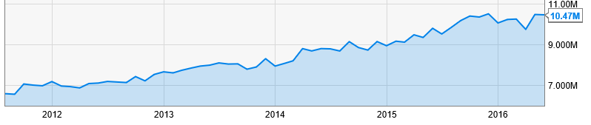
Light Truck Sales Remain Near Record Highs→Bodes Well for Comm. Auto
US Light truck sales in May 2016 were up 6.75% to 10.47M units vs. a year ago
Additional Commercial Auto Exposure Considerations
US heavy truck sales are up ~8% in 2016
Truck tonnage was up 5.7% in May 2016 Y-o-Y (ATA)
Employment in Transport & Warehousing up ~3% in 2016
Source: US Bureau of Economic Analysis accessed 7/12/16 from ycharts.com at
https://ycharts.com/indicators/us_retail_sales_of_light_trucks_saar ; Insurance Information Institute.

Slide 61
Commercial Auto Insurance
Net Written Premium, 2005–2018F
Commercial Auto premiums written continue to recover from a period of negative growth attributable to the weak economy and soft market
PPA will generate ~$1.5B - $2B in new premiums annually through 2018
$ Billion
Commercial Auto NWP volume in 2015 was up $2.2B or 8.4%.
Sources: A.M. Best (1990-2014); Conning (2015-18F); Insurance Information Institute.

Slide 62
Average Expenditures* on Auto Insurance, 1994-2015E
Annual Pct Changes
2001: 5.2%
2002: 8.6%
2003: 5.6%
2004: 1.5%
2005: -1.3%
2006: -1.8%
2007: -2.1%
2008: -1.0%
2009: -0.5%
2010: 0.6%
2011: 0.6%
2012: 2.3%
2013: 3.3%
The average expenditure on auto insurance now finally exceeds the pre-crisis high of $842 recorded in 2004, taking a full decade to recover, but on an inflation-adjusted basis premiums are still below 2004 levels
Across the U.S., auto insurance expenditures fell by 0.8% in 2008
and 0.5% in 2009 but rose 0.5% in 2010, 0.8% in 2011, 2.3% in 2012 and 3.3% in 2013; I.I.I. estimate is for +3.4% in 2014 and 2015.
* The NAIC data are per-vehicle (actually, per insured car-year)
Sources: NAIC for 1994-2013; Insurance Information Institute estimates for 2014-2015 based on CPI and other data.

Slide 63
Private Passenger Auto Insurance
Net Written Premium, 2000–2017F
PP Auto premiums written continue to recover from a period of flat growth attributable to the weak economy impacting new vehicle sales, car choice, and increased price sensitivity among consumers
PPA will generate $6B - $8B in new premiums annually through 2017
$ Billion
PPA NWP volume in 2014 was up $26.3B or 16.7% since the 2009 trough; By 2017 the gain is expected to be $46.8B or 29.7%
Sources: A.M. Best (1990-2014); Conning (2015-17F); Insurance Information Institute.

Slide 64
CIAB: Average Commercial Rate Change, All Lines, (1Q:2004–1Q:2016)
(Percent)
Q2 2011 marked the last of 30th consecutive quarter of price declines
Pricing as of Q1:2016 remained somewhat negative
KRW Effect
Note: CIAB data cited here are based on a survey. Rate changes earned by individual insurers can and do vary, potentially substantially.
Source: Council of Insurance Agents & Brokers; Insurance Information Institute

Slide 65
Change in Commercial Rate Renewals, by Line: 2016:Q1
Percentage Change (%)
Commercial Auto rate increases are larger than any other line, followed by EPL and D&O
Major Commercial Lines Renewals Were Mixed to Down in Q1:2016; EPL, D&O and Commercial Auto Saw Gains
Note: CIAB data cited here are based on a survey. Rate changes earned by individual insurers can and do vary, potentially substantially.
Source: Council of Insurance Agents and Brokers; Insurance Information Institute.

Slide 66
Auto/Light Truck Sales, 1999-2021F
Job growth and improved credit market conditions will boost auto sales in 2015 and beyond
Sales have returned to pre-crisis levels
(Millions of Units)
New auto/light truck sales fell to the lowest level since the late 1960s. Forecast for 2014-15 is still below 1999-2007 average of 17 million units, but a robust recovery is well underway.
Truck, SUV purchases by contractors are especially strong
Yearly car/light truck sales will likely continue at current levels, in part replacing cars that were held onto in 2008-12. PP Auto premium might grow by 3.5% - 5%.
Source: U.S. Department of Commerce; Blue Chip Economic Indicators (5/16 for 2016-17; 3/16 for 2018-21F; Insurance Information Institute.

Slide 67
Number of Registered Passenger Vehicles in US, 1999 – 2015E
Vehicle registrations are growing once again and now finally exceed pre-crisis peak
Vehicle registrations are expected to increase at an annual rate of about 1.5% per year in 2015 and 2016
Sources: Bureau of Transportation Statistics; Barclays Capital estimates, August 2015.

Slide 68
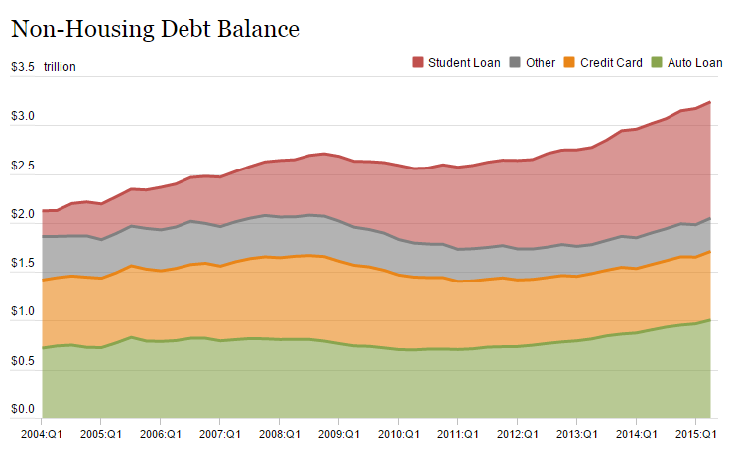
Auto Loans and Other Non-Housing Debt, 2004 – 2015*
Auto loan debt outstanding reached $1T for the first time ever in Q1 2015
Banks are becoming increasingly aggressive in marketing auto loans
*As of Q1 2015.
Source: Federal Reserve Bank of NY Consumer Credit Panel/Equifax; l. I.I.

Slide 69
AUTO TECHNOLOGY &
THE FUTURE OF AUTO INSURANCE
The Road to Fully Autonomous Vehicles: Long, Dark and Full of Potholes
Tales of the Death of Auto Insurance Are Greatly Exaggerated
69

Slide 70

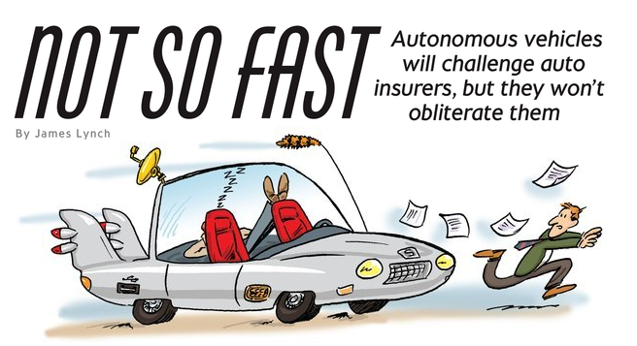
Media is Obsessed with Driverless Vehicles: Often Predicting the Demise of Auto Insurance
By 2035, it is estimated that 25% of new vehicle sales could be fully autonomous models
Questions
Are auto insurers monitoring these trends?
How are they reacting?
Will Google take over the industry?
Will the number of auto insurers shrink?
How will liability shift?
Source: Boston Consulting Group.

Slide 71
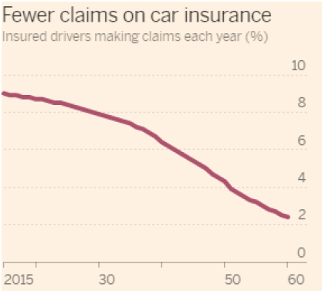
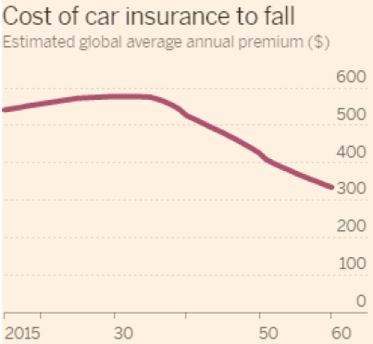
Media is Obsessed with Driverless Vehicles: Often Predicting the Demise of Auto Insurance
Some are predicting that the rise of autonomous vehicles will reduce claim frequency by 75% or more…
,,,and that this technology will cause average auto insurance premiums to plunge
Source: Autonomous Consulting as cited in the Financial Times: “Cost of Car Insurance to Plunge With Rise of Driverless Vehicles, June 28, 2016.

Slide 72
I.I.I. Poll: Auto Insurance
Q. Would you be willing to ride in a driverless car?
May 2015
May 2016
Don’t Know
Don’t Know
Yes
Yes
No
No
The Percentage Willing to Ride in a Driverless Car Rose Slightly.
71 Percent of People Over 64 Were Unwilling to Ride.
The Percentage Willing to Ride in a Driverless Car Rose Slightly;
71% of People Over 64 Were Unwilling to Ride.
Source: Insurance Information Institute Annual Pulse Survey.

Slide 73
I.I.I. Poll: Driverless Cars
Q. Would you be willing to ride in a driverless car?
The Percentage Willing to Ride in a Driverless Car Remains at 43%;
71% of People Over 64 Were Unwilling to Ride.
Source: Insurance Information Institute Annual Pulse Survey

Slide 74
I.I.I. Poll: Driverless Cars
Q. Would you be willing to ride in a driverless car?
The Percentage Willing to Ride in a Driverless Car Remains at 43%;
71% of People Over 64 Were Unwilling to Ride.
Source: Insurance Information Institute Annual Pulse Survey.

Slide 75
I.I.I. Poll: Driverless Cars
Why Americans Would Not Want to Ride in a Driverless Car,
May 2016¹
Safety Concerns Are Paramount Among Those Who Would Avoid Driverless Cars.
¹ Based on those who would not ride in a driverless car. Respondents could give more than one answer.
Source: Insurance Information Institute Annual Pulse Survey.

Slide 76
I.I.I. Poll: Telematics—
Consumers Still Hesitant
Q
Would you allow your auto insurer to collect information about how and when you drive in order to set your auto insurance premium?
Don’t Know
Allow if Premium Went Down
Not
Allow
Allow Whether or Not Premium Went Down
More Than Half of Auto Policyholders Would Allow Their Insurer to
Collect Their Driving Information in Order to Set Premiums.
¹Asked of those who have auto insurance.
Source: Insurance Information Institute Annual Pulse Survey.

Slide 77
The Sharing Economy
The On-Demand Economy Will Transform the American Workforce and the P/C Insurance Industry Too
77

Slide 78




On-Demand/Sharing/Peer-to-Peer Economy Impacts Many Lines of Insurance
The “On-Demand” Economy is or will impact many segments of the economy important to P/C insurers
  Auto (personal and commercial)
  Homeowners/Renters
  Many Liability Coverages
  Professional Liability
  Workers Comp
Many unanswered insurance questions
Insurance solutions are increasingly available to fill the many insurance gaps that arise
78
12/01/09 - 9pm
eSlide – P6466 – The Financial Crisis and the Future of the P/C
Notes:
78

Slide 79
TNC Ridesharing Arrangements: Insurance Applicability
The concern was that TNCs were seeking to offload risk on to personal auto insurers. An increasing number of personal auto insurers have developed solutions to ensure that coverage gaps are minimized
*From publically available sources as of June 2, 2015.
Source: ISO/Verisk.
79

Slide 80
Ridesharing Regulation/Legislation and Status of ISO Filings as of 9/30/15
Status Ride Sharing Legislation/Regulation
Status of ISO Filings
80
Source: ISO.

Slide 81
INDUSTRY DISRUPTORS
Technology, Society and the Economy Are All Changing at a Rapid Pace
Thoughts on the Future of Auto Insurance
81

Slide 82
Media is Obsessed with Driverless Vehicles: Often Predicting the Demise of Auto Insurance
By 2035, it is estimated that 25% of new vehicle sales could be fully autonomous models
Questions
Are auto insurers monitoring these trends?
How are they reacting?
Will Google take over the industry?
Will the number of auto insurers shrink?
How will liability shift?
Source: Boston Consulting Group.

Slide 83
On-Demand/Sharing/Peer-to-Peer Economy Impacts Many Lines of Insurance
The “On-Demand” Economy is or will impact many segments of the economy important to P/C insurers
  Auto (personal and commercial)
  Homeowners/Renters
  Many Liability Coverages
  Professional Liability
  Workers Comp
Many unanswered insurance questions
Insurance solutions are increasingly available to fill the many insurance gaps that arise
83
12/01/09 - 9pm
eSlide – P6466 – The Financial Crisis and the Future of the P/C
Notes:
83

Slide 84
The Sharing Economy
The On-Demand Economy Will Transform the Transportation Systems, Impacting the P/C Insurance Industry
84

Slide 85

The Sharing Economy Has Grown— And Attracted Political Scrutiny

Slide 86

Political Skepticism About the
‘Gig’ Economy
"Many Americans are making extra money renting out a spare room, designing a website ... even driving their own car. This on demand or so called 'gig' economy is creating exciting opportunities and unleashing innovation, but it's also raising hard questions about workplace protections and what a good job will look like in the future."
--Hillary Clinton,
July 13, 2015
86
12/01/09 - 9pm
eSlide – P6466 – The Financial Crisis and the Future of the P/C
Notes:
86

Slide 87

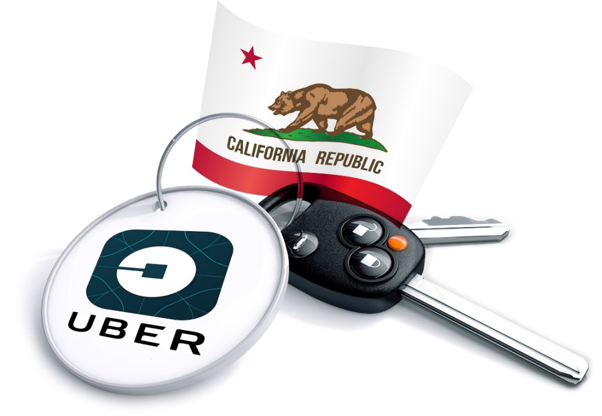
Regulatory Issues Abound as Well, With Implications for Insurance Coverages
A driver for Uber is an employee, not a
contractor, according to a California
Ruling that eventually could push up costs
‘for the smartphone-based ride hailing service
and hurt the closely watched start-up's valuation.
The California Labor Commissioner's decision could ripple through the burgeoning industry of providing services via smartphones, with potential implications for other “crowdsourced” services such as Uber rival Lyft, chore service TaskRabbit, and cleaning service Homejoy.
--Reuters, June 18, 2015
87
12/01/09 - 9pm
eSlide – P6466 – The Financial Crisis and the Future of the P/C
Notes:
87

Slide 88
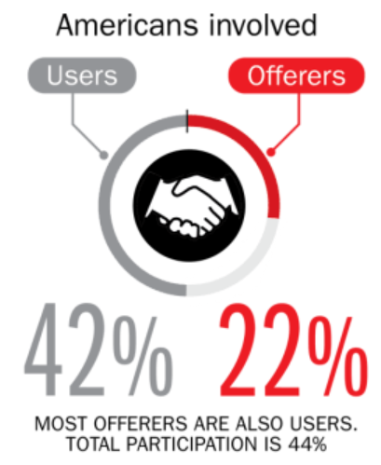
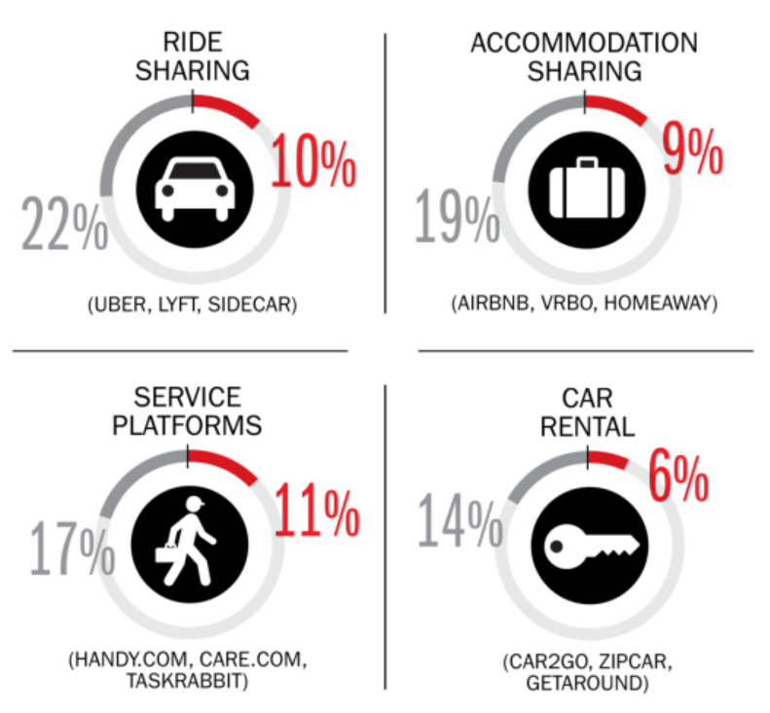
Percent of Americans Who Have Engaged in the “Gig/Sharing Economy” by Transaction
Drivers have significant WC exposures
Service platforms have the most direct link to WC; 11% of Americans have offered their services
About 22% of Americans have offered services in the sharing economy.
Sources: The SelfEmployed.com accessed at https://www.theselfemployed.com/gig-economy/infographic-inside-the-new-economy/ based on a poll by Time magazine, Bursten-Marsteller and The Aspen Institute; Insurance Information Institute.

Slide 89
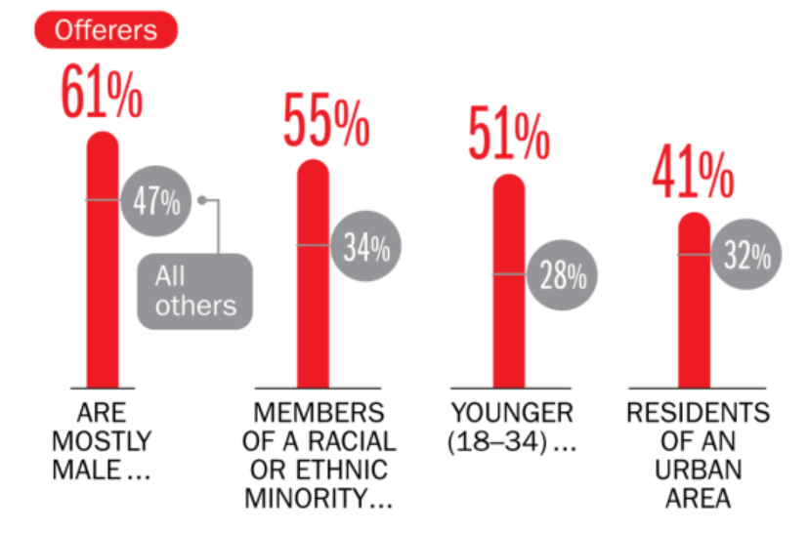
Americans Who Offer Services in the Sharing/Gig Economy Are Statistically More Prone to Workplace Injury
Young, urban minority males are the most likely to offer their services in the sharing economy.
Sources: The SelfEmployed.com accessed at https://www.theselfemployed.com/gig-economy/infographic-inside-the-new-economy/ based on a poll by Time magazine, Bursten-Marsteller and The Aspen Institute; Insurance Information Institute.

Slide 90
THE ‘INTERNET OF THINGS’
Capturing Economic Value Amid a Shifting Insurer Value Chain
90

Slide 91
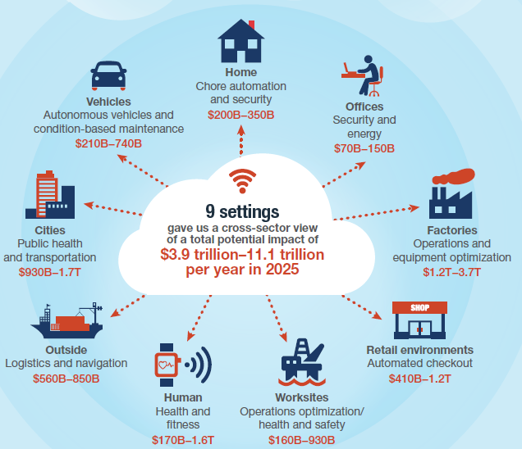
The Internet of Things and the Insurance Industry
The “Internet of Things” will create trillions in economic value throughout the global economy by 2025
What opportunities, challenges will this create for insurers?
What are the impact on the insurance industry “value chain”?
Sources: McKinsey Global Institute, The Internet of Things: Mapping the Value Beyond the Hype,
June 2015; Insurance Information Institute.
91
12/01/09 - 9pm
eSlide – P6466 – The Financial Crisis and the Future of the P/C
Notes:
91

Slide 92
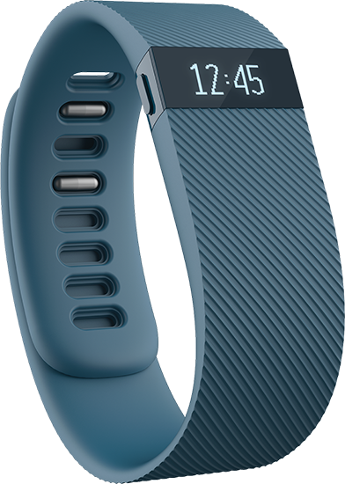
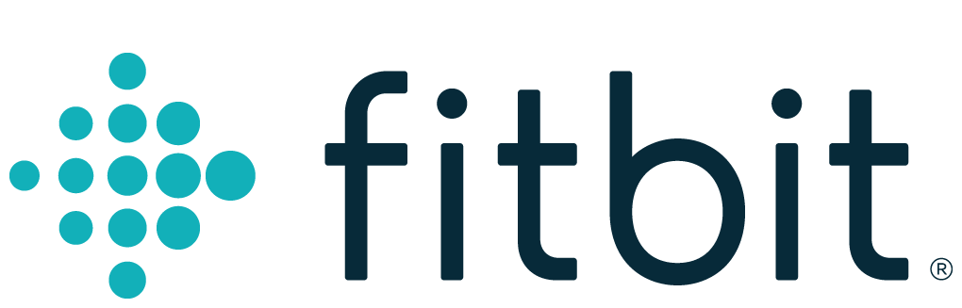
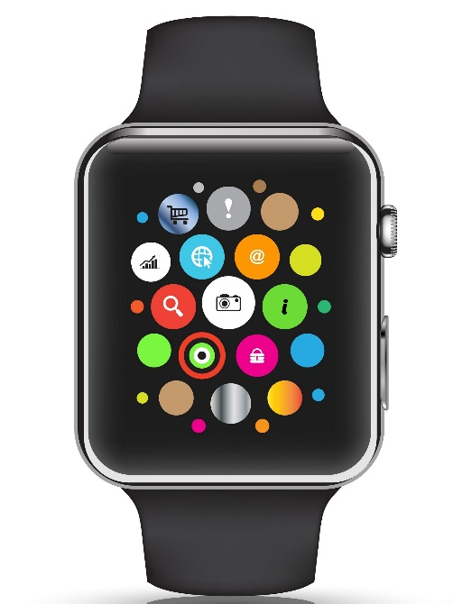

Wearables Show Significant Potential to Reduce Workplace Injury, Death
Wearables Today Can Monitor:
  Location
  Heart rate
  Temperature
  Steps/Exertion
  Sweat
  Sleep
In the Near Future Could Monitor:
  Glucose level
  Oxygen levels
  Pain
  Nausea
92
12/01/09 - 9pm
eSlide – P6466 – The Financial Crisis and the Future of the P/C
Notes:
92

Slide 93
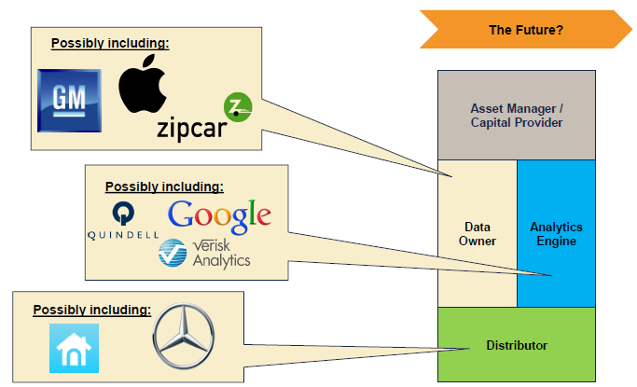
The Internet of Things and the Insurance Industry Value Chain
Who owns the data? Where does It flow? Who does the analytics? Who is the capital provider?
Source: Willis Capital Markets & Advisory; Insurance Information Institute.
93
12/01/09 - 9pm
eSlide – P6466 – The Financial Crisis and the Future of the P/C
Notes:
93

Slide 94
INSURANCE TECHNOLOGY:
FIN TECH ZEROES IN
Number and Value of Deals Is Increasing
In Search of the Elusive Insurance ‘Unicorn’
94

Slide 95
Insurance Technology Financing Trend: Change Is Coming
Insurance tech deals reached a new record in 2016:Q1
($ Millions)
Investment in insurance tech is rising
Source: CB Insights at https://www.cbinsights.com/blog/insurance-tech-overview-q1-2016/; Insurance Information Institute.

Slide 96
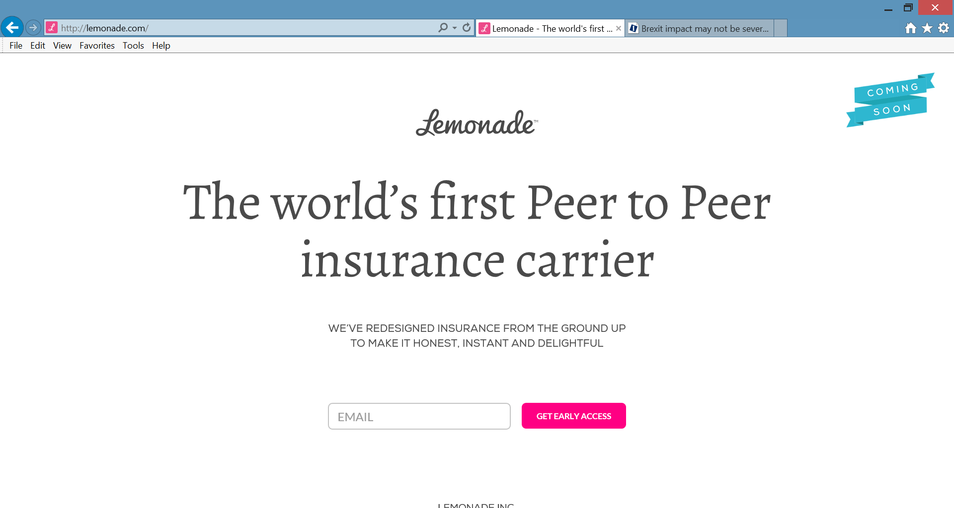
Lemonade: Peer-to-Peer (P2P) Insurance
Source: Lemonade.com accessed June 24, 2016.
96

Slide 97
Lemonade: Sour Words About Insurance
Daniel Schreiber here, with updates from Lemonade.
I’m thrilled to report that a few days ago, by unanimous vote of our board and shareholders, Lemonade became a Public Benefit Corporation, and was also awarded provisional ‘B-Corp’ certification. Both are firsts for an insurance carrier, and are points of tremendous pride for our team.
Rebuilding insurance as a social good, rather than a necessary evil, is now part of our legal mission. Our Chief Behavioral Officer, Professor Dan Ariely, says that “If you tried to create a system to bring out the worst in humans, it would look a lot like the insurance of today.” Working in partnership with nonprofits, and baking giving-back into our business model, holds the promise of a better insurance experience, and a more valuable insurance company.
In other news, I’m happy to say that we’re putting finishing touches on our product and will be ready to launch in New York within weeks. The final step is for us to get our license, and if all goes to plan, we’ll have that shortly.
Be sure to follow us on Twitter, Facebook, and LinkedIn to stay in the know.
Until next time,
Daniel
@daschreiber
97
Source: Email from Lemonade CEO Danieal Schreibeir, May 17, 2016.

Slide 98
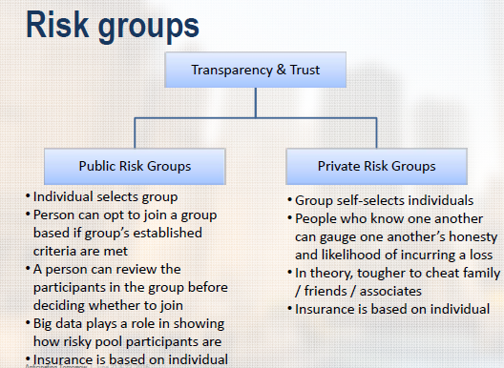
Risk Groups in P2P Structures
P2P model is predicated in part that view that individuals who know one another are less likely to commit fraud, etc.
Source: “UberX-ing Insurance : Is Peer-to-Peer Insurance Viable?”, presentation by Jay Sarzen, Aite Group at DrinkerBiddle Insurance Conference, June 21, 2016.
98

Slide 99
Insurance Information Institute Online:
www.iii.org
Thank you for your time
and your attention!
Twitter: twitter.com/bob_Hartwig

