Slide 1
The Economic State of the
P/C Insurance Industry
Focus on Auto Insurance Markets
Insurance Auto Auctions
Industry Leadership Summit
Sea Island, GA
September 15, 2015
Download at www.iii.org/presentations
Robert P. Hartwig, Ph.D., CPCU, President & Economist
Insurance Information Institute ♦ 110 William Street ♦ New York, NY 10038
Tel: 212.346.5520 ♦ Cell: 917.453.1885 ♦ bobh@iii.org ♦ www.iii.org

Slide 2
Presentation Outline
Premiums Growth Trends
Personal Auto Ad Spending
Economic Growth Drivers in Private Passenger Auto Insurance
Determinants of Household Demand for Auto Insurance
Rate and Exposure Trends
Underwriting and Profitability Analysis
Claim Trends by Coverage Type
Autonomous Vehicles
Hackers on the Highway?
Q&A

Slide 3
Auto Insurance Growth Analysis
Growth Trajectories Differ Substantially by State and Over Time
3

Slide 4
Distribution of Direct Premiums Written by Segment/Line, 2013
Personal/Commercial lines split has been about 50/50 for many years
Pvt. Passenger Auto is by far the largest line of insurance and is currently the most important source of industry profits
Commercial Auto accounts for about 5% of overall industry premium vs. 34% for Pvt. Passenger Auto
Distribution Facts
2013
Commercial Lines
$242.5B/46%
Homeowners
$80.7B/15%
Pvt. Pass Auto
$180.8B/34%
Commercial Auto
$26.7B/5%
Sources: A.M. Best; Insurance Information Institute research.

Slide 5
Private Passenger Auto Insurance
Net Written Premium, 2000–2017F
PP Auto premiums written continue to recover from a period of flat growth attributable to the weak economy impacting new vehicle sales, car choice, and increased price sensitivity among consumers
$ Billion
PPA NWP volume in 2014 was up $26.3B or 16.7% since the 2009 trough; By 2017 the gain is expected to be $46.8B or 29.7%
Sources: A.M. Best (1990-2014); Conning (2015-17F); Insurance Information Institute.

Slide 6
Direct Premiums Written: Total P/C
Percent Change by State, 2007-2014
Top 25 States
North Dakota was the country’s growth leader over the past 7 years with premiums written expanding by 70.7%, fueled by the state’s energy boom
Growth Benchmarks: Total P/C
US: 13.0%
Sources: SNL Financial LC.; Insurance Information Institute.

Slide 7
Direct Premiums Written: Total P/C
Percent Change by State, 2007-2014
Bottom 25 States
Growth was negative in 4 states and DC between 2007 and 2014
Sources: SNL Financial LC.; Insurance Information Institute.

Slide 8
Direct Premiums Written: PP Auto
Percent Change by State, 2007-2014
Top 25 States
Growth Benchmarks: PPA
US: 16.4%
Sources: SNL Financial LC.; Insurance Information Institute.

Slide 9
Direct Premiums Written: PP Auto
Percent Change by State, 2007-2014
Bottom 25 States
Pvt. Passenger Auto premium growth was negative in Hawaii between 2007 and 2014
Sources: SNL Financial LC.; Insurance Information Institute.

Slide 10
Commercial Auto Insurance
Net Written Premium, 2000–2015F
In contrast to positive PP Auto NPW growth, Commercial Auto premiums fell 21.3% between 2005 and 2011 due to soft market conditions in commercial lines and negative exposure trends, though growth resumed in 2012
$ Billion
Sources: A.M. Best (2000-2014); Conning (2015F); Insurance Information Institute.

Slide 11
Direct Premiums Written: Comm. Auto
Percent Change by State, 2007-2014
Top 25 States
Growth Benchmarks: Comm. Auto
US: 0.7%
Sources: SNL Financial LC.; Insurance Information Institute.

Slide 12
Direct Premiums Written: Comm. Auto
Percent Change by State, 2007-2014
Bottom 25 States
Comm. Auto premium growth was negative in 29 states between 2007 and 2014
Sources: SNL Financial LC.; Insurance Information Institute.

Slide 13
Vehicle and Driver Exposure Influences
Have We, Will We Hit “Peak Auto”?
13

Slide 14
Auto/Light Truck Sales, 1999-2021F
Job growth and improved credit market conditions will boost auto sales in 2014 and beyond
Sales have returned to pre-crisis levels
(Millions of Units)
New auto/light truck sales fell to the lowest level since the late 1960s. Forecast for 2014-15 is still below 1999-2007 average of 17 million units, but a robust recovery is well underway.
Truck, SUV purchases by contractors are especially strong
Yearly car/light truck sales will likely continue at current levels, in part replacing cars that were held onto in 2008-12. New vehicles will generate more physical damage insurance coverage but will be more expensive to repair. PP Auto premium might grow by 5% - 6%.
Source: U.S. Department of Commerce; Blue Chip Economic Indicators (8/15 and 3/15); Insurance Information Institute.

Slide 15
Number of Insured Vehicles in the US,
2000-2012*
The Number of Insured Passenger Vehicles Stopped Growing During the Economic Downturn. Growth Has Now Returned.
*Note: Texas car years are not available
Source: Automobile Insurance Plans Service Office.

Slide 16
Registered Passenger Vehicles,
1990-2013
Recession
Recession
(Millions)
The number of registered vehicles grew consistently (except following recessions) from 1990-2007. It has been flat (through 2013) since then.
Sources: http://www.rita.dot.gov/bts/sites/rita.dot.gov.bts/files/publications/national_transportation_statistics/html/table_01_11.html Insurance Information Institute.

Slide 17
Number of Registered Passenger Vehicles in US, 1999 – 2015E
Vehicle registrations are growing once again and now finally exceed pre-crisis peak
Vehicle registrations are expected to increase at an annual rate of about 1.5% per year in 2015 and 2016
Sources: Bureau of Transportation Statistics; Barclays Capital estimates, August 2015.

Slide 18
New Vehicle Registrations in the US, Dec. 2005 – Dec. 2014
New Vehicle registrations are close to their pre-crisis peak
Sources: Haver, CEIC; Barclays Capital.

Slide 19
Number of Licensed Drivers, 1984-2013
# of Licensed Drivers (millions)
Since 2009, virtually no growth in the number of licensed drivers (through 2013)
Sources: 2015 Ward’s Motor Vehicle Facts & Figures, p. 53; l I.I.

Slide 20
Average Vehicle Age, 2002 - 2014
Average age is still increasing but at a slower pace as new vehicles sales growth remains strong
Sources: HIS; Barclays Capital.

Slide 21
Registered Motorcycles,
1990-2013
(Millions)
103.6% growth, 2000-2011
No growth, 1990-1999
The number of registered motorcycles grew dramatically in the first decade of the 21st century. Baby boomers? Millennials?
Sources: http://www.rita.dot.gov/bts/sites/rita.dot.gov.bts/files/publications/national_transportation_statistics/html/table_01_11.html Insurance Information Institute.

Slide 22
Registered Motorcycles,1960-2012:
A Changing Exposure Base
Growth, 2000-2011
(Millions)
Shrinkage, 1985-1990
Growth, 1960-1980
The number of registered motorcycles grew dramatically in the first decade of the 21st century. Baby boomers? Millennials?
Sources: http://www.rita.dot.gov/bts/sites/rita.dot.gov.bts/files/publications/national_transportation_statistics/html/table_01_11.html Insurance Information Institute.

Slide 23
Personal Auto Ad Spend Trends
Growth in Ad Spend Remains Robust Among Many Top Auto Insurers
23

Slide 24
Advertising Expenditures by P/C Insurance Industry, 1999-2014E
$ Billions
P/C ad spend hit an all time record high of $6.186 billion in 2013 up 1.6% over 2012 but fell about 3% in 2014 to an estimated $6 billion
P/C ad spending more than tripled since 2002 (up ~251% from 2002-2014E)
Source: Insurance Information Institute from consolidated P/C Annual Statement data, Insurance Expense Exhibit (Part I, Line 4).

Slide 25
Auto Insurance Macro Growth Drivers: The Economy Is Supporting Growth in Personal and Commercial Auto
The Economy and Consumer Sentiment Remain Sufficient to Propel Auto Sales into 2016
25

Slide 26
US Real GDP Growth*
The Q4:2008 decline was the steepest since the Q1:1982 drop of 6.8%
Real GDP Growth (%)
Recession began in in June 2009
Q1 2014/15 GDP data were hit hard by this year’s “Polar Vortex” and harsh winter
Demand for Insurance Should Increase in 2015 as GDP Growth Accelerates Modestly and Gradually Benefits the Economy Broadly
* Estimates/Forecasts from Blue Chip Economic Indicators.
Source: US Department of Commerce, Blue Economic Indicators 8/15; Insurance Information Institute.

Slide 27
State Leading Economic Indicators through November 2015
Growth in the West is finally beginning to pick up
The economic outlook for most of the US is generally positive, though flat-to-negative for 10 states, several of them energy dependent
Sources: Federal Reserve Bank of Philadelphia at http://www.philadelphiafed.org/index.cfm ;Insurance Information Institute.

Slide 28
Real GDP by State Percent Change, 2014*:
Highest 25 States
North Dakota was the economic growth juggernaut of the US in 2014—by far
Only 7 states experienced growth in excess of 3% in 2014, which is a growth rate we would see nationally in a more typical recovery
Growth Benchmarks: Real GDP
US: 2.2%
*Advance statistics
Sources: U.S. Bureau of Economic Analysis; Insurance Information Institute.

Slide 29
Real GDP by State Percent Change, 2014*:
Lowest 25 States
Growth rates in 16 states were still below 1% in 2014
Mississippi and Alaska were the only states to shrink in 2014
*Advance statistics
Sources: US Bureau of Economic Analysis; Insurance Information Institute.

Slide 30
Consumer Sentiment Survey (1966 = 100)
January 2010 through August 2015
Optimism among consumers dropped in August fell but remains fairly strong
Impact of 2011 budget impasse
Consumer confidence has experienced a substantial recovery from its crisis and post-crisis lows, substantially contributing to increased demand for vehicles and homes.
Source: University of Michigan; Insurance Information Institute

Slide 31
Unemployment and Underemployment Rates: Still Too High, But Falling
January 2000 through July 2015, Seasonally Adjusted (%)
U-6 soared from 8.0% in March 2007 to 17.5% in
October 2009; Stood at 10.4% in June 2015.
8% to 10% is “normal.”
“Headline” unemployment was 5.3% in July 2015. 4.5% to 5.5% is “normal.”
Stubbornly high unemployment and underemployment constrain overall economic growth, but the job market is continuing to improve.
Source: US Bureau of Labor Statistics; Insurance Information Institute.
31
12/01/09 - 9pm
eSlide – P6466 – The Financial Crisis and the Future of the P/C
Notes:
31

Slide 32
Monthly Change in Private Employment
3,042,000 jobs were created in 2014, the most since 1997
January 2007 through July 2015 (000s, Seasonally Adj.)
Jobs Created
2014: 3.042 Mill
2013: 2.452 Mill
2012: 2.315 Mill
2011: 2.396 Mill
2010: 1.282 Mill
210,000 private sector jobs were created in July.
Monthly losses in Dec. 08–Mar. 09 were the largest in the
post-WW II period
Private Employers Added 12.84 Million Jobs Since Jan. 2010 After Having Shed 5.01 Million Jobs in 2009 and 3.76 Million in 2008 (State and Local Governments Have Shed Hundreds of Thousands of Jobs)
Source: US Bureau of Labor Statistics: http://www.bls.gov/ces/home.htm; Insurance Information Institute

Slide 33
US Unemployment Rate Forecast
Rising unemployment
eroded payrolls
and WC’s
exposure base.
Unemployment peaked at 10% in late 2009.
2007:Q1 to 2016:Q4F*
Jobless figures have been revised downwards for 2015/16
Unemployment forecasts have been revised modestly downwards. Optimistic scenarios put the unemployment as low as 5.0% by Q4 of 2015.
* = actual; = forecasts
Sources: US Bureau of Labor Statistics; Blue Chip Economic Indicators (8/15 edition); Insurance Information Institute.

Slide 34
Unemployment Rates by State, June 2015:
Highest 25 States*
In June, 21 states and the District of Columbia had over-the-month unemployment rate decreases, 12 states had increases, and 17 states had no change.
*Provisional figures for June 2015, seasonally adjusted.
Sources: US Bureau of Labor Statistics; Insurance Information Institute.

Slide 35
Unemployment Rates by State, June 2015:
Lowest 25 States*
In June, 21 states and the District of Columbia had over-the-month unemployment rate decreases, 12 states had increases, and 17 states had no change.
*Provisional figures for June 2015, seasonally adjusted.
Sources: US Bureau of Labor Statistics; Insurance Information Institute.

Slide 36
Construction Spending Helps Fuel Commercial Auto Growth
Value of New Private Construction, 2003 – 2015*
2015: Value of new pvt. construction hits $766.4B as of June 2015, up 53.1% from the 2010 trough but still 17.5% below 2006 peak
Billions of Dollars
New Construction peaks at $911.8. in 2006
Trough in 2010 at $500.6B, after plunging 55.1% ($411.2B)
$15.0
$613.7
$394.8
$298.1
$261.8
$371.6
$238.8
Private Construction Activity is an Important Driver of Commercial Auto Exposure Growth
*2015 figure is a seasonally adjusted annual rate as of June.
Sources: US Department of Commerce http://www.census.gov/construction/c30/c30index.html ; Insurance Information Institute.
36
12/01/09 - 9pm
eSlide – P6466 – The Financial Crisis and the Future of the P/C
Notes:
36

Slide 37
ISM Manufacturing Index
(Values > 50 Indicate Expansion)
January 2010 through April 2015
Manufacturing continues to expand in 2015
Expansion in the anufacturing sector also drives significant commercial auto exposure, though recent weakness in China, Europe could have a minor adverse impact as shipments flatten/fall
Source: Institute for Supply Management at http://www.ism.ws/ismreport/mfgrob.cfm; Insurance Information Institute.

Slide 38
Household Balance Sheets Are Relatively Strong
Auto Loan Market is Strong: Default Rates Remain Low
38

Slide 39
Net Worth of Households*
Recently Hit A Historic High
$ Trillions
Housing “bubble”
2008-09 Recession: -15.7%
Adjusted for population growth, net worth is now comparable to its pre-crisis peak
2001 recession
1992 recession
1982 recession
Rising net worth fuels a “wealth affect” that helps fuel consumer spending, which accounts for 70% of spending in the U.S. economy
*and nonprofit organizations. Data are as of year-end, except in 2015:Q1 (data posted on June 11, 2015. Data not seasonally adjusted or inflation-adjusted; http://www.federalreserve.gov/releases/z1/Current/z1r-5.pdf
Source: Federal Reserve Board at http://www.federalreserve.gov/releases/z1/Current/z1r-5.pdf

Slide 40
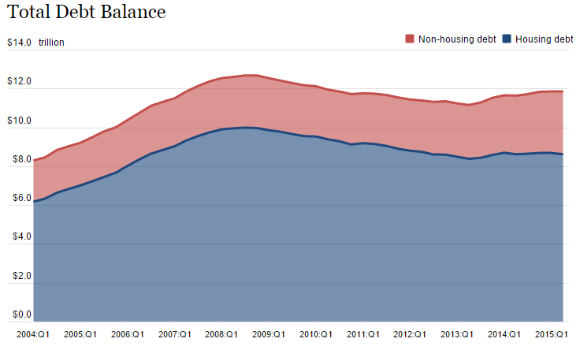
Household Debt Balance,
2004 – 2015:Q1
Overall household debt remains below pre-crisis peak but non-housing debt is actually larger due to student loans and auto loan debt
Household balance sheets remain much healthier than they were prior to the “Great Recession”
Source: Federal Reserve Bank of NY Consumer Credit Panel/Equifax; l. I.I.

Slide 41
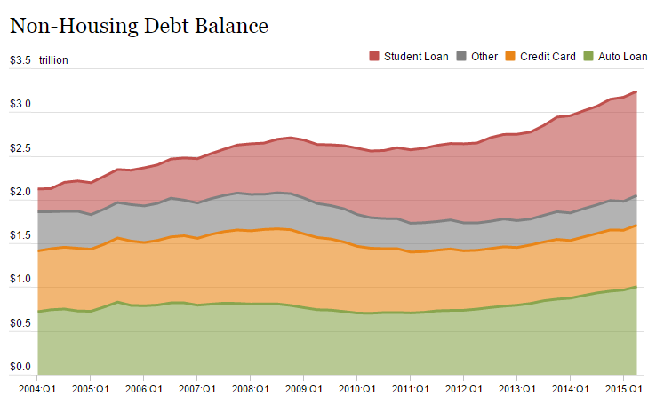
Auto Loans and Other Non-Housing Debt, 2004 – 2015:Q1
Auto loan debt outstanding reached $1T for the first time ever in Q1 2015
Banks are becoming increasingly aggressive in marketing auto loans
Source: Federal Reserve Bank of NY Consumer Credit Panel/Equifax; l. I.I.

Slide 42
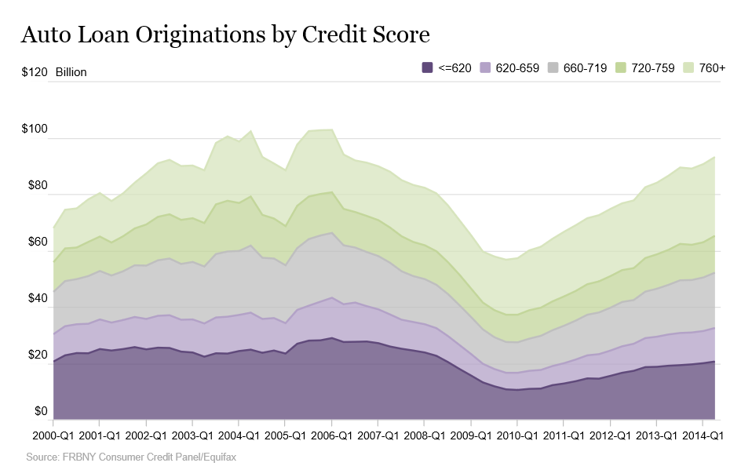
Lenders are Issuing a Rising Number of New Auto Loans, Even for People with Poor Credit Scores
Auto loan originations reached a 10-year high in 2015:Q2
For the past several years, auto loans in nonaccrual status remained at roughly 0.25% of outstanding loans.

Slide 43
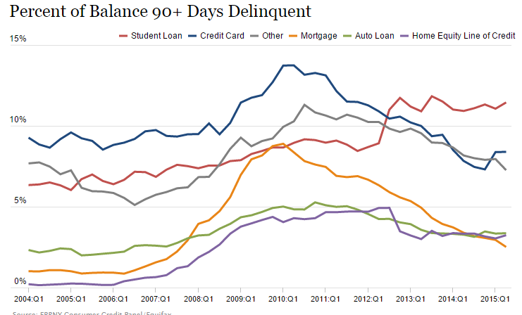
Auto Loan and Other Non-Housing Deliquencies, 2004 – 2015:Q1
Auto loan delinquencies have improved dramatically since their crisis peak but remain above pre-crisis levels
So far, increasingly aggressive marketing of auto loans has not resulting in a surge in loan delinquencies and defaults
Source: Federal Reserve Bank of NY Consumer Credit Panel/Equifax; l. I.I.

Slide 44
Rate and Exposure Trends for Private Passenger Auto
Rate and Exposure Are Both Important Drivers of Growth
44

Slide 45
Monthly Change in Auto Insurance Prices, 1991–2015*
Cyclical peaks in PP Auto tend to occur roughly every 10 years (early 1990s, early 2000s and likely the early 2010s)
Pricing peak occurred in late 2010 at 5.3%, falling to 2.8% by Mar. 2012
“Hard” markets tend to occur during recessionary periods
July 2015 reading of 5.4% is up from 4.2%
a year earlier
*Percentage change from same month in prior year; through July 2015; seasonally adjusted
Note: Recessions indicated by gray shaded columns.
Sources: US Bureau of Labor Statistics; National Bureau of Economic Research (recession dates); Insurance Information Institutes.
45
12/01/09 - 9pm
eSlide – P6466 – The Financial Crisis and the Future of the P/C
Notes:
45

Slide 46
Monthly Change* in Auto Insurance Prices, January 2005 - December 2013
Pricing weakened in 2011, strengthened in 2012/early 2013 but has since moderated
(Percent Change
from same month,
prior year)
Auto Insurance Price Increases Averaged 5.1% in 2010 over 2009, After Averaging 4.5% in 2009 over 2008.
PPA Auto, like most p/c lines, exhibits strong cyclicality in pricing. Prices rose from 2000 to late 2005, were flat/falling in 2006 and 2007 before beginning to rise gain in 2008.
Underwriting performance remained strong even when prices were flat or falling due to improvements in underlying frequency and severity trends
* Percentage change from same month in prior year, seasonally adjusted.
Sources: US Bureau of Labor Statistics; Insurance Information Institute

Slide 47
Change in Commercial Rate Renewals, by Line: 2015:Q1
Commercial Auto rate increases remain positive
Percentage Change (%)
Major Commercial Lines Renewals Were Mixed to Flat in Q1:2015; EPL and Commercial Auto Led the Way
Note: CIAB data cited here are based on a survey. Rate changes earned by individual insurers can and do vary, potentially substantially.
Source: Council of Insurance Agents and Brokers; Insurance Information Institute.

Slide 48
Inflation
Is it a Threat to Claim Cost Severities?
48

Slide 49
Annual Inflation Rates, (CPI-U, %),
1990–2016F
Annual Inflation Rates (%)
Inflation peaked at 5.6% in August 2008 on high energy and commodity crisis. The recession and the collapse of the commodity bubble reduced inflationary pressures in 2009/10
Inflationary expectations have slipped (due in part to falling energy costs) allowing the Fed to maintain low interest rates
Slack in the U.S. economy and falling energy prices suggests that inflationary pressures should remain subdued for an extended period of times
Sources: US Bureau of Labor Statistics; Blue Chip Economic Indicators, 8/15 (forecasts).

Slide 50
Auto Insurance Claim Cost Drivers Continue to Grow Faster than CPI
Price Level Change: July 2015 vs. July 2014
Excludes Food and Energy
Healthcare costs are a major cost driver and are expected to accelerate in the years ahead
Sources: Bureau of Labor Statistics; Insurance Information Institute.
50

Slide 51
Private Passenger Auto: Premium Growth vs. Loss Cost Spread
The Pure Premium Spread is the difference between price increases and loss cost inflation adjusted for frequency trends
Pure Premium Spread in 2015 Q1 was 0.0% meaning that rate gains were exactly offset by loss cost inflation
Sources: Barclays Capital, August 2015.

Slide 52
Average Expenditures* on Auto Insurance, 1994-2014E
Annual Pct Changes
2001: 5.2%
2002: 8.6%
2003: 5.6%
2004: 1.5%
2005: -1.3%
2006: -1.8%
2007: -2.1%
2008: -1.0%
2009: -0.5%
2010: 0.6%
2011: 0.6%
2012: 2.3%
The average expenditure on auto insurance in 2014 likely finally exceeded the pre-crisis high of $842 recorded in 2004—a full decade earlier
Across the U.S., auto insurance expenditures fell by 0.8% in 2008
and 0.5% in 2009 but rose 0.5% in 2010, 0.8% in 2011 and 2.3% in 2012
I.I.I. estimate for 2013 is +2.6% and +2.9 in 2014%.
* The NAIC data are per-vehicle (actually, per car-year)
Sources: NAIC for 1994-2012; Insurance Information Institute estimates for 2013-2014 based on CPI and other data.

Slide 53
Average Expenditures for Auto Insurance By State, 2012*
Top 25 States
US Average:
$814.99
*Latest available.
Sources: NAIC; Insurance Information Institute.
Note: * California’s figure is preliminary

Slide 54
Average Expenditures for Auto Insurance By State, 2012*
Bottom 25 States
*Latest available.
Sources: NAIC; Insurance Information Institute.

Slide 55
Annual Pct. Change in Avg. Expenditures on Auto Insurance, vs. Auto Insurance Prices, 1995-2015E
Since 2005 the gap between annual auto insurance price changes as measured by the BLS has increased, suggesting increased consumer price sensitivity
Annual auto insurance price changes, as measured by the BLS, roughly matched NAIC expenditure data from 1995-2004
The gap since 2005 between price changes and expenditures on auto insurance might be due to buyers increasing deductibles,
obtaining discounts, and other premium-reducing behavior.
Sources: NAIC for 1994-2012; BLS for auto price changes; I.I.I.

Slide 56
Underwriting and Profitability Performance in Auto Insurance
Significant Variability and Volatility Over Time and Across States
56

Slide 57
Private Passenger Auto Combined Ratio: 1993–2017F
Private Passenger Auto Underwriitng Performance Is Exhibiting Remarkable Stability
Sources: A.M. Best (1990-2013); Conning (2014P – 2017F); Insurance Information Institute.

Slide 58
Commercial Auto Combined Ratio: 1993–2015F
Commercial Auto is Expected to Improve Only Slowly as Rate Gains Barely Offset Adverse Frequency and Severity Trends
Sources: A.M. Best (1990-2014E);Conning (2015F); Insurance Information Institute.

Slide 59
Return on Net Worth: All P-C Lines vs. Homeowners & Pvt. Pass. Auto, 1990-2013*
(Percent)
Average RNW: 1990-2013*
All P-C Lines: 7.8% PP Auto: 8.3% Homeowners: 1.5%**
Hurricane Andrew
Pvt.Pass. Auto Has Consistently Outperformed the P-C Industry as a Whole. Homeowners Volatility is Associated Primarily With Coastal Exposure Issues
*Latest available.
**If 1992, the year of Hurricane Andrew is excluded, the resulting homeowners RNW is 3.9%.
Sources: NAIC; Insurance Information Institute.
59
Notes:
59

Slide 60
Return on Net Worth: All P-C Lines vs. Pvt. Pass. Auto, 1990-2013*
(Percent)
Average RNW: 1990-2013*
All P-C Lines: 7.8% PP Auto: 8.3%
Pvt.Pass. Auto Profitability Has Exceeded the P-C Industry as a Whole in 13 of the 24 Years from 1990-2013 (Inclusive)
*Latest available.
Sources: NAIC.
60
Notes:
60

Slide 61
Return on Net Worth: All P-C Lines vs. Homeowners & Pvt. Pass. Auto, 1990-2013*
(Percent)
Average RNW: 1990-2013*
All P-C Lines: 7.8% PP Auto: 8.3% Homeowners: 3.9%**
Excluding 1992’s Hurricane Andrew
Pvt.Pass. Auto Has Consistently Outperformed the P-C Industry as a Whole. Homeowners Volatility is Associated Primarily With Coastal Exposure Issues
*Latest available.
**Excludes 1992, the year of Hurricane Andrew. If 1992 is included the resulting homeowners RNW is 1.5%
Sources: NAIC; Insurance Information Institute.
61
Notes:
61

Slide 62
Return on Net Worth: Pvt. Passenger Auto,
10-Year Average (2004-2013*)
Top 25 States
(Percent)
Hawaii was the most profitable state for auto insurers from 2004-2013
*Latest available.
Sources: NAIC.

Slide 63
Return on Net Worth: Pvt. Passenger Auto,
10-Year Average (2004-2013*)
(Percent)
Bottom 25 States
Michigan was the least profitable state for auto insurers from 2004-2013
*Latest available.
Sources: NAIC

Slide 64
Return on Net Worth (RNW) All Lines:
2004-2013 Average
Commercial auto has tended to be more profitable than personal auto over the past decade
Source: NAIC; Insurance Information Institute.

Slide 65
INVESTMENTS: LOW YIELDS EXERT RATE PRESSURE
Investment Performance is a Key Driver of Profitability
Depressed Yields Will Necessarily Influence Underwriting & Pricing
65

Slide 66
Property/Casualty Insurance Industry Investment Income: 2000–2015E¹
Investment earnings are still below their 2007 pre-crisis peak
($ Billions)
Due to persistently low interest rates,
investment income fell in 2012, 2013 and 2014.
¹ Investment gains consist primarily of interest and stock dividends. *2015 figure is estimated based on annualized data through Q1.
Sources: ISO; Insurance Information Institute.

Slide 67
Claim Trends in Private Passenger Auto Insurance
Rising Frequencies and Severities in Many Coverages
Will that Pattern Be Sustained?
67

Slide 68
Number of Motor Vehicle Deaths,
1990- First Half 2015
The recession and high gas prices reduced miles driven, leading to fewer vehicle deaths
Total motor-vehicle fatalities in 2015 could possibly exceed 40,000 for the first time in eight years according to the NSC.
NSC counts both traffic and nontraffic deaths that occur within a year of the accident.
Source: National Safety Council; Insurance Information Institute.

Slide 69
Death Rates per 100,000,000 Vehicle miles, 1990-2015*
The recession and high gas prices reduced miles driven, accelerating the drop in death rates
Motor vehicle fatality rates appear to be ticking up in 2015
Vehicle death rates fell by nearly half between 1990 and 2010
*Projected rate for 2015 based on date through June 2015.
Source: National Safety Council; Insurance Information Institute.
69
Notes:
69

Slide 70
Bodily Injury: Severity Trend Is Up, Frequency Decline Has Ended—Rising?
Annual Change, 2005 through 2015:Q1*
Cost Pressures Will Increase if BI Frequency and Severity Trends Persist
*2015 figure is for Q1 2015 over Q1 2014.
Source: ISO/PCI Fast Track data; Insurance Information Institute

Slide 71
Property Damage Liability: Severity and Frequency Are Up
Annual Change, 2005 through 2015*
Severity/Frequency Trends Have Been Volatile, But Rising Severity since 2011 Is a Concern
*2015 figure is for the four quarters ending in 2015:Q1.
Source: ISO/PCI Fast Track data; Insurance Information Institute

Slide 72
No-Fault (PIP) Liability: Severity is Up, Frequency Relatively Flat*
Annual Change, 2005 through 2015**
No-Fault Systems Are Less Problematic in Some States but Still of Concern in Some, Such as MI
*No-fault states included are: FL, HI, KS, KY, MA, MI, MN, NY, ND and UT.
**2015 figure is for the 4 quarters ending in 2015:Q1.
Source: ISO/PCI Fast Track data; Insurance Information Institute

Slide 73
Collision Coverage: Severity & Frequency Trends Are Both Higher in 2015*
Annual Change, 2005 through 2015*
The Recession, High Fuel Prices Helped Temper Frequency and Severity, But this Trend Will Likely Be Reversed Based on Evidence from Past Recoveries
*2015 figure is for the 4 quarters ending with 2015:Q1.
Source: ISO/PCI Fast Track data; Insurance Information Institute

Slide 74
Comprehensive Coverage: Severity
Trends Are Unfavorable
Severe weather is a principal cause of the spikes in both frequency and severity
Annual Change, 2005 through 2015*
Weather Creates Volatility for Comprehensive Coverage
*2015 figure is for the 4 quarters ending with 2015:Q1.
Source: ISO/PCI Fast Track data; Insurance Information Institute

Slide 75
Driving Trends, Gas Prices
America’s Love Affair with their Cars Is Far from Over
75

Slide 76
America is Driving More Again:
Total Miles Driven*, 1990–2015
Billions
Some of the 1990-2007 growth in miles driven (+43.9%) is due to population growth (+20.7%)…
…but the population grew by 6.6% from 2007-2015 and miles driven didn’t grow at all.
New records in 2015
From November 2007 until January 2015, miles driven was below the prior peak for 87 straight months—
over 7 years! Previous record was in the early 1980s (39 months).
*Moving 12-month total. The 2015 data are through May 2015, the latest available.
Note: Recessions indicated by gray shaded columns.
Sources: Federal Highway Administration (http://www.fhwa.dot.gov/policyinformation/travel_monitoring/tvt.cfm );
National Bureau of Economic Research (recession dates); Insurance Information Institute.
76
12/01/09 - 9pm
eSlide – P6466 – The Financial Crisis and the Future of the P/C
Notes:
76

Slide 77
Do Changes in Miles Driven Affect
Auto Collision Claim Frequency?
Paid Claim Frequency = (No. of paid claims)/(Earned Car Years) x 100
People drove 2.8% more miles through May 2015 than through May 2014.
Sources: Federal Highway Administration (http://www.fhwa.dot.gov/ohim/tvtw/tvtpage.cfm; ISO Fast Track Monitoring System, Private Passenger Automobile Fast Track Data: 1st Qtr. 2015 and earlier reports. *2015 ISO figure is for 12 months ending 2015 Q1. FHA data for 2015 is 12-month moving average ending May 2015.

Slide 78
% Change in Real US GDP vs. % Change in Total Miles Driven
Percent Change in Total Miles Driven
% Change in Real US GDP*
The percent change in miles driven tracked the growth of the national economy fairly well. If this holds, miles driven will continue to rise.
*Data are annual rates
Sources: Federal Highway Administration (http://www.fhwa.dot.gov/policyinformation/travel_monitoring/tvt.cfm ); www.bea.gov (real GDP); l I.I.

Slide 79
The National Unemployment Rate vs. % Change in Total Miles Driven
Percent Change in Total Miles Driven
Unemployment rate*
Starting in 1999, the percent change in miles driven tracked (led?) the national unemployment rate fairly well. If this holds, miles driven will continue to rise.
*Data are annual rates
Sources: Federal Highway Administration (http://www.fhwa.dot.gov/policyinformation/travel_monitoring/tvt.cfm ); www.bls.gov (unemployment rate); l I.I.

Slide 80
The Price of Gas, Weekly, 2014-2015
Avg. Price /Gallon
Even after the rebound, prices remain 30% below the July 2014 peak.
Until July 2014, gas prices were persistently high
From July through December, gas prices fell virtually every week
Gas Prices Fell 34% Over the Second Half of the 2014
Price is U.S. All Grades All Formulations Retail Gasoline Prices, through August 10, 2015
Sources: Federal Energy Administration (http://www.eia.gov/petroleum/gasdiesel/ ); I.I.I.

Slide 81
Did Changes in Gas Prices
Affect Miles Driven? 2000-2014
Avg. Price
Miles Driven
/Gallon
(Billions)
Focus On 2014
2002-2007: People Drove More Despite Higher Prices
Many Factors Affect Miles Driven:
The State of Economy, Weather, Gas Prices, Etc.
Sources: Federal Energy Administration (http://www.eia.gov/petroleum/gasdiesel/ ); *gas prices and miles driven through December
Federal Highway Administration (http://www.fhwa.dot.gov/ohim/tvtw/tvtpage.cfm ); I.I.I.

Slide 82
Did Changes in Gas Prices Affect Miles Driven? A Closer Look at 2014
Avg. Price
% Chg. in Miles Driven
/Gallon
… Four Months Later, Mileage Starts to Surge.
June-July: Gas Prices Peak …
Still Lower Gas Prices Imply Surge Will Continue.
Prior research on the relationship between gas prices and miles driven says that, in the short run, an increase in gas prices produces little change in miles driven. No recent research on the effect of price drops.
Sources: Federal Energy Administration (http://www.eia.gov/petroleum/gasdiesel/ ); *gas prices and miles driven through December
Federal Highway Administration (http://www.fhwa.dot.gov/ohim/tvtw/tvtpage.cfm ); I.I.I.

Slide 83
Do Changes in Gas Prices Affect Miles Driven? A Closer Look at 2014-15
Avg. Price
% Chg. in Miles Driven
/Gallon
The Surge Continues Despite a Modest Gas Price Rebound
June-July 2014: Gas Prices Peak …
… Four Months Later, Miles Driven Starts to Surge.
Research on the relationship between gas prices and miles driven says that, in the short run, an increase in gas prices produces little change in miles driven. No recent research on the effect of price drops.
Sources: Federal Energy Administration (http://www.eia.gov/petroleum/gasdiesel/ ); *gas prices through July 2015
Federal Highway Administration (http://www.fhwa.dot.gov/ohim/tvtw/tvtpage.cfm ) miles driven through May 2015; I.I.I.

Slide 84
The National Unemployment Rate vs. the Estimated Uninsured Motorists Rate
Unemployment rate
UIM Rate
Recession
Recession
Until 2008, the UIM rate appeared to track the national unemployment rate
(as we would expect), but the two have diverged since then.
Data are annual rates
Sources: Insurance Research Council (UIM); www.bls.gov (unemployment rate); l I.I.

Slide 85
The Future of Auto Insurance?
Some Analysts and Many in Silicon Valley Are Predicting Doom for Auto Insurers
Not So Fast!
85

Slide 86
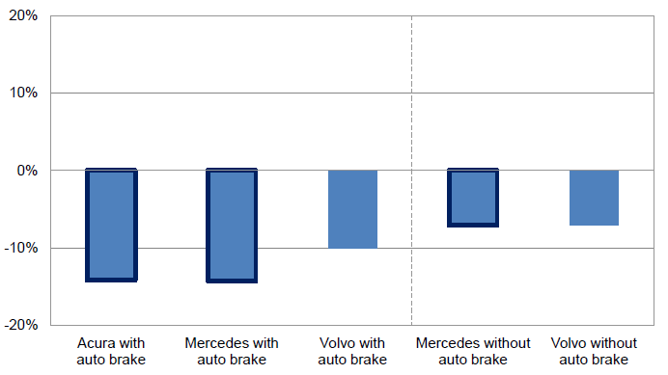
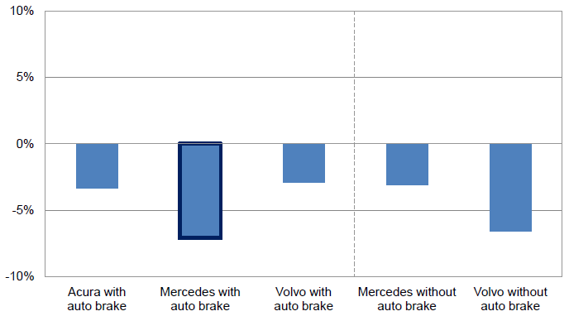
Impact of Forward Collision Warning With and Without Auto Brake
Forward collision warning systems have a material impact on PD liability claim frequency, especially when paired with auto braking
Property Damage Liability Claim Frequency by Manufacturer
Collision Claim Frequency by Manufacturer
Collision frequency falls as well
Source: Highway Loss Data Institute and Insurance Institute for Highway Safety presentation by Matthew Moore, Measuring Crash Avoidance System Effectiveness with Insurance Data,” January 30 2013; Insurance Information Institute.
86

Slide 87

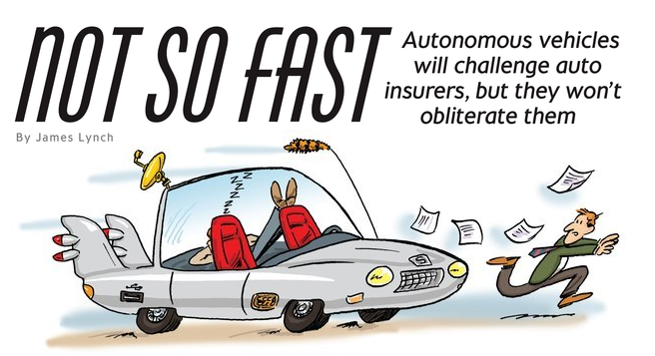

Media is Obsessed with Driverless Vehicles: Often Predicting the Demise of Auto Insurance
By 2035, it is estimated that 25% of new vehicle sales could be fully autonomous models
Questions
Are auto insurers monitoring these trends?
How are they reacting?
Will take over the industry? (cars/sales)
Will the number of auto insurers shrink?
How will liability shift?
Source: Boston Consulting Group; Insurance Information Institute.

Slide 88
A Few Thoughts on the Future of Auto Insurance
Global auto insurance premiums written total about $600B
  ~80% personal, 20% commercial
  US accounts for more than 1/3 of this total (about $210B in 2014)
Innovations in automobile safety will, over time, reduced claim frequency but severities could still rise as repair costs escalate
  Claim activity clearly not immune to economy
Frequency declines could lead price declines, aiding profitability
More cars, not fewer will be on highways in the US, world
  Exposure (insured car years) grows even as frequency declines
Timeline for large numbers of mass produced autonomous vehicles on American highways is wildly optimistic
  Mid-2030s is more likely timeframe; Transition occurring through mid-century
  Tech media is enamored with anything involving Google, Apple
Auto insurance will be the largest, most important of all P/C lines for many years to come

Slide 89
Cyber Threats, Motor Vehicles and Auto Insurance
Who Bears Liability for the Costs of Fixing Defects, Resulting Damage?
Auto Claims: The Next Generation?
89

Slide 90
Hackers’ on the Highway: The ‘Internet of Things’ Now Includes Motor Vehicles
An increasing number of passenger and commercial vehicles now have Internet connectivity
In July 2015, researchers successfully took control of the engine and braking functions of a Jeep Cherokee
Regulators request recall
Chrysler recalls 1.4 Jeeps and similarly vulnerable vehicles
  Fix is software driven
In recall notice, Chrysler asserts cyber risk is not a safety defect
  NHSTA disagrees with Chrysler disclaimer
Debate is ongoing
  “A cybersecurity vulnerability is a safety defect in the same way an exploding airbag or malfunction ignition is a safety defect.,,,Auto makers cannot ignore their responsibility to ensure the cars they sell are safe from hacking” [Sen. Edward Markey, D-MA]
  Auto manufacturers disagree…

Slide 91
Timeline: 2015 Jeep Hack Was First-Ever Auto Recall for a Cyber Defect, Certainly Not the Last
July 14: Fiat Chrysler approves extended warranty program and free software updates for owners of vehicles with cybersecurity vulnerability in certain radios
July 16: Fiat Chrysler releases software update blocking commands from unauthorized hackers
July 21: Regulators request the company recall vehicles with cybersecurity gap
July 23: Sprint Corp. closes access to open port on vehicles’ radios to remove long-range hacking risk. Fiat Chrysler agrees to recall request, submits filing asserting cyber risk isn’t a safety defect
July 24: NHSTA in letter disagrees with Fiat Chyrsler defect disclaimer, notes the disclaimer as no force or effect in terms of recall obligations
Source: “Is a Hacked Vehicle Also Defective?,” Wall Street Journal, August 26, 2015; Insurance Information Institute.

Slide 92
Insurance Information Institute Online:
www.iii.org
Thank you for your time
and your attention!
Twitter: twitter.com/bob_Hartwig
Download at www.iii.org/presentations

