Slide 1
“Coulda, Woulda, Shoulda” What Business Owners Need to Know About Insurance
Governor’s Hurricane Conference May 14, 2015
Presenters: Sam Miller, Florida Insurance Council Lynne McChristian, Insurance Information Institute

Slide 2
Businesses Need to be Disaster Ready
Natural disasters produce enormous business losses.
Superstorm Sandy in 2012: $18.8 billion in non-flood insured losses. Businesses accounted for 46.7 percent of the losses.
Average commercial claim: $44,500, compared to $6,500 for homeowners.
Only 35 percent of small businesses had business interruption coverage in 2007*.
Source: National Foundation of Independent Businesses.
418.8Business Interruption Losses:

Slide 3
Basics of a Business Owner’s Policy
What is Covered
Property insurance for buildings and contents.
There are 2 forms, Standard and Special, and the Special Form provides more comprehensive coverage.
Coverage includes debris removal, pollutant cleanup, fire department charges, mechanical breakdown, etc.
Business Interruption Insurance.
Covers loss of income from fire or other perils that disrupt the operation of the business. It can also include the extra expense of operating out of a temporary site.
Liability protection.
Covers your company’s legal responsibility for harm caused to others.

Slide 4
Basics of a Business Owner’s Policy
What is NOT Covered under a Business Owner’s Policy
Professional Liability.
Auto Insurance.
Worker’s Compensation.
Health or Disability Insurance.
Flood insurance
AND, you can get coverage for these with separate insurance policies.

Slide 5
About Commercial Flood Insurance
According to the National Flood Insurance Program, at least 25% of businesses that close after an event like a flood never reopen.
From 2010-2014 the average commercial flood claim amounted to nearly $89,000.
A flood policy from the NFIP covers up to $500,000 in building coverage and $500,000 for contents.
Cost for above ground property:
$2,938 building + contents/$965 contents only

Slide 6
Replacement Cost vs Actual Cash Value
Replacement Cost: This coverage pays the cost of replacing your property without deducting for depreciation. Actual Cash Value (ACV): Insurance pays the cost of damaged property after deducting for depreciation.
EXAMPLE: You paid $2,000 for a computer five years ago. ACV would pay only its current value, maybe about $500.

Slide 7
Commercial Auto Insurance
What It Protects Against:
Liability.
No-fault Medical Payments.
Uninsured/Underinsured Motorists.
Collision.
Comprehensive Physical Damage.
Almost every business needs it, even companies that don’t own autos --- because you may want this protection on non-owned vehicles for liability coverage.
REMINDER: Insurance pays for legal defense costs.

Slide 8
Business Interruption Coverage
Covers operating expenses and compensates for lost income after a temporary closure due to a covered loss.
It typically requires direct physical damage to the property.
Contingent Business Interruption Coverage: Compensates for certain losses you may have if a main customer or supplier was impacted.

Slide 9
Contingent Business Interruption Chain Rule
Physical
Damage or Loss
To Supplier, Customer,
Dependent
Property
For a Defined Indemnity Period
Which Causes an Interruption
Of the Type Covered
Insured Loss

Slide 10
Liability Insurance: Professional & Product
General Liability: Offers basic protection against accidents and injuries; also protects against product liability.
Product Liability: Protects against costs of judgements, settlements and legal fees arising from damages or alleged damages caused by a faulty or defective product.
Manufacturer, seller and even the wholesaler may need it.
Professional Liability: Protects against the financial effects of professions such as engineers, lawyers, accountants, financial advisers, etc.

Slide 11
Key Person Insurance
Life and disability coverage on key individuals.
Amount of coverage depends on the individual’s worth to the business or organization.
A review of the employee’s responsibilities can help determine the amount.
Costs are based on the same factors that apply to anyone seeking such coverage, i.e., age, height/weight, medical history.
The business owns the policy, pays the premiums and is the beneficiary.

Slide 12
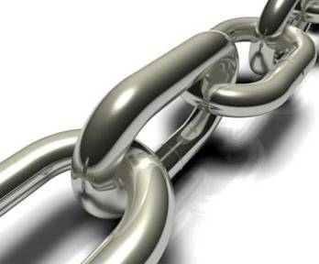
Supply Chain Risk Management
The longer the supply chain the greater likelihood of a weak link.
12

Slide 13
Global, Intertwined Economy
Over 50% of Fortune 500 profit now comes from overseas.
Supply chains have become more complex, extending to multiple levels.
Demographic change has placed more business in harm’s way.
Catastrophe events are having deeper, wide-spread impact.

Slide 14
How to Manage Supply Chain Disruptions
Identification of Risk
Conduct thorough supply chain mapping exercise.
Look at processes as they come together to create final products.
Look in reverse: starting with where profits are generated and work backwards to identify greatest financial threats.
Avoidance
Remove the threat of exposure to the supply chain.
Mitigation
Reduce the threat associated with exposures.
Manage
Includes transfer of risk through insurance.
Notes:
14

Slide 15
Managing Risk
The majority of property loss is preventable, even in supply chains.
“Nearly 90 percent of firms do not conduct a risk assessment when outsourcing production.” “Supply Chain Risk: It’s Time to Measure It” Harvard Business Review Blog, Feb. 5, 2010

Slide 16
Avoid or Mitigate the Interruption
Understand your supply chain at every tier.
Identify weaknesses. Map business operations and overlay it with financial mapping and a business impact analysis.
Harden facilities, owned or otherwise.
Define acceptable risk.
Create contingency and disaster plans.
Insurance professional are part of the team of trusted risk advisers.

Slide 17
Keeping Ahead of Risk
Insurance is part of the solution.
Insurance products evolve, so keep in tune.
Traditionally, coverage is for physical damage, business interruption and contingent coverage.
Business interruption has two levels:
Gross earnings (Production-based).
Gross profits (Sales-based).

Slide 18
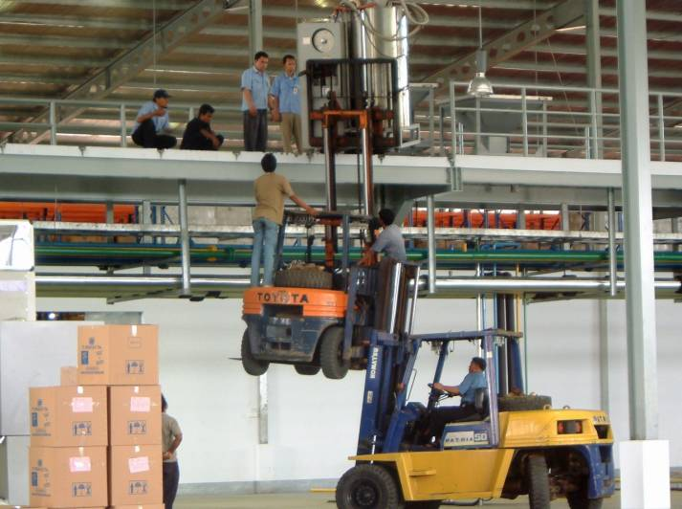
The Challenge: Risk
You can outsource operations, but that doesn’t mean you are outsourcing risk.

Slide 19
www.flains.org www.iii.org www.InsuringFlorida.org
Thank you for your time and your attention!
Download at www.iii.org/presentations

