Slide 1
2015, 2016 and beyond:
Financial Results From An Actuarial Point of View
Casualty Actuaries of Greater New York
May 23, 2016
Download at www.iii.org/presentations
James Lynch, Vice President and Chief Actuary
Insurance Information Institute ♦ 110 William Street ♦ New York, NY 10038
Tel: 212.346.5533 ♦ Cell: 917.359.3908♦ jamesl@iii.org ♦ www.iii.org

Slide 2
2015 Industry Results
Almost a Carbon Copy of 2014
L:
2
Notes:
2

Slide 3
P/C Industry Net Income After Taxes
1991–2015
$ Millions
2005 ROE*= 9.6%
2006 ROE = 12.7%
2007 ROE = 10.9%
2008 ROE = 0.1%
2009 ROE = 5.0%
2010 ROE = 6.6%
2011 ROAS¹ = 3.5%
2012 ROAS¹ = 5.9%
2013 ROAS¹ = 10.2%
2014 ROAS¹ = 8.4%
2015 ROAS = 8.4%
Net income in 2015 was on par with 2014; ROE unchanged at 8.4%
ROE figures are GAAP; ¹Return on avg. surplus. Excluding Mortgage & Financial Guaranty insurers yields a 8.2% ROAS in 2014, 9.8% ROAS in 2013, 6.2% ROAS in 2012, 4.7% ROAS for 2011, 7.6% for 2010 and 7.4% for 2009; 2015E is annualized figure based actual figure through Q3 of $44.0
Sources: A.M. Best, ISO; Insurance Information Institute

Slide 4
Commercial Lines NPW Premium Growth:
1975-2015E
ROE
NPW Δ > Nominal GDP Δ Implies Hard Market
Economic Shocks, Inflation:
1976: 22.2%
Tort Crisis
1986: 30.5%
Post-9/11
2002: 22.4%
Post-Hurricane Andrew Bump:
1993: 6.3%
1988-2000: Period of inter-cycle stability
Post Katrina Bump:
2006: 7.7%
2015E 3.3%
2010-20XX? Stable Growth
Recessions:
1982: 1.1%
Great Recession:2009: -9.0%
Note: Data include state funds beginning in 1998.
Source: A.M. Best; Insurance Information Institute.

Slide 5
P/C Direct Written Premium by Line
(Billions of Dollars)
LOB | 2014 | 2015
Personal Auto | 190.6 | 199.9
Homeowners | 90.7 | 93.3
GL (incl Products) | 62.6 | 65.7
WC | 55.4 | 57.6
Fire & Allied Lines | 43.5 | 42.2
CMP | 39.2 | 39.7
Comm Auto | 29.3 | 31.3
Other | 59.6 | 61.9
Total | 570.8 | 591.8
Sources: NAIC Data, sourced from S&P Global Market Intelligence, Insurance Information Institute.

Slide 6
P/C Insurance Industry
Combined Ratio, 2001–2015*
Heavy Use of Reinsurance Lowered Net Losses
Relatively Low CAT Losses, Reserve Releases
Higher CAT Losses, Shrinking Reserve Releases, Toll of Soft Market
As Recently as 2001, Insurers Paid Out Nearly $1.16 for Every $1 in Earned Premiums
Relatively Low CAT Losses, Reserve Releases
Avg. CAT Losses, More Reserve Releases
3 Consecutive Years of U/W Profits: First Time Since 1971-73
Best Combined Ratio Since 1949 (87.6)
Sandy Impacts
Cyclical Deterioration
Lower CAT Losses
* Excludes Mortgage & Financial Guaranty insurers 2008--2014. Including M&FG, 2008=105.1, 2009=100.7, 2010=102.4, 2011=108.1; 2012:=103.2; 2013: = 96.1; 2014: = 97.0.
Sources: A.M. Best, ISO (2014-2015); Figure for 2010-2013 is from A.M. Best P&C Review and Preview, Feb. 16, 2016.

Slide 7
P/C Net Combined Ratio by LOB
LOB | 2014 | 2015
Personal Auto | 103 | 105
Homeowners | 93 | 92
GL (incl Products) | 99 | 103
WC | 100 | 94
CMP | 100 | 95
Fire & Allied Lines | 88 | 86
Comm Auto | 104 | 109
Other | 84 | 84
Total | 97 | 98
Positive Number = Bad News
Source: National Council on Compensation Insurance.

Slide 8
Profitability Peaks & Troughs in the P/C Insurance Industry, 1975-2015
ROE
1977:19.0%
2016 Forecast: 6.3%
1987:17.3%
10 Years
1997:11.6%
2006:12.7%
10 Years
2015: 8.4%
2013 9.8%
9 Years
2014 8.4%
1975: 2.4%
1984: 1.8%
1992: 4.5%
2001: -1.2%
*Profitability = P/C insurer ROEs. 2011-15 figures are estimates based on ROAS data. Note: Data for 2008-2014 exclude mortgage and financial guaranty insurers.
Source: Insurance Information Institute; NAIC, ISO, A.M. Best, Conning

Slide 9
ROE: Property/Casualty Insurance by Major Event, 1987–2015
(Percent)
P/C Profitability Is Both by
Cyclicality and Ordinary Volatility
Modestly higher CATs
Katrina, Rita, Wilma
Low CATs
Sept. 11
Hugo
Lowest CAT Losses in
15 Years
4 Hurricanes
Sandy
Andrew, Iniki
Record Tornado Losses
Northridge
Financial Crisis*
* Excludes Mortgage & Financial Guarantee in 2008 – 2014.
Sources: ISO, Fortune; Insurance Information Institute.

Slide 10
Return on Equity by Financial Services Sector vs. Fortune 500, 2004-2015*
(Percent)
Average: 2004 - 2014
Fortune 500: 13.9% Commercial Banks: 9.8% Life: 8.2% P/C: 7.1%
Banks and Insurers Have Substantially Underperformed the Fortune 500 Since the Financial Crisis
*GAAP basis.
Sources: ISO, Fortune; Insurance Information Institute.
10
Notes:
10

Slide 11
Return on Net Worth (RNW)
Largest Lines: 2005-2014 Average
Percent
Commercial lines have tended to be more profitable than personal lines over the past decade
Source: NAIC; Insurance Information Institute.

Slide 12
RNW All Lines, 2005-2014 Average:
Highest 25 States
(Percent)
The most profitable states over the past decade are widely distributed geographically, though none are in the Northeast
Profitability Benchmark: All P/C
US: 7.7%
Source: NAIC; Insurance Information Institute.

Slide 13
RNW All Lines, 2005-2014 Average:
Lowest 25 States
NY, NJ Hit Hard by both Hurricane Irene (2011) and superstorm Sandy (2012)
(Percent)
Some of the least profitable states over the past decade were hit hard by catastrophes
Source: NAIC; Insurance Information Institute.

Slide 14
Policyholder Surplus,
2006:Q4–2015:Q4E
Higher Dividends, Drop in Unrealized Cap Gains Kept Surplus Flat
($ Billions)
2007:Q3
Pre-Crisis Peak
Surplus as of 12/31/15 stood at a near-record high $673.7B
The industry now has $1 of surplus for every $0.73 of NPW,
close to the strongest claims-paying status in its history.
The P/C Industry Entered 2016 in Strong Financial Condition, But Low Leverage Inhibits Investment Returns.
Sources: ISO, A.M .Best.
14
12/01/09 - 9pm
eSlide – P6466 – The Financial Crisis and the Future of the P/C
Notes:
14

Slide 15
2016: So Far, A Lot of Mini-Cats in USA
Costliest in TX History
Events Elsewhere in USA:
Jan NE Winter Storm
Feb (CA, SE) Winter Weather
March (CA, SE) CV Storm
  Incl. Florida tornadoes
Total Insured Loss > $1 B
Source: Aon Benfield, Insurance Council of Texas, A.M. Best, Insurance Information Institute.
Q2 Event

Slide 16
Distribution of Direct Premiums Written by Segment/Line, 2014
Personal/Commercial lines split has been about 50/50 for many years
Pvt. Passenger Auto is by far the largest line of insurance and is currently the most important source of industry profits
Billions of additional dollars in homeowners insurance premiums are written by state-run residual market plans
Distribution Facts
2014
Commercial Lines
$282.5B/51%
Homeowners
$86.1B/15%
Pvt. Pass Auto
$190.3B/34%
Sources: A.M. Best; Insurance Information Institute research.

Slide 17
Top 25 US P/C Insurers by Direct Premiums Written, 2014
The ACE/Chubb deal will create a much larger commercial presence for the combined entity
Commercial Lines
$269.2B/51%
Homeowners
$80.7B/15%
Pvt. Pass Auto
$180.8B/34%
Sources: Barclays PLC; Insurance Information Institute.

Slide 18
RNW Commercial Auto,
2005-2014 Average: Highest 25 States
(Percent)
Sources: NAIC; Insurance Information Institute

Slide 19
RNW Commercial Auto,
2005-2014 Average: Lowest 25 States
(Percent)
Sources: NAIC; Insurance Information Institute

Slide 20
RNW Workers Compensation,
2005-2014 Average: Highest 25 States
(Percent)
Sources: NAIC; Insurance Information Institute

Slide 21
RNW Workers Compensation,
2005-2014 Average: Lowest 25 States
(Percent)
Sources: NAIC; Insurance Information Institute

Slide 22
AY vs. CY Combined Ratio,
(Excl. Guaranty Lines) 1996-2015
Hurricane Ike
Higher AY → Favorable DOP
Tuscaloosa, Joplin Tornadoes
2015 Figures Preliminary. Sources: NAIC data from S&P Global Intelligence, Insurance Information Institute.
Three Consecutive Years of Deteriorating Combined Ratios, Despite Light Cat Losses. AY2015 Above 100.
22

Slide 23
Personal Lines Combined Ratio,
1996-2015
Higher AY → Favorable DOP
Tuscaloosa, Joplin Tornadoes
2015 Figures Preliminary. Sources: NAIC data from S&P Global Intelligence, Insurance Information Institute.
Lack of Catastrophes Let Personal Lines Writers Post Underwriting Profit Two Years In a Row. CY15>100, Despite Lack of Cats.
23

Slide 24
Commercial Lines Combined Ratio, 1996-2015
Low Cat Losses Contribute to Favorable Combined Ratios.
2015 Figures Preliminary. Sources: NAIC data from S&P Global Intelligence, Insurance Information Institute.
24

Slide 25
Development on Prior, 1996-2015
DoP ($ billions)
DoP (% of NEP)
Reserve Releases Keep Getting Smaller. 2015 Affected by a Single Company’s $3B Reserve Hit.
2015 Figures Preliminary. Sources: NAIC data from S&P Global Intelligence, Insurance Information Institute.
25

Slide 26
CY Development on Prior by LOB
Several Liability Lines (Auto, GL, Products) Had Reserve Spikes. WC Was an Exception.
2015 Figures Preliminary. Sources: NAIC data from S&P Global Intelligence, Insurance Information Institute.
26

Slide 27
Interest Rates and Investments
Investment Performance
Is a Key Driver of Profitability
27

Slide 28
Property/Casualty Insurance Industry Investment Income: 2000–2015¹
Investment earnings are still below their 2007 pre-crisis peak
($ Billions)
Due to persistently low interest rates,
investment income fell in 2012, 2013 and 2014 but showed a small (1.9%) increase in 2015—a trend that may continue
¹ Investment gains consist primarily of interest and stock dividends. Sources: ISO; Insurance Information Institute.

Slide 29
Net Yield on P/C Insurer Invested Assets, Year-end 2007-2015
From 2007 to 2015, P/C Insurer net yields dropped by 131 basis points.
Sources: National Association of Insurance Commissioners, sourced from S&P Global Market Intelligence.

Slide 30
U.S. Treasury Security Yields:
A Long Downward Trend, 1990–2016*
Yields on 10-Year U.S. Treasury Notes have been essentially below 5% for more than a decade.
Despite the Fed’s December 2015 rate hike, yield remain low though short-term yields have seen some gains
Since roughly 80% of P/C bond/cash investments are in 10-year or shorter durations, most P/C insurer portfolios will have low-yielding bonds for years to come.
*Monthly, constant maturity, nominal rates, through March 2016.
Sources: Federal Reserve Bank at http://www.federalreserve.gov/releases/h15/data.htm. National Bureau of Economic Research (recession dates); Insurance Information Institute.
30
12/01/09 - 9pm
eSlide – P6466 – The Financial Crisis and the Future of the P/C
Notes:
30

Slide 31
New Money vs. Embedded Yields,
U.S. Insurers, 1985-2015
Falling yields means less investment income, putting upward pressure on rates.
As long as new money rates are below the rates of maturing bonds,
the portfolio yield will continue to sink.
Sources: NCCI, Insurance Information Institute.
31
12/01/09 - 9pm
eSlide – P6466 – The Financial Crisis and the Future of the P/C
Notes:
31

Slide 32
Interest Rate Forecasts: 2016 – 2021
Yield (%)
3-Month Treasury
10-Year Treasury
The end of the Fed’s QE program in 2014 and a stronger economy have yet to push longer-term yields much higher
A full normalization of interest rates is unlikely until 2019, more than a decade after the onset of the financial crisis.
Sources: Blue Chip Economic Indicators (4/16 for 2016 and 2017; for 2018-2021 3/16 issue); Insurance Info. Institute.

Slide 33
Distribution of Bond Maturities,
P/C Insurance Industry, 2005-2014
The main shift over these years has been from longer maturities to shorter maturities, but the 2013-14 data suggest a shift back has begun. The 2014 distribution resembles that at year-end 2009.
Sources: SNL Financial; Insurance Information Institute.

Slide 34
Bonds Rated NAIC Quality Category 3-6 as a Percent of Total Bonds, 2003–2015:Q1
From 2006-07 to year-end 2012, the percentage of lower-quality bonds in P/C industry portfolios doubled
There are many ways to capture higher yields on bond portfolios. One is to accept greater risk, as measured by NAIC bond ratings.
The ratings range from 1 to 6, with investment grade rated 1 or 2.
Even in 2014-15, over 95% of the industry’s bonds were investment grade.
Sources: SNL Financial; Insurance Information Institute.

Slide 35
Treasury Yield Curves:
Pre-Crisis (July 2007) vs. May 2015
The Treasury yield curve remains near its most depressed level in at least 45 years. Even when the Fed begins to raise rates, yields are unlikely to return to pre-crisis levels anytime soon
The Fed is signaling that it is likely to begin raising short-term rates (and indirectly, the yield curve) later in 2015.
Source: Federal Reserve Board of Governors; Insurance Information Institute.

Slide 36
Commercial Rates
Steady Going
L:
36
Notes:
36

Slide 37
Commercial Lines Rate Change by Qtr (vs. Year Earlier)
20 consecutive quarters of rate increases
Decreases: WC, Property, D&O. ‘Meaningful’ Increases: Commercial Auto.
Sources: Willis Towers Watson Commercial Lines Insurance Pricing Survey, Insurance Information Institute.
37
12/01/09 - 9pm
eSlide – P6466 – The Financial Crisis and the Future of the P/C
Notes:
37

Slide 38
Canadian Commercial Lines Price Level Change by Qtr (vs. Year Earlier)
16 consecutive quarters of rate increases
Hard Market (Such As It Is) Appears to Have Passed Its Peak.
Sources: Willis Towers Watson Commercial Lines Insurance Pricing Survey, Insurance Information Institute.
38
12/01/09 - 9pm
eSlide – P6466 – The Financial Crisis and the Future of the P/C
Notes:
38

Slide 39
Commercial Lines Rate Change by Month (vs. Year Earlier) Since 6/09
Are Decreases Already Moderating?
Early Indication: The ‘Soft Market’ May Have Been Brief.
SOURCE: MarketScout, Insurance Information Institute.

Slide 40
Commercial Lines Rate Change by Month (vs. Year Earlier)
Three Straight Months: -4%; April -2%
Not Much of A Hard Market, By Historic Standards
Rates Are As Stable As They’ve Been in 15 Years but Beginning to Show Signs of Decline.
SOURCE: MarketScout, Insurance Information Institute.

Slide 41
Commercial Property Rate Change by Month (vs. Year Earlier)
Soft Reinsurance Market Holding Rates Down, But Not Significantly More Than Rest of P/C Market.
SOURCE: MarketScout, Insurance Information Institute.
Interpolated Commercial Property Estimates for May, August, September 2010.

Slide 42
Business Interruption Rate Change by Month (vs. Year Earlier)

Slide 43
BOP Rate Change by Month
(vs. Year Earlier)
Rate Change on Businessowners Policies Can Be A Bellwether for Small Commercial Risks.

Slide 44
Inland Marine Rate Change by Month
(vs. Year Earlier)

Slide 45
General Liability Rate Change by Month
(vs. Year Earlier)

Slide 46
Umbrella/Excess Rate Change by Month
(vs. Year Earlier)

Slide 47
Commercial Auto Rate Change by Month (vs. Year Earlier)
Willis Towers Watson Notes ‘Meaningful’ Increases in This Line.

Slide 48
Workers Comp Rate Change by Month (vs. Year Earlier)
Willis Towers Watson Notes ‘Meaningful’ Increases in This Line.
Willis Towers Watson Notes Decreases in This Line.
Sources: MarketScout, Insurance Information Institute.

Slide 49
2015 Premium Change-NCCI States
Premium Volume in Workers Comp Helped by Increase in Payroll, but Rates Trended Lower.
Other factors include: Change in audit impacts; change in average experience mod; change in mix of policy types; change in deductible credits; change in mix between private carrier and state fund markets.
Sources: Annual Statement data, NCCI.

Slide 50
Professional Liability Rate Change by Month (vs. Year Earlier)

Slide 51
D&O Liability Rate Change by Month (vs. Year Earlier)
Willis Towers Watson Notes Decreases in This Line.
Sources: MarketScout, Insurance Information Institute.

Slide 52
Monoline D&O:
Premium Growth, Loss Ratios
Monoline D&O Growth Slowed in 2015. Experience Appears to Have Deteriorated.
SOURCE: NAIC data, sourced from S&P Global Market Intelligence, Insurance Information Institute.

Slide 53
EPLI Rate Change by Month (vs. Year Earlier)

Slide 54
Fiduciary Liability Rate Change by Month (vs. Year Earlier)

Slide 55
Crime Rate Change by Month (vs. Year Earlier)

Slide 56
Surety Rate Change by Month (vs. Year Earlier)

Slide 57
Rates in The Northeast, Q4 2015*
By Account Size
 | Down > 10% | Down 1-10% | No Change | Up 1-10% | Up > 10% | N/A
Small (<25K) | 0.00% | 42.11% | 47.36% | 0.00% | 0.00% | 10.53%
Medium (25-100K) | 10.53% | 63.16% | 26.32% | 0.00% | 0.00% | 0.00%
Large (100K+) | 10.53% | 73.68% | 10.53% | 0.00% | 0.00% | 5.26%
This Survey is Based on Agent Estimates.
By Line of Business
 | Down > 10% | Down 1-10% | No Change | Up 1-10% | Up > 10% | N/A
Commercial Auto | 0.00% | 10.53% | 52.63% | 31.58% | 0.00% | 5.26%
Commercial Property | 15.79% | 63.16% | 10.52% | 10.53% | 0.00% | 0.00%
D&O | 0.00% | 26.32% | 42.11% | 15.78% | 5.26% | 10.53%
Flood Insurance | 5.26% | 10.53% | 52.62% | 10.53% | 10.53% | 10.53%
General Liability | 5.26% | 52.63% | 36.85% | 0.00% | 0.00% | 5.26%
Terrorism | 5.26% | 10.53% | 63.16% | 5.26% | 5.26% | 10.53%
Umbrella | 10.53% | 47.37% | 31.58% | 5.26% | 0.00% | 5.26%
Workers Compensation | 0.00% | 52.63% | 36.85% | 5.26% | 0.00% | 5.26%
Rate Changes Can Vary Significantly Within States, Lines of Business or Individual Markets.
* CT, DE, DC, MA, ME, MD, NH, NJ, NY, PA, RI.
SOURCE: Council of Insurance Agents & Brokers.

Slide 58
Auto Insurance
Rising Frequency, Severity Pinching the Largest P/C Line
L:
58
Notes:
58

Slide 59
Return on Net Worth: Personal & Commercial Auto, 2005-2014
Auto Insurance Profitability Has Been Falling for A Decade.
SOURCE: National Association of Insurance Commissioners.

Slide 60
Net Combined Ratio, 2005-2015
Loss Ratios Have Been Rising for A Decade. 2015 Return on Net Worth Is Likely Close to Zero or Negative.
SOURCE: National Association of Insurance Commissioners data, sourced from S&P Global Market Intelligence; Insurance Information Institute.

Slide 61
Why Personal Auto Loss Ratios Are Rising: Severity & Frequency by Coverage, 2015 vs. 2014
Annual Change, 2015 Over 2014
Across All Personal Coverage Types (Except Comprehensive) in 2015, Frequency and Severity Rose. This Pattern is Likely to Continue in 2016
Source: ISO/PCI Fast Track data; Insurance Information Institute

Slide 62
Auto Insurance: Frequency vs. Severity
In the Long Run, Frequency Falls. Severity Increases.
Sources: Insurance Institute for Highway Safety, Insurance Services Office, Insurance Information Institute.

Slide 63
Claim Trends by Coverage
Focus on Collision
63

Slide 64
Collision
64

Slide 65
Collision Claims: Frequency Trending Higher in 2015
Annual Change, 2005 through 2015
For a long time, claim frequency has been falling,
but since 2009 this trend seems to have reversed.
Source: ISO/PCI Fast Track data; Insurance Information Institute

Slide 66
Collision Claims:
Severity Trending Higher in 2009-2015
Annual Change, 2005 through 2015
The Great Recession and high fuel prices helped to
temper claim severity, but these forces have clearly reversed,
consistent with experience from past recoveries
Source: ISO/PCI Fast Track data; Insurance Information Institute

Slide 67
Collision Claims: Pure Premium (Losses per Insured Unit), 2011:Q4-2015:Q4
Over the latest four years,
the collision pure premium rose by 19.75%.
Note: Number of claims is for four quarters ending in quarter shown
Source: ISO/PCI Fast Track data; Insurance Information Institute

Slide 68
What’s Driving These Trends?
Frequency; Severity
68

Slide 69
America is Driving More Again:
Total Miles Driven*, 1990-2016
Billions of Miles Driven
*Moving 12-month total. Data through February 2016, the latest available.
Note: Recessions indicated by shaded columns.
Sources: Federal Highway Administration (http://www.fhwa.dot.gov/policyinformation/travel_monitoring/tvt.cfm );
National Bureau of Economic Research (recession dates); Insurance Information Institute.
69
12/01/09 - 9pm
eSlide – P6466 – The Financial Crisis and the Future of the P/C
Notes:
69

Slide 70
More Miles Driven
=> More Collisions, 2006–2015
Billions of Miles Driven in Prior Year
Overall Collision Claims Per 100 Insured Vehicles
Recession
The more miles people drive, the more likely they are to get in an accident, helping drive claim frequency higher.
Sources: Federal Highway Administration (http://www.fhwa.dot.gov/policyinformation/travel_monitoring/tvt.cfm ); Rolling Four-Qtr Avg. Frequency from Insurance Services Office; Insurance Institute for Highway Safety; Insurance Information Institute.
70
12/01/09 - 9pm
eSlide – P6466 – The Financial Crisis and the Future of the P/C
Notes:
70

Slide 71
Why Are People
Driving More Miles? Cheap Gas?
Billions of Miles Driven in Prior Year
Avg. Price Per Gallon
Recession
Gas Prices Don’t Seem Correlated With Miles Driven.
Sources: Federal Highway Administration (http://www.fhwa.dot.gov/policyinformation/travel_monitoring/tvt.cfm ); Energy Information Administration; Insurance Institute for Highway Safety; Insurance Information Institute.
71
12/01/09 - 9pm
eSlide – P6466 – The Financial Crisis and the Future of the P/C
Notes:
71

Slide 72
Why Are People
Driving More Miles? Jobs?
Billions of Miles Driven in Prior Year
Millions Employed
Recession
People Drive To and From Work and Drive to Entertainment. Out of Work, They Curtail Their Movement.
Sources: Federal Highway Administration (http://www.fhwa.dot.gov/policyinformation/travel_monitoring/tvt.cfm ); Seasonally Adjusted Employed from Bureau of Labor Statistics; Insurance Institute for Highway Safety; Insurance Information Institute.
72
12/01/09 - 9pm
eSlide – P6466 – The Financial Crisis and the Future of the P/C
Notes:
72

Slide 73
Comparing Gas Prices, Employment on Collision Frequency
Sources: Seasonally Adjusted Employed from Bureau of Labor Statistics; Energy Information Administration; Rolling Four-Qtr Avg. Frequency from Insurance Services Office; Insurance Information Institute.

Slide 74
More People Working and Driving
=> More Collisions, 2006-2016
Overall Collision Claims Per 100 Insured Vehicles
Number Employed,
Millions
Recession
When people are out of work, they drive less. When they get jobs,
they drive to work, helping drive claim frequency higher.
Sources: Seasonally Adjusted Employed from Bureau of Labor Statistics; Rolling Four-Qtr Avg. Frequency from Insurance Services Office; Insurance Information Institute.
74
12/01/09 - 9pm
eSlide – P6466 – The Financial Crisis and the Future of the P/C
Notes:
74

Slide 75
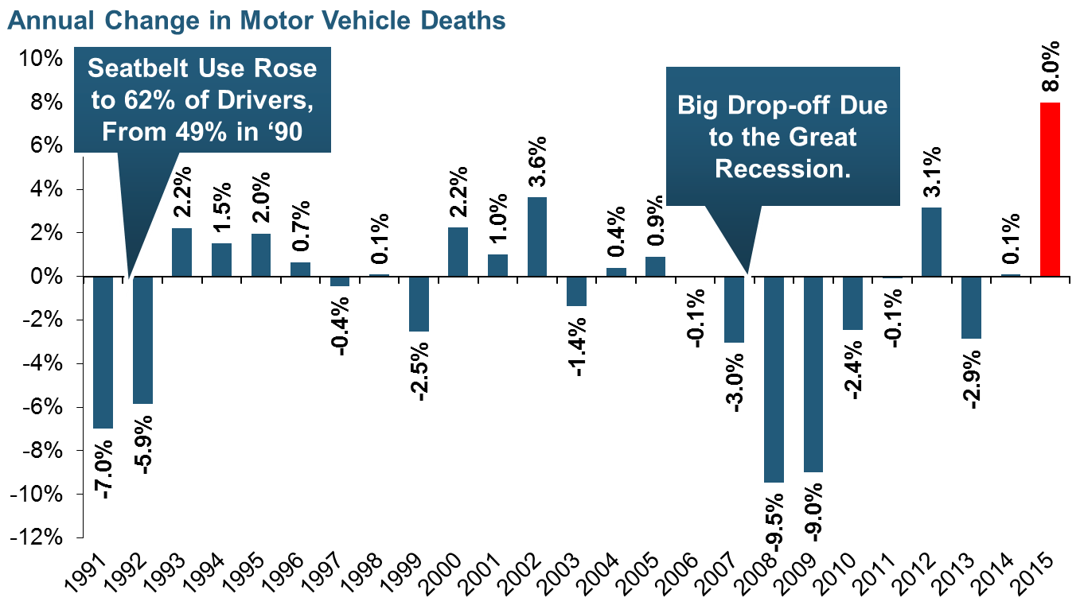
Severity: Driving Fatalities Are Rising
Driving Has Been Getting Safer For Decades, But Recent Trend Is Discouraging—38,300 Deaths in 2015
Sources: National Safety Council, Insurance Information Institute.

Slide 76
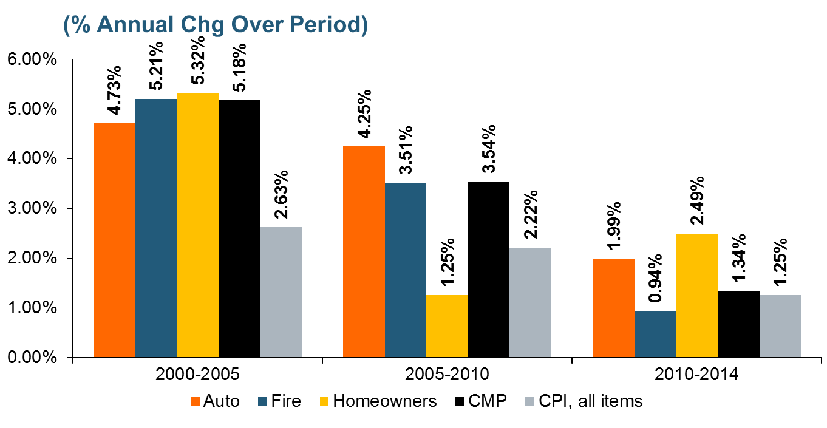
Loss Trends vs. CPI: Not Just Auto
In Recent Years, Claim Costs Have Risen at About the Inflation Rate. If We Return to the Norm, Claim Costs Will Rise.
Source: Insurance Information Institute calculation from Towers Watson data.

Slide 77
Death Rates per 100,000,000 Vehicle miles, 1990-2015*
The recession and high gas prices reduced miles driven, accelerating the drop in death rates
Motor vehicle fatality rates appear to be ticking up in 2015
Vehicle death rates fell by nearly half between 1990 and 2010.
Source: National Safety Council; Federal Highway Administration; Insurance Information Institute.
77
Notes:
77

Slide 78
Bodily Injury Liability
78

Slide 79
Bodily Injury:
Frequency Trending Higher Since 2009
Annual Change, 2005 through 2015
For a long time, claim frequency has been falling,
but since 2009 this trend seems to have reversed.
Source: ISO/PCI Fast Track data; Insurance Information Institute

Slide 80
Bodily Injury: Severity Rising
Every Year in the Past Decade
Annual Change, 2005 through 2015
The Great Recession and high fuel prices helped to
temper increases in claim severity, but the are signs that
larger increases have returned
Source: ISO/PCI Fast Track data; Insurance Information Institute

Slide 81
Property Damage Liability
81

Slide 82
Property Damage Pure Premium (Losses per Insured Unit), 2011:Q4-2015:Q4
In just the last year, the rolling 4-quarter PD pure premium rose by 7.8%.
Over the latest four years,
the PD pure premium rose by 21.04%.
Note: Number of claims is for four quarters ending in quarter shown
Source: ISO/PCI Fast Track data; Insurance Information Institute

Slide 83
Property Damage:
Frequency Trending Higher Since 2009
Annual Change, 2005 through 2015
Before 2009 property damage claim frequency generally fell.
Since 2009 claim frequency has been rising virtually every year.
Source: ISO/PCI Fast Track data; Insurance Information Institute

Slide 84
Property Damage: Severity Rising
Every Year in the Past Decade
Annual Change, 2005 through 2015
The Great Recession and high fuel prices helped to
temper increases in claim severity, but the are signs that
larger increases have returned
Source: ISO/PCI Fast Track data; Insurance Information Institute

Slide 85
Personal Injury Protection (PIP)
85

Slide 86
No-Fault (PIP):
Frequency Trending Higher Since 2009
Annual Change, 2005 through 2015
No-Fault Systems Are Less Problematic in Some States but Still of Concern in Some, Such as Florida
*No-fault states included are: FL, HI, KS, KY, MA, MI, MN, NY, ND and UT.
Source: ISO/PCI Fast Track data; Insurance Information Institute

Slide 87
No-Fault (PIP): Severity Rising
Virtually Every Year in the Past Decade
Annual Change, 2005 through 2015
No-Fault Systems Are Less Problematic in Some States but Still of Concern in Some, Such as MI
*No-fault states included are: FL, HI, KS, KY, MA, MI, MN, NY, ND and UT.
Source: ISO/PCI Fast Track data; Insurance Information Institute

Slide 88
Comprehensive
88

Slide 89
Comprehensive Coverage: Frequency and Severity Trends Are Volatile
Severe weather is a principal cause of the spikes in both frequency and severity
Annual Change, 2005 through 2015
Weather Creates Volatility for Comprehensive Coverage
Source: ISO/PCI Fast Track data; Insurance Information Institute

Slide 90
Economic Forecast:
Slow and Steady
90

Slide 91
US Real GDP Growth*
The Q4:2008 decline was the steepest since the Q1:1982 drop of 6.8%
Real GDP Growth (%)
Recession began in Dec, 2007
Q1 2014/15 GDP data were hit hard by this year’s “Polar Vortex” and harsh winter
Demand for Insurance Should Increase in 2016 as GDP Growth Continues at a Steady, Albeit Moderate Pace and Gradually Benefits the Economy Broadly
* Estimates/Forecasts from Blue Chip Economic Indicators.
Source: US Department of Commerce, Blue Economic Indicators 5/16; Insurance Information Institute.

Slide 92
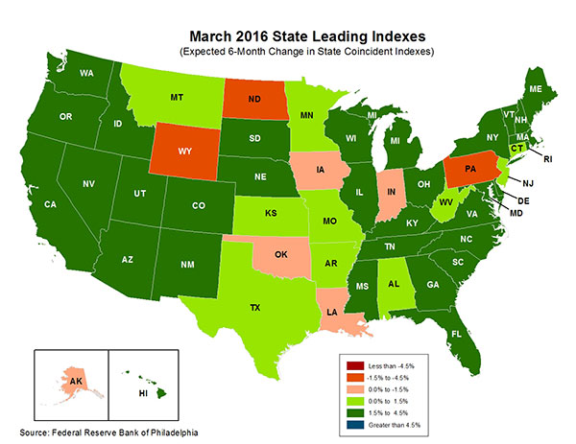
State-by-State Leading Indicators
through September 2016
Growth in the West is finally beginning to pick up
The economic outlook for most of the US is generally positive, though oil and coal states are hurting
Sources: Federal Reserve Bank of Philadelphia at http://www.philadelphiafed.org/index.cfm ;Insurance Information Institute.

Slide 93
Unemployment and Underemployment Rates: Still Falling
January 2000 through March 2016, Seasonally Adjusted (%)
For U-6, 8% to 10% is “normal.”
U-6 went from 8.0% in March 2007 to 17.5% in
October 2009
U-6 was 9.8% in March 2016.
“Headline” unemployment was 5.0% in March 2016. 4% to 6% is “normal.”
High unemployment and underemployment constrained overall economic growth for years, but the job market is clearly improving.
Source: US Bureau of Labor Statistics; Insurance Information Institute.
93
12/01/09 - 9pm
eSlide – P6466 – The Financial Crisis and the Future of the P/C
Notes:
93

Slide 94
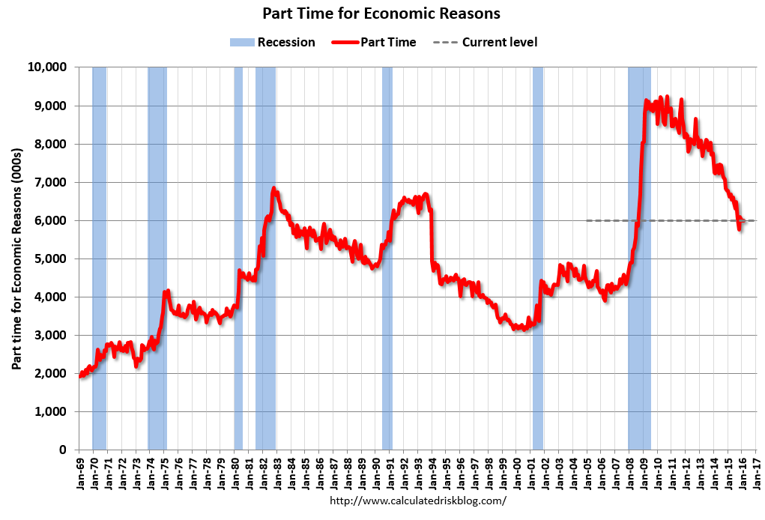
Labor Market Slack: Elevated Number of Involuntary Part-time Workers
Mar 2016:
6.1 million
In less than 18 months, 4.5 million additional people were involuntarily working part time
The “normal” range
(since 1992)

Slide 95
Number of “Discouraged Workers”:
Elevated, but Dropping Jan 1994 – Mar 2016
Thousands
A “discouraged worker” in a month did not actively look for work in the prior month
for reasons such as
--thinks no work available,
--could not find work,
--lacks schooling or training,
--thinks employer thinks too young or old, and other types of discrimination.
Latest reading: 585,000
in Mar. 2016.
Normal
In recent good times, the number of discouraged workers ranged from 200,000-400,000 (1995-2000) or from 300,000-500,000 (2002-2007).
Notes: Recessions indicated by gray shaded columns. Data are seasonally adjusted.
Sources: Bureau of Labor Statistics; National Bureau of Economic Research (recession dates).
95
12/01/09 - 9pm
eSlide – P6466 – The Financial Crisis and the Future of the P/C
Notes:
95

Slide 96
Full-time vs. Part-time Employment,
Quarterly, 2003-2016: WC Implications
Full time, millions
Part-time, millions
Recession
New full-time peak
Pre-recession, most new jobs were full-time
Recession shifted employment growth from full-time to part-time
The Great Recession shifted employment from full-time to part-time.
Full-time employment is finally above its pre-recession peak,
but part-time hasn’t receded.
Data are seasonally-adjusted. Sources: US Bureau of Labor Statistics, US Department of Labor; Insurance Information Institute.

Slide 97
US Unemployment Rate Forecast
Rising unemployment
eroded payrolls
and exposure base for WC and some GL.
Unemployment peaked at 10% in late 2009.
2007:Q1 to 2017:Q4F*
Jobless figures have been revised downwards for 2016
Unemployment forecasts have been revised modestly downwards. Optimistic scenarios put the unemployment as low as 4.4% by Q4 of 2016.
* = actual; = forecasts
Sources: US Bureau of Labor Statistics; Blue Chip Economic Indicators (4/16 edition); Insurance Information Institute.

Slide 98
Unemployment Rates by State, March 2016:
Highest 25 States*
In March, 21 states had over-the-month unemployment rate decreases, 15 states had increases, and 14 states and the District of Columbia had no change.
Residual impacts of the housing collapse, weak economies are holding back several states
*Provisional figures for March 2016, seasonally adjusted.
Sources: US Bureau of Labor Statistics; Insurance Information Institute.

Slide 99
Unemployment Rates by State, March 2016:
Lowest 25 States*
In March, 21 states had over-the-month unemployment rate decreases, 15 states had increases, and 14 states and the District of Columbia had no change.
Strength in Energy, Agricultural States-most also avoided housing bust
*Provisional figures for March 2016, seasonally adjusted.
Sources: US Bureau of Labor Statistics; Insurance Information Institute.

Slide 100
Nonfarm Payroll (Wages and Salaries):
Quarterly, 2005–2016:Q1
Billions
Latest (2016:Q1) was $8.03 trillion, a new peak--$1.80 trillion (29%) above 2009 trough
Prior Peak was 2008:Q3 at $6.54 trillion
Growth rates
2011:Q1 over 2010:Q1: 5.5%
2012:Q1 over 2011:Q1: 4.2%
2013:Q1 over 2012:Q1: 2.5%
2014:Q1 over 2013:Q1: 4.3% 2015:Q1 over 2014:Q1: 4.5%
2016:Q1 over 2015:Q1: 4.5%
Recent trough (2009:Q1) was $6.23 trillion, down 5.3% from prior peak
Note: Recession indicated by gray shaded column. Data are seasonally adjusted annual rates.
Sources: http://research.stlouisfed.org/fred2/series/WASCUR; National Bureau of Economic Research (recession dates); Insurance Information Institute.
100
12/01/09 - 9pm
eSlide – P6466 – The Financial Crisis and the Future of the P/C
Notes:
100

Slide 101
Value of Construction Put in Place, 2016 vs. 2015*
Growth (%)
Private: +10.6%
Public: +9.2%
Public sector construction activity is finally beginning to create less drag up after years of decline
Private sector construction activity is up in both the residential and nonresidential segments
Overall Construction Activity is Up Again After Languishing in Early 2015; State/Local Sector Government Sector May Be Recovering as Budget Woes Ease in Some Jurisdictions
*seasonally adjusted data through February 2016.
Source: U.S. Census Bureau, http://www.census.gov/construction/c30/c30index.html ; Insurance Information Institute.

Slide 102
Value of New Federal, State and Local Government Construction: 2003-2016*
Construction across all levels of government peaked at $314.9B in 2009
Austerity Reigns
Govt. construction MAY finally be turning around; still down $17.1B or 5.4% since 2009 peak
($ Billions)
Government Construction Spending Peaked in 2009, Helped by Stimulus Spending, but Contracted As State/Local Governments Grappled with Deficits and Federal Sequestration; Only Now Recovering
*2016 figure is a seasonally adjusted annual rate as of February; http://www.census.gov/construction/c30/historical_data.html
Sources: US Department of Commerce; Insurance Information Institute.

Slide 103
Construction Employment,
Jan. 2010—March 2016*
(Thousands)
Construction employment is +1.237 million above
Jan. 2011 (+22.8%) trough
Construction and manufacturing employment constitute 1/3 of all WC payroll exposure.
*Seasonally adjusted.
Sources: US Bureau of Labor Statistics at http://data.bls.gov; Insurance Information Institute.
103
12/01/09 - 9pm
eSlide – P6466 – The Financial Crisis and the Future of the P/C
Notes:
103

Slide 104
Construction Employment,
Jan. 2003–March 2016
(Thousands)
Construction employment as of March 2016 totaled 6.672 million, an increase of 1.237MM jobs or 22.8% from the Jan. 2011 trough
Construction employment peaked at 7.726 million in April 2006
Gap between pre-recession construction peak and today: 1.05 million jobs
The “Great Recession” and housing bust destroyed 2.3 million constructions jobs
Construction employment troughed at 5.435 million in Jan. 2011, after a loss of 2.291 million jobs, a 29.7% plunge from the April 2006 peak
The Construction Sector Was a Growth Leader in 2014-16 as the Housing Market, Private Investment and Govt. Spending Recover. WC Insurers Continue to Benefit.
Note: Recession indicated by gray shaded column.
Sources: U.S. Bureau of Labor Statistics; Insurance Information Institute.
104
12/01/09 - 9pm
eSlide – P6466 – The Financial Crisis and the Future of the P/C
Notes:
104

Slide 105
Dollar Value* of Manufacturers’ Shipments Monthly, Jan. 1992—Feb. 2016
$ Millions
The value of Manufacturing Shipments in Feb. 2016 was $462.8B—down 9% from the July 2014 record high of $508.1B
Weakness abroad, falling energy prices and a strong dollar are hurting the manufacturing sector, especially exports. Manufacturing growth leads to gains in many commercial exposures: WC, Commercial Auto, Marine, Property, and various Liability Coverages.
* Seasonally adjusted; Data published Apr. 4, 2016.
Source: U.S. Census Bureau, Full Report on Manufacturers’ Shipments, Inventories, and Orders, http://www.census.gov/manufacturing/m3/
105
12/01/09 - 9pm
eSlide – P6466 – The Financial Crisis and the Future of the P/C
Notes:
105

Slide 106
Employment in Oil & Gas Extraction,
Jan. 2010—March 2016*
Employment peaked in Oct. 2014 at 201,500—its highest level since Dec. 1986.
(000)
Oil and gas extraction employment is down 11.2% since Oct. 2014 as oil prices sink
*Seasonally adjusted
Sources: US Bureau of Labor Statistics at http://data.bls.gov; Insurance Information Institute.
106
12/01/09 - 9pm
eSlide – P6466 – The Financial Crisis and the Future of the P/C
Notes:
106

Slide 107
Cyber Insurance
By the Numbers
New Data from the Annual Statement
107

Slide 108

About the Data
New Reporting Requirement for Annual Statement
Only U.S. Carriers (No Bermuda, Lloyd’s Business)
Cyber Insurance vs. ID Theft
Direct Only
Calendar Year
I.I.I. Cyber White Paper To Be Updated in Fall: http://www.iii.org/white-paper/cyber-risks-threat-and-opportunities-100715

Slide 109
About the Data
Monoline Results
  Premium: Earned/Written
  Loss
    Paid vs. Incurred
    Indemnity/A&O/DCC
  In Force Policy Counts
Package Results
  Premium
    Earned/Written
    Quantified/Estimated
  Loss
    Paid/Reserve (No IBNR)
    Indemnity/A&O/DCC
  In Force Policy Counts

Slide 110
Reported 2015 Cyber Writings
Est. Avg. Policy
Stand-alone: $7,477
Package: $368
Stand-alone Policies Are Half the Written Premium but Only 5% of the Policies in Force
2015 Figures Preliminary. Sources: NAIC data from S&P Global Intelligence, Insurance Information Institute.

Slide 111
Reported 2015 ID Theft Writings
Est. Avg. Policy
Stand-alone: $43
Package: $13
Many Small Policies in This Add-on Personal Lines Coverage, Often Added to HO
2015 Figures Preliminary. Sources: NAIC data from S&P Global Intelligence, Insurance Information Institute.

Slide 112
Cyber Combined Ratio, Frequency
Stand-alone Covers Larger Business, Which Are More Frequently Targeted.
Package Data Lack IBNR; CR Understated.
SOURCE: Aon Benfield Analytics.

Slide 113
Summary
Industry Results Mimic Last Year
  Low Interest Rates Remain a Drag on Earnings
  Rates Have Been Flat
Auto Insurance – Loss Costs Are Rising Fast
  Frequency: Increase in Employment
  Severity: Trendline Returns to Normal + Rise in Fatalities
Economic Outlook: Slow but Steady Growth
U.S. Companies Cyber Market Data
  $1B Written in U.S. 2015; 94.1 C.R on Monoline Product

Slide 114
Insurance Information Institute Online:
www.iii.org
Thank you for your time
and your attention!

