Slide 1
Financial Literacy and P/C Insurance
Golden Gate CPCU I-Day
San Francisco, CA
March 6, 2015
Steven N. Weisbart, Ph.D., CLU, Senior Vice President & Chief Economist
Insurance Information Institute ♦ 110 William Street ♦ New York, NY 10038
Tel: 212.346.5540 ♦ Cell: 917.494.5945 ♦ stevenw@iii.org ♦ www.iii.org

Slide 2
The Role of the CPCU Professional
2
Notes:
2

Slide 3
Professional Conduct for CPCUs: Canon 7 and Related Rules
Insurance professionals should assist in improving the public understanding of insurance and risk management
A CPCU shall support efforts to provide members of the public with objective information concerning
their risk management and insurance needs and
the products, services, and techniques which are available to meet those needs.
A CPCU should also keep abreast of legislation, changing conditions, and/or other developments that may affect the insuring public.

Slide 4
Financial Literacy is the Skills Necessary to…
Assess financial risks and opportunities
Make informed choices, and
Take effective action to improve one’s financial well-being

Slide 5
Financial Literacy: A 3-Question Test
This test has been administered world-wide to provide a rough indicator of financial literacy among many populations.
5
Notes:
5

Slide 6
The First Financial Literacy Question
If you had $100 in a savings account with an interest rate of 2 percent per year, after 5 years, how much do you think you would have in the account if you left the money to grow?
More than $102
Exactly $102
Less than $102
Don’t know
Refuse to answer

Slide 7
The Second Financial Literacy Question
If the interest rate on your savings account was 1 percent per year and inflation was 2 percent per year, after 1 year with the money in this account would you be able to buy
More than today
Exactly the same as today
Less than today
Don’t know
Refuse to answer

Slide 8
The Third Financial Literacy Question
“Buying a single company stock usually provides a safer return than a stock mutual fund.” This statement is
True
False
Don’t know
Refuse to answer

Slide 9
Financial Literacy by Age Group and Education
Percent answering all three questions correctly
*The questions ask about interest rates, inflation, and risk diversification (comparing individual stocks vs. stock mutual funds). The details are on page 10 of the cited article and in other articles cited by the authors.
Source: Lusardi and Mitchell, “The Economic Importance of Financial Literacy: Theory and Evidence,” Journal of Economic Literature, 2014 (pp. 5-44).

Slide 10
Why Is This Important?
To make good decisions regarding the types and amounts of P/C insurance to buy, consumers should understand
The types of losses/claims that they might sustain
The likelihood/probability of those various kinds of losses/claims—what we call “frequency”
The potential severity of those losses

Slide 11
Do Financially Illiterate People Make Worse Financial Decisions?
How Do Economists Determine Whether a Person’s Financial Decisions Are Good or Bad?
11
Notes:
11

Slide 12
Economists: Good Decisions Are Consistent Decisions
The Concept: If your decisions are consistent, they’re likely based on an underlying and well-understood view of financial choices—in short, they’re “rational.”
For example, it a policyholder chose similar low deductibles for auto and HO, that’s consistent and could reflect little liquidity
But if the policyholder chose a small deductible for one policy and a large deductible in another, we suspect that the policyholder isn’t choosing based on his/her circumstances or preferences.
The Finding: Consistency in financial decisions is highly correlated with wealth, education, income, youth, and financial literacy.
Sources: S. Choi, S. Kariv, W. Muller, and D. Silverman, “Who is (More) Rational?” American Economic Review 104(6) [June 2014], pp. 1518-1550, and J. Brown, A. Kapteyn, E. Luttmer, and O. Mitchell, “Cognitive Constraints on Valuing Annuities,” Pension Research Council PRC WP 2014-21; Insurance Information Institute

Slide 13
Financial Literacy and P/C Insurance
A Low Level of Financial Literacy is Probably At Least Partly Responsible for a Number of Policyholder Problems
13
Notes:
13

Slide 14
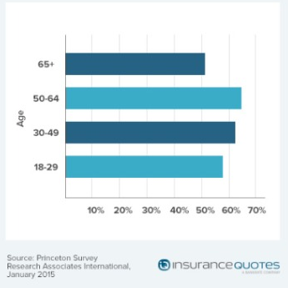
Percentages of Renters Who Don’t Have Renters Insurance, by Age Group

Slide 15
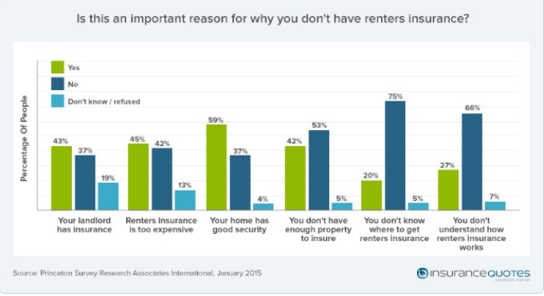
Why Renters Don’t Have Renters Insurance

Slide 16
Even Frequent & Severe Floods Haven’t Changed Flood Insurance Ownership Much
Q. Do you have a separate flood insurance policy?¹
After Hurricane Irene
After SuperStorm Sandy
Despite extensive flooding (and wide publicity), few U.S. homeowners say they have a flood insurance policy; moreover, there is no upward trend.
¹Asked of those who have homeowners insurance and who responded “yes”.
Source: Insurance Information Institute Annual Pulse Survey.

Slide 17
Financial Literacy and Psychological (or Mental) Accounts
Source: Barry Schwartz, The Paradox of Choice: Why More is Less (New York: Harper, 2004), pp. 66-67
17
Notes:
17

Slide 18
What is a “Psychological Account”?
An amount of money a person considers acceptable spending for a particular purpose
Classic example: you paid $100 for a ticket for a concert but when you arrive to see it the ticket is gone. Another ticket is available for another $100.
Do you spend another $100 or
Have you spent the money in “the concert account” and go home?
I argue that the reason why some people don’t buy certain insurance coverages is that they have a psychological or mental account that is too small
Source: Barry Schwartz, The Paradox of Choice: Why More is Less (New York: Harper, 2004), pp. 64-65

Slide 19
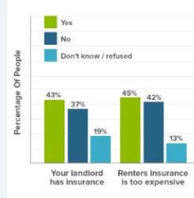
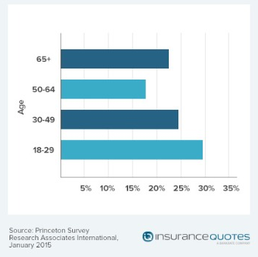
Renters Seem to Have A Psychological Account for Renters Insurance
45% of renters say renters insurance is too expensive
Percentages of Renters Who Thought An Annual Renters Insurance Policy Cost $1,000 or More

Slide 20
Inconsistent Financial Behavior
20
Notes:
20

Slide 21
A Risk Preference Test, Part 1
Imagine you have this choice:
You may choose a gamble that offers an 80 chance of winning $4,000 and a 20% chance of winning nothing, or
You get a guaranteed $3,000.
Which choice do you make?
4 out of 5 people chose the $3,000.
Source: David Rolpeik, How Risky Is It Really?: Why Our Fears Don’t Always Match the Facts (New York: McGraw-Hill, 2010), p. 40, citing Kahneman and Tversky.

Slide 22
A Risk Preference Test, Part 2
Now imagine you won $4,000 and you now have this choice:
You may choose a gamble that offers an 80 chance of losing the $4,000 and a 20% chance of keeping it, or
You pay $3,000 of your $4,000.
Which choice do you make?
92% of people chose the gamble.
Source: David Rolpeik, How Risky Is It Really?: Why Our Fears Don’t Always Match the Facts (New York: McGraw-Hill, 2010), p. 40, citing Kahneman and Tversky.

Slide 23
Risk Preference Test Observations
In the first test, involving only positive (or at worst non-negative) outcomes, most people are risk-averse. They choose the “sure thing.”
In part this is because the first dollars are more valuable to them than the higher amounts.
In the second test, involving only negative outcomes, most people are loss-averse. They choose the gamble, hoping the worse outcome doesn’t happen.
In part this is because the first dollars lost are more valuable to them than the higher amounts
Source: David Rolpeik, How Risky Is It Really?: Why Our Fears Don’t Always Match the Facts (New York: McGraw-Hill, 2010), p. 40, citing Kahneman and Tversky.

Slide 24
Anchoring
If we have no information about a number, we estimate by starting from a “reference number” or “anchor” and adjust from there.
The anchor can come from anywhere. An example: Two groups were asked, “What percent of countries in the U.N. are in Africa?” Before answering, each group spun a numbered wheel.
In one group, the wheel stopped at 65. The group then guessed 45% of countries in the U.N. are in Africa.
In the other group, the wheel stopped at 10. This group then guessed 25% of countries in the U.N. are in Africa
Source: David Rolpeik, How Risky Is It Really?: Why Our Fears Don’t Always Match the Facts (New York: McGraw-Hill, 2010), p. 45, citing Kahneman.

Slide 25
Are Renters Anchored to a High Number for Renters Insurance Premiums?
Percentages of Renters Who Thought An Annual Renters Insurance Policy Cost $1,000 or More
Is this the anchor?

Slide 26
Anchoring Observations
Anchoring seems to take place on an unconscious level
Your job, in helping your client, might be to
Try to detect any anchor and, if it is leading the client in an unsuitable direction, to
Try to suggest an alternate context or a new anchor.
For example, change the time frame.
Most people consider a 1-in-100-in-a-year chance event quite unlikely and many are unwilling to insure against it, even if it could cause a devastating loss.
However, the chance of it happening some time in a 30-year period is 1-in-4.
Source: David Rolpeik, How Risky Is It Really?: Why Our Fears Don’t Always Match the Facts (New York: McGraw-Hill, 2010), p. 40, citing Kahneman and Tversky.

Slide 27
Financial Numeracy and P/C Insurance
27
Notes:
27

Slide 28
A Financial Numeracy Test Question
Which is more likely?
1 in 100
1 in 1,000
1 in 10
20% of people who were asked this question got it wrong

Slide 29
Another Financial Numeracy Test Question
You buy a lottery ticket. In this lottery, 1 player in 1,000 wins.
If 1,000 people (that is, 999 others) buy that ticket, what percentage will win?
1%
10%
0.1%
80% of people who were asked this question got it wrong

Slide 30
Can/Should Financial Literacy Be Taught?
The State of Oklahoma is Trying
30
Notes:
30

Slide 31
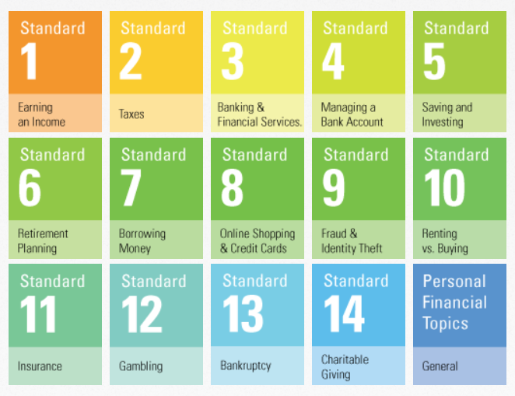
Oklahoma’s 14 Financial Literacy Standards Required for High School Graduation

Slide 32
What Oklahoma’s Insurance Literacy Standard Requires of High School Graduates

Slide 33
Does Education for Financial Literacy Work? Research Is Mixed
A January 2014 report by the World Bank reviewed 188 studies of financial literacy education.
Most showed some improvement in financial decision-making, but many studies were judged to be not rigorous.
Nearly 1 in 4 studies showed little or no benefit from the education
“Financial education will not lead to improved financial behavior, Dan Ariely* believes.”
“The real improvement will come from designing or enforcing mechanisms that make it easy for us to make the right decision, or prevent us from making big mistakes.”
*Dan Ariely, James B. Duke Professor, Duke University, is a leading thinker and writer in the field of behavioral economics Sources: The World Bank Development Research Group, “Can You Help Someone Become Financially Capable?” Policy Research Working Paper #6745; The Ariely quotes are from Allianz, Project M, #18, pp. 22-24; Insurance Information Institute

Slide 34
Insurance Literacy: A Proposed 3-Question Test
This test has never been administered to anyone but if it were it might provide a rough indicator of property/casualty insurance literacy.
34
Notes:
34

Slide 35
My First Insurance Literacy Question
If you had $500 deductible in your insurance policy and you had $2,000 of damage covered by the policy, how much would the insurance company pay?
$2,000
$1,500
$500
Don’t know
Refuse to answer

Slide 36
My Second Insurance Literacy Question
If your insurance policy had a policy limit of $50,000 and you had $80,000 of damage covered by the policy, how much would the insurance company pay?
$80,000
$50,000
$30,000
Don’t know
Refuse to answer

Slide 37
My Third Insurance Literacy Question
“Insurance policies usually cover several different types of losses in a single policy.” This statement is
True
False
Don’t know
Refuse to answer

Slide 38
In Conclusion
38
Notes:
38

Slide 39
Why the Issue of Financial Literacy Is Important for CPCUs
Increasingly severe weather, new exposures (e.g., cyber risk), etc. increases the likelihood that policyowners will have a significant loss that could be insured.
Research shows that financially literate people are more likely to act, while less-financially-literate people procrastinate and often don’t act
This might help explain why so few people have flood or earthquake insurance

Slide 40
We Could Be Blamed for the Consequences of Financial Illiteracy
People who don’t understand their policies—or the events they insure against—and who have a loss are likely to blame, or be antagonistic to, insurers and agents
Legislatures might create organizations like the federal Consumer Financial Protection Bureau to “protect” unsophisticated policyowners
Growing numbers of policyholders will be age 80 and over. Many will have cognitive limitations and might become financially illiterate even if they were previously financially literate. Agents and insurers will have to develop strategies for dealing with these people.

Slide 41
Implications of Financial Illiteracy for CPCUs
You should understand that many clients—even highly educated ones—have an inaccurate idea of the relevant frequency and severity of risks they face, and help them overcome
Anchoring
The Constraints of “Psychological accounts”
Ignorance of basic financial concepts,
Inconsistencies in financial choices, and
A tendency to inaction (because they aren’t sure what to do)

Slide 42
Implications of Financial Illiteracy for CPCUs
It seems likely that financially illiterate people are…
Less likely to buy and renew P/C insurance when they are not required to do so
Less likely to buy and renew P/C insurance even when they are required to do so
Low financial literacy might help to explain high percentages of drivers who don’t have auto insurance
Less likely to buy appropriate policy limits
Less likely to understand policy terms and features (e.g., hurricane deductibles)
More likely to focus on price (because they don’t understand other aspects of the P/C insurance relationship)

Slide 43
Insurance Information Institute Online:
www.iii.org
Thank you for your time and your attention!

Slide 44
A Simple Numeracy Test, Part 1
Imagine you are a physician working in an Asian village. 600 people have a life-threatening disease. Two alternative treatments exist.
If you choose treatment A, you will save exactly 200 people.
If you choose treatment B, there is a 1/3 chance of saving all 600 people but a 2/3 chance all 600 will die.
Which treatment do you choose?
Source: Barry Schwartz, The Paradox of Choice: Why More is Less (New York: Harper, 2004), pp. 64-65

Slide 45
A Simple Numeracy Test, Part 2
Imagine you are a physician working in an Asian village. 600 people have a life-threatening disease. Two alternative treatments exist.
If you choose treatment C, exactly 400 people will die.
If you choose treatment D, there is a 1/3 chance that no one will die but a 2/3 chance everyone will die.
Which treatment do you choose?
Source: Barry Schwartz, The Paradox of Choice: Why More is Less (New York: Harper, 2004), pp. 64-65

