Slide 1
What Really Keeps Insurance CEOs Awake at Night?
Trends, Challenges & Opportunities
Ole Miss Insurance Symposium
Oxford, MS
March 19, 2015
Download at www.iii.org/presentations
Robert P. Hartwig, Ph.D., CPCU, President & Economist
Insurance Information Institute ♦ 110 William Street ♦ New York, NY 10038
Tel: 212.346.5520 ♦ Cell: 917.453.1885 ♦ bobh@iii.org ♦ www.iii.org

Slide 2
PROFITABILITY
Consistent Profitability Is the Top Concern of All CEOs
2

Slide 3
P/C Industry Net Income After Taxes
1991–2014E
2005 ROE*= 9.6%
2006 ROE = 12.7%
2007 ROE = 10.9%
2008 ROE = 0.1%
2009 ROE = 5.0%
2010 ROE = 6.6%
2011 ROAS¹ = 3.5%
2012 ROAS¹ = 5.9%
2013 ROAS¹ = 10.3%
2014 ROAS¹ = 7.6%
Net income rose strongly (+81.9%) in 2013 vs. 2012 on lower cats, capital gains
$ Millions
ROE figures are GAAP; ¹Return on avg. surplus. Excluding Mortgage & Financial Guaranty insurers yields a 7.7% ROAS through 2014:Q2, 9.8% ROAS in 2013, 6.2% ROAS in 2012, 4.7% ROAS for 2011, 7.6% for 2010 and 7.4% for 2009.
Sources: A.M. Best, ISO; Insurance Information Institute

Slide 4
Life/Annuity Industry Profits, 2001-2013
Billions
The Life/Annuity industry has produced steady (if unspectacular) profits,
except for years in which the industry’s investment results produced significant realized capital losses.
Sources: NAIC, via SNL Financial; Insurance Information Institute.

Slide 5
U.S. Life/Annuity Insurance Industry
Profit Sources, by Percent, 2013
52.3%
10.3%
16.0%
Sources: NAIC Annual Statements, p. 6, from SNL Financial; I.I.I. calculations

Slide 6
Profitability Peaks & Troughs in the P/C Insurance Industry, 1975 – 2014:Q3*
ROE
1977:19.0%
History suggests next ROE peak will be in 2016-2017
1987:17.3%
10 Years
2006:12.7%
1997:11.6%
10 Years
2013 10.4%
9 Years
2014:Q3 7.6%
1975: 2.4%
1984: 1.8%
1992: 4.5%
2001: -1.2%
*Profitability = P/C insurer ROEs. 2011-14 figures are estimates based on ROAS data. Note: Data for 2008-2014 exclude mortgage and financial guaranty insurers.
Source: Insurance Information Institute; NAIC, ISO, A.M. Best.

Slide 7
Profitability Peaks & Troughs in the P/C Insurance Industry, 1975 – 2016F
ROE
1977:19.0%
History suggests next ROE peak will be in 2016-2017, but that seems unlikely
1987:17.3%
10 Years
2006:12.7%
1997:11.6%
10 Years
2013 10.4%
2015F=6.5%
2016F=6.3%
9 Years
2014E 7.6%
1975: 2.4%
1984: 1.8%
1992: 4.5%
2001: -1.2%
*Profitability = P/C insurer ROEs. 2011-14 figures are estimates based on ROAS data. Note: Data for 2008-2014 exclude mortgage and financial guaranty insurers.
Source: Insurance Information Institute; NAIC, ISO, A.M. Best, Conning

Slide 8
ROE: Property/Casualty Insurance by Major Event, 1987–2014E
(Percent)
P/C Profitability Is Both by
Cyclicality and Ordinary Volatility
Modestly higher CATs
Katrina, Rita, Wilma
Low CATs
Sept. 11
Hugo
Lowest CAT Losses in
15 Years
4 Hurricanes
Sandy
Andrew
Record Tornado Losses
Northridge
Financial Crisis*
* Excludes Mortgage & Financial Guarantee in 2008 – 2014. 2014 figure is through Q3:2014.
Sources: ISO, Fortune; Insurance Information Institute.

Slide 9
Back to the Future: Profitability Peaks & Troughs in the P/C Insurance Industry, 1950 – 2014*
ROE
1970-90: Peak ROEs were much higher in this period while troughs were comparable. High interest rates, rapid inflation, economic volatility all played roles
1950-70: ROEs were lower in this period. Low interest rates, low inflation, “Bureau” rate regulation all played a role
1990-2010s: Déjà vu. Excluding mega-CATs, this period is very similar to the 1950-1970 period
1977:19.0%
1987:17.3%
2006:12.7%
1972:13.7%
1997:11.6%
2013 10.4%
1950:8.0%
1966-67: 5.5%
1959:6.8%
2014:H1 7.6%
1969: 3.9%
1957: 1.8%
1965: 2.2%
1975: 2.4%
1984: 1.8%
1992: 4.5%
2001: -1.2%
*Profitability = P/C insurer ROEs. 2011-14 figures are estimates based on ROAS data. Note: Data for 2008-2014 exclude mortgage and financial guaranty insurers. 2014 figure is through Q3.
Source: Insurance Information Institute; NAIC, ISO, A.M. Best.

Slide 10
Return on Net Worth (RNW) All Lines:
2004-2013 Average
Commercial lines have tended to be more profitable than personal lines over the past decade
Source: NAIC; Insurance Information Institute.

Slide 11
RNW All Lines by State, 2004-2013 Average:
Highest 25 States
The most profitable states over the past decade are widely distributed geographically, though none are in the Gulf region
Profitability Benchmark: All P/C
US: 7.9%
Source: NAIC; Insurance Information Institute.

Slide 12
RNW All Lines by State, 2004-2013 Average:
Lowest 25 States
Some of the least profitable states over the past decade were hit hard by catastrophes
Source: NAIC; Insurance Information Institute.

Slide 13
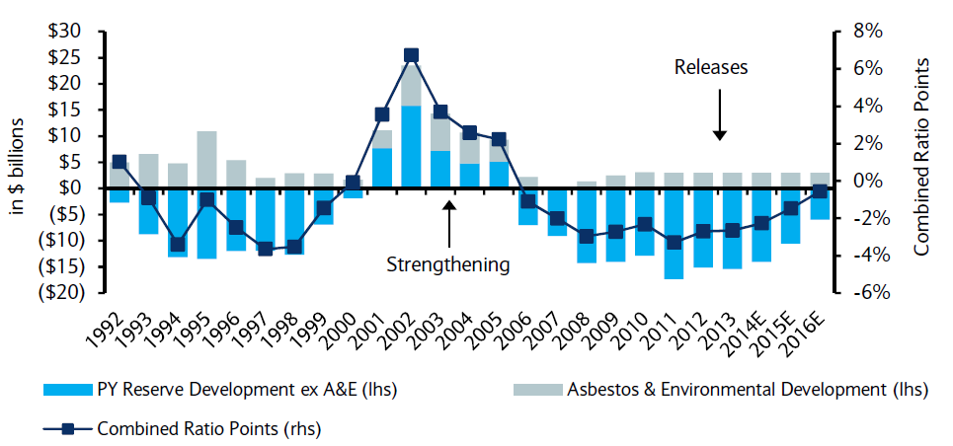
P/C Insurance Loss Reserve Development, 1992 – 2016E*
Reserve releases are expected to gradually taper off, but will continue to benefit the bottom line and combined ratio through at least 2016
Reserve Change
Source: A.M. Best; Barclays research for estimates.

Slide 14
Profitability in Mississippi’s P/C Insurance Markets
Analysis by Line and Nearby State Comparisons
14

Slide 15
RNW All Lines: MS vs. U.S., 2004-2013
(Percent)
P/C Insurer profitability in MS is below that of the US overall over the past decade
US: 7.9%
MS: -6.9%
Katrina
Sources: NAIC.
15
Notes:
15

Slide 16
RNW PP Auto: MS vs. U.S., 2004-2013
Average 2004-2013
US: 7.1%
MS: 4.5%
Katrina
Sources: NAIC.
16
Notes:
16

Slide 17
RNW Comm. Auto: MS vs. U.S.,
2004-2013
(Percent)
Commercial Auto profitability in MS is generally below the US average
Average 2004-2013
US: 9.2%
MS: 5.7%
Sources: NAIC.
17
Notes:
17

Slide 18
RNW Comm. Multi-Peril: MS vs. U.S.,
2004-2013
(Percent)
Average 2004-2013
US: 8.9%
MS: -6.4%
Katrina
Sources: NAIC.
18
Notes:
18

Slide 19
RNW Homeowners: MS vs. U.S.,
2004-2013
(Percent)
Average 2004-2013
US: 6.6%
MS: -25.8%
Katrina
Sources: NAIC.
19
Notes:
19

Slide 20
RNW Workers Comp: MS vs. U.S.,
2004-2013
(Percent)
Average 2004-2013
US: 7.1%
MS: 7.3%
Sources: NAIC.
20
Notes:
20

Slide 21
All Lines: 10-Year Average RNW MS & Nearby States
2004-2013
Mississippi All Lines profitability is below the US and the regional average
Source: NAIC, Insurance Information Institute

Slide 22
PP Auto: 10-Year Average RNW MS & Nearby States
2004-2013
Mississippi PP Auto profitability is below the US and regional average
Source: NAIC, Insurance Information Institute

Slide 23
Top Ten Most Expensive And Least Expensive States For Automobile Insurance, 2012 (1)
Rank | Most expensive states | Average expenditure | Rank | Least expensive states | Average expenditure
1 | New Jersey | $1,219.93 | 1 | Idaho | $534.56
2 | D.C. | 1,154.91 | 2 | South Dakota | 556.51
3 | New York | 1,152.45 | 3 | Iowa | 561.26
4 | Florida | 1,127.93 | 4 | North Dakota | 576.08
5 | Louisiana | 1,112.53 | 5 | Maine | 582.43
6 | Delaware | 1,065.37 | 6 | Wisconsin | 598.84
7 | Michigan | 1,048.87 | 7 | North Carolina | 611.48
8 | Rhode Island | 1,034.50 | 8 | Nebraska | 616.78
9 | Connecticut | 986.73 | 9 | Wyoming | 618.81
10 | Massachusetts | 976.65 | 10 | Kansas | 632.07
Mississippi ranked 23rd as the most expensive state in 2012, with an average expenditure for auto insurance of $748.44.
Based on average automobile insurance expenditures.
Source: © 2014 National Association of Insurance Commissioners.

Slide 24
Comm. Auto: 10-Year Average RNW
MS & Nearby States
2004-2013
Mississippi Commercial Auto profitability is below the US and above the regional average
Source: NAIC, Insurance Information Institute

Slide 25
Comm. M-P: 10-Year Average RNW
MS & Nearby States
2004-2013
Mississippi Commercial Multi-Peril profitability is below the US average and below the regional average
Source: NAIC, Insurance Information Institute

Slide 26
Homeowners: 10-Year Average RNW
MS & Nearby States
2004-2013
Mississippi Homeowners profitability is below the US average and below the regional average
Source: NAIC, Insurance Information Institute

Slide 27
Top Ten Most Expensive And Least Expensive States For Homeowners Insurance, 2012 (1)
Mississippi ranked as the 5th most expensive state for homeowners insurance in 2012, with an average expenditure of $1,314.
Rank | Most expensive states | HO average premium | Rank | Least expensive states | HO average premium
1 | Florida | $2,084 | 1 | Idaho | $538
2 | Louisiana | 1,742 | 2 | Oregon | 567
3 | Texas | 1,661 | 3 | Utah | 580
4 | Oklahoma | 1,501 | 4 | Wisconsin | 631
5 | Mississippi | 1,314 | 5 | Washington | 648
6 | Alabama | 1,248 | 6 | Nevada | 674
7 | Rhode Island | 1,233 | 7 | Delaware | 678
8 | Kansas | 1,213 | 8 | Arizona | 691
9 | Connecticut | 1,160 | 9 | Ohio | 721
10 | New York | 1,158 | 10 | Maine | 741
Includes policies written by Citizens Property Insurance Corp. (Florida) and Citizens Property Insurance Corp. (Louisiana), Alabama Insurance Underwriting Association, Mississippi Windstorm Underwriting Association, North Carolina Joint Underwriting Association and South Carolina Wind and Hail Underwriting Association. Other southeastern states have wind pools in operation and their data may not be included in this chart. Based on the HO-3 homeowner package policy for owner-occupied dwellings, 1 to 4 family units. Provides “all risks” coverage (except those specifically excluded in the policy) on buildings and broad named-peril coverage on personal property, and is the most common package written.
The Texas Department of Insurance developed home insurance policy forms that are similar but not identical to the standard forms. In addition, due to the Texas Windstorm Association (which writes wind-only policies) classifying HO-1, 2 and 5 premiums as HO-3, the average premium for homeowners insurance is artificially high.
Note: Average premium=Premiums/exposure per house years. A house year is equal to 365 days of insured coverage for a single dwelling. The NAIC does not rank state average expenditures and does not endorse any conclusions drawn from this data.
Source: ©2014 National Association of Insurance Commissioners (NAIC). Reprinted with permission. Further reprint or distribution strictly prohibited without written permission of NAIC.

Slide 28
Workers Comp: 10-Year Average RNW
MS & Nearby States
2004-2013
Mississippi Workers Comp profitability is above the US average and below the regional average
Source: NAIC, Insurance Information Institute

Slide 29
GROWTH
Growth (Preferably Profitable) Is a Top Priority of Most CEOs
Growth in Many Insurance Lines Is Volatile and Cyclical
29

Slide 30
Net Premium Growth: Annual Change,
1971—2016F
(Percent)
1975-78
1984-87
2000-03
Net Written Premiums Fell 0.7% in 2007 (First Decline Since 1943) by 2.0% in 2008, and 4.2% in 2009, the First 3-Year Decline Since 1930-33.
2015-16F: 4.0%
2014E: 3.9%*
2013: 4.6%
2012: +4.3%
*Actual figure based on data through Q3 2014.
Shaded areas denote “hard market” periods
Sources: A.M. Best (historical and forecast), ISO, Insurance Information Institute.

Slide 31
NPW Premium Growth: Peaks & Troughs in the P/C Insurance Industry, 1926 – 2014E
ROE
Post WW II Peak:
1947: 26.2%
1970-90: Peak premium growth was much higher in this period while troughs were comparable. Rapid inflation, economic volatility, high interest rates, tort environment all played roles
Start of WW II
1941: 15.8%
Economic Shocks, Inflation:
1976: 22.0%
Tort Crisis
1985/86: 22.2%
Post-9/11
2002:15.3%
1988-2000: Period of inter-cycle stability
2014E 4.0%
1950-70: Extended period of stability in growth and profitability. Low interest rates, low inflation, “Bureau” rate regulation all played a role
2010-20XX? Post-recession period of stable growth?
Twin Recessions; Interest Rate Hikes
1987: 3.7%
Great Recession:2010: -4.9%
Great Depression
1932: -15.9% max drop
Note: Data through 1934 are based on stock companies only. Data include state funds beginning in 1998.
Source: A.M. Best; Insurance Information Institute.

Slide 32
Commercial Lines NPW Premium Growth:
1975 – 2014E
ROE
Commercial lines is prone to more cyclical volatility that personal lines. Recently, growth has stabilized in the 4% to 5% range.
Economic Shocks, Inflation:
1976: 22.2%
Tort Crisis
1986: 30.5%
Post-9/11
2002: 22.4%
Post-Hurricane Andrew Bump:
1993: 6.3%
1988-2000: Period of inter-cycle stability
Post Katrina Bump:
2006: 7.7%
2014E 4.0%
2010-20XX? Post-recession period of stable growth?
Recessions:
1982: 1.1%
Great Recession:2009: -9.0%
Note: Data include state funds beginning in 1998.
Source: A.M. Best; Insurance Information Institute.

Slide 33
All Lines DWP Growth: MS vs. U.S., 2004-2013
(Percent)
Average 2004-2013
US: 2.2%
MS: 3.0%
Source: SNL Financial.
33
Notes:
33

Slide 34
Personal Lines DWP Growth:
MS vs. U.S., 2004-2013
(Percent)
Average 2004-2013
US: 2.6%
MS: 3.5%
Source: SNL Financial.
34
Notes:
34

Slide 35
Comm. Lines DWP Growth:
MS vs. U.S., 2004-2013
(Percent)
Average 2004-2013
US: 2.0%
MS: 2.7%
Source: SNL Financial.
35
Notes:
35

Slide 36
Private Passenger Auto DWP Growth:
MS vs. U.S., 2004-2013
(Percent)
Average 2004-2013
US: 1.5%
MS: 2.1%
Source: SNL Financial.
36
Notes:
36

Slide 37
Homeowner’s MP DWP Growth: MS vs. U.S., 2004-2013
(Percent)
Average 2004-2013
US: 5.4%
MS: 6.5%
Source: SNL Financial.
37
Notes:
37

Slide 38
Direct Premiums Written: Total P/C
Percent Change by State, 2007-2013
Top 25 States
North Dakota was the country’s growth leader over the past 6 years with premiums written expanding by 74.6%, fueled by the state’s energy boom
Growth Benchmarks: Total P/C
US: 7.9%
Sources: SNL Financial LC.; Insurance Information Institute.

Slide 39
Direct Premiums Written: Total P/C
Percent Change by State, 2007-2013
Bottom 25 States
Growth was negative in 7 states and DC between 2007 and 2013
Sources: SNL Financial LC.; Insurance Information Institute.

Slide 40

Direct Premiums Written: PP Auto
Percent Change by State, 2007-2013
Top 25 States
Growth Benchmarks: PPA
US: 10.9%
Sources: SNL Financial LC.; Insurance Information Institute.

Slide 41
Direct Premiums Written: PP Auto
Percent Change by State, 2007-2013
Bottom 25 States
Pvt. Passenger Auto premium growth was negative in 5 states between 2007 and 2013
Sources: SNL Financial LC.; Insurance Information Institute.

Slide 42
Direct Premiums Written: Homeowners
Percent Change by State, 2007-2013
Top 25 States
Growth Benchmarks: HO
US: 26.8%
Sources: SNL Financial LLC.; Insurance Information Institute.

Slide 43
Direct Premiums Written: Homeowners
Percent Change by State, 2007-2013
Bottom 25 States
The collapse of the housing bubble hit CA, FL and NV hard, leading to the slowest growth rates in the US between 2007 and 2013
Sources: SNL Financial LLC.; Insurance Information Institute.

Slide 44
Direct Premiums Written: Comm. Lines
Percent Change by State, 2007-2013
Top 25 States
Only 30 states showed any commercial lines growth from 2007 through 2013
Growth Benchmarks: Commercial
US: 1.3%
Sources: SNL Financial LLC.; Insurance Information Institute.

Slide 45
Direct Premiums Written: Comm. Lines
Percent Change by State, 2007-2013
Bottom 25 States
Nearly half the states have yet to see commercial lines premium volume return to pre-crisis levels
States with the poorest performing economies also produced the most negative net change in premiums of the past 6 years
Sources: SNL Financial LLC.; Insurance Information Institute.

Slide 46
Direct Premiums Written: Workers’ Comp
Percent Change by State, 2007-2013*
Top 25 States
Only 13 states have seen works comp premium volume return to pre-crisis levels
*Excludes monopolistic fund states: ND, OH, WA, WY as well as WV, which transitioned to a competitive structure during this period.
Sources: SNL Financial LC.; Insurance Information Institute.

Slide 47
Direct Premiums Written: Worker’s Comp
Percent Change by State, 2007-2013*
Bottom 25 States
States with the poorest performing economies also produced some of the most negative net change in premiums of the past 6 years
*Excludes monopolistic fund states: ND, OH, WA, WY as well as WV, which transitioned to a competitive structure during this period.
Sources: SNL Financial LC.; Insurance Information Institute.

Slide 48
Going Global
Insurance Industry Growth Is Fastest Outside the U.S. and Other Mature Markets
48

Slide 49
Distribution of Global Insurance Premiums, 2013 ($ Trillions)
Total Premium Volume = $4.641 Trillion*
Life insurance accounted for 56.2% of global premium volume in 2013 vs. 43.8% for Non-Life
Source: Swiss Re, sigma, No. 3/2014; Insurance Information Institute.

Slide 50
Distribution of Nonlife Premium: Industrialized vs. Emerging Markets, 2013
Emerging market’s share of nonlife premiums increased to 19.5% in 2013, up from 17.3% in 2012 and 14.3% in 2009. The share of premiums written in the $2 trillion global nonlife market remains much larger (80.5%) but continues to shrink.
The financial crisis and sluggish recovery in the major insurance markets will accelerate the expansion of the emerging market sector
Premium Growth Facts
2013, $Billions
Industrialized Economies
$1, 653.0
Emerging Markets
$399.8
Developing markets now account for about 40% of global GDP but just under 20% of nonlife premiums
Sources: Swiss Re sigma No.4/2013; Insurance Information Institute research.

Slide 51
GDP Growth: Advanced & Emerging Economies vs. World, 1970-2015F
Emerging economy growth rates are expected to ease to 4.4% in 2014 and 5.0% in 2015
GDP Growth (%)
World output is forecast to grow by 3.3% in 2014 and 3.8% in 2015. The world economy shrank by 0.6% in 2009 amid the global financial crisis
Advanced economies are expected to grow at a modest pace of 1.8% in 2014 and to 2.3% in 2015.
Source: International Monetary Fund, World Economic Outlook , October 2014; Insurance Information Institute.

Slide 52
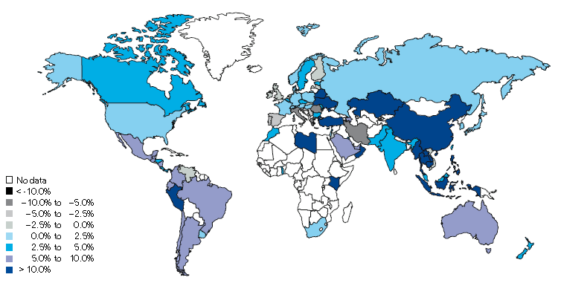
Non-Life Insurance: Global Real (Inflation Adjusted) Premium Growth, 2013
Real growth in non-life insurance premiums was faster in China and most of SE Asia than the US
Market | Life | Non-Life | Total
Advanced | -0.2 | 1.1 | 0.3
Emerging | 6.4 | 8.3 | 7.4
World | 0.7 | 2.3 | 1.4
Source: Swiss Re, sigma, No. 3/2014.
52
12/01/09 - 9pm
eSlide – P6466 – The Financial Crisis and the Future of the P/C
Notes:
52

Slide 53
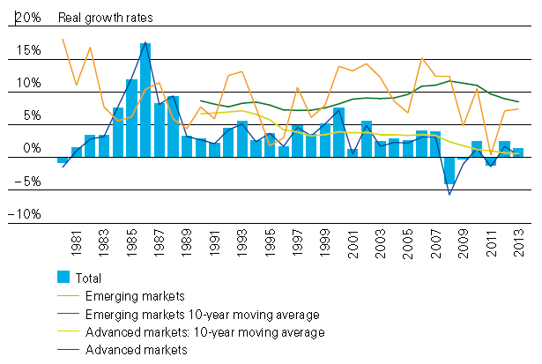
Global Real (Inflation Adjusted)
Premium Growth: 1980-2013
Premium growth is very erratic in part to inflation volatility in emerging markets as well as a lack of consistent cyclicality
Emerging market growth has exceeded that of industrialized countries in 30 of the past 34 years, including the entirety of the global financial crisis and subsequent recovery
Source: Swiss Re, sigma, No. 3/2014.
53
12/01/09 - 9pm
eSlide – P6466 – The Financial Crisis and the Future of the P/C
Notes:
53

Slide 54
COMPETITION & DISTRIBUTION
Insurance Is a Fiercely Competitive Business and Seems Likely Only to Intensify
Distribution Trends Continue to Evolve Rapidly
54

Slide 55
Advertising Expenditures by P/C Insurance Industry, 1999-2013
$ Billions
P/C ad spend hit an all time record high of $6.175 billion in 2013, up 1.5% over 2012. The pace of growth has slowed from 15.8% in 2011 and 23.8% in 2010
P/C ad spending has more than tripled since 2002 (up 256% from 2002-2013)
Source: Insurance Information Institute from consolidated P/C Annual Statement data, Insurance Expense Exhibit (Part I).

Slide 56
Growth in Premiums, Capacity vs. Growth in Advertising Expenditures, 2000 – 2013
Growth in the “Supply” of insurance has exceeded “Demand” → Efforts to sell have intensified
Average Annual Percent Change (%)
Overall Growth in Ad Spending has greatly exceeded growth in capacity (policyholder surplus) or premium growth. This suggests that there are diminishing returns to advertising.
Sources: Insurance Information Institute analysis from A.M. Best data.
56
12/01/09 - 9pm
eSlide – P6466 – The Financial Crisis and the Future of the P/C
Notes:
56

Slide 57
All P/C Lines Distribution Channels, Direct vs. Independent Agents
Independent agents steadily lost market share from the early 1980s through the early 2000s across all P/C lines with some further erosion in the 2010s. Direct channels include exclusive agency companies, direct marketers and direct sales (e.g., internet)
Source: Insurance Information Institute; based on data from Conning and A.M. Best.

Slide 58
Personal Lines Distribution Channels, Direct vs. Independent Agents
Independent agents have lost significant personal lines market share since the early 1970s. Although the trend has slowed, it may be accelerating again.
Source: Insurance Information Institute; based on data from Conning and A.M. Best.

Slide 59
Commercial P/C Distribution Channels, Direct vs. Independent Agents
Independent agents have seen only modest erosion in commercial lines market share in recent decades
Source: Insurance Information Institute; based on data from Conning and A.M. Best.

Slide 60
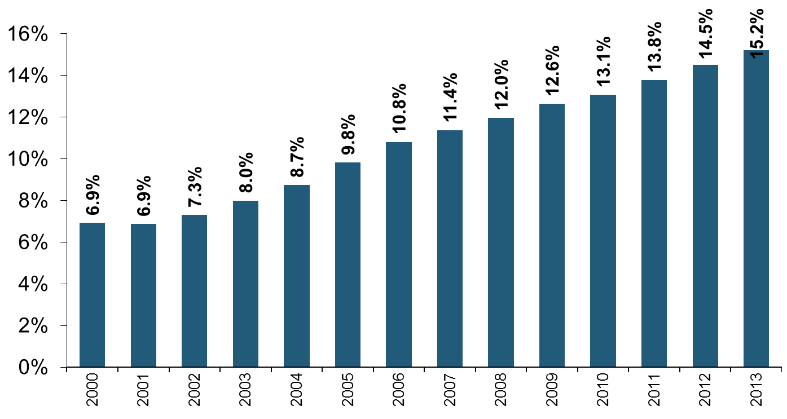
Growth in Select Major Pvt. Passenger Auto Direct Writers’ Market Share*
(% of Total PPA Market)
Direct Writers’ Market Share Has More Than Doubled Since 2000.
*Includes GEICO, Progressive Direct, Esurance and 21st Century.
Sources: SNL Financial; Insurance Information Institute.
60
12/01/09 - 9pm
eSlide – P6466 – The Financial Crisis and the Future of the P/C
Notes:
60

Slide 61
Direct Premiums Written for Select Major Pvt. Passenger Auto Direct Writers’
($ Billions)
Direct Writers Have More Than Tripled Their Premiums Written Since 2000.
*Includes GEICO, Progressive Direct, Esurance and 21st Century.
Sources: SNL Financial; Insurance Information Institute.
61
12/01/09 - 9pm
eSlide – P6466 – The Financial Crisis and the Future of the P/C
Notes:
61

Slide 62
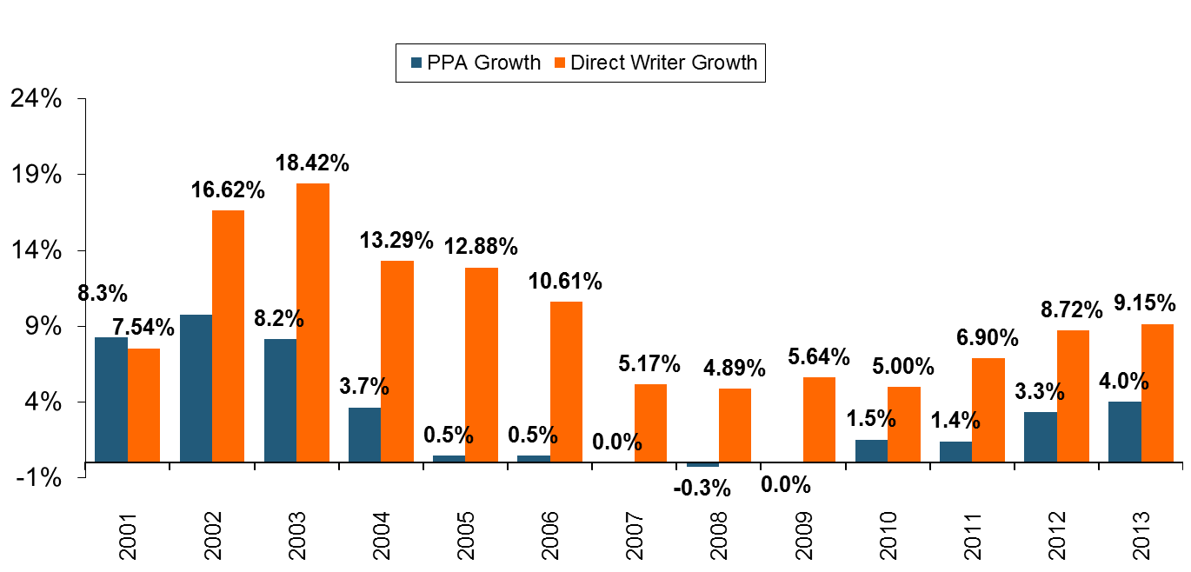
Growth Rates: Major PPA Direct Writers vs. All Private Passenger Auto Writers
(% Growth Vs. Prior Year)
Growth Has Picked Up With the Economic Recovery.
Direct Writers Have Grown Faster Than The Private Passenger Market for Twelve Consecutive Years.
*Includes GEICO, Progressive Direct, Esurance and 21st Century.
Sources: SNL Financial; Insurance Information Institute.

Slide 63
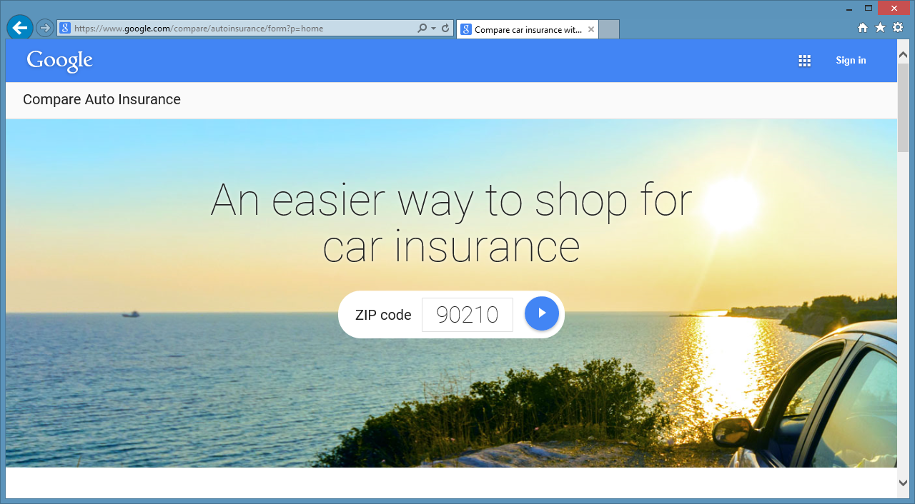
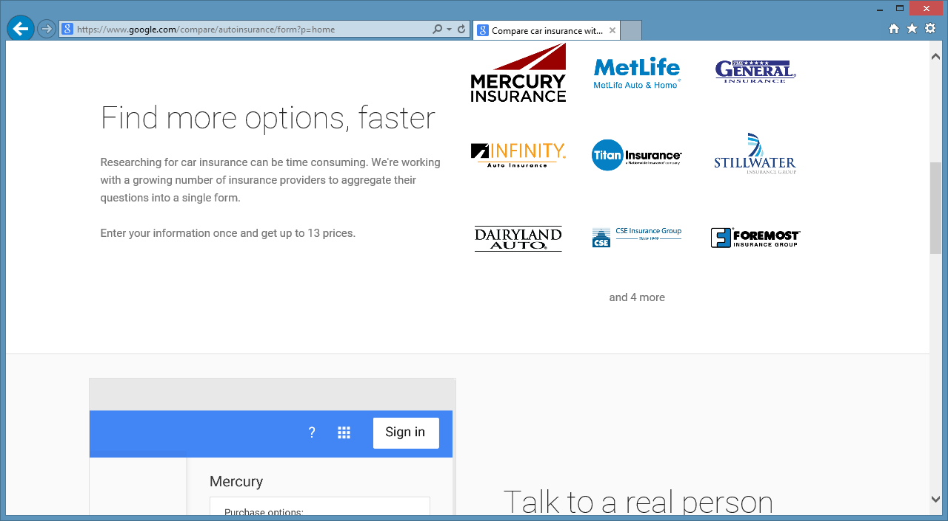
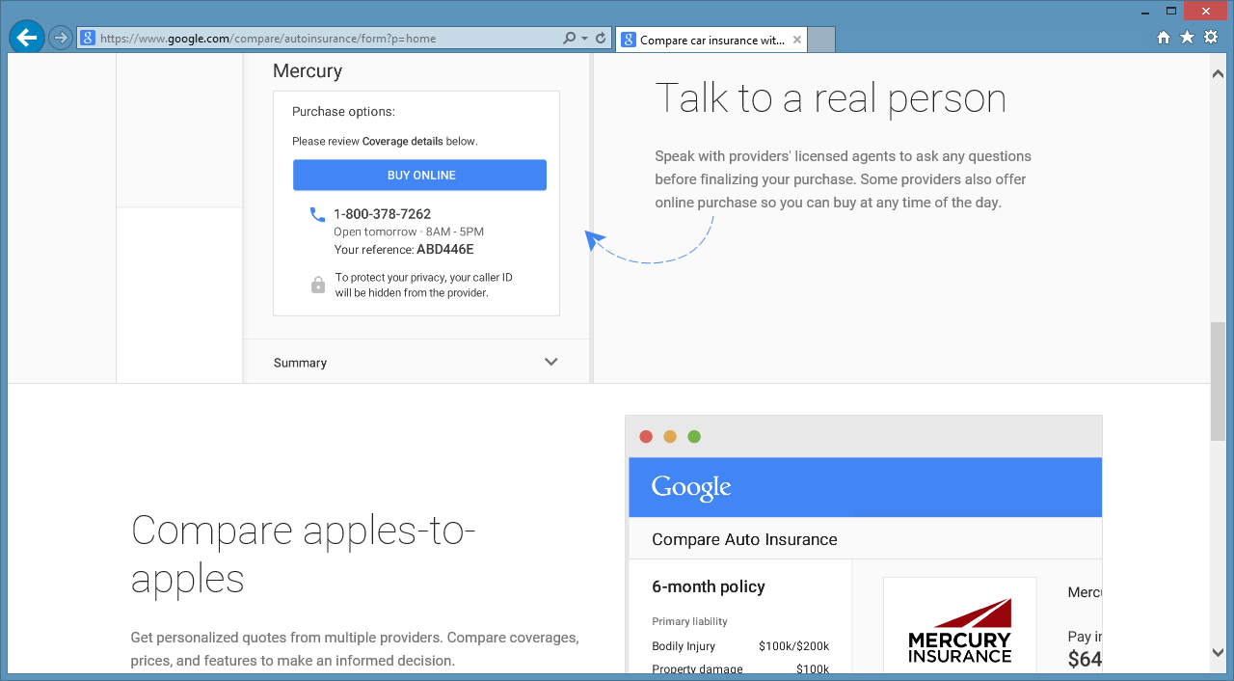
: Should Insurers Be Concerned?
Google Compare launched in California on March 5 and sent ripples through PPA market

Slide 64
INDUSTRY DISRUPTORS
Technology, Society and the Economy Are All Changing at a Rapid Pace
Thoughts on the Future
64

Slide 65
Percentage of Carriers Using Predictive Analytics by Major P/C Line, 2013
Predictive analytics is more like to be used in personal lines, but commercial lines use is growing
82% of insurers report using predicative analytics in at least one line. 18% do not use it all.
Benefits Cited
Drive Profitability: 85%
Reduce Risk: 55%
Grow Revenue: 52%
Improve Op. Efficiency: 39%
Source: ISO/Earnix Survey, September 2013; Insurance Information Institute.

Slide 66
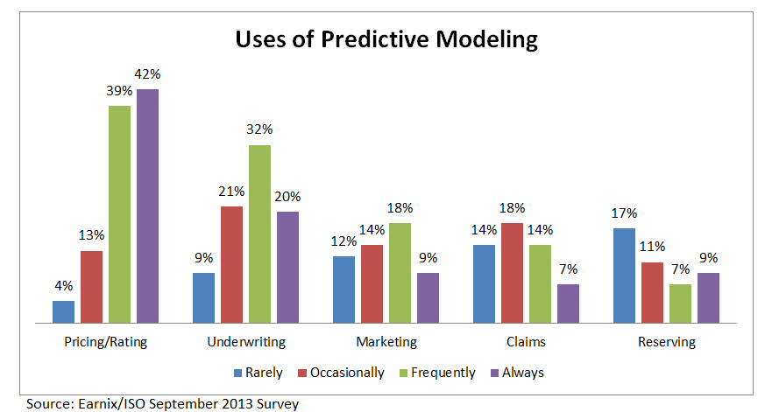
Uses of Predictive Analytics by Function
Pricing and Underwriting are the leading uses for predictive analytics

Slide 67
Usage-Based Insurance (UBI): Telematics
UBI Is Catching On Among Insurers and Consumers, But Is It a Transient Technology?
67

Slide 68
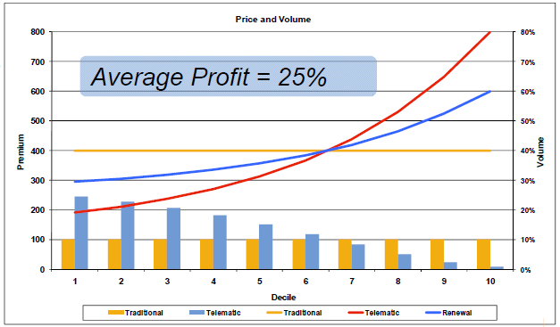
Driving Behavior Data Is Very Predictive
Provides significant lift above current rating plan
  Early programs had discounts of up to 61% and surcharges of 9%, but most companies are not giving such significant rate variation
  Difference between indication and selection can help fund technology while still providing marketing effect
  Must be matched with policy and claims data to develop predictive models and define lift
Smart implementation helps justify the technology cost
Source: Towers Perrin.

Slide 69
I.I.I. Poll: Telematics
Q. Would you be more likely to install a recording device on your car that allows your insurance company to monitor how many miles you drive, the time of day you drive and how often you make sudden stops if you could get an immediate discount on your auto insurance?¹
Support for telematics device is highest among youngest age group and declines among older people.
¹Asked of those who have auto insurance.
Source: Insurance Information Institute Annual Pulse Survey.

Slide 70

Autonomous/Driverless Vehicles
Rapid Technological Innovations in Motor Vehicle Engineering Are Likely to Transform Auto Insurance and Product Liability Markets
70

Slide 71
Likely Impacts of Successful, Incremental Autonomous Vehicle Technologies
Proven Collision Avoidance Technologies Will Likely Become Standard as Major Manufacturers, Google Set 2020-2025 Timeframes for Fully Autonomous
Auto Accident Frequency Will Fall, Possibly Substantially as Share of Cars with New Technology Grows (~20-yrs.)
  Collision, BI, PIP claims should fall
  Less litigation (due to fewer claims and “black box” technologies)
Historical Analogies to Aviation and Marine Insurance
  Both saw technology radically reduce claim frequency
Potential “Leapfrog” Technology Over Usage-Based Insurance (UBI) Technologies Currently Available
Insurance Price Will Be a Major Factor in Adoption Rate
  90% would consider an autonomous car if premium is 80% lower*
*CarInsurance.com survey http://www.carinsurance.com/Articles/autonomous-cars-ready.aspx, Nov. 2013.

Slide 72
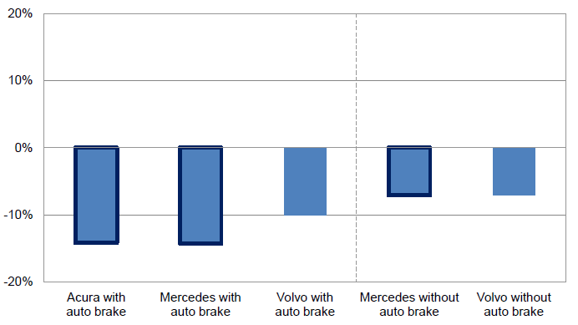
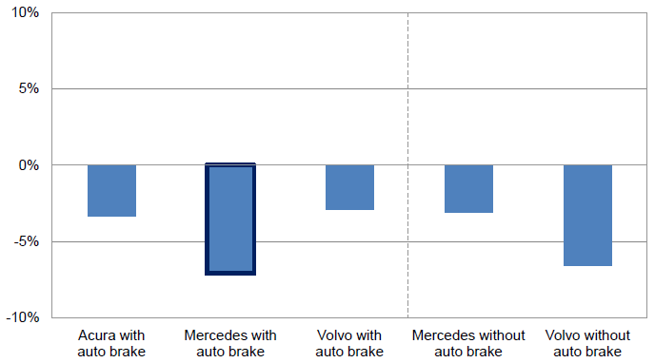
Impact of Forward Collision Warning With and Without Auto Brake
Forward collision warning systems have a material impact on PD liability claim frequency, especially when paired with auto braking
Property Damage Liability Claim Frequency by Manufacturer
Collision Claim Frequency by Manufacturer
Collision frequency falls as well
Source: Highway Loss Data Institute and Insurance Institute for Highway Safety presentation by Matthew Moore, Measuring Crash Avoidance System Effectiveness with Insurance Data,” January 30, 2013; Insurance Information Institute.
72

Slide 73
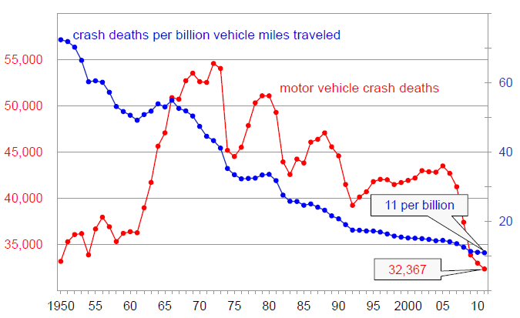
Enhanced Vehicle and Road Safety Have Made Driving Much Safer
Motor Vehicle Crash Deaths and Crash Death Rate, 1950-2012
Crash deaths are down 40% since the early 1970s
Fatal crash rates have fallen by 85% over the past 60 years. They could fall 80% form current levels over the next 20-30 years
Source: National Highway Transportation Safety Administration as cited in Insurance Institute for Highway Safety presentation by Adrian Lund, Ph.D., Drivers and Driver Assistance Systems: How Well Do They Match?’, June 18, 2013; Insurance Information Institute.
73

Slide 74


Additional Disruptors
“Peak Auto”
  Peak vehicle ownership per person/household likely already reached
  Less interest in auto ownership among youth
  Preference of youth to live in urban areas, use public transit
The “Sharing Economy”: Vehicles & Homes On Demand
  Vehicles on Demand: Fewer vehicles likely need in the future as the technologies of driverless vehicles and ride sharing (e.g., Uber, Lyft)
  Dwellings on Demand: Airbnb

Slide 75
Additional Disruptors (continued)
Disintermediation
  For commodity products, the power resides with whoever has contact with the customer
  Fear that tech firms such as Google or Apple or a major retailer such as Walmart or Amazon could disintermediate agency forces (or insurers themselves if regulatory environment were to permit)
Big Data
  Ushering a new era of advanced/predictive analytics which will presumably improve underwriting a pricing
  Could drive down pricing but also open up new risks to underwrite

Slide 76
Additional Disruptors (continued)
The Digital Economy
  Increasing share of GDP is intangible
  Insuring of “bits and bytes” and associated liability risks is in its infancy compared to “brinks and mortar” products
Reduced Relevancy of Insurance
  Many consumers, given the option, will forego the purchase of insurance (p/c and life/retirement)
  Mispreception of risk, cost, product complexity, moral hazard due to government subsidies, etc., are all factors
  Consumer perceptions need to adjusted

Slide 77
Net Written Premium/GDP
Peaked with 1986 Hard Market
(NWP/Nominal GDP)
Short-Term, Underwriting Cycle Drives NWP/GDP, but structural changes in the economy reduce penetration rate over the long run
Last Hard Market
1999-00 Soft Market
Financial Crisis
Sources: Insurance Information Institute calculation using data from A.M. Best, Bureau of Economic Analysis.

Slide 78
UNDERWRITING PERFORMANCE
Underwriting Performance is More Important than Ever in a Low Interest Rate Environment
78
Notes:
78

Slide 79
P/C Insurance Industry
Combined Ratio, 2001–2014:Q3*
Relatively Low CAT Losses, Reserve Releases
Higher CAT Losses, Shrinking Reserve Releases, Toll of Soft Market
As Recently as 2001, Insurers Paid Out Nearly $1.16 for Every $1 in Earned Premiums
Heavy Use of Reinsurance Lowered Net Losses
Relatively Low CAT Losses, Reserve Releases
Avg. CAT Losses, More Reserve Releases
Sandy Impacts
Best Combined Ratio Since 1949 (87.6)
Cyclical Deterioration
Lower CAT Losses
* Excludes Mortgage & Financial Guaranty insurers 2008--2014. Including M&FG, 2008=105.1, 2009=100.7, 2010=102.4, 2011=108.1; 2012:=103.2; 2013: = 96.1; 2014:9M = 97.7.
Sources: A.M. Best, ISO.

Slide 80
A 100 Combined Ratio Isn’t What It
Once Was: Investment Impact on ROEs
A combined ratio of about 100 generates an ROE of ~7.0% in 2012/13, ~7.5% ROE in 2009/10,
10% in 2005 and 16% in 1979
Combined Ratio / ROE
Lower CATs helped ROEs in 2013
Combined Ratios Must Be Lower in Today’s Depressed
Investment Environment to Generate Risk Appropriate ROEs
* 2008 -2014 figures are return on average surplus and exclude mortgage and financial guaranty insurers. 2014:9M combined ratio including M&FG insurers is 97.7; 2013 = 96.1; 2012 =103.2, 2011 = 108.1, ROAS = 3.5%.
Source: Insurance Information Institute from A.M. Best and ISO Verisk Analytics data.

Slide 81
Private Passenger Auto Combined Ratio: 1993–2016F
Private Passenger Auto Accounts for 37% of Industry Premiums and Remains the Profit Juggernaut of the P/C Insurance Industry
Sources: A.M. Best (1990-2013); Insurance Information Institute (2014F – 2015F).

Slide 82
Homeowners Insurance Combined Ratio: 1990–2015F
Hurricane Andrew
Record tornado activity
Hurricane Sandy
Hurricane Ike
Homeowners Performance in 2011/12 Impacted by Large Cat Losses. Extreme Regional Variation Can Be Expected Due to Local Catastrophe Loss Activity
Sources: A.M. Best (1990-2014F);Conning (2015F); Insurance Information Institute.

Slide 83
Commercial Lines Combined Ratio, 1990-2015F*
Commercial lines underwriting performance is expected to improve as improvement in pricing environment persists
*2007-2012 figures exclude mortgage and financial guaranty segments.
Source: A.M. Best (1990-2014F); Conning (2015F) Insurance Information Institute.

Slide 84
Commercial Auto Combined Ratio: 1993–2015F
Commercial Auto is Expected to Improve Only Slowly as Rate Gains Barely Offset Adverse Frequency and Severity Trends
Sources: A.M. Best (1990-2014E);Conning (2015F); Insurance Information Institute.

Slide 85
Commercial Property Combined Ratio:
2007–2016F
Commercial Property Underwriting Performance Has Been Volatile in Recent Years, Largely Due to Fluctuations in CAT Activity
Source: Conning Research and Consulting.

Slide 86
General Liability Combined Ratio:
2005–2015F
Commercial General Liability Underwriting Performance Has Been Volatile in Recent Years
Source: Conning Research and Consulting.

Slide 87
Workers Compensation Combined Ratio: 1994–2014E
WC results have improved markedly since 2011
Workers Comp Results Began to Improve in 2012. Underwriting Results Deteriorated Markedly from 2007-2010/11 and Were the Worst They Had Been in a Decade.
Sources: A.M. Best (1994-2009); NCCI (2010-2014F) and are for private carriers only; Insurance Information Institute.

Slide 88
U.S. Health Care Expenditures,
1965–2022F
$ Billions
From 1965 through 2013, US health care expenditures had increased by 69 fold. Population growth over the same period increased by a factor of just 1.6. By 2022, health spending will have increased 119 fold.
U.S. health care expenditures have been on a relentless climb for most of the past half century, far outstripping population growth, inflation of GDP growth
Sources: Centers for Medicare & Medicaid Services, Office of the Actuary at http://www.cms.gov/Research-Statistics-Data-and-Systems/Statistics-Trends-and-Reports/NationalHealthExpendData/NationalHealthAccountsProjected.html accessed 3/14/14; Insurance Information Institute.

Slide 89
National Health Care Expenditures as a Share of GDP, 1965 – 2022F*
% of GDP
Health care expenditures as a share of GDP rose from 5.8% in 1965 to 18.0% in 2013 and are expected to reach 19.9% of GDP by 2022
2022 19.9%
2010: 17.9%
2000: 13.8%
1990: 12.5%
Since 2009, heath expenditures as a % of GDP have flattened out at about 18%--the question is why and will it last?
1980: 9.2%
1965 5.8%
Sources: Centers for Medicare & Medicaid Services, Office of the Actuary at http://www.cms.gov/Research-Statistics-Data-and-Systems/Statistics-Trends-and-Reports/NationalHealthExpendData/NationalHealthAccountsProjected.html accessed 3/14/14; Insurance Information Institute.

Slide 90
Commercial Multi-Peril Combined Ratio: 1995–2015F
Commercial Multi-Peril Underwriting Performance is Expected to Improve in 2013 Assuming Normal Catastrophe Loss Activity
*2014E-2015F figures are Conning figures for the combined liability and non-liability components..
Sources: A.M. Best; Conning; Insurance Information Institute.

Slide 91
Inland Marine Combined Ratio:
2004–2015F
Inland Marine Underwriting Performance Has Been Consistently Strong for Many Years
Source: A.M. Best (2004-2014E); Conning Research and Consulting (2015F).

Slide 92
INVESTMENTS:
THE NEW REALITY
Investment Performance is a Key Driver of Profitability
Depressed Yields Will Necessarily Influence Underwriting & Pricing
92

Slide 93
Property/Casualty Insurance Industry Investment Income: 2000–2014¹
Investment earnings are still below their 2007 pre-crisis peak
($ Billions)
Due to persistently low interest rates,
investment income fell in 2012, 2013 and 2014.
¹ Investment gains consist primarily of interest and stock dividends. *2014 figure is estimated based on annualized data through Q3.
Sources: ISO; Insurance Information Institute.

Slide 94
Distribution of Invested Assets: P/C Insurance Industry, 2013
$ Billions
Total Invested Assets = $1.5 Trillion
Source: Insurance Information Institute Fact Book 2015, A.M. Best.

Slide 95
U.S. Treasury Security Yields:
A Long Downward Trend, 1990–2015*
Yields on 10-Year U.S. Treasury Notes have been essentially below 5% for a full decade.
U.S. Treasury yields plunged to historic lows in 2013. Longer-term yields rebounded then sank fell again.
Since roughly 80% of P/C bond/cash investments are in 10-year or shorter durations, most P/C insurer portfolios will have low-yielding bonds for years to come.
*Monthly, constant maturity, nominal rates, through Feb. 2015.
Sources: Federal Reserve Bank at http://www.federalreserve.gov/releases/h15/data.htm. National Bureau of Economic Research (recession dates); Insurance Information Institute.
95
12/01/09 - 9pm
eSlide – P6466 – The Financial Crisis and the Future of the P/C
Notes:
95

Slide 96
Book Yield on Property/Casualty Insurance Invested Assets, 2007–2016F
(Percent)
Book yield in 2014 is down 114 BP from pre-crisis levels
The yield on invested assets continues to decline as returns on maturing bonds generally still exceed new money yields. The end of the Fed’s QE program in Oct. 2014 should allow some increase in longer maturities while short term interest rate increases are unlikely until mid-to-late 2015
Sources: Conning.

Slide 97
Interest Rate Forecasts: 2015 – 2020
Yield (%)
3-Month Treasury
10-Year Treasury
The Fed is expected to begin raising short-term rates in mid-2015, but this timeline could easily slip to late 2015 or even 2016
The end of the Fed’s QE program in 2014 and a stronger economy have yet to push longer-term yields higher
A Full Normalization of Interest Rates Is Unlikely Until 2018, More than a Decade After the Onset of the Financial Crisis
Sources: Federal Reserve Board of Governors (historical); Blue Chip Economic Indicators (2/15 for 2015 and 2016; for 2017-2020 10/14 issue); Insurance Info. Institute.

Slide 98
Annual Inflation Rates, (CPI-U, %),
1990–2016F
Annual Inflation Rates (%)
Inflation peaked at 5.6% in August 2008 on high energy and commodity crisis. The recession and the collapse of the commodity bubble reduced inflationary pressures in 2009/10
Inflationary expectations have slipped (due in part to falling energy costs) allowing the Fed to maintain low interest rates
Slack in the U.S. economy and falling energy prices suggests that inflationary pressures should remain subdued for an extended period of times
Sources: US Bureau of Labor Statistics; Blue Chip Economic Indicators, 2/15 (forecasts).

Slide 99
Reduction in Combined Ratio Necessary to Offset 1% Decline in Investment Yield to Maintain Constant ROE, by Line*
Lower Investment Earnings Place a Greater Burden on Underwriting and Pricing Discipline
*Based on 2008 Invested Assets and Earned Premiums
**US domestic reinsurance only
Source: A.M. Best; Insurance Information Institute.
99
12/01/09 - 9pm
eSlide – P6466 – The Financial Crisis and the Future of the P/C
Notes:
99
This shows the drop in Combined Ratio for each line of business that would be needed to maintain a constant ROE, given a 1-percentage-point drop in investment yield

Slide 100
P/C Insurer Net Realized
Capital Gains/Losses, 1990-2014:Q3
Realized capital gains rose sharply as equity markets rallied in 2013-14
($ Billions)
Insurers Posted Net Realized Capital Gains in 2010 - 2014 Following Two Years of Realized Losses During the Financial Crisis. Realized Capital Losses Were a Primary Cause of 2008/2009’s Large Drop in Profits and ROE
Sources: A.M. Best, ISO, Insurance Information Institute.
100
12/01/09 - 9pm
eSlide – P6466 – The Financial Crisis and the Future of the P/C
Notes:
100

Slide 101
Property/Casualty Insurance Industry Investment Gain: 1994–2014E¹
($ Billions)
Investment gains in 2014 will rival the post-crisis high reached in 2013
Total Investment Gains Were Flat in 2014 as Low Interest Rates Pressured Investment Income but Realized Capital Gains Remained Robust
¹ Investment gains consist primarily of interest, stock dividends and realized capital gains and losses.
* 2005 figure includes special one-time dividend of $3.2B;
Sources: ISO; Insurance Information Institute.

Slide 102
S&P 500 Index Returns, 1950 – 2015*
Annual Return
Volatility is endemic to stock markets—and may be increasing—but there is no persistent downward trend over long periods of time
Fed Raises Rate
2014:
13.5%
Tech Bubble Implosion
Energy Crisis
Financial Crisis
*Through March 3, 2015.
Source: NYU Stern School of Business: http://pages.stern.nyu.edu/~adamodar/New_Home_Page/datafile/histretSP.html Ins. Info. Inst.

Slide 103
Distribution of Bond Maturities,
P/C Insurance Industry, 2003-2013
The main shift over these years has been from bonds with longer maturities to bonds with shorter maturities. The industry first trimmed its holdings of over-10-year bonds (from 24.6% in 2003 to 15.5% in 2012) and then trimmed bonds in the 5-10-year category (from 31.3% in 2003 to 27.6% in 2012) . Falling average maturity of the P/C industry’s bond portfolio is contributing to a drop in investment income along with lower yields.
Sources: SNL Financial; Insurance Information Institute.

Slide 104
PRICING TRENDS
Pricing Needs to Keep Up with Underlying Frequency and Severity Trends and Offset Declining Investment Income
104

Slide 105
Monthly Change in Auto Insurance Prices, 1991–2015*
Cyclical peaks in PP Auto tend to occur roughly every 10 years (early 1990s, early 2000s and likely the early 2010s)
Pricing peak occurred in late 2010 at 5.3%, falling to 2.8% by Mar. 2012
“Hard” markets tend to occur during recessionary periods
The Jan. 2015 reading of 5.0% is up from 3.4%
a year earlier
*Percentage change from same month in prior year; through January 2015; seasonally adjusted
Note: Recessions indicated by gray shaded columns.
Sources: US Bureau of Labor Statistics; National Bureau of Economic Research (recession dates); Insurance Information Institutes.
105
12/01/09 - 9pm
eSlide – P6466 – The Financial Crisis and the Future of the P/C
Notes:
105

Slide 106
Average Expenditures on Auto Insurance
The average expenditure on auto insurance remained below 2004 until 2013
Countrywide Auto Insurance Expenditures decreased by 6.5% from 2004 through 2009, rising gradually since the with annual increases in the 2.0% to 2.5% range
* Insurance Information Institute Estimates/Forecasts
Source: NAIC, Insurance Information Institute estimate for 2013-2015 based on CPI and other data.

Slide 107
Average Commercial Rate Change,
All Lines, (1Q:2004–4Q:2014)
(Percent)
Q2 2011 marked the last of 30th consecutive quarter of price declines
Pricing as of Q4:2014 had turned (slightly) negative for only the 2nd time in 3 years
KRW Effect
Note: CIAB data cited here are based on a survey. Rate changes earned by individual insurers can and do vary, potentially substantially.
Source: Council of Insurance Agents & Brokers; Insurance Information Institute

Slide 108
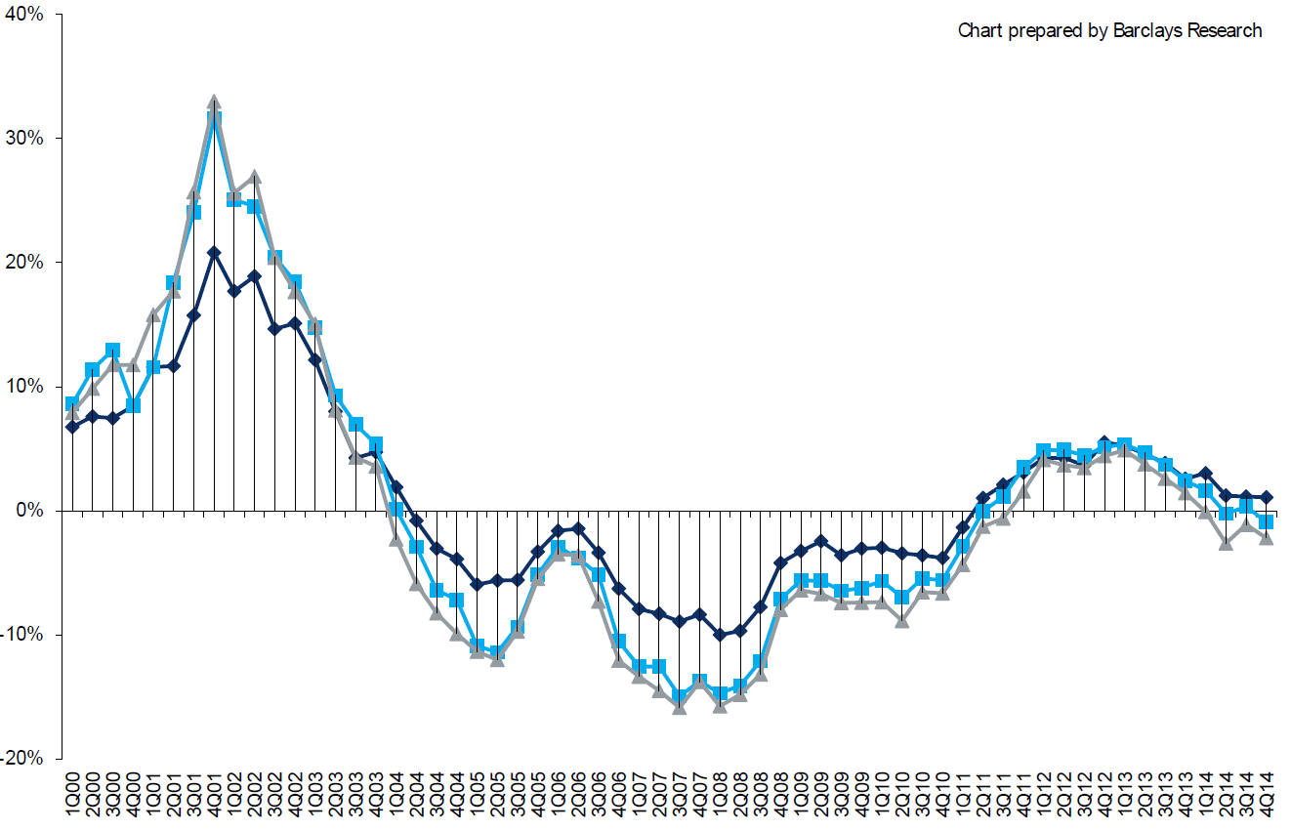
Change in Commercial Rate Renewals, by Account Size: 1999:Q4 to 2014:Q4
Percentage Change (%)
Peak = 2001:Q4 +28.5%
Pricing turned positive in Q3:2011, the first increase in nearly 8 years; Q1:2014 renewals were up 1.5%; Some insurers posted stronger numbers.
Pricing Turned Negative in Early 2004 and Remained that way for 7 ½ years
KRW : No Lasting Impact
Trough = 2007:Q3 -13.6%
Source: Council of Insurance Agents and Brokers; Barclay’s Capital; Insurance Information Institute.
Note: CIAB data cited here are based on a survey. Rate changes earned by individual insurers can and do vary, potentially substantially.

Slide 109
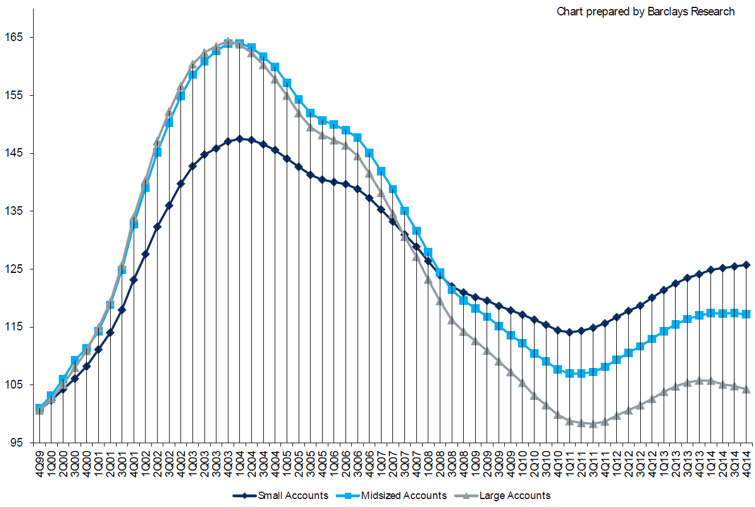
Cumulative Qtrly. Commercial Rate Changes, by Account Size: 1999:Q4 to 2014:Q4
1999:Q4 = 100
Despite several years of gains, pricing today for midsized accounts is where is was in late 2001 (around 9/11), suggesting additional rate need going forward, esp. in light of record low interest rates
Note: CIAB data cited here are based on a survey. Rate changes earned by individual insurers can and do vary, potentially substantially.
Source: Council of Insurance Agents and Brokers; Barclay’s Capital; Insurance Information Institute.

Slide 110
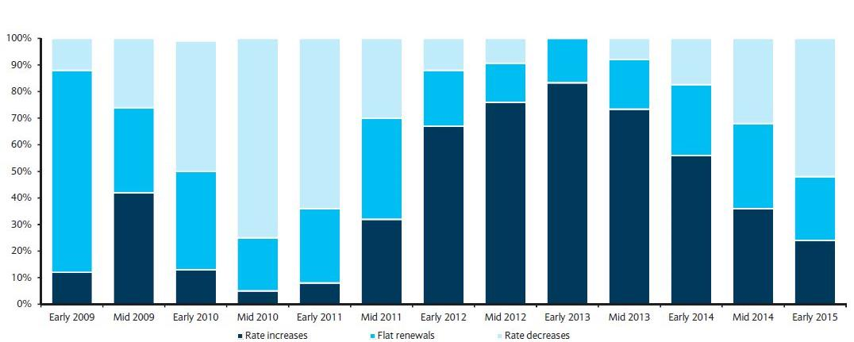
Directional Pricing Trend in Large Account P/C Renewals
Early 2009 through Early 2015
Few accounts are seeing increases
Source: Barclays’ Commercial Insurance Buyers Survey.

Slide 111
Change in Commercial Rate Renewals, by Line: 2014:Q4
Commercial Auto rate increases are large than any other line, followed by Employment Practices
Percentage Change (%)
Major Commercial Lines Renewals Were Mixed to Flat in Q4:2014; Commercial Auto and EPL Led the Way
Note: CIAB data cited here are based on a survey. Rate changes earned by individual insurers can and do vary, potentially substantially.
Source: Council of Insurance Agents and Brokers; Insurance Information Institute.

Slide 112
CATASTROPHE LOSSES
2014 Experiencing Below Average CAT Activity Following a Welcome Respite in 2013 from Very High CAT Losses in 2011/12
112

Slide 113
U.S. Insured Catastrophe Losses
($ Billions, $ 2013)
2012 was the 3rd most expensive year ever for insured CAT losses
2013 Was a Welcome Respite from 2012, the 3rd Costliest Year for Insured Disaster Losses in US History. Longer-term Trend is for more—not fewer—Costly Events
$15.3 billion in insured CAT losses estimated for 2014
*Through 12/31/14.
Note: 2001 figure includes $20.3B for 9/11 losses reported through 12/31/01 ($25.9B 2011 dollars). Includes only business and personal property claims, business interruption and auto claims. Non-prop/BI losses = $12.2B ($15.6B in 2011 dollars.)
Sources: Property Claims Service/ISO; Insurance Information Institute.
113
12/01/09 - 9pm
eSlide – P6466 – The Financial Crisis and the Future of the P/C
Notes:
113

Slide 114
Combined Ratio Points Associated with Catastrophe Losses: 1960 – 2013*
Avg. CAT Loss Component of the Combined Ratio by Decade
1960s: 1.04 1970s: 0.85 1980s: 1.31 1990s: 3.39 2000s: 3.52 2010s: 6.1E*
Catastrophe losses as a share of all losses reached a record high in 2012
Combined Ratio Points
The Catastrophe Loss Component of Private Insurer Losses Has Increased Sharply in Recent Decades
*2010s represent 2010-2013.
Notes: Private carrier losses only. Excludes loss adjustment expenses and reinsurance reinstatement premiums. Figures are adjusted for losses ultimately paid by foreign insurers and reinsurers.
Source: ISO (1960-2011); A.M. Best (2012E) Insurance Information Institute.

Slide 115
Homeowners Insurance Combined Ratio: 1990–2015F
Hurricane Andrew
Record tornado activity
Hurricane Sandy
Hurricane Ike
Homeowners Performance in 2011/12 Impacted by Large Cat Losses but Lower CATs Helped 2013. Extreme Regional Variation Can Be Expected Due to Local Catastrophe Loss Activity
Sources: A.M. Best (1990-2013); Insurance Information Institute (2014E-2015F).

Slide 116
Top 8 States for Insured
Catastrophe Losses, 2013
$ Millions
Oklahoma led the US with nearly $2 billion in insured CAT losses in 2013
Source: The Property Claim Services (PCS) unit of ISO, a Verisk Analytics company.

Slide 117
Inflation Adjusted U.S. Catastrophe Losses by Cause of Loss, 1994–2013¹
Wind/Hail/Flood (3), $14.6
Fires (4), $5.5
Other (5), $0.2
Insured cat losses from 1993-2012 totaled $386.7B, an average of $19.3B per year or $1.6B per month
Geological Events, $18.4
Terrorism, $24.8
Winter Storms, $24.7
Hurricanes & Tropical Storms, $159.1
Tornado share of CAT losses is rising
Wind losses are by far cause the most catastrophe losses, even if hurricanes/TS are excluded.
Events Involving Tornadoes (2), $139.3
Catastrophes are defined as events causing direct insured losses to property of $25 million or more in 2013 dollars.
Excludes snow.
Does not include NFIP flood losses
Includes wildland fires
Includes civil disorders, water damage, utility disruptions and non-property losses such as those covered by workers compensation.
Source: ISO’s Property Claim Services Unit.

Slide 118
Top 16 Most Costly Disasters in U.S. History
(Insured Losses, 2013 Dollars, $ Billions)
Superstorm Sandy in 2012 was the last mega-CAT to hit the US
Includes Tuscaloosa, AL, tornado
Includes Joplin, MO, tornado
12 of the 16 Most Expensive Events in US History Have Occurred Over the Past Decade
Sources: PCS; Insurance Information Institute inflation adjustments to 2013 dollars using the CPI.

Slide 119
Federal Disaster Declarations Patterns: 1953-2014
Disaster Declarations Set New Records in Recent Years
119

Slide 120
Number of Federal Major Disaster Declarations, 1953-2014*
There have been 2,180 federal disaster declarations since 1953. The average number of declarations per year is 35 from 1953-2013, though there few haven’t been recorded since 1995.
The number of federal disaster declarations set a new record in 2011, with 99, shattering 2010’s record 81 declarations.
54 federal disasters were declared in 2014*
The Number of Federal Disaster Declarations Is Rising and Set New Records in 2010 and 2011 Before Dropping in 2012-2014
*Through December 31, 2014.
Source: Federal Emergency Management Administration; http://www.fema.gov/disasters; Insurance Information Institute.

Slide 121
Federal Disasters Declarations by State,
1953 – 2014: Highest 25 States*
Over the past 60 years, MIssissippi has had the 13th highest number of Federal Disaster Declarations
*Through December 31, 2014. Includes Puerto Rico and the District of Columbia.
Source: FEMA: http://www.fema.gov/news/disaster_totals_annual.fema; Insurance Information Institute.

Slide 122
Federal Disasters Declarations by State,
1953 – 2014: Lowest 25 States*
Over the past 60 years, Wyoming and Rhode Island had the fewest number of Federal Disaster Declarations
*Through December 31, 2014. Includes Puerto Rico and the District of Columbia.
Source: FEMA: http://www.fema.gov/news/disaster_totals_annual.fema; Insurance Information Institute.

Slide 123
Natural Hazard Risk Scores, 2014
Highest 25 States*
Florida received the highest Natural Hazard Risk Score
Note: Score is based on data on 9 natural hazards: flood, wildfire, tornado, storm surge, earthquake, straight-line wind, hurricane, wind, hail and sinkhole.
*Analysis Includes DC. Excludes Alaska and Hawaii due to limited natural hazard risk data.
Sources: CoreLogic release “CoreLogic Identifies US States at Highest Risk of Property Damage Loss from Natural Hazards,” Sept. 10, 2014; Insurance Information Institute.

Slide 124
Natural Hazard Risk Scores, 2014
Bottom 24 States*
Michigan and West Virginia received the lowest Natural Hazard Risk Score
Note: Score is based on data on 9 natural hazards: flood, wildfire, tornado, storm surge, earthquake, straight-line wind, hurricane, wind, hail and sinkhole.
*Analysis Includes DC. Excludes Alaska and Hawaii due to limited natural hazard risk data.
Sources: CoreLogic release “CoreLogic Identifies US States at Highest Risk of Property Damage Loss from Natural Hazards,” Sept. 10, 2014; Insurance Information Institute.

Slide 125
CYBER RISK & CYBER INSURANCE
Cyber Risk is a Rapidly Emerging Exposure for Businesses Large and Small in Every Industry
Rapidly Increasing Interest from Businesses, Media & Public Policymakers
125

Slide 126







Data Breaches 2005-2014, by Number of Breaches and Records Exposed
# Data Breaches/Millions of Records Exposed
Millions
The Total Number of Data Breaches Rose 28% While the Number of Records Exposed Was Relatively Flat (-2.6%)
126
* 2014 figures as of Jan. 12, 2014 from the ITRC.
Source: Identity Theft Resource Center.

Slide 127
Worldwide Cybersecurity Spending, 2011- 2016F
($ Billions)
Cybersecurity spending increased by an estimated $5.2B in 2014, $5.8B in 2015 and $6.3B in 2016
Cybersecurity Spending Is Rising Sharply, Up by About 8%+ Annually through 2016—a Projected Increase of $12.1 Billion from 2014 to 2016
127
Source: Gartner Group; Insurance Information Institute; Adapted from Wall Street Journal: “Financial Firms Boost Cybersecurity Funds,” Nov. 17, 2014.

Slide 128
Data/Privacy Breach:
Many Potential Costs Can Be Insured
Data Breach Event
Costs of notifying affecting individuals
Defense and settlement costs
Lost customers and damaged reputation
Cyber extortion payments
Costs of notifying regulatory authorities
Regulatory fines at home & abroad
Business Income Loss
Forensic costs to discover cause
Source: Zurich Insurance; Insurance Information Institute
128

Slide 129
The Three Basic Elements of Cyber Coverage: Prevention, Transfer, Response
Loss Prevention
Post-Breach Response
(Insurable)
Loss Transfer (Insurance)
Cyber risk management today involves three essential components, each designed to reduce, mitigate or avoid loss. An increasing number of cyber risk products offered by insurers today provide all three.
Source: Insurance Information Institute research.
129

Slide 130
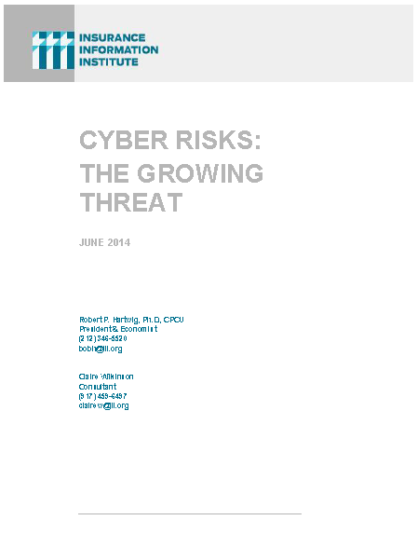
I.I.I. Released its Second Cyber Report in 2014: Cyber Risk: The Growing Threat
I.I.I.’s 2nd report on cyber risk released June 2014
Provides information on cyber threats and insurance market solutions
Global cyber risk overview
  Quantification of threats by type and industry
Cyber security and cost of attacks
Cyber terrorism
Cyber liability
Insurance market for cyber risk
3rd Report in Q2 2015

Slide 131
CAPITAL/CAPACITY
Capital Accumulation Has Multiple Impacts
131

Slide 132
Policyholder Surplus,
2006:Q4–2014:Q3
Drop due to near-record 2011 CAT losses
($ Billions)
2007:Q3
Pre-Crisis Peak
Surplus as of 9/30/14 stood at a record high $673.9B
The industry now has $1 of surplus for every $0.73 of NPW,
close to the strongest claims-paying status in its history.
2010:Q1 data includes $22.5B of paid-in capital from a holding company parent for one insurer’s investment in a non-insurance business .
The P/C insurance industry entered 2015
in very strong financial condition.
Sources: ISO, A.M .Best.
132
12/01/09 - 9pm
eSlide – P6466 – The Financial Crisis and the Future of the P/C
Notes:
132

Slide 133
US Policyholder Surplus:
1975–2014*
($ Billions)
Surplus as of 9/30/14 was a record $673.9, up 3.2% from $653.3 of 12/31/13, and up 53.6% ($234.5B) from the crisis trough of $437.1B at 3/31/09
“Surplus” is a measure of underwriting capacity. It is analogous to “Owners Equity” or “Net Worth” in non-insurance organizations
The Premium-to-Surplus Ratio Stood at $0.73:$1 as of
9/30/14, a Near Record Low (at Least in Recent History)
* As of 9/30/14.
Source: A.M. Best, ISO, Insurance Information Institute.

Slide 134
Premium-to-Surplus Ratio:
1985–2014*
(Ratio of NWP to PHS)
The larger surplus is in relation to premiums—the lower the P:S ratio—and the great the industry’s capacity to handle the risk it has accepted
Surplus as of 9/30/14 was $0.75:$1, a near-record low (at least in modern history)
9/11, Recession & Hard Market
The Premium-to-Surplus Ratio Stood at $0.75:$1 as of
9/30/14, a Record Low (at Least in Recent History)
* As of 9/30/14.
Source: A.M. Best, ISO, Insurance Information Institute.

Slide 135
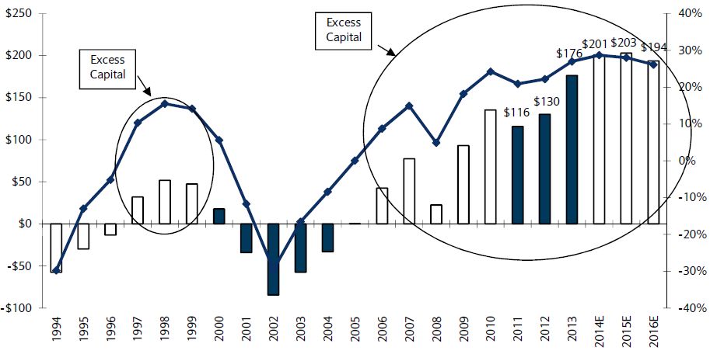
US P/C Insurance Industry Excess Capital Position: 1994–2016E
Barclay’s suggests that surplus is approximately $200B (~30%)
Surplus Redundancy (Deficiency)
Percent Redundancy (Deficiency)
The Industry’s Strong Capital Position Suggests Insurers Are in a Good Position to Increase Risk Appetite, Repurchase Shares and Pursue Acquisitions
Source: Barclays Research estimates.

Slide 136
P/C Industry: Loss Reserve-to-Surplus Ratio, 1971-2014:Q3
Inflation, Liability Crisis Increased Reserves, Plunging Stock Prices Depleted Surplus
The Property/Casualty Industry Adjusted Its Risk Portfolio in Response to Risk-Based Capital Requirements Implemented in 1994.
Source: Calculations from A.M. Best data by Insurance Information Institute.

Slide 137
Alternative Capital
New Investors Continue to Change the Reinsurance Landscape
First I.I.I. White Paper on Issue Will Be Released March 2015
137

Slide 138
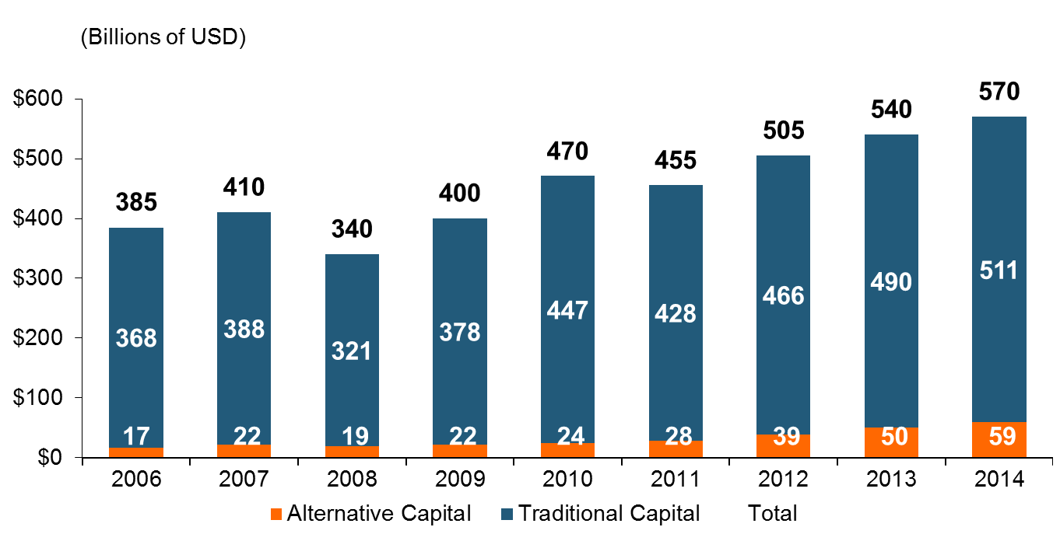
Global Reinsurance Capital (Traditional and Alternative), 2006 - 2014
Total reinsurance capital reached a record $570B in 2013, up 68% from 2008.
But alternative capacity has grown 210% since 2008, to $50B. It has more than doubled in the past three years.
2014 data is as of June 30, 2014.
Source: Aon Benfield Analytics; Insurance Information Institute.

Slide 139
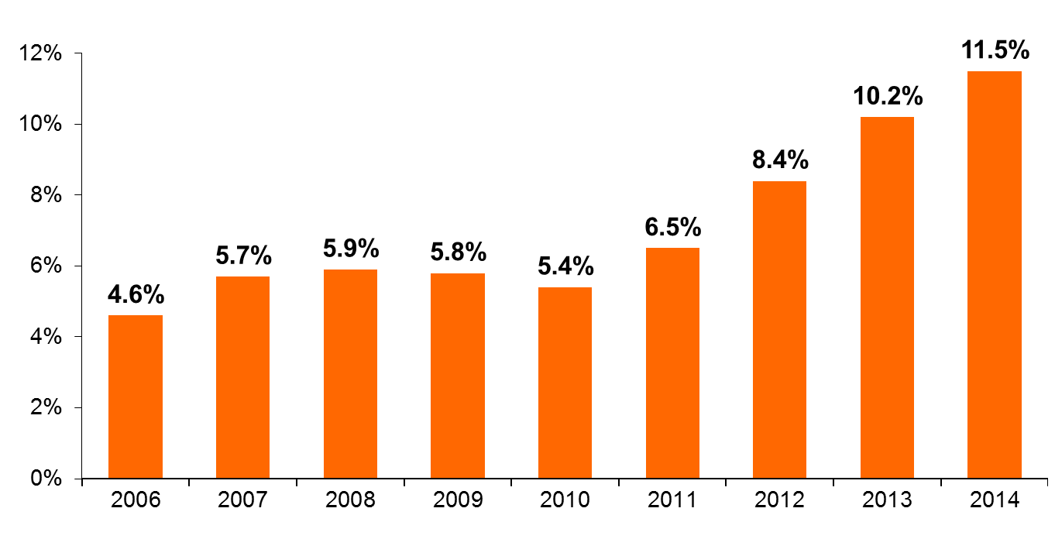
Alternative Capital as a Percentage of Traditional Global Reinsurance Capital
Alternative Capital’s Share of Global Reinsurance Capital Has More Than Doubled Since 2010.
2014 data is as of June 30, 2014.
Source: Aon Benfield Analytics; Insurance Information Institute.

Slide 140
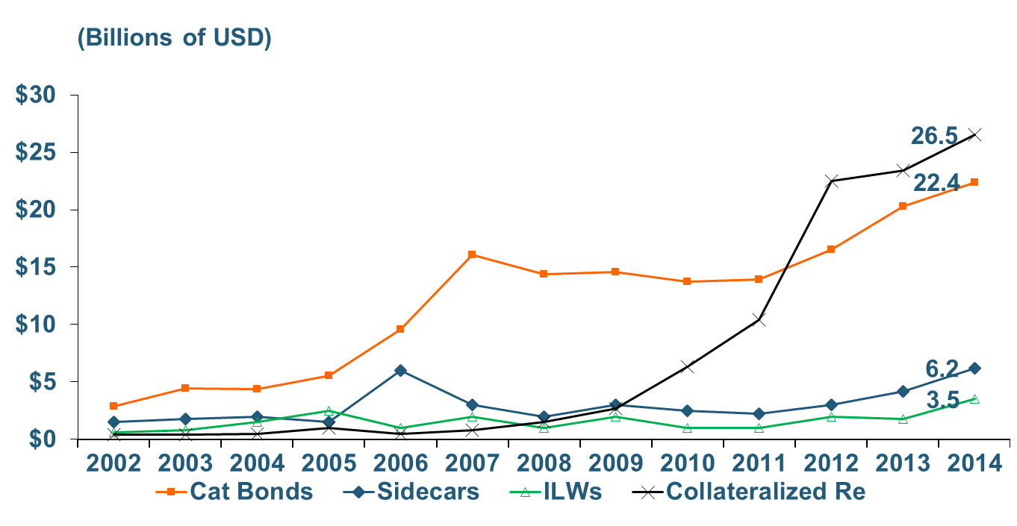
Growth of Alternative Capital Structures, 2002 - 2014
Collateralized Re’s Growth Has Accelerated in the Past Three Years.
Collateralized Reinsurance and Catastrophe Bonds Currently Dominate the Alternative Capital Market.
2014 data is as of June 30, 2014.
Source: Aon Benfield Analytics; Insurance Information Institute.

Slide 141
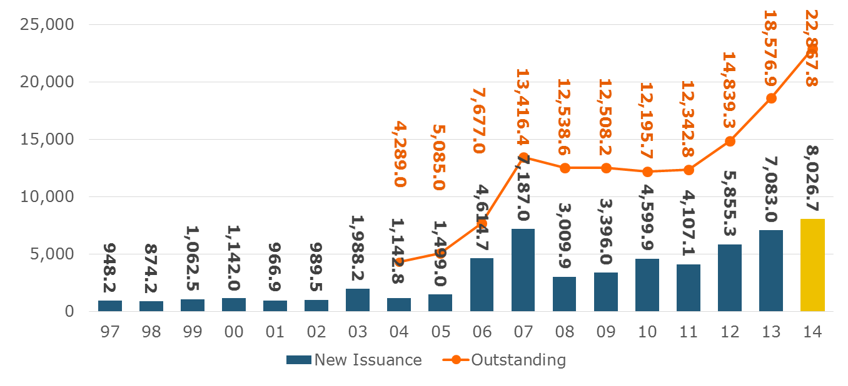
Catastrophe Bond Issuance and Outstanding: 1997-2014
Risk Capital Amount ($ Millions)
2014 Has Seen the Largest Cat Bond Ever - $1.5 Billion (Florida Citizens). Bond Issuance Set a Record.
Source: Guy Carpenter.

Slide 142
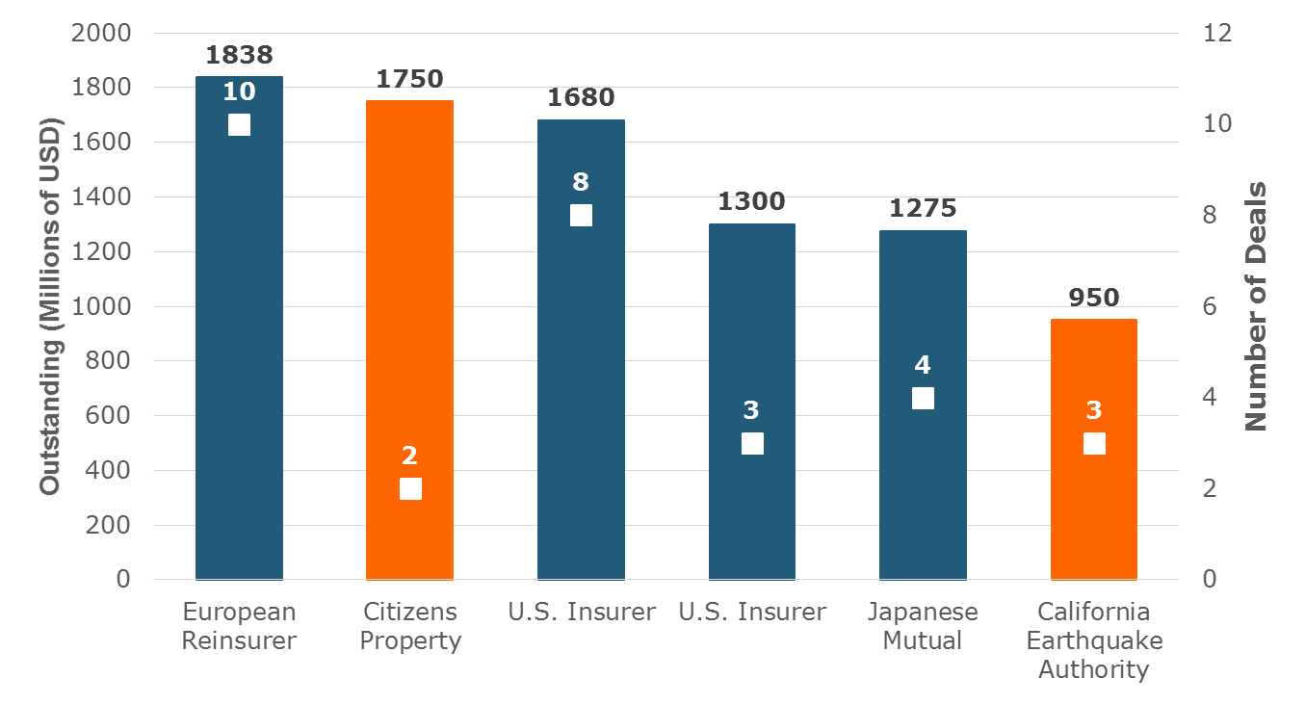
Largest Sponsors of ILS, Year-End 2014
Two of the Largest ILS Issuers Are Government-Sponsored Insurers. Nine Government-Related Insurers Have $4.6 Billion in Outstanding Securities.
Source: Artemis.bm; Insurance Information Institute.

Slide 143
Reinsurance Pricing: Change in Rate on Line for Cat Business
Alternative Capital, Low Levels of Catastrophe Drive Rates Down.
76%
Catastrophe Prices Fell 11 Percent on January 1 Renewals, Driven by Emergence of New Capital, Mild Catastrophe Losses.
2014 reflects change through June 30 from prior year end. 2015 is for January 1 renewals..
Source: Guy Carpenter; Insurance Information Institute.

Slide 144
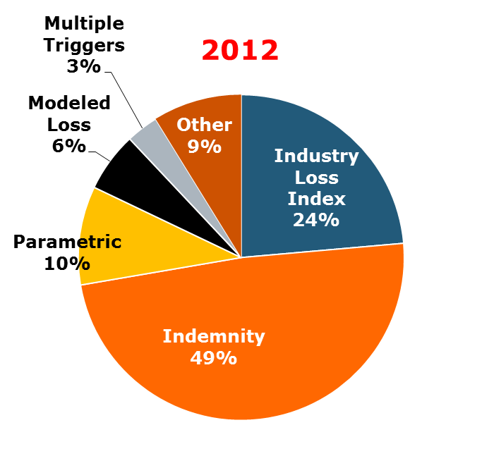
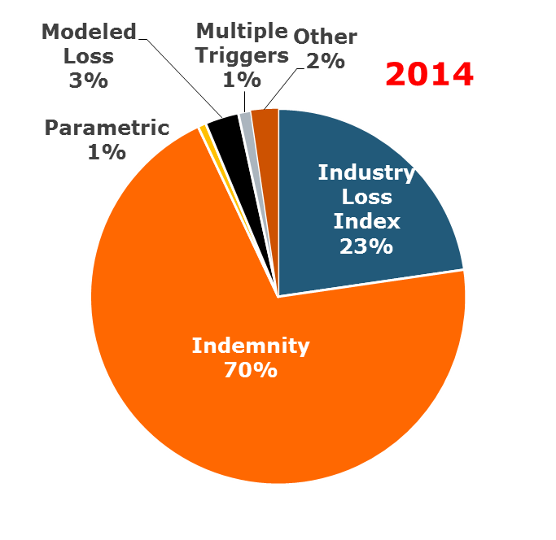
ILS Issuance by Trigger
Terms Are Shifting Away From ‘Objective’ Triggers (Favored by Investors) Toward Indemnity Trigger (Favored by Insurers).
Source: Artemis.bm; Insurance Information Institute.

Slide 145
U.S. Wind-Exposed Risk Premium* 2010:Q1 to 2014: Q1
Risk spreads dropped – equivalent to lower rates – low cat losses, capital entering market.
* Trailing 12-month average
SOURCE: Willis Capital Markets, Insurance Information Institute.

Slide 146

I.I.I. Will Release its First Report on Alternative Capital During Q1 2015
Issue of alternative capital in (re)insurance has received increased attention in recent years
Significant structural changes in property catastrophe reinsurance space
Questions addressed include:
  Sources of new capital
  Reasons/Drivers of growth
  New structures
  Impact of major triggering event(s)
  Impacts of higher interest rates
  Cat bond yield compression
Forthcoming: Q1 2015

Slide 147
Questions Arising from Influence of Alternative Capital
What Will Happen When Investors Face Large-Scale Losses?
What Happens When Interest Rates Rise?
Does ILS Have a Higher Propensity to Litigate?
How Much Lower Will Risk Premiums Shrink/ROLs Fall?
Will There Be Spillover Into Casualty Reinsurance?
Will Alternative Capital Drive Consolidation?

Slide 148
Top Insurance Issues:
What’s Hot, What’s Not
No Dominant Even in 2014, but Some Key Commercial Lines Issues Spiked
Terrorism, TRIA & Cyber
148

Slide 149
I.I.I. Media Index, P/C, 2014 vs 2013
Percent increase/decrease from previous year
Terrorism, Cyber, Autonomous/Driverless Vehicles and Aviation insurance issues experienced the sharpest increase in media attention. Year-ago leaders included Flood Insurance and Gun Liability; Hurricanes, Tornadoes and Wildfires faded
Coverage of Epidemics/Pandemics and insurance increased 85,000% due the Ebola scare. I.I.I. members uniformly directed media to us. WC was the principal issue, along with business interruption.
Source: Insurance Information Institute based on a search of Lexis/Nexis.

Slide 150
TERRORISM & TRIA LAPSE
Reauthorization Was a Major Industry Effort Over the Past Few Years
Outline of New TRIA Structure
150

Slide 151
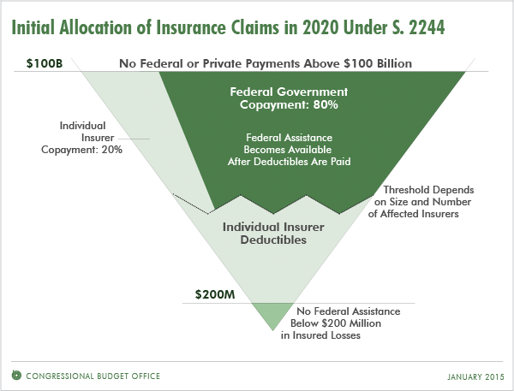
Structure of Reauthorized TRIA Program (as of 2020)
Major Changes
6-Year reauthorization
Trigger rises in steps from $100MM to $200MM
Industry aggregate retention rises in steps from $27.5B to $37.5B
Industry co-share above retained losses rise in steps from 15% to 20%
Insurers required to assume materially more risk
Source: Congressional Budget Office: http://www.cbo.gov/publication/49866; Insurance Information Institute research.

Slide 152
Industry Aggregate Retention Under TRIA, from Inception through Extension
The Industry Aggregate Retention Will Have Nearly Quadrupled from $10 Billion at Inception to $37.5 Billion in 2019
Reauthorization
$ Billions
Industry aggregate retentions will rise by $2B per year from 2015 through 2019
*First full year of program; TRIA was signed in to law on Nov. 26, 2002, with provisions identical to those in 2003.
Source: Insurance Information Institute research.

Slide 153
TRIA Program Trigger, from Inception through Extension
The TRIA program trigger will double between 2015 and 2020
$ Millions
Reauthorization
Program trigger will rise in steps beginning in 2016 from $100 million to $200 million by 2020
*First full year of program; TRIA was signed in to law on Nov. 26, 2002, with provisions identical to those in 2003.
Source: Insurance Information Institute research.

Slide 154
Industry Co-Pay Share in Excess of Individual Retention
The industry co-pay share will have double by 2020 from program inception
Percent
Reauthorization
Insurer co-payments in excess of their individual retentions will rise in steps beginning in 2016 from 15% to 20%
*First full year of program; TRIA was signed in to law on Nov. 26, 2002, with provisions identical to those in 2003.
Source: Insurance Information Institute research.

Slide 155
THE ECONOMY
Strength of the Economy Will Influence Growth Across Most Lines
155

Slide 156
US Real GDP Growth*
The Q4:2008 decline was the steepest since the Q1:1982 drop of 6.8%
Real GDP Growth (%)
Recession began in in June 2009
Q1 2014 GDP data were hit hard by this year’s “Polar Vortex” and harsh winter
Demand for Insurance Should Increase in 2015 as GDP Growth Accelerates Modestly and Gradually Benefits the Economy Broadly
* Estimates/Forecasts from Blue Chip Economic Indicators.
Source: US Department of Commerce, Blue Economic Indicators 2/15; Insurance Information Institute.

Slide 157
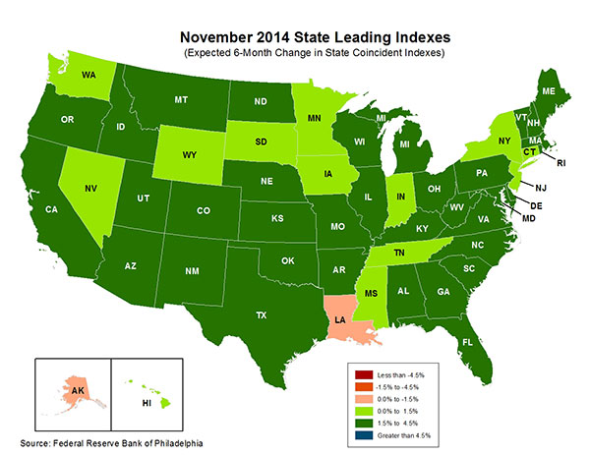
State-by-State Leading Indicators
through 2015:Q2
Growth in the West is finally beginning to pick up
The economic outlook for most of the US is generally positive, though flat-to-negative for 2 states
Sources: Federal Reserve Bank of Philadelphia at http://www.philadelphiafed.org/index.cfm ;Insurance Information Institute.

Slide 158
Real GDP by State Percent Change, 2013:
Highest 25 States
North Dakota was the economic growth juggernaut of the US in 2013—by far
Only 9 states experienced growth in excess of 3% in 2013, which is what we would see nationally in a more typical recovery
Growth Benchmarks: Real GDP
US: 1.8%
Sources: U.S. Bureau of Economic Analysis; Insurance Information Institute.

Slide 159
Real GDP by State Percent Change, 2013:
Lowest 25 States
Growth rates in 11 states were still below 1% in 2013
DC and Alabama were the only states to shrink in 2013
Sources: US Bureau of Economic Analysis; Insurance Information Institute.

Slide 160
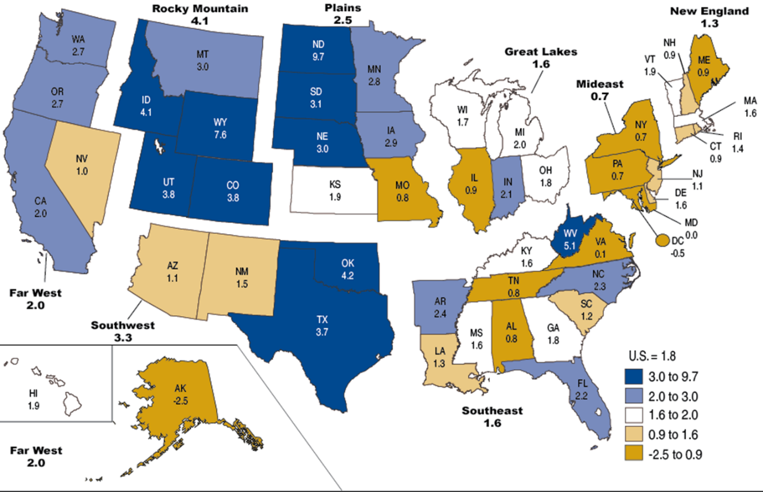
Percent Change in Real GDP by State, 2013
Sources: US Bureau of Economic Analysis; Insurance Information Institute.

Slide 161
Consumer Sentiment Survey (1966 = 100)
January 2010 through February 2015
Optimism among consumers soared in late in 2014 and into early 2015 to its highest level in 11 years in January. Job gains, falling gas prices help.
Impact of 2011 budget impasse
Consumer confidence had been low for years amid high unemployment, falling home prices and other factors adversely impact consumers, but improved substantially over the past 2+ years, as job growth and falling energy prices aid consumers
Source: University of Michigan; Insurance Information Institute

Slide 162
Auto/Light Truck Sales, 1999-2020F
Job growth and improved credit market conditions will boost auto sales in 2014 and beyond
Sales have returned to pre-crisis levels
(Millions of Units)
New auto/light truck sales fell to the lowest level since the late 1960s. Forecast for 2014-15 is still below 1999-2007 average of 17 million units, but a robust recovery is well underway.
Truck purchases by contractors are especially strong
Yearly car/light truck sales will likely continue at current levels, in part replacing cars that were held onto in 2008-12. New vehicles will generate more physical damage insurance coverage but will be more expensive to repair. PP Auto premium might grow by 5% - 6%.
Source: U.S. Department of Commerce; Blue Chip Economic Indicators (2/15 and 10/14); Insurance Information Institute.

Slide 163
New Private Housing Starts, 1990-2020F
Job growth, low inventories of existing homes, low mortgage rates and demographics should continue to stimulate new home construction for several more years
(Millions of Units)
New home starts plunged 72% from 2005-2009; A net annual decline of 1.49 million units, lowest since records began in 1959
Insurers Are Continue to See Meaningful Exposure Growth in the Wake of the “Great Recession” Associated with Home Construction: Construction Risk Exposure, Surety, Commercial Auto; Potent Driver of Workers Comp Exposure
Source: U.S. Department of Commerce; Blue Chip Economic Indicators (2/15 and 10/14); Insurance Information Institute.

Slide 164
Interest Rate on Convention 30-Year Mortgages: Up a Bit, 1990–2014*
Mortgages rates plunged to near-record lows in early 2013 but rose as the Fed initiated tapering in its QE program, but have come down a again through mid- and late-2014
Yields on 30-Year mortgages have been below 6% for a six years
Mortgage interest rates remain low by historical standards, aiding the housing recovery. Changes in Fed policy could push rates up modestly later in 2015.
*Monthly, through Dec. 2014. Note: Recessions indicated by gray shaded columns.
Sources: Federal Reserve Bank at http://www.federalreserve.gov/releases/h15/data.htm.
National Bureau of Economic Research (recession dates); Insurance Information Institutes.
164
12/01/09 - 9pm
eSlide – P6466 – The Financial Crisis and the Future of the P/C
Notes:
164

Slide 165
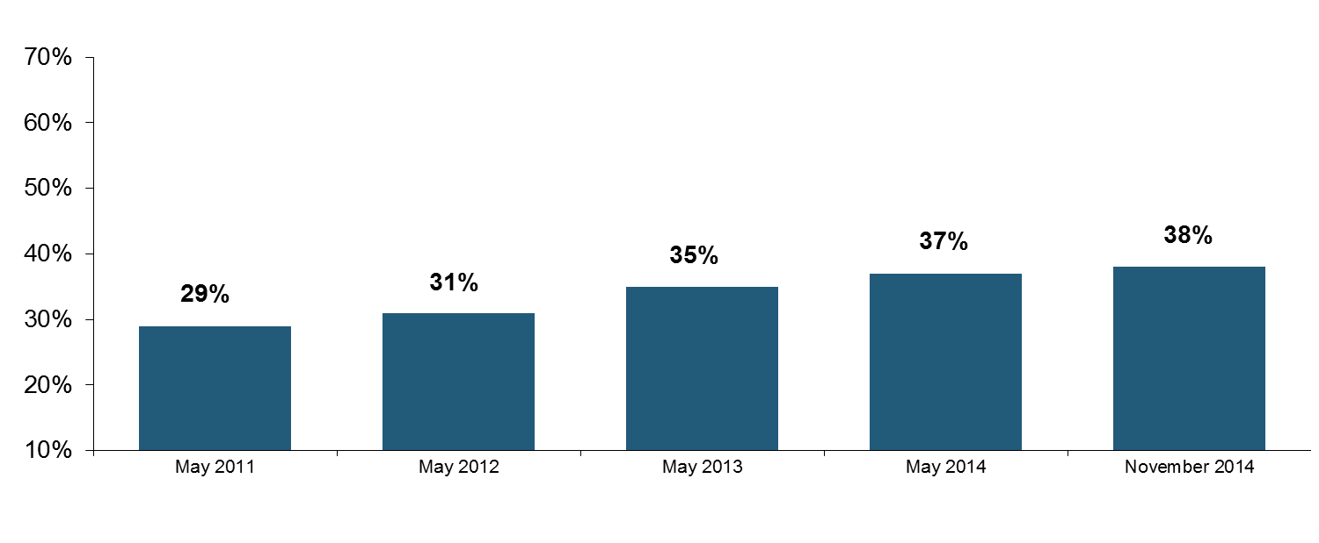
I.I.I. Poll: Renters Insurance
Percentage of Renters Who Have Renters Insurance, 2011-2014
Educational efforts about the need for renters insurance are slowly but surely penetrating the large and growing renting population; Understanding of affordability is improving.
Percentage Of Renters With Renters Insurance Is Increasing.
Source: Insurance Information Institute Annual Pulse Survey.

Slide 166
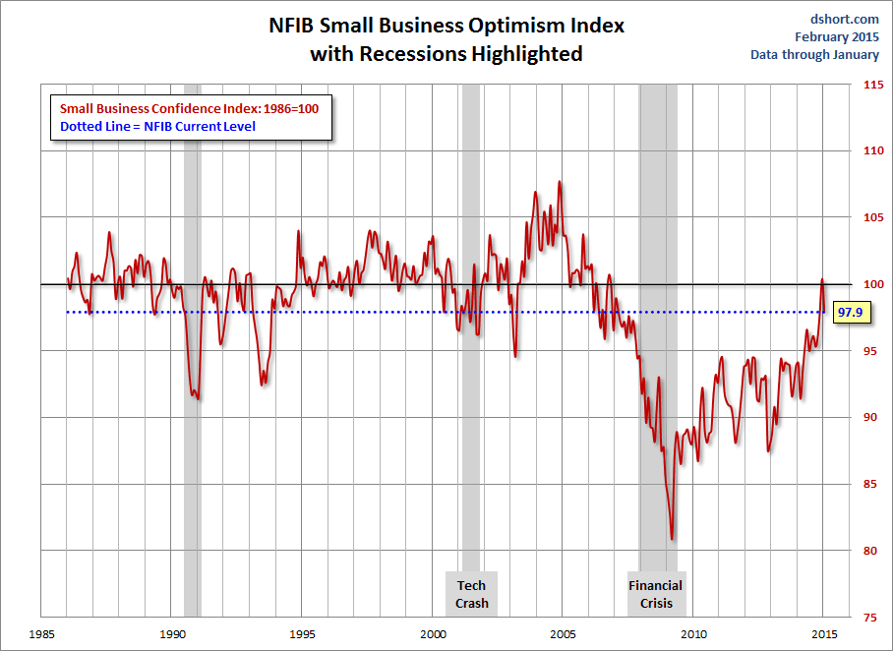
NFIB Small Business Optimism Index
January 1985 through December 2014
Small business optimism remains near its post-crisis highs
Source: National Federation of Independent Business at http://www.advisorperspectives.com/dshort/charts/indicators/Sentiment.html?NFIB-optimism-index.gif ; Insurance Information Institute.

Slide 167
Business Bankruptcy Filings: Still Falling
(1994:Q1 – 2014:Q4)
(Thousands)
New Bankruptcy Law Takes Effect
Below pre-recession level
Recessions in orange
Business bankruptcies in 2014 were below both the Great Recession levels and the 2003:Q3-2005:Q1 period (the best five-quarter stretch in the last 20 years). Bankruptcies restrict exposure growth in all commercial lines.
Sources: U.S. Courts at http://www.uscourts.gov/; Insurance Information Institute
167
12/01/09 - 9pm
eSlide – P6466 – The Financial Crisis and the Future of the P/C
Notes:
167

Slide 168
Business Bankruptcy Filings,
1980-2014
% Change Surrounding Recessions
1980-82 58.6%
1980-87 88.7%
1990-91 10.3%
2000-01 13.0%
2006-09 208.9%
2014 bankruptcies totaled 26,983, down 18.8% from 2013—the 5th consecutive year of decline. Business bankruptcies more than tripled during the financial crisis.
Significant Exposure Implications for All Commercial Lines as Business Bankruptcies Begin to Decline
Sources: American Bankruptcy Institute (1980-2012) at http://www.abiworld.org/AM/AMTemplate.cfm?Section=Home&TEMPLATE=/CM/ContentDisplay.cfm&CONTENTID=61633; 2013-14 data from United States Courts at http://news.uscourts.gov; Insurance Information Institute.
168
12/01/09 - 9pm
eSlide – P6466 – The Financial Crisis and the Future of the P/C
Notes:
168

Slide 169
Private Sector Business Starts:
1993:Q2 – 2013:Q4* As Strong as Ever?
Business Starts
2006: 861,000
2007: 844,000
2008: 787,000
2009: 701,000 2010: 742,000 2011: 781,000
2012: 800,000
2013: 870,000**
Recessions in orange
2013:Q1 578,000 business starts*
Thousands
*Data posted Apr 29, 2014, the latest available; a classification change in 2013:Q1 resulted in a report of 578,000 businesses started in that quarter. Seasonally adjusted. **2014 number assumes 1st quarter equaled average of other three quarters
Sources: Bureau of Labor Statistics, http://www.bls.gov/news.release/cewbd.t08.htm. NBER (recession dates)
169
12/01/09 - 9pm
eSlide – P6466 – The Financial Crisis and the Future of the P/C
Notes:
169

Slide 170
ISM Non-Manufacturing Index
(Values > 50 Indicate Expansion)
January 2010 through September 2014
Optimism among non-manufacturers has been generally increasing in 2014
Non-manufacturing industries have been expanding and adding jobs. This trend is likely to continue through 2014.
Source: Institute for Supply Management at http://www.ism.ws/ismreport/nonmfgrob.cfm; Insurance Information Institute.

Slide 171
12 Industries for the Next 10 Years: Insurance Solutions Needed
Health Care
Health Sciences
Energy (Traditional)
Many industries are poised for growth, though insurers’ ability to capitalize on these industries varies widely
Alternative Energy
Petrochemical
Agriculture
Natural Resources
Technology (incl. Biotechnology)
Light Manufacturing
Insourced Manufacturing
Export-Oriented Industries
Shipping (Rail, Marine, Trucking, Pipelines)

Slide 172
CONSTRUCTION INDUSTRY OVERVIEW & OUTLOOK
The Construction Sector Is Critical to the Economy and the P/C Insurance Industry
172

Slide 173
Value of New Private Construction: Residential & Nonresidential, 2003-2014*
2014: Value of new pvt. construction hits $698.6B as of Nov. 2014, up 40% from the 2010 trough but still 23% below 2006 peak
New Construction peaks at $911.8. in 2006
Billions of Dollars
Trough in 2010 at $500.6B, after plunging 55.1% ($411.2B)
$15.0
$613.7
$349.6
$298.1
$261.8
$349.0
$238.8
Private Construction Activity Is Moving in a Positive Direction though Remains Well Below Pre-Crisis Peak; Residential Dominates
*2014 figure is a seasonally adjusted annual rate as of December.
Sources: US Department of Commerce http://www.census.gov/construction/c30/c30index.html ; Insurance Information Institute.
173
12/01/09 - 9pm
eSlide – P6466 – The Financial Crisis and the Future of the P/C
Notes:
173

Slide 174
Value of Construction Put in Place, Dec. 2014 vs. Dec. 2013*
Growth (%)
Private: +0.4%
Public: +6.7%
Private sector construction activity is up in the residential and nonresidential segments but growth is sluggish
Public sector construction activity is finally beginning to pick up after years of decline
Overall Construction Activity is Up, But Growth In the Private Sector Slowed in Late 2014 While Picking in the State/Local Sector Government Sector as Budget Woes Ease in Some Jurisdictions
*seasonally adjusted
Source: U.S. Census Bureau, http://www.census.gov/construction/c30/c30index.html ; Insurance Information Institute.

Slide 175
Value of Private Construction Put in Place, by Segment, Dec. 2014 vs. Dec. 2013*
Led by the Manufacturing, Office and Lodging segments, Private nonresidential sector construction activity continues to rising after plunging during the “Great Recession.” Residential weakened.
Growth (%)
Private Construction Activity is Up in Many Segments, though the Key Residential Construction Sector Weakened in Late 2014; Mixed Outlook for 2015, though Expansion Should Continue
*seasonally adjusted
Source: U.S. Census Bureau, http://www.census.gov/construction/c30/c30index.html ; Insurance Information Institute.

Slide 176
Value of Public Construction Put in Place, by Segment, Dec. 2014 vs. Dec. 2013*
Growth (%)
Public sector construction activity is down substantially in many segments, a situation that will likely persist, dragging on public entity risk exposures
Amusement & Recreation, Sewage & Waste Disposal and Conservation projects lead public sector construction
Public Construction Activity is Beginning to Recover from its Long Contraction which Will Drive Demand in Many Commercial Insurance Lines
*seasonally adjusted
Source: U.S. Census Bureau, http://www.census.gov/construction/c30/c30index.html ; Insurance Information Institute.

Slide 177
Real (Inflation-Adjusted)
Nonresidential Construction, 2000-2014*
(Bar = CAGR; Line = Y/Y Growth Rate)
Construction activity has generally been positive since late 2010 but has occasionally be erratic. Forecast is for slowing improving growth
*Through Q1 2014.
Source: US Dept. of Commerce; Wells Fargo Securities (June 6, 2014 research report).
177
12/01/09 - 9pm
eSlide – P6466 – The Financial Crisis and the Future of the P/C
Notes:
177

Slide 178
Value of New Federal, State and Local Government Construction: 2003-2014*
Construction across all levels of government peaked at $314.9B in 2009
Austerity Reigns
Govt. construction MAY be turning a corner; still down $33.8B or 10.7% since 2009 peak
($ Billions)
Government Construction Spending Peaked in 2009, Helped by Stimulus Spending, but Contracted As State/Local Governments Grappled with Deficits and Federal Sequestration
*2014 figure is a seasonally adjusted annual rate as of December; http://www.census.gov/construction/c30/historical_data.html
Sources: US Department of Commerce; Insurance Information Institute.

Slide 179
New Private Housing Starts, 1990-2020F
Job growth, low inventories of existing homes, low mortgage rates and demographics should continue to stimulate new home construction for several more years
(Millions of Units)
New home starts plunged 72% from 2005-2009; A net annual decline of 1.49 million units, lowest since records began in 1959
Insurers Are Continue to See Meaningful Exposure Growth in the Wake of the “Great Recession” Associated with Home Construction: Construction Risk Exposure, Surety, Commercial Auto; Potent Driver of Workers Comp Exposure
Source: U.S. Department of Commerce; Blue Chip Economic Indicators (2/15 and 10/14); Insurance Information Institute.

Slide 180
Construction Employment,
Jan. 2010—December 2014*
(Thousands)
Construction employment is +731,000 above
Jan. 2011 (+13.4%) trough
Construction and manufacturing employment constitute 1/3 of all WC payroll exposure.
*Seasonally adjusted.
Sources: US Bureau of Labor Statistics at http://data.bls.gov; Insurance Information Institute.
180
12/01/09 - 9pm
eSlide – P6466 – The Financial Crisis and the Future of the P/C
Notes:
180

Slide 181
Construction Employment,
Jan. 2003–December 2014
(Thousands)
Construction employment as of Dec. 2014 totaled 6.166 million, an increase of 731,000 jobs or 13.4% from the Jan. 2011 trough
Construction employment peaked at 7.726 million in April 2006
Gap between pre-recession construction peak and today: 1.56 million jobs
The “Great Recession” and housing bust destroyed 2.3 million constructions jobs
Construction employment troughed at 5.435 million in Jan. 2011, after a loss of 2.291 million jobs, a 29.7% plunge from the April 2006 peak
The Construction Sector Could Be a Growth Leader in 2014 as the Housing Market, Private Investment and Govt. Spending Recover. WC Insurers Will Benefit.
Note: Recession indicated by gray shaded column.
Sources: U.S. Bureau of Labor Statistics; Insurance Information Institute.
181
12/01/09 - 9pm
eSlide – P6466 – The Financial Crisis and the Future of the P/C
Notes:
181

Slide 182
MANUFACTURING SECTOR OVERVIEW & OUTLOOK
The U.S. Is Experiencing a Mini Manufacturing Renaissance but Headwinds from Weak Export Markets and Strong Dollar
182

Slide 183
Dollar Value* of Manufacturers’ Shipments Monthly, Jan. 1992—November 2014
$ Millions
The value of Manufacturing Shipments in Nov. 2014 was $495.7B—down slightly since the July 2014 record high of $508.1B
Monthly shipments in Nov. 2014 exceeded the pre-crisis (July 2008) peak but has declined in recent months. Manufacturing is energy-intensive and growth leads to gains in many commercial exposures: WC, Commercial Auto, Marine, Property, and various Liability Coverages.
* Seasonally adjusted; Data published Jan. 6, 2015.
Source: U.S. Census Bureau, Full Report on Manufacturers’ Shipments, Inventories, and Orders, http://www.census.gov/manufacturing/m3/
183
12/01/09 - 9pm
eSlide – P6466 – The Financial Crisis and the Future of the P/C
Notes:
183

Slide 184
Manufacturing Growth for Selected Sectors, 2014 vs. 2013*
Growth (%)
Durables: +4.8%
Non-Durables: +0.5%
Manufacturing of durable goods is stronger than nondurables in 2014
Manufacturing Is Expanding—Albeit Slowly—Across a Number of Sectors that Will Contribute to Growth in Insurable Exposures Including: WC, Commercial Property, Commercial Auto and Many Liability Coverages
*Seasonally adjusted; Date are YTD comparing data through November 2014 to the same period in 2013.
Source: U.S. Census Bureau, Full Report on Manufacturers’ Shipments, Inventories, and Orders, http://www.census.gov/manufacturing/m3/

Slide 185
Manufacturing Employment,
Jan. 2010—December 2014*
(Thousands)
Since Jan 2010, manufacturing employment is up (+877,000 or +7.7%)
and still growing.
Manufacturing employment is a surprising source of strength in the economy. Employment in the sector is at a multi-year high.
*Seasonally adjusted.
Sources: US Bureau of Labor Statistics at http://data.bls.gov; Insurance Information Institute.
185
12/01/09 - 9pm
eSlide – P6466 – The Financial Crisis and the Future of the P/C
Notes:
185

Slide 186
ISM Manufacturing Index
(Values > 50 Indicate Expansion)
January 2010 through February 2015
Manufacturing continued to expand throughout 2014
The manufacturing sector expanded for 60 of the 62 months from Jan. 2010 through Feb. 2015. Pace of recovery has been uneven due to economic turbulence in the U.S., Europe and China.
Source: Institute for Supply Management at http://www.ism.ws/ismreport/mfgrob.cfm; Insurance Information Institute.

Slide 187
Index of Total Industrial Production:*
A Near Peak as of December 2014
Many economists expect business investment to rise in 2015
December 2014 Index at 106.5
Peak at 100.82 in December 2007 (officially the 1st month of the Great Recession)
Insurance exposures for industrial production will continue growing in 2015, and commercial insurance premium volume with them. Y-o-Y growth to December 2014 was 4.6%. Both production and premium volume growth for 2015 should exceed this.
*Monthly, seasonally adjusted, through December 2014 (which is preliminary). Index based on year 2007 = 100
Sources: Federal Reserve Board at http://www.federalreserve.gov/releases/g17/ipdisk/ip_sa.txt .
National Bureau of Economic Research (recession dates); Insurance Information Institute.
187
12/01/09 - 9pm
eSlide – P6466 – The Financial Crisis and the Future of the P/C
Notes:
187

Slide 188
Recovery in Capacity Utilization is a Positive Sign for Commercial Exposures
March 2001 through Dec. 2014
“Full Capacity”
The US operated at 79.7% of industrial capacity in Dec. 2014, well above the June 2009 low of 66.9% but is still below pre-recession levels.
Percent of Industrial Capacity
Hurricane Katrina
The closer the economy is to operating at “full capacity,” the greater the inflationary pressure
March 2001-November 2001 recession
December 2007-
June 2009 Recession
188
Source: Federal Reserve Board statistical releases at http://www.federalreserve.gov/releases/g17/Current/default.htm.
Notes:
188

Slide 189
Business Fixed Investment is Forecast to Grow Steadily in 2015-16, Fueling Commercial Exposure Growth
Business investment will drive commercial property and liability insurance exposures and should drive employment and WC payroll exposures as well (with a lag)
Growth Rate
Sources: Wells Fargo Economic Group; Insurance Information Institute.

Slide 190
ENERGY SECTOR: OIL & GAS INDUSTRY FUTURE IS BRIGHT BUT VOLATILE
US Is Becoming an Energy Powerhouse but Fall in Prices Will Have Negative Impact
190

Slide 191
U.S. Crude Oil Production, 2005-2016P
Millions of Barrels per Day
Crude oil production in the U.S. is expected to increase by 90.6% from 2008 through 2016—and could overtake Saudi Arabia as the world’s largest oil producer
Source: Energy Information Administration, Short-Term Energy Outlook (January 15, 2015) , Insurance Information Institute.

Slide 192
U.S. Natural Gas Production, 2000-2013
Trillions of Cubic Ft. per Year
The U.S. is already the world’s largest natural gas producer—recently overtaking Russia. This is a potent driver of commercial insurance exposures
Source: Energy Information Administration, Short-Term Energy Outlook (April 8, 2014) , Insurance Information Institute.

Slide 193
Employment in Oil & Gas Extraction,
Jan. 2010—Dec. 2014*
Oil and gas extraction employment is up 37.7% since Jan. 2010 as the energy sector booms. (Previous boom in 1979-81, employment peak at 267,000 in March 1982.)
Highest employment in this sector since July 1986.
(000)
*Seasonally adjusted
Sources: US Bureau of Labor Statistics at http://data.bls.gov; Insurance Information Institute.
193
12/01/09 - 9pm
eSlide – P6466 – The Financial Crisis and the Future of the P/C
Notes:
193

Slide 194
Labor Market Trends
Massive Job Losses Sapped the Economy and Commercial/Personal Lines Exposure, But Trend Has Greatly Improved
194

Slide 195
Unemployment and Underemployment Rates: Still Too High, But Falling
January 2000 through February 2015, Seasonally Adjusted (%)
U-6 went from 8.0% in March 2007 to 17.5% in
October 2009; Stood at 11.0% in Feb. 2015.
8% to 10% is “normal.”
“Headline” unemployment was 5.5% in Feb. 2015. 4.5% to 5.5% is “normal.”
Stubbornly high unemployment and underemployment constrain overall economic growth, but the job market is now clearly improving.
Source: US Bureau of Labor Statistics; Insurance Information Institute.
195
12/01/09 - 9pm
eSlide – P6466 – The Financial Crisis and the Future of the P/C
Notes:
195

Slide 196
US Unemployment Rate Forecast
Rising unemployment
eroded payrolls
and WC’s
exposure base.
Unemployment peaked at 10% in late 2009.
2007:Q1 to 2016:Q4F*
Jobless figures have been revised downwards for 2015/16
Unemployment forecasts have been revised modestly downwards. Optimistic scenarios put the unemployment as low as 5.0% by Q4 of 2015.
* = actual; = forecasts
Sources: US Bureau of Labor Statistics; Blue Chip Economic Indicators (2/15 edition); Insurance Information Institute.

Slide 197
Monthly Change in Private Employment
3,042,000 jobs were created in 2014
January 2007 through Feb. 2015 (Thousands, Seasonally Adjusted)
288,000 private sector jobs were created in Feb. In March 2014, the last of the private jobs lost in the Great Recession were recovered
Jobs Created
2014: 3.042 Mill
2013: 2.368 Mill
2012: 2.294 Mill
2011: 2.400 Mill
2010: 1.277 Mill
Monthly losses in Dec. 08–Mar. 09 were the largest in the
post-WW II period
Private Employers Added 11.38 million Jobs Since Jan. 2010 After Having Shed 5.01 Million Jobs in 2009 and 3.76 Million in 2008 (State and Local Governments Have Shed Hundreds of Thousands of Jobs)
Source: US Bureau of Labor Statistics: http://www.bls.gov/ces/home.htm; Insurance Information Institute

Slide 198
Nonfarm Payroll (Wages and Salaries):
Quarterly, 2005–2014:Q3
Billions
Latest (2014:Q3) was $7.46 trillion, a new peak--$1.21 trillion above 2009 trough
Prior Peak was 2008:Q3 at $6.54 trillion
Growth rates
2011:Q3 over 2010:Q3: 4.1%
2012:Q3 over 2011:Q3: 3.2%
2013:Q3 over 2012:Q3: 3.6%
2014:Q3 over 2013:Q3: 4.4%
Recent trough (2009:Q1) was $6.23 trillion, down 5.3% from prior peak
Note: Recession indicated by gray shaded column. Data are seasonally adjusted annual rates.
Sources: http://research.stlouisfed.org/fred2/series/WASCUR; National Bureau of Economic Research (recession dates); Insurance Information Institute.
198
12/01/09 - 9pm
eSlide – P6466 – The Financial Crisis and the Future of the P/C
Notes:
198

Slide 199
Payroll vs. Workers Comp Net Written Premiums, 1990-2014P
Payroll Base* WC NWP
$Billions $Billions
7/90-3/91
3/01-11/01
12/07-6/09
WC premium volume dropped two years before the recession began
WC net premiums written were down $14B or 29.3% to $33.8B in 2010 after peaking at $47.8B in 2005
Continued Payroll Growth and Rate Gains Suggest WC NWP Will Grow Again in 2015
*Private employment; Shaded areas indicate recessions. WC premiums for 2014 are I.I.I. estimates..
Sources: NBER (recessions); Federal Reserve Bank of St. Louis at http://research.stlouisfed.org/fred2/series/WASCUR ; NCCI; I.I.I.

Slide 200
Construction Employment,
Jan. 2010—December 2014*
(Thousands)
Construction employment is +734,000 above
Jan. 2011 (+13.5%).
Construction and manufacturing employment constitute 1/3 of all workers comp payroll exposure.
*Seasonally adjusted; Dec and Nov 2014 are preliminary
Sources: US Bureau of Labor Statistics at http://data.bls.gov; Insurance Information Institute.
200
12/01/09 - 9pm
eSlide – P6466 – The Financial Crisis and the Future of the P/C
Notes:
200

Slide 201
Construction Employment,
Jan. 2003–December 2014
(Thousands)
Construction employment troughed at 5.435 million in Jan. 2011, after a loss of 2.291 million jobs, a 29.7% plunge from the April 2006 peak
Construction employment peaked at 7.726 million in April 2006
The “Great Recession” and housing bust destroyed 2.3 million constructions jobs
The Construction Sector Could Be a Growth Leader in 2015 as the Housing Market, Private Investment and Govt. Spending Recover.
Note: Recession indicated by gray shaded column.
Sources: U.S. Bureau of Labor Statistics; Insurance Information Institute.
201
12/01/09 - 9pm
eSlide – P6466 – The Financial Crisis and the Future of the P/C
Notes:
201

Slide 202
Manufacturing Employment,
January 2010—December 2014*
Thousands
In the past 5 years (from January 2010) manufacturing employment is up (+877,000 or +7.7%)
and still growing.
Manufacturing employment is a surprising source of strength in the economy. Employment in the sector is at a multi-year high.
*Seasonally adjusted; Dec and Nov 2013 are preliminary
Sources: US Bureau of Labor Statistics at http://data.bls.gov; Insurance Information Institute.

Slide 203
Employment in Oil & Gas Extraction,
Jan. 2010—Dec. 2014*
Oil and gas extraction employment is up 37.7% since Jan. 2010 as the energy sector booms. (Previous boom in 1979-81, employment peak at 267,000 in March 1982.)
Highest employment in this sector since July 1986.
(000)
*Seasonally adjusted
Sources: US Bureau of Labor Statistics at http://data.bls.gov; Insurance Information Institute.
203
12/01/09 - 9pm
eSlide – P6466 – The Financial Crisis and the Future of the P/C
Notes:
203

Slide 204
Workers Compensation Operating Environment
Workers Comp Results Have Improved Substantially in Recent Years
204

Slide 205
Workers Compensation Combined Ratio: 1994–2014E
WC results have improved markedly since 2011
Workers Comp Results Began to Improve in 2012. Underwriting Results Deteriorated Markedly from 2007-2010/11 and Were the Worst They Had Been in a Decade.
Sources: A.M. Best (1994-2009); NCCI (2010-2014F) and are for private carriers only; Insurance Information Institute.

Slide 206
Workers Compensation Premium:
Third Consecutive Year of Increase
Net Written Premium
$ Billions
p Preliminary
Source: 1990–2013p Private Carriers, Annual Statement Data, NCCI.
1996–2013p State Funds: AZ, CA, CO, HI, ID, KY, LA, MD, MO, MT, NM, OK, OR, RI, TX, UT Annual Statements
State Funds available for 1996 and subsequent
Calendar Year

Slide 207
2013 Workers Compensation Direct Written Premium Growth, by State*
PRIVATE CARRIERS: Overall 2013 Growth = +5.4%
While growth rates varied widely, all states experienced positive growth in 2013
*Excludes monopolistic fund states (in white): OH, ND, WA and WY.
Source: NCCI.

Slide 208
Workers Compensation Lost-Time
Claim Frequency Declined in 2013
Lost-Time Claims
Percent
Cumulative Change of –55.4%
(1991–2011 adj.)
*Adjustments primarily due to significant audit activity.
2013p: Preliminary based on data valued as of 12/31/2013
1991–2012: Based on data through 12/31/2012, developed to ultimate
Based on the states where NCCI provides ratemaking services, including state funds; excludes high deductible policies
Frequency is the number of lost-time claims per $1M pure premium at current wage and voluntary loss cost level
Source: NCCI.
Accident Year

Slide 209
Workers Compensation Medical Severity
Moderate Increase in 2013
Medical
Claim Cost ($000s)
Average Medical Cost per Lost-Time Claim
Annual Change 1991–1993: +1.9%
Annual Change 1994–2001: +8.9%
Annual Change 2002–2010: +6.0%
Annual Change 1991–1993: +1.9%
Annual Change 1994–2001: +8.9%
Annual Change 2002–2013: +5.2%
Cumulative Change = 256%
(1991-2013p)
Accident Year
Accident Year
2013p: Preliminary based on data valued as of 12/31/2013.
1991-2012: Based on data through 12/31/2012, developed to ultimate
Based on the states where NCCI provides ratemaking services including state funds, excluding WV; Excludes high deductible policies.

Slide 210
WC Medical Severity Generally Outpaces the Medical CPI Rate
Average annual increase in WC medical severity form 1995 through 2011 was well above the medical CPI (6.8% vs. 3.8%), but the gap is narrowing.
Sources: Med CPI from US Bureau of Labor Statistics, WC med severity from NCCI based on NCCI states.

Slide 211
Medical Cost Inflation vs. Overall CPI, 1995 – 2014*
Though moderating, medical inflation will continue to exceed inflation in the overall economy
Average Annual Growth Average 1995 – 2013
Healthcare: 3.8%
Total Nonfarm: 2.4%
*July 2014 compared to July 2013.
Sources: Med CPI from US Bureau of Labor Statistics, WC med severity from NCCI based on NCCI states.

Slide 212
U.S. Health Care Expenditures,
1965–2022F
$ Billions
From 1965 through 2013, US health care expenditures had increased by 69 fold. Population growth over the same period increased by a factor of just 1.6. By 2022, health spending will have increased 119 fold.
U.S. health care expenditures have been on a relentless climb for most of the past half century, far outstripping population growth, inflation of GDP growth
Sources: Centers for Medicare & Medicaid Services, Office of the Actuary at http://www.cms.gov/Research-Statistics-Data-and-Systems/Statistics-Trends-and-Reports/NationalHealthExpendData/NationalHealthAccountsProjected.html accessed 3/14/14; Insurance Information Institute.

Slide 213
National Health Care Expenditures as a Share of GDP, 1965 – 2022F*
% of GDP
Health care expenditures as a share of GDP rose from 5.8% in 1965 to 18.0% in 2013 and are expected to reach 19.9% of GDP by 2022
2022 19.9%
2010: 17.9%
2000: 13.8%
1990: 12.5%
Since 2009, heath expenditures as a % of GDP have flattened out at about 18%--the question is why and will it last?
1980: 9.2%
1965 5.8%
Sources: Centers for Medicare & Medicaid Services, Office of the Actuary at http://www.cms.gov/Research-Statistics-Data-and-Systems/Statistics-Trends-and-Reports/NationalHealthExpendData/NationalHealthAccountsProjected.html accessed 3/14/14; Insurance Information Institute.

Slide 214
The Affordable Care Act & Implications for P/C Insurance
The ACA Is Now Being Fully Implemented; Consequences for P/C Insurance Are Yet to Be Determined
214

Slide 215
Projected Number of People with No Health Insurance, 2013—2022*
By 2018 the number of people under age 65 without insurance is expected to drop by 25 million (~45%)
Millions
The projected decline in the uninsured population is very sensitive to the enrollment rate under the Affordable Care Act
*Under age 65.
Sources: Centers for Medicare & Medicaid Services, Office of the Actuary at http://www.cms.gov/Research-Statistics-Data-and-Systems/Statistics-Trends-and-Reports/NationalHealthExpendData/NationalHealthAccountsProjected.html accessed 3/14/14; Insurance Information Institute.
215
12/01/09 - 9pm
eSlide – P6466 – The Financial Crisis and the Future of the P/C
Notes:
215

Slide 216
A Few Potential Impacts of the ACA on Workers Compensation
Issue | Concern | Contravening Argument
Surge in People Covered by Health Insurance | System is overwhelmed MD shortage Patient care adversely impacted | Over time, people will have access to preventative care, improving the general health of the population Greater use of PA’s, etc.
Electronic Health Records | Cost | Computerization of patient data could help flag issues and improve risk management and improve patient outcomes
Claim Shifting | Provider/patient may prefer claim handled via WC system | Reduction in uninsured population reduces shifting
Reimbursement Rates | Cuts in MC reimbursement rates could makes docs less willing to take WC claims | Impact would be short-lived. All MC-linked states already boost WC reimbursements
Source: Insurance Information Institute research; WCRI.
216

Slide 217
ACA Impact on WC May Occur via Changes in Rates Set by State Regulators
WC rates often tied to Medicare but can change for reasons independent of this link
There could be both positive and negative effects of a cut in Medicare rates on WC performance in states which tie reimbursement to Medicare
  WC reimbursement rates would go down
  Doctors may be unwilling to see WC patients:
    64% of Dr.’s surveyed said they would stop accepting new Medicare patients if planned rate cuts go through; some of these same doctors may also refuse WC patients if WC rates also decrease
These effects would likely be short lived
  All states which tie their fee schedules to Medicare already increase the Medicare rates to set WC rates, so any drop in the Medicare rates would likely be soon offset by a higher WC adjustment
WC Maximum Allowable Reimbursement Rates
as Percentage of Medicare
WC rates tied to Medicare
WC rates not tied to Medicare
SOURCE: NCCI Annual Issues Symposium 2009, Medicare’s Impact on Workers’ Compensation, AMA: “Physicians’ reactions to the Medicare physician payment cuts.”

Slide 218
PPACA May Have Distinct Impacts on WC Depending on Claim Frequency/Severity
Industry Portfolio by Claim Type
(Relative Volume by Claim Frequency & Paid Dollars)
Potential ACA Impact
Expanded coverage may shift some small claims to the health insurance system (+)
Physician access problems could lead to indemnity increases and may bleed into the complicated cases (-)
High Volume, Low Severity
Ex: med only, quick to settle, <25K
Preventative care and early record keeping decreases WC comorbidities (+)
Soft tissue treatments, a large portion of “slow burn claims,” may decrease in cost (+)
Complicated
Ex: back pain claims, very litigious
Catastrophic Injuries
Ex: spinal cord injury, multiple trauma claims
No significant impacts
SOURCE: Christopher Cunniff, FCAS, Impacts of Healthcare Reform on Workers Compensation.

Slide 219
Possible Effects on Workers Comp
Could slow the growth in WC medical care costs
  IPAB recommendations and PCORI reports, plus Medicare changes, could have beneficial effects on cost and treatment effectiveness
Could ACA be first step in federal regulation of insurance products and markets?
  Will regulation like that requiring products to be priced to meet Medical Loss Ratios be applied to WC?
  Will cost-control mechanisms such as the Independent Payment Advisory Board be developed for WC?
  Will WC insurers lose their limited exemption from anti-trust laws that they have had under McCarran-Ferguson since 1945?

Slide 220
Potential Impacts of the ACA on Medical Professional Liability
Issue | Concern | Contravening Argument
Surge in People Covered by Health Insurance | System is overwhelmed Doctors spend less time on patients Patient care adversely impacted | Over time, people will have access to preventative care, improving the general health of the population People are receiving care already via suboptimal channels Less use of ERs
Electronic Health Records | Digitization could create a treasure trove of data for plaintiff attorneys | Computerization of patient data could help flag issues and improve risk management and improve patient outcomes
MPL Claim Severity | More large verdicts will | ACA will help contain system costs
Source: Insurance Information Institute research.
220

Slide 221
Shifting Legal Liability &
Tort Environment
Will the Tort Pendulum
Swing Against Insurers?
221

Slide 222
Over the Last Three Decades, Total Tort Costs as a % of GDP Appear Somewhat Cyclical, 1980-2013E
($ Billions)
2.21% of GDP in 2003 = pre-tort reform peak
Deepwater Horizon Spike in 2010
Tort costs in dollar terms have remained high but relatively stable since the mid-2000s., but are down substantially as a share of GDP
1.68% of GDP in 2013
Sources: Towers Watson, 2011 Update on US Tort Cost Trends, Appendix 1A

Slide 223
Commercial Lines Tort Costs: Insured vs. Self-(Un)Insured Shares, 1973-2010
2005: $143.5B 66.4% insured, 33.6% self-(un)insured
Billions of Dollars
$15.0
1995: $83.6B 69.5% insured, 30.5% self-(un)insured
1973: Commercial Tort Costs Totaled $6.49B, 94% was insured, 6% self-(un)insured
1985: $46.6B 74.5% insured, 25.5% self-(un)insured
$9.5
$6.0
2009: $126.5B 64.4% insured, 35.6% self-(un)insured
Tort Costs and the Share Retained by Risks Both Grew Rapidly from the mid-1970s to mid-2000s, When Tort Costs Began to Fall But Self-Insurance Shares Continued to Rise
Sources: Towers Watson, 2011 Update on US Tort Cost Trends, III Calculations based on data from Appendix 4.
223
12/01/09 - 9pm
eSlide – P6466 – The Financial Crisis and the Future of the P/C
Notes:
223

Slide 224
Commercial Lines Tort Costs: Insured vs. Self-(Un)Insured Shares, 1973-2010
Percent
2010: $138.1B 56.6% insured, 44.4% self-(un)insured (distorted by Deepwater Horizon event with most losses retained by BP)
1973: 94% was insured, 6% self-(un)insured
1985:74.5% insured, 25.5% self-(un)insured
1995: 69.5% insured, 30.5% self-(un)insured
2005: 66.4% insured, 33.6% self-(un)insured
The Share of Tort Costs Retained by Risks Has Been Steadily Increasing for Nearly 40 Years. This Trend Contributes Has Left Insurers With Less Control Over Pricing.
Sources: Towers Watson, 2011 Update on US Tort Cost Trends, III Calculations based on data from Appendix 4.
224
12/01/09 - 9pm
eSlide – P6466 – The Financial Crisis and the Future of the P/C
Notes:
224

Slide 225
Business Leaders Ranking of Liability Systems in 2012
Best States
Delaware
Nebraska
Wyoming
Minnesota
Kansas
Idaho
Virginia
North Dakota
Utah
Iowa
Worst States
Florida
Oklahoma
Alabama
New Mexico
Montana
Illinois
California
Mississippi
Louisiana
West Virginia
New in 2012
Wyoming
Minnesota
Kansas
Idaho
Newly Notorious
Oklahoma
Drop-offs
Rising Above
Indiana
Colorado
Massachusetts
South Dakota
Arkansas
Source: US Chamber of Commerce 2012 State Liability Systems Ranking Study; Insurance Info. Institute.

Slide 226
The Nation’s Judicial Hellholes: 2012/2013
Watch List
Illinois
Madison County
West Virginia
Maryland
Baltimore
Philadelphia, Pennsylvania
South Florida
Cook County, Illinois
New Jersey
Nevada
Louisiana
California
Dishonorable Mention
New York
Albany and NYC
MO Supreme Court
WA Supreme Court
Source: American Tort Reform Association; Insurance Information Institute

Slide 227
ATTRACTING TALENT
Most CEOs Say that Attracting and Retaining Talent is a Concern and a Challenge
Insurance Industry Employment Trends
227

Slide 228
Insurance Industry Employment Trends
From 1998 through 2013, total industry employment has stayed in a narrow band of 2.3-2.4 million; in 2014 it rose above that band
228

Slide 229
Overview of Insurance Sector Employment Changes*
Insurance Subsector | December 2014 Employment | January 2015 Employment | Change
CARRIERS
P-C Direct | 524,400 | 525,600 | +1,200
Life Direct | 350,100 | 353,400 | +3,300
Health/Medical Direct | 505,300 | 506,800 | +1,500
Title & Other Direct | 76,200 | 76,600 | +400
Reinsurers | 24,900 | 24,900 | +0
OTHERS
Agents/Brokers | 725,400 | 729,000 | +3,600
3rd-Party Administration | 175,600 | 177,800 | +2,200
Claims Adjusters | 51,800 | 51,100 | -700
*Data are through January 2015 and are preliminary (i.e., subject to later revision); seasonally adjusted.
229
Notes:
229

Slide 230
U.S. Employment in the Direct
P/C Insurance Industry: 1990–2015*
Thousands
Sometimes the BLS reclassifies employment within industries. When this happens, the change is spread evenly over a 12-month period (in this case March 2010-March 2011.
*As of January 2015; not seasonally adjusted; Does not including agents & brokers.
Note: Recessions indicated by gray shaded columns.
Sources: U.S. Bureau of Labor Statistics; National Bureau of Economic Research (recession dates); Insurance Information Institute.
230
Notes:
230

Slide 231
U.S. Employment in the Direct
Life Insurance Industry: 1990–2015*
Thousands
Every 4-5 years BLS reconciles its data with census data; sometimes this reclassifies employment within industries. This drop, spread over March 2004-March 2005, moved some people to the Health/Medical Expense sector.
*As of January 2015; not seasonally adjusted; Does not including agents & brokers.
Note: Recessions indicated by gray shaded columns.
Sources: U.S. Bureau of Labor Statistics; National Bureau of Economic Research (recession dates); Insurance Information Institute.
231
Notes:
231

Slide 232
U.S. Employment in the Direct Health-
Medical Insurance Industry: 1990–2015*
Thousands
*As of January 2015; not seasonally adjusted; Does not including agents & brokers.
Note: Recessions indicated by gray shaded columns.
Sources: U.S. Bureau of Labor Statistics; National Bureau of Economic Research (recession dates); Insurance Information Institute.
232
Notes:
232

Slide 233
U.S. Employment in the
Reinsurance Industry: 1990–2015*
Thousands
*As of January 2015; not seasonally adjusted; Does not including agents & brokers.
Note: Recessions indicated by gray shaded columns.
Sources: U.S. Bureau of Labor Statistics; National Bureau of Economic Research (recession dates); Insurance Information Institute.
233
Notes:
233

Slide 234
U.S. Employment in Insurance
Agencies & Brokerages: 1990–2015*
Thousands
*As of January 2015; not seasonally adjusted. Includes all types of insurance.
Note: Recessions indicated by gray shaded columns.
Sources: U.S. Bureau of Labor Statistics; National Bureau of Economic Research (recession dates); Insurance Information Institute.
234
Notes:
234

Slide 235
U.S. Employment in Insurance
Claims Adjusting: 1990–2015*
Thousands
*As of January, 2015; not seasonally adjusted.
Note: Recessions indicated by gray shaded columns.
Sources: U.S. Bureau of Labor Statistics; National Bureau of Economic Research (recession dates); Insurance Information Institute.
235
Notes:
235

Slide 236
U.S. Employment in Third-Party Administration of Insurance Funds: 1990–2015*
Thousands
*As of January 2015; not seasonally adjusted. Includes all types of insurance.
Note: Recessions indicated by gray shaded columns.
Sources: U.S. Bureau of Labor Statistics; National Bureau of Economic Research (recession dates); Insurance Information Institute.
236
Notes:
236

Slide 237
Insurance Information Institute Online:
www.iii.org
Thank you for your time
and your attention!
Twitter: twitter.com/bob_hartwig
Download at www.iii.org/presentations

