Slide 1
The Property/Casualty Landscape
Challenges and Disruptions?
October 6, 2016
Download at www.iii.org/presentations
James Lynch, FCAS MAAA, Chief Actuary
Insurance Information Institute  110 William Street  New York, NY 10038
Tel: 212.346.5533  jamesl@iii.org  www.iii.org

Slide 2
Auto Insurance
Rising Frequency, Severity Pinching
the Largest P/C Line

Slide 3
Net Combined Ratio, 2005-2015
Loss Ratios Have Been Rising for a Decade.
2015 Return on Net Worth is Likely Close to Zero or Negative.
Source: National Association of Insurance Commissioners data, sourced from S&P Global Market Intelligence;
Insurance Information Institute.

Slide 4
Why Personal Auto Loss Ratios are Rising: Severity & Frequency by Coverage, 2016 vs. 2015
Annual Change, 2016 Over 2015*
Across All Personal Coverage Types (Except Comprehensive) in 2015, Frequency and Severity Rose. This Pattern is Continuing in 2016.
*Four quarters ending in March.
Source: ISO, a Verisk Analytics company; Insurance Information Institute.

Slide 5
Claim Trends by Coverage
Focus on Collision

Slide 6
Collision Claims: Frequency Trending
Higher in 2015
Annual Change, 2005 through 2015
For a Long Time, Claim Frequency Was Falling,
But Since 2010 This Trend Seems to Have Reversed.
Source: ISO, a Verisk Analytics company; Insurance Information Institute.

Slide 7
Collision Claims: Severity Trending Higher in 2009-2015
Annual Change, 2005 through 2015
The Great Recession and High Fuel Prices Helped to Temper
Claim Severity, But These forces Have Clearly Reversed,
Consistent with Experience from Past Recoveries.
Source: ISO, a Verisk Analytics company; Insurance Information Institute.

Slide 8
What’s Driving These Trends?
Frequency; Severity

Slide 9
America is Driving More Again: 2000-2016
Percent Change, Miles Driven*
Fastest Growth Since 2000
Tremendous Growth In Miles Driven. The More People Drive, The More Frequently They Get Into Accidents.
*2000-2015: Moving 12-month total vs. prior year. 2016 data through July 2016, the latest available, vs. July 2015.
Sources: Federal Highway Administration; National Bureau of Economic Research (recession dates); Insurance Information Institute.
Notes:
9

Slide 10
More Miles Driven
=> More Collisions, 2006-2016
Billions of Miles Driven in Prior Year
Overall Collision Claims Per 100 Insured Vehicles
Recession
The More Miles People Drive, the More Likely They are to
Get in an Accident, Helping Drive Claim Frequency Higher.
Sources: Federal Highway Administration; Rolling four-quarter average frequency from ISO, a Verisk Analytics company; Insurance Institute for Highway Safety; Insurance Information Institute.
Notes:
10

Slide 11
Why Are People Driving More Miles?
Cheap Gas?
Billions of Miles Driven in Prior Year
Average Price Per Gallon
Recession
Gas Prices Don’t Seem Correlated With Miles Driven.
Sources: Federal Highway Administration; Energy Information Administration (All Grades All Formulations Retail Gasoline Prices-quarterly average); Insurance Institute for Highway Safety; Insurance Information Institute.
Notes:
11

Slide 12
Why Are People Driving More Miles?
Jobs?
Billions of Miles Driven in Prior Year
Millions Employed
Recession
People Drive to and from Work and Drive to Entertainment.
Out of Work, They Curtail Their Movement.
Sources: Federal Highway Administration; Seasonally Adjusted Employed from Bureau of Labor Statistics (Series ID CES0000000001); Insurance Institute for Highway Safety; Insurance Information Institute.
Notes:
12

Slide 13
Comparing Gas Prices, Employment on
Collision Frequency Through 2015
Gas Price vs.
Collision Frequency
Number Employed vs.
Collision Frequency
Sources: Seasonally Adjusted Employed from Bureau of Labor Statistics; Energy Information Administration; Rolling Four-Qtr Avg. Frequency from Insurance Services Office; Insurance Information Institute.

Slide 14
More People Working and Driving
=> More Collisions, 2006-2016
Number Employed, Millions
Overall Collision Claims Per 100 Insured Vehicles
Recession
When People are Out of Work, They Drive Less. When They Get Jobs,
They Drive to Work, Helping Drive Claim Frequency Higher.
Sources: Seasonally Adjusted Employed from Bureau of Labor Statistics; Rolling four-quarter average frequency from ISO, a Verisk Analytics company; Insurance Information Institute.
Notes:
14

Slide 15
Severity: Driving Fatalities are Rising
On Track for 18% Increase in Two Years
Annual Change in Motor Vehicle Deaths
Seatbelt Use Rose to 62% of Drivers, From 49% in ‘90
Big Drop-off Due to the Great Recession
Driving Has Been Getting Safer for Decades, But Recent Trend is Discouraging—38,300 Deaths in 2015.
Sources: National Safety Council, Insurance Information Institute.

Slide 16
What About Distractions?
It’s A Problem. Is It Growing?
What We Do Behind The Wheel
But Impact Is Not Clear
Talking Less . . .
Most Recent Year
* Property Damage Only.
SOURCES: State Farm, National Highway Transportation Safety Administration (distraction.gov)

Slide 17
On the Horizon
Sharing Economy and Disruption

Slide 18
What Is A Value Chain?
Example: Local Newspapers
Create Product (Publish the Newspaper)
Gather Information (News, Ads)
Distribute Product (Deliver the Newspaper)
Improve World
Printing Press
Provide Information to Local Audience
This Industry Was Radically Disrupted by the Internet. Its Barriers to Entry Were Destroyed. Is Insurance Next?

Slide 19
Insurance Technology Financing – Change Is Coming
Investment ($ Millions)
Deals
Investment In Insurance Tech Is Rising. Number of Deals Reached A Record in First Quarter.
SOURCES: CB Insights, Insurance Information Institute.

Slide 20
Insurance Tech Activity by Area of Interest, 2013 – 2016:Q1
With the ACA in the rear view window, non-health insurance tech accounts for the majority of investment
(Percent)
Silicon Valley, Venture Capitalists Have Insurance Industry in Their Sights. Most Will Fail. Some Will Succeed.
Source: CB Insights at https://www.cbinsights.com/blog/insurance-tech-overview-q1-2016/; Insurance Information Institute.

Slide 21
The (Re)Insurance Value Chain
Where Could Disruption Lie?
Create Policy/ Treaty
Brains + Bank Account
Under-write, Price Risk
Perform Loss Control
Settle Claims
Market Policy/ Treaty
Improve World
Protecting People & Organizations
Most Links in the Value Chain Have the Potential
to Be Disrupted in Next 10 Years.

Slide 22
Alternative Capital
Potentially Disrupting the Bank Account
Alternative capacity has grown 263% since 2008. It has more than tripled in the past six years.
Source: Aon Benfield Analytics; Insurance Information Institute.

Slide 23
Alternative Capital
Potentially Disrupting the Bank Account
Collateralized Reinsurance and Catastrophe Bonds Currently Dominate the Alternative Capital Market.
Source: Aon Benfield Analytics; Insurance Information Institute.

Slide 24
The Internet
Will It Disrupt Marketing?
Lead Generators
  InsWeb, NetQuote, Insurance.com
  Site allows comparison shopping, sells lead to insurer
Call Center Agencies
  SelectQuote, Goji
  Call center employs agents
Digital agencies
  Esurance, Policy Genius
  Quote and buy online
But Customers Still Like Agents
Did You Compare Prices When Your Auto Policy Was Up for Renewal?
SOURCES: The New Age of Insurance Aggregators, http://insurancethoughtleadership.com/the-new-age-of-insurance-aggregators/; Insurance Information Institute November 2015 Pulse Survey.

Slide 25




Pricing Disruptor: The Fragmented Risk
The Insurance Contract Is Being Split into Tiny Pieces.
  By-peril HO insurance – Rate Water, Theft, Liability Risk Separately
  The Sharing/“On-Demand” Economy – Personal Exposures Become Commercial Exposures, Then Switch Back
  Pay By Mile Insurance – Exposure Basis for Auto – Vehicle-Mile Replaces Vehicle-Year
Expect More As
  Computers Get Stronger
  Data Storage Gets Cheaper
  Information Collection Grows
25
12/01/09 - 9pm
eSlide – P6466 – The Financial Crisis and the Future of the P/C
Notes:
25

Slide 26
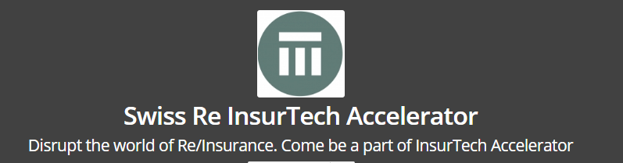
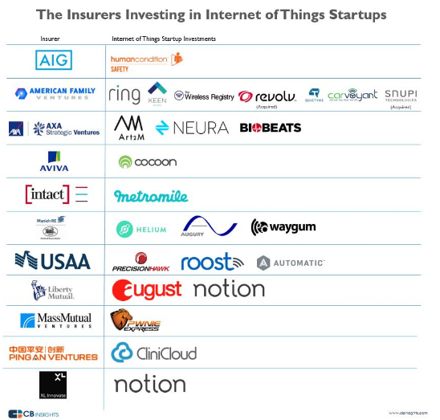
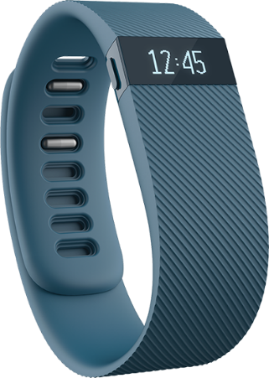
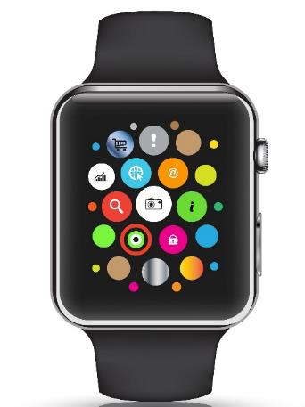
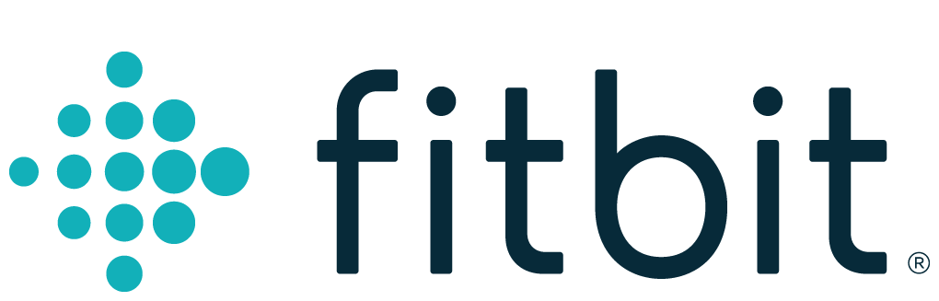

The Internet of Things
Gathering Big Data Affects
  Underwriting
  Pricing
Monitoring Could Affect
  Loss Control
  Pricing?
SOURCE: F6S.com, CB Insights.
26
12/01/09 - 9pm
eSlide – P6466 – The Financial Crisis and the Future of the P/C
Notes:
26

Slide 27
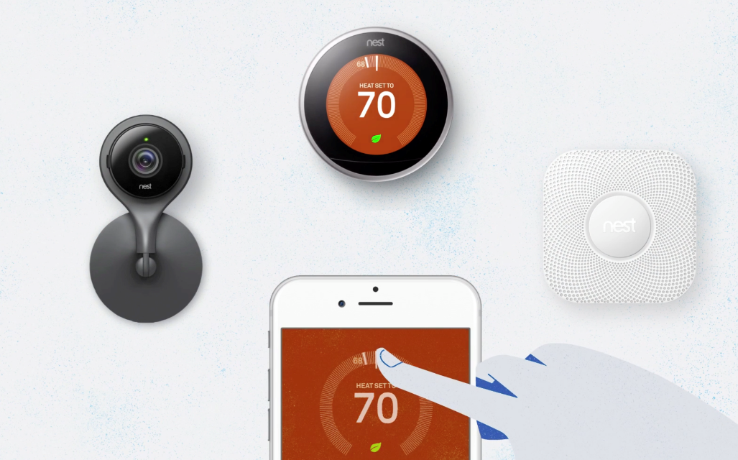

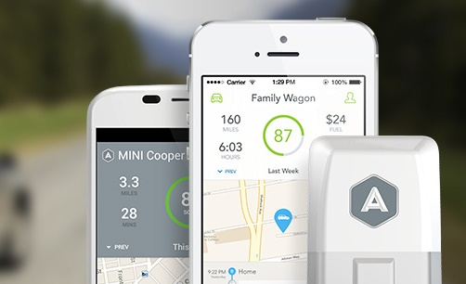
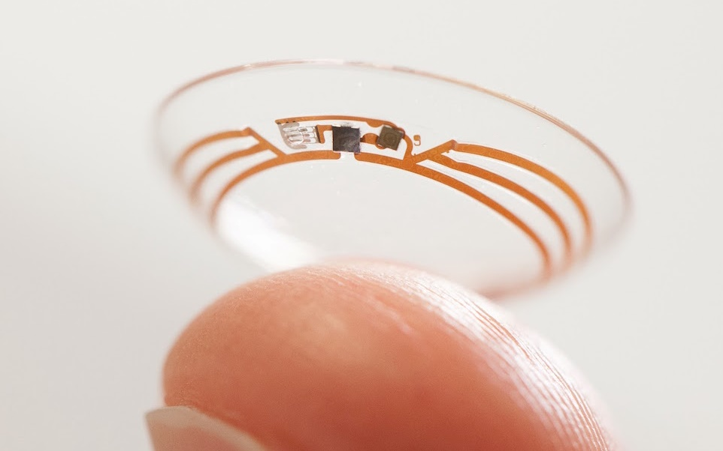
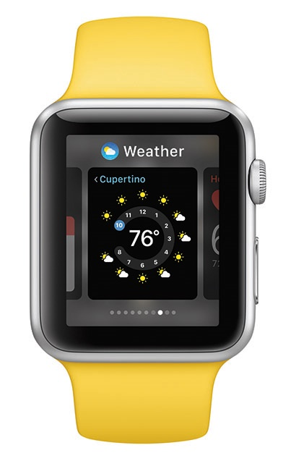
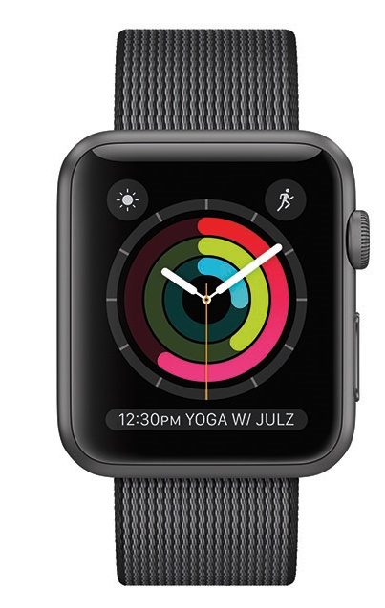
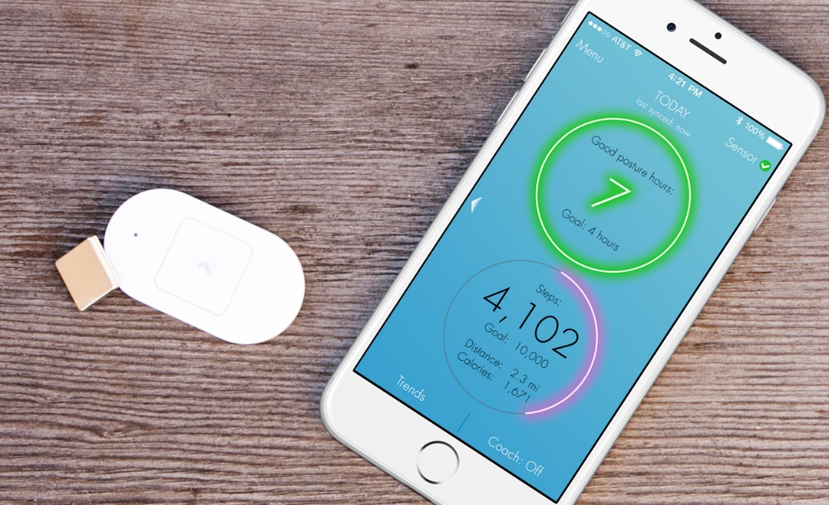
As For The Future…
IoT Could Disrupt UW, Claims, Loss Control
Image sources, clockwise: Nest, Jawbone, Automatic, Lumo, Apple, PSFK

Slide 28
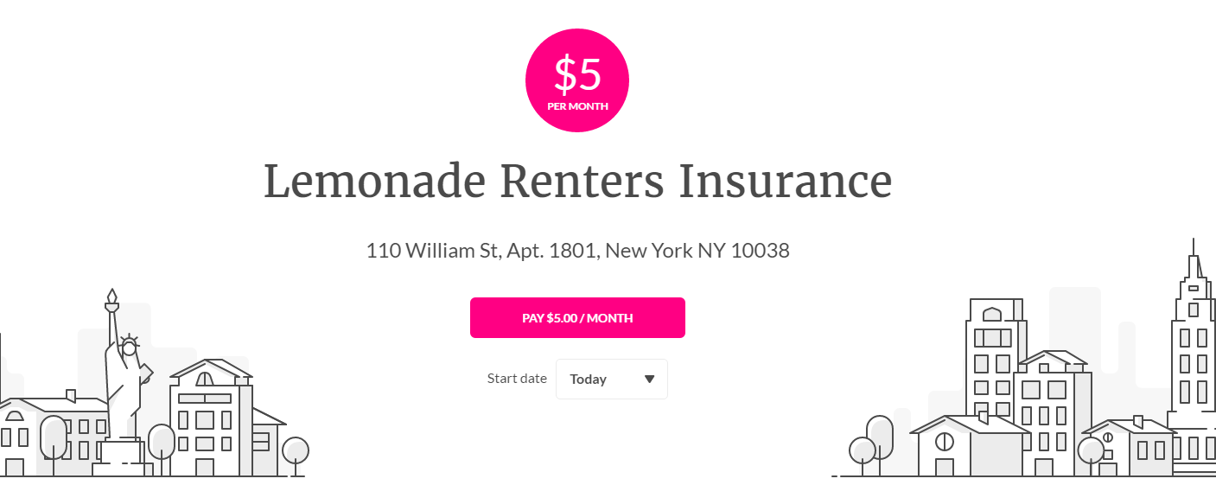
Peer-to-Peer (P2P) Insurance
Taking on the Entire Value Chain
The Business Model
Resembles Mutuals/
Reciprocals
20% of Premium to
Expenses, 80% to
Cover Risk.
Risk Pool for Each Charity
Leftover Pool Money Goes to Charity.
May Deter Fraud – You Wouldn’t Cheat Your Favorite Charity!
Chief Behavioral Officer
Dan Ariely: “If you tried to create a system to bring out the worst in humans, it would look a lot like the insurance of today.”
Source: “UberX-ing Insurance : Is Peer-to-Peer Insurance Viable?”, presentation by Jay Sarzen, Aite Group at Drinker Biddle Insurance Conference, June 21, 2016; Financial Times; www.lemonade.com.

Slide 29
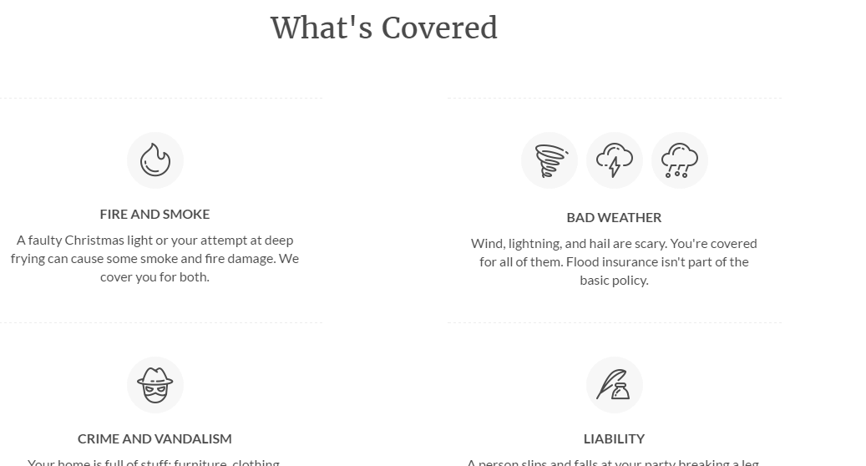
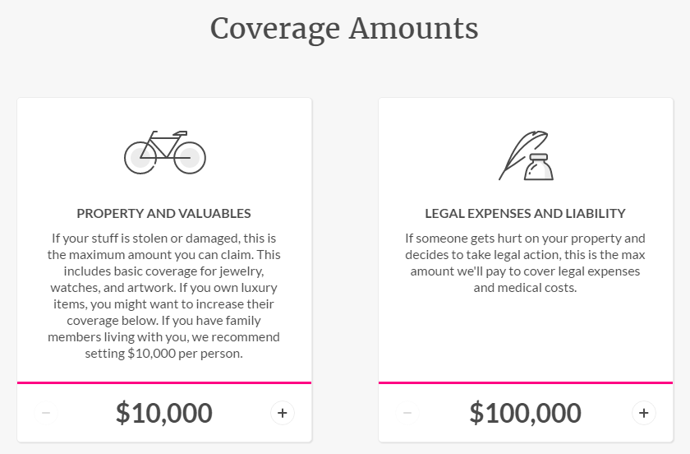
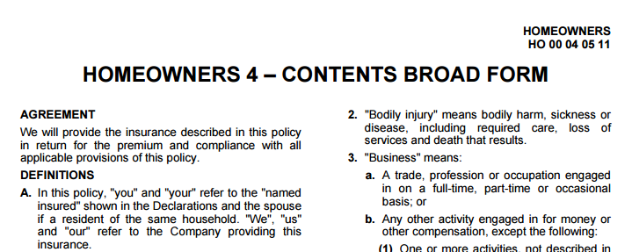
Lemonade’s P2P Model
Example: Renters’ Insurance (HO-4)
Attractive Graphics, Simple Explanations of a Basic ISO Form
SOURCE: Lemonade.com, Insurance Information Institute.

Slide 30
Lemonade’s P2P Model
Questions
Who Holds the Risk?
Other Questions
How Are Charitable Pools Separated?
Who Gets the Float?
  Insurer, Reinsurer or Charity?
Who Gets the Tax Deduction (Worth More Than the Float)?
The Giveback Occurs on June 20 – 4 Equal Payments Over 4 Years – (Active Policies Only)
SOURCE: Lemonade.com, Insurance Information Institute.

Slide 31
Summary
Auto costs are rising (both frequency and severity)
  People Are Driving More: Improving employment picture driving frequency higher
  People Are Driving Faster: Fatalities have risen 16 percent in two years
Disruption provides opportunities and challenges throughout the value chain

Slide 32
Thank you for your time and your attention!
www.iii.org
Download at www.iii.org/presentations

