Slide 1
Trends, Challenges & Opportunities in the P/C Insurance Industry:
2014 and Beyond
Guy Carpenter Mutual Company Conference
Philadelphia, PA
June 4, 2014
Download at www.iii.org/presentations
Robert P. Hartwig, Ph.D., CPCU, President & Economist
Insurance Information Institute ♦ 110 William Street ♦ New York, NY 10038
Tel: 212.346.5520 ♦ Cell: 917.453.1885 ♦ bobh@iii.org ♦ www.iii.org

Slide 2
P/C Insurance Industry Financial Overview
2013: Best Year in the Post-Crisis Era
Performance Improved with Lower CATs, Strong Markets
2

Slide 3
P/C Net Income After Taxes
1991–2013 ($ Millions)
2005 ROE*= 9.6%
2006 ROE = 12.7%
2007 ROE = 10.9%
2008 ROE = 0.1%
2009 ROE = 5.0%
2010 ROE = 6.6%
2011 ROAS¹ = 3.5%
2012 ROAS¹ = 6.1%
2013 ROAS¹ = 10.3%
Net income in 2013 was up substantially (+81.9%) from 2012
2013 ROAS was 10.3%
ROE figures are GAAP; ¹Return on avg. surplus. Excluding Mortgage & Financial Guaranty insurers yields a 9.8% ROAS in 2013, 6.3% ROAS in 2012, 4.7% ROAS for 2011, 7.6% for 2010 and 7.4% for 2009.
Sources: A.M. Best, ISO, Insurance Information Institute

Slide 4
Profitability Peaks & Troughs in the P/C Insurance Industry, 1975 – 2013*
ROE
1977:19.0%
1987:17.3%
10 Years
2006:12.7%
1997:11.6%
2013: 9.8 %
10 Years
9 Years
2011: 4.7%
1975: 2.4%
1984: 1.8%
1992: 4.5%
2001: -1.2%
*Profitability = P/C insurer ROEs. 2011-13 figures are estimates based on ROAS data. Note: Data for 2008-2013 exclude mortgage and financial guaranty insurers.
Source: Insurance Information Institute; NAIC, ISO, A.M. Best.

Slide 5
A 100 Combined Ratio Isn’t What It
Once Was: Investment Impact on ROEs
A combined ratio of about 100 generates an ROE of ~7.0% in 2012, ~7.5% ROE in 2009/10,
10% in 2005 and 16% in 1979
Combined Ratio / ROE
Lower CATs helped ROEs in 2013
Combined Ratios Must Be Lower in Today’s Depressed
Investment Environment to Generate Risk Appropriate ROEs
* 2008 -2013 figures are return on average surplus and exclude mortgage and financial guaranty insurers. 2013 combined ratio including M&FG insurers is 96.1; 2012 =103.2, 2011 = 108.1, ROAS = 3.5%.
Source: Insurance Information Institute from A.M. Best and ISO Verisk Analytics data.

Slide 6
ROE: Property/Casualty Insurance vs. Fortune 500, 1987–2013E*
(Percent)
P/C Profitability Is Both by
Cyclicality and Ordinary Volatility
Katrina, Rita, Wilma
Low CATs
Sept. 11
Hugo
Lowest CAT Losses in
15 Years
4 Hurricanes
Sandy
Andrew
Record Tornado Losses
Northridge
Financial Crisis*
* Excludes Mortgage & Financial Guarantee in 2008 – 2013. 2013 Fortune 500 figure is I.I.I. estimate.
Sources: ISO, Fortune; Insurance Information Institute.

Slide 7
ROE: ROEs by Industry vs. Fortune 500, 1987–2012*
Average: 1987-2012
Diversified Finl: 15.0% Commercial Banks: 13.1% All Industries (F500): 13.4% Life/Health Insurance: 8.8% P/C Insurance: 7.6%
(Percent)
* All figures are GAAP.
Sources: ISO, Fortune; Insurance Information Institute.

Slide 8
RNW for Major P/C Lines,
2003-2012 Average
10-year returns for some lines are excellent, though homeowners is a major laggard, largely due to major catastrophes. WC returns slipped.
Source: NAIC; Insurance Information Institute

Slide 9
RNW All Lines by State, 2003-2012 Average:
Highest 25 States
The most profitable states over the past decade are widely distributed geographically, though none are in the Gulf region
Source: NAIC.

Slide 10
RNW All Lines by State, 2003-2012 Average:
Lowest 25 States
Some of the least profitable states over the past decade were hit hard by catastrophes
Source: NAIC.

Slide 11
Net Premium Growth: Annual Change,
1971—2014F
(Percent)
1975-78
1984-87
2000-03
Net Written Premiums Fell 0.7% in 2007 (First Decline Since 1943) by 2.0% in 2008, and 4.2% in 2009, the First 3-Year Decline Since 1930-33.
2014F: 4.0%
2013: 4.6%
2012: +4.3%
Shaded areas denote “hard market” periods
Sources: A.M. Best (historical and forecast), ISO, Insurance Information Institute.

Slide 12
Growth by Major P/C Line, 2013
Other Liability and Homeowners were the fastest growing lines in 2013
*Includes Products Liability.
Source: Annual Statement data for by line statistics; NCCI for WC; ISO for Total P/C; Insurance Information Institute.

Slide 13
Average Commercial Rate Change,
All Lines, (1Q:2004–1Q:2014)
Pricing as of Q1:2014 was positive for the 11th consecutive quarter.
(Percent)
Q2 2011 marked the last of 30th consecutive quarter of price declines
KRW Effect
Note: CIAB data cited here are based on a survey. Rate changes earned by individual insurers can and do vary, potentially substantially.
Source: Council of Insurance Agents & Brokers; Insurance Information Institute

Slide 14
Change in Commercial Rate Renewals, by Line: 2014:Q1
D&O increases are large than any other line, followed by EPL and Workers Comp
Percentage Change (%)
Major Commercial Lines Renewed Generally Upward in Q4:2014 for the 11th Consecutive Quarter; D&O, Employment Practices and Workers Comp Leading the Way; Lower Cat Losses and Falling Reinsurance Prices Have Pressured Property Coverages Lower; Low Interest Rates Still Exert Upward Rate Pressure
Note: CIAB data cited here are based on a survey. Rate changes earned by individual insurers can and do vary, potentially substantially.
Source: Council of Insurance Agents and Brokers; Insurance Information Institute.

Slide 15
Growth Analysis by State and Business Segment
Post-Crisis Paradox?
Premium Growth Rates Vary Tremendously by State
15

Slide 16
Direct Premiums Written: Total P/C
Percent Change by State, 2007-2013
Top 25 States
North Dakota was the country’s growth leader over the past 6 years with premiums written expanding by 74.6%
Sources: SNL Financial LC.; Insurance Information Institute.

Slide 17
Direct Premiums Written: Total P/C
Percent Change by State, 2007-2013
Bottom 25 States
Growth was negative in 7 states and DC between 2007 and 2013
Sources: SNL Financial LC.; Insurance Information Institute.

Slide 18
Direct Premiums Written: PP Auto
Percent Change by State, 2007-2013
Top 25 States
Sources: SNL Financial LC.; Insurance Information Institute.

Slide 19
Direct Premiums Written: PP Auto
Percent Change by State, 2007-2013
Bottom 25 States
Sources: SNL Financial LC.; Insurance Information Institute.

Slide 20
Advertising Expenditures by P/C Insurance Industry, 1999-2013
$ Billions
P/C ad spend hit an all time record high of $6.175 billion in 2013, up 1.5% over 2012. The pace of growth has slowed from 15.8% in 2011 and 23.8% in 2010
P/C ad spending has more than tripled since 2002 (up 256% from 2002-2013)
Source: Insurance Information Institute from consolidated P/C Annual Statement data, Insurance Expense Exhibit (Part I).

Slide 21
Direct Premiums Written: Homeowners
Percent Change by State, 2007-2013
Top 25 States
Sources: SNL Financial LLC.; Insurance Information Institute.

Slide 22
Direct Premiums Written: Homeowners
Percent Change by State, 2007-2013
Bottom 25 States
Sources: SNL Financial LLC.; Insurance Information Institute.

Slide 23
Direct Premiums Written: Comm. Lines
Percent Change by State, 2007-2013
Top 25 States
Only 30 states showed any commercial lines growth from 2007 through 2013
Sources: SNL Financial LLC.; Insurance Information Institute.

Slide 24
Direct Premiums Written: Comm. Lines
Percent Change by State, 2007-2013
Bottom 25 States
Nearly half the states have yet to see commercial lines premium volume return to pre-crisis levels
States with the poorest performing economies also produced the most negative net change in premiums of the past 6 years
Sources: SNL Financial LLC.; Insurance Information Institute.

Slide 25
Direct Premiums Written: Workers’ Comp
Percent Change by State, 2007-2013*
Top 25 States
Only 13 states have seen works comp premium volume return to pre-crisis levels
*Excludes monopolistic fund states: ND, OH, WA, WY as well as WV, which transitioned to a competitive structure during this period.
Sources: SNL Financial LC.; Insurance Information Institute.

Slide 26
Direct Premiums Written: Worker’s Comp
Percent Change by State, 2007-2013*
Bottom 25 States
States with the poorest performing economies also produced some of the most negative net change in premiums of the past 6 years
*Excludes monopolistic fund states: ND, OH, WA, WY as well as WV, which transitioned to a competitive structure during this period.
Sources: SNL Financial LC.; Insurance Information Institute.

Slide 27
The Strength of the Economy Will Influence P/C Insurer Growth Opportunities
Growth Will Expand Insurer Exposure Base Across Most Lines
27

Slide 28
US Real GDP Growth*
The Q4:2008 decline was the steepest since the Q1:1982 drop of 6.8%
Real GDP Growth (%)
Recession began in Dec. 2007. Economic toll of credit crunch, housing slump, labor market contraction was severe
2014/15 are expected to see a modest acceleration in growth
Demand for Insurance Should Increase in 2014/15 as GDP Growth Accelerates Modestly and Gradually Benefits the Economy Broadly
* Estimates/Forecasts from Blue Chip Economic Indicators.
Source: US Department of Commerce, Blue Economic Indicators 4/14; Insurance Information Institute.

Slide 29
Real GDP by State Percent Change, 2012:
Highest 25 States
North Dakota was the economic growth juggernaut of the US in 2012—by far
Only 10 states experienced growth in excess of 3%, which is what we would see nationally in a more typical recovery
Sources: US Bureau of Labor Statistics; Insurance Information Institute.

Slide 30
Real GDP by State Percent Change, 2012:
Lowest 25 States
Growth rates in 8 states (and DC) were still below 1% in 2012
Connecticut was the only state to shrink in 2012
Sources: US Bureau of Labor Statistics; Insurance Information Institute.

Slide 31
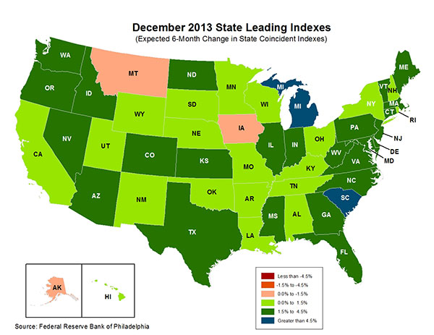
State-by-State Leading Indicators
through 2014:Q2
The economic outlook for most of the US is positive for the first time in many years
Sources: Federal Reserve Bank of Philadelphia at http://www.philadelphiafed.org/index.cfm ;Insurance Information Institute.

Slide 32
Consumer Sentiment Survey (1966 = 100)
January 2010 through May 2014
Optimism among consumers improved in the first part of 2014
Impact of 2011 budget impasse
Consumer confidence has been low for years amid high unemployment, falling home prices and other factors adversely impact consumers, but improved substantially over the past 2+ years, though uncertainty in Washington sometimes takes a toll.
Source: University of Michigan; Insurance Information Institute

Slide 33
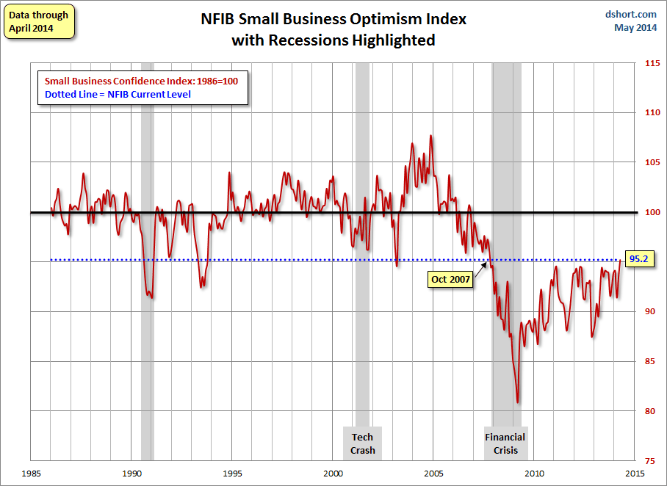
NFIB Small Business Optimism Index
January 1985 through April 2014
Small business optimism in April exceeded for the first time its level when the crisis began in Dec. 2007.
Source: National Federation of Independent Business at http://www.advisorperspectives.com/dshort/charts/indicators/Sentiment.html?NFIB-optimism-index.gif ; Insurance Information Institute.

Slide 34
Net Worth of Households*
Recently Hit A Historic High
2008-09 recession: -15.7%
$ Trillions
Adjusted for population growth, net worth is slightly short of its prior peak
Housing “bubble”
2001 recession
1992 recession
1982 recession
Rising net worth fuels a “wealth affect” that helps fuel consumer spending, which accounts for 70% of spending in the U.S. economy
*and nonprofit organizations. Data are as of year-end, except in 2013:Q3 (data posted on Dec 9, 2013).
Next release March 6, 2014. Data not seasonally adjusted or inflation-adjusted
Source: Federal Reserve Board

Slide 35
Household Financial Obligations
Ratio Recently Hit A Historic Low
Financial Obligations Ratio
Financial Obligations Ratio: debt service (mortgage and consumer debt), auto lease, residence rent, HO insurance, and property tax payments as % of personal disposable income.
Household balance sheets are stronger than they’ve been in many years, setting the stage for more consumer spending
Decline began in 2008:Q1.
15.23% in 2012:Q4
is lowest ratio since 1980:Q4 (15.09%).
*through 2013:Q3 (data posted on Dec 13, 2013)
Source: Federal Reserve Board, at http://www.federalreserve.gov/releases/housedebt

Slide 36
Auto/Light Truck Sales, 1999-2019F
Job growth and improved credit market conditions will boost auto sales in 2014 and beyond
(Millions of Units)
New auto/light truck sales fell to the lowest level since the late 1960s. Forecast for 2014-15 is still below 1999-2007 average of 17 million units, but a robust recovery is well underway.
Truck purchases by contractors are especially strong
Car/Light Truck Sales Will Continue to Recover from the 2009 Low Point, Bolstering the Auto Insurer Growth and the Manufacturing Sector Along With Workers Comp Exposures
Source: U.S. Department of Commerce; Blue Chip Economic Indicators (5/14 and 3/13); Insurance Information Institute.

Slide 37
Personal Auto Insurance Direct Written Premiums vs. Recently-Registered Cars
$ Billions
4%/yr growth forecast for PP DWP from recovering new car/truck sales
In 2004-07 no growth in PP DWP despite strong new car/truck sales
New car/truck sales grow to 14-15M/year
Average age of registered cars rose as fewer new cars were bought (and insured)
PP DWP, flat from 2004-2009, is rising again.
Conning forecasts growth at 3.5% in 2013 and 4.0% in 2014.
Sources: AIPSO Facts (various issues); SNL Financial; Conning Research & Consulting, Property-Casualty Forecast and Analysis, First Quarter 2012; Insurance Information Institute.

Slide 38
Average Age of Vehicles on the Road, 2006—2013
Average vehicle age continues to increase because the slow economy leads many drivers to keep cars on the road longer and because cars are becoming more reliable
The average vehicle age reached a record 11.4 years in 2013
Average Vehicle
Age (Years)
The average age of a vehicle on the road is is expected to continue to increase until 2018. By 2018, the number of vehicles 12+ years old is expected to rise 11.6% from 2013 and the number that are under 5 years old is expected to increase by 41%
Sources: Polk, August 2013 Survey; Insurance Information Institute.
38
12/01/09 - 9pm
eSlide – P6466 – The Financial Crisis and the Future of the P/C
Notes:
38

Slide 39
Monthly Change* in Auto Insurance Prices, 1991–2014*
Cyclical peaks in PP Auto tend to occur roughly every 10 years (early 1990s, early 2000s and likely the early 2010s)
Pricing peak occurred in late 2010 at 5.3%, falling to 2.8% by Mar. 2012
“Hard” markets tend to occur during recessionary periods
The Apr. 2014 reading of 4.4% is up from 4.2%
a year earlier
*Percentage change from same month in prior year; through April 2014; seasonally adjusted
Note: Recessions indicated by gray shaded columns.
Sources: US Bureau of Labor Statistics; National Bureau of Economic Research (recession dates); Insurance Information Institutes.
39
12/01/09 - 9pm
eSlide – P6466 – The Financial Crisis and the Future of the P/C
Notes:
39

Slide 40
Auto Insurance Price Index vs. CPI, 1994–2014*
Index: Jan 1994 = 100
Annual average growth rate of the CPI from 1994 to now: 2.5%.
Annual average growth rate of auto insurance prices from 1994 to now: 3.3%.
*Seasonally adjusted, through March 2014
Sources: US Bureau of Labor Statistics; National Bureau of Economic Research (recession dates); Insurance Information Institute.
40
12/01/09 - 9pm
eSlide – P6466 – The Financial Crisis and the Future of the P/C
Notes:
40

Slide 41
Yearly Change in Auto Insurance Prices vs. Median Weekly Earnings
Sources: US Bureau of Labor Statistics; Insurance Information Institute

Slide 42
Monthly Change* in Auto Insurance Prices, January 2005 - December 2013
Pricing weakened in 2011, strengthened in 2012/early 2013 but has since moderated
(Percent Change
from same month,
prior year)
Auto Insurance Price Increases Averaged 5.1% in 2010 over 2009, After Averaging 4.5% in 2009 over 2008.
PPA Auto, like most p/c lines, exhibits strong cyclicality in pricing. Prices rose from 2000 to late 2005, were flat/falling in 2006 and 2007 before beginning to rise gain in 2008.
Underwriting performance remained strong even when prices were flat or falling due to improvements in underlying frequency and severity trends
* Percentage change from same month in prior year, seasonally adjusted.
Sources: US Bureau of Labor Statistics; Insurance Information Institute

Slide 43
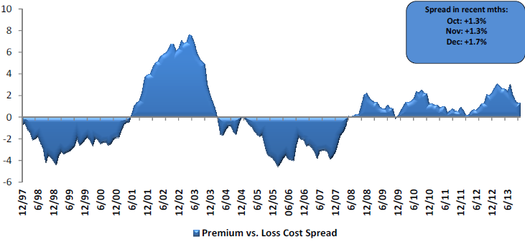
Private Passenger Auto: Premium Growth vs. Loss Cost Spread
Premium growth has generally exceeded underlying loss cost trends since mid-2008
Sources: Evercore Equity Research, Jan. 2014.

Slide 44
Average Expenditures on Auto Insurance
The average expenditure on auto insurance is lower today than it was in 2004
Countrywide Auto Insurance Expenditures Decreased by 0.8% in 2008 and 0.5% in 2009 and Increased 0.5% in 2010, 1.5% in 2011 (est.), 2.0% in 2012 and 2.2% in 2013 (forecast)
* Insurance Information Institute Estimates/Forecasts
Source: NAIC, Insurance Information Institute estimate for 2011-2013 based on CPI and other data.

Slide 45
New Private Housing Starts, 1990-2019F
Job growth, low inventories of existing homes, low mortgage rates and demographics should continue to stimulate new home construction for several more years
(Millions of Units)
New home starts plunged 72% from 2005-2009; A net annual decline of 1.49 million units, lowest since records began in 1959
Insurers Are Continue to See Meaningful Exposure Growth in the Wake of the “Great Recession” Associated with Home Construction: Construction Risk Exposure, Surety, Commercial Auto; Potent Driver of Workers Comp Exposure
Source: U.S. Department of Commerce; Blue Chip Economic Indicators (5/14 and 3/13); Insurance Information Institute.

Slide 46
Average Premium for
Home Insurance Policies**
Countrywide Home Insurance Expenditures Increased by an Estimated 4.0% in 2011-2013
* Insurance Information Institute Estimates/Forecasts **Excludes state-run insurers.
Source: NAIC, Insurance Information Institute estimates for 2011-2013 based on CPI data and other data.

Slide 47
Interest Rate on Convention 30-Year Mortgages: Headed Back Up, 1990–2013*
Yields on 30-Year Mortgages in the U.S. plunged to all time record lows in late 2012 and early 2013 but are now rising as the Fed considers tapering its QE program
Yields on 30-Year mortgages have been below 6% for a five years
30-yr. mortgage rates are up 105 basis points since the beginning of the year
Since roughly 80% of P/C bond/cash investments are in 10-year or shorter durations, most P/C insurer portfolios will have low-yielding bonds for years to come.
*Monthly, through December 2013. Note: Recessions indicated by gray shaded columns.
Sources: Federal Reserve Bank at http://www.federalreserve.gov/releases/h15/data.htm.
National Bureau of Economic Research (recession dates); Insurance Information Institutes.
47
12/01/09 - 9pm
eSlide – P6466 – The Financial Crisis and the Future of the P/C
Notes:
47

Slide 48
30-Year Mortgages in 2013 Are Rising: What Will Be the Impact on Construction?
30-year mortgage rates were up sharply from their lows earlier in the year
Mortgage Interest Rates Will Rise as Expectations Over the Fed’s Tapering of QE3 Persist; Still Low by Historical Standards
*Weekly through November 14, 2013.
Sources: Federal Reserve Bank at http://www.federalreserve.gov/releases/h15/data.htm.; Insurance Information Institutes.
48
12/01/09 - 9pm
eSlide – P6466 – The Financial Crisis and the Future of the P/C
Notes:
48

Slide 49
Commercial & Industrial Loans Outstanding at FDIC-Insured Banks, Quarterly, 2006-2013*
$Trillions
Recession
In nominal dollar terms, this is an all-time high.
Outstanding loan volume has been growing for over two years
and (as of year-end 2012) surpassed previous peak levels.
*Latest data as of 9/8/2013.
Source: FDIC at http://www2.fdic.gov/qbp/ (Loan Performance spreadsheet); Insurance Information Institute.

Slide 50
Percent of Non-Current Commercial & Industrial Loans Outstanding at FDIC-Insured Banks,
Quarterly, 2006-2013:Q2*
Almost back to “normal” levels of noncurrent industrial & commercial loans
Recession
Non-current loans (those past due 90 days or more or in nonaccrual status) are nearly back to early-recession levels, fueling bank willingness to lend.
*Latest data as of 9/8/2013.
Source: FDIC at http://www2.fdic.gov/qbp/ (Loan Performance spreadsheet); Insurance Information Institute.

Slide 51
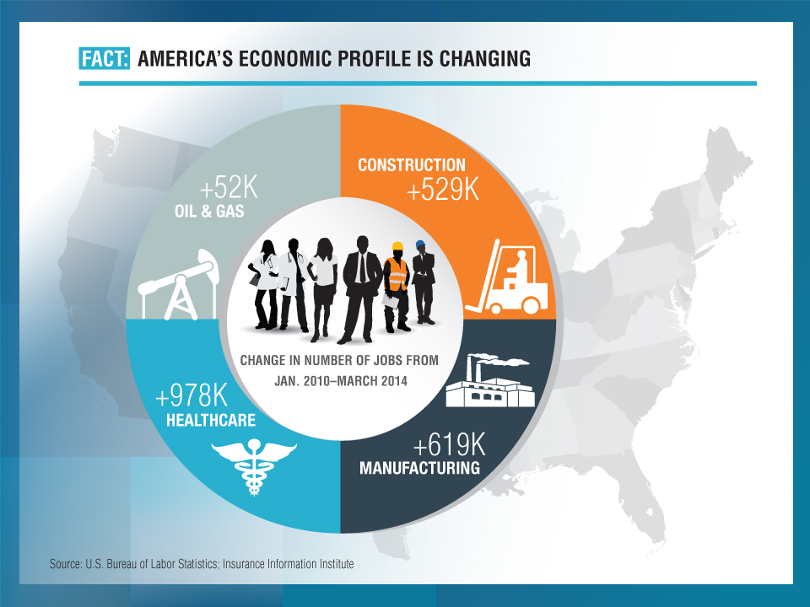
+53K
+600K
+990K
- April 2014
+640K

Slide 52
CONSTRUCTION, MANUFACTURING & ENERGY OUTLOOK
Key Sectors Critical to the Economy and the P/C Insurance Industry
52

Slide 53
Value of New Private Construction: Residential & Nonresidential, 2003-2014*
2014: Value of new pvt. construction hits $686.5B as of Apr. 2014, up 37% from the 2010 trough but still 25% below 2006 peak
New Construction peaks at $911.8. in 2006
Billions of Dollars
Trough in 2010 at $500.6B, after plunging 55.1% ($411.2B)
$15.0
$613.7
$308.0
$298.1
$261.8
$378.5
$238.8
Private Construction Activity Is Moving in a Positive Direction though Remains Well Below Pre-Crisis Peak; Residential Dominates
*2014 figure is a seasonally adjusted annual rate as of April.
Sources: US Department of Commerce; Insurance Information Institute.
53
12/01/09 - 9pm
eSlide – P6466 – The Financial Crisis and the Future of the P/C
Notes:
53

Slide 54
Value of Private Construction Put in Place, by Segment, April 2014 vs. April 2013*
Led by the Residential Construction, Lodging and Communication segments, Private sector construction activity is rising after plunging during the “Great Recession.”
Growth (%)
Private Construction Activity is Up in Many Segments, Including the Key Residential Construction Sector; Bodes Well for the Remainder of 2014
*seasonally adjusted
Source: U.S. Census Bureau, http://www.census.gov/construction/c30/c30index.html ; Insurance Information Institute.

Slide 55
Value of New Federal, State and Local Government Construction: 2003-2014*
Construction across all levels of government peaked at $314.9B in 2009
Austerity Reigns
Govt. construction is still shrinking, down $47.9B or 15.2% since 2009 peak
($ Billions)
Government Construction Spending Peaked in 2009, Helped by Stimulus Spending, but Continues to Contract As State/Local Governments Grapple with Deficits and Federal Sequestration Takes Hold
*2014 figure is a seasonally adjusted annual rate as of April; http://www.census.gov/construction/c30/historical_data.html
Sources: US Department of Commerce; Insurance Information Institute.

Slide 56
Construction Employment,
Jan. 2010—April 2014*
(Thousands)
Construction employment is +565,000 above
Jan. 2011 (+10.4%) trough
Construction and manufacturing employment constitute 1/3 of all payroll exposure.
*Seasonally adjusted.
Sources: US Bureau of Labor Statistics at http://data.bls.gov; Insurance Information Institute.
56
12/01/09 - 9pm
eSlide – P6466 – The Financial Crisis and the Future of the P/C
Notes:
56

Slide 57
Construction Employment,
Jan. 2003–April 2014
(Thousands)
Construction employment as of Apr. 2014 totaled 6.0 million, an increase of 565,000 jobs or 10.4% from the Jan. 2011 trough
Construction employment peaked at 7.726 million in April 2006
Gap between pre-recession construction peak and today: 1.7 million jobs
The “Great Recession” and housing bust destroyed 2.3 million constructions jobs
Construction employment troughed at 5.435 million in Jan. 2011, after a loss of 2.291 million jobs, a 29.7% plunge from the April 2006 peak
The Construction Sector Could Be a Growth Leader in 2014 as the Housing Market, Private Investment and Govt. Spending Recover. WC Insurers Will Benefit.
Note: Recession indicated by gray shaded column.
Sources: U.S. Bureau of Labor Statistics; Insurance Information Institute.
57
12/01/09 - 9pm
eSlide – P6466 – The Financial Crisis and the Future of the P/C
Notes:
57

Slide 58
MANUFACTURING SECTOR
A Potent Driver of Jobs and Commercial Lines Exposure
America’s Manufacturing Renaissance
58

Slide 59
Manufacturing Employment,
Jan. 2010—April 2014*
(Thousands)
Since Jan 2010, manufacturing employment is up (+640,000 or +5.6%)
and still growing.
Manufacturing employment is a surprising source of strength in the economy. Employment in the sector is at a multi-year high.
*Seasonally adjusted.
Sources: US Bureau of Labor Statistics at http://data.bls.gov; Insurance Information Institute.
59
12/01/09 - 9pm
eSlide – P6466 – The Financial Crisis and the Future of the P/C
Notes:
59

Slide 60
Dollar Value* of Manufacturers’ Shipments Monthly, Jan. 1992—Apr. 2014
$ Millions
The value of Manufacturing Shipments in Apr. 2014 was $497.6B—a new record high.
Monthly shipments in Apr. 2014 exceeded the pre-crisis (July 2008) peak. Manufacturing is energy-intensive and growth leads to gains in many commercial exposures: WC, Commercial Auto, Marine, Property, and various Liability Coverages.
* Seasonally adjusted; Data published June 3, 2014.
Source: U.S. Census Bureau, Full Report on Manufacturers’ Shipments, Inventories, and Orders, http://www.census.gov/manufacturing/m3/
60
12/01/09 - 9pm
eSlide – P6466 – The Financial Crisis and the Future of the P/C
Notes:
60

Slide 61
ISM Manufacturing Index
(Values > 50 Indicate Expansion)
January 2010 through May 2014
Manufacturing continues to expand in 2014
The manufacturing sector expanded for 51 of the 53 months from Jan. 2010 through May 2014. Pace of recovery has been uneven due to economic turbulence in the U.S., Europe and China
Source: Institute for Supply Management at http://www.ism.ws/ismreport/mfgrob.cfm; Insurance Information Institute.

Slide 62
Manufacturing Growth for Selected Sectors, 2014 vs. 2013*
Growth (%)
Durables: +3.5%
Non-Durables: +0.1%
Manufacturing of durable goods was stronger than nondurables in 2013
Manufacturing Is Expanding—Albeit Slowly—Across a Number of Sectors that Will Contribute to Growth in Insurable Exposures Including: WC, Commercial Property, Commercial Auto and Many Liability Coverages
*Seasonally adjusted; Date are YTD comparing data through March 2014 to the same period in 2013.
Source: U.S. Census Bureau, Full Report on Manufacturers’ Shipments, Inventories, and Orders, http://www.census.gov/manufacturing/m3/

Slide 63
Business Investment: Expected to Accelerate, Fueling Commercial Exposure Growth
Accelerating business investment will be a potent driver of commercial property and liability insurance exposures and should drive employment and WC payroll exposures as well (with a lag)
Source: IHS Global Insights as of Jan. 13, 2014; Insurance Information Institute.

Slide 64
12 Industries for the Next 10 Years: Insurance Solutions Needed
Health Care
Health Sciences
Energy (Traditional)
Many industries are poised for growth, though insurers’ ability to capitalize on these industries varies widely
Alternative Energy
Petrochemical
Agriculture
Natural Resources
Technology (incl. Biotechnology)
Light Manufacturing
Insourced Manufacturing
Export-Oriented Industries
Shipping (Rail, Marine, Trucking, Pipelines)

Slide 65
ENERGY SECTOR
America’s Energy Boom Is Potentially the Most Transformative Economic Force in the Country Today
Commercial Insurers Will Generate Billions in Premiums as Exposures Mushroom
65

Slide 66

Oil & Gas Extraction Employment,
Jan. 2010—April 2014*
Oil and gas extraction employment is up 33.6% since Jan. 2010 as the energy sector booms. Domestic energy production is essential to any robust economic recovery in the US.
Highest since Aug. 1986
(Thousands)
*Seasonally adjusted
Sources: US Bureau of Labor Statistics at http://data.bls.gov; Insurance Information Institute.
66
12/01/09 - 9pm
eSlide – P6466 – The Financial Crisis and the Future of the P/C
Notes:
66

Slide 67
U.S. Natural Gas Production, 2000-2013
Trillions of Cubic Ft. per Year
The U.S. is already the world’s largest natural gas producer—recently overtaking Russia. This is a potent driver of commercial insurance exposures
Source: Energy Information Administration, Short-Term Energy Outlook (April 8, 2014) , Insurance Information Institute.

Slide 68
U.S. Natural Has Imports and Exports, 1990 - 2040
Trillions of Cubic Feet
The US is now the largest gas producer in the world, though Russia is the largest exporter. The US needs to invest in its pipeline and LNG infrastructure and expedite regulatory approval to realize its full export potential
Sources: US Energy Information Administration, Annual Energy Outlook 2014 Early Release Overview; ;Insurance Information Institute.

Slide 69
U.S. Crude Oil Production, 2005-2015P
Millions of Barrels per Day
Crude oil production in the U.S. is expected to increase by 82.6% from 2008 through 2015—and could overtake Saudi Arabia as the world’s largest oil producer
Source: Energy Information Administration, Short-Term Energy Outlook (April 8, 2014) , Insurance Information Institute.

Slide 70
Trends in the Healthcare Industry
Growth of the Health Sector and Health Sector Employment Will Continue to Outpace
70

Slide 71
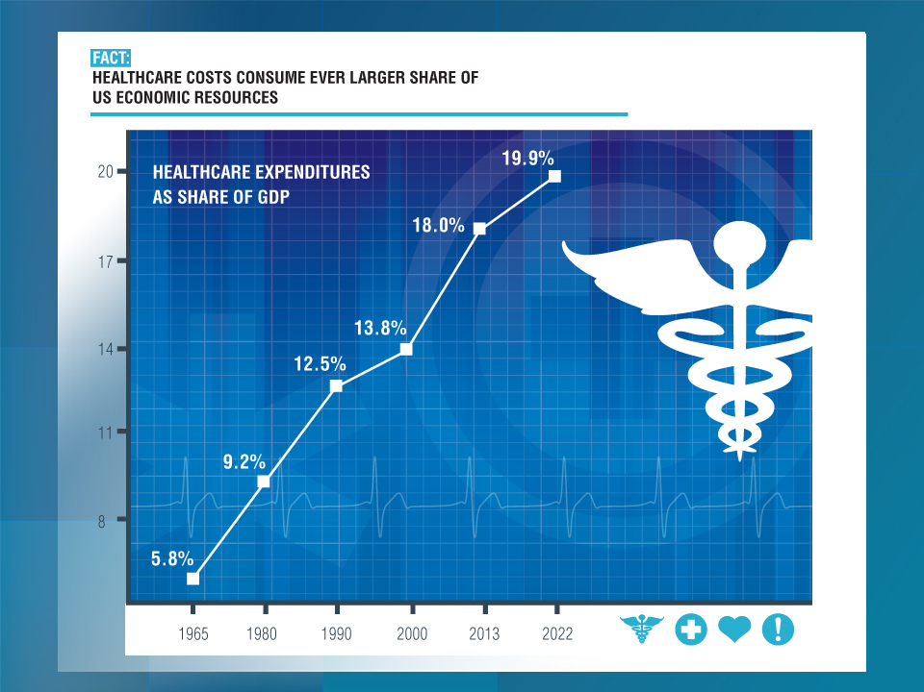

Slide 72
U.S. Health Care Expenditures,
1965–2022F
$ Billions
Healthcare is a labor intensive industry. Spending will rise from $3 trillion today to $5 trillion in 2022
From 1965 through 2013, US health care expenditures had increased by 69 fold. Population growth over the same period increased by a factor of just 1.6. By 2022, health spending will have increased 119 fold.
U.S. health care expenditures have been on a relentless climb for most of the past half century, far outstripping population growth, inflation of GDP growth
Sources: Centers for Medicare & Medicaid Services, Office of the Actuary at http://www.cms.gov/Research-Statistics-Data-and-Systems/Statistics-Trends-and-Reports/NationalHealthExpendData/NationalHealthAccountsProjected.html accessed 3/14/14; Insurance Information Institute.

Slide 73
Rate of Health Care Expenditure Increase Compared to Population, CPI and GDP
Health care expenditures increased 68 fold since 1965—about 3 times the pace of GDP growth
1965: $42.0 Bill
2013: $2,914.7 Bill
1965: $719.1 Bill
2013: $16,797.5 Bill
1965: 194.3 Mill
2013: 317.0 Mill
Source: Insurance Information Institute research.

Slide 74
National Health Care Expenditures as a Share of GDP, 1965 – 2022F*
% of GDP
Health care expenditures as a share of GDP rose from 5.8% in 1965 to 18.0% in 2013 and are expected to reach 19.9% of GDP by 2022
2022 19.9%
2010: 17.9%
2000: 13.8%
1990: 12.5%
Since 2009, heath expenditures as a % of GDP have flattened out at about 18%--the question is why and will it last?
1980: 9.2%
1965 5.8%
Sources: Centers for Medicare & Medicaid Services, Office of the Actuary at http://www.cms.gov/Research-Statistics-Data-and-Systems/Statistics-Trends-and-Reports/NationalHealthExpendData/NationalHealthAccountsProjected.html accessed 3/14/14; Insurance Information Institute.

Slide 75
Medical Cost Inflation vs. Overall CPI, 1995 - 2013
Though moderating, medical inflation will continue to exceed inflation in the overall economy
Average Annual Growth Average
Healthcare: 3.8%
Total Nonfarm: 2.4%
Sources: Med CPI from US Bureau of Labor Statistics, WC med severity from NCCI based on NCCI states.

Slide 76
Projected Number of People with No Health Insurance, 2013—2022*
By 2018 the number of people under age 65 without insurance is expected to drop by 25 million (~45%)
Millions
The projected decline in the uninsured population is very sensitive to the enrollment rate under the Affordable Care Act
*Under age 65.
Sources: Centers for Medicare & Medicaid Services, Office of the Actuary at http://www.cms.gov/Research-Statistics-Data-and-Systems/Statistics-Trends-and-Reports/NationalHealthExpendData/NationalHealthAccountsProjected.html accessed 3/14/14; Insurance Information Institute.
76
12/01/09 - 9pm
eSlide – P6466 – The Financial Crisis and the Future of the P/C
Notes:
76

Slide 77
Growth in Health Professions,
1991-2013
(Percent Annual Change)
Average Annual Growth Average
Healthcare: 2.5%
Total Nonfarm: 1.0%
The U.S. economy lost more than 8 million jobs during the Great Recession, but health sector employment expanded
Healthcare employment has continued to grow in good times and bad - including the Great Recession.
Sources: Bureau of Labor Statistics, Insurance Information Institute.
77
Notes:
77

Slide 78
Occupations Ranked by Projected Percentage Growth, 2012-2022F (%)
Healthcare professions are expected to grow at 2 to nearly 3 times employment growth overall
Source: Bureau of Labor Statistics, Insurance Information Institute.

Slide 79
Growth in Healthcare Profession by Skill Level, 2012 – 2022F
Nearly 3 million new healthcare jobs are projected through 2022!
(Thousands of Jobs)
+1.015 Mill +20.3%
+697,000 +24.1%
+750,000 +30.1%
+425,000 +24.0%
Source: Bureau of Labor Statistics, Insurance Information Institute.
79
Notes:
79

Slide 80
Labor Market Trends
Massive Job Losses Sapped the Economy and Commercial/Personal Lines Exposure, But Trend is Improving
80

Slide 81
Unemployment and Underemployment Rates: Still Too High, But Falling
January 2000 through April 2014, Seasonally Adjusted (%)
U-6 went from 8.0% in March 2007 to 17.5% in
October 2009; Stood at 12.3% in Apr. 2014.
8% to 10% is “normal.”
“Headline” unemployment was 6.3% in April 2014. 4% to 6% is “normal.”
Stubbornly high unemployment and underemployment constrain overall economic growth, but the job market is now clearly improving.
Source: US Bureau of Labor Statistics; Insurance Information Institute.
81
12/01/09 - 9pm
eSlide – P6466 – The Financial Crisis and the Future of the P/C
Notes:
81

Slide 82
US Unemployment Rate Forecast
2007:Q1 to 2015:Q4F*
Rising unemployment
eroded payrolls
and WC’s
exposure base.
Unemployment peaked at 10% in late 2009.
Jobless figures have been revised slightly downwards for 2014/15
Unemployment forecasts have been revised slightly downwards. Optimistic scenarios put the unemployment as low as 6.9% by Q4 of this year.
* = actual; = forecasts
Sources: US Bureau of Labor Statistics; Blue Chip Economic Indicators (5/14 edition); Insurance Information Institute.

Slide 83
Monthly Change in Private Employment
842,000 jobs created so far in 2014
January 2007 through April 2014 (Thousands, Seasonally Adjusted)
273,000 private sector jobs were created in April. In March 2014, the last of the jobs lost in the Great Recession were recovered
Jobs Created
2013: 2.368 Mill
2012: 2.294 Mill
2011: 2.400 Mill
2010: 1.277 Mill
Monthly losses in Dec. 08–Mar. 09 were the largest in the
post-WW II period
Private Employers Added 9.18 million Jobs Since Jan. 2010 After Having Shed 5.01 Million Jobs in 2009 and 3.76 Million in 2008 (State and Local Governments Have Shed Hundreds of Thousands of Jobs)
Source: US Bureau of Labor Statistics: http://www.bls.gov/ces/home.htm; Insurance Information Institute

Slide 84
Cumulative Change in Private Employment: Dec. 2007—Apr. 2014
Pvt. employment hit 116.4 million in April 2014—580,000 above its pre-crisis peak of 115.8 million
December 2007 through April 2014 (Millions)
Cumulative job losses peaked at 8.765 million in February 2010
It took more than 6 ½ years (79 months) to recover all of the private sector jobs lost in the Great Recession
Private Employers Added 9.18 million Jobs Since Jan. 2010 After Having Shed 4.98 Million Jobs in 2009 and 3.80 Million in 2008 (State and Local Governments Have Shed Hundreds of Thousands of Jobs)
Source: US Bureau of Labor Statistics: http://www.bls.gov/ces/home.htm; Insurance Information Institute

Slide 85
Cumulative Change in Private Sector Employment: Jan. 2010—Apr. 2014
(Millions)
Job gains and pay increases have added more than $750 billion to payrolls since Jan. 2010
Cumulative job gains through Apr. 2014 totaled 9.18 million
Private Employers Added 9.18 million Jobs Since Jan. 2010 After Having Shed 4.98 Million Jobs in 2009 and 3.80 Million in 2008 (State and Local Governments Have Shed Hundreds of Thousands of Jobs)
Source: US Bureau of Labor Statistics: http://www.bls.gov/ces/home.htm; Insurance Information Institute

Slide 86
Net Change in Government Employment: Jan. 2010—Apr. 2014
State government employment fell by 1.5% since the end of 2009 but is recovering while Federal employment is down by 5.3% and deteriorating
(Thousands)
Local government employment shrank by 380,000 from Jan. 2010 through Apr. 2014, accounting for 62% of all government job losses, negatively impacting WC exposures for those cities and counties that insure privately
Source: US Bureau of Labor Statistics http://www.bls.gov/data/#employment; Insurance Information Institute

Slide 87
Cumulative Change in Government Employment: Jan. 2010—Dec. 2013
Government at all levels has shed more than 600,000 jobs since Jan. 2010 even as private employers created 8.14 million jobs, though losses may now be stabilizing.
January 2010 through Dec. 2013* (Millions)
Cumulative job losses through Dec. 2013 totaled 631,000
Temporary Census hiring distorted 2010 figures
Governments at All Levels are Under Severe Fiscal Strain As Tax Receipts Plunged and Pension Obligations Soared During the Financial Crisis: Sequestration Will Add to this Toll
Source: US Bureau of Labor Statistics http://www.bls.gov/data/#employment; Insurance Information Institute

Slide 88
Unemployment Rates by State, April 2014:
Highest 25 States*
In April, 43 states had over-the-month unemployment rate decreases, 2 states had increases, and 5 states and the District of Columbia had no change.
*Provisional figures for April 2014, seasonally adjusted.
Sources: US Bureau of Labor Statistics; Insurance Information Institute.

Slide 89
Unemployment Rates by State, April 2014:
Lowest 25 States*
In April, 43 states had over-the-month unemployment rate decreases, 2 states had increases, and 5 states and the District of Columbia had no change.
*Provisional figures for April 2014, seasonally adjusted.
Sources: US Bureau of Labor Statistics; Insurance Information Institute.

Slide 90
U.S. Insured Catastrophe Loss Update
2013 Was a Welcome Respite from the High Catastrophe Losses in Recent Years
90

Slide 91

U.S. Insured Catastrophe Losses
($ Billions, $ 2012)
2012 was the third most expensive year ever for insured CAT losses
2012 Was the 3rd Highest Year on Record for Insured Losses in U.S. History on an Inflation-Adj. Basis. 2011 Losses Were the 6th Highest. YTD 2013 Running Well Below 2011 and 2012 YTD Totals.
Record tornado losses caused 2011 CAT losses to surge
*Through 12/31/13.
Note: 2001 figure includes $20.3B for 9/11 losses reported through 12/31/01 ($25.9B 2011 dollars). Includes only business and personal property claims, business interruption and auto claims. Non-prop/BI losses = $12.2B ($15.6B in 2011 dollars.)
Sources: Property Claims Service/ISO; Insurance Information Institute.
91
12/01/09 - 9pm
eSlide – P6466 – The Financial Crisis and the Future of the P/C
Notes:
91

Slide 92
Combined Ratio Points Associated with Catastrophe Losses: 1960 – 2013*
Avg. CAT Loss Component of the Combined Ratio by Decade
1960s: 1.04 1970s: 0.85 1980s: 1.31 1990s: 3.39 2000s: 3.52 2010s: 6.1E*
Catastrophe losses as a share of all losses reached a record high in 2012
Combined Ratio Points
The Catastrophe Loss Component of Private Insurer Losses Has Increased Sharply in Recent Decades
*2010s represent 2010-2013.
Notes: Private carrier losses only. Excludes loss adjustment expenses and reinsurance reinstatement premiums. Figures are adjusted for losses ultimately paid by foreign insurers and reinsurers.
Source: ISO (1960-2011); A.M. Best (2012E) Insurance Information Institute.

Slide 93
Top 10 States for Insured
Catastrophe Losses, 2013
$ Millions
Oklahoma had the highest CAT losses in the US in 2013
Source: The Property Claim Services (PCS) unit of ISO, a Verisk Analytics company.

Slide 94
Top 5 States by Insured Catastrophe Losses in 2012*
(2012, $ Billions)
Texas is almost always one of the top 5 states for insured CAT losses
*Includes catastrophe losses of at least $25 million.
Sources: PCS unit of ISO; Insurance Information Institute.

Slide 95
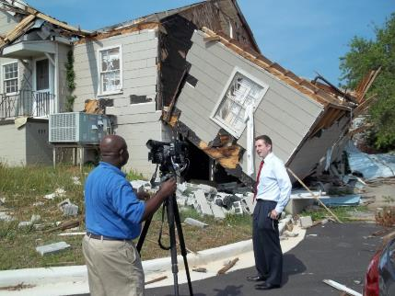
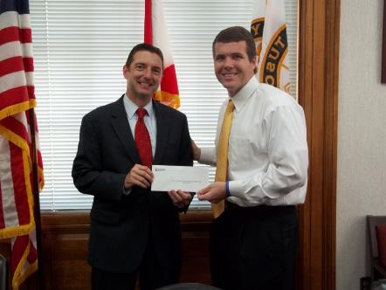

Insurers Making a Difference in Impacted Communities
Destroyed home in Tuscaloosa. Insurers will pay some 165,000 claims totaling $2 billion in the Tuscaloosa/ Birmingham areas alone.
Presentation of a check to Moore, OK, Public School Relief Fund
Presentation of a check to Tuscaloosa Mayor Walt Maddox to the Tuscaloosa Storm Recovery Fund
Source: Insurance Information Institute
95

Slide 96
Top States by Inflation-Adjusted Insured Catastrophe Losses, 1983–2012
Over the Past 30 Years Florida Has Accounted for the Largest Share of Catastrophe Losses in the U.S., Followed by Texas and Louisiana
TX is the 2nd costliest state for CATs, with nearly $50B in insured losses over the past 30 years
Louisiana
$42.0B
Texas
$48.8B
Rest of the U.S.
$309.9B
Florida
$66.7B
Total: $467.5 Billion, an average of $16.6B per year or $1.3B per month
Source: PCS unit of ISO, Verisk Company.; Insurance Information Institute.

Slide 97
Inflation Adjusted U.S. Catastrophe Losses by Cause of Loss, 1993–2012¹
Wind/Hail/Flood (3), $14.9
Fires (4), $6.5
Other (5), $0.2
Insured cat losses from 1993-2012 totaled $391.7B, an average of $19.6B per year or $1.6B per month
Geological Events, $18.4
Terrorism, $24.8
Winter Storms, $27.8
Hurricanes & Tropical Storms, $158.2
Tornado share of CAT losses is rising
Wind losses are by far cause the most catastrophe losses, even if hurricanes/TS are excluded.
Tornadoes (2), $140.9
Catastrophes are defined as events causing direct insured losses to property of $25 million or more in 2012 dollars.
Excludes snow.
Does not include NFIP flood losses
Includes wildland fires
Includes civil disorders, water damage, utility disruptions and non-property losses such as those covered by workers compensation.
Source: ISO’s Property Claim Services Unit.

Slide 98
Top 10 Winter Storm and Winter Damage Events in the US and Canada, 1980-2013*
Ranked by Insured Loss, in Millions of $ 2013*
Period | Area | Economic Loss (in inflation-adjusted 2013 $US mill) | Insured Loss (in inflation-adjusted 2013 $US mill) | Fatalities
Mar. 11-14, 1993 | CAN, USA | 8,061 | 3,224 | 270
Dec. 17-30,1983 | USA | 2,339 | 2,058 | 500
Apr. 13-17, 2007 | CAN, USA | 2,247 | 1,775 | 23
Dec. 10-13, 1992 | USA | 4,981 | 1,660 | 19
Jan. 5-12, 1998 | CAN, USA | 4,145 | 1,644 | 45
Feb. 10-12, 1994 | USA | 4,716 | 1,258 | 9
Jan. 17-20, 1994 | USA | 1,572 | 1,258 | 70
Apr. 7-11, 2013 | USA | 1,600 | 1,200 | N/A
Jan. 1-4, 1999 | CAN, USA | 1,398 | 1,084 | 25
Jan. 31-Feb. 2, 2011 | USA | 1,346 | 1,010 | 36
*Top 10 events in original insured loss dollars were adjusted to and ranked by the Insurance Information Institute to 2013 inflation-adjusted values.
Sources: Munich Re NatCatSERVICE; Insurance Information Institute.

Slide 99
Winter Storm and Winter Damage Events in the US and Canada, 1980-2013 (2013 US$)
Three of the four most costly years ever for insured losses from winter storms and damage occurred in the 1990s, led by the “Storm of the Century” in 1993.
Insured Losses (Millions, $ 2013)
5-year running average
Insured losses from severe winter events totaled $2 billion in 2013.
Insured winter storm and damage losses in Jan. 2014 already totaled $1.5 billion. Continued severe weather since then makes it likely that 2014 will become one of the top 5 costliest winters since 1980.
Sources: Munich Re NatCatSERVICE; Insurance Information Institute.
99

Slide 100
Top 16 Most Costly Disasters in U.S. History
(Insured Losses, 2012 Dollars, $ Billions)
Hurricane Sandy became the 5th costliest event in US insurance history
Includes Tuscaloosa, AL, tornado
Includes Joplin, MO, tornado
Hurricane Irene became the 12th most expense hurricane in US history in 2011
12 of the 16 Most Expensive Events in US History Have Occurred Over the Past Decade
*PCS estimate as of 4/12/13.
Sources: PCS; Insurance Information Institute inflation adjustments to 2012 dollars using the CPI.

Slide 101
Top 16 Most Costly World Insurance Losses, 1970-2013*
(Insured Losses, 2012 Dollars, $ Billions)
5 of the top 14 most expensive catastrophes in world history have occurred within the past 3 years (2010-2012)
2012 insured CAT Losses totaled $60B; Economic losses totaled $140B, according to Swiss Re
Hurricane Sandy is now the 6th costliest event in global insurance history
*Figures do not include federally insured flood losses.
**Estimate based on PCS value of $18.75B as of 4/12/13.
Sources: Munich Re; Swiss Re; Insurance Information Institute research.

Slide 102
Natural Disasters in the United States, 1980 – 2013
Number of Events (Annual Totals 1980 – 2013)
There were 128 natural disaster events in 2013
Number
22
19
81
6
Geophysical
(earthquake, tsunami,
volcanic activity)
Meteorological (storm)
Climatological
(temperature extremes,
drought, wildfire)
Hydrological
(flood, mass movement)
Source: MR NatCatSERVICE
102

Slide 103
Losses Due to Natural Disasters in the US, 1980–2013
(Overall and Insured Losses)
(2013 Dollars, $ Billions)
2013 CAT Losses
Overall : $21.8B
Insured: $12.8B
Indicates a great deal of losses are uninsured (~40%-50% in the US) = Growth Opportunity
2013 losses were far below 2011 and 2012 and were 44% lower than the average from 2000-2012
Overall losses (in 2012 values)
Insured losses (in 2013 values)
Source: MR NatCatSERVICE
103

Slide 104
Hurricane Sandy: Average Claim Payment by Type of Claim
Commercial (i.e., business claims) are more expensive because the value of property is often higher as well as the impact of insured business interruption losses
The average insured flood loss was nearly 9 times larger than the average non-flood insured loss (mostly wind)
Post-Sandy, the I.I.I. worked very hard to make help media, consumers and regulators understand the distinction between a flood claim and a standard homeowners claim. NFIP is $24B in debt.
*Includes rental and condo policies (excludes NFIP flood). **As of Oct. 31, 2013.
Sources: Catastrophe loss data is for Catastrophe Serial No. 90 (Oct. 28 – 31, 2012) from PCS as of March 2013; Insurance Information Institute.

Slide 105
Natural Disaster Losses in the United States, by Type, 2013
As of December 31, 2013 | Number of Events | Fatalities | Estimated Overall Losses (US $m) | Estimated Insured Losses (US $m)
Severe Thunderstorm | 69 | 110 | 16,341 | 10,274
Winter Storm | 11 | 43 | 2,935 | 1,895
Flood | 19 | 23 | 1,929 | 240
Earthquake & Geophysical | 6 | 1 | Minor | Minor
Tropical Cyclone | 1 | 1 | Minor | Minor
Wildfire, Heat, & Drought | 22 | 29 | 620 | 385
Totals | 128 | 207 | 21,825 | 12,794
Source: Munich Re NatCatSERVICE
105
105

Slide 106
Significant Natural Catastrophes, 2013
(Events with $1 billion economic loss and/or 50 fatalities)
Date | Event | Estimated Economic Losses (US $m) | Estimated Insured Losses (US $m)
February 24 – 25 | Winter Storm | 1,300 | 690
March 18 – 19 | Thunderstorms | 2,200 | 1,600
April 7 – 11 | Winter Storm | 1,600 | 1,200
April 16 – 18 | Thunderstorms | 1,100 | 560
May 18 – 20 | Thunderstorms | 3,100 | 1,800
May 28 – 31 | Thunderstorms | 2,800 | 1,400
August 6 – 7 | Thunderstorms | 1,300 | 740
September 9 – 16 | Flooding | 1,500 | 160
November 17 - 18 | Thunderstorms | 1,300 | 931
Source: Munich Re NatCatSERVICE
106

Slide 107
Top 12 Most Costly Hurricanes in U.S. History
(Insured Losses, 2012 Dollars, $ Billions)
10 of the 12 most costly hurricanes in insurance history occurred over the past 9 years (2004—2012)
Hurricane Sandy became the 3rd costliest hurricane in US insurance history
Hurricane Irene became the 12th most expensive hurricane in US history in 2011
*PCS estimate as of 4/12/13.
Sources: PCS; Insurance Information Institute inflation adjustments to 2012 dollars using the CPI.

Slide 108
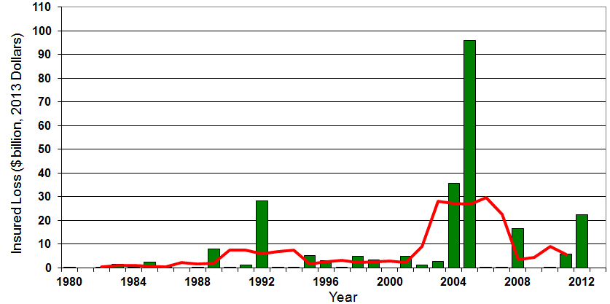

Insured US Tropical Cyclone Losses, 1980 - 2013
The current 5-year average (2008 - 2013) insured tropical cyclone loss is $5.6 billion per year.
Sources: Property Claims Service, Munich Re NatCatSERVICE, NFIP
108

Slide 109
Total Value of Insured Coastal Exposure in 2012
(2012, $ Billions)
The value of insured coastal exposure in FL and NY is close to $3 trillion
In 2012, New York Ranked as the #1 Most
Exposed State to Hurricane Loss, Overtaking Florida with $2.862 Trillion. Texas is very exposed too, and ranked #3 with $1.175 Trillion
in insured coastal exposure
The Insured Value of All Coastal Property Was $10.6 Trillion in 2012 , Up 20% from $8.9 Trillion in 2007 and Up 48% from $7.2 Trillion in 2004
Source: AIR Worldwide

Slide 110
Total Value of Insured Coastal Exposure in 2007
(2007, $ Billions)
In 2007, Florida Still Ranked as the #1 Most
Exposed State to Hurricane Loss, with
$2.459 Trillion Exposure, but Texas is very exposed too, and ranked #3 with $895B
in insured coastal exposure
The Insured Value of All Coastal Property Was $8.9 Trillion in 2007, Up 24% from $7.2 Trillion in 2004
Source: AIR Worldwide

Slide 111
Total Potential Home Value Exposure to Storm Surge Risk in 2013*
($ Billions)
Florida is by the state most vulnerable to storm surge.
The Value of Homes Exposed to Storm Surge was $1.147 Trillion in 2013.* Only a fraction of this is insured, hence the huge demand for federal aid following major coastal flooding events.
*Insured and uninsured property. Based on estimated property values as of April 2013.
Source: Storm Surge Report 2013, CoreLogic.

Slide 112
The combined ratios for both personal and commercial lines improved substantially in 2013:H1

Slide 114
The combined ratios for both personal and commercial lines improved substantially in 2013:H1

Slide 115
Florida Citizens Exposure to Loss,
2002 – 2014* ($ Billions)
Total exposure to loss in Florida Citizens since its 2002 inception increased by 230 percent, from $154.6 billion to $510.7 billion in 2011 but has now dropped by $212.3 billion or 41.6% through 3/31/14
*As of March 31, 2014 from Florida Citizens accessed at: https://www.citizensfla.com/about/bookofbusiness/
Source: PIPSO; Insurance Information Institute (I.I.I.).
Notes:
115

Slide 116
Convective Loss Events in the U.S.
Number of events 1980 – 2012 and First Half 2013
Number
The frequency of convective events has rising tremendously over the past 30+ years
Convective events are those caused by straight-line winds, tornadoes, hail, heavy precipitation, flash floods and lightning
Source: Geo Risks Research, NatCatSERVICE – As at July 2013
116

Slide 117
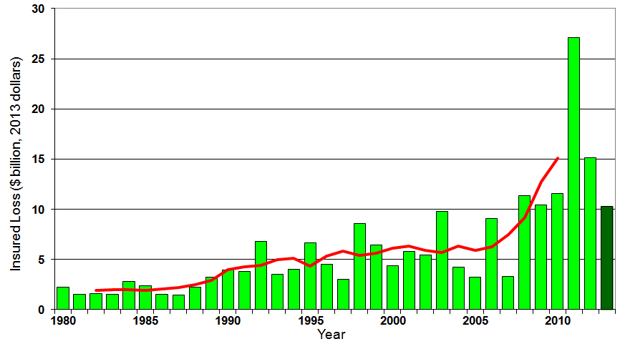
U.S. Thunderstorm Insured Loss Trends, 1980 – 2013
Hurricanes get all the headlines, but thunderstorms are consistent producers of large scale loss. 2008-2013 are the most expensive years on record.
Average thunderstorm losses are up 7 fold since the early 1980s. The 5-year running average loss is up sharply
Thunderstorm losses in 2013 totaled $10.3 billion, the 6th highest on record
Source: Property Claims Service, MR NatCatSERVICE
117

Slide 118
Convective Loss Events in the U.S.
Number of events 1980 – 2013
Number
The frequency of convective events has rising tremendously over the past 30+ years
Convective events are those caused by straight-line winds, tornadoes, hail, heavy precipitation, flash floods and lightning
Source: Geo Risks Research, NatCatSERVICE.
118

Slide 119
Convective Loss Events in the U.S.
Overall and insured losses 1980 – 2012 and First Half 2013
(Bill. US$)
The insured and total economic cost of convective events has rising tremendously over the past 30+ years
Convective events are those caused by straight-line winds, tornadoes, hail, heavy precipitation, flash floods and lightning
Analysis contains: straight-line winds, tornadoes, hail, heavy precipitation, flash floods, lightning.
Overall losses (in 2013 values)
Insured losses (in 2013 values)
Source: Geo Risks Research, NatCatSERVICE.
119

Slide 120
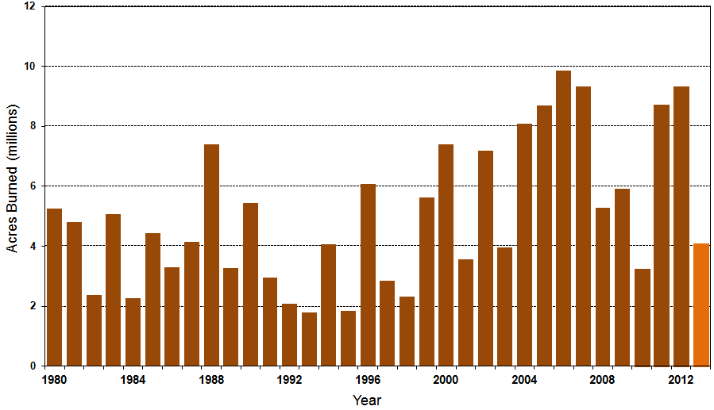
Number of Acres Burned in Wildfires, 1980 – 2013
TX experienced significant wildfire losses in 2011 (Bastrop fire insured losses ~$500 million)
Source: National Interagency Fire Center
120

Slide 121
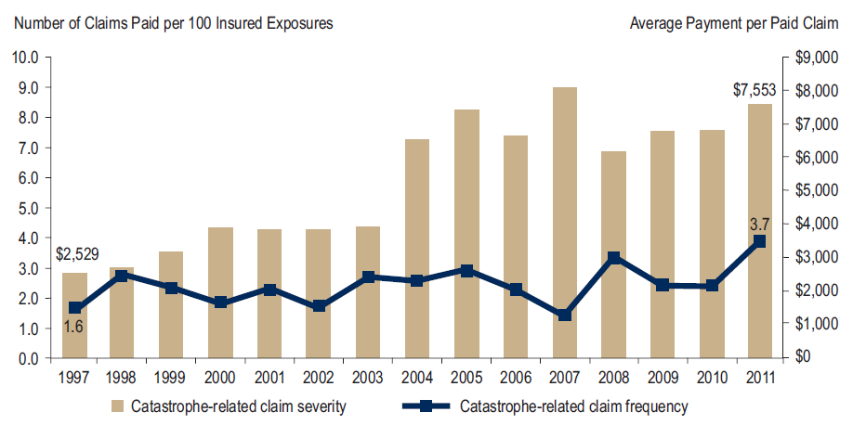
Homeowners Insurance Catastrophe-Related Claim Frequency and Severity, 1997—2012*
Avg. catastrophe claim cost rose approximately 200% from 1997-2011
Cat claim frequency in 2011 was at historic highs and more than double the rate in 1997
*All policy forms combined, countrywide.
Source: Insurance Research Council, Trends in Homeowners Insurance Claims, Sept. 2012 from ISO Fast Track data.
121

Slide 122
Homeowners Insurance Combined Ratio: 1990–2013P
Hurricane Andrew
Record tornado activity
Hurricane Sandy
Hurricane Ike
Low Cat Losses Led to 2013 Improvement. Homeowners Performance in 2011/12 Impacted by Large Cat Losses. Extreme Regional Variation Can Be Expected Due to Local Catastrophe Loss Activity
Sources: A.M. Best (1990-2012);NCCI (2013P); Insurance Information Institute.

Slide 123
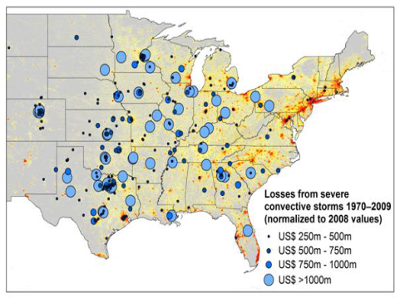
New Research Suggests Increase in Convective Activity Is Costly for Insurers
Study examines convective (hail, tornado, thundersquall and heavy rainfall) events in the US with losses exceeding US$ 250m in the period 1970–2009 (80% of all losses)
Past losses are normalized (i.e., adjusted) to currently exposed values
After normalization there are still increases of losses
Increases are correlated with
the increase in the meteorological
potential for severe thunderstorms
and its variability
For the first time research shows
that climatic changes have already
influenced US thunderstorm losses
Source: Munich Re research paper, Marhc 18, 2013: Rising Variability in Thunderstorm-Related U.S. Losses as a Reflection of Changes in Large-Scale Thunderstorm Forcing.
123

Slide 124
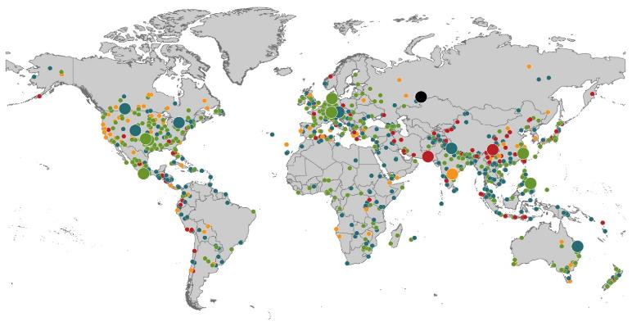
Natural Loss Events:
Full Year 2013
World Map
Winter Storm Christian (St. Jude)
Europe, 27–30 October
Floods
Europe,
30 May–19 June
Meteorite impact
Russian Federation, 15 February
Flash floods
Canada, 8–9 July
Floods
Canada, 19–24 June
Earthquake
China, 20 April
Hailstorms
Germany,
27–28 July
Floods
USA, 9–16 September
Typhoon Fitow
China, Japan,
5–9 October
Severe storms, tornadoes
USA, 18–22 May
Typhoon Haiyan
Philippines,
8–12 November
Severe storms, tornadoes
USA, 28–31 May
Floods
India, 14–30 June
Hurricanes Ingrid & Manuel
Mexico, 12–19 September
Floods
Australia,
21–31 January
880
Loss events
Earthquake (series)
Pakistan, 24–28 September
Heat wave
India, April–June
Geophysical events
(earthquake, tsunami, volcanic activity)
Hydrological events
(flood, mass movement)
Natural catastrophes
Geophysical events
(earthquake, tsunami, volcanic activity)
Hydrological events
(flood, mass movement)
Selection of significant
Natural catastrophes
Meteorological events
(storm)
Climatological events
(extreme temperature, drought, wildfire)
Meteorological events
(storm)
Climatological events
(extreme temperature, drought, wildfire)
Extraterrestrial events
(Meteorite impact)
Source: Munich Re Geo Risks Research, NatCatSERVICE – as of January 2014.
124

Slide 125
Natural Disasters Worldwide,
1980 – 2013 (Number of Events)
There were 880 natural disaster events globally in 2013 compared to 905 in 2012
Number
Geophysical
(earthquake, tsunami,
volcanic activity)
Meteorological (storm)
Climatological
(temperature extremes,
drought, wildfire)
Hydrological
(flood, mass movement)
Source: MR NatCatSERVICE
125

Slide 126
Losses Due to Natural Disasters Worldwide, 1980–2013 (Overall & Insured Losses)
(Overall and Insured Losses)
(2013 Dollars, $ Billions)
10-Yr. Avg. Losses
Overall : $184B
Insured: $56B
2013 Losses
Overall : $125B
Insured: $34B
There is a clear upward trend in both insured and overall losses over the past 30+ years
Overall losses (in 2013 values)
Insured losses (in 2013 values)
Source: MR NatCatSERVICE
126

Slide 127
Outlook for the 2014 Atlantic Hurricane Season
Somewhat Below Average Activity, Fewer Landfalls Expected
127

Slide 128
Outlook for 2014 Hurricane Season: 30% Less Active Than Typical Year
 | Median* | 2005 (Katrina Year) | 2014F
Named Storms | 12.0 | 28 | 10
Named Storm Days | 60.1 | 115.5 | 40
Hurricanes | 6.5 | 14 | 4
Hurricane Days | 21.3 | 47.5 | 15
Major Hurricanes | 2.0 | 7 | 1
Major Hurricane Days | 3.9 | 7 | 3
Accumulated Cyclone Energy | 92.0 | NA | 65
Net Tropical Cyclone Activity | 103% | 275% | 70%
*Over the period 1981-2010.
Source: Dr. Philip Klotzbach and Dr. William Gray, Colorado State University, June 2, 2014.

Slide 129
Probability of Major Hurricane Landfall (CAT 3, 4, 5) in 2014
 | Average* | 2014F
Entire US Coast | 52% | 40%
US East Coast Including Florida Peninsula | 31% | 22%
Gulf Coast from FL Panhandle to Brownsville, TX | 30% | 23%
ALSO…Above-Average Major Hurricane Landfall Risk in Caribbean for 2011 (32% vs. 42%)
*Average over the past century.
Source: Dr. Philip Klotzbach and Dr. William Gray, Colorado State University, June 2, 2014.

Slide 130
Federal Disaster Declarations Patterns: 1953-2014
Disaster Declarations Set New Records in Recent Years
130

Slide 131
Number of Federal Major Disaster Declarations, 1953-2014*
There have been 2,163 federal disaster declarations since 1953. The average number of declarations per year is 35 from 1953-2013, though there few haven’t been recorded since 1995.
The number of federal disaster declarations set a new record in 2011, with 99, shattering 2010’s record 81 declarations.
23 federal disasters were declared so far in 2014*
The Number of Federal Disaster Declarations Is Rising and Set New Records in 2010 and 2011 Before Dropping in 2012/13
*Through June 3, 2014.
Source: Federal Emergency Management Administration; http://www.fema.gov/disasters; Insurance Information Institute.

Slide 132
Federal Disasters Declarations by State,
1953 – 2014: Highest 25 States*
Over the past 60 years, Texas has had the highest number of Federal Disaster Declarations
*Through June 3, 2014. Includes Puerto Rico and the District of Columbia.
Source: FEMA: http://www.fema.gov/news/disaster_totals_annual.fema; Insurance Information Institute.

Slide 133
Federal Disasters Declarations by State,
1953 – 2014: Lowest 25 States*
Over the past 60 years, Wyoming and Rhode Island had the fewest number of Federal Disaster Declarations
*Through June 3, 2014. Includes Puerto Rico and the District of Columbia.
Source: FEMA: http://www.fema.gov/news/disaster_totals_annual.fema; Insurance Information Institute.

Slide 134
SEVERE WEATHER REPORT UPDATE: 2014
Damage from Tornadoes, Large Hail and High Winds Keep Insurers Busy
134

Slide 135
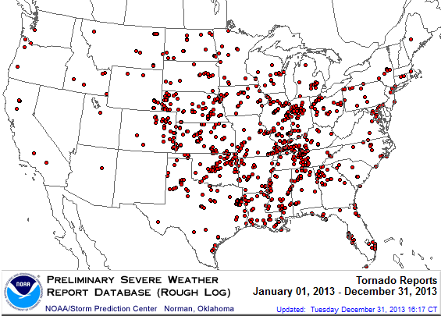
Location of Tornado Reports in 2013
A deadly EF-5 tornado in May in Moore, OK, produced insured losses of $1.575 billion. November tornadoes in the Midwest like produced $1B in insured losses.
There were 943 tornadoes through Dec. 31, causing extensive property damage in several states
Source: NOAA Storm Prediction Center; http://www.spc.noaa.gov/climo/online/monthly/2013_annual_summary.html#; PCS.
135

Slide 136
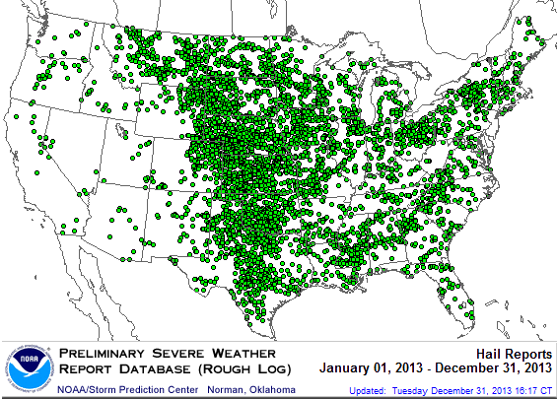
Location of Large Hail Reports: 2013
There were 5,457 “Large Hail” reports in 2013, causing extensive property and vehicle damage
Source: NOAA Storm Prediction Center; http://www.spc.noaa.gov/climo/online/monthly/2013_annual_summary.html#
136

Slide 137
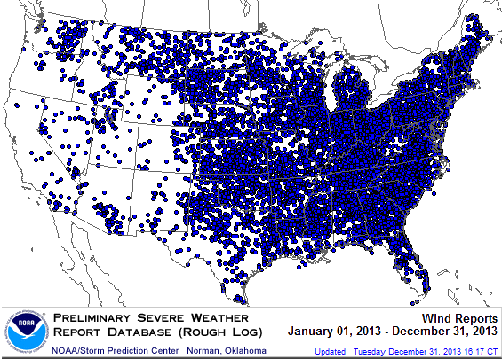
Location of High Wind Reports: 2013
There were 12,942 “Wind Damage” in 2013, causing extensive property damage
Source: NOAA Storm Prediction Center; http://www.spc.noaa.gov/climo/online/monthly/2013_annual_summary.html#
137

Slide 138
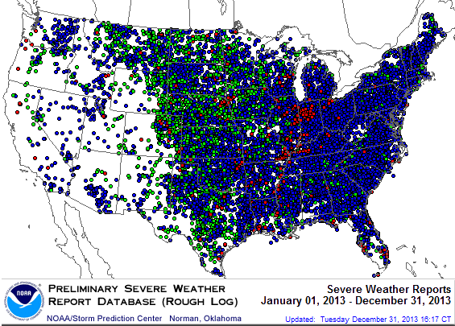
Severe Weather Reports: 2013
Severe weather reports are concentrated east of the Rockies
There were 19,342 severe weather reports in 2013; including 942 tornadoes; 5,457 “Large Hail” reports and 12,942 high wind events
Source: NOAA Storm Prediction Center; http://www.spc.noaa.gov/climo/online/monthly/2013_annual_summary.html#
138

Slide 139
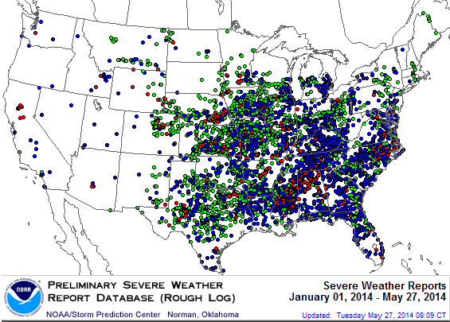
Severe Weather Reports: 2014*
Severe weather reports are concentrated east of the Rockies
There were 5,017 severe weather reports so far in 2014; including 415 tornadoes; 2,077 “Large Hail” reports and 2,524 high wind events
*Through May 27.
Source: NOAA Storm Prediction Center; http://www.spc.noaa.gov/climo/online/monthly/2014_annual_summary.html#
139

Slide 140
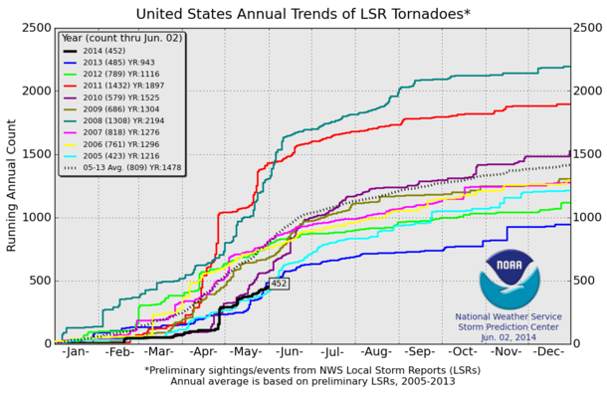
U.S. Tornado Count, 2005-2014*
There were 1,897 tornadoes in the U.S. in 2011 far above average, but well below 2008’s record
The YTD tornado count in 2014 is well below average
2013 count was the lowest in a decade
*Through June 2, 2014.
Source: http://www.spc.noaa.gov/wcm/.
140

Slide 141
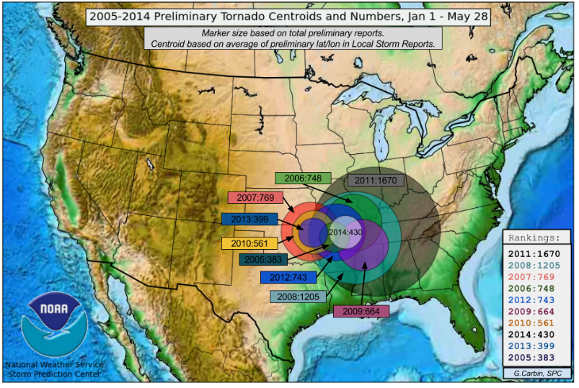
Tornado Spheroids, Jan. 1 – May 28, 2005-2014
2014 activity YTD is below average but concentrated a bit east of the center of “Tornado Alley”
Source: http://www.spc.noaa.gov/wcm/.
141

Slide 142
Flood Insurance &
Biggert-Waters Reforms
Implementation of BW-12 Has Caught Media and Public Policymaker Attention
142

Slide 143
Hurricane Sandy: Average Claim Payment by Type of Claim
Commercial (i.e., business claims) are more expensive because the value of property is often higher as well as the impact of insured business interruption losses
The average insured flood loss was nearly 9 times larger than the average non-flood insured loss (mostly wind)
Post-Sandy, the I.I.I. worked very hard to make help media, consumers and regulators understand the distinction between a flood claim and a standard homeowners claim. NFIP is $24B in debt.
*Includes rental and condo policies (excludes NFIP flood). **As of Oct. 31, 2013.
Sources: Catastrophe loss data is for Catastrophe Serial No. 90 (Oct. 28 – 31, 2012) from PCS as of March 2013; Insurance Information Institute.

Slide 144
Top 12 Most Costly Flood Events by NFIP Payout*
(NFIP Insured Losses, $ Millions)
8 of the 10 most costly events in NFIP history occurred over the past decade (2004‒2013); NFIP deficit now totals $24 billion
Katrina and Sandy are by far the most costly events in NFIP history
*Expressed in original dollars (not inflation-adjusted).
Sources: PCS; Insurance Information Institute inflation adjustments to 2012 dollars using the CPI.

Slide 145
Total Potential Home Value Exposure to Storm Surge Risk in 2013*
($ Billions)
Extreme risk shows why reforms are needed but also why some in Congress are having second thoughts (e.g., Marco Rubio in FL)
The value of homes exposed to storm surge was $1.147 trillion in 2013.* Only a fraction of this is insured, hence the huge demand for federal aid following major coastal flooding events
*Insured and uninsured property. Based on estimated property values as of April 2013.
Source: Storm Surge Report 2013, CoreLogic.

Slide 146
Biggert-Waters: Media and Congressional Maelstrom
BW-12 Rate Increases to Phase Out Subsidies Began in 2013
  Note: Only 20% of NFIP policies are subsidized
Jan. 1, 2013: Non-Primary/Secondary Residences
  Increases of 25% per year until full-risk rate achieved
  Reaction: Very muted; Vacation homes/wealthier owners
Oct. 1, 2013: Subsidized Severe or Repetitive Loss Policies and Owners of Business/Non-Residential Properties
  Increases of 25% per year until full-risk rate achieved
  Reaction: Huge consumer backlash, intense media coverage leading to a Congressional effort to delay BW-12 by 4 years (effectively killing it). Even Maxine Waters supports delay…
Subsidy Lost if Policy Lapses, Severe Repeated, New Policy
I.I.I. Is Explaining the Risks Associated with BW-12 Delay
Future Pvt. Insurer Flood Participation Impacted by BW-12 Debate
I.I.I. Research Report on Issue Due Soon Under BW-12 Section 236 Study Requirement (National Academy of Sciences)
146
12/01/09 - 9pm
eSlide – P6466 – The Financial Crisis and the Future of the P/C
Notes:
146

Slide 147
Terrorism Update
TRIA’s Success
Consequences of Expiration
Download III’s Terrorism Insurance Report at: http://www.iii.org/white_papers/terrorism-risk-a-constant-threat-2014.html
147
Notes:
147

Slide 148
Loss Distribution by Type of Insurance from Sept. 11 Terrorist Attack ($ 2013)
($ Billions)
Total Insured Losses Estimate: $42.9B**
*Loss total does not include March 2010 New York City settlement of up to $657.5 million to compensate approximately 10,000 Ground Zero workers or any subsequent settlements.
**$32.5 billion in 2001 dollars.
Source: Insurance Information Institute.

Slide 149
Terrorism Insurance Take-up Rates,
By Year, 2003-2013
TRIA’s high take-up rates, availability and affordability have benefitted businesses, workers and the entire US economy since the program’s enactment
In 2003, the first year TRIA was in effect, the terrorism take-up rate was 27 percent. Since then, it has increased steadily, remaining in the low 60 percent range since 2009.
Source: Marsh Global Analytics, 2014 Terrorism Risk Insurance Report, April 2014 and earlier editions.
149
Notes:
149

Slide 150
Terrorism Insurance Take-Up Rates by State for 2013*
The overall US take-up rate for terrorism coverage was 62% in 2013 and ranged from a lows of 41% in Michigan to a high of 84% in Massachusetts (where demand likely increased due to the April 2013 Boston Marathon bombing)
*Data for 27 states with sufficient data.
Source: Marsh 2014 Terrorism Risk Insurance Report; Insurance Information Institute.

Slide 151
I.I.I. White Paper (March 2014):
Terrorism Risk: A Constant Threat
Detailed history of TRIA
How TRIA works
Assessing the threat of terrorism
Terrorism market conditions
Global perspective
Download at http://www.iii.org/white_papers/terrorism-risk-a-constant-threat-2014.html
151
12/01/09 - 9pm
eSlide – P6466 – The Financial Crisis and the Future of the P/C
Notes:
151

Slide 152
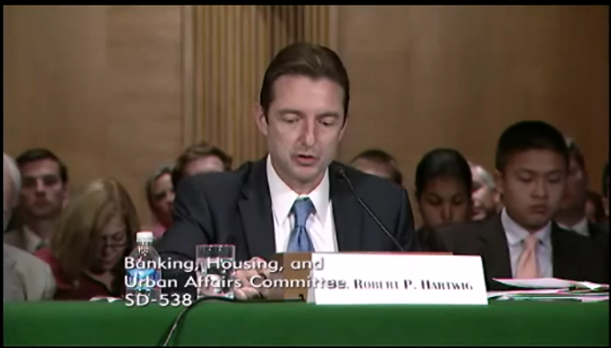
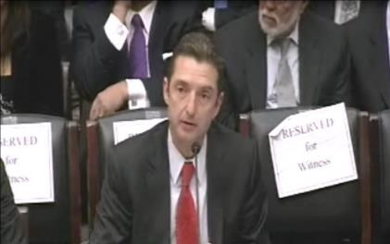
Terrorism Risk Insurance Program
Testified before House Financial Services Nov. 2013
Testified before Senate Banking Cmte. in Sept. 2013
Provided testimony at NYC hearing in June 2013
Provided Capitol Hill Joint House/Senate Staff Briefing in April 2014
I.I.I. Published Several Updates to its Study on Terrorism Risk and Insurance
Working with Trades, Congressional Staff, GAO & Others
House Financial Services Subcommittee, 11/13/13
Senate Banking Committee, 9/25/13
152
12/01/09 - 9pm
eSlide – P6466 – The Financial Crisis and the Future of the P/C
Notes:
152

Slide 153
Summary of President’s Working Group Report on TRIA (April 2014)
Insurance for terrorism risk is available and affordable
  Availability/affordability have has not changed appreciably since 2010
Prices for terrorism risk insurance vary considerably depending on the policyholder’s industry and location of risk
Prices have declined since TRIA was enacted
  Currently ~3% to 5% of commercial property insurance premiums
Take-up rates have improved since adoption of TRIA
  Overall take-up rate is steady at ~60% (62% in 2013 per Marsh)
Market capacity is currently tightening given uncertainty over TRIA reauthorization
The private market does not have the capacity to provide reinsurance for terror risk to the extent currently provided by TRIA
In the absence of TRIA, terrorism risk insurance would likely be less available. Coverage that would be available likely would be more costly and/or limited in scope
Source: Report of the President’s Working Group on Financial Markets,The Long-Term Availability and Affordability of Insurance for Terrorism Risk,
April 2014.

Slide 154
CAT OF THE FUTURE?
CYBER RISK
Cyber Risk is a Rapidly Emerging Exposure for Businesses Large and Small in Every Industry
NEW III White Paper: http://www.iii.org/assets/docs/pdf/paper_CyberRisk_2013.pdf
154

Slide 155





Data Breaches 2005-2013, by Number of Breaches and Records Exposed
# Data Breaches/Millions of Records Exposed
Millions
The Total Number of Data Breaches (+38%) and Number of Records Exposed (+408%) in 2013 Soared
* 2013 figures as of Jan. 1, 2014 from the ITRC updated to an additional 30 million records breached (Target) as disclosed in Jan. 2014.
Source: Identity Theft Resource Center.

Slide 156
2013 Data Breaches By Business Category, By Number of Breaches
The majority of the 614 data breaches in 2013 affected business and medical/healthcare organizations, according to the Identity Theft Resource Center.
Banking/Credit/Financial, 23 (3.7%)
Govt/Military, 56 (9.1%)
Business, 211 (34.4%)
Educational, 55 (9.0%)
Medical/Healthcare, 269 (43.8%)
Source: Identity Theft Resource Center, http://www.idtheftcenter.org/images/breach/2013/UpdatedITRCBreachStatsReport.pdf

Slide 157
The Most Costly Cyber Crimes, Fiscal Year 2013
Denial of service, malicious code and web-based attacks account for more than 55 percent of all cyber costs per U.S. organization on an annual basis.
Botnets
Viruses, Worms, Trojans
Malicious code
Malware
Malicious insiders
Stolen devices
Denial of service
Phishing + social engineering
Web-based attacks
Source: 2013 Cost of Cyber Crime: United States, Ponemon Institute.

Slide 158
External Cyber Crime Costs: Fiscal Year 2013
Information loss (43%) and business disruption or lost productivity (36%) account for the majority of external costs due to cyber crime.
Equipment damages
Information loss
Revenue loss
Business disruption
Other costs* 0%
* Other costs include direct and indirect costs that could not be allocated to a main external cost category
Source: 2013 Cost of Cyber Crime: United States, Ponemon Institute.

Slide 159
Distribution Trends
Distribution by Channel Type Continues to Evolve Around the World
159

Slide 160
All P/C Lines Distribution Channels, Direct vs. Independent Agents
Independent agents steadily lost market share from the early 1980s through the early 2000s across all P/C lines, but have gained or held generally steady in recent years. Direct channels include exclusive agency companies, direct marketers and direct sales (e.g., internet)
Source: Insurance Information Institute; based on data from Conning and A.M. Best.

Slide 161
Commercial P/C Distribution Channels, Direct vs. Independent Agents
Independent agents have seen only modest erosion in commercial lines market share in recent decades
Source: Insurance Information Institute; based on data from Conning and A.M. Best (Aggregates & Averages).

Slide 162
Personal Lines Distribution Channels, Direct vs. Independent Agents
Independent agents have lost significant personal lines market share since the early 1970s. Although the trend has slowed, it may be accelerating again.
Source: Insurance Information Institute; based on data from Conning and A.M. Best (Aggregates & Averages).

Slide 163
The BIG Question:
Where Is the Market Heading?
Catastrophes and Other Factors Are Pressuring Insurance Markets
New Factor: Record Low Interest Rates Are Contributing to Underwriting and Pricing Pressures
163
Notes:
163

Slide 164
INVESTMENTS:
THE NEW REALITY
Investment Performance is a Key Driver of Profitability
Depressed Yields Will Necessarily Influence Underwriting & Pricing
164

Slide 165
Property/Casualty Insurance Industry Investment Income: 2000–2013¹
($ Billions)
Investment earnings are running below their 2007 pre-crisis peak
Investment Income Fell in 2012 and 2013 Due to Persistently Low Interest Rates, Putting Additional Pressure on (Re) Insurance Pricing
¹ Investment gains consist primarily of interest and stock dividends...
Sources: ISO; Insurance Information Institute.

Slide 166
P/C Insurer Net Realized
Capital Gains/Losses, 1990-2013
Realized capital gains were up sharply as equity markets rallied
($ Billions)
Insurers Posted Net Realized Capital Gains in 2010 - 2013 Following Two Years of Realized Losses During the Financial Crisis. Realized Capital Losses Were the Primary Cause of 2008/2009’s Large Drop in Profits and ROE
Sources: A.M. Best, ISO, Insurance Information Institute.
166
12/01/09 - 9pm
eSlide – P6466 – The Financial Crisis and the Future of the P/C
Notes:
166

Slide 167
Property/Casualty Insurance Industry Investment Gain: 1994–2013¹
($ Billions)
Investment gains in 2013 were their highest in the post-crisis era
Investment Income Continued to Fall in 2013 Due to Low Interest Rates but Realized Investment Gains Were Up Sharply; The Financial Crisis Caused Investment Gains to Fall by 50% in 2008
¹ Investment gains consist primarily of interest, stock dividends and realized capital gains and losses.
* 2005 figure includes special one-time dividend of $3.2B;
Sources: ISO; Insurance Information Institute.

Slide 168
Reduction in Combined Ratio Necessary to Offset 1% Decline in Investment Yield to Maintain Constant ROE, by Line*
Lower Investment Earnings Place a Greater Burden on Underwriting and Pricing Discipline
*Based on 2008 Invested Assets and Earned Premiums
**US domestic reinsurance only
Source: A.M. Best; Insurance Information Institute.
168
12/01/09 - 9pm
eSlide – P6466 – The Financial Crisis and the Future of the P/C
Notes:
168
This shows the drop in Combined Ratio for each line of business that would be needed to maintain a constant ROE, given a 1-percentage-point drop in investment yield

Slide 169
U.S. 10-Year Treasury Note Yields:
A Long Downward Trend, 1990–2014*
Yields on 10-Year U.S. Treasury Notes recently plunged to record modern-era lows in early 2013 but have since risen as the Fed begins “tapering” its QE program in 2014
Yields on 10-Year U.S. Treasury Notes have been essentially below 5% for a full decade.
Since roughly 80% of P/C bond/cash investments are in 10-year or shorter durations, most P/C insurer portfolios will have low-yielding bonds for years to come.
*Monthly, through February 2014. Note: Recessions indicated by gray shaded columns.
Sources: Federal Reserve Bank at http://www.federalreserve.gov/releases/h15/data.htm.
National Bureau of Economic Research (recession dates); Insurance Information Institutes.
169
12/01/09 - 9pm
eSlide – P6466 – The Financial Crisis and the Future of the P/C
Notes:
169

Slide 170
U.S. Treasury Security Yields:
A Long Downward Trend, 1990–2014*
Yields on 10-Year U.S. Treasury Notes have been essentially below 5% for a full decade.
U.S. Treasury yields plunged to historic lows in 2013. Longer-term yields have rebounded a bit.
Since roughly 80% of P/C bond/cash investments are in 10-year or shorter durations, most P/C insurer portfolios will have low-yielding bonds for years to come.
*Monthly, constant maturity, nominal rates, through May 2014.
Sources: Federal Reserve Bank at http://www.federalreserve.gov/releases/h15/data.htm. National Bureau of Economic Research (recession dates); Insurance Information Institute.
170
12/01/09 - 9pm
eSlide – P6466 – The Financial Crisis and the Future of the P/C
Notes:
170

Slide 171
Treasury Yield Curves:
Pre-Crisis (July 2007) vs. April 2014
Treasury yield curve remains near its most depressed level in at least 45 years. Investment income is falling as a result. Even as the Fed “tapers” rates are unlikely to return to pre-crisis levels anytime soon
The Fed Is Actively Signaling that it Is Determined to Keep Rates Low Until Well Into 2015; Low Rates Add to Pricing Pressure for Insurers.
Source: Federal Reserve Board of Governors; Insurance Information Institute.

Slide 172
Treasury Yield Curves:
Pre-Crisis (July 2007) vs. Feb. 2014
Longer term yields are expected to rise in 2014 and 2015 while short-term yields will not begin to normalize until 2015
Higher longer-term yields will help insurers but short term yields are expected to lag behind
Source: Federal Reserve Board of Governors (2006-2013), Swiss Re (2014-2015); Insurance Information Institute.

Slide 173
Outlook for U.S. Treasury Bond Yields Through 2015
Long-term yields should begin to normalize in 2014 but short-term yields will remain very low until 2015
% Yield
Longer-tail lines like MPL and workers comp will benefit the most from the normalization of yields
Source: Federal Reserve Board of Governors (2012-2013), Blue Economic Forecasts (2014-2015 3-month and 10-yr; 4/14) Swiss Re (2014-2015, 5-yr yield; 5/14); Insurance Information Institute.
173
12/01/09 - 9pm
eSlide – P6466 – The Financial Crisis and the Future of the P/C
Notes:
173

Slide 174
Average Maturity of Bonds Held by US P/C Insurers, 2006—2011*
Average Maturity (Years)
The average bond maturity is down by a full year between 2007 and 2011
Falling Average Maturity (and Duration) of the P/C Industry’s Bond Portfolio is Contributing to the Drop in Investment Income Along With Lower Yields
*Year-end figures. Latest available.
Sources: Insurance Information Institute calculations based on A.M. Best data.
174
12/01/09 - 9pm
eSlide – P6466 – The Financial Crisis and the Future of the P/C
Notes:
174

Slide 175
Distribution of Bond Maturities,
P/C Insurance Industry, 2003-2013
The main shift over these years has been from bonds with longer maturities to bonds with shorter maturities. The industry first trimmed its holdings of over-10-year bonds (from 24.6% in 2003 to 15.5% in 2012) and then trimmed bonds in the 5-10-year category (from 31.3% in 2003 to 27.6% in 2012) . Falling average maturity of the P/C industry’s bond portfolio is contributing to a drop in investment income along with lower yields.
Sources: SNL Financial; Insurance Information Institute.

Slide 176
Bonds Rated NAIC Quality Category 3-6 as a Percent of Total Bonds, 2003–2012
From 2006-07 to year-end 2012, the percentage of lower-quality bonds in P/C industry portfolios more than doubled
There are many ways to capture higher yields on bond portfolios.
One is to accept greater risk, as measured by NAIC bond ratings.
The ratings range from 1 to 6, with the highest quality rated 1.
Even in 2012, over 95% of the industry’s bonds were rated 1 or 2.
Sources: SNL Financial; Insurance Information Institute.

Slide 177
P/C UNDERWRITING
Underwriting Losses in 2013 Much Improved After High Catastrophe Losses in 2011/12
177

Slide 178
P/C Insurance Industry
Combined Ratio, 2001–2013*
Relatively Low CAT Losses, Reserve Releases
Higher CAT Losses, Shrinking Reserve Releases, Toll of Soft Market
As Recently as 2001, Insurers Paid Out Nearly $1.16 for Every $1 in Earned Premiums
Heavy Use of Reinsurance Lowered Net Losses
Relatively Low CAT Losses, Reserve Releases
Avg. CAT Losses, More Reserve Releases
Best Combined Ratio Since 1949 (87.6)
Sandy Impacts
Cyclical Deterioration
Lower CAT Losses
* Excludes Mortgage & Financial Guaranty insurers 2008--2012. Including M&FG, 2008=105.1, 2009=100.7, 2010=102.4, 2011=108.1; 2012:=103.2; 2013: = 96.1.
Sources: A.M. Best, ISO.

Slide 179
Number of Years with Underwriting Profits by Decade, 1920s–2010s
Number of Years with Underwriting Profits
Underwriting Profits Were Common Before the 1980s
(40 of the 60 Years Before 1980 Had Combined Ratios Below 100) –
But Then They Vanished. Not a Single Underwriting Profit Was
Recorded in the 25 Years from 1979 Through 2003
* 2009 combined ratio excl. mort. and finl. guaranty insurers was 99.3, which would bring the 2000s total to 4 years with an u/w profit.
**Data for the 2010s is for the period 2010 through 2013.
Note: Data for 1920–1934 based on stock companies only.
Sources: Insurance Information Institute research from A.M. Best Data.
179
12/01/09 - 9pm
eSlide – P6466 – The Financial Crisis and the Future of the P/C
Notes:
179

Slide 180
Combined Ratios by Predominant Business Segment, 2013 vs. 2012*
The combined ratios for both personal and commercial lines improved substantially in 2013
(Percent)
*Excludes mortgage and financial guaranty insurers.
Source: ISO/PCI; Insurance Information Institute

Slide 181
Underwriting Gain (Loss)
1975–2013*
Underwriting profit in 2013 totaled $15.5B
($ Billions)
Cumulative underwriting deficit from 1975 through 2012 is $510B
High cat losses in 2011 led to the highest underwriting loss since 2002
Large Underwriting Losses Are NOT Sustainable
in Current Investment Environment
* Includes mortgage and financial guaranty insurers in all years.
Sources: A.M. Best, ISO; Insurance Information Institute.

Slide 182
P/C Reserve Development, 1992–2015E
Note: 2005 reserve development excludes a $6 billion loss portfolio transfer between American Re and Munich Re. Including this transaction, total prior year adverse development in 2005 was $7 billion. The data from 2000 and subsequent years excludes development from financial guaranty and mortgage insurance.
Sources: A.M. Best, ISO, Barclays Research (estimates for 2013-2015).

Slide 183
P/C Estimated Loss Reserve Deficiency/ (Redundancy), Excl. Statutory Discount
Line of Business | 2013
Personal Auto Liability | -$3.9B
Homeowners | -$0.4
Other Liab (incl. Prod Liab) | $7.5
Workers Compensation | $11.1
Commercial Multi Peril | $1.9
Commercial Auto Liability | $0.7
Medical Professional Liab. | -$3.5
Reinsurance—Nonprop Assumed | $1.0
All Other Lines* | -$4.6
Total Core Reserves | $9.8
Asbestos & Environmental | $11.2
Total P/C Industry | $21.0B
Source: A.M. Best, P/C Review/Preview 2014; Insurance Information Institute. *Excluding mortgage and financial guaranty segments.

Slide 184
Questionable Claims:
On the Rise
Fraud Concerns:
More Questionable Claims in Most State and Across Most Lines of Insurance
184

Slide 185
Questionable Claims, Top 10 Loss States, All Lines: 2010–2012
California had the largest number of Questionable Claims in 2012, but Maryland led the way in growth, with the number of QCs up by 72.9% from 2010 to 2012
(Number of Questionable Claims)
+28.3%
IL saw a 0.8% increase in questionable claims from 2010 to 2012, one of the slowest growing states
+22.6%
+37.9%
+29.1%
+72.9%
+39.3%
+37.1%
+0.8
+53.3
+50.0
Source: National Insurance Crime Bureau, ForeCAST Report, May 10, 2013; Insurance Information Institute

Slide 186
Total Number of Questionable Claims by State,
2012: Highest 25 States
California had the largest number of Questionable Claims in 2012
Sources: NICB; Insurance Information Institute.

Slide 187
Total Number of Questionable Claims by State,
2012: Highest 25 States
North Dakota had the fewest number of Questionable Claims in 2012
Sources: NICB; Insurance Information Institute.

Slide 188
Total Number of Questionable Claims by State, per 100K Persons, 2012: Highest 25 States
DC followed by Maryland California had the highest rate of Questionable Claims in 2012
Sources: NICB; Insurance Information Institute.

Slide 189
Total Number of Questionable Claims by State, per 100K Persons, 2012: Lowest 25 States
North and South Dakota had the lowest rate of Questionable Claims in 2012
Sources: NICB; Insurance Information Institute.

Slide 190
Questionable Claims, Top 10 Loss Cities, All Lines: 2010–2012
New York City had the largest number of Questionable Claims in 2012, but Miami and Baltimore led the way in growth, with the number of QCs nearly doubling from 2010 to 2012
(Number of Questionable Claims)
+28.5%
+55.1%
Philadelphia saw a 63.8% increase in questionable claims from 2010 to 2012, one of the fastest growing states
+93.2%
+18.7%
+99.0%
+19.8%
-27.7%
+63.8
+82.8
+1.2
Source: National Insurance Crime Bureau, ForeCAST Report, May 10, 2013; Insurance Information Institute

Slide 191
Questionable Claims, Top 10 Policy Types: 2010–2012
Private Passenger Auto had the largest number of Questionable Claims in 2012, but Personal Property (Other) led the way in growth, with the number of QCs more than tripling from 2010 to 2012
(Number of Questionable Claims)
+24.9%
+47.1%
+38.4%
+2.4%
+15.3%
+205.1%
+34.8%
+30.0%
-10.1%
+6.0%
Source: National Insurance Crime Bureau, ForeCAST Report, May 10, 2013; Insurance Information Institute

Slide 192
Financial Strength & Underwriting
Cyclical Pattern is P-C Impairment History is Directly Tied to Underwriting, Reserving & Pricing
192

Slide 193
P/C Insurer Impairments, 1969–2012
Impairments among P/C insurers remain infrequent
The Number of Impairments Varies Significantly Over the P/C Insurance Cycle, With Peaks Occurring Well into Hard Markets
Source: A.M. Best Special Report “Pace of P/C Impairments Slowed in 2012; Auto Writers, RRGs Continued to Struggle,” June 2013; Insurance Information Institute.

Slide 194
P/C Insurer Impairment Frequency vs. Combined Ratio, 1969-2012
2012 impairment rate was 0.69%, down from 1.11% in 2011; the rate is lower than the 0.82% average since 1969
Impairment Rates Are Highly Correlated With Underwriting Performance and Reached Record Lows in 2007; Recent Increase Was Associated Primarily With Mortgage and Financial Guaranty Insurers and Not Representative of the Industry Overall
Source: A.M. Best; Insurance Information Institute

Slide 195
Reasons for US P/C Insurer Impairments, 1969–2012
Historically, Deficient Loss Reserves and Inadequate Pricing Are
By Far the Leading Cause of P-C Insurer Impairments.
Investment and Catastrophe Losses Play a Much Smaller Role
Reinsurance Failure
Sig. Change in Business
Misc.
Investment Problems (Overstatement of Assets)
Deficient Loss Reserves/
Inadequate Pricing
Affiliate Impairment
Catastrophe Losses
Alleged Fraud
Rapid Growth
Source: A.M. Best Special Report “Pace of P/C Impairments Slowed in 2012; Auto Writers, RRGs Continued to Struggle,” June 2013; Insurance Information Institute.

Slide 196
Rapid Growth ‘A Leading Cause’ of Impairment’
“The leading causes of impairment are deficient loss reserves (inadequate pricing) and rapid growth, together comprising more than 50 percent of annual impairments.”
- A.M. Best, 2013
Source: SNL Financial, Insurance Information Institute.

Slide 197
Top 10 Lines of Business for US P/C Impaired Insurers, 2000–2012
Workers Comp and Pvt. Passenger Auto Account for More Than 40 Percent of the Impaired Insurers Since 2000
Other
Title
Surety
Workers Comp
Med Mal
Other Liability
Pvt. Passenger Auto
Commercial Auto Liability
Commercial Multiperil
Homeowners
Source: A.M. Best Special Report “Pace of P/C Impairments Slowed in 2012; Auto Writers, RRGs Continued to Struggle,” June 2013; Insurance Information Institute.
.

Slide 198
Performance by Segment
198
Notes:
198

Slide 199
Private Passenger Auto Combined Ratio: 1993–2015F
Private Passenger Auto Accounts for 34% of Industry Premiums and Remains the Profit Juggernaut of the P/C Insurance Industry
Sources: A.M. Best (1990-2012);Conning (2013F-15F); Insurance Information Institute.

Slide 200
Homeowners Insurance Combined Ratio: 1990–2015F
Hurricane Andrew
Record tornado activity
Hurricane Sandy
Hurricane Ike
Low Cat Losses Led to 2013 Improvement. Homeowners Performance in 2011/12 Impacted by Large Cat Losses. Extreme Regional Variation Can Be Expected Due to Local Catastrophe Loss Activity
Sources: A.M. Best (1990-2012);Conning (2014E-2015F); Insurance Information Institute.

Slide 201
Homeowners Multi-Peril Loss & LAE Ratio, 2011:
Highest 25 States
TN and AL had the worst underwriting performance of all states in 2011 due to high tornado and storm losses
Sources: SNL Financial; Insurance Information Institute.

Slide 202
Homeowners Multi-Peril Loss & LAE Ratio, 2011:
Lowest 25 States
HI and FL had the best performance in 2011 due to the absence of hurricanes/tropical storms impacts in either state last year
Sources: SNL Financial; Insurance Information Institute.

Slide 203
Commercial Lines Combined Ratio, 1990-2015F*
Commercial lines underwriting performance is expected to improve as improvement in pricing environment persists
*2007-2012 figures exclude mortgage and financial guaranty segments.
Source: A.M. Best (1990-2012); Conning (2013F-2015F) Insurance Information Institute

Slide 204
Commercial Auto Combined Ratio: 1993–2015F
Commercial Auto is Expected to Improve as Rate Gains Outpace Any Adverse Frequency and Severity Trends
Sources: A.M. Best (1990-2012);Conning (2013F-2015F); Insurance Information Institute.

Slide 205
Commercial Multi-Peril Combined Ratio: 1995–2015F
Commercial Multi-Peril Underwriting Performance is Expected to Improve in 2013 Assuming Normal Catastrophe Loss Activity
*2013F-2012F figures are Conning figures for the combined liability and non-liability components..
Sources: A.M. Best; Conning; Insurance Information Institute.

Slide 206
General Liability Combined Ratio:
2005–2015F
Commercial General Liability Underwriting Performance Has Been Volatile in Recent Years
Source: Conning Research and Consulting.

Slide 207
Inland Marine Combined Ratio: 1999–2015F
Inland Marine is Expected to Remain Among the Most Profitable of All Lines
Sources: A.M. Best (1999-2011); Conning (2012-2015F)

Slide 208
Other & Products Liability Combined Ratio: 1991–2013F
Liability Lines Have Performed Better in the Post-Tort Reform Era (~2005), but There Has Been Some Deterioration in Recent Years
Sources: A.M. Best ; Insurance Information Institute.

Slide 209
Medical Malpractice Combined Ratio vs. All Lines Combined Ratio, 1991-2015F
Med Mal Insurers in 2012 paid out $0.91 in loss and expense for every $1 they earned in premiums
The dramatic improvement over the past decade has restored med mal’s viability, though some deterioration is anticipated
In 2001, med mal insurers paid out $1.55 for every dollar earned
Source: AM Best (1991-2011); Conning (2012E-2015F) Insurance Information Institute

Slide 210
Workers Compensation Combined Ratio: 1994–2015F
WC results have improved markedly since 2011
Workers Comp Results Began to Improve in 2012. Underwriting Results Deteriorated Markedly from 2007-2010/11 and Were the Worst They Had Been in a Decade.
Sources: A.M. Best (1994-2009); NCCI (2010-2013P) and are for private carriers only; Insurance Information Institute (2014-15).

Slide 211
SURPLUS/CAPITAL/CAPACITY
2013 Recorded Yet Another Record High in the Primary and Reinsurance Sectors
211

Slide 212
Policyholder Surplus,
2006:Q4–2013:Q4
Drop due to near-record 2011 CAT losses
($ Billions)
2007:Q3
Pre-Crisis Peak
Surplus as of 12/31/13 stood at a record high $653.3B
The industry now has $1 of surplus for every $0.73 of NPW,
close to the strongest claims-paying status in its history.
2010:Q1 data includes $22.5B of paid-in capital from a holding company parent for one insurer’s investment in a non-insurance business .
The P/C insurance industry entered 2014
in very strong financial condition.
Sources: ISO, A.M .Best.
212
12/01/09 - 9pm
eSlide – P6466 – The Financial Crisis and the Future of the P/C
Notes:
212

Slide 213
US Policyholder Surplus:
1975–2013*
($ Billions)
Surplus as of 9/30/13 was a record $624.4, up 6.4% from $586.9 of 12/31/12, and up 42.9% ($187.3B) from the crisis trough of $437.1B at 3/31/09. Pre-crisis peak was $521.8 as of 9/30/07. Surplus as of 9/30/13 was 19.7% above 2007 peak.
“Surplus” is a measure of underwriting capacity. It is analogous to “Owners Equity” or “Net Worth” in non-insurance organizations
The Premium-to-Surplus Ratio Stood at $0.78:$1 as of
9/30/13, a Near Record Low (at Least in Recent History)*
* As of 9/30/13.
Source: A.M. Best, ISO, Insurance Information Institute.

Slide 214
U.S. INSURANCE MERGERS AND ACQUISITIONS, All Sectors, 1989-2013 (1)
M&A activity recovered to pre-crisis levels but deal values dropped sharply in 2013
($ Billions)
$165.4
(1) Includes transactions where a U.S. company was the acquirer and/or the target.
Source: Conning proprietary database.

Slide 215
U.S. INSURANCE MERGERS AND ACQUISITIONS,
P/C SECTOR, 2002-2013 (1)
M&A activity in the P/C sector remains below pre-crisis levels.
($ Millions)
(1) Includes transactions where a U.S. company was the acquirer and/or the target.
Source: Conning proprietary database.

Slide 216
U.S. INSURANCE MERGERS AND ACQUISITIONS,
LIFE/ANNUITY SECTOR, 2002-2013 (1)
Life/Annuity sector M&A activity is highly volatile
($ Millions)
(1) Includes transactions where a U.S. company was the acquirer and/or the target.
Source: Conning proprietary database.

Slide 217
REINSURANCE MARKET CONDITIONS
Ample Capacity as Alternative Capital is Transforming the Market—And Pushing Down Prices
217

Slide 218
Global Reinsurance Capital (Traditional and Alternative), 2007 - 2013
Total reinsurance capital reached a record $540B in 2013, up 58.8% from 2008. Of that, $50B (9.3%) is alternative capacity, up 163% from $19B since 2008
Source: Aon Benfield Reinsurance Market Outlook, April 1, 2014; Insurance Information Institute.

Slide 219
Global Reinsurer Capital, 2007-2013:H1*
($ Billions)
+11%
+1%
+18%
-3%
+18%
-17%
Global Reinsurance Capital Has Been Trending Generally Upward Since the Global Financial Crisis, a Trend that Seems Likely to Continue
*Includes both traditional and non-traditional forms of reinsurance capital.
Source: Aon Benfield Aggregate study for the 6 months ending June 2013; Insurance Information Institute.

Slide 220
Long-Term Evolution of Shareholders’ Funds for the Guy Carpenter Global Reinsurance Composite
Source: Guy Carpenter

Slide 221
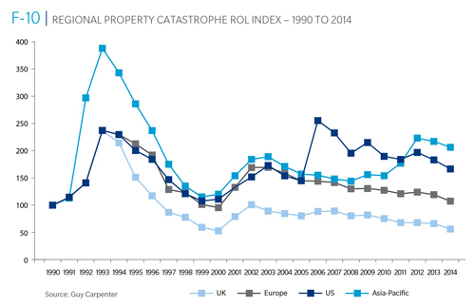
Reinsurance Pricing: Rate-on-Line Index by Region, 1990 – 2014*
Lower CATs and a flood of new capital has pushed reinsurance pricing down in most regions, including the US
*As of Jan. 1.
Source: Guy Carpenter

Slide 222
Reinsurer Combined Ratios
(Aon Benfield Aggregate), 2007 - 2013
Reinsurers posted a combined under 90 in 2013, the best result since 2009
Source: Aon Benfield Reinsurance Market Outlook, April 1, 2014; Insurance Information Institute.

Slide 223
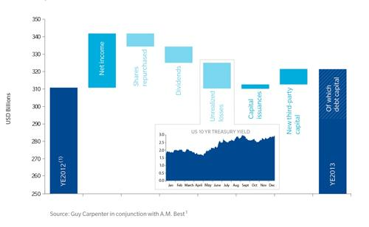
Sources of Reinsurance Capital Change: YE 2012 to YE 2013
Net income and new 3rd party capital were the leading source of reinsurance capital growth in 2013
Sources: Guy Carpenter and A.M. Best; Insurance Information Institute .
223
12/01/09 - 9pm
eSlide – P6466 – The Financial Crisis and the Future of the P/C
Notes:
223

Slide 224
Global Insurance Capital,
2007 - 2013
Insurance capital increased by 69.4% ($1.5 trillion) since the depths of the global financial crisis in 2008
Source: Aon Benfield Reinsurance Market Outlook, April 1, 2014; Insurance Information Institute.

Slide 225
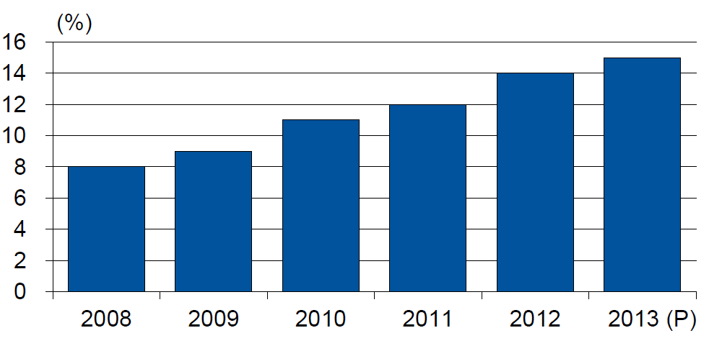
Alternative Capacity as a Percentage of Global Property Catastrophe Reinsurance Limit
(As of Year End)
Alternative Capacity accounted for approximately 14% or $45 billion of the $316 in global property catastrophe reinsurance capital as of mid-2013 (expected to rise to ~15% by year-end 2013)
Source: Guy Carpenter

Slide 226
Property Catastrophe Reinsurance Capacity by Source as of Mid-2013 ($ Bill)
Total = $316 Billion*
“Convergence Capital” accounted for an estimated $45B or 14% or total property catastrophe reinsurance capacity as of mid-2013, up $10B over the past 18 months (since 1/1/12). Penetration of this type of capacity is growing
Collateralized reinsurance (sidecars) is the fastest growing segment recently
Source: Guy Carpenter; Mid-Year Market Report, September 2013; Insurance Information Institute.

Slide 227
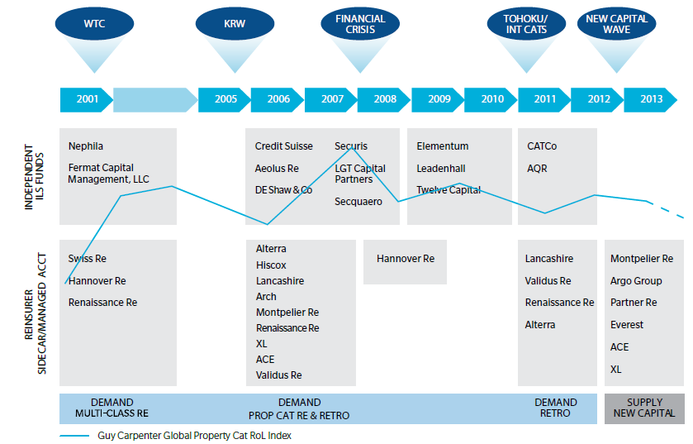
Alternative Capacity Development,
2001—2013:H1
Source: Guy Carpenter; Mid-Year Market Report, September 2013; Insurance Information Institute.

Slide 228
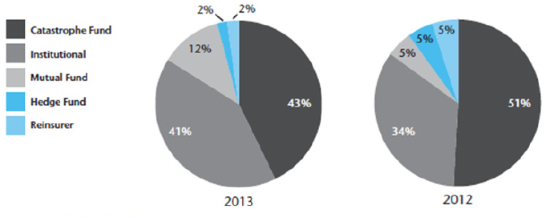
Investor by Category, 2013 vs. 2012*
Institutional Investors are accounting for a larger share of alternative reinsurance investors
*As of June 30 each year.
Source: Aon Benfield Securities; Insurance Information Institute.

Slide 229
Non-Traditional Property Catastrophe
Limits by Type, YE 2012 vs. YE 2015E
Alternative capital is expected to rise by 30% by YE 2015 and will ultimately account for 20-30% of total reinsurance spend, according to Guy Carpenter
Source: Guy Carpenter; Reinsurance Association of America; Insurance Information Institute.

Slide 230
Catastrophe Bonds: Issuance and Outstanding, 1997- 2014:Q1*
Risk Capital Amount ($ Millions)
Risk capital outstanding reached a record high in 2013
Financial crisis depressed issuance
CAT bond issuance reached a record high in 2013
Catastrophe Bond Issuance Is Approaching Pre-Crisis Levels While Risk Capital Outstanding Stands at an All-Time Record
*Through Jan. 31, 2014.
Source: Guy Carpenter; Insurance Information Institute.

Slide 231
Questions Arising from Influence of Alternative Capital
Could Pension Fund Money Swamp Traditional Capacity?
  US private pension funds hold ~$7 trillion in assets
  2% allocation = $140 billion
  Global property cat capital = ~$316 bill as of mid-2013
Do New Investors Have a Lower Cost of Capital?
  New capacity expects 6-8% rate of return compared to 8-10% for traditional reinsurance, according to Dowling & Partners
Will Reinsurance Pricing Become More Closely Linked to Interest Rates?
  What happens when interest rates rise?
Terms and Conditions Could Weaken
  Multi-year deals

Slide 232
Questions Arising from Influence of Alternative Capital
What Will Happen When Investors Face Large-Scale Losses?
Does ILS Have a Higher Propensity to Litigate?
  Short-term focus could contribute to disputes
  Large share of triggered transactions ended up in dispute
How Low Will ROLs Be Pushed?
Does the New Interconnectedness with Capital Markets Lend Credence to the Suggestion that Reinsurance Is a Systemic Risky Business?
Will Alternative Capital Drive Consolidation Among Traditional Reinsurers?
  Has the mating dance begun? → Endurance/Aspen

Slide 233
Reinsurer Share of Recent Significant Market Losses
Billions of 2011 Dollars
40% Reinsurance share of total insured loss
$37.5
$15.0
73%
60%
95%
$13.0
44%
$10.0
$22.5
$8.3
$9.5
$6.0
$5.0
$7.9
$2.2
$3.5
$4.0
$2.8
$0.4
Reinsurers Paid a High Proportion of Insured Losses Arising from Major Catastrophic Events Around the World in Recent Years
Source: Insurance Information Institute from reinsurance share percentages provided in RAA, ABIR and CEA press release, Jan. 13, 2011.
233
12/01/09 - 9pm
eSlide – P6466 – The Financial Crisis and the Future of the P/C
Notes:
233

Slide 234
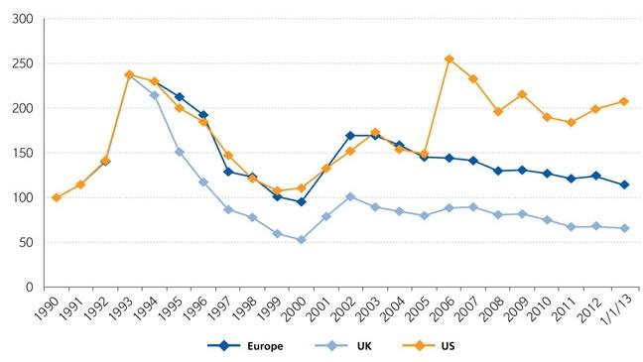
Regional Property Catastrophe Rate on Line Index, 1990—2013 (as of January 1)
Property-Cat reinsurance pricing was up in the US as of 1/1/13 but was down in Europe/UK
Sources: Guy Carpenter; Insurance Information Institute.

Slide 235
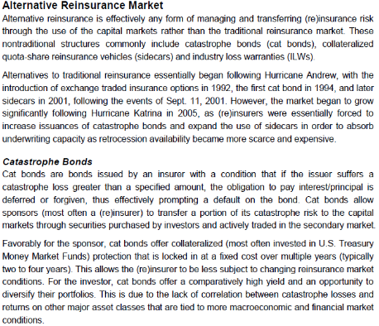
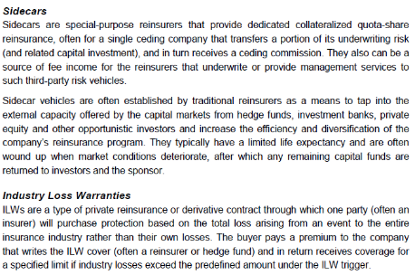
Alternative Capital: Important Definitions
Sources: Fitch Ratings; Insurance Information Institute.

Slide 236
P/C PRICING TRENDS
Modest Pricing Gains in 2014
236

Slide 237
Net Premium Growth: Annual Change,
1971—2013
(Percent)
1975-78
1984-87
2000-03
Net Written Premiums Fell 0.7% in 2007 (First Decline Since 1943) by 2.0% in 2008, and 4.2% in 2009, the First 3-Year Decline Since 1930-33.
2013 = +4.6%
2012 = +4.3%
Shaded areas denote “hard market” periods
Sources: A.M. Best (historical and forecast), ISO, Insurance Information Institute.

Slide 238
P/C Net Premiums Written: % Change, Quarter vs. Year-Prior Quarter
Premium growth in Q3 2013 was up 3.8% over Q3 2012, marking the 14th consecutive quarter of growth
Sustained Growth in Written Premiums
(vs. the same quarter, prior year) Will Continue into 2014
Sources: ISO, Insurance Information Institute.
238
12/01/09 - 9pm
eSlide – P6466 – The Financial Crisis and the Future of the P/C
Notes:
238

Slide 239
Growth in Net Written Premium by Segment, 2013:H1 vs. 2012:H1*
(Percent)
*Excludes mortgage and financial guaranty insurers.
Source: ISO/PCI; Insurance Information Institute

Slide 240
Growth in Direct Written Premium by Line, 2013-2015F*
(Percent)
P/C growth is expected to remain fairly stable through 2015
Source: Conning.

Slide 241
Average Commercial Rate Change,
All Lines, (1Q:2004–4Q:2013)
Pricing as of Q4:2013 was positive for the 10th consecutive quarter. Gains are likely to continue into 2014.
(Percent)
Q2 2011 marked the last of 30th consecutive quarter of price declines
KRW Effect
Note: CIAB data cited here are based on a survey. Rate changes earned by individual insurers can and do vary, potentially substantially.
Source: Council of Insurance Agents & Brokers; Insurance Information Institute

Slide 242
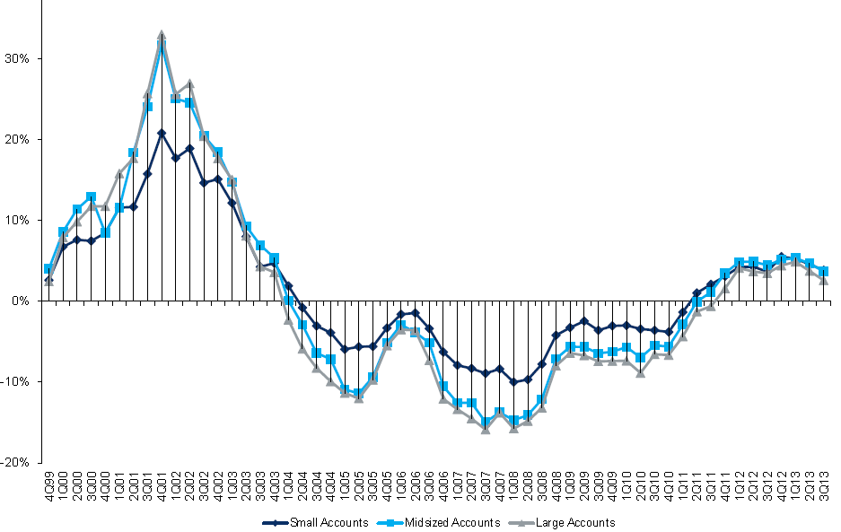
Change in Commercial Rate Renewals, by Account Size: 1999:Q4 to 2013:Q3
Percentage Change (%)
Peak = 2001:Q4 +28.5%
Pricing turned positive in Q3:2011, the first increase in nearly 8 years; Q3:2013 renewals were up 3.4%. Some insurers posted stronger numbers.
Pricing Turned Negative in Early 2004 and Remained that way for 7 ½ years
KRW : No Lasting Impact
Trough = 2007:Q3 -13.6%
Source: Council of Insurance Agents and Brokers; Barclay’s Capital; Insurance Information Institute.
Note: CIAB data cited here are based on a survey. Rate changes earned by individual insurers can and do vary, potentially substantially.

Slide 243
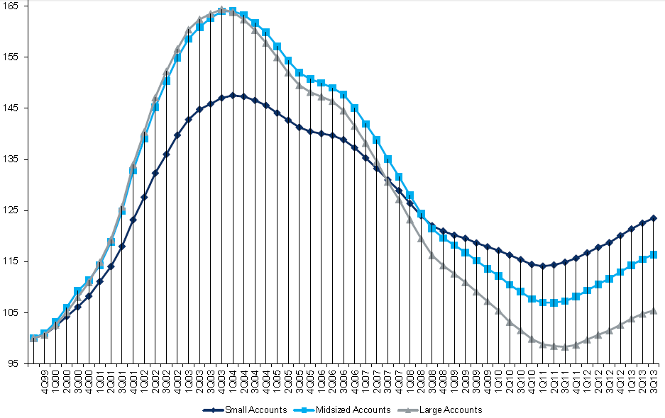
Cumulative Qtrly. Commercial Rate Changes, by Account Size: 1999:Q4 to 2013:Q3
1999:Q4 = 100
Despite 9 consecutive quarters of gains (Q3:2013 = 3.4%), pricing today is where is was in late 2001 (around 9/11), suggesting additional rate need going forward, esp. in light of record low interest rates
Note: CIAB data cited here are based on a survey. Rate changes earned by individual insurers can and do vary, potentially substantially.
Source: Council of Insurance Agents and Brokers; Barclay’s Capital; Insurance Information Institute.

Slide 244
Change in Commercial Rate Renewals, by Line: 2013:Q3
Workers Comp rate increases are large than any other line, followed by Property lines
Percentage Change (%)
Major Commercial Lines Renewed Uniformly Upward in Q3:2013 for the 9th Consecutive Quarter; Property Lines & Workers Comp Leading the Way; Cat Losses and Low Interest Rates Provide Momentum Going Forward
Note: CIAB data cited here are based on a survey. Rate changes earned by individual insurers can and do vary, potentially substantially.
Source: Council of Insurance Agents and Brokers; Insurance Information Institute.

Slide 245
Workers Comp Rate Changes,
2008:Q4 – 2013:Q3
WC rate changes have been positive for 10 consecutive quarters, longer than any other commercial line
(Percent Change)
Note: CIAB data cited here are based on a survey. Rate changes earned by individual insurers can and do vary, potentially substantially.
Source: Council of Insurance Agents and Brokers; Information Institute.

Slide 246
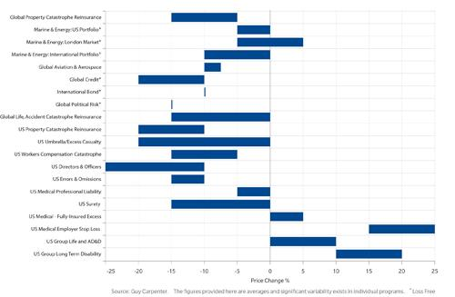
Rate Movements by Business Segment as of January 1, 2014
Many business segments renewed were under price pressure as of 1/1/14
Sources: Guy Carpenter; Insurance Information Institute .
246
12/01/09 - 9pm
eSlide – P6466 – The Financial Crisis and the Future of the P/C
Notes:
246

Slide 247
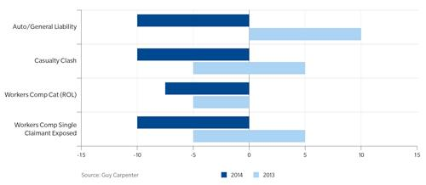
Casualty: Typical Excess of Loss Rate Changes as of Jan. 1, 2014
Casualty excess of loss renewals turned generally negative as of 1/1/14
Sources: Guy Carpenter; Insurance Information Institute .
247
12/01/09 - 9pm
eSlide – P6466 – The Financial Crisis and the Future of the P/C
Notes:
247

Slide 248
Shifting Legal Liability &
Tort Environment
Is the Tort Pendulum
Swinging Against Insurers?
248

Slide 249
Over the Last Three Decades, Total Tort Costs as a % of GDP Appear Somewhat Cyclical, 1980-2013E
($ Billions)
2.21% of GDP in 2003 = pre-tort reform peak
Deepwater Horizon Spike in 2010
Tort costs in dollar terms have remained high but relatively stable since the mid-2000s., but are down substantially as a share of GDP
1.68% of GDP in 2013
Sources: Towers Watson, 2011 Update on US Tort Cost Trends, Appendix 1A

Slide 250
Commercial Lines Tort Costs: Insured vs. Self-(Un)Insured Shares, 1973-2010
2005: $143.5B 66.4% insured, 33.6% self-(un)insured
Billions of Dollars
$15.0
1995: $83.6B 69.5% insured, 30.5% self-(un)insured
1973: Commercial Tort Costs Totaled $6.49B, 94% was insured, 6% self-(un)insured
1985: $46.6B 74.5% insured, 25.5% self-(un)insured
$9.5
$6.0
2009: $126.5B 64.4% insured, 35.6% self-(un)insured
Tort Costs and the Share Retained by Risks Both Grew Rapidly from the mid-1970s to mid-2000s, When Tort Costs Began to Fall But Self-Insurance Shares Continued to Rise
Sources: Towers Watson, 2011 Update on US Tort Cost Trends, III Calculations based on data from Appendix 4.
250
12/01/09 - 9pm
eSlide – P6466 – The Financial Crisis and the Future of the P/C
Notes:
250

Slide 251
Commercial Lines Tort Costs: Insured vs. Self-(Un)Insured Shares, 1973-2010
Percent
2010: $138.1B 56.6% insured, 44.4% self-(un)insured (distorted by Deepwater Horizon event with most losses retained by BP)
1973: 94% was insured, 6% self-(un)insured
1985:74.5% insured, 25.5% self-(un)insured
1995: 69.5% insured, 30.5% self-(un)insured
2005: 66.4% insured, 33.6% self-(un)insured
The Share of Tort Costs Retained by Risks Has Been Steadily Increasing for Nearly 40 Years. This Trend Contributes Has Left Insurers With Less Control Over Pricing.
Sources: Towers Watson, 2011 Update on US Tort Cost Trends, III Calculations based on data from Appendix 4.
251
12/01/09 - 9pm
eSlide – P6466 – The Financial Crisis and the Future of the P/C
Notes:
251

Slide 252
Business Leaders Ranking of Liability Systems in 2012
Best States
Delaware
Nebraska
Wyoming
Minnesota
Kansas
Idaho
Virginia
North Dakota
Utah
Iowa
Worst States
Florida
Oklahoma
Alabama
New Mexico
Montana
Illinois
California
Mississippi
Louisiana
West Virginia
New in 2012
Wyoming
Minnesota
Kansas
Idaho
Newly Notorious
Oklahoma
Drop-offs
Rising Above
Indiana
Colorado
Massachusetts
South Dakota
Arkansas
Source: US Chamber of Commerce 2012 State Liability Systems Ranking Study; Insurance Info. Institute.

Slide 253
The Nation’s Judicial Hellholes: 2012/2013
Watch List
Illinois
Madison County
West Virginia
Maryland
Baltimore
Philadelphia, Pennsylvania
South Florida
Cook County, Illinois
New Jersey
Nevada
Louisiana
California
Dishonorable Mention
New York
Albany and NYC
MO Supreme Court
WA Supreme Court
Source: American Tort Reform Association; Insurance Information Institute

Slide 254
Insurance Information Institute Online:
www.iii.org
Thank you for your time
and your attention!
Twitter: twitter.com/bob_hartwig
Download at www.iii.org/presentations

