Slide 1
The P/C Insurance Industry:
Top 5 Changes in 25 Years
John Street Club
New York, NY
June 10, 2016
Download at www.iii.org/presentations
Robert P. Hartwig, Ph.D., CPCU, President & Economist
Insurance Information Institute ♦ 110 William Street ♦ New York, NY 10038
Tel: 212.346.5520 ♦ Cell: 917.453.1885 ♦ bobh@iii.org ♦ www.iii.org

Slide 2
#1. Less Cyclicality
Is the Global P/C Insurance Industry Becoming Less Volatile?
2

Slide 3
Profitability Peaks & Troughs in the P/C Insurance Industry, 1975 – 2015
ROE
1977:19.0%
History suggests next ROE peak will be in 2016-2017
1987:17.3%
10 Years
1997:11.6%
2006:12.7%
10 Years
2015: 8.4%
2013 9.8%
9 Years
2014 8.4%
1975: 2.4%
1984: 1.8%
1992: 4.5%
2001: -1.2%
*Profitability = P/C insurer ROEs. 2011-15 figures are estimates based on ROAS data. Note: Data for 2008-2014 exclude mortgage and financial guaranty insurers.
Source: Insurance Information Institute; NAIC, ISO, A.M. Best, Conning

Slide 4
ROE: Property/Casualty Insurance by Major Event, 1987–2015
(Percent)
P/C Profitability Is Both by
Cyclicality and Ordinary Volatility
Modestly higher CATs
Katrina, Rita, Wilma
Low CATs
Sept. 11
Hugo
Lowest CAT Losses in
15 Years
4 Hurricanes
Sandy
Andrew, Iniki
Record Tornado Losses
Northridge
Financial Crisis*
* Excludes Mortgage & Financial Guarantee in 2008 – 2014.
Sources: ISO, Fortune; Insurance Information Institute.

Slide 5
P/C Insurance Industry ROE: Magnitude of Cyclicality, Volatility Changes Over Time, 1950-2015
1950 - 1970
Low
Volatility
1971 - 1992
Extreme
Volatility
1993 - 2008
Modest
Volatility
2009 - Present
Modest
Volatility
.
Source: Insurance Information Institute

Slide 6
P/C Industry Net Income After Taxes
1991–2015
$ Millions
2005 ROE*= 9.6%
2006 ROE = 12.7%
2007 ROE = 10.9%
2008 ROE = 0.1%
2009 ROE = 5.0%
2010 ROE = 6.6%
2011 ROAS¹ = 3.5%
2012 ROAS¹ = 5.9%
2013 ROAS¹ = 10.2%
2014 ROAS¹ = 8.4%
2015 ROAS = 8.4%
Net income in 2015 was on par with 2014; ROE unchanged at 8.4%
ROE figures are GAAP; ¹Return on avg. surplus. Excluding Mortgage & Financial Guaranty insurers yields a 8.2% ROAS in 2014, 9.8% ROAS in 2013, 6.2% ROAS in 2012, 4.7% ROAS for 2011, 7.6% for 2010 and 7.4% for 2009; 2015E is annualized figure based actual figure through Q3 of $44.0
Sources: A.M. Best, ISO; Insurance Information Institute

Slide 7
Commercial Lines NPW Premium Growth:
1975 – 2015E
ROE
Commercial lines is prone to more cyclical volatility that personal lines. Recently, growth has stabilized in the 4% to 5% range.
Economic Shocks, Inflation:
1976: 22.2%
Tort Crisis
1986: 30.5%
Post-9/11
2002: 22.4%
Post-Hurricane Andrew Bump:
1993: 6.3%
1988-2000: Period of inter-cycle stability
Post Katrina Bump:
2006: 7.7%
2015E 3.3%
2010-20XX? Post-recession period of stable growth?
Recessions:
1982: 1.1%
Great Recession:2009: -9.0%
Note: Data include state funds beginning in 1998.
Source: A.M. Best; Insurance Information Institute.

Slide 8
#2. Stronger & More Resilient
Global Capacity Is at or Near Record Highs Despite Record CATs, Economic Turmoil Since the 1990s
Capital Accumulation: A Double Edged Sword
8

Slide 9
U.S. Insured Catastrophe Losses
($ Billions, $ 2015)
2012 was the 3rd most expensive year ever for insured CAT losses
2013/14/15 Were Welcome Respites from 2011/12, among the Costliest Years for Insured Disaster Losses in US History. Longer-term Trend is for more—not fewer—Costly Events
$15.2B in insured CAT losses though 12/31/15
*Through 12/31/15 in 2015 dollars.
Note: 2001 figure includes $20.3B for 9/11 losses reported through 12/31/01 ($25.9B 2011 dollars). Includes only business and personal property claims, business interruption and auto claims. Non-prop/BI losses = $12.2B ($15.6B in 2011 dollars.)
Sources: Property Claims Service/ISO; Insurance Information Institute.
9
12/01/09 - 9pm
eSlide – P6466 – The Financial Crisis and the Future of the P/C
Notes:
9

Slide 10
Top 16 Most Costly Disasters in U.S. History—Katrina Still Ranks #1
(Insured Losses, 2014 Dollars, $ Billions)
Storm Sandy in 2012 was the last mega-CAT to hit the US
Includes Tuscaloosa, AL, tornado
Includes Joplin, MO, tornado
12 of the 16 Most Expensive Events in US History Have Occurred Since 2004
Sources: PCS; Insurance Information Institute inflation adjustments to 2014 dollars using the CPI.

Slide 11
Combined Ratio Points Associated with Catastrophe Losses: 1960 – 2016F*
Avg. CAT Loss Component of the Combined Ratio by Decade
1960s: 1.04 1970s: 0.85 1980s: 1.31 1990s: 3.39 2000s: 3.52 2010s: 5.47*
Catastrophe losses as a share of all losses reached a record high in 2011
Combined Ratio Points
The Catastrophe Loss Component of Private Insurer Losses Has Increased Sharply in Recent Decades
*2010s represent 2010-2015.
Notes: Private carrier losses only. Excludes loss adjustment expenses and reinsurance reinstatement premiums. Figures are adjusted for losses ultimately paid by foreign insurers and reinsurers.
Source: ISO (1960-2009); A.M. Best (2010-16E) Insurance Information Institute.

Slide 12
Policyholder Surplus,
2006:Q4–2015:Q4
($ Billions)
2007:Q3
Pre-Crisis Peak
Drop due to near-record 2011 CAT losses
Surplus as of 12/31/15 stood at a near-record high $673.7B
The industry now has $1 of surplus for every $0.76 of NPW,
close to the strongest claims-paying status in its history.
2010:Q1 data includes $22.5B of paid-in capital from a holding company parent for one insurer’s investment in a non-insurance business .
The P/C insurance industry entered 2016
in very strong financial condition.
Sources: ISO, A.M .Best.
12
12/01/09 - 9pm
eSlide – P6466 – The Financial Crisis and the Future of the P/C
Notes:
12

Slide 13
US Policyholder Surplus:
1975–2015*
($ Billions)
Surplus as of 12/31/15 was a near-record $673.7, down 0.2% from $675.2 of 12/31/14, and up 54.1% ($236.6B) from the crisis trough of $437.1B at 3/31/09
“Surplus” is a measure of underwriting capacity. It is analogous to “Owners Equity” or “Net Worth” in non-insurance organizations
The Premium-to-Surplus Ratio Stood at $0.76:$1 as of
12/31/15, a Near Record Low (at Least in Recent History)
* As of 12/31/15.
Source: A.M. Best, ISO, Insurance Information Institute.

Slide 14
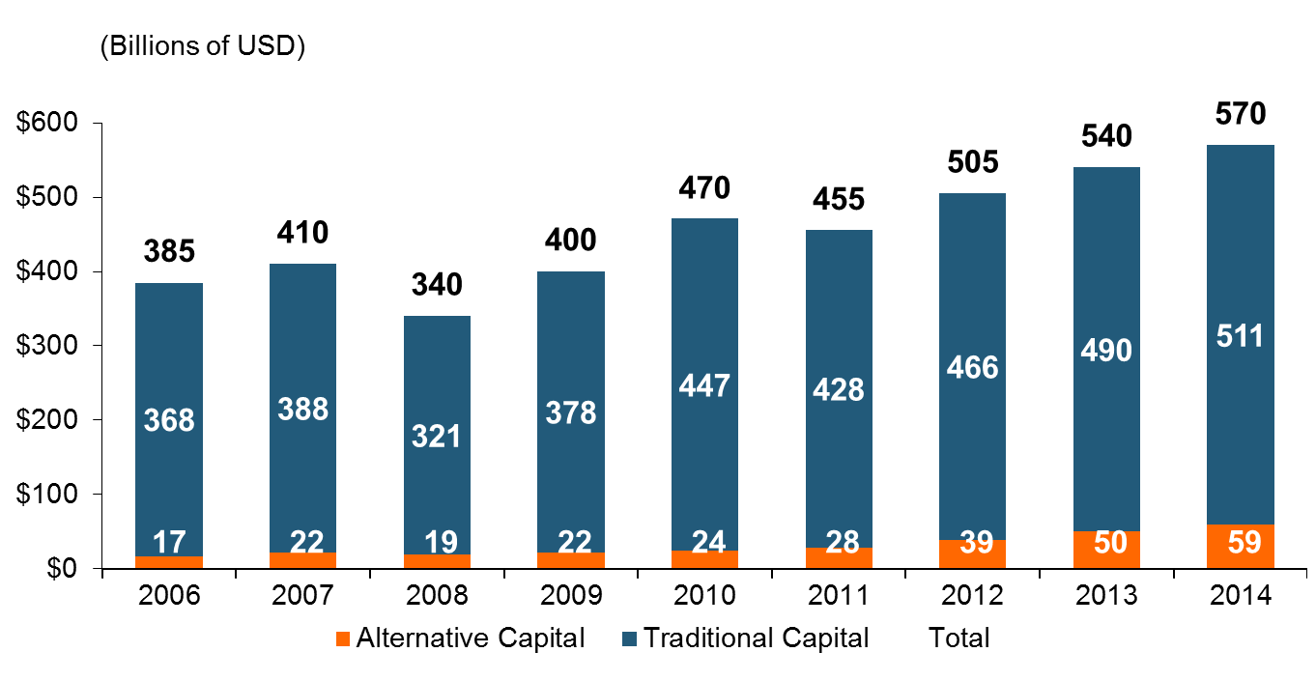
Global Reinsurance Capital (Traditional and Alternative), 2006 - 2014
Total reinsurance capital reached a record $570B in 2013, up 68% from 2008.
But alternative capacity has grown 210% since 2008, to $50B. It has more than doubled in the past three years.
2014 data is as of June 30, 2014.
Source: Aon Benfield Analytics; Insurance Information Institute.

Slide 15
Alternative Capital as a Percentage of Traditional Global Reinsurance Capital
Alternative Capital’s Share of Global Reinsurance Capital Has More Than Doubled Since 2010.
2014 data is as of June 30, 2014.
Source: Aon Benfield Analytics; Insurance Information Institute.

Slide 16
Catastrophe Bond Issuance and Outstanding: 1997-2015
Risk Capital Amount ($ Millions)
Cat Bond Issuance Declined Slightly in 2015 from 2014’s Record Pace. Lower Yields on Bonds Explain Some of the Contraction.
Source: Guy Carpenter, Artemis accessed at http://www.artemis.bm/deal_directory/cat_bonds_ils_issued_outstanding.html .

Slide 17
US Property CAT Rate on Line Index & Global Reinsurance ROE
US Property CAT ROL
Global Reinsurance ROE
Record traditional capacity, alternative capital and low CAT activity have pressured reinsurance prices; ROEs are own only very modestly
Source: Barclays PLC from Guy Carpenter; Insurance Information Institute.

Slide 18
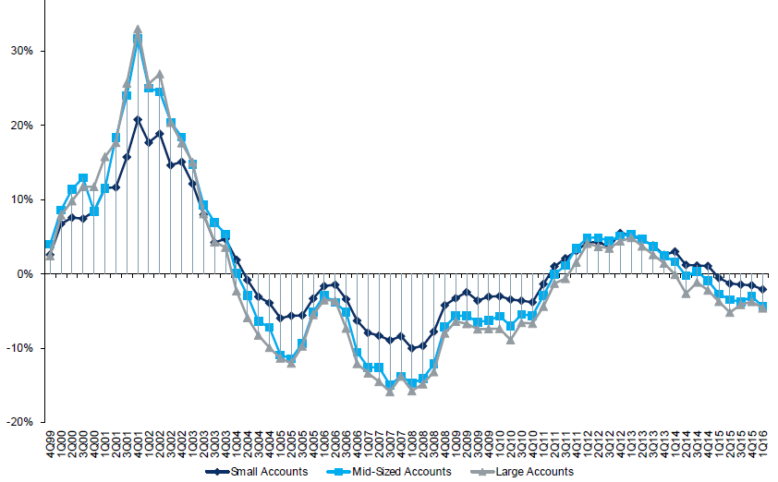
Change in Commercial Rate Renewals, by Account Size: 1999:Q4 to 2016:Q1
Percentage Change (%)
Peak = 2001:Q4 +28.5%
Pricing turned positive in Q3:2011, the first inrease in nearly 8 years; Q1:2015 renewals were down 2.8%; Some insurers posted stronger numbers.
Pricing Turned Negative in Early 2004 and Remained that way for 7 ½ years
Trough = 2007:Q3 -13.6%
KRW : No Lasting Impact
Source: Council of Insurance Agents and Brokers; Barclay’s Capital; Insurance Information Institute.
Note: CIAB data cited here are based on a survey. Rate changes earned by individual insurers can and do vary, potentially substantially.

Slide 19
CIAB: Average Commercial Rate Change, All Lines, (1Q:2004–1Q:2016)
(Percent)
Q2 2011 marked the last of 30th consecutive quarter of price declines
Pricing as of Q1:2016 remained somewhat negative
KRW Effect
Note: CIAB data cited here are based on a survey. Rate changes earned by individual insurers can and do vary, potentially substantially.
Source: Council of Insurance Agents & Brokers; Insurance Information Institute

Slide 20
Change in Commercial Rate Renewals, by Line: 2016:Q1
Percentage Change (%)
Commercial Auto rate increases are larger than any other line, followed by EPL and D&O
Major Commercial Lines Renewals Were Mixed to Down in Q1:2016; EPL, D&O and Commercial Auto Saw Gains
Note: CIAB data cited here are based on a survey. Rate changes earned by individual insurers can and do vary, potentially substantially.
Source: Council of Insurance Agents and Brokers; Insurance Information Institute.

Slide 21
#3. Less Dependent on Investment Income
Low Interest Are the Reality
Depressed Yields Increase Pressure on Underwriting, Pricing & Expenses
21

Slide 22
Property/Casualty Insurance Industry Investment Income: 2000–2015¹
Investment earnings are still below their 2007 pre-crisis peak
($ Billions)
Due to persistently low interest rates, investment income fell in 2012, 2013 and 2014 but showed a small (1.9%) increase in 2015—a trend that may continue.
¹ Investment gains consist primarily of interest and stock dividends. Sources: ISO; Insurance Information Institute.

Slide 23
U.S. Treasury Security Yields:
A Long Downward Trend, 1990–2016*
Yields on 10-Year U.S. Treasury Notes have been essentially below 5% for more than a decade.
Despite the Fed’s December 2015 rate hike, yields remain low though short-term yields have seen some gains; Yield curve is flattening.
Since roughly 80% of P/C bond/cash investments are in 10-year or shorter durations, most P/C insurer portfolios will have low-yielding bonds for years to come.
*Monthly, constant maturity, nominal rates, through May 20, 2016.
Sources: Federal Reserve Bank at http://www.federalreserve.gov/releases/h15/data.htm. National Bureau of Economic Research (recession dates); Insurance Information Institute.
23
12/01/09 - 9pm
eSlide – P6466 – The Financial Crisis and the Future of the P/C
Notes:
23

Slide 24
Treasury Yield Curves:
Pre-Crisis (July 2007) vs. May 2016*
Treasury yield curve remains near its most depressed level in at least 45 years. Investment income is depressed as a result. Fed began to raise rates in Dec. 2015, but yields unlikely to return to pre-crisis levels anytime soon
The Fed Began to Raise Rates in Dec. 2015 but Market Volatility and Weakness Abroad Have Made Additional Hikes Difficult
*As of May 20, 2016.
Source: Federal Reserve Board of Governors: http://www.federalreserve.gov/releases/h15/data.htm; Insurance Information Institute.

Slide 25
Net Investment Yield on Property/ Casualty Insurance Invested Assets, 2007–2016P*
(Percent)
Estimated book yield in 2016 is down about 140 BP from pre-crisis levels
The yield on invested assets remains low relative to pre-crisis yields. The Fed’s plan to raise interest rates in late 2015 has pushed up some yields, albeit quite modestly.
Sources: A.M. Best; 2015E-2016P figures from A.M. Best P/C Review and Preview, Feb. 2016; Insurance Information Institute

Slide 26
Interest Rate Forecasts: 2016 – 2021
Yield (%)
3-Month Treasury
10-Year Treasury
The end of the Fed’s QE program in 2014 and a stronger economy have yet to push longer-term yields much higher
A full normalization of interest rates is unlikely until 2019, more than a decade after the onset of the financial crisis.
Sources: Blue Chip Economic Indicators (4/16 for 2016 and 2017; for 2018-2021 3/16 issue); Insurance Info. Institute.

Slide 27
#4. The Industry Has Become More Regulated
The Global Financial Crisis Spawned the Most Recent Wave of Regulation in the US and Internationally
27

Slide 28
The Global Financial Crisis: The Pendulum Swings Again: Dodd-Frank & Systemic Risk
Dodd-Frank Act of 2010: The implosion of the housing bubble and virtual collapse of the US banking system, the seizure of credit markets and massive government bailouts of US financial institutions led to calls for sweeping regulatory reforms of the financial industry
Limiting Systemic Risk is at the Core of Dodd-Frank
Designation as a Systemically Important Financial Institutional (SIFI) Has Resulted in Greater Regulatory Scrutiny and Heightened Capital Requirements
Dodd-Frank Established Several Entities Impacting Insurers
  Federal Insurance Office
  Financial Stability Oversight Council
  Office of Financial Research
  Consumer Financial Protection Bureau
Parallel Efforts Internationally (FSB→IAIS)

Slide 29
Global Financial Crises &
Global Systemic Risk: Key Dates
Implementation Date | Action
July 2013 | Designation of G-SIIs (annual updates thereafter beginning Nov. 2014)
July 2014 | FSB to make a decision on the G-SII status of, and appropriate risk mitigating measures for major reinsurers
By G-20 Summit 2014 | IAIS to develop backstop capital requirements to apply to all group activities, incl. non-ins. subs.
End 2015 | IAIS to develop HLA requirements that will apply to G-SIIs staring in 2019
January 2019 | G-SIIs to apply HLA requirements
G-SIIs as Designated by the FSB as of July 2013:
  Allianz SE AIG Assicurazioni Generali
  Aviva Axa MetLife
  Ping An Prudential Financial Prudential plc
Sources: Financial Stability Board, “Globally Systemically Important Insurers (G-SIIs) and the Policy Measures that Will Apply to Them,” July 18, 2013.

Slide 30

#5. The Industry Has Become More Innovative and Nimble with Technology Risks
Technology Risks Are a Major Growth Opportunity—And Always Have Been
Disruptors Can Be Managed
30

Slide 31
Interest in Technology Issues and Insurance Is Surging: Presents Opportunity
Insurers are at the intersection of many of the most important technological innovations of the early 21st century
  Problem→Solution→Opportunity
Industry is too often depicted as a technology laggard
I.I.I. is highlighting the industry as being on the technological cutting edge—an innovative, nimble industry with solutions for managing countless new risks of the current era:
  Sharing economy Cyber Auto Technology
  Supply Chain Climate Risk Drones
  Wearable devices The “Internet of Things”
Positions industry well with customers, investors, current and prospective workers/Millennials, regulators/legislators and (tech) media
31
12/01/09 - 9pm
eSlide – P6466 – The Financial Crisis and the Future of the P/C
Notes:
31

Slide 32






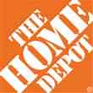

Data Breaches 2005-2015, by Number of Breaches and Records Exposed
# Data Breaches/Millions of Records Exposed
Millions
The 781 reported data breaches in 2015 was virtually unchanged form the record 783 reported in 2014. The number of exposed records soared to 169.1 million, and increase of 97.5%.
Source: Identity Theft Resource Center (updated as of Jan. 6, 2016);
http://www.idtheftcenter.org/images/breach/ITRCBreachReport2015.pdf

Slide 33
Data/Privacy Breach:
Many Potential Costs Can Be Insured
Data Breach Event
Costs of notifying affecting individuals
Defense and settlement costs
Lost customers and damaged reputation
Cyber extortion payments
Costs of notifying regulatory authorities
Regulatory fines at home & abroad
Business Income Loss
Forensic costs to discover cause
33

Slide 34
Estimated Cyber Insurance Premiums Written, 2014 – 2020F
Cyber insurance premiums written could more than triple to $7.5 billion by 2020
$ Billions
I.I.I.’s Cyber Risk paper issued Oct. 2015
Source: Advisen (2014 est.); PwC (2015, 2020); Insurance Information Institute.

Slide 35
Ridesharing Regulation/Legislation and Status of ISO Filings as of 9/30/15
Status Ride Sharing Legislation/Regulation
Status of ISO Filings
35
Source: ISO.

Slide 36




On-Demand/Sharing/Peer-to-Peer Economy Impacts Many Lines of Insurance
The “On-Demand” Economy is or will impact many segments of the economy important to P/C insurers
  Auto (personal and commercial)
  Homeowners/Renters
  Many Liability Coverages
  Professional Liability
  Workers Comp
Many unanswered insurance questions
Insurance solutions are increasingly available to fill the many insurance gaps that arise
36
12/01/09 - 9pm
eSlide – P6466 – The Financial Crisis and the Future of the P/C
Notes:
36

Slide 37
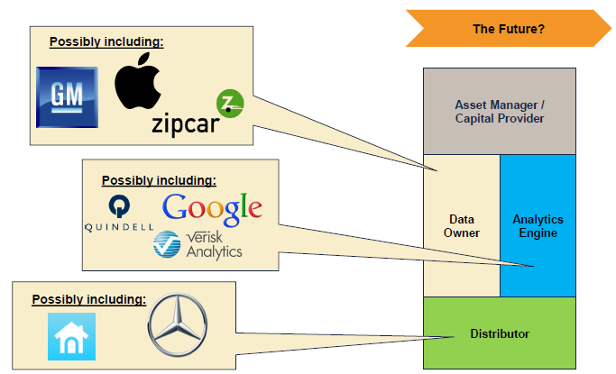

The Internet of Things and the Insurance Industry Value Chain
Who owns the data? Where does It flow? Who does the analytics? Who is the capital provider?
Source: Willis Capital Markets & Advisory; Insurance Information Institute.
37
12/01/09 - 9pm
eSlide – P6466 – The Financial Crisis and the Future of the P/C
Notes:
37

Slide 38
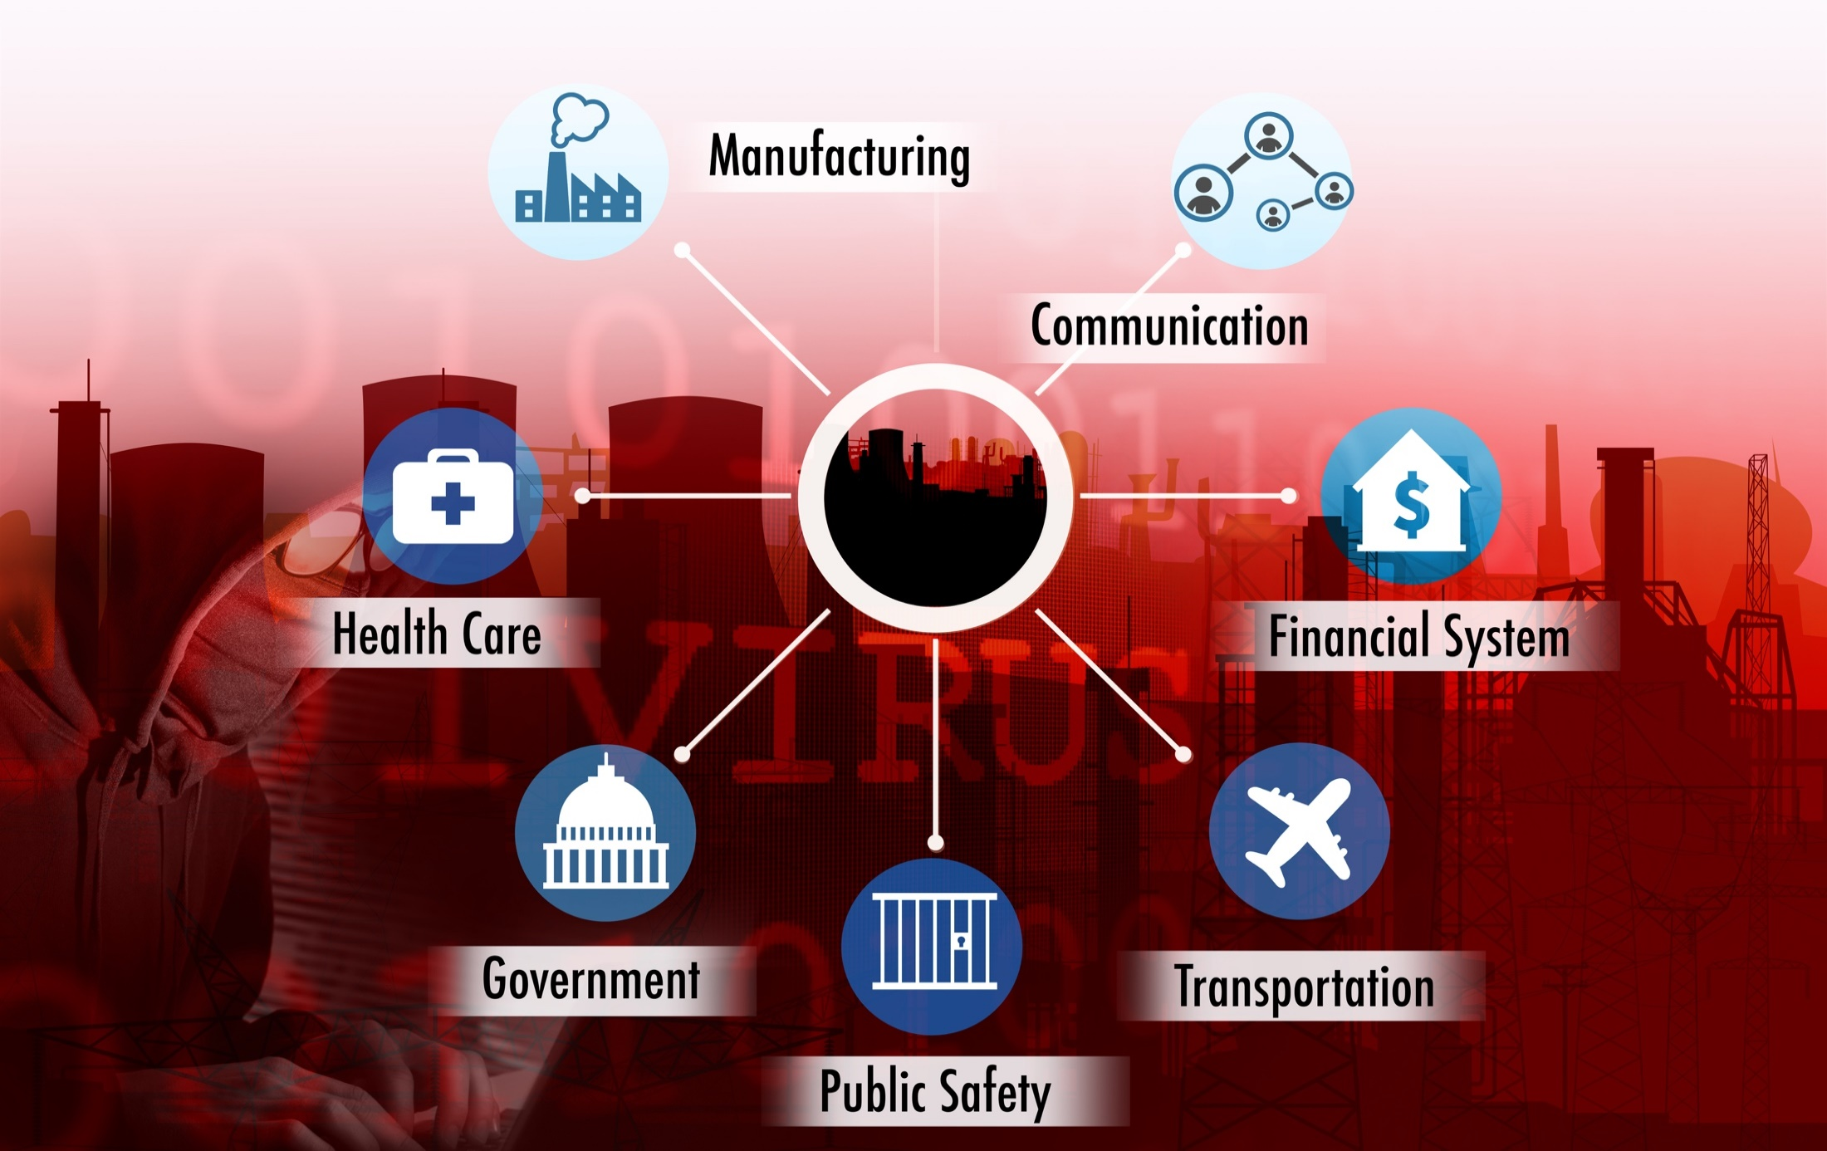
The ‘Internet of Things’ and ‘The Insurance-Net of Things’

Slide 39

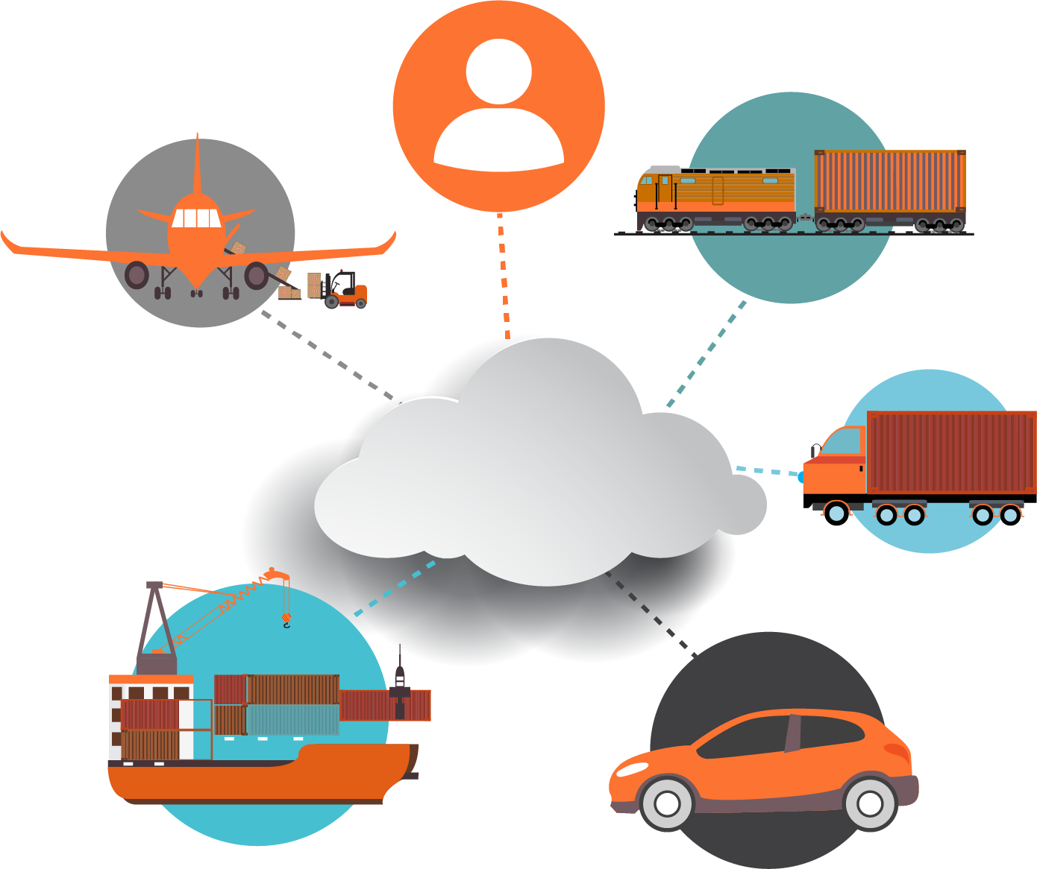
The Insurance Industry’s Future Is in the Cloud…
Human Beings
Rail & Public
Transport
Aviation
Trucking & Fleet Vehicles
The Cloud
Marine Transport
Private Motor Vehicles

Slide 40
INSURANCE TECHNOLOGY:
FIN TECH ZEROES IN
Number and Value of Deals Is Increasing
In Search of the Elusive Insurance ‘Unicorn’
40

Slide 41
Insurance Technology Financing Trend: Change Is Coming
Insurance tech deals reached a new record in 2016:Q1
($ Millions)
Investment in insurance tech is rising
Source: CB Insights at https://www.cbinsights.com/blog/insurance-tech-overview-q1-2016/; Insurance Information Institute.

Slide 42
Insurance Tech Activity by Area of Interest, 2013 – 2016:Q1
With the ACA in the rear view window, non-health insurance tech accounts for the majority of investment
(Percent)
Silicon Valley and the venture capital community have the insurance industry in their sights. Most will fail. Some will succeed.
Source: CB Insights at https://www.cbinsights.com/blog/insurance-tech-overview-q1-2016/; Insurance Information Institute.

Slide 43
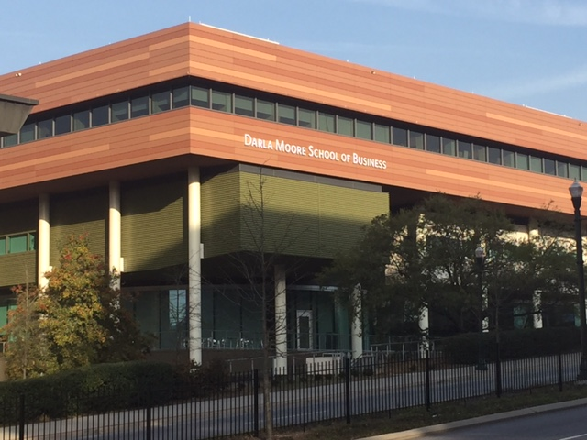
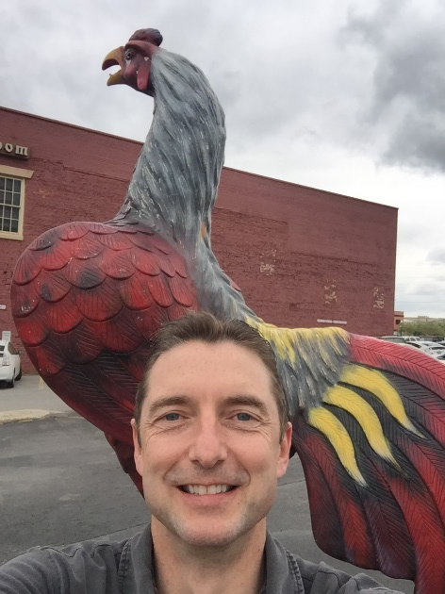
Thank You & Questions!
43

Slide 44
Insurance Information Institute Online:
www.iii.org
Thank you for your time
and your attention!
Twitter: twitter.com/bob_Hartwig
Download at www.iii.org/presentations

