Slide 1
Partnership with the LPI/ULPA An Overview of Communications Strategies
Jeanne M. Salvatore
Senior Vice President and Chief Communications Officer
Insurance Information Institute
Gaylord Hotel and Conference Center, Nashville, Tennessee
March 28, 2015
Insurance Information Institute ♦ 110 William Street ♦ New York, NY 10038
Tel: 212.346.55555 ♦ Cell: 917-612-4088♦ www.iii.org

Slide 2
Presentation Outline
Update on the Partnership between the I.I.I. and the LPI/ULPA – 2014 and 2015 activities
Overview of Lightning Related Resources on the I.I.I. Website
Use the site as a way to promote lightning-related issues to member companies
Facts and Statistics
Consumer article
Videos
Florida Specific Information
Presentations

Slide 3
Update: Partnership Between the I.I.I. and the LPI/ULPA
2014 Activities
Promoted the 2014 Lightning Safety Awareness week in a multi-media news releases and via social engagement, as well as delivered a PowerPoint Presentation at the event. Promote Lightning Safety Awareness Week with updated insured lightning stats.
Made Kim Loehr available to speak to I.I.I. member companies at the I.I.I.’s all-industry weekly call, as well as the June 2014 I.I.I. Communications Committee meeting.
Distributed LPI materials to senior communicators at I.I.I. member companies.
Incorporated lightning protection systems in the home buyers checklist.

Slide 4
Update: Partnership Between the I.I.I. and the LPI/ULPA
2015 Update
Provided Media Training at the 2015 LPI/ULPA Conference, as well as follow-up assistance with media inquiries as needed. This includes putting LPI members in touch with state insurance trades as required.
Distributed two new media advisories on the conference. One with LPI letterhead focused on conference topics. And, another with I.I.I. letterhead featuring I.I.I. resources.
Meet with fire safety organizations to develop more partnerships and encourage better data collection of lightning losses.
Reissue news releases promoting the three videos (How to Pick a Lightning Protection System, Lightning Myths and Lightning Safety).

Slide 5
Update: Partnership Between the I.I.I. and the LPI/ULPA
2015 Update
Update insurance and lightning information in time for Lightning Safety Awareness Week in June.
Participate in Lightning Safety Awareness Week as a presenter and provider of media support.
Work with LPI on a series of videos they are producing with the Federal Alliance for Safe Homes
Work with LPI on a video possibly produced by the University of Maryland geared toward lightning safety in sporting venues.
Consider updating the “How to Pick a Lightning Protection System” video.
Discuss more communications in Spanish.

Slide 6
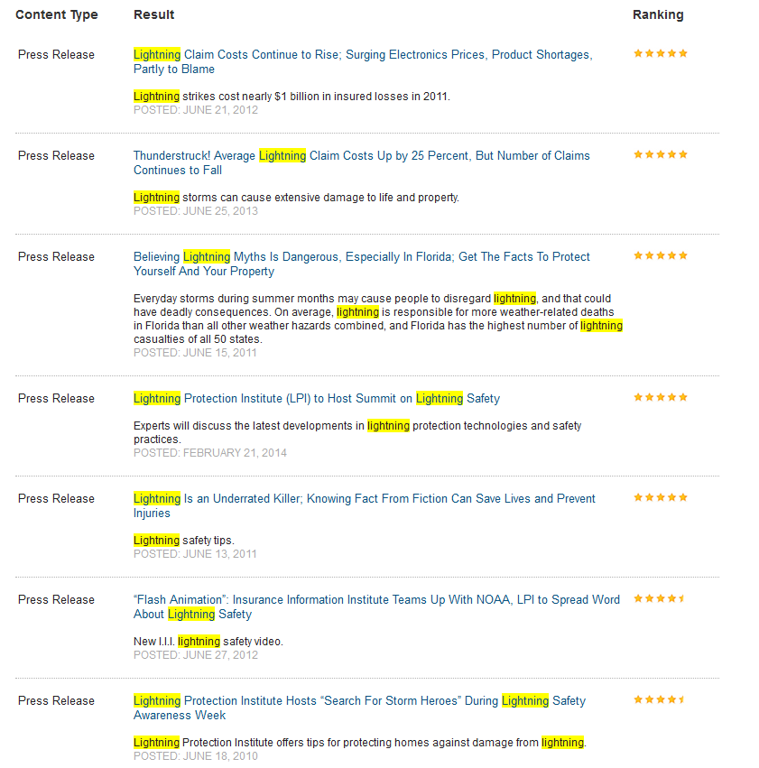
Issue News Releases – Since I.I.I. began partnering with the LPI/UPLA, 21 releases were issued and posted to our website -- with four issued in 2013, four in 2014 and two in 2015
Notes:
Can we have a new screen caption here? Please just go to news release and do a search with the word lightning. The latest news release should show up.

Slide 7
Lightning Resources on the I.I.I. Website
www.iii.org

Slide 8
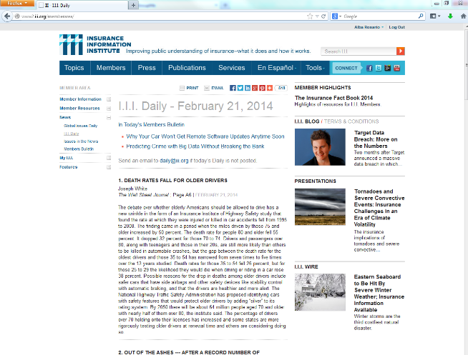
Use I.I.I. website to promote LPI to insurance companies

Slide 9
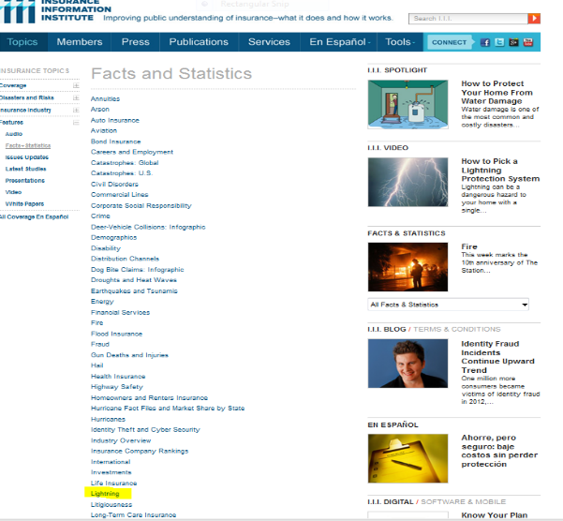
I.I.I. Provides Updated Lightning Facts and Statistics on its Website
Lightning facts and statistics are updated and featured on the I.I.I. website with a link to the LPI.

Slide 10
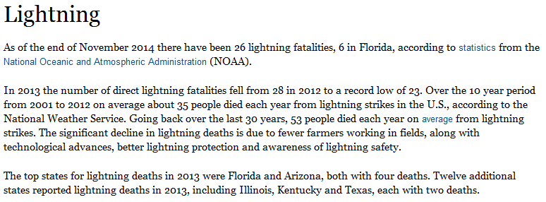
Lightning Facts and Statistics- Fatalities

Slide 11
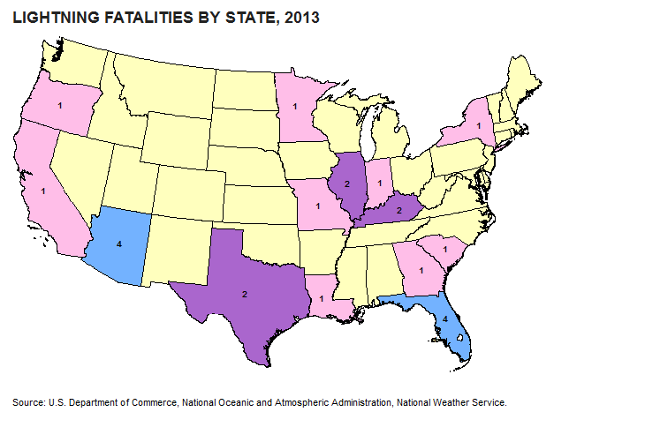
Lightning Fatalities by State

Slide 12
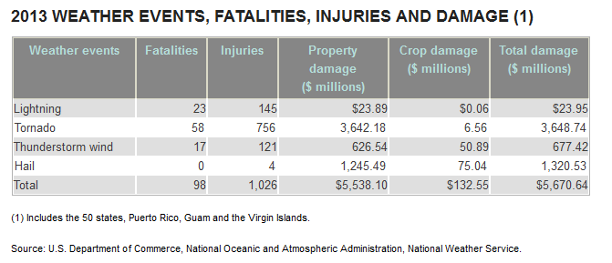
Lightning Compared to Other Disasters

Slide 13
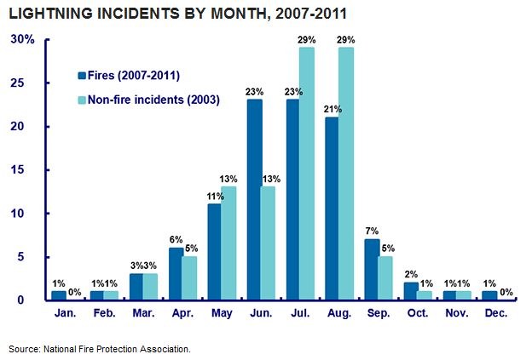
Lightning

Slide 14
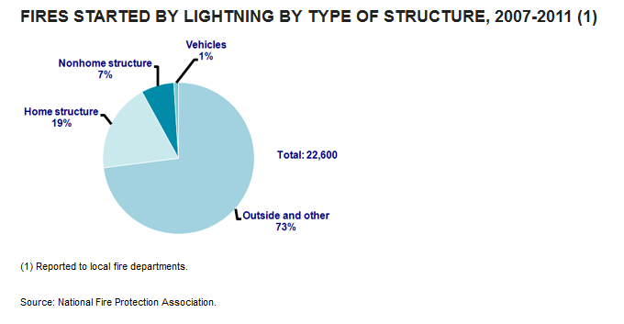
Lightning and Fire

Slide 15
Lightning Fires – Residential/Non Residential

Slide 16
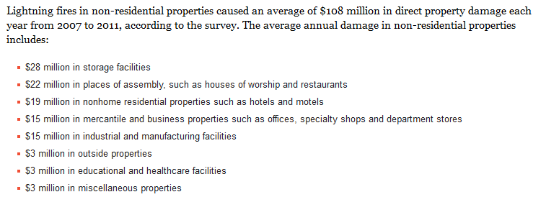
Lightning

Slide 17
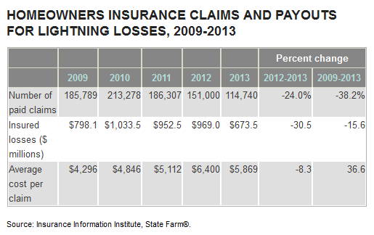
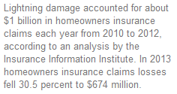
Lightning and Home Insurance Claims

Slide 18
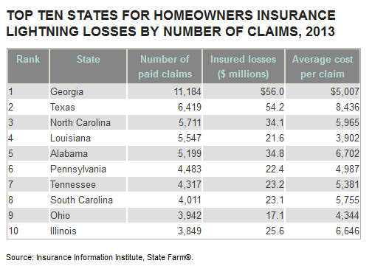
Lightning and Home Insurance Claims

Slide 19
Consumer Articles

Slide 20
Beyond Thunder Dumb: When Lightning Strikes…
View on I.I.I. Site: http://www.iii.org/video/beyond-thunder-dumb-when-lightning-strikes
View on YouTube: https://www.youtube.com/watch?v=QR78RB52ggw

Slide 21
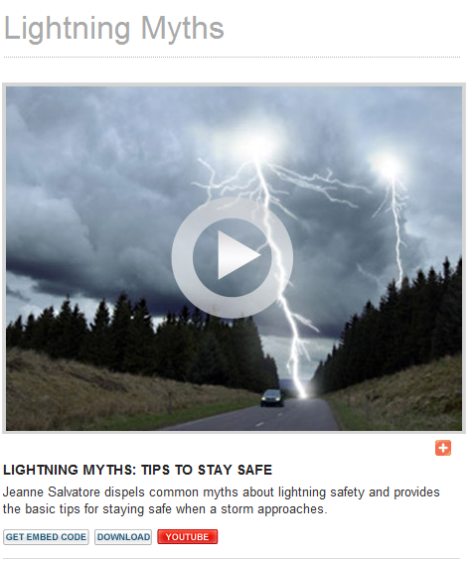
Web Video
Watch Video

Slide 22
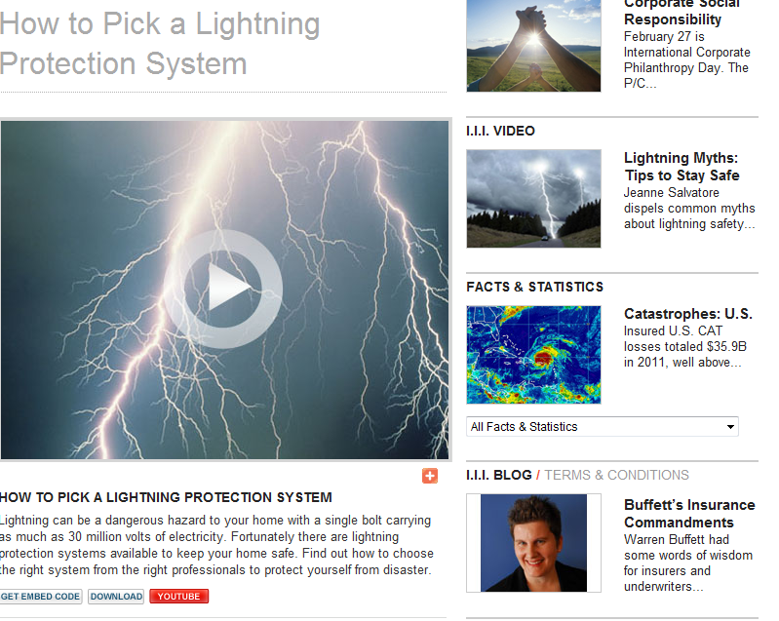
Podcasts and Video
Watch Video

Slide 23
Web videos
Watch Video

Slide 24
Video: b-roll/bites

Slide 25
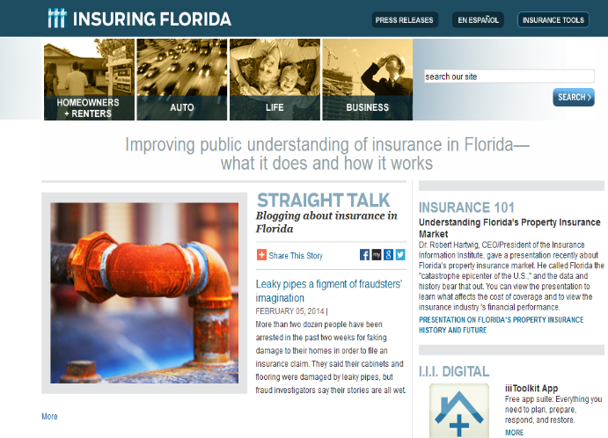
Lightning information, tailored to Florida audiences
Notes:
Is there something more up-to-date on the Florida site? Was there a news release in 2013? If not, let’s take the press release out. – No release in 2013.

Slide 26
Media Training PowerPoint

Slide 27
Thank you!
Please feel free to contact me:
Jeanne M. Salvatore
jeannes@iii.org
917-612-4088 (cell)
212-346-5555 (work)
www.iii.org
Notes:
27

