Slide 1
Trends and Opportunities in
P&C Insurance Industry:
Focus on Midwest Markets
Chicago, IL
October 8, 2015
Download at www.iii.org/presentations
James Lynch, FCAS MAAA, Chief Actuary
Insurance Information Institute ♦ 110 William Street ♦ New York, NY 10038
Tel: 212.346.5533 ♦ Cell: 917.359.3908 ♦ jamesl@iii.org ♦ www.iii.org

Slide 2
Insurance Industry:
Financial Update & Outlook
2014 Was a Reasonably Good Year
2015: A Repeat of 2014?
2

Slide 3
P/C Industry Net Income After Taxes
1991–2015:H1
$ Millions
2005 ROE*= 9.6%
2006 ROE = 12.7%
2007 ROE = 10.9%
2008 ROE = 0.1%
2009 ROE = 5.0%
2010 ROE = 6.6%
2011 ROAS¹ = 3.5%
2012 ROAS¹ = 5.9%
2013 ROAS¹ = 10.2%
2014 ROAS¹ = 8.4%
2015E ROAS = 8.5%
Net income fell modestly (-12.5%) in 2014 vs. 2013
ROE figures are GAAP; ¹Return on avg. surplus. Excluding Mortgage & Financial Guaranty insurers yields a 8.2% ROAS in 2014, 9.8% ROAS in 2013, 6.2% ROAS in 2012, 4.7% ROAS for 2011, 7.6% for 2010 and 7.4% for 2009.
Sources: A.M. Best, ISO; Insurance Information Institute

Slide 4
Profitability Peaks & Troughs in the P/C Insurance Industry, 1975 – 2015E
ROE
1977:19.0%
History suggests next ROE peak will be in 2016-2017
1987:17.3%
10 Years
1997:11.6%
2006:12.7%
10 Years
2015E: 8.5%
2013 9.8%
9 Years
2014 8.2%
1975: 2.4%
1984: 1.8%
1992: 4.5%
2001: -1.2%
*Profitability = P/C insurer ROEs. 2011-14 figures are estimates based on ROAS data. Note: Data for 2008-2014 exclude mortgage and financial guaranty insurers.
Source: Insurance Information Institute; NAIC, ISO, A.M. Best, Conning

Slide 5
ROE: Property/Casualty Insurance by Major Event, 1987–2015E
(Percent)
P/C Profitability Is Both by
Cyclicality and Ordinary Volatility
Modestly higher CATs
Katrina, Rita, Wilma
Low CATs
Sept. 11
Hugo
Lowest CAT Losses in
15 Years
4 Hurricanes
Sandy
Andrew
Record Tornado Losses
Northridge
Financial Crisis*
* Excludes Mortgage & Financial Guarantee in 2008 – 2014.
Sources: ISO, Fortune; Insurance Information Institute.

Slide 6
P/C Insurance Industry
Combined Ratio, 2001–2015:H1*
Heavy Use of Reinsurance Lowered Net Losses
Relatively Low CAT Losses, Reserve Releases
Higher CAT Losses, Shrinking Reserve Releases, Toll of Soft Market
As Recently as 2001, Insurers Paid Out Nearly $1.16 for Every $1 in Earned Premiums
Relatively Low CAT Losses, Reserve Releases
Avg. CAT Losses, More Reserve Releases
Sandy Impacts
Best Combined Ratio Since 1949 (87.6)
Cyclical Deterioration
Lower CAT Losses
* Excludes Mortgage & Financial Guaranty insurers 2008--2014. Including M&FG, 2008=105.1, 2009=100.7, 2010=102.4, 2011=108.1; 2012:=103.2; 2013: = 96.1; 2014: = 97.0.
Sources: A.M. Best, ISO.

Slide 7
A 100 Combined Ratio Isn’t What It
Once Was: Investment Impact on ROEs
A combined ratio of about 100 generates an ROE of ~7.0% in 2012/13, ~7.5% ROE in 2009/10,
10% in 2005 and 16% in 1979
Combined Ratio / ROE
Lower CATs helped ROEs in 2013-15:Q2
Combined Ratios Must Be Lower in Today’s Depressed
Investment Environment to Generate Risk Appropriate ROEs
* 2008 -2014 figures are return on average surplus and exclude mortgage and financial guaranty insurers. 2014 combined ratio including M&FG insurers is 97.0; 2013 = 96.1; 2012 =103.2, 2011 = 108.1, ROAS = 3.5%.
Source: Insurance Information Institute from A.M. Best and ISO Verisk Analytics data.

Slide 8
NPW Premium Growth: Peaks & Troughs in the P/C Insurance Industry, 1926 – 2015E
ROE
Post WW II Peak:
1947: 26.2%
1970-90: Peak premium growth was much higher in this period while troughs were comparable. Rapid inflation, economic volatility, high interest rates, tort environment all played roles
Start of WW II
1941: 15.8%
Economic Shocks, Inflation:
1976: 22.0%
Tort Crisis
1985/86: 22.2%
Post-9/11
2002:15.3%
1988-2000: Period of inter-cycle stability
2014 4.1%
1950-70: Extended period of stability in growth and profitability. Low interest rates, low inflation, “Bureau” rate regulation all played a role
2010-20XX? Post-recession period of stable growth?
Twin Recessions; Interest Rate Hikes
1987: 3.7%
Great Recession:2010: -4.9%
Great Depression
1932: -15.9% max drop
Note: Data through 1934 are based on stock companies only. Data include state funds beginning in 1998.
Source: A.M. Best; Insurance Information Institute.

Slide 9
Direct Premiums Written Growth,
1997–2014
DPW (% chg from prior year)
Post 9/11 Hard Market
Steady Post-Recession Growth
Mild Soft Market/Great Recession
Personal and Commercial Lines Both Have Pricing Cycle; Commercial Lines is More Pronounced.
Sources: SNL Financial, Insurance Information Institute.

Slide 10
Countrywide Growth by Line
2015 to Date
Growing Slightly Faster Than Nominal GDP (3.7%)
(% Change in DPW from Q2 2014)
Auto Coverages Showing Strong Growth as Exposures – and Perhaps Rates - Are Increasing
Auto Physical Damage includes Personal and Commercial.
Source: SNL Financial, Insurance Information Institute.

Slide 11
RNW All Lines by State, 2004-2013 Average:
Highest 25 States
The most profitable states over the past decade are widely distributed geographically, though none are in the Midwest
Profitability Benchmark: All P/C
US: 7.9%
Source: NAIC; Insurance Information Institute.

Slide 12
RNW All Lines by State, 2004-2013 Average:
Lowest 25 States
Some of the least profitable states over the past decade were hit hard by catastrophes
Source: NAIC; Insurance Information Institute.

Slide 13
INVESTMENTS:
THE NEW REALITY
Investment Performance is a Key Driver of Profitability
Depressed Yields Will Necessarily Influence Underwriting & Pricing
13

Slide 14
Property/Casualty Insurance Industry Investment Income: 2000–2015E¹
Investment earnings are still below their 2007 pre-crisis peak
($ Billions)
Due to persistently low interest rates,
investment income fell in 2012, 2013 and 2014.
¹ Investment gains consist primarily of interest and stock dividends. *2015 figure is estimated based on annualized data through Q1.
Sources: ISO; Insurance Information Institute.

Slide 15
Distribution of Invested Assets: P/C Insurance Industry, 2013
$ Billions
Total Invested Assets = $1.5 Trillion
Source: Insurance Information Institute Fact Book 2015, A.M. Best.

Slide 16
U.S. Treasury Security Yields:
A Long Downward Trend, 1990–2015*
Yields on 10-Year U.S. Treasury Notes have been essentially below 5% for a full decade.
U.S. Treasury yields plunged to historic lows in 2013. Longer-term yields rebounded then sank fell again.
Since roughly 80% of P/C bond/cash investments are in 10-year or shorter durations, most P/C insurer portfolios will have low-yielding bonds for years to come.
*Monthly, constant maturity, nominal rates, through August 2015.
Sources: Federal Reserve Bank at http://www.federalreserve.gov/releases/h15/data.htm. National Bureau of Economic Research (recession dates); Insurance Information Institute.
16
12/01/09 - 9pm
eSlide – P6466 – The Financial Crisis and the Future of the P/C
Notes:
16

Slide 17
Book Yield on Property/Casualty Insurance Invested Assets, 2007–2015*
(Percent)
Book yield in 2015 is down 74 BP from pre-crisis levels
The yield on invested assets remains low relative to pre-crisis yields. The Fed’s decision to hold interest rates steady has depressed yields more.
*2015 figure is the average of the four quarters ending in 2015:Q1.
Sources: SNL Financial; Insurance Information Institute

Slide 18
CAPITAL/CAPACITY
Capital Accumulation Has Multiple Impacts
18

Slide 19
Policyholder Surplus,
2006:Q4–2015:Q1
($ Billions)
2007:Q3
Pre-Crisis Peak
Drop due to near-record 2011 CAT losses
Surplus as of 3/31/15 stood at a near-record high $671.7B
The industry now has $1 of surplus for every $0.73 of NPW,
close to the strongest claims-paying status in its history.
2010:Q1 data includes $22.5B of paid-in capital from a holding company parent for one insurer’s investment in a non-insurance business .
The P/C insurance industry entered 2015
in very strong financial condition.
Sources: ISO, A.M .Best.
19
12/01/09 - 9pm
eSlide – P6466 – The Financial Crisis and the Future of the P/C
Notes:
19

Slide 20
US Policyholder Surplus:
1975–2015:Q1*
($ Billions)
Surplus as of 3/31/15 was a near-record $671.7, down 0.4% from the record $674.7 of 12/31/14 but up 53.7% ($234.6B) from the crisis trough of $437.1B at 3/31/09
“Surplus” is a measure of underwriting capacity. It is analogous to “Owners Equity” or “Net Worth” in non-insurance organizations
The Premium-to-Surplus Ratio Stood at $0.73:$1 as of
3/31/15, a Near Record Low (at Least in Recent History)
* As of 3/31/15.
Source: A.M. Best, ISO, Insurance Information Institute.

Slide 21
Premium-to-Surplus Ratio:
1985–2014*
(Ratio of NWP to PHS)
The larger surplus is in relation to premiums—the lower the P:S ratio—and the great the industry’s capacity to handle the risk it has accepted
Surplus as of 12/31/14 was $0.73:$1, a near-record low (at least in modern history)
9/11, Recession & Hard Market
Low P/S Ratio Means Insurers Have Less Leverage to Drive ROE.
* As of 12/31/14.
Source: A.M. Best, ISO, Insurance Information Institute.

Slide 22
Underwriting Performance
22
Notes:
22

Slide 23
Commercial Lines Combined Ratio, 1990-2016F*
Commercial lines underwriting performance improved in 2013/14 but higher cats, diminishing prior year reserves and rising loss cost trends in some lines could push combined ratios higher
*2007-2012 figures exclude mortgage and financial guaranty segments.
Source: A.M. Best (1990-2014); Conning (2015-16F) Insurance Information Institute.

Slide 24
Commercial Lines Rate Change by Month (vs. Year Earlier)
Not Much of A Soft Market, To Date
Not Much of A Hard Market, By Historic Standards
Rates Are As Stable As They’ve Been in 15 Years, Though Individual Lines and Segments May Differ Greatly.
SOURCE: MarketScout, Insurance Information Institute.

Slide 25
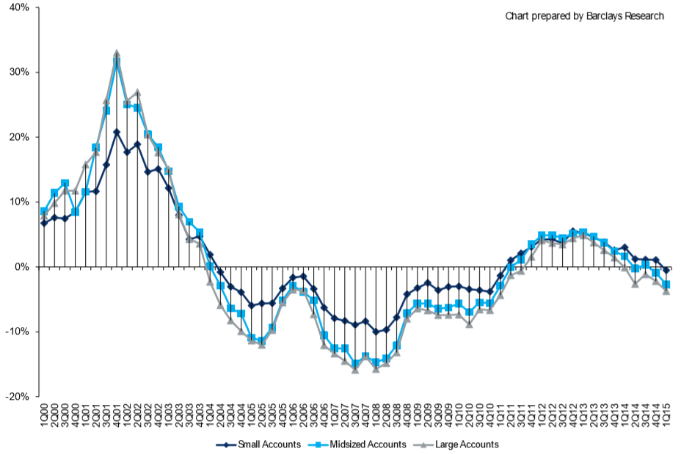
Change in Commercial Rate Renewals, by Account Size: 1999:Q4 to 2015:Q1
Percentage Change (%)
Peak = 2001:Q4 +28.5%
Pricing turned positive in Q3:2011, the first increase in nearly 8 years
Pricing Turned Negative in Early 2004 and Remained that way for 7 ½ years
KRW : No Lasting Impact
Large accounts appear falling more than small, medium-sized.
Trough = 2007:Q3 -13.6%
Source: Council of Insurance Agents and Brokers; Barclay’s Capital; Insurance Information Institute.
Note: CIAB data cited here are based on a survey. Rate changes earned by individual insurers can and do vary, potentially substantially.

Slide 26
Commercial Auto Combined Ratio: 2005–2017F
Legacy of Low Rates, Under-reserving Will Hurt Results for a Few More Years.
Sources: A.M. Best (2005-2014); Conning (2015F – 2017F); Insurance Information Institute.

Slide 27
Commercial Auto Rate Change by Month (vs. Year Earlier)
Rates Rising in Commercial Auto but Might Not Be Enough to Offset Loss Trend, Increase in Frequency.
SOURCE: MarketScout, Insurance Information Institute.

Slide 28
Miles Driven is Climbing
Billions of Miles
In Past 18 Months, Miles Driven Have Soared – More Accidents, More Exposures
*Moving 12-month total. Data through July 2015.
Note: Recessions indicated by gray shaded columns.
Sources: Federal Highway Administration (http://www.fhwa.dot.gov/policyinformation/travel_monitoring/tvt.cfm);
National Bureau of Economic Research (recession dates); Insurance Information Institute.
28
12/01/09 - 9pm
eSlide – P6466 – The Financial Crisis and the Future of the P/C
Notes:
28

Slide 29
Driving Fatalities Are Rising
Driving Has Been Getting Safer For Decades, But Recent Trend Is Discouraging.
* Through June 2015.
Sources: National Safety Council, Insurance Information Institute.

Slide 30
Driving Fatalities Are Rising
On Track for Most Auto Fatalities Since 2007.
Sources: National Safety Council, Insurance Information Institute.

Slide 31
Truck Safety – Long-Term Trends
Deaths per 100 Million Truck Miles Driven
Fatality Rate Has Hit a Temporary Bottom
Occupants of large trucks and passenger vehicles combined.
Sources: Insurance Institute for Highway Safety/Highway Loss Data Institute; Insurance Information Institute.
31
12/01/09 - 9pm
eSlide – P6466 – The Financial Crisis and the Future of the P/C
Notes:
31

Slide 32
Personal Auto Collision Coverage:
Severity & Frequency Are Both Rising
Annual Change, 2005 through 2015*
The Same Appears to Be Happening in Commercial Auto
*2015 figure is for the 4 quarters ending with 2015:Q1.
Source: ISO/PCI Fast Track data; Insurance Information Institute.

Slide 33
Auto: Loss Trend vs. Inflation
Annual Change, 2005 through 2014
Trend, CPI Converged Around 2011. . .
Normally Trend > CPI
. . . And Starting to Diverge Again
If Loss Trends Return to the Norm, Upward Pressure Will Be Applied to Loss Costs.
Source: Towers Watson Claim Cost Index, Insurance Information Institute.

Slide 34
Claim Inflation vs. CPI
In Recent Years, Claim Costs Have Risen at About the Inflation Rate. If We Return to the Norm, Claim Costs Will Rise.
Source: Insurance Information Institute calculation from Towers Watson data.

Slide 35
General Liability Combined Ratio:
2005–2015F
Favorable Loss Trends May Stoke Competition
Source: A.M. Best (2005-2014), Conning Research and Consulting, Insurance Information Insitute.

Slide 36
General Liability Rate Change by Month
(vs. Year Earlier)
Like Most Lines, Rates Have Been Flat Countrywide This Year.
SOURCE: MarketScout, Insurance Information Institute.

Slide 37
Umbrella/Excess Rate Change by Month
(vs. Year Earlier)
Like Most Lines, Rates Have Been Flat Countrywide This Year.
SOURCE: MarketScout, Insurance Information Institute.

Slide 38
Professional Liability Rate Change by Month (vs. Year Earlier)
Like Most Lines, Rates Have Been Flat Countrywide This Year.
SOURCE: MarketScout, Insurance Information Institute.

Slide 39
D&O Liability Rate Change by Month (vs. Year Earlier)
Like Most Lines, Rates Have Been Flat Countrywide This Year.
SOURCE: MarketScout, Insurance Information Institute.

Slide 40
D&O Countrywide Premium & Loss
Monoline Premium, Growth
Monoline Direct Loss Ratio
Steady Growth, Faster Than Average LOB.
Source: SNL Financial, Insurance Information Institute.

Slide 41
D&O: Securities Litigation
Number of Filings Less Than Long-Term Average, But Chances of Class Action is Rising (Fewer Listed Companies)
* Annualized based on First-Half Filings
Sources: Securities Class Action Clearinghouse, Cornerstone Research, Insurance Information Institute.

Slide 42
Other Class Action Trends
Filings Against Foreign Issuers (Listed in US, HQ Outside U.S.) Is Rising
  1.4% of All Filings in 2000 vs. 3.9% in 2015 (Annualized)
  Foreign Issuer More Likely to Face Action Than S&P500 Firm
% Dismissed Within Three-Years Is Rising
  57% of 2011 Filings (Most Recent with Three Years) vs. 28% in 2000
  More Recent Cohort (2012-2014) Unlikely to Match That Record
On the Wane: Chinese Reverse Mergers: 13 in 2014 vs. 43 in 2011

Slide 43
EPLI Rate Change by Month (vs. Year Earlier)
Like Most Lines, Rates Have Been Flat Countrywide This Year.
SOURCE: MarketScout, Insurance Information Institute.

Slide 44
EEOC Charge Statistics
Overall Filings Declining – Growth In Title VII (discrimination allegations) Retaliation, Disability Charges
Sources: Equal Employment Opportunity Commission.

Slide 45
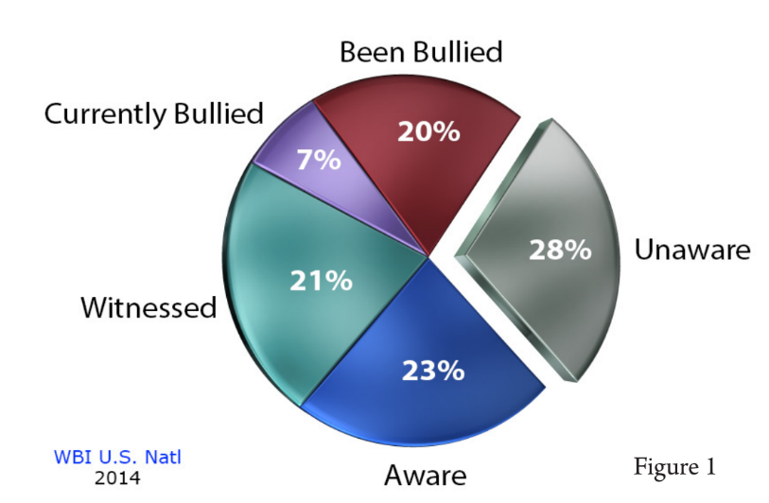
Other EPLI Trends
GINA (Genetic Information Nondiscrimination Act) Prohibits Work Discrimination Based on Genetic Information
  333 EEOC Charges in FY2014
  Zero in FY2009
Bullying/Cyberbullying
Interns
Religious Attire at Work
Source: Workplace Bullying Institute.

Slide 46
Profitability and Growth in Midwest P/C Insurance Markets
Analysis by Line and Nearby State Comparisons
46

Slide 47
Direct Premiums Written: Total P/C
Percent Change by State, 2007-2014
Top 25 States
North Dakota was the country’s growth leader over the past 7 years with premiums written expanding by 70.7%, fueled by the state’s energy boom
Growth Benchmarks: Total P/C
US: 13.0%
Sources: SNL Financial LC.; Insurance Information Institute.

Slide 48
Direct Premiums Written: Total P/C
Percent Change by State, 2007-2014
Bottom 25 States
Growth was negative in 4 states and DC between 2007 and 2014
Sources: SNL Financial LC.; Insurance Information Institute.

Slide 49
All Lines: 10-Year DPW Growth, IL & Nearby States
2005-2014
Only Illinois Lags U.S. Average (Declines in GL, MedMal, Mtg. Guaranty)
Source: SNL Financial, Insurance Information Institute.

Slide 50
All Lines: 2015 DPW Growth, IL & Nearby States
Through Q2 2015
This Year Illinois Has Fastest Premium Growth
Source: SNL Financial, Insurance Information Institute.

Slide 51
All Lines: 10-Year Average RNW IL & Nearby States
Iowa’s All Lines profitability is Highest in the Region
2004-2013
Source: NAIC, Insurance Information Institute

Slide 52
RNW All Lines: IL vs. U.S., 2004-2013
(Percent)
Average 2004-2013
U.S.: 7.9%
IL: 7.7%
IL Results Closely Follow the Nation
Katrina, Rita Wilma Hurt U.S. Result
Source: NAIC, Insurance Information Institute
52
Notes:
52

Slide 53
Comm Auto: 10-Year DPW Growth, IL & Nearby States
Premium Fell Everywhere
2005-2014
Other Liability Excludes Products, Medical Malpractice.
Source: SNL Financial, Insurance Information Institute.

Slide 54
Commercial Auto: 10-Year Average RNW IL & Nearby States
2004-2013
All States in Area Exceed U.S. Average
Source: NAIC, Insurance Information Institute

Slide 55
RNW Comm. Auto: IL vs. U.S.,
2004-2013
(Percent)
Average 2004-2013
U.S.: 7.7%
IL: 9.8%
IL Results Deteriorating, Similar to Rest of USA
Source: NAIC, Insurance Information Institute
55
Notes:
55

Slide 56
Other Liability: 10-Year DPW Growth, IL & Nearby States
2005-2014
Only Illinois Lags U.S. Average
Other Liability Excludes Products, Medical Malpractice.
Source: SNL Financial, Insurance Information Institute.

Slide 57
Other Liability: 10-Year Average RNW IL
& Nearby States
2004-2013
All States in Area Exceed U.S. Average
Source: NAIC, Insurance Information Institute

Slide 58
RNW Other Liability*: IL vs. U.S.,
2004-2013
(Percent)
Average 2004-2013
U.S.: 7.4%
IL: 7.8%
* Occurrence, Claims-Made Combined. Products Liability through 2008.
Source: NAIC, Insurance Information Institute
58
Notes:
58

Slide 59
The Strength of the Economy Will Influence P/C Insurer Growth Opportunities
Growth Will Expand Insurer Exposure Base Across Most Lines
59

Slide 60
US Real GDP Growth*
The Q4:2008 decline was the steepest since the Q1:1982 drop of 6.8%
Real GDP Growth (%)
Recession began in in June 2009
Q1 2014/15 GDP data were hit hard by this year’s “Polar Vortex” and harsh winter
Demand for Insurance Should Increase in 2015 as GDP Growth Accelerates Modestly and Gradually Benefits the Economy Broadly
* Estimates/Forecasts from Blue Chip Economic Indicators.
Source: US Department of Commerce, Blue Economic Indicators 9/15; Insurance Information Institute.

Slide 61
Real GDP by State Percent Change, 2014*:
Highest 25 States
North Dakota was the economic growth juggernaut of the US in 2014—by far
Only 7 states experienced growth in excess of 3% in 2014, which is a growth rate we would see nationally in a more typical recovery
Growth Benchmarks: Real GDP
US: 2.2%
*Advance statistics
Sources: U.S. Bureau of Economic Analysis; Insurance Information Institute.

Slide 62
Real GDP by State Percent Change, 2014*:
Lowest 25 States
Growth rates in 16 states were still below 1% in 2014
Midwest Had Been Slow to Recover: IL, WI, IA, IN All Below Average Growth
*Advance statistics
Sources: US Bureau of Economic Analysis; Insurance Information Institute.

Slide 63
State Leading Economic Indicators through November 2015
Growth in the West is finally beginning to pick up
The economic outlook for most of the US is generally positive, though flat-to-negative for 10 states, several of them energy dependent
Sources: Federal Reserve Bank of Philadelphia at http://www.philadelphiafed.org/index.cfm ;Insurance Information Institute.

Slide 64
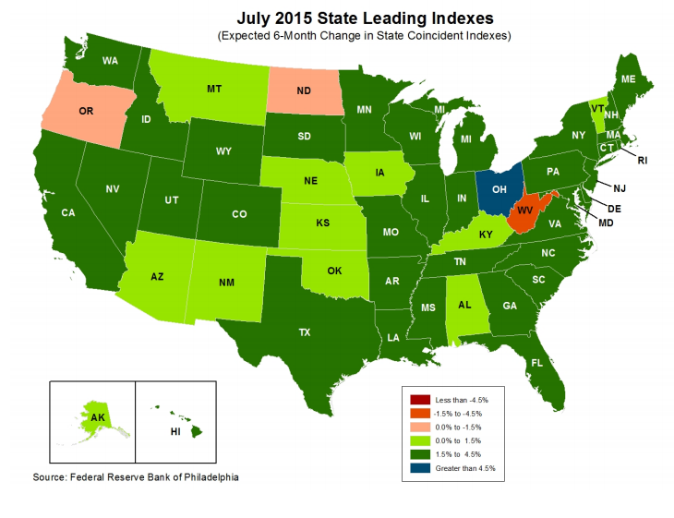
State Leading Economic Indicators through January 2016
ND, Formerly A Leader, Becoming a Laggard.
Solid Growth Projected for Midwest.
Much of Nation Has Robust Outlook
Sources: Federal Reserve Bank of Philadelphia at http://www.philadelphiafed.org/index.cfm ;Insurance Information Institute.

Slide 65
Labor Market Trends
Massive Job Losses Sapped the Economy and Commercial/Personal Lines Exposure, But Trend Has Greatly Improved
65

Slide 66
Unemployment and Underemployment Rates: Still Too High, But Falling
January 2000 through September 2015, Seasonally Adjusted (%)
U-6 soared from 8.0% in March 2007 to 17.5% in
October 2009; Stood at 9.6% in Sept. 2015.
8% to 10% is “normal.”
“Headline” unemployment was 5.1% in Sept. 2015. 4.5% to 5.5% is “normal.”
Job Growth Has Been Slow, But Continues to Improve.
Source: US Bureau of Labor Statistics; Insurance Information Institute.
66
12/01/09 - 9pm
eSlide – P6466 – The Financial Crisis and the Future of the P/C
Notes:
66

Slide 67
Monthly Change in Private Employment
3,042,000 jobs were created in 2014, the most since 1997
January 2007 through July 2015 (000s, Seasonally Adj.)
Jobs Created
2014: 3.042 Mill
2013: 2.452 Mill
2012: 2.315 Mill
2011: 2.396 Mill
2010: 1.282 Mill
210,000 private sector jobs were created in July.
Monthly losses in Dec. 08–Mar. 09 were the largest in the
post-WW II period
Private Employers Added 12.84 Million Jobs Since Jan. 2010 After Having Shed 5.01 Million Jobs in 2009 and 3.76 Million in 2008 (State and Local Governments Have Shed Hundreds of Thousands of Jobs)
Source: US Bureau of Labor Statistics: http://www.bls.gov/ces/home.htm; Insurance Information Institute

Slide 68
US Unemployment Rate Forecast
Rising unemployment
eroded payrolls
and WC’s
exposure base.
Unemployment peaked at 10% in late 2009.
2007:Q1 to 2016:Q4F*
Jobless figures have been revised downwards for 2015/16
Unemployment forecasts have been revised modestly downwards. Optimistic scenarios put the unemployment as low as 5.0% by Q4 of 2015.
* = actual; = forecasts
Sources: US Bureau of Labor Statistics; Blue Chip Economic Indicators (9/15 edition); Insurance Information Institute.

Slide 69
Unemployment Rates by State, August 2015:
Highest States*
Illinois Has Highest Unemployment in Region.
*Provisional figures for August 2015, seasonally adjusted.
Sources: US Bureau of Labor Statistics; Insurance Information Institute.

Slide 70
Unemployment Rates by State, August 2015:
Lowest States*
Other Midwest States Have Below-Average Unemployment Rates
*Provisional figures for August 2015, seasonally adjusted.
Sources: US Bureau of Labor Statistics; Insurance Information Institute.

Slide 71
CONSTRUCTION INDUSTRY OVERVIEW & OUTLOOK
The Construction Sector Is Critical to the Economy and the P/C Insurance Industry
71

Slide 72
Value of New Private Construction: Residential & Nonresidential, 2003-2015*
2015: Value of new pvt. construction hits $766.4B as of June 2015, up 53.1% from the 2010 trough but still 17.5% below 2006 peak
New Construction peaks at $911.8. in 2006
Billions of Dollars
Trough in 2010 at $500.6B, after plunging 55.1% ($411.2B)
$15.0
$613.7
$394.8
$298.1
$261.8
$371.6
$238.8
Private Construction Activity Is Moving in a Positive Direction though Remains Well Below Pre-Crisis Peak; Residential Dominates
*2015 figure is a seasonally adjusted annual rate as of June.
Sources: US Department of Commerce http://www.census.gov/construction/c30/c30index.html ; Insurance Information Institute.
72
12/01/09 - 9pm
eSlide – P6466 – The Financial Crisis and the Future of the P/C
Notes:
72

Slide 73
Value of Construction Put in Place, June 2015 vs. June 2014*
Growth (%)
Private: +13.7%
Public: +8.0%
Public sector construction activity is finally beginning to create less drag up after years of decline
Private sector construction activity is up in both the residential and nonresidential segments
Overall Construction Activity is Up Again After Languishing in Early 2015; State/Local Sector Government Sector May Be Recovering as Budget Woes Ease in Some Jurisdictions
*seasonally adjusted
Source: U.S. Census Bureau, http://www.census.gov/construction/c30/c30index.html ; Insurance Information Institute.

Slide 74
New Private Housing Starts, 1990-2021F
Job growth, low inventories of existing homes, low mortgage rates and demographics should continue to stimulate new home construction for several more years
(Millions of Units)
New home starts plunged 72% from 2005-2009; A net annual decline of 1.49 million units, lowest since records began in 1959
Insurers Are Continue to See Meaningful Exposure Growth in the Wake of the “Great Recession” Associated with Home Construction: Construction Risk Exposure, Surety, Commercial Auto; Potent Driver of Workers Comp Exposure
Source: U.S. Department of Commerce; Blue Chip Economic Indicators (9/15); Insurance Information Institute.

Slide 75
U.S.: Pct. Of Private Housing Unit Starts
In Multi-Unit Projects, 1990-2015
Units in Multiple-Unit Projects
as Percent of Total
A NEW NORMAL?
In 5 of the last 7 years, over 30% of housing unit starts were in 5+-unit projects
For the U.S. as a whole, the trend toward multi-unit housing projects (vs. single-unit homes) is recent. Commercial insurers with Workers Comp, Construction risk exposure, and Surety benefit.
*January through April 2015; April is preliminary; calculations based on seasonally adjusted at annual rates
Sources: U.S. Census Bureau, New Residential Construction in April 2015 and earlier releases; next release June 16, 2015; Insurance Information Institute calculations.

Slide 76
Construction Employment,
Jan. 2010—July 2015*
(Thousands)
Construction employment is +948,000 above
Jan. 2011 (+17.4%) trough
Construction and manufacturing employment constitute 1/3 of all WC payroll exposure.
*Seasonally adjusted.
Sources: US Bureau of Labor Statistics at http://data.bls.gov; Insurance Information Institute.
76
12/01/09 - 9pm
eSlide – P6466 – The Financial Crisis and the Future of the P/C
Notes:
76

Slide 77
MANUFACTURING SECTOR OVERVIEW & OUTLOOK
The U.S. Is Experiencing a Mini Manufacturing Renaissance but Headwinds from Weak Export Markets and Strong Dollar
77

Slide 78
ISM Manufacturing Index
(Values > 50 Indicate Expansion)
January 2010 through April 2015
Manufacturing continues to expand in 2015
The manufacturing sector expanded for 62 of the 64 months from Jan. 2010 through Apr. 2015. Pace of recovery has been uneven due to economic turbulence in the U.S., Europe and China and the high dollar.
Source: Institute for Supply Management at http://www.ism.ws/ismreport/mfgrob.cfm; Insurance Information Institute.

Slide 79
Manufacturing Growth for Selected Sectors, 2015 vs. 2014*
Growth (%)
Durables: +3.0%
Non-Durables: -9.7%
Manufacturing of durable goods is stronger than nondurables in 2015
Impact of falling energy prices
Manufacturing Is Expanding in Many Sectors But Declining Energy Prices Are Dragging Down Industry Figures. Continued Gortwh Across a Number of Sectors that Will Contribute to Growth in Insurable Exposures Including: WC, Commercial Property, Commercial Auto and Many Liability Coverages
*Seasonally adjusted; Date are YTD comparing data through February 2015 to the same period in 2014.
Source: U.S. Census Bureau, Full Report on Manufacturers’ Shipments, Inventories, and Orders, http://www.census.gov/manufacturing/m3/

Slide 80
Manufacturing Employment,
Jan. 2010—July 2015*
(Thousands)
Since Jan 2010, manufacturing employment is up (+890,000 or +7.8%)
and still growing.
Manufacturing employment is a surprising source of strength in the economy. Employment in the sector is at a multi-year high.
*Seasonally adjusted.
Sources: US Bureau of Labor Statistics at http://data.bls.gov; Insurance Information Institute.
80
12/01/09 - 9pm
eSlide – P6466 – The Financial Crisis and the Future of the P/C
Notes:
80

Slide 81
Dollar Value* of Manufacturers’ Shipments Monthly, Jan. 1992—March 2015
$ Millions
The value of Manufacturing Shipments in March 2015 was $482.2B—down 5.1% since the July 2014 record high of $508.1B
Monthly shipments in March 2015 are similar to pre-crisis (July 2008) peak but has declined in recent months due to the strong US dollar and weakness abroad. Manufacturing is energy-intensive and growth leads to gains in many commercial exposures: WC, Commercial Auto, Marine, Property, and various Liability Coverages.
* Seasonally adjusted; Data published May 4, 2015.
Source: U.S. Census Bureau, Full Report on Manufacturers’ Shipments, Inventories, and Orders, http://www.census.gov/manufacturing/m3/
81
12/01/09 - 9pm
eSlide – P6466 – The Financial Crisis and the Future of the P/C
Notes:
81

Slide 82
CYBER RISK & CYBER INSURANCE
Cyber Risk is a Rapidly Emerging Exposure for Businesses Large and Small in Every Industry
I.I.I. White Paper to Be Published in Oct.
82

Slide 83






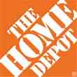

Data Breaches 2005-2015, by Number of Breaches and Records Exposed
# Data Breaches/Millions of Records Exposed
Millions
The total number of data breaches (+27.5%) hit a record high of 783 in 2014, exposing 85.6 million records. Through June 30, this year has seen 117.6 million records exposed in 400 breaches.*
*Figures as of June 30, 2015, from the Identity Theft Resource Center,
http://www.idtheftcenter.org/images/breach/ITRCBreachReport2015.pdf

Slide 84
High Profile Data Breaches, 2014-2015
Date | Company | Description of Breach
May 2015 | OPM | Hackers broke into U.S. Government Personnel Office stealing personal identifying information of as many as 14 million civilian U.S. government employees.
Mar 2015 | Premera Blue Cross | Data breach compromises financial and medical records of 11 million customers.
Feb 2015 | Anthem, Inc | Massive data breach after hackers gained access to corporate data base containing personal information of as many as 80 million current and former U.S. customers and employees.
Dec 2014 | Sony Pictures Entertainment | Hacker break-in involving theft of unreleased motion pictures, and theft of more than 25 gigabytes of sensitive data on tens of thousands of Sony employees, including social security numbers, medical and salary information.
Nov 2014 | Staples | Point-of-sale (POS) malware attack and breach exposing customer data, and resulting in compromise of 1.2 million records.
Sept 2014 | Home Depot | Huge data breach exposes 56 million credit and debit cards and 53 million email addresses.
Aug 2014 | Community Health Systems | Cyber attack originating in China resulted in data breach, compromising 4.5 million patient records. Hackers broke into company’s computer system by exploiting Heartbleed bug.
June/July 2014 | JP Morgan Chase | Massive data breach compromised data associated with 76 million household and 7 million small business accounts. Hackers obtained personal identifying nformation.
June 2014 | PF Changs | Security breach affected customers at 33 restaurants located in 16 states, with potential credit and debit card data stolen.
May 2014 | eBay | Massive data breach exposed records of site’s 233 million customers, including names, email addresses, physical addresses, phone numbers and birthdates.
Feb 2014 | Michaels Stores | Possible fraudulent activity on some U.S. payment cards used at Michaels stores suggests it may have experienced data security attack, exposing 2.6 million records.
Jan 2014 | Snapchat | Security breach compromises phone numbers and usernames for 4.6 million accounts.
Jan 2014 | Neiman Marcus | Hacker break-in exposed unknown no. of customer cards, compromising est. 1.1 million records.
Nov/Dec 2013 | Target | Malware stored on Target’s checkout registers led to theft of data from about 40 million credit and debit card accounts and the personal information of up to 70 million customers.
Sources: Identity Theft Resource Center; Insurance Information Institute (I.I.I.) research.

Slide 85
Worldwide Cybersecurity Spending, 2011- 2016F
($ Billions)
Cybersecurity spending increased by an estimated $5.2B in 2014, $5.8B in 2015 and $6.3B in 2016
Cybersecurity Spending Is Rising Sharply, Up by About 8%+ Annually through 2016—a Projected Increase of $12.1 Billion from 2014 to 2016
85
Source: Gartner Group; Insurance Information Institute; Adapted from Wall Street Journal: “Financial Firms Boost Cybersecurity Funds,” Nov. 17, 2014.

Slide 86
2014 Data Breaches By Business Category, By Number of Breaches
The majority of the 783 data breaches in 2014 affected business and medical/healthcare organizations, according to the Identity Theft Resource Center.
Banking/Credit/Financial, 43 (5.5%)
Govt/Military, 92 (11.7%)
Business, 258 (33.3%)
Educational, 57 (7.3%)
Medical/Healthcare, 333 (42.5%)
Source: Identity Theft Resource Center, http://www.idtheftcenter.org/ITRC-Surveys-Studies/2014databreaches.html

Slide 87
Evolving Threats: Cyber Crime and Cyber Terrorism
State sponsored groups:
Foreign government sponsored
Sophisticated and well-funded
Organized cyber criminals:
Traditional organized crime groups
Loosely organized global hacker crews
Hacktivists:
Politically-motivated hackers
Increasing capabilities
Insiders:
Easy access to sensitive information
Difficult to detect
Terrorists:
Destruction of physical and digital assets
Source: Lewis Brisbois, Practical Strategies to Address Cyber Risk in Your Business, November 2014

Slide 88
Main Causes of Data Breach Globally
Malicious or criminal attacks are most often the cause of data breach globally. Some 42 percent of incidents concern a malicious or criminal attack, while 30 percent concern a negligent employee or contractor (human factor).
Malicious or criminal attack*
Human error
System glitch
*The most common types of malicious or criminal attacks include malware infections, criminal insiders, phishing/social engineering and SQL injection.
Source: 2014 Cost of a Data Breach Study: Global Analysis, the Ponemon Institute, sponsored by IBM, May 2014

Slide 89
US: Most Costly Types of Cyber Crimes, Fiscal Year 2014
Malicious code, denial of service and web-based attacks account for more than 55 percent of the total annualized cost of cyber crime experienced by 59 U.S. companies.
Viruses, Worms, Trojans
Botnets
Malicious code
Malware
Malicious insiders
Stolen devices
Denial of service
Phishing + social engineering
Web-based attacks
Source: 2014 Cost of Cyber Crime: United States, Ponemon Institute.

Slide 90
US: External Cyber Crime Costs: Fiscal Year 2014
Information theft (40%) and business disruption or lost productivity (38%) account for the majority of external costs due to cyber crime.
Equipment damages
Other costs*
Information theft
Revenue loss
Business disruption
* Other costs include direct and indirect costs that could not be allocated to a main external cost category
Source: 2014 Cost of Cyber Crime: United States, Ponemon Institute.

Slide 91
PWC Survey: Cybercrime Costs Greater for U.S. Companies
U.S. organizations are more at risk of suffering financial losses in excess of $1 million due to cybercrime.
Source: 2014 Global Economic Crime Survey, PWC.
91
Notes:
91

Slide 92
Top 10 Global Business Risks for 2015
Cyber is one of the most significant movers in this year’s Risk Barometer rankings, gaining five percentage points to move into the top 5 global business risks for the first time.
Source: Allianz Risk Barometer on Business Risks 2015
92
Notes:
92

Slide 93
Marsh: Percentage of U.S. Companies Purchasing Cyber Insurance Increased in 2014
Ever larger numbers of insureds seek financial protection via cyber insurance. The percentage of U.S. companies buying cyber insurance rose to 16 percent in 2014.
*Take-up rate refers to the overall percentage of clients that purchased standalone cyber insurance.
Source: Benchmarking Trends: As Cyber Concerns Broaden, Insurance Purchases Rise, Marsh Risk Management Research Briefing, March 2015
93
Notes:
93

Slide 94
Marsh: Total Limits Purchased, By Industry – Cyber Liability, All Revenue Size
Average limits purchased for cyber risk rose to $12.8 million for all industries and all company sizes in 2014. Power and utility companies witnessed the sharpest percentage increase in average limits, at 59 percent.
($ Millions)
Source: Benchmarking Trends: As Cyber Concerns Broaden, Insurance Purchases Rise, Marsh Risk Management Research Briefing, March 2015
94
Notes:
94

Slide 95
Marsh: Total Limits Purchased, By Industry – Cyber Liability, Revenue $1 Billion+
Among larger companies, average cyber insurance limits purchased increased by 22 percent to $34.1 million in 2014, from $27.8 million in 2013.
($ Millions)
Source: Benchmarking Trends: As Cyber Concerns Broaden, Insurance Purchases Rise, Marsh Risk Management Research Briefing, March 2015
95
Notes:
95

Slide 96
Cyber Liability: Historical Rate (price per million) Changes
Cyber insurance premiums were generally volatile in 2014 due to increased frequency and severity of losses. Average rate increases at renewal for both primary layers and total programs were lower in Q4 2014 than in Q1.
Source: Benchmarking Trends: As Cyber Concerns Broaden, Insurance Purchases Rise, Marsh Risk Management Research Briefing, March 2015

Slide 97
Data/Privacy Breach:
Many Potential Costs Can Be Insured
Data Breach Event
Costs of notifying affecting individuals
Defense and settlement costs
Lost customers and damaged reputation
Cyber extortion payments
Costs of notifying regulatory authorities
Regulatory fines at home & abroad
Business Income Loss
Forensic costs to discover cause
Source: Zurich Insurance; Insurance Information Institute
97

Slide 98
The Three Basic Elements of Cyber Coverage: Prevention, Transfer, Response
Loss Prevention
Post-Breach Response
(Insurable)
Loss Transfer (Insurance)
Cyber risk management today involves three essential components, each designed to reduce, mitigate or avoid loss. An increasing number of cyber risk products offered by insurers today provide all three.
Source: Insurance Information Institute research.
98

Slide 99
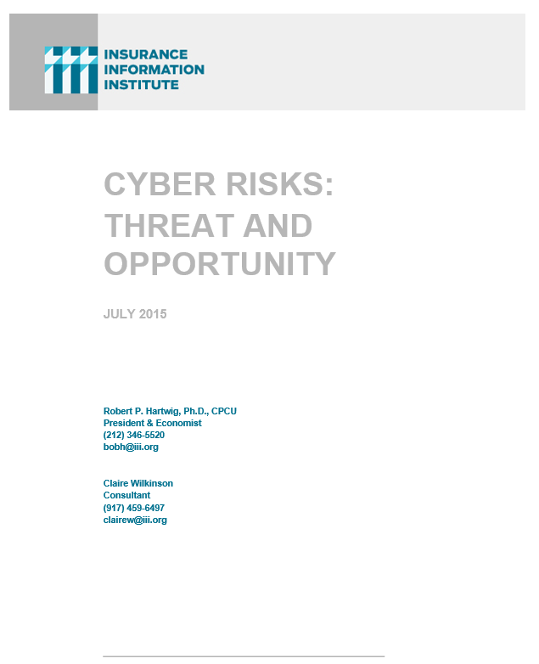
I.I.I. Will Release its Third Cyber Report in 2015: Cyber Risks Threat and Opportunity
I.I.I.’s 3rd report on cyber risk scheduled for Q3 2015
Provides information on cyber threats and insurance market solutions
Global cyber risk overview
  Quantification of threats by type and industry
Cyber security and cost of attacks
Cyber terrorism
Cyber liability
Insurance market for cyber risk

Slide 100
INDUSTRY DISRUPTORS
Technology, Society and the Economy Are All Changing at a Rapid Pace
Thoughts on the Future
100

Slide 101

Technology and Insurance
Rapid Technological Innovations Are Impacting Many Segments of the P/C Insurance Industry
101

Slide 102

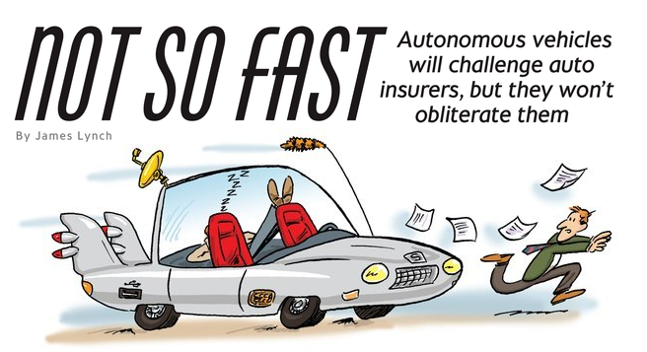
Media is Obsessed with Driverless Vehicles: Often Predicting the Demise of Auto Insurance
By 2035, it is estimated that 25% of new vehicle sales could be fully autonomous models
Questions
Are auto insurers monitoring these trends?
How are they reacting?
Will Google take over the industry?
Will the number of auto insurers shrink?
How will liability shift?
Source: Boston Consulting Group.

Slide 103
A Few Thoughts on the Future of Auto Insurance
Global auto insurance premiums written total about $600B
  ~80% personal, 20% commercial
  US accounts for more than 1/3 of this total (about $210B in 2014)
Innovations in automobile safety will, over time, reduced claim frequency but severities could still rise as repair costs escalate
  Claim activity clearly not immune to economy
Frequency declines could lead price declines, aiding profitability
More cars, not fewer will be on highways in the US, world
  Exposure (insured car years) grows even as frequency declines
Timeline for large numbers of mass produced autonomous vehicles on American highways is wildly optimistic
  Mid-2030s is more likely timeframe; Transition occurring through mid-century
  Tech media is enamored with anything involving Google, Apple
Auto insurance will be the largest, most important of all P/C lines for many years to come

Slide 104




On-Demand/Sharing/Peer-to-Peer Economy Impacts Many Lines of Insurance
The “On-Demand” Economy is or will impact many segments of the economy important to P/C insurers
  Auto (personal and commercial)
  Homeowners/Renters
  Many Liability Coverages
  Workers Comp
Many unanswered insurance questions
Insurance solutions are increasingly available to fill the many insurance gaps that arise
104
12/01/09 - 9pm
eSlide – P6466 – The Financial Crisis and the Future of the P/C
Notes:
104

Slide 105



Labor on Demand: Huge Implications for the US Economy, Workers & Insurers
Will YOUR job be reduced to an app?

Slide 106


Send in the Drones: Potential Rapid
Adoption in Industry; Media Loves It
Drones or Unmanned Aerial Vehicle (UAV) technology is seeing rapid adoption rate in many industries, including insurance
FAA granting Section 333 exemptions for commercial use and testing of UAS
At least 5 insurers have received permission to test
Wide variety of applications: claims, pre-event property inspections…
Insurers partnering with construction industry to guide R&D and regulation of UAV use via Property Drone Consortium: www.propertydrone.org

Slide 107
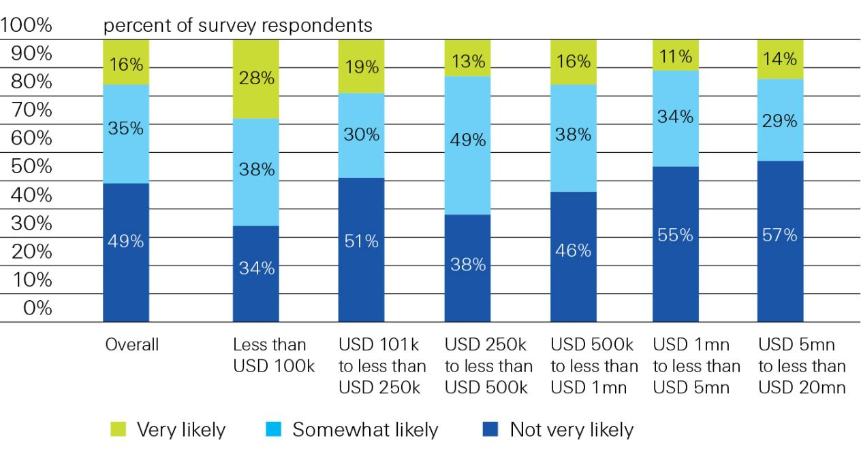
Proportion of Businesses Interested in Buying Insurance Online
Interest diminishes with account size
Likelihood of small US businesses buying insurance online directly from the insurer, overall and by annual company revenue, in 2013
Source: Swiss Re from “Voice of the Small Commercial Insurance Consumer Survey.” Deloitte, March (2013)

Slide 108
Summary
2015 Appears Profitable for P/C Industry (So Far)
Low Interest Rates are Here for a While . . .
. . . So Underwriting Profits Are Key to Overall Profitability
Frequency/Severity Appear to Be Rising, Counter to Recent Trends
Midwest Results Mirror National Trends
Region’s Economic Outlook Improving
Disruptors Create Opportunities for Future

Slide 109
Insurance Information Institute Online:
www.iii.org
Thank you for your time
and your attention!
Twitter: twitter.com/III_Research
Download at www.iii.org/presentations

