Slide 1
Trends, Challenges and Opportunities in P/C Insurance Focus on Mississippi Markets
MSU Insurance-Day
Starkville, MS
April 6, 2016
Steven N. Weisbart, Ph.D., CLU, Senior Vice President & Chief Economist
Insurance Information Institute ♦ 110 William Street ♦ New York, NY 10038
Tel: 212.346.5540 ♦ Cell: 917.494.5945 ♦ stevenw@iii.org ♦ www.iii.org

Slide 2
Insurance Industry: Financial Update & Outlook
2015 Was a Reasonably Good Year
2016: A Repeat of 2015?
2

Slide 3
Net Premium Growth: Annual Change, 1971—2016F
(Percent)
1975-78
1984-87
2000-03
Net Written Premiums Fell 0.7% in 2007 (First Decline Since 1943) by 2.0% in 2008, and 4.2% in 2009, the First 3-Year Decline Since 1930-33.
2015-16F: 4.0%
2014E: 4.1%
2013: 4.6%
2012: +4.3%
Shaded areas denote “hard market” periods
Sources: A.M. Best (historical and forecast), ISO, Insurance Information Institute.

Slide 4
P/C Insurance Industry Combined Ratio, 2001–2015:Q3 (Est.)*
Insurers Paid Nearly $1.16 for Every $1 in Earned Premiums
Higher CAT Losses, Shrinking Reserve Releases, Toll of Soft Market
Best Combined Ratio Since 1949 (87.6)
Heavy Use of Reinsurance Lowered Net Losses
* Excludes Mortgage & Financial Guaranty insurers 2008--2014. Including M&FG, 2008=105.1, 2009=100.7, 2010=102.4, 2011=108.1; 2012:=103.2; 2013: = 96.1; 2014: = 97.0.
Sources: A.M. Best, ISO.

Slide 5
P/C Industry Net Income After Taxes 1991–2015 (Est.)
$ Millions
2006 ROE = 12.7%
2007 ROE = 10.9%
2008 ROE = 0.1%
2009 ROE = 5.0%
2010 ROE = 6.6%
2011 ROAS¹ = 3.5%
2012 ROAS¹ = 5.9%
2013 ROAS¹ = 10.2%
2014 ROAS¹ = 8.4%
2015:H1 ROAS = 9.2%
ROE figures are GAAP; ¹Return on avg. surplus. Excluding Mortgage & Financial Guaranty insurers yields a 8.2% ROAS in 2014, 9.8% ROAS in 2013, 6.2% ROAS in 2012, 4.7% ROAS for 2011, 7.6% for 2010 and 7.4% for 2009.
Sources: A.M. Best, ISO; Insurance Information Institute.

Slide 6
Profitability Peaks & Troughs in the P/C Insurance Industry, 1975 – 2016F
ROE
1977:19.0%
History suggests next ROE peak will be in 2016-2017, but that seems unlikely
1987:17.3%
10 Years
2006:12.7%
1997:11.6%
10 Years
2013 9.8%
2015F=6.5%
2016F=6.3%
9 Years
2014 8.2%
1975: 2.4%
1984: 1.8%
1992: 4.5%
2001: -1.2%
*Profitability = P/C insurer ROEs. 2011-14 figures are estimates based on ROAS data. Note: Data for 2008-2014 exclude mortgage and financial guaranty insurers.
Source: Insurance Information Institute; NAIC, ISO, A.M. Best, Conning

Slide 7
Return on Net Worth (RNW) Largest Lines: 2005-2014 Average
Percent
Commercial lines have tended to be more profitable than personal lines over the past decade
Source: NAIC; Insurance Information Institute.

Slide 8
RNW All Lines by State, 10-Year (2005-2014) Avg
Return on Net Worth (%)
Profitability Benchmark: All P/C
US: 8.4%
The most profitable states over the past decade are widely distributed geographically
Source: NAIC; Insurance Information Institute.

Slide 9
RNW All Lines by State, 2005-2014 Average:
(cont’d)
Return on Net Worth (%)
Source: NAIC; Insurance Information Institute.

Slide 10
Policyholder Surplus, 2006:Q4–2015:Q3
($ Billions)
2007:Q3 Pre-Crisis Peak
Drop due to near-record 2011 CAT losses
Surplus as of 9/30/15 stood at $663.9B
The industry now has $1 of surplus for every $0.75 of NPW, close to the strongest claims-paying status in its history.
2010:Q1 data includes $22.5B of paid-in capital from a holding company parent for one insurer’s investment in a non-insurance business.
The P/C insurance industry entered 2016 in very strong financial condition.
Sources: ISO, A.M .Best.
10
12/01/09 - 9pm
eSlide – P6466 – The Financial Crisis and the Future of the P/C
Notes:
10

Slide 11
Advertising Expenditures by P/C Insurance Industry, 1999-2014
$ Billions
P/C ad spend hit an all time high of $6.175 billion in 2013, up 1.5% over 2012.
P/C ad spending has tripled since 2004 (the end of the last “hard market”). The pace of growth has slowed from 15.8% in 2011 and 23.8% in 2010
Source: Insurance Information Institute from consolidated P/C Annual Statement data, Insurance Expense Exhibit (Part I).

Slide 12
Historical Analysis of Mississippi P/C Insurance Markets
Analysis by Line and Nearby State Comparisons
12

Slide 13
Profitability: Return on Net Worth
13

Slide 14
RNW All Lines: MS vs. U.S., 2005-2014
Average 2005-2014
US: 6.7% MS: -7.4%
Source: NAIC, Insurance Information Institute
14
Notes:
14

Slide 15
RNW All Lines: MS vs. U.S., 2005-2014
Average 2005-2014
US: 6.7% MS: -7.4%
Mississippi’s all-lines RNW topped the US overall in most years of the last decade
Source: NAIC, Insurance Information Institute
15
Notes:
15

Slide 16
RNW PP Auto: MS vs. U.S., 2005-2013
Average 2005-2014
US: 6.2% MS: 3.6%
Mississippi’s PP Auto RNW topped the US overall in most years of the last decade
Source: NAIC, Insurance Information Institute
16
Notes:
16

Slide 17
RNW Commercial Auto: MS vs. U.S., 2005-2014
Average 2005-2014
US: 6.9% MS: 4.9%
Source: NAIC, Insurance Information Institute
17
Notes:
17

Slide 18
RNW Commercial Multi-Peril: MS vs. U.S., 2005-2014
Average 2005-2014
US: 6.4% MS: -7.5%
Sources: NAIC, Insurance Information Institute
18
Notes:
18

Slide 19
RNW Homeowners: MS vs. U.S., 2005-2014
Average 2005-2014
US: 3.8% MS: -26.8%
Source: NAIC, Insurance Information Institute
19
Notes:
19

Slide 20
RNW Workers Compensation: MS vs. U.S., 2005-2014
Average 2005-2014
US: 6.3% MS: 7.7%
Source: NAIC, Insurance Information Institute
20
Notes:
20

Slide 21
All Lines: 10-Year Average RNW MS & Nearby States
Mississippi All-Lines profitability for this decade is below its neighbors
2004-2013
Source: NAIC, Insurance Information Institute

Slide 22
PP Auto: 10-Year Average RNW MS & Nearby States
Mississippi PP Auto profitability is in the middle of its neighbors
2005-2014
Source: NAIC, Insurance Information Institute

Slide 23
Commercial Auto: 10-Year Average RNW, MS & Nearby States
Mississippi Commercial Auto profitability is in the middle of its neighbors
2005-2014
Sources: NAIC, Insurance Information Institute

Slide 24
Commercial Multiple-Peril: 10-Year Average RNW, MS & Neighbors
Mississippi Commercial Multi-Peril profitability is far below its regional neighbors
2005-2014
Source: NAIC, Insurance Information Institute

Slide 25
Homeowners: 10-Year Average RNW MS & Nearby States
Mississippi HO profitability is below all but one of its neighbors
2005-2014
Source: NAIC, Insurance Information Institute

Slide 26
Workers Comp: 10-Year Average RNW MS & Nearby States
Mississippi Workers Comp profitability is basically even with its neighbors
2005-2014
Source: NAIC, Insurance Information Institute

Slide 27
Premium Growth
27

Slide 28
All Lines DWP Growth: MS vs. U.S., 2005-2014
(Percent)
Average 2005-2014
US: 1.9%
MS: 2.9%
Source: SNL Financial.
28
Notes:
28

Slide 29
Commercial Lines DWP Growth: MS vs. U.S., 2005-2014
Average 2005-2014
US: 1.4% MS: 2.8%
Source: SNL Financial.
29
Notes:
29

Slide 30
Personal Lines DWP Growth: MS vs. U.S., 2005-2014
Average 2005-2014
US: 2.6% MS: 3.2%
Source: SNL Financial.
30
Notes:
30

Slide 31
Homeowner’s MP DWP Growth: MS vs. U.S., 2005-2014
Average 2005-2014
US: 4.7% MS: 5.5%
Source: SNL Financial.
31
Notes:
31

Slide 32
Private Passenger Auto Growth: MS vs. U.S., 2005-2014
Average 2005-2014
US: 1.6% MS: 2.1%
Source: SNL Financial.
32
Notes:
32

Slide 33
Competition
33

Slide 34
Brief Background on the HH Index
It is the sum of the square of the market shares of sellers
It is commonly used by the Justice Department to help determine whether a merger will harm the competitive environment
34
12/01/09 - 9pm
eSlide – P6466 – The Financial Crisis and the Future of the P/C
Notes:
34

Slide 35
Examples for the HH Index
First, assume a market with 5 sellers, each of which has a 20% market share
Each seller would have a score of 400, and the HH Index would be 2000
Next, assume a market with 10 sellers, each of which has a 10% market share
Each seller would have a score of 100, and the HH Index would be 1000
Now assume a market with 20 sellers, each of which has a 5% market share
Each seller would have a score of 25, and the HH Index would be 500
35
12/01/09 - 9pm
eSlide – P6466 – The Financial Crisis and the Future of the P/C
Notes:
35

Slide 36
LOB Competition in MS in 2014, as Indicated by the HH Index
Line of Business | Number of Companies | HH Index
PP Auto | 57 | 1162.5
HO | 48 | 1317.8
Workers Comp | 99 | 510.3
Commercial | 290 | 247.8
Sources: NAIC, via SNL Financial; Insurance Information Institute

Slide 37
HH Index for PP Auto in Mississippi, 2014
Rank of Insurers writing PP Auto in MS | Market Share | HH Index
Top 5 | 63.5% | 1053.9
6-10 | 20.8% | 91.9
11-15 | 7.6% | 12.1
42 others | 8.1% | 4.7
Total (57) | 100.0% | 1162.5

Slide 38
Personal Lines Exposure Growth Analysis
38

Slide 39
Growth of PP Auto Exposures
39

Slide 40
Auto/Light Truck Sales Will Likely Continue at Recent Levels
(Millions of Units)
We’re back to new vehicle sales levels last seen pre-recession
Yearly car/light truck sales will likely continue at current levels, in part replacing cars that were held onto in 2008-12. But rising interest rates could eventually restrain demand for new vehicles.
Sources: US Department of Commerce; Blue Chip Economic Indicators, 3/16 issue (forecasts); Insurance Information Institute.

Slide 41
America is Driving More Again: Total Miles Driven*, 1996–2016
Billions
New miles driven records in 2015
From 1996 (and well before), miles driven rose virtually every month, even through recessions.
From November 2007 until January 2015, miles driven was below the prior peak for 87 straight months— over 7 years! Previous record was in the early 1980s (39 months).
*Moving 12-month total. The data are through January 2016, the latest available. Note: Recessions indicated by gray shaded columns.
Sources: Federal Highway Administration (http://www.fhwa.dot.gov/policyinformation/travel_monitoring/tvt.cfm ); National Bureau of Economic Research (recession dates); Insurance Information Institute.
41
12/01/09 - 9pm
eSlide – P6466 – The Financial Crisis and the Future of the P/C
Notes:
41

Slide 42
More People Working and Driving => More Collisions, 2006–2015
Overall Collision Claims Per 100 Insured Vehicles
Number Employed, Millions
Recession
When people are out of work, they drive less. When they get jobs, they drive to work, helping drive claim frequency higher.
Sources: Seasonally Adjusted Employed from Bureau of Labor Statistics; Rolling Four-Qtr Avg. Frequency from Insurance Services Office; Insurance Institute for Highway Safety; Insurance Information Institute.
42
12/01/09 - 9pm
eSlide – P6466 – The Financial Crisis and the Future of the P/C
Notes:
42

Slide 43
Growth of Homeowners/Renters Exposures
43

Slide 44
Forecast: Continued Growth in Private Housing Unit Starts, 1995-2019F
Rising mortgage rates could dampen the demand for new residential construction
(Millions of Units)
Housing unit starts plunged 72% from 2005-2009, down 1.49 million, to lowest level since records began in 1959
Housing starts are climbing slowly. Recently, the fastest growth is in multi-unit residences. Personal lines exposure will grow, and commercial insurers with Workers Comp, Construction risk exposure and Surety also benefit.
Sources: US Department of Commerce (history); Blue Chip Economic Indicators (3/2016), forecasts; Insurance Information Institute.

Slide 45
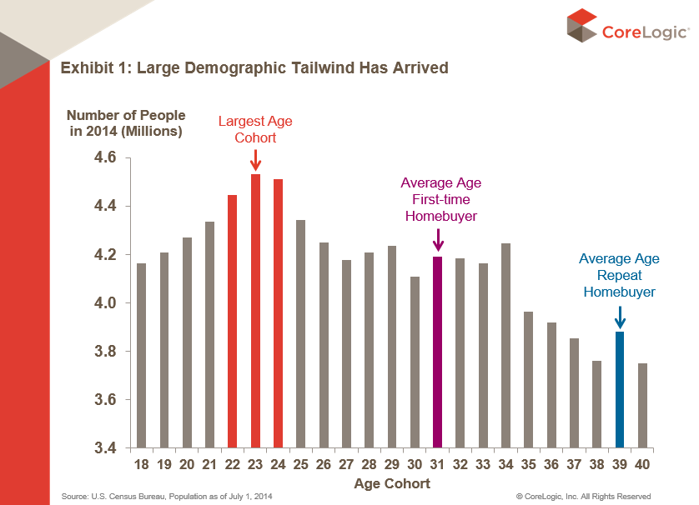
Giant Age Cohort (Millenials) Is Approaching Home-Buying Stage

Slide 46
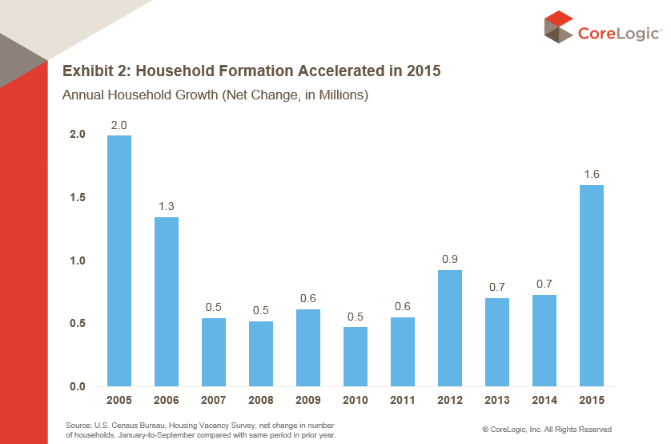
Growth in Number of Households => Increased Demand for Housing

Slide 47
Number of Owner-Occupied & Renter-Occupied Housing Units, US, Quarterly, 1990:Q1-2015:Q4
Millions of Renter-Occupied Housing Units
Millions of Owner-Occupied Housing Units
Number of owner-occupied units has been stuck at roughly 75 million units since 2005:Q4
Trough in 2004:Q2 at 32.61 million units.
Latest renter-occupied was 42.58 million units in 2015:Q4.
Since 2004 the number of renter-occupied housing units has grown by over 10 million units (+31.5%), but there has been no growth in the number of owner-occupied housing units in nearly 10 years. When will this end?
Sources: US Census Bureau at http://www.census.gov/housing/hvs/data/histtabs.html , Table 8; Insurance Information Institute.
47
12/01/09 - 9pm
eSlide – P6466 – The Financial Crisis and the Future of the P/C
Notes:
47

Slide 48
I.I.I. Poll: Renters Insurance
Percentage of Renters Who Have Renters Insurance, 2011-2015
Percentage Of Renters With Renters Insurance Continues to Increase.
Source: Insurance Information Institute Annual Pulse Survey.

Slide 49
Catastrophes & U.S. Insured Catastrophe Losses
49

Slide 50
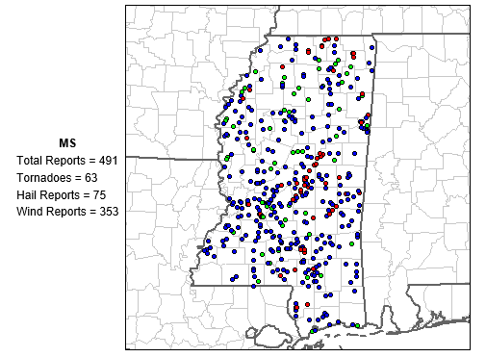
Tornadoes, Hail, and Wind Events in Mississippi, 2015
Sources: http://www.spc.noaa.gov/climo/online/monthly/states.php?month=00&year=2000&state=MS ; Insurance Information Institute.

Slide 51
Number of Tornadoes in Mississippi, Yearly, 2000-2015
Avg., 2000-2007: 49.0
Avg., 2008-2015: 85.8
Is the number of tornadoes that strike Mississippi each year increasing? Based on the last 16 years—and especially the last 8—it certainly seems so.
Sources: http://www.spc.noaa.gov/climo/online/monthly/states.php?month=00&year=2000&state=MS ; Insurance Information Institute.

Slide 52
Number of High Wind Events in Mississippi, Yearly, 2000-2015
Avg., 2000-2007: 450
Avg., 2008-2015: 528
Is the number of high wind events that strike Mississippi each year increasing? Based on the last 16 years, it certainly doesn’t seem so.
Sources: http://www.spc.noaa.gov/climo/online/monthly/states.php?month=00&year=2000&state=MS ; Insurance Information Institute.

Slide 53
P/C Industry Homeowners Claim Frequency, Mississippi, 1997-2013
Claims Paid per 100 Exposures
Sources: Insurance Research Council, “Trends in Homeowners Insurance Claims,” p.72; Insurance Information Institute

Slide 54
P/C Industry HO Average Claim Severity, Mississippi, 1997-2013
Current dollars
Sources: Insurance Research Council, “Trends in Homeowners Insurance Claims,” 2015 edition, p. 72; BLS inflation calculator, with Insurance Information Institute calculations

Slide 55
P/C Industry HO Average Claim Severity, Inflation-adjusted, Mississippi, 1997-2013
Constant dollars
Non-CAT inflation-adjusted claim severity tripled in the 17 years 1997-2013
Sources: Insurance Research Council, “Trends in Homeowners Insurance Claims,” 2015 edition, p. 72; BLS inflation calculator, with Insurance Information Institute calculations

Slide 56
U.S. Insured Catastrophe Losses
($ Billions, $ 2013)
2012 was the 3rd most expensive year ever for insured CAT losses
2013/14 Were Welcome Respites from 2011/12, among the Costliest Years for Insured Disaster Losses in US History. Longer-term Trend is for more—not fewer—Costly Events
$15.5 billion in insured CAT losses in 2014
*Through 12/31/14.
Note: 2001 figure includes $20.3B for 9/11 losses reported through 12/31/01 ($25.9B 2011 dollars). Includes only business and personal property claims, business interruption and auto claims. Non-prop/BI losses = $12.2B ($15.6B in 2011 dollars.)
Sources: Property Claims Service/ISO; Insurance Information Institute.
56
12/01/09 - 9pm
eSlide – P6466 – The Financial Crisis and the Future of the P/C
Notes:
56

Slide 57
Combined Ratio Points Associated with Catastrophe Losses: 1960 – 2013*
Avg. CAT Loss Component of the Combined Ratio by Decade
1960s: 1.04 1970s: 0.85 1980s: 1.31 1990s: 3.39 2000s: 3.52 2010s: 6.1E*
Catastrophe losses as a share of all losses reached a record high in 2012
Combined Ratio Points
The Catastrophe Loss Component of Private Insurer Losses Has Increased Sharply in Recent Decades
*2010s represent 2010-2013.
Notes: Private carrier losses only. Excludes loss adjustment expenses and reinsurance reinstatement premiums. Figures are adjusted for losses ultimately paid by foreign insurers and reinsurers.
Source: ISO (1960-2011); A.M. Best (2012E) Insurance Information Institute.

Slide 58
Inflation Adjusted U.S. Catastrophe Losses by Cause of Loss, 1994–2013¹
Wind/Hail/Flood (3), $14.6
Fires (4), $5.5
Winter storm losses were much above average in 2014/15 and will push this share up
Other (5), $0.2
Insured cat losses from 1993-2012 totaled $386.7B, an average of $19.3B per year or $1.6B per month
Geological Events, $18.4
Terrorism, $24.8
Winter Storms, $24.7
Hurricanes & Tropical Storms, $159.1
Tornado share of CAT losses is rising
Wind losses are by far cause the most catastrophe losses, even if hurricanes/TS are excluded.
Events Involving Tornadoes (2), $139.3
Catastrophes are defined as events causing direct insured losses to property of $25 million or more in 2013 dollars.
Excludes snow.
Does not include NFIP flood losses
Includes wildland fires
Includes civil disorders, water damage, utility disruptions and non-property losses such as those covered by workers compensation.
Source: ISO’s Property Claim Services Unit.

Slide 59
Loss events in the US, 1980 – 2014 Number of events
Number of Events
2014 Total:
119 Events
Geophysical events (Earthquake, tsunami, volcanic activity)
The number of loss events surged from 2006 – 2010, though insured losses remained elevated through 2012
Meteorological events
(Tropical storm, extratropical storm, convective storm,
local storm)
Hydrological events
(Flood,
mass movement)
16
Climatological events (Extreme temperature,
drought, forest fire)
24
72
7
Source: Geo Risks Research, NatCatSERVICE
59

Slide 60
Loss Events in the US, 1980 – 2014 Overall and insured losses
Overall losses totaled US$ 25bn; Insured losses totaled US$ 15.3bn
$ Billions
Overall losses
(in 2013 values)*
Insured losses
(in 2013 values)*
*Losses adjusted to inflation based on CPI.
Source: Property Claim Services, MR NatCatSERVICE.
60

Slide 61
Investments: The Grim Reality
Investment Performance is a Key Driver of Profitability
Depressed Yields Will Necessarily Affect Underwriting & Pricing
61

Slide 62
US Treasury Note 10-Year Yields: A Long Downward Trend, 2000–2016*
Yields on 10-Year US Treasury Notes have been below 3% for 4½ years
US Treasury yields plunged to historic lows in 2013, then rebounded and sank again
Since roughly 80% of P/C bond/cash investments are in 5-to-10-year durations, most P/C insurer portfolios will have low-yielding bonds for years to come.
*Monthly, constant maturity, nominal rates.
Sources: Federal Reserve Bank at http://www.federalreserve.gov/releases/h15/data.htm; National Bureau of Economic Research (recession dates); Insurance Information Institute.
62
12/01/09 - 9pm
eSlide – P6466 – The Financial Crisis and the Future of the P/C
Notes:
62

Slide 63
P/C Insurer Portfolio Yields, 2002-2015:Q3
P/C carrier yields have been falling for over a decade, reflecting the long downtrend in prevailing interest rates. Even as prevailing rates rise in the next few years, portfolio yields are unlikely to rise quickly, since low yields of recent years are “baked in” to future returns.
Sources: NAIC, via SNL Financial; Insurance Information Institute.

Slide 64
Forecasts of Avg. Yield of 10-Year US Treasury Notes
Top 10 Avg.: 4.2% Bot 10 Avg.: 2.6%
Top 10 Avg.: 4.5% Bot 10 Avg.: 3.0%
Top 10 Avg.: 3.6% Bot 10 Avg.: 2.2%
Top 10 Avg.: 2.5% Bot 10 Avg.: 1.9%
Top 10 Avg.: 4.4% Bot 10 Avg.: 2.8%
Top 10 Avg.: 4.5% Bot 10 Avg.: 3.2%
All forecasts expect US intermediate- and long-term interest rates to rise over the next three years and stabilize about 2019.
Sources: Blue Chip Economic Indicators, March 2016 issue; I.I.I.

Slide 65
Inflation Expectations, 5 Years Ahead* from the Bond Market
Since roughly 80% of P/C bond/cash investments are in 5-to10-year durations, most P/C insurer portfolios will have low-yielding bonds for years to come.
*Monthly, yields on US Treasury 5-Year Notes minus yields on 5-Year TIPS, through Nov. 2015. **CPI less food and energy.
Sources: Federal Reserve Bank at http://www.federalreserve.gov/releases/h15/data.htm. National Bureau of Economic Research (recession dates); Insurance Information Institute.
65
12/01/09 - 9pm
eSlide – P6466 – The Financial Crisis and the Future of the P/C
Notes:
65

Slide 66
P/C Insurers Below-Investment-Grade (BIG) Bonds as a Percent of Total Bonds, 2001-2015:Q3
As a group, P/C carriers have increased the percentage of bond investments in riskier instruments. Since 2006-07, that percentage has risen over 200 basis points (double what it was). As interest rates rise, will this percentage return to pre-recession levels?
Sources: NAIC, via SNL Financial; Insurance Information Institute.

Slide 67
P/C Insurer Groups Holdings of BIG** Bonds as a Percent of Total Bonds, 2014
Number of Groups
The 67 groups graphed are those with over $3 billion in cash & admitted assets as of year-end
P/C industry average
There is a wide disparity among insurance groups regarding holdings of below-investment-grade bonds. Some hold none (or almost none); a few have over 10% of their bond portfolio in BIGs.
*Below Investment Grade Sources: NAIC, via SNL Financial; Insurance Information Institute.

Slide 68
Other Things That Could Affect the Course of Interest Rates
Prices of world currencies (the value of the US Dollar vs. the Euro, the Yen, the Yuan and other major world currencies)
Prices of a number of commodities (especially oil)
Prevailing interest rates in other countries (determined, in part, by those countries’ central banks)
The demand for, and the supply of, loanable funds
68
12/01/09 - 9pm
eSlide – P6466 – The Financial Crisis and the Future of the P/C
Notes:
68

Slide 69
Property/Casualty Insurance Industry Investment Income: 2000–2014¹
Investment earnings are still below their 2007 pre-crisis peak
($ Billions)
Due to persistently low interest rates, investment income fell in 2012, 2013 and 2014.
¹ Investment gains consist primarily of interest and stock dividends. *2014 figure is estimated based on annualized data through Q3.
Sources: ISO; Insurance Information Institute.

Slide 70
Property/Casualty Insurance Industry Investment Gain: 1994–2014¹
($ Billions)
Investment gains in 2014 will rival the post-crisis high reached in 2013
Total Investment Gains Were Down Slightly in 2014 as Low Interest Rates Pressured Investment Income but Realized Capital Gains Remained Robust
¹ Investment gains consist primarily of interest, stock dividends and realized capital gains and losses.
* 2005 figure includes special one-time dividend of $3.2B;
Sources: ISO; Insurance Information Institute.

Slide 71
Insurance Information Institute Online:
www.iii.org
Thank you for your time and your attention!

