Slide 1
The Rough and Tumble Recovery
How the Great Recession Upset the Workers Comp Apple Cart
NCCI Annual Issues Symposium
Orlando, FL
May 8, 2014
Download at www.iii.org/presentations
Robert P. Hartwig, Ph.D., CPCU, President & Economist
Insurance Information Institute ♦ 110 William Street ♦ New York, NY 10038
Tel: 212.346.5520 ♦ Cell: 917.453.1885 ♦ bobh@iii.org ♦ www.iii.org

Slide 2
P/C Insurance Industry Financial Overview
2013: Best Year in the Post-Crisis Era
Lower CATs, Strong Markets
Workers Comp Improvement Helped Too
2

Slide 3
P/C Net Income After Taxes
1991–2013 ($ Millions)
2005 ROE*= 9.6%
2006 ROE = 12.7%
2007 ROE = 10.9%
2008 ROE = 0.1%
2009 ROE = 5.0%
2010 ROE = 6.6%
2011 ROAS¹ = 3.5%
2012 ROAS¹ = 6.1%
2013 ROAS¹ = 10.3%
Net income in 2013 was up substantially (+81.9%) from 2012
2013 ROAS was 10.3%
ROE figures are GAAP; ¹Return on avg. surplus. Excluding Mortgage & Financial Guaranty insurers yields a 9.8% ROAS in 2013, 6.3% ROAS in 2012, 4.7% ROAS for 2011, 7.6% for 2010 and 7.4% for 2009.
Sources: A.M. Best, ISO, Insurance Information Institute

Slide 4
Profitability Peaks & Troughs in the P/C Insurance Industry, 1975 – 2013*
ROE
1977:19.0%
1987:17.3%
10 Years
2006:12.7%
1997:11.6%
2013: 9.8 %
10 Years
9 Years
2011: 4.7%
1975: 2.4%
1984: 1.8%
1992: 4.5%
2001: -1.2%
*Profitability = P/C insurer ROEs. 2011-13 figures are estimates based on ROAS data. Note: Data for 2008-2013 exclude mortgage and financial guaranty insurers.
Source: Insurance Information Institute; NAIC, ISO, A.M. Best.

Slide 5
P/C Insurance Industry
Combined Ratio, 2001–2013*
Relatively Low CAT Losses, Reserve Releases
Higher CAT Losses, Shrinking Reserve Releases, Toll of Soft Market
As Recently as 2001, Insurers Paid Out Nearly $1.16 for Every $1 in Earned Premiums
Heavy Use of Reinsurance Lowered Net Losses
Relatively Low CAT Losses, Reserve Releases
Avg. CAT Losses, More Reserve Releases
Best Combined Ratio Since 1949 (87.6)
Sandy Impacts
Cyclical Deterioration
Lower CAT Losses
* Excludes Mortgage & Financial Guaranty insurers 2008--2012. Including M&FG, 2008=105.1, 2009=100.7, 2010=102.4, 2011=108.1; 2012:=103.2; 2013: = 96.1.
Sources: A.M. Best, ISO.

Slide 6
Underwriting Gain (Loss)
1975–2013*
Underwriting profit in 2013 totaled $15.5B
($ Billions)
Cumulative underwriting deficit from 1975 through 2013 is $493B
High cat losses in 2011 led to the highest underwriting loss since 2002
Large Underwriting Losses Are NOT Sustainable
in Current Investment Environment
* Includes mortgage and financial guaranty insurers in all years.
Sources: A.M. Best, ISO; Insurance Information Institute.

Slide 7
Policyholder Surplus,
2006:Q4–2013:Q4
Drop due to near-record 2011 CAT losses
($ Billions)
2007:Q3
Pre-Crisis Peak
Surplus as of 12/31/13 stood at a record high $653.3B
The industry now has $1 of surplus for every $0.73 of NPW,
close to the strongest claims-paying status in its history.
2010:Q1 data includes $22.5B of paid-in capital from a holding company parent for one insurer’s investment in a non-insurance business .
The P/C insurance industry entered 2014
in very strong financial condition.
Sources: ISO, A.M .Best.
7
12/01/09 - 9pm
eSlide – P6466 – The Financial Crisis and the Future of the P/C
Notes:
7

Slide 8
Net Premium Growth (All P/C Lines): Annual Change, 1971—2014F
(Percent)
1975-78
1984-87
2000-03
Net Written Premiums Fell 0.7% in 2007 (First Decline Since 1943) by 2.0% in 2008, and 4.2% in 2009, the First 3-Year Decline Since 1930-33.
2014F: 4.0%
2013: 4.6%
2012: +4.3%
Shaded areas denote “hard market” periods
Sources: A.M. Best (historical and forecast), ISO, Insurance Information Institute.

Slide 9
Direct Premiums Written: Workers’ Comp
Percent Change by State, 2007-2012*
Top 25 States
Only 5 states showed positive growth in the workers comp line from 2007 – 2012, the result of large job and payroll losses and a soft market. Even through 2013, fewer than half the states will have recouped DPW losses
*Excludes monopolistic fund states: ND, OH, WA, WY as well as WV, which transitioned to a competitive structure during this period.
Sources: SNL Financial LC.; Insurance Information Institute.

Slide 10
Direct Premiums Written: Worker’s Comp
Percent Change by State, 2007-2012*
Bottom 25 States
States with the poorest performing economies also produced the most negative net change in premiums of the past 5 years
*Excludes monopolistic fund states: ND, OH, WA, WY as well as WV, which transitioned to a competitive structure during this period.
Sources: SNL Financial LC.; Insurance Information Institute.

Slide 11
Winners, Losers and the “Great Recession”
Reshuffling the Workers Comp Exposure Deck
11

Slide 12
Labor Force Participation Rate,
Jan. 2002—April 2014*
Labor Force Participation as a % of Population
Labor force participation continues to shrink despite a falling unemployment rate
Large numbers of people are exiting (or not returning to the labor force)
*Defined as the percentage of working age persons in the population who are employed or actively seeking work.
Note: Recessions indicated by gray shaded columns.
Sources: US Bureau of Labor Statistics at http://www.bls.gov/data/; National Bureau of Economic Research (recession dates); Insurance Information Institute.
12
12/01/09 - 9pm
eSlide – P6466 – The Financial Crisis and the Future of the P/C
Notes:
12

Slide 13
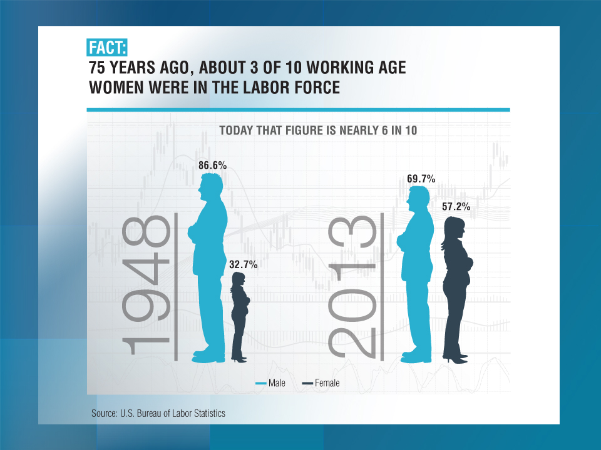

Slide 14

Labor Force Participation Rate by Gender, 1948—2013
(Percent)
86.6% or working age men participated in the labor force in 1948 compared to 32.7% or women
By 2013, the labor force participation rate for men had declined to 69.7% while the participation rate for women had risen to 57.2%
By 2013, 57.2% of working age women participated in the labor force, up from 32.7% in 1948 but down from its all time high of 60.0% in 1999
Sources: U.S. Bureau of Labor Statistics; Insurance Information Institute.

Slide 15
Gender Wage Gap: Ratio of Median Annual Earnings of Women to Men, 1955 – 2012*
Full-Time, Year-Round Workers
In 2012, women earned 76.5% of what men earned on an annual basis
(Percent)
In 1955, women earned 63.9% of what men earned
Over the next 20+ years the gender gap narrowed substantially but reached a plateau of about 77% of men’s earnings where it remains today
But by 1975, women were earning just 58.8% of what men earned
*Latest available.
Sources: U.S. Bureau of Labor Statistics; Insurance Information Institute.

Slide 16
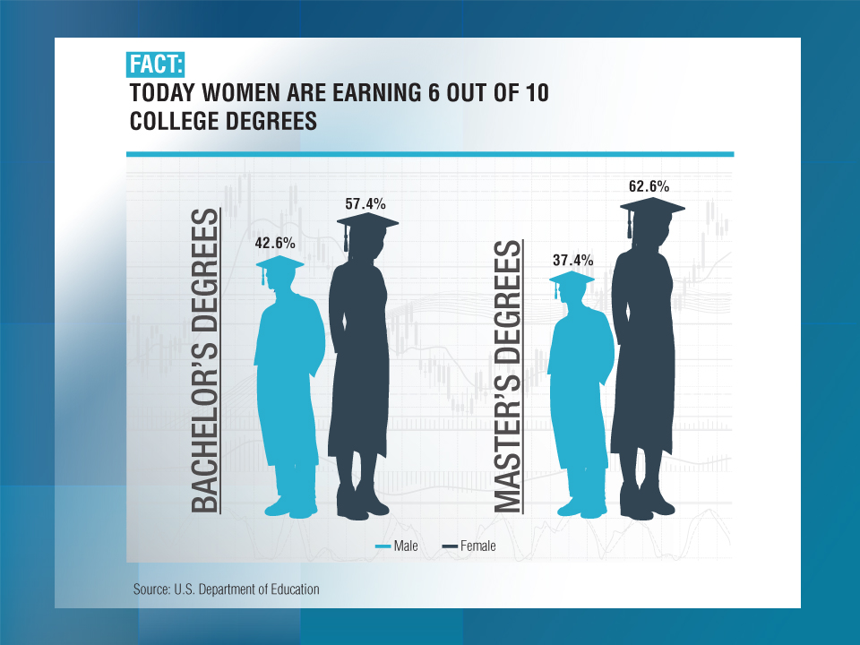

Slide 17
Unemployment Rates by Gender and Education: 2006, 2010 and 2013
Men were hit harder and continue to do worse than women in the job market. Women are likely to do better than men for the indefinite future.
Workers lacking a college degree suffer from much higher rates of unemployment
Unemployment Rate (%)
Source: U.S. Bureau of Labor Statistics; Insurance Information Institute.

Slide 18
Labor Force Participation Rate by Age: 2006, 2010 and 2013
Labor force participation rates remain below pre-recession levels for young and middle-age workers
Labor Force Participation Rate (%)
Labor force participation rates have increased for older workers
Age
Source: U.S. Bureau of Labor Statistics; Insurance Information Institute.

Slide 19

Labor Force Participation Rates for Workers Age 62-74 by Gender and Education*
Participation Rate
A worker with an professional or doctoral degree is twice as likely likely to be working
A worker with a bachelors degree is about 50% more likely to be working
Better educated workers are far more likely to work in their 60s and 70s
*Data are for 2009-10.
Source: Gary Burtless, Brookings Institution and The Economist, April 24, 2014.

Slide 20
Unemployment Rates by Age and Race: 2006, 2010 and 2013
Unemployment among younger workers remains a chronic problem
Unemployment among some minority groups remains far above pre-recession levels
Unemployment Rate (%)
Source: U.S. Bureau of Labor Statistics; Insurance Information Institute.

Slide 21
The BIG Picture
Labor Market Trends
RECOVERY MODE
The Last Job Lost During the Recession Was Recouped in March Where Do the Economy and Workers Comp Go From Here?
21

Slide 22


Slide 23
US Real GDP Growth*
The Q4:2008 decline was the steepest since the Q1:1982 drop of 6.8%
Real GDP Growth (%)
Recession began in Dec. 2007. Economic toll of credit crunch, housing slump, labor market contraction was severe
The remainder of 2014 into 2015 are expected to see a modest acceleration in growth
Demand for Insurance Should Increase in 2014/15 as GDP Growth Accelerates Modestly and Gradually Benefits the Economy Broadly
* Estimates/Forecasts from Blue Chip Economic Indicators.
Source: US Department of Commerce, Blue Economic Indicators 4/14; Insurance Information Institute.

Slide 24
Unemployment and Underemployment Rates: Still Too High, But Falling
January 2000 through April 2014, Seasonally Adjusted (%)
U-6 went from 8.0% in March 2007 to 17.5% in
October 2009; Stood at 12.3% in Apr. 2014.
8% to 10% is “normal.”
“Headline” unemployment was 6.3% in April 2014. 4% to 6% is “normal.”
Stubbornly high unemployment and underemployment constrain overall economic growth, but the job market is now clearly improving.
Source: US Bureau of Labor Statistics; Insurance Information Institute.
24
12/01/09 - 9pm
eSlide – P6466 – The Financial Crisis and the Future of the P/C
Notes:
24

Slide 25
US Unemployment Rate Forecast
2007:Q1 to 2015:Q4F*
Rising unemployment
eroded payrolls
and WC’s
exposure base.
Unemployment peaked at 10% in late 2009.
Jobless figures have been revised slightly downwards for 2014/15
Unemployment forecasts have been revised slightly downwards. Optimistic scenarios put the unemployment as low as 6.0% by Q4 of this year.
* = actual; = forecasts
Sources: US Bureau of Labor Statistics; Blue Chip Economic Indicators (4/14 edition); Insurance Information Institute.

Slide 26
Monthly Change in Private Employment
842,000 jobs created so far in 2014
January 2007 through April 2014 (Thousands, Seasonally Adjusted)
273,000 private sector jobs were created in April. In March 2014, the last of the jobs lost in the Great Recession were recovered
Jobs Created
2013: 2.368 Mill
2012: 2.294 Mill
2011: 2.400 Mill
2010: 1.277 Mill
Monthly losses in Dec. 08–Mar. 09 were the largest in the
post-WW II period
Private Employers Added 9.18 million Jobs Since Jan. 2010 After Having Shed 5.01 Million Jobs in 2009 and 3.76 Million in 2008 (State and Local Governments Have Shed Hundreds of Thousands of Jobs)
Source: US Bureau of Labor Statistics: http://www.bls.gov/ces/home.htm; Insurance Information Institute

Slide 27
Cumulative Change in Private Employment: Dec. 2007—Apr. 2014
Pvt. employment hit 116.4 million in April 2014—580,000 above its pre-crisis peak of 115.8 million
December 2007 through April 2014 (Millions)
Cumulative job losses peaked at 8.765 million in February 2010
It took more than 6 ½ years (79 months) to recover all of the private sector jobs lost in the Great Recession
Private Employers Added 9.18 million Jobs Since Jan. 2010 After Having Shed 4.98 Million Jobs in 2009 and 3.80 Million in 2008 (State and Local Governments Have Shed Hundreds of Thousands of Jobs)
Source: US Bureau of Labor Statistics: http://www.bls.gov/ces/home.htm; Insurance Information Institute

Slide 28
Cumulative Change in Private Sector Employment: Jan. 2010—Apr. 2014
(Millions)
Job gains and pay increases have added more than $750 billion to payrolls since Jan. 2010
Cumulative job gains through Apr. 2014 totaled 9.18 million
Private Employers Added 9.18 million Jobs Since Jan. 2010 After Having Shed 4.98 Million Jobs in 2009 and 3.80 Million in 2008 (State and Local Governments Have Shed Hundreds of Thousands of Jobs)
Source: US Bureau of Labor Statistics: http://www.bls.gov/ces/home.htm; Insurance Information Institute

Slide 29
Nonfarm Payroll (Wages and Salaries):
Quarterly, 2005–2014:Q1
Billions
Latest (2014:Q1) was $7.29 trillion, a new peak--$1.04 trillion above 2009 trough
Prior Peak was 2008:Q1 at $6.60 trillion
Payrolls are 16.6% above their 2009 trough and up 3.6% over the past year
Recent trough (2009:Q3) was $6.25 trillion, down 5.3% from prior peak
Note: Recession indicated by gray shaded column. Data are seasonally adjusted annual rates.
Sources: http://research.stlouisfed.org/fred2/series/WASCUR; National Bureau of Economic Research (recession dates); Insurance Information Institute.
29
12/01/09 - 9pm
eSlide – P6466 – The Financial Crisis and the Future of the P/C
Notes:
29

Slide 30
Net Change in Government Employment: Jan. 2010—Apr. 2014
State government employment fell by 1.5% since the end of 2009 but is recovering while Federal employment is down by 5.3% and deteriorating
(Thousands)
Local government employment shrank by 380,000 from Jan. 2010 through Apr. 2014, accounting for 62% of all government job losses, negatively impacting WC exposures for those cities and counties that insure privately
Source: US Bureau of Labor Statistics http://www.bls.gov/data/#employment; Insurance Information Institute

Slide 31
Unemployment Rates by State, March 2014:
Highest 25 States*
In March, 21 states had over-the-month unemployment rate decreases, 17 states and the District of Columbia had increases, and 12 states had no change.
Residual impacts of the housing collapse, weak economies are holding back several states
*Provisional figures for March 2014, seasonally adjusted.
Sources: US Bureau of Labor Statistics; Insurance Information Institute.

Slide 32
Unemployment Rates by State, March 2014:
Lowest 25 States*
In March, 21 states had over-the-month unemployment rate decreases, 17 states and the District of Columbia had increases, and 12 states had no change.
Energy-fueled employment boom in ND
*Provisional figures for March 2014, seasonally adjusted.
Sources: US Bureau of Labor Statistics; Insurance Information Institute.

Slide 33
Payroll vs. Workers Comp Net Written Premiums, 1990-2013P
Payroll Base* WC NWP
$Billions $Billions
7/90-3/91
3/01-11/01
12/07-6/09
WC premium volume dropped two years before the recession began
WC net premiums written were down $14B or 29.3% to $33.8B in 2010 after peaking at $47.8B in 2005
Continued Payroll Growth and Rate Gains Suggest WC NWP Will Grow Again in 2014; +8.6% Growth Estimated for 2013
*Private employment; Shaded areas indicate recessions. WC premiums for 2012 are I.I.I. estimate based YTD 2013 actuals.
Sources: NBER (recessions); Federal Reserve Bank of St. Louis at http://research.stlouisfed.org/fred2/series/WASCUR ; NCCI; I.I.I.

Slide 34
POSITIVE LABOR MARKET DEVELOPMENTS
Key Factors Driving Workers Compensation Exposure
34

Slide 35
Business Bankruptcy Filings,
1980-2013
% Change Surrounding Recessions
1980-82 58.6%
1980-87 88.7%
1990-91 10.3%
2000-01 13.0%
2006-09 208.9%
2013 bankruptcies totaled 33,212, down 17.1% from 2012—the fourth consecutive year of decline. Business bankruptcies more than tripled during the financial crisis.
Significant Exposure Implications for All Commercial Lines as Business Bankruptcies Begin to Decline
Sources: American Bankruptcy Institute (1980-2012) at http://www.abiworld.org/AM/AMTemplate.cfm?Section=Home&TEMPLATE=/CM/ContentDisplay.cfm&CONTENTID=61633; 2013 data from United States Courts at http://news.uscourts.gov; Insurance Information Institute.
35
12/01/09 - 9pm
eSlide – P6466 – The Financial Crisis and the Future of the P/C
Notes:
35

Slide 36
Mass Layoff Announcements,
Jan. 2002—May 2013*
Mass layoff announcements peaked at more than 3,000 per month in Feb. 2009
There were 1,301 mass layoffs announced in May 2013, similar to pre-crisis levels
*BLS discontinued series effective May 2013. Data are seasonally adjusted.
Note: Recessions indicated by gray shaded columns.
Sources: US Bureau of Labor Statistics at http://www.bls.gov/mls/; National Bureau of Economic Research (recession dates); Insurance Information Institute.
36
12/01/09 - 9pm
eSlide – P6466 – The Financial Crisis and the Future of the P/C
Notes:
36

Slide 37
Average Weekly Hours of All Private Workers, Mar. 2006—Apr. 2014
(Hours Worked)
Hours worked plunged during the recession, impacting payroll exposures
Hours worked totaled 34.5 per week in April, just shy of the 34.6 hours typically worked before the “Great Recession”
*Seasonally adjusted
Note: Recessions indicated by gray shaded columns.
Sources: US Bureau of Labor Statistics at http://www.bls.gov/data/#employment; National Bureau of Economic Research (recession dates); Insurance Information Institute.
37
12/01/09 - 9pm
eSlide – P6466 – The Financial Crisis and the Future of the P/C
Notes:
37

Slide 38
Average Hourly Wage of All Private Workers, Mar. 2006—Apr. 2014
(Hourly Wage)
The average hourly wage was $24.31 in Apr. 2013, up 14.4% from $21.25 when the recession began in Dec. 2007
Wage gains continued during the recession, despite massive job losses
*Seasonally adjusted
Note: Recessions indicated by gray shaded columns.
Sources: US Bureau of Labor Statistics at http://www.bls.gov/data/#employment; National Bureau of Economic Research (recession dates); Insurance Information Institute.
38
12/01/09 - 9pm
eSlide – P6466 – The Financial Crisis and the Future of the P/C
Notes:
38

Slide 39
ADVERSE LONG-TERM
LABOR MARKET DEVELOPMENTS
Key Factors Harming Workers Compensation Exposure and the Overall Economy
39

Slide 40
Labor Force Participation Rate,
Jan. 2002—April 2014*
Labor Force Participation as a % of Population
Labor force participation continues to shrink despite a falling unemployment rate
Large numbers of people are exiting (or not returning to the labor force)
*Defined as the percentage of working age persons in the population who are employed or actively seeking work.
Note: Recessions indicated by gray shaded columns.
Sources: US Bureau of Labor Statistics at http://www.bls.gov/data/; National Bureau of Economic Research (recession dates); Insurance Information Institute.
40
12/01/09 - 9pm
eSlide – P6466 – The Financial Crisis and the Future of the P/C
Notes:
40

Slide 41
Number of “Discouraged Workers,”
Jan. 2002—April 2013
Thousands
“Discouraged Workers” are people who have searched for work for so long in vain that they actually stop searching and drop out of the labor force
Large numbers of people are exiting (or not returning to) the labor force
There were 783,000 discouraged workers in Apr. 2014
In recent good times, the number of discouraged workers ranged from 200,000-400,000 (1995-2000) or from 300,000-500,000 (2002-2007).
Notes: Recessions indicated by gray shaded columns. Data are seasonally adjusted.
Sources: Bureau of Labor Statistics http://www.bls.gov/news.release/empsit.a.htm ; NBER (recession dates); Ins. Info. Inst.
41
12/01/09 - 9pm
eSlide – P6466 – The Financial Crisis and the Future of the P/C
Notes:
41

Slide 42
Change in Number of Discouraged Workers: Apr. 2013 vs. Apr. 2014
(Percent Change)
Men remain much more discouraged about their job prospects
The number of discouraged workers fell by 52,000 over the past year to 783,000, a decline of 6.2%
Younger workers remain more discouraged than older workers
AGE
GENDER
Source: US Bureau of Labor Statistics at http://www.bls.gov/cps/tables.htm#pnilf_m; Insurance Information Institute.

Slide 43
Discouraged Workers by Gender
(as of April 2014)
The overwhelming majority of discouraged workers are male, for a variety of reasons
Female = 295,000
Male = 488,000
Reasons for Lower Female Discouragement Rate
Less likely to work in heavily impacted industries such as construction
More likely to retrain
More likely to retrain quickly
Better educated
Men account for 62% of discouraged workers today, up from 59% a year ago
TOTAL = 783,000
Source: Bureau of Labor Statistics: at http://www.bls.gov/web/empsit/cpseea38.htm; Insurance Information Institute.

Slide 44
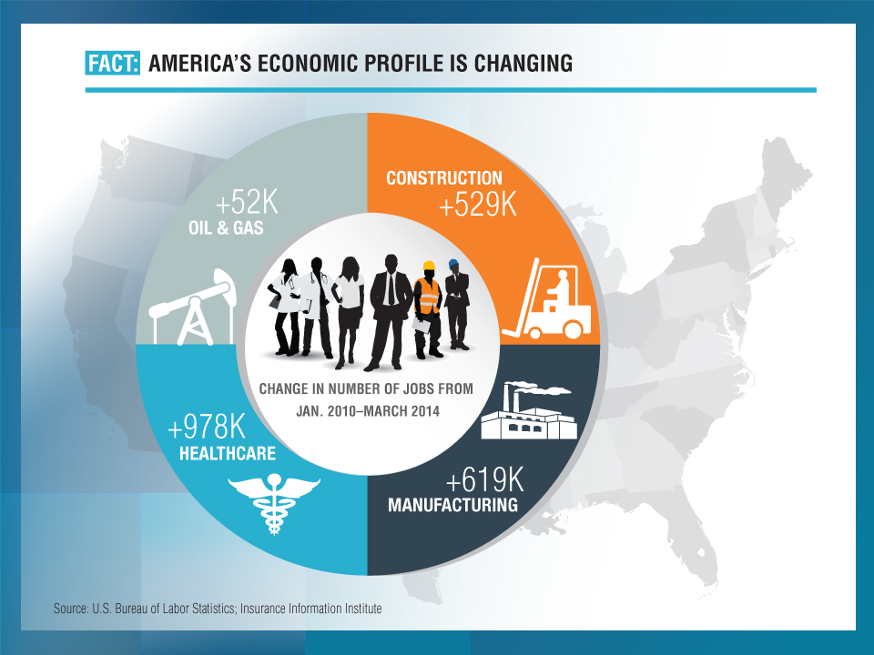

Slide 45
CONSTRUCTION, MANUFACTURING & ENERGY OUTLOOK
Key Sectors Critical to the Economy and the P/C Insurance Industry
45

Slide 46
Value of New Private Construction: Residential & Nonresidential, 2003-2013*
2013: Value of new pvt. construction hits $667.5B, up 33% from the 2010 trough but still 27% below 2006 peak
New Construction peaks at $911.8. in 2006
Billions of Dollars
Trough in 2010 at $500.6B, after plunging 55.1% ($411.2B)
$15.0
$613.7
$311.5
$298.1
$261.8
$238.8
$356.0
Private Construction Activity Is Moving in a Positive Direction though Remains Well Below Pre-Crisis Peak; Residential Dominates
*2013 figure is a seasonally adjusted annual rate as of December.
Sources: US Department of Commerce; Insurance Information Institute.
46
12/01/09 - 9pm
eSlide – P6466 – The Financial Crisis and the Future of the P/C
Notes:
46

Slide 47
Value of Private Construction Put in Place, by Segment, March 2014 vs. March 2013*
Led by the Residential Construction, Lodging and Communication segments, Private sector construction activity is rising after plunging during the “Great Recession.”
Growth (%)
Private Construction Activity is Up in Most Segments, Including the Key Residential Construction Sector; Bodes Well for the Remainder of 2014
*seasonally adjusted
Source: U.S. Census Bureau, http://www.census.gov/construction/c30/c30index.html ; Insurance Information Institute.

Slide 48
New Private Housing Starts, 1990-2019F
Job growth, low inventories of existing homes, low mortgage rates and demographics should continue to stimulate new home construction for several more years
(Millions of Units)
New home starts plunged 72% from 2005-2009; A net annual decline of 1.49 million units, lowest since records began in 1959
Insurers Are Continue to See Meaningful Exposure Growth in the Wake of the “Great Recession” Associated with Home Construction: Construction Risk Exposure, Surety, Commercial Auto; Potent Driver of Workers Comp Exposure
Source: U.S. Department of Commerce; Blue Chip Economic Indicators (4/14 and 3/13); Insurance Information Institute.

Slide 49
Value of New Federal, State and Local Government Construction: 2003-2014*
Construction across all levels of government peaked at $314.9B in 2009
Austerity Reigns
Govt. construction is still shrinking, down $52.0B or 16.5% since 2009 peak
($ Billions)
Government Construction Spending Peaked in 2009, Helped by Stimulus Spending, but Continues to Contract As State/Local Governments Grapple with Deficits and Federal Sequestration Takes Hold
*2014 figure is a seasonally adjusted annual rate as of March; http://www.census.gov/construction/c30/historical_data.html
Sources: US Department of Commerce; Insurance Information Institute.

Slide 50
Construction Employment,
Jan. 2010—April 2014*
(Thousands)
Construction employment is +565,000 above
Jan. 2011 (+10.4%) trough
Construction and manufacturing employment constitute 1/3 of all payroll exposure.
*Seasonally adjusted.
Sources: US Bureau of Labor Statistics at http://data.bls.gov; Insurance Information Institute.
50
12/01/09 - 9pm
eSlide – P6466 – The Financial Crisis and the Future of the P/C
Notes:
50

Slide 51
Construction Employment,
Jan. 2003–April 2014
(Thousands)
Construction employment as of Apr. 2014 totaled 6.0 million, an increase of 565,000 jobs or 10.4% from the Jan. 2011 trough
Construction employment peaked at 7.726 million in April 2006
Gap between pre-recession construction peak and today: 1.7 million jobs
The “Great Recession” and housing bust destroyed 2.3 million constructions jobs
Construction employment troughed at 5.435 million in Jan. 2011, after a loss of 2.291 million jobs, a 29.7% plunge from the April 2006 peak
The Construction Sector Could Be a Growth Leader in 2014 as the Housing Market, Private Investment and Govt. Spending Recover. WC Insurers Will Benefit.
Note: Recession indicated by gray shaded column.
Sources: U.S. Bureau of Labor Statistics; Insurance Information Institute.
51
12/01/09 - 9pm
eSlide – P6466 – The Financial Crisis and the Future of the P/C
Notes:
51

Slide 52
MANUFACTURING SECTOR
A Potent Driver of Jobs, Workers Comp Payroll Exposure
America’s Manufacturing Renaissance
52

Slide 53
Manufacturing Employment,
Jan. 2010—April 2014*
(Thousands)
Since Jan 2010, manufacturing employment is up (+640,000 or +5.6%)
and still growing.
Manufacturing employment is a surprising source of strength in the economy. Employment in the sector is at a multi-year high.
*Seasonally adjusted.
Sources: US Bureau of Labor Statistics at http://data.bls.gov; Insurance Information Institute.
53
12/01/09 - 9pm
eSlide – P6466 – The Financial Crisis and the Future of the P/C
Notes:
53

Slide 54
Dollar Value* of Manufacturers’ Shipments Monthly, Jan. 1992—Mar. 2014
$ Millions
The value of Manufacturing Shipments in Mar. 2014 was $494.9B—a new record high.
Monthly shipments in Mar. 2014 exceeded the pre-crisis (July 2008) peak. Manufacturing is energy-intensive and growth leads to gains in many commercial exposures: WC, Commercial Auto, Marine, Property, and various Liability Coverages.
* Seasonally adjusted; Data published May 2, 2014.
Source: U.S. Census Bureau, Full Report on Manufacturers’ Shipments, Inventories, and Orders, http://www.census.gov/manufacturing/m3/
54
12/01/09 - 9pm
eSlide – P6466 – The Financial Crisis and the Future of the P/C
Notes:
54

Slide 55
ISM Manufacturing Index
(Values > 50 Indicate Expansion)
January 2010 through April 2014
Manufacturing continues to expand in 2014
The manufacturing sector expanded for 50 of the 52 months from Jan. 2010 through April 2014. Pace of recovery has been uneven due to economic turbulence in the U.S., Europe and China
Source: Institute for Supply Management at http://www.ism.ws/ismreport/mfgrob.cfm; Insurance Information Institute.

Slide 56
Manufacturing Growth for Selected Sectors, 2014 vs. 2013*
Growth (%)
Durables: +3.5%
Non-Durables: +0.1%
Manufacturing of durable goods was stronger than nondurables in 2013
Manufacturing Is Expanding—Albeit Slowly—Across a Number of Sectors that Will Contribute to Growth in Insurable Exposures Including: WC, Commercial Property, Commercial Auto and Many Liability Coverages
*Seasonally adjusted; Date are YTD comparing data through March 2014 to the same period in 2013.
Source: U.S. Census Bureau, Full Report on Manufacturers’ Shipments, Inventories, and Orders, http://www.census.gov/manufacturing/m3/

Slide 57
Business Investment: Expected to Accelerate, Fueling Commercial Exposure Growth
Accelerating business investment will be a potent driver of commercial property and liability insurance exposures and should drive employment and WC payroll exposures as well (with a lag)
Source: IHS Global Insights as of Jan. 13, 2014; Insurance Information Institute.

Slide 58
12 Industries for the Next 10 Years: Insurance Solutions Needed
Health Care
Health Sciences
Energy (Traditional)
Many industries are poised for growth, though insurers’ ability to capitalize on these industries varies widely
Alternative Energy
Petrochemical
Agriculture
Natural Resources
Technology (incl. Biotechnology)
Light Manufacturing
Insourced Manufacturing
Export-Oriented Industries
Shipping (Rail, Marine, Trucking, Pipelines)

Slide 59
ENERGY SECTOR
America’s Energy Boom Is Potentially the Most Transformative Economic Force in the Country Today
Workers Comp and Commercial Insurers in General Will Generate Billions in Premiums as Exposures Mushroom
59

Slide 60

Oil & Gas Extraction Employment,
Jan. 2010—April 2014*
Oil and gas extraction employment is up 33.6% since Jan. 2010 as the energy sector booms. Domestic energy production is essential to any robust economic recovery in the US.
Highest since Aug. 1986
(Thousands)
*Seasonally adjusted
Sources: US Bureau of Labor Statistics at http://data.bls.gov; Insurance Information Institute.
60
12/01/09 - 9pm
eSlide – P6466 – The Financial Crisis and the Future of the P/C
Notes:
60

Slide 61
U.S. Natural Gas Production, 2000-2013
Trillions of Cubic Ft. per Year
The U.S. is already the world’s largest natural gas producer—recently overtaking Russia. This is a potent driver of commercial insurance exposures
Source: Energy Information Administration, Short-Term Energy Outlook (April 8, 2014) , Insurance Information Institute.

Slide 62
U.S. Crude Oil Production, 2005-2015P
Millions of Barrels per Day
Crude oil production in the U.S. is expected to increase by 82.6% from 2008 through 2015—and could overtake Saudi Arabia as the world’s largest oil producer
Source: Energy Information Administration, Short-Term Energy Outlook (April 8, 2014) , Insurance Information Institute.

Slide 63
Employment Trends in the Healthcare Industry
Health Sector Employment Will Continue to Outpace Increasing Opportunities for Workers Comp Insurers
63

Slide 64
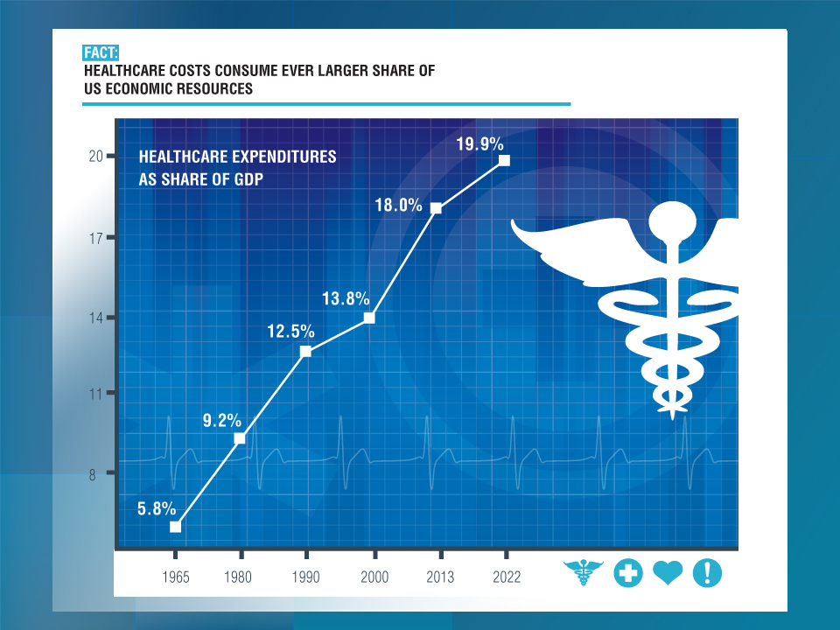

Slide 65
U.S. Health Care Expenditures,
1965–2022F
$ Billions
Healthcare is a labor intensive industry. Spending will rise from $3 trillion today to $5 trillion in 2022
From 1965 through 2013, US health care expenditures had increased by 69 fold. Population growth over the same period increased by a factor of just 1.6. By 2022, health spending will have increased 119 fold.
U.S. health care expenditures have been on a relentless climb for most of the past half century, far outstripping population growth, inflation of GDP growth
Sources: Centers for Medicare & Medicaid Services, Office of the Actuary at http://www.cms.gov/Research-Statistics-Data-and-Systems/Statistics-Trends-and-Reports/NationalHealthExpendData/NationalHealthAccountsProjected.html accessed 3/14/14; Insurance Information Institute.

Slide 66
Rate of Health Care Expenditure Increase Compared to Population, CPI and GDP
Health care expenditures increased 68 fold since 1965—about 3 times the pace of GDP growth
1965: $42.0 Bill
2013: $2,914.7 Bill
1965: $719.1 Bill
2013: $16,797.5 Bill
1965: 194.3 Mill
2013: 317.0 Mill
Source: Insurance Information Institute research.

Slide 67
National Health Care Expenditures as a Share of GDP, 1965 – 2022F*
% of GDP
Health care expenditures as a share of GDP rose from 5.8% in 1965 to 18.0% in 2013 and are expected to reach 19.9% of GDP by 2022
2022 19.9%
2010: 17.9%
2000: 13.8%
1990: 12.5%
Since 2009, heath expenditures as a % of GDP have flattened out at about 18%--the question is why and will it last?
1980: 9.2%
1965 5.8%
Sources: Centers for Medicare & Medicaid Services, Office of the Actuary at http://www.cms.gov/Research-Statistics-Data-and-Systems/Statistics-Trends-and-Reports/NationalHealthExpendData/NationalHealthAccountsProjected.html accessed 3/14/14; Insurance Information Institute.

Slide 68
Medical Cost Inflation vs. Overall CPI, 1995 - 2013
Though moderating, medical inflation will continue to exceed inflation in the overall economy
Average Annual Growth Average
Healthcare: 3.8%
Total Nonfarm: 2.4%
Sources: Med CPI from US Bureau of Labor Statistics, WC med severity from NCCI based on NCCI states.

Slide 69
Projected Number of People with No Health Insurance, 2013—2022*
By 2018 the number of people under age 65 without insurance is expected to drop by 25 million (~45%)
Millions
The projected decline in the uninsured population is very sensitive to the enrollment rate under the Affordable Care Act
*Under age 65.
Sources: Centers for Medicare & Medicaid Services, Office of the Actuary at http://www.cms.gov/Research-Statistics-Data-and-Systems/Statistics-Trends-and-Reports/NationalHealthExpendData/NationalHealthAccountsProjected.html accessed 3/14/14; Insurance Information Institute.
69
12/01/09 - 9pm
eSlide – P6466 – The Financial Crisis and the Future of the P/C
Notes:
69

Slide 70
Growth in Health Professions,
1991-2013
(Percent Annual Change)
Average Annual Growth Average
Healthcare: 2.5%
Total Nonfarm: 1.0%
The U.S. economy lost more than 8 million jobs during the Great Recession, but health sector employment expanded
Healthcare employment has continued to grow in good times and bad - including the Great Recession.
Sources: Bureau of Labor Statistics, Insurance Information Institute.
70
Notes:
70

Slide 71
Occupations Ranked by Projected Percentage Growth, 2012-2022F (%)
Healthcare professions are expected to grow at 2 to nearly 3 times employment growth overall
Source: Bureau of Labor Statistics, Insurance Information Institute.

Slide 72
Growth in Healthcare Profession by Skill Level, 2012 – 2022F
Nearly 3 million new healthcare jobs are projected through 2022!
(Thousands of Jobs)
+1.015 Mill +20.3%
+697,000 +24.1%
+750,000 +30.1%
+425,000 +24.0%
Source: Bureau of Labor Statistics, Insurance Information Institute.
72
Notes:
72

Slide 73
INVESTMENTS:
THE NEW REALITY
Investment Performance is a Key Driver of Profitability
Low Yields Have an Especially Large Influence on Profitability of Long-Tailed Lines Like WC
73

Slide 74
Property/Casualty Insurance Industry Investment Income: 2000–2013¹
($ Billions)
Investment earnings are running below their 2007 pre-crisis peak
Investment Income Fell in 2012 and 2013 Due to Persistently Low Interest Rates, Putting Additional Pressure on (Re) Insurance Pricing
¹ Investment gains consist primarily of interest and stock dividends...
Sources: ISO; Insurance Information Institute.

Slide 75
Property/Casualty Insurance Industry Investment Gain: 1994–2013¹
($ Billions)
Investment gains in 2013 were their highest in the post-crisis era
Investment Income Continued to Fall in 2013 Due to Low Interest Rates but Realized Investment Gains Were Up Sharply; The Financial Crisis Caused Investment Gains to Fall by 50% in 2008
¹ Investment gains consist primarily of interest, stock dividends and realized capital gains and losses.
* 2005 figure includes special one-time dividend of $3.2B;
Sources: ISO; Insurance Information Institute.

Slide 76
P/C Insurer Net Realized
Capital Gains/Losses, 1990-2013
Realized capital gains were up sharply as equity markets rallied
($ Billions)
Insurers Posted Net Realized Capital Gains in 2010 - 2013 Following Two Years of Realized Losses During the Financial Crisis. Realized Capital Losses Were the Primary Cause of 2008/2009’s Large Drop in Profits and ROE
Sources: A.M. Best, ISO, Insurance Information Institute.
76
12/01/09 - 9pm
eSlide – P6466 – The Financial Crisis and the Future of the P/C
Notes:
76

Slide 77
U.S. Treasury Security Yields:
A Long Downward Trend, 1990–2014*
Yields on 10-Year U.S. Treasury Notes have been essentially below 5% for a full decade.
U.S. Treasury yields plunged to historic lows in 2013. Only longer-term yields have rebounded.
Since roughly 80% of P/C bond/cash investments are in 10-year or shorter durations, most P/C insurer portfolios will have low-yielding bonds for years to come.
*Monthly, constant maturity, nominal rates, through March 2014.
Sources: Federal Reserve Bank at http://www.federalreserve.gov/releases/h15/data.htm.
National Bureau of Economic Research (recession dates); Insurance Information Institute.
77
12/01/09 - 9pm
eSlide – P6466 – The Financial Crisis and the Future of the P/C
Notes:
77

Slide 78
Treasury Yield Curves:
Pre-Crisis (July 2007) vs. March 2014
Treasury yield curve remains near its most depressed level in at least 45 years. Investment income is falling as a result. Even as the Fed “tapers” rates are unlikely to return to pre-crisis levels anytime soon
The Fed Is Actively Signaling that it Is Determined to Keep Rates Low Until Unemployment Drops Below 6.5% or Until Inflation Expectations Exceed 2.5%; Low Rates Add to Pricing Pressure for Insurers.
Source: Federal Reserve Board of Governors; Insurance Information Institute.

Slide 79
Distribution of Bond Maturities,
P/C Insurance Industry, 2003-2013
The main shift over these years has been from bonds with longer maturities to bonds with shorter maturities. The industry first trimmed its holdings of over-10-year bonds (from 24.6% in 2003 to 15.5% in 2012) and then trimmed bonds in the 5-10-year category (from 31.3% in 2003 to 27.6% in 2012) . Falling average maturity of the P/C industry’s bond portfolio is contributing to a drop in investment income along with lower yields.
Sources: SNL Financial; Insurance Information Institute.

Slide 80
Reduction in Combined Ratio Necessary to Offset 1% Decline in Investment Yield to Maintain Constant ROE, by Line*
Lower Investment Earnings Place a Greater Burden on Underwriting and Pricing Discipline
*Based on 2008 Invested Assets and Earned Premiums
**US domestic reinsurance only
Source: A.M. Best; Insurance Information Institute.
80
12/01/09 - 9pm
eSlide – P6466 – The Financial Crisis and the Future of the P/C
Notes:
80
This shows the drop in Combined Ratio for each line of business that would be needed to maintain a constant ROE, given a 1-percentage-point drop in investment yield

Slide 81
Outlook for U.S. Treasury Bond Yields Through 2015
Long-term yields should begin to normalize in 2014 but short-term yields will remain very low until 2015
% Yield
Longer-tail lines like MPL and workers comp will benefit the most from the normalization of yields
Source: Federal Reserve Board of Governors (2012-2013), Blue Economic Forecasts (2014-2015 3-month and 10-yr; 4/14) Swiss Re (2014-2015, 5-yr yield; 4/14); Insurance Information Institute.
81
12/01/09 - 9pm
eSlide – P6466 – The Financial Crisis and the Future of the P/C
Notes:
81

Slide 82
LOW YIELDS—A REINSURANCE ASIDE
Surge in Alternative Capital Is Fundamentally Transforming Reinsurance Markets
82

Slide 83
Global Reinsurance Capital (Traditional and Alternative), 2007 - 2013
Total reinsurance capital reached a record $540B in 2013, up 58.8% from 2008. Of that, $50B (9.3%) is alternative capacity, up 163% from $19B since 2008
Source: Aon Benfield Reinsurance Market Outlook, April 1, 2014; Insurance Information Institute.

Slide 84
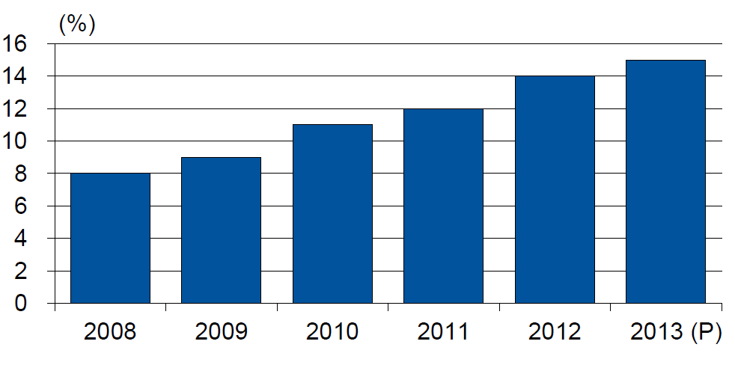
Alternative Capacity as a Percentage of Global Property Catastrophe Reinsurance Limit
(As of Year End)
Alternative Capacity accounted for approximately 14% or $45 billion of the $316 in global property catastrophe reinsurance capital as of mid-2013 (expected to rise to ~15% by year-end 2013)
Source: Guy Carpenter

Slide 85
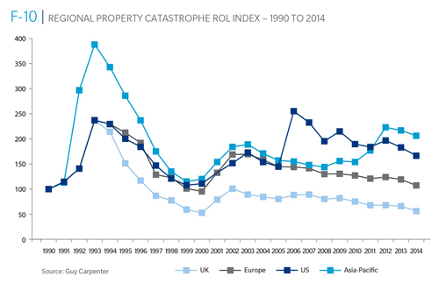
Reinsurance Pricing: Rate-on-Line Index by Region, 1990 – 2014*
Lower CATs and a flood of new capital has pushed reinsurance pricing down in most regions, including the US
*As of Jan. 1.
Source: Guy Carpenter

Slide 86
Terrorism Update
TRIA: An Unqualified Success
Expiration or Scaling Back Will Result in Impacts on the Workers Comp Market
86
Notes:
86

Slide 87
Loss Distribution by Type of Insurance from Sept. 11 Terrorist Attack ($ 2013)
($ Billions)
Total Insured Losses Estimate: $42.9B**
*Loss total does not include March 2010 New York City settlement of up to $657.5 million to compensate approximately 10,000 Ground Zero workers or any subsequent settlements.
**$32.5 billion in 2001 dollars.
Source: Insurance Information Institute.

Slide 88
Summary of President’s Working Group Report on TRIA (April 2014)
Insurance for terrorism risk is available and affordable
  Availability/affordability have has not changed appreciably since 2010
Prices for terrorism risk insurance vary considerably depending on the policyholder’s industry and location of risk
Prices have declined since TRIA was enacted
Take-up rates have improved since adoption of TRIA
  Overall take-up rate is steady at ~60% (62% in 2013 per Marsh)
  Effectively 100% for workers compensation
Market capacity is currently tightening given uncertainty over TRIA reauthorization
The private market does not have the capacity to provide reinsurance for terror risk to the extent currently provided by TRIA
In the absence of TRIA, terrorism risk insurance would likely be less available. Coverage that would be available likely would be more costly and/or limited in scope
Source: Report of the President’s Working Group on Financial Markets,The Long-Term Availability and Affordability of Insurance
for Terrorism Risk, April 2014.

Slide 89
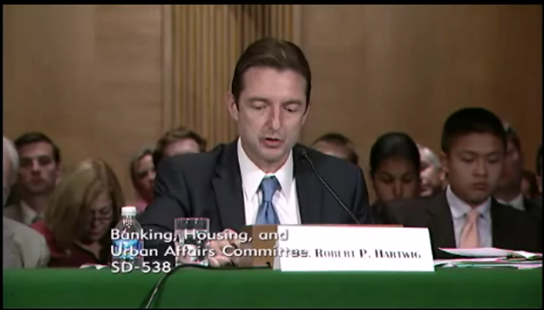

Terrorism Risk Insurance Program
Industry Is Working Hard for Reauthorization
At Least 4 Congressional Hearings in House & Senate
3 House Bills Introduced in 2013
Senate Bill 2244 Introduced in April
  Increases mandatory recoupment from $27.5B to $37.5B
  Increase insurer co-share 20% from 15%
House Financial Services Subcommittee, 11/13/13
Senate Banking Committee, 9/25/13
89
12/01/09 - 9pm
eSlide – P6466 – The Financial Crisis and the Future of the P/C
Notes:
89

Slide 90
I.I.I. White Paper (March 2014):
Terrorism Risk: A Constant Threat
Detailed history of TRIA
How TRIA works
Assessing the threat of terrorism
Terrorism market conditions
Global perspective
Download at http://www.iii.org/white_papers/terrorism-risk-a-constant-threat-2014.html
90
12/01/09 - 9pm
eSlide – P6466 – The Financial Crisis and the Future of the P/C
Notes:
90

Slide 91
Terrorism Insurance Take-up Rates,
By Year, 2003-2013
TRIA’s high take-up rates, availability and affordability have benefitted businesses, workers and the entire US economy since the program’s enactment
The Take-Up Rate for Workers Compensation is 100%
Source: Marsh Global Analytics, 2014 Terrorism Risk Insurance Report, April 2014 and earlier editions.
91
Notes:
91

Slide 92
Terrorism Insurance Take-Up Rates by State for 2013*
The overall US take-up rate for terrorism coverage was 62% in 2013 and ranged from a low of 41% in Michigan to a high of 84% in Massachusetts (where demand likely increased due to the April 2013 Boston Marathon bombing)
*Data for 27 states with sufficient data.
Source: Marsh 2014 Terrorism Risk Insurance Report; Insurance Information Institute.

Slide 93
Top 3 Key Facts About TRIA
TRIA costs taxpayers virtually nothing
TRIA as currently structured continues to provide tangible benefits to the U.S. economy in the form of:
  Terrorism insurance market stability, affordability and availability
  Smooth functioning of commercial lending activity
  Employment stimulus
TRIA is now clearly a critical part of the U.S. national economic security infrastructure
  A primary goal of terrorism is to destabilize the U.S. economy
  Terrorism risk insurance is critical to ensure a swift recovery in the event of future attacks
Bottom Line: TRIA is an unambiguous, unmitigated success

Slide 94
Insurance Information Institute Online:
www.iii.org
Thank you for your time
and your attention!
Twitter: twitter.com/bob_hartwig
Download at www.iii.org/presentations

