Slide 1
The Commercial P/C Insurance Industry: Overview & Outlook
19th Annual NYSSA Insurance Conference
New York, NY
March 17, 2015
Steven N. Weisbart, Ph.D., CLU, Senior Vice President & Chief Economist
Insurance Information Institute ♦ 110 William Street ♦ New York, NY 10038
Tel: 212.346.5540 ♦ Cell: 917.494.5945 ♦ stevenw@iii.org ♦ www.iii.org

Slide 2
Insurance Industry:
Financial Update & Outlook
2014 Was a Reasonably Good Year
2013 Was the Industry’s Best Year
in the Post-Crisis Era
2

Slide 3
P/C Industry Net Income After Taxes
1991–2014E
2005 ROE*= 9.6%
2006 ROE = 12.7%
2007 ROE = 10.9%
2008 ROE = 0.1%
2009 ROE = 5.0%
2010 ROE = 6.6%
2011 ROAS¹ = 3.5%
2012 ROAS¹ = 5.9%
2013 ROAS¹ = 10.3%
2014 ROAS¹ = 7.6%
Net income rose strongly (+81.9%) in 2013 vs. 2012 on lower cats, capital gains
$ Millions
ROE figures are GAAP; ¹Return on avg. surplus. Excluding Mortgage & Financial Guaranty insurers yields a 7.7% ROAS through 2014:Q2, 9.8% ROAS in 2013, 6.2% ROAS in 2012, 4.7% ROAS for 2011, 7.6% for 2010 and 7.4% for 2009.
Sources: A.M. Best, ISO; Insurance Information Institute

Slide 4
Back to ‘60s? P/C Insurance
Industry Profitability, 1950 – 2014*
ROE
1970-90: Peak ROEs were much higher but troughs were comparable. High interest rates, rapid inflation, economic volatility all played roles.
1990-2010s: Excluding mega-CATs, this period resembles the 1950-1970 period
1950-70: ROEs were low due to low interest rates, low inflation, and “Bureau” rate regulation.
*Profitability = P/C insurer ROEs. 2011-14 figures are estimates based on ROAS data. Note: Data for 2008-2014 exclude mortgage and financial guaranty insurers. 2014 figure is through Q3.
Source: Insurance Information Institute; NAIC, ISO, A.M. Best.

Slide 5
P/C Insurance Industry
Combined Ratio, 2001–2014:Q3*
Relatively Low CAT Losses, Reserve Releases
Higher CAT Losses, Shrinking Reserve Releases, Toll of Soft Market
As Recently as 2001, Insurers Paid Out Nearly $1.16 for Every $1 in Earned Premiums
Heavy Use of Reinsurance Lowered Net Losses
Relatively Low CAT Losses, Reserve Releases
Avg. CAT Losses, More Reserve Releases
Sandy Impacts
Best Combined Ratio Since 1949 (87.6)
Cyclical Deterioration
Lower CAT Losses
* Excludes Mortgage & Financial Guaranty insurers 2008--2014. Including M&FG, 2008=105.1, 2009=100.7, 2010=102.4, 2011=108.1; 2012:=103.2; 2013: = 96.1; 2014:9M = 97.7.
Sources: A.M. Best, ISO.

Slide 6
A 100 Combined Ratio Isn’t What It
Once Was: Investment Impact on ROEs
A combined ratio of about 100 generates an ROE of ~7.0% in 2012/13, ~7.5% ROE in 2009/10,
10% in 2005 and 16% in 1979
Combined Ratio / ROE
Lower CATs helped ROEs in 2013
Combined Ratios Must Be Lower in Today’s Depressed
Investment Environment to Generate Risk Appropriate ROEs
* 2008 -2014 figures are return on average surplus and exclude mortgage and financial guaranty insurers. 2014:9M combined ratio including M&FG insurers is 97.7; 2013 = 96.1; 2012 =103.2, 2011 = 108.1, ROAS = 3.5%.
Source: Insurance Information Institute from A.M. Best and ISO Verisk Analytics data.

Slide 7
Return on Net Worth (RNW) All Lines: 2004-2013 Average
Commercial lines have tended to be more profitable than personal lines over the past decade
Personal lines
Source: NAIC; Insurance Information Institute.

Slide 8
RNW All Lines by State, 2004-2013 Average:
Highest 25 States
Percent
The most profitable states over the past decade are widely distributed geographically, though none are in the Gulf region
Profitability Benchmark: All P/C
US: 7.9%
Source: NAIC; Insurance Information Institute.

Slide 9
RNW All Lines by State, 2004-2013 Average:
Lowest 25 States
Percent
The least profitable states over the past decade were hit hard by catastrophes
Source: NAIC; Insurance Information Institute.

Slide 10
U.S. Insured Catastrophe Loss Update
2013/14 Had Below-Average CAT Activity Following Very High CAT Losses in 2011/12
10

Slide 11
U.S. Insured Catastrophe Losses
($ Billions, $ 2013)
2012 was the 3rd most expensive year ever for insured CAT losses
2013 Was a Welcome Respite from 2012, the 3rd Costliest Year for Insured Disaster Losses in US History. Longer-term Trend is for more—not fewer—Costly Events
$15.3 billion in insured CAT losses estimated for 2014
*Through 12/31/14.
Note: 2001 figure includes $20.3B for 9/11 losses reported through 12/31/01 ($25.9B 2011 dollars). Includes only business and personal property claims, business interruption and auto claims. Non-prop/BI losses = $12.2B ($15.6B in 2011 dollars.)
Sources: Property Claims Service/ISO; Insurance Information Institute.
11
12/01/09 - 9pm
eSlide – P6466 – The Financial Crisis and the Future of the P/C
Notes:
11

Slide 12
Inflation Adjusted U.S. Catastrophe Losses by Cause of Loss, 1994–2013¹
Wind/Hail/Flood (3), $14.6
Fires (4), $5.5
Other (5), $0.2
Insured cat losses from 1993-2012 totaled $386.7B, an average of $19.3B per year or $1.6B per month
Geological Events, $18.4
Terrorism, $24.8
Winter Storms, $24.7
Hurricanes & Tropical Storms, $159.1
Tornado share of CAT losses is rising
Wind losses are by far cause the most catastrophe losses, even if hurricanes/TS are excluded.
Events Involving Tornadoes (2), $139.3
Catastrophes are defined as events causing direct insured losses to property of $25 million or more in 2013 dollars.
Excludes snow.
Does not include NFIP flood losses
Includes wildland fires
Includes civil disorders, water damage, utility disruptions and non-property losses such as those covered by workers compensation.
Source: ISO’s Property Claim Services Unit.

Slide 13
Top 16 Most Costly Disasters in U.S. History
(Insured Losses, 2013 Dollars, $ Billions)
Superstorm Sandy in 2012 was the last mega-CAT to hit the US
Includes Tuscaloosa, AL, tornado
Includes Joplin, MO, tornado
12 of the 16 Most Expensive Events in US History Have Occurred Over the Past Decade
Sources: PCS; Insurance Information Institute inflation adjustments to 2013 dollars using the CPI.

Slide 14
CYBER RISK:
A Rapidly Emerging Exposure for Businesses Large and Small in Every Industry
Rapidly Increasing Interest from Businesses, Media, & Public Policymakers
14

Slide 15
Data Breaches 2005-2014, by Number of Breaches and Records Exposed
# Data Breaches/Millions of Records Exposed
Millions
The Total Number of Data Breaches Rose 28% While the Number of Records Exposed Was Relatively Flat (-2.6%)
15
* 2014 figures as of Jan. 12, 2014 from the ITRC.
Source: Identity Theft Resource Center.

Slide 16
Worldwide Cybersecurity Spending, 2011- 2016F
($ Billions)
Cybersecurity spending increased by an estimated $5.2B in 2014, $5.8B in 2015 and $6.3B in 2016
Cybersecurity Spending Is Rising Sharply, Up by About 8%+ Annually through 2016—a Projected Increase of $12.1 Billion from 2014 to 2016
16
Source: Gartner Group; Insurance Information Institute; Adapted from Wall Street Journal: “Financial Firms Boost Cybersecurity Funds,” Nov. 17, 2014.

Slide 17
Data/Privacy Breach:
Many Potential Costs Can Be Insured
Data Breach Event
Costs of notifying affecting individuals
Defense and settlement costs
Lost customers and damaged reputation
Cyber extortion payments
Costs of notifying regulatory authorities
Regulatory fines at home & abroad
Business Income Loss
Forensic costs to discover cause
Source: Zurich Insurance; Insurance Information Institute
17

Slide 18
The Three Basic Elements of Cyber Coverage: Prevention, Transfer, Response
Loss Prevention
Post-Breach Response
(Insurable)
Loss Transfer (Insurance)
Cyber risk management today involves three essential components, each designed to reduce, mitigate or avoid loss. An increasing number of cyber risk products offered by insurers today provide all three.
Source: Insurance Information Institute research.
18

Slide 19

I.I.I. Released its Second Cyber Report in 2014: Cyber Risk: The Growing Threat
I.I.I.’s 2nd report on cyber risk released June 2014
Provides information on cyber threats and insurance market solutions
Global cyber risk overview
  Quantification of threats by type and industry
Cyber security and cost of attacks
Cyber terrorism
Cyber liability
Insurance market for cyber risk
3rd Report in Q2 2015

Slide 20
INVESTMENTS:
A Key Driver of Profitability
Depressed Yields Will Continue
to Affect Underwriting & Pricing
20

Slide 21
Distribution of Invested Assets:
P/C Insurance Industry, 2013
$ Billions
Total Invested Assets = $1.5 Trillion
Source: Insurance Information Institute Fact Book 2015, A.M. Best.

Slide 22
Distribution of Bond Maturities,
P/C Insurance Industry, 2004-2013
The main shift over these years has been from longer maturities to shorter maturities, but the 2013 data suggest a shift back has begun. The 2013 distribution resembles that at year-end 2009.
Sources: SNL Financial; Insurance Information Institute.

Slide 23
Property/Casualty Insurance Industry Investment Income: 2000–2014¹
Investment earnings are still below their 2007 pre-crisis peak
($ Billions)
Due to persistently low interest rates,
investment income fell in 2012, 2013 and 2014.
¹ Investment gains consist primarily of interest and stock dividends. *2014 figure is estimated based on annualized data through Q3.
Sources: ISO; Insurance Information Institute.

Slide 24
U.S. Treasury 2- and 10-Year Note Yields*: Monthly, 1990–2015
Yields on 10-Year U.S. Treasury Notes have been essentially below 5% for over a decade.
U.S. Treasury 10-year note yields “spiked”
Since roughly 80% of P/C bond/cash investments are in 10-year or shorter durations, most P/C insurer portfolios will have low-yielding bonds for years to come.
*Monthly, constant maturity, nominal rates, through January 2015.
Sources: Federal Reserve Bank at http://www.federalreserve.gov/releases/h15/data.htm.
National Bureau of Economic Research (recession dates); Insurance Information Institutes.
24
12/01/09 - 9pm
eSlide – P6466 – The Financial Crisis and the Future of the P/C
Notes:
24

Slide 25
Book Yield on Property/Casualty Insurance Invested Assets, 2007–2016F
(Percent)
Book yield in 2014 is down 114 BP from pre-crisis levels
The yield on invested assets continues to decline as returns on maturing bonds generally still exceed new money yields. Even short term interest rate increases are unlikely until mid-to-late 2015
Sources: Conning.

Slide 26
Interest Rate Forecasts: 2015 – 2020
Yield (%)
3-Month Treasury
10-Year Treasury
The Fed is expected to begin raising short-term rates in mid-2015, but this timeline could easily slip to late 2015 or even 2016
The end of the Fed’s QE program in 2014 and a stronger economy are expected to push longer-term yields higher
A Full Normalization of Interest Rates Is Unlikely Until 2018, More than a Decade After the Onset of the Financial Crisis
Sources: Federal Reserve Board of Governors (historical); Blue Chip Economic Indicators (1/15 for 2015 and 2016; for 2017-2020 10/14 issue); Insurance Info. Institute.

Slide 27
Reduction in Combined Ratio Necessary to Offset 1% Decline in Investment Yield to Maintain Constant ROE, by Line*
Lower Investment Earnings Place a Greater Burden on Underwriting and Pricing Discipline
*Based on 2008 Invested Assets and Earned Premiums
**US domestic reinsurance only
Source: A.M. Best; Insurance Information Institute.
27
12/01/09 - 9pm
eSlide – P6466 – The Financial Crisis and the Future of the P/C
Notes:
27
This shows the drop in Combined Ratio for each line of business that would be needed to maintain a constant ROE, given a 1-percentage-point drop in investment yield

Slide 28
P/C Insurer Net Realized
Capital Gains/Losses, 1990-2014:Q3
Realized capital gains rose sharply as equity markets rallied in 2013-14
($ Billions)
Insurers Posted Net Realized Capital Gains in 2010 - 2014 Following Two Years of Realized Losses During the Financial Crisis. Realized Capital Losses Were a Primary Cause of 2008/2009’s Large Drop in Profits and ROE
Sources: A.M. Best, ISO, Insurance Information Institute.
28
12/01/09 - 9pm
eSlide – P6466 – The Financial Crisis and the Future of the P/C
Notes:
28

Slide 29
Property/Casualty Insurance Industry Investment Gain: 1994–2014E¹
($ Billions)
Investment gains in 2014 will rival the post-crisis high reached in 2013
Total Investment Gains Were Flat in 2014 as Low Interest Rates Pressured Investment Income but Realized Capital Gains Remained Robust
¹ Investment gains consist primarily of interest, stock dividends and realized capital gains and losses.
* 2005 figure includes special one-time dividend of $3.2B;
Sources: ISO; Insurance Information Institute.

Slide 30
CAPITAL/CAPACITY
Capital Accumulation Has Multiple Impacts
30

Slide 31
Policyholder Surplus,
2006:Q4–2014:Q3
Drop due to near-record 2011 CAT losses
($ Billions)
2007:Q3
Pre-Crisis Peak
Surplus as of 9/30/14 stood at a record high $673.9B
The industry now has $1 of surplus for every $0.73 of NPW,
close to the strongest claims-paying status in its history.
2010:Q1 data includes $22.5B of paid-in capital from a holding company parent for one insurer’s investment in a non-insurance business .
The P/C insurance industry entered 2015
in very strong financial condition.
Sources: ISO, A.M .Best.
31
12/01/09 - 9pm
eSlide – P6466 – The Financial Crisis and the Future of the P/C
Notes:
31

Slide 32
Premium-to-Surplus Ratio:
1985–2014*
The larger surplus is in relation to premiums—the lower the P:S ratio—the greater the industry’s capacity to handle the risk it has accepted
(Ratio of NWP to PHS)
Surplus as of 9/30/14 was $0.75:$1, a near-record low (at least in modern history)
9/11, Recession & Hard Market
The Premium-to-Surplus Ratio Stood at $0.75:$1 as of
9/30/14, a Record Low (at Least in Recent History)
* As of 9/30/14.
Source: A.M. Best, ISO, Insurance Information Institute.

Slide 33
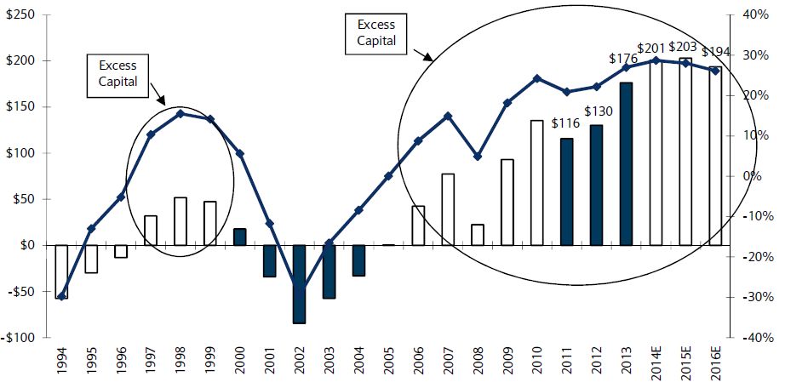
US P/C Insurance Industry Excess Capital Position: 1994–2016E
Barclay’s suggests that excess is about $200B (~30%)
Surplus Redundancy (Deficiency)
Percent Redundancy (Deficiency)
The Industry’s Strong Capital Position Suggests Insurers Are in a Good Position to Increase Risk Appetite, Repurchase Shares and Pursue Acqusitions
Source: Barclays Research estimates.

Slide 34
P/C Industry: Loss Reserve-to-Surplus Ratio, 1971-2014:Q3
Inflation, Liability Crisis Increased Reserves, Plunging Stock Prices Depleted Surplus
The Property/Casualty Industry Adjusted Its Risk Portfolio in Response to Risk-Based Capital Requirements Implemented in 1994.
Source: Calculations from A.M. Best data by Insurance Information Institute.

Slide 35
Alternative Capital
New Investors are Changing
the Reinsurance Landscape
The First I.I.I. White Paper on This Issue Will Be Released Q1 2015
35

Slide 36
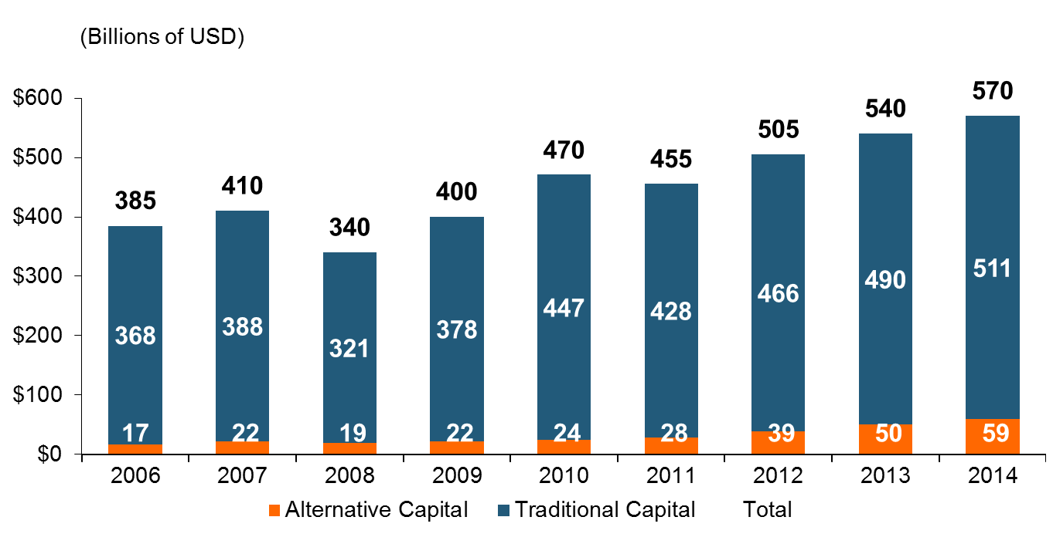
Global Reinsurance Capital (Traditional and Alternative), 2006 - 2014
Total reinsurance capital reached a record $570B in 2013, up 68% from 2008.
But alternative capacity has grown 210% since 2008, to $50B. It has more than doubled in the past three years.
2014 data is as of June 30, 2014.
Source: Aon Benfield Analytics; Insurance Information Institute.

Slide 37
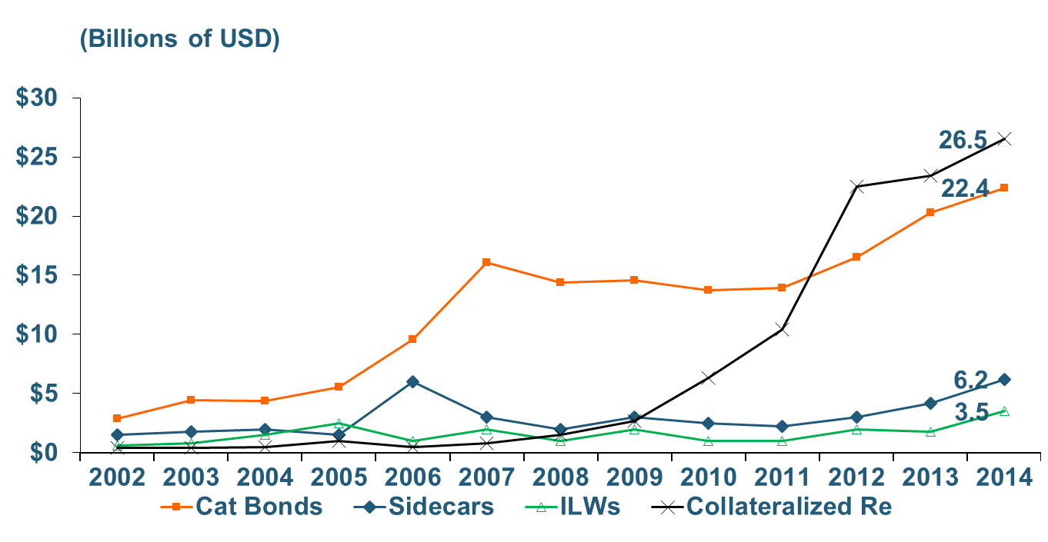
Growth of Alternative Capital Structures, 2002 - 2014
Collateralized Re’s Growth Has Accelerated in the Past Three Years.
Collateralized Reinsurance and Catastrophe Bonds Currently Dominate the Alternative Capital Market.
2014 data is as of June 30, 2014.
Source: Aon Benfield Analytics; Insurance Information Institute.

Slide 38
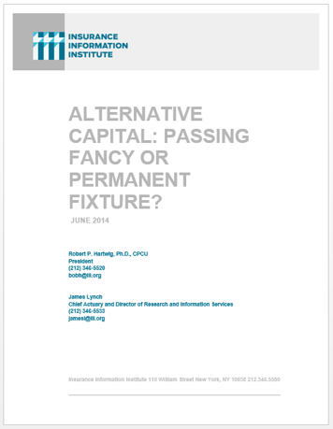
I.I.I. Will Release its First Report on Alternative Capital During Q1 2015
Issue of alternative capital in (re)insurance has received increased attention in recent years
Significant structural changes in property catastrophe reinsurance space
Questions addressed include:
  Sources of new capital
  Reasons/Drivers of growth
  New structures
  Impact of major triggering event(s)
  Impacts of higher interest rates
  Cat bond yield compression
Forthcoming: Q1 2015

Slide 39
Questions Arising from Influence of Alternative Capital
What Will Happen When Investors Face Large-Scale Losses?
What Happens When Interest Rates Rise?
Does ILS Have a Higher Propensity to Litigate?
How Much Lower Will Risk Premiums Shrink/ROLs Fall?
Will There Be Spillover Into Casualty Reinsurance?
Will Alternative Capital Drive Consolidation?

Slide 40
The Strength of the Economy Will Influence P/C Insurer Growth Opportunities
Growth Will Expand Insurer Exposure Base Across Most Lines
40

Slide 41
Real U.S. Quarterly GDP Growth
Since the “Great Recession
Since the Great Recession ended, even 3% real growth (at an annual rate) in a quarter has been unusual. It happened only 7 times in 22 quarters, but 4 of those 7 were in the most recent 6 quarters.
Data are quarterly changes at annualized rates. 2014:Q4 is revised estimate
Sources: US Department of Commerce, at http://www.bea.gov/national/index.htm#gdp ; Insurance Information Institute.

Slide 42
Index of Total Industrial Production:*
A Near Peak as of December 2014
Many economists expect business investment to rise in 2015
December 2014 Index at 106.5
Peak at 100.82 in December 2007 (officially the 1st month of the Great Recession)
Insurance exposures for industrial production will continue growing in 2015, and commercial insurance premium volume with them. Y-o-Y growth to December 2014 was 4.6%. Both production and premium volume growth for 2015 should exceed this.
*Monthly, seasonally adjusted, through December 2014 (which is preliminary). Index based on year 2007 = 100
Sources: Federal Reserve Board at http://www.federalreserve.gov/releases/g17/ipdisk/ip_sa.txt .
National Bureau of Economic Research (recession dates); Insurance Information Institute.
42
12/01/09 - 9pm
eSlide – P6466 – The Financial Crisis and the Future of the P/C
Notes:
42

Slide 43
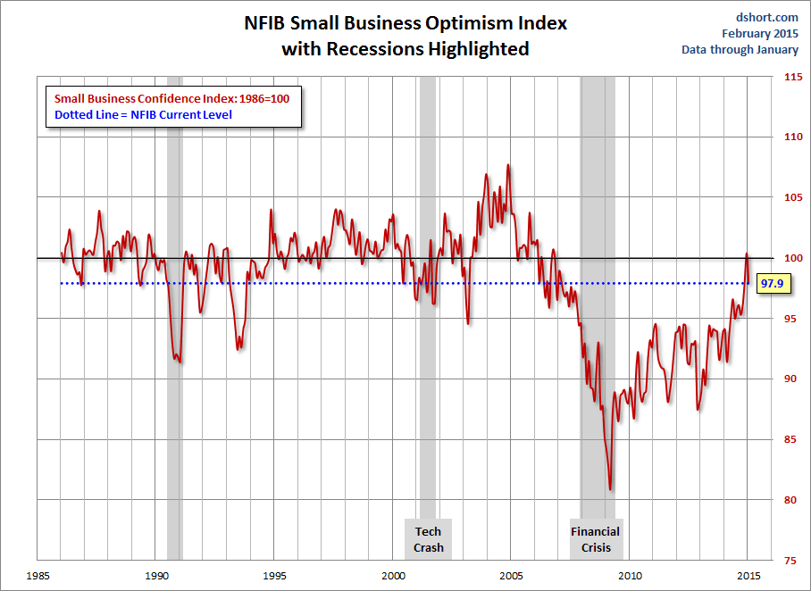
NFIB Small Business Optimism Index
January 1985 through January 2015
Source: National Federation of Independent Business at http://www.advisorperspectives.com/dshort/charts/indicators/Sentiment.html?NFIB-optimism-index.gif ; Insurance Information Institute.

Slide 44
Business Bankruptcy Filings: Still Falling
(1994:Q1 – 2014:Q3)
(Thousands)
New Bankruptcy Law Takes Effect
Below pre-recession level
Recessions in orange
Business bankruptcies in 2014 were below both the Great Recession levels and the 2003:Q3-2005:Q1 period (the best five-quarter stretch in the last 20 years). Bankruptcies restrict exposure growth in all commercial lines.
Sources: U.S. Courts at http://www.uscourts.gov/uscourts/Statistics/BankruptcyStatistics/BankruptcyFilings/2013/0913_f2q.pdf ; Insurance Information Institute
44
12/01/09 - 9pm
eSlide – P6466 – The Financial Crisis and the Future of the P/C
Notes:
44

Slide 45
Insurance Information Institute Online:
www.iii.org
Thank you for your time
and your attention!

Slide 46
Recovery in Capacity Utilization is a Positive Sign for Commercial Exposures
March 2001 through Dec. 2014
“Full Capacity”
The US operated at 79.7% of industrial capacity in Dec. 2014, well above the June 2009 low of 66.9% but is still below pre-recession levels.
Percent of Industrial Capacity
Hurricane Katrina
The closer the economy is to operating at “full capacity,” the greater the inflationary pressure
March 2001-November 2001 recession
December 2007-
June 2009 Recession
46
Source: Federal Reserve Board statistical releases at http://www.federalreserve.gov/releases/g17/Current/default.htm.
Notes:
46

Slide 47
Business Fixed Investment is Forecast to Grow Steadily in 2015-16, Fueling Commercial Exposure Growth
Business investment will drive commercial property and liability insurance exposures and should drive employment and WC payroll exposures as well (with a lag)
Growth Rate
Sources: Wells Fargo Economic Group; Insurance Information Institute.

Slide 48
Labor Market Trends
Massive Job Losses Sapped the Economy and Commercial/Personal Lines Exposure, But Trend Has Greatly Improved
48

Slide 49
Unemployment and Underemployment Rates: Still Too High, But Falling
January 2000 through February 2015, Seasonally Adjusted (%)
U-6 went from 8.0% in March 2007 to 17.5% in
October 2009
U-6 was 11.0% in Feb. 2015.
“Headline” unemployment was 5.5% in February 2015. 4% to 6% is “normal.”
For U-6, 8% to 10% is “normal.”
High unemployment and underemployment still constrain overall economic growth, but the job market is now clearly improving.
Source: US Bureau of Labor Statistics; Insurance Information Institute.
49
12/01/09 - 9pm
eSlide – P6466 – The Financial Crisis and the Future of the P/C
Notes:
49

Slide 50
Nonfarm Payroll (Wages and Salaries):
Quarterly, 2005–2014:Q3
Billions
Latest (2014:Q3) was $7.46 trillion, a new peak--$1.21 trillion above 2009 trough
Prior Peak was 2008:Q3 at $6.54 trillion
Growth rates
2011:Q3 over 2010:Q3: 4.1%
2012:Q3 over 2011:Q3: 3.2%
2013:Q3 over 2012:Q3: 3.6%
2014:Q3 over 2013:Q3: 4.4%
Recent trough (2009:Q1) was $6.23 trillion, down 5.3% from prior peak
Note: Recession indicated by gray shaded column. Data are seasonally adjusted annual rates.
Sources: http://research.stlouisfed.org/fred2/series/WASCUR; National Bureau of Economic Research (recession dates); Insurance Information Institute.
50
12/01/09 - 9pm
eSlide – P6466 – The Financial Crisis and the Future of the P/C
Notes:
50

Slide 51
Payroll vs. Workers Comp Net Written Premiums, 1990-2014P
Payroll Base* WC NWP
$Billions $Billions
7/90-3/91
3/01-11/01
12/07-6/09
WC premium volume dropped two years before the recession began
WC net premiums written were down $14B or 29.3% to $33.8B in 2010 after peaking at $47.8B in 2005
Continued Payroll Growth and Rate Gains Suggest WC NWP Will Grow Again in 2015
*Private employment; Shaded areas indicate recessions. WC premiums for 2014 are I.I.I. estimates..
Sources: NBER (recessions); Federal Reserve Bank of St. Louis at http://research.stlouisfed.org/fred2/series/WASCUR ; NCCI; I.I.I.

Slide 52
Construction Employment,
Jan. 2003–December 2014
(Thousands)
Construction employment troughed at 5.435 million in Jan. 2011, after a loss of 2.291 million jobs, a 29.7% plunge from the April 2006 peak
Construction employment peaked at 7.726 million in April 2006
The “Great Recession” and housing bust destroyed 2.3 million constructions jobs
The Construction Sector Could Be a Growth Leader in 2015 as the Housing Market, Private Investment and Govt. Spending Recover.
Note: Recession indicated by gray shaded column.
Sources: U.S. Bureau of Labor Statistics; Insurance Information Institute.
52
12/01/09 - 9pm
eSlide – P6466 – The Financial Crisis and the Future of the P/C
Notes:
52

Slide 53
Manufacturing Employment,
January 2010—December 2014*
Thousands
In the past 5 years (from January 2010) manufacturing employment is up (+877,000 or +7.7%)
and still growing.
Manufacturing employment is a surprising source of strength in the economy. Employment in the sector is at a multi-year high.
*Seasonally adjusted; Dec and Nov 2013 are preliminary
Sources: US Bureau of Labor Statistics at http://data.bls.gov; Insurance Information Institute.

Slide 54
Employment in Oil & Gas Extraction,
Jan. 2010—Dec. 2014*
Oil and gas extraction employment is up 37.7% since Jan. 2010 as the energy sector booms. (Previous boom in 1979-81, employment peak at 267,000 in March 1982.)
Highest employment in this sector since July 1986.
(000)
*Seasonally adjusted
Sources: US Bureau of Labor Statistics at http://data.bls.gov; Insurance Information Institute.
54
12/01/09 - 9pm
eSlide – P6466 – The Financial Crisis and the Future of the P/C
Notes:
54

Slide 55
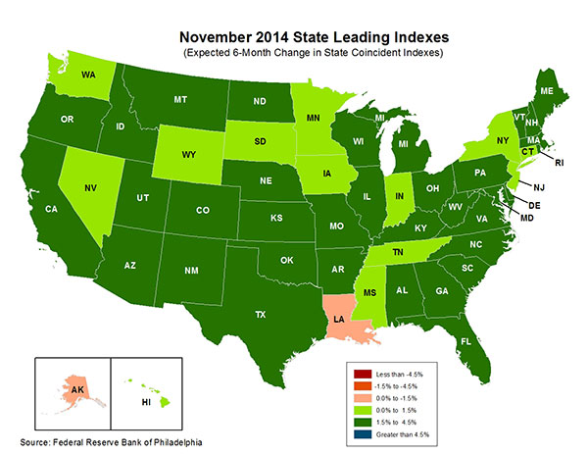
State-by-State Leading Indicators
through 2015:Q2
Growth in the West is finally beginning to pick up
The economic outlook for most of the US is generally positive, though flat-to-negative for 2 states
Sources: Federal Reserve Bank of Philadelphia at http://www.philadelphiafed.org/index.cfm ;Insurance Information Institute.

Slide 56
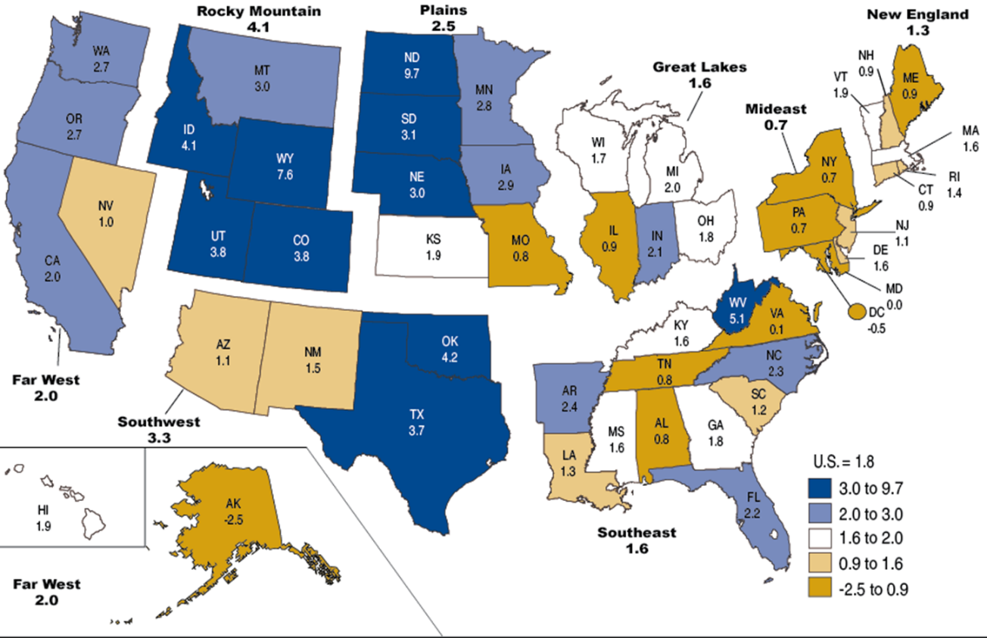
Percent Change in Real GDP by State, 2013
Sources: US Bureau of Economic Analysis; Insurance Information Institute.

Slide 57
Performance by Segment and by State
57
Notes:
57

Slide 58
Net Premium Growth: Annual Change,
1971—2016F
(Percent)
1975-78
1984-87
2000-03
Net Written Premiums Fell 0.7% in 2007 (First Decline Since 1943) by 2.0% in 2008, and 4.2% in 2009, the First 3-Year Decline Since 1930-33.
2015-16F: 4.0%
2014E: 3.9%*
2013: 4.6%
2012: +4.3%
*Actual figure based on data through Q3 2014.
Shaded areas denote “hard market” periods
Sources: A.M. Best (historical and forecast), ISO, Insurance Information Institute.

Slide 59
Commercial Lines Combined Ratio, 1990-2015F*
Commercial lines underwriting performance is expected to improve as improvement in pricing environment persists
*2007-2012 figures exclude mortgage and financial guaranty segments.
Source: A.M. Best (1990-2014F); Conning (2015F) Insurance Information Institute.

Slide 60
Commercial Auto Combined Ratio: 1993–2015F
Commercial Auto is Expected to Improve as Rate Gains Outpace Any Adverse Frequency and Severity Trends
Sources: A.M. Best (1990-2014F);Conning (2015F); Insurance Information Institute.

Slide 61
Commercial Multi-Peril Combined Ratio: 1995–2015F
Commercial Multi-Peril Underwriting Performance is Expected to Improve in 2013 Assuming Normal Catastrophe Loss Activity
*2013F-2012F figures are Conning figures for the combined liability and non-liability components..
Sources: A.M. Best; Conning; Insurance Information Institute.

Slide 62
General Liability Combined Ratio:
2005–2015F
Commercial General Liability Underwriting Performance Has Been Volatile in Recent Years
Source: Conning Research and Consulting.

Slide 63
Direct Premiums Written: Comm. Lines
Percent Change by State, 2007-2013
Top 25 States
Only 30 states showed any commercial lines growth from 2007 through 2013
Growth Benchmarks: Commercial
US: 1.3%
Sources: SNL Financial LLC.; Insurance Information Institute.

Slide 64
Direct Premiums Written: Comm. Lines
Percent Change by State, 2007-2013
Bottom 25 States
Nearly half the states have yet to see commercial lines premium volume return to pre-crisis levels
States with the poorest performing economies also produced the most negative net change in premiums of the past 6 years
Sources: SNL Financial LLC.; Insurance Information Institute.

Slide 65
Top Insurance Issues:
What’s Hot, What’s Not
No Dominant Event in 2014, but Some Key Commercial Lines Issues Spiked
Terrorism, TRIA, & Cyber
65

Slide 66
TERRORISM
TRIA Reauthorization Was
a Major Industry Effort
Over the Past Few Years
Outline of New TRIA Structure
66

Slide 67
TRIA Program Trigger, from Inception (2003) through Extension (2020)
$ Millions
Reauthorization
Program trigger will rise in steps beginning in 2016 from $100 million to $200 million by 2020
The TRIA program trigger is the amount of claims insurers will incur before any Federal participation starts
*First full year of program; TRIA was signed in to law on Nov. 26, 2002, with provisions identical to those in 2003.
Source: Insurance Information Institute research.

Slide 68
Industry Co-Pay Share in Excess of Individual Retention
The industry co-pay share will have double by 2020 from program inception
Percent
Reauthorization
Insurer co-payments in excess of their individual retentions will rise in steps beginning in 2016 from 15% to 20%
*First full year of program; TRIA was signed in to law on Nov. 26, 2002, with provisions identical to those in 2003.
Source: Insurance Information Institute research.

Slide 69
Industry Aggregate Retention Under TRIA, from Inception through Extension
The Industry Aggregate Retention Will Have Nearly Quadrupled from $10 Billion at Inception to $37.5 Billion in 2019
Reauthorization
$ Billions
Industry aggregate retentions will rise by $2B per year from 2015 through 2019
*First full year of program; TRIA was signed in to law on Nov. 26, 2002, with provisions identical to those in 2003.
Source: Insurance Information Institute research.

Slide 70
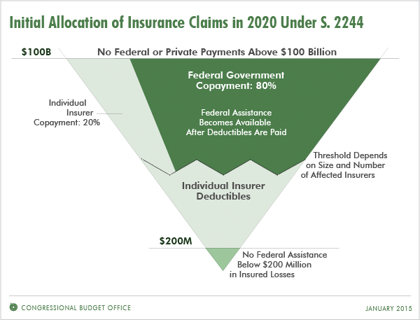
Structure of Reauthorized TRIA Program (as of 2020)
Major Changes
6-Year reauthorization
Trigger rises in steps from $100MM to $200MM
Industry aggregate retention rises in steps from $27.5B to $37.5B
Industry co-share above retained losses rises in steps from 15% to 20%
Insurers required to assume materially more risk
Source: Congressional Budget Office: http://www.cbo.gov/publication/49866; Insurance Information Institute research.

