Slide 1
Increasing Customer Awareness: Enhancing the Customer Experience
PCI National Flood Insurance Conference
Tuesday, May 2, 2017
Crystal Gateway Marriott,
Arlington, Virginia
Jeanne M. Salvatore, Senior Vice President, Chief Engagement Officer and Spokesperson
Insurance Information Institute  110 William Street  New York, NY 10038
Tel: 212.346.5555  Cell: 917.612.4088  Jeannes@iii.org  www.iii.org

Slide 2
Presentation Overview
Insuring Against a Disaster
What is the Insurance Information Institute
What do Consumers Know About Flood Insurance and Water Damage
What Should We Be Communicating
Key Resources
Questions

Slide 3

I.I.I. Mission Statement
Simple and succinct; and should stay that way…
Improving public understanding
of insurance...
…what it does and how it works
3

Slide 4
What do Consumers Know About Flood Insurance and Water Damage
They don’t purchase the coverage and don’t understand what they have

Slide 5
Homeowners and Renters Insurance
Most Homeowners Purchase Coverage, and Growing Number of Renters do too!
A 2016 Insurance Information Institute poll conducted by ORC International found that 93 percent of homeowners had homeowners insurance
And, 41 percent of renters had renters insurance. This number has been growing over the last decade, though.
But, only 12 percent of had a flood insurance policy, lower than the 14 percent who had the coverage in 2015.

Slide 6
At Peak (2007), Only 5% of Occupied Residences Had an NFIP Flood Insurance Policy In Force
5.1%
4.3%
Since 2007 the number of occupied residences has grown by 7.25% but the number of flood policies in force fell by 10.25%.
Sources: https://www.fema.gov/total-policies-force-calendar-year ; https://www.census.gov/housing/hvs/data/histtabs.html Insurance Information Institute.

Slide 7
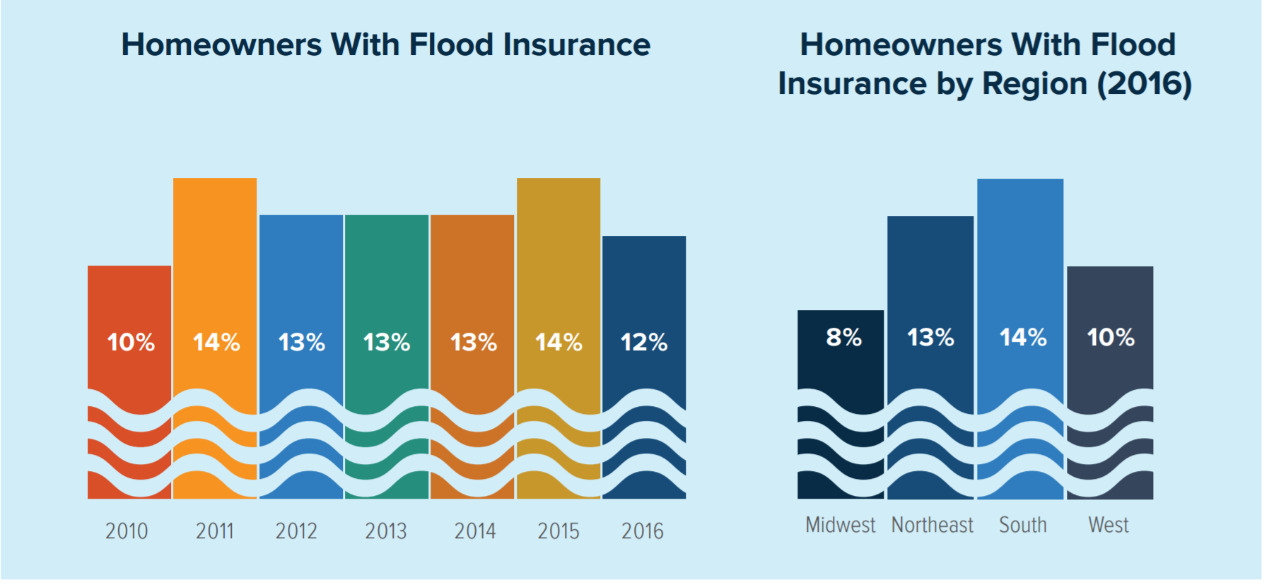
Flood Insurance by Year and By Region

Slide 8
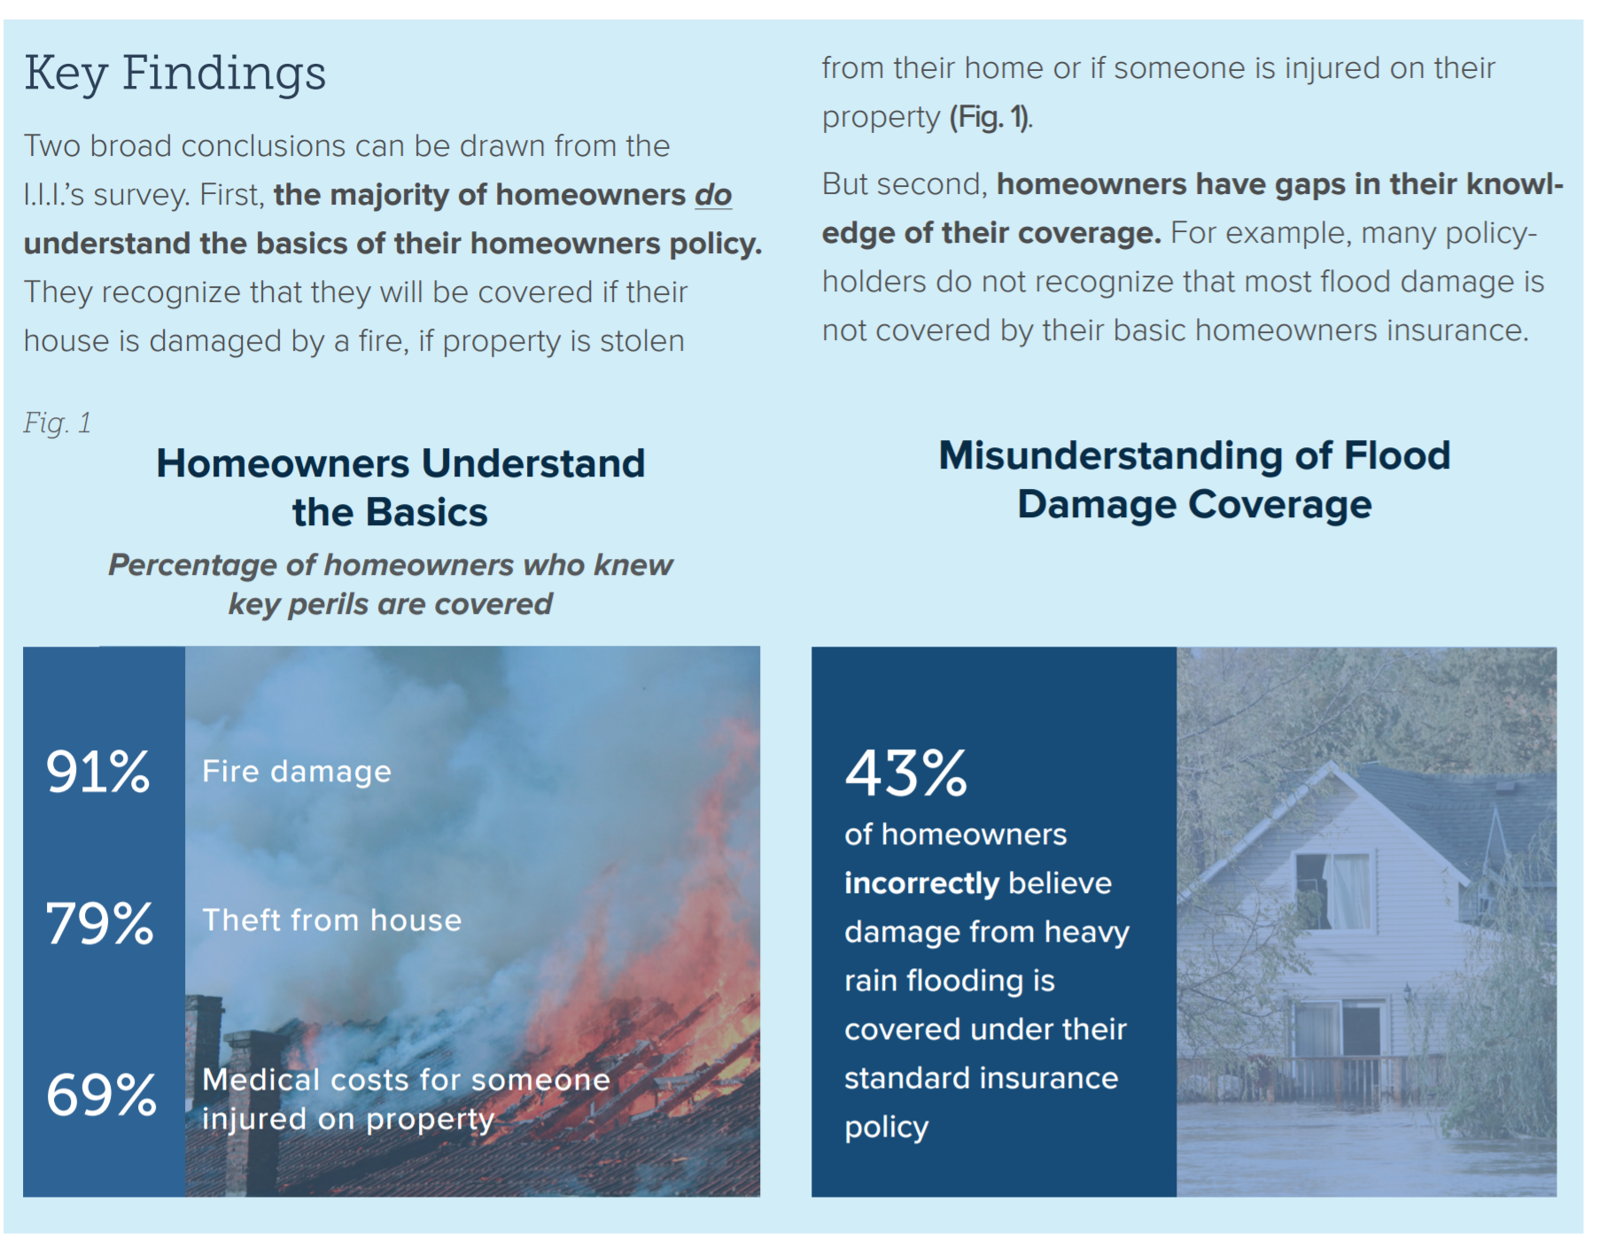
Consumer Understanding of Home and Flood Insurance: Good News and Bad News
Most homeowners understand the basics in a home insurance policy but don’t understand water damage and flooding
Insurance Information Institute, 2016 Consumer Insurance Survey, Homeowners Insurance: Understanding, Attitudes, and Shopping Practices, February 2017, p. 2.

Slide 9
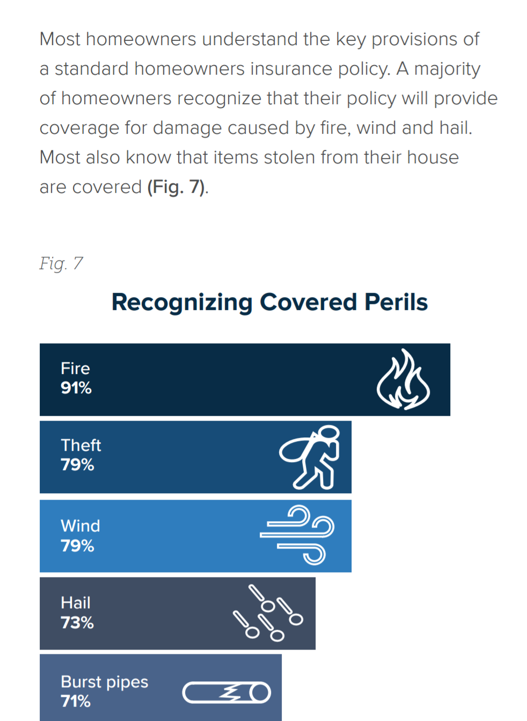
Homeowners Understand the Key Provisions in A Policy
Most consumers understand that
Fire
Theft
Wind
Hail
Burst Pipes
Covered by standard home policies

Slide 10
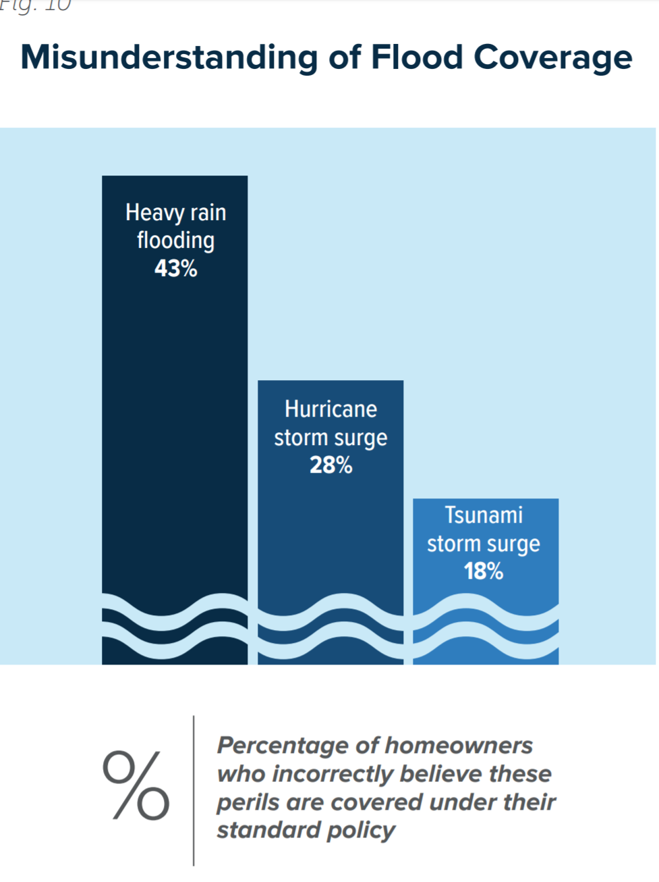
Misconceptions Regarding Flood Coverage
Troubling Results

Slide 11
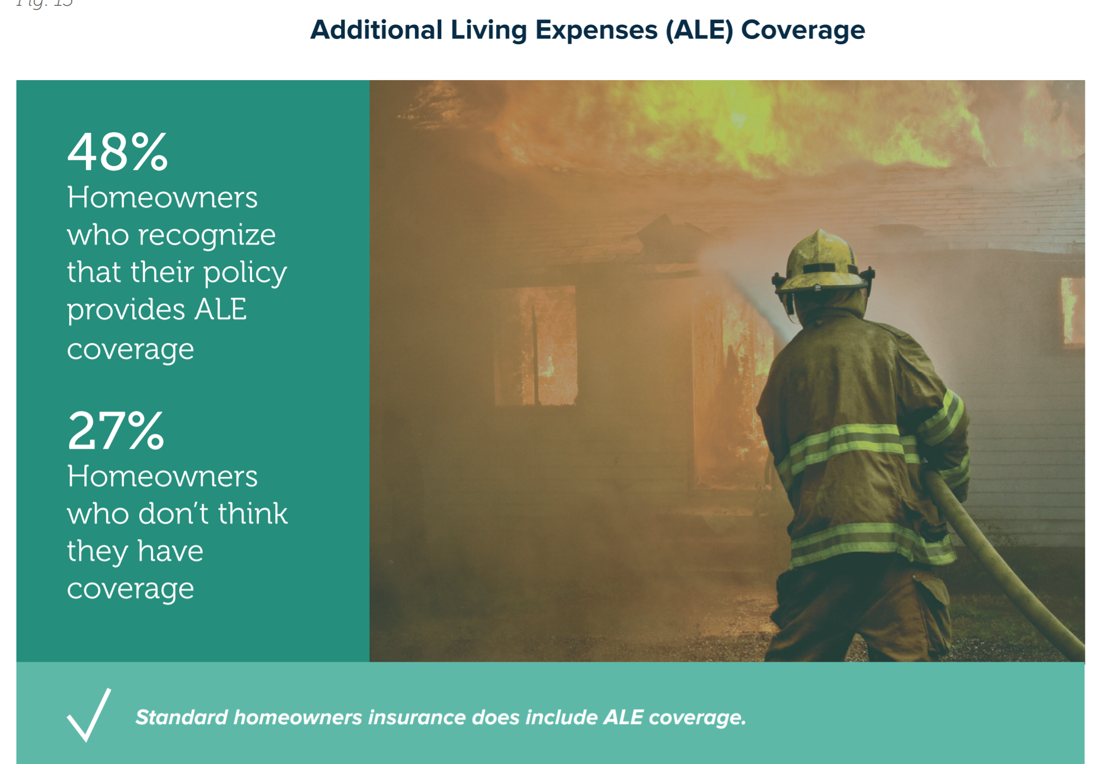
Most Know that there is ALE Coverage in a Home Insurance Policy
No ALE in Flood Insurance Policy – A Source of Confusion
Consumers
are also
confused by
coverage for
basements.

Slide 12
Reason for Confusion
Confusion about flood coverage may arise from the fact that some types of water and storm-related damage are covered by a standard homeowners policy.
For example, most homeowners insurance includes coverage for damage caused by wind-driven rain, burst pipes and water leaking into your house because of a roofline ice dam.
But, not by flood.
Consumer advocates, public policy experts, the media can also help close the knowledge gap by bringing attention to the need for homeowners to learn more about their insurance coverage and seek professional guidance when they purchase insurance

Slide 13

“Surround Sound” Approach to Disaster Communications
Consumers
Consumers
Industry
Policymakers
Media
Relevant
Experts
Relevant
Experts
Industry
Media
Policymakers

Slide 14
What Should We Be Communicating

Slide 15
Need to Communicate the Basics As Often as Possible
Key Messages Include:
Flooding is the most common and costly natural disaster in the United States, causing billions in economic losses each year. Most U.S. natural disasters declared by the president involve flooding.
Everyone – no matter where they live – needs to speak to their insurance professional about the risk of flooding and the cost of a policy.
Standard home, renters and business insurance policies clearly list the disasters that are covered and the disasters that are not. The two biggest disasters that are not covered are floods and earthquakes
Flooding is available from the National Flood Insurance Program (NFIP) and a few private insurance companies. Excess flood insurance is available from private insurance.
Flooding is covered under the optional comprehensive portion of an a auto insurance policy.

Slide 16
Focus on Renters – Encourage to get both a Renters Insurance Policy and a Flood Insurance Policy
We are increasingly becoming a Nation that Eschews
Home Ownership at Every Demographic!
The U.S. homeownership rate was 62.9 percent in second-quarter 2016, down from 63.4 percent a year ago to the lowest rate since the third quarter of 1965, according to data from the U.S. Census Bureau.
The 2010 Census showed that in some of the largest cities renters outnumbered owners, including New York, where 69.0 percent of households were occupied by
renters, followed by Los Angeles (61.8 percent), Chicago (55.1 percent) and Houston (54.6 percent).

Slide 17
Need to Point out Limitations of the Policy
Important to Not Sugar Coat it!
Stress the following:
There is no ALE coverage.
Coverage for Basements is limited.
There are limits on the amount and type of coverage under an NFIP flood insurance policy. Homes are covered for up to $250,000 on a replacement cost basis and the contents for up to $100,000 on an actual cash value basis.
Coverage limits for commercial property are $500,000 for the structure and another $500,000 for its contents.

Slide 18
Disaster-Related Resources

Slide 19
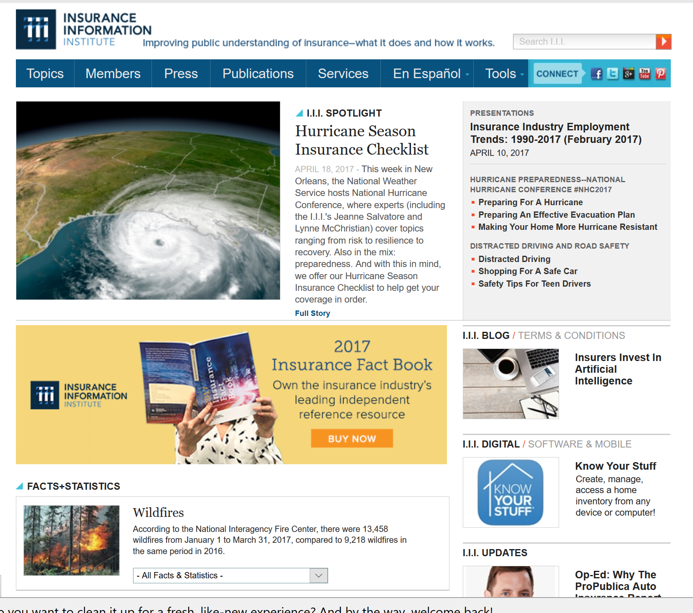
Great Resources – I.I.I. Website
www.I.I.I.org
Consumer Articles
Tips for Business owners
Educational Videos
Infographics
Apps
Research
Statistics

Slide 20
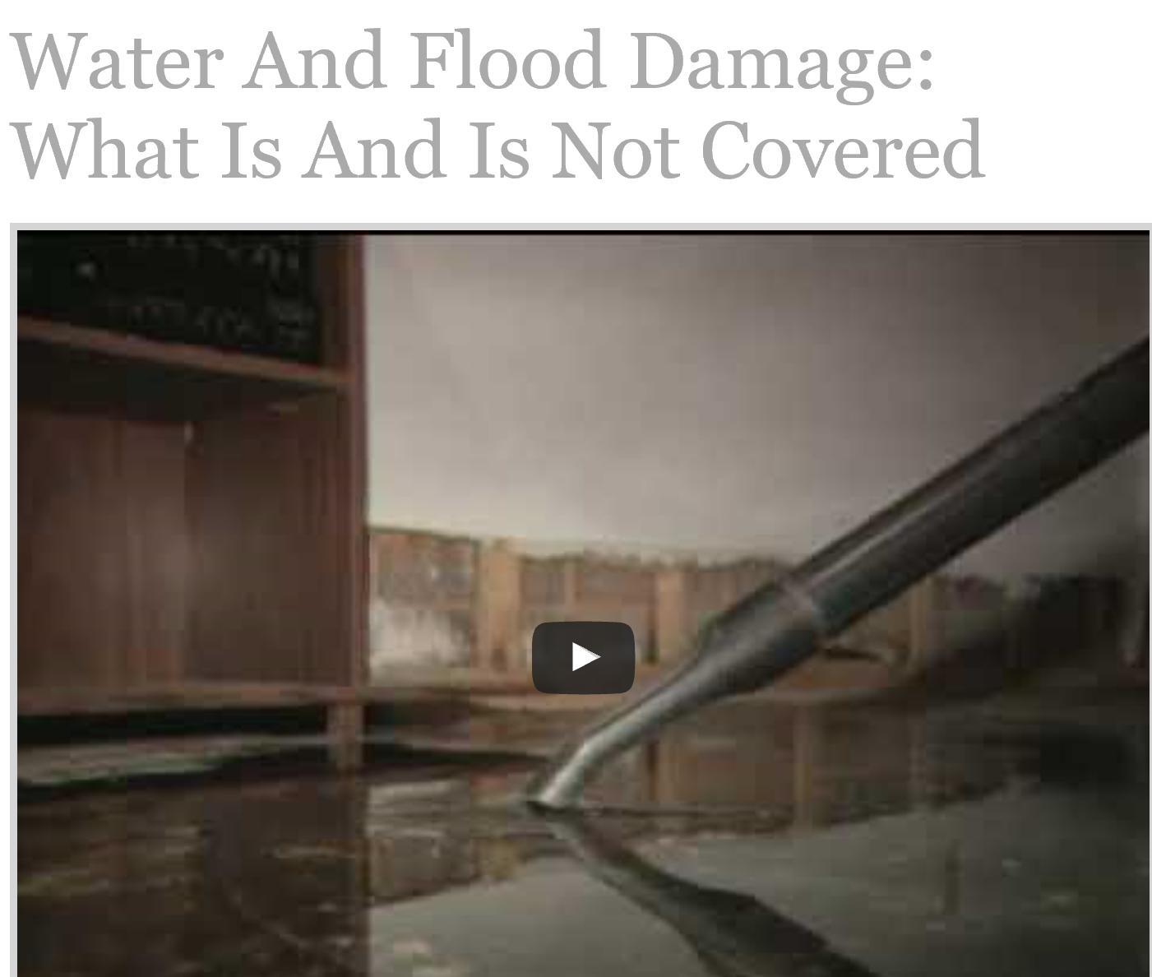
I.I.I. Flood Insurance Resources
Articles, Facts, Stats and More
Variety of Videos and Infographics
  Facts About Flood Insurance Article
  In Case Of A Flood Article
  Recovering from a Flood Article
  Flood Insurance Issues Updates
  Infographic: How To File A Flood Insurance Claim Article
  National Flood Insurance Program Article
  Sandy Flood Claim Payouts Article

Slide 21
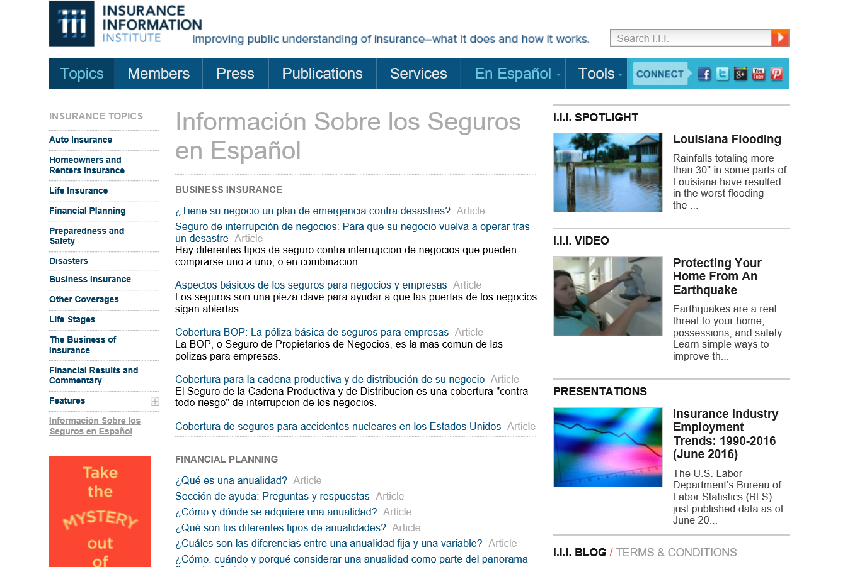
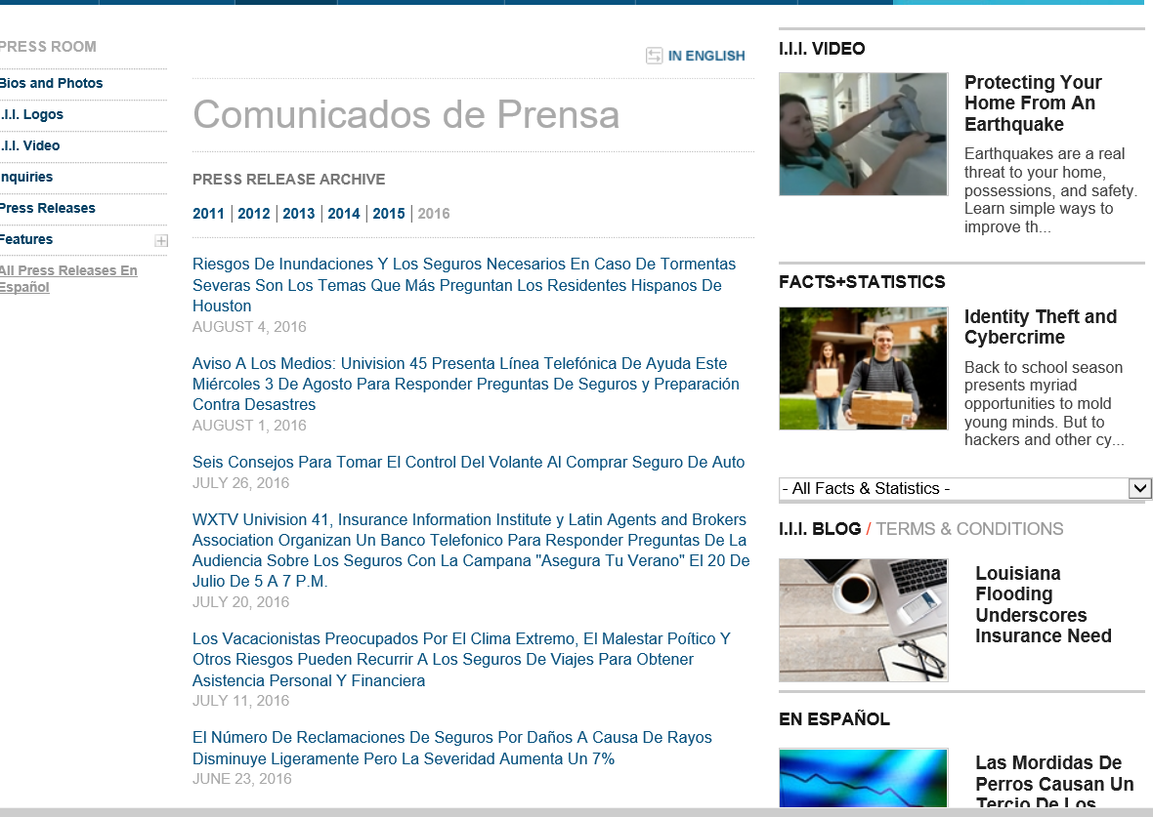
I.I.I.’s Spanish Language Resources
Consumer News Releases Translated into Spanish
Articles
News Releases

Slide 22
Thank You!
@JeanneSalvatore
212-346-5555
917-612-4088
jeannes@iii.org

