Slide 1
P/C Insurance in the Age of Mega-Catastrophes
Trends, Challenges & Opportunities
2014 PCS Catastrophe Conference
Minneapolis, MN
April 28, 2014
Download at www.iii.org/presentations
Robert P. Hartwig, Ph.D., CPCU, President & Economist
Insurance Information Institute ♦ 110 William Street ♦ New York, NY 10038
Tel: 212.346.5520 ♦ Cell: 917.453.1885 ♦ bobh@iii.org ♦ www.iii.org

Slide 2
Presentation Outline
P/C Insurance Industry Overview & Outlook
  Measuring the impact of catastrophe losses
Catastrophe Loss Overview
  US and global trends
Public Policy Issues
  Federal disaster response
  Flood insurance
  Terrorism
  Cyber Risk: The Cat of the Future?
Reinsurance Market Update
  The flood of alternative capital is transforming this sector
Property Exposure Overview & Residual Markets
The Importance of Financial Strength

Slide 3
P/C Insurance Industry Financial Overview
2013: Best Year in the Post-Crisis Era
Performance Improved with Lower CATs, Strong Markets
3

Slide 4
P/C Net Income After Taxes
1991–2013 ($ Millions)
2005 ROE*= 9.6%
2006 ROE = 12.7%
2007 ROE = 10.9%
2008 ROE = 0.1%
2009 ROE = 5.0%
2010 ROE = 6.6%
2011 ROAS¹ = 3.5%
2012 ROAS¹ = 6.1%
2013 ROAS¹ = 10.3%
Net income in 2013 was up substantially (+81.9%) from 2012
2013 ROAS was 10.3%
ROE figures are GAAP; ¹Return on avg. surplus. Excluding Mortgage & Financial Guaranty insurers yields a 9.8% ROAS in 2013, 6.3% ROAS in 2012, 4.7% ROAS for 2011, 7.6% for 2010 and 7.4% for 2009.
Sources: A.M. Best, ISO, Insurance Information Institute

Slide 5
Profitability Peaks & Troughs in the P/C Insurance Industry, 1975 – 2013*
ROE
History suggests next ROE peak will be in 2016-2017
1977:19.0%
1987:17.3%
10 Years
2006:12.7%
1997:11.6%
2013: 9.8 %
10 Years
9 Years
2011: 4.7%
1975: 2.4%
1984: 1.8%
1992: 4.5%
2001: -1.2%
*Profitability = P/C insurer ROEs. 2011-13 figures are estimates based on ROAS data. Note: Data for 2008-2013 exclude mortgage and financial guaranty insurers.
Source: Insurance Information Institute; NAIC, ISO, A.M. Best.

Slide 6
A 100 Combined Ratio Isn’t What It
Once Was: Investment Impact on ROEs
A combined ratio of about 100 generates an ROE of ~7.0% in 2012, ~7.5% ROE in 2009/10,
10% in 2005 and 16% in 1979
Combined Ratio / ROE
Lower CATs helped ROEs in 2013
Combined Ratios Must Be Lower in Today’s Depressed
Investment Environment to Generate Risk Appropriate ROEs
* 2008 -2013 figures are return on average surplus and exclude mortgage and financial guaranty insurers. 2013 combined ratio including M&FG insurers is 96.1; 2012 =103.2, 2011 = 108.1, ROAS = 3.5%.
Source: Insurance Information Institute from A.M. Best and ISO Verisk Analytics data.

Slide 7
ROE: Property/Casualty Insurance vs. Fortune 500, 1987–2013E*
(Percent)
P/C Profitability Is Both by
Cyclicality and Ordinary Volatility
Katrina, Rita, Wilma
Low CATs
Sept. 11
Hugo
Lowest CAT Losses in
15 Years
4 Hurricanes
Sandy
Andrew
Record Tornado Losses
Northridge
Financial Crisis*
* Excludes Mortgage & Financial Guarantee in 2008 – 2013. 2013 Fortune 500 figure is I.I.I. estimate.
Sources: ISO, Fortune; Insurance Information Institute.

Slide 8
RNW All Lines by State, 2003-2012 Average:
Highest 25 States
The most profitable states over the past decade are widely distributed geographically, though none are in the Gulf region
Source: NAIC.

Slide 9
RNW All Lines by State, 2003-2012 Average:
Lowest 25 States
Some of the least profitable states over the past decade were hit hard by catastrophes
Source: NAIC.

Slide 10
Net Premium Growth: Annual Change,
1971—2014F
(Percent)
1975-78
1984-87
2000-03
Net Written Premiums Fell 0.7% in 2007 (First Decline Since 1943) by 2.0% in 2008, and 4.2% in 2009, the First 3-Year Decline Since 1930-33.
2014F: 4.0%
2013: 4.6%
2012: +4.3%
Shaded areas denote “hard market” periods
Sources: A.M. Best (historical and forecast), ISO, Insurance Information Institute.

Slide 11
Growth in Direct Written Premium by Line, 2013-2015F*
(Percent)
P/C growth is expected to remain fairly stable through 2015
Source: Conning.

Slide 12
Average Commercial Rate Change,
All Lines, (1Q:2004–4Q:2013)
Pricing as of Q4:2013 was positive for the 10th consecutive quarter. Gains are likely to continue into 2014.
(Percent)
Q2 2011 marked the last of 30th consecutive quarter of price declines
KRW Effect
Note: CIAB data cited here are based on a survey. Rate changes earned by individual insurers can and do vary, potentially substantially.
Source: Council of Insurance Agents & Brokers; Insurance Information Institute

Slide 13
U.S. Insured Catastrophe Loss Update
2013 Was a Welcome Respite from the High Catastrophe Losses in Recent Years
2014 Winter Storm Losses Manageable
13

Slide 14
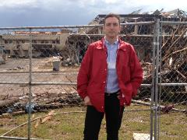
U.S. Insured Catastrophe Losses
($ Billions, $ 2012)
2012 was the third most expensive year ever for insured CAT losses
2012 Was the 3rd Highest Year on Record for Insured Losses in U.S. History on an Inflation-Adj. Basis. 2011 Losses Were the 6th Highest. YTD 2013 Running Well Below 2011 and 2012 YTD Totals.
Record tornado losses caused 2011 CAT losses to surge
*Through 12/31/13.
Note: 2001 figure includes $20.3B for 9/11 losses reported through 12/31/01 ($25.9B 2011 dollars). Includes only business and personal property claims, business interruption and auto claims. Non-prop/BI losses = $12.2B ($15.6B in 2011 dollars.)
Sources: Property Claims Service/ISO; Insurance Information Institute.
14
12/01/09 - 9pm
eSlide – P6466 – The Financial Crisis and the Future of the P/C
Notes:
14

Slide 15
Combined Ratio Points Associated with Catastrophe Losses: 1960 – 2013*
Avg. CAT Loss Component of the Combined Ratio by Decade
1960s: 1.04 1970s: 0.85 1980s: 1.31 1990s: 3.39 2000s: 3.52 2010s: 6.1E*
Catastrophe losses as a share of all losses reached a record high in 2012
Combined Ratio Points
The Catastrophe Loss Component of Private Insurer Losses Has Increased Sharply in Recent Decades
*2010s represent 2010-2013.
Notes: Private carrier losses only. Excludes loss adjustment expenses and reinsurance reinstatement premiums. Figures are adjusted for losses ultimately paid by foreign insurers and reinsurers.
Source: ISO (1960-2011); A.M. Best (2012E) Insurance Information Institute.

Slide 16
Homeowners Insurance Combined Ratio: 1990–2015F
Hurricane Andrew
Record tornado activity
Hurricane Sandy
Hurricane Ike
Homeowners Performance in 2011/12 Impacted by Large Cat Losses. Extreme Regional Variation Can Be Expected Due to Local Catastrophe Loss Activity
Sources: A.M. Best (1990-2011);Conning (2012E-2015F); Insurance Information Institute.

Slide 17
Top 10 States for Insured
Catastrophe Losses, 2013
$ Millions
Oklahoma let the country in insured CAT losses in 2013
Source: The Property Claim Services (PCS) unit of ISO, a Verisk Analytics company.

Slide 18
Top 5 States by Insured Catastrophe Losses in 2012*
(2012, $ Billions)
NY and NJ let the US in CAT losses in 2012 due Sandy
*Includes catastrophe losses of at least $25 million.
Sources: PCS unit of ISO; Insurance Information Institute.

Slide 19
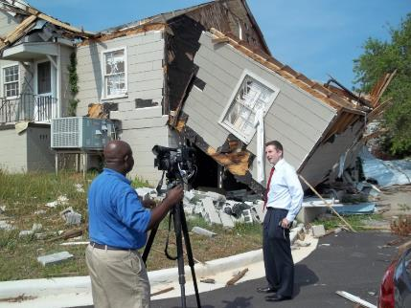
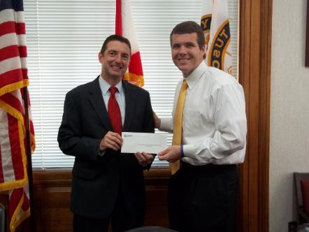

Insurers Making a Difference in Impacted Communities
Destroyed home in Tuscaloosa. Insurers will pay some 165,000 claims totaling $2 billion in the Tuscaloosa/ Birmingham areas alone.
Presentation of a check to Moore, OK, Public School Relief Fund
Presentation of a check to Tuscaloosa Mayor Walt Maddox to the Tuscaloosa Storm Recovery Fund
Source: Insurance Information Institute
19

Slide 20
Top States by Inflation-Adjusted Insured Catastrophe Losses, 1983–2012
Over the Past 30 Years Florida Has Accounted for the Largest Share of Catastrophe Losses in the U.S., Followed by Texas and Louisiana
FL is the most costly state for CATs, with nearly $67B in insured losses over the past 30 years
Louisiana
$42.0B
Texas
$48.8B
Rest of the U.S.
$309.9B
Florida
$66.7B
Total: $467.5 Billion, an average of $16.6B per year or $1.3B per month
Source: PCS unit of ISO, Verisk Company.; Insurance Information Institute.

Slide 21
Inflation Adjusted U.S. Catastrophe Losses by Cause of Loss, 1993–2012¹
Wind/Hail/Flood (3), $14.9
Fires (4), $6.5
Other (5), $0.2
Insured cat losses from 1993-2012 totaled $391.7B, an average of $19.6B per year or $1.6B per month
Geological Events, $18.4
Terrorism, $24.8
Winter Storms, $27.8
Hurricanes & Tropical Storms, $158.2
Tornado share of CAT losses is rising
Wind losses are by far cause the most catastrophe losses, even if hurricanes/TS are excluded.
Tornadoes (2), $140.9
Catastrophes are defined as events causing direct insured losses to property of $25 million or more in 2012 dollars.
Excludes snow.
Does not include NFIP flood losses
Includes wildland fires
Includes civil disorders, water damage, utility disruptions and non-property losses such as those covered by workers compensation.
Source: ISO’s Property Claim Services Unit.

Slide 22
Top 16 Most Costly Disasters in U.S. History
(Insured Losses, 2012 Dollars, $ Billions)
Hurricane Sandy became the 5th costliest event in US insurance history
Includes Tuscaloosa, AL, tornado
Includes Joplin, MO, tornado
Hurricane Irene became the 12th most expense hurricane in US history in 2011
12 of the 16 Most Expensive Events in US History Have Occurred Over the Past Decade
*PCS estimate as of 4/12/13.
Sources: PCS; Insurance Information Institute inflation adjustments to 2012 dollars using the CPI.

Slide 23
Top 16 Most Costly World Insurance Losses, 1970-2013*
(Insured Losses, 2012 Dollars, $ Billions)
5 of the top 14 most expensive catastrophes in world history have occurred within the past 3 years (2010-2012)
2012 insured CAT Losses totaled $60B; Economic losses totaled $140B, according to Swiss Re
Hurricane Sandy is now the 6th costliest event in global insurance history
*Figures do not include federally insured flood losses.
**Estimate based on PCS value of $18.75B as of 4/12/13.
Sources: Munich Re; Swiss Re; Insurance Information Institute research.

Slide 24
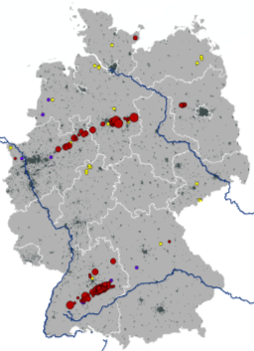
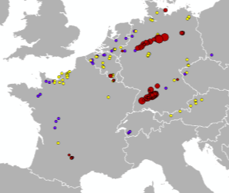
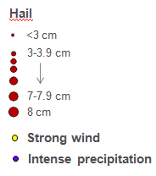
Hailstorm on July 27-28 in Germany Was Most Expensive CAT Worldwide in 2013!
Hailstones with
diameters up to 8 cm
(tennis ball ≈ 7 cm)
July 27
July 28
Region | Overall losses | Insured losses | Fatalities
Southwestern and Northern Germany | US$ 4.8bn | US$ 3.7bn | 0
Source: Munich Re Geo Risks Research, NatCatSERVICE – as of January 2014.
24

Slide 25
Top 12 Most Costly Hurricanes in U.S. History
(Insured Losses, 2012 Dollars, $ Billions)
10 of the 12 most costly hurricanes in insurance history occurred over the past 9 years (2004—2012)
Hurricane Sandy became the 3rd costliest hurricane in US insurance history
Hurricane Irene became the 12th most expensive hurricane in US history in 2011
*PCS estimate as of 4/12/13.
Sources: PCS; Insurance Information Institute inflation adjustments to 2012 dollars using the CPI.

Slide 26
Total Value of Insured Coastal Exposure in 2012
(2012, $ Billions)
NY and FL lead the US in the value of insured coastal exposure at $2.9 Trillion
In 2012, New York Ranked as the #1 Most
Exposed State to Hurricane Loss, Overtaking Florida with $2.862 Trillion. Texas is very exposed too, and ranked #3 with $1.175 Trillion
in insured coastal exposure
The Insured Value of All Coastal Property Was $10.6 Trillion in 2012 , Up 20% from $8.9 Trillion in 2007 and Up 48% from $7.2 Trillion in 2004
Source: AIR Worldwide

Slide 27
Total Value of Insured Coastal Exposure in 2007
(2007, $ Billions)
In 2007, Florida Still Ranked as the #1 Most
Exposed State to Hurricane Loss, with
$2.459 Trillion Exposure, but Texas is very exposed too, and ranked #3 with $895B
in insured coastal exposure
The Insured Value of All Coastal Property Was $8.9 Trillion in 2007, Up 24% from $7.2 Trillion in 2004
Source: AIR Worldwide

Slide 28
Winter Storm and Winter Damage Events in the US and Canada, 1980-2013 (2013 US$)
Three of the four most costly years ever for insured losses from winter storms and damage occurred in the 1990s, led by the “Storm of the Century” in 1993.
Insured Losses (Millions, $ 2013)
5-year running average
Insured losses from severe winter events totaled $2 billion in 2013.
Insured winter storm and damage losses in Jan. 2014 already totaled $1.5 billion. Continued severe weather since then makes it likely that 2014 will become one of the top 5 costliest winters since 1980.
Sources: Munich Re NatCatSERVICE; Insurance Information Institute.
28

Slide 29
Top 10 Winter Storm and Winter Damage Events in the US and Canada, 1980-2013*
Ranked by Insured Loss, in Millions of $ 2013*
Period | Area | Economic Loss (in inflation-adjusted 2013 $US mill) | Insured Loss (in inflation-adjusted 2013 $US mill) | Fatalities
Mar. 11-14, 1993 | CAN, USA | 8,061 | 3,224 | 270
Dec. 17-30,1983 | USA | 2,339 | 2,058 | 500
Apr. 13-17, 2007 | CAN, USA | 2,247 | 1,775 | 23
Dec. 10-13, 1992 | USA | 4,981 | 1,660 | 19
Jan. 5-12, 1998 | CAN, USA | 4,145 | 1,644 | 45
Feb. 10-12, 1994 | USA | 4,716 | 1,258 | 9
Jan. 17-20, 1994 | USA | 1,572 | 1,258 | 70
Apr. 7-11, 2013 | USA | 1,600 | 1,200 | N/A
Jan. 1-4, 1999 | CAN, USA | 1,398 | 1,084 | 25
Jan. 31-Feb. 2, 2011 | USA | 1,346 | 1,010 | 36
*Top 10 events in original insured loss dollars were adjusted to and ranked by the Insurance Information Institute to 2013 inflation-adjusted values.
Sources: Munich Re NatCatSERVICE; Insurance Information Institute.

Slide 30
Insured Homeowners Losses Due
Dog Bite Liability Claims, 2003-2012
$ Millions
Dog bite liability claims cost insurers an estimated $489.7 million in 2012, up 51.0% from $324.2 million in 2003
The Increased Average Cost per Dog Bite Claim is Pushing Total Dog Bite Liabiity Claim Costs Higher Even as the Number of Claims Remains Relatively Flat
Source: Insurance Information Institute.

Slide 31
Natural Disaster Losses in the United States, by Type, 2013
As of December 31, 2013 | Number of Events | Fatalities | Estimated Overall Losses (US $m) | Estimated Insured Losses (US $m)
Severe Thunderstorm | 69 | 110 | 16,341 | 10,274
Winter Storm | 11 | 43 | 2,935 | 1,895
Flood | 19 | 23 | 1,929 | 240
Earthquake & Geophysical | 6 | 1 | Minor | Minor
Tropical Cyclone | 1 | 1 | Minor | Minor
Wildfire, Heat, & Drought | 22 | 29 | 620 | 385
Totals | 128 | 207 | 21,825 | 12,794
Source: Munich Re NatCatSERVICE
31
31

Slide 32
Significant Natural Catastrophes, 2013
(Events with $1 billion economic loss and/or 50 fatalities)
Date | Event | Estimated Economic Losses (US $m) | Estimated Insured Losses (US $m)
February 24 – 25 | Winter Storm | 1,300 | 690
March 18 – 19 | Thunderstorms | 2,200 | 1,600
April 7 – 11 | Winter Storm | 1,600 | 1,200
April 16 – 18 | Thunderstorms | 1,100 | 560
May 18 – 20 | Thunderstorms | 3,100 | 1,800
May 28 – 31 | Thunderstorms | 2,800 | 1,400
August 6 – 7 | Thunderstorms | 1,300 | 740
September 9 – 16 | Flooding | 1,500 | 160
November 17 - 18 | Thunderstorms | 1,300 | 931
Source: Munich Re NatCatSERVICE
32

Slide 33
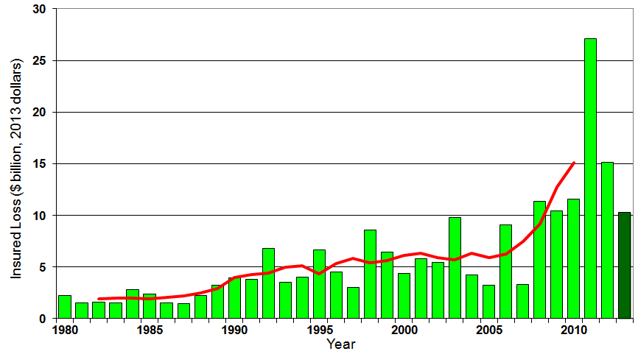
U.S. Thunderstorm Insured Loss Trends, 1980 – 2013
Hurricanes get all the headlines, but thunderstorms are consistent producers of large scale loss. 2008-2013 are the most expensive years on record.
Average thunderstorm losses are up 7 fold since the early 1980s. The 5-year running average loss is up sharply
Thunderstorm losses in 2013 totaled $10.3 billion, the 6th highest on record
Source: Property Claims Service, and MR NatCatSERVICE
33

Slide 34
Convective Loss Events in the U.S.
Number of events 1980 – 2012 and First Half 2013
Number
The frequency of convective events has rising tremendously over the past 30+ years
Convective events are those caused by straight-line winds, tornadoes, hail, heavy precipitation, flash floods and lightning
Source: Geo Risks Research, NatCatSERVICE – As at July 2013
34

Slide 35
Convective Loss Events in the U.S.
Overall and insured losses 1980 – 2012 and First Half 2013
(Bill. US$)
The insured and total economic cost of convective events has rising tremendously over the past 30+ years
Convective events are those caused by straight-line winds, tornadoes, hail, heavy precipitation, flash floods and lightning
Analysis contains: straight-line winds, tornadoes, hail, heavy precipitation, flash floods, lightning.
Overall losses (in 2012 values)
Insured losses (in 2012 values)
Source: Geo Risks Research, NatCatSERVICE – As at July 2013
35

Slide 36
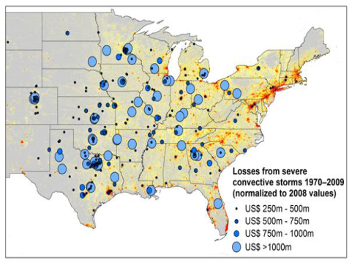
New Research Suggests Increase in Convective Activity Is Costly for Insurers
Study examines convective (hail, tornado, thundersquall and heavy rainfall) events in the US with losses exceeding US$ 250m in the period 1970–2009 (80% of all losses)
Past losses are normalized (i.e., adjusted) to currently exposed values
After normalization there are still increases of losses
Increases are correlated with
the increase in the meteorological
potential for severe thunderstorms
and its variability
For the first time research shows
that climatic changes have already
influenced US thunderstorm losses
Source: Munich Re research paper, Marhc 18, 2013: Rising Variability in Thunderstorm-Related U.S. Losses as a Reflection of Changes in Large-Scale Thunderstorm Forcing.
36

Slide 37
Insured Homeowners Losses Due to Lightning, 2004-2012
$ Millions
Lightning claims cost insurers an estimated $969 million in 2012, 31.7% from $735.5 million in 2004
The Increased Number and Value of Expensive Electronic Devices in Homes is Pushing the Total Lightning Claim Costs Up Even as the Number of Lightning Claims Falls
Source: Insurance Information Institute.

Slide 38
Natural Disasters in the United States, 1980 – 2013
Number of Events (Annual Totals 1980 – 2013)
There were 128 natural disaster events in 2013
Number
22
19
81
6
Geophysical
(earthquake, tsunami,
volcanic activity)
Meteorological (storm)
Climatological
(temperature extremes,
drought, wildfire)
Hydrological
(flood, mass movement)
Source: MR NatCatSERVICE
38

Slide 39
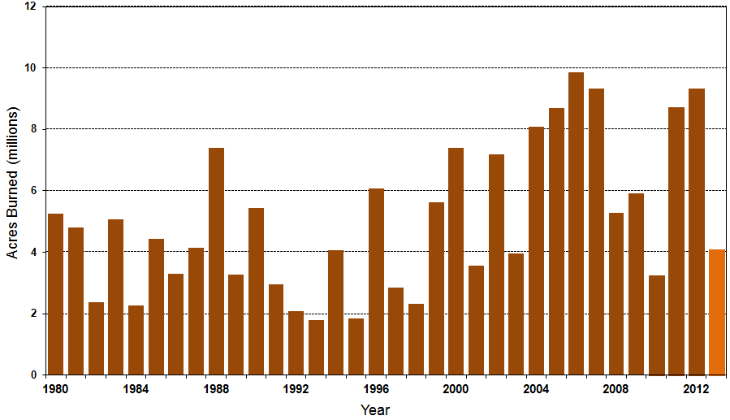
Number of Acres Burned in Wildfires, 1980 – 2013
TX experienced significant wildfire losses in 2011 (Bastrop fire insured losses ~$500 million)
Source: National Interagency Fire Center
39

Slide 40
Losses Due to Natural Disasters in the US, 1980–2013
(Overall and Insured Losses)
(2013 Dollars, $ Billions)
2013 CAT Losses
Overall : $21.8B
Insured: $12.8B
Indicates a great deal of losses are uninsured (~40%-50% in the US) = Growth Opportunity
2013 losses were far below 2011 and 2012 and were 44% lower than the average from 2000-2012
Overall losses (in 2012 values)
Insured losses (in 2013 values)
Source: MR NatCatSERVICE
40

Slide 41
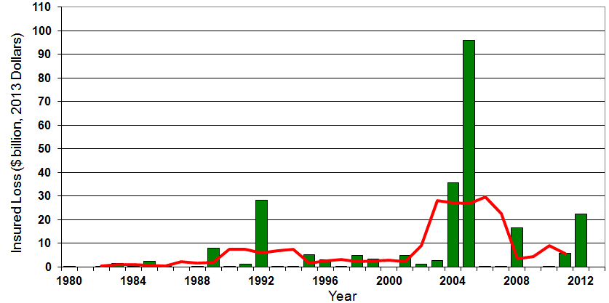

Insured US Tropical Cyclone Losses, 1980 - 2013
The current 5-year average (2008 - 2013) insured tropical cyclone loss is $5.6 billion per year.
Sources: Property Claims Service, Munich Re NatCatSERVICE, NFIP
41

Slide 42
The combined ratios for both personal and commercial lines improved substantially in 2013:H1

Slide 44
The combined ratios for both personal and commercial lines improved substantially in 2013:H1

Slide 45
Florida Citizens Exposure to Loss,
2002 – 2014* ($ Billions)
Total exposure to loss in Florida Citizens since its 2002 inception increased by 230 percent, from $154.6 billion to $510.7 billion in 2011 but has now dropped by $212.3 billion or 41.6% through 3/31/14
*As of March 31, 2014 from Florida Citizens accessed at: https://www.citizensfla.com/about/bookofbusiness/
Source: PIPSO; Insurance Information Institute (I.I.I.).
Notes:
45

Slide 46
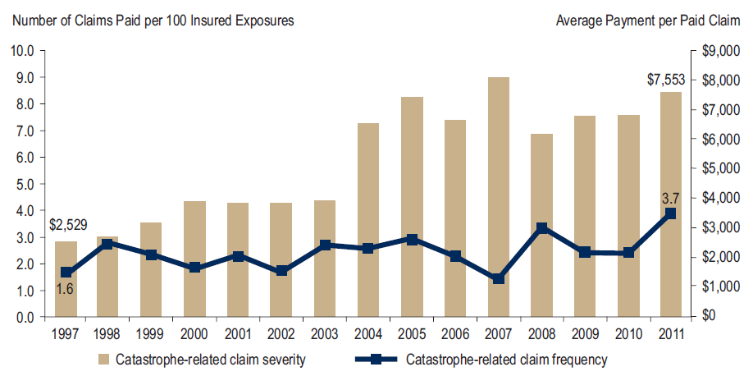
Homeowners Insurance Catastrophe-Related Claim Frequency and Severity, 1997—2012*
Avg. catastrophe claim cost rose approximately 200% from 1997-2011
Cat claim frequency in 2011 was at historic highs and more than double the rate in 1997
*All policy forms combined, countrywide.
Source: Insurance Research Council, Trends in Homeowners Insurance Claims, Sept. 2012 from ISO Fast Track data.
46

Slide 47
Homeowners Insurance Combined Ratio: 1990–2015F
Hurricane Andrew
Record tornado activity
Hurricane Sandy
Hurricane Ike
Homeowners Performance in 2011/12 Impacted by Large Cat Losses. Extreme Regional Variation Can Be Expected Due to Local Catastrophe Loss Activity
Sources: A.M. Best (1990-2014F);Conning (2015F); Insurance Information Institute.

Slide 48
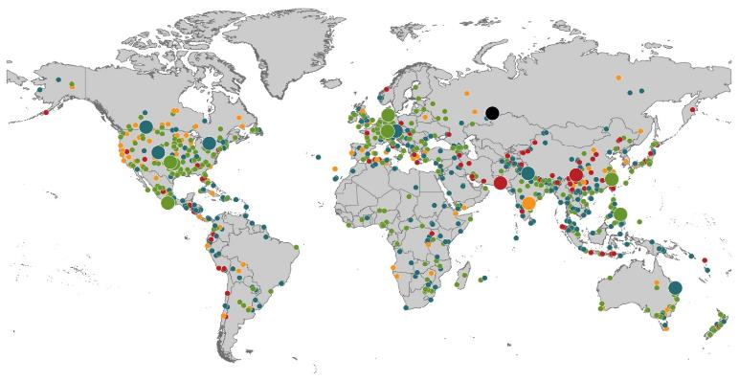
Natural Loss Events:
Full Year 2013
World Map
Winter Storm Christian (St. Jude)
Europe, 27–30 October
Floods
Europe,
30 May–19 June
Meteorite impact
Russian Federation, 15 February
Flash floods
Canada, 8–9 July
Floods
Canada, 19–24 June
Earthquake
China, 20 April
Hailstorms
Germany,
27–28 July
Floods
USA, 9–16 September
Typhoon Fitow
China, Japan,
5–9 October
Severe storms, tornadoes
USA, 18–22 May
Typhoon Haiyan
Philippines,
8–12 November
Severe storms, tornadoes
USA, 28–31 May
Floods
India, 14–30 June
Hurricanes Ingrid & Manuel
Mexico, 12–19 September
Floods
Australia,
21–31 January
880
Loss events
Earthquake (series)
Pakistan, 24–28 September
Heat wave
India, April–June
Geophysical events
(earthquake, tsunami, volcanic activity)
Hydrological events
(flood, mass movement)
Natural catastrophes
Geophysical events
(earthquake, tsunami, volcanic activity)
Hydrological events
(flood, mass movement)
Selection of significant
Natural catastrophes
Meteorological events
(storm)
Climatological events
(extreme temperature, drought, wildfire)
Meteorological events
(storm)
Climatological events
(extreme temperature, drought, wildfire)
Extraterrestrial events
(Meteorite impact)
Source: Munich Re Geo Risks Research, NatCatSERVICE – as of January 2014.
48

Slide 49
Natural Disasters Worldwide,
1980 – 2013 (Number of Events)
There were 880 natural disaster events globally in 2013 compared to 905 in 2012
Number
Geophysical
(earthquake, tsunami,
volcanic activity)
Meteorological (storm)
Climatological
(temperature extremes,
drought, wildfire)
Hydrological
(flood, mass movement)
Source: MR NatCatSERVICE
49

Slide 50
Losses Due to Natural Disasters Worldwide, 1980–2013 (Overall & Insured Losses)
(Overall and Insured Losses)
(2013 Dollars, $ Billions)
10-Yr. Avg. Losses
Overall : $184B
Insured: $56B
2013 Losses
Overall : $125B
Insured: $34B
There is a clear upward trend in both insured and overall losses over the past 30+ years
Overall losses (in 2013 values)
Insured losses (in 2013 values)
Source: MR NatCatSERVICE
50

Slide 51
Federal Disaster Declarations Patterns: 1953-2014
Disaster Declarations Set New Records in Recent Years
51

Slide 52
Number of Federal Major Disaster Declarations, 1953-2014*
There have been 2,163 federal disaster declarations since 1953. The average number of declarations per year is 35 from 1953-2013, though there few haven’t been recorded since 1995.
The number of federal disaster declarations set a new record in 2011, with 99, shattering 2010’s record 81 declarations.
19 federal disasters were declared so far in 2014*
The Number of Federal Disaster Declarations Is Rising and Set New Records in 2010 and 2011 Before Dropping in 2012/13
*Through April 23, 2014.
Source: Federal Emergency Management Administration; http://www.fema.gov/disasters; Insurance Information Institute.

Slide 53
Federal Disasters Declarations by State,
1953 – 2014: Highest 25 States*
Over the past 60 years, Texas has had the highest number of Federal Disaster Declarations
*Through April 23, 2014. Includes Puerto Rico and the District of Columbia.
Source: FEMA: http://www.fema.gov/news/disaster_totals_annual.fema; Insurance Information Institute.

Slide 54
Federal Disasters Declarations by State,
1953 – 2014: Lowest 25 States*
Over the past 60 years, Wyoming and Rhode Island had the fewest number of Federal Disaster Declarations
*Through April 23, 2014. Includes Puerto Rico and the District of Columbia.
Source: FEMA: http://www.fema.gov/news/disaster_totals_annual.fema; Insurance Information Institute.

Slide 55
SEVERE WEATHER REPORT UPDATE:
2013-2014
Damage from Tornadoes, Large Hail and High Winds Keep Insurers Busy
55

Slide 56
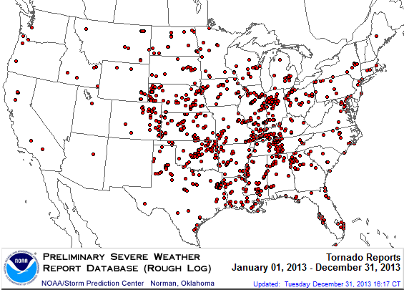
Location of Tornado Reports in 2013
A deadly EF-5 tornado in May in Moore, OK, produced insured losses of $1.575 billion. November tornadoes in the Midwest like produced $1B in insured losses.
There were 943 tornadoes through Dec. 31, causing extensive property damage in several states
Source: NOAA Storm Prediction Center; http://www.spc.noaa.gov/climo/online/monthly/2013_annual_summary.html#; PCS.
56

Slide 57
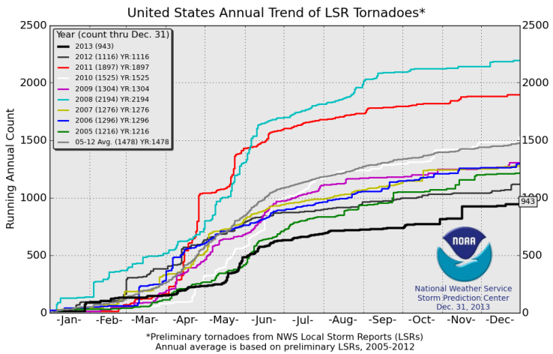
U.S. Tornado Count, 2005-2013*
There were 1,897 tornadoes in the U.S. in 2011 far above average, but well below 2008’s record
2013 count was the lowest in a decade
*Through Dec. 31, 2013.
Source: http://www.spc.noaa.gov/wcm/.
57

Slide 58
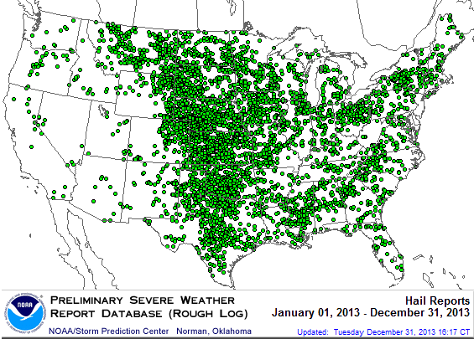
Location of Large Hail Reports: 2013
There were 5,457 “Large Hail” reports in 2013, causing extensive property and vehicle damage
Source: NOAA Storm Prediction Center; http://www.spc.noaa.gov/climo/online/monthly/2013_annual_summary.html#
58

Slide 59
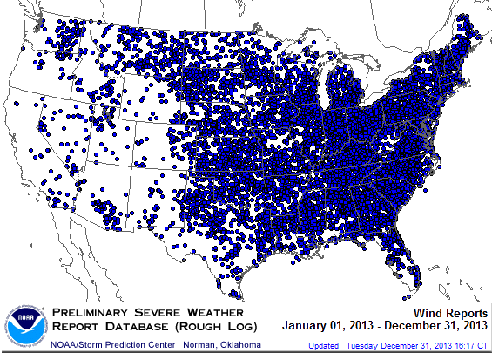
Location of High Wind Reports: 2013
There were 12,942 “Wind Damage” in 2013, causing extensive property damage
Source: NOAA Storm Prediction Center; http://www.spc.noaa.gov/climo/online/monthly/2013_annual_summary.html#
59

Slide 60
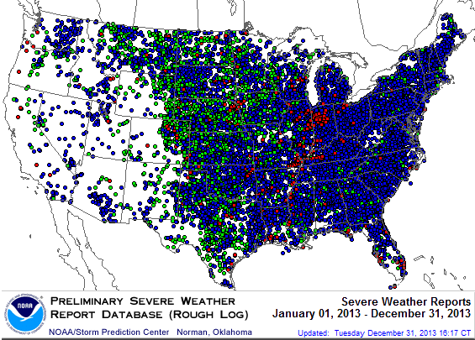
Severe Weather Reports: 2013
Severe weather reports are concentrated east of the Rockies
There were 19,342 severe weather reports in 2013; including 942 tornadoes; 5,457 “Large Hail” reports and 12,942 high wind events
Source: NOAA Storm Prediction Center; http://www.spc.noaa.gov/climo/online/monthly/2013_annual_summary.html#
60

Slide 61
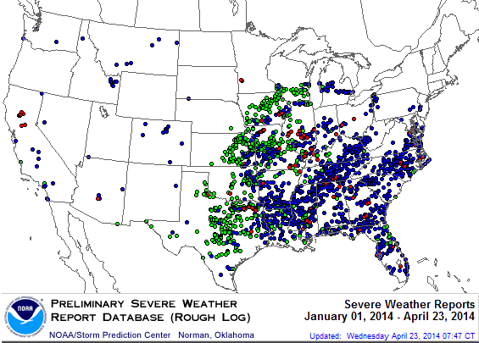
Severe Weather Reports: 2014*
Severe weather reports are concentrated east of the Rockies
There were 2,066 severe weather reports in 2013; including 109 tornadoes; 689 “Large Hail” reports and 1,268 high wind events
*Through April 23.
Source: NOAA Storm Prediction Center; http://www.spc.noaa.gov/climo/online/monthly/2014_annual_summary.html#
61

Slide 62
Flood Insurance
I.I.I. Survey: Public Conflicted on Flood
Flood Should Reflect True Risk
Keep the Subsidies
Would Prefer to Purchase from Private Insurers
62

Slide 63
Hurricane Sandy: Average Claim Payment by Type of Claim
Commercial (i.e., business claims) are more expensive because the value of property is often higher as well as the impact of insured business interruption losses
The average insured flood loss was nearly 9 times larger than the average non-flood insured loss (mostly wind)
Post-Sandy, the I.I.I. worked very hard to make help media, consumers and regulators understand the distinction between a flood claim and a standard homeowners claim. NFIP is $24B in debt.
*Includes rental and condo policies (excludes NFIP flood). **As of Oct. 31, 2013.
Sources: Catastrophe loss data is for Catastrophe Serial No. 90 (Oct. 28 – 31, 2012) from PCS as of March 2013; Insurance Information Institute.

Slide 64
Total Potential Home Value Exposure to Storm Surge Risk in 2013*
($ Billions)
Florida is by the state most vulnerable to storm surge.
The Value of Homes Exposed to Storm Surge was $1.147 Trillion in 2013.* Only a fraction of this is insured, hence the huge demand for federal aid following major coastal flooding events.
*Insured and uninsured property. Based on estimated property values as of April 2013.
Source: Storm Surge Report 2013, CoreLogic.

Slide 65
Biggert-Waters: Media and Congressional Maelstrom
BW-12 Rate Increases to Phase Out Subsidies Began in 2013
  Note: Only 20% of NFIP policies are subsidized
Jan. 1, 2013: Non-Primary/Secondary Residences
  Increases of 25% per year until full-risk rate achieved
  Reaction: Very muted; Vacation homes/wealthier owners
Oct. 1, 2013: Subsidized Severe or Repetitive Loss Policies and Owners of Business/Non-Residential Properties
  Increases of 25% per year until full-risk rate achieved
  Reaction: Huge consumer backlash, intense media coverage leading to a Congressional effort to delay BW-12 by 4 years (effectively killing it). Even Maxine Waters supports delay…
Subsidy Lost if Policy Lapses, Severe Repeated, New Policy
House and Senate Bills to Reduce Burden Need to be Reconciled
Future Pvt. Insurer Flood Participation Impacted by BW-12 Debate
65
12/01/09 - 9pm
eSlide – P6466 – The Financial Crisis and the Future of the P/C
Notes:
65

Slide 66
Summary of House Bill
(Passed March 4, 2014)
9 Premium classifications with increases capped at 18%
$25 surcharge on primary residences; $250 for non-primary
Restoration of “grandfather” clause allowing continued subsidies for homes that were compliant under old FEMA maps but no longer are
Eliminates property sales trigger
Reimburses home owners for successful FEMA map challenges
Creates a “flood insurance advocate”
Refunds policyholders who were charged higher rates under BW-12 for homes built before FEMA established flood-risk maps
CBO scoring of bill said that it will not increase the deficit
  Didn’t say that it would eliminate the current $24 bill deficit
66
12/01/09 - 9pm
eSlide – P6466 – The Financial Crisis and the Future of the P/C
Notes:
66

Slide 67
I.I.I. Poll: Flood Insurance
Q. Do you think it is fair that flood insurance premium increases are higher if people who live in high flood risk areas and rebuild their homes do not elevate them?
Don’t know
No
Yes
Almost two-thirds of Americans think that it is fair that flood insurance premiums be raised for people who live in high flood risk areas and rebuild their homes after a flood but do not elevate them.
Source: Insurance Information Institute Annual Pulse Survey.

Slide 68
I.I.I. Poll: Flood Insurance
Q. Do you think flood insurance premiums should reflect the risk of flooding no matter what the cost or do you think the government should subsidize the cost of flood insurance with taxpayers’ dollars?
Don’t know
Government should subsidize cost with taxpayers’ dollars
Premiums should reflect flood risk
Almost two-thirds of Americans think flood insurance premiums should be raised to reflect the risk of flooding.
Source: Insurance Information Institute Annual Pulse Survey (Nov. 2013).

Slide 69
I.I.I. Poll: Flood Insurance
Q. The federal government provides insurance coverage at taxpayer-subsidized rates for damage from floods through the National Flood Insurance Plan. A new law eliminates the subsidy and raises rates. Do you think the rate increase should be repealed?
It is inconsistent for the public to support full-risk rates but maintain subsidies, but this exactly mirrors Congressional sentiments, with supporters of BW-12 and even Tea Party conservatives supporting continuation of the subsidies
Don’t know
No
Yes
More than half of Americans polled for the November 2013 Pulse thought that hikes in National Flood Insurance premiums should be repealed.
Source: Insurance Information Institute Annual Pulse Survey.

Slide 70
I.I.I. Poll: Flood Insurance
Q. If the costs were similar, would you prefer to buy flood insurance from a private insurance company or from the federal government through the National Flood Insurance Program?
Don’t know
The federal government through the NFIP
Private insurance company
Six out of 10 Americans would prefer to buy flood insurance from a private insurance company as opposed to the federal government, if costs were similar.
Source: Insurance Information Institute Annual Pulse Survey.

Slide 71
Terrorism Update
TRIA’s Success
Consequences of Expiration
Download III’s Terrorism Insurance Report at: http://www.iii.org/white_papers/terrorism-risk-a-constant-threat-2014.html
71
Notes:
71

Slide 72
Loss Distribution by Type of Insurance from Sept. 11 Terrorist Attack ($ 2013)
($ Billions)
Total Insured Losses Estimate: $42.9B**
*Loss total does not include March 2010 New York City settlement of up to $657.5 million to compensate approximately 10,000 Ground Zero workers or any subsequent settlements.
**$32.5 billion in 2001 dollars.
Source: Insurance Information Institute.

Slide 73
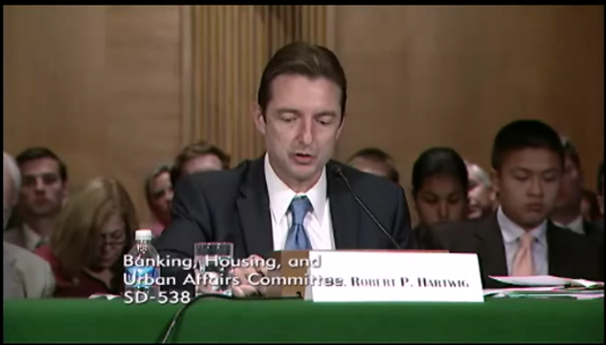
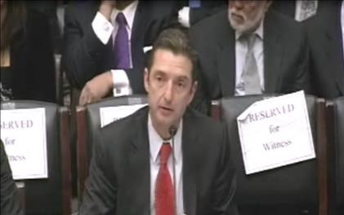
Terrorism Risk Insurance Program
Testified before House Financial Services Nov. 2013
Testified before Senate Banking Cmte. in Sept. 2013
Provided testimony at NYC hearing in June 2013
Provided Capitol Hill Joint House/Senate Staff Briefing in April 2014
I.I.I. Published Several Updates to its Study on Terrorism Risk and Insurance
Working with Trades, Congressional Staff, GAO & Others
House Financial Services Subcommittee, 11/13/13
Senate Banking Committee, 9/25/13
73
12/01/09 - 9pm
eSlide – P6466 – The Financial Crisis and the Future of the P/C
Notes:
73

Slide 74
I.I.I. White Paper (March 2014):
Terrorism Risk: A Constant Threat
Detailed history of TRIA
How TRIA works
Assessing the threat of terrorism
Terrorism market conditions
Global perspective
Download at http://www.iii.org/white_papers/terrorism-risk-a-constant-threat-2014.html
74
12/01/09 - 9pm
eSlide – P6466 – The Financial Crisis and the Future of the P/C
Notes:
74

Slide 75
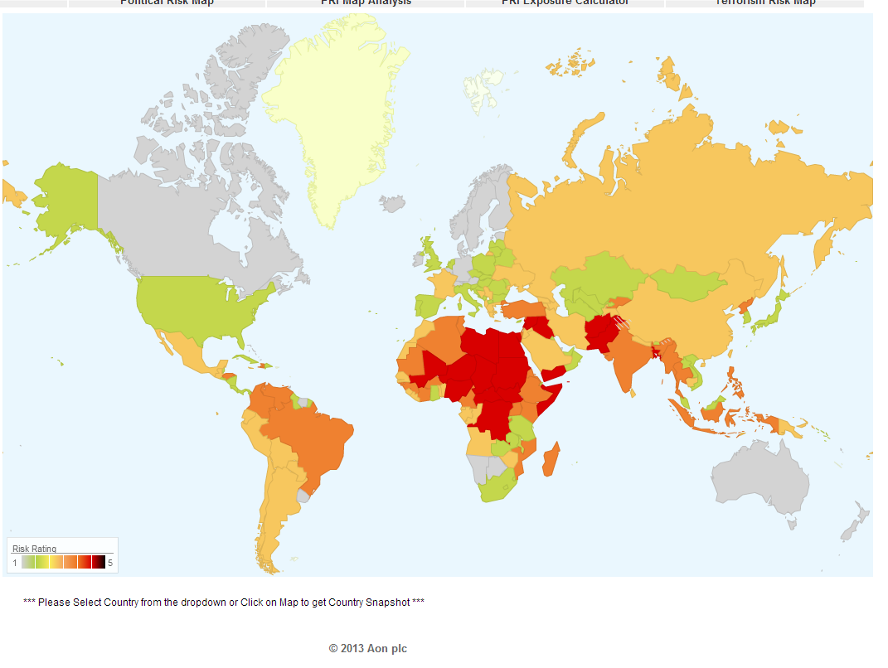
Terrorism Risk in 2013: Greatest Business Opportunities Are Often in Risky Nations
Latin and South America have modest terrorist threats though Brazil is elevated
Terrorism remains a greater concern in the Middle East, Africa and South Asia
Source: Aon PLC; Insurance Information Institute.

Slide 76
Terrorism Insurance Take-Up Rates by State for 2013*
The overall US take-up rate for terrorism coverage was 62% in 2013 and ranged from a lows of 41% in Michigan to a high of 84% in Massachusetts (where demand likely increased due to the April 2013 Boston Marathon bombing)
*Data for 27 states with sufficient data.
Source: Marsh 2014 Terrorism Risk Insurance Report; Insurance Information Institute.

Slide 77
Summary of President’s Working Group Report on TRIA (April 2014)
Insurance for terrorism risk is available and affordable
  Availability/affordability have has not changed appreciably since 2010
Prices for terrorism risk insurance vary considerably depending on the policyholder’s industry and location of risk
Prices have declined since TRIA was enacted
  Currently ~3% to 5% of commercial property insurance premiums
Take-up rates have improved since adoption of TRIA
  Overall take-up rate is steady at ~60% (62% in 2013 per Marsh)
Market capacity is currently tightening given uncertainty over TRIA reauthorization
The private market does not have the capacity to provide reinsurance for terror risk to the extent currently provided by TRIA
In the absence of TRIA, terrorism risk insurance would likely be less available. Coverage that would be available likely would be more costly and/or limited in scope
Source: Report of the President’s Working Group on Financial Markets,The Long-Term Availability and Affordability of Insurance for Terrorism Risk,
April 2014.

Slide 78
Top 3 Key Facts About TRIA
TRIA costs taxpayers virtually nothing
TRIA as currently structured continues to provide tangible benefits to the U.S. economy in the form of:
  Terrorism insurance market stability, affordability and availability
  Smooth functioning of commercial lending activity
  Employment stimulus
TRIA is now clearly a critical part of the U.S. national economic security infrastructure
  A primary goal of terrorism is to destabilize the U.S. economy
  Terrorism risk insurance is critical to ensure a swift recovery in the event of future attacks
Bottom Line: TRIA is an unambiguous, unmitigated success

Slide 79
Terrorism Insurance Take-up Rates,
By Year, 2003-2013
TRIA’s high take-up rates, availability and affordability have benefitted businesses, workers and the entire US economy since the program’s enactment
In 2003, the first year TRIA was in effect, the terrorism take-up rate was 27 percent. Since then, it has increased steadily, remaining in the low 60 percent range since 2009.
Source: Marsh Global Analytics, 2014 Terrorism Risk Insurance Report, April 2014 and earlier editions.
79
Notes:
79

Slide 80
Pyramid of Taxpayer Protection:
Strong, Stable, Sound and Secure
TRIA in its current form provides at least 8 levels of taxpayer protection
Hard Cap
$100 Bill
Government Recoupment
Industry Aggregate
Retention: $27.5 Bill
Insurer Co-Payments
15% Above Retention
Individual Insurer Retention
20% of Premiums Earned
Program Dollar Threshold
$100 Million
Certification Dollar Threshold
$5 Million
Certification of Terrorist Act: Definition Must Be Met
Source: Insurance Information Institute.

Slide 81
Consequences of Substantially Restructuring TRIA
Increases in required insurer retentions/deductibles do not “create” new capacity
New capacity has entered primarily because:
  TRIA remains in place
  No major successful attack has occurred since 9/11
  Modest improvement in modeling/understanding terror risk
Many smaller/medium-sized insurers are likely already at or near their exposure limits, so increasing required retentions will not incentivize them to write more coverage
  A.M. Best: 19% of insurers with < $500 million in surplus failed stress tests; 11% of those with $500 to $1 billion failed
  Insurance Information Institute: Insurers with <$500 million in surplus wrote 16.8% of TRIA-back lines in 2012; those with less than $1 billion in surplus wrote 23.6% of TRIA-backed coverages

Slide 82
Consequences of a Failure to Reauthorize TRIA Followed by a Major Terrorist Attack
If TRIA is not reauthorized, only limited private insurance would be available to cover losses arising from future attacks
  Potentially large gap between insured and economic losses
The federal government would be called upon to provide very large amounts of aid (tens of billions of dollars +)
  Federal govt. has no delivery mechanism for post-attack aid
  Under TRIA, federal response largely piggybacks on an efficient pvt. Insurer claims adjusting and payment system
The existing standalone market would likely seize and contract
  Depletion of capital→Availability crunch, Prices soar
  Uncertainty over likelihood of future attacks
  Terrorism exclusions would become ubiquitous
Congress would likely be compelled to legislate TRIA anew

Slide 83
Summary of Terrorism Risk Insurance Program Extension Bills Introduced in 2013
Bill | Summary
H.R. 508: “Terrorism Risk Insurance Act of 2002 Reauthorization Act of 2013” Introduced Feb. 5 by Rep. Michael Grimm (D-NY) | 5-Year Extension (through 2019) Extend recoupment period for any TRIA assistance from 2017 to 2019
H.R. 2146: “Terrorism Risk Insurance Program Reauthorization Act of 2013” Introduced May 23 by Rep. Michael Capuano (D-MA) | 10-Year Extension (through 2024) Extend recoupment period for any TRIA assistance from 2017 to 2024 Requires President’s Working Group on Financial Markets (PWGFM) to issue reports on long-term availability and affordability of terrorism insurance in 2017, 2020 and 2023 Reports to be drafted with consultation from NAIC and representatives of the insurance and securities industries and policyholders
H.R. 1945: “Fostering Resilience to Terrorism Act of 2013” Introduced May 9 by Rep. Benny Thompson (D-MS) | 10-Year Extension (through 2024) Recoupment period changed to 2024 Would transfer responsibility for certification of a “act of terrorism” to the Secretary of Homeland Security from Secretary of Treasury. PWGFM to issue reports in 2017, 2020 and 2023 Requires Sec. of DHS to provide insureds with “timely homeland security information, including terrorism risk information, at the appropriate level of classification and information on best practices to foster resilience to an act of terrorism.”
Source: Nelson, Levine, de Luca & Hamilton, FIO Focus, June 10, 2013; Insurance Information Institute.

Slide 84
Terrorism Violates Traditional Requirements for Insurability
Requirement | Definition | Violation
Estimable Frequency | Insurance requires large number of observations to develop predictive rate-making models (an actuarial concept known as credibility) | Very few data points Terror modeling still in infancy, untested. Inconsistent assessment of threat
Estimable Severity | Maximum possible/ probable loss must be at least estimable in order to minimize “risk of ruin” (insurer cannot run an unreasonable risk of insolvency though assumption of the risk) | Potential loss is virtually unbounded. Losses can easily exceed insurer capital resources for paying claims. Extreme risk in workers compensation and statute forbids exclusions.
Source: Insurance Information Institute

Slide 85
Terrorism Violates Traditional Requirements for Insurability (cont’d)
Requirement | Definition | Violation
Diversifiable Risk | Must be able to spread/distribute risk across large number of risks “Law of Large Numbers” helps makes losses manageable and less volatile | Losses likely highly concentrated geographically or by industry (e.g., WTC, power plants)
Random Loss Distribution/Fortuity | Probability of loss occurring must be purely random and fortuitous Events are individually unpredictable in terms of time, location and magnitude | Terrorism attacks are planned, coordinated and deliberate acts of destruction Dynamic target shifting from “hardened targets” to “soft targets” Terrorist adjust tactics to circumvent new security measures Actions of US and foreign govts. may affect likelihood, nature and timing of attack
Source: Insurance
Information Institute

Slide 86
REINSURANCE MARKET CONDITIONS
Ample Capacity as Alternative Capital is Transforming the Market—And Pushing Down Prices
86

Slide 87
Global Reinsurance Capital (Traditional and Alternative), 2007 - 2013
Total reinsurance capital reached a record $540B in 2013, up 58.8% from 2008. Of that, $50B (9.3%) is alternative capacity, up 163% from $19B since 2008
Source: Aon Benfield Reinsurance Market Outlook, April 1, 2014; Insurance Information Institute.

Slide 88
Global Reinsurer Capital, 2007-2013:H1*
($ Billions)
+11%
+1%
+18%
-3%
+18%
-17%
Global Reinsurance Capital Has Been Trending Generally Upward Since the Global Financial Crisis, a Trend that Seems Likely to Continue
*Includes both traditional and non-traditional forms of reinsurance capital.
Source: Aon Benfield Aggregate study for the 6 months ending June 2013; Insurance Information Institute.

Slide 89
Long-Term Evolution of Shareholders’ Funds for the Guy Carpenter Global Reinsurance Composite
Source: Guy Carpenter

Slide 90
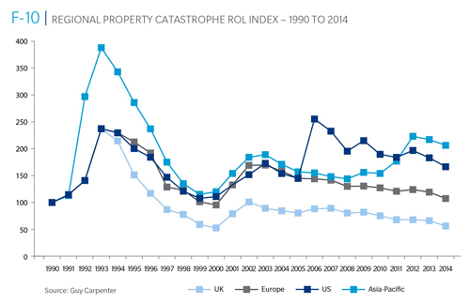
Reinsurance Pricing: Rate-on-Line Index by Region, 1990 – 2014*
Lower CATs and a flood of new capital has pushed reinsurance pricing down in most regions, including the US
*As of Jan. 1.
Source: Guy Carpenter

Slide 91
Reinsurer Combined Ratios
(Aon Benfield Aggregate), 2007 - 2013
Reinsurers posted a combined under 90 in 2013, the best result since 2009
Source: Aon Benfield Reinsurance Market Outlook, April 1, 2014; Insurance Information Institute.

Slide 92
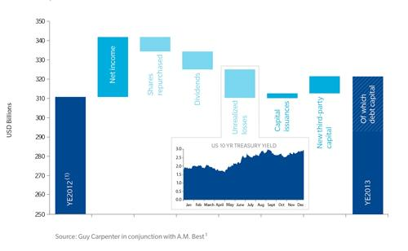
Sources of Reinsurance Capital Change: YE 2012 to YE 2013
Net income and new 3rd party capital were the leading source of reinsurance capital growth in 2013
Sources: Guy Carpenter and A.M. Best; Insurance Information Institute .
92
12/01/09 - 9pm
eSlide – P6466 – The Financial Crisis and the Future of the P/C
Notes:
92

Slide 93
Global Insurance Capital,
2007 - 2013
Insurance capital increased by 69.4% ($1.5 trillion) since the depths of the global financial crisis in 2008
Source: Aon Benfield Reinsurance Market Outlook, April 1, 2014; Insurance Information Institute.

Slide 94
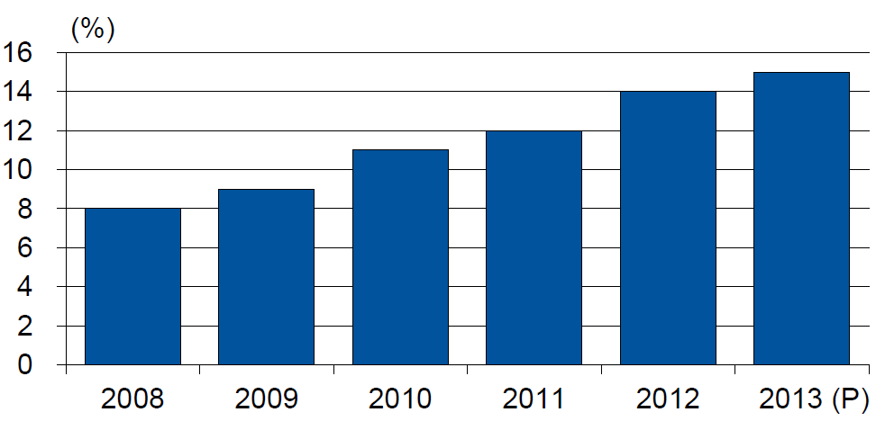
Alternative Capacity as a Percentage of Global Property Catastrophe Reinsurance Limit
(As of Year End)
Alternative Capacity accounted for approximately 14% or $45 billion of the $316 in global property catastrophe reinsurance capital as of mid-2013 (expected to rise to ~15% by year-end 2013)
Source: Guy Carpenter

Slide 95
Property Catastrophe Reinsurance Capacity by Source as of Mid-2013 ($ Bill)
Total = $316 Billion*
“Convergence Capital” accounted for an estimated $45B or 14% or total property catastrophe reinsurance capacity as of mid-2013, up $10B over the past 18 months (since 1/1/12). Penetration of this type of capacity is growing
Collateralized reinsurance (sidecars) is the fastest growing segment recently
Source: Guy Carpenter; Mid-Year Market Report, September 2013; Insurance Information Institute.

Slide 96
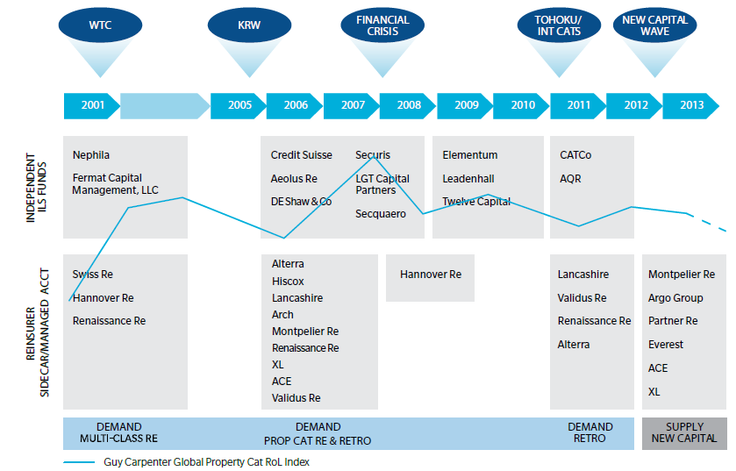
Alternative Capacity Development,
2001—2013:H1
Source: Guy Carpenter; Mid-Year Market Report, September 2013; Insurance Information Institute.

Slide 97
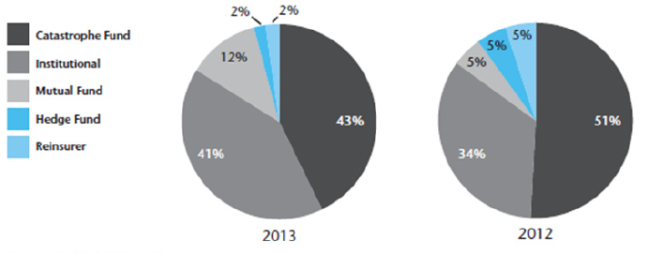
Investor by Category, 2013 vs. 2012*
Institutional Investors are accounting for a larger share of alternative reinsurance investors
*As of June 30 each year.
Source: Aon Benfield Securities; Insurance Information Institute.

Slide 98
Non-Traditional Property Catastrophe
Limits by Type, YE 2012 vs. YE 2015E
Alternative capital is expected to rise by 30% by YE 2015 and will ultimately account for 20-30% of total reinsurance spend, according to Guy Carpenter
Source: Guy Carpenter; Reinsurance Association of America; Insurance Information Institute.

Slide 99
Catastrophe Bonds: Issuance and Outstanding, 1997- 2014:Q1*
Risk Capital Amount ($ Millions)
Risk capital outstanding reached a record high in 2013
Financial crisis depressed issuance
CAT bond issuance reached a record high in 2013
Catastrophe Bond Issuance Is Approaching Pre-Crisis Levels While Risk Capital Outstanding Stands at an All-Time Record
*Through Jan. 31, 2014.
Source: Guy Carpenter; Insurance Information Institute.

Slide 100
Questions Arising from Influence of Alternative Capital
Could Pension Fund Money Swamp Traditional Capacity?
  US private pension funds hold ~$7 trillion in assets
  2% allocation = $140 billion
  Global property cat capital = ~$316 bill as of mid-2013
Do New Investors Have a Lower Cost of Capital?
  New capacity expects 6-8% rate of return compared to 8-10% for traditional reinsurance, according to Dowling & Partners
Will Reinsurance Pricing Become More Closely Linked to Interest Rates?
  What happens when interest rates rise?
Terms and Conditions Could Weaken
  Multi-year deals

Slide 101
Questions Arising from Influence of Alternative Capital
What Will Happen When Investors Face Large-Scale Losses?
Does ILS Have a Higher Propensity to Litigate?
  Short-term focus could contribute to disputes
  Large share of triggered transactions ended up in dispute
How Low Will ROLs Be Pushed?
Does the New Interconnectedness with Capital Markets Lend Credence to the Suggestion that Reinsurance Is a Systemic Risky Business?
Will Alternative Capital Drive Consolidation Among Traditional Reinsurers?
  Has the mating dance begun? → Endurance/Aspen

Slide 102
CAT OF THE FUTURE?
CYBER RISK
Cyber Risk is a Rapidly Emerging Exposure for Businesses Large and Small in Every Industry
NEW III White Paper: http://www.iii.org/assets/docs/pdf/paper_CyberRisk_2013.pdf
102

Slide 103





Data Breaches 2005-2013, by Number of Breaches and Records Exposed
# Data Breaches/Millions of Records Exposed
Millions
The Total Number of Data Breaches (+38%) and Number of Records Exposed (+408%) in 2013 Soared
* 2013 figures as of Jan. 1, 2014 from the ITRC updated to an additional 30 million records breached (Target) as disclosed in Jan. 2014.
Source: Identity Theft Resource Center.

Slide 104
The Most Costly Cyber Crimes, Fiscal Year 2012
Malicious code, denial of service and web-based attacks account for more than 58 percent of the total annualized cost of cyber crime experienced by 56 companies.
Malware
Botnets
Malicious code
Viruses, Worms, Trojans
Phishing + social engineering
Malicious insiders
Stolen devices
Denial of service
Web-based attacks
Source: 2012 Cost of Cyber Crime: United States, Ponemon Institute.

Slide 105
External Cyber Crime Costs: Fiscal Year 2012
Information loss (44%) and business disruption or lost productivity (30%) account for the majority of external costs due to cyber crime.
Other costs*
Equipment damages
Information loss
Revenue loss
Business disruption
* Other costs include direct and indirect costs that could not be allocated to a main external cost category
Source: 2012 Cost of Cyber Crime: United States, Ponemon Institute.

Slide 106
The Strength of the Economy Will Influence P/C Insurer Growth Opportunities
Growth Will Expand Insurer Exposure Base Across Most Lines
106

Slide 107
US Real GDP Growth*
The Q4:2008 decline was the steepest since the Q1:1982 drop of 6.8%
Real GDP Growth (%)
Recession began in Dec. 2007. Economic toll of credit crunch, housing slump, labor market contraction was severe
2014/15 are expected to see a modest acceleration in growth
Demand for Insurance Should Increase in 2014/15 as GDP Growth Accelerates Modestly and Gradually Benefits the Economy Broadly
* Estimates/Forecasts from Blue Chip Economic Indicators.
Source: US Department of Commerce, Blue Economic Indicators 4/14; Insurance Information Institute.

Slide 108
Real GDP by State Percent Change, 2012:
Highest 25 States
North Dakota was the economic growth juggernaut of the US in 2012—by far
Only 10 states experienced growth in excess of 3%, which is what we would see nationally in a more typical recovery
Sources: US Bureau of Labor Statistics; Insurance Information Institute.

Slide 109
Real GDP by State Percent Change, 2012:
Lowest 25 States
Growth rates in 8 states (and DC) were still below 1% in 2012
Connecticut was the only state to shrink in 2012
Sources: US Bureau of Labor Statistics; Insurance Information Institute.

Slide 110
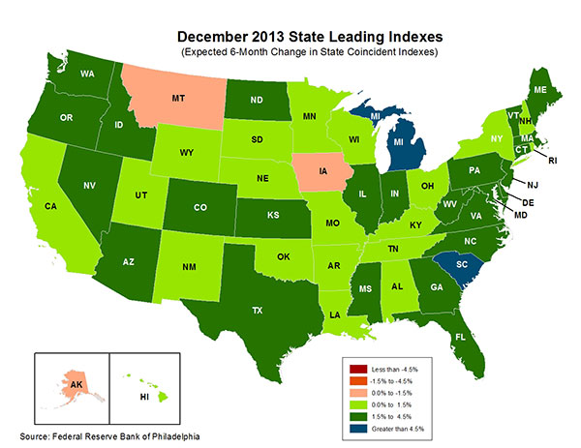
State-by-State Leading Indicators
through 2014:Q2
The economic outlook for most of the US is positive for the first time in many years
Sources: Federal Reserve Bank of Philadelphia at http://www.philadelphiafed.org/index.cfm ;Insurance Information Institute.

Slide 111
Consumer Sentiment Survey (1966 = 100)
January 2010 through March 2014
Optimism among consumers dropped in Q3 2013 as the government shutdown created uncertainty, then rebounded though the harsh winter took a toll
Impact of 2011 budget impasse
Consumer confidence has been low for years amid high unemployment, falling home prices and other factors adversely impact consumers, but improved substantially over the past 2+ years, though uncertainty in Washington sometimes takes a toll.
Source: University of Michigan; Insurance Information Institute

Slide 112
Unemployment and Underemployment Rates: Still Too High, But Falling
January 2000 through March 2014, Seasonally Adjusted (%)
U-6 went from 8.0% in March 2007 to 17.5% in
October 2009; Stood at 12.7% in Mar. 2014.
8% to 10% is “normal.”
As the unemployment rate approaches 6%, the Fed will begin signaling on short-term rates
“Headline” unemployment was 6.7% in March 2014. 4% to 6% is “normal.”
Stubbornly high unemployment and underemployment constrain overall economic growth, but the job market is now clearly improving.
Source: US Bureau of Labor Statistics; Insurance Information Institute.
112
12/01/09 - 9pm
eSlide – P6466 – The Financial Crisis and the Future of the P/C
Notes:
112

Slide 113
US Unemployment Rate Forecast
2007:Q1 to 2015:Q4F*
Rising unemployment
eroded payrolls
and WC’s
exposure base.
Unemployment peaked at 10% in late 2009.
Jobless figures have been revised slightly downwards for 2014/15
Unemployment forecasts have been revised slightly downwards. Optimistic scenarios put the unemployment as low as 6.0% by Q4 of this year.
* = actual; = forecasts
Sources: US Bureau of Labor Statistics; Blue Chip Economic Indicators (4/14 edition); Insurance Information Institute.

Slide 114
Monthly Change in Private Employment
January 2007 through March 2014 (Thousands, Seasonally Adjusted)
192,000 private sector jobs were created in March. As of March 2014, all the jobs lost in the Great Recession have been recovered
Jobs Created
2013: 2.368 Mill
2012: 2.294 Mill
2011: 2.400 Mill
2010: 1.277 Mill
Monthly losses in Dec. 08–Mar. 09 were the largest in the
post-WW II period
Private Employers Added 8.88 million Jobs Since Jan. 2010 After Having Shed 5.01 Million Jobs in 2009 and 3.76 Million in 2008 (State and Local Governments Have Shed Hundreds of Thousands of Jobs)
Source: US Bureau of Labor Statistics: http://www.bls.gov/ces/home.htm; Insurance Information Institute

Slide 115
Net Worth of Households*
Recently Hit A Historic High
2008-09 recession: -15.7%
$ Trillions
Adjusted for population growth, net worth is slightly short of its prior peak
Housing “bubble”
2001 recession
1992 recession
1982 recession
Rising net worth fuels a “wealth affect” that helps fuel consumer spending, which accounts for 70% of spending in the U.S. economy
*and nonprofit organizations. Data are as of year-end, except in 2013:Q3 (data posted on Dec 9, 2013).
Next release March 6, 2014. Data not seasonally adjusted or inflation-adjusted
Source: Federal Reserve Board

Slide 116
Household Financial Obligations
Ratio Recently Hit A Historic Low
Financial Obligations Ratio
Financial Obligations Ratio: debt service (mortgage and consumer debt), auto lease, residence rent, HO insurance, and property tax payments as % of personal disposable income.
Household balance sheets are stronger than they’ve been in many years, setting the stage for more consumer spending
Decline began in 2008:Q1.
15.23% in 2012:Q4
is lowest ratio since 1980:Q4 (15.09%).
*through 2013:Q3 (data posted on Dec 13, 2013)
Source: Federal Reserve Board, at http://www.federalreserve.gov/releases/housedebt

Slide 117
Auto/Light Truck Sales, 1999-2019F
Job growth and improved credit market conditions will boost auto sales in 2014 and beyond
(Millions of Units)
New auto/light truck sales fell to the lowest level since the late 1960s. Forecast for 2013-14 is still below 1999-2007 average of 17 million units, but a robust recovery is well underway.
Truck purchases by contractors are especially strong
Car/Light Truck Sales Will Continue to Recover from the 2009 Low Point, Bolstering the Auto Insurer Growth and the Manufacturing Sector Along With Workers Comp Exposures
Source: U.S. Department of Commerce; Blue Chip Economic Indicators (4/14 and 3/13); Insurance Information Institute.

Slide 118
Personal Auto Insurance Direct Written Premiums vs. Recently-Registered Cars
$ Billions
4%/yr growth forecast for PP DWP from recovering new car/truck sales
In 2004-07 no growth in PP DWP despite strong new car/truck sales
New car/truck sales grow to 14-15M/year
Average age of registered cars rose as fewer new cars were bought (and insured)
PP DWP, flat from 2004-2009, is rising again.
Conning forecasts growth at 3.5% in 2013 and 4.0% in 2014.
Sources: AIPSO Facts (various issues); SNL Financial; Conning Research & Consulting, Property-Casualty Forecast and Analysis, First Quarter 2012; Insurance Information Institute.

Slide 119
Average Age of Vehicles on the Road, 2006—2013
Average vehicle age continues to increase because the slow economy leads many drivers to keep cars on the road longer and because cars are becoming more reliable
The average vehicle age reached a record 11.4 years in 2013
Average Vehicle
Age (Years)
The average age of a vehicle on the road is is expected to continue to increase until 2018. By 2018, the number of vehicles 12+ years old is expected to rise 11.6% from 2013 and the number that are under 5 years old is expected to increase by 41%
Sources: Polk, August 2013 Survey; Insurance Information Institute.
119
12/01/09 - 9pm
eSlide – P6466 – The Financial Crisis and the Future of the P/C
Notes:
119

Slide 120
Monthly Change* in Auto Insurance Prices, 1991–2014*
Cyclical peaks in PP Auto tend to occur approximately every 10 years (early 1990s, early 2000s and likely the early 2010s)
Pricing peak occurred in late 2010 at 5.3%, falling to 2.8% by Mar. 2012
“Hard” markets tend to occur during recessionary periods
The Jan. 2014 reading of 3.4% down from 4.9% a year earlier
*Percentage change from same month in prior year; through January 2014; seasonally adjusted
Note: Recessions indicated by gray shaded columns.
Sources: US Bureau of Labor Statistics; National Bureau of Economic Research (recession dates); Insurance Information Institutes.
120
12/01/09 - 9pm
eSlide – P6466 – The Financial Crisis and the Future of the P/C
Notes:
120

Slide 121
Monthly Change* in Auto Insurance Prices, January 2005 - December 2013
Pricing weakened in 2011, strengthened in 2012/early 2013 but has since moderated
(Percent Change
from same month,
prior year)
Auto Insurance Price Increases Averaged 5.1% in 2010 over 2009, After Averaging 4.5% in 2009 over 2008.
PPA Auto, like most p/c lines, exhibits strong cyclicality in pricing. Prices rose from 2000 to late 2005, were flat/falling in 2006 and 2007 before beginning to rise gain in 2008.
Underwriting performance remained strong even when prices were flat or falling due to improvements in underlying frequency and severity trends
* Percentage change from same month in prior year, seasonally adjusted.
Sources: US Bureau of Labor Statistics; Insurance Information Institute

Slide 122
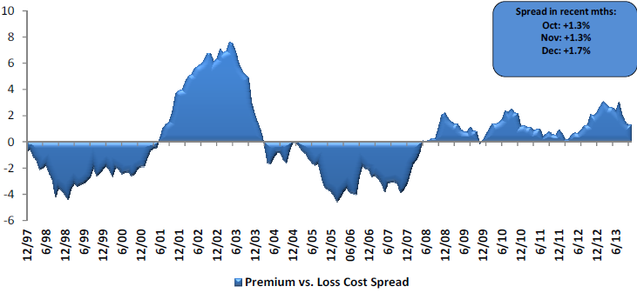
Private Passenger Auto: Premium Growth vs. Loss Cost Spread
Premium growth has generally exceeded underlying loss cost trends since mid-2008
Sources: Evercore Equity Research, Jan. 2014.

Slide 123
Average Expenditures* on Auto Insurance, 1994-2014F
Annual Pct Changes
2001: 5.2%
2002: 8.6%
2003: 5.6%
2004: 1.5%
2005: -1.3%
2006: -1.8%
2007: -2.1%
2008: -1.0%
2009: -0.5%
2010: 0.6%
2011: 0.6%
The average expenditure on auto insurance is lower today than it was in 2004
Across the U.S., auto insurance expenditures fell by 0.8% in 2008
and 0.5% in 2009 but rose 0.5% in 2010 and 0.8% in 2011.
I.I.I. estimates for 2012-2014 are each +2.0%.
* The NAIC data are per-vehicle (actually, per car-year)
Sources: NAIC for 1994-2011; Insurance Information Institute estimates for 2012-2014 based on CPI and other data.

Slide 124
Annual Pct. Change in Avg. Expenditures on Auto Insurance, vs. Auto Insurance Prices, 1995-2011
Annual auto insurance price changes, as measured by the BLS, have been 2 to 4 percentage points higher than NAIC data since 2005
Annual auto insurance price changes, as measured by the BLS, roughly matched NAIC expenditure data from 1995-2004
The gap since 2005 between price changes and expenditures on auto insurance might be due to buyers increasing deductibles,
obtaining discounts, and other premium-reducing behavior.
Sources: NAIC for 1994-2011; BLS for auto price changes; I.I.I.

Slide 125
New Private Housing Starts, 1990-2019F
Job growth, low inventories of existing homes, low mortgage rates and demographics should continue to stimulate new home construction for several more years
(Millions of Units)
New home starts plunged 72% from 2005-2009; A net annual decline of 1.49 million units, lowest since records began in 1959
Insurers Are Continue to See Meaningful Exposure Growth in the Wake of the “Great Recession” Associated with Home Construction: Construction Risk Exposure, Surety, Commercial Auto; Potent Driver of Workers Comp Exposure
Source: U.S. Department of Commerce; Blue Chip Economic Indicators (4/14 and 3/13); Insurance Information Institute.

Slide 126
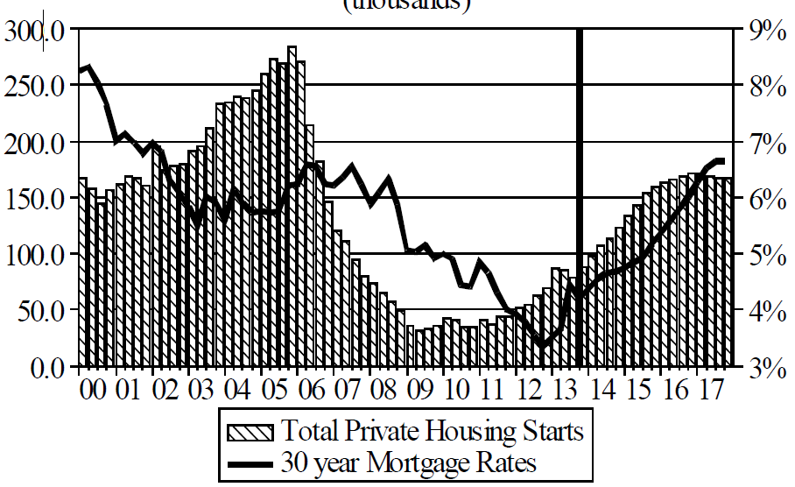
Florida Total Private Housing Starts,
2000 – 2017F
(Thousands of Units)
CRASH, CRATER, RECOVERY Homebuilding in FL continues to recover, adding substantially to coastal exposures.
The economic outlook for most of the US is positive for the first time in many years
Source: University of Central Florida Institute for Economic Competitiveness: http://iec.ucf.edu/post/2014/01/07/Florida-Metro-Forecast-December-2013.aspx

Slide 127
Value of New Private Construction: Residential & Nonresidential, 2003-2013*
2013: Value of new pvt. construction hits $667.5B, up 33% from the 2010 trough but still 27% below 2006 peak
New Construction peaks at $911.8. in 2006
Billions of Dollars
Trough in 2010 at $500.6B, after plunging 55.1% ($411.2B)
$15.0
$613.7
$311.5
$298.1
$261.8
$238.8
$356.0
Private Construction Activity Is Moving in a Positive Direction though Remains Well Below Pre-Crisis Peak; Residential Dominates
*2013 figure is a seasonally adjusted annual rate as of December.
Sources: US Department of Commerce; Insurance Information Institute.
127
12/01/09 - 9pm
eSlide – P6466 – The Financial Crisis and the Future of the P/C
Notes:
127

Slide 128
Value of Construction Put in Place, January 2014 vs. January 2013*
Growth (%)
Private: +12.3%
Public: +2.5%
Private sector construction activity is now up in the residential and nonresidential segments
Public sector construction activity remains low but is no longer contracting
Overall Construction Activity is Up, But Growth Is Almost Entirely in the Private Sector as State/Local Government Budget Woes Continue
*seasonally adjusted
Source: U.S. Census Bureau, http://www.census.gov/construction/c30/c30index.html ; Insurance Information Institute.

Slide 129
Construction Employment,
Jan. 2010—March 2014*
(Thousands)
Construction employment is +529,000 above
Jan. 2011 (+9.7%) trough
Construction and manufacturing employment constitute 1/3 of all payroll exposure.
*Seasonally adjusted.
Sources: US Bureau of Labor Statistics at http://data.bls.gov; Insurance Information Institute.
129
12/01/09 - 9pm
eSlide – P6466 – The Financial Crisis and the Future of the P/C
Notes:
129

Slide 130
Average Premium for
Home Insurance Policies**
Annual Pct Changes
2001: 5.5%
2002: 10.6%
2003: 12.7%
2004: 9.1%
2005: 4.8%
2006: 5.2%
2007: 2.2%
2008: 1.0%
2009: 6.0%
2010: 3.3%
2011: 7.6%
Across the U.S., home insurance expenditures rose by an estimated 4.0% in 2012-2014
* Insurance Information Institute Estimates/Forecasts **Excludes state-run insurers.
Sources: NAIC; Insurance Information Institute estimates for 2012-2014 based on CPI data and other data.

Slide 131
Homeowners Insurance
Net Written Premium, 2000–2015F
$ Billions
Homeowners insurance NWP continues to rise (up 128% 2000-2013) despite very little unit growth during the real estate crash. Reasons include rate increases, especially in coastal zones, ITV endorsements (e.g., “inflation guards”), and inelastic demand
Sources: A.M. Best; Insurance Information Institute.

Slide 132
Average Premiums For Home Insurance
By State, 2011* (1)
Top 25 States and DC
*Latest available.
(1) Based on the HO-3 homeowner package policy for owner-occupied dwellings, 1 to 4 family units. Provides “all risks” coverage (except those specifically excluded in the policy) on buildings and broad named-peril coverage on personal property, and is the most common package written.
Note: Average premium=Premiums/exposure per house years. A house year is equal to 365 days insured coverage for a single dwelling.
Source: NAIC; Insurance Information Institute.

Slide 133
Average Premiums For Home Insurance
By State, 2011* (1)
Bottom 25 States
Latest available
(1) Based on the HO-3 homeowner package policy for owner-occupied dwellings, 1 to 4 family units. Provides “all risks” coverage (except those specifically excluded in the policy) on buildings and broad named-peril coverage on personal property, and is the most common package written.
Note: Average premium=Premiums/exposure per house years. A house year is equal to 365 days insured coverage for a single dwelling.
Source: © 2013 National Association of Insurance Commissioners (NAIC). Reprinted with permission. Further reprint or distribution strictly prohibited without written permission of NAIC.

Slide 134
Estimated Median Rate For Home
Insurance By State, 2011* (1)
Top 25 States
Chart answers question: What is the rate to insure the average home in the state?
*Latest available.
(1) Based on the HO-3 homeowner package policy for owner-occupied dwellings, 1 to 4 family units. Provides “all risks” coverage (except those specifically excluded in the policy) on buildings and broad named-peril coverage on personal property, and is the most common package written.
Note: Estimated median = average premium in median insurance range/estimated average insurance value in that range.
Source: Insurance Information Institute estimate from NAIC data.

Slide 135
Estimated Median Rate For Home
Insurance By State, 2011* (1)
Bottom 25 States and DC
*Latest available.
(1) Based on the HO-3 homeowner package policy for owner-occupied dwellings, 1 to 4 family units. Provides “all risks” coverage (except those specifically excluded in the policy) on buildings and broad named-peril coverage on personal property, and is the most common package written.
Note: Estimated median = average premium in median insurance range/estimated average insurance value in that range.
Source: Insurance Information Institute estimate from NAIC data.

Slide 136
Financial Strength & Underwriting
Cyclical Pattern is P-C Impairment History is More Closely Tied to Underwriting, Reserving & Pricing than to Catastrophe Activity
136

Slide 137
P/C Insurer Impairments, 1969–2012
Impairments among P/C insurers remain infrequent
The Number of Impairments Varies Significantly Over the P/C Insurance Cycle, With Peaks Occurring Well into Hard Markets
Source: A.M. Best Special Report “Pace of P/C Impairments Slowed in 2012; Auto Writers, RRGs Continued to Struggle,” June 2013; Insurance Information Institute.

Slide 138
P/C Insurer Impairment Frequency vs. Combined Ratio, 1969-2012
2012 impairment rate was 0.69%, down from 1.11% in 2011; the rate is lower than the 0.82% average since 1969
Impairment Rates Are Highly Correlated With Underwriting Performance and Reached Record Lows in 2007; Recent Increase Was Associated Primarily With Mortgage and Financial Guaranty Insurers and Not Representative of the Industry Overall
Source: A.M. Best; Insurance Information Institute

Slide 139
Reasons for US P/C Insurer Impairments, 1969–2012
Historically, Deficient Loss Reserves and Inadequate Pricing Are
By Far the Leading Cause of P-C Insurer Impairments.
Investment and Catastrophe Losses Play a Much Smaller Role
Reinsurance Failure
Sig. Change in Business
Misc.
Investment Problems (Overstatement of Assets)
Deficient Loss Reserves/
Inadequate Pricing
Affiliate Impairment
Catastrophe Losses
Alleged Fraud
Rapid Growth
Source: A.M. Best Special Report “Pace of P/C Impairments Slowed in 2012; Auto Writers, RRGs Continued to Struggle,” June 2013; Insurance Information Institute.

Slide 140
Top 10 Lines of Business for US P/C Impaired Insurers, 2000–2012
Workers Comp and Pvt. Passenger Auto Account for More Than 40 Percent of the Impaired Insurers Since 2000
Other
Title
Surety
Workers Comp
Med Mal
Other Liability
Pvt. Passenger Auto
Commercial Auto Liability
Commercial Multiperil
Homeowners
Source: A.M. Best Special Report “Pace of P/C Impairments Slowed in 2012; Auto Writers, RRGs Continued to Struggle,” June 2013; Insurance Information Institute.
.

Slide 141
Insurance Information Institute Online:
www.iii.org
Thank you for your time
and your attention!
Twitter: twitter.com/bob_hartwig
Download at www.iii.org/presentations

