Slide 1
2016 ANNUAL SITA CONFERENCE
The Hilton Promenade at Branson Landing
Branson, Missouri
Key Issues Affecting the Insurance Industry
Monday, October 3, 2016
Jeanne M. Salvatore, SVP, Public Affairs and Chief Communications Officer
Insurance Information Institute  110 William Street  New York, NY 10038

Slide 2
Presentation Overview
2016 SITA ANNUAL CONFERENCE
Important Role of the State Trades in the I.I.I.’s Overall Mission
How the I.I.I. Supports the State Trades
State Issues Dominating the National Insurance Discussion
  Rising cost of auto insurance
  Attacks on Underwriting
  Catastrophes
  Sharing Economy
  Unclaimed life insurance
Industry-wide Initiatives of Vital importance – Attracting New Talent and Improving the Industry’s Image

Slide 3
Import Role of the State Trades in the I.I.I.’s overall mission

Slide 4
Who We Are and What We Do
The mission of the Insurance Information Institute is to build public understanding of insurance—what it does and how it works.
We Are…
  A voice for the property/casualty insurance industry.
  The go-to source for credible and unbiased insurance information for the media, the industry and consumers.
  Dedicated to ensuring the media covers our business fairly and accurately.
  Ready to assist our member companies with their communications, research and planning needs.
  Work closely with the network of state trade associations
We do not lobby.

Slide 5
I.I.I.’s Relationship with the State Trades
Key Component in the I.I.I.’s Overall Communications Strategy
Highly dependent on the state trades to be our “eyes and ears” for emerging issues on the state and local levels.
Provide early warning regarding emerging:
  consumer questions,
  consumer dissatisfaction
  emerging legislative or regulatory issues.
Alert us to media issues that potentially could result in national interest.
Support each other’s social engagement on Twitter, Facebook, etc.
Notes:
Remember to complement them on their good work. We try to be smart and strategic in our approach. We simply can’t be in all places at all times. That is why we need you.

Slide 6
How the I.I.I. can Support the State Trades

Slide 7
Ways I.I.I. Supports the State Trades
Deploy I.I.I. communicators post-catastrophe if needed.
Make I.I.I. consumer information and research available.
Assist in media strategy, messaging or even handle a media inquiry on your behalf (via Skype or local studio.)
Organize monthly call, hosts the SITA website and update the State Insurance Exchange List (STIX).
Invited to participate in the all-industry weekly media call
Provides speakers to your important events and present at legislative or regulatory events and hearings:
  I.I.I.’s President, Sean Kevelighan; Chief Economist, Dr. Steven Weisbart; Jim Lynch, Chief Actuary and others are all available as needed.

Slide 8
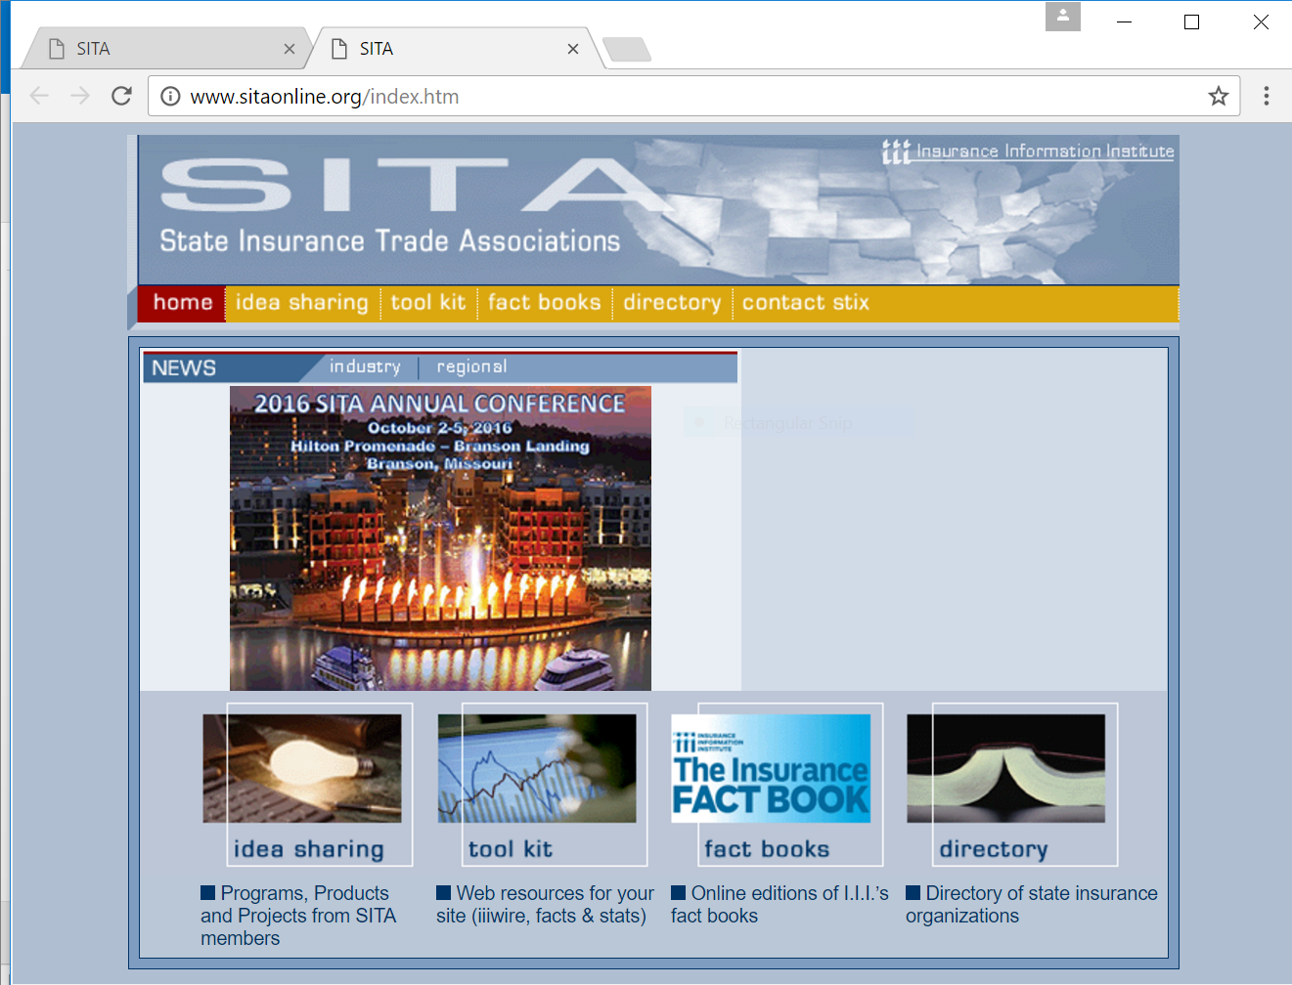
I.I.I. Hosts the SITA Website
Go to www.sitaonline.org
I.I.I. Insurance Fact book
State Directory
And other resources can be found here

Slide 9
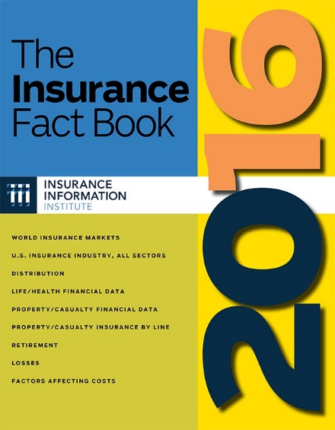
Insurance Fact Book
The Insurance Fact Book is the almanac of the insurance industry designed for quick and easy reference.
Thousands of facts, figures, tables and graphs
Factors affecting costs
Losses by category
Laws affecting motorists
Premiums by line
And much more…
9
12/01/09 - 9pm
eSlide – P6466 – The Financial Crisis and the Future of the P/C

Slide 10
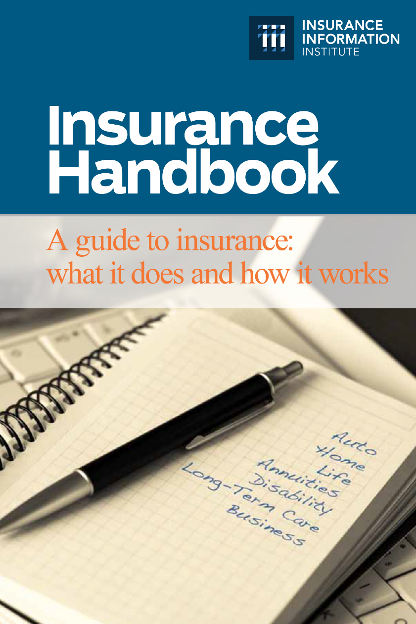
Insurance Handbook
The I.I.I. Insurance Handbook provides vital information for a wide variety of audiences:
Public Policymakers
Reporters
Regulators
Students
Insurance Company Employees
Academics
10
12/01/09 - 9pm
eSlide – P6466 – The Financial Crisis and the Future of the P/C

Slide 11
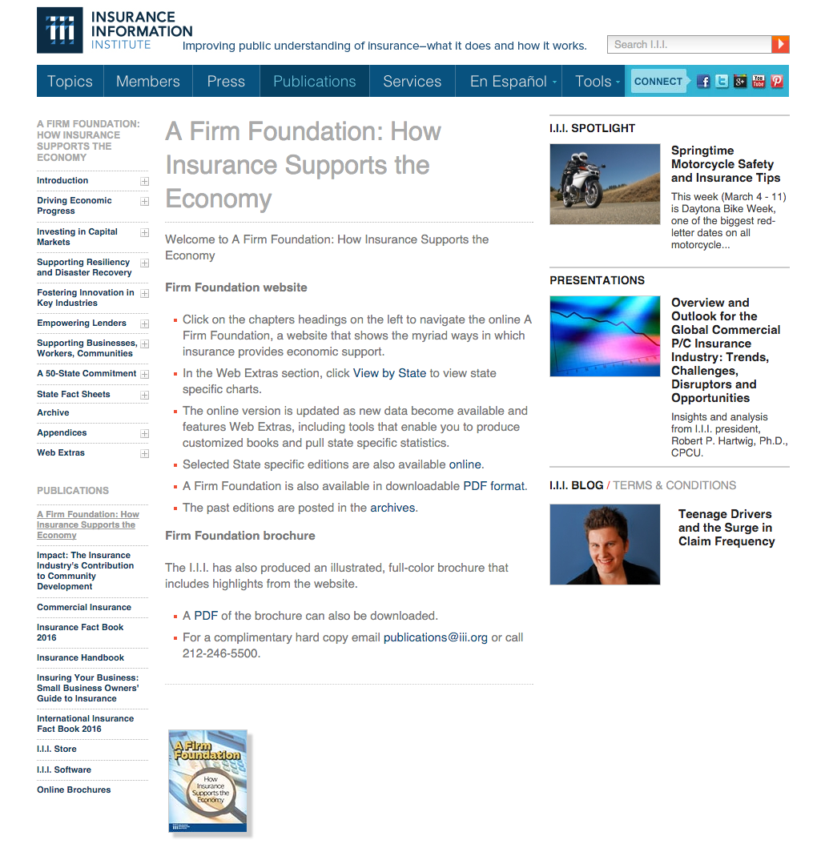
A Firm Foundation
A Firm Foundation provides details on the impact and importance of the insurance industry on national and state economies
Employers
Income Providers
Taxpayers
Investors
Engines of Growth & Recovery
Philanthropists
Insurers Don’t Just Pay Claims; They Are:
11
12/01/09 - 9pm
eSlide – P6466 – The Financial Crisis and the Future of the P/C
Notes:
Economic first responders – important data points – jobs, taxes paid, investments in mitigation and the infusion of capital after a disaster in the form of claims dollars.

Slide 12
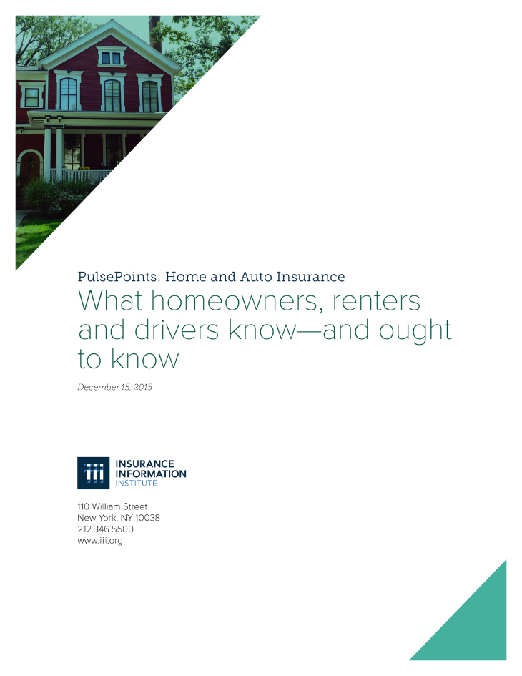

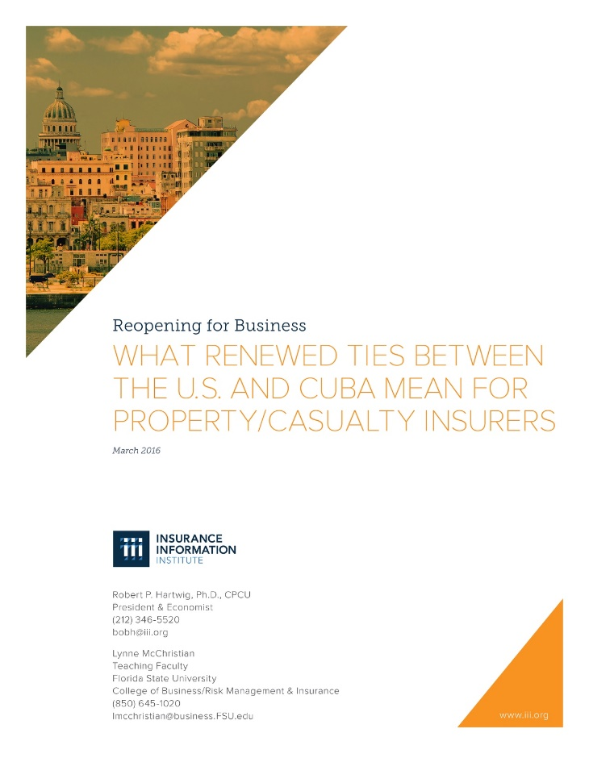
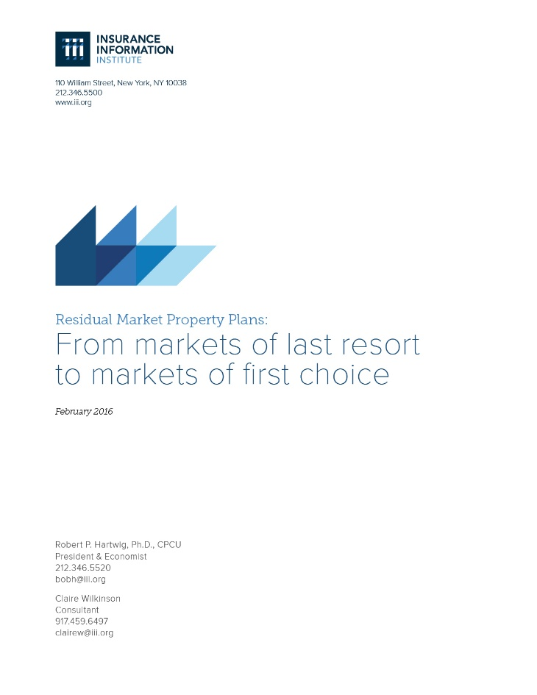
I.I.I. White Papers

Slide 13

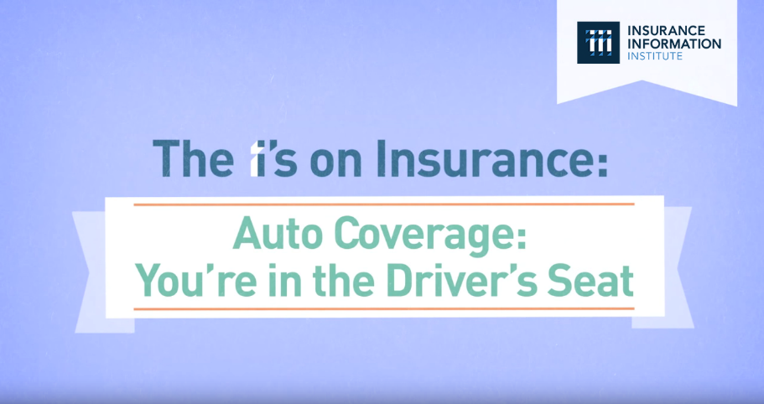

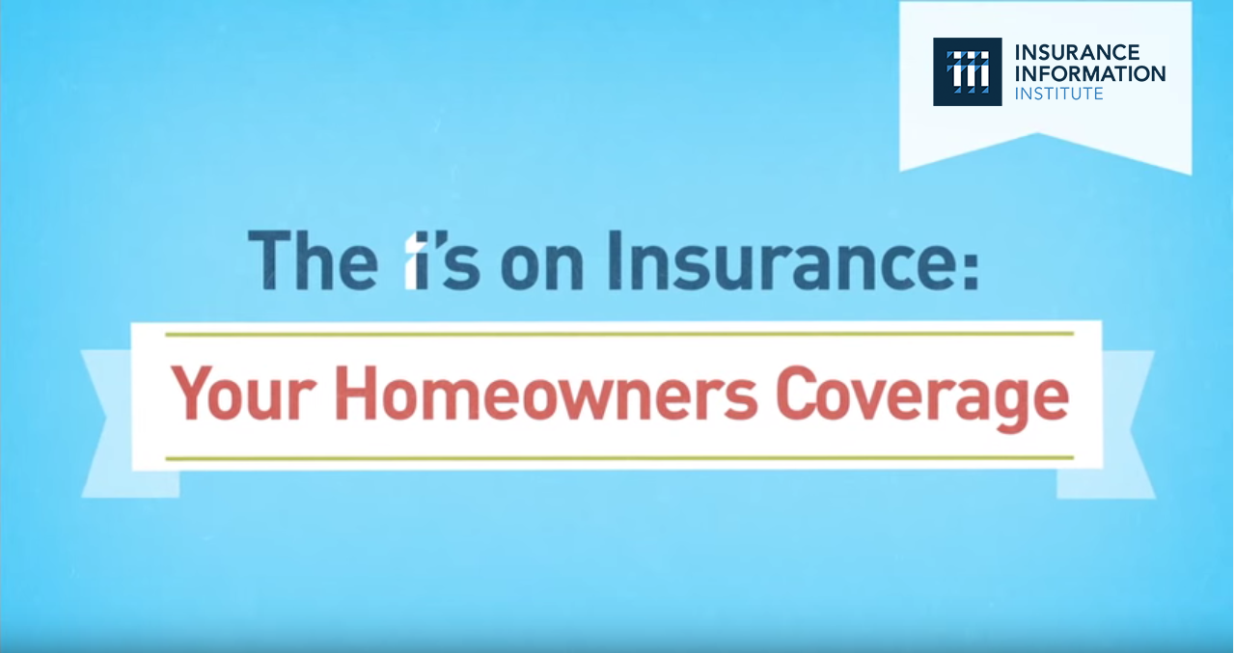
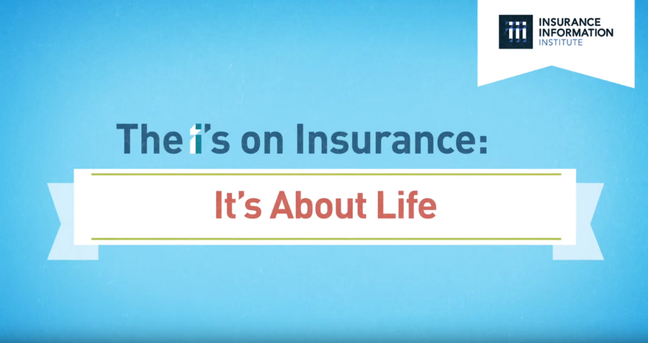
“The I’s on Insurance” Video Series
Animated video series covering Homeowners, Auto, Small Business and Life Insurance.
Goal: To engage and encourage viewers to reach out to their agent, broker, or company representative to discuss insurance coverage.

Slide 14
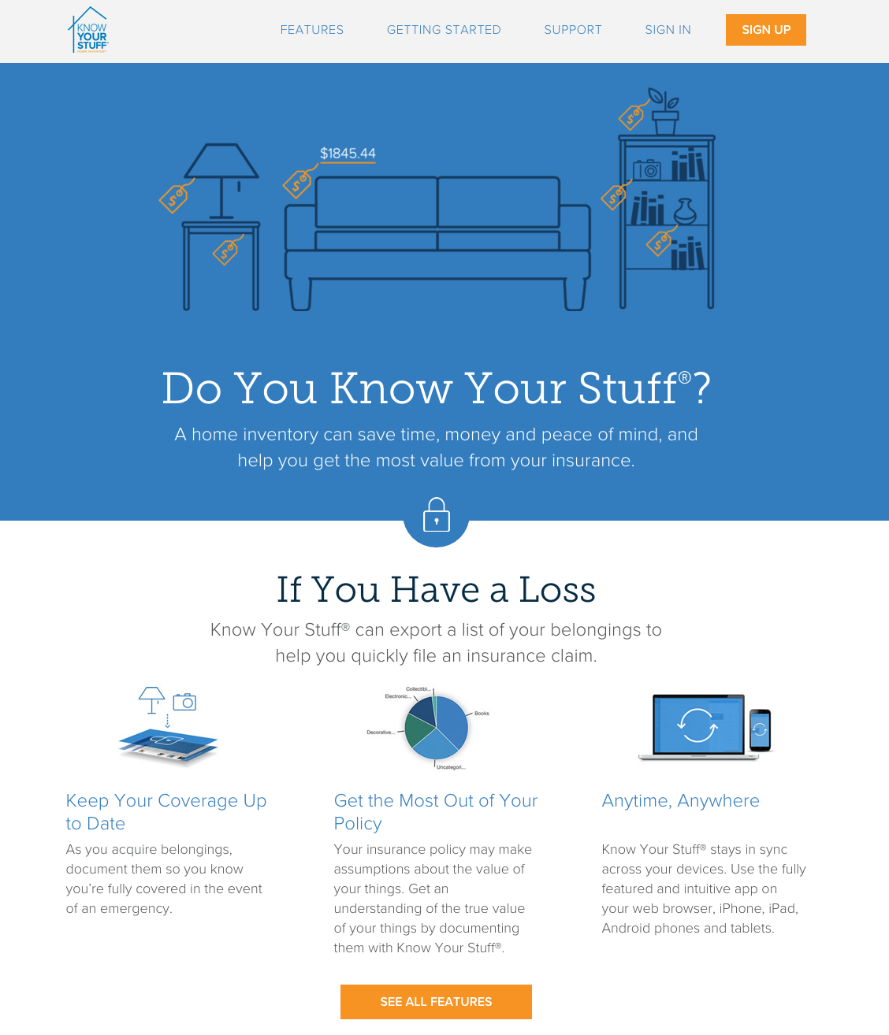
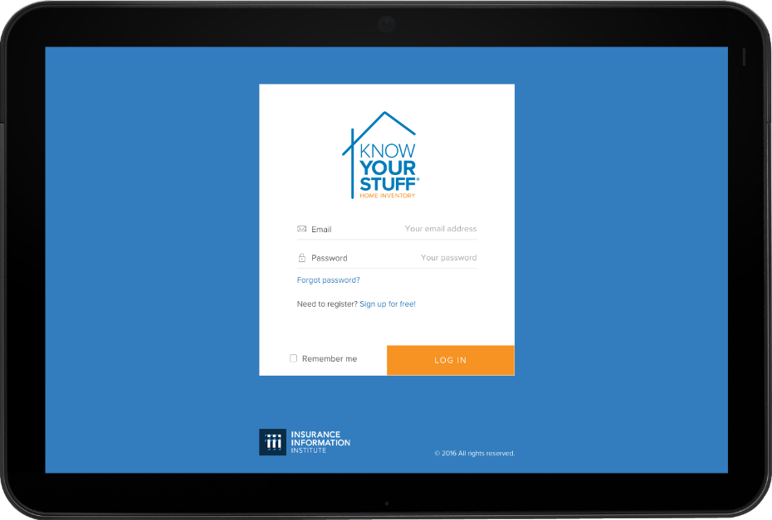
Know Your Stuff® - Home Inventory Software & App Demo
Know Your Stuff is a free home inventory desktop and mobile app
Highly regarded by the public and media, and highly effective consumer outreach.
Please post positive reviews in google play to drive up user rates
14

Slide 15
State Issues Dominating the National Insurance Discussion

Slide 16
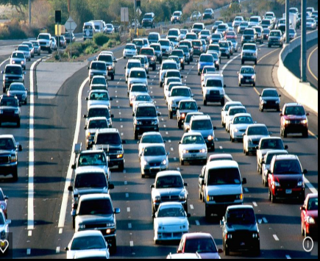
Auto Insurance Trends – Costs are Rising
Key Messages
More Congested Roads
Auto accidents are increasing in both frequency and severity.
  More people are driving because more people are working which means there are more drivers commuting and taking vacations.
  The number of fatal U.S. auto accidents increased 8 percent in 2015 compared to 2014.
  People are driving faster due to higher speed limits.

Slide 17

Auto Insurance Trends
Key Messages
Costlier Claims
Auto insurance payouts are increasing.
  People are driving more expensive cars, which are costlier to repair.
  Medical, litigation costs are also on the rise.
  Careful to not use the word “rates.” We use the word, “costs.”

Slide 18
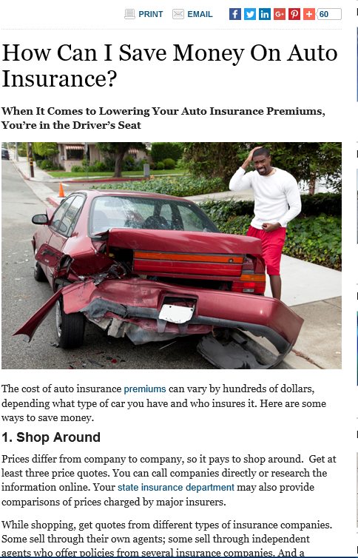
Auto Insurance Trends
Key Messages
Consumers have many choices
Auto insurance is a competitive business so drivers have many auto insurers to choose from.
There are many things that a consumer can do to save money such as taking a higher deductible, maintaining good credit and taking advantage of every available discount.
Drivers should think about the cost of insurance when selecting a car.

Slide 19
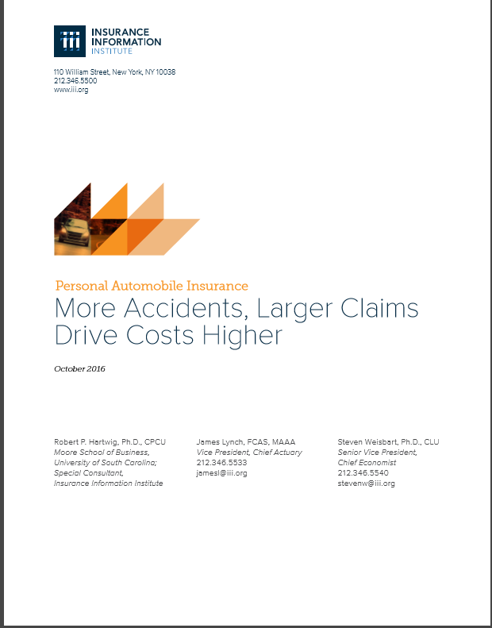
Rising Auto Rates
New White Paper to be Released soon!
New White Paper Auto Costs
Release Schedule
Unless the CFA or other group attacks the industry, the I.I.I. will first release this to our members on Oct. 12
A media advisory and wider distribution will occur on Oct. 13.
PowerPoint slides are being developed for industry use based on the key facts in the paper.

Slide 20
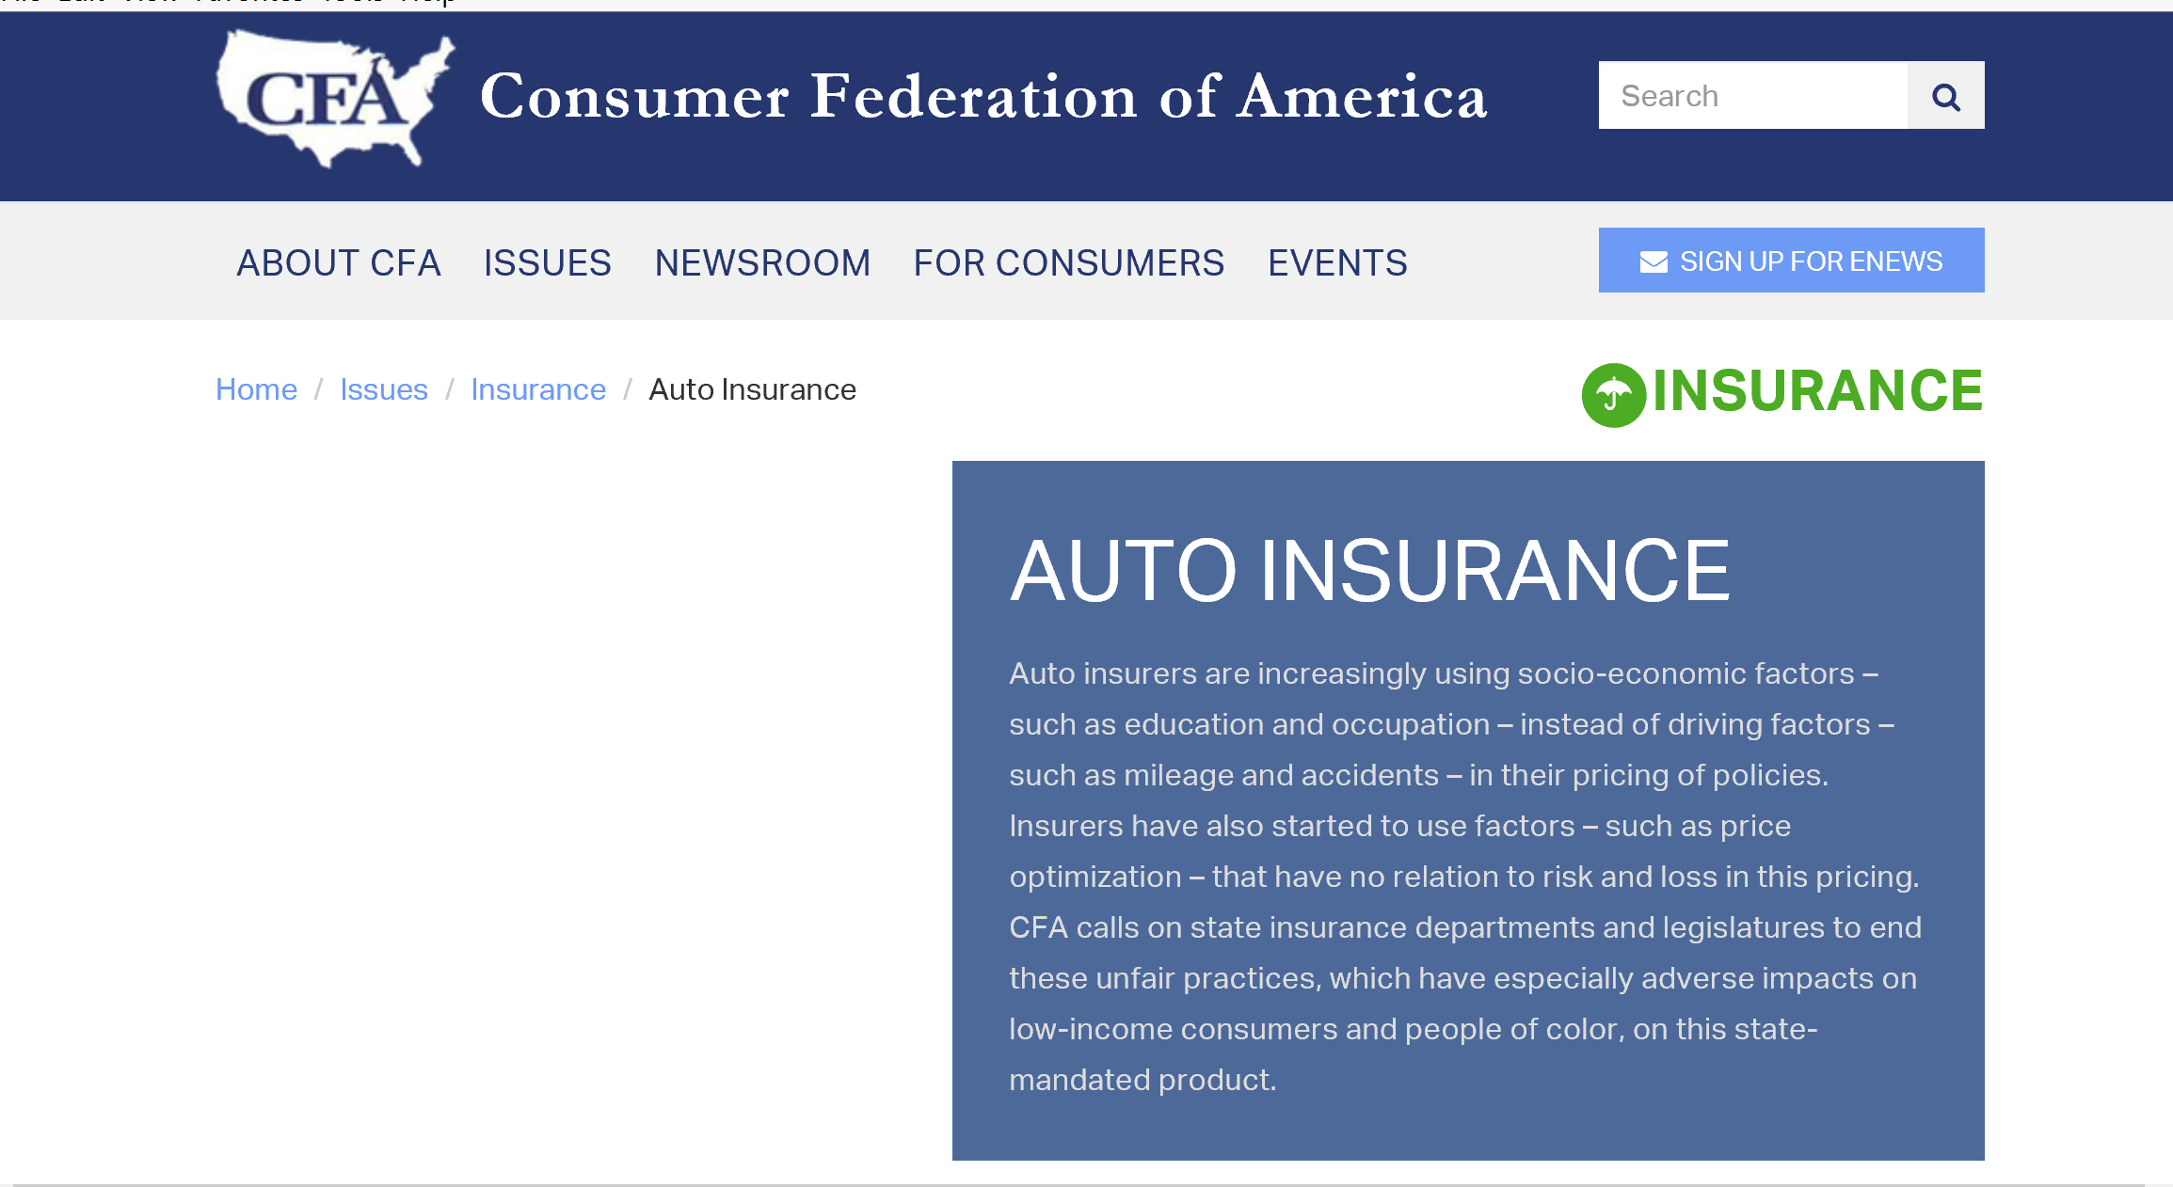
Attacks on Auto Underwriting
CFA Believes that only diving record should be used
Finds Fault with credit, marital status, location of car
I.I.I. Key Message
A key part of our strategy is to communicate the more underwriting criteria that insurers are allowed to use, the more competitive the insurance marketplace is for consumers.
This gives consumers the power to pick an insurance policy that is right for them at a competitive price.
The I.I.I. has many consumer focused materials on how to shop for auto insurance.

Slide 21
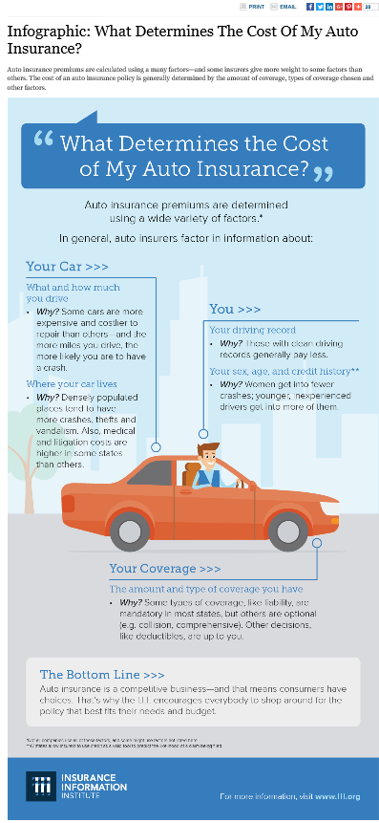
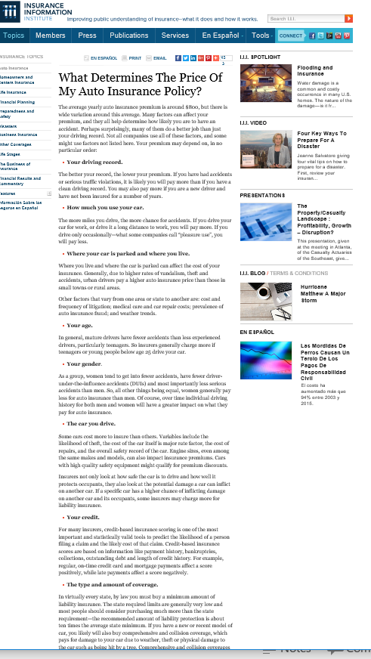
Attacks on Auto Insurance Underwriting
I.I.I. Tactic – Explain What Rating Factors Go Into An Auto Policy
Created an Infographic
Consumer article
Explain all of the components that go into underwriting an auto policy

Slide 22
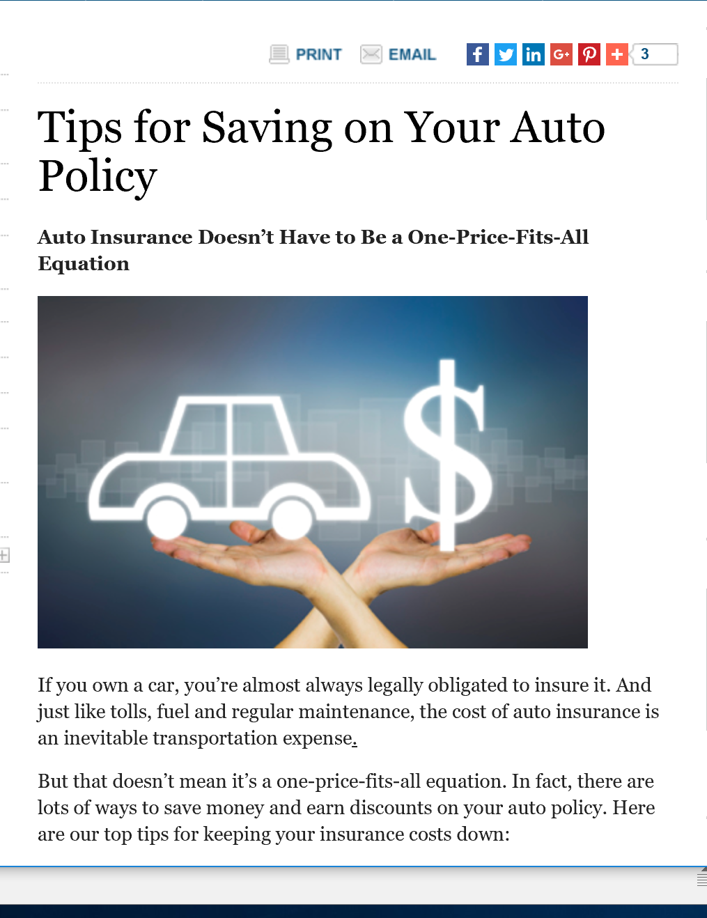
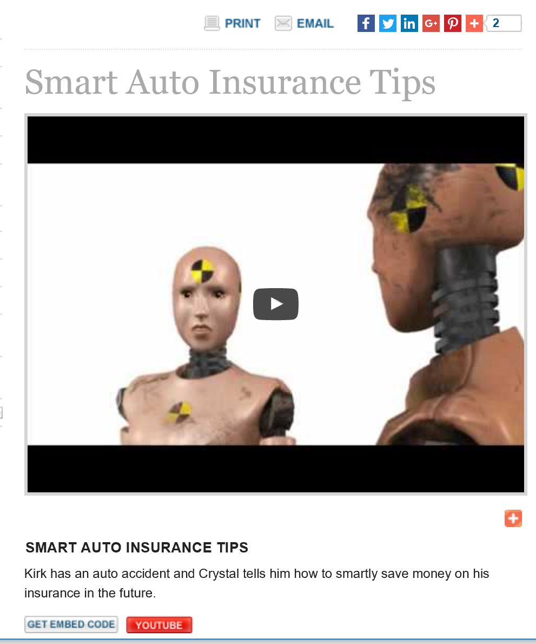
I.I.I. Provides a Full Library of Articles and Videos on How to Shop and Save Money on Auto Insurance
Articles
Videos

Slide 23
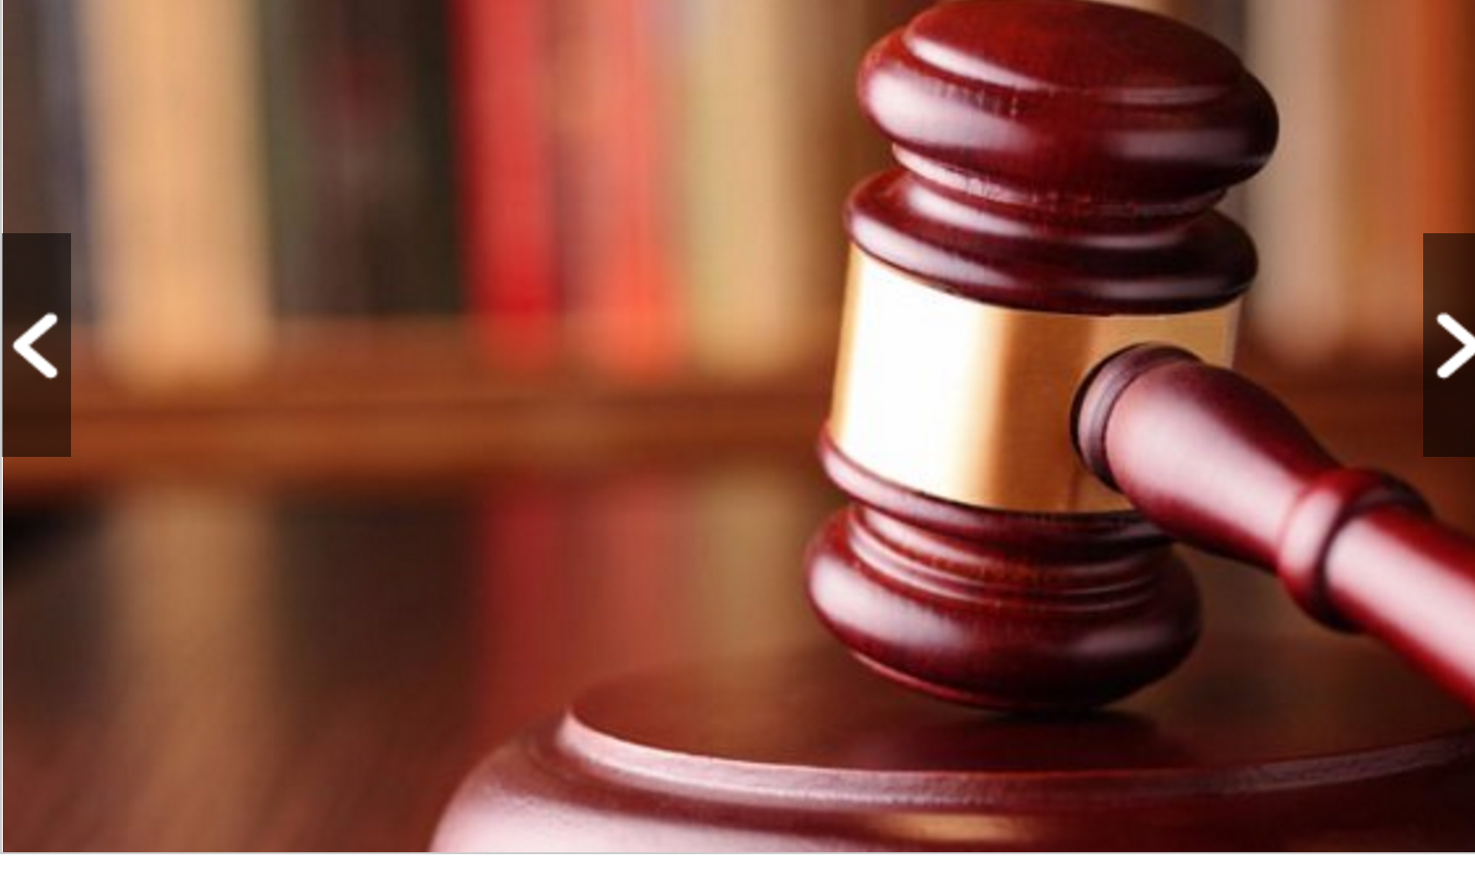
CFA ha been successful in pushing states to ban price optimization
Takes Regulators to Task for Not Protecting Consumers
18 States Have Banned Price Op
I.I.I. Developed Content
Insurers Have Always ‘Optimized’ – With Regulator Knowledge & Approval
Optimization Doesn’t Raise Rates; It Distributes the Rate Change. Remains True to Cost-Based Price
Innovations Are Usually Encouraged, With Appropriate Restraint by regulators

Slide 24




On-Demand/Sharing/Peer-to-Peer Economy Impacts Many Lines of Insurance
The “On-Demand” Economy is or will impact many segments of the economy important to P/C insurers
  Auto (personal and commercial)
  Homeowners/Renters
  Many Liability Coverages
  Professional Liability
Creating a number of questions and issues for the state insurance trades
Insurance solutions are increasingly available to fill the many insurance gaps that arise
24
12/01/09 - 9pm
eSlide – P6466 – The Financial Crisis and the Future of the P/C
Notes:
24

Slide 25

Consumer Article on Insurance Implications of Renting out Your Home

Slide 26
Catastrophes
State-specific issues
Hurricane deductibles - Nineteen states and the District of Columbia have hurricane deductibles: Alabama, Connecticut, Delaware, Florida, Georgia, Hawaii, Louisiana, Maine, Maryland, Massachusetts, Mississippi, New Jersey, New York, North Carolina, Pennsylvania, Rhode Island, South Carolina, Texas, Virginia and Washington DC.
Flood maps are being updated – Starting Sept 30 – new flood maps will be available. The NFIP working in coordination with state and local municipalities have invested in community-wide mitigation. This has reduced the risk of flooding and reduced the cost of flood insurance. It has taken home and business owners out of the high-risk zone. While this is a positive step, it has also increased the possibility that people will drop flood insurance.

Slide 27

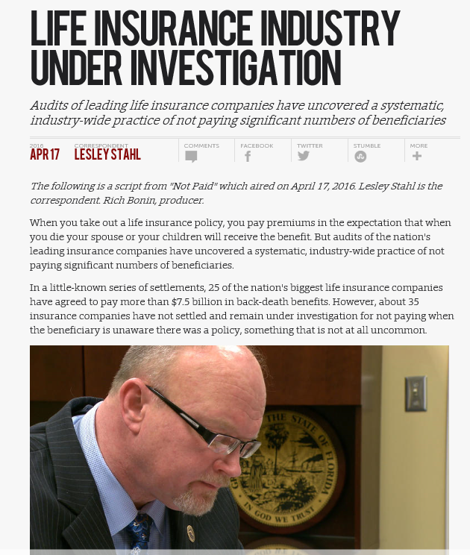
Lost or Unclaimed Life Insurance Covered by Leslie Stahl, Program Entitled, “ Not Paid!”
Accusation- Insurers will use the Death Master File to stop paying annuity claims. But, not to pay a life insurance claim.
Numerous States Entered into Settlements with Life Insurers
I.I.I.’s Key messages
This is a preventable problem
Insurers are using procedures where they are likely to find a pay claims.
Insurance want to pay claims.
But they appose retroactively changing the terms of the policy.
Segment Premiered in April and then Rebroadcast in August

Slide 28
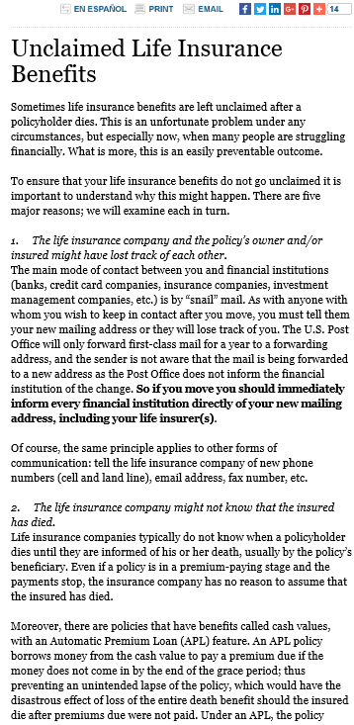
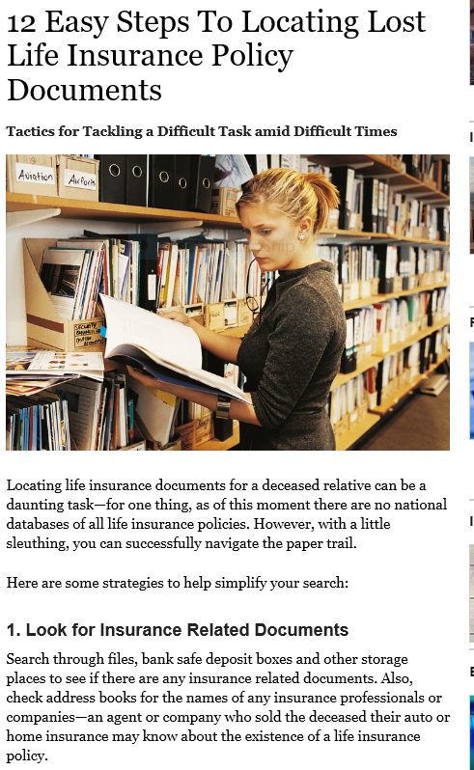
I.I.I. Consumer Content on Lost Life Insurance

Slide 29

Millennials describe their careers in insurance… My Career in Insurance is….
I.I.I. is taking a leadership role in promoting insurance careers to students and young workers. The video playlist is on our YouTube channel: https://www.youtube.com/watch?v=oZok9ftn41M&list=PL8QsOg2Byw0nTF6DCUNF5McZgd4T_1WYV
We’re currently working with Gamma Iota Sigma, the college Actuarial fraternity, on promoting careers and content. We’re also developing a landing page and other resources to engage with “millennials,” students, and young professionals.
For more of these videos, visit youtube.com/user/iiivideo/playlists
https://www.youtube.com/watch?v=oZok9ftn41M

Slide 30
Thank you for your time and your attention!
www.iii.org
Download at www.iii.org/presentations

