Slide 1
What’s Keeping Insurance CEOs Awake at Night?
Trends, Challenges & Opportunities
State Insurance Trade Association Conference
Louisville, KY
October 6, 2015
Download at www.iii.org/presentations
Robert P. Hartwig, Ph.D., CPCU, President & Economist
Insurance Information Institute ♦ 110 William Street ♦ New York, NY 10038
Tel: 212.346.5520 ♦ Cell: 917.453.1885 ♦ bobh@iii.org ♦ www.iii.org

Slide 2
Insurance Industry Financial Performance
2014 Was a Reasonably Good Year
2015: A Repeat of 2014?
2

Slide 3
P/C Industry Net Income After Taxes
1991–2015:H1
$ Millions
2005 ROE*= 9.6%
2006 ROE = 12.7%
2007 ROE = 10.9%
2008 ROE = 0.1%
2009 ROE = 5.0%
2010 ROE = 6.6%
2011 ROAS¹ = 3.5%
2012 ROAS¹ = 5.9%
2013 ROAS¹ = 10.2%
2014 ROAS¹ = 8.4%
2015:H1 ROAS = 9.2%
Net income fell modestly (-12.5%) in 2014 vs. 2013
ROE figures are GAAP; ¹Return on avg. surplus. Excluding Mortgage & Financial Guaranty insurers yields a 8.2% ROAS in 2014, 9.8% ROAS in 2013, 6.2% ROAS in 2012, 4.7% ROAS for 2011, 7.6% for 2010 and 7.4% for 2009.
Sources: A.M. Best, ISO; Insurance Information Institute

Slide 4
Profitability Peaks & Troughs in the P/C Insurance Industry, 1975 – 2015E
ROE
1977:19.0%
History suggests next ROE peak will be in 2016-2017
1987:17.3%
10 Years
1997:11.6%
2006:12.7%
10 Years
2015E: 8.8%
2013 9.8%
9 Years
2014 8.2%
1975: 2.4%
1984: 1.8%
1992: 4.5%
2001: -1.2%
*Profitability = P/C insurer ROEs. 2011-14 figures are estimates based on ROAS data. Note: Data for 2008-2014 exclude mortgage and financial guaranty insurers.
Source: Insurance Information Institute; NAIC, ISO, A.M. Best, Conning

Slide 5
ROE: Property/Casualty Insurance by Major Event, 1987–2015E
(Percent)
P/C Profitability Is Both by
Cyclicality and Ordinary Volatility
Modestly higher CATs
Katrina, Rita, Wilma
Low CATs
Sept. 11
Hugo
Lowest CAT Losses in
15 Years
4 Hurricanes
Sandy
Andrew
Record Tornado Losses
Northridge
Financial Crisis*
* Excludes Mortgage & Financial Guarantee in 2008 – 2014.
Sources: ISO, Fortune; Insurance Information Institute.

Slide 6
Commercial Lines NPW Premium Growth:
1975 – 2014E
ROE
Commercial lines is prone to more cyclical volatility that personal lines. Recently, growth has stabilized in the 4% to 5% range.
Economic Shocks, Inflation:
1976: 22.2%
Tort Crisis
1986: 30.5%
Post-9/11
2002: 22.4%
Post-Hurricane Andrew Bump:
1993: 6.3%
1988-2000: Period of inter-cycle stability
Post Katrina Bump:
2006: 7.7%
2014E 4.0%
2010-20XX? Post-recession period of stable growth?
Recessions:
1982: 1.1%
Great Recession:2009: -9.0%
Note: Data include state funds beginning in 1998.
Source: A.M. Best; Insurance Information Institute.

Slide 7
P/C Insurance Industry
Combined Ratio, 2001–2015:H1*
Heavy Use of Reinsurance Lowered Net Losses
Relatively Low CAT Losses, Reserve Releases
Higher CAT Losses, Shrinking Reserve Releases, Toll of Soft Market
As Recently as 2001, Insurers Paid Out Nearly $1.16 for Every $1 in Earned Premiums
Relatively Low CAT Losses, Reserve Releases
Avg. CAT Losses, More Reserve Releases
Sandy Impacts
Best Combined Ratio Since 1949 (87.6)
Cyclical Deterioration
Lower CAT Losses
* Excludes Mortgage & Financial Guaranty insurers 2008--2014. Including M&FG, 2008=105.1, 2009=100.7, 2010=102.4, 2011=108.1; 2012:=103.2; 2013: = 96.1; 2014: = 97.0.
Sources: A.M. Best, ISO.

Slide 8
A 100 Combined Ratio Isn’t What It
Once Was: Investment Impact on ROEs
A combined ratio of about 100 generates an ROE of ~7.0% in 2012/13, ~7.5% ROE in 2009/10,
10% in 2005 and 16% in 1979
Combined Ratio / ROE
Lower CATs helped ROEs in 2013-15:Q2
Combined Ratios Must Be Lower in Today’s Depressed
Investment Environment to Generate Risk Appropriate ROEs
* 2008 -2014 figures are return on average surplus and exclude mortgage and financial guaranty insurers. 2014 combined ratio including M&FG insurers is 97.0; 2013 = 96.1; 2012 =103.2, 2011 = 108.1, ROAS = 3.5%.
Source: Insurance Information Institute from A.M. Best and ISO Verisk Analytics data.

Slide 9
Return on Net Worth (RNW) All Lines:
2004-2013 Average
Commercial lines have tended to be more profitable than personal lines over the past decade
Source: NAIC; Insurance Information Institute.

Slide 10
Back to the Future: Profitability Peaks & Troughs in the P/C Insurance Industry, 1950 – 2015E*
ROE
1970-90: Peak ROEs were much higher in this period while troughs were comparable. High interest rates, rapid inflation, economic volatility all played roles
1950-70: ROEs were lower in this period. Low interest rates, low inflation, “Bureau” rate regulation all played a role
1990-2010s: Déjà vu. Excluding mega-CATs, this period is very similar to the 1950-1970 period
1977:19.0%
1987:17.3%
2006:12.7%
1972:13.7%
1997:11.6%
2013 9.8%
1950:8.0%
1966-67: 5.5%
1959:6.8%
2015E 8.8%
1969: 3.9%
1992: 4.5%
1957: 1.8%
1965: 2.2%
1975: 2.4%
1984: 1.8%
2001: -1.2%
*Profitability = P/C insurer ROEs. 2011-14 figures are estimates based on ROAS data. Note: Data for 2008-2014 exclude mortgage and financial guaranty insurers.
Source: Insurance Information Institute; NAIC, ISO, A.M. Best.

Slide 11
NPW Premium Growth: Peaks & Troughs in the P/C Insurance Industry, 1926 – 2015E
ROE
Post WW II Peak:
1947: 26.2%
1970-90: Peak premium growth was much higher in this period while troughs were comparable. Rapid inflation, economic volatility, high interest rates, tort environment all played roles
Start of WW II
1941: 15.8%
Economic Shocks, Inflation:
1976: 22.0%
Tort Crisis
1985/86: 22.2%
Post-9/11
2002:15.3%
1988-2000: Period of inter-cycle stability
2015E 4.1%
1950-70: Extended period of stability in growth and profitability. Low interest rates, low inflation, “Bureau” rate regulation all played a role
2010-20XX? Post-recession period of stable growth?
Twin Recessions; Interest Rate Hikes
1987: 3.7%
Great Recession:2010: -4.9%
Great Depression
1932: -15.9% max drop
Note: Data through 1934 are based on stock companies only. Data include state funds beginning in 1998.
Source: A.M. Best; Insurance Information Institute.

Slide 12
Distribution of Direct Premiums Written by Segment/Line, 2013
Personal/Commercial lines split has been about 50/50 for many years
Pvt. Passenger Auto is by far the largest line of insurance and is currently the most important source of industry profits
Billions of additional dollars in homeowners insurance premiums are written by state-run residual market plans
Distribution Facts
2013
Commercial Lines
$269.2B/51%
Homeowners
$80.7B/15%
Pvt. Pass Auto
$180.8B/34%
Sources: A.M. Best; Insurance Information Institute research.

Slide 13
RNW All Lines by State, 2004-2013 Average:
Highest 25 States
The most profitable states over the past decade are widely distributed geographically, though none are in the Gulf region
Profitability Benchmark: All P/C
US: 7.9%
Source: NAIC; Insurance Information Institute.

Slide 14
RNW All Lines by State, 2004-2013 Average:
Lowest 25 States
Some of the least profitable states over the past decade were hit hard by catastrophes
Source: NAIC; Insurance Information Institute.

Slide 15
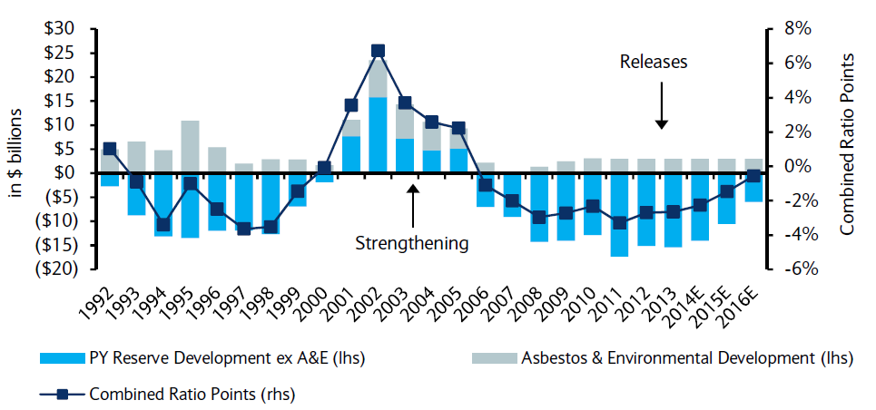
P/C Insurance Loss Reserve Development, 1992 – 2016E*
Reserve releases are expected to gradually taper off, but will continue to benefit the bottom line and combined ratio through at least 2016
Reserve Change
Source: A.M. Best; Barclays research for estimates.

Slide 16
INVESTMENTS:
THE NEW REALITY
Investment Performance is a Key Driver of Profitability
Depressed Yields Will Necessarily Influence Underwriting & Pricing
16

Slide 17
Property/Casualty Insurance Industry Investment Income: 2000–2015E¹
Investment earnings are still below their 2007 pre-crisis peak
($ Billions)
Due to persistently low interest rates,
investment income fell in 2012, 2013 and 2014.
¹ Investment gains consist primarily of interest and stock dividends. *2015 figure is estimated based on annualized data through Q2.
Sources: ISO; Insurance Information Institute.

Slide 18
Distribution of Invested Assets: P/C Insurance Industry, 2013
$ Billions
Total Invested Assets = $1.5 Trillion
Source: Insurance Information Institute Fact Book 2015, A.M. Best.

Slide 19
U.S. Treasury Security Yields:
A Long Downward Trend, 1990–2015*
Yields on 10-Year U.S. Treasury Notes have been essentially below 5% for a full decade.
U.S. Treasury yields plunged to historic lows in 2013. Longer-term yields rebounded then sank fell again.
Since roughly 80% of P/C bond/cash investments are in 10-year or shorter durations, most P/C insurer portfolios will have low-yielding bonds for years to come.
*Monthly, constant maturity, nominal rates, through August 2015.
Sources: Federal Reserve Bank at http://www.federalreserve.gov/releases/h15/data.htm. National Bureau of Economic Research (recession dates); Insurance Information Institute.
19
12/01/09 - 9pm
eSlide – P6466 – The Financial Crisis and the Future of the P/C
Notes:
19

Slide 20
Treasury Yield Curves:
Pre-Crisis (July 2007) vs. June 2015
Treasury yield curve remains near its most depressed level in at least 45 years. Investment income is falling as a result. Even when the Fed begins to raise rates, yields unlikely to return to pre-crisis levels anytime soon
The Fed Is Actively is Signaling that it Is Likely to Begin Raising Rates Later in 2015 but Only Very Gradually
Source: Federal Reserve Board of Governors; Insurance Information Institute.

Slide 21
Net Yield on Property/Casualty Insurance Invested Assets, 2007–2015*
(Percent)
Book yield in 2015 is down 77 BP from pre-crisis levels
The yield on invested assets remains low relative to pre-crisis yields. The Fed’s plan to raise interest rates in late 2015 has already pushed up some yields, albeit quite modestly.
*2015 figure is the average of the four quarters ending in 2015:Q2.
Sources: SNL Financial; Insurance Information Institute

Slide 22
Interest Rate Forecasts: 2015 – 2021
Yield (%)
3-Month Treasury
10-Year Treasury
The end of the Fed’s QE program in 2014 and a stronger economy have yet to push longer-term yields much higher
A full normalization of interest rates is unlikely until 2018, more than a decade after the onset of the financial crisis.
Sources: Blue Chip Economic Indicators (9/15 for 2015 and 2016; for 2017-2021 3/15 issue); Insurance Info. Institute.

Slide 23
Annual Inflation Rates, (CPI-U, %),
1990–2016F
Annual Inflation Rates (%)
Inflation peaked at 5.6% in August 2008 on high energy and commodity crisis. The recession and the collapse of the commodity bubble reduced inflationary pressures in 2009/10
Inflationary expectations have slipped (due in part to falling energy costs) allowing the Fed to maintain low interest rates
Slack in the U.S. economy and falling energy prices suggests that inflationary pressures should remain subdued for an extended period of times
Sources: US Bureau of Labor Statistics; Blue Chip Economic Indicators, 9/15 (forecasts).

Slide 24
Reduction in Combined Ratio Necessary to Offset 1% Decline in Investment Yield to Maintain Constant ROE, by Line*
Lower Investment Earnings Place a Greater Burden on Underwriting and Pricing Discipline
*Based on 2008 Invested Assets and Earned Premiums
**US domestic reinsurance only
Source: A.M. Best; Insurance Information Institute.
24
12/01/09 - 9pm
eSlide – P6466 – The Financial Crisis and the Future of the P/C
Notes:
24
This shows the drop in Combined Ratio for each line of business that would be needed to maintain a constant ROE, given a 1-percentage-point drop in investment yield

Slide 25
P/C Insurer Net Realized
Capital Gains/Losses, 1990-2015:Q2
Realized capital gains rose sharply as equity markets rallied in 2013-14
($ Billions)
Insurers Posted Net Realized Capital Gains in 2010 - 2014 Following Two Years of Realized Losses During the Financial Crisis. Realized Capital Losses Were a Primary Cause of 2008/2009’s Large Drop in Profits and ROE.
*Through Q2 2015.
Sources: A.M. Best, ISO, SNL, Insurance Information Institute.
25
12/01/09 - 9pm
eSlide – P6466 – The Financial Crisis and the Future of the P/C
Notes:
25

Slide 26
Property/Casualty Insurance Industry Investment Gain: 1994–2015:Q2¹
($ Billions)
Investment gains in 2014 will rival the post-crisis high reached in 2013
Total Investment Gains Were Down Slightly in 2014 as Low Interest Rates Pressured Investment Income but Realized Capital Gains Remained Robust
¹ Investment gains consist primarily of interest, stock dividends and realized capital gains and losses.
* 2005 figure includes special one-time dividend of $3.2B; 2015 figure is through Q2 2015.
Sources: ISO, SNL; Insurance Information Institute.

Slide 27
S&P 500 Index Returns, 1950 – 2015*
Annual Return
Volatility is endemic to stock markets—and may be increasing—but there is no persistent downward trend over long periods of time
Fed Raises Rate
Tech Bubble Implosion
2015*:
-5.2%
Energy Crisis
Financial Crisis
*Through Oct. 2, 2015.
Source: NYU Stern School of Business: http://pages.stern.nyu.edu/~adamodar/New_Home_Page/datafile/histretSP.html Ins. Info. Inst.

Slide 28
Distribution of Bond Maturities,
P/C Insurance Industry, 2003-2013
The main shift over these years has been from bonds with longer maturities to bonds with shorter maturities. The industry first trimmed its holdings of over-10-year bonds (from 24.6% in 2003 to 15.5% in 2012) and then trimmed bonds in the 5-10-year category (from 31.3% in 2003 to 27.6% in 2012) . Falling average maturity of the P/C industry’s bond portfolio is contributing to a drop in investment income along with lower yields.
Sources: SNL Financial; Insurance Information Institute.

Slide 29
CAPITAL/CAPACITY
Capital Accumulation Has Multiple Impacts
29

Slide 30
Policyholder Surplus,
2006:Q4–2015:Q2
($ Billions)
2007:Q3
Pre-Crisis Peak
Drop due to near-record 2011 CAT losses
Surplus as of 6/30/15 stood at a near-record high $672.4B
The industry now has $1 of surplus for every $0.73 of NPW,
close to the strongest claims-paying status in its history.
2010:Q1 data includes $22.5B of paid-in capital from a holding company parent for one insurer’s investment in a non-insurance business .
The P/C insurance industry entered 2015
in very strong financial condition.
Sources: ISO, A.M .Best.
30
12/01/09 - 9pm
eSlide – P6466 – The Financial Crisis and the Future of the P/C
Notes:
30

Slide 31
US Policyholder Surplus:
1975–2015:Q2*
($ Billions)
Surplus as of 6/30/15 was a near-record $672.4, down 0.3% from the record $674.7 of 12/31/14 but up 53.8% ($235.3B) from the crisis trough of $437.1B at 3/31/09
“Surplus” is a measure of underwriting capacity. It is analogous to “Owners Equity” or “Net Worth” in non-insurance organizations
The Premium-to-Surplus Ratio Stood at $0.76:$1 as of
6/30/15, a Near Record Low (at Least in Recent History)
* As of 6
*As of 6/30/15.
Source: A.M. Best, ISO, Insurance Information Institute.

Slide 32
Premium-to-Surplus Ratio:
1985–2014*
(Ratio of NWP to PHS)
The larger surplus is in relation to premiums—the lower the P:S ratio—and the great the industry’s capacity to handle the risk it has accepted
Surplus as of 12/31/14 was $0.73:$1, a near-record low (at least in modern history)
9/11, Recession & Hard Market
The Premium-to-Surplus Ratio Stood at $0.73:$1 as of
12/31/14, a Record Low (at Least in Recent History)
* As of 12/31/14.
Source: A.M. Best, ISO, Insurance Information Institute.

Slide 33
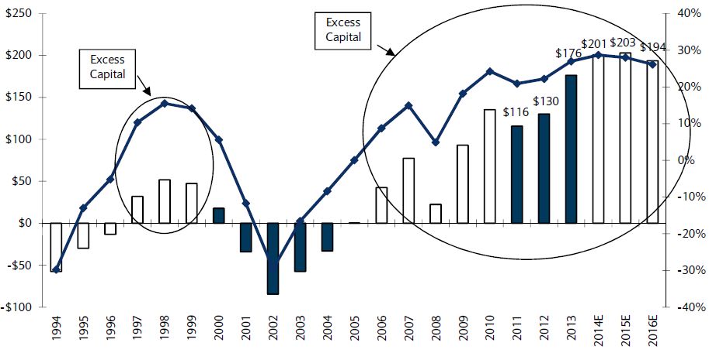
US P/C Insurance Industry Excess Capital Position: 1994–2016E
Barclay’s suggests that surplus is approximately $200B (~30%)
Surplus Redundancy (Deficiency)
Percent Redundancy (Deficiency)
The Industry’s Strong Capital Position Suggests Insurers Are in a Good Position to Increase Risk Appetite, Repurchase Shares and Pursue Acquisitions
Source: Barclays Research estimates.

Slide 34
P/C Industry: Loss Reserve-to-Surplus Ratio, 1971-2014
Inflation, Liability Crisis Increased Reserves, Plunging Stock Prices Depleted Surplus
The Property/Casualty Industry Adjusted Its Risk Portfolio in Response to Risk-Based Capital Requirements Implemented in 1994.
Source: Calculations from A.M. Best and ISO data by Insurance Information Institute.

Slide 35
Alternative Capital
New Investors Continue to Change the Reinsurance Landscape
First I.I.I. White Paper on Issue Was Released in March 2015
35

Slide 36
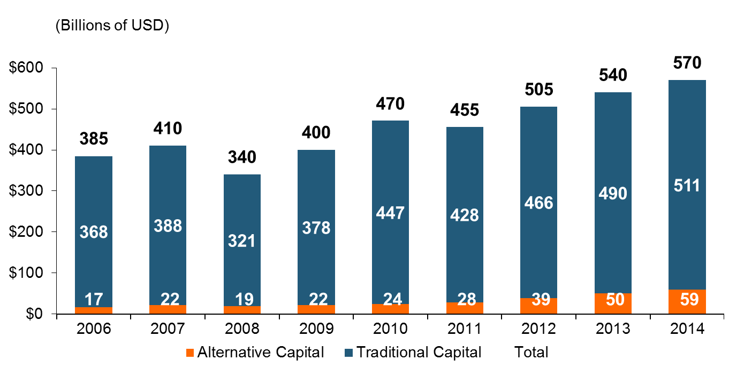
Global Reinsurance Capital (Traditional and Alternative), 2006 - 2014
Total reinsurance capital reached a record $570B in 2013, up 68% from 2008.
But alternative capacity has grown 210% since 2008, to $50B. It has more than doubled in the past three years.
2014 data is as of June 30, 2014.
Source: Aon Benfield Analytics; Insurance Information Institute.

Slide 37
Alternative Capital as a Percentage of Traditional Global Reinsurance Capital
Alternative Capital’s Share of Global Reinsurance Capital Has More Than Doubled Since 2010.
2014 data is as of June 30, 2014.
Source: Aon Benfield Analytics; Insurance Information Institute.

Slide 38
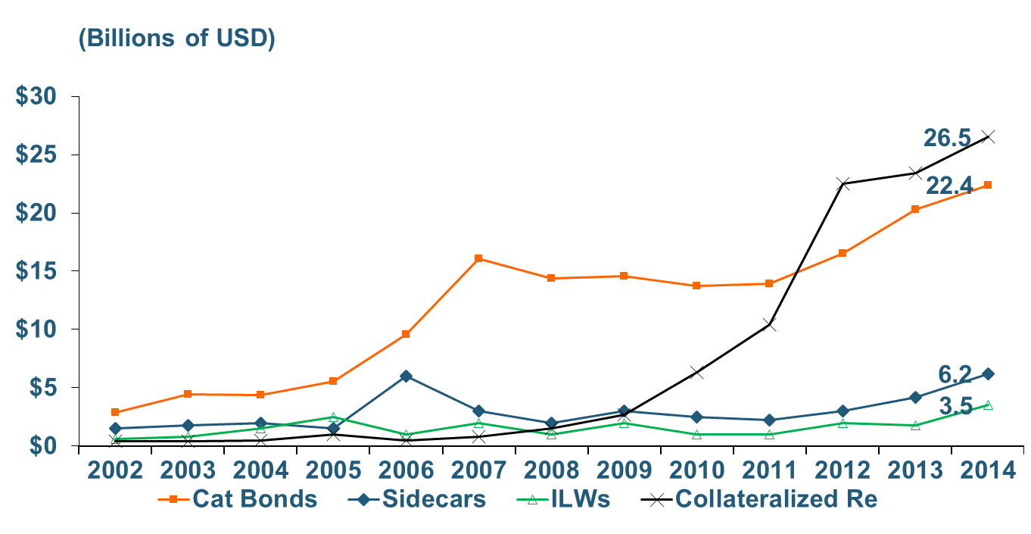
Growth of Alternative Capital Structures, 2002 - 2014
Collateralized Re’s Growth Has Accelerated in the Past Three Years.
Collateralized Reinsurance and Catastrophe Bonds Currently Dominate the Alternative Capital Market.
2014 data is as of June 30, 2014.
Source: Aon Benfield Analytics; Insurance Information Institute.

Slide 39
Catastrophe Bond Issuance and Outstanding: 1997-2015:Q1
Risk Capital Amount ($ Millions)
2014 Has Seen the Largest Cat Bond Ever - $1.5 Billion (Florida Citizens). Bond Issuance Set a Record.
Source: Guy Carpenter.

Slide 40
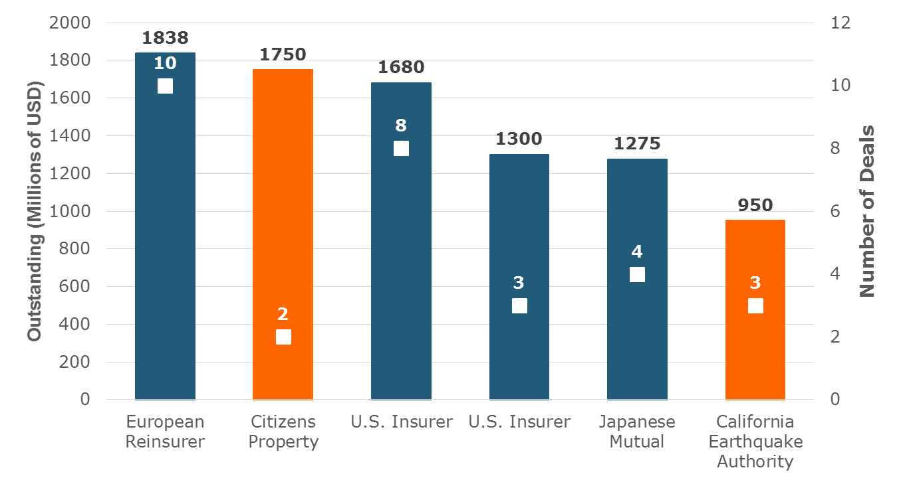
Largest Sponsors of ILS, Year-End 2014
Two of the Largest ILS Issuers Are Government-Sponsored Insurers. Nine Government-Related Insurers Have $4.6 Billion in Outstanding Securities.
Source: Artemis.bm; Insurance Information Institute.

Slide 41
Reinsurance Pricing: Change in Rate on Line for Cat Business
Alternative Capital, Low Levels of Catastrophe Drive Rates Down.
76%
Catastrophe Prices Fell 11 Percent on January 1 Renewals, Driven by Emergence of New Capital, Mild Catastrophe Losses.
2014 reflects change through June 30 from prior year end. 2015 is for January 1 renewals..
Source: Guy Carpenter; Insurance Information Institute.

Slide 42
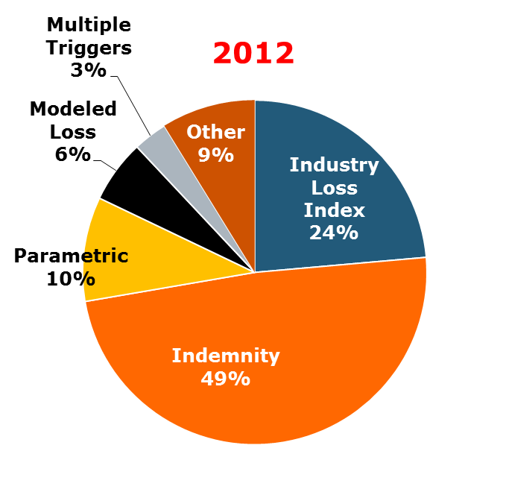
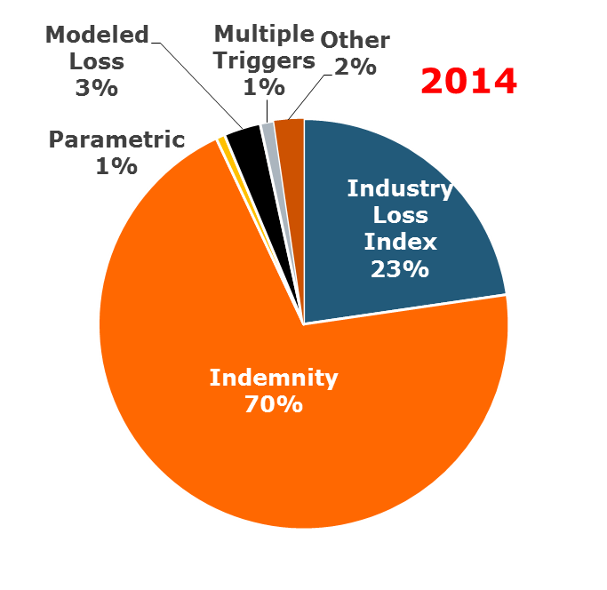
ILS Issuance by Trigger
Terms Are Shifting Away From ‘Objective’ Triggers (Favored by Investors) Toward Indemnity Trigger (Favored by Insurers).
Source: Artemis.bm; Insurance Information Institute.

Slide 43
Questions Arising from Influence of Alternative Capital
What Will Happen When Investors Face Large-Scale Losses?
What Happens When Interest Rates Rise?
Does ILS Have a Higher Propensity to Litigate?
How Much Lower Will Risk Premiums Shrink/ROLs Fall?
Will There Be Spillover Into Casualty Reinsurance?
Will Alternative Capital Drive Consolidation?

Slide 44
Performance by Segment
44
Notes:
44

Slide 45
Homeowners Insurance Combined Ratio: 1990–2015F
Hurricane Andrew
Record tornado activity
Hurricane Sandy
Hurricane Ike
Homeowners Performance in 2011/12 Impacted by Large Cat Losses. Extreme Regional Variation Can Be Expected Due to Local Catastrophe Loss Activity
Sources: A.M. Best (1990-2014F);Conning (2015F); Insurance Information Institute.

Slide 46
Private Passenger Auto Combined Ratio: 1993–2017F
Private Passenger Auto Underwriitng Performance Is Exhibiting Remarkable Stability
Sources: A.M. Best (1990-2014); Conning (2015F – 2017F); Insurance Information Institute.

Slide 47
Collision Coverage: Severity & Frequency Trends Are Both Higher in 2015*
Annual Change, 2005 through 2015*
The Recession, High Fuel Prices Helped Temper Frequency and Severity, But this Trend Will Likely Be Reversed Based on Evidence from Past Recoveries
*2015 figure is for the 4 quarters ending with 2015:Q1.
Source: ISO/PCI Fast Track data; Insurance Information Institute

Slide 48
Commercial Lines Combined Ratio, 1990-2016F*
Commercial lines underwriting performance improved in 2013/14 but higher cats, diminishing prior year reserves and rising loss cost trends in some lines could push combined ratios higher
*2007-2012 figures exclude mortgage and financial guaranty segments.
Source: A.M. Best (1990-2014); Conning (2015-16F) Insurance Information Institute.

Slide 49
Commercial Auto Combined Ratio: 1993–2015F
Commercial Auto is Expected to Improve Only Slowly as Rate Gains Barely Offset Adverse Frequency and Severity Trends
Sources: A.M. Best (1990-2014);Conning (2015F); Insurance Information Institute.

Slide 50
Commercial Property Combined Ratio:
2007–2016F
Commercial Property Underwriting Performance Has Been Volatile in Recent Years, Largely Due to Fluctuations in CAT Activity
Source: Conning Research and Consulting.

Slide 51
General Liability Combined Ratio:
2005–2016F
Commercial General Liability Underwriting Performance Has Been Volatile in Recent Years
Source: Conning Research and Consulting.

Slide 52
Workers Compensation Combined Ratio: 1994–2014P
WC results have improved markedly since 2011
Workers Comp Results Began to Improve in 2012. Underwriting Results Deteriorated Markedly from 2007-2010/11 and Were the Worst They Had Been in a Decade.
Sources: A.M. Best (1994-2009); NCCI (2010-2014P) and are for private carriers only; Insurance Information Institute.

Slide 53
Commercial Multi-Peril Combined Ratio: 1995–2016F
Commercial Multi-Peril Underwriting Performance is Expected to Remains Stable in 2015 Assuming Normal Catastrophe Loss Activity
*2015F-2016F figures are Conning figures for the combined liability and non-liability components.
Sources: A.M. Best; Conning; Insurance Information Institute.

Slide 54
Inland Marine Combined Ratio:
2004–2015F
Inland Marine Underwriting Performance Has Been Consistently Strong for Many Years
Source: A.M. Best (2004-2014E); Conning Research and Consulting (2015F).

Slide 55
Workers Compensation Operating Environment
Workers Comp Results Have Improved Substantially in Recent Years
55

Slide 56
Nonfarm Payroll (Wages and Salaries):
Quarterly, 2005–2015:Q1
Billions
Latest (2015:Q1) was $7.66 trillion, a new peak--$1.34 trillion above 2009 trough
Prior Peak was 2008:Q3 at $6.54 trillion
Growth rates
2011:Q1 over 2010:Q1: 5.5%
2012:Q1 over 2011:Q1: 4.2%
2013:Q1 over 2012:Q1: 2.5%
2014:Q1 over 2013:Q1: 4.3%
2015:Q1 over 2014:Q1: 4.4%
Recent trough (2009:Q1) was $6.23 trillion, down 5.3% from prior peak
Note: Recession indicated by gray shaded column. Data are seasonally adjusted annual rates.
Sources: http://research.stlouisfed.org/fred2/series/WASCUR; National Bureau of Economic Research (recession dates); Insurance Information Institute.
56
12/01/09 - 9pm
eSlide – P6466 – The Financial Crisis and the Future of the P/C
Notes:
56

Slide 57
Payroll vs. Workers Comp Net Written Premiums, 1990-2014P
Payroll Base* WC NWP
$Billions $Billions
7/90-3/91
3/01-11/01
12/07-6/09
WC premium volume dropped two years before the recession began
WC net premiums written were down $14B or 29.3% to $33.8B in 2010 after peaking at $47.8B in 2005
Continued Payroll Growth and Rate Gains Suggest WC NWP Will Grow Again in 2015
*Private employment; Shaded areas indicate recessions. WC premiums for 2014 are from NCCI.
Sources: NBER (recessions); Federal Reserve Bank of St. Louis at http://research.stlouisfed.org/fred2/series/WASCUR ; NCCI; I.I.I.

Slide 58
Workers Compensation Combined Ratio: 1994–2014P
WC results have improved markedly since 2011
Workers Comp Results Began to Improve in 2012. Underwriting Results Deteriorated Markedly from 2007-2010/11 and Were the Worst They Had Been in a Decade.
Sources: A.M. Best (1994-2009); NCCI (2010-2014P) and are for private carriers only; Insurance Information Institute.

Slide 59
Workers Compensation Premium:
Fourth Consecutive Year of Increase
Net Written Premium
$ Billions
p Preliminary
Source: NCCI from Annual Statement Data.
Includes state insurance fund data for the following states: AZ, CA, CO, HI, ID, KY, LA, MD, MO, MT, NM, OK, OR, RI, TX, UT.
Each calendar year total for State Funds includes all funds operating as a state fund that year.
Calendar Year

Slide 60
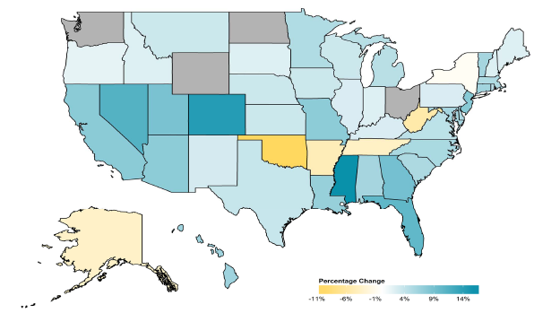
2014 Workers Compensation Direct Written Premium Growth, by State*
PRIVATE CARRIERS: Overall 2014 Growth = +4.6%
While growth rates varied widely, most states experienced positive growth in 2014
*Excludes monopolistic fund states (in gray): OH, ND, WA and WY.
Source: NCCI.

Slide 61
2013 Workers Compensation Direct Written Premium Growth, by State*
PRIVATE CARRIERS: Overall 2013 Growth = +5.4%
While growth rates varied widely, all states experienced positive growth in 2013
*Excludes monopolistic fund states (in white): OH, ND, WA and WY.
Source: NCCI.

Slide 62
Workers Compensation Components of Written Premium Change, 2013 to 2014
Written Premium Change from 2013 to 2014
Net Written Premium—Countrywide | +4.6%
Direct Written Premium—Countrywide | +4.6%
Direct Written Premium—NCCI States | +4.5%
Components of DWP Change for NCCI States
Change in Carrier Estimated Payroll | +4.7%
Change in Bureau Loss Costs and Mix | -1.4%
Change in Carrier Discounting | +0.4%
Change in Other Factors | +0.8%
Combined Effect | +4.5%
Growth is now almost entirely payroll driven
Sources: Countrywide: Annual Statement data.
NCCI States: Annual Statement Statutory Page 14 for all states where NCCI provides ratemaking services.
Components: NCCI Policy data.

Slide 63
WC Approved Changes in Bureau Premium Level (Rates/Loss Costs)
Percent
By Effective Date for Total Market
Cumulative 2000–2003
+17.1%
Cumulative 2011–2014
+11.8%
Cumulative 1994–1999
-27.8%
Cumulative 2004–2011
-30.8%
Cumulative
1990–1993
+36.3%
Approved rates/loss costs are down for the first time since 2010
Calendar Year
*States approved through 4/24/15.
Note: Bureau premium level changes are countrywide approved changes in advisory rates, loss costs and assigned risk rates as filed by applicable rating organization, relative to those previously approved.
Source: NCCI.

Slide 64
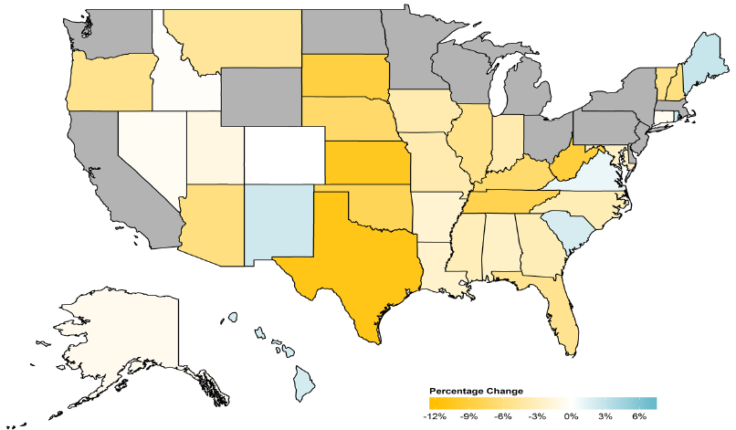
WC Approved or Filed and Pending Change in NCCI Premium Level by State
Latest Change for Voluntary Market
While growth rates varied widely, most states experienced positive growth in 2014
*Excludes monopolistic fund states (in gray): OH, ND, WA and WY.
Source: NCCI.

Slide 65
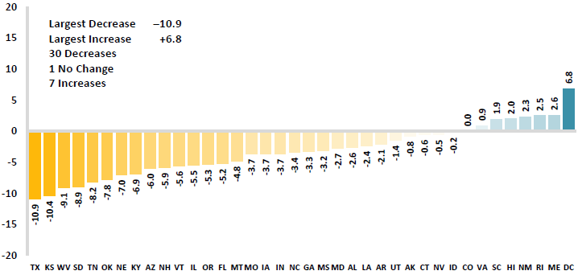
WC Approved or Filed and Pending Change in NCCI Premium Level by State
Latest Change for Voluntary Market
Excludes Law-Only Filings
The majority of states experienced decreases in rates/loss costs over
Note: Premium level changes are approved changes are approved or filed and pending changes in advisory rates, loss costs and rating values as of 4/24/15 as filed by applicable rating organization, relative to those previously approved. SC is filed and pending. IN and NC are in cooperation with state rating bureaus.
Source: NCCI.

Slide 66
Workers Compensation Lost-Time
Claim Frequency Declined in 2014
Percent
Cumulative Change of –51.1%
(1994–2013 adj.)
*Adjustments primarily due to significant audit activity.
2014p: Preliminary based on data valued as of 12/31/2014.
Source: NCCI Financial Call data, developed to ultimate and adjusted to current wage an voluntary loss cost level; Excludes high deductible policies; 1994-2013: Based on data through 12/31/13. Data for all states where NCCI provides ratemaking services, excluding WV.
Frequency is the number of lost-time claims per $1M pure premium at current wage and voluntary loss cost level
Accident Year

Slide 67
Workers Comp Indemnity Claim Costs: Modest Increase in 2014
Average Indemnity Cost per Lost-Time Claim
Indemnity
Claim Cost ($ 000s)
Average indemnity costs per claim were up 4% in 2014 to $23,600, the largest increase since 2008
+1.9%
+4%
Cumulative Change = 141%
(1991-2014p)
Accident Year
2014p: Preliminary based on data valued as of 12/31/2014.
1991-2013: Based on data through 12/31/2013, developed to ultimate
Based on the states where NCCI provides ratemaking services including state funds, excluding WV; Excludes high deductible policies.
Notes:
67
Exhibit 11 of Article

Slide 68
WC Indemnity Severity vs. Wage Inflation, 1995 -2014p
Indemnity severities usually outpace wage gains
Annual Change 1994–2014
Indemnity Claim Sev.: +4.6
US Avg. Weekly Wage: +3.4%
WC indemnity severity turned positive again in 2011
2014p: Preliminary based on data valued as of 12/31/2014; 1991-2010: Based on data through 12/31/2010, developed to ultimate. Based on the states where NCCI provides ratemaking services. Excludes the effects of deductible policies. CPS = Current Population Survey.
Source: NCCI

Slide 69
Workers Compensation Medical Severity:
Moderate Increase in 2014
Medical
Claim Cost ($000s)
Average Medical Cost per Lost-Time Claim
Medical severity for lost time claims was up 4% in 2014, the largest increase since 2009
Annual Change 1991–1993: +1.9%
Annual Change 1994–2001: +8.9%
Annual Change 2002–2010: +6.0%
Cumulative Change = 263%
(1991-2014p)
Accident Year
Accident Year
2014p: Preliminary based on data valued as of 12/31/2014.
1991-2013: Based on data through 12/31/2013, developed to ultimate
Based on the states where NCCI provides ratemaking services including state funds, excluding WV; Excludes high deductible policies.

Slide 70
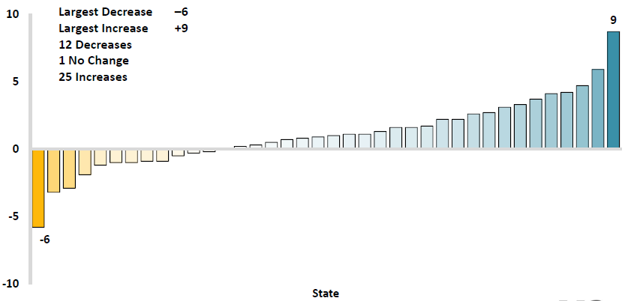
Workers Comp Change in Medical Severity by State, Avg. Annual Change, 2009-2013
Percent
The change in lost-time medical severities from 2009-2013 ranged from a low of -6% to a high of 9%
While growth rates varied widely, most states experienced positive growth in 2014
Source: NCCI’s Analysis of Frequency and Severity of Claims Across the Country as of 12/31/13 on ncci.com.
Values reflect methodology and state data underlying the most recent rate/lost cost filing.
TX changes are for the years 2010-2013.

Slide 71
Annual Inflation Rates, (CPI-U, %),
1990–2016F
Annual Inflation Rates (%)
Inflation peaked at 5.6% in August 2008 on high energy and commodity crisis. The recession and the collapse of the commodity bubble reduced inflationary pressures in 2009/10
Inflationary expectations have slipped (due in part to falling energy costs) allowing the Fed to maintain low interest rates
Slack in the U.S. economy and falling energy prices suggests that inflationary pressures should remain subdued for an extended period of times
Sources: US Bureau of Labor Statistics; Blue Chip Economic Indicators, 5/15 (forecasts).

Slide 72
Workers Compensation
Change in Medical Severity
Comparison to Change in Medical Consumer Price Index (CPI)
Percent Change
Average Annual Change: 1994—2014
Lost-Time Medical Severity: +6.4%
US Medical CPI: +3.7%
Year
2014p: Preliminary based on data valued as of 12/31/2014.
Sources: Severity: 995-2013: Based on data through 12/31/2013, developed to ultimate
Based on the states where NCCI provides ratemaking services including state funds, excluding WV; Excludes high deductible policies.
US Medical CPI: US Bureau of Labor Statistics.

Slide 73
WC Medical Severity Generally Outpaces the Medical CPI Rate
Average annual increase in WC medical severity from 1995 through 2014 was well above the medical CPI (6.4% vs. 3.7%), but the gap has narrowing. Lost-time medical severities appear to on the rise again.
Sources: Med CPI from US Bureau of Labor Statistics, WC med severity from NCCI based on NCCI states.

Slide 74
Medical Cost Inflation vs. Overall CPI, 1995 – 2014*
Though moderating, medical inflation will continue to exceed inflation in the overall economy
Average Annual Growth Average 1995 – 2013
Healthcare: 3.8%
Total Nonfarm: 2.4%
*July 2014 compared to July 2013.
Sources: Med CPI from US Bureau of Labor Statistics, WC med severity from NCCI based on NCCI states.

Slide 75
U.S. Health Care Expenditures,
1965–2022F
$ Billions
From 1965 through 2013, US health care expenditures had increased by 69 fold. Population growth over the same period increased by a factor of just 1.6. By 2022, health spending will have increased 119 fold.
U.S. health care expenditures have been on a relentless climb for most of the past half century, far outstripping population growth, inflation of GDP growth
Sources: Centers for Medicare & Medicaid Services, Office of the Actuary at http://www.cms.gov/Research-Statistics-Data-and-Systems/Statistics-Trends-and-Reports/NationalHealthExpendData/NationalHealthAccountsProjected.html accessed 3/14/14; Insurance Information Institute.

Slide 76
National Health Care Expenditures as a Share of GDP, 1965 – 2022F*
% of GDP
Health care expenditures as a share of GDP rose from 5.8% in 1965 to 18.0% in 2013 and are expected to reach 19.9% of GDP by 2022
2022 19.9%
2010: 17.9%
2000: 13.8%
1990: 12.5%
Since 2009, heath expenditures as a % of GDP have flattened out at about 18%--the question is why and will it last?
1980: 9.2%
1965 5.8%
Sources: Centers for Medicare & Medicaid Services, Office of the Actuary at http://www.cms.gov/Research-Statistics-Data-and-Systems/Statistics-Trends-and-Reports/NationalHealthExpendData/NationalHealthAccountsProjected.html accessed 3/14/14; Insurance Information Institute.

Slide 77
Recent Attacks on the Insurance Industry
Why Are Critics Suddenly More Aggressive?
77

Slide 78
What’s Driving Attacks on the Insurance Industry?
Recent Surge in Attacks is Associated with Income Inequality Debate in the United States
  Attacks not confined to auto insurance (e.g., Workers Comp, Health)
  Not confined to insurance (banks, lending in general, student loans)
Politics, Economics, Regulation & Demographics Are Principal Drivers
  CFA/CR and others (ProPublica) emboldened in current environment
  Dodd-Frank Act stuffed with income inequality mandates and studies
  FIO now studying auto insurance affordability; Wants to create index.
  Definition of “fairness” is shifting
CFA Has Been Able to Attack Certain Rating Factors Based on New Perception of Fairness (which is independent of actual risk)
  Education Occupation Marital Status Gender
  Age Credit Profile Location “Price Optimization”
All of These Are Vulnerable to Attack in the Current Environment
Infinite Number of Quotes Online→CFA Uses to Highlight Perceived Inequities

Slide 79

I.I.I. Actions: NCOIL Hearing Testimony
Testified as industry’s witness at July 17 National Conference of Insurance Legislators’ hearing on Price Optimization;
Worked very closely with PCI, AIA, NAMIC and independent companies.

Slide 80
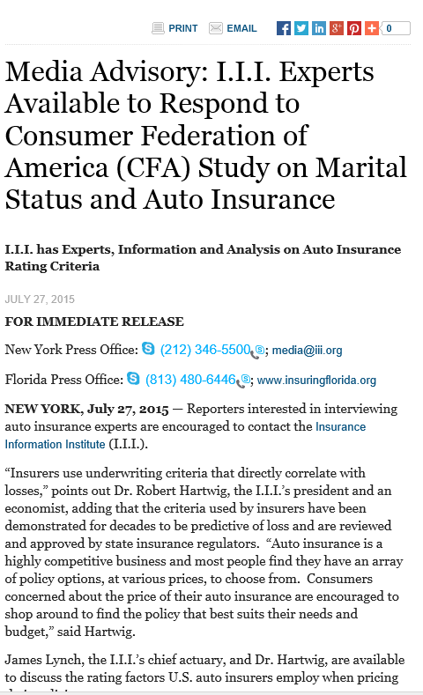
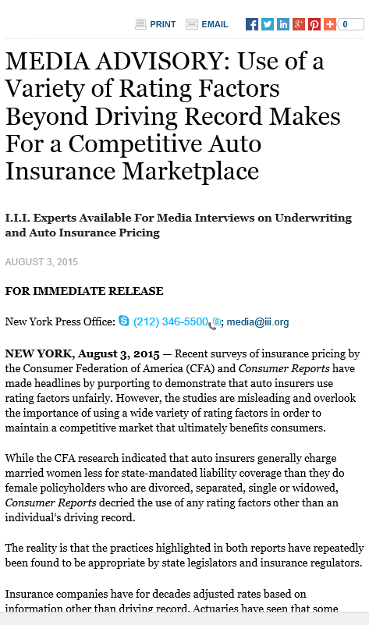
I.I.I. Media Advisories

Slide 81
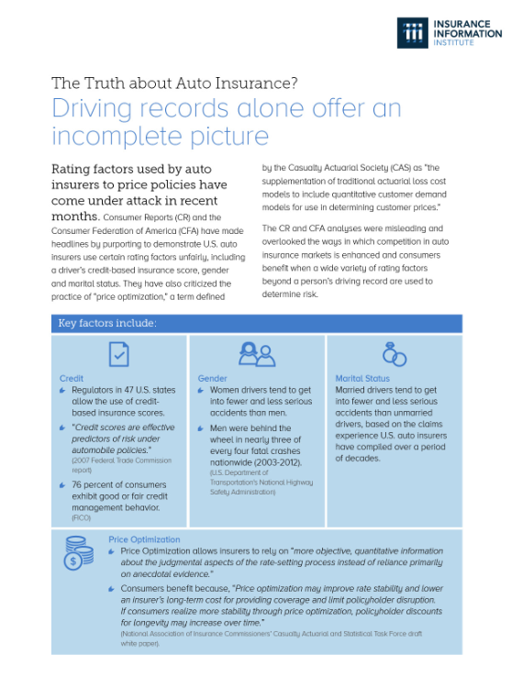
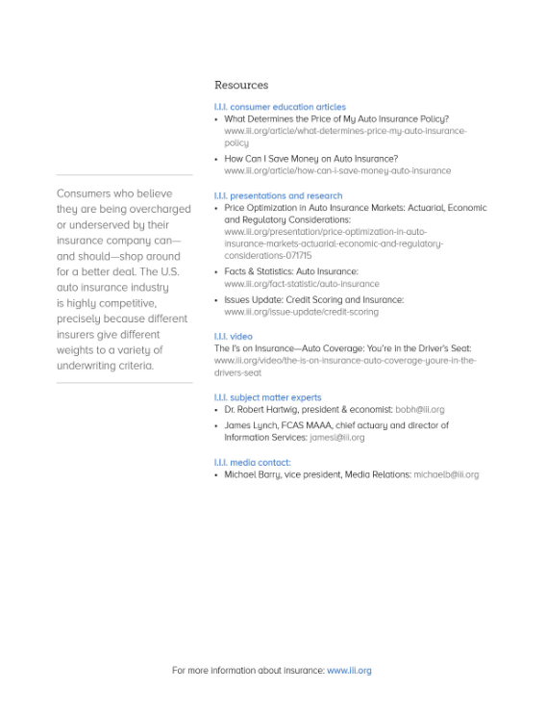
Handout for Government Affairs Staff Attending NAIC Meeting

Slide 82
Growth Analysis by State and Business Segment
Post-Crisis Paradox?
Premium Growth Rates Vary Tremendously by State
82

Slide 83
Direct Premiums Written: Total P/C
Percent Change by State, 2007-2014
Top 25 States
North Dakota was the country’s growth leader over the past 7 years with premiums written expanding by 70.7%, fueled by the state’s energy boom
Growth Benchmarks: Total P/C
US: 13.0%
Sources: SNL Financial LC.; Insurance Information Institute.

Slide 84
Direct Premiums Written: Total P/C
Percent Change by State, 2007-2014
Bottom 25 States
Growth was negative in 4 states and DC between 2007 and 2014
Sources: SNL Financial LC.; Insurance Information Institute.

Slide 85
Net Premium Growth (All P/C Lines): Annual Change, 1971—2015:H1
(Percent)
1975-78
1984-87
2000-03
Net Written Premiums Fell 0.7% in 2007 (First Decline Since 1943) by 2.0% in 2008, and 4.2% in 2009, the First 3-Year Decline Since 1930-33.
2015:H1: 4.1%
2014: 4.1%
2013: 4.4%
2012: +4.2%
Shaded areas denote “hard market” periods
Sources: A.M. Best (1971-2013), ISO (2014-15).

Slide 86
Direct Premiums Written: Comm. Lines
Percent Change by State, 2007-2014
Top 25 States
43 states showed commercial lines growth from 2007 through 2014
Growth Benchmarks: Commercial
US: 5.9%
Sources: SNL Financial LLC.; Insurance Information Institute.

Slide 87
Direct Premiums Written: Comm. Lines
Percent Change by State, 2007-2014
Bottom 25 States
Nearly half the states have yet to see commercial lines premium volume return to pre-crisis levels
States with the poorest performing economies also produced the most negative net change in premiums of the past 6 years
Sources: SNL Financial LLC.; Insurance Information Institute.

Slide 88
Direct Premiums Written: Workers’ Comp
Percent Change by State, 2007-2014*
Top 25 States
Only 21 states have seen works comp premium volume return to pre-crisis levels
*Excludes monopolistic fund states: ND, OH, WA, WY as well as WV, which transitioned to a competitive structure during this period.
Sources: SNL Financial LC.; Insurance Information Institute.

Slide 89
Direct Premiums Written: Worker’s Comp
Percent Change by State, 2007-2014*
Bottom 25 States
States with the poorest performing economies also produced some of the most negative net change in premiums of the past 7 years
*Excludes monopolistic fund states: ND, OH, WA, WY as well as WV, which transitioned to a competitive structure during this period.
Sources: SNL Financial LC.; Insurance Information Institute.

Slide 90
Pricing Trends
Survey Results Suggest Commercial Pricing Has Flattened Out but Personal Lines Are Up
90

Slide 91
Monthly Change in Auto Insurance Prices, 1991–2015*
Cyclical peaks in PP Auto tend to occur roughly every 10 years (early 1990s, early 2000s and likely the early 2010s)
Pricing peak occurred in late 2010 at 5.3%, falling to 2.8% by Mar. 2012
“Hard” markets tend to occur during recessionary periods
July 2015 reading of 5.4% is up from 4.2%
a year earlier
*Percentage change from same month in prior year; through July 2015; seasonally adjusted
Note: Recessions indicated by gray shaded columns.
Sources: US Bureau of Labor Statistics; National Bureau of Economic Research (recession dates); Insurance Information Institutes.
91
12/01/09 - 9pm
eSlide – P6466 – The Financial Crisis and the Future of the P/C
Notes:
91

Slide 92
Average Commercial Rate Change,
All Lines, (1Q:2004–1Q:2015)
(Percent)
Q2 2011 marked the last of 30th consecutive quarter of price declines
Pricing as of Q1:2015 had turned (slightly) negative for only the 3rd time in 3 years
KRW Effect
Note: CIAB data cited here are based on a survey. Rate changes earned by individual insurers can and do vary, potentially substantially.
Source: Council of Insurance Agents & Brokers; Insurance Information Institute

Slide 93
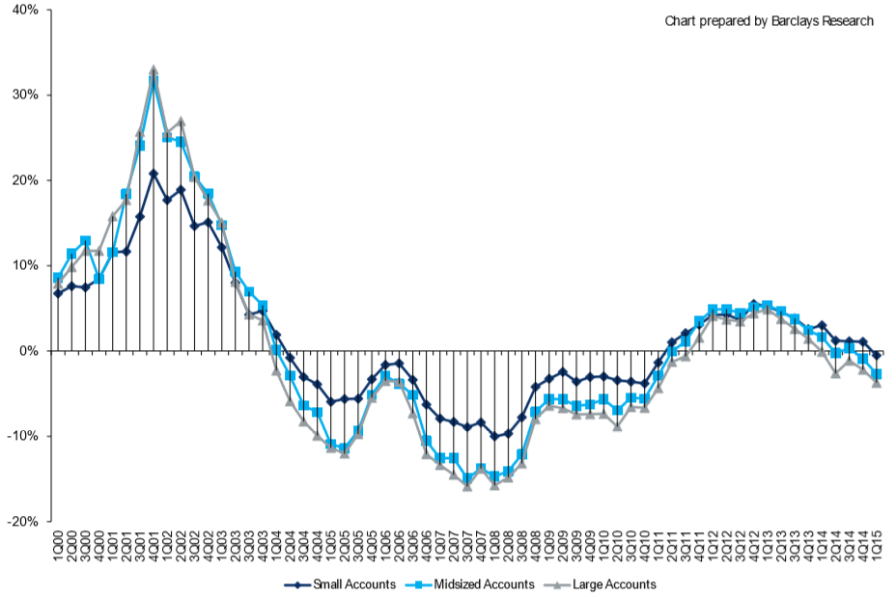
Change in Commercial Rate Renewals, by Account Size: 1999:Q4 to 2015:Q1
Percentage Change (%)
Peak = 2001:Q4 +28.5%
Pricing turned positive in Q3:2011, the first increase in nearly 8 years
Pricing Turned Negative in Early 2004 and Remained that way for 7 ½ years
KRW : No Lasting Impact
Rate trends are roughly flat, some carriers reporting small gains, others flat, others small declines
Trough = 2007:Q3 -13.6%
Source: Council of Insurance Agents and Brokers; Barclay’s Capital; Insurance Information Institute.
Note: CIAB data cited here are based on a survey. Rate changes earned by individual insurers can and do vary, potentially substantially.

Slide 94
Change in Commercial Rate Renewals, by Line: 2015:Q1
Employment Practices rate increases are large than any other line, followed by Commercial Auto and D&O
Percentage Change (%)
Major Commercial Lines Renewals Were Mixed to Flat in Q1:2015; EPL and Commercial Auto Led the Way
Note: CIAB data cited here are based on a survey. Rate changes earned by individual insurers can and do vary, potentially substantially.
Source: Council of Insurance Agents and Brokers; Insurance Information Institute.

Slide 95
How the Risk Dollar is Spent
(U.S. Firms with Revenues Under $1 Bill)
Source: 2015 RIMS Benchmark Survey; Insurance Information Institute.
95
Notes:
95

Slide 96
M&A UPDATE:
A PATH TO GROWTH?
Are Capital Accumulation, Drive for Growth and Scale Stimulating M&A Activity?
96

Slide 97
U.S. INSURANCE MERGERS AND ACQUISITIONS,
P/C SECTOR, 1994-2014 (1)
M&A activity in 2015 will likely reach its highest level since 1998
M&A activity in the P/C sector was up sharply in 2014 but remains well below pre-crisis or late 1990s levels.
($ Millions)
(1) Includes transactions where a U.S. company was the acquirer and/or the target.
Source: Conning proprietary database.

Slide 98
Top Global P&C M&As in 2014 - YTD 2015
Acquirer | Target | Transaction Value
ACE (Switzerland) | Chubb (US) | $28,300
Exor (Italy) | PartnerRe Ltd. (Bermuda) | $6,900
Zurich (Switzerland) | RSA (UK) | 8,000
XL Group plc (Ireland) | Catlin Group Ltd. (Bermuda) | 4,200
RenaissanceRe Holdings Ltd. (Bermuda) | Platinum Underwriters Holdings Ltd. (Bermuda) | 1,900
Fairfax Financial Holdings Ltd. (Canada) | Brit Insurance Holdings NV (Netherlands) | 1,880
Desjardins Financial Corp. (Canada) | State Farm's property/casualty and life insurance operations in Canada (Canada) | 1,500
TPG Capital LP | The Warranty Group, Inc. (Canada) | 1,500
Fosun International Ltd. (China) | Caixa Seguros e Saude SGPA SA (Portugal) | 1,360
Progressive Corp. | ARX Holding Corp. | 875
Assured Guaranty Ltd. (Bermuda) | Radian Asset Assurance, Inc. | 810
Mapfre S.A. (Spain) | German and Italina operations of Direct Line Insurance Group plc (Germany/Italy) | 701
Validus Holdings Ltd. (Bermuda) | Western World Insurance Group, Inc. | 690
ACE Ltd. (Switzerland) | P&C business from Itau Seguros S.A. (Brazil) | 685
Update: Alleghany Corp. announced in May 2015 that it is considering the sale of TransAtlantic Holding Co. (TransRe).
*Source: Conning; Insurance information Institute.

Slide 99
Recent M&A Transactions Involving
Lloyd's and Bermuda Re/Insurers
Date | Acquirer | Target | Deal Value $ Billion
Dec 2012 | Aquiline | Equity Redstar | 0.1
Jun 2013 | Enstar/Stone Point | Atrium | 0.2
Jul 2013 | Enstar/Stone Point | Torus | 0.7
Aug 2013 | Ian Beaton and Management | Ark Syndicate Management | 0.4
Aug 2013 | Lancashire | Cathedral | 0.4
Aug 2013 | AmTrust | Sagicor | 0.1
Sep 2013 | ANV | Jubilee Managing Agency | N/A
Dec 2013 | Sompo | Canopius | 1.0
Feb 2014 | Qatar Insurance Company | Antares | 0.2
Jul 2014 | BTG Pactual | Ariel Re | 0.4
Nov 2014 | RenaissanceRe | Platinum Underwriters | 1.9
Dec 2014 | XL Group | Catlin | 4.1
Jan 2015 | PartnerRe | AXIS | 11.0*
Feb 2015 | Fairfax Financial Holdings | Brit | 1.9
*Deal was not complete as of 6/4/15 and a rival bid from Italian investment firm Exor was still under consideration.
Source: Swiss Re sigma 3/2015; Insurance information Institute.

Slide 100
What’s Driving Global Insurance M&A Activity and Will It Continue?
Excess Capital in Global Reinsurance and Primary Commercial Insurance in US
  (Re)Insurers, like corporations in many industry, are sitting are large amounts of cash accumulated since the Global Financial Crisis that earns very little
Alternative Capital
Slow Top Line (Premium) Growth
Slowdown in Pace of Earnings Growth/ROE
Low Interest Rates Make Debt Financing for Acquisitions Attractive
  Concern that interest rates in US may soon rise so best to act now
Desire to Achieve Economies of Scale
Peer Pressure/Momentum
  Management concerns about being “left out”

Slide 101
Insured Catastrophe Losses
2013/14 and YTD 2015 Experienced Below Average CAT Activity After Very High CAT Losses in 2011/12
Winter Storm Losses Far Above Average in 2014 and 2015
101

Slide 102
U.S. Insured Catastrophe Losses
($ Billions, $ 2014)
2012 was the 3rd most expensive year ever for insured CAT losses
2013/14 Were Welcome Respites from 2011/12, among the Costliest Years for Insured Disaster Losses in US History. Longer-term Trend is for more—not fewer—Costly Events
$10.3B in insured CAT losses though 6/30/15, up slightly from $7.3B in 2014
*Through 6/30/15 in 2015 dollars.
Note: 2001 figure includes $20.3B for 9/11 losses reported through 12/31/01 ($25.9B 2011 dollars). Includes only business and personal property claims, business interruption and auto claims. Non-prop/BI losses = $12.2B ($15.6B in 2011 dollars.)
Sources: Property Claims Service/ISO; Insurance Information Institute.
102
12/01/09 - 9pm
eSlide – P6466 – The Financial Crisis and the Future of the P/C
Notes:
102

Slide 103
Loss Events in the US, 1980 – 2014
Overall and Insured Losses
Overall losses totaled $25bn; Insured losses totaled $15.3bn
$ Billions
2015 First Half:
$8.2 Billion Insured Losses
$12.0 Overall Losses
Overall losses
(in 2013 values)*
Insured losses
(in 2013 values)*
*Losses adjusted to inflation based on CPI.
Source: Property Claim Services, MR NatCatSERVICE.
103

Slide 104
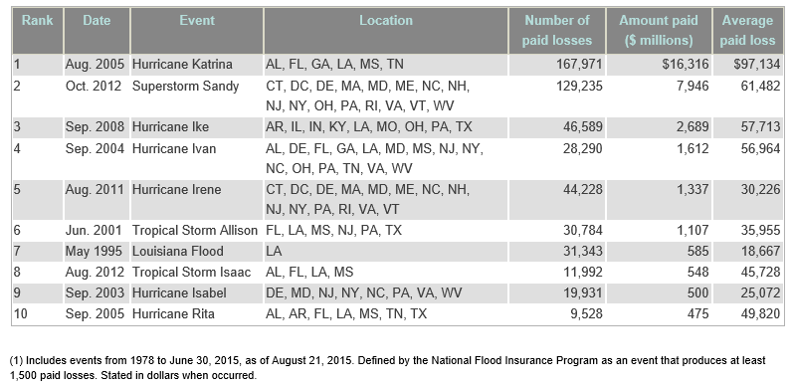
Top 10 Largest NFIP Flood Claim Payout Events
Source: NFIP; Insurance information Institute http://www.iii.org/issue-update/flood-insurance

Slide 105
Number of National Flood Insurance Program Policies in Force at Year-End, 1980-2015*
(millions)
The number of NFIP policies in force has plunged by 549,000 or 9.6% since 2009, even as coastal development surges and sea levels rise
Source: National Flood Insurance Program.
* As of July, 2015

Slide 106
Take-Up Rates for Various Types of Insurance in the U.S.
Take-Up Rate
Take-up rates vary widely by type of coverage
Sources: CA Earthquake (WSJ, http://www.wsj.com/articles/california-pushes-homeowners-to-insure-against-earthquakes-1440980138 ); Flood and Renters (I.I.I. June 2015 Pulse Survey); Cyber (Advisen, 2015); Terrorism (Marsh Global Analytics, 2014 Terrorism Risk Insurance Report, April 2014; data for 2013); Pvt. Passenger Auto (Insurance Research Council, Uninsured Motorists, 2014 Edition, data for 2012); Home and Workers Comp (I.I.I. estimates); Insurance Information Institute research.

Slide 107
Top 16 Most Costly Disasters in U.S. History—Katrina Still Ranks #1
(Insured Losses, 2014 Dollars, $ Billions)
Storm Sandy in 2012 was the last mega-CAT to hit the US
Includes Tuscaloosa, AL, tornado
Includes Joplin, MO, tornado
12 of the 16 Most Expensive Events in US History Have Occurred Since 2004
Sources: PCS; Insurance Information Institute inflation adjustments to 2014 dollars using the CPI.

Slide 108
Combined Ratio Points Associated with Catastrophe Losses: 1960 – 2015F*
Avg. CAT Loss Component of the Combined Ratio by Decade
1960s: 1.04 1970s: 0.85 1980s: 1.31 1990s: 3.39 2000s: 3.52 2010s: 5.82*
Catastrophe losses as a share of all losses reached a record high in 2011
Combined Ratio Points
The Catastrophe Loss Component of Private Insurer Losses Has Increased Sharply in Recent Decades
*2010s represent 2010-2014.
Notes: Private carrier losses only. Excludes loss adjustment expenses and reinsurance reinstatement premiums. Figures are adjusted for losses ultimately paid by foreign insurers and reinsurers.
Source: ISO (1960-2010); A.M. Best (2011-15E) Insurance Information Institute.

Slide 109
Inflation Adjusted U.S. Catastrophe Losses by Cause of Loss, 1995–2014¹
Wind/Hail/Flood (3), $21.4
Fires (4), $6.0
Winter storm losses were much above average in 2014/15 are will push this share up
Other (5), $0.2
Insured cat losses from 1995-2014 totaled $395.6B, an average of $19.8B per year or $1.65B per month
Geological Events, $0.5
Terrorism, $24.5
Winter Storms, $26.9
Hurricanes & Tropical Storms, $161.2
Tornado share of CAT losses is rising
Wind losses are by far cause the most catastrophe losses, even if hurricanes/TS are excluded.
Events Involving Tornadoes (2), $154.9
Catastrophes are defined as events causing direct insured losses to property of $25 million or more in 2014 dollars.
Excludes snow.
Does not include NFIP flood losses
Includes wildland fires
Includes civil disorders, water damage, utility disruptions and non-property losses such as those covered by workers compensation.
Source: ISO’s Property Claim Services Unit.

Slide 110
Convective Loss Events in the US
Overall and insured losses, 1980 – 2014
Overall losses
(in 2014 values)*
$ Billions
The period from 2008-2014 has been the most expensive on record for insured losses from “Convective Events” (severe thunderstorms, tornado, hail, lightning and flash flood)
Insured losses
(in 2014 values)*
2015 First Half:
$5.1 Billion Insured Losses
$7.0 Overall Losses
*Losses adjusted to inflation based on CPI
Analysis contains:
severe storm, tornado, hail, flash flood and lightning
110
Source: Geo Risks Research, NatCatSERVICE

Slide 111
Top 5 Insured Catastrophe Losses in 2015*
As in 2014, a “Polar Vortex” event was the most costly cat through the first half of 2015 with $1.84 billion in insured losses
($ Millions)
In 2015, Winter Storm cat events resulting in $2.3 billion in insured losses, little changed from $2.4 billion in 2013. These figures are about double the long-term average.
*Through June 10, 2015.
Sources: PCS unit of Verisk Analytics; Insurance Information Institute.

Slide 112
Winter Storm and Winter Damage Events in the US, 1980-2015 (2014 US$)
Three of the four most costly years ever for insured losses from winter storms and damage occurred in the 1990s, led by the “Storm of the Century” in 1993.
2015 insured winter storm losses totaled $2.3B, similar to 2014 and about double the long-run average
$ Billions, in 2014 Dollars
5-year running average
*Winter storms include winter damage, blizzard, snow storm and cold wave
**Losses adjusted to inflation based on country CPI
Source: Property Claim Services, MR NatCatSERVICE.
112

Slide 113
Natural Disaster Losses in the U.S.,
First Half 2015
As of July 1, 2015 | Number of Events | Fatalities | Estimated Overall Losses (US $m) | Estimated Insured Losses (US $m)*
Severe Thunderstorm | 38 | 66 | 7,000 | 5,100
Winter Storms & Cold Waves | 11 | 80 | 3,800 | 2,900
Flood, Flash Flood | 10 | 4 | 500 | 150
Earthquake & Geophysical | 1 | - | - | -
Tropical Cyclone | 2 | 4 | Loss est. in progress | Loss est. in progress
Wildfire, Heat Waves, & Drought | 18 | - | 1,300 | Minor market loss
Totals | 80 | 154 | 12,600 | 8,200
113
*Source: Property Claim Services (PCS) as of 7/7/2015; Munich Re.

Slide 114
Natural Disaster Losses in the US, 2014
Based on perils
As of January, 2015 | Number of Events | Fatalities | Estimated Overall Losses (US $m) | Estimated Insured Losses (US $m)
Severe Thunderstorm | 62 | 98 | 17,000 | 12,300
Winter Storm, winter damage, cold wave, snow storm | 13 | 115 | 3,700 | 2,300
Flood, flash flood, storm surge | 20 | 5 | 1,800 | 500
Earthquake & Geophysical, landslides | 11 | 45 | 750 | 150
Tropical Cyclone | 2 | 1 | 95 | Minor market losses
Wildfire, Heat, & Drought | 11 | 2 | 1,700 | Minor market losses
Totals | 119 | 266 | 25,000 | 15,300
Source: Munich Re.
114

Slide 115
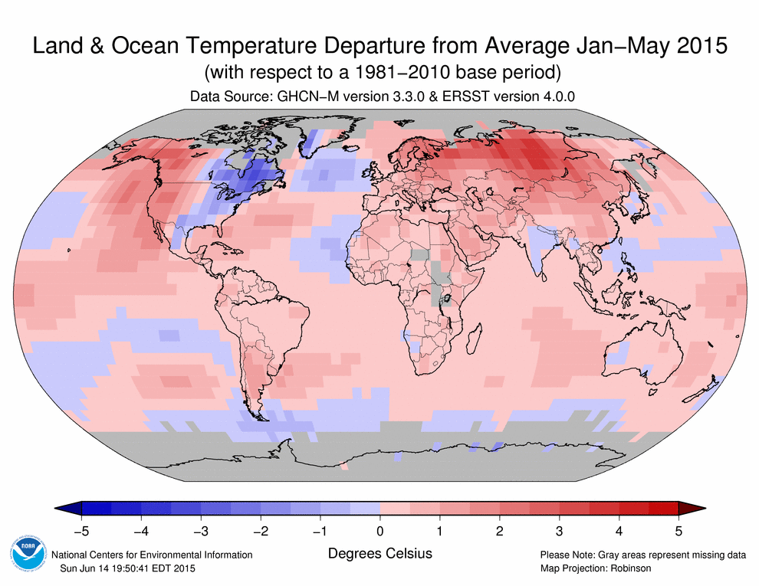
The World is Warmer...With One Big Exception!
HIGHLIGHTS
2014 was the warmest year across global land and ocean surfaces since records began in 1880.
9 of the 10 warmest years in the 135-year period of record have occurred in the 21st century. 1998 currently ranks as the fourth warmest year on record.
January to May 2015 warmest first five months on record!
Source: NOAA; Munich Re.

Slide 116
Top 11 Insured Loss Events from Riots and Civil Commotion
Year | Deaths | Date | State | Insured Loss When Occurred | Insured Losses (2014 $MM)
1992 | 14 | Apr 29 - May 4 | CA | 775,000,000 | 1,307.7
1980 | 62 | May 17 - 19 | FL | 65,250,000 | 187.5
1967 | 48 | Jul 23 - 31 | MI | 41,500,000 | 294.2
1965 | 87 | 11-Aug | CA | 38,000,000 | 285.6
1977 | 99 | Jul 13 - 14 | NY | 28,000,000 | 109.4
1967 | 47 | Jul 12 - 21 | NJ | 11,000,000 | 78.0
1966 | 20 | 12-Jul | IL | 4,000,000 | 29.2
2015 | 0 | Apr 18 – May 1 | MD | 23,900,000 | 23.9*
1971 | 63 | Jun 13 - 15 | NM | 3,000,000 | 17.5
1977 | 11 | Jul 13 - 14 | NY | 2,000,000 | 7.8
1968 | 77 | Jul 23 - 24 | OH | 1,500,000 | 10.2
April 2015 Baltimore riots were designated a PCS CAT event on April 29 (first PCS designation for a riot in 23 years) as of 6/10/15 insured losses totaled $23.9 million (2014 Ferguson riots did not receive PCS designation)
*As of 6/10/15.
Source: PCS unit of Verisk Analytics; Insurance Information Institute

Slide 117
Insurance Coverage for Riots and Civil Commotions: Home, Auto and Business
Auto, homeowners, and business insurance policies generally include coverage for property losses caused by riots and civil commotions
Homeowners policies pay to repair, or rebuild, an insured home if its structure is damaged or destroyed as the result of a riot or civil commotion, as well as to replace the homeowner’s personal belongings if they are damaged or stolen during the event.
  If the home is rendered uninhabitable by the damage caused by a riot or civil commotion, policyholders can file an additional living expenses (ALE) claim to finance their temp. housing expenses until the residence has been repaired.
The optional comprehensive coverage on an auto insurance policy reimburses losses to a vehicle due to damage caused by falling objects, fire, riots and vandalism, among other things.
Standard business property insurance policies provide coverage for the structure of the building as well as the contents inside, and cover losses arising from riots or civil commotion. Business interruption (BI) coverage, whereby the policyholder can file a claim for lost income, is usually only triggered when the insured business incurs direct physical damage.
Source: Insurance Information Institute, www.iii.org .

Slide 118
Loss events in the US, 1980 – 2014
Number of events
2014 Total:
119 Events
2015 First Half:
80 Events
Number of Events
Geophysical events
(Earthquake, tsunami,
volcanic activity)
The number of loss events surged from 2006 – 2010, though insured losses remained elevated through 2012
Meteorological events
(Tropical storm, extratropical storm, convective storm,
local storm)
Hydrological events
(Flood,
mass movement)
16
Climatological events
(Extreme temperature,
drought, forest fire)
24
72
7
Source: Geo Risks Research, NatCatSERVICE
118

Slide 119
Federal Disaster Declarations Patterns: 1953-2015
Disaster Declarations Set New Records in Recent Years
119

Slide 120
Number of Federal Major Disaster Declarations, 1953-2015*
There have been 2,239 federal disaster declarations since 1953. The average number of declarations per year is 36 from 1953-2014, though there haven’t been that few recorded since 1995.
The number of federal disaster declarations set a new record in 2011, with 99, shattering 2010’s record 81 declarations.
36 federal disasters have declared so far in 2015*
The Number of Federal Disaster Declarations Is Generally Rising and Set New Records in 2010 and 2011 Before Dropping in 2012-2014
*Through October 3, 2015.
Source: Federal Emergency Management Administration; http://www.fema.gov/disasters; Insurance Information Institute.

Slide 121
Federal Disasters Declarations by State,
1953 – 2015: Highest 25 States*
Over the past 60 years, Texas has had the highest number of Federal Disaster Declarations
*Through Oct. 3, 2015. Includes Puerto Rico and the District of Columbia.
Source: FEMA: http://www.fema.gov/news/disaster_totals_annual.fema; Insurance Information Institute.

Slide 122
Federal Disasters Declarations by State,
1953 – 2015: Lowest 25 States*
Over the past 60 years, Wyoming and Utah had the fewest number of Federal Disaster Declarations
*Through Oct. 3, 2015. Includes Puerto Rico and the District of Columbia.
Source: FEMA: http://www.fema.gov/news/disaster_totals_annual.fema; Insurance Information Institute.

Slide 123
Natural Hazard Risk Scores, 2014
Highest 25 States*
Florida received the highest Natural Hazard Risk Score
Note: Score is based on data on 9 natural hazards: flood, wildfire, tornado, storm surge, earthquake, straight-line wind, hurricane, wind, hail and sinkhole.
*Analysis Includes DC. Excludes Alaska and Hawaii due to limited natural hazard risk data.
Sources: CoreLogic release “CoreLogic Identifies US States at Highest Risk of Property Damage Loss from Natural Hazards,” Sept. 10, 2014; Insurance Information Institute.

Slide 124
Natural Hazard Risk Scores, 2014
Bottom 24 States*
Michigan and West Virginia received the lowest Natural Hazard Risk Score
Note: Score is based on data on 9 natural hazards: flood, wildfire, tornado, storm surge, earthquake, straight-line wind, hurricane, wind, hail and sinkhole.
*Analysis Includes DC. Excludes Alaska and Hawaii due to limited natural hazard risk data.
Sources: CoreLogic release “CoreLogic Identifies US States at Highest Risk of Property Damage Loss from Natural Hazards,” Sept. 10, 2014; Insurance Information Institute.

Slide 125
The Strength of the Economy Will Influence P/C Insurer Growth Opportunities
Growth Will Expand Insurer Exposure Base Across Most Lines
125

Slide 126
US Real GDP Growth*
The Q4:2008 decline was the steepest since the Q1:1982 drop of 6.8%
Real GDP Growth (%)
Recession began in in June 2009
Q1 2014/15 GDP data were hit hard by this year’s “Polar Vortex” and harsh winter
Demand for Insurance Should Increase in 2015 as GDP Growth Accelerates Modestly and Gradually Benefits the Economy Broadly
* Estimates/Forecasts from Blue Chip Economic Indicators.
Source: US Department of Commerce, Blue Economic Indicators 9/15; Insurance Information Institute.

Slide 127
State Leading Economic Indicators through November 2015
Growth in the West is finally beginning to pick up
The economic outlook for most of the US is generally positive, though flat-to-negative for 10 states, several of them energy dependent
Sources: Federal Reserve Bank of Philadelphia at http://www.philadelphiafed.org/index.cfm ;Insurance Information Institute.

Slide 128
Real GDP by State Percent Change, 2014*:
Highest 25 States
North Dakota was the economic growth juggernaut of the US in 2014—by far
Only 7 states experienced growth in excess of 3% in 2014, which is a growth rate we would see nationally in a more typical recovery
Growth Benchmarks: Real GDP
US: 2.2%
*Advance statistics
Sources: U.S. Bureau of Economic Analysis; Insurance Information Institute.

Slide 129
Real GDP by State Percent Change, 2014*:
Lowest 25 States
Growth rates in 16 states were still below 1% in 2014
Mississippi and Alaska were the only states to shrink in 2014
*Advance statistics
Sources: US Bureau of Economic Analysis; Insurance Information Institute.

Slide 130
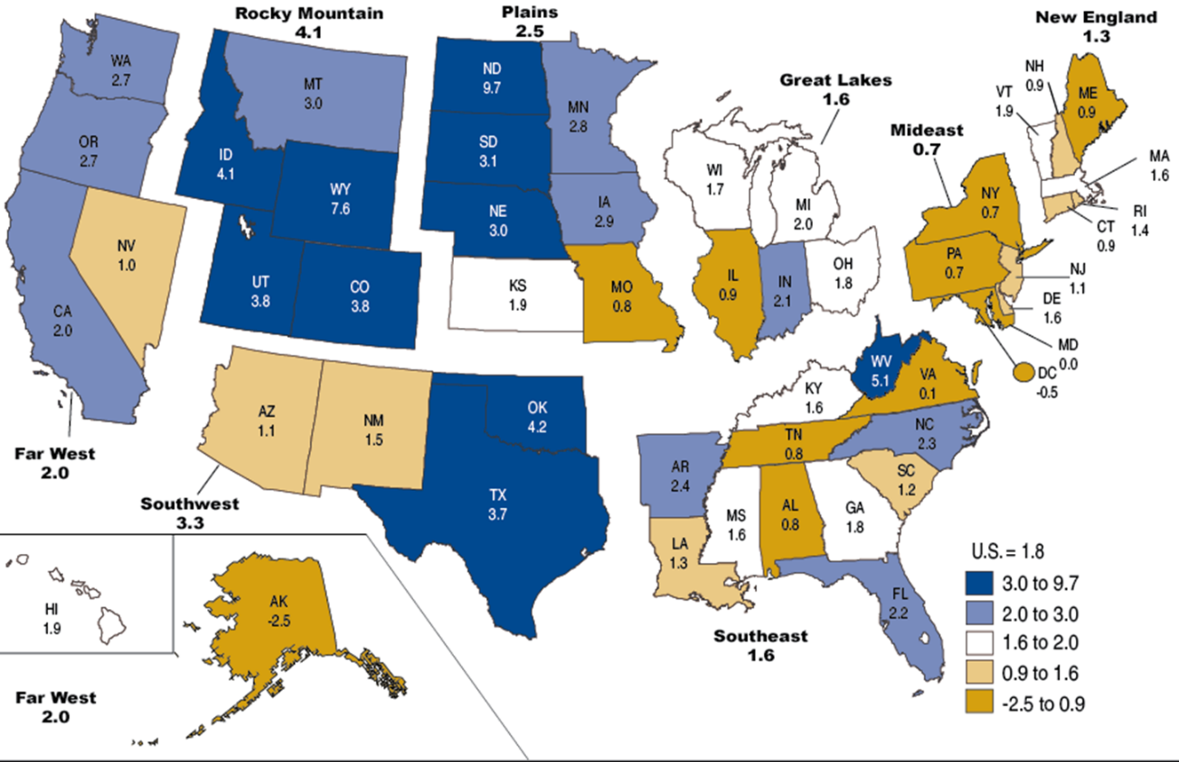
Percent Change in Real GDP by State, 2013
Sources: US Bureau of Economic Analysis; Insurance Information Institute.

Slide 131
Labor Market Trends
Massive Job Losses Sapped the Economy and Commercial/Personal Lines Exposure, But Trend Has Greatly Improved
131

Slide 132
Unemployment and Underemployment Rates: Still Too High, But Falling
January 2000 through September 2015, Seasonally Adjusted (%)
U-6 soared from 8.0% in March 2007 to 17.5% in
October 2009; Stood at 10.0% in Sept. 2015.
8% to 10% is “normal.”
“Headline” unemployment was 5.1% in Sep. 2015. 4.5% to 5.5% is “normal.”
Stubbornly high unemployment and underemployment constrain overall economic growth, but the job market is continuing to improve.
Source: US Bureau of Labor Statistics; Insurance Information Institute.
132
12/01/09 - 9pm
eSlide – P6466 – The Financial Crisis and the Future of the P/C
Notes:
132

Slide 133
Monthly Change in Private Employment
3,042,000 jobs were created in 2014, the most since 1997
January 2007 through Sept. 2015 (000s, Seasonally Adj.)
Jobs Created
2014: 3.042 Mill
2013: 2.452 Mill
2012: 2.315 Mill
2011: 2.396 Mill
2010: 1.282 Mill
118,000 private sector jobs were created in Sept.
Monthly losses in Dec. 08–Mar. 09 were the largest in the
post-WW II period
Private Employers Added 13.03 Million Jobs Since Jan. 2010 After Having Shed 5.01 Million Jobs in 2009 and 3.76 Million in 2008 (State and Local Governments Have Shed Hundreds of Thousands of Jobs)
Source: US Bureau of Labor Statistics: http://www.bls.gov/ces/home.htm; Insurance Information Institute

Slide 134
US Unemployment Rate Forecast
Rising unemployment
eroded payrolls
and WC’s
exposure base.
Unemployment peaked at 10% in late 2009.
2007:Q1 to 2016:Q4F*
Jobless figures have been revised downwards for 2015/16
Unemployment forecasts have been revised modestly downwards. Optimistic scenarios put the unemployment as low as 5.0% by Q4 of 2015.
* = actual; = forecasts
Sources: US Bureau of Labor Statistics; Blue Chip Economic Indicators (9/15 edition); Insurance Information Institute.

Slide 135
Unemployment Rates by State, July 2015:
Highest 25 States*
In July, 24 states and the District of Columbia had over-the-month unemployment rate decreases, 14 states had increases, and 12 states had no change.
*Provisional figures for July 2015, seasonally adjusted.
Sources: US Bureau of Labor Statistics; Insurance Information Institute.

Slide 136
Unemployment Rates by State, July 2015:
Lowest 25 States*
In July, 24 states and the District of Columbia had over-the-month unemployment rate decreases, 14 states had increases, and 12 states had no change.
*Provisional figures for July 2015, seasonally adjusted.
Sources: US Bureau of Labor Statistics; Insurance Information Institute.

Slide 137
CONSTRUCTION INDUSTRY OVERVIEW & OUTLOOK
The Construction Sector Is Critical to the Economy and the P/C Insurance Industry
137

Slide 138
Value of New Private Construction: Residential & Nonresidential, 2003-2015*
2015: Value of new pvt. construction hits $787.8B as of July 2015, up 57.4% from the 2010 trough but still 13.6% below 2006 peak
New Construction peaks at $911.8. in 2006
Billions of Dollars
Trough in 2010 at $500.6B, after plunging 55.1% ($411.2B)
$15.0
$613.7
$407.0
$298.1
$261.8
$380.8
$238.8
Private Construction Activity Is Moving in a Positive Direction though Remains Well Below Pre-Crisis Peak; Residential Dominates
*2015 figure is a seasonally adjusted annual rate as of July.
Sources: US Department of Commerce http://www.census.gov/construction/c30/c30index.html ; Insurance Information Institute.
138
12/01/09 - 9pm
eSlide – P6466 – The Financial Crisis and the Future of the P/C
Notes:
138

Slide 139
Value of Construction Put in Place, July 2015 vs. July 2014*
Growth (%)
Private: +16.9%
Public: +6.1%
Private sector construction activity is up in both the residential and nonresidential segments
Public sector construction activity is finally beginning to create less drag up after years of decline
Overall Construction Activity is Up Again After Languishing in Early 2015; State/Local Sector Government Sector May Be Recovering as Budget Woes Ease in Some Jurisdictions
*seasonally adjusted
Source: U.S. Census Bureau, http://www.census.gov/construction/c30/c30index.html ; Insurance Information Institute.

Slide 140
Value of Private Construction Put in Place, by Segment, July 2015 vs. July 2014*
Led by the Manufacturing, Lodging, Office and Amusement & Recreations segments, Private nonresidential sector construction activity continues to rise after plunging during the “Great Recession.”
Growth (%)
Private Construction Activity is Up in Most Segments in the Second Half of 2015; Expansion Should Continue
*seasonally adjusted
Source: U.S. Census Bureau, http://www.census.gov/construction/c30/c30index.html ; Insurance Information Institute.

Slide 141
Value of Public Construction Put in Place, by Segment, July 2015 vs. July 2014*
Public sector construction activity finally up in most segments after many months of decline, pushing up public entity risk exposures
Residential, Commercial and Conservation lead public sector construction
Growth (%)
Public Construction Activity is Beginning to Recover from its Long Contraction which Will Drive Demand in Many Commercial Insurance Lines
*seasonally adjusted
Source: U.S. Census Bureau, http://www.census.gov/construction/c30/c30index.html ; Insurance Information Institute.

Slide 142
Value of New Federal, State and Local Government Construction: 2003-2015*
Construction across all levels of government peaked at $314.9B in 2009
Austerity Reigns
Govt. construction MAY finally be turning around; still down $16.7B or 5.3% since 2009 peak
($ Billions)
Government Construction Spending Peaked in 2009, Helped by Stimulus Spending, but Contracted As State/Local Governments Grappled with Deficits and Federal Sequestration; Only Now Recovering
*2015 figure is a seasonally adjusted annual rate as of June; http://www.census.gov/construction/c30/historical_data.html
Sources: US Department of Commerce; Insurance Information Institute.

Slide 143
New Private Housing Starts, 1990-2021F
Job growth, low inventories of existing homes, low mortgage rates and demographics should continue to stimulate new home construction for several more years
(Millions of Units)
New home starts plunged 72% from 2005-2009; A net annual decline of 1.49 million units, lowest since records began in 1959
Insurers Are Continue to See Meaningful Exposure Growth in the Wake of the “Great Recession” Associated with Home Construction: Construction Risk Exposure, Surety, Commercial Auto; Potent Driver of Workers Comp Exposure
Source: U.S. Department of Commerce; Blue Chip Economic Indicators (9/15); Insurance Information Institute.

Slide 144
U.S.: Pct. Of Private Housing Unit Starts
In Multi-Unit Projects, 1990-2015
Units in Multiple-Unit Projects
as Percent of Total
A NEW NORMAL?
In 5 of the last 7 years, over 30% of housing unit starts were in 5+-unit projects
For the U.S. as a whole, the trend toward multi-unit housing projects (vs. single-unit homes) is recent. Commercial insurers with Workers Comp, Construction risk exposure, and Surety benefit.
*January through April 2015; April is preliminary; calculations based on seasonally adjusted at annual rates
Sources: U.S. Census Bureau, New Residential Construction in April 2015 and earlier releases; next release June 16, 2015; Insurance Information Institute calculations.

Slide 145
Rental-Occupied Housing Units as % of Total Occupied Units, Quarterly, 1990:Q1-2015:Q1
Trend down began in 1994:Q3 from 36.2% in Q2
Increasing percent of renters
Increasing percent of owners
Latest was 36.3% in 2015:Q1
Trough in 2004:Q2 and Q4 at 30.8%
Since the Great Recession ended in June 2009, renters occupied 5.7 million more units (+15.6%).
Sources: US Census Bureau, Residential Vacancies & Home Ownership in the First Quarter of 2015 (released April 28, 2015) and earlier issues; Insurance Information Institute. Next Census Bureau report to be released on July 28, 2015.
145
12/01/09 - 9pm
eSlide – P6466 – The Financial Crisis and the Future of the P/C
Notes:
145

Slide 146
Rental Vacancy Rates, Quarterly,
1990:Q1-2015:Q1
Percent vacant
Peak vacancy rate 11.1% in 2009:Q3
Latest vacancy rate was 7.1% in 2015:Q1
Vacancy rate 10.4% in 2004:Q1
Before the 2001 recession, rental vacancy rates were 8% or less.
We’re below those levels now. => More multi-unit construction?
Sources: US Census Bureau, Residential Vacancies & Home Ownership in the First Quarter of 2015 (released April 28, 2015) and earlier issues; Insurance Information Institute. Next Census Bureau report to be released on July 28, 2015.
146
12/01/09 - 9pm
eSlide – P6466 – The Financial Crisis and the Future of the P/C
Notes:
146

Slide 147
Construction Employment,
Jan. 2010—Sept. 2015*
(Thousands)
Construction employment is +948,000 above
Jan. 2011 (+17.4%) trough
Construction and manufacturing employment constitute 1/3 of all WC payroll exposure.
*Seasonally adjusted.
Sources: US Bureau of Labor Statistics at http://data.bls.gov; Insurance Information Institute.
147
12/01/09 - 9pm
eSlide – P6466 – The Financial Crisis and the Future of the P/C
Notes:
147

Slide 148
Construction Employment,
Jan. 2003–Sept. 2015
(Thousands)
Construction employment as of Sept. 2015 totaled 6.396 million, an increase of 961,000 jobs or 17.7% from the Jan. 2011 trough
Construction employment peaked at 7.726 million in April 2006
Gap between pre-recession construction peak and today: 1.33 million jobs
The “Great Recession” and housing bust destroyed 2.3 million constructions jobs
Construction employment troughed at 5.435 million in Jan. 2011, after a loss of 2.291 million jobs, a 29.7% plunge from the April 2006 peak
The Construction Sector Was a Growth Leader in 2014-15 as the Housing Market, Private Investment and Govt. Spending Recover. WC Insurers Will Benefit.
Note: Recession indicated by gray shaded column.
Sources: U.S. Bureau of Labor Statistics; Insurance Information Institute.
148
12/01/09 - 9pm
eSlide – P6466 – The Financial Crisis and the Future of the P/C
Notes:
148

Slide 149
ENERGY SECTOR: OIL & GAS INDUSTRY FUTURE IS BRIGHT BUT VOLATILE
US Is Becoming an Energy Powerhouse but Fall in Prices Will Have Negative Impact
149

Slide 150
U.S. Crude Oil Production, 2005-2016P
Millions of Barrels per Day
Crude oil production in the U.S. is expected to increase by 90.6% from 2008 through 2016—and could overtake Saudi Arabia as the world’s largest oil producer
Source: Energy Information Administration, Short-Term Energy Outlook (January 15, 2015) , Insurance Information Institute.

Slide 151
U.S. Natural Gas Production, 2000-2013
Trillions of Cubic Ft. per Year
The U.S. is already the world’s largest natural gas producer—recently overtaking Russia. This is a potent driver of commercial insurance exposures
Source: Energy Information Administration, Short-Term Energy Outlook (April 8, 2014) , Insurance Information Institute.

Slide 152
Employment in Oil & Gas Extraction,
Jan. 2010—Sept. 2015*
(000)
Oil and gas extraction employment was up 28.8% by Oct. 2014 but falling energy prices have taken their toll
Employment in the O&G segment is down 5.2% since its Oct. 2014 peak
*Seasonally adjusted
Sources: US Bureau of Labor Statistics at http://data.bls.gov; Insurance Information Institute.
152
12/01/09 - 9pm
eSlide – P6466 – The Financial Crisis and the Future of the P/C
Notes:
152

Slide 153
MANUFACTURING SECTOR OVERVIEW & OUTLOOK
The U.S. Is Experiencing a Mini Manufacturing Renaissance but Headwinds from Weak Export Markets and Strong Dollar
153

Slide 154
ISM Manufacturing Index
(Values > 50 Indicate Expansion)
January 2010 through April 2015
Manufacturing continues to expand in 2015
The manufacturing sector expanded for 62 of the 64 months from Jan. 2010 through Apr. 2015. Pace of recovery has been uneven due to economic turbulence in the U.S., Europe and China and the high dollar.
Source: Institute for Supply Management at http://www.ism.ws/ismreport/mfgrob.cfm; Insurance Information Institute.

Slide 155
Manufacturing Growth for Selected Sectors, 2015 vs. 2014*
Growth (%)
Durables: +3.0%
Non-Durables: -9.7%
Manufacturing of durable goods is stronger than nondurables in 2015
Impact of falling energy prices
Manufacturing Is Expanding in Many Sectors But Declining Energy Prices Are Dragging Down Industry Figures. Continued Gortwh Across a Number of Sectors that Will Contribute to Growth in Insurable Exposures Including: WC, Commercial Property, Commercial Auto and Many Liability Coverages
*Seasonally adjusted; Date are YTD comparing data through February 2015 to the same period in 2014.
Source: U.S. Census Bureau, Full Report on Manufacturers’ Shipments, Inventories, and Orders, http://www.census.gov/manufacturing/m3/

Slide 156
Auto/Light Truck Sales, 1999-2021F
Job growth and improved credit market conditions will boost auto sales in 2014 and beyond
Sales have returned to pre-crisis levels
(Millions of Units)
New auto/light truck sales fell to the lowest level since the late 1960s. Forecast for 2014-15 is still below 1999-2007 average of 17 million units, but a robust recovery is well underway.
Truck, SUV purchases by contractors are especially strong
Yearly car/light truck sales will likely continue at current levels, in part replacing cars that were held onto in 2008-12. New vehicles will generate more physical damage insurance coverage but will be more expensive to repair. PP Auto premium might grow by 5% - 6%.
Source: U.S. Department of Commerce; Blue Chip Economic Indicators (8/15 and 3/15); Insurance Information Institute.

Slide 157
Manufacturing Employment,
Jan. 2010—Sept. 2015*
(Thousands)
Since Jan 2010, manufacturing employment is up (+858,000 or +7.5%) but has slipped in recent months as economies abroad weaken, hurting exports of manufactured goods
Manufacturing employment has been a surprising source of strength in the economy. Employment was at a multi-year high until recently.
*Seasonally adjusted.
Sources: US Bureau of Labor Statistics at http://data.bls.gov; Insurance Information Institute.
157
12/01/09 - 9pm
eSlide – P6466 – The Financial Crisis and the Future of the P/C
Notes:
157

Slide 158
Dollar Value* of Manufacturers’ Shipments Monthly, Jan. 1992—March 2015
$ Millions
The value of Manufacturing Shipments in March 2015 was $482.2B—down 5.1% since the July 2014 record high of $508.1B
Monthly shipments in March 2015 are similar to pre-crisis (July 2008) peak but has declined in recent months due to the strong US dollar and weakness abroad. Manufacturing is energy-intensive and growth leads to gains in many commercial exposures: WC, Commercial Auto, Marine, Property, and various Liability Coverages.
* Seasonally adjusted; Data published May 4, 2015.
Source: U.S. Census Bureau, Full Report on Manufacturers’ Shipments, Inventories, and Orders, http://www.census.gov/manufacturing/m3/
158
12/01/09 - 9pm
eSlide – P6466 – The Financial Crisis and the Future of the P/C
Notes:
158

Slide 159
Index of Total Industrial Production:*
A Near Peak as of December 2014
Many economists expect business investment to rise in 2015
December 2014 Index at 106.5
Peak at 100.82 in December 2007 (officially the 1st month of the Great Recession)
Insurance exposures for industrial production will continue growing in 2015, and commercial insurance premium volume with them. Y-o-Y growth to December 2014 was 4.6%. Both production and premium volume growth for 2015 should exceed this.
*Monthly, seasonally adjusted, through December 2014 (which is preliminary). Index based on year 2007 = 100
Sources: Federal Reserve Board at http://www.federalreserve.gov/releases/g17/ipdisk/ip_sa.txt .
National Bureau of Economic Research (recession dates); Insurance Information Institute.
159
12/01/09 - 9pm
eSlide – P6466 – The Financial Crisis and the Future of the P/C
Notes:
159

Slide 160
Recovery in Capacity Utilization is a Positive Sign for Commercial Exposures
March 2001 through March 2015
The US operated at 78.4% of industrial capacity in Feb. 2015, well above the June 2009 low of 66.9% but is still below pre-recession levels.
Percent of Industrial Capacity
Hurricane Katrina
The closer the economy is to operating at “full capacity,” the greater the inflationary pressure
Capacity utilization is falling due to strong dollar and falling energy prices
March 2001-November 2001 recession
December 2007-
June 2009 Recession
160
Source: Federal Reserve Board statistical releases at http://www.federalreserve.gov/releases/g17/Current/default.htm.
Notes:
160

Slide 161
Index of Total Industrial Production:*
Strong Dollar Is a Headwind
Many economists expect business investment to rise in 2015
April 2015 Index at 105.2
Peak at 100.82 in December 2007 (officially the 1st month of the Great Recession)
Insurance exposures for industrial production will continue growing in 2015, and commercial insurance premium volume with them. Y-o-y growth to December 2014 was 4.6%. Both production and premium volume growth for 2015 should exceed this.
*Monthly, seasonally adjusted, through March 2015 (which is preliminary). Index based on year 2007 = 100
Sources: Federal Reserve Board at http://www.federalreserve.gov/releases/g17/ipdisk/ip_sa.txt .
National Bureau of Economic Research (recession dates); Insurance Information Institute.
161
12/01/09 - 9pm
eSlide – P6466 – The Financial Crisis and the Future of the P/C
Notes:
161

Slide 162
Profitability & Politics
How Is Profitability Affected by the President’s Political Party?
162

Slide 163
P/C Insurance Industry ROE by Presidential Administration, 1950-2014*
OVERALL RECORD: 1950-2014*
Democrats 7.72%
Republicans 7.85%
Party of President has marginal bearing on profitability of P/C insurance industry
*Truman administration ROE of 6.97% based on 3 years only, 1950-52;.
Source: Insurance Information Institute

Slide 164
P/C insurance Industry ROE by Presidential Party Affiliation, 1950- 2014
BLUE = Democratic President RED = Republican President
Nixon/Ford
Carter
Reagan/Bush I
Clinton
Bush II
Obama
Truman
Eisenhower
Kennedy/ Johnson
.
Source: Insurance Information Institute

Slide 165
CYBER RISK & CYBER INSURANCE
Cyber Risk is a Rapidly Emerging Exposure for Businesses Large and Small in Every Industry
Nonprofits Including Religious Institutions Are Vulnerable
165

Slide 166






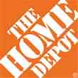

Data Breaches 2005-2015, by Number of Breaches and Records Exposed
# Data Breaches/Millions of Records Exposed
Millions
The total number of data breaches (+27.5%) hit a record high of 783 in 2014, exposing 85.6 million records. Through June 30, this year has seen 117.6 million records exposed in 400 breaches.*
*Figures as of June 30, 2015, from the Identity Theft Resource Center,
http://www.idtheftcenter.org/images/breach/ITRCBreachReport2015.pdf

Slide 167
High Profile Data Breaches, 2014-2015
Date | Company | Description of Breach
May 2015 | OPM | Hackers broke into U.S. Government Personnel Office stealing personal identifying information of as many as 14 million civilian U.S. government employees.
Mar 2015 | Premera Blue Cross | Data breach compromises financial and medical records of 11 million customers.
Feb 2015 | Anthem, Inc | Massive data breach after hackers gained access to corporate data base containing personal information of as many as 80 million current and former U.S. customers and employees.
Dec 2014 | Sony Pictures Entertainment | Hacker break-in involving theft of unreleased motion pictures, and theft of more than 25 gigabytes of sensitive data on tens of thousands of Sony employees, including social security numbers, medical and salary information.
Nov 2014 | Staples | Point-of-sale (POS) malware attack and breach exposing customer data, and resulting in compromise of 1.2 million records.
Sept 2014 | Home Depot | Huge data breach exposes 56 million credit and debit cards and 53 million email addresses.
Aug 2014 | Community Health Systems | Cyber attack originating in China resulted in data breach, compromising 4.5 million patient records. Hackers broke into company’s computer system by exploiting Heartbleed bug.
June/July 2014 | JP Morgan Chase | Massive data breach compromised data associated with 76 million household and 7 million small business accounts. Hackers obtained personal identifying nformation.
June 2014 | PF Changs | Security breach affected customers at 33 restaurants located in 16 states, with potential credit and debit card data stolen.
May 2014 | eBay | Massive data breach exposed records of site’s 233 million customers, including names, email addresses, physical addresses, phone numbers and birthdates.
Feb 2014 | Michaels Stores | Possible fraudulent activity on some U.S. payment cards used at Michaels stores suggests it may have experienced data security attack, exposing 2.6 million records.
Jan 2014 | Snapchat | Security breach compromises phone numbers and usernames for 4.6 million accounts.
Jan 2014 | Neiman Marcus | Hacker break-in exposed unknown no. of customer cards, compromising est. 1.1 million records.
Nov/Dec 2013 | Target | Malware stored on Target’s checkout registers led to theft of data from about 40 million credit and debit card accounts and the personal information of up to 70 million customers.
Sources: Identity Theft Resource Center; Insurance Information Institute (I.I.I.) research.

Slide 168
Worldwide Cybersecurity Spending, 2011- 2016F
($ Billions)
Cybersecurity spending increased by an estimated $5.2B in 2014, $5.8B in 2015 and $6.3B in 2016
Cybersecurity Spending Is Rising Sharply, Up by About 8%+ Annually through 2016—a Projected Increase of $12.1 Billion from 2014 to 2016
168
Source: Gartner Group; Insurance Information Institute; Adapted from Wall Street Journal: “Financial Firms Boost Cybersecurity Funds,” Nov. 17, 2014.

Slide 169
Top 10 Global Business Risks for 2015
Cyber is one of the most significant movers in this year’s Risk Barometer rankings, gaining five percentage points to move into the top 5 global business risks for the first time.
Source: Allianz Risk Barometer on Business Risks 2015
169
Notes:
169

Slide 170
2014 Data Breaches By Business Category, By Number of Breaches
The majority of the 783 data breaches in 2014 affected business and medical/healthcare organizations, according to the Identity Theft Resource Center.
Banking/Credit/Financial, 43 (5.5%)
Govt/Military, 92 (11.7%)
Business, 258 (33.3%)
Educational, 57 (7.3%)
Medical/Healthcare, 333 (42.5%)
Source: Identity Theft Resource Center, http://www.idtheftcenter.org/ITRC-Surveys-Studies/2014databreaches.html

Slide 171
Evolving Threats: Cyber Crime and Cyber Terrorism
State sponsored groups:
Foreign government sponsored
Sophisticated and well-funded
Organized cyber criminals:
Traditional organized crime groups
Loosely organized global hacker crews
Hacktivists:
Politically-motivated hackers
Increasing capabilities
Insiders:
Easy access to sensitive information
Difficult to detect
Terrorists:
Destruction of physical and digital assets
Source: Lewis Brisbois, Practical Strategies to Address Cyber Risk in Your Business, November 2014

Slide 172
Main Causes of Data Breach Globally
Malicious or criminal attacks are most often the cause of data breach globally. Some 42 percent of incidents concern a malicious or criminal attack, while 30 percent concern a negligent employee or contractor (human factor).
Malicious or criminal attack*
Human error
System glitch
*The most common types of malicious or criminal attacks include malware infections, criminal insiders, phishing/social engineering and SQL injection.
Source: 2014 Cost of a Data Breach Study: Global Analysis, the Ponemon Institute, sponsored by IBM, May 2014

Slide 173
US: Most Costly Types of Cyber Crimes, Fiscal Year 2014
Malicious code, denial of service and web-based attacks account for more than 55 percent of the total annualized cost of cyber crime experienced by 59 U.S. companies.
Viruses, Worms, Trojans
Botnets
Malicious code
Malware
Malicious insiders
Stolen devices
Denial of service
Phishing + social engineering
Web-based attacks
Source: 2014 Cost of Cyber Crime: United States, Ponemon Institute.

Slide 174
US: External Cyber Crime Costs: Fiscal Year 2014
Information theft (40%) and business disruption or lost productivity (38%) account for the majority of external costs due to cyber crime.
Equipment damages
Other costs*
Information theft
Revenue loss
Business disruption
* Other costs include direct and indirect costs that could not be allocated to a main external cost category
Source: 2014 Cost of Cyber Crime: United States, Ponemon Institute.

Slide 175
PWC Survey: Cybercrime Costs Greater for U.S. Companies
U.S. organizations are more at risk of suffering financial losses in excess of $1 million due to cybercrime.
Source: 2014 Global Economic Crime Survey, PWC.
175
Notes:
175

Slide 176
Marsh: Percentage of U.S. Companies Purchasing Cyber Insurance Increased in 2014
Ever larger numbers of insureds seek financial protection via cyber insurance. The percentage of U.S. companies buying cyber insurance rose to 16 percent in 2014.
*Take-up rate refers to the overall percentage of clients that purchased standalone cyber insurance.
Source: Benchmarking Trends: As Cyber Concerns Broaden, Insurance Purchases Rise, Marsh Risk Management Research Briefing, March 2015
176
Notes:
176

Slide 177
Marsh: Total Limits Purchased, By Industry – Cyber Liability, All Revenue Size
Average limits purchased for cyber risk rose to $12.8 million for all industries and all company sizes in 2014. Power and utility companies witnessed the sharpest percentage increase in average limits, at 59 percent.
($ Millions)
Source: Benchmarking Trends: As Cyber Concerns Broaden, Insurance Purchases Rise, Marsh Risk Management Research Briefing, March 2015
177
Notes:
177

Slide 178
Marsh: Total Limits Purchased, By Industry – Cyber Liability, Revenue $1 Billion+
Among larger companies, average cyber insurance limits purchased increased by 22 percent to $34.1 million in 2014, from $27.8 million in 2013.
($ Millions)
Source: Benchmarking Trends: As Cyber Concerns Broaden, Insurance Purchases Rise, Marsh Risk Management Research Briefing, March 2015
178
Notes:
178

Slide 179
Cyber Liability: Historical Rate (price per million) Changes
Cyber insurance premiums were generally volatile in 2014 due to increased frequency and severity of losses. Average rate increases at renewal for both primary layers and total programs were lower in Q4 2014 than in Q1.
Source: Benchmarking Trends: As Cyber Concerns Broaden, Insurance Purchases Rise, Marsh Risk Management Research Briefing, March 2015

Slide 180
Data/Privacy Breach:
Many Potential Costs Can Be Insured
Data Breach Event
Costs of notifying affecting individuals
Defense and settlement costs
Lost customers and damaged reputation
Cyber extortion payments
Costs of notifying regulatory authorities
Regulatory fines at home & abroad
Business Income Loss
Forensic costs to discover cause
Source: Zurich Insurance; Insurance Information Institute
180

Slide 181
The Three Basic Elements of Cyber Coverage: Prevention, Transfer, Response
Loss Prevention
Post-Breach Response
(Insurable)
Loss Transfer (Insurance)
Cyber risk management today involves three essential components, each designed to reduce, mitigate or avoid loss. An increasing number of cyber risk products offered by insurers today provide all three.
Source: Insurance Information Institute research.
181

Slide 182
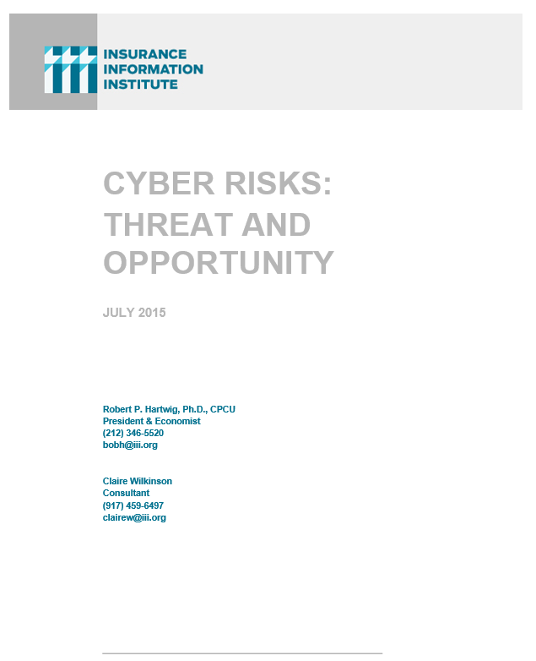
I.I.I. Will Release its Third Cyber Report in 2015: Cyber Risks Threat and Opportunity
I.I.I.’s 3rd report on cyber risk scheduled for Q3 2015
Provides information on cyber threats and insurance market solutions
Global cyber risk overview
  Quantification of threats by type and industry
Cyber security and cost of attacks
Cyber terrorism
Cyber liability
Insurance market for cyber risk

Slide 183
INDUSTRY DISRUPTORS
Technology, Society and the Economy Are All Changing at a Rapid Pace
Thoughts on the Future
183

Slide 184

Technology and Insurance
Rapid Technological Innovations Are Impacting Many Segments of the P/C Insurance Industry
184

Slide 185

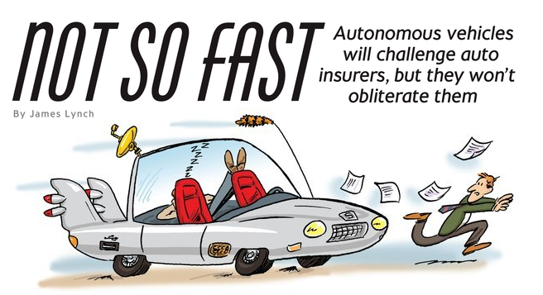
Media is Obsessed with Driverless Vehicles: Often Predicting the Demise of Auto Insurance
By 2035, it is estimated that 25% of new vehicle sales could be fully autonomous models
Questions
Are auto insurers monitoring these trends?
How are they reacting?
Will Google take over the industry?
Will the number of auto insurers shrink?
How will liability shift?
Source: Boston Consulting Group.

Slide 186




On-Demand/Sharing/Peer-to-Peer Economy Impacts Many Lines of Insurance
The “On-Demand” Economy is or will impact many segments of the economy important to P/C insurers
  Auto (personal and commercial)
  Homeowners/Renters
  Many Liability Coverages
  Professional Liability
  Workers Comp
Many unanswered insurance questions
Insurance solutions are increasingly available to fill the many insurance gaps that arise
186
12/01/09 - 9pm
eSlide – P6466 – The Financial Crisis and the Future of the P/C
Notes:
186

Slide 187
A Few Thoughts on the Future of Auto Insurance
Global auto insurance premiums written total about $600B
  ~80% personal, 20% commercial
  US accounts for more than 1/3 of this total (about $210B in 2014)
Innovations in automobile safety will, over time, reduced claim frequency but severities could still rise as repair costs escalate
  Claim activity clearly not immune to economy
Frequency declines could lead price declines, aiding profitability
More cars, not fewer will be on highways in the US, world
  Exposure (insured car years) grows even as frequency declines
Timeline for large numbers of mass produced autonomous vehicles on American highways is wildly optimistic
  Mid-2030s is more likely timeframe; Transition occurring through mid-century
  Tech media is enamored with anything involving Google, Apple
Auto insurance will be the largest, most important of all P/C lines for many years to come

Slide 188



Labor on Demand: Huge Implications for the US Economy, Workers & Insurers
Will YOUR job be reduced to an app?

Slide 189


Send in the Drones: Potential Rapid
Adoption in Industry; Media Loves It
Drones or Unmanned Aerial Vehicle (UAV) technology is seeing rapid adoption rate in many industries, including insurance
FAA granting Section 333 exemptions for commercial use and testing of UAS
At least 5 insurers have received permission to test
Wide variety of applications: claims, pre-event property inspections…
Insurers partnering with construction industry to guide R&D and regulation of UAV use via Property Drone Consortium: www.propertydrone.org

Slide 190
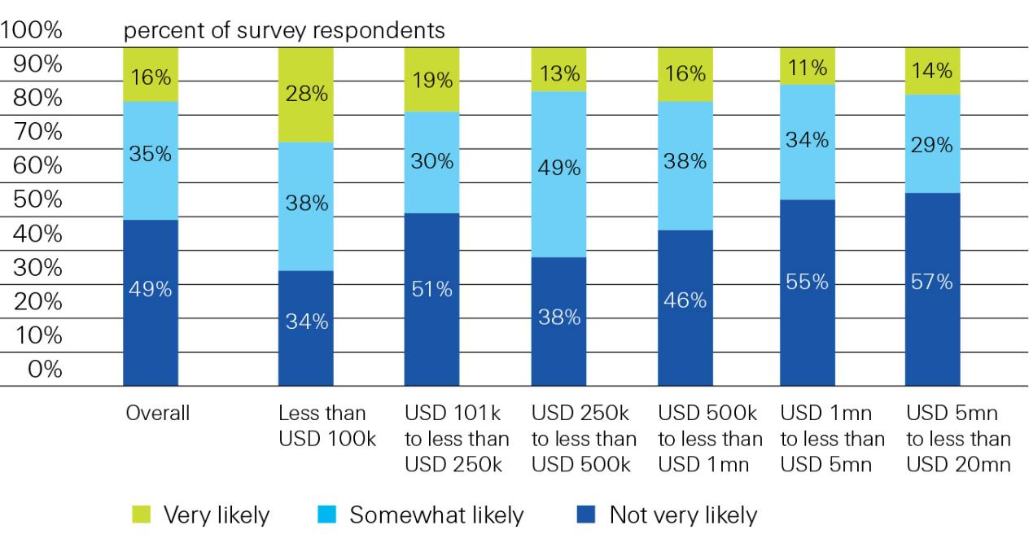
Proportion of Businesses Interested in Buying Insurance Online
Interest diminishes with account size
Likelihood of small US businesses buying insurance online directly from the insurer, overall and by annual company revenue, in 2013
Source: Swiss Re from “Voice of the Small Commercial Insurance Consumer Survey.” Deloitte, March (2013)

Slide 191
Shifting Legal Liability &
Tort Environment
Will the Tort Pendulum
Swing Against Insurers?
191

Slide 192
Over the Last Three Decades, Total Tort Costs as a % of GDP Appear Somewhat Cyclical, 1980-2013E
($ Billions)
2.21% of GDP in 2003 = pre-tort reform peak
Deepwater Horizon Spike in 2010
Tort costs in dollar terms have remained high but relatively stable since the mid-2000s., but are down substantially as a share of GDP
1.68% of GDP in 2013
Sources: Towers Watson, 2011 Update on US Tort Cost Trends, Appendix 1A

Slide 193
Commercial Lines Tort Costs: Insured vs. Self-(Un)Insured Shares, 1973-2010
2005: $143.5B 66.4% insured, 33.6% self-(un)insured
Billions of Dollars
$15.0
1995: $83.6B 69.5% insured, 30.5% self-(un)insured
1973: Commercial Tort Costs Totaled $6.49B, 94% was insured, 6% self-(un)insured
1985: $46.6B 74.5% insured, 25.5% self-(un)insured
$9.5
$6.0
2009: $126.5B 64.4% insured, 35.6% self-(un)insured
Tort Costs and the Share Retained by Risks Both Grew Rapidly from the mid-1970s to mid-2000s, When Tort Costs Began to Fall But Self-Insurance Shares Continued to Rise
Sources: Towers Watson, 2011 Update on US Tort Cost Trends, III Calculations based on data from Appendix 4.
193
12/01/09 - 9pm
eSlide – P6466 – The Financial Crisis and the Future of the P/C
Notes:
193

Slide 194
Commercial Lines Tort Costs: Insured vs. Self-(Un)Insured Shares, 1973-2010
Percent
2010: $138.1B 56.6% insured, 44.4% self-(un)insured (distorted by Deepwater Horizon event with most losses retained by BP)
1973: 94% was insured, 6% self-(un)insured
1985:74.5% insured, 25.5% self-(un)insured
1995: 69.5% insured, 30.5% self-(un)insured
2005: 66.4% insured, 33.6% self-(un)insured
The Share of Tort Costs Retained by Risks Has Been Steadily Increasing for Nearly 40 Years. This Trend Contributes Has Left Insurers With Less Control Over Pricing.
Sources: Towers Watson, 2011 Update on US Tort Cost Trends, III Calculations based on data from Appendix 4.
194
12/01/09 - 9pm
eSlide – P6466 – The Financial Crisis and the Future of the P/C
Notes:
194

Slide 195
Business Leaders Ranking of Liability Systems in 2012
Best States
Delaware
Nebraska
Wyoming
Minnesota
Kansas
Idaho
Virginia
North Dakota
Utah
Iowa
Worst States
Florida
Oklahoma
Alabama
New Mexico
Montana
Illinois
California
Mississippi
Louisiana
West Virginia
New in 2012
Wyoming
Minnesota
Kansas
Idaho
Newly Notorious
Oklahoma
Drop-offs
Rising Above
Indiana
Colorado
Massachusetts
South Dakota
Arkansas
Source: US Chamber of Commerce 2012 State Liability Systems Ranking Study; Insurance Info. Institute.

Slide 196
The Nation’s Judicial “Hellholes”: 2014/2015
Watch List
Illinois
Madison County
West Virginia
Atlantic County, New Jersey
Mississippi Delta
Montana
Nevada
Newport News, Virginia
Philadelphia, Pennsylvania
California
Dishonorable Mention
New York City Asbestos Litigation
AL Supreme Court
PA Supreme Court
Volkswagen: Massive tort actions, fines, penalties certain. Are others vulnerable? Issue of cheating on environmental standards and liability looms large.
Florida
Source: American Tort Reform Association; Insurance Information Institute

Slide 197
Insurance Information Institute Online:
www.iii.org
Thank you for your time
and your attention!
Twitter: twitter.com/bob_Hartwig
Download at www.iii.org/presentations

