Slide 1
Insurance Research: Recent Studies & Trends and Information Sources
Special Libraries Association Conference
June 13, 2016
Download at www.iii.org/presentations
James Lynch, Chief Actuary and Vice President
Data and Information Services
Insurance Information Institute ♦ 110 William Street ♦ New York, NY 10038
Tel: 212.346.5533 ♦ Cell: 917.359.3908♦ jamesl@iii.org ♦ www.iii.org

Slide 2
What We’ll Talk About Today
Overview of I.I.I.
  Our mission and how it can help you
  Publications that might interest you
Insurance Data Sources
  Free/Low Cost Sources (<$100)
  Expensive Sources (Thousands and thousands of dollars in annual fees)

Slide 3
Who We Are and What We Do
The mission of the Insurance Information Institute is to build public understanding of insurance—what it does and how it works.
We Are…
  A voice for the property/casualty insurance industry.
  The go-to source for credible and unbiased insurance information for the media, the industry and consumers.
  We Are…
  Dedicated to ensuring the media covers our business fairly and accurately.
  Ready to assist our member companies with their communications, research and planning needs.
We do not lobby.

Slide 4
How We Do It
Communications: Media relations specialists, knowledgeable about the insurance business and what consumers need to know.
Research: Collect industry-related data and develop research and analysis on current topics of interest.
Organizational: Partnerships with other insurance industry organizations and government bodies such as FEMA and NOAA

Slide 5
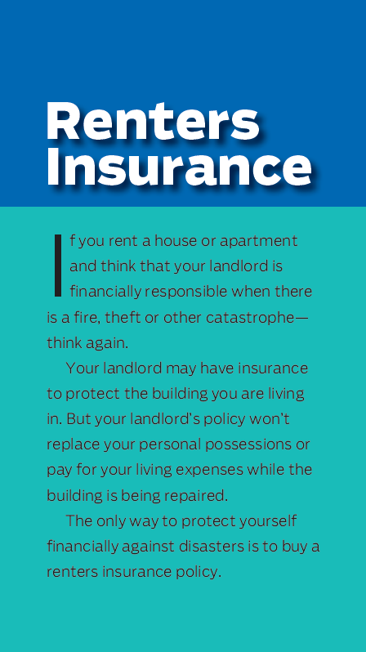
Our Library/Research/Outreach
Pamphlets and books
  Free Online
  Available by Mail/Phone - 212.346.5500
I.I.I. Database
  100,000 abstracts from business, trade and consumer press
  Found in
    Factiva (Insurance Information Institute Database)
    LexisNexis (III Abstracts)
    West Law (III-Database and III-The Insurance Daily).

Slide 6
About the I.I.I. (continued…)
In addition to direct contact with the media, individuals and organizations, the I.I.I. publishes a host of helpful pamphlets and books ranging in subjects from 9 Ways to Lower Your Auto Insurance Costs to the I.I.I. Insurance Fact Book.
The I.I.I. Database includes over 100,000 abstracts related to the insurance industry taken from business, trade and consumer press, government documents and studies and is updated weekly. It can be found in Factiva (Insurance Information Institute Database), LexisNexis (III Abstracts) and West Law (III-Database and III-The Insurance Daily).
    Insurance Pulse is a survey of consumers I.I.I. conducts regularly. The poll gauges the public’s opinions toward auto and home insurers and other industries and what people think about the price of auto and homeowners insurance.

Slide 7
I.I.I. PUBLICATIONS
7

Slide 8
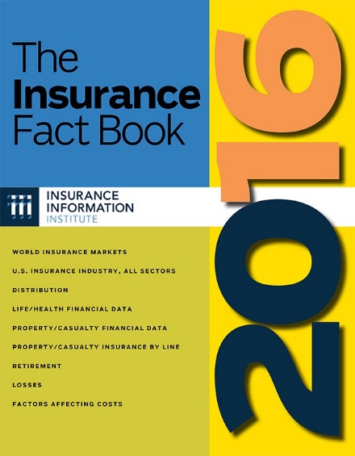
Insurance Fact Book
The Insurance Fact Book is the almanac of the insurance industry designed for quick and easy reference.
Thousands of facts, figures, tables and graphs
Factors affecting costs
Losses by category
Laws affecting motorists
Premiums by line
And much more…
8
12/01/09 - 9pm
eSlide – P6466 – The Financial Crisis and the Future of the P/C

Slide 9
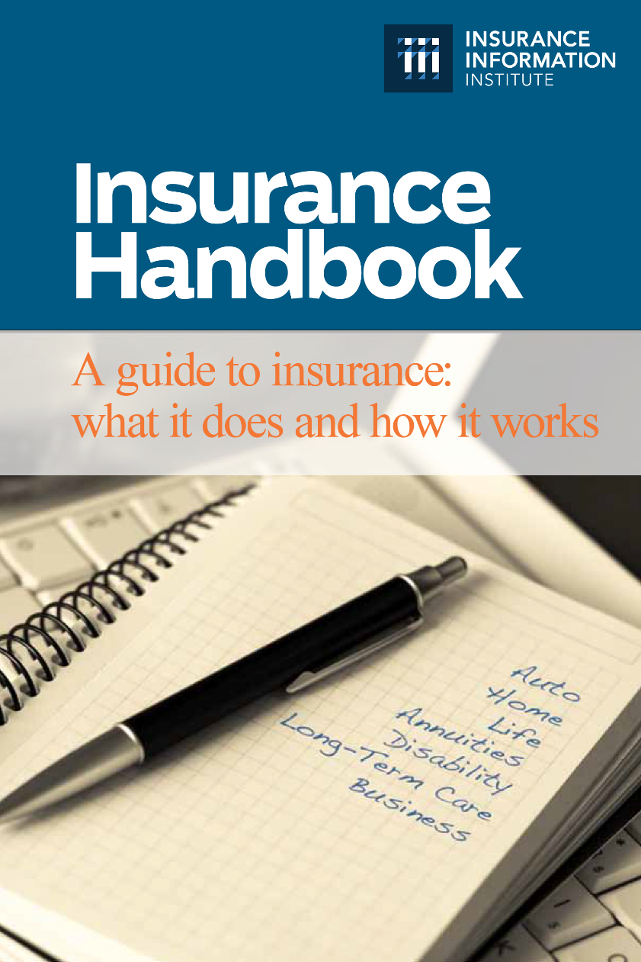
Insurance Handbook
The I.I.I. Insurance Handbook provides vital information for a wide variety of audiences:
Public Policymakers
Reporters
Regulators
Students
Insurance Company Employees
Academics
9
12/01/09 - 9pm
eSlide – P6466 – The Financial Crisis and the Future of the P/C

Slide 10
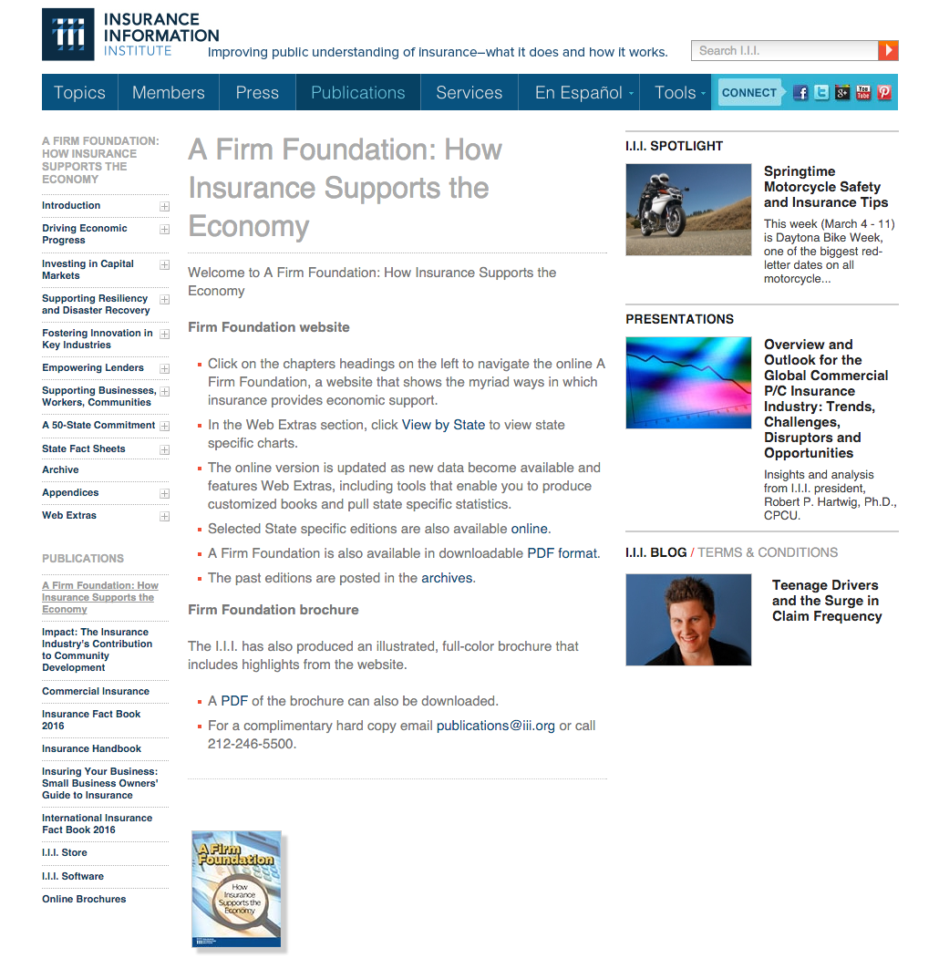
A Firm Foundation
A Firm Foundation provides details on the impact and importance of the insurance industry on national and state economies
Insurers Don’t Just Pay Claims; They Are:
Employers
Income Providers
Taxpayers
Investors
Engines of Growth & Recovery
Philanthropists
10
12/01/09 - 9pm
eSlide – P6466 – The Financial Crisis and the Future of the P/C

Slide 11
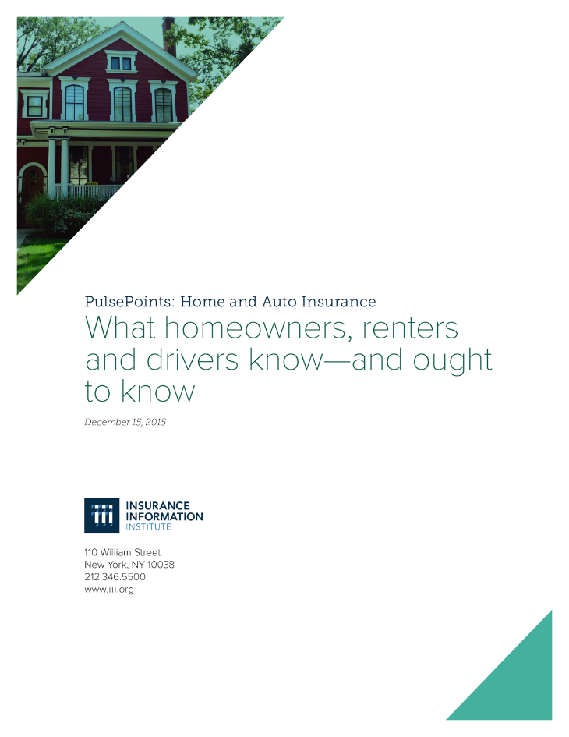
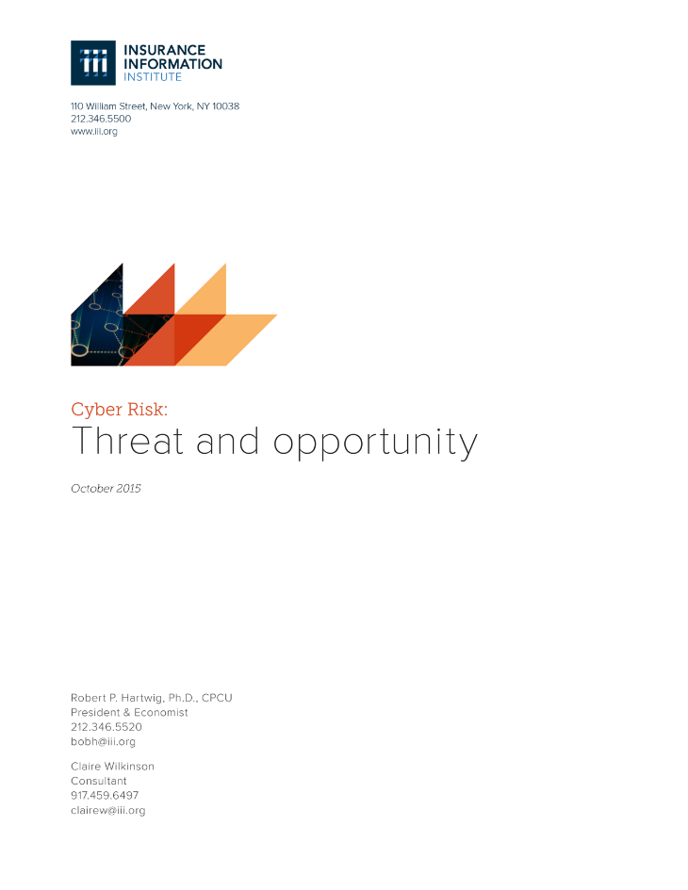
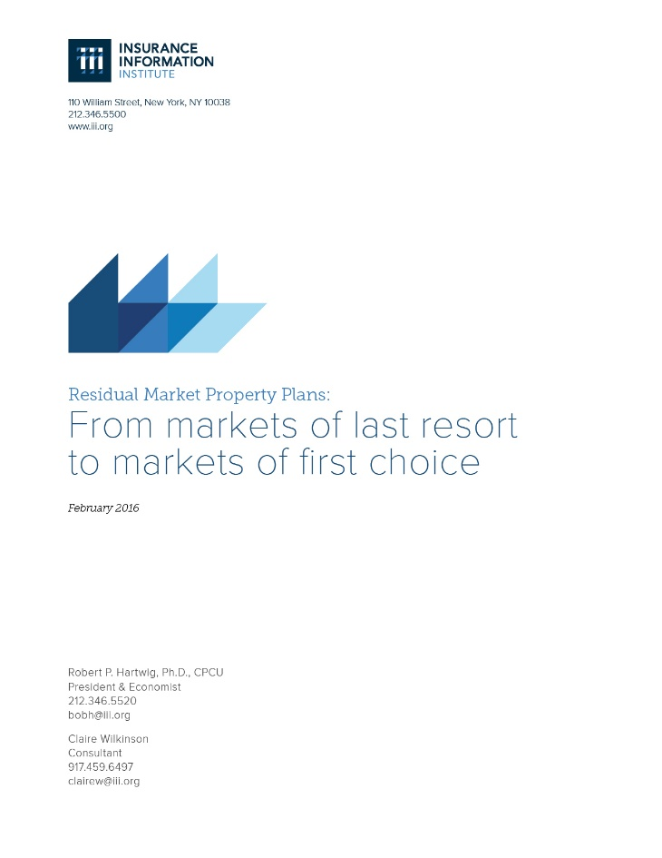
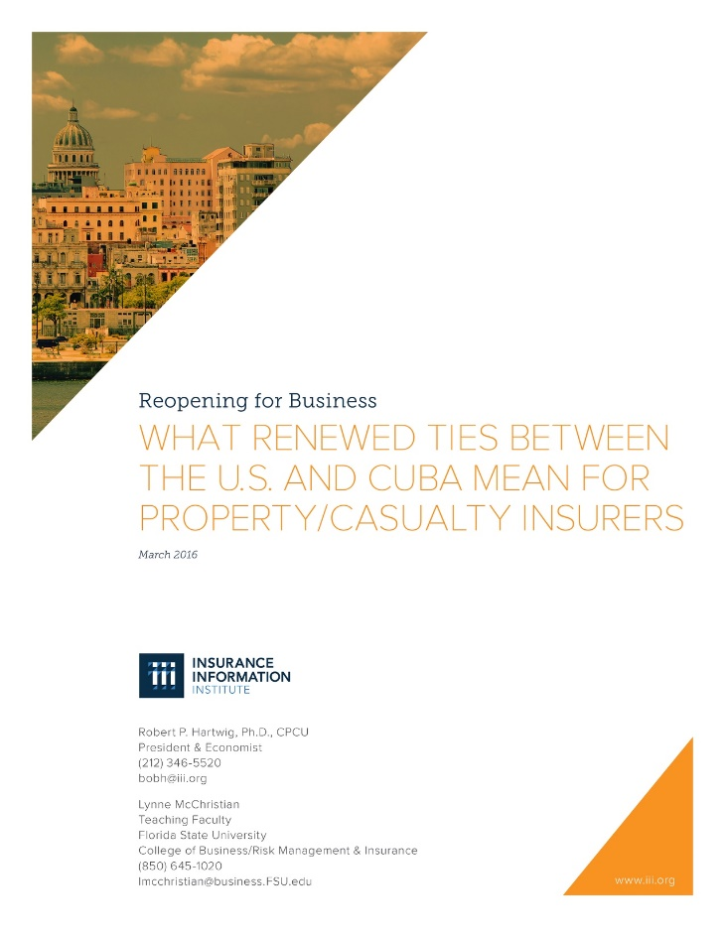
White Papers www.iii.org/insurance-topics/features/white-papers

Slide 12
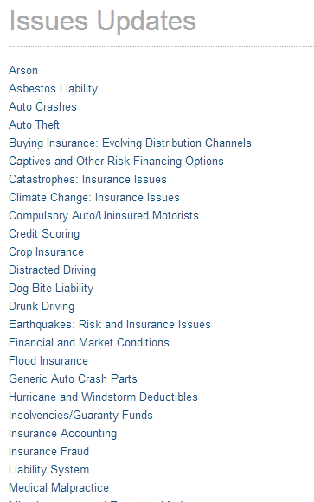
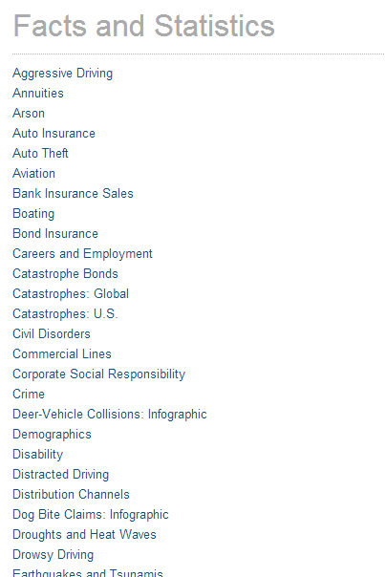
Issues Updates/Facts and Statistics
Background papers and statistical information are available on the I.I.I. website and are continually updated as new information becomes available
Notes:
Freq. reporters have less insurance background, so information like this helps them get a good grounding in a topic.
Industry numbers, send it to the reporter – they won’t mistranscribe

Slide 13
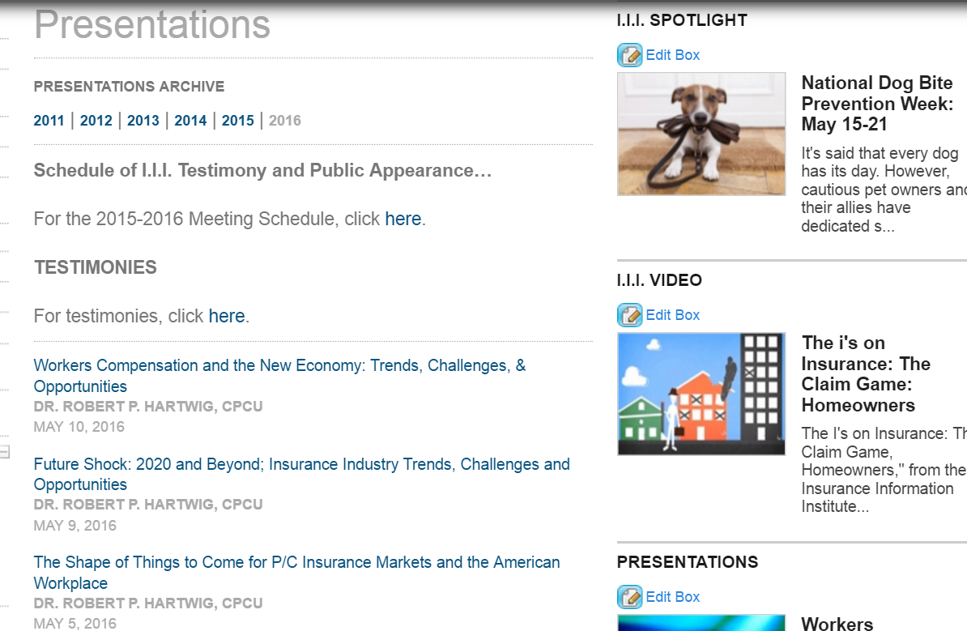
I.I.I. Presentations (like this one!)

Slide 14
Data Sources
14

Slide 15

Data Sources – Free Sources (1/4)
National Association of Insurance Commissioners (NAIC) - www.naic.org/prod_serv_publications.htm
    Studies and Statistical Reports
    Consumer Information
    State laws and regulations

Slide 16


Data Sources – Free Sources (2/4)
Government Sources
    FEMA – www.fema.gov
    NOAA – www.noaa.gov
    Government Accountability Office (GAO) - www.gao.gov
    Rand - www.rand.org (Quasi-government)
  Free Trade Periodicals
    Insurance Journal and Claims Journal
    Rough Notes/Insurance Marketplace
    PC360 (create a free account to access articles)
    Business Insurance (tiered subscription)

Slide 17

Data Sources – Free Sources (3/4)
Trade Organizations (to name just a few…)
    Insurance Institute for Highway Safety
    www.iihs.org
    Insurance Institute for Business and Home Safety - https://disastersafety.org
    National Insurance Crime Bureau – www.nicb.org
    International Insurance Society – www.internationalinsurance.org
    National Association of Mutual Insurance Companies – www.namic.org
    Property Casualty Insurance Association of America – www.pciaa.net
    American Insurance Association – www.aiadc.org
    Casualty Actuarial Society – www.casact.org
    Workers Compensation Research Institute – www.wcri.org
    National Council on Compensation Insurance – www.ncci.org

Slide 18

Data Sources – Free Sources (4/4)
  Large Companies’ Research Offerings
  Swiss Re (sigma and other reports) - www.swissre.com/sigma
  Zurich Insurance - www.zurich.com/en/knowledge
  Allianz - www.allianz.com/en/economic_research
  GenRe - www.genre.com/knowledge
  AON - www.aon.com
  XL Catlin - http://xlcatlin.com/fast-fast-forward
  Munich Re - www.munichre.com
  Guy Carpenter - www.guycarp.com

Slide 19
Data Sources – Specialized and Expensive Sources
S&P Global Market Intelligence (was SNL Financial) - www.snl.com
AM Best - www.ambest.com (Note: Company Ratings are Free)
AXCO - www.axcoinfo.com
FC&S Online (used to stand for Fire, Casualty and Surety) - www.nationalunderwriterpc.com

Slide 20
Insurance Information Institute Online:
www.iii.org
Thank you for your time
and your attention!

