Slide 1
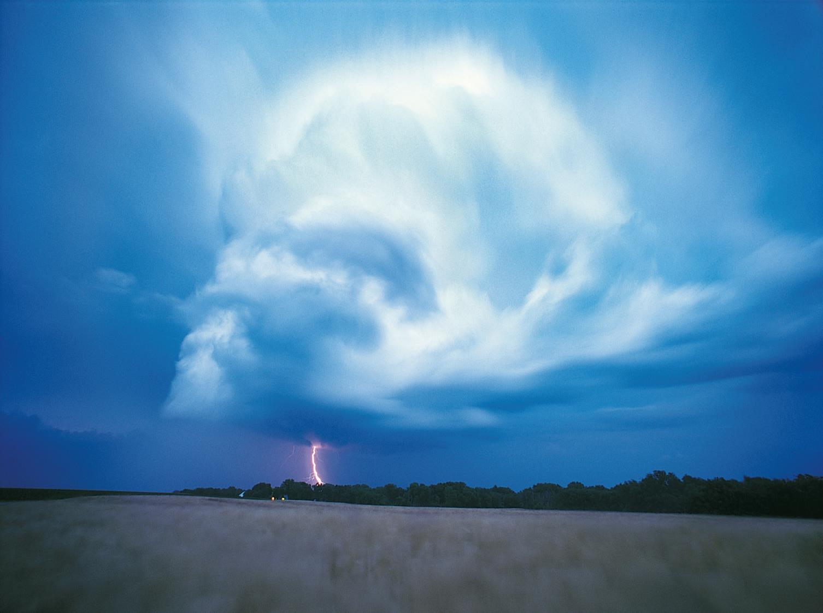
sigma No 5/2015:
Underinsurance of property risks:
closing the gap
Swiss Re Economic Research & Consulting

Slide 2
Outline
1
How big is the natural catastrophe protection gap?
2
The global shortfall in property insurance
3
Dealing with underinsurance
5
Conclusions

Slide 3
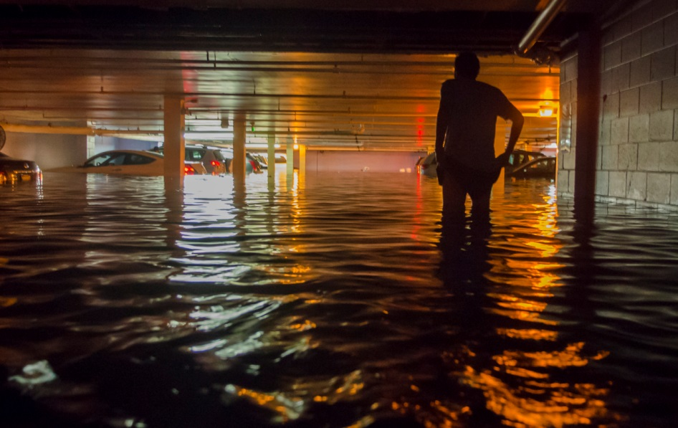
How big is the natural catastrophe protection gap?

Slide 4
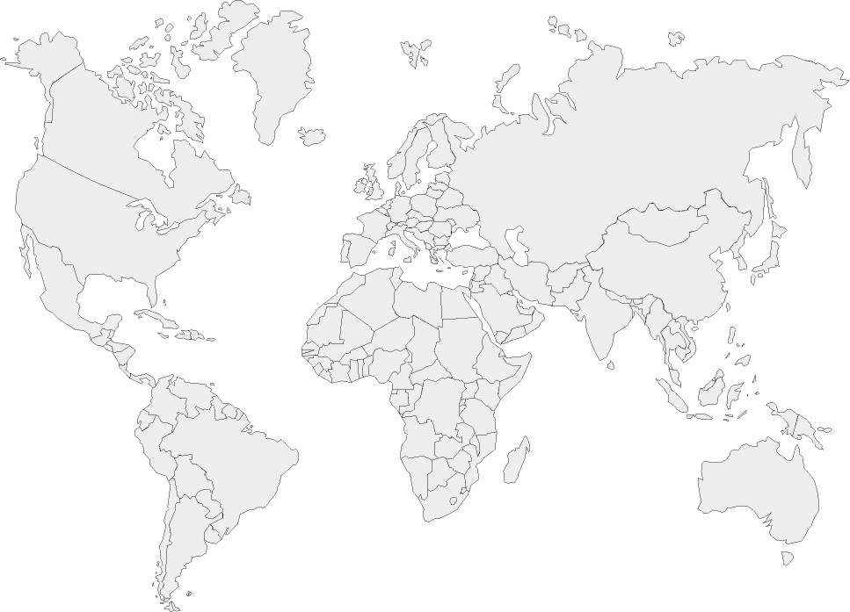
Global natural catastrophe losses totalled USD 1.8 trillion* over the last decade, with 70% uninsured
USD 548 billion insured losses*
USD 1.3 trillion
Uninsured losses last 10 years
The global natural catastrophe property protection gap has risen steadily over the last 10 years
70% of the economic losses, or USD 1.3 trillion, were uninsured
* in 2014 dollars
Source: Swiss Re Economic Research & Consulting and Cat Perils.
Notes:
The bad news is over two thirds of losses were uninsured globally.

Slide 5
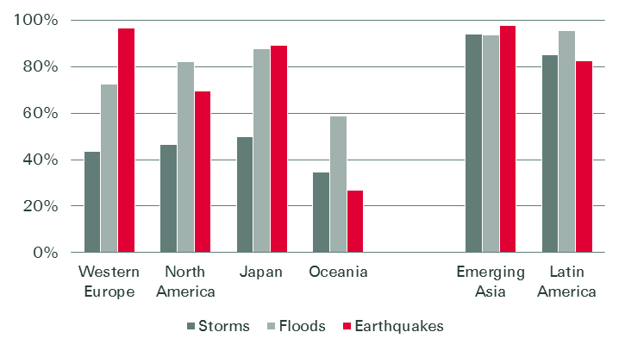
Natural catastrophe protection gap by region and peril, 1975-2014
In the emerging markets, 80-98% of the losses are uninsured.
Average uninsured portions have been around 55% for windstorms, 86% for floods, and 90% for earthquakes.
Source: Swiss Re Economic Research & Consulting and Non-Life Risk Transformation.

Slide 6
Expected insured and uninsured losses from natural catastrophes
USD bn
uninsured
insured
The largest uninsured natural catastrophe exposures are in the US, Japan, and China
Catastrophe models estimate the global annual uninsured losses from future natural disaster events to be USD 153 billion
Source: Swiss Re Economic Research & Consulting and Non-Life Risk Transformation.

Slide 7
Many other economies are highly exposed as a % of GDP
Although the US is highest in terms of absolute uninsured value exposed…
Smaller countries and emerging markets are likely to lose significant portions of GDP due to major catastrophes.
Urbanization in emerging markets has contributed to higher property concentrations in risky areas.
One-in-250 year earthquake loss scenarios (% of GDP)
One-in-100 year storm loss scenarios (% of GDP)
Source: Swiss Re Economic Research & Consulting and Non-Life Risk Transformation.

Slide 8
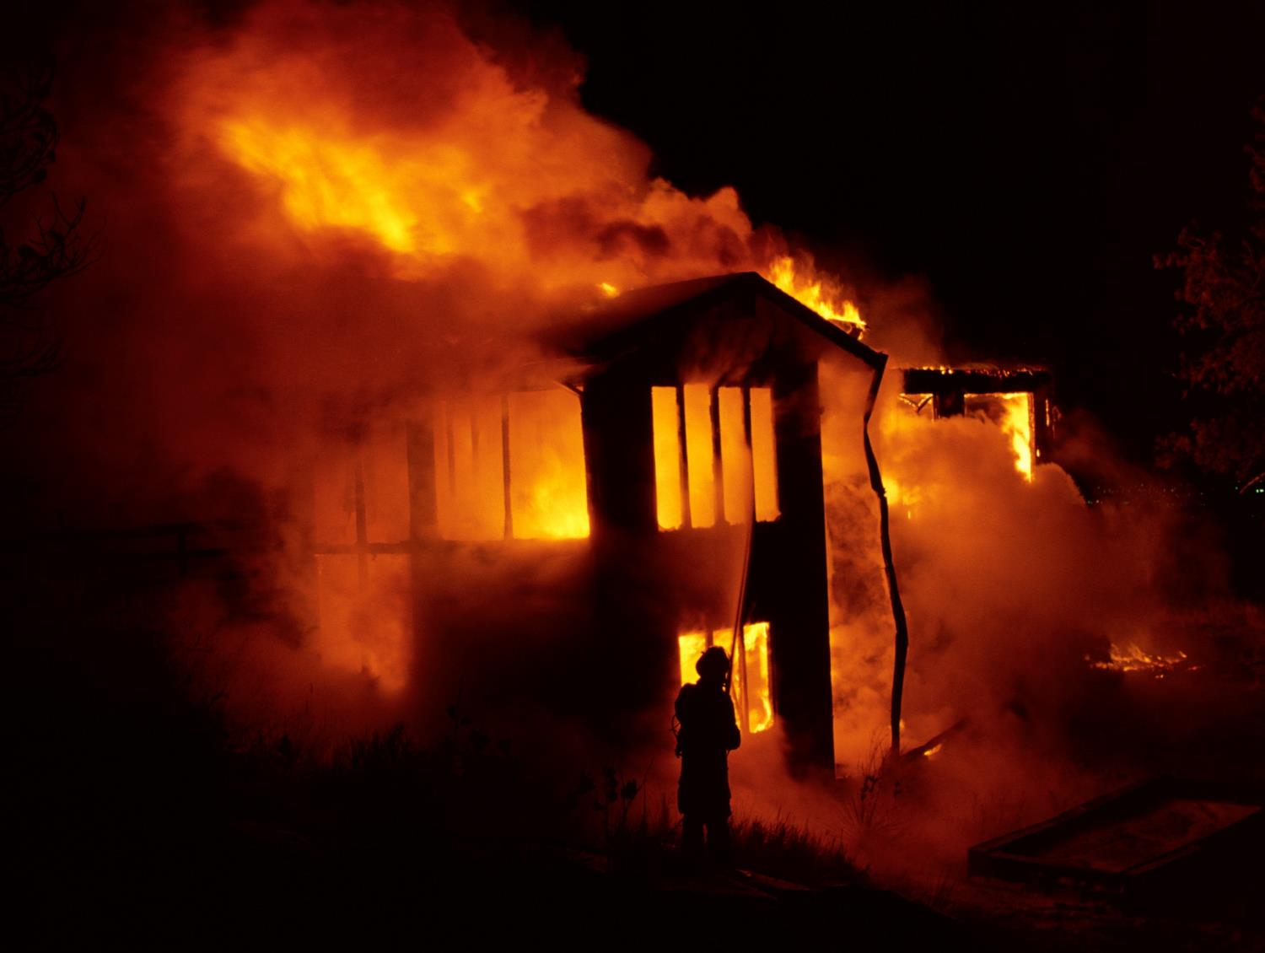
The global shortfall in property insurance

Slide 9
Benchmarking property underinsurance - Insurance penetration vs. consumption per capita
Source: Swiss Re Economic Research & Consulting

Slide 10
Benchmarking property underinsurance - Insurance penetration vs. consumption per capita
Source: Swiss Re Economic Research & Consulting

Slide 11
Benchmarking property underinsurance - Insurance penetration vs. consumption per capita
Source: Swiss Re Economic Research & Consulting

Slide 12
Benchmarking property underinsurance - Insurance penetration vs. consumption per capita
underinsurance
Source: Swiss Re Economic Research & Consulting

Slide 13
Benchmarking property underinsurance – demand lags in many emerging economies
For the broader scope of property risks – including fire, burglary and water – and business interruption risks, underinsurance can be estimated by the difference between best-practice countries and those with lower insurance penetration rates (premiums as a % of GDP).
A global benchmarking of insurance penetration across nations suggests an additional general underinsurance protection gap of USD 68 billion worldwide. With the USD 153 billion underinsurance for catastrophe, this totals USD 221 billion annually of underinsurance.
Of the countries most underinsured relative to GDP, many are high-growth economies. Buying insurance still lags in these economies, even though they have a rapidly growing middle class which is accumulating substantial new wealth.

Slide 14
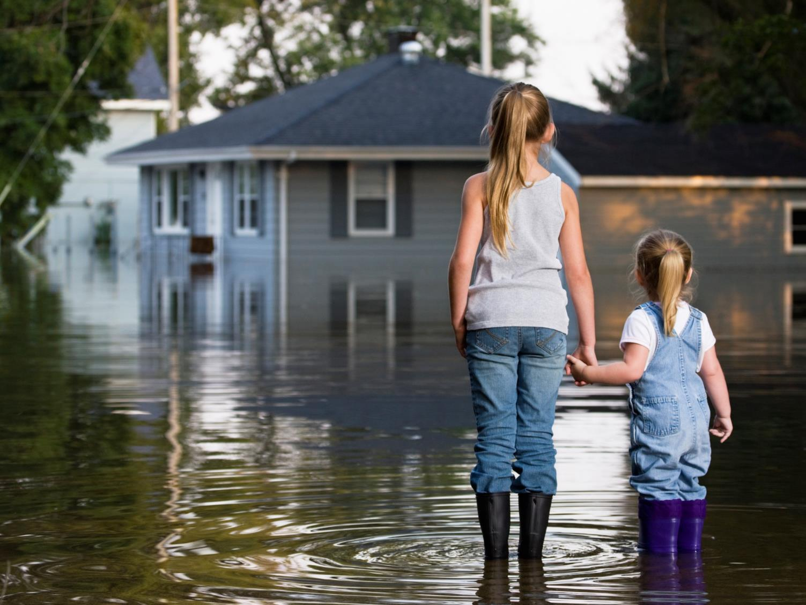

Dealing with underinsurance
14

Slide 15
Underinsurance explained
Insurability: Certain risks such as some peak natural catastrophe, terrorism, cyber or contingent business interruption risk, can challenge the bounds of insurability.
Buying behavior: Factors like perception of risk, insurance knowledge, affordability, reliance on government post-disaster relief, trust in insurers and ease of doing business can hinder adequate take up of cover, especially in new markets.
Undervaluation: Valuing properties at less than replacement value means that insurance policies may not fully cover the total damages.
Completely uninsured
Insured for certain perils
Restrictive policy terms
Undervaluation of assets

Slide 16
Difficult-to-insure risks contribute to underinsurance
Risks that are hard to prepare for and sometimes not fully insurable
  Lacking historical data
  Difficult to measure or model
These difficult-to-insure risks include
  New scenarios that have not occurred previously
  Human behaviour, deliberate avoidance of prediction
Source: Allianz Risk Barometer 2015

Slide 17
The US has the most uninsured losses of any country
The US is home to the “peak” natural disaster risks of Atlantic hurricanes and west coast earthquakes.
US property values are growing faster rate than GDP and inflation. Total insured property values are estimated to be more than USD 90 trillion, with only USD 40 trillion insured.
Consumer awareness and buying behavior is an important challenge:
  Surveys in New York after Hurricane Sandy in 2012 showed that only 54% of residents whose homes were less than a block away from a body of water had flood insurance.
  Earthquake insurance take-up in California is only 12%, lower than other high earthquake risk regions such as New Zealand and Japan.
Undervaluation is a core reason for underinsurance:
  A large 2014 sample of commercial property in the US and Canada revealed that properties with limits below USD 20 million (representing 95% of the sample) were under-valued by an average 26%.
Sources: Karen Clark & Co, CoreLogic, Wharton Risk Center, Swiss Re Economic Research & Consulting

Slide 18


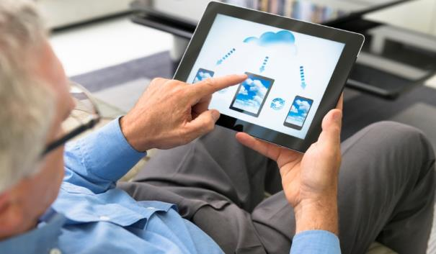
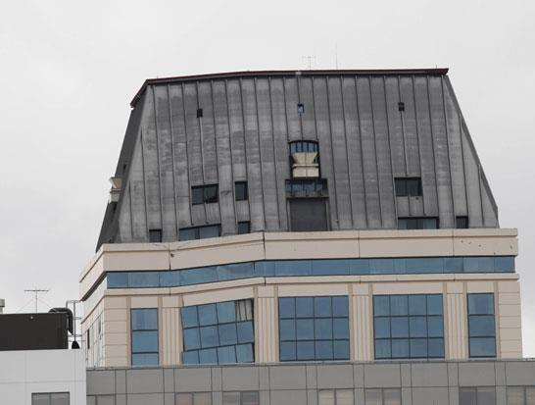
How can we close the underinsurance gap?
Public/private collaboration
Increase access and distribution
Improve product design
Mitigation, building standards, and zoning

Slide 19
Dealing with underinsurance: Who needs to be involved to reduce underinsurance?
Measures which promote risk mitigation or expand insurability
Measures | Objectives |  |  | Agents
 | Affordability of coverage | Improve product design | Increase access and distribution | Insurance industry | Government | Public-private partnerships
Product innovation | ✓ | ✓ | ✓ | ✓ |  | ✓
Microinsurance | ✓ | ✓ | ✓ | ✓ |  | ✓
Index-based insurance | ✓ | ✓ | ✓ | ✓ |  | ✓
Product bundling | ✓ | ✓ | ✓ | ✓ | ✓ | ✓
New technologies and distribution innovation | ✓ | ✓ | ✓ | ✓
Government setting the rules for the insurance market | ✓ | ✓ | ✓ |  | ✓
Developing the takaful sector |  | ✓ |  | ✓
Mitigation, building standards, and zoning | ✓ | ✓ | ✓ | ✓ | ✓ | ✓
Mandatory insurance programs |  |  | ✓ | ✓ | ✓ | ✓
Government- backed programs for risks that are not fully insurable | ✓ |  | ✓ | ✓ | ✓ | ✓
Public sector insurance programs |  | ✓ | ✓ |  | ✓
Source: Swiss Re Economic Research & Consulting

Slide 20
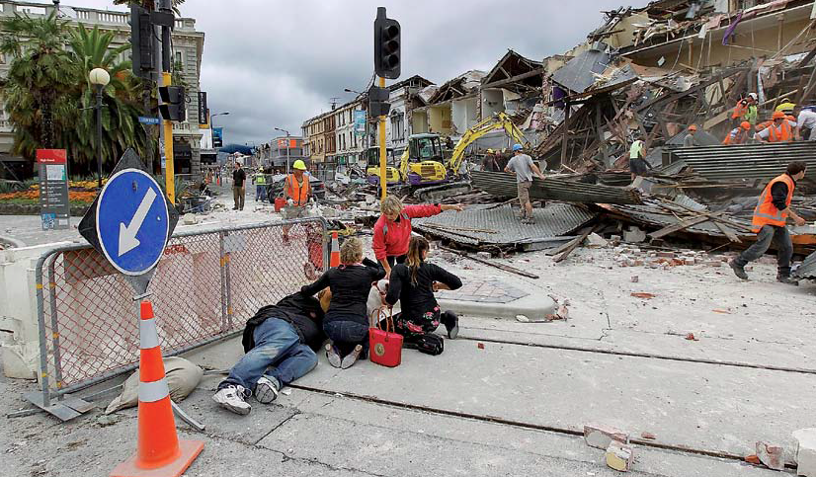
Conclusions

Slide 21
Conclusions
The global shortfall in insurance cover for property risks is
estimated at USD 221 billion per year.
The challenge for the insurance industry is to focus on the needs of those who are totally or insufficiently insured.
Government support in risk mitigation and insurance market governance is key for success.
Further innovation in products, processes, and distribution are needed to reach previously uninsured consumers and risks.

Slide 22
Legal notice
©2015 Swiss Re. All rights reserved. You are not permitted to create any modifications
or derivative works of this presentation or to use it for commercial or other public purposes
without the prior written permission of Swiss Re.
The information and opinions contained in the presentation are provided as at the date of
the presentation and are subject to change without notice. Although the information used
was taken from reliable sources, Swiss Re does not accept any responsibility for the accuracy
or comprehensiveness of the details given. All liability for the accuracy and completeness
thereof or for any damage or loss resulting from the use of the information contained in this
presentation is expressly excluded. Under no circumstances shall Swiss Re or its Group
companies be liable for any financial or consequential loss relating to this presentation.

Slide 23
Underinsurance, Economics & Politics in the United States
Minding the Gap
Insurance Information Institute
September 28, 2015
Robert P. Hartwig, Ph.D., CPCU, President & Economist
Insurance Information Institute ♦ 110 William Street ♦ New York, NY 10038
Tel: 212.346.5520 ♦ Cell: 917.453.1885 ♦ bobh@iii.org ♦ www.iii.org

Slide 24
UNDERSINSURANCE: POLITICAL AND ECONOMIC CONSIDERATIONS IN THE U.S.
Vulnerable Economic Development, Subsidies and Underinsurance Are Inextricably Intertwined
24

Slide 25
The Four Types of Underinsurance
Entirely Uninsured
  People/Businesses in this group buy no insurance at all because:
    Unaware of it
    Belief that cost outweighs benefit
Insured, but Certain Perils Excluded
  Covered for many perils but some are excluded (e.g., flood, earthquake)
  Fail to completely insurer because:
    Unaware of availability of coverage
    Belief that cost outweighs benefit
    Lack of available coverage
Insured, but Policy Terms Restrictive
  Coverage is restrictive/limited, often due to limits of insurability
Insured, but Undervalued
  Perils are covered and level of coverage meets stated demand, but exposures are undervalued
Source: Swiss Re Economic Research & Consulting, sigma no. 5/2015.

Slide 26
Factors Influencing the Decision to Buy Property Insurance
Risk Awareness
  Vulnerability to (natural disaster) risk often poorly understood
  Awareness does not necessarily lead to insurance purchases
  Lack of awareness; perceptions on low-probability events
Knowledge about Insurance Products and their Availability
  Insurance ‘literacy’ is key
  Understanding of what’s covered, limits, premiums, claims process often lacking
Affordability
  As with any product, insurance buyers are price sensitive
  Budget constraints could be binding for low-income consumers
Trust in Insurers
  Stories of claim disputes, litigation have impact
Ease of Buying Insurance Products
  Insurance products are intangible and may seem abstract to many consumers
Reliance on Government Aid as a Substitute for Insurance
  Widespread expectation of government aid can reduce incentives to buy insurance, leading to a crowding out of private sector solutions
Source: Swiss Re Economic Research & Consulting, sigma no. 5/2015.

Slide 27
Take-Up Rates for Various Types of Insurance in the U.S.
Take-Up Rate
Take-up rates vary widely by type of coverage
Sources: CA Earthquake (WSJ, http://www.wsj.com/articles/california-pushes-homeowners-to-insure-against-earthquakes-1440980138 ); Flood and Renters (I.I.I. June 2015 Pulse Survey); Cyber (Advisen, 2015); Terrorism (Marsh Global Analytics, 2014 Terrorism Risk Insurance Report, April 2014; data for 2013); Pvt. Passenger Auto (Insurance Research Council, Uninsured Motorists, 2014 Edition, data for 2012); Home and Workers Comp (I.I.I. estimates); Insurance Information Institute research.

Slide 28
PROPERTY UNDERINSURANCE:
A BY-PRODUCT OF A RATIONAL ECONOMIC AND POLITICAL PROCESS?
Consumers, Politicians Act in their Own Self-Interest Underinsurance Results
28

Slide 29
Excessive Catastrophe Exposure→Underinsurance:
Outcomes of Economically & Politically Rational Decision Process?
Property Owners
  Make economically rational decision to live in disaster-prone areas
  Low cost of living, low real estate prices & rapid appreciation, low/no income tax, low property tax, rapid job growth
  Government-run insurers (e.g., FL Citizens, NFIP) often provide implicit subsidies by selling insurance at below-market prices, fewer underwriting restrictions
  Government aid, tax deductions, litigation recovery for uninsured losses
  No fear of death and injury
Local Zoning/Permitting Authorities
  Allowing development is economically & politically rational & fiscally sound
  Residential construction creates jobs, attracts wealth, increases tax receipts, stimulates commercial construction & permanent jobs, develops infrastructure
  Increases local representation in state legislature & political influence
  Property and infrastructure damage costs shifted to others (state and federal taxpayers, policyholders in unaffected areas)
Developers
  Coastal development is a high-margin business
  Financial interest reduced to zero after sale
Source: Insurance Information Institute.

Slide 30
Excessive Catastrophe Exposure→Underinsurance:
Outcomes of Economically & Politically Rational Decision Process?
State Legislators
  Loathe to pass laws negatively impacting development in home districts
  Local development benefits local economy and enhances political influence
  Rapid development lessens need for higher income and property taxes
  Can redistribute CAT losses to unaffected policyholders and taxpayers
  Can suppress insurance prices via state insurance regulator, suppress pricing and weaken underwriting standards in state-run insurer & redistribute losses
Congressional Delegation
  Home state development increases influence in Washington
    Political representation, share of federal expenditures
  Loathe to pass laws harming development in home state/district
  Tax law promotes homeownership and actually produces supplemental benefits for property owners in disaster-prone areas
  Large amounts of unbudgeted disaster aid easily authorized
  Tax burden largely borne by those outside CAT zone & those with no representation (children & unborn)
President
  Presidential disaster declarations and associated aid are increasing
  Political benefits to making declarations and distributing large amounts of aid
  Direct impact on favorability ratings & election outcomes
  Losses can be distributed to other areas and the unrepresented
Source: I.I.I.

Slide 31
Negative Outcomes from Subsidies and Flawed Design of Govt.-Run Insurers
True risk associated with building activity is obscured
Subsidies lead to market distortions/inequities:
  Many thousands of homes likely would not have been built (or built differently) if property owner obligated to pay actuarially sound rates
Serial rebuilding in disaster-prone areas is the norm
Property owners come to assume that the government rate is the “fair” rate and object to moves to actuarially sound rates.
Government-run insurer can’t control its own exposure
  Legislature mandates for govt. coverage in most cases if no private insurer will offer coverage due to high risk, near certainty of destruction
Taxpayer Burden: NFIP is $20B+ in debt

Slide 32
CONSUMER AWARENESS AND UNDERINSURANCE
Education of the Public Is a Difficult, Continuous Process
Case Study: Flood Insurance
32

Slide 33
I.I.I. Poll: Home Insurance
Q. Do you have renters insurance? ¹
Americans are increasingly choosing to rent, but are slow to understand the need to insure, exacerbating the underinsurance gap
The Percentage of Renters Who Have Renters Insurance Has Been Rising Since 2011.
¹Asked of those who rent their home.
Source: Insurance Information Institute Annual Pulse Survey.

Slide 34
I.I.I. Poll: Home Insurance
Q. Does your homeowners policy cover damage from flooding during a hurricane?¹
Don’t know
Yes
No
More Than Half of Homeowners Know Their HO Insurance Does Not Cover Flood From a Hurricane, But A Significant Proportion Either Think It Does Or Do Not Know.
¹Asked of those who have home insurance.
Source: Insurance Information Institute Annual Pulse Survey.

Slide 35
I.I.I. Poll: Home Insurance
Q. Does your homeowners policy cover damage from flooding during a hurricane?¹
Respondents answering “YES”
Homeowners in the South and Northeast Were Most Likely to Think Home Insurance Pays for Flood Damage.
¹Asked of those who have home insurance.
Source: Insurance Information Institute Annual Pulse Survey.

Slide 36
I.I.I. Poll: Superstorm Sandy Claims
Q. Do you think that the damages in these disputed claims from Hurricane Sandy were covered by homeowners insurance or flood insurance policies?¹
Don’t know
Home insurance
Flood insurance
Only 1/3 Third of Those Who Heard About Superstorm Sandy Claim Disputes Thought the Claims Were Related to Home Insurance while 43% Understood Correctly that the Claims are on Flood Policies.
¹Asked of those who had heard about disputes following Hurricane Sandy.
Source: Insurance Information Institute Annual Pulse Survey.

Slide 37
Number of National Flood Insurance Program Policies in Force at Year-End, 1980-2015*
(millions)
The number of NFIP policies in force has plunged by 549,000 or 9.6% since 2009, even as coastal development surges and sea levels rise
Source: National Flood Insurance Program.
* As of July, 2015

Slide 38
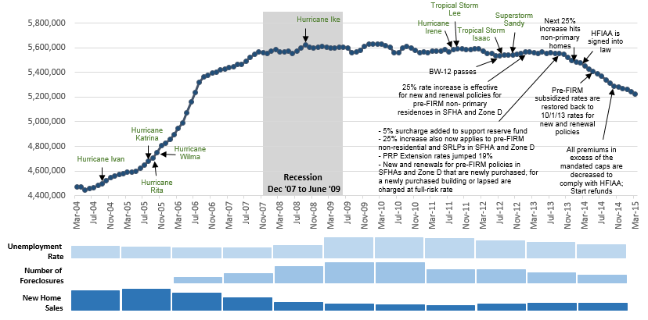
Number of National Flood Insurance Program Policies in Force by Month, Mar. 2004 – Mar. 2015
Source: FEMA/NFIP.

Slide 39
Florida’s Longest Spans Between Major Hurricanes
The current hurricane dry spell is now the longest in recorded history. Despite recent low activity, it is not a question of “IF” a hurricane will hit Florida but “WHEN”
Years
9 Years
339 Days
6 Years
249 Days*
6 Years
79 Days*
6 Years
317 Days*
*As of Sept. 28, 2015
Source: Insurance Information Institute and flhurricane.com.

Slide 40
Florida’s Longest Span Between Hurricanes
The current hurricane dry spell is now the longest in recorded history. Despite recent low activity, it is not a question of “IF” a hurricane will hit Florida but “WHEN”
9 Years
53 Days
6 Years
249 Days*
6 Years
79 Days*
6 Years
317 Days*
*As of Sept. 28, 2015
Source: Insurance Information Institute and flhurricane.com.

Slide 41
21st CENTURY RISKS
Insurers Are Working to Keep the Gap Small
Innovation Is the Key
41

Slide 42
Terrorism Insurance Take-up Rates,
By Year, 2003-2013
TRIA’s high take-up rates, availability and affordability have benefitted businesses, workers and the entire US economy since the program’s enactment
In 2003, the first year TRIA was in effect, the terrorism take-up rate was 27 percent. Since then, it has increased steadily, remaining in the low 60 percent range since 2009.
Source: Marsh Global Analytics, 2014 Terrorism Risk Insurance Report, April 2014 and earlier editions.
42
Notes:
42

Slide 43
Percentage of U.S. Companies Purchasing Cyber Insurance Increased in 2014
Ever larger numbers of insureds seek financial protection via cyber insurance. The percentage of U.S. companies buying cyber insurance rose to 16 percent in 2014.
*Take-up rate refers to the overall percentage of clients that purchased standalone cyber insurance.
Source: Benchmarking Trends: As Cyber Concerns Broaden, Insurance Purchases Rise, Marsh Risk Management Research Briefing, March 2015
43
Notes:
43

Slide 44
Marsh: Total Limits Purchased, By Industry – Cyber Liability, All Revenue Size
Average limits purchased for cyber risk rose to $12.8 million for all industries and all company sizes in 2014. Power and utility companies witnessed the sharpest percentage increase in average limits, at 59 percent.
($ Millions)
Source: Benchmarking Trends: As Cyber Concerns Broaden, Insurance Purchases Rise, Marsh Risk Management Research Briefing, March 2015
44
Notes:
44

Slide 45




The On-Demand/Sharing Economy: Insurers Are Minding the Gap!
The “On-Demand” Economy is or will impact many segments of the economy important to P/C insurers
  Auto (personal and commercial)
  Homeowners/Renters
  Many Liability Coverages
  Professional Liability
  Workers Comp
Many unanswered insurance questions due to regulation and litigation, but…
Insurance solutions are increasingly available to fill the many insurance needs and gaps that arise
45
12/01/09 - 9pm
eSlide – P6466 – The Financial Crisis and the Future of the P/C
Notes:
45

Slide 46
Insurance Information Institute Online:
www.iii.org
Thank you for your time
and your attention!
Twitter: twitter.com/bob_Hartwig

