Slide 1
P/C Insurance Industry Outlook for 2016 & Beyond
Focus on Texas Markets
Insurance Council of Texas
Annual Issues Symposium
Austin, TX
July 14, 2016
Download at www.iii.org/presentations
Robert P. Hartwig, Ph.D., CPCU, President & Economist
Insurance Information Institute ♦ 110 William Street ♦ New York, NY 10038
Tel: 212.346.5520 ♦ Cell: 917.453.1885 ♦ bobh@iii.org ♦ www.iii.org

Slide 2
P/C Industry Net Income After Taxes
1991–2016:Q1
$ Millions
2005 ROE*= 9.6%
2006 ROE = 12.7%
2007 ROE = 10.9%
2008 ROE = 0.1%
2009 ROE = 5.0%
2010 ROE = 6.6%
2011 ROAS¹ = 3.5%
2012 ROAS¹ = 5.9%
2013 ROAS¹ = 10.2%
2014 ROAS¹ = 8.4%
2015 ROAS = 8.4%
2016 ROAS = 7.9%*
Net income in Q1:2016 was down 26.6% from Q1:2015 in part due to higher CATs
ROE figures are GAAP; ¹Return on avg. surplus. 2016 data are for Q1. Excluding Mortgage & Financial Guaranty insurers yields a 8.2% ROAS in 2014, 9.8% ROAS in 2013, 6.2% ROAS in 2012, 4.7% ROAS for 2011, 7.6% for 2010 and 7.4% for 2009; 2015E is annualized figure based actual figure through Q3 of $44.0
Sources: A.M. Best, ISO; Insurance Information Institute

Slide 3
Profitability Peaks & Troughs in the P/C Insurance Industry, 1975 – 2016*
ROE
1977:19.0%
History suggests next ROE peak will be in 2016-2017
1987:17.3%
10 Years
1997:11.6%
2006:12.7%
10 Years
2015: 8.4%
2013 9.8%
9 Years
2014 8.4%
1975: 2.4%
1984: 1.8%
1992: 4.5%
2001: -1.2%
*2016 data through Q1. Profitability = P/C insurer ROEs. 2011-15 figures are estimates based on ROAS data. Note: Data for 2008-2014 exclude mortgage and financial guaranty insurers.
Source: Insurance Information Institute; NAIC, ISO, A.M. Best, Conning

Slide 4
ROE: Property/Casualty Insurance by Major Event, 1987–2016:Q1
(Percent)
P/C Profitability Is Both by
Cyclicality and Ordinary Volatility
Modestly higher CATs
Katrina, Rita, Wilma
Low CATs
Sept. 11
Hugo
Lowest CAT Losses in
15 Years
4 Hurricanes
Sandy
Andrew, Iniki
Record Tornado Losses
Northridge
Financial Crisis*
* Data for 2016 through Q1. Excludes Mortgage & Financial Guarantee in 2008 – 2014.
Sources: ISO, Fortune; Insurance Information Institute.

Slide 5
P/C Insurance Industry ROE: Magnitude of Cyclicality, Volatility Changes Over Time, 1950-2016:Q1
1950 - 1970
Low
Volatility
1971 - 1992
Extreme
Volatility
1993 - 2008
Moderate
Volatility
2009 - Present
Modest
Volatility
.*Through Q1 2016.
Source: Insurance Information Institute

Slide 6
P/C Insurance Industry
Combined Ratio, 2001–2016:Q1*
Heavy Use of Reinsurance Lowered Net Losses
Relatively Low CAT Losses, Reserve Releases
Higher CAT Losses, Shrinking Reserve Releases, Toll of Soft Market
As Recently as 2001, Insurers Paid Out Nearly $1.16 for Every $1 in Earned Premiums
Relatively Low CAT Losses, Reserve Releases
Avg. CAT Losses, More Reserve Releases
3 Consecutive Years of U/W Profits: First Time Since 1971-73
Sandy Impacts
Best Combined Ratio Since 1949 (87.6)
Cyclical Deterioration
Lower CAT Losses
Elevated CATs
* Excludes Mortgage & Financial Guaranty insurers 2008--2014. Including M&FG, 2008=105.1, 2009=100.7, 2010=102.4, 2011=108.1; 2012:=103.2; 2013: = 96.1; 2014: = 97.0.
Sources: 2016 figure from ISO/Verisk; A.M. Best, ISO (2014-2015); Figure for 2010-2013 is from A.M. Best P&C Review and Preview, Feb. 16, 2016.

Slide 7
NPW Premium Growth: Peaks & Troughs in the P/C Insurance Industry, 1926 – 2016:Q1
ROE
Post WW II Peak:
1947: 26.2%
1970-90: Peak premium growth was much higher in this period while troughs were comparable. Rapid inflation, economic volatility, high interest rates, tort environment all played roles
Start of WW II
1941: 15.8%
Economic Shocks, Inflation:
1976: 22.0%
Tort Crisis
1985/86: 22.2%
Post-9/11
2002:15.3%
1988-2000: Period of inter-cycle stability
2015 3.4%
1950-70: Extended period of stability in growth and profitability. Low interest rates, low inflation, “Bureau” rate regulation all played a role
2010-20XX? Post-recession period of stable growth?
Twin Recessions; Interest Rate Hikes
1987: 3.7%
Great Recession:2010: -4.9%
Great Depression
1932: -15.9% max drop
*Q1 data.
Note: Data through 1934 are based on stock companies only. Data include state funds beginning in 1998.
Source: A.M. Best; Insurance Information Institute.

Slide 8
Policyholder Surplus,
2006:Q4–2016:Q1
($ Billions)
2007:Q3
Pre-Crisis Peak
Drop due to near-record 2011 CAT losses
Surplus as of 3/31/16 stood at a record high of $676.3B
The industry now has $1 of surplus for every $0.77 of NPW,
close to the strongest claims-paying status in its history.
2010:Q1 data includes $22.5B of paid-in capital from a holding company parent for one insurer’s investment in a non-insurance business .
The P/C insurance industry entered 2016
in very strong financial condition.
Sources: ISO, A.M .Best.
8
12/01/09 - 9pm
eSlide – P6466 – The Financial Crisis and the Future of the P/C
Notes:
8

Slide 9
U.S. INSURANCE MERGERS AND ACQUISITIONS,
P/C SECTOR, 1994-2015E (1)
M&A activity in 2015 will likely reach its highest level since 1998. Globally, across all sectors, M&A activity exceeded $200B
($ Millions)
M&A activity in the P/C sector was up sharply in 2015
(1) Includes transactions where a U.S. company was the acquirer and/or the target.
Source: Conning proprietary database; 2015 I.I.I. estimate.

Slide 10
INVESTMENTS:
THE NEW REALITY
Investment Performance is a Key Driver of Profitability
Depressed Yields Will Necessarily Influence Underwriting & Pricing
10

Slide 11
Property/Casualty Insurance Industry Investment Income: 2000–2016:Q1¹
Investment earnings are still below their 2007 pre-crisis peak
($ Billions)
Due to persistently low interest rates, investment income fell in 2012, 2013 and 2014 but showed a small (1.9%) increase in 2015—another drop in 2016 seems likely.
*Annualized figure based on actual Q1:2016 net investment income earned of $10.893B.
¹ Investment gains consist primarily of interest and stock dividends. Sources: ISO; Insurance Information Institute.

Slide 12
U.S. Treasury Security Yields:
A Long Downward Trend, 1990–2016*
Yields on 10-Year U.S. Treasury Notes have been essentially below 5% for more than a decade.
Despite the Fed’s December 2015 rate hike, yields remain low though short-term yields have seen some gains; Yield curve is flattening.
Since roughly 80% of P/C bond/cash investments are in 10-year or shorter durations, most P/C insurer portfolios will have low-yielding bonds for years to come.
*Monthly, constant maturity, nominal rates, through May 20, 2016.
Sources: Federal Reserve Bank at http://www.federalreserve.gov/releases/h15/data.htm. National Bureau of Economic Research (recession dates); Insurance Information Institute.
12
12/01/09 - 9pm
eSlide – P6466 – The Financial Crisis and the Future of the P/C
Notes:
12

Slide 13
Net Investment Yield on Property/ Casualty Insurance Invested Assets, 2007–2016P*
(Percent)
Estimated book yield in 2016 is down about 140 BP from pre-crisis levels
The yield on invested assets remains low relative to pre-crisis yields. The Fed’s plan to raise interest rates in late 2015 has pushed up some yields, albeit quite modestly.
Sources: A.M. Best; 2015E-2016P figures from A.M. Best P/C Review and Preview, Feb. 2016; Insurance Information Institute

Slide 14
THE ECONOMY
The Strength of the Economy Will Greatly Influence Insurer Exposure Base Across Most Lines
14

Slide 15
US Real GDP Growth*
The Q4:2008 decline was the steepest since the Q1:1982 drop of 6.8%
Real GDP Growth (%)
Recession began in Dec, 2007
Q1 2014/15 GDP data were hit hard by this year’s “Polar Vortex” and harsh winter
Demand for Insurance Should Increase in 2016 as GDP Growth Continues at a Steady, Albeit Moderate Pace and Gradually Benefits the Economy Broadly
* Estimates/Forecasts from Blue Chip Economic Indicators.
Source: US Department of Commerce, Blue Economic Indicators 6/16; Insurance Information Institute.

Slide 16
US Unemployment Rate Forecast
Rising unemployment
eroded payrolls
and WC’s
exposure base.
Unemployment peaked at 10% in late 2009.
2007:Q1 to 2017:Q4F*
Jobless figures have been revised downwards for 2016
Unemployment forecasts have been revised modestly downwards. Optimistic scenarios put the unemployment as low as 4.4% by Q4 of 2016.
* = actual; = forecasts
Sources: US Bureau of Labor Statistics; Blue Chip Economic Indicators (6/16 edition); Insurance Information Institute.

Slide 17
Unemployment Rates by State, May 2016:
Highest 25 States*
In May, unemployment rates were significantly higher in 5 states, lower in 4 states and the District of Columbia, and stable in 41 states.
Weak economies are keeping unemployment relatively high in several states; Low energy prices play a role in some.
*Provisional figures for May 2016, seasonally adjusted.
Sources: US Bureau of Labor Statistics; Insurance Information Institute.

Slide 18
Unemployment Rates by State, May 2016:
Lowest 25 States*
In May, unemployment rates were significantly higher in 5 states, lower in 4 states and the District of Columbia, and stable in 41 states.
15 states have unemployment rates under 4%
*Provisional figures for May 2016, seasonally adjusted.
Sources: US Bureau of Labor Statistics; Insurance Information Institute.

Slide 19
Profitability & Politics
How Is Profitability Affected by the President’s Political Party?
19

Slide 20
P/C Insurance Industry ROE by Presidential Administration, 1950-2015*
OVERALL RECORD: 1950-2015*
Democrats 7.72%
Republicans 7.85%
Party of President has marginal bearing on profitability of P/C insurance industry
*Truman administration ROE of 6.97% based on 3 years only, 1950-52;.
Source: Insurance Information Institute

Slide 21
P/C insurance Industry ROE by Presidential Party Affiliation, 1950- 2015*
BLUE = Democratic President RED = Republican President
Nixon/Ford
Carter
Reagan/Bush I
Clinton
Bush II
Obama
Truman
Eisenhower
Kennedy/ Johnson
.
*2015 data is through Q3.
Source: Insurance Information Institute

Slide 22
Trump vs. Clinton:
Issues that Matter to P/C Insurers
Issue | Trump | Clinton
Economy | Supply Side-Like Philosophy: Lower taxes→Faster real GDP growth; Deficits likely grow as tax cuts are combined with targeted increased spending on Homeland Security, Defense, etc. | Keynesian Philosophy: More government spending on infrastructure, education, social services; Deficits likely increase as tax increases likely difficult to pass
Interest Rates | May trend higher with larger deficits; Shift from monetary policy to fiscal focus (tax cuts, government spending) | Status quo at the Fed; Net impact on interest rates unclear
Taxes | Favors lower tax rates for corporate and personal income tax rates; Tax code overhaul? | Unlikely to reduce taxes or embark on major overhaul of tax code
International Trade | Protectionist Tendencies (appeal primarily to manufacturing sector) | Has criticized Trans-Pacific Partnership but is a realist on international matters
Tort System | Doesn’t like trial lawyers but seems to like filing lawsuits | Status Quo
Health Care | ACA should be repealed & replaced | Incremental Change

Slide 23
2015 Property and Casualty Insurance
Regulatory Report Card
C
AK
AL
A
WA
ME
C
MT
B
ND
C
VT
D
MN
D
NH
B
OR
ID
C+
C
NY
MA
= A
= B
= C
= D
= F
= NG
B
SD
B+
WI
MI
CT
RI C+
B
B
NJ
WY
PA
C
B
B+
IA
B
C-
A
C+
OH
MD
NV
NE
A-
IL
IN
DE
B+
WV
B
UT
B
C
VA
CO
C+
A
B
A
B
KS
MO
KY
CA
B
A
F
D
A-
TN
NC
C
AZ
NM
OK
C
AR
C
SC
Source: James Madison Institute, February 2008.
A-
D
HI
B
B
AL
B
MS
C
GA
LA
D+
TX
D
Not Graded: District of Columbia
FL
D
D
Source: R Street Insurance Regulation Report Card, December 2015

Slide 24
Profitability and Growth in Texas P/C Insurance Markets
Analysis by Line and Nearby State Comparisons
24

Slide 25
Real GDP Growth: TX vs. U.S.,
2010-2015*
(Percent)
Average 2006-2015
US: 2.1%
TX: 4.0%
The TX economy has grown twice as fast as the US, on average, since 2010. Recent slowdown is due to the swoon in energy prices.
*2015 Texas figure is average of Q1 through Q3 (latest available).
Source: US Bureau of Economic Analysis; Insurance Information Institute.
25
Notes:
25

Slide 26
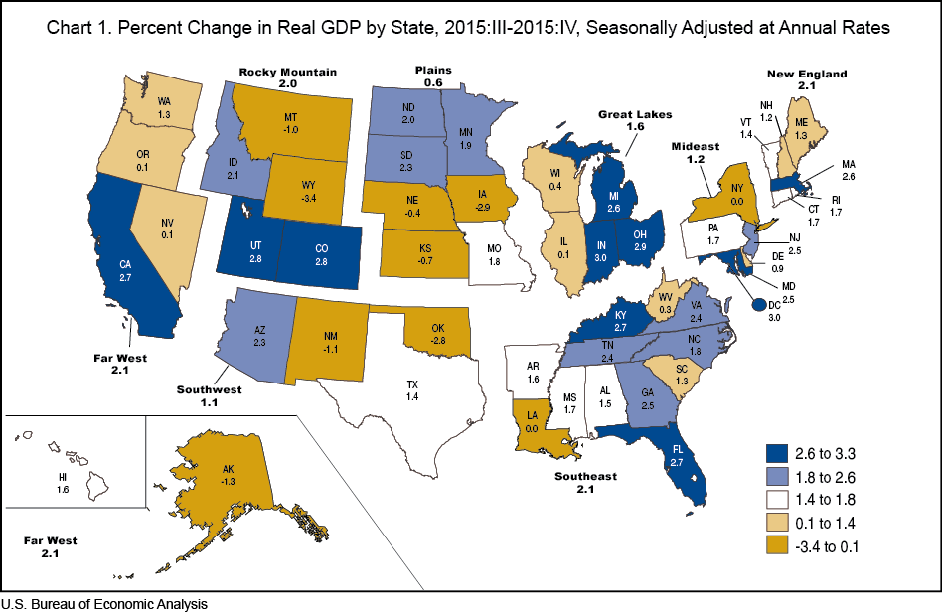
Real GDP Growth by State:
2015:III - 2015:IV
26

Slide 27
RNW All Lines: TX vs. U.S., 2005-2014
(Percent)
P/C Insurer profitability in TX is above that of the US overall over the past decade
US: 7.7%
TX: 7.5%
Sources: NAIC.
27
Notes:
27

Slide 28
RNW All Lines: TX vs. U.S., 1992-2014
P/C Insurer profitability in TX is since 1992 is somewhat below that of the US overall primarily to periodic tropical events and the “mold crisis” of the early 2000s
US: 7.4%
TX: 6.0%
(Percent)
Hurricane Rita
“Mold Crisis”
Hurricane Ike
Sources: NAIC.
28
Notes:
28

Slide 29
RNW PP Auto: TX vs. U.S., 2005-2014
Average 2005-2014
US: 6.2%
TX: 6.4%
Sources: NAIC.
29
Notes:
29

Slide 30
RNW Comm. Auto: TX vs. U.S.,
2005-2014
(Percent)
Commercial Auto profitability in TX is generally below the US average
Average 2005-2014
US: 8.1%
TX: 6.3%
Sources: NAIC.
30
Notes:
30

Slide 31
RNW Comm. Multi-Peril: TX vs. U.S.,
2005-2014
(Percent)
Average 2005-2014
US: 8.9%
TX: 2.7%
Sources: NAIC.
31
Notes:
31

Slide 32
RNW Homeowners: TX vs. U.S.,
2005-2014
(Percent)
Average 2005-2014
US: 7.6%
TX: 8.3%
Sources: NAIC.
32
Notes:
32

Slide 33
RNW Homeowners: TX vs. U.S.,
1992-2014
(Percent)
Average 1992-2014
US: 2.4%
TX: 1.8%
Hurricane Rita
Hurricanes Andrew, Iniki
Hurricane Ike
“Mold Crisis” and TS Alicia
Sources: NAIC.
33
Notes:
33

Slide 34
RNW Workers Comp: TX vs. U.S.,
2005-2014
(Percent)
Average 2005-2014
US: 6.8%
TX: 10.9%
Sources: NAIC.
34
Notes:
34

Slide 35
All Lines: 10-Year Average RNW TX & Nearby States
2005-2014
Texas All Lines profitability is below the US and above the regional averages
Source: NAIC, Insurance Information Institute

Slide 36
PP Auto: 10-Year Average RNW TX & Nearby States
2005-2014
Texas PP Auto profitability is above the US and regional averages
Source: NAIC, Insurance Information Institute

Slide 37
Top Ten Most Expensive And Least Expensive States For Automobile Insurance, 2013 (1)
Rank | Most expensive states | Average expenditure | Rank | Least expensive states | Average expenditure
1 | New Jersey | $1,254.10 | 1 | Idaho | $553.38
2 | D.C. | 1,187.49 | 2 | Iowa | 572.14
3 | New York | 1,181.86 | 3 | South Dakota | 580.99
4 | Louisiana | 1,146.29 | 4 | Maine | 592.82
5 | Florida | 1,143.83 | 5 | North Dakota | 604.58
6 | Michigan | 1,131.40 | 6 | Wisconsin | 621.05
7 | Delaware | 1,101.12 | 7 | Indiana | 621.71
8 | Rhode Island | 1,066.25 | 8 | North Carolina | 624.76
9 | Connecticut | 1,011.27 | 9 | Nebraska | 638.74
10 | Massachusetts | 1,007.98 | 10 | Wyoming | 639.71
Texas ranked 13th as the most expensive state in 2013, with an average expenditure for auto insurance of $895.44.
Based on average automobile insurance expenditures.
Source: © 2016 National Association of Insurance Commissioners.

Slide 38
Comm. Auto: 10-Year Average RNW TX & Nearby States
2005-2014
Texas Comm. Auto profitability is below the US average and above the regional averages
Source: NAIC, Insurance Information Institute

Slide 39
Comm. M-P: 10-Year Average RNW TX & Nearby States
2005-2014
Texas Comm. M-P profitability is below the US and above the regional averages
Source: NAIC, Insurance Information Institute

Slide 40
Homeowners: 10-Year Average RNW
TX & Nearby States
2005-2014
Texas Homeowners profitability is above the US and regional averages
Source: NAIC, Insurance Information Institute

Slide 41
Top Ten Most Expensive And Least Expensive States For Homeowners Insurance, 2013 (1)
Texas ranked as the 2nd most expensive state for homeowners insurance in 2013, with an average expenditure of $1,837.
Rank | Most expensive states | HO average premium | Rank | Least expensive states | HO average premium
1 | Florida | $2,115 | 1 | Idaho | 561
2 | Texas (2) | 1,837 | 2 | Oregon | 568
3 | Louisiana | 1,822 | 3 | Utah | 609
4 | Oklahoma | 1,654 | 4 | Wisconsin | 665
5 | Mississippi | 1,395 | 5 | Washington | 676
6 | Kansas | 1,343 | 6 | Nevada | 687
7 | Rhode Island | 1,334 | 7 | Delaware | 709
8 | Alabama | 1,323 | 8 | Arizona | 724
9 | Connecticut | 1,274 | 9 | Ohio | 763
10 | Massachusetts | 1,263 | 10 | Maine | 776
Includes policies written by Citizens Property Insurance Corp. (Florida) and Citizens Property Insurance Corp. (Louisiana), Alabama Insurance Underwriting Association, Mississippi Windstorm Underwriting Association, North Carolina Joint Underwriting Association and South Carolina Wind and Hail Underwriting Association. Other southeastern states have wind pools in operation and their data may not be included in this chart. Based on the HO-3 homeowner package policy for owner-occupied dwellings, 1 to 4 family units. Provides “all risks” coverage (except those specifically excluded in the policy) on buildings and broad named-peril coverage on personal property, and is the most common package written.
The Texas Department of Insurance developed home insurance policy forms that are similar but not identical to the standard forms. In addition, due to the Texas Windstorm Association (which writes wind-only policies) classifying HO-1, 2 and 5 premiums as HO-3, the average premium for homeowners insurance is artificially high.
Note: Average premium=Premiums/exposure per house years. A house year is equal to 365 days of insured coverage for a single dwelling. The NAIC does not rank state average expenditures and does not endorse any conclusions drawn from this data.
Source: ©2016 National Association of Insurance Commissioners (NAIC). Reprinted with permission. Further reprint or distribution strictly prohibited without written permission of NAIC.

Slide 42
Workers Comp.: 10-Year Average RNW
TX & Nearby States
2005-2014
Texas Workers Comp profitability is above the US and regional averages
Source: NAIC, Insurance Information Institute

Slide 43
All Lines DWP Growth: TX vs. U.S., 2006-2015
Average 2006-2015
US: 2.1%
TX: 4.1%
(Percent)
Source: SNL Financial.
43
Notes:
43

Slide 44
Comm. Lines DWP Growth:
TX vs. U.S., 2006-2015
(Percent)
Average 2006-2015
US: 1.4%
TX: 3.6%
Source: SNL Financial.
44
Notes:
44

Slide 45
Personal Lines DWP Growth:
TX vs. U.S., 2006-2015
(Percent)
Average 2006-2015
US: 2.8%
TX: 4.7%
Source: SNL Financial.
45
Notes:
45

Slide 46
Private Passenger Auto DWP Growth:
TX vs. U.S., 2006-2015
(Percent)
Average 2006-2015
US: 2.1%
TX: 4.3%
Source: SNL Financial.
46
Notes:
46

Slide 47
Homeowner’s MP DWP Growth: TX vs. U.S., 2006-2015
(Percent)
Average 2006-2015
US: 4.4%
TX: 5.4%
Source: SNL Financial.
47
Notes:
47

Slide 48
Top Insurance Issues:
What’s Hot, What’s Not
Eclectic Mix of Issues Garnered Media Attention So Far in 2016
Interest in Tech Issues Remains High
48

Slide 49
I.I.I. Media Index, P/C, First Five Months 2015 vs. First Five Months* 2016¹
Percent Increase/Decrease from Previous Year
*Through May 15.
¹Based on a search of Meltwater News

Slide 50
Auto & Home Insurance:
State of the Personal Lines Market
Auto Frequency and Severity Are an Immediate Challenge
Dearth of Major CATs (Until Recently), Pricing Discipline Has Helped Home
50

Slide 51
Return on Net Worth (RNW) All Lines:
2005-2014 Average
Commercial lines have tended to be more profitable than personal lines over the past decade, but Homeowners is on the rise due to the dearth of major catastrophes in recent years
Source: NAIC; Insurance Information Institute.

Slide 52
Return on Net Worth: All P-C Lines vs. Homeowners & Pvt. Pass. Auto, 1990-2014*
(Percent)
Average RNW: 1990-2013*
All P-C Lines: 7.8% PP Auto: 8.1% Homeowners: 4.3%**
Excluding 1992’s Hurricane Andrew
Pvt.Pass. Auto Has Consistently Outperformed the P-C Industry as a Whole. Homeowners Volatility is Associated Primarily With Coastal Exposure Issues
*Latest available.
**Excludes 1992, the year of Hurricane Andrew. If 1992 is included the resulting homeowners RNW is 1.9%
Sources: NAIC; Insurance Information Institute.
52
Notes:
52

Slide 53
RNW Pvt. Passenger Auto, 2005-2014 Average: Highest 25 States
(Percent)
Hawaii was the most profitable state for auto insurers from 2005-2014
Sources: NAIC; Insurance Information Institute

Slide 54
RNW Pvt. Passenger Auto,
2005-2014 Average: Lowest 25 States
(Percent)
Michigan was the least profitable state for auto insurers from 2005-2014
Sources: NAIC; Insurance Information Institute

Slide 55
RNW Homeowners Insurance,
2005-2014 Average: Highest 25 States
(Percent)
Hawaii was the most profitable state for home insurers from 2005-2014 due to the absence of hurricanes during this period
Sources: NAIC; Insurance Information Institute

Slide 56
RNW Homeowners Insurance,
2005-2014 Average: Lowest 25 States
(Percent)
Hurricanes Katrina and Rita made Louisiana and Mississippi the least profitable states for home insurers from 2005-2014
Sources: NAIC; Insurance Information Institute

Slide 57
Personal Lines Underwriting Performance
Auto, Home Underwriting Performance Exhibit Periods of Both Stability and Volatility
57

Slide 58
Homeowners Insurance Combined Ratio: 1990–2017F
Hurricane Andrew
Record tornado activity
Hurricane Ike
Hurricane Sandy
Homeowners Performance Has Improved Markedly Since the 2011/12’s Large Cat Losses. Extreme Regional Variation Can Be Expected Due to Local Catastrophe Loss Activity. Results in 2016 Will Be Impacted by Severe Spring Weather
Sources: A.M. Best (1990-2014); Insurance Information Institute (2015E-17F).

Slide 59
Private Passenger Auto Combined Ratio: 1993–2017F
Private Passenger Auto Underwriting Performance Is Showing the Strains of Rising Frequency (and Severity) Trends in Many States
Sources: A.M. Best (1990-2014); Conning (2015E-17F); Insurance Information Institute.

Slide 60
Claim Trends in Private Passenger Auto Insurance
Rising Frequencies and Severities in Many Coverages
Will that Pattern Be Sustained?
60

Slide 61
Auto Severity & Frequency by Coverage: Trending Up in 2015
Annual Change, 2015 Over 2014
Frequency and Severity Were Up Across Most Coverage Types in 2015; A Trend Likely to Continue in 2016
Source: ISO/PCI Fast Track data; Insurance Information Institute

Slide 62
Collision Coverage: Severity & Frequency Trends Are Both Higher in 2015
Annual Change, 2005 through 2015
The Recession, High Fuel Prices Helped Temper Frequency and Severity, But this Trend Has Clearly Reversed, Consistent with Experience from Past Recoveries
Source: ISO/PCI Fast Track data; Insurance Information Institute

Slide 63
Collision Loss Ratio Trending Upward:
Private Passenger Auto, 2010 – 2015
Loss Ratio
Collision Loss Ratios are Trending Steadily Upward
Source: ISO/PCI Fast Track data; Insurance Information Institute

Slide 64
Bodily Injury: Severity Trend Is Up, Frequency Decline Has Ended—Rising?
Annual Change, 2005 through 2015
Cost Pressures Will Increase if BI Frequency and Severity Trends Persist
Source: ISO/PCI Fast Track data; Insurance Information Institute

Slide 65
Property Damage Liability: Severity and Frequency Are Up
Annual Change, 2005 through 2015
Severity/Frequency Trends Have Been Volatile, But Rising Severity since 2011 Is a Concern
Source: ISO/PCI Fast Track data; Insurance Information Institute

Slide 66
Comprehensive Coverage: Frequency and Severity Trends Are Volatile
Severe weather is a principal cause of the spikes in both frequency and severity
Annual Change, 2005 through 2015
Weather Creates Volatility for Comprehensive Coverage
Source: ISO/PCI Fast Track data; Insurance Information Institute

Slide 67
A Few Factors Driving Adverse Private Passenger Auto Loss Trends
More People Driving, Lower Gas Prices, Higher Speed Limits…
67

Slide 68
Why Are People
Driving More Miles? Jobs?
Billions of Miles Driven in Prior Year
Millions Employed
Recession
People Drive To and From Work and Drive to Entertainment. Out of Work, They Curtail Their Movement.
Sources: Federal Highway Administration (http://www.fhwa.dot.gov/policyinformation/travel_monitoring/tvt.cfm ); Seasonally Adjusted Employed from Bureau of Labor Statistics; Insurance Institute for Highway Safety; Insurance Information Institute.
68
12/01/09 - 9pm
eSlide – P6466 – The Financial Crisis and the Future of the P/C
Notes:
68

Slide 69
More People Working and Driving
=> More Collisions, 2006-2016
Overall Collision Claims Per 100 Insured Vehicles
Number Employed,
Millions
Recession
When people are out of work, they drive less. When they get jobs,
they drive to work, helping drive claim frequency higher.
Sources: Seasonally Adjusted Employed from Bureau of Labor Statistics; Rolling Four-Qtr Avg. Frequency from Insurance Services Office; Insurance Information Institute.
69
12/01/09 - 9pm
eSlide – P6466 – The Financial Crisis and the Future of the P/C
Notes:
69

Slide 70
Change in Auto Fatalities by State: Especially Severe in Georgia
GA’s auto fatality rate has increased at a pace nearly 3 times that of the US overall and far in excess of any other state in the region
2015 vs. 2014
Fatalities in Southeast Rising Faster Than USA as a Whole
SOURCE: Estimates from National Safety Council.

Slide 71
Personal Lines Growth Drivers
Rate and Exposure are Both Presently Important Growth Drivers
71

Slide 72
Monthly Change in Auto Insurance Prices, 1991–2015*
Cyclical peaks in PP Auto tend to occur roughly every 10 years (early 1990s, early 2000s and likely the early 2010s)
Pricing peak occurred in late 2010 at 5.3%, falling to 2.8% by Mar. 2012
“Hard” markets tend to occur during recessionary periods
Dec. 2015 reading of 5.5% is up from 4.7%
a year earlier
*Percentage change from same month in prior year; through Dec. 2015; seasonally adjusted
Note: Recessions indicated by gray shaded columns.
Sources: US Bureau of Labor Statistics; National Bureau of Economic Research (recession dates); Insurance Information Institutes.
72
12/01/09 - 9pm
eSlide – P6466 – The Financial Crisis and the Future of the P/C
Notes:
72

Slide 73
Average Expenditures* on Auto Insurance, 1994-2015E
Annual Pct Changes
2001: 5.2%
2002: 8.6%
2003: 5.6%
2004: 1.5%
2005: -1.3%
2006: -1.8%
2007: -2.1%
2008: -1.0%
2009: -0.5%
2010: 0.6%
2011: 0.6%
2012: 2.3%
2013: 3.3%
The average expenditure on auto insurance now finally exceeds the pre-crisis high of $842 recorded in 2004, taking a full decade to recover, but on an inflation-adjusted basis premiums are still below 2004 levels
Across the U.S., auto insurance expenditures fell by 0.8% in 2008
and 0.5% in 2009 but rose 0.5% in 2010, 0.8% in 2011, 2.3% in 2012 and 3.3% in 2013; I.I.I. estimate is for +3.4% in 2014 and 2015.
* The NAIC data are per-vehicle (actually, per insured car-year)
Sources: NAIC for 1994-2013; Insurance Information Institute estimates for 2014-2015 based on CPI and other data.

Slide 74
Private Passenger Auto Insurance
Net Written Premium, 2000–2017F
PP Auto premiums written continue to recover from a period of flat growth attributable to the weak economy impacting new vehicle sales, car choice, and increased price sensitivity among consumers
PPA will generate $6B - $8B in new premiums annually through 2017
$ Billion
PPA NWP volume in 2014 was up $26.3B or 16.7% since the 2009 trough; By 2017 the gain is expected to be $46.8B or 29.7%
Sources: A.M. Best (1990-2014); Conning (2015-17F); Insurance Information Institute.

Slide 75
Homeowners Insurance
Net Written Premium, 2000–2016F
$ Billions
Homeowners insurance NWP continues to rise (up 150% 2000-2015F) despite very little unit growth during the real estate crash. Reasons include rate increases, especially in coastal zones, ITV endorsements (e.g., “inflation guards”), compulsory for mortgaged properties and resumption of home building activity
The Homeowners line will generate about $4B in new premiums annually through 2016
Sources: A.M. Best; Insurance Information Institute.

Slide 76
Personal Lines: Economic and Demographic Considerations
Auto, Home Are Sensitive to Underlying Economic Conditions
76

Slide 77
New Private Housing Starts, 1990-2021F
Job growth, low inventories of existing homes, still-low mortgage rates and demographics should continue to stimulate new home construction for several more years
(Millions of Units)
New home starts plunged 72% from 2005-2009; A net annual decline of 1.49 million units, lowest since records began in 1959
Insurers Are Continue to See Meaningful Exposure Growth in the Wake of the “Great Recession” Associated with Home Construction: Construction Risk Exposure, Surety, Commercial Auto; Potent Driver of Workers Comp Exposure
Source: U.S. Department of Commerce; Blue Chip Economic Indicators (5/16 for 2016-17; 3/16 for 2018-21F; Insurance Information Institute.

Slide 78
I.I.I. Poll: Renter’s Insurance
Q. Do you have renters insurance? ¹
Americans are increasingly choosing to rent, but are slow to understand the need to insure, exacerbating the underinsurance gap
The Percentage of Renters Who Have Renters Insurance Has Been Rising Since 2011.
¹Asked of those who rent their home.
Source: Insurance Information Institute Annual Pulse Survey.

Slide 79
Auto/Light Truck Sales, 1999-2021F
Job growth and improved credit market conditions will boost auto sales in 2015 and beyond
Sales have returned to pre-crisis levels
(Millions of Units)
New auto/light truck sales fell to the lowest level since the late 1960s. Forecast for 2014-15 is still below 1999-2007 average of 17 million units, but a robust recovery is well underway.
Truck, SUV purchases by contractors are especially strong
Yearly car/light truck sales will likely continue at current levels, in part replacing cars that were held onto in 2008-12. PP Auto premium might grow by 3.5% - 5%.
Source: U.S. Department of Commerce; Blue Chip Economic Indicators (5/16 for 2016-17; 3/16 for 2018-21F; Insurance Information Institute.

Slide 80
Number of Registered Passenger Vehicles in US, 1999 – 2015E
Vehicle registrations are growing once again and now finally exceed pre-crisis peak
Vehicle registrations are expected to increase at an annual rate of about 1.5% per year in 2015 and 2016
Sources: Bureau of Transportation Statistics; Barclays Capital estimates, August 2015.

Slide 81
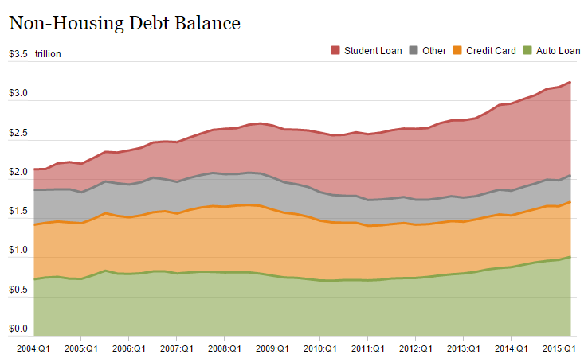
Auto Loans and Other Non-Housing Debt, 2004 – 2015*
Auto loan debt outstanding reached $1T for the first time ever in Q1 2015
Banks are becoming increasingly aggressive in marketing auto loans
*As of Q1 2015.
Source: Federal Reserve Bank of NY Consumer Credit Panel/Equifax; l. I.I.

Slide 82
Commercial Lines Underwriting Performance
82
Notes:
82

Slide 83
Commercial Lines Combined Ratio, 1990-2017F*
Commercial lines underwriting performance improved in 2013/14 but higher cats, diminishing prior year reserves and rising loss cost trends in some lines could push combined ratios higher
*2007-2012 figures exclude mortgage and financial guaranty segments.
Source: A.M. Best (1990-2014); Conning (2015E-17F) Insurance Information Institute.

Slide 84
Commercial Property Combined Ratio:
2007–2017F
Commercial Property Underwriting Performance Has Improved in Recent Years, Largely Due to Diminished CAT Activity
Source: Conning Research and Consulting.

Slide 85
General Liability Combined Ratio:
2005–2017F
Commercial General Liability Underwriting Performance Has Been Volatile in Recent Years
Source: Conning Research and Consulting.

Slide 86
Commercial Auto Combined Ratio: 1993–2017F
Commercial Auto Results Are Challenged as Rate Gains Barely Have Yet to Offset Adverse Frequency and Severity Trends
Sources: A.M. Best (1990-2014);Conning (2015E-2017F); Insurance Information Institute.

Slide 87
Workers Compensation Combined Ratio: 1994–2015P
WC results have improved markedly since 2011
Workers Comp Results Began to Improve in 2012. Underwriting Results Deteriorated Markedly from 2007-2010/11 and Were the Worst They Had Been in a Decade.
Sources: A.M. Best (1994-2009); NCCI (2010-2015P) and are for private carriers only; Insurance Information Institute.

Slide 88
Workers Compensation Premium:
Fifth Consecutive Year of Increase
Net Written Premium
$ Billions
p Preliminary
Source: NCCI from Annual Statement Data.
Includes state insurance fund data for the following states: AZ, CA, CO, HI, ID, KY, LA, MD, MO, MT, NM, OK, OR, RI, TX, UT.
Each calendar year total for State Funds includes all funds operating as a state fund that year.
Calendar Year

Slide 89
2015 Workers Compensation Direct Written Premium Growth, by State*
PRIVATE CARRIERS: Overall 2015 Growth = +4.3%
While growth rates varied widely, most states experienced modest positive growth in 2015
*Excludes monopolistic fund states (in gray): OH, ND, WA and WY.
Source: NCCI.

Slide 90
Workers Compensation Lost-Time
Claim Frequency Declined in 2015
Percent
Average Annual Change = –3.6%
(1994–2014)
*Adjustments primarily due to significant audit activity.
2015p: Preliminary based on data valued as of 12/31/2015.
Source: NCCI Financial Call data, developed to ultimate and adjusted to current wage an voluntary loss cost level; Excludes high deductible policies; 1994-2014: Based on data through 12/31/14. Data for all states where NCCI provides ratemaking services, excluding WV.
Frequency is the number of lost-time claims per $1M pure premium at current wage and voluntary loss cost level
Accident Year

Slide 91
Workers Compensation Medical Severity:
Small Decrease in 2015
Medical
Claim Cost ($000s)
Average Medical Cost per Lost-Time Claim
Medical severity for lost time claims was down 1% in 2015, the first decline in at least 20 years
Annual Change 1991–1993: +1.9%
Annual Change 1994–2001: +8.9%
Annual Change 2002–2010: +6.0%
Cumulative Change = 252%
(1991-2015p)
Accident Year
Accident Year
2015p: Preliminary based on data valued as of 12/31/2015.
1991-2013: Based on data through 12/31/2014, developed to ultimate
Based on the states where NCCI provides ratemaking services including state funds, excluding WV; Excludes high deductible policies.

Slide 92
Pricing Trends
Survey Results Suggest Commercial Pricing Has Flattened Out
92

Slide 93
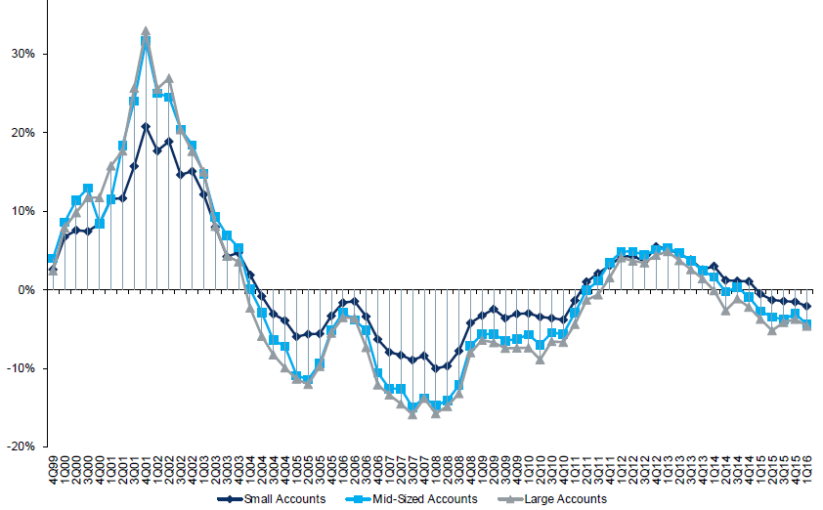
Change in Commercial Rate Renewals, by Account Size: 1999:Q4 to 2016:Q1
Percentage Change (%)
Peak = 2001:Q4 +28.5%
Pricing turned positive in Q3:2011, the first inrease in nearly 8 years; Q1:2015 renewals were down 2.8%; Some insurers posted stronger numbers.
Pricing Turned Negative in Early 2004 and Remained that way for 7 ½ years
Trough = 2007:Q3 -13.6%
KRW : No Lasting Impact
Source: Council of Insurance Agents and Brokers; Barclay’s Capital; Insurance Information Institute.
Note: CIAB data cited here are based on a survey. Rate changes earned by individual insurers can and do vary, potentially substantially.

Slide 94
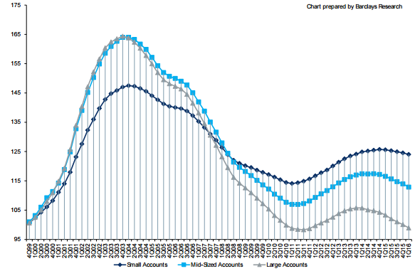
Cumulative Qtrly. Commercial Rate Changes, by Account Size: 1999:Q4 to 2016:Q1
1999:Q4 = 100
Pricing for smaller accounts has been more stable than for larger accounts
Note: CIAB data cited here are based on a survey. Rate changes earned by individual insurers can and do vary, potentially substantially.
Source: Council of Insurance Agents and Brokers; Barclay’s Capital; Insurance Information Institute.

Slide 95
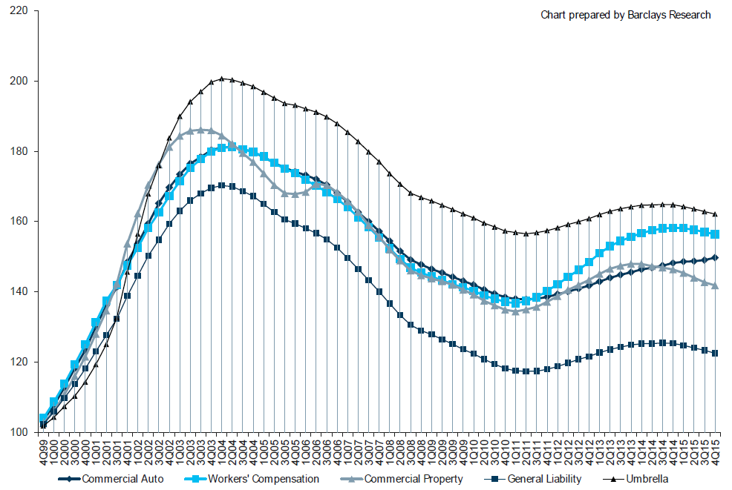
Cumulative Qtrly. Rate Changes, by Line: 1999:Q4 to 2015:Q4
1999:Q4 = 100
Commercial Auto is currently experiencing the strongest rate trend, supplanting WC
Note: CIAB data cited here are based on a survey. Rate changes earned by individual insurers can and do vary, potentially substantially.
Source: Council of Insurance Agents and Brokers; Barclay’s Capital; Insurance Information Institute.

Slide 96
CIAB: Average Commercial Rate Change, All Lines, (1Q:2004–1Q:2016)
(Percent)
Q2 2011 marked the last of 30th consecutive quarter of price declines
Pricing as of Q1:2016 remained somewhat negative
KRW Effect
Note: CIAB data cited here are based on a survey. Rate changes earned by individual insurers can and do vary, potentially substantially.
Source: Council of Insurance Agents & Brokers; Insurance Information Institute

Slide 97
Change in Commercial Rate Renewals, by Line: 2016:Q1
Percentage Change (%)
Commercial Auto rate increases are larger than any other line, followed by EPL and D&O
Major Commercial Lines Renewals Were Mixed to Down in Q1:2016; EPL, D&O and Commercial Auto Saw Gains
Note: CIAB data cited here are based on a survey. Rate changes earned by individual insurers can and do vary, potentially substantially.
Source: Council of Insurance Agents and Brokers; Insurance Information Institute.

Slide 98
Insured Catastrophe Losses
2013/14 and YTD 2015 Experienced Below Average CAT Activity After Very High CAT Losses in 2011/12
2016 CAT Losses YTD Running Higher
98

Slide 99
U.S. Insured Catastrophe Losses
($ Billions, $ 2015)
2012 was the 3rd most expensive year ever for insured CAT losses
2013/14/15 Were Welcome Respites from 2011/12, among the Costliest Years for Insured Disaster Losses in US History. 2016 Is Off to a Costlier Start.
$11.0B in insured CAT losses though 6/30/16
*Through 6/30/16. 2016 figure stated in 2016 dollars.
Note: 2001 figure includes $20.3B for 9/11 losses reported through 12/31/01 ($25.9B 2011 dollars). Includes only business and personal property claims, business interruption and auto claims. Non-prop/BI losses = $12.2B ($15.6B in 2011 dollars.)
Sources: Property Claims Service/ISO; Insurance Information Institute.
99
12/01/09 - 9pm
eSlide – P6466 – The Financial Crisis and the Future of the P/C
Notes:
99

Slide 100
Recent Large CATs in Texas in 2016 (except as noted)
Hail caused the majority of damage in what was a costly start to 2016 in Texas
$ Millions
Sources: Insurance Council of Texas

Slide 101
Combined Ratio Points Associated with Catastrophe Losses: 1960 – 2015E*
Avg. CAT Loss Component of the Combined Ratio by Decade
1960s: 1.04 1970s: 0.85 1980s: 1.31 1990s: 3.39 2000s: 3.52 2010s: 5.46*
Catastrophe losses as a share of all losses reached a record high in 2011
Combined Ratio Points
The Catastrophe Loss Component of Private Insurer Losses Has Increased Sharply in Recent Decades
*2010s represent 2010-2015E.
Notes: Private carrier losses only. Excludes loss adjustment expenses and reinsurance reinstatement premiums. Figures are adjusted for losses ultimately paid by foreign insurers and reinsurers.
Source: ISO (1960-2009); A.M. Best (2010-15E) Insurance Information Institute.

Slide 102
Inflation Adjusted U.S. Catastrophe Losses by Cause of Loss, 1995–2014¹
Wind/Hail/Flood (3), $21.4
Fires (4), $6.0
Winter storm losses were much above average in 2014/15 are will push this share up
Other (5), $0.2
Insured cat losses from 1995-2014 totaled $395.6B, an average of $19.8B per year or $1.65B per month
Geological Events, $0.5
Terrorism, $24.5
Winter Storms, $26.9
Hurricanes & Tropical Storms, $161.2
Tornado share of CAT losses is rising
Wind losses are by far cause the most catastrophe losses, even if hurricanes/TS are excluded.
Events Involving Tornadoes (2), $154.9
Catastrophes are defined as events causing direct insured losses to property of $25 million or more in 2014 dollars.
Excludes snow.
Does not include NFIP flood losses
Includes wildland fires
Includes civil disorders, water damage, utility disruptions and non-property losses such as those covered by workers compensation.
Source: ISO’s Property Claim Services Unit.

Slide 103
Top 16 Most Costly Disasters in U.S. History—Katrina Still Ranks #1
(Insured Losses, 2014 Dollars, $ Billions)
Storm Sandy in 2012 was the last mega-CAT to hit the US
Includes Tuscaloosa, AL, tornado
Includes Joplin, MO, tornado
12 of the 16 Most Expensive Events in US History Have Occurred Since 2004
Sources: PCS; Insurance Information Institute inflation adjustments to 2014 dollars using the CPI.

Slide 104
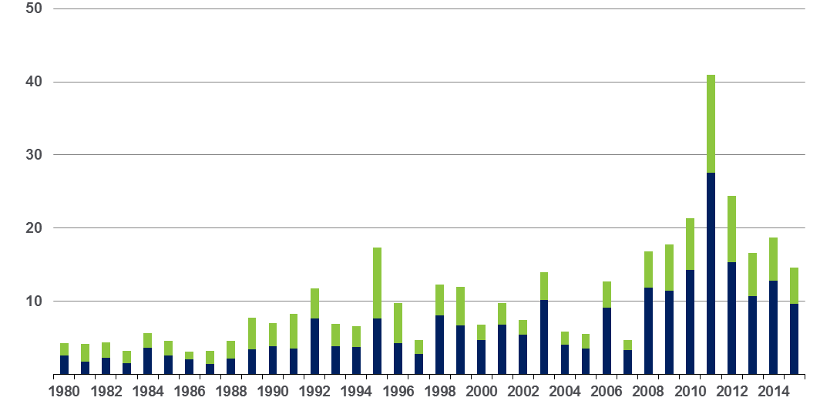
Convective Loss Events in the US
Overall and insured losses, 1980 – 2015
Overall losses
(in 2015 values)*
$ Billions
Insured losses
(in 2015 values)*
The period from 2008-2015 has been the most expensive on record for insured losses from “Convective Events” (severe thunderstorms, tornado, hail, lightning and flash flood)
*Losses adjusted to inflation based on CPI
Analysis contains:
severe storm, tornado, hail, flash flood and lightning
104
Source: Geo Risks Research, NatCatSERVICE

Slide 105
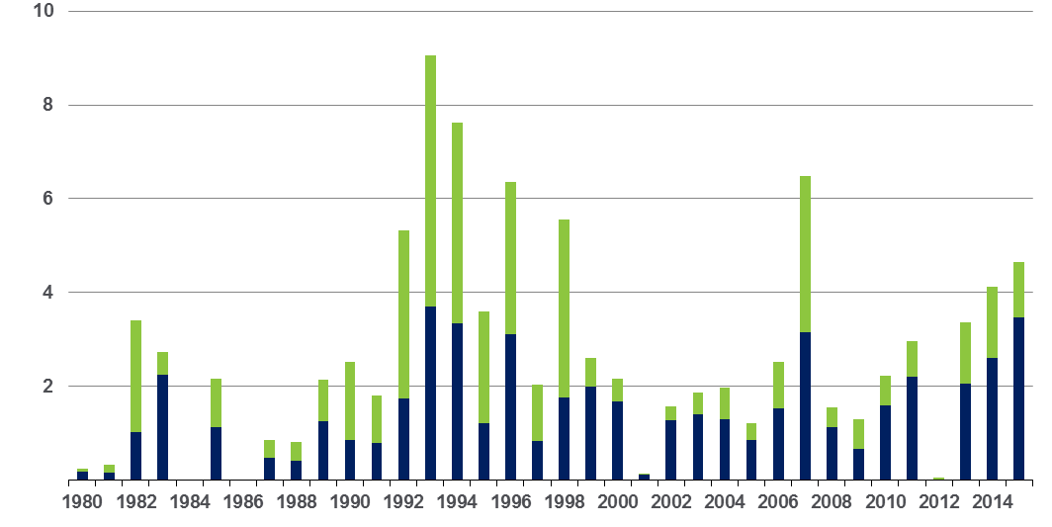
Winter Storm Losses in the US
1980 – 2015 (Overall and Insured Losses)*
$ Billions
Winter storm losses have been increasing rapidly in recent years
Overall losses
(in 2015 values)*
Insured losses
(in 2015 values)*
*Winter storms include also winter damages, blizzards and cold waves
Source: Property Claim Services, MR NatCatSERVICE.
*Losses adjusted to inflation based on CPI.
105

Slide 106
US Property CAT Rate on Line Index & Global Reinsurance ROE
US Property CAT ROL
Global Reinsurance ROE
Record traditional capacity, alternative capital and low CAT activity have pressured reinsurance prices; ROEs are own only very modestly
Source: Barclays PLC from Guy Carpenter; Insurance Information Institute.

Slide 107
INDUSTRY DISRUPTORS
Technology, Society and the Economy Are All Changing at a Rapid Pace
Thoughts on the Future
107

Slide 108

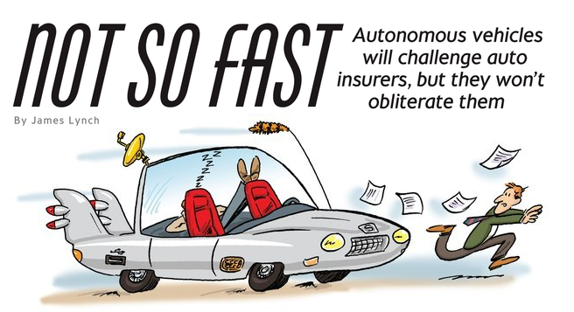
Media is Obsessed with Driverless Vehicles: Often Predicting the Demise of Auto Insurance
By 2035, it is estimated that 25% of new vehicle sales could be fully autonomous models
Questions
Are auto insurers monitoring these trends?
How are they reacting?
Will Google take over the industry?
Will the number of auto insurers shrink?
How will liability shift?
Source: Boston Consulting Group.

Slide 109




On-Demand/Sharing/Peer-to-Peer Economy Impacts Many Lines of Insurance
The “On-Demand” Economy is or will impact many segments of the economy important to P/C insurers
  Auto (personal and commercial)
  Homeowners/Renters
  Many Liability Coverages
  Professional Liability
  Workers Comp
Many unanswered insurance questions
Insurance solutions are increasingly available to fill the many insurance gaps that arise
109
12/01/09 - 9pm
eSlide – P6466 – The Financial Crisis and the Future of the P/C
Notes:
109

Slide 110






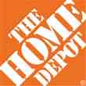

Data Breaches 2005-2015, by Number of Breaches and Records Exposed
# Data Breaches/Millions of Records Exposed
Millions
The total number of data breaches (+27.5%) hit a record high of 783 in 2014, exposing 85.6 million records. Through June 30, this year has seen 117.6 million records exposed in 400 breaches.*
*Figures as of June 30, 2015, from the Identity Theft Resource Center,
http://www.idtheftcenter.org/images/breach/ITRCBreachReport2015.pdf

Slide 111
The Sharing Economy: An Update
The On-Demand Economy Will Transform the American Workforce and the P/C Insurance Industry Too
111

Slide 112

The Sharing Economy Has Grown— And Attracted Political Scrutiny

Slide 113

Political Skepticism About the
‘Gig’ Economy
"Many Americans are making extra money renting out a spare room, designing a website ... even driving their own car. This on demand or so called 'gig' economy is creating exciting opportunities and unleashing innovation, but it's also raising hard questions about workplace protections and what a good job will look like in the future."
--Hillary Clinton,
July 13, 2015
113
12/01/09 - 9pm
eSlide – P6466 – The Financial Crisis and the Future of the P/C
Notes:
113

Slide 114
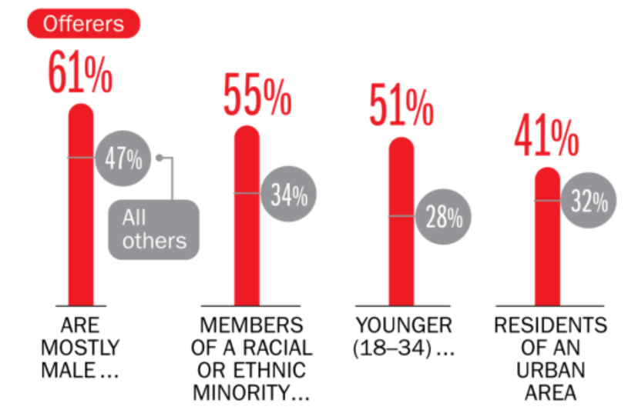
Americans Who Offer Services in the Sharing/Gig Economy Are Statistically More Prone to Workplace Injury
Young, urban minority males are the most likely to offer their services in the sharing economy.
Sources: The SelfEmployed.com accessed at https://www.theselfemployed.com/gig-economy/infographic-inside-the-new-economy/ based on a poll by Time magazine, Bursten-Marsteller and The Aspen Institute; Insurance Information Institute.

Slide 115
THE ‘INTERNET OF THINGS’
Capturing Economic Value Amid a Shifting Insurer Value Chain
115

Slide 116
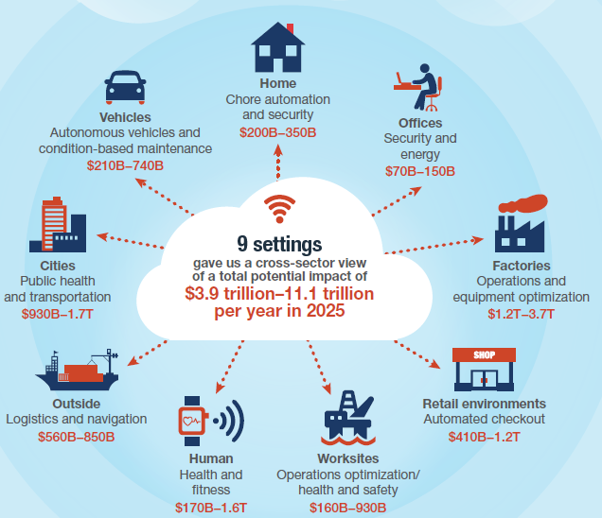
The Internet of Things and the Insurance Industry
The “Internet of Things” will create trillions in economic value throughout the global economy by 2025
What opportunities, challenges will this create for insurers?
What are the impact on the insurance industry “value chain”?
Sources: McKinsey Global Institute, The Internet of Things: Mapping the Value Beyond the Hype,
June 2015; Insurance Information Institute.
116
12/01/09 - 9pm
eSlide – P6466 – The Financial Crisis and the Future of the P/C
Notes:
116

Slide 117
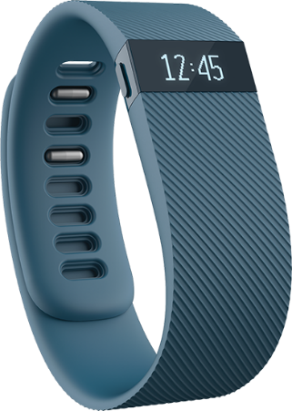
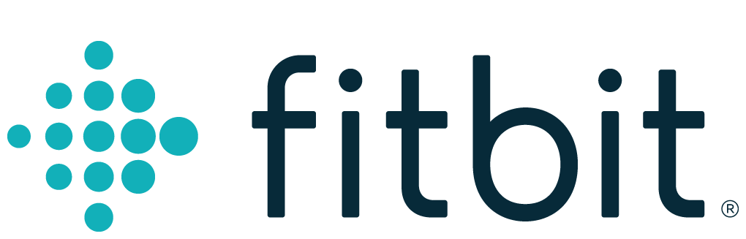
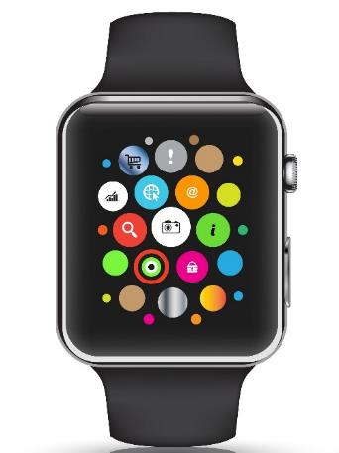

Wearables Show Significant Potential to Reduce Workplace Injury, Death
Wearables Today Can Monitor:
  Location
  Heart rate
  Temperature
  Steps/Exertion
  Sweat
  Sleep
In the Near Future Could Monitor:
  Glucose level
  Oxygen levels
  Pain
  Nausea
117
12/01/09 - 9pm
eSlide – P6466 – The Financial Crisis and the Future of the P/C
Notes:
117

Slide 118
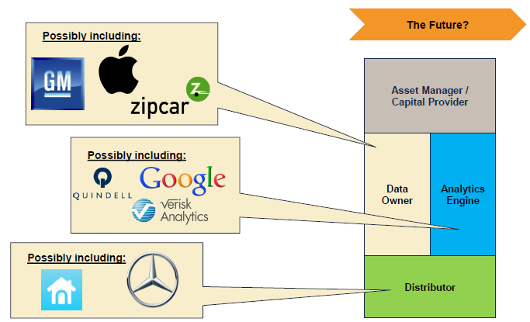
The Internet of Things and the Insurance Industry Value Chain
Who owns the data? Where does It flow? Who does the analytics? Who is the capital provider?
Source: Willis Capital Markets & Advisory; Insurance Information Institute.
118
12/01/09 - 9pm
eSlide – P6466 – The Financial Crisis and the Future of the P/C
Notes:
118

Slide 119
INSURANCE TECHNOLOGY:
FIN TECH ZEROES IN
Number and Value of Deals Is Increasing
In Search of the Elusive Insurance ‘Unicorn’
119

Slide 120
Insurance Technology Financing Trend: Change Is Coming
Insurance tech deals reached a new record in 2016:Q1
($ Millions)
Investment in insurance tech is rising
Source: CB Insights at https://www.cbinsights.com/blog/insurance-tech-overview-q1-2016/; Insurance Information Institute.

Slide 121
Insurance Tech Activity by Area of Interest, 2013 – 2016:Q1
With the ACA in the rear view window, non-health insurance tech accounts for the majority of investment
(Percent)
Silicon Valley and the venture capital community have the insurance industry in their sights. Most will fail. Some will succeed.
Source: CB Insights at https://www.cbinsights.com/blog/insurance-tech-overview-q1-2016/; Insurance Information Institute.

Slide 122
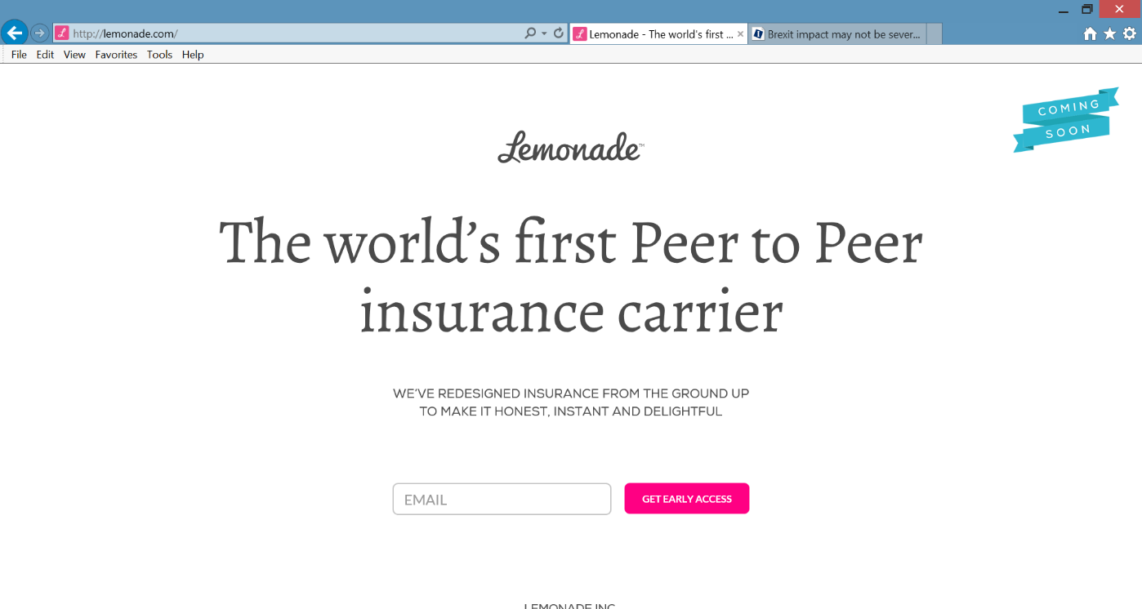
Lemonade: Peer-to-Peer (P2P) Insurance
Source: Lemonade.com accessed June 24, 2016.
122

Slide 123
Lemonade: Sour Words About Insurance
Daniel Schreiber here, with updates from Lemonade.
I’m thrilled to report that a few days ago, by unanimous vote of our board and shareholders, Lemonade became a Public Benefit Corporation, and was also awarded provisional ‘B-Corp’ certification. Both are firsts for an insurance carrier, and are points of tremendous pride for our team.
Rebuilding insurance as a social good, rather than a necessary evil, is now part of our legal mission. Our Chief Behavioral Officer, Professor Dan Ariely, says that “If you tried to create a system to bring out the worst in humans, it would look a lot like the insurance of today.” Working in partnership with nonprofits, and baking giving-back into our business model, holds the promise of a better insurance experience, and a more valuable insurance company.
In other news, I’m happy to say that we’re putting finishing touches on our product and will be ready to launch in New York within weeks. The final step is for us to get our license, and if all goes to plan, we’ll have that shortly.
Be sure to follow us on Twitter, Facebook, and LinkedIn to stay in the know.
Until next time,
Daniel
@daschreiber
123
Source: Email from Lemonade CEO Danieal Schreibeir, May 17, 2016.

Slide 124
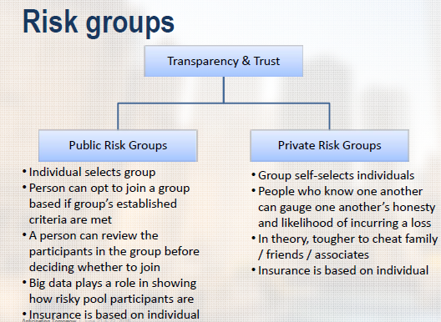
Risk Groups in P2P Structures
P2P model is predicated in part that view that individuals who know one another are less likely to commit fraud, etc.
Source: “UberX-ing Insurance : Is Peer-to-Peer Insurance Viable?”, presentation by Jay Sarzen, Aite Group at DrinkerBiddle Insurance Conference, June 21, 2016.
124

Slide 125
Insurance Information Institute Online:
www.iii.org
Thank you for your time
and your attention!
Twitter: twitter.com/bob_Hartwig
Download at www.iii.org/presentations

