Slide 1
Workers Compensation and the New Economy:
Trends, Challenges and Opportunities
Minnesota Workers’ Comp Insurers Association
Minneapolis, MN
April 27, 2015
Download at www.iii.org/presentations
Robert P. Hartwig, Ph.D., CPCU, President & Economist
Insurance Information Institute ♦ 110 William Street ♦ New York, NY 10038
Tel: 212.346.5520 ♦ Cell: 917.453.1885 ♦ bobh@iii.org ♦ www.iii.org

Slide 2
Insurance Industry:
Financial Update & Outlook
2014 Was a Reasonably Good Year
2015: A Repeat of 2014?
2

Slide 3
P/C Industry Net Income After Taxes
1991–2014E
2005 ROE*= 9.6%
2006 ROE = 12.7%
2007 ROE = 10.9%
2008 ROE = 0.1%
2009 ROE = 5.0%
2010 ROE = 6.6%
2011 ROAS¹ = 3.5%
2012 ROAS¹ = 5.9%
2013 ROAS¹ = 10.3%
2014 ROAS¹ = 7.6%
Net income rose strongly (+81.9%) in 2013 vs. 2012 on lower cats, capital gains
$ Millions
ROE figures are GAAP; ¹Return on avg. surplus. Excluding Mortgage & Financial Guaranty insurers yields a 7.7% ROAS through 2014:Q2, 9.8% ROAS in 2013, 6.2% ROAS in 2012, 4.7% ROAS for 2011, 7.6% for 2010 and 7.4% for 2009.
Sources: A.M. Best, ISO; Insurance Information Institute

Slide 4
Profitability Peaks & Troughs in the P/C Insurance Industry, 1975 – 2014:Q3*
ROE
1977:19.0%
History suggests next ROE peak will be in 2016-2017
1987:17.3%
10 Years
2006:12.7%
1997:11.6%
10 Years
2013 10.4%
9 Years
2014:Q3 7.6%
1975: 2.4%
1984: 1.8%
1992: 4.5%
2001: -1.2%
*Profitability = P/C insurer ROEs. 2011-14 figures are estimates based on ROAS data. Note: Data for 2008-2014 exclude mortgage and financial guaranty insurers.
Source: Insurance Information Institute; NAIC, ISO, A.M. Best.

Slide 5
Profitability Peaks & Troughs in the P/C Insurance Industry, 1975 – 2016F
ROE
1977:19.0%
History suggests next ROE peak will be in 2016-2017, but that seems unlikely
1987:17.3%
10 Years
2006:12.7%
1997:11.6%
10 Years
2013 10.4%
2015F=6.5%
2016F=6.3%
9 Years
2014E 7.6%
1975: 2.4%
1984: 1.8%
1992: 4.5%
2001: -1.2%
*Profitability = P/C insurer ROEs. 2011-14 figures are estimates based on ROAS data. Note: Data for 2008-2014 exclude mortgage and financial guaranty insurers.
Source: Insurance Information Institute; NAIC, ISO, A.M. Best, Conning

Slide 6
ROE: Property/Casualty Insurance by Major Event, 1987–2014E
(Percent)
P/C Profitability Is Both by
Cyclicality and Ordinary Volatility
Modestly higher CATs
Katrina, Rita, Wilma
Low CATs
Sept. 11
Hugo
Lowest CAT Losses in
15 Years
4 Hurricanes
Sandy
Andrew
Record Tornado Losses
Northridge
Financial Crisis*
* Excludes Mortgage & Financial Guarantee in 2008 – 2014. 2014 figure is through Q3:2014.
Sources: ISO, Fortune; Insurance Information Institute.

Slide 7
Back to the Future: Profitability Peaks & Troughs in the P/C Insurance Industry, 1950 – 2014*
ROE
1970-90: Peak ROEs were much higher in this period while troughs were comparable. High interest rates, rapid inflation, economic volatility all played roles
1950-70: ROEs were lower in this period. Low interest rates, low inflation, “Bureau” rate regulation all played a role
1990-2010s: Déjà vu. Excluding mega-CATs, this period is very similar to the 1950-1970 period
1977:19.0%
1987:17.3%
2006:12.7%
1972:13.7%
1997:11.6%
2013 10.4%
1950:8.0%
1966-67: 5.5%
1959:6.8%
2014:H1 7.6%
1969: 3.9%
1957: 1.8%
1965: 2.2%
1975: 2.4%
1984: 1.8%
1992: 4.5%
2001: -1.2%
*Profitability = P/C insurer ROEs. 2011-14 figures are estimates based on ROAS data. Note: Data for 2008-2014 exclude mortgage and financial guaranty insurers. 2014 figure is through Q3.
Source: Insurance Information Institute; NAIC, ISO, A.M. Best.

Slide 8
NPW Premium Growth: Peaks & Troughs in the P/C Insurance Industry, 1926 – 2014E
ROE
Post WW II Peak:
1947: 26.2%
1970-90: Peak premium growth was much higher in this period while troughs were comparable. Rapid inflation, economic volatility, high interest rates, tort environment all played roles
Start of WW II
1941: 15.8%
Economic Shocks, Inflation:
1976: 22.0%
Tort Crisis
1985/86: 22.2%
Post-9/11
2002:15.3%
1988-2000: Period of inter-cycle stability
2014E 4.0%
1950-70: Extended period of stability in growth and profitability. Low interest rates, low inflation, “Bureau” rate regulation all played a role
2010-20XX? Post-recession period of stable growth?
Twin Recessions; Interest Rate Hikes
1987: 3.7%
Great Recession:2010: -4.9%
Great Depression
1932: -15.9% max drop
Note: Data through 1934 are based on stock companies only. Data include state funds beginning in 1998.
Source: A.M. Best; Insurance Information Institute.

Slide 9
Commercial Lines NPW Premium Growth:
1975 – 2014E
ROE
Commercial lines is prone to more cyclical volatility that personal lines. Recently, growth has stabilized in the 4% to 5% range.
Economic Shocks, Inflation:
1976: 22.2%
Tort Crisis
1986: 30.5%
Post-9/11
2002: 22.4%
Post-Hurricane Andrew Bump:
1993: 6.3%
1988-2000: Period of inter-cycle stability
Post Katrina Bump:
2006: 7.7%
2014E 4.0%
2010-20XX? Post-recession period of stable growth?
Recessions:
1982: 1.1%
Great Recession:2009: -9.0%
Note: Data include state funds beginning in 1998.
Source: A.M. Best; Insurance Information Institute.

Slide 10
P/C Insurance Industry
Combined Ratio, 2001–2014:Q3*
Relatively Low CAT Losses, Reserve Releases
Higher CAT Losses, Shrinking Reserve Releases, Toll of Soft Market
As Recently as 2001, Insurers Paid Out Nearly $1.16 for Every $1 in Earned Premiums
Heavy Use of Reinsurance Lowered Net Losses
Relatively Low CAT Losses, Reserve Releases
Avg. CAT Losses, More Reserve Releases
Sandy Impacts
Best Combined Ratio Since 1949 (87.6)
Cyclical Deterioration
Lower CAT Losses
* Excludes Mortgage & Financial Guaranty insurers 2008--2014. Including M&FG, 2008=105.1, 2009=100.7, 2010=102.4, 2011=108.1; 2012:=103.2; 2013: = 96.1; 2014:9M = 97.7.
Sources: A.M. Best, ISO.

Slide 11
A 100 Combined Ratio Isn’t What It
Once Was: Investment Impact on ROEs
A combined ratio of about 100 generates an ROE of ~7.0% in 2012/13, ~7.5% ROE in 2009/10,
10% in 2005 and 16% in 1979
Combined Ratio / ROE
Lower CATs helped ROEs in 2013
Combined Ratios Must Be Lower in Today’s Depressed
Investment Environment to Generate Risk Appropriate ROEs
* 2008 -2014 figures are return on average surplus and exclude mortgage and financial guaranty insurers. 2014:9M combined ratio including M&FG insurers is 97.7; 2013 = 96.1; 2012 =103.2, 2011 = 108.1, ROAS = 3.5%.
Source: Insurance Information Institute from A.M. Best and ISO Verisk Analytics data.

Slide 12
RNW All Lines by State, 2004-2013 Average:
Highest 25 States
The most profitable states over the past decade are widely distributed geographically, though none are in the Gulf region
Profitability Benchmark: All P/C
US: 7.9%
Source: NAIC; Insurance Information Institute.

Slide 13
RNW All Lines by State, 2004-2013 Average:
Lowest 25 States
Some of the least profitable states over the past decade were hit hard by catastrophes
Source: NAIC; Insurance Information Institute.

Slide 14
Return on Net Worth (RNW) All Lines:
2004-2013 Average
Commercial lines have tended to be more profitable than personal lines over the past decade, though WC has lagged behind
Source: NAIC; Insurance Information Institute.

Slide 15
RNW Workers Comp: MN vs. U.S.,
2004-2013
(Percent)
Average 2004-2013
US: 7.1%
MN: 6.8%
Source: NAIC, Insurance Information Institute
15
Notes:
15

Slide 16
Workers Comp: 10-Year Average RNW
MN & Nearby States
Minnesota Workers Comp profitability is comparable to the US average and regional average
2004-2013
Source: NAIC, Insurance Information Institute

Slide 17
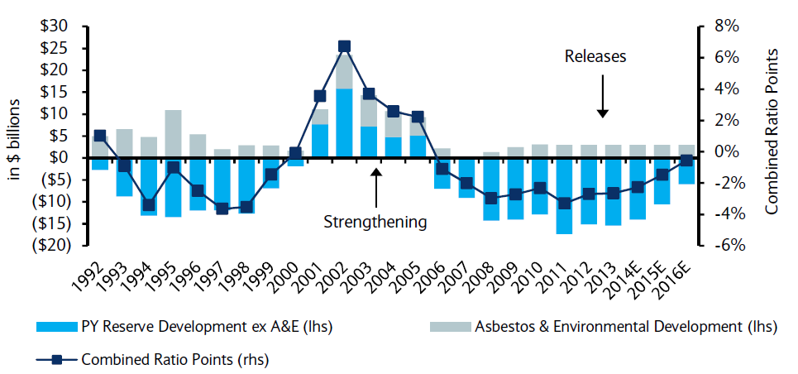
P/C Insurance Loss Reserve Development, 1992 – 2016E*
Reserve releases are expected to gradually taper off, but will continue to benefit the bottom line and combined ratio through at least 2016
Reserve Change
Source: A.M. Best; Barclays research for estimates.

Slide 18
CAPITAL/CAPACITY
Capital Accumulation Has Multiple Impacts
18

Slide 19
Policyholder Surplus,
2006:Q4–2014:Q4E
Drop due to near-record 2011 CAT losses
($ Billions)
2007:Q3
Pre-Crisis Peak
Surplus as of 12/31/14 stood at a record high $675B
The industry now has $1 of surplus for every $0.73 of NPW,
close to the strongest claims-paying status in its history.
2010:Q1 data includes $22.5B of paid-in capital from a holding company parent for one insurer’s investment in a non-insurance business .
The P/C insurance industry entered 2015
in very strong financial condition.
Sources: ISO, A.M .Best.
19
12/01/09 - 9pm
eSlide – P6466 – The Financial Crisis and the Future of the P/C
Notes:
19

Slide 20
US Policyholder Surplus:
1975–2014*
($ Billions)
Surplus as of 9/30/14 was a record $673.9, up 3.2% from $653.3 of 12/31/13, and up 53.6% ($234.5B) from the crisis trough of $437.1B at 3/31/09
“Surplus” is a measure of underwriting capacity. It is analogous to “Owners Equity” or “Net Worth” in non-insurance organizations
The Premium-to-Surplus Ratio Stood at $0.73:$1 as of
9/30/14, a Near Record Low (at Least in Recent History)
* As of 9/30/14.
Source: A.M. Best, ISO, Insurance Information Institute.

Slide 21
Premium-to-Surplus Ratio:
1985–2014*
(Ratio of NWP to PHS)
The larger surplus is in relation to premiums—the lower the P:S ratio—and the great the industry’s capacity to handle the risk it has accepted
Surplus as of 9/30/14 was $0.75:$1, a near-record low (at least in modern history)
9/11, Recession & Hard Market
The Premium-to-Surplus Ratio Stood at $0.75:$1 as of
9/30/14, a Record Low (at Least in Recent History)
* As of 9/30/14.
Source: A.M. Best, ISO, Insurance Information Institute.

Slide 22
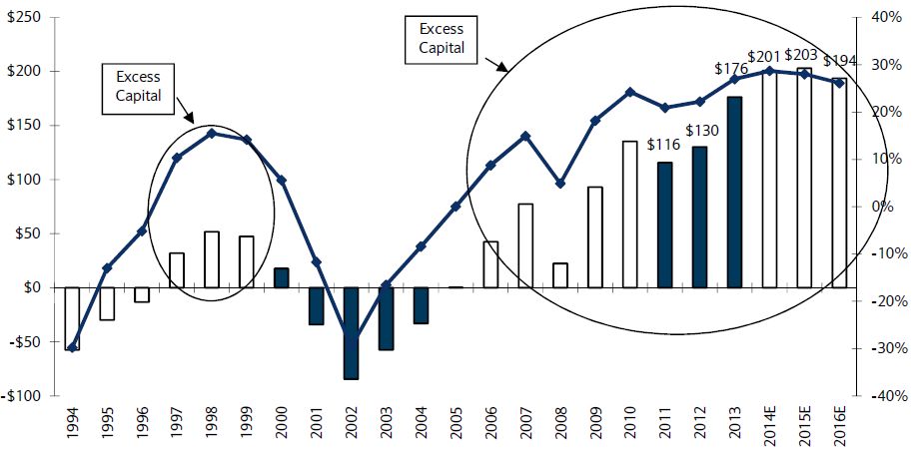
US P/C Insurance Industry Excess Capital Position: 1994–2016E
Barclay’s suggests that surplus is approximately $200B (~30%)
Surplus Redundancy (Deficiency)
Percent Redundancy (Deficiency)
The Industry’s Strong Capital Position Suggests Insurers Are in a Good Position to Increase Risk Appetite, Repurchase Shares and Pursue Acquisitions
Source: Barclays Research estimates.

Slide 23
P/C Industry: Loss Reserve-to-Surplus Ratio, 1971-2014:Q3
Inflation, Liability Crisis Increased Reserves, Plunging Stock Prices Depleted Surplus
The Property/Casualty Industry Adjusted Its Risk Portfolio in Response to Risk-Based Capital Requirements Implemented in 1994.
Source: Calculations from A.M. Best data by Insurance Information Institute.

Slide 24
INVESTMENTS:
THE NEW REALITY
Investment Performance is a Key Driver of Profitability
Depressed Yields Will Necessarily Influence Underwriting & Pricing
24

Slide 25
Property/Casualty Insurance Industry Investment Income: 2000–2014¹
Investment earnings are still below their 2007 pre-crisis peak
($ Billions)
Due to persistently low interest rates,
investment income fell in 2012, 2013 and 2014.
¹ Investment gains consist primarily of interest and stock dividends. *2014 figure is estimated based on annualized data through Q3.
Sources: ISO; Insurance Information Institute.

Slide 26
Distribution of Invested Assets: P/C Insurance Industry, 2013
$ Billions
Total Invested Assets = $1.5 Trillion
Source: Insurance Information Institute Fact Book 2015, A.M. Best.

Slide 27
U.S. Treasury Security Yields:
A Long Downward Trend, 1990–2015*
Yields on 10-Year U.S. Treasury Notes have been essentially below 5% for a full decade.
U.S. Treasury yields plunged to historic lows in 2013. Longer-term yields rebounded then sank fell again.
Since roughly 80% of P/C bond/cash investments are in 10-year or shorter durations, most P/C insurer portfolios will have low-yielding bonds for years to come.
*Monthly, constant maturity, nominal rates, through Mar. 2015.
Sources: Federal Reserve Bank at http://www.federalreserve.gov/releases/h15/data.htm. National Bureau of Economic Research (recession dates); Insurance Information Institute.
27
12/01/09 - 9pm
eSlide – P6466 – The Financial Crisis and the Future of the P/C
Notes:
27

Slide 28
Book Yield on Property/Casualty Insurance Invested Assets, 2007–2016F
(Percent)
Book yield in 2014 is down 114 BP from pre-crisis levels
The yield on invested assets continues to decline as returns on maturing bonds generally still exceed new money yields. The end of the Fed’s QE program in Oct. 2014 should allow some increase in longer maturities while short term interest rate increases are unlikely until mid-to-late 2015
Sources: Conning.

Slide 29
Interest Rate Forecasts: 2015 – 2021
Yield (%)
3-Month Treasury
10-Year Treasury
The Fed is expected to begin raising short-term rates in mid-2015, but this timeline could easily slip to late 2015 or even 2016
The end of the Fed’s QE program in 2014 and a stronger economy have yet to push longer-term yields higher
A Full Normalization of Interest Rates Is Unlikely Until 2018 or Later, More than a Decade After the Onset of the Financial Crisis
Sources: Federal Reserve Board of Governors (historical); Blue Chip Economic Indicators (4/15 for 2015 and 2016; for 2017-2021 3/15 issue); Insurance Info. Institute.

Slide 30
Annual Inflation Rates, (CPI-U, %),
1990–2016F
Annual Inflation Rates (%)
Inflation peaked at 5.6% in August 2008 on high energy and commodity crisis. The recession and the collapse of the commodity bubble reduced inflationary pressures in 2009/10
Inflationary expectations have slipped (due in part to falling energy costs) allowing the Fed to maintain low interest rates
Slack in the U.S. economy and falling energy prices suggests that inflationary pressures should remain subdued for an extended period of times
Sources: US Bureau of Labor Statistics; Blue Chip Economic Indicators, 4/15 (forecasts).

Slide 31
Reduction in Combined Ratio Necessary to Offset 1% Decline in Investment Yield to Maintain Constant ROE, by Line*
Lower Investment Earnings Place a Greater Burden on Underwriting and Pricing Discipline
*Based on 2008 Invested Assets and Earned Premiums
**US domestic reinsurance only
Source: A.M. Best; Insurance Information Institute.
31
12/01/09 - 9pm
eSlide – P6466 – The Financial Crisis and the Future of the P/C
Notes:
31
This shows the drop in Combined Ratio for each line of business that would be needed to maintain a constant ROE, given a 1-percentage-point drop in investment yield

Slide 32
P/C Insurer Net Realized
Capital Gains/Losses, 1990-2014:Q3
Realized capital gains rose sharply as equity markets rallied in 2013-14
($ Billions)
Insurers Posted Net Realized Capital Gains in 2010 - 2014 Following Two Years of Realized Losses During the Financial Crisis. Realized Capital Losses Were a Primary Cause of 2008/2009’s Large Drop in Profits and ROE
Sources: A.M. Best, ISO, Insurance Information Institute.
32
12/01/09 - 9pm
eSlide – P6466 – The Financial Crisis and the Future of the P/C
Notes:
32

Slide 33
Property/Casualty Insurance Industry Investment Gain: 1994–2014E¹
($ Billions)
Investment gains in 2014 will rival the post-crisis high reached in 2013
Total Investment Gains Were Flat in 2014 as Low Interest Rates Pressured Investment Income but Realized Capital Gains Remained Robust
¹ Investment gains consist primarily of interest, stock dividends and realized capital gains and losses.
* 2005 figure includes special one-time dividend of $3.2B;
Sources: ISO; Insurance Information Institute.

Slide 34
S&P 500 Index Returns, 1950 – 2015*
Annual Return
Volatility is endemic to stock markets—and may be increasing—but there is no persistent downward trend over long periods of time
Fed Raises Rate
2014:
13.5%
Tech Bubble Implosion
Energy Crisis
Financial Crisis
*Through April 9, 2015.
Source: NYU Stern School of Business: http://pages.stern.nyu.edu/~adamodar/New_Home_Page/datafile/histretSP.html Ins. Info. Inst.

Slide 35
Performance by Segment
35
Notes:
35

Slide 36
Commercial Lines Combined Ratio, 1990-2015F*
Commercial lines underwriting performance is expected to improve as improvement in pricing environment persists
*2007-2012 figures exclude mortgage and financial guaranty segments.
Source: A.M. Best (1990-2014F); Conning (2015F) Insurance Information Institute.

Slide 37
Workers Compensation Combined Ratio: 1994–2014E
WC results have improved markedly since 2011
Workers Comp Results Began to Improve in 2012. Underwriting Results Deteriorated Markedly from 2007-2010/11 and Were the Worst They Had Been in a Decade.
Sources: A.M. Best (1994-2009); NCCI (2010-2014F) and are for private carriers only; Insurance Information Institute.

Slide 38
Commercial Property Combined Ratio:
2007–2016F
Commercial Property Underwriting Performance Has Been Volatile in Recent Years, Largely Due to Fluctuations in CAT Activity
Source: Conning Research and Consulting.

Slide 39
Commercial Auto Combined Ratio: 1993–2015F
Commercial Auto is Expected to Improve Only Slowly as Rate Gains Barely Offset Adverse Frequency and Severity Trends
Sources: A.M. Best (1990-2014E);Conning (2015F); Insurance Information Institute.

Slide 40
General Liability Combined Ratio:
2005–2015F
Commercial General Liability Underwriting Performance Has Been Volatile in Recent Years
Source: Conning Research and Consulting.

Slide 41
Commercial Multi-Peril Combined Ratio: 1995–2015F
Commercial Multi-Peril Underwriting Performance is Expected to Improve in 2013 Assuming Normal Catastrophe Loss Activity
*2014E-2015F figures are Conning figures for the combined liability and non-liability components..
Sources: A.M. Best; Conning; Insurance Information Institute.

Slide 42
Inland Marine Combined Ratio:
2004–2015F
Inland Marine Underwriting Performance Has Been Consistently Strong for Many Years
Source: A.M. Best (2004-2014E); Conning Research and Consulting (2015F).

Slide 43
Workers Compensation Operating Environment
Workers Comp Results Have Improved Substantially in Recent Years
43

Slide 44
Workers Compensation Combined Ratio: 1994–2014E
WC results have improved markedly since 2011
Workers Comp Results Began to Improve in 2012. Underwriting Results Deteriorated Markedly from 2007-2010/11 and Were the Worst They Had Been in a Decade.
Sources: A.M. Best (1994-2009); NCCI (2010-2014F) and are for private carriers only; Insurance Information Institute.

Slide 45
Workers Compensation Premium:
Third Consecutive Year of Increase
Net Written Premium
$ Billions
p Preliminary
Source: 1990–2013p Private Carriers, Annual Statement Data, NCCI.
1996–2013p State Funds: AZ, CA, CO, HI, ID, KY, LA, MD, MO, MT, NM, OK, OR, RI, TX, UT Annual Statements
State Funds available for 1996 and subsequent
Calendar Year

Slide 46
2013 Workers Compensation Direct Written Premium Growth, by State*
PRIVATE CARRIERS: Overall 2013 Growth = +5.4%
While growth rates varied widely, all states experienced positive growth in 2013
*Excludes monopolistic fund states (in white): OH, ND, WA and WY.
Source: NCCI.

Slide 47
Workers Comp. DWP Growth: MN vs. U.S., 2005-2013
(Percent)
Average 2005-2013
US: -0.04%
MN: 1.7%
Source: SNL Financial.
47
Notes:
47

Slide 48
Workers Compensation Lost-Time
Claim Frequency Declined in 2013
Lost-Time Claims
Percent
Cumulative Change of –55.4%
(1991–2011 adj.)
*Adjustments primarily due to significant audit activity.
2013p: Preliminary based on data valued as of 12/31/2013
1991–2012: Based on data through 12/31/2012, developed to ultimate
Based on the states where NCCI provides ratemaking services, including state funds; excludes high deductible policies
Frequency is the number of lost-time claims per $1M pure premium at current wage and voluntary loss cost level
Source: NCCI.
Accident Year

Slide 49
Workers Compensation Medical Severity
Moderate Increase in 2013
Medical
Claim Cost ($000s)
Average Medical Cost per Lost-Time Claim
Annual Change 1991–1993: +1.9%
Annual Change 1994–2001: +8.9%
Annual Change 2002–2010: +6.0%
Annual Change 1991–1993: +1.9%
Annual Change 1994–2001: +8.9%
Annual Change 2002–2013: +5.2%
Cumulative Change = 256%
(1991-2013p)
Accident Year
Accident Year
2013p: Preliminary based on data valued as of 12/31/2013.
1991-2012: Based on data through 12/31/2012, developed to ultimate
Based on the states where NCCI provides ratemaking services including state funds, excluding WV; Excludes high deductible policies.

Slide 50
Workers Compensation
Change in Medical Severity
Comparison to Change in Medical Consumer Price Index (CPI)
Percent Change
Year
Change in lost-time medical claim severity, 2013p: Preliminary based on data valued as of 12/31/2013
1995–2012: Based on data through 12/31/2012, developed to ultimate; excludes high deductible policies
Average severity for the states where NCCI provides ratemaking services, including state funds; excluding WV
Sources: NCCI from US Medical CPI: US Bureau of Labor Statistics (BLS)

Slide 51
WC Medical Severity Generally Outpaces the Medical CPI Rate
Average annual increase in WC medical severity form 1995 through 2011 was well above the medical CPI (6.8% vs. 3.8%), but the gap is narrowing.
Sources: Med CPI from US Bureau of Labor Statistics, WC med severity from NCCI based on NCCI states.

Slide 52
Medical Cost Inflation vs. Overall CPI, 1995 – 2014*
Though moderating, medical inflation will continue to exceed inflation in the overall economy
Average Annual Growth Average 1995 – 2013
Healthcare: 3.8%
Total Nonfarm: 2.4%
*July 2014 compared to July 2013.
Sources: Med CPI from US Bureau of Labor Statistics, WC med severity from NCCI based on NCCI states.

Slide 53
U.S. Health Care Expenditures,
1965–2022F
$ Billions
From 1965 through 2013, US health care expenditures had increased by 69 fold. Population growth over the same period increased by a factor of just 1.6. By 2022, health spending will have increased 119 fold.
U.S. health care expenditures have been on a relentless climb for most of the past half century, far outstripping population growth, inflation of GDP growth
Sources: Centers for Medicare & Medicaid Services, Office of the Actuary at http://www.cms.gov/Research-Statistics-Data-and-Systems/Statistics-Trends-and-Reports/NationalHealthExpendData/NationalHealthAccountsProjected.html accessed 3/14/14; Insurance Information Institute.

Slide 54
National Health Care Expenditures as a Share of GDP, 1965 – 2022F*
% of GDP
Health care expenditures as a share of GDP rose from 5.8% in 1965 to 18.0% in 2013 and are expected to reach 19.9% of GDP by 2022
2022 19.9%
2010: 17.9%
2000: 13.8%
1990: 12.5%
Since 2009, heath expenditures as a % of GDP have flattened out at about 18%--the question is why and will it last?
1980: 9.2%
1965 5.8%
Sources: Centers for Medicare & Medicaid Services, Office of the Actuary at http://www.cms.gov/Research-Statistics-Data-and-Systems/Statistics-Trends-and-Reports/NationalHealthExpendData/NationalHealthAccountsProjected.html accessed 3/14/14; Insurance Information Institute.

Slide 55
Growth Analysis by State and Business Segment
Post-Crisis Paradox?
Premium Growth Rates Vary Tremendously by State
55

Slide 56
Net Premium Growth: Annual Change,
1971—2016F
(Percent)
1975-78
1984-87
2000-03
Net Written Premiums Fell 0.7% in 2007 (First Decline Since 1943) by 2.0% in 2008, and 4.2% in 2009, the First 3-Year Decline Since 1930-33.
2015-16F: 4.0%
2014E: 4.0%*
2013: 4.6%
2012: +4.3%
*2014 figure is estimate based on actual data through Q3:2014.
Shaded areas denote “hard market” periods
Sources: A.M. Best (historical and forecast), ISO, Insurance Information Institute.

Slide 57
Direct Premiums Written: Total P/C
Percent Change by State, 2007-2013
Top 25 States
North Dakota was the country’s growth leader over the past 6 years with premiums written expanding by 74.6%, fueled by the state’s energy boom
Growth Benchmarks: Total P/C
US: 7.9%
Sources: SNL Financial LC.; Insurance Information Institute.

Slide 58
Direct Premiums Written: Total P/C
Percent Change by State, 2007-2013
Bottom 25 States
Growth was negative in 7 states and DC between 2007 and 2013
Sources: SNL Financial LC.; Insurance Information Institute.

Slide 59
Advertising Expenditures by P/C Insurance Industry, 1999-2013
$ Billions
P/C ad spend hit an all time record high of $6.175 billion in 2013, up 1.5% over 2012. The pace of growth has slowed from 15.8% in 2011 and 23.8% in 2010
P/C ad spending has more than tripled since 2002 (up 256% from 2002-2013)
Source: Insurance Information Institute from consolidated P/C Annual Statement data, Insurance Expense Exhibit (Part I).

Slide 60
Growth in Premiums, Capacity vs. Growth in Advertising Expenditures, 2000 – 2013
Growth in the “Supply” of insurance has exceeded “Demand” → Efforts to sell have intensified
Average Annual Percent Change (%)
Overall Growth in Ad Spending has greatly exceeded growth in capacity (policyholder surplus) or premium growth. This suggests that there are diminishing returns to advertising.
Sources: Insurance Information Institute analysis from A.M. Best data.
60
12/01/09 - 9pm
eSlide – P6466 – The Financial Crisis and the Future of the P/C
Notes:
60

Slide 61
Direct Premiums Written: Comm. Lines
Percent Change by State, 2007-2013
Top 25 States
Only 30 states showed any commercial lines growth from 2007 through 2013
Growth Benchmarks: Commercial
US: 1.3%
Sources: SNL Financial LLC.; Insurance Information Institute.

Slide 62
Direct Premiums Written: Comm. Lines
Percent Change by State, 2007-2013
Bottom 25 States
Nearly half the states have yet to see commercial lines premium volume return to pre-crisis levels
States with the poorest performing economies also produced the most negative net change in premiums of the past 6 years
Sources: SNL Financial LLC.; Insurance Information Institute.

Slide 63
Direct Premiums Written: Workers’ Comp
Percent Change by State, 2007-2013*
Top 25 States
Only 13 states have seen works comp premium volume return to pre-crisis levels
*Excludes monopolistic fund states: ND, OH, WA, WY as well as WV, which transitioned to a competitive structure during this period.
Sources: SNL Financial LC.; Insurance Information Institute.

Slide 64
Direct Premiums Written: Worker’s Comp
Percent Change by State, 2007-2013*
Bottom 25 States
States with the poorest performing economies also produced some of the most negative net change in premiums of the past 6 years
*Excludes monopolistic fund states: ND, OH, WA, WY as well as WV, which transitioned to a competitive structure during this period.
Sources: SNL Financial LC.; Insurance Information Institute.

Slide 65
Commercial Lines Pricing Trends
Survey Results Suggest Commercial Pricing Has Flattened Out
65

Slide 66
Average Commercial Rate Change,
All Lines, (1Q:2004–1Q:2015)
(Percent)
Q2 2011 marked the last of 30th consecutive quarter of price declines
Pricing as of Q1:2015 had turned (slightly) negative for only the 3rd time in 3 years
KRW Effect
Note: CIAB data cited here are based on a survey. Rate changes earned by individual insurers can and do vary, potentially substantially.
Source: Council of Insurance Agents & Brokers; Insurance Information Institute

Slide 67
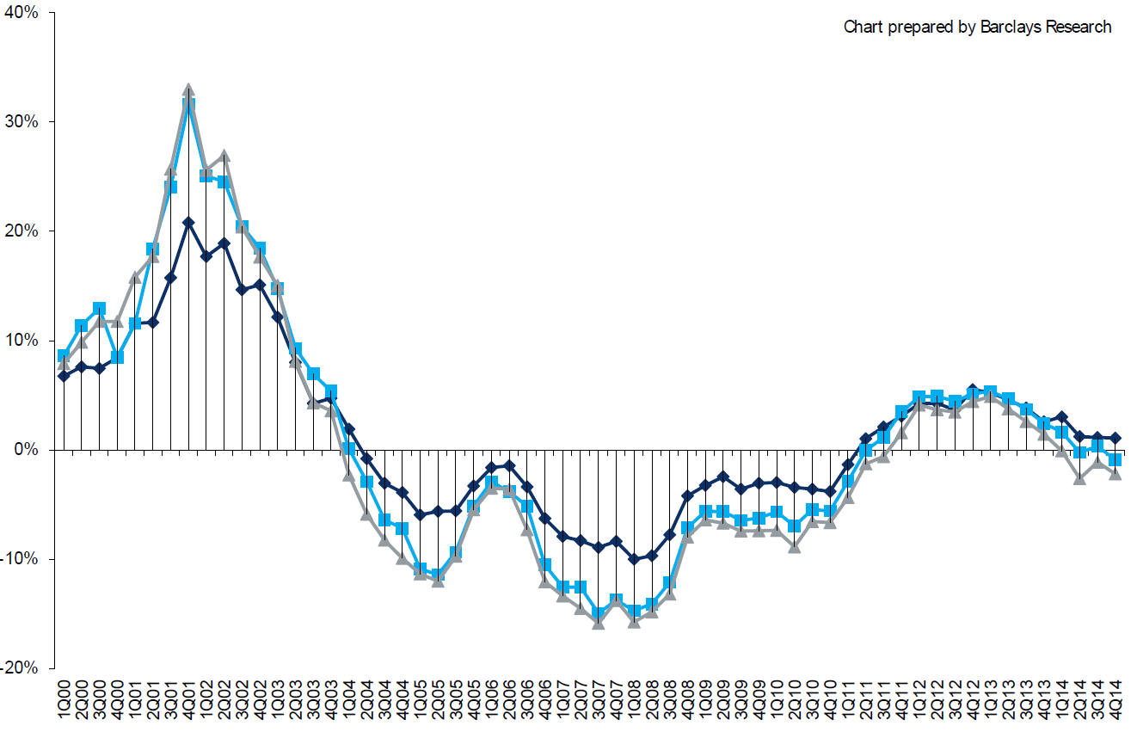
Change in Commercial Rate Renewals, by Account Size: 1999:Q4 to 2014:Q4
Percentage Change (%)
Peak = 2001:Q4 +28.5%
Pricing turned positive in Q3:2011, the first increase in nearly 8 years; Q1:2014 renewals were up 1.5%; Some insurers posted stronger numbers.
Pricing Turned Negative in Early 2004 and Remained that way for 7 ½ years
KRW : No Lasting Impact
Trough = 2007:Q3 -13.6%
Source: Council of Insurance Agents and Brokers; Barclay’s Capital; Insurance Information Institute.
Note: CIAB data cited here are based on a survey. Rate changes earned by individual insurers can and do vary, potentially substantially.

Slide 68
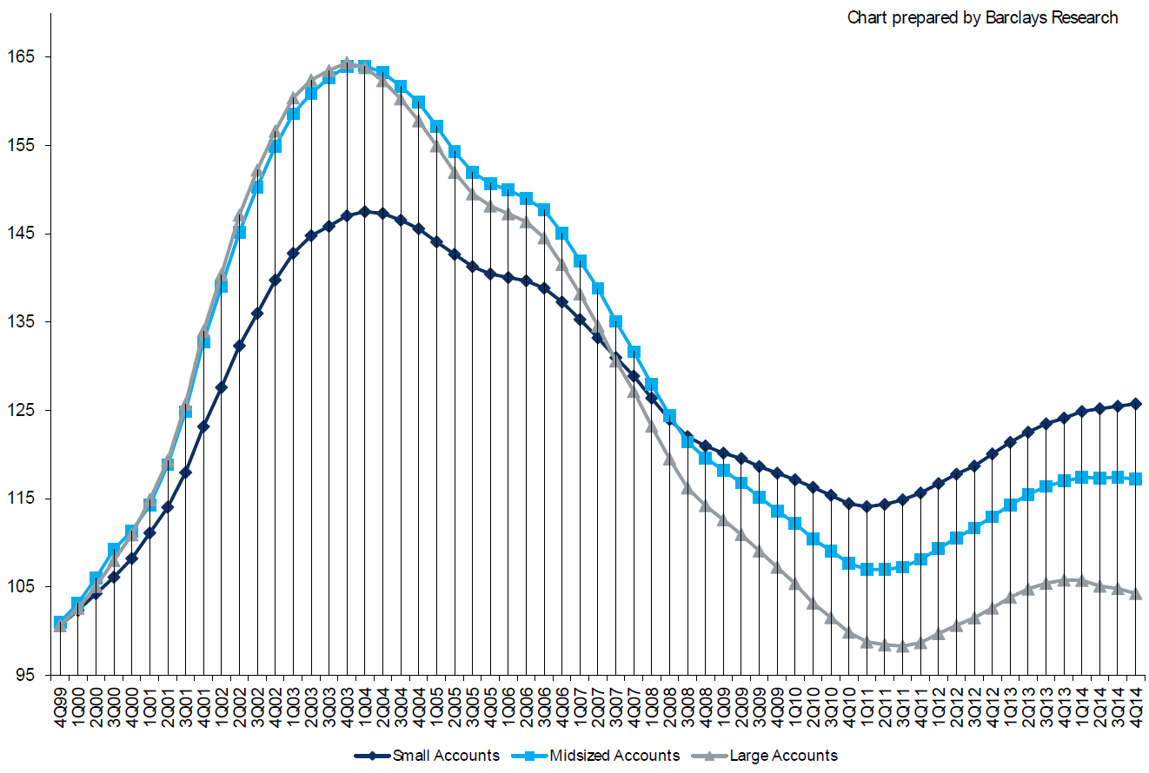
Cumulative Qtrly. Commercial Rate Changes, by Account Size: 1999:Q4 to 2014:Q4
1999:Q4 = 100
Despite several years of gains, pricing today for midsized accounts is where is was in late 2001 (around 9/11), suggesting additional rate need going forward, esp. in light of record low interest rates
Note: CIAB data cited here are based on a survey. Rate changes earned by individual insurers can and do vary, potentially substantially.
Source: Council of Insurance Agents and Brokers; Barclay’s Capital; Insurance Information Institute.

Slide 69
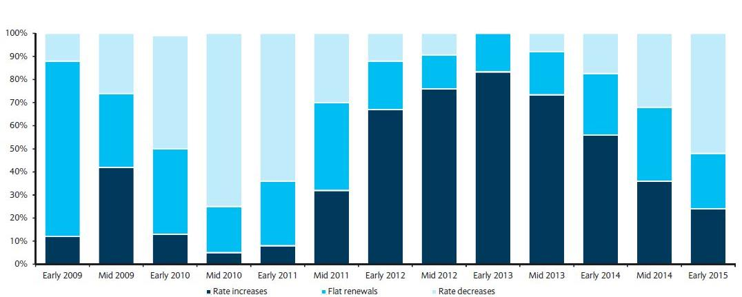
Directional Pricing Trend in Large Account P/C Renewals
Early 2009 through Early 2015
Few accounts are seeing increases
Source: Barclays’ Commercial Insurance Buyers Survey.

Slide 70
Change in Commercial Rate Renewals, by Line: 2015:Q1
Employment Practices rate increases are large than any other line, followed by Commercial Auto and D&O
Percentage Change (%)
Major Commercial Lines Renewals Were Mixed to Flat in Q1:2015; EPL and Commercial Auto Led the Way
Note: CIAB data cited here are based on a survey. Rate changes earned by individual insurers can and do vary, potentially substantially.
Source: Council of Insurance Agents and Brokers; Insurance Information Institute.

Slide 71
Workers Compensation Approved Changes in Bureau Rates/Loss Costs
All States
Percent Change
Calendar Year
* States approved through 4/8/2014
Countrywide approved changes in advisory rates, loss costs, and assigned risk rates as filed by the applicable rating organization, relative to the previously filed rates

Slide 72
Workers Compensation
Approved Changes in Bureau Rates/Loss Costs
All States vs. NCCI States
Percent Change
Cumulative 2005–2013
–18.1% All States
–15.1% NCCI States
Calendar Year
* States approved through 4/8/2014
Countrywide approved changes in advisory rates, loss costs, and assigned risk rates as filed by the applicable rating organization, relative to the previously filed rates

Slide 73
Current NCCI Voluntary Market
Rate/Loss Cost Changes
Approved or Pending Rate/Loss Cost Changes
Excludes Law-Only Filings
+1.2
-7.7
-3.6
-7.6
-6.5
-0.9
-8.3
+3.2
-2.0
+3.2
+3.0
-4.8
-1.1
-4.5
-7.7
-8.8
+3.0
+0.9
+11.6
+4.1
+1.4
-7.9
+2.8
-7.0
+0.3
+3.2
+4.0
-14.6
-1.4
-7.4
+3.8
+3.3
+2.3
Changes > 0
Changes < 0
+0.1
-2.6
-5.1
+0.7
+6.2
States approved or pending as of 4/8/2014
IN and NC filed in cooperation with state rating bureau

Slide 74
The Strength of the Economy Will Influence P/C Insurer Growth Opportunities
Growth Will Expand Insurer Exposure Base Across Most Lines
74

Slide 75
US Real GDP Growth*
The Q4:2008 decline was the steepest since the Q1:1982 drop of 6.8%
Real GDP Growth (%)
Recession began in in June 2009
Q1 2014 GDP data were hit hard by this year’s “Polar Vortex” and harsh winter
Demand for Insurance Should Increase in 2015 as GDP Growth Accelerates Modestly and Gradually Benefits the Economy Broadly
* Estimates/Forecasts from Blue Chip Economic Indicators.
Source: US Department of Commerce, Blue Economic Indicators 4/15; Insurance Information Institute.

Slide 76
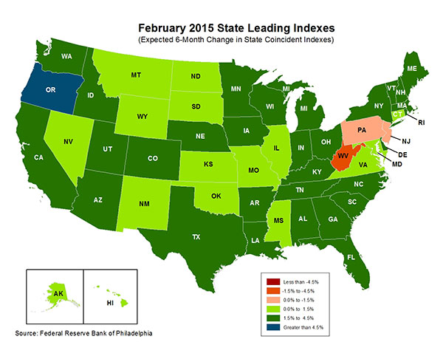
State-by-State Leading Indicators
through August 2015
Growth in the West is finally beginning to pick up
The economic outlook for most of the US is generally positive, though flat-to-negative for 2 states
Sources: Federal Reserve Bank of Philadelphia at http://www.philadelphiafed.org/index.cfm ;Insurance Information Institute.

Slide 77
Real GDP by State Percent Change, 2013:
Highest 25 States
North Dakota was the economic growth juggernaut of the US in 2013—by far
Only 9 states experienced growth in excess of 3% in 2013, which is what we would see nationally in a more typical recovery
Growth Benchmarks: Real GDP
US: 1.8%
Sources: U.S. Bureau of Economic Analysis; Insurance Information Institute.

Slide 78
Real GDP by State Percent Change, 2013:
Lowest 25 States
Growth rates in 11 states were still below 1% in 2013
DC and Alabama were the only states to shrink in 2013
Sources: US Bureau of Economic Analysis; Insurance Information Institute.

Slide 79
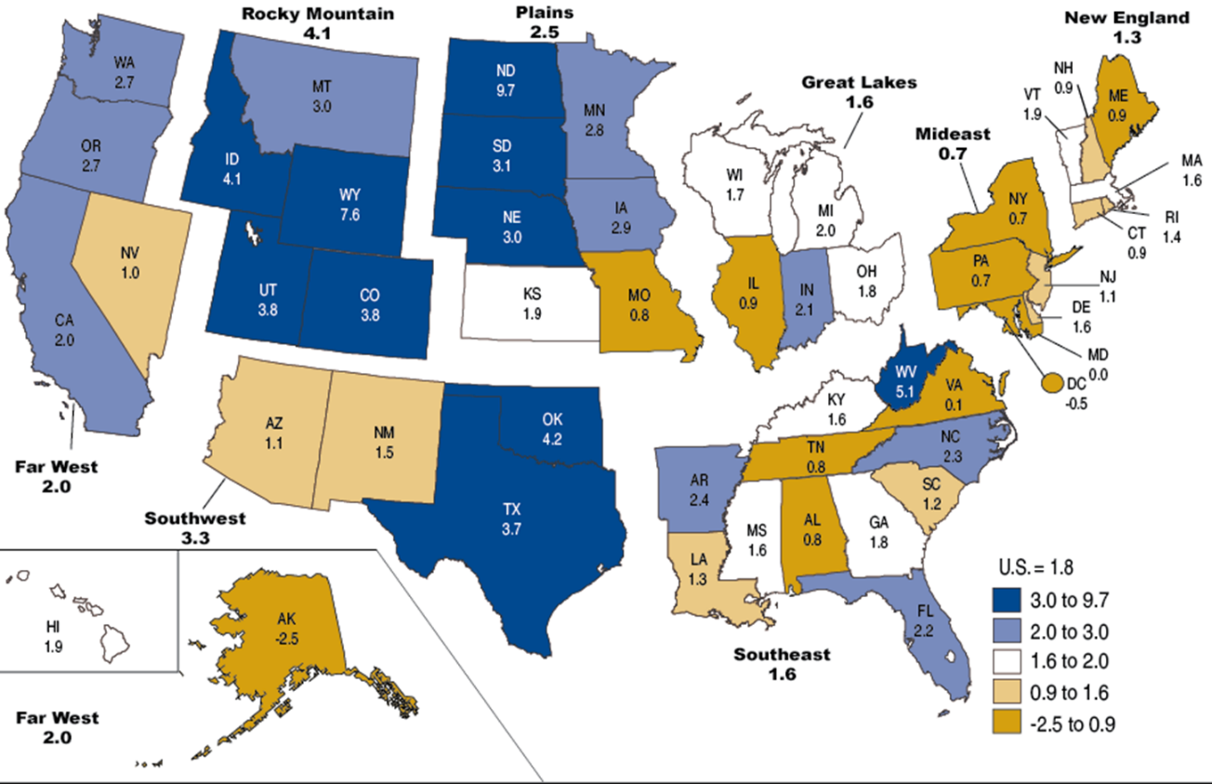
Percent Change in Real GDP by State, 2013
Sources: US Bureau of Economic Analysis; Insurance Information Institute.

Slide 80
Unemployment and Underemployment Rates: Still Too High, But Falling
January 2000 through March 2015, Seasonally Adjusted (%)
U-6 soared from 8.0% in March 2007 to 17.5% in
October 2009; Stood at 10.9% in Mar. 2015.
8% to 10% is “normal.”
“Headline” unemployment was 5.5% in Mar. 2015. 4.5% to 5.5% is “normal.”
Stubbornly high unemployment and underemployment constrain overall economic growth, but the job market is now clearly improving.
Source: US Bureau of Labor Statistics; Insurance Information Institute.
80
12/01/09 - 9pm
eSlide – P6466 – The Financial Crisis and the Future of the P/C
Notes:
80

Slide 81
Consumer Sentiment Survey (1966 = 100)
January 2010 through March 2015
Optimism among consumers soared in late in 2014 and into early 2015 to its highest level in 11 years in January. Job gains, falling gas prices help.
Impact of 2011 budget impasse
Consumer confidence had been low for years amid high unemployment, falling home prices and other factors adversely impact consumers, but improved substantially over the past 2+ years, as job growth and falling energy prices aid consumers
Source: University of Michigan; Insurance Information Institute

Slide 82
New Private Housing Starts, 1990-2021F
Job growth, low inventories of existing homes, low mortgage rates and demographics should continue to stimulate new home construction for several more years
(Millions of Units)
New home starts plunged 72% from 2005-2009; A net annual decline of 1.49 million units, lowest since records began in 1959
Insurers Are Continue to See Meaningful Exposure Growth in the Wake of the “Great Recession” Associated with Home Construction: Construction Risk Exposure, Surety, Commercial Auto; Potent Driver of Workers Comp Exposure
Source: U.S. Department of Commerce; Blue Chip Economic Indicators (3/15); Insurance Information Institute.

Slide 83
Auto/Light Truck Sales, 1999-2021F
Job growth and improved credit market conditions will boost auto sales in 2014 and beyond
Sales have returned to pre-crisis levels
(Millions of Units)
New auto/light truck sales fell to the lowest level since the late 1960s. Forecast for 2014-15 is still below 1999-2007 average of 17 million units, but a robust recovery is well underway.
Truck purchases by contractors are especially strong
Yearly car/light truck sales will likely continue at current levels, in part replacing cars that were held onto in 2008-12. New vehicles will generate more physical damage insurance coverage but will be more expensive to repair. PP Auto premium might grow by 5% - 6%.
Source: U.S. Department of Commerce; Blue Chip Economic Indicators (4/15 and 3/15); Insurance Information Institute.

Slide 84
Interest Rate on Convention 30-Year Mortgages: Up a Bit, 1990–2014*
Mortgages rates plunged to near-record lows in early 2013 but rose as the Fed initiated tapering in its QE program, but have come down a again through mid- and late-2014
Yields on 30-Year mortgages have been below 6% for a six years
Mortgage interest rates remain low by historical standards, aiding the housing recovery. Changes in Fed policy could push rates up modestly later in 2015.
*Monthly, through Dec. 2014. Note: Recessions indicated by gray shaded columns.
Sources: Federal Reserve Bank at http://www.federalreserve.gov/releases/h15/data.htm.
National Bureau of Economic Research (recession dates); Insurance Information Institutes.
84
12/01/09 - 9pm
eSlide – P6466 – The Financial Crisis and the Future of the P/C
Notes:
84

Slide 85
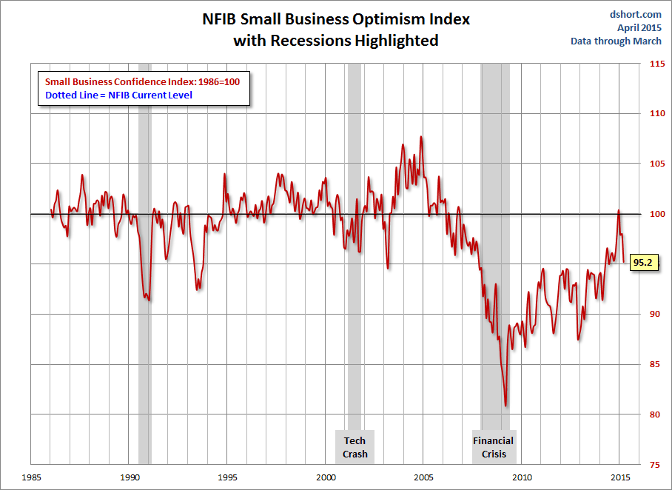
NFIB Small Business Optimism Index
January 1985 through March 2015
Small business optimism has dropped somewhat since reaching post-crisis highs in late 2014
Source: National Federation of Independent Business at http://www.advisorperspectives.com/dshort/charts/indicators/Sentiment.html?NFIB-optimism-index.gif ; Insurance Information Institute.

Slide 86
Business Bankruptcy Filings: Still Falling
(1994:Q1 – 2014:Q4)
(Thousands)
New Bankruptcy Law Takes Effect
Below pre-recession level
Recessions in orange
Business bankruptcies in 2014 were below both the Great Recession levels and the 2003:Q3-2005:Q1 period (the best five-quarter stretch in the last 20 years). Bankruptcies restrict exposure growth in all commercial lines.
Sources: U.S. Courts at http://www.uscourts.gov/; Insurance Information Institute
86
12/01/09 - 9pm
eSlide – P6466 – The Financial Crisis and the Future of the P/C
Notes:
86

Slide 87
Business Bankruptcy Filings,
1980-2014
% Change Surrounding Recessions
1980-82 58.6%
1980-87 88.7%
1990-91 10.3%
2000-01 13.0%
2006-09 208.9%
2014 bankruptcies totaled 26,983, down 18.8% from 2013—the 5th consecutive year of decline. Business bankruptcies more than tripled during the financial crisis.
Significant Exposure Implications for All Commercial Lines as Business Bankruptcies Begin to Decline
Sources: American Bankruptcy Institute (1980-2012) at http://www.abiworld.org/AM/AMTemplate.cfm?Section=Home&TEMPLATE=/CM/ContentDisplay.cfm&CONTENTID=61633; 2013-14 data from United States Courts at http://news.uscourts.gov; Insurance Information Institute.
87
12/01/09 - 9pm
eSlide – P6466 – The Financial Crisis and the Future of the P/C
Notes:
87

Slide 88
Private Sector Business Starts:
1993:Q2 – 2013:Q4* As Strong as Ever?
Business Starts
2006: 861,000
2007: 844,000
2008: 787,000
2009: 701,000 2010: 742,000 2011: 781,000
2012: 800,000
2013: 870,000**
Recessions in orange
2013:Q1 578,000 business starts*
Thousands
*A classification change in 2013:Q1 resulted in a report of 578,000 businesses started in that quarter. Seasonally adjusted. **2014 number assumes 1st quarter equaled average of other three quarters
Sources: Bureau of Labor Statistics, http://www.bls.gov/news.release/cewbd.t08.htm. NBER (recession dates)
88
12/01/09 - 9pm
eSlide – P6466 – The Financial Crisis and the Future of the P/C
Notes:
88

Slide 89
Labor Markets Trends:
RECOVERY CONTINUES
2014
Largest Increase in Jobs Since 1997
Unemployment Rate Fell to Lowest Level Since 2008
Payrolls Expanded to Record High
89

Slide 90
Unemployment and Underemployment Rates: Still Too High, But Falling
January 2000 through March 2015, Seasonally Adjusted (%)
U-6 soared from 8.0% in March 2007 to 17.5% in
October 2009; Stood at 10.9% in Mar. 2015.
8% to 10% is “normal.”
“Headline” unemployment was 5.5% in Mar. 2015. 4.5% to 5.5% is “normal.”
Stubbornly high unemployment and underemployment constrain overall economic growth, but the job market is now clearly improving.
Source: US Bureau of Labor Statistics; Insurance Information Institute.
90
12/01/09 - 9pm
eSlide – P6466 – The Financial Crisis and the Future of the P/C
Notes:
90

Slide 91
US Unemployment Rate Forecast
Rising unemployment
eroded payrolls
and WC’s
exposure base.
Unemployment peaked at 10% in late 2009.
2007:Q1 to 2016:Q4F*
Jobless figures have been revised downwards for 2015/16
Unemployment forecasts have been revised modestly downwards. Optimistic scenarios put the unemployment as low as 5.0% by Q4 of 2015.
* = actual; = forecasts
Sources: US Bureau of Labor Statistics; Blue Chip Economic Indicators (4/15 edition); Insurance Information Institute.

Slide 92
Unemployment Rates by State, March 2015:
Highest 25 States*
In March, 23 states and the District of Columbia had over-the-month unemployment rate decreases, 12 states had increases, and 15 states had no change..
*Provisional figures for March 2015, seasonally adjusted.
Sources: US Bureau of Labor Statistics; Insurance Information Institute.

Slide 93
Unemployment Rates by State, March 2015:
Lowest 25 States*
In March, 23 states and the District of Columbia had over-the-month unemployment rate decreases, 12 states had increases, and 15 states had no change.
*Provisional figures for March 2015, seasonally adjusted.
Sources: US Bureau of Labor Statistics; Insurance Information Institute.

Slide 94
Monthly Change in Private Employment
2,722,000 jobs were created in 2014
January 2007 through Mar. 2015 (Thousands, Seasonally Adj.)
129,000 private sector jobs were created in March. In March 2014, the last of the private jobs lost in the Great Recession were recovered
Jobs Created
2014: 2.722 Mill
2013: 2.368 Mill
2012: 2.294 Mill
2011: 2.400 Mill
2010: 1.277 Mill
Monthly losses in Dec. 08–Mar. 09 were the largest in the
post-WW II period
Private Employers Added 11.20 million Jobs Since Jan. 2010 After Having Shed 5.01 Million Jobs in 2009 and 3.76 Million in 2008 (State and Local Governments Have Shed Hundreds of Thousands of Jobs)
Source: US Bureau of Labor Statistics: http://www.bls.gov/ces/home.htm; Insurance Information Institute

Slide 95
Nonfarm Payroll (Wages and Salaries):
Quarterly, 2005–2014:Q4
Billions
Latest (2014:Q4) was $7.57 trillion, a new peak--$1.34 trillion above 2009 trough
Prior Peak was 2008:Q3 at $6.54 trillion
Growth rates
2011:Q4 over 2010:Q4: 2.6%
2012:Q4 over 2011:Q4: 6.7%
2013:Q4 over 2012:Q4: 1.7%
2014:Q4 over 2013:Q4: 5.1%
Recent trough (2009:Q1) was $6.23 trillion, down 5.3% from prior peak
Note: Recession indicated by gray shaded column. Data are seasonally adjusted annual rates.
Sources: http://research.stlouisfed.org/fred2/series/WASCUR; National Bureau of Economic Research (recession dates); Insurance Information Institute.
95
12/01/09 - 9pm
eSlide – P6466 – The Financial Crisis and the Future of the P/C
Notes:
95

Slide 96
Payroll vs. Workers Comp Net Written Premiums, 1990-2014P
Payroll Base* WC NWP
$Billions $Billions
7/90-3/91
3/01-11/01
12/07-6/09
WC premium volume dropped two years before the recession began
WC net premiums written were down $14B or 29.3% to $33.8B in 2010 after peaking at $47.8B in 2005
Continued Payroll Growth and Rate Gains Suggest WC NWP Will Grow Again in 2015
*Private employment; Shaded areas indicate recessions. WC premiums for 2014 are I.I.I. estimates..
Sources: NBER (recessions); Federal Reserve Bank of St. Louis at http://research.stlouisfed.org/fred2/series/WASCUR ; NCCI; I.I.I.

Slide 97
Construction Employment,
Jan. 2010—March 2015*
(Thousands)
Construction employment is +990,000 above
Jan. 2011 (+16.7%) trough
Construction and manufacturing employment constitute 1/3 of all WC payroll exposure.
*Seasonally adjusted.
Sources: US Bureau of Labor Statistics at http://data.bls.gov; Insurance Information Institute.
97
12/01/09 - 9pm
eSlide – P6466 – The Financial Crisis and the Future of the P/C
Notes:
97

Slide 98
Construction Employment,
Jan. 2003–March 2015
(Thousands)
Construction employment as of Mar. 2015 totaled 6.344 million, an increase of 990,000 jobs or 16.7% from the Jan. 2011 trough
Construction employment peaked at 7.726 million in April 2006
Gap between pre-recession construction peak and today: 1.38 million jobs
The “Great Recession” and housing bust destroyed 2.3 million constructions jobs
Construction employment troughed at 5.435 million in Jan. 2011, after a loss of 2.291 million jobs, a 29.7% plunge from the April 2006 peak
The Construction Sector Was a Growth Leader in 2014 as the Housing Market, Private Investment and Govt. Spending Recover. WC Insurers Will Benefit.
Note: Recession indicated by gray shaded column.
Sources: U.S. Bureau of Labor Statistics; Insurance Information Institute.
98
12/01/09 - 9pm
eSlide – P6466 – The Financial Crisis and the Future of the P/C
Notes:
98

Slide 99
Manufacturing Employment,
Jan. 2010—March 2015*
(Thousands)
Since Jan 2010, manufacturing employment is up (+859,000 or +7.5%)
and still growing.
Manufacturing employment is a surprising source of strength in the economy. Employment in the sector is at a multi-year high.
*Seasonally adjusted.
Sources: US Bureau of Labor Statistics at http://data.bls.gov; Insurance Information Institute.
99
12/01/09 - 9pm
eSlide – P6466 – The Financial Crisis and the Future of the P/C
Notes:
99

Slide 100

Oil & Gas Extraction Employment,
Jan. 2010—March 2015*
After peaking at its highest level since 1986, O&G employment is falling as oil and gas prices decline
(Thousands)
Despite recent declines, Oil and gas extraction employment is still up 26.8% since Jan. 2010 as the energy sector booms. Domestic energy production is essential to any robust economic recovery in the US.
*Seasonally adjusted
Sources: US Bureau of Labor Statistics at http://data.bls.gov; Insurance Information Institute.
100
12/01/09 - 9pm
eSlide – P6466 – The Financial Crisis and the Future of the P/C
Notes:
100

Slide 101
POSITIVE LABOR MARKET DEVELOPMENTS
Key Factors Driving Workers Compensation Exposure
101

Slide 102
Average Weekly Hours of All Private Workers, Mar. 2006—Mar. 2015
(Hours Worked)
Hours worked plunged during the recession, impacting payroll exposures
Hours worked totaled 34.5 per week in March, just shy of the 34.6 hours typically worked before the “Great Recession”
*Seasonally adjusted
Note: Recessions indicated by gray shaded columns.
Sources: US Bureau of Labor Statistics at http://www.bls.gov/data/#employment; National Bureau of Economic Research (recession dates); Insurance Information Institute.
102
12/01/09 - 9pm
eSlide – P6466 – The Financial Crisis and the Future of the P/C
Notes:
102

Slide 103
Average Hourly Wage of All Private Workers, Mar. 2006—Mar. 2015
(Hourly Wage)
The average hourly wage was $24.86 in Mar. 2015, up 17.2% from $21.22 when the recession began in Dec. 2007
Wage gains continued during the recession, despite massive job losses
*Seasonally adjusted
Note: Recessions indicated by gray shaded columns.
Sources: US Bureau of Labor Statistics at http://www.bls.gov/data/#employment; National Bureau of Economic Research (recession dates); Insurance Information Institute.
103
12/01/09 - 9pm
eSlide – P6466 – The Financial Crisis and the Future of the P/C
Notes:
103

Slide 104
ADVERSE LONG-TERM
LABOR MARKET DEVELOPMENTS
Key Factors Harming Workers Compensation Exposure and the Overall Economy
104

Slide 105
Labor Force Participation Rate,
Jan. 2002—March 2015*
Labor Force Participation as a % of Population
Labor force participation continues to shrink despite a falling unemployment rate
Large numbers of people are exiting (or not returning to the labor force)
*Defined as the percentage of working age persons in the population who are employed or actively seeking work.
Note: Recessions indicated by gray shaded columns.
Sources: US Bureau of Labor Statistics at http://www.bls.gov/data/; National Bureau of Economic Research (recession dates); Insurance Information Institute.
105
12/01/09 - 9pm
eSlide – P6466 – The Financial Crisis and the Future of the P/C
Notes:
105

Slide 106
Number of “Discouraged Workers,”
Jan. 2002—March 2015
Thousands
“Discouraged Workers” are people who have searched for work for so long in vain that they actually stop searching and drop out of the labor force
Large numbers of people are exiting (or not returning to) the labor force
There were 738,000 discouraged workers in March 2015
In recent good times, the number of discouraged workers ranged from 200,000-400,000 (1995-2000) or from 300,000-500,000 (2002-2007).
Notes: Recessions indicated by gray shaded columns. Data are seasonally adjusted.
Sources: Bureau of Labor Statistics http://www.bls.gov/news.release/empsit.a.htm ; NBER (recession dates); Ins. Info. Inst.
106
12/01/09 - 9pm
eSlide – P6466 – The Financial Crisis and the Future of the P/C
Notes:
106

Slide 107
ProPublica/NPR Attack on Workers Compensation
In March 2015, ProPublica/NPR published a series entitled “The Demolition of Workers Comp”
Thesis: WC benefits have been hollowed out and that workers were often no longer well served by the system
Series relied on a number of anecdotal cases of claimants who believed they were adversely impacted
Claims 33 states have watered down benefits under the guise of “reform”
I.I.I. made forceful rebuttal, demonstrating that:
  Insurers spend $40B+ each year treating injured workers
  Workplace is materially safer, in part due to WC incentives
  Application of managed care to WC reduces cost with no adverse impact on outcome (“blank check” unsustainable)

Slide 108
CONSTRUCTION INDUSTRY OVERVIEW & OUTLOOK
The Construction Sector Is Critical to the Economy and the P/C Insurance Industry
108

Slide 109
Value of New Private Construction: Residential & Nonresidential, 2003-2015*
2014: Value of new pvt. construction hits $698.2B as of Feb. 2015, up 40% from the 2010 trough but still 23% below 2006 peak
New Construction peaks at $911.8. in 2006
Billions of Dollars
Trough in 2010 at $500.6B, after plunging 55.1% ($411.2B)
$15.0
$613.7
$348.4
$298.1
$261.8
$349.9
$238.8
Private Construction Activity Is Moving in a Positive Direction though Remains Well Below Pre-Crisis Peak; Residential Dominates
*2015 figure is a seasonally adjusted annual rate as of February.
Sources: US Department of Commerce http://www.census.gov/construction/c30/c30index.html ; Insurance Information Institute.
109
12/01/09 - 9pm
eSlide – P6466 – The Financial Crisis and the Future of the P/C
Notes:
109

Slide 110
Value of Construction Put in Place, Feb. 2015 vs. Feb. 2014*
Growth (%)
Private: +1.8%
Public: +3.1%
Public sector construction activity is finally beginning to pick up after years of decline
Private sector construction activity is up in the residential and nonresidential segments but growth is sluggish
Overall Construction Activity is Up, But Growth In the Private Sector Slowed in Late 2014 While Picking in the State/Local Sector Government Sector as Budget Woes Ease in Some Jurisdictions
*seasonally adjusted
Source: U.S. Census Bureau, http://www.census.gov/construction/c30/c30index.html ; Insurance Information Institute.

Slide 111
Value of Private Construction Put in Place, by Segment, Feb. 2015 vs. Feb. 2014*
Growth (%)
Led by the Manufacturing and Office segments, Private nonresidential sector construction activity continues to rising after plunging during the “Great Recession.” Residential weakened.
Private Construction Activity is Up in Many Segments, though the Key Residential Construction Sector Weakened in Late 2014/Early 2015; Mixed Outlook for 2015, though Expansion Should Continue
*seasonally adjusted
Source: U.S. Census Bureau, http://www.census.gov/construction/c30/c30index.html ; Insurance Information Institute.

Slide 112
Value of Public Construction Put in Place, by Segment, Feb. 2015 vs. Feb. 2014*
Public sector construction activity is down substantially in many segments, a situation that will likely persist, dragging on public entity risk exposures
Amusement & Recreation, Sewage & Waste Disposal and Commercial projects lead public sector construction
Growth (%)
Public Construction Activity is Beginning to Recover from its Long Contraction which Will Drive Demand in Many Commercial Insurance Lines
*seasonally adjusted
Source: U.S. Census Bureau, http://www.census.gov/construction/c30/c30index.html ; Insurance Information Institute.

Slide 113
Real (Inflation-Adjusted)
Nonresidential Construction, 2000-2014*
(Bar = CAGR; Line = Y/Y Growth Rate)
Construction activity has generally been positive since late 2010 but has occasionally be erratic. Forecast is for slowing improving growth
*Through Q1 2014.
Source: US Dept. of Commerce; Wells Fargo Securities (June 6, 2014 research report).
113
12/01/09 - 9pm
eSlide – P6466 – The Financial Crisis and the Future of the P/C
Notes:
113

Slide 114
Value of New Federal, State and Local Government Construction: 2003-2015*
Construction across all levels of government peaked at $314.9B in 2009
Austerity Reigns
Govt. construction MAY be turning a corner; still down $46.0B or 14.6% since 2009 peak
($ Billions)
Government Construction Spending Peaked in 2009, Helped by Stimulus Spending, but Contracted As State/Local Governments Grappled with Deficits and Federal Sequestration
*2014 figure is a seasonally adjusted annual rate as of December; http://www.census.gov/construction/c30/historical_data.html
Sources: US Department of Commerce; Insurance Information Institute.

Slide 115
New Private Housing Starts, 1990-2021F
Job growth, low inventories of existing homes, low mortgage rates and demographics should continue to stimulate new home construction for several more years
(Millions of Units)
New home starts plunged 72% from 2005-2009; A net annual decline of 1.49 million units, lowest since records began in 1959
Insurers Are Continue to See Meaningful Exposure Growth in the Wake of the “Great Recession” Associated with Home Construction: Construction Risk Exposure, Surety, Commercial Auto; Potent Driver of Workers Comp Exposure
Source: U.S. Department of Commerce; Blue Chip Economic Indicators (4/15 and 3/15); Insurance Information Institute.

Slide 116
Construction Employment,
Jan. 2010—March 2015*
(Thousands)
Construction employment is +990,000 above
Jan. 2011 (+16.7%) trough
Construction and manufacturing employment constitute 1/3 of all WC payroll exposure.
*Seasonally adjusted.
Sources: US Bureau of Labor Statistics at http://data.bls.gov; Insurance Information Institute.
116
12/01/09 - 9pm
eSlide – P6466 – The Financial Crisis and the Future of the P/C
Notes:
116

Slide 117
Construction Employment,
Jan. 2003–March 2015
(Thousands)
Construction employment as of Mar. 2015 totaled 6.344 million, an increase of 990,000 jobs or 16.7% from the Jan. 2011 trough
Construction employment peaked at 7.726 million in April 2006
Gap between pre-recession construction peak and today: 1.38 million jobs
The “Great Recession” and housing bust destroyed 2.3 million constructions jobs
Construction employment troughed at 5.435 million in Jan. 2011, after a loss of 2.291 million jobs, a 29.7% plunge from the April 2006 peak
The Construction Sector Was a Growth Leader in 2014 as the Housing Market, Private Investment and Govt. Spending Recover. WC Insurers Will Benefit.
Note: Recession indicated by gray shaded column.
Sources: U.S. Bureau of Labor Statistics; Insurance Information Institute.
117
12/01/09 - 9pm
eSlide – P6466 – The Financial Crisis and the Future of the P/C
Notes:
117

Slide 118
MANUFACTURING SECTOR OVERVIEW & OUTLOOK
The U.S. Is Experiencing a Mini Manufacturing Renaissance but Headwinds from Weak Export Markets and Strong Dollar Have Hurt
118

Slide 119
Dollar Value* of Manufacturers’ Shipments Monthly, Jan. 1992—February 2015
$ Millions
The value of Manufacturing Shipments in Feb. 2015 was $481.3B—down slightly since the July 2014 record high of $508.1B
Monthly shipments in Feb. 2015 are similar to pre-crisis (July 2008) peak but has declined in recent months. Manufacturing is energy-intensive and growth leads to gains in many commercial exposures: WC, Commercial Auto, Marine, Property, and various Liability Coverages.
* Seasonally adjusted; Data published Apr. 2, 2015.
Source: U.S. Census Bureau, Full Report on Manufacturers’ Shipments, Inventories, and Orders, http://www.census.gov/manufacturing/m3/
119
12/01/09 - 9pm
eSlide – P6466 – The Financial Crisis and the Future of the P/C
Notes:
119

Slide 120
Manufacturing Growth for Selected Sectors, 2015 vs. 2014*
Growth (%)
Durables: +3.0%
Non-Durables: -9.7%
Manufacturing of durable goods is stronger than nondurables in 2015
Impact of falling energy prices
Manufacturing Is Expanding in Many Sectors But Declining Energy Prices Are Dragging Down Industry Figures. Continued Gortwh Across a Number of Sectors that Will Contribute to Growth in Insurable Exposures Including: WC, Commercial Property, Commercial Auto and Many Liability Coverages
*Seasonally adjusted; Date are YTD comparing data through February 2015 to the same period in 2014.
Source: U.S. Census Bureau, Full Report on Manufacturers’ Shipments, Inventories, and Orders, http://www.census.gov/manufacturing/m3/

Slide 121
Manufacturing Employment,
January 2010—March 2015*
Thousands
In the past 5 years (from January 2010) manufacturing employment is up (+857,000 or +7.5%)
and still growing.
Manufacturing employment is a surprising source of strength in the economy. Employment in the sector is at a multi-year high.
*Seasonally adjusted; Feb. and Mar. 2015 are preliminary
Sources: US Bureau of Labor Statistics at http://data.bls.gov; Insurance Information Institute.

Slide 122
ISM Manufacturing Index
(Values > 50 Indicate Expansion)
January 2010 through March 2015
Manufacturing continued to expand throughout 2014
The manufacturing sector expanded for 61 of the 63 months from Jan. 2010 through Mar. 2015. Pace of recovery has been uneven due to the rising dollar and economic weakness in Europe and China.
Source: Institute for Supply Management at http://www.ism.ws/ismreport/mfgrob.cfm; Insurance Information Institute.

Slide 123
Index of Total Industrial Production:*
A Near Peak as of December 2014
Many economists expect business investment to rise in 2015
December 2014 Index at 106.5
Peak at 100.82 in December 2007 (officially the 1st month of the Great Recession)
Insurance exposures for industrial production will continue growing in 2015, and commercial insurance premium volume with them. Y-o-Y growth to December 2014 was 4.6%. Both production and premium volume growth for 2015 should exceed this.
*Monthly, seasonally adjusted, through December 2014 (which is preliminary). Index based on year 2007 = 100
Sources: Federal Reserve Board at http://www.federalreserve.gov/releases/g17/ipdisk/ip_sa.txt .
National Bureau of Economic Research (recession dates); Insurance Information Institute.
123
12/01/09 - 9pm
eSlide – P6466 – The Financial Crisis and the Future of the P/C
Notes:
123

Slide 124
Recovery in Capacity Utilization is a Positive Sign for Commercial Exposures
March 2001 through Feb. 2015
“Full Capacity”
The US operated at 78.9% of industrial capacity in Feb. 2015, well above the June 2009 low of 66.9% but is still below pre-recession levels.
Percent of Industrial Capacity
Hurricane Katrina
The closer the economy is to operating at “full capacity,” the greater the inflationary pressure
March 2001-November 2001 recession
December 2007-
June 2009 Recession
124
Source: Federal Reserve Board statistical releases at http://www.federalreserve.gov/releases/g17/Current/default.htm.
Notes:
124

Slide 125
Business Fixed Investment is Forecast to Grow Steadily in 2015-16, Fueling Commercial Exposure Growth
Business investment will drive commercial property and liability insurance exposures and should drive employment and WC payroll exposures as well (with a lag)
Growth Rate
Sources: Wells Fargo Economic Group; Insurance Information Institute.

Slide 126
ENERGY SECTOR: OIL & GAS INDUSTRY FUTURE IS BRIGHT BUT VOLATILE
US Is Becoming an Energy Powerhouse but Fall in Prices Will Have Negative Impact
126

Slide 127
U.S. Crude Oil Production, 2005-2016P
Millions of Barrels per Day
Crude oil production in the U.S. is expected to increase by 90.6% from 2008 through 2016—and could overtake Saudi Arabia as the world’s largest oil producer
Source: Energy Information Administration, Short-Term Energy Outlook (January 15, 2015) , Insurance Information Institute.

Slide 128
U.S. Natural Gas Production, 2000-2013
Trillions of Cubic Ft. per Year
The U.S. is already the world’s largest natural gas producer—recently overtaking Russia. This is a potent driver of commercial insurance exposures
Source: Energy Information Administration, Short-Term Energy Outlook (April 8, 2014) , Insurance Information Institute.

Slide 129
Oil & Gas Extraction Employment,
Jan. 2010—March 2015*
After peaking at its highest level since 1986, O&G employment is falling as oil and gas prices decline
(Thousands)
Despite recent declines, Oil and gas extraction employment is still up 26.8% since Jan. 2010 as the energy sector booms. Domestic energy production is essential to any robust economic recovery in the US.
*Seasonally adjusted
Sources: US Bureau of Labor Statistics at http://data.bls.gov; Insurance Information Institute.
129
12/01/09 - 9pm
eSlide – P6466 – The Financial Crisis and the Future of the P/C
Notes:
129

Slide 130
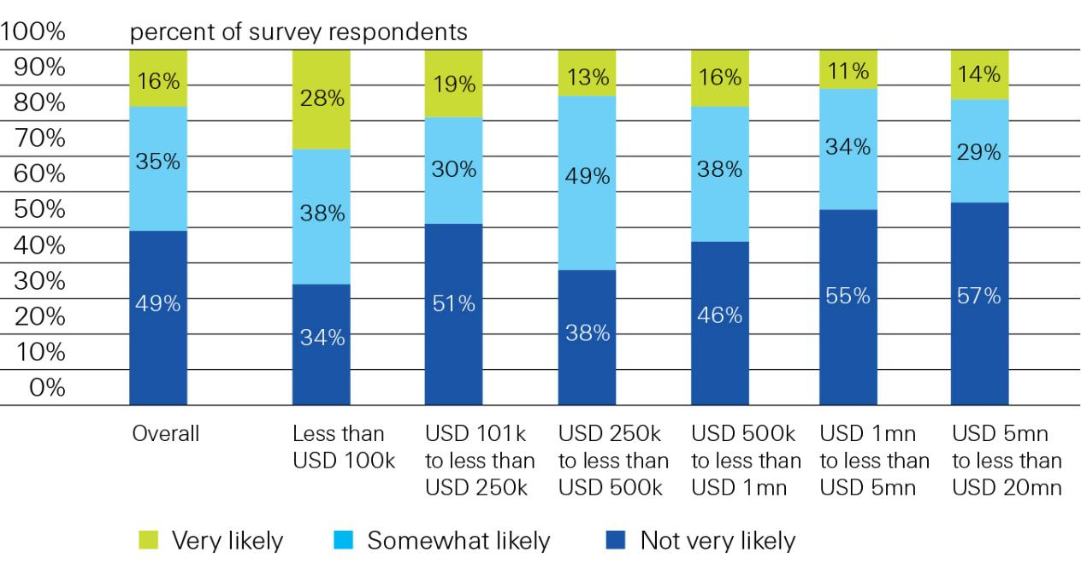
Proportion of Businesses Interested in Buying Insurance Online
Interest diminishes with account size
Likelihood of small US businesses buying insurance online directly from the insurer, overall and by annual company revenue, in 2013
Source: Swiss Re from “Voice of the Small Commercial Insurance Consumer Survey.” Deloitte, March (2013)

Slide 131
The Affordable Care Act & Implications for P/C Insurance
The ACA Is Now Being Fully Implemented; Consequences for P/C Insurance Are Yet to Be Determined
131

Slide 132
Projected Number of People with No Health Insurance, 2013—2022*
By 2018 the number of people under age 65 without insurance is expected to drop by 25 million (~45%)
Millions
The projected decline in the uninsured population is very sensitive to the enrollment rate under the Affordable Care Act
*Under age 65.
Sources: Centers for Medicare & Medicaid Services, Office of the Actuary at http://www.cms.gov/Research-Statistics-Data-and-Systems/Statistics-Trends-and-Reports/NationalHealthExpendData/NationalHealthAccountsProjected.html accessed 3/14/14; Insurance Information Institute.
132
12/01/09 - 9pm
eSlide – P6466 – The Financial Crisis and the Future of the P/C
Notes:
132

Slide 133
A Few Potential Impacts of the ACA on Workers Compensation
Issue | Concern | Contravening Argument
Surge in People Covered by Health Insurance | System is overwhelmed MD shortage Patient care adversely impacted | Over time, people will have access to preventative care, improving the general health of the population Greater use of PA’s, etc.
Electronic Health Records | Cost | Computerization of patient data could help flag issues and improve risk management and improve patient outcomes
Claim Shifting | Provider/patient may prefer claim handled via WC system | Reduction in uninsured population reduces shifting
Reimbursement Rates | Cuts in MC reimbursement rates could makes docs less willing to take WC claims | Impact would be short-lived. All MC-linked states already boost WC reimbursements
Source: Insurance Information Institute research; WCRI.
133

Slide 134
ACA Impact on WC May Occur via Changes in Rates Set by State Regulators
WC rates often tied to Medicare but can change for reasons independent of this link
There could be both positive and negative effects of a cut in Medicare rates on WC performance in states which tie reimbursement to Medicare
  WC reimbursement rates would go down
  Doctors may be unwilling to see WC patients:
    64% of Dr.’s surveyed said they would stop accepting new Medicare patients if planned rate cuts go through; some of these same doctors may also refuse WC patients if WC rates also decrease
These effects would likely be short lived
  All states which tie their fee schedules to Medicare already increase the Medicare rates to set WC rates, so any drop in the Medicare rates would likely be soon offset by a higher WC adjustment
WC Maximum Allowable Reimbursement Rates
as Percentage of Medicare
WC rates tied to Medicare
WC rates not tied to Medicare
SOURCE: NCCI Annual Issues Symposium 2009, Medicare’s Impact on Workers’ Compensation, AMA: “Physicians’ reactions to the Medicare physician payment cuts.”

Slide 135
PPACA May Have Distinct Impacts on WC Depending on Claim Frequency/Severity
Industry Portfolio by Claim Type
(Relative Volume by Claim Frequency & Paid Dollars)
Potential ACA Impact
Expanded coverage may shift some small claims to the health insurance system (+)
Physician access problems could lead to indemnity increases and may bleed into the complicated cases (-)
High Volume, Low Severity
Ex: med only, quick to settle, <25K
Preventative care and early record keeping decreases WC comorbidities (+)
Soft tissue treatments, a large portion of “slow burn claims,” may decrease in cost (+)
Complicated
Ex: back pain claims, very litigious
Catastrophic Injuries
Ex: spinal cord injury, multiple trauma claims
No significant impacts
SOURCE: Christopher Cunniff, FCAS, Impacts of Healthcare Reform on Workers Compensation.

Slide 136
Possible Effects on Workers Comp
Could slow the growth in WC medical care costs
  IPAB recommendations and PCORI reports, plus Medicare changes, could have beneficial effects on cost and treatment effectiveness
Could ACA be first step in federal regulation of insurance products and markets?
  Will regulation like that requiring products to be priced to meet Medical Loss Ratios be applied to WC?
  Will cost-control mechanisms such as the Independent Payment Advisory Board be developed for WC?
  Will WC insurers lose their limited exemption from anti-trust laws that they have had under McCarran-Ferguson since 1945?

Slide 137
Insurance Information Institute Online:
www.iii.org
Thank you for your time
and your attention!
Twitter: twitter.com/bob_hartwig
Download at www.iii.org/presentations

