Slide 1
Workers Compensation and the New Economy:
Trends, Challenges and Opportunities
Insurance Information Institute
June 1, 2015
Download at www.iii.org/presentations
Robert P. Hartwig, Ph.D., CPCU, President & Economist
Insurance Information Institute ♦ 110 William Street ♦ New York, NY 10038
Tel: 212.346.5520 ♦ Cell: 917.453.1885 ♦ bobh@iii.org ♦ www.iii.org

Slide 2
The Economy Will Impact Workers Compensation Growth and Performance
Workers Comp Is Among the Fastest Growing Major Commercial Lines
2

Slide 3
US Real GDP Growth*
The Q4:2008 decline was the steepest since the Q1:1982 drop of 6.8%
Real GDP Growth (%)
Recession began in in June 2009
Q1 2015 GDP data were hit hard by this year’s and harsh winter, high dollar
Demand for Insurance Should Increase in 2015 as GDP Growth Accelerates Modestly and Gradually Benefits the Economy Broadly
* Estimates/Forecasts from Blue Chip Economic Indicators.
Source: US Department of Commerce, Blue Economic Indicators 5/15; Insurance Information Institute.

Slide 4
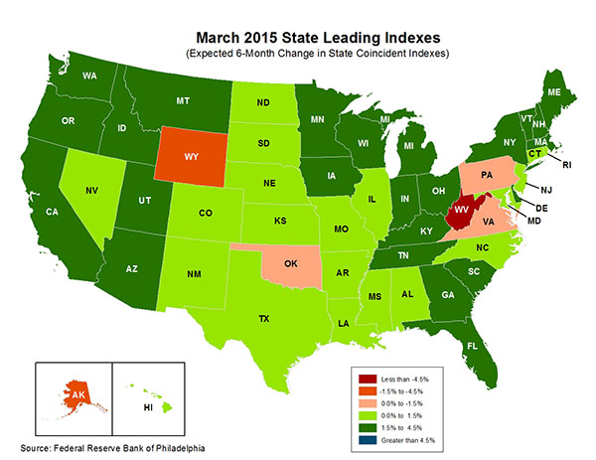
State-by-State Leading Indicators
through September 2015
Growth in the West is finally beginning to pick up
The economic outlook for most of the US is generally positive, though flat-to-negative for 2 states
Sources: Federal Reserve Bank of Philadelphia at http://www.philadelphiafed.org/index.cfm ;Insurance Information Institute.

Slide 5
Real GDP by State Percent Change, 2013:
Highest 25 States
North Dakota was the economic growth juggernaut of the US in 2013—by far
Only 9 states experienced growth in excess of 3% in 2013, which is what we would see nationally in a more typical recovery
Growth Benchmarks: Real GDP
US: 1.8%
Sources: U.S. Bureau of Economic Analysis; Insurance Information Institute.

Slide 6
Real GDP by State Percent Change, 2013:
Lowest 25 States
Growth rates in 11 states were still below 1% in 2013: Maryland had zero real growth in 2013
DC and Alabama were the only states to shrink in 2013
Sources: US Bureau of Economic Analysis; Insurance Information Institute.

Slide 7
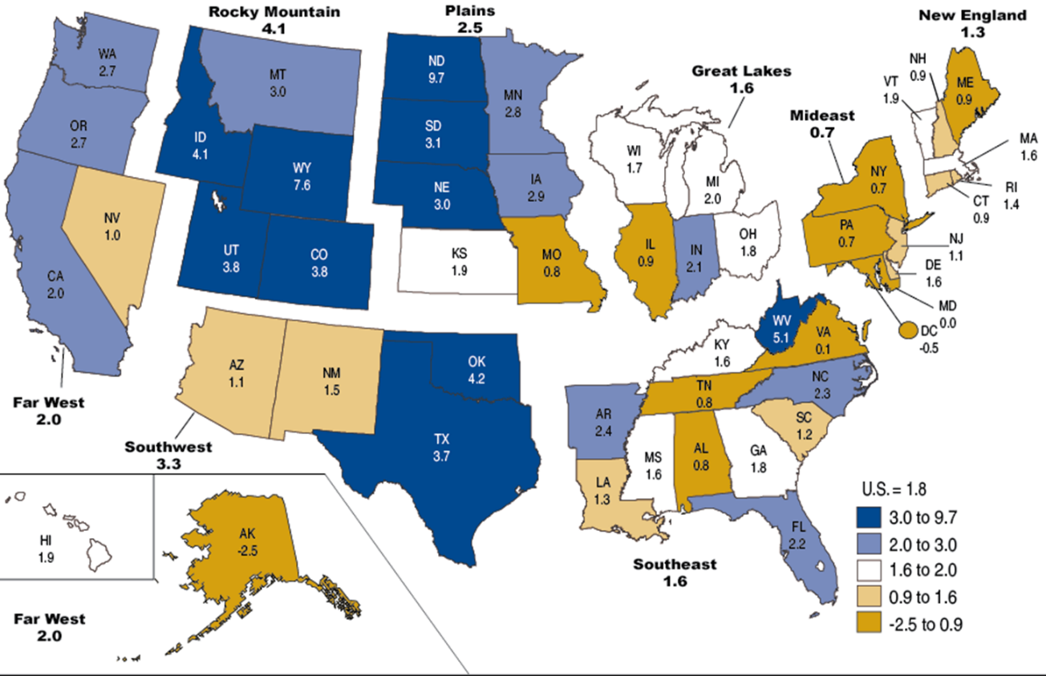
Percent Change in Real GDP by State, 2013
Sources: US Bureau of Economic Analysis; Insurance Information Institute.

Slide 8
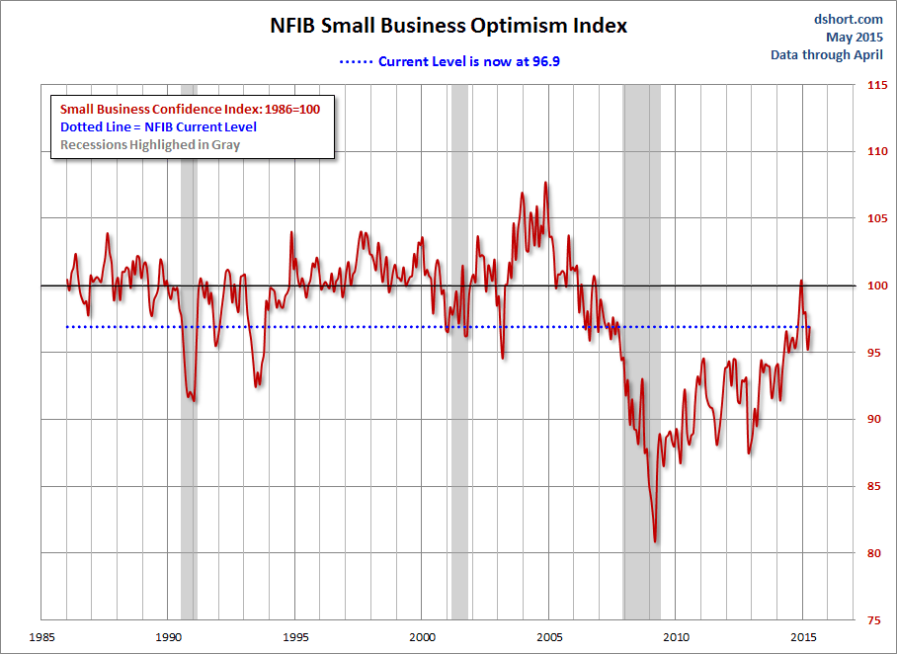
NFIB Small Business Optimism Index
January 1985 through April 2015
Small business optimism has dropped somewhat since reaching post-crisis highs in late 2014
Source: National Federation of Independent Business at http://www.advisorperspectives.com/dshort/charts/indicators/Sentiment.html?NFIB-optimism-index.gif ; Insurance Information Institute.

Slide 9
Business Bankruptcy Filings: Still Falling
(1994:Q1 – 2014:Q4)
(Thousands)
New Bankruptcy Law Takes Effect
Below pre-recession level
Recessions in orange
Business bankruptcies in 2014 were below both the Great Recession levels and the 2003:Q3-2005:Q1 period (the best five-quarter stretch in the last 20 years). Bankruptcies restrict exposure growth in all commercial lines.
Sources: U.S. Courts at http://www.uscourts.gov/; Insurance Information Institute
9
12/01/09 - 9pm
eSlide – P6466 – The Financial Crisis and the Future of the P/C
Notes:
9

Slide 10
Business Bankruptcy Filings,
1980-2014
% Change Surrounding Recessions
1980-82 58.6%
1980-87 88.7%
1990-91 10.3%
2000-01 13.0%
2006-09 208.9%
2014 bankruptcies totaled 26,983, down 18.8% from 2013—the 5th consecutive year of decline. Business bankruptcies more than tripled during the financial crisis.
Significant Exposure Implications for All Commercial Lines as Business Bankruptcies Begin to Decline
Sources: American Bankruptcy Institute (1980-2012) at http://www.abiworld.org/AM/AMTemplate.cfm?Section=Home&TEMPLATE=/CM/ContentDisplay.cfm&CONTENTID=61633; 2013-14 data from United States Courts at http://news.uscourts.gov; Insurance Information Institute.
10
12/01/09 - 9pm
eSlide – P6466 – The Financial Crisis and the Future of the P/C
Notes:
10

Slide 11
Private Sector Business Starts:
1993:Q2 – 2013:Q4* As Strong as Ever?
Business Starts
2006: 861,000
2007: 844,000
2008: 787,000
2009: 701,000 2010: 742,000 2011: 781,000
2012: 800,000
2013: 870,000**
Recessions in orange
2013:Q1 578,000 business starts*
Thousands
*A classification change in 2013:Q1 resulted in a report of 578,000 businesses started in that quarter. Seasonally adjusted. **2014 number assumes 1st quarter equaled average of other three quarters
Sources: Bureau of Labor Statistics, http://www.bls.gov/news.release/cewbd.t08.htm. NBER (recession dates)
11
12/01/09 - 9pm
eSlide – P6466 – The Financial Crisis and the Future of the P/C
Notes:
11

Slide 12
Profitability and Growth in Maryland Overall P/C and WC Insurance Markets
Maryland and Nearby State Comparisons
12

Slide 13
RNW All Lines: MD vs. U.S., 2004-2013
(Percent)
Average 2004-2013
US: 7.9%
MD: 9.5%
Source: NAIC, Insurance Information Institute
13
Notes:
13

Slide 14
RNW Workers Comp: MD vs. U.S.,
2004-2013
(Percent)
Average 2004-2013
US: 7.1%
MD: 5.0%
Source: NAIC, Insurance Information Institute
14
Notes:
14

Slide 15
All Lines: 10-Year Average RNW MD & Nearby States
Maryland All Lines profitability is above the US and slightly above the regional average
2004-2013
Source: NAIC, Insurance Information Institute

Slide 16
Workers Comp: 10-Year Average RNW
MD & Nearby States
Maryland Workers Comp profitability is below the US average and regional average
2004-2013
Source: NAIC, Insurance Information Institute

Slide 17
Workers Comp. DWP Growth: MD vs. U.S., 2004-2013
(Percent)
Average 2004-2013
US: 3.7%
MD: 7.0%
Source: SNL Financial.
17
Notes:
17

Slide 18
Labor Markets Trends:
Recovery Continues in 2015
2014
Largest Increase in Jobs Since 1997
Unemployment Rate Fell to Lowest Level Since 2008
Payrolls Expanded to Record High
18

Slide 19
Unemployment and Underemployment Rates: Still Too High, But Falling
January 2000 through April 2015, Seasonally Adjusted (%)
U-6 soared from 8.0% in March 2007 to 17.5% in
October 2009; Stood at 10.8% in Apr. 2015.
8% to 10% is “normal.”
“Headline” unemployment was 5.4% in Apr. 2015. 4.5% to 5.5% is “normal.”
Stubbornly high unemployment and underemployment constrain overall economic growth, but the job market is continuing to improve.
Source: US Bureau of Labor Statistics; Insurance Information Institute.
19
12/01/09 - 9pm
eSlide – P6466 – The Financial Crisis and the Future of the P/C
Notes:
19

Slide 20
US Unemployment Rate Forecast
Rising unemployment
eroded payrolls
and WC’s
exposure base.
Unemployment peaked at 10% in late 2009.
2007:Q1 to 2016:Q4F*
Jobless figures have been revised downwards for 2015/16
Unemployment forecasts have been revised modestly downwards. Optimistic scenarios put the unemployment as low as 5.0% by Q4 of 2015.
* = actual; = forecasts
Sources: US Bureau of Labor Statistics; Blue Chip Economic Indicators (5/15 edition); Insurance Information Institute.

Slide 21
Unemployment Rates by State, April 2015:
Highest 25 States*
In April, 23 states and the District of Columbia had over-the-month unemployment rate decreases, 11 states had increases, and 16 states had no change.
Residual impacts of the housing collapse, weak economies are holding back several states
*Provisional figures for April 2015, seasonally adjusted.
Sources: US Bureau of Labor Statistics; Insurance Information Institute.

Slide 22
Unemployment Rates by State, April 2015:
Lowest 25 States*
In April, 23 states and the District of Columbia had over-the-month unemployment rate decreases, 11 states had increases, and 16 states had no change.
Strength in Energy, Agricultural States-most also avoided housing bust
*Provisional figures for April 2015, seasonally adjusted.
Sources: US Bureau of Labor Statistics; Insurance Information Institute.

Slide 23
Monthly Change in Private Employment
3,042,000 jobs were created in 2014, the most since 1997
January 2007 through Apr. 2015 (000s, Seasonally Adj.)
Jobs Created
2014: 3.042 Mill
2013: 2.452 Mill
2012: 2.315 Mill
2011: 2.396 Mill
2010: 1.282 Mill
213,000 private sector jobs were created in April.
Monthly losses in Dec. 08–Mar. 09 were the largest in the
post-WW II period
Private Employers Added 11.97 Million Jobs Since Jan. 2010 After Having Shed 5.01 Million Jobs in 2009 and 3.76 Million in 2008 (State and Local Governments Have Shed Hundreds of Thousands of Jobs)
Source: US Bureau of Labor Statistics: http://www.bls.gov/ces/home.htm; Insurance Information Institute

Slide 24
Number of Employed Persons in Maryland (annual averages): 2005-2015*
Great Recession
Maryland lost 145,300 jobs (-5.6%) from pre-crisis peak of 2.6125 million in April 2008 to trough of 2.4672 million in Feb. 2010
Maryland did not fully recoup job losses from the great Recession until April 2014
(Thousands)
Healthcare ending Peaked in 2009, Helped by Stimulus Spending, but Contracted As State/Local Governments Grappled with Deficits and Federal Sequestration
*2015 figure is a seasonally adjusted annual rate as of April; http://www.census.gov/construction/c30/historical_data.html
Sources: US Bureau of Labor Statistsics; Insurance Information Institute.

Slide 25
Nonfarm Payroll (Wages and Salaries):
Quarterly, 2005–2015:Q1
Billions
Latest (2015:Q1) was $7.69 trillion, a new peak--$1.46 trillion above 2009 trough
Prior Peak was 2008:Q3 at $6.54 trillion
Growth rates
2011:Q4 over 2010:Q4: 2.6%
2012:Q4 over 2011:Q4: 6.7%
2013:Q4 over 2012:Q4: 1.7%
2014:Q4 over 2013:Q4: 5.1%
Recent trough (2009:Q1) was $6.23 trillion, down 5.3% from prior peak
Note: Recession indicated by gray shaded column. Data are seasonally adjusted annual rates.
Sources: http://research.stlouisfed.org/fred2/series/WASCUR; National Bureau of Economic Research (recession dates); Insurance Information Institute.
25
12/01/09 - 9pm
eSlide – P6466 – The Financial Crisis and the Future of the P/C
Notes:
25

Slide 26
Payroll vs. Workers Comp Net Written Premiums, 1990-2014P
Payroll Base* WC NWP
$Billions $Billions
7/90-3/91
3/01-11/01
12/07-6/09
WC premium volume dropped two years before the recession began
WC net premiums written were down $14B or 29.3% to $33.8B in 2010 after peaking at $47.8B in 2005
Continued Payroll Growth and Rate Gains Suggest WC NWP Will Grow Again in 2015
*Private employment; Shaded areas indicate recessions. WC premiums for 2014 are from NCCI.
Sources: NBER (recessions); Federal Reserve Bank of St. Louis at http://research.stlouisfed.org/fred2/series/WASCUR ; NCCI; I.I.I.

Slide 27
CONSTRUCTION, MANUFACTURING & ENERGY OUTLOOK
Key Sectors Critical to the Economy and the P/C Insurance Industry
27

Slide 28
Value of New Private Construction: Residential & Nonresidential, 2003-2015*
2015: Value of new pvt. construction hits $702.4B as of Mar. 2015, up 40% from the 2010 trough but still 23% below 2006 peak
New Construction peaks at $911.8. in 2006
Billions of Dollars
Trough in 2010 at $500.6B, after plunging 55.1% ($411.2B)
$15.0
$613.7
$353.4
$298.1
$261.8
$349.0
$238.8
Private Construction Activity Is Moving in a Positive Direction though Remains Well Below Pre-Crisis Peak; Residential Dominates
*2015 figure is a seasonally adjusted annual rate as of March.
Sources: US Department of Commerce http://www.census.gov/construction/c30/c30index.html ; Insurance Information Institute.
28
12/01/09 - 9pm
eSlide – P6466 – The Financial Crisis and the Future of the P/C
Notes:
28

Slide 29
Value of Construction Put in Place, March 2015 vs. March 2014*
Growth (%)
Private: +2.9%
Public: -0.3%
Public sector construction activity is finally beginning to create less drag up after years of decline
Private sector construction activity is up in the nonresidential segment but residential growth is sluggish
Overall Construction Activity is Up, But Growth In the Private Sector Slowed in Late 2014 While Picking Up in the State/Local Sector Government Sector as Budget Woes Ease in Some Jurisdictions
*seasonally adjusted
Source: U.S. Census Bureau, http://www.census.gov/construction/c30/c30index.html ; Insurance Information Institute.

Slide 30
Value of New Federal, State and Local Government Construction: 2003-2015*
Construction across all levels of government peaked at $314.9B in 2009
Austerity Reigns
Govt. construction MAY be stabilizing; still down $47.3B or 15.0% since 2009 peak
($ Billions)
Government Construction Spending Peaked in 2009, Helped by Stimulus Spending, but Contracted As State/Local Governments Grappled with Deficits and Federal Sequestration
*2015 figure is a seasonally adjusted annual rate as of March; http://www.census.gov/construction/c30/historical_data.html
Sources: US Department of Commerce; Insurance Information Institute.

Slide 31
New Private Housing Starts, 1990-2021F
Job growth, low inventories of existing homes, low mortgage rates and demographics should continue to stimulate new home construction for several more years
(Millions of Units)
New home starts plunged 72% from 2005-2009; A net annual decline of 1.49 million units, lowest since records began in 1959
Insurers Are Continue to See Meaningful Exposure Growth in the Wake of the “Great Recession” Associated with Home Construction: Construction Risk Exposure, Surety, Commercial Auto; Potent Driver of Workers Comp Exposure
Source: U.S. Department of Commerce; Blue Chip Economic Indicators (5/15 and 3/15); Insurance Information Institute.

Slide 32
Construction Employment,
Jan. 2010—April 2015*
(Thousands)
Construction employment is +948,000 above
Jan. 2011 (+17.4%) trough
Construction and manufacturing employment constitute 1/3 of all WC payroll exposure.
*Seasonally adjusted.
Sources: US Bureau of Labor Statistics at http://data.bls.gov; Insurance Information Institute.
32
12/01/09 - 9pm
eSlide – P6466 – The Financial Crisis and the Future of the P/C
Notes:
32

Slide 33
Construction Employment,
Jan. 2003–April 2015
(Thousands)
Construction employment as of Apr. 2015 totaled 6.383 million, an increase of 948,000 jobs or 17.4% from the Jan. 2011 trough
Construction employment peaked at 7.726 million in April 2006
Gap between pre-recession construction peak and today: 1.34 million jobs
The “Great Recession” and housing bust destroyed 2.3 million constructions jobs
Construction employment troughed at 5.435 million in Jan. 2011, after a loss of 2.291 million jobs, a 29.7% plunge from the April 2006 peak
The Construction Sector Was a Growth Leader in 2014 as the Housing Market, Private Investment and Govt. Spending Recover. WC Insurers Will Benefit.
Note: Recession indicated by gray shaded column.
Sources: U.S. Bureau of Labor Statistics; Insurance Information Institute.
33
12/01/09 - 9pm
eSlide – P6466 – The Financial Crisis and the Future of the P/C
Notes:
33

Slide 34
MANUFACTURING SECTOR
A Potent Driver of Jobs, Workers Comp Payroll Exposure
America’s Manufacturing Renaissance Has Hit a Rough Patch with the High Dollar and Collapse in Oil Prices
34

Slide 35
Manufacturing Employment,
Jan. 2010—April 2015*
(Thousands)
Since Jan 2010, manufacturing employment is up (+862,000 or +7.5%)
and still growing.
Manufacturing employment is a surprising source of strength in the economy. Employment in the sector is at a multi-year high.
*Seasonally adjusted.
Sources: US Bureau of Labor Statistics at http://data.bls.gov; Insurance Information Institute.
35
12/01/09 - 9pm
eSlide – P6466 – The Financial Crisis and the Future of the P/C
Notes:
35

Slide 36
Auto/Light Truck Sales, 1999-2021F
Job growth and improved credit market conditions will boost auto sales in 2014 and beyond
Sales have returned to pre-crisis levels
(Millions of Units)
New auto/light truck sales fell to the lowest level since the late 1960s. Forecast for 2014-15 is still below 1999-2007 average of 17 million units, but a robust recovery is well underway.
Truck purchases by contractors are especially strong
Yearly car/light truck sales will likely continue at current levels, in part replacing cars that were held onto in 2008-12. New vehicles will generate more physical damage insurance coverage but will be more expensive to repair. PP Auto premium might grow by 5% - 6%.
Source: U.S. Department of Commerce; Blue Chip Economic Indicators (5/15 and 3/15); Insurance Information Institute.

Slide 37
ISM Manufacturing Index
(Values > 50 Indicate Expansion)
January 2010 through April 2015
Manufacturing continues to expand in 2015
The manufacturing sector expanded for 62 of the 64 months from Jan. 2010 through Apr. 2015. Pace of recovery has been uneven due to economic turbulence in the U.S., Europe and China and the high dollar.
Source: Institute for Supply Management at http://www.ism.ws/ismreport/mfgrob.cfm; Insurance Information Institute.

Slide 38
Dollar Value* of Manufacturers’ Shipments Monthly, Jan. 1992—March 2015
$ Millions
The value of Manufacturing Shipments in March 2015 was $482.2B—down 5.1% since the July 2014 record high of $508.1B
Monthly shipments in March 2015 are similar to pre-crisis (July 2008) peak but has declined in recent months due to the strong US dollar and weakness abroad. Manufacturing is energy-intensive and growth leads to gains in many commercial exposures: WC, Commercial Auto, Marine, Property, and various Liability Coverages.
* Seasonally adjusted; Data published May 4, 2015.
Source: U.S. Census Bureau, Full Report on Manufacturers’ Shipments, Inventories, and Orders, http://www.census.gov/manufacturing/m3/
38
12/01/09 - 9pm
eSlide – P6466 – The Financial Crisis and the Future of the P/C
Notes:
38

Slide 39
Manufacturing Growth for Selected Sectors, 2015 vs. 2014*
Growth (%)
Durables: +3.6%
Non-Durables: -9.4%
Manufacturing of durable goods is stronger than nondurables in 2015
Impact of falling energy prices
Manufacturing Is Expanding in Many Sectors But Declining Energy Prices Are Dragging Down Industry Figures. Continued Gortwh Across a Number of Sectors that Will Contribute to Growth in Insurable Exposures Including: WC, Commercial Property, Commercial Auto and Many Liability Coverages
*Seasonally adjusted; Date are YTD comparing data through March 2015 to the same period in 2014.
Source: U.S. Census Bureau, Full Report on Manufacturers’ Shipments, Inventories, and Orders, http://www.census.gov/manufacturing/m3/

Slide 40
Recovery in Capacity Utilization is a Positive Sign for Commercial Exposures
March 2001 through March 2015
The US operated at 78.4% of industrial capacity in Feb. 2015, well above the June 2009 low of 66.9% but is still below pre-recession levels.
Percent of Industrial Capacity
Hurricane Katrina
The closer the economy is to operating at “full capacity,” the greater the inflationary pressure
Capacity utilization is falling due to strong dollar and falling energy prices
March 2001-November 2001 recession
December 2007-
June 2009 Recession
40
Source: Federal Reserve Board statistical releases at http://www.federalreserve.gov/releases/g17/Current/default.htm.
Notes:
40

Slide 41
States with Lowest Average Manufacturing Payroll Distribution
MD has among the lowest manufacturing payrolls shares in the US
Payroll Share (%)
Source: NCCI (2015 Regulatory and Legislative Trends Workshop, May 14, 2015); Insurance Information Institute.

Slide 42
States with Highest Office and Clerical Payroll Distribution
MD has among the highest office and payroll shares in the US
Payroll Share (%)
Source: NCCI (2015 Regulatory and Legislative Trends Workshop, May 14, 2015); Insurance Information Institute.

Slide 43
ENERGY SECTOR
America’s Energy Boom Has Been a Strong Driver of the Economic Recovery, but Prices Are Falling
Workers Comp Have Benefited from the Energy Boom, But Exposures Will Suffer as Energy Prices Swoon
43

Slide 44
Price of Crude Oil (West Texas Intermediate), 2000 – 2015*
Dollars per Barrel
Crude oil prices have fallen by nearly half from their levels just a year ago, adversely impact oil and gas industry employment
*Through March 2015.
Source: Energy Information Administration; Insurance Information Institute.

Slide 45

Oil & Gas Extraction Employment,
Jan. 2010—April 2015*
After peaking at its highest level since 1986, O&G employment is falling as oil and gas prices decline
(Thousands)
Despite recent declines, Oil and gas extraction employment is still up 24.3% since Jan. 2010 as the energy sector booms. Domestic energy production is essential to any robust economic recovery in the US.
*Seasonally adjusted
Sources: US Bureau of Labor Statistics at http://data.bls.gov; Insurance Information Institute.
45
12/01/09 - 9pm
eSlide – P6466 – The Financial Crisis and the Future of the P/C
Notes:
45

Slide 46
U.S. Natural Gas Production, 2000-2013
Trillions of Cubic Ft. per Year
The U.S. is already the world’s largest natural gas producer—recently overtaking Russia. This is a potent driver of commercial insurance exposures
Source: Energy Information Administration, Short-Term Energy Outlook (April 2015) , Insurance Information Institute.

Slide 47
POSITIVE LABOR MARKET DEVELOPMENTS
Key Factors Driving Workers Compensation Exposure
47

Slide 48
Average Weekly Hours of All Private Workers, Mar. 2006—April 2015
(Hours Worked)
Hours worked plunged during the recession, impacting payroll exposures
Hours worked totaled 34.5 per week in April, just shy of the 34.6 hours typically worked before the “Great Recession”
*Seasonally adjusted
Note: Recessions indicated by gray shaded columns.
Sources: US Bureau of Labor Statistics at http://www.bls.gov/data/#employment; National Bureau of Economic Research (recession dates); Insurance Information Institute.
48
12/01/09 - 9pm
eSlide – P6466 – The Financial Crisis and the Future of the P/C
Notes:
48

Slide 49
Average Hourly Wage of All Private Workers, Mar. 2006—April 2015
(Hourly Wage)
The average hourly wage was $24.87 in April 2015, up 17.2% from $21.22 when the recession began in Dec. 2007
Wage gains continued during the recession, despite massive job losses
*Seasonally adjusted
Note: Recessions indicated by gray shaded columns.
Sources: US Bureau of Labor Statistics at http://www.bls.gov/data/#employment; National Bureau of Economic Research (recession dates); Insurance Information Institute.
49
12/01/09 - 9pm
eSlide – P6466 – The Financial Crisis and the Future of the P/C
Notes:
49

Slide 50
ADVERSE LONG-TERM
LABOR MARKET DEVELOPMENTS
Key Factors Harming Workers Compensation Exposure and the Overall Economy
50

Slide 51
Labor Force Participation Rate,
Jan. 2002—April 2015*
Labor Force Participation as a % of Population
Labor force participation continues to shrink despite a falling unemployment rate
Large numbers of people are exiting (or not returning to the labor force)
*Defined as the percentage of working age persons in the population who are employed or actively seeking work.
Note: Recessions indicated by gray shaded columns.
Sources: US Bureau of Labor Statistics at http://www.bls.gov/data/; National Bureau of Economic Research (recession dates); Insurance Information Institute.
51
12/01/09 - 9pm
eSlide – P6466 – The Financial Crisis and the Future of the P/C
Notes:
51

Slide 52
Number of “Discouraged Workers,”
Jan. 2002—April 2015
Thousands
“Discouraged Workers” are people who have searched for work for so long in vain that they actually stop searching and drop out of the labor force
Large numbers of people are exiting (or not returning to) the labor force
There were 756,000 discouraged workers in March 2015
In recent good times, the number of discouraged workers ranged from 200,000-400,000 (1995-2000) or from 300,000-500,000 (2002-2007).
Notes: Recessions indicated by gray shaded columns. Data are seasonally adjusted.
Sources: Bureau of Labor Statistics http://www.bls.gov/news.release/empsit.a.htm ; NBER (recession dates); Ins. Info. Inst.
52
12/01/09 - 9pm
eSlide – P6466 – The Financial Crisis and the Future of the P/C
Notes:
52

Slide 53
Growth in Temporary Workers vs.
All Nonfarm Employment, 2010-2015*
Annual Percent Change
Demand for temporary workers has increased 2 to 3 times faster than for workers overall in recent years
*Through March 2015.
Source: US Bureau of Labor Statistics , Insurance Information Institute.

Slide 54



Labor on Demand: Huge Implications for the US Economy, Workers & Insurers
Will YOUR job be reduced to an app?

Slide 55
The “On-Demand” (Sharing) Economy
The On-Demand Economy Will Transform the American Workforce and the P/C Insurance Industry Too, Including Workers Comp
55

Slide 56




On-Demand/Sharing/Peer-to-Peer Economy Impacts Many Lines of Insurance
The “On-Demand” Economy is or will impact many segments of the economy important to P/C insurers
  Auto (personal and commercial)
  Homeowners/Renters
  Many Liability Coverages
  Professional Liability
  Workers Comp
Many unanswered insurance questions
Insurance solutions are increasingly available to fill the many insurance gaps that arise
56
12/01/09 - 9pm
eSlide – P6466 – The Financial Crisis and the Future of the P/C
Notes:
56

Slide 57
The On-Demand Economy and American Workers: What Is Happening?
Technology is Fundamentally Transforming How Resources are Allocated and Used in the Economy
Labor is No Exception to this Transformation
Technology Offers New Opportunities to Match Labor to Jobs
  Owners of spare capacity (workers with time and skill) can be paired at low cost with those with a demand for that time and skill
  Bringing together labor and those who employ labor is not new
  BUT: Pairing occurs with a speed and breadth never before possible
Witnessing the Demise of the Traditional Understanding of What is Meant by a “Good” Job
  Concept born in the Industrial Age (1880-1980), is eroding
  Disintermediation of the firm as the place where labor, jobs matched
Accelerating Trends that Started with Labor Strife, Globalization and Automation that Began in the 1970s and 1980s
57
12/01/09 - 9pm
eSlide – P6466 – The Financial Crisis and the Future of the P/C
Notes:
57

Slide 58
What’s In Store for the American Worker, Labor Force and Workers Comp
THE NEW AMERICAN WORKER: Two Schools of Thought
OPTIMISTIC OUTLOOK
  Technology frees workers from the bonds of centralized, hierarchical institutions (the firm)
  Enhanced coordination of “haves” with “needs” that bypass firms as intermediaries
Who Benefits?
  “Flexers”: People who value or require flexibility in work arrangements (stay-at-home parents, retirees, students, disabled)
  Professionals: People with portable skills that can be offered through online platforms (semi and high-skilled trades, professional services)
  Unemployed/Underemployed: Offers at least some opportunity to offer and utilize skills and generate income
Sources: Wall Street Journal; The Economist; Insurance Information Institute research.
58
12/01/09 - 9pm
eSlide – P6466 – The Financial Crisis and the Future of the P/C
Notes:
58

Slide 59
What’s In Store for the American Worker, Labor Force and Workers Comp
PESSIMISTIC OUTLOOK
  On-Demand companies are software-driven marketplaces and position themselves as “platforms” rather than “employers”
  Enormous valuations (e.g., $40B for Uber on $2B in earnings) reflect the extraction of resources that otherwise would go to benefits, investments in safety, training, etc.
    Uber’s valuation was greater than that of 72% of the S&P500 at YE 2014
    Valued more than Delta Airlines, Kraft Foods, CBS, Macy’s, Hilton, Aflac…
  Jobs reduced to freelanced, temporary “gigs”
  Low skill workers and those who lack flexibility are left further behind
  Workers treated as independent contractors without intrinsic or basic economic rights
What Is Potentially Lost or Compromised?
  Stability, Retirement Benefits, Sick Pay, Maternity Leave, Overtime
  Health Insurance, Liability Coverage, Workers Comp Coverage
Sources: Wall Street Journal; The Economist; Fortune; Insurance Information Institute research.
59
12/01/09 - 9pm
eSlide – P6466 – The Financial Crisis and the Future of the P/C
Notes:
59

Slide 60
Potential Consequences for Insurers
On-Demand Platforms Have Struggled with Concepts of Liability
There Has Been a General Resistance to Assuming Liability or Responsibility Unless Compelled to Do So
Companies Have Sought to Keep as Much Liability as Possible on the Individual Offering their (Contracted) Labor or Resources
Minding the Gap
  Traditional insurance will often not cover a worker engaged in offering labor or resources through these platforms
  E.g., Auto ins. generally won’t cover you if you while driving for Uber
  Home ins. won’t cover for other than occasional rentals of property
  Unless self-procured, on-demand worker (independent contactors) will generally have no workers comp recourse if injured on the job
Long Legislative and Court Battles Lie Ahead
Insurance Solutions Becoming More Common
60
12/01/09 - 9pm
eSlide – P6466 – The Financial Crisis and the Future of the P/C
Notes:
60

Slide 61
P/C Insurance Industry Financial Overview
2014: Second-Best Year in the Post-Crisis Era
Modest CATs, Strong Markets
Workers Comp Improvement Helped Too
61

Slide 62
P/C Industry Net Income After Taxes
1991–2014
2005 ROE*= 9.6%
2006 ROE = 12.7%
2007 ROE = 10.9%
2008 ROE = 0.1%
2009 ROE = 5.0%
2010 ROE = 6.6%
2011 ROAS¹ = 3.5%
2012 ROAS¹ = 5.9%
2013 ROAS¹ = 10.2%
2014 ROAS¹ = 8.4%
$ Millions
Net income fell modestly (-12.5%) in 2014 vs. 2013
ROE figures are GAAP; ¹Return on avg. surplus. Excluding Mortgage & Financial Guaranty insurers yields a 8.2% ROAS in 2014, 9.8% ROAS in 2013, 6.2% ROAS in 2012, 4.7% ROAS for 2011, 7.6% for 2010 and 7.4% for 2009.
Sources: A.M. Best, ISO; Insurance Information Institute

Slide 63
Profitability Peaks & Troughs in the P/C Insurance Industry, 1975 – 2016F
ROE
1977:19.0%
History suggests next ROE peak will be in 2016-2017, but that seems unlikely
1987:17.3%
10 Years
2006:12.7%
1997:11.6%
10 Years
2013 9.8%
2015F=7.0%
2016F=6.8%
9 Years
2014 8.2%
1975: 2.4%
1984: 1.8%
1992: 4.5%
2001: -1.2%
*Profitability = P/C insurer ROEs. 2011-14 figures are estimates based on ROAS data. Note: Data for 2008-2014 exclude mortgage and financial guaranty insurers.
Source: Insurance Information Institute; NAIC, ISO, A.M. Best, Conning

Slide 64
ROE: Property/Casualty Insurance by Major Event, 1987–2014
(Percent)
P/C Profitability Is Both by
Cyclicality and Ordinary Volatility
Modestly higher CATs
Katrina, Rita, Wilma
Low CATs
Sept. 11
Hugo
Lowest CAT Losses in
15 Years
4 Hurricanes
Sandy
Andrew
Record Tornado Losses
Northridge
Financial Crisis*
* Excludes Mortgage & Financial Guarantee in 2008 – 2014.
Sources: ISO, Fortune; Insurance Information Institute.

Slide 65
Return on Net Worth (RNW) All Lines:
2004-2013 Average
Commercial lines have tended to be more profitable than personal lines over the past decade
Source: NAIC; Insurance Information Institute.

Slide 66
P/C Insurance Industry
Combined Ratio, 2001–2014*
Relatively Low CAT Losses, Reserve Releases
Higher CAT Losses, Shrinking Reserve Releases, Toll of Soft Market
As Recently as 2001, Insurers Paid Out Nearly $1.16 for Every $1 in Earned Premiums
Heavy Use of Reinsurance Lowered Net Losses
Relatively Low CAT Losses, Reserve Releases
Avg. CAT Losses, More Reserve Releases
Sandy Impacts
Best Combined Ratio Since 1949 (87.6)
Cyclical Deterioration
Lower CAT Losses
* Excludes Mortgage & Financial Guaranty insurers 2008--2014. Including M&FG, 2008=105.1, 2009=100.7, 2010=102.4, 2011=108.1; 2012:=103.2; 2013: = 96.1; 2014: = 97.0.
Sources: A.M. Best, ISO.

Slide 67
A 100 Combined Ratio Isn’t What It
Once Was: Investment Impact on ROEs
A combined ratio of about 100 generates an ROE of ~7.0% in 2012/13, ~7.5% ROE in 2009/10,
10% in 2005 and 16% in 1979
Combined Ratio / ROE
Lower CATs helped ROEs in 2013
Combined Ratios Must Be Lower in Today’s Depressed
Investment Environment to Generate Risk Appropriate ROEs
* 2008 -2014 figures are return on average surplus and exclude mortgage and financial guaranty insurers. 2014 combined ratio including M&FG insurers is 97.0; 2013 = 96.1; 2012 =103.2, 2011 = 108.1, ROAS = 3.5%.
Source: Insurance Information Institute from A.M. Best and ISO Verisk Analytics data.

Slide 68
Underwriting Gain (Loss)
1975–2014*
Underwriting profit in 2014 totaled $12.3B
($ Billions)
Cumulative underwriting deficit from 1975 through 2013 was $493B
High cat losses in 2011 led to the highest underwriting loss since 2002
Large Underwriting Losses Are NOT Sustainable
in Current Investment Environment
* Includes mortgage and financial guaranty insurers in all years.
Sources: A.M. Best, ISO; Insurance Information Institute.

Slide 69
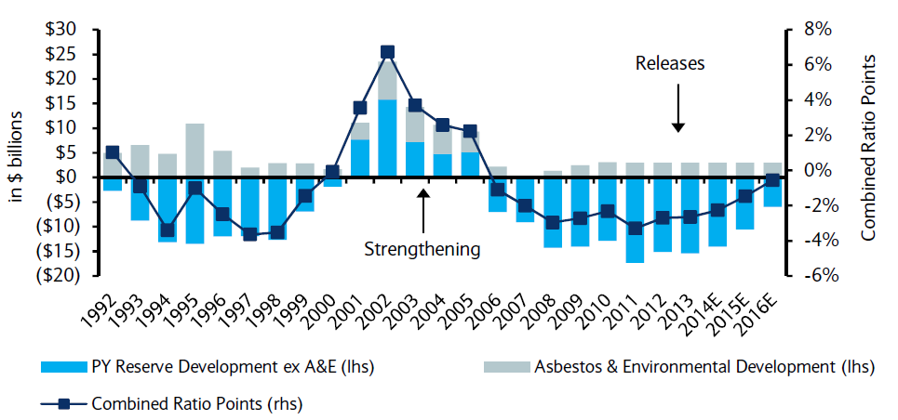
P/C Insurance Loss Reserve Development, 1992 – 2016E*
Reserve releases are expected to gradually taper off, but will continue to benefit the bottom line and combined ratio through at least 2016
Reserve Change
Source: A.M. Best; Barclays research for estimates.

Slide 70
Policyholder Surplus,
2006:Q4–2014:Q4
Drop due to near-record 2011 CAT losses
($ Billions)
2007:Q3
Pre-Crisis Peak
Surplus as of 12/31/14 stood at a record high $674.7B
The industry now has $1 of surplus for every $0.74 of NPW,
close to the strongest claims-paying status in its history.
2010:Q1 data includes $22.5B of paid-in capital from a holding company parent for one insurer’s investment in a non-insurance business .
The P/C insurance industry entered 2015
in very strong financial condition.
Sources: ISO, A.M .Best.
70
12/01/09 - 9pm
eSlide – P6466 – The Financial Crisis and the Future of the P/C
Notes:
70

Slide 71
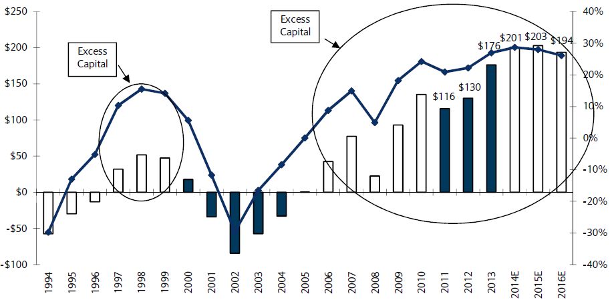
US P/C Insurance Industry Excess Capital Position: 1994–2016E
Barclay’s suggests that surplus is approximately $200B (~30%)
Surplus Redundancy (Deficiency)
Percent Redundancy (Deficiency)
The Industry’s Strong Capital Position Suggests Insurers Are in a Good Position to Increase Risk Appetite, Repurchase Shares and Pursue Acquisitions
Source: Barclays Research estimates.

Slide 72
Net Premium Growth (All P/C Lines): Annual Change, 1971—2014
(Percent)
1975-78
1984-87
2000-03
Net Written Premiums Fell 0.7% in 2007 (First Decline Since 1943) by 2.0% in 2008, and 4.2% in 2009, the First 3-Year Decline Since 1930-33.
2014: 4.1%
2013: 4.4%
2012: +4.2%
Shaded areas denote “hard market” periods
Sources: A.M. Best (1971-2013), ISO (2014), Insurance Information Institute.

Slide 73
NPW Premium Growth: Peaks & Troughs in the P/C Insurance Industry, 1926 – 2014
ROE
Post WW II Peak:
1947: 26.2%
1970-90: Peak premium growth was much higher in this period while troughs were comparable. Rapid inflation, economic volatility, high interest rates, tort environment all played roles
Start of WW II
1941: 15.8%
Economic Shocks, Inflation:
1976: 22.0%
Tort Crisis
1985/86: 22.2%
Post-9/11
2002:15.3%
1988-2000: Period of inter-cycle stability
2014 4.1%
1950-70: Extended period of stability in growth and profitability. Low interest rates, low inflation, “Bureau” rate regulation all played a role
2010-20XX? Post-recession period of stable growth?
Twin Recessions; Interest Rate Hikes
1987: 3.7%
Great Recession:2010: -4.9%
Great Depression
1932: -15.9% max drop
Note: Data through 1934 are based on stock companies only. Data include state funds beginning in 1998.
Source: A.M. Best; Insurance Information Institute.

Slide 74
Commercial Lines NPW Premium Growth:
1975 – 2014E
ROE
Commercial lines is prone to more cyclical volatility that personal lines. Recently, growth has stabilized in the 4% to 5% range.
Economic Shocks, Inflation:
1976: 22.2%
Tort Crisis
1986: 30.5%
Post-9/11
2002: 22.4%
Post-Hurricane Andrew Bump:
1993: 6.3%
1988-2000: Period of inter-cycle stability
Post Katrina Bump:
2006: 7.7%
2014E 4.0%
2010-20XX? Post-recession period of stable growth?
Recessions:
1982: 1.1%
Great Recession:2009: -9.0%
Note: Data include state funds beginning in 1998.
Source: A.M. Best; Insurance Information Institute.

Slide 75
Direct Premiums Written: Comm. Lines
Percent Change by State, 2007-2013
Top 25 States
Only 30 states showed any commercial lines growth from 2007 through 2013
Growth Benchmarks: Commercial
US: 1.3%
Sources: SNL Financial LLC.; Insurance Information Institute.

Slide 76
Direct Premiums Written: Comm. Lines
Percent Change by State, 2007-2013
Bottom 25 States
Nearly half the states have yet to see commercial lines premium volume return to pre-crisis levels
States with the poorest performing economies also produced the most negative net change in premiums of the past 6 years
Sources: SNL Financial LLC.; Insurance Information Institute.

Slide 77
Direct Premiums Written: Workers’ Comp
Percent Change by State, 2007-2013*
Top 25 States
Only 13 states showed positive growth in the workers comp line from 2007 – 2013 (up from just 5 through 2012), the result of large job and payroll losses and a soft market. Even through 2014, fewer than half the states will have recouped DPW losses
*Excludes monopolistic fund states: ND, OH, WA, WY as well as WV, which transitioned to a competitive structure during this period.
Sources: SNL Financial LC.; Insurance Information Institute.

Slide 78
Direct Premiums Written: Worker’s Comp
Percent Change by State, 2007-2013*
Bottom 25 States
States with the poorest performing economies also produced some of the most negative net change in premiums of the past 6 years
*Excludes monopolistic fund states: ND, OH, WA, WY as well as WV, which transitioned to a competitive structure during this period.
Sources: SNL Financial LC.; Insurance Information Institute.

Slide 79
INVESTMENTS:
THE NEW REALITY
Investment Performance is a Key Driver of Profitability
Low Yields Have an Especially Large Influence on Profitability of Long-Tailed Lines Like WC
79

Slide 80
Property/Casualty Insurance Industry Investment Income: 2000–2014¹
Investment earnings are still below their 2007 pre-crisis peak
($ Billions)
Due to persistently low interest rates,
investment income fell in 2012, 2013 and 2014.
¹ Investment gains consist primarily of interest and stock dividends.
*Sources: ISO; Insurance Information Institute.

Slide 81
Distribution of Invested Assets: P/C Insurance Industry, 2013
$ Billions
Total Invested Assets =
$1.5 Trillion
Source: Insurance Information Institute Fact Book 2015, A.M. Best.

Slide 82
U.S. Treasury Security Yields:
A Long Downward Trend, 1990–2015*
Yields on 10-Year U.S. Treasury Notes have been essentially below 5% for a full decade.
U.S. Treasury yields plunged to historic lows in 2013. Longer-term yields rebounded then sank fell again.
Since roughly 80% of P/C bond/cash investments are in 10-year or shorter durations, most P/C insurer portfolios will have low-yielding bonds for years to come.
*Monthly, constant maturity, nominal rates, through April 2015.
Sources: Federal Reserve Bank at http://www.federalreserve.gov/releases/h15/data.htm. National Bureau of Economic Research (recession dates); Insurance Information Institute.
82
12/01/09 - 9pm
eSlide – P6466 – The Financial Crisis and the Future of the P/C
Notes:
82

Slide 83
Treasury Yield Curves:
Pre-Crisis (July 2007) vs. April 2015
Treasury yield curve remains near its most depressed level in at least 45 years. Investment income is falling as a result. Even when the Fed begins to raise rates, yields unlikely to return to pre-crisis levels anytime soon
The Fed Is Actively is Signaling that it Is Like to Begin to Raise Rates But No Sooner than June and Probably Later
Source: Federal Reserve Board of Governors; Insurance Information Institute.

Slide 84
Book Yield on Property/Casualty Insurance Invested Assets, 2007–2016F
(Percent)
Book yield in 2014 is down 114 BP from pre-crisis levels
The yield on invested assets continues to decline as returns on maturing bonds generally still exceed new money yields. The end of the Fed’s QE program in Oct. 2014 should allow some increase in longer maturities while short term interest rate increases are unlikely until mid-to-late 2015
Sources: Conning.

Slide 85
Reduction in Combined Ratio Necessary to Offset 1% Decline in Investment Yield to Maintain Constant ROE, by Line*
Lower Investment Earnings Place a Greater Burden on Underwriting and Pricing Discipline
*Based on 2008 Invested Assets and Earned Premiums
**US domestic reinsurance only
Source: A.M. Best; Insurance Information Institute.
85
12/01/09 - 9pm
eSlide – P6466 – The Financial Crisis and the Future of the P/C
Notes:
85
This shows the drop in Combined Ratio for each line of business that would be needed to maintain a constant ROE, given a 1-percentage-point drop in investment yield

Slide 86
Interest Rate Forecasts: 2015 – 2021
Yield (%)
3-Month Treasury
10-Year Treasury
The Fed is expected to begin raising short-term rates in mid-2015, but this timeline could easily slip to late 2015 or even 2016
The end of the Fed’s QE program in 2014 and a stronger economy have yet to push longer-term yields higher
A Full Normalization of Interest Rates Is Unlikely Until 2018 or Later, More than a Decade After the Onset of the Financial Crisis
Sources: Federal Reserve Board of Governors (historical); Blue Chip Economic Indicators (4/15 for 2015 and 2016; for 2017-2021 3/15 issue); Insurance Info. Institute.

Slide 87
P/C Insurer Net Realized
Capital Gains/Losses, 1990-2014
Realized capital gains rose sharply as equity markets rallied in 2013-14
($ Billions)
Insurers Posted Net Realized Capital Gains in 2010 - 2014 Following Two Years of Realized Losses During the Financial Crisis. Realized Capital Losses Were a Primary Cause of 2008/2009’s Large Drop in Profits and ROE
Sources: A.M. Best, ISO, Insurance Information Institute.
87
12/01/09 - 9pm
eSlide – P6466 – The Financial Crisis and the Future of the P/C
Notes:
87

Slide 88
Property/Casualty Insurance Industry Investment Gain: 1994–2014¹
($ Billions)
Investment gains in 2014 dropped slightly (-4.3%) from the post-crisis high reached in 2013
Total Investment Gains Were Relatively Flat in 2014 as Low Interest Rates Pressured Investment Income but Realized Capital Gains Remained Robust
¹ Investment gains consist primarily of interest, stock dividends and realized capital gains and losses.
* 2005 figure includes special one-time dividend of $3.2B;
Sources: ISO; Insurance Information Institute.

Slide 89
S&P 500 Index Returns, 1950 – 2015*
Annual Return
Volatility is endemic to stock markets—and may be increasing—but there is no persistent downward trend over long periods of time
Fed Raises Rate
2014:
13.5%
Tech Bubble Implosion
Energy Crisis
Financial Crisis
*Through May 28, 2015.
Source: NYU Stern School of Business: http://pages.stern.nyu.edu/~adamodar/New_Home_Page/datafile/histretSP.html Ins. Info. Inst.

Slide 90
Workers Compensation Operating Environment
Workers Comp Results Have Improved Substantially in Recent Years
Can Gains Be Maintained?
90

Slide 91
Workers Compensation Combined Ratio: 1994–2014P
WC results have improved markedly since 2011
Workers Comp Results Began to Improve in 2012. Underwriting Results Deteriorated Markedly from 2007-2010/11 and Were the Worst They Had Been in a Decade.
Sources: A.M. Best (1994-2009); NCCI (2010-2014P) and are for private carriers only; Insurance Information Institute.

Slide 92
Commercial Lines Combined Ratio, 1990-2015F*
Commercial lines underwriting performance in 2013-14 benefited from favorable rate environment, low cats, modest loss cost trends and prior year reserve releases
Source: A.M. Best (1990-2013); Conning (2014E-2015F) Insurance Information Institute.

Slide 93
States with Highest and Lowest WC Combined Ratios for AY 2013
Growth (%)
5 Highest
5 Lowest
MD had the 3rd highest AY combined ratio in the US in 2013
There is Enormous Variation in Accident Year Combined Ratios Across States
Source: NCCI (2015 Regulatory and Legislative Trends Workshop, May 14, 2015); Insurance Information Institute.

Slide 94
WC Net Combined Ratios: Private Carriers vs. State Funds, 2000 – 2014p
Average: 2000-2014p
Private Carriers: 107.7
State Funds: 118.2
Source: NCCI (2015 Regulatory and Legislative Trends Workshop, May 14, 2015); Insurance Information Institute.

Slide 95
WC Investment Gain on Insurance Transactions: 5-Year Moving Average
PRIVATE CARRIERS
PERCENT
Average (1994-2014): 14.1%
Source: NCCI analysis based on Annual Statement data.
Investment Gain on Insurance Transactions Includes Other Income.
Averages reflect the following adjustments: 1990-91: adjusted to include realized capital gains to be consistent with 1992 and subsequent years; 2013: adjusted to exclude a material realized gain resulting from a single company transaction that involved corporate restructuring.

Slide 96
WC Pretax Operating Gain
PRIVATE CARRIERS
PERCENT
Average (1994-2014p): 5.9%
Source: NCCI analysis based on Annual Statement data.
Investment Gain Equals 1.00 minus (Combined Ratio less Investment Gains on Insurance Transactions and Other Income).
Averages reflect the following adjustments: 1990-91: adjusted to include realized capital gains to be consistent with 1992 and subsequent years; **2013: adjusted to exclude a material realized gain resulting from a single company transaction that involved corporate restructuring. Excluding the adjustment the operating gain is 17.7%.

Slide 97
Workers Compensation Loss and LAE Net Reserve Deficiencies, 1995 - 2014
PRIVATE CARRIERS
$ Billions
2014 Tabular Discount Is $4.6 Billion
33%
Percent of CY Total Reserves As Reported
8%
Source: NCCI analysis based on Annual Statement data.
Considers all reserve discounts as deficiencies.

Slide 98
Workers Compensation Premium:
Fourth Consecutive Year of Increase
Net Written Premium
$ Billions
p Preliminary
Source: NCCI from Annual Statement Data.
Includes state insurance fund data for the following states: AZ, CA, CO, HI, ID, KY, LA, MD, MO, MT, NM, OK, OR, RI, TX, UT.
Each calendar year total for State Funds includes all funds operating as a state fund that year.
Calendar Year

Slide 99
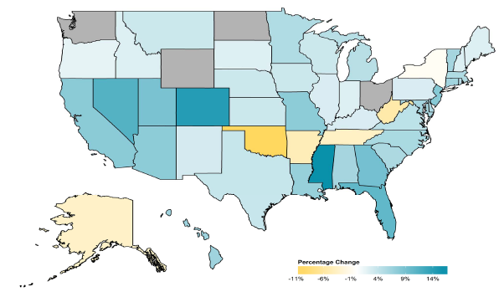
2014 Workers Compensation Direct Written Premium Growth, by State*
PRIVATE CARRIERS: Overall 2014 Growth = +4.6%
While growth rates varied widely, most states experienced positive growth in 2014
*Excludes monopolistic fund states (in gray): OH, ND, WA and WY.
Source: NCCI.

Slide 100
2013 Workers Compensation Direct Written Premium Growth, by State*
PRIVATE CARRIERS: Overall 2013 Growth = +5.4%
While growth rates varied widely, all states experienced positive growth in 2013
*Excludes monopolistic fund states (in white): OH, ND, WA and WY.
Source: NCCI.

Slide 101
Workers Compensation Components of Written Premium Change, 2013 to 2014
Written Premium Change from 2013 to 2014
Net Written Premium—Countrywide | +4.6%
Direct Written Premium—Countrywide | +4.6%
Direct Written Premium—NCCI States | +4.5%
Components of DWP Change for NCCI States
Change in Carrier Estimated Payroll | +4.7%
Change in Bureau Loss Costs and Mix | -1.4%
Change in Carrier Discounting | +0.4%
Change in Other Factors | +0.8%
Combined Effect | +4.5%
Growth is now almost entirely payroll driven
Sources: Countrywide: Annual Statement data.
NCCI States: Annual Statement Statutory Page 14 for all states where NCCI provides ratemaking services.
Components: NCCI Policy data.

Slide 102
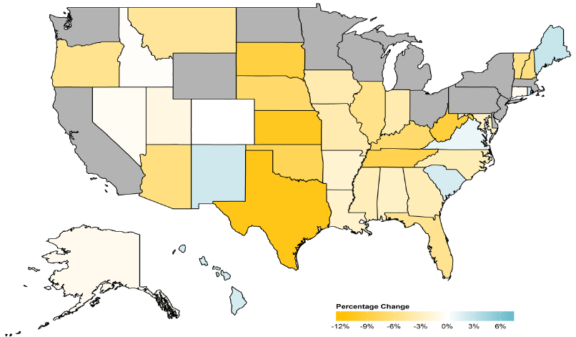
WC Approved or Filed and Pending Change in NCCI Premium Level by State
Latest Change for Voluntary Market
While growth rates varied widely, most states experienced positive growth in 2014
*Excludes monopolistic fund states (in gray): OH, ND, WA and WY.
Source: NCCI.

Slide 103
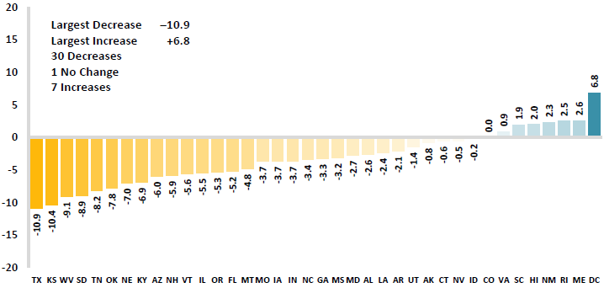
WC Approved or Filed and Pending Change in NCCI Premium Level by State
Latest Change for Voluntary Market
Excludes Law-Only Filings
The majority of states experienced decreases in rates/loss costs over
Note: Premium level changes are approved changes are approved or filed and pending changes in advisory rates, loss costs and rating values as of 4/24/15 as filed by applicable rating organization, relative to those previously approved. SC is filed and pending. IN and NC are in cooperation with state rating bureaus.
Source: NCCI.

Slide 104
WC Approved Changes in Bureau Premium Level (Rates/Loss Costs)
Percent
By Effective Date for Total Market
Cumulative 2000–2003
+17.1%
Cumulative 2011–2014
+11.8%
Cumulative 1994–1999
-27.8%
Cumulative 2004–2011
-30.8%
Cumulative
1990–1993
+36.3%
Approved rates/loss costs are down for the first time since 2010
Calendar Year
*States approved through 4/24/15.
Note: Bureau premium level changes are countrywide approved changes in advisory rates, loss costs and assigned risk rates as filed by applicable rating organization, relative to those previously approved.
Source: NCCI.

Slide 105
WC COST DRIVERS
Medical and Indemnity Factors
105

Slide 106
Workers Compensation Lost-Time
Claim Frequency Declined in 2014
Percent
Cumulative Change of –51.1%
(1994–2013 adj.)
*Adjustments primarily due to significant audit activity.
2014p: Preliminary based on data valued as of 12/31/2014.
Source: NCCI Financial Call data, developed to ultimate and adjusted to current wage an voluntary loss cost level; Excludes high deductible policies; 1994-2013: Based on data through 12/31/13. Data for all states where NCCI provides ratemaking services, excluding WV.
Frequency is the number of lost-time claims per $1M pure premium at current wage and voluntary loss cost level
Accident Year

Slide 107
Workers Comp Indemnity Claim Costs: Modest Increase in 2014
Average Indemnity Cost per Lost-Time Claim
Indemnity
Claim Cost ($ 000s)
Average indemnity costs per claim were up 4% in 2014 to $23,600, the largest increase since 2008
+1.9%
+4%
Cumulative Change = 141%
(1991-2014p)
Accident Year
2014p: Preliminary based on data valued as of 12/31/2014.
1991-2013: Based on data through 12/31/2013, developed to ultimate
Based on the states where NCCI provides ratemaking services including state funds, excluding WV; Excludes high deductible policies.
Notes:
107
Exhibit 11 of Article

Slide 108
WC Indemnity Severity vs. Wage Inflation, 1995 -2014p
Indemnity severities usually outpace wage gains
Annual Change 1994–2014
Indemnity Claim Sev.: +4.6
US Avg. Weekly Wage: +3.4%
WC indemnity severity turned positive again in 2011
2014p: Preliminary based on data valued as of 12/31/2014; 1991-2010: Based on data through 12/31/2010, developed to ultimate. Based on the states where NCCI provides ratemaking services. Excludes the effects of deductible policies. CPS = Current Population Survey.
Source: NCCI

Slide 109
States with Top 5 Highest Approved Indemnity Loss Ratio Trend*
2014-2015 Rate Filing Season*
Indemnity Trend (%)
MD has among the “highest” indemnity loss ratio trends, though the figure is still negative
*NCCI states only. Filings with effective dates between 10/1/14 and 9/1/15.
Source: NCCI (2015 Regulatory and Legislative Trends Workshop, May 14, 2015); Insurance Information Institute.

Slide 110
Workers Compensation Medical Severity:
Moderate Increase in 2014
Medical
Claim Cost ($000s)
Average Medical Cost per Lost-Time Claim
Medical severity for lost time claims was up 4% in 2014, the largest increase since 2009
Annual Change 1991–1993: +1.9%
Annual Change 1994–2001: +8.9%
Annual Change 2002–2010: +6.0%
Cumulative Change = 263%
(1991-2014p)
Accident Year
Accident Year
2014p: Preliminary based on data valued as of 12/31/2014.
1991-2013: Based on data through 12/31/2013, developed to ultimate
Based on the states where NCCI provides ratemaking services including state funds, excluding WV; Excludes high deductible policies.

Slide 111
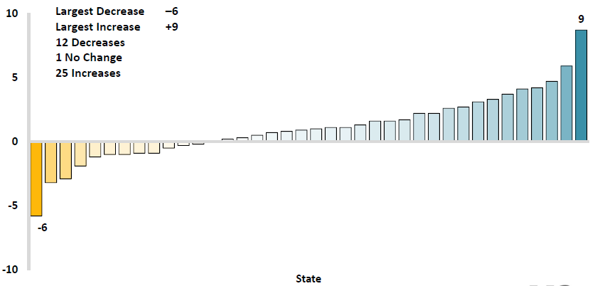
Workers Comp Change in Medical Severity by State, Avg. Annual Change, 2009-2013
Percent
The change in lost-time medical severities from 2009-2013 ranged from a low of -6% to a high of 9%
While growth rates varied widely, most states experienced positive growth in 2014
Source: NCCI’s Analysis of Frequency and Severity of Claims Across the Country as of 12/31/13 on ncci.com.
Values reflect methodology and state data underlying the most recent rate/lost cost filing.
TX changes are for the years 2010-2013.

Slide 112
States with Top 5 Lowest Approved Medical Loss Ratio Trend*
2014-2015 Rate Filing Season*
Indemnity Trend (%)
MD has among the lowest indemnity loss ratio trends
*NCCI states only. Filings with effective dates between 10/1/14 and 9/1/15.
Source: NCCI (2015 Regulatory and Legislative Trends Workshop, May 14, 2015); Insurance Information Institute.

Slide 113
Annual Inflation Rates, (CPI-U, %),
1990–2016F
Annual Inflation Rates (%)
Inflation peaked at 5.6% in August 2008 on high energy and commodity crisis. The recession and the collapse of the commodity bubble reduced inflationary pressures in 2009/10
Inflationary expectations have slipped (due in part to falling energy costs) allowing the Fed to maintain low interest rates
Slack in the U.S. economy and falling energy prices suggests that inflationary pressures should remain subdued for an extended period of times
Sources: US Bureau of Labor Statistics; Blue Chip Economic Indicators, 5/15 (forecasts).

Slide 114
Workers Compensation
Change in Medical Severity
Comparison to Change in Medical Consumer Price Index (CPI)
Percent Change
Average Annual Change: 1994—2014
Lost-Time Medical Severity: +6.4%
US Medical CPI: +3.7%
Year
2014p: Preliminary based on data valued as of 12/31/2014.
Sources: Severity: 995-2013: Based on data through 12/31/2013, developed to ultimate
Based on the states where NCCI provides ratemaking services including state funds, excluding WV; Excludes high deductible policies.
US Medical CPI: US Bureau of Labor Statistics.

Slide 115
WC Medical Severity Generally Outpaces the Medical CPI Rate
Average annual increase in WC medical severity from 1995 through 2014 was well above the medical CPI (6.4% vs. 3.7%), but the gap has narrowing. Lost-time medical severities appear to on the rise again.
Sources: Med CPI from US Bureau of Labor Statistics, WC med severity from NCCI based on NCCI states.

Slide 116
Medical Cost Inflation vs. Overall CPI, 1995 – 2014*
Though moderating, medical inflation will continue to exceed inflation in the overall economy
Average Annual Growth Average 1995 – 2013
Healthcare: 3.8%
Total Nonfarm: 2.4%
*July 2014 compared to July 2013.
Sources: Med CPI from US Bureau of Labor Statistics, WC med severity from NCCI based on NCCI states.

Slide 117
U.S. Health Care Expenditures,
1965–2022F
$ Billions
From 1965 through 2013, US health care expenditures had increased by 69 fold. Population growth over the same period increased by a factor of just 1.6. By 2022, health spending will have increased 119 fold.
U.S. health care expenditures have been on a relentless climb for most of the past half century, far outstripping population growth, inflation of GDP growth
Sources: Centers for Medicare & Medicaid Services, Office of the Actuary at http://www.cms.gov/Research-Statistics-Data-and-Systems/Statistics-Trends-and-Reports/NationalHealthExpendData/NationalHealthAccountsProjected.html accessed 3/14/14; Insurance Information Institute.

Slide 118
National Health Care Expenditures as a Share of GDP, 1965 – 2022F*
% of GDP
Health care expenditures as a share of GDP rose from 5.8% in 1965 to 18.0% in 2013 and are expected to reach 19.9% of GDP by 2022
2022 19.9%
2010: 17.9%
2000: 13.8%
1990: 12.5%
Since 2009, heath expenditures as a % of GDP have flattened out at about 18%--the question is why and will it last?
1980: 9.2%
1965 5.8%
Sources: Centers for Medicare & Medicaid Services, Office of the Actuary at http://www.cms.gov/Research-Statistics-Data-and-Systems/Statistics-Trends-and-Reports/NationalHealthExpendData/NationalHealthAccountsProjected.html accessed 3/14/14; Insurance Information Institute.

Slide 119
WC RESIDUAL MARKETS
WC Residual Markets Remain
Fairly Stable
119

Slide 120
WC Residual Market Share, 1985-2014p
Percent
NCCI-Serviced WC Residual Market Pools
Residual market share is up slightly over the past few years
Calendar Year
Includes pool and direct assignment data for all NCCI-serviced WC residual market pool states.
Source: NCCI, Residual Market Management Summary.

Slide 121
WC Residual Market Combined Ratio, 1985-2014p
Percent
NCCI-Serviced WC Residual Market Pools
Residual market combined ratios have fallen along with voluntary market combineds
Calendar Year
Includes pool and direct assignment data for all NCCI-serviced WC residual market pool states.
Source: NCCI, Residual Market Management Summary.

Slide 122
Commercial Lines Pricing Trends
Survey Results Suggest Commercial Pricing Has Flattened Out
122

Slide 123
Average Commercial Rate Change,
All Lines, (1Q:2004–1Q:2015)
(Percent)
Q2 2011 marked the last of 30th consecutive quarter of price declines
Pricing as of Q1:2015 had turned (slightly) negative for only the 3rd time in 3 years
KRW Effect
Note: CIAB data cited here are based on a survey. Rate changes earned by individual insurers can and do vary, potentially substantially.
Source: Council of Insurance Agents & Brokers; Insurance Information Institute

Slide 124
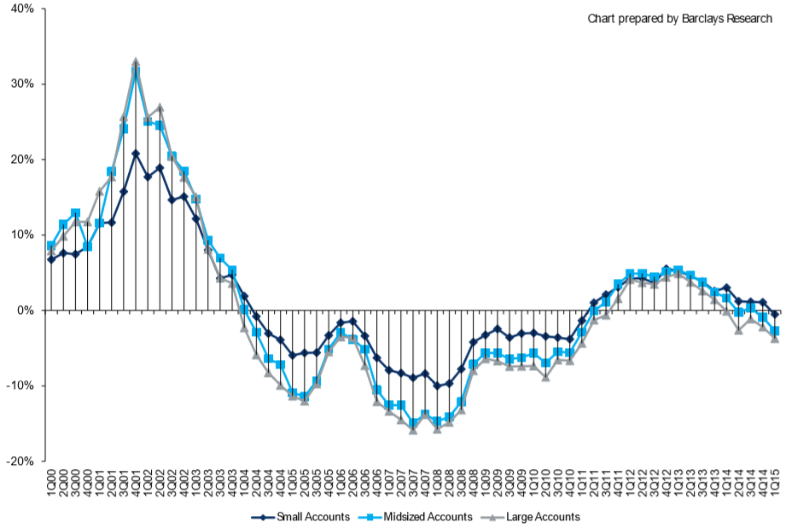
Change in Commercial Rate Renewals, by Account Size: 1999:Q4 to 2015:Q1
Percentage Change (%)
Peak = 2001:Q4 +28.5%
Pricing turned positive in Q3:2011, the first increase in nearly 8 years
Pricing Turned Negative in Early 2004 and Remained that way for 7 ½ years
KRW : No Lasting Impact
Rate trends are roughly flat, some carriers reporting small gains, others flat, others small declines
Trough = 2007:Q3 -13.6%
Source: Council of Insurance Agents and Brokers; Barclay’s Capital; Insurance Information Institute.
Note: CIAB data cited here are based on a survey. Rate changes earned by individual insurers can and do vary, potentially substantially.

Slide 125
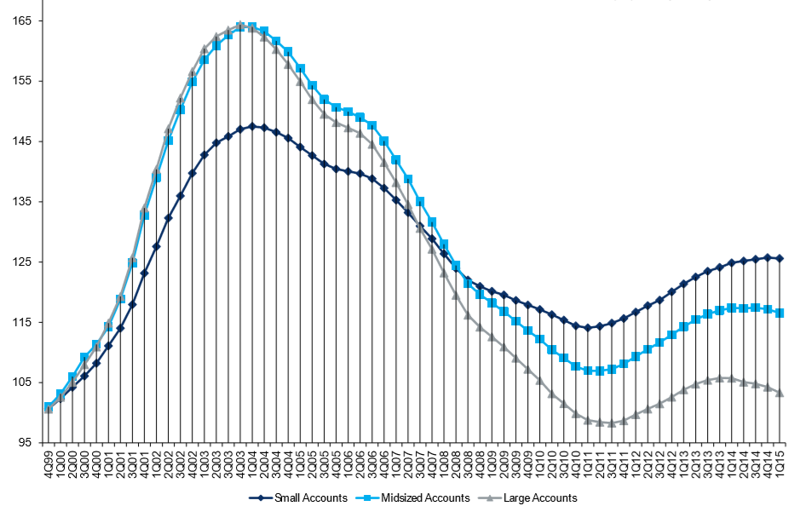
Cumulative Qtrly. Commercial Rate Changes, by Account Size: 1999:Q4 to 2015:Q1
1999:Q4 = 100
Despite several years of gains, pricing today for midsized accounts is where is was in late 2001 (around 9/11), suggesting additional rate need going forward, esp. in light of record low interest rates
Note: CIAB data cited here are based on a survey. Rate changes earned by individual insurers can and do vary, potentially substantially.
Source: Council of Insurance Agents and Brokers; Barclay’s Capital; Insurance Information Institute.

Slide 126
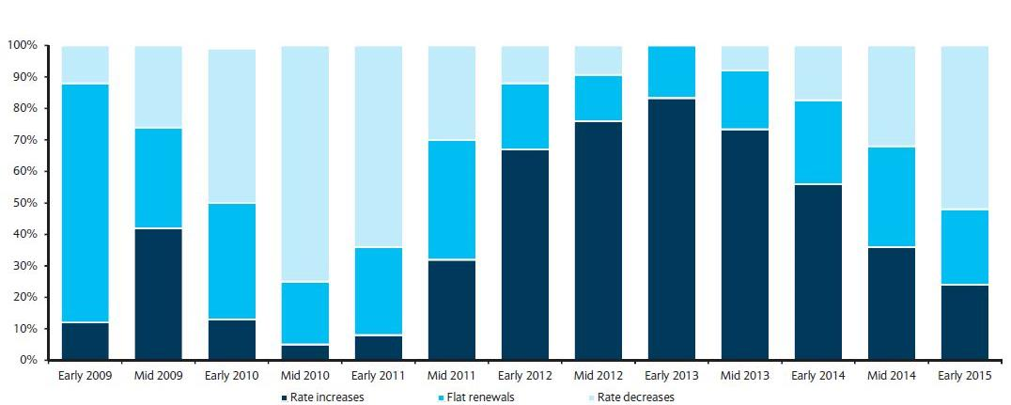
Directional Pricing Trend in Large Account P/C Renewals
Early 2009 through Early 2015
Few accounts are seeing increases
Source: Barclays’ Commercial Insurance Buyers Survey.

Slide 127
Change in Commercial Rate Renewals, by Line: 2015:Q1
Employment Practices rate increases are large than any other line, followed by Commercial Auto and D&O
Percentage Change (%)
Major Commercial Lines Renewals Were Mixed to Flat in Q1:2015; EPL and Commercial Auto Led the Way
Note: CIAB data cited here are based on a survey. Rate changes earned by individual insurers can and do vary, potentially substantially.
Source: Council of Insurance Agents and Brokers; Insurance Information Institute.

Slide 128
Workers Comp Rate Changes,
2008:Q4 – 2015:Q1
WC rate changes were positive for 15 consecutive quarters, before turning slightly negative in early 2015
(Percent Change)
Note: CIAB data cited here are based on a survey. Rate changes earned by individual insurers can and do vary, potentially substantially.
Source: Council of Insurance Agents and Brokers; Information Institute.

Slide 129
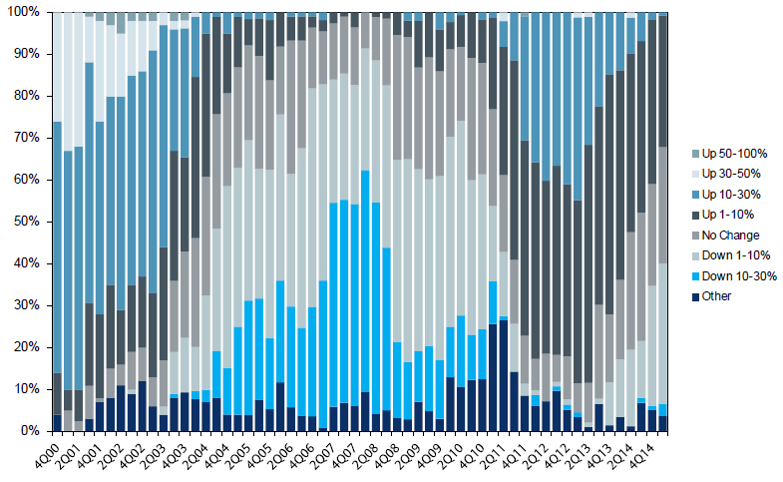
Workers Comp. Quarterly Rate Changes, by Line: 2000:Q1 to 2015:Q1
1999:Q4 = 100
Most accounts are renewing flat or slightly down
Note: CIAB data cited here are based on a survey. Rate changes earned by individual insurers can and do vary, potentially substantially.
Source: Council of Insurance Agents & Brokers; Insurance Information Institute

Slide 130
Selected Challenges in the Workers Comp Market
A Number of Issues Have Stirred Interest in Workers Compensation in the First Part of 2015
130

Slide 131
Challenges Raised in the Workers Comp Line
Opt Out Legislation: Coalition of large employers is aggressively pushing for legislation that would allow them to forego purchasing WC coverage in favor of creating their own programs while also seeking to specify the criteria for claiming and the size of benefits
  Allowed in TX for many years and passed in OK in 2014
  Failed in TN in 2015; Lobbying in AL, FL, GA, NC, SC
Challenges to Exclusive Remedy: Assertion that after reforms in several states the WC “Grand Bargain” has been breached and that benefits are now insufficient
  Objective of trial lawyers is to tap into the tort system

Slide 132
Recent Challenges Raised in the
Workers Comp Line (continued)
ProPublica/NPR Attack Series: “The Demolition of Workers Comp” (Published in March 2015)
Thesis: WC benefits have been hollowed out and that workers were often no longer well served by the system
  Claims 33 states watered down benefits under the guise of reform
Series relied on a number of anecdotal cases of claimants who believed they were adversely impacted
I.I.I. made forceful rebuttal focusing on:
  Magnitude of insurer payouts to injured workers
  Material improvements in workplace safety, in part due to WC incentives
  Benefits of cost controls without compromising outcomes
  http://www.iii.org/article/a-letter-to-the-editor-about-workers-compensation

Slide 133
Five Leading WC Proposal Categories to Watch in 2015
Drug Formularies: A few states have formularies and interested is increasing as studies show formularies can save money
Medical Marijuana: Not priceable (no data). Some states take position that medical marijuana is not reimbursable (even if legal in state). Impact on drug-free workplace credit?
Fee Schedules: Most states have fee schedules but 9 still do not. CT, NC added schedules in 2015, AK expected soon. Failed to introduce in NH and VA. Cost savings are often significant.
Attorney Fees: Fee caps being challenged. Moving from a fee schedule to an uncapped “reasonable” fee standard is expected result in a significant increase in costs. Should fee be paid out of the award or by insurer/employer?
Opt Out: Effort by some large corporations to restructure WC system

Slide 134
Insurance Information Institute Online:
www.iii.org
Thank you for your time
and your attention!
Twitter: twitter.com/bob_hartwig
Download at www.iii.org/presentations

Slide 135
APPENDIX:
The “On-Demand” Economy
135

Slide 136



The “On-Demand” World is Not New…
Companies like Angie’s List (established in 1995 and going online in 1999) have been around for decades
The Geek Squad has been around since 1994…
Peapod sprouted way back in 1989!
Source: Insurance Information Institute.

Slide 137



…But the “On-Demand” World is Exploding as Is the Demand for “On-Tap” Workers
Need something done around the house…Click on Handy
Hate doing laundry? Washio will do it for you…
Hate doing just about everything? Taskrabbit will take on virtually all your “tasks”…
Source: Insurance Information Institute.

Slide 138




You Can Live Your Life with the Swipe of a Finger…
Get married…
…Move
…And if it doesn’t work out…

Slide 139

Some Players in the On-Demand Economy
Have Become Household Names
Rent a place…
…Need a Lyft?
…This ride has taken Wall Street to the stratosphere

Slide 140
Technology and Employment
What Makes the On-Demand Economy Possible?
Why Does It Matter for Insurers?
140

Slide 141
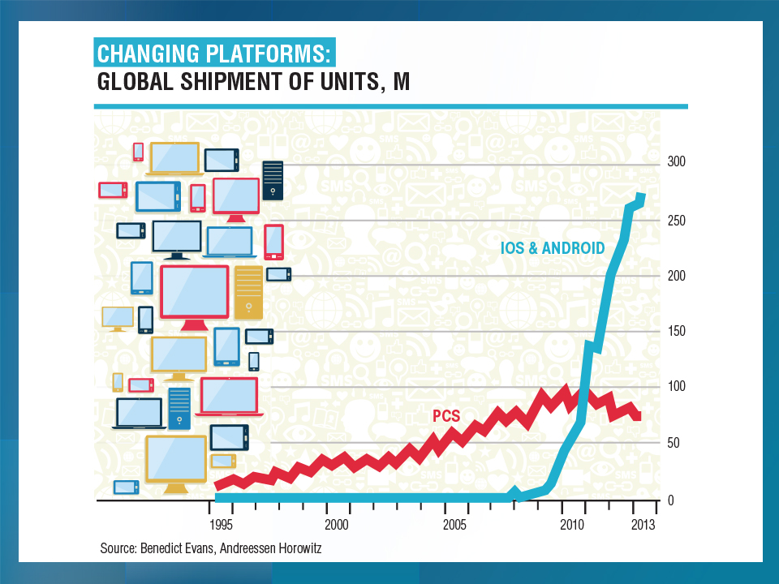
GLOBAL SHIPMENTS OF SMARTPHONES (MILLIONS)
Smartphones are the breakthrough technology behind the on-demand economy
2015: ~50% of adults globally have a smartphone
2020: About 80% will own one

Slide 142
Growth in Temporary Workers vs.
All Nonfarm Employment, 2010-2015*
Annual Percent Change
Demand for temporary workers has increased 2 to 3 times faster than for workers overall in recent years
*Through March 2015.
Source: US Bureau of Labor Statistics , Insurance Information Institute.

Slide 143
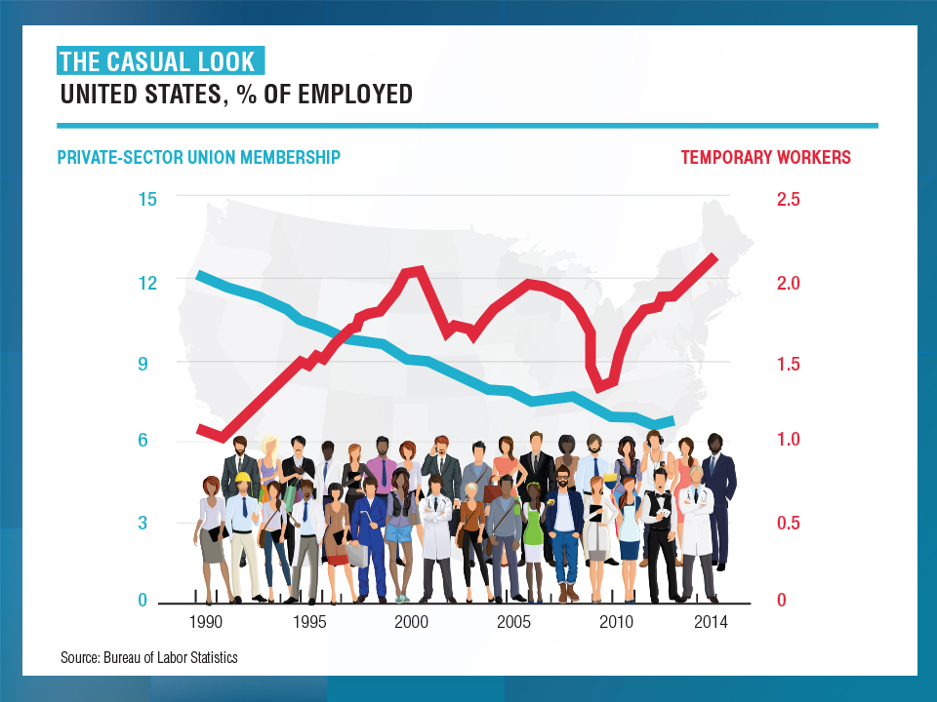

Slide 144
The “On-Demand” (Sharing) Economy
The On-Demand Economy Will Transform the American Workforce and the P/C Insurance Industry Too
144

Slide 145
On-Demand/Sharing/Peer-to-Peer Economy Impacts Many Lines of Insurance
The “On-Demand” Economy is or will impact many segments of the economy important to P/C insurers
  Auto (personal and commercial)
  Homeowners/Renters
  Many Liability Coverages
  Professional Liability
  Workers Comp
Many unanswered insurance questions
Insurance solutions are increasingly available to fill the many insurance gaps that arise
145
12/01/09 - 9pm
eSlide – P6466 – The Financial Crisis and the Future of the P/C
Notes:
145

Slide 146
The On-Demand Economy and American Workers: What Is Happening?
Technology is Fundamentally Transforming How Resources are Allocated and Used in the Economy
Labor is No Exception to this Transformation
Technology Offers New Opportunities to Match Labor to Jobs
  Owners of spare capacity (workers with time and skill) can be paired at low cost with those with a demand for that time and skill
  Bringing together labor and those who employ labor is not new
  BUT: Pairing occurs with a speed and breadth never before possible
Witnessing the Demise of the Traditional Understanding of What is Meant by a “Good” Job
  Concept born in the Industrial Age (1880-1980), is eroding
  Disintermediation of the firm as the place where labor, jobs matched
Accelerating Trends that Started with Labor Strife, Globalization and Automation that Began in the 1970s and 1980s
146
12/01/09 - 9pm
eSlide – P6466 – The Financial Crisis and the Future of the P/C
Notes:
146

Slide 147
What’s In Store for the American Worker, Labor Force and Workers Comp
THE NEW AMERICAN WORKER: Two Schools of Thought
OPTIMISTIC OUTLOOK
  Technology frees workers from the bonds of centralized, hierarchical institutions (the firm)
  Enhanced coordination of “haves” with “needs” that bypass firms as intermediaries
Who Benefits?
  “Flexers”: People who value or require flexibility in work arrangements (stay-at-home parents, retirees, students, disabled)
  Professionals: People with portable skills that can be offered through online platforms (semi and high-skilled trades, professional services)
  Unemployed/Underemployed: Offers at least some opportunity to offer and utilize skills and generate income
Sources: Wall Street Journal; The Economist; Insurance Information Institute research.
147
12/01/09 - 9pm
eSlide – P6466 – The Financial Crisis and the Future of the P/C
Notes:
147

Slide 148
What’s In Store for the American Worker, Labor Force and Workers Comp
PESSIMISTIC OUTLOOK
  On-Demand companies are software-driven marketplaces and position themselves as “platforms” rather than “employers”
  Enormous valuations (e.g., $40B for Uber on $2B in earnings) reflect the extraction of resources that otherwise would go to benefits, investments in safety, training, etc.
    Uber’s valuation was greater than that of 72% of the S&P500 at YE 2014
    Valued more than Delta Airlines, Kraft Foods, CBS, Macy’s, Hilton, Aflac…
  Jobs reduced to freelanced, temporary “gigs”
  Low skill workers and those who lack flexibility are left further behind
  Workers treated as independent contractors without intrinsic or basic economic rights
What Is Potentially Lost or Compromised?
  Stability, Retirement Benefits, Sick Pay, Maternity Leave, Overtime
  Health Insurance, Liability Coverage, Workers Comp Coverage
Sources: Wall Street Journal; The Economist; Fortune; Insurance Information Institute research.
148
12/01/09 - 9pm
eSlide – P6466 – The Financial Crisis and the Future of the P/C
Notes:
148

Slide 149
Potential Consequences for Insurers
On-Demand Platforms Have Struggled with Concepts of Liability
There Has Been a General Resistance to Assuming Liability or Responsibility Unless Compelled to Do So
Companies Have Sought to Keep as Much Liability as Possible on the Individual Offering their (Contracted) Labor or Resources
Minding the Gap
  Traditional insurance will often not cover a worker engaged in offering labor or resources through these platforms
  E.g., Auto ins. generally won’t cover you if you while driving for Uber
  Home ins. won’t cover for other than occasional rentals of property
  Unless self-procured, on-demand worker (independent contactors) will generally have no workers comp recourse if injured on the job
Long Legislative and Court Battles Lie Ahead
Insurance Solutions Becoming More Common
149
12/01/09 - 9pm
eSlide – P6466 – The Financial Crisis and the Future of the P/C
Notes:
149

Slide 150
On-Demand Workers
Who Are They?
And Who’s Driving Demand for Them?
150

Slide 151
Percent of People Who Have Engaged in an “On Demand/Sharing Economy” Transaction
Percent
The majority of the US population has yet to engage in the “On Demand” economy
About 19% of the US population has engaged in an “On Demand/Sharing Economy” Transaction
Sources: PwC survey of 1,000 adults in the U.S., conducted online, December 2014; Insurance Information Institute.

Slide 152
Age of People Who are Providing the Sharing/On-Demand Economy
Being a provider of services in the Sharing/On-Demand Economy is attractive to workers in the 25-44 age range (who want flexibility in raising families) as well as seniors age 65+ who see the offering their services on-demand as a way to augment retirement income
About 7% of US population are providers in the Sharing Economy, cutting across age and incomes; 51% of those familiar with the concept could see them selves as providers within the next two years.
Sources: PwC survey of 1,000 adults in the U.S., conducted online, December 2014; Insurance Information Institute.

Slide 153
Household Income: Providers of the Sharing/On-Demand Economy
Being a provider of services in the Sharing/On-Demand Economy is particularly attractive to workers with household incomes under $50,000
About 7% of US population are providers in the Sharing Economy, cutting across age and incomes; 51% of those familiar with the concept could see them selves as providers within the next two years.
Sources: PwC survey of 1,000 adults in the U.S., conducted online, December 2014; Insurance Information Institute.

Slide 154
The On-Demand Economy and
Wall Street
Wall Street Loves the On-Demand Economy
Labor Markets, Insurance Markets Will Be Impacted
154

Slide 155
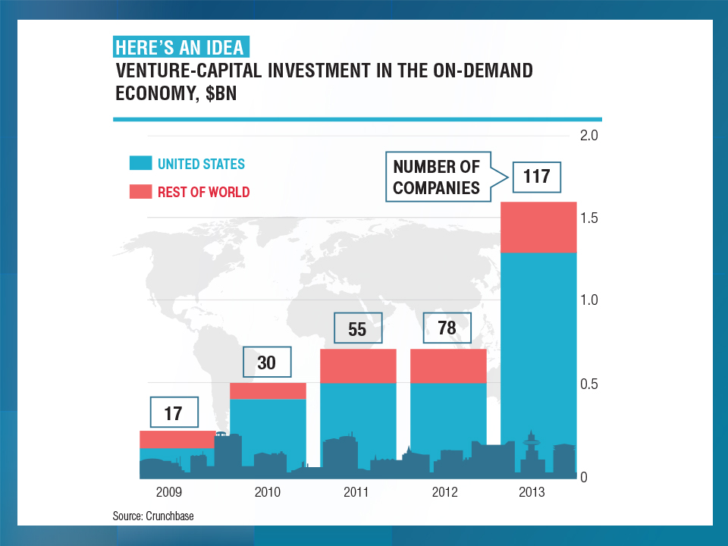

Slide 156
An UBER Case Study
Uber is the Best Known of the
On-Demand Companies
Wall Street Loves Uber
Vested Interests Hate Uber
156

Slide 157
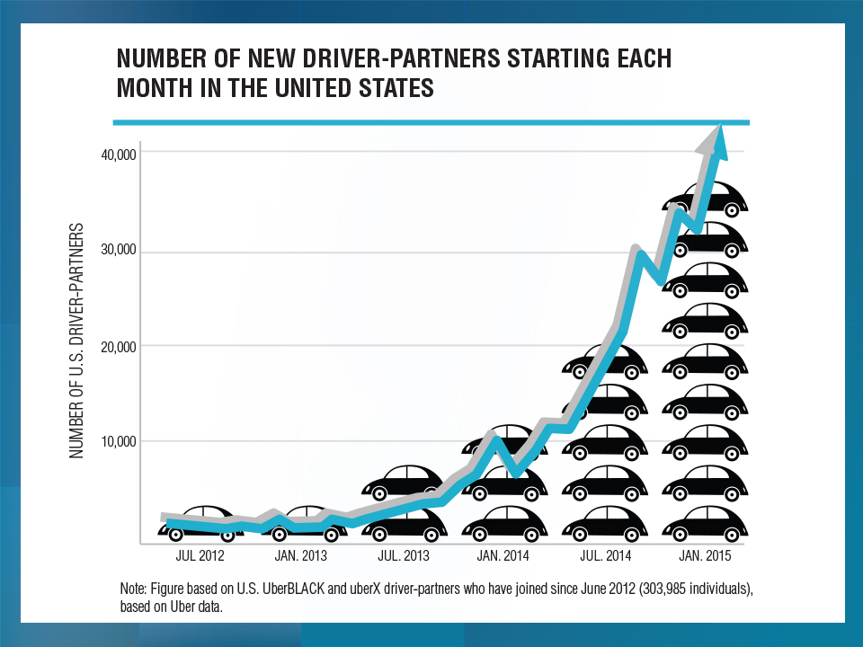

Slide 158
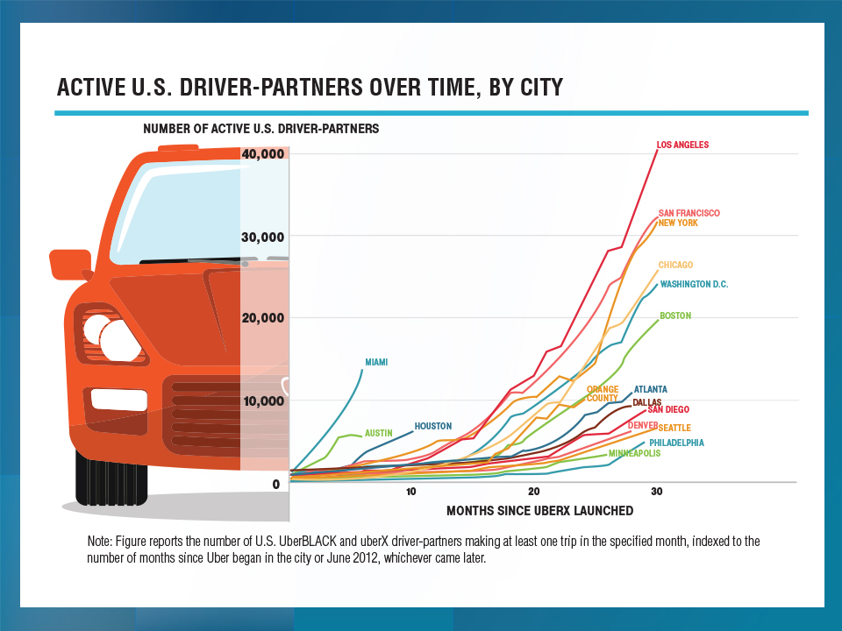

Slide 159
Looking Ahead:
Disruptive Forces Rule
Technology’s Impacts on the Economy, the Workforce and the Insurance Industry Will Be Significant
159

Slide 160
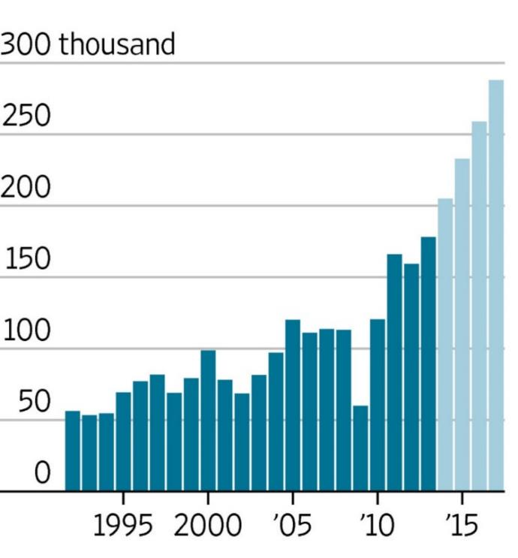
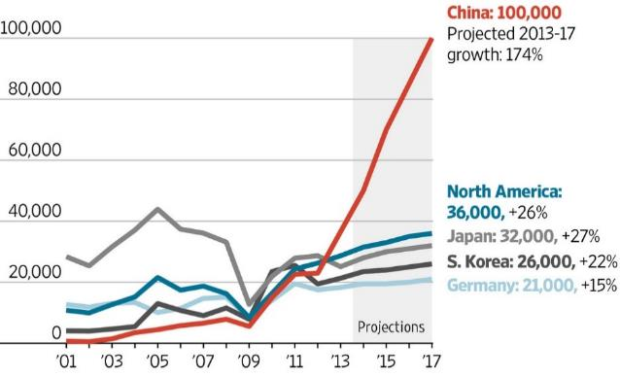
Worldwide Industrial Robot Installations,
1992-2017F
Worldwide installations of industrial robots exceeded 200,000 in 2014—a new record and will approach 300,000 by 2017
36,000 installations are expected in North America by 2017
*Estimate.
Sources: Outlook on World Robotics 2014, International Federation of Robotics; Insurance Information Institute.

Slide 161

Future Shock: Many More Transformative Technologies Are Around the Corner
By 2035, it is estimated that 25% of new vehicle sales could be fully autonomous models (more than 4 million people work in transportation occupations today)
Up Next
Driverless cars
Driverless trucks, trains, planes and ships
Wearable devices
Implantable devices
Artificial intelligence
Advanced robotics
Source: Boston Consulting Group.

