Slide 1
Workers Compensation: Trends, Challenges and Opportunities Focus on New York Markets
New York State Insurance Fund
New York, NY
June 17, 2015
Robert P. Hartwig, Ph.D., CPCU, President & Economist
Insurance Information Institute ♦ 110 William Street ♦ New York, NY 10038
Tel: 212.346.5520 ♦ Cell: 917.453.1885 ♦ bobh@iii.org ♦ www.iii.org

Slide 2
Workers Compensation Operating Environment
Workers Comp Results Have Improved Substantially in Recent Years
Can Gains Be Maintained?
2

Slide 3
Workers Compensation Combined Ratio: 1994–2014P
WC results have improved markedly since 2011
Workers Comp Results Began to Improve in 2012. Underwriting Results Deteriorated Markedly from 2007-2010/11 and Were the Worst They Had Been in a Decade.
Sources: A.M. Best (1994-2009); NCCI (2010-2014P) and are for private carriers only; Insurance Information Institute.

Slide 4
Commercial Lines Combined Ratio, 1990-2015F*
Commercial lines underwriting performance in 2013-14 benefited from favorable rate environment, low cats, modest loss cost trends and prior year reserve releases
Source: A.M. Best (1990-2013); Conning (2014E-2015F) Insurance Information Institute.

Slide 5
WC Net Combined Ratios: Private Carriers vs. State Funds, 2000 – 2014p
Average: 2000-2014p
Private Carriers: 107.7
State Funds: 118.2
Source: NCCI (2015 Regulatory and Legislative Trends Workshop, May 14, 2015); Insurance Information Institute.

Slide 6
WC Pretax Operating Gain
PRIVATE CARRIERS
PERCENT
Average (1994-2014p): 5.9%
Source: NCCI analysis based on Annual Statement data.
Investment Gain Equals 1.00 minus (Combined Ratio less Investment Gains on Insurance Transactions and Other Income).
Averages reflect the following adjustments: 1990-91: adjusted to include realized capital gains to be consistent with 1992 and subsequent years; **2013: adjusted to exclude a material realized gain resulting from a single company transaction that involved corporate restructuring. Excluding the adjustment the operating gain is 17.7%.

Slide 7
Workers Compensation Loss and LAE Net Reserve Deficiencies, 1995 - 2014
PRIVATE CARRIERS
$ Billions
2014 Tabular Discount Is $4.6 Billion
33%
Percent of CY Total Reserves As Reported
8%
Source: NCCI analysis based on Annual Statement data.
Considers all reserve discounts as deficiencies.

Slide 8
Workers Compensation Premium: Fourth Consecutive Year of Increase Net Written Premium
$ Billions
p Preliminary
Source: NCCI from Annual Statement Data.
Includes state insurance fund data for the following states: AZ, CA, CO, HI, ID, KY, LA, MD, MO, MT, NM, OK, OR, RI, TX, UT.
Each calendar year total for State Funds includes all funds operating as a state fund that year.
Calendar Year

Slide 9
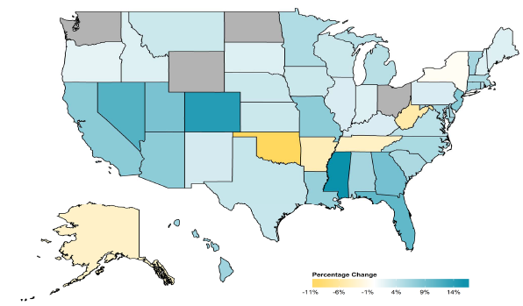
2014 Workers Compensation Direct Written Premium Growth, by State*
PRIVATE CARRIERS: Overall 2014 Growth = +4.6%
While growth rates varied widely, most states experienced positive growth in 2014
*Excludes monopolistic fund states (in gray): OH, ND, WA and WY.
Source: NCCI.

Slide 10
2013 Workers Compensation Direct Written Premium Growth, by State*
PRIVATE CARRIERS: Overall 2013 Growth = +5.4%
While growth rates varied widely, all states experienced positive growth in 2013
*Excludes monopolistic fund states (in white): OH, ND, WA and WY.
Source: NCCI.

Slide 11
Workers Compensation Components of Written Premium Change, 2013 to 2014
Written Premium Change from 2013 to 2014
Net Written Premium—Countrywide | +4.6%
Direct Written Premium—Countrywide | +4.6%
Direct Written Premium—NCCI States | +4.5%
Components of DWP Change for NCCI States
Change in Carrier Estimated Payroll | +4.7%
Change in Bureau Loss Costs and Mix | -1.4%
Change in Carrier Discounting | +0.4%
Change in Other Factors | +0.8%
Combined Effect | +4.5%
Growth is now almost entirely payroll driven
Sources: Countrywide: Annual Statement data.
NCCI States: Annual Statement Statutory Page 14 for all states where NCCI provides ratemaking services.
Components: NCCI Policy data.

Slide 12
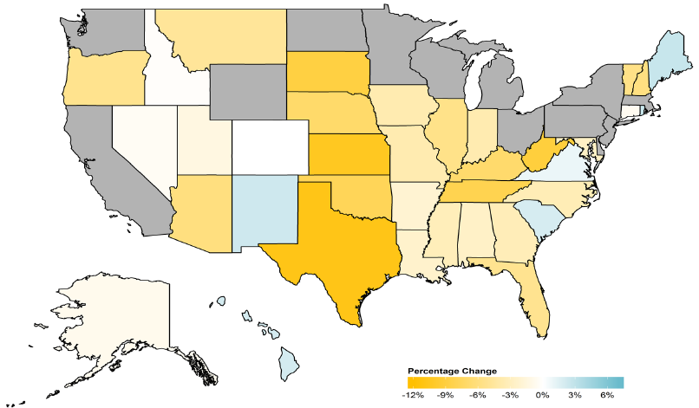
WC Approved or Filed and Pending Change in NCCI Premium Level by State
Latest Change for Voluntary Market
While growth rates varied widely, most states experienced positive growth in 2014
*Excludes monopolistic fund states (in gray): OH, ND, WA and WY.
Source: NCCI.

Slide 13
WC Approved Changes in Bureau Premium Level (Rates/Loss Costs)
Percent
By Effective Date for Total Market
Cumulative 2000–2003
+17.1%
Cumulative 2011–2014
+11.8%
Cumulative 1994–1999
-27.8%
Cumulative 2004–2011
-30.8%
Cumulative
1990–1993
+36.3%
Approved rates/loss costs are down for the first time since 2010
Calendar Year
*States approved through 4/24/15.
Note: Bureau premium level changes are countrywide approved changes in advisory rates, loss costs and assigned risk rates as filed by applicable rating organization, relative to those previously approved.
Source: NCCI.

Slide 14
Labor Markets Trends:
Recovery Continues in 2015
2014
Largest Increase in Jobs Since 1997
Unemployment Rate Fell to Lowest Level Since 2008
Payrolls Expanded to Record High
14

Slide 15
Unemployment and Underemployment Rates: Still Too High, But Falling
January 2000 through April 2015, Seasonally Adjusted (%)
U-6 soared from 8.0% in March 2007 to 17.5% in October 2009; Stood at 10.8% in Apr. 2015. 8% to 10% is “normal.”
“Headline” unemployment was 5.4% in Apr. 2015. 4.5% to 5.5% is “normal.”
Stubbornly high unemployment and underemployment constrain overall economic growth, but the job market is continuing to improve.
Source: US Bureau of Labor Statistics; Insurance Information Institute.
15
12/01/09 - 9pm
eSlide – P6466 – The Financial Crisis and the Future of the P/C
Notes:
15

Slide 16
Unemployment Rates by State, April 2015: Highest 25 States*
In April, 23 states and the District of Columbia had over-the-month unemployment rate decreases, 11 states had increases, and 16 states had no change.
Residual impacts of the housing collapse, weak economies are holding back several states
*Provisional figures for April 2015, seasonally adjusted.
Sources: US Bureau of Labor Statistics; Insurance Information Institute.

Slide 17
Unemployment Rates by State, April 2015:
Lowest 25 States*
In April, 23 states and the District of Columbia had over-the-month unemployment rate decreases, 11 states had increases, and 16 states had no change.
Strength in Energy, Agricultural States-most also avoided housing bust
*Provisional figures for April 2015, seasonally adjusted.
Sources: US Bureau of Labor Statistics; Insurance Information Institute.

Slide 18
Monthly Change in Private Employment
3,042,000 jobs were created in 2014, the most since 1997
January 2007 through Apr. 2015 (000s, Seasonally Adj.)
Jobs Created
2014: 3.042 Mill
2013: 2.452 Mill
2012: 2.315 Mill
2011: 2.396 Mill
2010: 1.282 Mill
213,000 private sector jobs were created in April.
Monthly losses in Dec. 08–Mar. 09 were the largest in the post-WW II period
Private Employers Added 11.97 Million Jobs Since Jan. 2010 After Having Shed 5.01 Million Jobs in 2009 and 3.76 Million in 2008 (State and Local Governments Have Shed Hundreds of Thousands of Jobs)
Source: US Bureau of Labor Statistics: http://www.bls.gov/ces/home.htm; Insurance Information Institute

Slide 19
Growth in Temporary Workers vs. All Nonfarm Employment, 2010-2015*
Annual Percent Change
Demand for temporary workers has increased 2 to 3 times faster than for workers overall in recent years
*Through March 2015.
Source: US Bureau of Labor Statistics , Insurance Information Institute.

Slide 20
Average Weekly Hours of All Private Workers, Mar. 2006—April 2015
(Hours Worked)
Hours worked plunged during the recession, impacting payroll exposures
Hours worked totaled 34.5 per week in April, just shy of the 34.6 hours typically worked before the “Great Recession”
*Seasonally adjusted
Note: Recessions indicated by gray shaded columns.
Sources: US Bureau of Labor Statistics at http://www.bls.gov/data/#employment; National Bureau of Economic Research (recession dates); Insurance Information Institute.
20
12/01/09 - 9pm
eSlide – P6466 – The Financial Crisis and the Future of the P/C
Notes:
20

Slide 21
Average Hourly Wage of All Private Workers, Mar. 2006—April 2015
(Hourly Wage)
The average hourly wage was $24.87 in April 2015, up 17.2% from $21.22 when the recession began in Dec. 2007
Wage gains continued during the recession, despite massive job losses
*Seasonally adjusted
Note: Recessions indicated by gray shaded columns.
Sources: US Bureau of Labor Statistics at http://www.bls.gov/data/#employment; National Bureau of Economic Research (recession dates); Insurance Information Institute.
21
12/01/09 - 9pm
eSlide – P6466 – The Financial Crisis and the Future of the P/C
Notes:
21

Slide 22
Payroll vs. Workers Comp Net Written Premiums, 1990-2014P
Payroll Base* WC NWP
$Billions $Billions
7/90-3/91
3/01-11/01
12/07-6/09
WC premium volume dropped two years before the recession began
WC net premiums written were down $14B or 29.3% to $33.8B in 2010 after peaking at $47.8B in 2005
Continued Payroll Growth and Rate Gains Suggest WC NWP Will Grow Again in 2015
*Private employment; Shaded areas indicate recessions. WC premiums for 2014 are from NCCI.
Sources: NBER (recessions); Federal Reserve Bank of St. Louis at http://research.stlouisfed.org/fred2/series/WASCUR ; NCCI; I.I.I.

Slide 23
Construction Employment, Jan. 2010—April 2015*
(Thousands)
Construction employment is +948,000 above Jan. 2011 (+17.4%) trough
Construction and manufacturing employment constitute 1/3 of all WC payroll exposure.
*Seasonally adjusted.
Sources: US Bureau of Labor Statistics at http://data.bls.gov; Insurance Information Institute.
23
12/01/09 - 9pm
eSlide – P6466 – The Financial Crisis and the Future of the P/C
Notes:
23

Slide 24
Manufacturing Employment, Jan. 2010—April 2015*
(Thousands)
Since Jan 2010, manufacturing employment is up (+862,000 or +7.5%) and still growing.
Manufacturing employment is a surprising source of strength in the economy. Employment in the sector is at a multi-year high.
*Seasonally adjusted.
Sources: US Bureau of Labor Statistics at http://data.bls.gov; Insurance Information Institute.
24
12/01/09 - 9pm
eSlide – P6466 – The Financial Crisis and the Future of the P/C
Notes:
24

Slide 25
12 Industries for the Next 10 Years: Insurance Solutions Needed
Health Care
Health Sciences
Energy (Traditional)
Many industries are poised for growth, though insurers’ ability to capitalize on these industries varies widely
Alternative Energy
Petrochemical
Agriculture
Natural Resources
Technology (incl. Biotechnology)
Light Manufacturing
Insourced Manufacturing
Export-Oriented Industries
Shipping (Rail, Marine, Trucking, Pipelines)

Slide 26
WC Profitability and Growth Trends in New York
Profitability Lags,
But Growth Leads
26

Slide 27
RNW Workers Comp: NY vs. U.S., 2004-2013
(Percent)
Average 2004-2013
US: 7.1%
NY: 4.9%
Source: NAIC, Insurance Information Institute
27
Notes:
27

Slide 28
Workers Comp: 10-Year Average RNW NY & Nearby States
2004-2013
New York Workers Comp profitability is below the US average and regional average
Source: NAIC, Insurance Information Institute

Slide 29
Workers Comp. DWP Growth: NY vs. U.S., 2005-2013
(Percent)
Average 2005-2013
US: -0.04%
NY: 5.2%
Source: SNL Financial.
29
Notes:
29

Slide 30
WC COST DRIVERS
Medical and Indemnity Factors
30

Slide 31
Workers Compensation Lost-Time Claim Frequency Declined in 2014
Percent
Cumulative Change of –51.1%
(1994–2013 adj.)
*Adjustments primarily due to significant audit activity.
2014p: Preliminary based on data valued as of 12/31/2014.
Source: NCCI Financial Call data, developed to ultimate and adjusted to current wage an voluntary loss cost level; Excludes high deductible policies; 1994-2013: Based on data through 12/31/13. Data for all states where NCCI provides ratemaking services, excluding WV.
Frequency is the number of lost-time claims per $1M pure premium at current wage and voluntary loss cost level
Accident Year

Slide 32
Workers Comp Indemnity Claim Costs: Modest Increase in 2014
Average Indemnity Cost per Lost-Time Claim
Indemnity
Claim Cost ($ 000s)
Average indemnity costs per claim were up 4% in 2014 to $23,600, the largest increase since 2008
+1.9%
+4%
Cumulative Change = 141%
(1991-2014p)
Accident Year
2014p: Preliminary based on data valued as of 12/31/2014.
1991-2013: Based on data through 12/31/2013, developed to ultimate
Based on the states where NCCI provides ratemaking services including state funds, excluding WV; Excludes high deductible policies.
Notes:
32
Exhibit 11 of Article

Slide 33
WC Indemnity Severity vs. Wage Inflation, 1995 -2014p
Indemnity severities usually outpace wage gains
Annual Change 1994–2014
Indemnity Claim Sev.: +4.6
US Avg. Weekly Wage: +3.4%
WC indemnity severity turned positive again in 2011
2014p: Preliminary based on data valued as of 12/31/2014; 1991-2010: Based on data through 12/31/2010, developed to ultimate. Based on the states where NCCI provides ratemaking services. Excludes the effects of deductible policies. CPS = Current Population Survey.
Source: NCCI

Slide 34
Workers Compensation Medical Severity: Moderate Increase in 2014
Medical
Claim Cost ($000s)
Average Medical Cost per Lost-Time Claim
Medical severity for lost time claims was up 4% in 2014, the largest increase since 2009
Annual Change 1991–1993: +1.9%
Annual Change 1994–2001: +8.9%
Annual Change 2002–2010: +6.0%
Cumulative Change = 263%
(1991-2014p)
Accident Year
Accident Year
2014p: Preliminary based on data valued as of 12/31/2014.
1991-2013: Based on data through 12/31/2013, developed to ultimate
Based on the states where NCCI provides ratemaking services including state funds, excluding WV; Excludes high deductible policies.

Slide 35
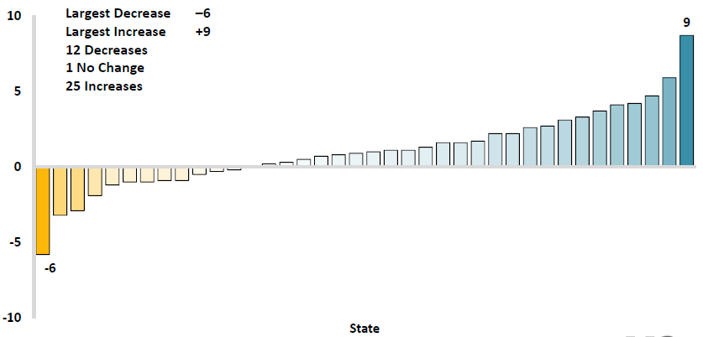
Workers Comp Change in Medical Severity by State, Avg. Annual Change, 2009-2013
Percent
The change in lost-time medical severities from 2009-2013 ranged from a low of -6% to a high of 9%
While growth rates varied widely, most states experienced positive growth in 2014
Source: NCCI’s Analysis of Frequency and Severity of Claims Across the Country as of 12/31/13 on ncci.com.
Values reflect methodology and state data underlying the most recent rate/lost cost filing.
TX changes are for the years 2010-2013.

Slide 36
WC Medical Severity Generally Outpaces the Medical CPI Rate
Average annual increase in WC medical severity from 1995 through 2014 was well above the medical CPI (6.4% vs. 3.7%), but the gap has narrowing. Lost-time medical severities appear to on the rise again.
Sources: Med CPI from US Bureau of Labor Statistics, WC med severity from NCCI based on NCCI states.

Slide 37
WC RESIDUAL MARKETS
WC Residual Markets Remain
Fairly Stable
37

Slide 38
WC Residual Market Combined Ratio, 1985-2014p
Percent
NCCI-Serviced WC Residual Market Pools
Residual market combined ratios have fallen along with voluntary market combineds
Calendar Year
Includes pool and direct assignment data for all NCCI-serviced WC residual market pool states.
Source: NCCI, Residual Market Management Summary.

Slide 39
Commercial Lines Pricing Trends
Survey Results Suggest Commercial Pricing Has Flattened Out
39

Slide 40
Change in Commercial Rate Renewals, by Line: 2015:Q1
Percentage Change (%)
WC renewals were roughly flat in early 2015
Major Commercial Lines Renewals Were Mixed to Flat in Q1:2015; EPL and Commercial Auto Led the Way
Note: CIAB data cited here are based on a survey. Rate changes earned by individual insurers can and do vary, potentially substantially.
Source: Council of Insurance Agents and Brokers; Insurance Information Institute.

Slide 41
Workers Comp Rate Changes, 2008:Q4 – 2015:Q1
WC rate changes were positive for 15 consecutive quarters, before turning slightly negative in early 2015
(Percent Change)
Note: CIAB data cited here are based on a survey. Rate changes earned by individual insurers can and do vary, potentially substantially.
Source: Council of Insurance Agents and Brokers; Information Institute.

Slide 42
Selected Challenges in the Workers Comp Market
A Number of Issues Have Stirred Interest in Workers Compensation in the First Part of 2015
42

Slide 43
Challenges Raised in the Workers Comp Line
Opt Out Legislation: Coalition of large employers is aggressively pushing for legislation that would allow them to forego purchasing WC coverage in favor of creating their own programs while also seeking to specify the criteria for claiming and the size of benefits
Allowed in TX for many years and passed in OK in 2014
Failed in TN in 2015; Lobbying in AL, FL, GA, NC, SC
Challenges to Exclusive Remedy: Assertion that after reforms in several states the WC “Grand Bargain” has been breached and that benefits are now insufficient
Objective of trial lawyers is to tap into the tort system

Slide 44
Five Leading WC Proposal Categories to Watch in 2015
Drug Formularies: A few states have formularies and interested is increasing as studies show formularies can save money
Medical Marijuana: Not priceable (no data). Some states take position that medical marijuana is not reimbursable (even if legal in state). Impact on drug-free workplace credit?
Fee Schedules: Most states have fee schedules but 9 still do not. CT, NC added schedules in 2015, AK expected soon. Failed to introduce in NH and VA. Cost savings are often significant.
Attorney Fees: Fee caps being challenged. Moving from a fee schedule to an uncapped “reasonable” fee standard is expected result in a significant increase in costs. Should fee be paid out of the award or by insurer/employer?
Opt Out: Effort by some large corporations to restructure WC system

Slide 45
Insurance Information Institute Online:
www.iii.org
Thank you for your time and your attention!
Twitter: twitter.com/bob_hartwig
Download at www.iii.org/presentations

