Slide 1
Construction, Manufacturing and Oil & Gas Industries and the P/C Insurance Industry:
Trends, Challenges & Opportunities
Insurance Information Institute
June 12, 2013
Download at www.iii.org/presentations
Robert P. Hartwig, Ph.D., CPCU, President & Economist
Insurance Information Institute ♦ 110 William Street ♦ New York, NY 10038
Tel: 212.346.5520 ♦ Cell: 917.453.1885 ♦ bobh@iii.org ♦ www.iii.org

Slide 2
The Strength of the U.S. Economy Will Influence P/C Insurer Growth Opportunities
U.S. Growth Will Expand Insurer Exposure Base Across Most Lines
2

Slide 3
US Real GDP Growth*
The Q4:2008 decline was the steepest since the Q1:1982 drop of 6.8%
Real GDP Growth (%)
Recession began in Dec. 2007. Economic toll of credit crunch, housing slump, labor market contraction was severe
2013 is expected to see uneven growth, then gradually accelerate throughout the year and into 2014
Demand for Insurance Continues To Be Impacted by Sluggish Economic Conditions, but the Benefits of Even Slow Growth Will Compound and Gradually Benefit the Economy Broadly
* Estimates/Forecasts from Blue Chip Economic Indicators.
Source: US Department of Commerce, Blue Economic Indicators 6/13; Insurance Information Institute.

Slide 4
Real GDP by State Percent Change, 2012:
Highest 25 States
North Dakota was the economic growth juggernaut of the US in 2012—by far
Only 10 states experienced growth in excess of 3%, which is what we would see nationally in a more typical recovery
Sources: US Bureau of Labor Statistics; Insurance Information Institute.

Slide 5
Real GDP by State Percent Change, 2012:
Lowest 25 States
Growth rates in 8 states (and DC) were still below 1% in 2012
Connecticut was the only state to shrink in 2012
Sources: US Bureau of Labor Statistics; Insurance Information Institute.

Slide 6

Federal Spending as a Share of State GDP: Vulnerability to Sequestration Varies
Many northern states have relatively little exposure to sequester cuts
Sources: Pew Center on the States (2012) Impact of the Fiscal Cliff on the States; Wells Fargo; Insurance Information Institute.

Slide 7
Defense and Non-Defense Federal Spending as a Share of State GDP: Top 10 States*
Defense Spending
Non-Defense Spending
Federal defense spending accounts for approximately 10%+ of GDP in 5 states
Federal non-defense spending accounts for 10%+ of GDP in 3 states
Sequestration Could Adversely Impact Commercial Insurance Exposures Directly at Defense Contractors and Indirectly in Impacted Communities
*As of 2010.
Sources: Pew Center on the States (2012) Impact of the Fiscal Cliff on the States; Wells Fargo Securities; Insurance Information Institute.

Slide 8
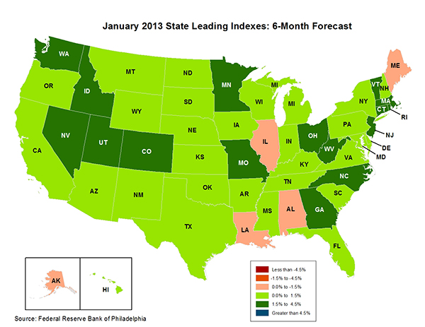
State-by-State Leading Indicators
through 2013:Q2
The economic outlook for most of New England is relatively strong, suggesting future strength in the creation of insurable exposures
Sources: Federal Reserve Bank of Philadelphia at http://www.philadelphiafed.org/index.cfm ;Insurance Information Institute.

Slide 9
Annual Inflation Rates, (CPI-U, %),
1990–2014F
Annual Inflation Rates (%)
Inflation peaked at 5.6% in August 2008 on high energy and commodity crisis. The recession and the collapse of the commodity bubble reduced inflationary pressures in 2009/10
Inflationary expectations remain quite low, allowing the Fed to continue its QE3 program
The slack in the U.S. economy suggests that inflationary pressures should remain subdued for an extended period of times. Energy, health care and commodity prices, plus U.S. debt burden, remain longer-run concerns
Sources: US Bureau of Labor Statistics; Blue Chip Economic Indicators, 6/13 (forecasts).

Slide 10
Consumer Sentiment Survey (1966 = 100)
January 2010 through May 2013
Optimism among consumers has remained fairly strong despite tax hike, federal budget concerns. May’s reading was the highest since July 2007
Consumer confidence has been low for years amid high unemployment, falling home prices and other factors adversely impact consumers, but improved substantially in late 2011 and in 2012
Source: University of Michigan; Insurance Information Institute

Slide 11
Auto/Light Truck Sales, 1999-2019F
Job growth and improved credit market conditions will boost auto sales in 2013 and beyond
(Millions of Units)
New auto/light truck sales fell to the lowest level since the late 1960s. Forecast for 2013-14 is still below 1999-2007 average of 17 million units, but a robust recovery is well underway.
Truck purchases by contractors are especially strong
Car/Light Truck Sales Will Continue to Recover from the 2009 Low Point, Bolstering the Auto Insurer Growth and the Manufacturing Sector Along With Workers Comp Exposures
Source: U.S. Department of Commerce; Blue Chip Economic Indicators (5/13 and 3/13); Insurance Information Institute.

Slide 12
Business Bankruptcy Filings,
1980-2012:Q3
% Change Surrounding Recessions
1980-82 58.6%
1980-87 88.7%
1990-91 10.3%
2000-01 13.0%
2006-09 208.9%*
2011 bankruptcies totaled 47,806, down 15.1% from 56,282 in 2010—the second consecutive year of decline. Business bankruptcies more than tripled during the financial crisis. Through Q3:2012, filings were down 15.8% vs. Q3:2011
Significant Exposure Implications for All Commercial Lines as Business Bankruptcies Begin to Decline
Sources: American Bankruptcy Institute at http://www.abiworld.org/AM/AMTemplate.cfm?Section=Home&TEMPLATE=/CM/ContentDisplay.cfm&CONTENTID=61633; Insurance Information Institute
12
12/01/09 - 9pm
eSlide – P6466 – The Financial Crisis and the Future of the P/C
Notes:
12

Slide 13
Private Sector Business Starts,
1993:Q2 – 2012:Q3*
Business Starts
2006: 872,000
2007: 843,000
2008: 790,000
2009: 697,000 2010: 742,000 2011: 748,000 2012E: 769,000*
(Thousands)
Business starts were up an estimated 2.8% in 2012 to 769,000 following a 2.2% to 748,000 in 2011. Start-ups could accelerate in 2013.
Business Starts Were Down Nearly 20% in the Recession,
Holding Back Most Types of Commercial Insurance Exposure, But Are Recovering Slowly
* Data through Sep. 30, 2012 are the latest available as of May 13, 2013; Seasonally adjusted.
Source: Bureau of Labor Statistics, http://www.bls.gov/news.release/cewbd.t08.htm.
13
12/01/09 - 9pm
eSlide – P6466 – The Financial Crisis and the Future of the P/C
Notes:
13

Slide 14
ISM Non-Manufacturing Index
(Values > 50 Indicate Expansion)
January 2010 through May 2013
Optimism among non-manufacturers is stable and remains expansionary in 2013
Non-manufacturing industries have been expanding and adding jobs. The question is whether this will continue.
Source: Institute for Supply Management at http://www.ism.ws/ismreport/nonmfgrob.cfm; Insurance Information Institute.

Slide 15
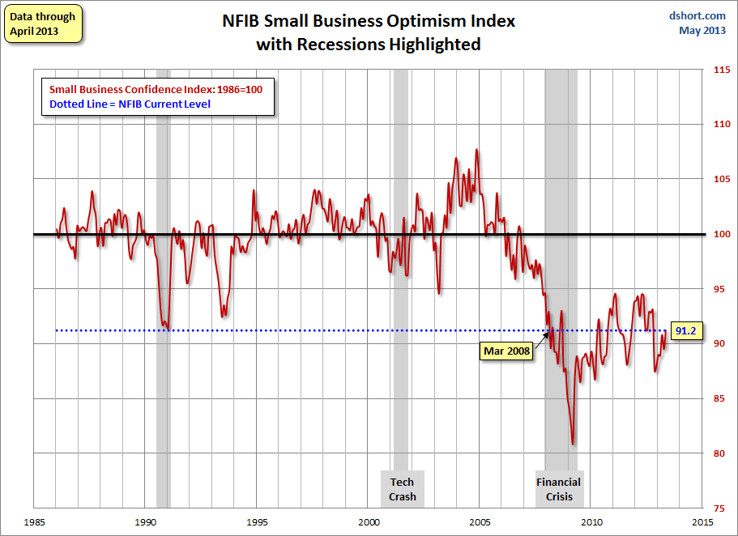
NFIB Small Business Optimism Index
January 1985 through April 2013
Small business optimism is off crisis lows but still suffering from economic and regulatory uncertainty
Source: National Federation of Independent Business at http://www.advisorperspectives.com/dshort/charts/indicators/Sentiment.html?NFIB-optimism-index.gif ; Insurance Information Institute.

Slide 16
12 Industries for the Next 10 Years: Insurance Solutions Needed
Health Care
Health Sciences
Energy (Traditional)
Many industries are poised for growth, though insurers’ ability to capitalize on these industries varies widely
Alternative Energy
Petrochemical
Agriculture
Natural Resources
Technology (incl. Biotechnology)
Light Manufacturing
Insourced Manufacturing
Export-Oriented Industries
Shipping (Rail, Marine, Trucking, Pipelines)

Slide 17
CONSTRUCTION INDUSTRY OVERVIEW & OUTLOOK
The Construction Sector Is Critical to the Economy and the P/C Insurance Industry
17

Slide 18
Value of Construction Put in Place, April 2013 vs. April 2012*
Growth (%)
Private: +9.0%
Public: -5.1%
Public sector construction activity remains depressed
Private sector construction activity is up in the residential segment but down in nonresidential
Overall Construction Activity is Up, But Growth Is Entirely in the Private Sector as State/Local Government Budget Woes Continue
*seasonally adjusted
Source: U.S. Census Bureau, http://www.census.gov/construction/c30/c30index.html ; Insurance Information Institute.

Slide 19
Value of Private Construction Put in Place, by Segment, Apr. 2013 vs. Apr. 2012*
Growth (%)
Led by the Residential Construction, Lodging, Office, and Manufacturing industries, Private sector construction activity is mixed up across many segments after plunging during the “Great Recession.” Most segments expanded in 2012 but weakened in early 2013.
Private Construction Activity is Up inSome Segments, Including the Key Residential Construction Sector, But Weakening in Early 2013
*seasonally adjusted
Source: U.S. Census Bureau, http://www.census.gov/construction/c30/c30index.html ; Insurance Information Institute.

Slide 20
Value of Public Construction Put in Place, by Segment, Apr. 2013 vs. Apr. 2012*
Growth (%)
Public sector construction activity is down substantially in most segments, a situation that will likely persist, dragging on public entity risk exposures
Transportation and Power projects lead public sector construction
Public Construction Activity is Down in Many Segments as State and Local Budgets Remain Under Stress; Improvement Possible in 2014.
*seasonally adjusted
Source: U.S. Census Bureau, http://www.census.gov/construction/c30/c30index.html ; Insurance Information Institute.

Slide 21
New Private Housing Starts, 1990-2019F
Job growth, low inventories of existing homes, low mortgage rates and demographics are stimulating new home construction for the first time in years
(Millions of Units)
New home starts plunged 72% from 2005-2009; A net annual decline of 1.49 million units, lowest since records began in 1959
Insurers Are Starting to See Meaningful Exposure Growth for the First Time Since 2005 Associated with Home Construction: Construction Risk Exposure, Surety, Commercial Auto; Potent Driver of Workers Comp Exposure
Source: U.S. Department of Commerce; Blue Chip Economic Indicators (6/13 and 3/13); Insurance Information Institute.

Slide 22
Construction Employment,
Jan. 2010—May 2013*
(Thousands)
Construction employment growth accelerated in the second half of 2012. Continued growth in this key sector is possible through 2013. Construction is a key driver of workers comp exposure growth.
*Seasonally adjusted
Sources: US Bureau of Labor Statistics at http://data.bls.gov; Insurance Information Institute.
22
12/01/09 - 9pm
eSlide – P6466 – The Financial Crisis and the Future of the P/C
Notes:
22

Slide 23
Construction Employment,
Jan. 2003–May 2013
(Thousands)
Construction employment as of May 2013 totaled 5.804 million, an increase of 369,000 jobs or 6.8% from the Jan. 2011 trough
Construction employment peaked at 7.726 million in April 2006
Construction employment troughed at 5.435 million in Jan. 2011, after a loss of 2.291 million jobs, a 29.7% plunge from the April 2006 peak
The “Great Recession” and housing bust destroyed 2.3 million constructions jobs
The Construction Sector Could Be a Growth Leader in 2013 and 2014 as the Housing Market and Private Investment Recover. WC Insurers Will Benefit.
Note: Recession indicated by gray shaded column.
Sources: U.S. Bureau of Labor Statistics; Insurance Information Institute.
23
12/01/09 - 9pm
eSlide – P6466 – The Financial Crisis and the Future of the P/C
Notes:
23

Slide 24
Logging Employment,
Jan. 2010—May 2013*
Mining employment has been somewhat volatile but is up from its 2010/2011 lows. Home construction activity in the US, wood pellet demand from Europe and pulp demand from Asia should help this sector
(Thousands)
*Seasonally adjusted
Sources: US Bureau of Labor Statistics at http://data.bls.gov; Insurance Information Institute.
24
12/01/09 - 9pm
eSlide – P6466 – The Financial Crisis and the Future of the P/C
Notes:
24

Slide 25
Logging Employment,
Jan. 2003–May 2013
(Thousands)
Logging employment peaked at about 71,000 in early 2003
Logging employment as of May 2013 totaled 51,000, an increase of 3,300 jobs or 6.9% from the Dec. 2010 trough
Logging employment troughed at 47,700 in Dec. 2010
The “Great Recession” and housing bust destroyed at least 15,000 logging jobs
The Logging Sector Is Benefitting from Residential Home Construction, Renewable Energy Regulations in Europe (encourage wood burning) and some Asian pulp demand
Note: Recession indicated by gray shaded column.
Sources: U.S. Bureau of Labor Statistics; Insurance Information Institute.
25
12/01/09 - 9pm
eSlide – P6466 – The Financial Crisis and the Future of the P/C
Notes:
25

Slide 26
Commercial & Industrial Loans Outstanding at FDIC-Insured Banks, Quarterly, 2006-2012:Q4*
$Trillions
Commercial lending activity is exceeds pre-crisis levels (+29.1% or $340B above mid-2010 trough)
Commercial lending plunged by 21.2% ($330B) during the financial crisis and ensuing period of tight credit
Outstanding Commercial Loan Volume Has Been Growing for Over Two Years and Is Now Nearly Back to Early Recession Levels. Bodes Very Well for the Creation of Current and Future Commercial Insurance Exposures
*Latest data as of 5/13/2013.
Source: FDIC at http://www2.fdic.gov/qbp/ (Balance Sheet spreadsheet); Insurance Information Institute.

Slide 27
Percent of Non-current Commercial & Industrial Loans Outstanding at FDIC-Insured Banks,
Quarterly, 2006-2012:Q4*
Almost back to “normal” levels of noncurrent industrial & commercial loans
Recession
Non-current loans (those past due 90 days or more or in nonaccrual status) are back to early-recession levels, fueling bank willingness to lend.
*Latest data as of 3/18/2013.
Source: FDIC at http://www2.fdic.gov/qbp/ (Loan Performance spreadsheet); Insurance Information Institute.

Slide 28
Interest Rate on Convention 30-Year Mortgages: Headed Back Up, 1990–2013*
Yields on 10-Year U.S. Treasury Notes plunged to all time record lows in early 2013 but are now rising as the Fed considers tapering its QE program
Yields on 30-Year mortgages have been below 6% for a five years
Since roughly 80% of P/C bond/cash investments are in 10-year or shorter durations, most P/C insurer portfolios will have low-yielding bonds for years to come.
*Monthly, through June 2013 (as of June 6). Note: Recessions indicated by gray shaded columns.
Sources: Federal Reserve Bank at http://www.federalreserve.gov/releases/h15/data.htm.
National Bureau of Economic Research (recession dates); Insurance Information Institutes.
28
12/01/09 - 9pm
eSlide – P6466 – The Financial Crisis and the Future of the P/C
Notes:
28

Slide 29
30-Year Mortgages in 2013 Are Rising: What Will Be the Impact on Construction?
30-year mortgage rates are up nearly 60 basis points since early May
Mortgage Interest Rates Will Rise as Expectations Over the Fed’s Tapering of QE3 Persist; Still Low by Historical Standards
*Weekly through June 6, 2013.
Sources: Federal Reserve Bank at http://www.federalreserve.gov/releases/h15/data.htm.; Insurance Information Institutes.
29
12/01/09 - 9pm
eSlide – P6466 – The Financial Crisis and the Future of the P/C
Notes:
29

Slide 30
MANUFACTURING SECTOR OVERVIEW & OUTLOOK
The Manufacturing Sector Could See a Resurgence Benefitting the US Economy and the P/C Insurance Industry
30

Slide 31
Nonfarm Payroll (Wages and Salaries):
Quarterly, 2005–2013:Q1
Billions
Latest (2013:Q4) was $7.01 trillion, a new peak--$762B above 2009 trough
Prior Peak was 2008:Q1 at $6.60 trillion
Payrolls are 12.2% above their 2009 trough and up 2.7% over the past year
Recent trough (2009:Q3) was $6.25 trillion, down 5.3% from prior peak
Note: Recession indicated by gray shaded column. Data are seasonally adjusted annual rates.
Sources: http://research.stlouisfed.org/fred2/series/WASCUR; National Bureau of Economic Research (recession dates); Insurance Information Institute.
31
12/01/09 - 9pm
eSlide – P6466 – The Financial Crisis and the Future of the P/C
Notes:
31

Slide 32
ISM Manufacturing Index
(Values > 50 Indicate Expansion)
January 2010 through May 2013
Manufacturing contracted in May, albeit modestly
The manufacturing sector expanded for 39 of the 41 months from Jan. 2010 through May 2013. Recent weakness stems largely from woes in Europe and a Slowdown in China.
Source: Institute for Supply Management at http://www.ism.ws/ismreport/mfgrob.cfm; Insurance Information Institute.

Slide 33
Dollar Value* of Manufacturers’ Shipments Monthly, Jan. 1992—Apr. 2013
$ Millions
The value of Manufacturing Shipments in Apr. 2013 were up 34% to $478.7B from its May 2009 trough. March figure is now 2.2% below its previous record high in Feb. 2013. Modest weakening in recent months.
Monthly shipments in Feb. 2013 exceeded their pre-crisis (July 2008) peak. Trough in May 2009. Growth from trough to Apr. 2013 was 34%. Manufacturing is an energy intensive activity and growth leads to gains in many commercial exposures: WC, Commercial Auto, Marine, Property and Various Liability Coverages
*seasonally adjusted
Source: U.S. Census Bureau, Full Report on Manufacturers’ Shipments, Inventories, and Orders, http://www.census.gov/manufacturing/m3/
33
12/01/09 - 9pm
eSlide – P6466 – The Financial Crisis and the Future of the P/C
Notes:
33

Slide 34
Manufacturing Growth for Selected Sectors, 2013 vs. 2013*
Growth (%)
Durables: +2.5%
Non-Durables: -0.3%
Construction machinery is up 35.4% YTD
Manufacturing of durable goods was especially strong in 2012 but weakened in 2013
Manufacturing Is Expanding—Albeit More Slowly—Across a Number of Sectors that Will Contribute to Growth in Insurable Exposures Including: WC, Commercial Property, Commercial Auto and Many Liability Coverages
*Seasonally adjusted; Date are YTD comparing data through April 2013 to the same period in 2012.
Source: U.S. Census Bureau, Full Report on Manufacturers’ Shipments, Inventories, and Orders, http://www.census.gov/manufacturing/m3/

Slide 35
Recovery in Capacity Utilization is a Positive Sign for Commercial Exposures
March 2001 through April 2013
“Full Capacity”
The US operated at 77.8% of industrial capacity in Apr. 2013, well above the June 2009 low of 66.9% but is still below pre-recession levels.
Percent of Industrial Capacity
Hurricane Katrina
The closer the economy is to operating at “full capacity,” the greater the inflationary pressure
March 2001-November 2001 recession
December 2007-
June 2009 Recession
35
Source: Federal Reserve Board statistical releases at http://www.federalreserve.gov/releases/g17/Current/default.htm.
Notes:
35

Slide 36
Manufacturing Employment,
Jan. 2010—May 2013*
Manufacturing employment is up by more than 500,000 or 4.4% since Jan. 2010—a surprising source of strength in the economy. The sector has weakened recently as US corporations remains cautious and Europe, China slow.
(Thousands)
*Seasonally adjusted
Sources: US Bureau of Labor Statistics at http://data.bls.gov; Insurance Information Institute.
36
12/01/09 - 9pm
eSlide – P6466 – The Financial Crisis and the Future of the P/C
Notes:
36

Slide 37
ENERGY SECTOR: OIL & GAS INDUSTRY FUTURE IS BRIGHT
US Is Becoming an Energy Powerhouse; Domestic Demand and Exports Are Key
Need Infrastructure Investment
37

Slide 38
US Oil & Gas Extraction: Value of Output: 2000–2012E
($ Billions)
Value of oil and gas activity in the US economy is up an estimated 82% or $150 billion since 2009
The contribution of oil & gas extraction to the US economy is now at record high levels
Sources: U.S. Bureau of Economic Analysis (2000-2011); Insurance Information Institute (2012E).

Slide 39

Oil & Gas Extraction Employment,
Jan. 2010—May 2013*
(Thousands)
Oil and gas extraction employment is up 23.9% since Jan. 2010 as the energy sector booms. Domestic energy production is essential to any robust economic recovery in the US.
*Seasonally adjusted
Sources: US Bureau of Labor Statistics at http://data.bls.gov; Insurance Information Institute.
39
12/01/09 - 9pm
eSlide – P6466 – The Financial Crisis and the Future of the P/C
Notes:
39

Slide 40
World Primary Energy Consumption, 1990-2030P
Quadrillion BTUs
Global energy consumption is expected to increase by 33.4% between 2010 and 2030 but by only 12% in the US
Between 2006 and 2030, energy consumption in projected to increase annually by 1.5% worldwide but only 0.5% in the US
Source: Energy Information Administration, 2009 International Energy Outlook, Insurance Information Institute.

Slide 41
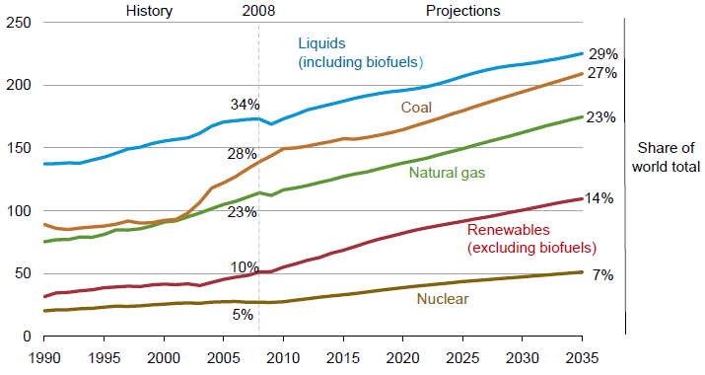
World Energy Consumption by Fuel,
1990—2035F
Renewables will account for 14% of global energy consumption by 2035, up from 20% in 2008
Source: US Energy Information Administration, International Energy Outlook 2011; Insurance Information Institute.
41
12/01/09 - 9pm
eSlide – P6466 – The Financial Crisis and the Future of the P/C
Notes:
41

Slide 42
US Electric Power Generation by Fuel Source, 2010-2035F (Billions of Kilowatt Hours)
4,279
4,427
3,937
4,118
3,806
3,796
Demand for Electricity Is Expected to Grow at a 0.6% Annual Rate Through 2035. Renewables and Natural Gas Will Account for an Increasing Share of Fuel Source
Source: US Energy Information Administration, Annual Energy Outlook 2012, Appendix A7.
42
12/01/09 - 9pm
eSlide – P6466 – The Financial Crisis and the Future of the P/C
Notes:
42

Slide 43
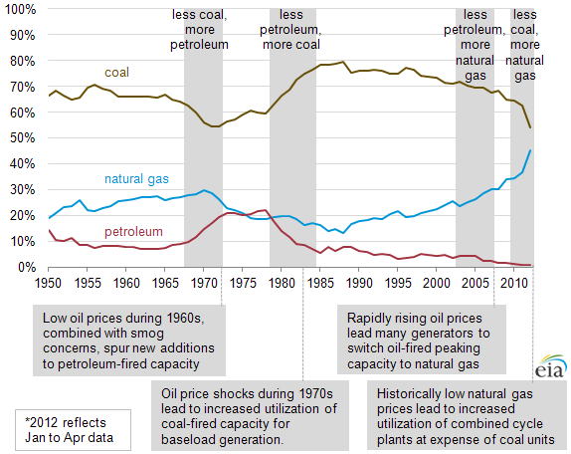
U.S. Annual Share of Fossil Fired Electric Power Generation, 1950-2012*
Natural gas share of fossil fired generation has more than tripled to 45% in 2012 from less than 15% in 1988. Coal’s share is down significantly and Petroleum’s share is approaching zero
Source: US Energy Information Administration, http://www.eia.gov/todayinenergy/detail.cfm?id=7090# ; Insurance Information Institute.
43
12/01/09 - 9pm
eSlide – P6466 – The Financial Crisis and the Future of the P/C
Notes:
43

Slide 44
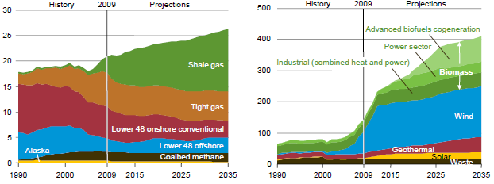
US Natural Gas Production and Non-Hydro Renewable Electricity Generation, 1990-2035P
Shale gas production is expected to grow rapidly in the US
Wind is expected to account for the majority of renewable electricity generation
Tight gas production involves controversial hydraulic fracturing (fracking) techniques
Source: US Energy Information Administration, Annual Energy Outlook 2011; Insurance Information Institute.
44
12/01/09 - 9pm
eSlide – P6466 – The Financial Crisis and the Future of the P/C
Notes:
44

Slide 45
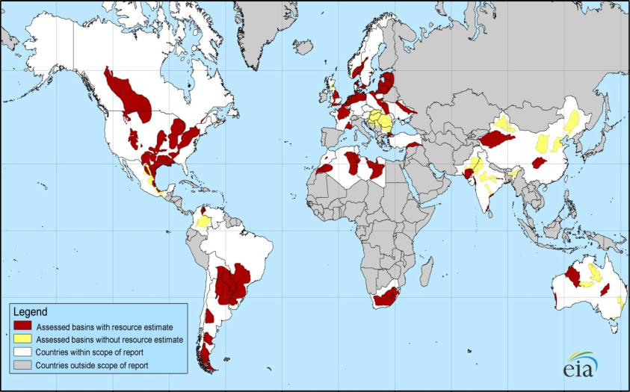
Distribution of Major Shale Deposits: 5.76 Tr. Cu. Ft. in 48 Shale Basins in 32 Countries
Europe and S. America also have large deposits
Initial assessments reveal 5.76 trillion cu. ft. of shale gas worldwide, including 1.069 trillion cu. Ft. in North America
Source: US Energy Information Administration; Insurance Information Institute.
45
12/01/09 - 9pm
eSlide – P6466 – The Financial Crisis and the Future of the P/C
Notes:
45

Slide 46
Technically Recoverable Shale Gas Deposits, by Region
North America has 1,069 trillion cu. ft. of technically recoverable shale gas recources—18.6% of the global total
Trillion Cubic Ft.tts
Source: US Energy Information Administration; Insurance Information Institute.

Slide 47
Global Oil Consumption and Price,
2008 – 2035F
The nominal price of oil is expected to rise by 2.8% per year on average through 2035
Millions of Barrels per Day Nominal Price/BBL
Global oil consumption is expected to rise by 1.1% per year on average through 2035
Oil Will Become Relatively More Expensive Over Time, With Price Increases Outstripping Income Growth in Many Parts of the World
*
Source: US Energy Information Administration; Insurance Information Institute

Slide 48
Cumulative Projected Investment in Global Energy Infrastructure, 2011-2035 ($ Trill.)
Projected energy infrastructure investment through 2035 total $38 trillion; Implies substantial incurrence of risk.
Source: International Energy Agency, World Energy Outlook 2011.

Slide 49
Labor Market Trends
Massive Job Losses Sapped the Economy and Commercial/Personal Lines Exposure, But Trend is Improving
49

Slide 50
Unemployment and Underemployment Rates: Stubbornly High in 2012, But Falling
January 2000 through May 2013, Seasonally Adjusted (%)
U-6 went from 8.0% in March 2007 to 17.5% in
October 2009; Stood at 13.8% in May 2013
Recession ended in November 2001
Unemployment kept rising for 19 more months
Recession began in December 2007
Unemployment stood at 7.6% in May 2013—nealry its lowest level in 4 years.
Unemployment peaked at 10.1% in October 2009, highest monthly rate since 1983.
Peak rate in the last 30 years: 10.8% in November - December 1982
Stubbornly high unemployment and underemployment constrain overall economic growth, but the job market is now clearly improving
Source: US Bureau of Labor Statistics; Insurance Information Institute.
50
12/01/09 - 9pm
eSlide – P6466 – The Financial Crisis and the Future of the P/C
Notes:
50

Slide 51
Unemployment Rates by State, April 2013:
Highest 25 States*
In April, 40 states and the District of Columbia had over-the-month unemployment rate decreases, 3 states had increases, and 7 states had no change.
*Provisional figures for April 2013, seasonally adjusted.
Sources: US Bureau of Labor Statistics; Insurance Information Institute.

Slide 52
Unemployment Rates by State, April 2013:
Lowest 25 States*
In April, 40 states and the District of Columbia had over-the-month unemployment rate decreases, 3 states had increases, and 7 states had no change.
*Provisional figures for April 2013, seasonally adjusted.
Sources: US Bureau of Labor Statistics; Insurance Information Institute.

Slide 53
Monthly Change in Private Employment
January 2007 through May 2013 (Thousands)
178,000 private sector jobs were created in May
Jobs Created
2012: 2.247 Mill
2011: 2.420 Mill
2010: 1.235 Mill
Monthly Losses in Dec. 08–Mar. 09 Were the Largest in the
Post-WW II Period
Private Employers Added 6.90 million Jobs Since Jan. 2010 After Having Shed 4.98 Million Jobs in 2009 and 3.80 Million in 2008 (State and Local Governments Have Shed Hundreds of Thousands of Jobs)
Source: US Bureau of Labor Statistics: http://www.bls.gov/ces/home.htm; Insurance Information Institute

Slide 54
Cumulative Change in Private Employment: Dec. 2007—May 2013
December 2007 through May 2013 (Millions)
Cumulative job losses as of May 2013 totaled 1.826 million
Cumulative job losses peaked at 8.765 million in February 2010
All of the jobs “lost” since President Obama took office in Jan. 2009 have been recouped
Private Employers Added 6.90 million Jobs Since Jan. 2010 After Having Shed 4.98 Million Jobs in 2009 and 3.80 Million in 2008 (State and Local Governments Have Shed Hundreds of Thousands of Jobs)
Source: US Bureau of Labor Statistics: http://www.bls.gov/ces/home.htm; Insurance Information Institute

Slide 55
Cumulative Change in Private Sector Employment: Jan. 2010—May 2013
January 2010 through May 2013* (Millions)
Job gains and pay increases have added more than $600 billion to payrolls since Jan. 2010
Cumulative job gains through May 2013 totaled 6.90 million
Private Employers Added 6.90 million Jobs Since Jan. 2010 After Having Shed 4.98 Million Jobs in 2009 and 3.80 Million in 2008 (State and Local Governments Have Shed Hundreds of Thousands of Jobs)
Source: US Bureau of Labor Statistics: http://www.bls.gov/ces/home.htm; Insurance Information Institute

Slide 56
Cumulative Change in Government Employment: Jan. 2010—May 2013
Government at all levels has shed more than 630,000 jobs since Jan. 2010 even as private employers created 6.90 million jobs, though losses may now be ending.
January 2010 through May 2013* (Millions)
Cumulative job losses through May 2013 totaled 632,000
Temporary Census hiring distorted 2010 figures
Governments at All Levels are Under Severe Fiscal Strain As Tax Receipts Plunged and Pension Obligations Soared During the Financial Crisis: Sequestration Will Add to this Toll
Source: US Bureau of Labor Statistics http://www.bls.gov/data/#employment; Insurance Information Institute

Slide 57
US Unemployment Rate Forecast
2007:Q1 to 2014:Q4F*
Rising unemployment
eroded payrolls
and workers comp’s
exposure base.
Unemployment peaked at 10% in late 2009.
Jobless figures have been revised slightly downwards for 2013/14
Unemployment forecasts have been revised slightly downwards. Optimistic scenarios put the unemployment as low as 6.5% by Q4 of next year.
* = actual; = forecasts
Sources: US Bureau of Labor Statistics; Blue Chip Economic Indicators (6/13 edition); Insurance Information Institute.

Slide 58
Nonfarm Payroll (Wages and Salaries):
Quarterly, 2005–2013:Q1
Billions
Latest (2013:Q4) was $7.01 trillion, a new peak--$762B above 2009 trough
Prior Peak was 2008:Q1 at $6.60 trillion
Payrolls are 12.2% above their 2009 trough and up 2.7% over the past year
Recent trough (2009:Q3) was $6.25 trillion, down 5.3% from prior peak
Note: Recession indicated by gray shaded column. Data are seasonally adjusted annual rates.
Sources: http://research.stlouisfed.org/fred2/series/WASCUR; National Bureau of Economic Research (recession dates); Insurance Information Institute.
58
12/01/09 - 9pm
eSlide – P6466 – The Financial Crisis and the Future of the P/C
Notes:
58

Slide 59
Payroll vs. Workers Comp Net Written Premiums, 1990-2012E
Payroll Base* WC NWP
$Billions $Billions
7/90-3/91
3/01-11/01
12/07-6/09
WC premium volume dropped two years before the recession began
+9% in 2012E
WC net premiums written were down $14B or 29.3% to $33.8B in 2010 after peaking at $47.8B in 2005
Continued Payroll Growth and Rate Increases Suggest WC NWP Will Grow Again in 2012; +7.9% Growth in 2011 Was the First Gain Since 2005
*Private employment; Shaded areas indicate recessions. WC premiums for 2012 are I.I.I. estimate based YTD 2012 actuals.
Sources: NBER (recessions); Federal Reserve Bank of St. Louis at http://research.stlouisfed.org/fred2/series/WASCUR ; NCCI; I.I.I.

Slide 60
Workers Compensation Operating Environment
The Weak Economy and Soft Market Have Made the Workers Comp Operating Increasingly Challenging
60

Slide 61
Workers Compensation Combined Ratio: 1994–2012P
WC showed a better-than-expected improvement for private carriers in 2012
Workers Comp Results Began to Improve in 2012. Underwriting Results Deteriorated Markedly from 2007-2010/11 and Were the Worst They Had Been in a Decade.
Sources: A.M. Best (1994-2009); NCCI (2010-2012P) and are for private carriers only; Insurance Information Institute.

Slide 62
Workers Compensation Premium:
Second Consecutive Year of Increase
Net Written Premium
$ Billions
p Preliminary
Source: 1990–20102p Private Carriers, Annual Statement Data, NCCI.
1996–2012p State Funds: AZ, CA, CO, HI, ID, KY, LA, MD, MO, MT, NM, OK, OR, RI, TX, UT Annual Statements
State Funds available for 1996 and subsequent
Calendar Year

Slide 63
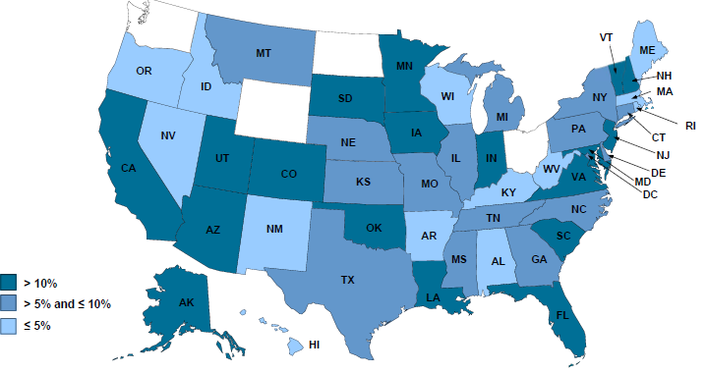
2012 Workers Compensation Direct Written Premium Growth, by State*
PRIVATE CARRIERS: Overall 2012 Growth = +9%
While growth rates varied widely, all states experienced growth in excess of 5% in 2012
*Excludes monopolistic fund states (in white): OH, ND, WA and WY.
Source: NCCI.

Slide 64
Workers Compensation Medical Severity
Moderate Increase in 2012
Medical
Claim Cost ($000s)
Average Medical Cost per Lost-Time Claim
Annual Change 1991–1993: +1.9%
Annual Change 1994–2001: +8.9%
Annual Change 2002–2010: +6.0%
Annual Change 1991–1993: +1.9%
Annual Change 1994–2001: +8.9%
Annual Change 2002–2011: +5.7%
Cumulative Change = 252%
(1991-2012p)
Accident Year
Accident Year
2012p: Preliminary based on data valued as of 12/31/2012.
1991-2011: Based on data through 12/31/2011, developed to ultimate
Based on the states where NCCI provides ratemaking services including state funds, excluding WV; Excludes high deductible policies.

Slide 65
Change in Price Paid for Medical Professional Services in WC, 2002-2012*
%
Increases in WC med costs varied enormously over the past decade from a high of 56% in Wisconsin to a low of 2% in North Carolina
States in GOLD had no fee schedule in 2012. These generally saw larger increases in WC medical costs over the past decade.
*Data are preliminary as of 6/30/12.
Sources: Workers Compensation Research Institute, WCRI Medical Price Index for Workers Compensation, 5th Edition; Ins. Info. Institute.

Slide 66
WC Medical Severity Generally Outpaces the Medical CPI Rate
Average annual increase in WC medical severity form 1995 through 2011 was well above the medical CPI (6.8% vs. 3.8%), but the gap is narrowing.
Sources: Med CPI from US Bureau of Labor Statistics, WC med severity from NCCI based on NCCI states.

Slide 67
Workers Comp Indemnity Claim Costs: Small Increase in 2012
Average Indemnity Cost per Lost-Time Claim
Indemnity
Claim Cost ($ 000s)
Average indemnity costs per claim were up 1% in 2012 to $22,400
Annual Change 1991–1993: -1.7%
Annual Change 1994–2001: +7.3%
Annual Change 2002–2011: +3.2%
Accident Year
2012p: Preliminary based on data valued as of 12/31/2012.
1991-2011: Based on data through 12/31/2011, developed to ultimate
Based on the states where NCCI provides ratemaking services including state funds, excluding WV; Excludes high deductible policies.
Notes:
67
Exhibit 11 of Article

Slide 68
Workers Compensation Lost-Time
Claim Frequency Declined in 2012
Lost-Time Claims
Percent
Cumulative Change of –55.4%
(1991–2011 adj.)
Accident Year
*Adjustments primarily due to significant audit activity.
2012p: Preliminary based on data valued as of 12/31/2012
1991–2011: Based on data through 12/31/2011, developed to ultimate
Based on the states where NCCI provides ratemaking services, including state funds; excludes high deductible policies
Frequency is the number of lost-time claims per $1M pure premium at current wage and voluntary loss cost level
Source: NCCI.

Slide 69
WC Indemnity Severity vs. Wage Inflation, 1995 -2012p
Indemnity severities usually outpace wage gains
Annual Change 1991–1993: -1.7%
Annual Change 1994–2001: +7.3%
Annual Change 2002–2011: +3.2%
WC indemnity severity turned positive again in 2011
2011p: Preliminary based on data valued as of 12/31/2011; 1991-2010: Based on data through 12/31/2010, developed to ultimate. Based on the states where NCCI provides ratemaking services. Excludes the effects of deductible policies. CPS = Current Population Survey.
Source: NCCI

Slide 70
Nonfarm Payroll (Wages and Salaries):
Quarterly, 2005–2011:Q4
Billions
Peak was 2008:Q1 at $6.60 trillion
Latest (2011:Q4) was $6.71 trillion, a new peak
Pace of payroll growth is accelerating
Recent trough (2009:Q3) was $6.25 trillion, down 5.3% from prior peak
Growth rates in 2011
Q2 over Q1: 0.6%
Q3 over Q2: 0.4% Q4 over Q3: 1.0%
Note: Recession indicated by gray shaded column. Data are seasonally adjusted annual rates.
Sources: http://research.stlouisfed.org/fred2/series/WASCUR; National Bureau of Economic Research (recession dates); Insurance Information Institute.
70
12/01/09 - 9pm
eSlide – P6466 – The Financial Crisis and the Future of the P/C
Notes:
70

Slide 71
Payroll vs. Workers Comp Net Written Premiums, 1990-2011
Payroll Base* WC NWP
$Billions $Billions
12/07-6/09
7/90-3/91
3/01-11/01
WC premium volume dropped two years before the recession began
WC net premiums written were down $14B or 29.3% to $33.8B in 2010 after peaking at $47.8B in 2005
Resumption of payroll growth and rate increases suggests WC NWP will grow again in 2012
*Private employment; Shaded areas indicate recessions. Payroll and WC premiums for 2011 is I.I.I. estimate
Sources: NBER (recessions); Federal Reserve Bank of St. Louis at http://research.stlouisfed.org/fred2/series/WASCUR ; NCCI; I.I.I.

Slide 72
Average Approved Bureau
Rates/Loss Costs
Percent (%)
History of Average WC Bureau Rate/Loss Cost Level Changes
Cumulative 2000–2003
+17.1%
2012 experienced the largest increase since 2003
Cumulative 1994–1999
-27.8%
Cumulative 2004–2011
-25.9%
Cumulative
1990–1993
+36.3%
Calendar Year
*States approved through 4/15/123
Note: Countrywide approved changes in advisory rates, loss costs and assigned risk rates as filed by applicable rating organization.
Source: NCCI.

Slide 73
Impact of Discounting on Workers Compensation Premium
NCCI States—Private Carriers
Percent
p Preliminary
Dividend ratios are based on calendar year statistics
NCCI benchmark level does not include an underwriting contingency provision
Based on data through 12/31/2011 for the states where NCCI provides ratemaking services
Source: NCCI.
Policy Year

Slide 74
Workers Comp Rate Changes,
2008:Q4 – 2013:Q1
WC rate changes have been positive for 8 consecutive quarters, longer than any other commercial line
(Percent Change)
Note: CIAB data cited here are based on a survey. Rate changes earned by individual insurers can and do vary, potentially substantially.
Source: Council of Insurance Agents and Brokers; Information Institute.

Slide 75
Workers Comp Combined Ratio to
Achieve Selected Cost of Capital in 2012
Private Carriers
WC insurers need to run combined ratios below 100 to earn their cost of capital.
2012 private carrier combined ratio was 109.
Source: NCCI; Insurance Information Institute..

Slide 76
P/C Insurance Industry Financial Overview
Profit Recovery in 2012 After High CAT Losses; Ultimate Impact of Sandy Still Unclear
76

Slide 77
P/C Net Income After Taxes
1991–2012 ($ Millions)
2005 ROE*= 9.6%
2006 ROE = 12.7%
2007 ROE = 10.9%
2008 ROE = 0.1%
2009 ROE = 5.0%
2010 ROE = 6.6%
2011 ROAS¹ = 3.5%
2012 ROAS¹ = 5.9%
P-C Industry 2012:Q3 profits were up 222% from 2011:Q3, due primarily to lower catastrophe losses
* ROE figures are GAAP; ¹Return on avg. surplus. Excluding Mortgage & Financial Guaranty insurers yields a 6.2% ROAS in 2012, 4.7% ROAS for 2011, 7.6% for 2010 and 7.4% for 2009.
Sources: A.M. Best, ISO, Insurance Information Institute

Slide 78
A 100 Combined Ratio Isn’t What It
Once Was: Investment Impact on ROEs
A combined ratio of about 100 generates an ROE of ~7.0% in 2012, ~7.5% ROE in 2009/10,
10% in 2005 and 16% in 1979
Combined Ratio / ROE
Catastrophes and lower investment income pulled down ROE in 2012
Combined Ratios Must Be Lower in Today’s Depressed
Investment Environment to Generate Risk Appropriate ROEs
* 2008 -2012 figures are return on average surplus and exclude mortgage and financial guaranty insurers. 2012 combined ratio including M&FG insurers is 103.2, 2011 combined ratio including M&FG insurers is 108.1, ROAS = 3.5%.
Source: Insurance Information Institute from A.M. Best and ISO data.

Slide 79
Profitability Peaks & Troughs in the P/C Insurance Industry, 1975 – 2013F*
ROE
History suggests next ROE peak will be in 2016-2017
1977:19.0%
1987:17.3%
10 Years
2006:12.7%
1997:11.6%
10 Years
9 Years
2013F: 6.2%
2012: 5.9%
1975: 2.4%
1984: 1.8%
1992: 4.5%
2001: -1.2%
*Profitability = P/C insurer ROEs. 2011 figure is an estimate based on ROAS data. Note: Data for 2008-2013 exclude mortgage and financial guaranty insurers. 2012:Q3 ROAS = 6.2% including M&FG.
Source: Insurance Information Institute; NAIC, ISO, A.M. Best.

Slide 80
US Policyholder Surplus:
1975–2012*
($ Billions)
Surplus as of 9/30/12 was a record $583.5, up 6.0% from $550.3 of 12/31/11, but still up 33.5% ($146.4B) from the crisis trough of $437.1B at 3/31/09. Pre-crisis peak was $521.8 as of 9/30/07. Surplus as of 9/30/12 was 11.8% above 2007 peak.
“Surplus” is a measure of underwriting capacity. It is analogous to “Owners Equity” or “Net Worth” in non-insurance organizations
The Premium-to-Surplus Ratio Stood at $0.80:$1 as of
9/30/12, A Near Record Low (at Least in Recent History)*
* As of 9/30/12.
Source: A.M. Best, ISO, Insurance Information Institute.

Slide 81
Policyholder Surplus,
2006:Q4–2012:Q4
Drop due to near-record 2011 CAT losses
2007:Q3
Pre-Crisis Peak
($ Billions)
Surplus as of 12/31/12 was up $16.2B or 2.8% from the previous record high of $570.7B set as of 3/31/12.
The Industry now has $1 of surplus for every $0.80 of NPW, close to the strongest claims-paying status in its history.
*Includes $22.5B of paid-in capital from a holding company parent for one insurer’s investment in a non-insurance business in early 2010.
The P/C Insurance Industry Both Entered and Emerged from the 2012 Hurricane Season Very Strong Financially.
Sources: ISO, A.M .Best.
81
12/01/09 - 9pm
eSlide – P6466 – The Financial Crisis and the Future of the P/C
Notes:
81

Slide 82
UNDERWRITING
Underwriting Losses in 2011 and 2012 Were Impacted by High Catastrophe Losses
82

Slide 83
P/C Insurance Industry
Combined Ratio, 2001–2012*
Higher CAT Losses, Shrinking Reserve Releases, Toll of Soft Market
As Recently as 2001, Insurers Paid Out Nearly $1.16 for Every $1 in Earned Premiums
Heavy Use of Reinsurance Lowered Net Losses
Relatively Low CAT Losses, Reserve Releases
Relatively Low CAT Losses, Reserve Releases
Avg. CAT Losses, More Reserve Releases
Best Combined Ratio Since 1949 (87.6)
Lower CAT Losses Before Sandy
Cyclical Deterioration
* Excludes Mortgage & Financial Guaranty insurers 2008--2012. Including M&FG, 2008=105.1, 2009=100.7, 2010=102.4, 2011=108.1; 2012:=103.2.
Sources: A.M. Best, ISO.

Slide 84
Underwriting Gain (Loss)
1975–2012*
($ Billions)
Cumulative underwriting deficit from 1975 through 2012 is $510B
Underwriting losses in 2012 totaled $16.7B
High cat losses in 2011 led to the highest underwriting loss since 2002
Large Underwriting Losses Are NOT Sustainable
in Current Investment Environment
* Includes mortgage and financial guaranty insurers in all years.
Sources: A.M. Best, ISO; Insurance Information Institute.

Slide 85
Combined Ratios by Predominant Business Segment, 2012 vs. 2011*
The combined ratios for both personal and commercial lines improved substantially in 2012, Despite Sandy
(Percent)
*Excludes mortgage and financial guaranty insurers.
Source: ISO/PCI; Insurance Information Institute

Slide 86
P/C Reserve Development, 1992–2015E
Note: 2005 reserve development excludes a $6 billion loss portfolio transfer between American Re and Munich Re. Including this transaction, total prior year adverse development in 2005 was $7 billion. The data from 2000 and subsequent years excludes development from financial guaranty and mortgage insurance.
Sources: A.M. Best, ISO, Barclays Research (estimates).

Slide 87
Performance by Segment
87
Notes:
87

Slide 88
Commercial Lines Combined Ratio, 1990-2015F*
Commercial lines underwriting performance is expected to improve as improvement in pricing environment persists
*2007-2012 figures exclude mortgage and financial guaranty segments.
Source: A.M. Best (1990-2011); Conning (2012-2015F) Insurance Information Institute

Slide 89
Commercial Auto Combined Ratio: 1993–2015F
Commercial Auto is Expected to Improve as Rate Gains Outpace Any Adverse Frequency and Severity Trends
Sources: A.M. Best (1990-2012E);Conning (2012-2015F); Insurance Information Institute.

Slide 90
Commercial Multi-Peril Combined Ratio: 1995–2015F
Commercial Multi-Peril Underwriting Performance is Expected to Improve in 2013 Assuming Normal Catastrophe Loss Activity
*2012-2013 figures are A.M. Best estimate/forecast for the combined liability and non-liability components. Same for Conning 2014-2015F figures.
Sources: A.M. Best; Conning; Insurance Information Institute.

Slide 91
General Liability Combined Ratio:
2005–2015F
Commercial General Liability Underwriting Performance Has Been Volatile in Recent Years
Source: Conning Research and Consulting.

Slide 92
Inland Marine Combined Ratio: 1999–2015F
Inland Marine is Expected to Remain Among the Most Profitable of All Lines
Sources: A.M. Best (1999-2011); Conning (2012-2015F)

Slide 93
Other & Products Liability Combined Ratio: 1991–2013F
Liability Lines Have Performed Better in the Post-Tort Reform Era (~2005), but There Has Been Some Deterioration in Recent Years
Sources: A.M. Best ; Insurance Information Institute.

Slide 94
Insured Catastrophe Loss Update
2012 Catastrophe Losses Were Close to “Average” Until Sandy Hit
2011 Was the 5th Most Expensive Year on Record
94

Slide 95
US Insured Catastrophe Losses
($ Billions, 2012 Dollars)
2012 was likely the third most expensive year ever for insured CAT losses
2012 Was the 3rd Highest Year on Record for Insured Losses in US History on An Inflation-Adjusted Basis. 2011 Losses Were the 6th Highest.
Record Tornado Losses Caused 2011 CAT Losses to Surge
Note: 2001 figure includes $20.3B for 9/11 losses reported through 12/31/01 ($25.9B 2011 dollars). Includes only business and personal property claims, business interruption and auto claims. Non-prop/BI losses = $12.2B ($15.6B in 2011 dollars.)
Sources: Property Claims Service/ISO; Insurance Information Institute.
95
12/01/09 - 9pm
eSlide – P6466 – The Financial Crisis and the Future of the P/C
Notes:
95

Slide 96
Top 16 Most Costly Disasters in U.S. History
(Insured Losses, 2012 Dollars, $ Billions)
Hurricane Sandy could become the 4th or 5th costliest event in US insurance history
Includes Tuscaloosa, AL, tornado
Includes Joplin, MO, tornado
Hurricane Irene became the 12th most expense hurricane in US history in 2011
12 of the 16 Most Expensive Events in US History Have Occurred Over the Past Decade
*PCS estimate as of 4/12/13.
Sources: PCS; Insurance Information Institute inflation adjustments to 2012 dollars using the CPI.

Slide 97
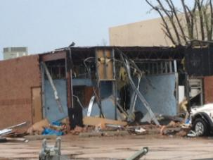
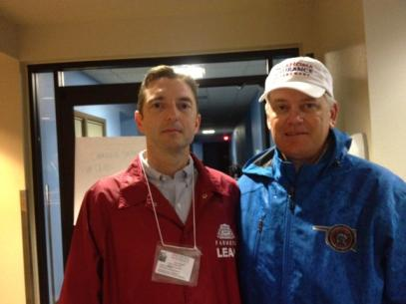
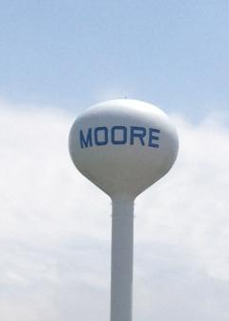

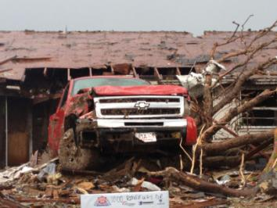
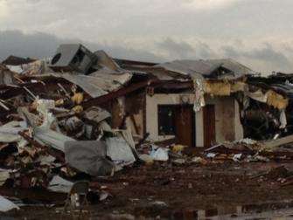

Scenes from My Visit to Moore, Oklahoma, Tornado: High Claim Severity
Me with OK Insurance Commissioner John Doak
97

Slide 98
Top 12 Most Costly Hurricanes in U.S. History
(Insured Losses, 2012 Dollars, $ Billions)
10 of the 12 most costly hurricanes in insurance history occurred over the past 9 years (2004—2012)
Hurricane Sandy became the 3rd costliest hurricane in US insurance history
Hurricane Irene became the 12th most expensive hurricane in US history in 2011
*PCS estimate as of 4/12/13.
Sources: PCS; Insurance Information Institute inflation adjustments to 2012 dollars using the CPI.

Slide 99
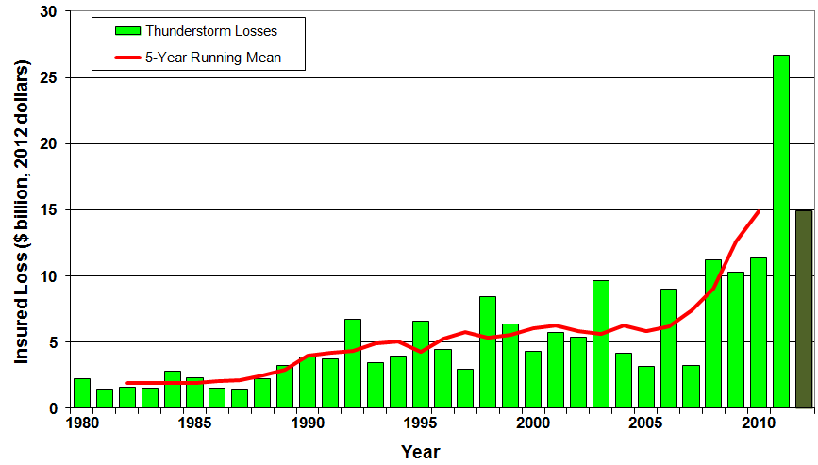
U.S. Thunderstorm Loss Trends, 1980 – 2012
Hurricanes get all the headlines, but thunderstorms are consistent producers of large scale loss. 2008-2012 are the most expensive years on record.
Average thunderstorm losses are up 7 fold since the early 1980s. The 5- year running average loss is up sharply.
Thunderstorm losses in 2012 totaled $14.9 billion, the 2nd highest on record
Source: Property Claims Service, MR NatCatSERVICE
99

Slide 100
Outlook for 2013 Hurricane Season:
75% Worse Than Average
Forecast Parameter | Median (1981-2010) | 2013F
Named Storms | 12.0 | 18
Named Storm Days | 60.1 | 95
Hurricanes | 6.5 | 9
Hurricane Days | 21.3 | 40
Major Hurricanes | 2.0 | 4
Major Hurricane Days | 3.9 | 9
Accumulated Cyclone Energy | 92.0 | 165
Net Tropical Cyclone Activity | 103% | 175%
Source: Philip Klotzbach and Dr. William Gray, Colorado State University, April 10, 2013, accessed at http://tropical.atmos.colostate.edu/forecasts/2013/apr2013/apr2013.pdf ; Insurance Information Institute..

Slide 101
Landfall Probabilities for 2013 Hurricane Season: Above Average
 | Average* | 2013F
Entire US East & Gulf Coasts | 52% | 72%
US East Coast Including Florida Peninsula | 31% | 48%
Gulf Coast from Florida Panhandle to Brownsville | 30% | 47%
Caribbean | 42% | 61%
*Average over the past century.
Source: Philip Klotzbach and Dr. William Gray, Colorado State University, April 10, 2013.

Slide 102
Total Value of Insured Coastal Exposure in 2012
(2012, $ Billions)
$2.923 Trillion Insured Coastal Exposure in New York in 2012
In 2012, New York Ranked as the #1 Most
Exposed State to Hurricane Loss, Overtaking Florida with $2.862 Trillion. Texas is very exposed too, and ranked #3 with $1.175 Trillion
in insured coastal exposure
The Insured Value of All Coastal Property Was $10.6 Trillion in 2012 , Up 20% from $8.9 Trillion in 2007 and Up 48% from $7.2 Trillion in 2004
Source: AIR Worldwide

Slide 103
Total Value of Insured Coastal Exposure in 2007
(2007, $ Billions)
In 2007, Florida Still Ranked as the #1 Most
Exposed State to Hurricane Loss, with
$2.459 Trillion Exposure, but Texas is very exposed too, and ranked #3 with $895B
in insured coastal exposure
The Insured Value of All Coastal Property Was $8.9 Trillion in 2007, Up 24% from $7.2 Trillion in 2004
Source: AIR Worldwide

Slide 104
Total Potential Home Value Exposure to Storm Surge Risk in 2013*
($ Billions)
Nearly $400 billion in home value is exposed to storm surge in FL
The Value of Homes Exposed to Storm Surge was $1.147 Trillion in 2013.* Only a fraction of this is insured, hence the huge demand for federal aid following major coastal flooding events.
*Insured and uninsured property. Based on estimated property values as of April 2013.
Source: Storm Surge Report 2013, CoreLogic.

Slide 105
Combined Ratio Points Associated with Catastrophe Losses: 1960 – 2012*
Avg. CAT Loss Component of the Combined Ratio by Decade
1960s: 1.04 1970s: 0.85 1980s: 1.31 1990s: 3.39 2000s: 3.52 2010s: 7.20*
Catastrophe losses as a share of all losses reached a record high in 2012
Combined Ratio Points
The Catastrophe Loss Component of Private Insurer Losses Has Increased Sharply in Recent Decades
Notes: Private carrier losses only. Excludes loss adjustment expenses and reinsurance reinstatement premiums. Figures are adjusted for losses ultimately paid by foreign insurers and reinsurers.
Source: ISO (1960-2011); A.M. Best (2012E) Insurance Information Institute.

Slide 106
Federal Disaster Declarations Patterns: 1953-2013
Despite 13 Sandy Declarations, Fewer Disasters Were Declared in 2012 than the Record Number of Declarations in 2010 and 2011
106

Slide 107
Number of Federal Disaster Declarations, 1953-2013*
There have been 2,112 federal disaster declarations since 1953. The average number of declarations per year is 35 from 1953-2012, though there few haven’t been recorded since 1995.
The number of federal disaster declarations set a new record in 2011, with 99, shattering 2010’s record 81 declarations.
47 federal disasters were declared in 2012
The Number of Federal Disaster Declarations Is Rising and Set New Records in 2010 and 2011. Hurricane Sandy Produced 13 Declarations in 2012/13.
*Through June 4, 2013.
Source: Federal Emergency Management Administration; http://www.fema.gov/disasters; Insurance Information Institute.

Slide 108
Federal Disasters Declarations by State,
1953 – 2013: Highest 25 States*
Over the past 60 years, Texas has had the highest number of Federal Disaster Declarations
*Through June 4, 2013. Includes Puerto Rico and the District of Columbia.
Source: FEMA: http://www.fema.gov/news/disaster_totals_annual.fema; Insurance Information Institute.

Slide 109
Federal Disasters Declarations by State,
1953 – 2013: Lowest 25 States*
Over the past 60 years, Wyoming and Rhode Island had the fewest number of Federal Disaster Declarations
*Through June 4, 2013. Includes Puerto Rico and the District of Columbia.
Source: FEMA: http://www.fema.gov/news/disaster_totals_annual.fema; Insurance Information Institute.

Slide 110
RENEWED PRICING DISCIPLINE
Evidence of a Broad and Sustained Shift in Pricing
110

Slide 111
Distribution of Direct Premiums Written by Segment/Line, 2010
Personal/Commercial lines split has been about 50/50 for many years; Personal Lines overtook Commercial Lines in 2010
Pvt. Passenger Auto is by far the largest line of insurance and is currently the most important source of industry profits
Billions of additional dollars in homeowners insurance premiums are written by state-run residual market plans
Distribution Facts
2010
Commercial Lines
$226.8B/49%
Homeowners
$68.2B/15%
Pvt. Pass Auto
$165.0B/36%
Sources: A.M. Best; Insurance Information Institute research.

Slide 112
Net Premium Growth: Annual Change,
1971—2012
(Percent)
1975-78
1984-87
2000-03
Net Written Premiums Fell 0.7% in 2007 (First Decline Since 1943) by 2.0% in 2008, and 4.2% in 2009, the First 3-Year Decline Since 1930-33.
2012 growth was +4.3%
Shaded areas denote “hard market” periods
Sources: A.M. Best (historical and forecast), ISO, Insurance Information Institute.

Slide 113
P/C Net Premiums Written: % Change, Quarter vs. Year-Prior Quarter
Premium growth in Q3 2012 was up 5.1% over Q3 2011, the strongest growth since Q4 2006
Sustained Growth in Written Premiums
(vs. the same quarter, prior year) Will Continue through 2013
Sources: ISO, Insurance Information Institute.
113
12/01/09 - 9pm
eSlide – P6466 – The Financial Crisis and the Future of the P/C
Notes:
113

Slide 114
Growth in Net Written Premium by Segment, 2012 vs. 2011*
(Percent)
*Excludes mortgage and financial guaranty insurers.
Source: ISO/PCI; Insurance Information Institute

Slide 115
Average Commercial Rate Change,
All Lines, (1Q:2004–1Q:2013)
Pricing as of Q1:2013 was positive for the 8th consecutive quarter. Gains are likely to continue through 2013.
(Percent)
Q2 2011 marked the last of 30th consecutive quarter of price declines
KRW Effect
Note: CIAB data cited here are based on a survey. Rate changes earned by individual insurers can and do vary, potentially substantially.
Source: Council of Insurance Agents & Brokers; Insurance Information Institute

Slide 116
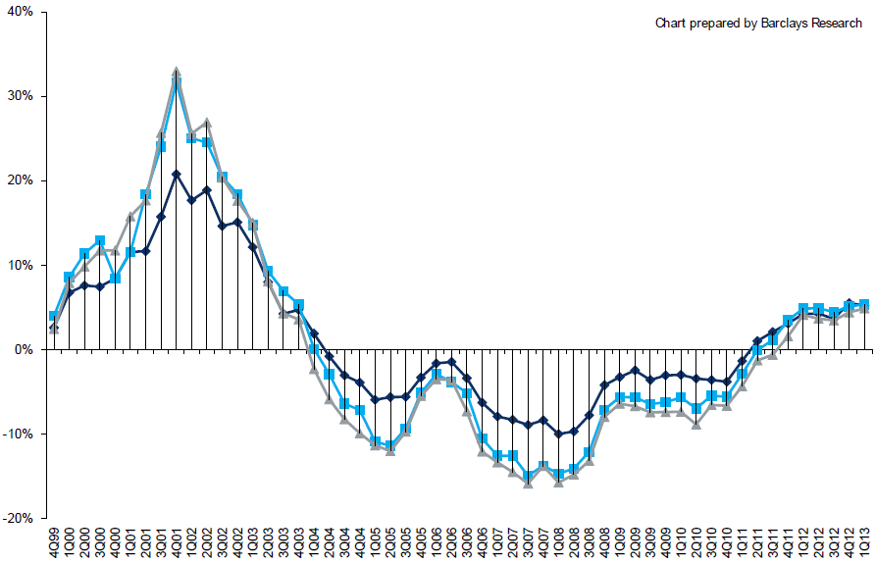
Change in Commercial Rate Renewals, by Account Size: 1999:Q4 to 2013:Q1
Percentage Change (%)
Peak = 2001:Q4 +28.5%
Pricing turned positive in Q3:2011, the first increase in nearly 8 years; Q1:2013 renewals were up 5.2%, the largest increase since late 2003; Some insurers posted stronger numbers.
Pricing Turned Negative in Early 2004 and Remained that way for 7 ½ years
KRW : No Lasting Impact
Trough = 2007:Q3 -13.6%
Source: Council of Insurance Agents and Brokers; Barclay’s Capital; Insurance Information Institute.
Note: CIAB data cited here are based on a survey. Rate changes earned by individual insurers can and do vary, potentially substantially.

Slide 117
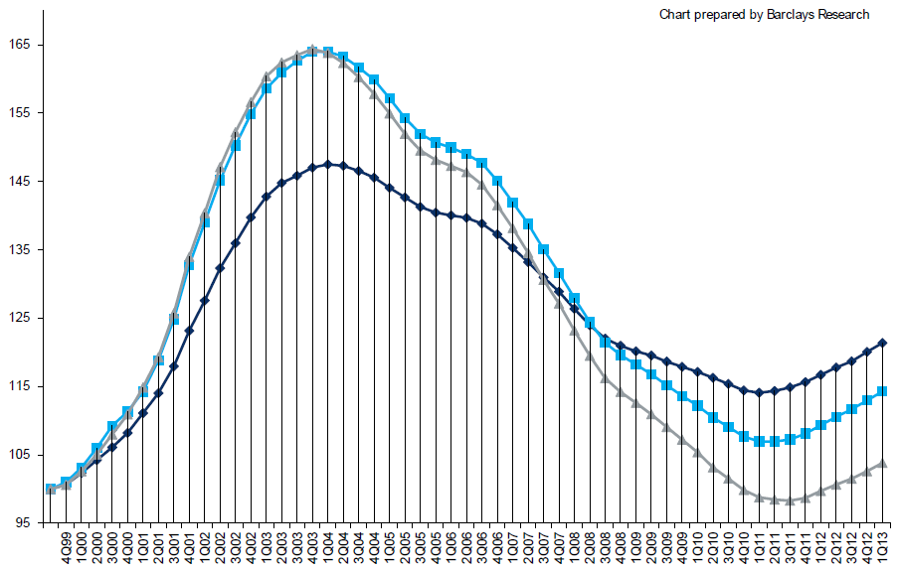
Cumulative Qtrly. Commercial Rate Changes, by Account Size: 1999:Q4 to 2013:Q1
1999:Q4 = 100
Despite 8 consecutive quarters of gains (Q4:2012 = 5.0%), pricing today is where is was in mid-2001 (pre-9/11), suggesting additional rate need going forward, esp. in light of record low interest rates
Note: CIAB data cited here are based on a survey. Rate changes earned by individual insurers can and do vary, potentially substantially.
Source: Council of Insurance Agents and Brokers; Barclay’s Capital; Insurance Information Institute.

Slide 118
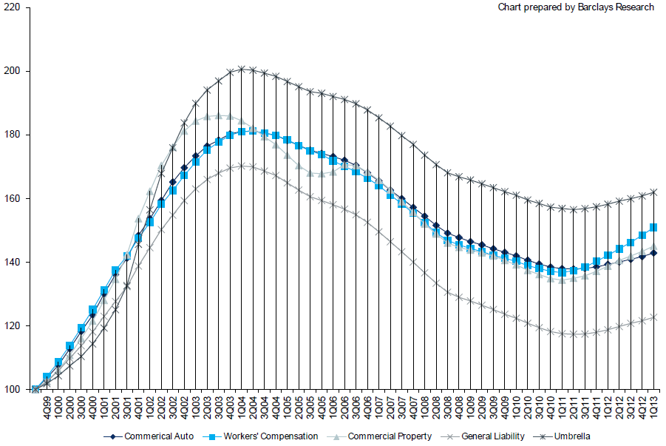
Cumulative Qtrly. Commercial Rate Changes, by Line: 1999:Q4 to 2013:Q1
1999:Q4 = 100
WC rate levels are rising and are now back to where they were in late 2008 and shortly after 9/11
Note: CIAB data cited here are based on a survey. Rate changes earned by individual insurers can and do vary, potentially substantially.
Source: Council of Insurance Agents and Brokers; Barclay’s Capital; Insurance Information Institute.

Slide 119
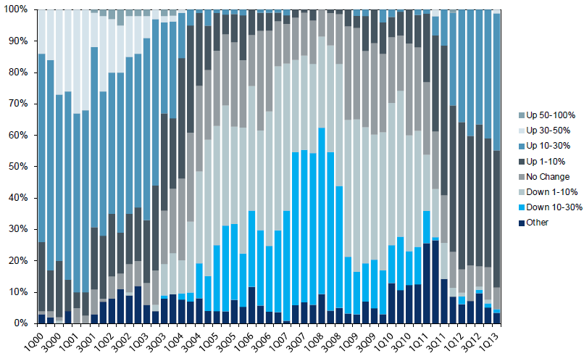
Workers Comp. Quarterly Rate Changes, by Line: 2000:Q1 to 2013:Q1
1999:Q4 = 100
Most accounts are now renewing upwards
Note: CIAB data cited here are based on a survey. Rate changes earned by individual insurers can and do vary, potentially substantially.
Source: Council of Insurance Agents and Brokers; Barclay’s Capital; Insurance Information Institute.

Slide 120
Change in Commercial Rate Renewals, by Line: 2013:Q1
Workers Comp rate increases are large than any other line, followed by Property lines
Percentage Change (%)
Major Commercial Lines Renewed Uniformly Upward in Q1:2013 for the 8th Consecutive Quarter; Property Lines & Workers Comp Leading the Way; Cat Losses and Low Interest Rates Provide Momentum Going Forward
Note: CIAB data cited here are based on a survey. Rate changes earned by individual insurers can and do vary, potentially substantially.
Source: Council of Insurance Agents and Brokers; Insurance Information Institute.

Slide 121
CLIPS: Change in Written Price Level:
All Lines, 2010:Q2 – 2012:Q4
Rate changes have been positive for 8 consecutive quarters, longer than any other commercial line
(Percent Change)
Note: Towers Watson data cited here are based on a survey. Rate changes earned by individual insurers can and do vary, potentially substantially.
Source: Towers Watson; Information Institute.

Slide 122
Workers Comp Rate Changes,
2008:Q4 – 2013:Q1
WC rate changes have been positive for 7 consecutive quarters, longer than any other commercial line
(Percent Change)
Note: CIAB data cited here are based on a survey. Rate changes earned by individual insurers can and do vary, potentially substantially.
Source: Council of Insurance Agents and Brokers; Information Institute.

Slide 123
Growth Analysis by State and Business Segment
Premium Growth Rates Vary Tremendously by State
123

Slide 124
Direct Premiums Written: Total P/C
Percent Change by State, 2007-2012*
Top 25 States
*Data are preliminary as of 5/1/13 and do not yet fully reflect the impact of state-run pools and plans.
Sources: SNL Financial LC.; Insurance Information Institute.

Slide 125
Direct Premiums Written: Total P/C
Percent Change by State, 2007-2012*
Bottom 25 States
*Data are preliminary as of 5/1/13 and do not yet fully reflect the impact of state-run pools and plans.
Sources: SNL Financial LC.; Insurance Information Institute.

Slide 126
Direct Premiums Written: Comm. Lines
Percent Change by State, 2006-2011*
Top 25 States
Only 12 states showed any commercial lines growth 2006 and 2011
Sources: SNL Financial LC.; Insurance Information Institute.

Slide 127
Direct Premiums Written: Comm. Lines
Percent Change by State, 2006-2011*
Bottom 25 States
States with the poorest performing economies also produced the most negative net change in premiums of the past 5 years
Sources: SNL Financial LC.; Insurance Information Institute.

Slide 128
Terrorism Update
Boston Marathon Bombings Underscore the Need for Extension of the Terrorism Risk Insurance Program
128
Notes:
128

Slide 129
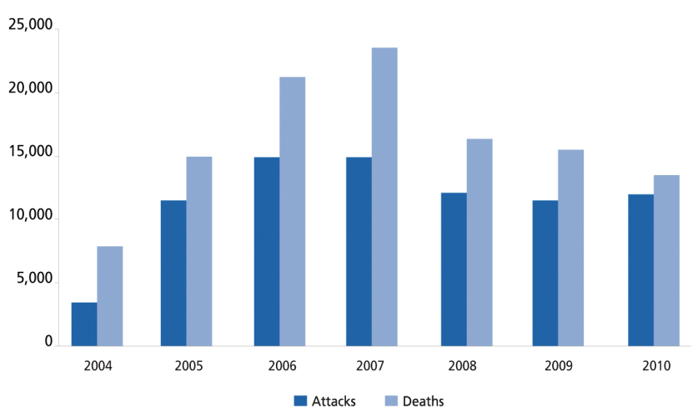
Global Terrorist Attacks and Deaths, 2004-2011
The number of terrorist attacks globally fell by 11.7% in 2011 while the number of deaths dropped by 5.0%
13,193
12,533
11,641
10,283
2011
Sources: National Counterterrorism Center, 2011 Report on Terrorism; Guy Carpenter; Insurance Information Institute.

Slide 130

Terrorism Risk Insurance Program
Boston Marathon Bombing Should Help Focus Attention in Congress on TRIA
  Act expires 12/31/14
  Numerous headwinds
Exclusionary Language Will Be Inserted for Renewals Occurring After 1/1/14
Boston Marathon Issues
  Property and BI losses not large but could breach $5 mill threshold for certification under TRIPRA
  Certification issue is generating press; No deadline to certify
  Disincentive to certify?
  Few of the impacted business had terror coverage
  Longer-term: Litigation issues (e.g., race organizers)
130
12/01/09 - 9pm
eSlide – P6466 – The Financial Crisis and the Future of the P/C
Notes:
130

Slide 131
Loss Distribution by Type of Insurance from Sept. 11 Terrorist Attack ($ 2011)
($ Billions)
Total Insured Losses Estimate: $40.0B**
*Loss total does not include March 2010 New York City settlement of up to $657.5 million to compensate approximately 10,000 Ground Zero workers or any subsequent settlements.
**$32.5 billion in 2001 dollars.
Source: Insurance Information Institute.

Slide 132
Terrorism Violates Traditional Requirements for Insurability
Requirement | Definition | Violation
Estimable Frequency | Insurance requires large number of observations to develop predictive rate-making models (an actuarial concept known as credibility) | Very few data points Terror modeling still in infancy, untested. Inconsistent assessment of threat
Estimable Severity | Maximum possible/ probable loss must be at least estimable in order to minimize “risk of ruin” (insurer cannot run an unreasonable risk of insolvency though assumption of the risk) | Potential loss is virtually unbounded. Losses can easily exceed insurer capital resources for paying claims. Extreme risk in workers compensation and statute forbids exclusions.
Source: Insurance Information Institute

Slide 133
Terrorism Violates Traditional Requirements for Insurability (cont’d)
Requirement | Definition | Violation
Diversifiable Risk | Must be able to spread/distribute risk across large number of risks “Law of Large Numbers” helps makes losses manageable and less volatile | Losses likely highly concentrated geographically or by industry (e.g., WTC, power plants)
Random Loss Distribution/Fortuity | Probability of loss occurring must be purely random and fortuitous Events are individually unpredictable in terms of time, location and magnitude | Terrorism attacks are planned, coordinated and deliberate acts of destruction Dynamic target shifting from “hardened targets” to “soft targets” Terrorist adjust tactics to circumvent new security measures Actions of US and foreign govts. may affect likelihood, nature and timing of attack
Source: Insurance
Information Institute

Slide 134
INVESTMENTS:
THE NEW REALITY
Investment Performance is a Key Driver of Profitability
Depressed Yields Will Necessarily Influence Underwriting & Pricing
134

Slide 135
Property/Casualty Insurance Industry Investment Income: 2000–2012¹
($ Billions)
Investment earnings in 2012 were running 13% below their 2007 pre-crisis peak
Investment Income Fell in 2012 Due to Persistently Low Interest Rates, Putting Additional Pressure on (Re) Insurance Pricing
¹ Investment gains consist primarily of interest and stock dividends..
Sources: ISO; Insurance Information Institute.

Slide 136
P/C Insurer Net Realized
Capital Gains/Losses, 1990-2012
Realized capital gains in 2012 were down 12% from 2011
($ Billions)
Insurers Posted Net Realized Capital Gains in 2010, 2011 and 2012 Following Two Years of Realized Losses During the Financial Crisis. Realized Capital Losses Were the Primary Cause of 2008/2009’s Large Drop in Profits and ROE
Sources: A.M. Best, ISO, Insurance Information Institute.
136
12/01/09 - 9pm
eSlide – P6466 – The Financial Crisis and the Future of the P/C
Notes:
136

Slide 137
Property/Casualty Insurance Industry Investment Gain: 1994–2012¹
($ Billions)
Investment gains in 2012 are running approximately 16% below their pre-crisis peak
Investment Gains Are Slipping in 2012 as Low Interest Rates Reduce Investment Income and Lower Realized Investment Gains; The Financial Crisis Caused Investment Gains to Fall by 50% in 2008
¹ Investment gains consist primarily of interest, stock dividends and realized capital gains and losses.
* 2005 figure includes special one-time dividend of $3.2B;
Sources: ISO; Insurance Information Institute.

Slide 138
U.S. 10-Year Treasury Note Yields:
A Long Downward Trend, 1990–2013*
Yields on 10-Year U.S. Treasury Notes recently plunged to all time record lows but are now up slightly
Yields on 10-Year U.S. Treasury Notes have been essentially below 5% for a full decade.
Since roughly 80% of P/C bond/cash investments are in 10-year or shorter durations, most P/C insurer portfolios will have low-yielding bonds for years to come.
*Monthly, through May 2013. Note: Recessions indicated by gray shaded columns.
Sources: Federal Reserve Bank at http://www.federalreserve.gov/releases/h15/data.htm.
National Bureau of Economic Research (recession dates); Insurance Information Institutes.
138
12/01/09 - 9pm
eSlide – P6466 – The Financial Crisis and the Future of the P/C
Notes:
138

Slide 139
Average Maturity of Bonds Held by US P/C Insurers, 2006—2011*
Average Maturity (Years)
The average bond maturity is down by a full year between 2007 and 2011
Falling Average Maturity (and Duration) of the P/C Industry’s Bond Portfolio is Contributing to the Drop in Investment Income Along With Lower Yields
*Year-end figures. Latest available.
Sources: Insurance Information Institute calculations based on A.M. Best data.
139
12/01/09 - 9pm
eSlide – P6466 – The Financial Crisis and the Future of the P/C
Notes:
139

Slide 140
Distribution of Bond Maturities,
P/C Insurance Industry, 2003-2012
The main shift over these years has been from bonds with longer maturities to bonds with shorter maturities. The industry first trimmed its holdings of over-10-year bonds (from 24.6% in 2003 to 15.5% in 2012) and then trimmed bonds in the 5-10-year category (from 31.3% in 2003 to 27.6% in 2012) . Falling average maturity of the P/C industry’s bond portfolio is contributing to a drop in investment income along with lower yields.
Sources: SNL Financial; Insurance Information Institute.

Slide 141
Reduction in Combined Ratio Necessary to Offset 1% Decline in Investment Yield to Maintain Constant ROE, by Line*
Lower Investment Earnings Place a Greater Burden on Underwriting and Pricing Discipline
*Based on 2008 Invested Assets and Earned Premiums
**US domestic reinsurance only
Source: A.M. Best; Insurance Information Institute.
141
12/01/09 - 9pm
eSlide – P6466 – The Financial Crisis and the Future of the P/C
Notes:
141
This shows the drop in Combined Ratio for each line of business that would be needed to maintain a constant ROE, given a 1-percentage-point drop in investment yield

Slide 142
Annual Inflation Rates, (CPI-U, %),
1990–2014F
Annual Inflation Rates (%)
Inflation peaked at 5.6% in August 2008 on high energy and commodity crisis. The recession and the collapse of the commodity bubble reduced inflationary pressures in 2009/10
Inflationary expectations remain quite low, allowing the Fed to continue its QE3 program
The slack in the U.S. economy suggests that inflationary pressures should remain subdued for an extended period of times. Energy, health care and commodity prices, plus U.S. debt burden, remain longer-run concerns
Sources: US Bureau of Labor Statistics; Blue Chip Economic Indicators, 5/13 (forecasts).

Slide 143
Financial Strength & Underwriting
Cyclical Pattern is P-C Impairment History is Directly Tied to Underwriting, Reserving & Pricing
143

Slide 144
P/C Insurer Impairments, 1969–2012
Impairments among P/C insurers remain infrequent
The Number of Impairments Varies Significantly Over the P/C Insurance Cycle, With Peaks Occurring Well into Hard Markets
Source: A.M. Best Special Report “1969-2011 Impairment Review,” June 2012 and March 6, 2013 update; Insurance Info. Institute.

Slide 145
P/C Insurer Impairment Frequency vs. Combined Ratio, 1969-2011
2011 impairment rate was 0.91%, up from 0.67% in 2010; the rate is slightly higher than the 0.82% average since 1969
Impairment Rates Are Highly Correlated With Underwriting Performance and Reached Record Lows in 2007; Recent Increase Was Associated Primarily With Mortgage and Financial Guaranty Insurers and Not Representative of the Industry Overall
Source: A.M. Best; Insurance Information Institute

Slide 146
Reasons for US P/C Insurer Impairments, 1969–2010
Historically, Deficient Loss Reserves and Inadequate Pricing Are
By Far the Leading Cause of P-C Insurer Impairments.
Investment and Catastrophe Losses Play a Much Smaller Role
Reinsurance Failure
Sig. Change in Business
Misc.
Investment Problems (Overstatement of Assets)
Deficient Loss Reserves/
Inadequate Pricing
Affiliate Impairment
Catastrophe Losses
Alleged Fraud
Rapid Growth
Source: A.M. Best: 1969-2010 Impairment Review, Special Report, April 2011.

Slide 147
Top 10 Lines of Business for US P/C Impaired Insurers, 2000–2010
Workers Comp and Pvt. Passenger Auto Account for Nearly Half of the Premium Volume of Impaired Insurers Over the Past Decade
Title
Financial Guaranty
Surety
Med Mal
Workers Comp
Other Liability
Commercial Auto Liability
Pvt. Passenger Auto
Commercial Multiperil
Homeowners
Source: A.M. Best: 1969-2010 Impairment Review, Special Report, April 2011.

Slide 148
Number of Recessions Endured by P/C Insurers, by Number of Years in Operation
Number of Recessions Since 1860
Insurers are true survivors—not just of natural catastrophes but also economic ones
Number of Years in Operation
Many US Insurers Are Close to a Century Old or Older
Sources: Insurance Information Institute research from National Bureau of Economic Research data.
148
12/01/09 - 9pm
eSlide – P6466 – The Financial Crisis and the Future of the P/C
Notes:
148

Slide 149
3. REINSURANCE MARKET CONDITIONS
Record Global Catastrophes Activity is Pressuring Pricing
149

Slide 150
Reinsurer Share of Recent Significant Market Losses
Billions of 2011 Dollars
40% Reinsurance share of total insured loss
$37.5
$15.0
73%
60%
95%
$13.0
44%
$10.0
$22.5
$8.3
$9.5
$6.0
$5.0
$7.9
$2.2
$3.5
$4.0
$2.8
$0.4
Reinsurers Paid a High Proportion of Insured Losses Arising from Major Catastrophic Events Around the World in Recent Years
Source: Insurance Information Institute from reinsurance share percentages provided in RAA, ABIR and CEA press release, Jan. 13, 2011.
150
12/01/09 - 9pm
eSlide – P6466 – The Financial Crisis and the Future of the P/C
Notes:
150

Slide 151
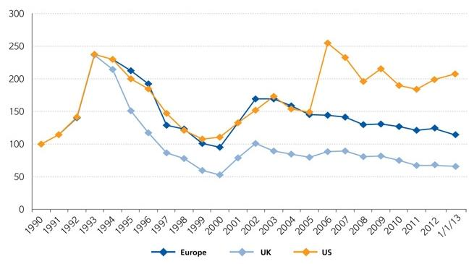
Regional Property Catastrophe Rate on Line Index, 1990—2013 (as of January 1)
Property-Cat reinsurance pricing was up in the US as of 1/1/13 but was down in Europe/UK
Sources: Guy Carpenter; Insurance Information Institute.

Slide 152
Shifting Legal Liability &
Tort Environment
Is the Tort Pendulum
Swinging Against Insurers?
152

Slide 153
Over the Last Three Decades, Total Tort Costs as a % of GDP Appear Somewhat Cyclical, 1980-2013E
($ Billions)
2.21% of GDP in 2003 = pre-tort reform peak
Deepwater Horizon Spike in 2010
Tort costs in dollar terms have remained high but relatively stable since the mid-2000s., but are down substantially as a share of GDP
1.68% of GDP in 2013
Sources: Towers Watson, 2011 Update on US Tort Cost Trends, Appendix 1A

Slide 154
Commercial Lines Tort Costs: Insured vs. Self-(Un)Insured Shares, 1973-2010
2005: $143.5B 66.4% insured, 33.6% self-(un)insured
Billions of Dollars
$15.0
1995: $83.6B 69.5% insured, 30.5% self-(un)insured
1973: Commercial Tort Costs Totaled $6.49B, 94% was insured, 6% self-(un)insured
1985: $46.6B 74.5% insured, 25.5% self-(un)insured
$9.5
$6.0
2009: $126.5B 64.4% insured, 35.6% self-(un)insured
Tort Costs and the Share Retained by Risks Both Grew Rapidly from the mid-1970s to mid-2000s, When Tort Costs Began to Fall But Self-Insurance Shares Continued to Rise
Sources: Towers Watson, 2011 Update on US Tort Cost Trends, III Calculations based on data from Appendix 4.
154
12/01/09 - 9pm
eSlide – P6466 – The Financial Crisis and the Future of the P/C
Notes:
154

Slide 155
Commercial Lines Tort Costs: Insured vs. Self-(Un)Insured Shares, 1973-2010
Percent
2010: $138.1B 56.6% insured, 44.4% self-(un)insured (distorted by Deepwater Horizon event with most losses retained by BP)
1973: 94% was insured, 6% self-(un)insured
1985:74.5% insured, 25.5% self-(un)insured
1995: 69.5% insured, 30.5% self-(un)insured
2005: 66.4% insured, 33.6% self-(un)insured
The Share of Tort Costs Retained by Risks Has Been Steadily Increasing for Nearly 40 Years. This Trend Contributes Has Left Insurers With Less Control Over Pricing.
Sources: Towers Watson, 2011 Update on US Tort Cost Trends, III Calculations based on data from Appendix 4.
155
12/01/09 - 9pm
eSlide – P6466 – The Financial Crisis and the Future of the P/C
Notes:
155

Slide 156
Business Leaders Ranking of Liability Systems in 2012
Best States
Delaware
Nebraska
Wyoming
Minnesota
Kansas
Idaho
Virginia
North Dakota
Utah
Iowa
Worst States
Florida
Oklahoma
Alabama
New Mexico
Montana
Illinois
California
Mississippi
Louisiana
West Virginia
New in 2012
Wyoming
Minnesota
Kansas
Idaho
Newly Notorious
Oklahoma
Drop-offs
Rising Above
Indiana
Colorado
Massachusetts
South Dakota
Arkansas
Source: US Chamber of Commerce 2012 State Liability Systems Ranking Study; Insurance Info. Institute.

Slide 157
The Nation’s Judicial Hellholes: 2011
Watch List
Illinois
Madison , St. Clair and McLean counties
West Virginia
Philadelphia
Eastern District of Texas
Cook County, IL
Southern NJ
Franklin County, AL
Smith County, MS
Louisiana
California
Dishonorable Mention
New York
Albany and NYC
MI Supreme Court
AK Supreme Court
MO Supreme Court
Nevada
Clark County
South Florida
Source: American Tort Reform Association; Insurance Information Institute

Slide 158
Insurance Information Institute Online:
www.iii.org
Thank you for your time
and your attention!
Twitter: twitter.com/bob_hartwig
Download at www.iii.org/presentations

