Slide 1
State of the Florida Property Insurance Market:
Past, Present and Future
Florida House Insurance & Banking Sub-Committee
February 19, 2014
Download at www.iii.org/presentations
Lynne McChristian, Florida Representative
Insurance Information Institute ♦ 110 William Street ♦ New York, NY 10038
Cell: 813.480.6446 ♦ lynnem@iii.org ♦ www.iii.org ♦ www.Insuring.Florida

Slide 2
Presentation Outline
Property/Casualty Performance & Historical Impacts
Profitability & Growth Analyses
Economic Outlook & Property Exposure Impacts
Catastrophe Loss Update: Florida’s Role in History
  It’s Not Just Hurricanes Anymore!
    Tornado
    Flood/Surge—Key Issues in Flood Insurance

Slide 3
Property/Casualty Insurance Industry Financial Overview
2013: Best Year in the Post-Crisis Era
Few Catastrophes in U.S.
What Happens (or Doesn’t Happen) in Florida Impacts Performance
3

Slide 4
P/C Net Income After Taxes
1991–2013:Q3 ($ Millions)
2005 ROE*= 9.6%
2006 ROE = 12.7%
2007 ROE = 10.9%
2008 ROE = 0.1%
2009 ROE = 5.0%
2010 ROE = 6.6%
2011 ROAS¹ = 3.5%
2012 ROAS¹ = 5.9%
2013:9M ROAS¹ = 9.5%
Net income is up substantially (+54.7%) from 2012:Q3 $27.8B
2013:9M ROAS was 9.5%
Katrina, Rita, Wilma
4 Hurricanes
Andrew
ROE figures are GAAP; ¹Return On Avg. Surplus. Excluding Mortgage & Financial Guaranty insurers yields a 8.9% ROAS through 2013:Q3, 6.2% ROAS in 2012, 4.7% ROAS for 2011, 7.6% for 2010 and 7.4% for 2009.
Sources: A.M. Best, ISO, Insurance Information Institute

Slide 5
Profitability Peaks & Troughs in the P/C Insurance Industry, 1975 – 2013:Q3*
ROE
History suggests next ROE peak will be in 2016-2017
1977:19.0%
1987:17.3%
10 Years
2006:12.7%
1997:11.6%
2013:Q3 8.9%
10 Years
9 Years
2004/5 Storms
Andrew
2012: 5.9%
1975: 2.4%
1984: 1.8%
1992: 4.5%
2001: -1.2%
*Profitability = P/C insurer ROEs. 2011-13 figures are estimates based on ROAS data. Note: Data for 2008-2013 exclude mortgage and financial guaranty insurers.
Source: Insurance Information Institute; NAIC, ISO, A.M. Best.

Slide 6
A 100 Combined Ratio Isn’t What It
Once Was: Investment Impact on ROEs
A combined ratio of about 100 generates an ROE of ~7.0% in 2012, ~7.5% ROE in 2009/10,
10% in 2005 and 16% in 1979
Combined Ratio / ROE
Lower CATs are improved ROEs in 2013
Combined Ratios Must Be Lower in Today’s Depressed
Investment Environment to Generate Risk Appropriate ROEs
* 2008 -2013 figures are return on average surplus and exclude mortgage and financial guaranty insurers. 2013:9M combined ratio including M&FG insurers is 95.8; 2012 =103.2, 2011 = 108.1, ROAS = 3.5%.
Source: Insurance Information Institute from A.M. Best and ISO Verisk Analytics data.

Slide 7
Return on Equity: Property/Casualty Insurance vs. Fortune 500, 1987–2013E*
(Percent)
P/C Profitability Is Both by
Cyclicality and Ordinary Volatility
Katrina, Rita, Wilma
Sandy
Sept. 11
Hugo
Lowest CAT Losses in
15 Years
4 Hurricanes
Andrew
Record Tornado Losses
Northridge
Financial Crisis*
* Excludes Mortgage & Financial Guarantee in 2008 – 2013E. 2013 P/C ROE is through 2013:Q3.
Sources: ISO, Fortune; Insurance Information Institute.

Slide 8
Return on Net Worth:
All Lines of Insurance by State, 2003-2012 Average
Highest 25 States
The most profitable states over the past decade are widely distributed geographically, though none are in the Gulf region
Source: NAIC.

Slide 9
Return on Net Worth: All Lines by State, 2003-2012 Average
Lowest 25 States
Florida All Lines profitability was slightly above the US on average from 2003-2012
Some of the least profitable states over the past decade were hit hard by catastrophes
Source: NAIC.

Slide 10
Profitability and Growth in Florida P/C Insurance Markets
Analysis by Line and Nearby State Comparisons
10

Slide 11
Return on Net Worth
All Lines: FL vs. U.S., 2003-2012
(Percent)
P/C Insurer profitability in FL is above that of the US overall over the past decade
US: 7.9%
FL: 8.6%
2004/2005 hurricanes
Sources: NAIC.
11
Notes:
11

Slide 12
Return on Net Worth
Homeowners: FL vs. U.S., 2003-2012
(Percent)
Average 2003-2012
US: 6.0%
FL: 0.0%
The average rate of return on the FL homeowners line is ZERO percent over the decade from 2003 - 2012
-53.4%
2004/2005 hurricanes
183.3%
Sources: NAIC.
12
Notes:
12

Slide 13
Return on Net Worth
Commercial Multi-Peril: FL vs. U.S.,
(Percent)
2003-2012
Average 2003-2012
US: 9.0%
FL: 7.3%
-28.8%
2004/2005 hurricanes
-77.2%
Sources: NAIC.
13
Notes:
13

Slide 14
Return on Net Worth
Private Passenger Auto: FL vs. U.S.
Average 2003-2012
US: 7.6%
FL: 4.7%
Sources: NAIC.
14
Notes:
14

Slide 15
Return on Net Worth
Workers Comp: FL vs. U.S.
(Percent)
Average 2003-2012
US: 7.1%
FL: 11.0%
Sources: NAIC.
15
Notes:
15

Slide 16
All Lines: 10-Year Average Return on Net Worth: FL & Nearby States
2003-2012
Florida All Lines profitability is above the US and the regional average
Source: NAIC, Insurance Information Institute

Slide 17
Private Passenger Auto: 10-Year Average Return on Net Worth: FL & Nearby States
2003-2012
Florida PP Auto profitability is below the US and regional average
Source: NAIC, Insurance Information Institute

Slide 18
Top Ten Most Expensive And Least Expensive States For Automobile Insurance, 2011 (1)
Rank | Most expensive states | Average expenditure | Rank | Least expensive states | Average expenditure
1 | New Jersey | $1,183.95 | 1 | Idaho | $525.15
2 | District of Columbia | 1,138.03 | 2 | South Dakota | 540.04
3 | Louisiana | 1,110.68 | 3 | North Dakota | 549.81
4 | New York | 1,108.64 | 4 | Iowa | 552.54
5 | Florida | 1,090.65 | 5 | Maine | 577.38
6 | Delaware | 1,052.28 | 6 | North Carolina | 600.33
7 | Rhode Island | 1,004.14 | 7 | Wisconsin | 601.40
8 | Michigan | 983.60 | 8 | Nebraska | 602.57
9 | Connecticut | 970.22 | 9 | Wyoming | 619.88
10 | Maryland | 956.17 | 10 | Ohio | 619.96
Florida ranked 5th as the most expensive state in 2011, with an average expenditure for auto insurance of $1,090.65.
Based on average automobile insurance expenditures.
Source: © 2013 National Association of Insurance Commissioners.

Slide 19
Homeowners: 10-Year Average Return on Net Worth: FL & Nearby States
At 0.0%, Florida Homeowners profitability is below the US average and above the regional average
2003-2012
Source: NAIC, Insurance Information Institute

Slide 20
Commercial Multi-Peril: 10-Year Average Return on Net Worth: FL & Nearby States
2003-2012
Florida Commercial Multi-Peril profitability is below the US average and above the regional average
Source: NAIC, Insurance Information Institute

Slide 21
Top Ten Most Expensive And Least Expensive States For Homeowners Insurance, 2011 (1)
Florida ranked as the most expensive state for homeowners insurance in 2011, with an average expenditure of $1,933.
Rank | Most expensive states | HO average premium | Rank | Least expensive states | HO average premium
1 | Florida | $1,933 | 1 | Idaho | $518
2 | Louisiana | 1,672 | 2 | Oregon | 559
3 | Texas (2) | 1,578 | 3 | Utah | 563
4 | Mississippi | 1,409 | 4 | Wisconsin | 592
5 | Oklahoma | 1,386 | 5 | Washington | 626
6 | Alabama | 1,163 | 6 | Ohio | 644
7 | Rhode Island | 1,139 | 7 | Delaware | 664
8 | Kansas | 1,103 | 8 | Arizona | 675
9 | New York | 1,097 | 9 | Nevada | 689
10 | Connecticut | 1,096 | 10 | Iowa | 713
Includes policies written by Citizens Property Insurance Corp. (Florida) and Citizens Property Insurance Corp. (Louisiana), Alabama Insurance Underwriting Association, Mississippi Windstorm Underwriting Association, North Carolina Joint Underwriting Association and South Carolina Wind and Hail Underwriting Association. Other southeastern states have wind pools in operation and their data may not be included in this chart. Based on the HO-3 homeowner package policy for owner-occupied dwellings, 1 to 4 family units. Provides “all risks” coverage (except those specifically excluded in the policy) on buildings and broad named-peril coverage on personal property, and is the most common package written.
The Texas Department of Insurance developed home insurance policy forms that are similar but not identical to the standard forms. In addition, due to the Texas Windstorm Association (which writes wind-only policies) classifying HO-1, 2 and 5 premiums as HO-3, the average premium for homeowners insurance is artificially high.
Note: Average premium=Premiums/exposure per house years. A house year is equal to 365 days of insured coverage for a single dwelling. The NAIC does not rank state average expenditures and does not endorse any conclusions drawn from this data.
Source: ©2013 National Association of Insurance Commissioners (NAIC). Reprinted with permission. Further reprint or distribution strictly prohibited without written permission of NAIC.

Slide 22
Florida Premium Growth Analysis
Premium Growth in Florida Have Been Very Volatile
22

Slide 23
Direct Premiums Written: Property/Casualty Change by State
Percentage Change
2007-2012*
Top 25 States
North Dakota was the country’s growth leader over the past 5 years with premiums written expanding by 58.4%
Sources: SNL Financial LC.; Insurance Information Institute.

Slide 24
Direct Premiums Written: Total P/C
Percent Change by State, 2007-2012*
Bottom 25 States
Overall premium volume across all P/C lines declined by 5.6% between 2007 and 2012
Sources: SNL Financial LC.; Insurance Information Institute.

Slide 25
Direct Premiums Written: Homeowners
Percent Change by State, 2007-2012*
Top 25 States
Sources: SNL Financial LLC.; Insurance Information Institute.

Slide 26
Direct Premiums Written: Homeowners
Percent Change by State, 2007-2012*
Bottom 25 States
Sources: SNL Financial LLC.; Insurance Information Institute.

Slide 27
All Lines Direct Written Premiums Growth: FL vs. U.S., 2003-2012
(Percent)
Average 2003-2012
US: 2.6%
FL: 3.9%
FL’s home building boom helped fuel industry growth
The housing bubble burst, hurting industry growth
Source: SNL Financial.
27
Notes:
27

Slide 28
Homeowner’s Multi-Peril Direct Written Premium Growth: FL vs. U.S., 2003-2012
(Percent)
The homeowners line grew rapidly during the housing boom then contracted during the crash
Average 2003-2012
US: 6.2%
FL: 9.4%
Source: SNL Financial.
28
Notes:
28

Slide 29
Florida Homeowners Direct Written Premium, 2000-2013E*
Homeowners premium volume peaked at $8.59B prior to the housing collapse
($ Billions)
2007-09: -19% Growth
20090-13E: +21% Growth
2000-2007: +196% Growth
FL’s premium volume likely hit a new record high in 2013 as the economy continued to recover
Florida’s homeowners insurance market has been on a 15-year rollercoaster ride in terms of both volume and performance
*2013 is an I.I.I. estimate and assumes a 6.6% growth rate (same as in 2012).
Sources: SNL Financial; Insurance Information Institute.

Slide 30
The Strength of the Florida Economy Will Influence P/C Insurer Growth and Exposure
Growth Will Expand Insurer Property Exposures
30

Slide 31
Florida’ Economy: Primed for Growth; Hurricane Vulnerability Increases
Home Construction in FL Will Rise Sharply
  110,000 new homes are expected to be built in FL in 2014
  148,000 in 2015; 167,000 in 2016 and 168,000+ in 2017
  Florida will account for 1-in-10 new homes built in the US
Real Economic Growth Average About 3% through 2017
  Will fuel commercial property exposures
Population Growth Will Greatly Exceed the US Overall
  1.3% to 1.4% per year, almost double ~0.75% for the US
  In 2013, FL likely overtook NY as the 3rd most populace state
  More than 1 million increase through 2017
  Will drive demand for housing, infrastructure, commercial prop.
  Increase of about 600,000 jobs through 2017

Slide 32
Florida vs. US Real GDP Growth
PRE-CRISIS: Florida grew much faster than the US economy before the financial crisis but contracted more sharply when the housing bubble collapsed
POST-CRISIS: Florida’s economy is now growing at a pace more consistent with the US overall
Housing bubble collapse
Source: US Department of Commerce; Blue Economic Indicators 1/14 (for US 2013-15 figures); University of Central Florida for 2013-2015 Florida figures: http://iec.ucf.edu/post/2014/01/07/Florida-Metro-Forecast-December-2013.aspx

Slide 33
Strong Florida Population Growth Will Drive Coastal Exposure Sharply Upward
(Millions)
At 1.3% to 1.4%, FL’s population growth will well above the US
Florida is expected to add 1.1 million new residents by 2017 relative to 2013
Source: US Census Bureau; University of Central Florida Institute for Economic Competitiveness: http://iec.ucf.edu/post/2014/01/07/Florida-Metro-Forecast-December-2013.aspx ; Insurance Information Institute.

Slide 34
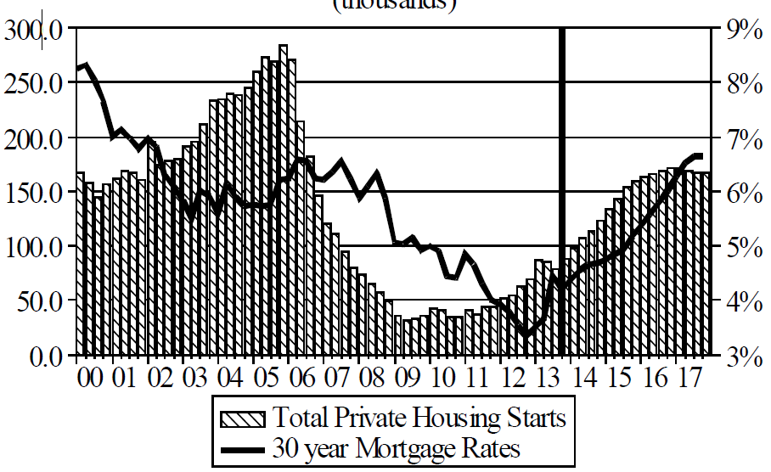
Florida Total Private Housing Starts,
2000 – 2017F
(Thousands of Units)
CRASH, CRATER, RECOVERY Homebuilding in FL continues to recover, adding substantially to coastal exposures.
The economic outlook for most of the US is positive for the first time in many years
Source: University of Central Florida Institute for Economic Competitiveness: http://iec.ucf.edu/post/2014/01/07/Florida-Metro-Forecast-December-2013.aspx

Slide 35
Insured Catastrophe Loss Update
Florida Has Played a Critical Role in the History of Catastrophe Losses in the U.S.
Relative Calm in Recent Years Is Unlikely to Endure
35

Slide 36
U.S. Insured Catastrophe Losses
($ Billions, $ 2012)
Storms of 2004/05
2012 was the third most expensive year ever for insured CAT losses
Andrew
2013 CATs Were Well Below Recent Years. 2012 Was the 3rd Highest Year on Record for Insured Losses in U.S. History on an Inflation-Adj. Basis. 2011 Losses Were the 6th Highest.
Record tornado losses caused 2011 CAT losses to surge
*Through 12/31/13.
Note: 2001 figure includes $20.3B for 9/11 losses reported through 12/31/01 ($25.9B 2011 dollars). Includes only business and personal property claims, business interruption and auto claims. Non-prop/BI losses = $12.2B ($15.6B in 2011 dollars.)
Sources: Property Claims Service/ISO; Insurance Information Institute.
36
12/01/09 - 9pm
eSlide – P6466 – The Financial Crisis and the Future of the P/C
Notes:
36

Slide 37
Combined Ratio Points Associated with Catastrophe Losses: 1960 – 2013*
Avg. CAT Loss Component of the Combined Ratio by Decade
1960s: 1.04 1970s: 0.85 1980s: 1.31 1990s: 3.39 2000s: 3.52 2010s: 6.1E*
Catastrophe losses as a share of all losses reached a record high in 2012
Combined Ratio Points
The Catastrophe Loss Component of Private Insurer Losses Has Increased Sharply in Recent Decades
*2010s represent 2010-2013.
Notes: Private carrier losses only. Excludes loss adjustment expenses and reinsurance reinstatement premiums. Figures are adjusted for losses ultimately paid by foreign insurers and reinsurers.
Source: ISO (1960-2011); A.M. Best (2012E) Insurance Information Institute.

Slide 38
Top 8 States for Insured
Catastrophe Losses, 2013
$ Millions
Oklahoma led the country in insured CAT losses in 2013
Source: The Property Claim Services (PCS) unit of ISO, a Verisk Analytics company.

Slide 39
Top 5 States by Insured Catastrophe Losses in 2012*
(2012, $ Billions)
NY and NJ led the US in CAT losses in 2012 due Sandy
*Includes catastrophe losses of at least $25 million.
Sources: PCS unit of ISO; Insurance Information Institute.

Slide 40
Top States by Inflation-Adjusted Insured Catastrophe Losses, 1983–2012
Over the Past 30 Years Florida Has Accounted for the Largest Share of Catastrophe Losses in the U.S., Followed by Texas and Louisiana
FL is the most costly state for CATs, with nearly $67B in insured losses over the past 30 years
Louisiana
$42.0B
Texas
$48.8B
Rest of the U.S.
$309.9B
Florida
$66.7B
Total: $467.5 Billion, an average of $16.6B per year or $1.3B per month
Source: PCS unit of ISO, Verisk Company.; Insurance Information Institute.

Slide 41
Inflation Adjusted U.S. Catastrophe Losses by Cause of Loss, 1993–2012¹
Wind/Hail/Flood (3), $14.9
Fires (4), $6.5
Other (5), $0.2
Insured cat losses from 1993-2012 totaled $391.7B, an average of $19.6B per year or $1.6B per month
Geological Events, $18.4
Terrorism, $24.8
Winter Storms, $27.8
Hurricanes & Tropical Storms, $158.2
Tornado share of CAT losses is rising
Wind losses are by far cause the most catastrophe losses, even if hurricanes/TS are excluded.
Tornadoes (2), $140.9
Catastrophes are defined as events causing direct insured losses to property of $25 million or more in 2012 dollars.
Excludes snow.
Does not include NFIP flood losses
Includes wildland fires
Includes civil disorders, water damage, utility disruptions and non-property losses such as those covered by workers compensation.
Source: ISO’s Property Claim Services Unit.

Slide 42
Top 16 Most Costly Disasters in U.S. History
(Insured Losses, 2012 Dollars, $ Billions)
Hurricane Andrew remains the second most expensive natural disaster in US history
Includes Tuscaloosa, AL, tornado
Includes Joplin, MO, tornado
12 of the 16 Most Expensive Events in US History Have Occurred Over the Past Decade
*PCS estimate as of 4/12/13.
Sources: PCS; Insurance Information Institute inflation adjustments to 2012 dollars using the CPI.

Slide 43
Top 16 Most Costly World Insurance Losses, 1970-2013*
(Insured Losses, 2012 Dollars, $ Billions)
4 of the top 12 most expensive catastrophes in world history impacted Florida
Hurricane Sandy is now the 6th costliest event in global insurance history
*Figures do not include federally insured flood losses.
**Estimate based on PCS value of $18.75B as of 4/12/13.
Sources: Munich Re; Swiss Re; Insurance Information Institute research.

Slide 44
Top 12 Most Costly Hurricanes in U.S. History
(Insured Losses, 2012 Dollars, $ Billions)
6 of the 12 most costly hurricanes in insurance history impacted Florida
Hurricane Sandy is the costliest tropical event to not impact FL
*PCS estimate as of 4/12/13.
Sources: PCS; Insurance Information Institute inflation adjustments to 2012 dollars using the CPI.

Slide 45
Total Value of Insured Coastal Exposure in 2012
(2012, $ Billions)
The value of coastal exposure in FL was nearly $2.9 trillion in 2012, up 19% or $465 billion since 2007 despite the housing collapse
In 2012, New York Ranked as the #1 Most
Exposed State to Hurricane Loss, Overtaking Florida with $2.862 Trillion. Texas is very exposed too, and ranked #3 with $1.175 Trillion
in insured coastal exposure
The Insured Value of All Coastal Property Was $10.6 Trillion in 2012 , Up 20% from $8.9 Trillion in 2007 and Up 48% from $7.2 Trillion in 2004
Source: AIR Worldwide

Slide 46
Total Value of Insured Coastal Exposure in 2007
(2007, $ Billions)
In 2007, Florida Still Ranked as the #1 Most
Exposed State to Hurricane Loss, with
$2.459 Trillion Exposure, but Texas is very exposed too, and ranked #3 with $895B
in insured coastal exposure
The Insured Value of All Coastal Property Was $8.9 Trillion in 2007, Up 24% from $7.2 Trillion in 2004
Source: AIR Worldwide

Slide 47
The combined ratios for both personal and commercial lines improved substantially in 2013:H1

Slide 49
Flood Insurance
Flood Exposure: Reforms in Danger?
Flood Should Reflect True Risk
Keep the Subsidies
Would Prefer to Purchase from Private Insurers
49

Slide 50
Total Potential Home Value Exposure to Storm Surge Risk in 2013*
($ Billions)
Florida is by the state most vulnerable to storm surge.
The Value of Homes Exposed to Storm Surge was $1.147 Trillion in 2013.* Only a fraction of this is insured, hence the huge demand for federal aid following major coastal flooding events.
*Insured and uninsured property. Based on estimated property values as of April 2013.
Source: Storm Surge Report 2013, CoreLogic.

Slide 51
Total NFIP Policies in Force, 2012
Florida has almost three times as much flood insurance in force as any other state, accounting for 37% of all policies in the US
Source: U.S. Department of Homeland Security, Federal Emergency Management Agency; Insurance Information Institute.

Slide 52
Growth of NFIP program
Policies in Force at Year-End
Number of policies has not changed significantly though more homes are in harm’s way
Despite the growth of the program, approximately half of all properties in a flood zone lack flood insurance.
Source: U.S. Department of Homeland Security, Federal Emergency Management Agency; Insurance Information Institute.

Slide 53
What kind of Buildings Does Flood Insurance Protect?
One-fourth of all flood policies are written on commercial (non-residential) risks or on secondary homes.
Sources: Congressional Budget Office (2007), Insurance Information Institute.

Slide 54
Median Value of Flood Properties
A CBO survey indicated the typical home with flood insurance is worth significantly more than the typical home. The typical subsidized coastal risk was worth more than unsubsidized risks.
Congressional Budget Office 2007 survey of coastal risks, with U.S. owner-occupied home median from Bureau of Census, 2005 American Housing Survey; Insurance Information Institute.

Slide 55
Hurricane Sandy: Average Claim Payment by Type of Claim
Commercial (i.e., business claims) are more expensive because the value of property is often higher as well as the impact of insured business interruption losses
The average insured flood loss was nearly 9 times larger than the average non-flood insured loss (mostly wind)
Post-Sandy, the I.I.I. worked very hard to make help media, consumers and regulators understand the distinction between a flood claim and a standard homeowners claim. NFIP is $24B in debt.
*Includes rental and condo policies (excludes NFIP flood). **As of Oct. 31, 2013.
Sources: Catastrophe loss data is for Catastrophe Serial No. 90 (Oct. 28 – 31, 2012) from PCS as of March 2013; Insurance Information Institute.

Slide 56
Top 12 Most Costly Flood Events by NFIP Payout*
(NFIP Insured Losses, $ Millions)
8 of the 10 most costly events in NFIP history occurred over the past decade (2004‒2013); NFIP deficit now totals $24 billion
Katrina and Sandy are by far the most costly events in NFIP history
*Expressed in original dollars (not inflation-adjusted).
Sources: PCS; Insurance Information Institute inflation adjustments to 2012 dollars using the CPI.

Slide 57
I.I.I. Poll: Disaster Preparedness
Q. Do you have a separate flood insurance policy?¹
Percentage of people with flood insurance is unchanged
Only 13 percent of American homeowners say they have a flood insurance policy; the percentage is lowest in the Northeast at 10 percent.
¹Asked of those who have homeowners insurance and who responded “yes”.
Source: Insurance Information Institute Annual Pulse Survey.

Slide 58
I.I.I. Poll: Disaster Preparedness
Q. Does your homeowners policy cover damage from flooding during a hurricane?¹
About 30 percent of homeowners in the South still believe flooding from a hurricane is covered
The proportion of homeowners who believe their homeowners policy covers damage from flooding during a hurricane stands at 21 percent. This proportion rises eight percentage points in the South, to 29 percent.
¹Asked of those who have homeowners insurance and who responded “yes”.
Source: Insurance Information Institute Annual Pulse Survey.

Slide 59
Biggert-Waters: Media and Congressional Maelstrom
BW-12 Rate Increases to Phase Out Subsidies Began in 2013
  Note: Only 20% of NFIP policies are subsidized
Jan. 1, 2013: Non-Primary/Secondary Residences
  Increases of 25% per year until full-risk rate achieved
  Reaction: Very muted; Vacation homes/wealthier owners
Oct. 1, 2013: Subsidized Severe or Repetitive Loss Policies and Owners of Business/Non-Residential Properties
  Increases of 25% per year until full-risk rate achieved
  Reaction: Huge consumer backlash, intense media coverage leading to a Congressional effort to delay BW-12 by 4 years (effectively killing it). Even Maxine Waters supports delay…
Subsidy Lost if Policy Lapses, Severe Repeated, New Policy
I.I.I. Is Explaining the Risks Associated with BW-12 Delay
Future Pvt. Insurer Flood Participation Impacted by BW-12 Debate
I.I.I. Research Report on Issue Due Soon Under BW-12 Section 236 Study Requirement (National Academy of Sciences)
59
12/01/09 - 9pm
eSlide – P6466 – The Financial Crisis and the Future of the P/C
Notes:
59

Slide 60
Success of Write Your Own Program
Write Your Own Policies vs. Written Directly by NFIP
More than 80% of flood policies in the NFIP are written through the Write Your Own program, a public-private partnership.
Source: U.S. Department of Homeland Security, Federal Emergency Management Agency; Insurance Information Institute.

Slide 61
Extent of Flood Insurance Subsidy
The average subsidized policy pays about 40 percent of the full actuarial rate. Eliminating the subsidy would increase program premium by more than 50 percent.
Sources: NFIP 2011 Actuarial Rate Review, Insurance Information Institute.

Slide 62
I.I.I. Poll: Flood Insurance
Q. Do you think it is fair that flood insurance premium increases are higher if people who live in high flood risk areas and rebuild their homes do not elevate them?
Don’t know
No
Yes
Almost two-thirds of Americans think that it is fair that flood insurance premiums be raised for people who live in high flood risk areas and rebuild their homes after a flood but do not elevate them.
Source: Insurance Information Institute Annual Pulse Survey.

Slide 63
I.I.I. Poll: Flood Insurance
Q. Do you think flood insurance premiums should reflect the risk of flooding no matter what the cost or do you think the government should subsidize the cost of flood insurance with taxpayers’ dollars?
Don’t know
Government should subsidize cost with taxpayers’ dollars
Premiums should reflect flood risk
Almost two-thirds of Americans think flood insurance premiums should be raised to reflect the risk of flooding.
Source: Insurance Information Institute Annual Pulse Survey (Nov. 2013).

Slide 64
I.I.I. Poll: Flood Insurance
Q. The federal government provides insurance coverage at taxpayer-subsidized rates for damage from floods through the National Flood Insurance Plan. A new law eliminates the subsidy and raises rates. Do you think the rate increase should be repealed?
Don’t know
It is inconsistent for the public to support full-risk rates while wanting to maintain subsidies, but this exactly mirrors Congressional sentiments.
No
Yes
More than half of Americans polled for the November 2013 Pulse thought that hikes in National Flood Insurance premiums should be repealed.
Source: Insurance Information Institute Annual Pulse Survey.

Slide 65
Federal Disaster Declarations Patterns: 1953-2013
Disaster Declarations Set New Records in Recent Years
65

Slide 66
Number of Federal Major Disaster Declarations, 1953-2014*
There have been 2,147 federal disaster declarations since 1953. The average number of declarations per year is 35 from 1953-2013, though there few haven’t been recorded since 1995.
The number of federal disaster declarations set a new record in 2011, with 99, shattering 2010’s record 81 declarations.
3 federal disasters were declared so far in 2014*
The Number of Federal Disaster Declarations Is Rising and Set New Records in 2010 and 2011 Before Dropping in 2012/13
*Through January 25, 2014.
Source: Federal Emergency Management Administration; http://www.fema.gov/disasters; Insurance Information Institute.

Slide 67
Federal Disasters Declarations by State,
1953 – 2014: Highest 25 States*
Over the past 60 years, Florida has had the 5th highest number of Federal Disaster Declarations (32 were associated with tropical events)
Hurricanes Tornadoes Floods Freezes Wildfires Severe T-Storms High Winds Extreme Tides
*Through Jan. 25, 2014. Includes Puerto Rico and the District of Columbia.
Source: FEMA: http://www.fema.gov/news/disaster_totals_annual.fema; Insurance Information Institute.

Slide 68
Federal Disasters Declarations by State,
1953 – 2014: Lowest 25 States*
Over the past 60 years, Wyoming and Rhode Island had the fewest number of Federal Disaster Declarations
*Through Jan. 25, 2014. Includes Puerto Rico and the District of Columbia.
Source: FEMA: http://www.fema.gov/news/disaster_totals_annual.fema; Insurance Information Institute.

Slide 69
SEVERE WEATHER REPORT UPDATE: 2013
Damage from Tornadoes, Large Hail and High Winds Keep Insurers Busy in Every State—Including Florida
69

Slide 70
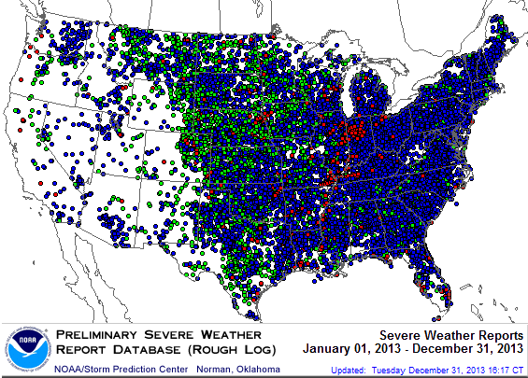
Severe Weather Reports: 2013
Severe weather reports are concentrated east of the Rockies
There were 19,342 severe weather reports in 2013; including 942 tornadoes; 5,457 “Large Hail” reports and 12,942 high wind events
Source: NOAA Storm Prediction Center; http://www.spc.noaa.gov/climo/online/monthly/2013_annual_summary.html#
70

Slide 71
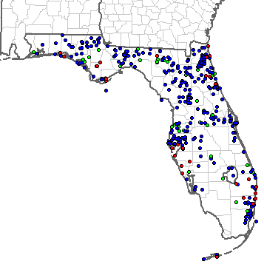
Severe Weather Reports in Florida: 2013
There were 400 severe weather reports in 2013
37 Tornadoes
47 Large Hail Reports
316 High Wind Events
Source: NOAA Storm Prediction Center; http://www.spc.noaa.gov/climo/online/monthly/2013_annual_summary.html#
71

Slide 72
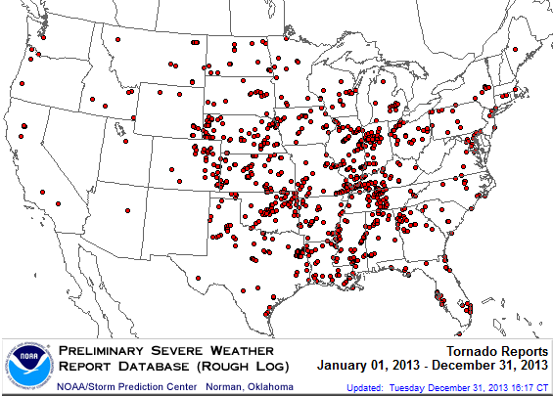
Location of Tornado Reports in 2013
A deadly EF-5 tornado in May in Moore, OK, produced insured losses of $1.575 billion
There were 943 tornadoes through Dec. 31, (37 of them in FL)causing extensive property damage in several states
Source: NOAA Storm Prediction Center; http://www.spc.noaa.gov/climo/online/monthly/2013_annual_summary.html#; PCS.
72

Slide 73
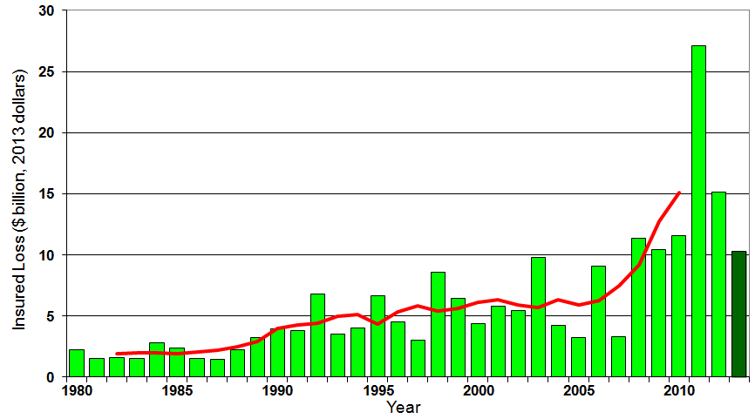
U.S. Thunderstorm Insured Loss Trends, 1980 – 2013
Hurricanes get all the headlines, but thunderstorms are consistent producers of large scale loss. 2008-2013 are the most expensive years on record.
Average thunderstorm losses are up 7 fold since the early 1980s. The 5-year running average loss is up sharply
Thunderstorm losses in 2013 totaled $10.3 billion, the 6th highest on record
Source: Property Claims Service, and MR NatCatSERVICE
73

Slide 74
SURPLUS/CAPITAL/CAPACITY
2013 Recorded Yet Another Record High
74

Slide 75
Policyholder Surplus,
2006:Q4–2013:Q3
Drop due to near-record 2011 CAT losses
($ Billions)
2007:Q3
Pre-Crisis Peak
Surplus as of 9/30/13 stood at a record high $624.4B
The industry now has $1 of surplus for every $0.78 of NPW,
close to the strongest claims-paying status in its history.
2010:Q1 data includes $22.5B of paid-in capital from a holding company parent for one insurer’s investment in a non-insurance business .
The P/C insurance industry entered 2014
in very strong financial condition.
Sources: ISO, A.M .Best.
75
12/01/09 - 9pm
eSlide – P6466 – The Financial Crisis and the Future of the P/C
Notes:
75

Slide 76
US Policyholder Surplus:
1975–2013*
($ Billions)
Surplus as of 9/30/13 was a record $624.4, up 6.4% from $586.9 of 12/31/12, and up 42.9% ($187.3B) from the crisis trough of $437.1B at 3/31/09. Pre-crisis peak was $521.8 as of 9/30/07. Surplus as of 9/30/13 was 19.7% above 2007 peak.
“Surplus” is a measure of underwriting capacity. It is analogous to “Owners Equity” or “Net Worth” in non-insurance organizations
The Premium-to-Surplus Ratio Stood at $0.78:$1 as of
9/30/13, a Near Record Low (at Least in Recent History)*
* As of 9/30/13.
Source: A.M. Best, ISO, Insurance Information Institute.

Slide 77
Insurance Information Institute Online:
www.iii.org
www.InsuringFlorida.org
Thank you for your time
and your attention!
Download at www.iii.org/presentations

