Slide 1
The Global Insurance Industry:
Overview and Outlook for Non-Life, Life and Reinsurance Markets
Insurance Information Institute
New York, NY
September 18, 2013
Robert P. Hartwig, Ph.D., CPCU, President & Economist
Insurance Information Institute ♦ 110 William Street ♦ New York, NY 10038
Tel: 212.346.5520 ♦ Cell: 917.453.1885 ♦ bobh@iii.org ♦ www.iii.org

Slide 2
Presentation Outline
Is the World Becoming a Riskier Place?
Global Economic Overview: Insurance Implications
Global Insurance Overview
  Life, Non-Life Analysis
  Regional Differences
  A Look Ahead
Global Catastrophe Loss Trends
The New Investment Reality
  The Challenge of Persistently Low Interest Rates
Global Reinsurance Market Trends
  The Increasing Role of Alternative Capital
Cyber Risk: A Growing Global Concern

Slide 3
What in the World Is Going On? U.S. and Global Perspective
Is the World Becoming a Riskier, More Uncertain Place?
All Major Categories of Risk Influence Economies and Insurance Industry on a Global Scale
3

Slide 4
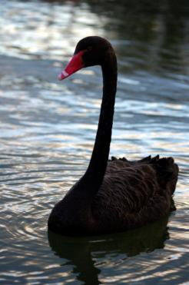
Uncertainty, Risk and Fear Abound: Insurance Can Help Mitigate Risk
Never Ending Echoes of the Financial Crisis
European Sovereign Debt & Eurozone Crises
US Debt and Budget Crisis
“Hard Landing” in China
Unemployment
Monetary Policy/Taper/Interest Rates
Political Gridlock
Political Upheaval in the Middle East/Syria
Resurgent Terrorism Risk
Diffusion of Weapons of Mass Destruction
Cyber Attacks
Record Natural Disaster Losses
Climate Change
Environmental Degradation
Income Inequality
Are “Black Swans” everywhere or does it just seem that way?

Slide 5





5 Major Categories for Global Risks, Uncertainties and Fears: Insurance Solutions
Economic Risks
Geopolitical Risks
Environmental Risks
Technological Risks
Societal Risks
While risks can be broadly categorized, none are mutually exclusive
Source: World Economic Forum, Global Risks 2012; Insurance Information Institute.

Slide 6
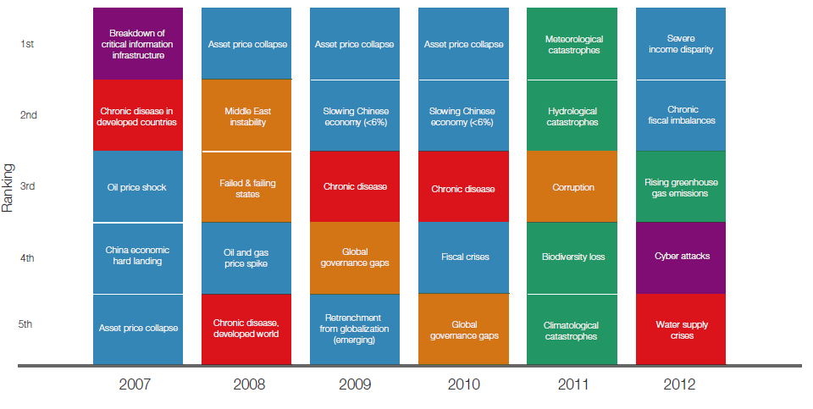
Top 5 Global Risks in Terms of Likelihood, 2007—2012: Insurance Can Help With Most
In 2012, concerns over income disparity and fiscal imbalances displaced weather and water concerns, as ranked by likelihood
Concerns Shift Considerably Over Short Spans of Time. Shift in 2012 to Economic Risks and Away from Environmental Risks
Source: World Economic Forum, Global Risks 2012; Insurance Information Institute.
6
12/01/09 - 9pm
eSlide – P6466 – The Financial Crisis and the Future of the P/C
Notes:
6

Slide 7
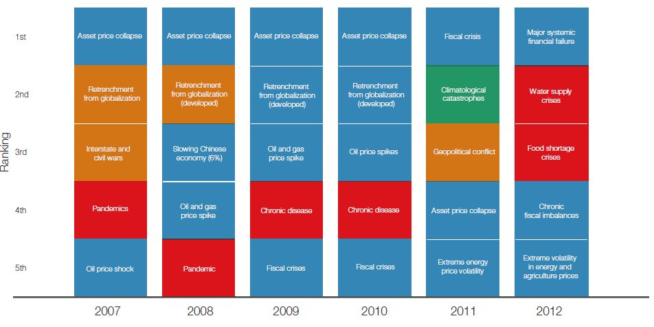
Top 5 Global Risks in Terms of Impact,
2007—2012: Insurance Can Help With Most
Impacts from economic and societal risks were of the greatest concern in 2012
Concerns Over the Impacts of Economics Risks Remained High in 2012, but Societal Risks Displaced Environmental Risks
Source: World Economic Forum, Global Risks 2012; Insurance Information Institute.
7
12/01/09 - 9pm
eSlide – P6466 – The Financial Crisis and the Future of the P/C
Notes:
7

Slide 8
The Strength of the Economy Will Influence P/C Insurer Growth Opportunities
Growth Will Expand Insurer Exposure Base Across Most Lines
8

Slide 9
GDP Growth: Advanced & Emerging Economies vs. World, 1970-2014F
Emerging economies (led by China) are expected to grow by 5.0% in 2013 and 5.4% in 2014.
GDP Growth (%)
World output is forecast to grow by 3.1% in 2013 and 3.8% in 2014. The world economy shrank by 0.6% in 2009 amid the global financial crisis
Advanced economies are expected to grow at a sluggish pace of 1.2% in 2013 but accelerate to 2.1% in 2014.
Source: International Monetary Fund, World Economic Outlook , July 2013 WEO Update; Ins. Info. Institute.

Slide 10
US Real GDP Growth*
The Q4:2008 decline was the steepest since the Q1:1982 drop of 6.8%
Real GDP Growth (%)
Recession began in Dec. 2007. Economic toll of credit crunch, housing slump, labor market contraction was severe
2013 is expected to see uneven growth, then gradually accelerate throughout the year and into 2014
Demand for Insurance Continues To Be Impacted by Sluggish Economic Conditions, but the Benefits of Even Slow Growth Will Compound and Gradually Benefit the Economy Broadly
* Estimates/Forecasts from Blue Chip Economic Indicators.
Source: US Department of Commerce, Blue Economic Indicators 9/13; Insurance Information Institute.

Slide 11
Real GDP Growth Forecasts:
Major Economies: 2011 – 2014F
US growth should acceleratein 2014
Growth in China has outpaced the US and Europe
The Eurozone is ending
Growth Prospects Vary Widely by Region: Growth Returning in the US, Recession in the Eurozone, Some strengthening in Latin America
Sources: Blue Chip Economic Indicators (9/2013 issue); Insurance Information Institute.
11
Notes:
11

Slide 12
Real GDP Growth Forecasts:
Selected Economies: 2011 – 2014F
Strong economies in smaller industrialized nations will bolster demand for products, services, international trade and insure
Growth Outside the US, Europe and Japan is Relatively Strong
Sources: Blue Chip Economic Indicators (9/2013 issue); Insurance Information Institute.
12
Notes:
12

Slide 13
Global Insurance Premium Growth Trends:
Life and Non-Life
Growth Is Uneven Across Regions and Market Segments
13

Slide 14
Premium Growth by Region, 2012
Latin America growth was the strongest in 2012
Growth in Advanced Asia (incl. China) markets was third highest in 2012
Global Premium Volume Totaled $4.613 Trillion in 2012, up 2.4% from $4.566 Trillion in 2011. Global Growth Was Weighed Down by Slow Growth in N. America and W. Europe and Partially Offset by Emerging Markets
Source: Swiss Re, sigma, No. 3/2013.
14
Notes:
14

Slide 15
Distribution of Global Insurance Premiums, 2012 ($ Trillions)
Total Premium Volume = $4.613 Trillion*
Life insurance accounted for nearly 57% of global premium volume in 2012 vs. 43% for Non-Life
Source: Swiss Re, sigma, No. 3/2013; Insurance Information Institute.

Slide 16
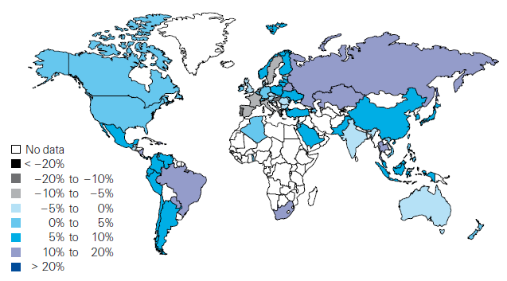
Global Real (Inflation Adjusted) Premium Growth (Life and Non-Life): 2012
Emerging markets in Asia, including China, showed faster growth an the US or Europe
Market | Life | Non-Life | Total
Advanced | 1.8 | 1.5 | 1.7
Emerging | 4.9 | 8.6 | 6.8
World | 2.3 | 2.6 | 2.4
Source: Swiss Re, sigma, No. 3/2013.
16
12/01/09 - 9pm
eSlide – P6466 – The Financial Crisis and the Future of the P/C
Notes:
16

Slide 17
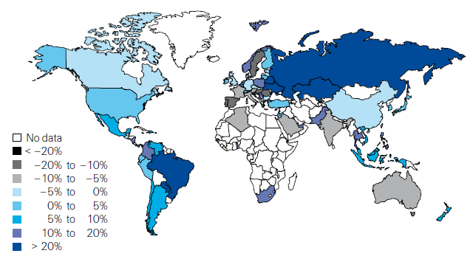
Life Insurance: Global Real (Inflation Adjusted) Premium Growth, 2012
Real growth in life insurance premiums was a bit slower in China than the US
Market | Life | Non-Life | Total
Advanced | 1.8 | 1.5 | 1.7
Emerging | 4.9 | 8.6 | 6.8
World | 2.3 | 2.6 | 2.4
Source: Swiss Re, sigma, No. 3/2013.
17
12/01/09 - 9pm
eSlide – P6466 – The Financial Crisis and the Future of the P/C
Notes:
17

Slide 18
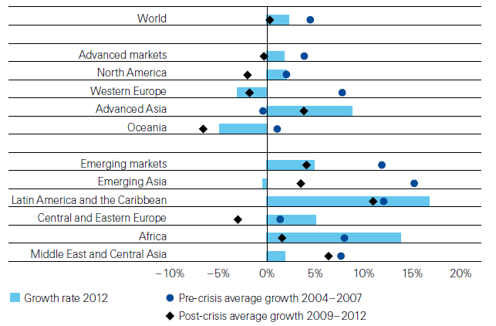
Life Insurance: Global Real (Inflation Adjusted) Premium Growth, 2012
Global Life Insurance growth in 2012 was lower than the pre-crisis average but above than the post-crisis average. Advanced Asia economies like China saw stronger growth on average than before or after the crisis.
Source: Swiss Re, sigma, No. 3/2013.
18
12/01/09 - 9pm
eSlide – P6466 – The Financial Crisis and the Future of the P/C
Notes:
18

Slide 19
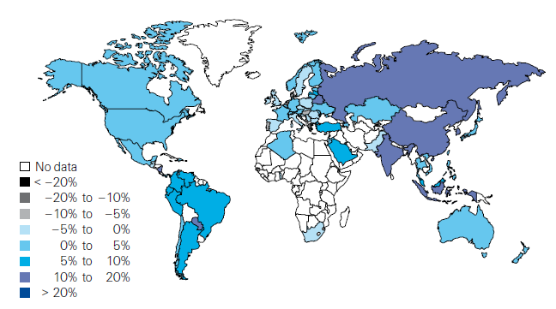
Non-Life Insurance: Global Real (Inflation Adjusted) Premium Growth, 2012
Real growth in non-life insurance premiums was faster in China than the US
Market | Life | Non-Life | Total
Advanced | 1.8 | 1.5 | 1.7
Emerging | 4.9 | 8.6 | 6.8
World | 2.3 | 2.6 | 2.4
Source: Swiss Re, sigma, No. 3/2013.
19
12/01/09 - 9pm
eSlide – P6466 – The Financial Crisis and the Future of the P/C
Notes:
19

Slide 20
Global Real (Inflation Adjusted) Nonlife
Premium Growth: 1980-2010
Average: 1980-2010
Industrialized Countries: 3.8%
Emerging Markets: 9.2%
Overall Total: 4.2%
Nonlife premium growth in emerging markets has exceeded that of industrialized countries in 27 of the past 31 years, including the entirety of the global financial crisis..
Real nonlife premium growth is very erratic in part to inflation volatility in emerging markets as well as a lack of consistent cyclicality
Source: Swiss Re, sigma, No. 2/2010.
20
12/01/09 - 9pm
eSlide – P6466 – The Financial Crisis and the Future of the P/C
Notes:
20

Slide 21
Net Premium Growth: Annual Change,
1971—2013:Q1
(Percent)
1975-78
1984-87
2000-03
Net Written Premiums Fell 0.7% in 2007 (First Decline Since 1943) by 2.0% in 2008, and 4.2% in 2009, the First 3-Year Decline Since 1930-33.
2013:Q1 = 4.1%
2012 growth was +4.3%
Shaded areas denote “hard market” periods
Sources: A.M. Best (historical and forecast), ISO, Insurance Information Institute.

Slide 22
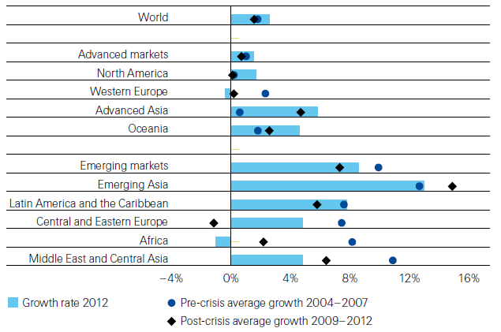
Non-Life Insurance: Global Real (Inflation Adjusted) Premium Growth, 2012
Global Non-Life growth in 2012 exceeded the pre-crisis and post-crisis average. The same is true for advanced Asia economies like China
Source: Swiss Re, sigma, No. 3/2013.
22
12/01/09 - 9pm
eSlide – P6466 – The Financial Crisis and the Future of the P/C
Notes:
22

Slide 23
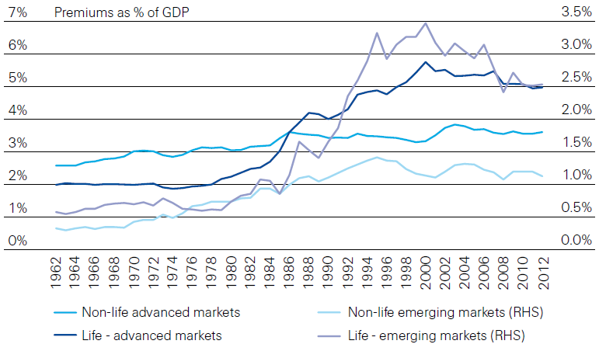
Life and Non-Life Insurance Penetration as a % of GDP: 1962-2012
Life insurance in emerging markets has experienced the fastest in recent decades
Advanced Markets
Emerging Markets
Non-life markets have been slower to grow than life
Source: Swiss Re, sigma, No. 3/2013.
23
12/01/09 - 9pm
eSlide – P6466 – The Financial Crisis and the Future of the P/C
Notes:
23

Slide 24
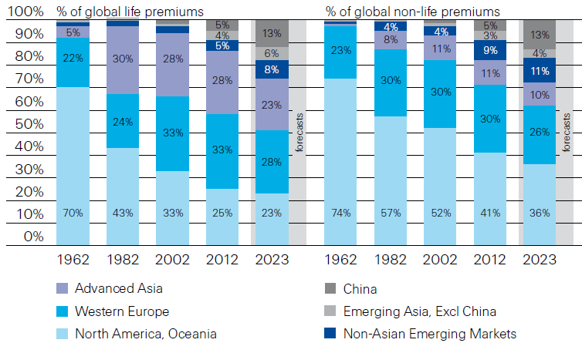
Premiums Written in Life and Non-Life, by Region: 1962-2012
Emerging market shares rose rapidly over the past 50 years
Source: Swiss Re, sigma, No. 3/2013.
24
12/01/09 - 9pm
eSlide – P6466 – The Financial Crisis and the Future of the P/C
Notes:
24

Slide 25
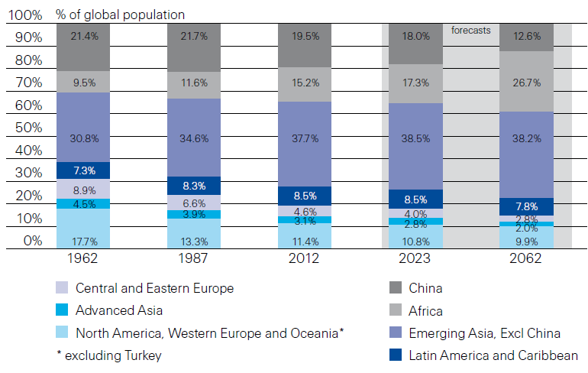
Population Distribution, by Region:
1962-2062F
Enormous population shifts will impact insurance demand over the next half century
Africa is expected to be the fastest population growth over the next 50 years, but no expectation now of Asia-like growth in economies or insurance demand
Source: Swiss Re, sigma, No. 3/2013 from United Nations Department of Economic and Sovial Affairs, Population Division.
25
12/01/09 - 9pm
eSlide – P6466 – The Financial Crisis and the Future of the P/C
Notes:
25

Slide 26
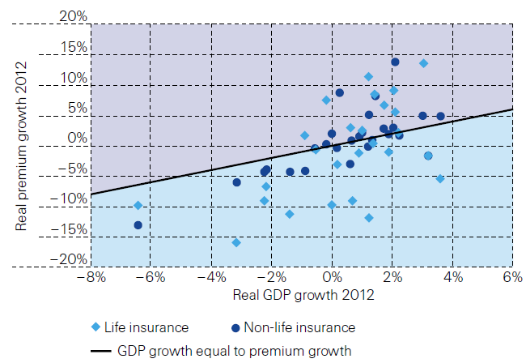
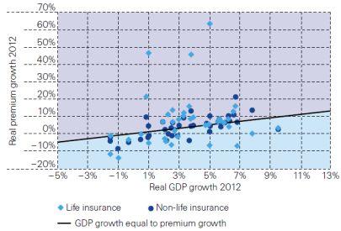
Relationship Between Real GDP and Real Life and Non-Life Premium Growth, 2012
Advanced Markets
Emerging Markets
The was a clear but highly relationship between real GDP growth and real premium growth in advance markets in 2012
The correlation between real GDP growth and real premium growth in emerging markets was much stronger than in advanced markets in 2012
Source: Swiss Re, sigma, No. 3/2013.
26
12/01/09 - 9pm
eSlide – P6466 – The Financial Crisis and the Future of the P/C
Notes:
26

Slide 27
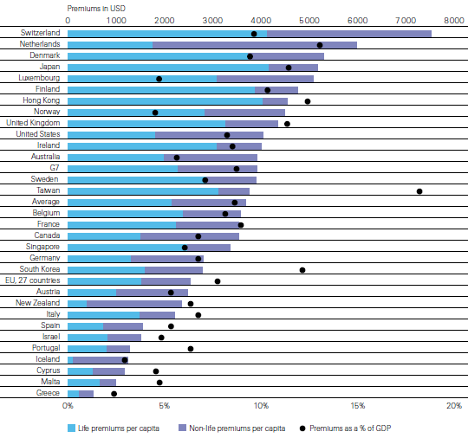
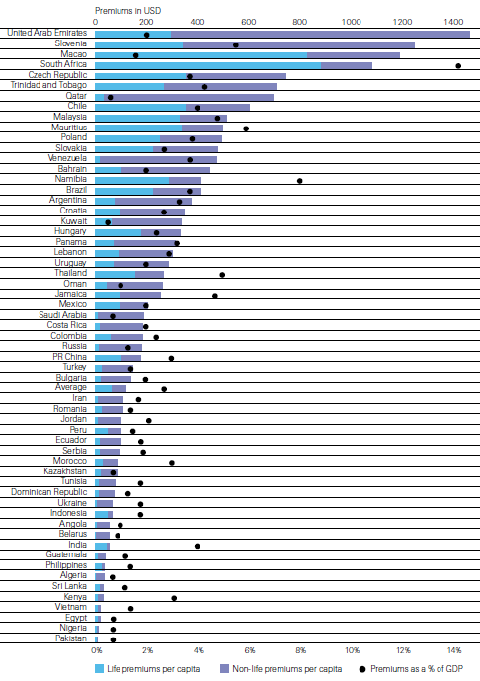
Insurance Density and Penetration for Advanced and Emerging Markets, 2012
Advanced Markets
Emerging Markets
Spending and penetration are highly variable in emerging markets
Spending and penetration are generally much higher in advanced markets, though growth is fastest in emerging markets
Chinese spending on insurance is very similar to Russia, but Russian spending is mostly non-life and in China the majority is life
Source: Swiss Re, sigma, No. 3/2013.
27
12/01/09 - 9pm
eSlide – P6466 – The Financial Crisis and the Future of the P/C
Notes:
27

Slide 28
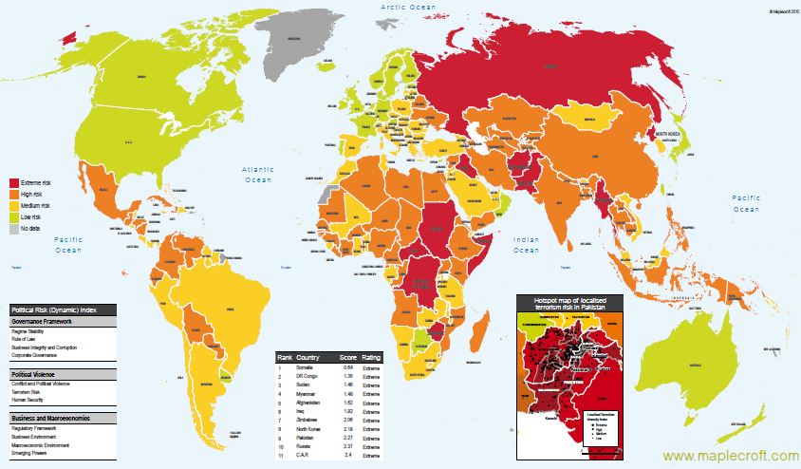
Political Risk in 2011/12: Greatest Business Opportunities Are Often in Risky Nations
The fastest growing markets are generally also among the politically riskiest, including East and South Asia
Heightened risk has economic and insurance implications
Australia and NZ rate well but most neighbors do not
Source: Maplecroft
28
12/01/09 - 9pm
eSlide – P6466 – The Financial Crisis and the Future of the P/C
Notes:
28

Slide 29
U.S. P/C (Non-Life) Insurance Industry Financial Overview
So Far, So Good:
Profit Recovery in 2013 After High CAT Losses in 2011-12
29

Slide 30
P/C Net Income After Taxes
1991–2013:H1 ($ Millions)
2005 ROE*= 9.6%
2006 ROE = 12.7%
2007 ROE = 10.9%
2008 ROE = 0.1%
2009 ROE = 5.0%
2010 ROE = 6.6%
2011 ROAS¹ = 3.5%
2012 ROAS¹ = 5.9%
2013:H1 ROAS¹ = 9.1%E
Net income is up substantially (+64%) from 2012:H1 $16.4B
ROE figures are GAAP; ¹Return on avg. surplus. Excluding Mortgage & Financial Guaranty insurers yields a 9.7% ROAS in 2013:Q1, 6.2% ROAS in 2012, 4.7% ROAS for 2011, 7.6% for 2010 and 7.4% for 2009.
Sources: A.M. Best, ISO, Insurance Information Institute

Slide 31
Profitability Peaks & Troughs in the P/C Insurance Industry, 1975 – 2013:H1*
ROE
History suggests next ROE peak will be in 2016-2017
1977:19.0%
1987:17.3%
10 Years
2006:12.7%
1997:11.6%
2013:H1 9.1%(est)
10 Years
9 Years
2012: 5.9%
1975: 2.4%
1984: 1.8%
1992: 4.5%
2001: -1.2%
*Profitability = P/C insurer ROEs. 2011-13 figures are estimates based on ROAS data. Note: Data for 2008-2013 exclude mortgage and financial guaranty insurers.
Source: Insurance Information Institute; NAIC, ISO, A.M. Best.

Slide 32
US Non-Life Policyholder Surplus (Capital), 2006:Q4–2013:Q1
Drop due to near-record 2011 CAT losses
2007:Q3
Pre-Crisis Peak
($ Billions)
The Industry now has $1 of surplus for every $0.80 of NPW, close to the strongest claims-paying status in its history.
Surplus as of 3/31/13 stood at a record high $607.7B
*Includes $22.5B of paid-in capital from a holding company parent for one insurer’s investment in a non-insurance business in early 2010.
The P/C Insurance Industry Both Entered and Emerged from the 2012 Hurricane Season Very Strong Financially.
Sources: ISO, A.M .Best.
32
12/01/09 - 9pm
eSlide – P6466 – The Financial Crisis and the Future of the P/C
Notes:
32

Slide 33
Current Yields on 10-Year
Government Bonds*
Yield in the US are among the lowest in the world. Persistently low yields are exerting pricing pressure on all insurers.
*Latest available.
Source: The Economist, Aug. 31, 2013; Insurance Information Institute.

Slide 34
INVESTMENTS:
THE NEW REALITY
Investment Performance is a Key Driver of Profitability
Depressed Yields Will Necessarily Influence Underwriting & Pricing
34

Slide 35
Property/Casualty Insurance Industry Investment Income: 2000–2013*¹
($ Billions)
Investment earnings are running below their 2007 pre-crisis peak
Investment Income Fell in 2012 and is Falling in 2013 Due to Persistently Low Interest Rates, Putting Additional Pressure on (Re) Insurance Pricing
¹ Investment gains consist primarily of interest and stock dividends..
*Estimate based on annualized actual Q1:2013 investment income of $11.385B.
Sources: ISO; Insurance Information Institute.

Slide 36
P/C Insurer Net Realized
Capital Gains/Losses, 1990-2013:Q1
Realized capital gains in 2012 were down 12% from 2011
($ Billions)
Insurers Posted Net Realized Capital Gains in 2010, 2011 and 2012 Following Two Years of Realized Losses During the Financial Crisis. Realized Capital Losses Were the Primary Cause of 2008/2009’s Large Drop in Profits and ROE
Sources: A.M. Best, ISO, Insurance Information Institute.
36
12/01/09 - 9pm
eSlide – P6466 – The Financial Crisis and the Future of the P/C
Notes:
36

Slide 37
Property/Casualty Insurance Industry Investment Gain: 1994–2013:Q1¹
($ Billions)
Investment gains in 2012 were approximately 16% below their pre-crisis peak
Investment Gains Are Slipping in 2012 as Low Interest Rates Reduce Investment Income and Lower Realized Investment Gains; The Financial Crisis Caused Investment Gains to Fall by 50% in 2008
¹ Investment gains consist primarily of interest, stock dividends and realized capital gains and losses.
* 2005 figure includes special one-time dividend of $3.2B;
Sources: ISO; Insurance Information Institute.

Slide 38
U.S. Treasury Security Yields:
A Long Downward Trend, 1990–2013*
Yields on 10-Year U.S. Treasury Notes have been essentially below 5% for a full decade.
U.S. Treasury security yields recently plunged to record lows
Since roughly 80% of P/C bond/cash investments are in 10-year or shorter durations, most P/C insurer portfolios will have low-yielding bonds for years to come.
*Monthly, constant maturity, nominal rates, through July 2013.
Sources: Federal Reserve Bank at http://www.federalreserve.gov/releases/h15/data.htm.
National Bureau of Economic Research (recession dates); Insurance Information Institute.
38
12/01/09 - 9pm
eSlide – P6466 – The Financial Crisis and the Future of the P/C
Notes:
38

Slide 39
U.S. Insured Catastrophe Loss Update
Catastrophe Losses in Recent Years Have Been Very High
39

Slide 40
Natural Disasters Worldwide,
1980 – 2013* (Number of Events)
There were 460 natural disaster events globally in the first half of 2013 and 905 for full-year 2012
Number
41
19
121
3
Geophysical
(earthquake, tsunami,
volcanic activity)
Meteorological (storm)
Climatological
(temperature extremes,
drought, wildfire)
Hydrological
(flood, mass movement)
*Through June 30, 2013.
Source: MR NatCatSERVICE
40

Slide 41
Top 16 Most Costly World Insurance Losses, 1970-2012*
(Insured Losses, 2012 Dollars, $ Billions)
5 of the top 14 most expensive catastrophes in world history have occurred within the past 3 years (2010-2012)
2012 insured CAT Losses totaled $60B; Economic losses totaled $140B, according to Swiss Re
Hurricane Sandy is now the 6th costliest event in global insurance history
*Figures do not include federally insured flood losses.
**Estimate based on PCS value of $18.75B as of 4/12/13.
Sources: Munich Re; Swiss Re; Insurance Information Institute research.

Slide 42
Losses Due to Natural Disasters Worldwide, 1980–2013* (Overall & Insured Losses)
(Overall and Insured Losses)
(2012 Dollars, $ Billions)
2012 Losses
Overall : $101.1B
Insured: $57.9B
2013: 1st Half Losses
Overall : $45B
Insured: $13B
There is a clear upward trend in both insured and overall losses over the past 30+ years
Overall losses (in 2012 values)
Insured losses (in 2012 values)
*Through June 30, 2013.
Source: MR NatCatSERVICE
42

Slide 43
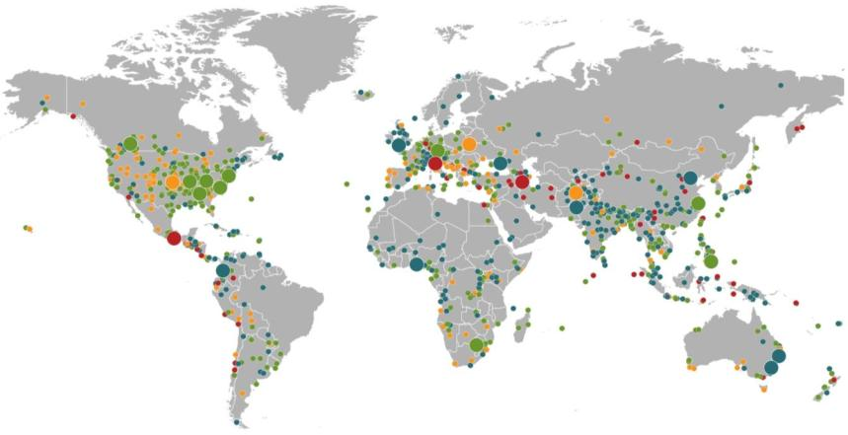
Natural Loss Events:
Full Year 2012
World Map
Winter Storm Andrea
Europe, 5–6 January
Floods
United Kingdom,
21–27 November
Cold Wave
Eastern Europe, Jan – Feb
Cold Wave
Afghanistan, Jan – Mar
Severe Weather
USA, 28–29 April
Hailstorms, severe weather
Canada, 12–14 August
Severe storms
USA, 28 June –2 July
Flash Floods
Russia, 6–8 July
Floods
China, 21–24 July
Drought
USA, Summer
Hurricane Sandy
USA, Caribbean
24–31 October
Earthquake
Italy,
29 May/3 June
Typhoon Haikui China, 8–9 August
Severe Storms, tornadoes
USA, 2–4 March
Hurricane Isaac
USA, Caribbean
24–31 August
Earthquake
Iran, 11 August
Earthquake
Mexico, 20 March
Floods
Nigeria, Jul – Oct
Floods
Pakistan, 3 –27 September
Typhoon Bopha Philippines, 4–5 December
Floods
Columbia, Mar – Jun
Floods, flash floods
Australia, Jan – Feb
Number of events: 905
Floods, hailstorms
South Africa, 20 –21 October
Floods. flash floods
Australia, Feb – Mar
Natural catastrophes
Geophysical events
(earthquake, tsunami, volcanic activity)
Hydrological events
(flood, mass movement)
Selection of significant
Natural catastrophes
Meteorological events
(storm)
Climatological events
(extreme temperature, drought, wildfire)
Source: Geo Risks Research, NatCatSERVICE – As of January 2013
43

Slide 44
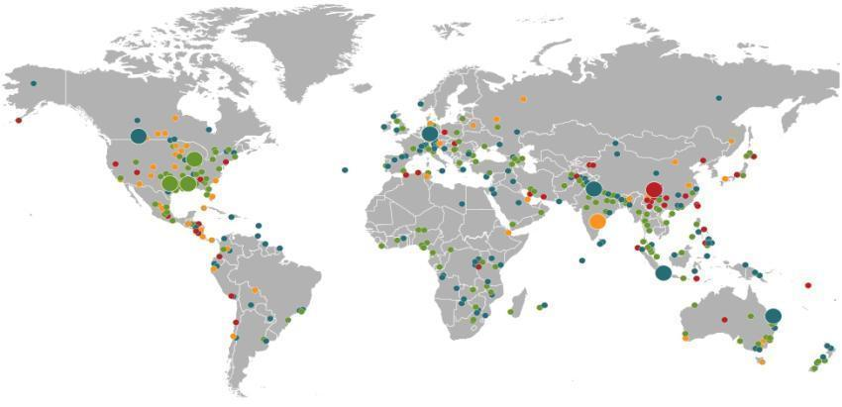
Natural Catastrophes January – June 2013
World map with significant events
Floods
Canada, June
Floods
Europe,
June
Winter storm
USA, 7–11 April
Earthquake
China,
20 April
Severe storms, tornadoes
USA, 18–20 March
Floods
India,
June
Severe storms, tornadoes
USA, 18–19 March
Heat wave
India, June
Number of events: 460
Floods
Indonesia,
15–22 January
Floods
Australia,
21–31 January
Natural catastrophes
Geophysical events
(earthquake, tsunami, volcanic activity)
Hydrological events
(flood, mass movement)
Selection of significant
loss events
Meteorological events
(storm)
Climatological events
(extreme temperature, drought, wildfire)
Source: 2013 Münchener Rückversicherungs-Gesellschaft, Geo Risks Research, NatCatSERVICE – as at June 2013
44

Slide 45

U.S. Insured Catastrophe Losses
($ Billions, $ 2012)
2012 was likely the third most expensive year ever for insured CAT losses
2012 Was the 3rd Highest Year on Record for Insured Losses in U.S. History on an Inflation-Adj. Basis. 2011 Losses Were the 6th Highest. YTD 2013 Running Below Average But Q3 Is Typically the Costliest Quarter.
Record tornado losses caused 2011 CAT losses to surge
*Through 6/2/13. Includes $2.6B for 2013:Q1 (PCS) and $5.32B for the period 4/1 – 6/2/13 (Aon Benfield Monthly Global Catastrophe Recap).
Note: 2001 figure includes $20.3B for 9/11 losses reported through 12/31/01 ($25.9B 2011 dollars). Includes only business and personal property claims, business interruption and auto claims. Non-prop/BI losses = $12.2B ($15.6B in 2011 dollars.)
Sources: Property Claims Service/ISO; Insurance Information Institute.
45
12/01/09 - 9pm
eSlide – P6466 – The Financial Crisis and the Future of the P/C
Notes:
45

Slide 46
Top 16 Most Costly Disasters in U.S. History
(Insured Losses, 2012 Dollars, $ Billions)
Hurricane Sandy could become the 4th or 5th costliest event in US insurance history
Includes Tuscaloosa, AL, tornado
Includes Joplin, MO, tornado
Hurricane Irene became the 12th most expense hurricane in US history in 2011
12 of the 16 Most Expensive Events in US History Have Occurred Over the Past Decade
*PCS estimate as of 4/12/13.
Sources: PCS; Insurance Information Institute inflation adjustments to 2012 dollars using the CPI.

Slide 47
Natural Disasters in the United States, 1980 – June 2013*
Number of Events (Annual Totals 1980 – June 2013*)
There were 68 natural disaster events in the first half of 2013
Number
41
19
121
3
Geophysical
(earthquake, tsunami,
volcanic activity)
Meteorological (storm)
Climatological
(temperature extremes,
drought, wildfire)
Hydrological
(flood, mass movement)
*Through June 30, 2013.
Source: MR NatCatSERVICE
47

Slide 48
Losses Due to Natural Disasters in the US, 1980–2012 (Overall & Insured Losses)
(Overall and Insured Losses)
(2012 Dollars, $ Billions)
2012 was the 2nd or 3rd most expensive year on record for insured catastrophe losses in the US.
Approximately 57% of the overall cost of catastrophes in the US was covered by insurance in 2012
2012 Losses
Overall : $101.1B
Insured: $57.9B
Overall losses (in 2012 values)
Insured losses (in 2012 values)
Source: MR NatCatSERVICE
48

Slide 49
Convective Loss Events in the U.S.
Number of events 1980 – 2012 and First Half 2013
Number
The frequency of convective events has rising tremendously over the past 30+ years
Convective events are those caused by straight-line winds, tornadoes, hail, heavy precipitation, flash floods and lightning
Source: Geo Risks Research, NatCatSERVICE – As at July 2013
49

Slide 50
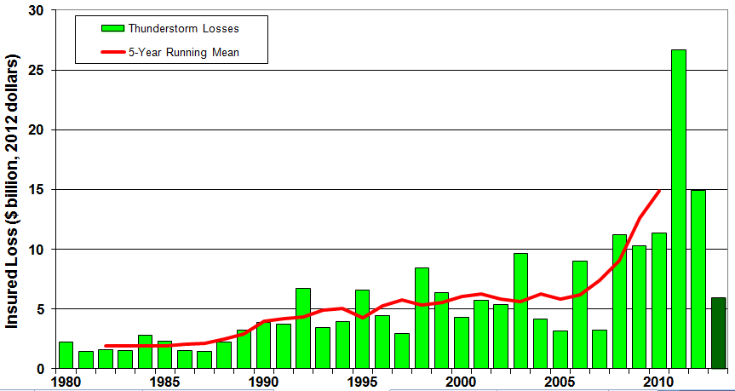
U.S. Thunderstorm Loss Trends, 1980 – June 30, 2013
Hurricanes get all the headlines, but thunderstorms are consistent producers of large scale loss. 2008-2012 are the most expensive years on record.
Average thunderstorm losses are up 7 fold since the early 1980s. The 5- year running average loss is up sharply.
1st Half 2013 thunderstorm losses total $6.325B; The system that included the EF-5 tornado in Moore, OK, accounted for $1.575B
Source: Property Claims Service, MR NatCatSERVICE
50

Slide 51
Terrorism Update
Boston Marathon Bombings Underscore the Need for Extension of the Terrorism Risk Insurance Program
Download III’s Terrorism Insurance Report at: http://www.iii.org/white_papers/terrorism-risk-a-constant-threat-2013.html
51
Notes:
51

Slide 52

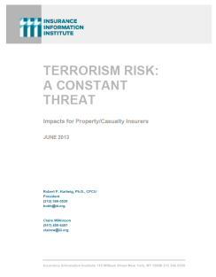

Terrorism Risk Insurance Program
Reauthorization Was a Major Industry Initiative for 2013 Even Before Boston
I.I.I. Testified at First Congressional Hearing on 9/11/12
  Provided testimony at NYC hearing on 6/17/13
I.I.I. Accelerated Planned Study on Terrorism Risk and Insurance in the Wake of Boston and Was Well Received
  Terrorism: A Constant Threat issued in June 2013
52
12/01/09 - 9pm
eSlide – P6466 – The Financial Crisis and the Future of the P/C
Notes:
52

Slide 53
Terrorism Risk Insurance Program
Boston Marathon Bombing Has Helped Focus Attention in Congress on TRIPRA and its Looming Expiration
  Act expires 12/31/14
  Exclusionary language will likely be inserted for post-1/1/2014 renewals and will likely lead to significant media interest (educational opportunity)
  Numerous headwinds; not a priority issue in 2013 in Congress
  3 extension bills introduced in 2013—2 since Boston
Media Interest Soared
  I.I.I. was conducting its first interviews within minutes after live-tweeting (nearly) from the scene; TV interest was high
  Local, national and international media focused on this topic for the first time in any significant way since TRIA’s inception in late 2002
  Inquiries revealed very little/no understanding (or even awareness) outside insurance industry and business owners
  Certification process caused confusion
53
12/01/09 - 9pm
eSlide – P6466 – The Financial Crisis and the Future of the P/C
Notes:
53

Slide 54
Summary of Terrorism Risk Insurance Program Extension Bills Introduced in 2013
Bill | Summary
H.R. 508: “Terrorism Risk Insurance Act of 2002 Reauthorization Act of 2013” Introduced Feb. 5 by Rep. Michael Grimm (D-NY) | 5-Year Extension (through 2019) Extend recoupment period for any TRIA assistance from 2017 to 2019
H.R. 2146: “Terrorism Risk Insurance Program Reauthorization Act of 2013” Introduced May 23 by Rep. Michael Capuano (D-MA) | 10-Year Extension (through 2024) Extend recoupment period for any TRIA assistance from 2017 to 2024 Requires President’s Working Group on Financial Markets (PWGFM) to issue reports on long-term availability and affordability of terrorism insurance in 2017, 2020 and 2023 Reports to be drafted with consultation from NAIC and representatives of the insurance and securities industries and policyholders
H.R. 1945: “Fostering Resilience to Terrorism Act of 2013” Introduced May 9 by Rep. Benny Thompson (D-MS) | 10-Year Extension (through 2024) Recoupment period changed to 2024 Would transfer responsibility for certification of a “act of terrorism” to the Secretary of Homeland Security from Secretary of Treasury. PWGFM to issue reports in 2017, 2020 and 2023 Requires Sec. of DHS to provide insureds with “timely homeland security information, including terrorism risk information, at the appropriate level of classification and information on best practices to foster resilience to an act of terrorism.”
Source: Nelson, Levine, de Luca & Hamilton, FIO Focus, June 10, 2013; Insurance Information Institute.

Slide 55
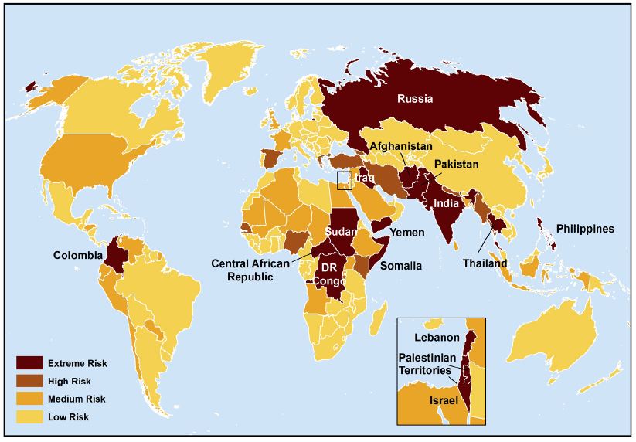
Terrorist Risk Index
The threat of terrorism is highest in South Asia, Russia, the Middle East and Central and East Africa
The US is still considered to be at “Medium Risk” for a terrorist attack
Sources: Maplecroft Terrorism Risk Index; (2011); Guy Carpenter; Insurance Information Institute.

Slide 56
Loss Distribution by Type of Insurance from Sept. 11 Terrorist Attack ($ 2011)
($ Billions)
Total Insured Losses Estimate: $40.0B**
*Loss total does not include March 2010 New York City settlement of up to $657.5 million to compensate approximately 10,000 Ground Zero workers or any subsequent settlements.
**$32.5 billion in 2001 dollars.
Source: Insurance Information Institute.

Slide 57
P/C Industry Investment Gains, Inflation-Adjusted: 1994–2012¹
($ Billions, 2012 dollars)
1994-2012 average yearly gain: $60.85B. We haven’t hit that average in the last 5 years.
Because the Federal Reserve Board aims to keep interest rates exceptionally low until the unemployment rate hits 6.5%—likely at least another year off—maturing bonds will be re-invested at even lower rates.
¹Investment gains consist primarily of interest, stock dividends and realized capital gains and losses.
*2005 figure includes special one-time dividend of $3.2B; 2013F figure is I.I.I. estimate for 2013:Q1, annualized.
Sources: ISO; Insurance Information Institute.

Slide 58
U.S. 10-Year Treasury Note Yields:
A Long Downward Trend, 1990–2013*
Yields on 10-Year U.S. Treasury Notes recently plunged to record modern-era lows and remain low by historical standards
Yields on 10-Year U.S. Treasury Notes have been essentially below 5% for a full decade.
Since roughly 80% of P/C bond/cash investments are in 10-year or shorter durations, most P/C insurer portfolios will have low-yielding bonds for years to come.
*Monthly, through June 2013. Note: Recessions indicated by gray shaded columns.
Sources: Federal Reserve Bank at http://www.federalreserve.gov/releases/h15/data.htm.
National Bureau of Economic Research (recession dates); Insurance Information Institutes.
58
12/01/09 - 9pm
eSlide – P6466 – The Financial Crisis and the Future of the P/C
Notes:
58

Slide 59
Treasury Yield Curves:
Pre-Crisis (July 2007) vs. July 2013
Treasury yield curve remains near its most depressed level in at least 45 years. Investment income is falling as a result. Even if as the Fed “tapers” rates are unlikely to return to pre-crisis levels anytime soon
The Fed Is Actively Signaling that it Is Determined to Keep Rates Low Until Unemployment Drops Below 6.5% or Until Inflation Expectations Exceed 2.5%; Low Rates Add to Pricing Pressure for Insurers.
Source: Federal Reserve Board of Governors; Insurance Information Institute.

Slide 60
Average Maturity of Bonds Held by US P/C Insurers, 2006—2011*
Average Maturity (Years)
The average bond maturity is down by a full year between 2007 and 2011
Falling Average Maturity (and Duration) of the P/C Industry’s Bond Portfolio is Contributing to the Drop in Investment Income Along With Lower Yields
*Year-end figures. Latest available.
Sources: Insurance Information Institute calculations based on A.M. Best data.
60
12/01/09 - 9pm
eSlide – P6466 – The Financial Crisis and the Future of the P/C
Notes:
60

Slide 61
Distribution of Bond Maturities,
P/C Insurance Industry, 2003-2012
The main shift over these years has been from bonds with longer maturities to bonds with shorter maturities. The industry first trimmed its holdings of over-10-year bonds (from 24.6% in 2003 to 15.5% in 2012) and then trimmed bonds in the 5-10-year category (from 31.3% in 2003 to 27.6% in 2012) . Falling average maturity of the P/C industry’s bond portfolio is contributing to a drop in investment income along with lower yields.
Sources: SNL Financial; Insurance Information Institute.

Slide 62
Bonds Rated NAIC Quality Category 3-6 as a Percent of Total Bonds, 2003–2012
From 2006-07 to year-end 2012, the percentage of lower-quality bonds in P/C industry portfolios more than doubled
There are many ways to capture higher yields on bond portfolios.
One is to accept greater risk, as measured by NAIC bond ratings.
The ratings range from 1 to 6, with the highest quality rated 1.
Even in 2012, over 95% of the industry’s bonds were rated 1 or 2.
Sources: SNL Financial; Insurance Information Institute.

Slide 63
Insurance Industry Fair Value as a Percent of Par History, by Bond Type, 2002–2012
“flight to safety”
Because the Federal Reserve Board aims to keep interest rates exceptionally low until the “headline” unemployment rate hits 6.5%,
maturing bonds will be re-invested at even lower rates.
Sources: NAIC Capital Markets Special Report 5.21.13 “The Trajectory of Interest Rates and Its Impact on the Market Value of the U.S. Insurance Industry’s Bond Portfolio,” Table 2; Insurance Information Institute.

Slide 64
As Yields (Blue) Sank, Fair Value as a Percent of Par (Orange) Rose, 2002–2012
When interest rates rise again, the Fair Value of Insurance Industry bonds will fall. How far and how fast the fall occurs depends on many factors, but the direction of change is clear.
Sources: NAIC Capital Markets Special Report 5.21.13 “The Trajectory of Interest Rates and Its Impact on the Market Value of the U.S. Insurance Industry’s Bond Portfolio,” Table 2; Insurance Information Institute.

Slide 65
Reduction in Combined Ratio Necessary to Offset 1% Decline in Investment Yield to Maintain Constant ROE, by Line*
Lower Investment Earnings Place a Greater Burden on Underwriting and Pricing Discipline
*Based on 2008 Invested Assets and Earned Premiums
**US domestic reinsurance only
Source: A.M. Best; Insurance Information Institute.
65
12/01/09 - 9pm
eSlide – P6466 – The Financial Crisis and the Future of the P/C
Notes:
65
This shows the drop in Combined Ratio for each line of business that would be needed to maintain a constant ROE, given a 1-percentage-point drop in investment yield

Slide 66
3. REINSURANCE MARKET CONDITIONS
Ample Capacity as Alternative Capital is Transforming the Market
66

Slide 67
Global Reinsurer Capital, 2007-2013:H1*
($ Billions)
+11%
+1%
+18%
-3%
+18%
-17%
Global Reinsurance Capital Has Been Trending Generally Upward Since the Global Financial Crisis, a Trend that Seems Likely to Continue
*Includes both traditional and non-traditional forms of reinsurance capital.
Source: Aon Benfield Aggregate study for the 6 months ending June 2013; Insurance Information Institute.

Slide 68
Long-Term Evolution of Shareholders’ Funds for the Guy Carpenter Global Reinsurance Composite
Source: Guy Carpenter

Slide 69
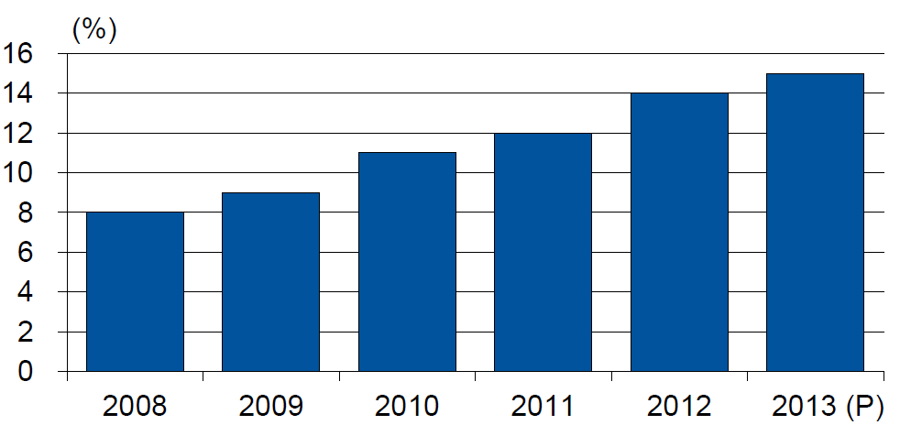
Alternative Capacity as a Percentage of Global Property Catastrophe Reinsurance Limit
(As of Year End)
Alternative Capacity accounted for approximately 14% or $45 billion of the $316 in global property catastrophe reinsurance capital as of mid-2013 (expected to rise to ~15% by year-end 2013)
Source: Guy Carpenter

Slide 70
Property Catastrophe Reinsurance Capacity by Source as of Mid-2013 ($ Bill)
Total = $316 Billion*
“Convergence Capital” accounted for an estimated $45B or 14% or total property catastrophe reinsurance capacity as of mid-2013, up $10B over the past 18 months (since 1/1/12). Penetration of this type of capacity is growing
Collateralized reinsurance (sidecars) is the fastest growing segment recently
Source: Guy Carpenter; Mid-Year Market Report, September 2013; Insurance Information Institute.

Slide 71
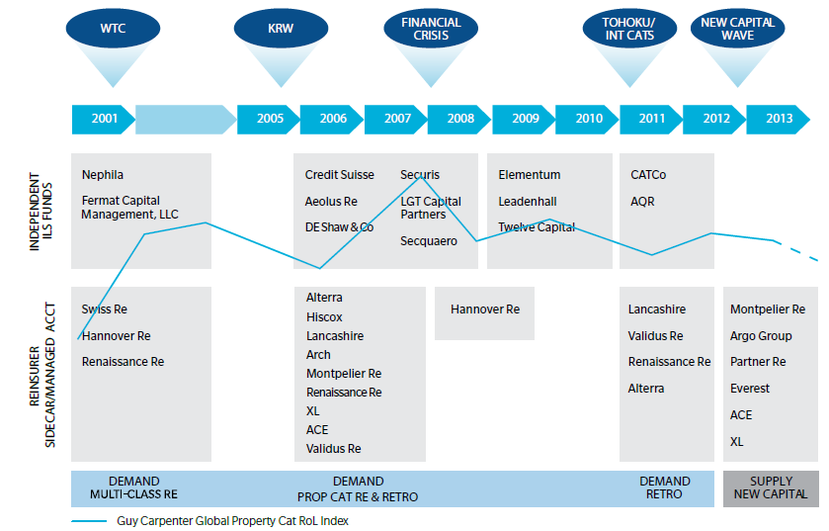
Alternative Capacity Development,
2001—2013:H1
Source: Guy Carpenter; Mid-Year Market Report, September 2013; Insurance Information Institute.

Slide 72
Non-Traditional Property Catastrophe
Limits by Type, YE 2012 vs. YE 2015E
Alternative capital is expected to rise by 30% by YE 2015 and will ultimately account for 20-30% of total reinsurance spend, according to Guy Carpenter
Source: Guy Carpenter; Reinsurance Association of America; Insurance Information Institute.

Slide 73
Catastrophe Bonds: Issuance and Outstanding, 1997- 2013*
Risk Capital Amount ($ Millions)
Risk capital outstanding reached a record high in 2013
Financial crisis depressed issuance
CAT bond issuance will likely reach a record high in 2013v
Catastrophe Bond Issuance Is Approaching Pre-Crisis Levels While Risk Capital Outstanding Stands at an All-Time Record
*Through July 2013.
Source: Guy Carpenter; Insurance Information Institute.

Slide 74
Reinsurer Share of Recent Significant Market Losses
Billions of 2011 Dollars
40% Reinsurance share of total insured loss
$37.5
$15.0
73%
60%
95%
$13.0
44%
$10.0
$22.5
$8.3
$9.5
$6.0
$5.0
$7.9
$2.2
$3.5
$4.0
$2.8
$0.4
Reinsurers Paid a High Proportion of Insured Losses Arising from Major Catastrophic Events Around the World in Recent Years
Source: Insurance Information Institute from reinsurance share percentages provided in RAA, ABIR and CEA press release, Jan. 13, 2011.
74
12/01/09 - 9pm
eSlide – P6466 – The Financial Crisis and the Future of the P/C
Notes:
74

Slide 75
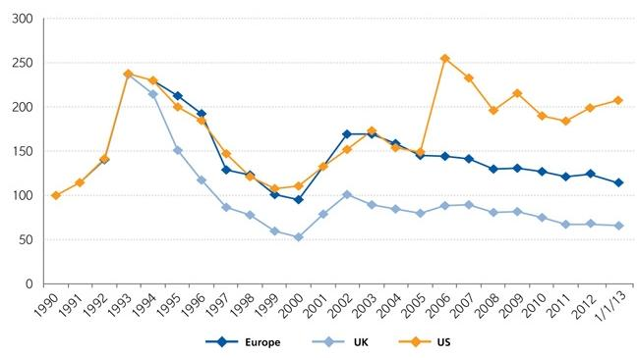
Regional Property Catastrophe Rate on Line Index, 1990—2013 (as of January 1)
Property-Cat reinsurance pricing was up in the US as of 1/1/13 but was down in Europe/UK
Sources: Guy Carpenter; Insurance Information Institute.

Slide 76
CATASTROPHE BONDS, ANNUAL RISK CAPITAL ISSUED, 2002-2012
($ Billions)
Note
Source: GC Securities and Guy Carpenter & Company, LLC.

Slide 77
CATASTROPHE BONDS, RISK CAPITAL OUTSTANDING, 2002-2012
($ Billions)
Note
Source: GC Securities and Guy Carpenter & Company, LLC.

Slide 78
CYBER RISK
Cyber Risk is a Rapidly Emerging Exposure for Businesses Large and Small in Every Industry
NEW III White Paper: http://www.iii.org/assets/docs/pdf/paper_CyberRisk_2013.pdf
78

Slide 79
Data Breaches 2005-2013, By Number of Breaches and Records Exposed
# Data Breaches/Millions of Records Exposed
Millions
The total number of data breaches and number of records exposed fluctuates from year to year and over time.
* 2013 figures as of March 19, 2013.
Source: Identity Theft Resource Center

Slide 80
2012 Data Breaches By Business Category, By Number of Breaches
The majority of the 447 data breaches in 2012 affected business and medical/healthcare organizations, according to the Identity Theft Resource Center.
Banking/Credit/Financial, 17 (3.8%)
Govt/Military, 50 (11.2%)
Business, 165 (36.9%)
Educational, 61 (13.6%)
Medical/Healthcare, 154 (34.5%)
Source: Identity Theft Resource Center, http://www.idtheftcenter.org/ITRC%20Breach%20Report%202012.pdf.

Slide 81
2012 Data Breaches By Category, By Number of Records Exposed
Government/Military and Business organizations accounted for the majority of records exposed by data breaches during 2012.
Banking/Credit/Financial, 470,048 (2.7%)
Medical/Healthcare, 2.2 million (12.9%)
Govt/Military, 7.7 million (44.4%)
Educational, 2.3 million (13.3%)
Business, 4.6 million (26.7%)
Source: Identity Theft Resource Center, http://www.idtheftcenter.org/ITRC%20Breach%20Report%202012.pdf.

Slide 82
AIG Survey: Cyber Attacks Top Concern Among Execs
While companies are focused on managing a variety of business risks, cyber attacks are a top concern. Some 85% of 258 executives surveyed said they were very or somewhat concerned about cyber attacks on their businesses.
Source: Penn Schoen Berland on behalf of American International Group.
82
Notes:
82

Slide 83
The Most Costly Cyber Crimes, Fiscal Year 2012
Malicious code, denial of service and web-based attacks account for more than 58 percent of the total annualized cost of cyber crime experienced by 56 companies.
Malware
Botnets
Malicious code
Viruses, Worms, Trojans
Phishing + social engineering
Malicious insiders
Stolen devices
Denial of service
Web-based attacks
Source: 2012 Cost of Cyber Crime: United States, Ponemon Institute.

Slide 84
External Cyber Crime Costs: Fiscal Year 2012
Information loss (44%) and business disruption or lost productivity (30%) account for the majority of external costs due to cyber crime.
Other costs*
Equipment damages
Information loss
Revenue loss
Business disruption
* Other costs include direct and indirect costs that could not be allocated to a main external cost category
Source: 2012 Cost of Cyber Crime: United States, Ponemon Institute.

Slide 85
High Profile Data Breaches, 2012-2013
Date | Company | Description of Breach
Mar 2013* | South Korean banks, media cos | Cyber attack causes computers to crash at South Korean banks and media companies, paralyzing bank machines across the country. No immediate reports of records compromised.
July 2012 | Yahoo | Security breach at Yahoo in which some 450,000 passwords lifted and posted to the Internet.
July 2012 | eHarmony | Online dating site eHarmony confirms security breach in which some 1.5 million user names and passwords compromised.
July 2012 | LinkedIn | Social networking site LinkedIn reportedly targeted in hacker attack that saw 6.5 million hashed passwords posted to the Internet.
April 2012 | Utah Dept of Technology Services | Utah Department of Technology notifies of a March 30 breach of a server containing personal data including social security numbers for about 780,000 Medicaid patient claims. Breach traced to Eastern Europe hackers.
Mar 2012 | Global Payments | Credit card processor Global Payments confirms hacker attack has compromised the payment card numbers of around 1.5 million cardholders.
Mar 2012 | CA Dept of Child Support Services | Officials announce that four computer storage devices containing personal information for about 800,000 adults and children in California’s child support system were lost by IBM and Iron Mountain Inc.
Jan 2012 | Zappos | Online shoe retailer Zappos announces that information, such as names, addresses and passwords on as many as 24 million customers illegally accessed.
Jan 2012 | NY State Electric + Gas Co | Security breach at NYSEG that allowed unauthorized access to NYSEG customer data, containing social security numbers, dates of birth and bank account numbers, exposing 1.8 million records.
*March 2013 attack is not part of ITRC research.
Sources: Identity Theft Resource Center, http://www.idtheftcenter.org/ITRC%20Breach%20Report%202012.pdf; Insurance Information Institute (I.I.I.) research.

Slide 86
Average Organizational Cost of a Data Breach, 2008-2011* ($ Millions)
The average organizational cost of a data breach in 2011 was $5.5 million, down 24% from $7.2 million in 2010. Companies have improved steps taken in both preparing for and responding to a data breach.
($ Millions)
*Findings of this benchmark study pertain to the actual data breach experiences of 49 U.S. companies from 14 different industry sectors, all of which participated in the 2011 study. Total breach costs include: lost business resulting from diminished trust or confidence of customers ;costs related to detection, escalation, and notification of the breach; and ex-post response activities, such as credit report monitoring.
Source: 2011 Annual Study: U.S. Cost of a Data Breach, the Ponemon Institute.
86
Notes:
86

Slide 87
Main Causes of Data Breach
Negligent employees and malicious attacks are most often the cause of the data breach. Some 39 percent of incidents involve a negligent employee or contractor, while 37 percent concern a malicious or criminal attack.
Negligence
System glitch
Malicious or criminal attack
Source: 2011 Cost of Data Breach Study: United States, Ponemon Institute, March 2012

Slide 88
Marsh: Increase in Purchase of Cyber Insurance Among U.S. Companies, 2012
Interest in cyber insurance continues to climb. The number of companies purchasing cyber insurance increased 33 percent from 2011 to 2012.
Source: Marsh Global Analytics, Marsh Risk Management Research Briefing, March 2013
88
Notes:
88

Slide 89
Marsh: Total Limits Purchased, By Industry – Cyber Liability, All Revenue Size
Cyber insurance limits purchased in 2012 averaged $16.8 million across all industries, an increase of nearly 20% over 2011.
($ Millions)
Source: Marsh Global Analytics, Marsh Risk Management Research Briefing, March 2013
89
Notes:
89

Slide 90
Marsh: Total Limits Purchased, By Industry – Cyber Liability, Revenue $1 Billion+
Among larger companies, average cyber insurance limits purchased in 2012 increased nearly 30% over 2011.
($ Millions)
Source: Marsh Global Analytics, Marsh Risk Management Research Briefing, March 2013
90
Notes:
90

Slide 91
Cyber Liability: Historical Rate (price per million) Changes
Overall, rates for cyber insurance were essentially flat in the fourth quarter of 2012.
Source: Marsh Global Analytics, Marsh Risk Management Research Briefing, March 2013

Slide 92
Insurance Information Institute Online:
www.iii.org
Thank you for your time
and your attention!
Twitter: twitter.com/bob_hartwig
Download at www.iii.org/presentations

